Slide 1
VI
ART APPRECIATION · UNIT III
The Table as
Moral Space
Food, the Table and Ethics · Lesson 06
Five sessions · Monday 19 to Friday 23 October
Notes:
Unit 3 opens on a film because the table is easier to see when it is moving.

Slide 2
VI
THE FRAME
The table is easier
to see when it
is moving.
Notes:
Ang Lee's cooking scenes are the argument. Students notice the noticing before they notice the structure.

Slide 3
DAYS TWO TO THREE
EAT DRINK MAN WOMAN
Said through food
01
02
The Sunday dinner
Watch the noticing
A widowed chef and three daughters. Everything the family cannot say to one another is said in the kitchen, over the food, at the table.
You will notice yourself noticing before you notice the structure. That is the point: the table shows what talk conceals.
ART APPRECIATION · SEMESTER I
01

Slide 4
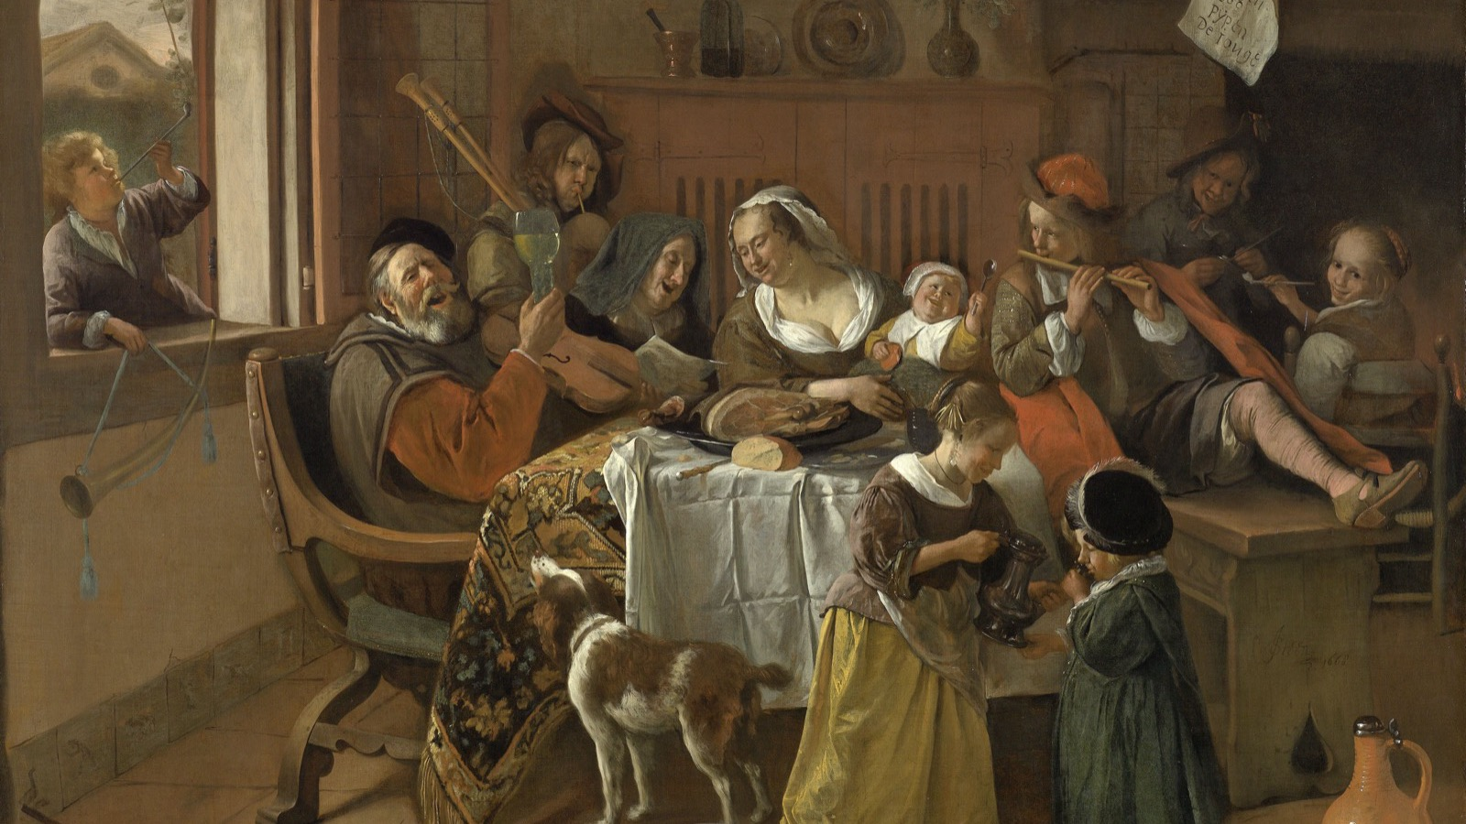
WHO IS WHERE
Read the table before the story: who sits, who serves, who is turned away.
Jan Steen, The Merry Family, 1668
Notes:
First look at paintings of meals: who is where. Hold back Heda, the Last Supper and the Qingming scroll; they arrive later.

Slide 5
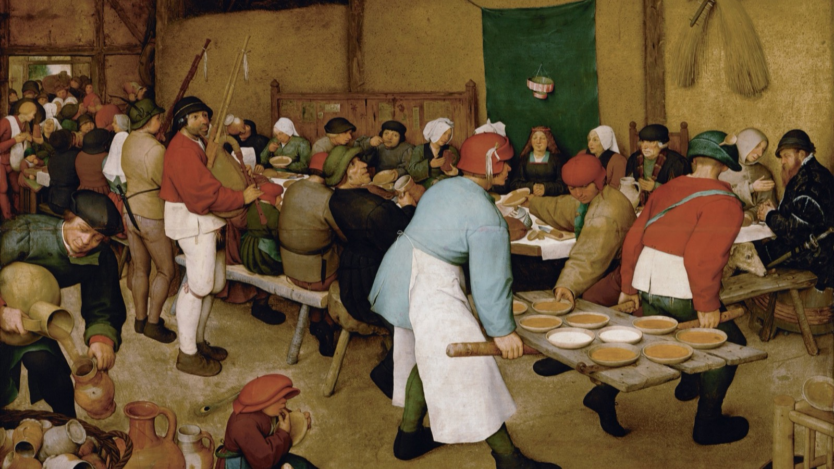
THE FEAST, AND ITS EDGES
A whole community fed, and the two men carrying the food doing the looking.
Pieter Bruegel the Elder, The Peasant Wedding, 1567
Notes:
A meal is a social order made visible. Who carries, who is seated, who is at the head.

Slide 6
“
Tell me what you eat,
and I will tell you
what you are.
Jean Anthelme Brillat-Savarin, The Physiology of Taste, 1826

Slide 7
THE READING
THE TABLE AS A MORAL SPACE
A space with rules
01
02
What it shows
Why it is moral
Who is fed and who feeds; what is abundant and what is withheld; where the honour seat is and who never reaches it.
Every meal decides something about worth and belonging. To paint a table is to take a position on all of it, whether the painter admits it or not.
ART APPRECIATION · SEMESTER I
02

Slide 8
DAY FIVE · SEMINAR
FOOD, CLASS, AND ABSENCE
Who is not in the picture?
Every meal painting has a kitchen it does not show, a field it does not show, and a set of hands that grew, carried and cooked the food. The seminar asks where they went, and why the picture could spare them.
ART APPRECIATION · SEMESTER I
03
Notes:
LB3 posts from this seminar. Autumn field trip may take Friday; if it does, LB3 moves.

Slide 9
HOW IT RUNS
FIVE SESSIONS
The week, day by day
MON 19 OCT
The table as moral space; three paintings of meals
TUE–WED 20–21
Eat Drink Man Woman, screened as one session
THU 22 OCT
One meal replayed twice; the written reading
FRI 23 OCT
Seminar: food, class, who is not in the picture (LB3)
ART APPRECIATION · SEMESTER I
04

Slide 10
NEXT
The Split Weeks
Lesson 07. Five ways into one question, while half the room is away.
ART APPRECIATION · SEMESTER I
05

