Slide 1
VII
ART APPRECIATION · UNIT III
The Split
Weeks
Food, the Table and Ethics · Lesson 07
Five sessions · Monday 26 to Friday 30 October
Notes:
G12 is at Seniors' Day all week, so nothing carries from one day to the next and nothing assessable can sit here.

Slide 2
VII
THE SHAPE
Five ways into
one question.
Notes:
The through-line is thematic, not sequential. A G12 student who misses all five has missed content, not an argument.

Slide 3
THE WEEK THAT BREAKS ITS RULE
HALF THE ROOM IS AWAY
Nothing accumulates
01
02
Why it is built this way
So each day stands alone
The course is built on things that build. This one week cannot be, because half the people who would carry an argument forward are not in the building.
Five self-contained ways into one question, food and its ethics. Any single day works by itself; none depends on the day before.
ART APPRECIATION · SEMESTER I
01

Slide 4
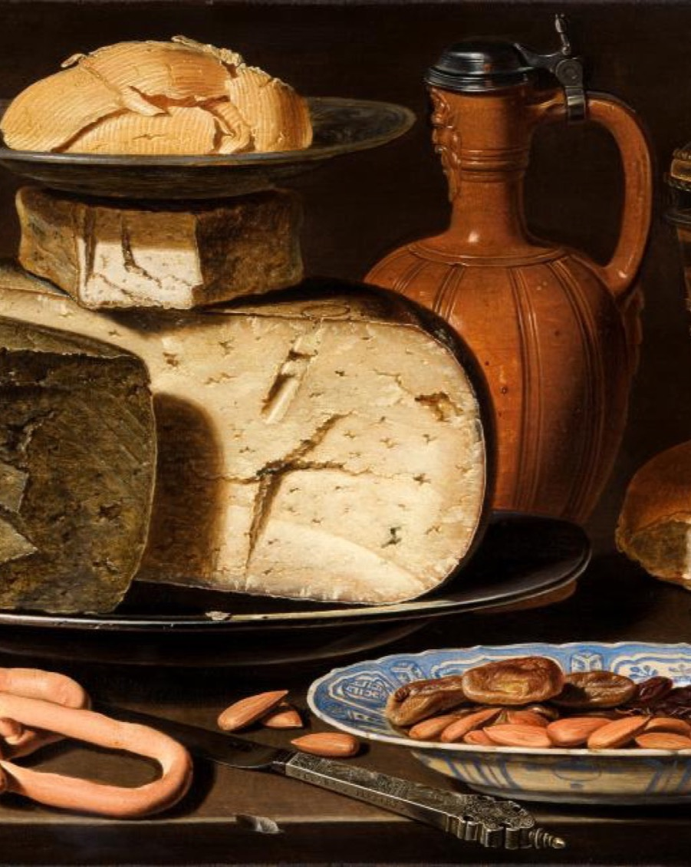
DAY ONE · THE MEAL AS ARTWORK
Composed,
not gathered
Plan a shared lunch as a made thing, in pairs, with every choice defended rather than merely preferred. A still life is the same act: someone chose what goes where, and why.
Clara Peeters, Still Life with Cheeses, Almonds and Pretzels, c. 1613
Notes:
Shared-lunch prep: the meal as artwork, planned in pairs, decisions defended.

Slide 5
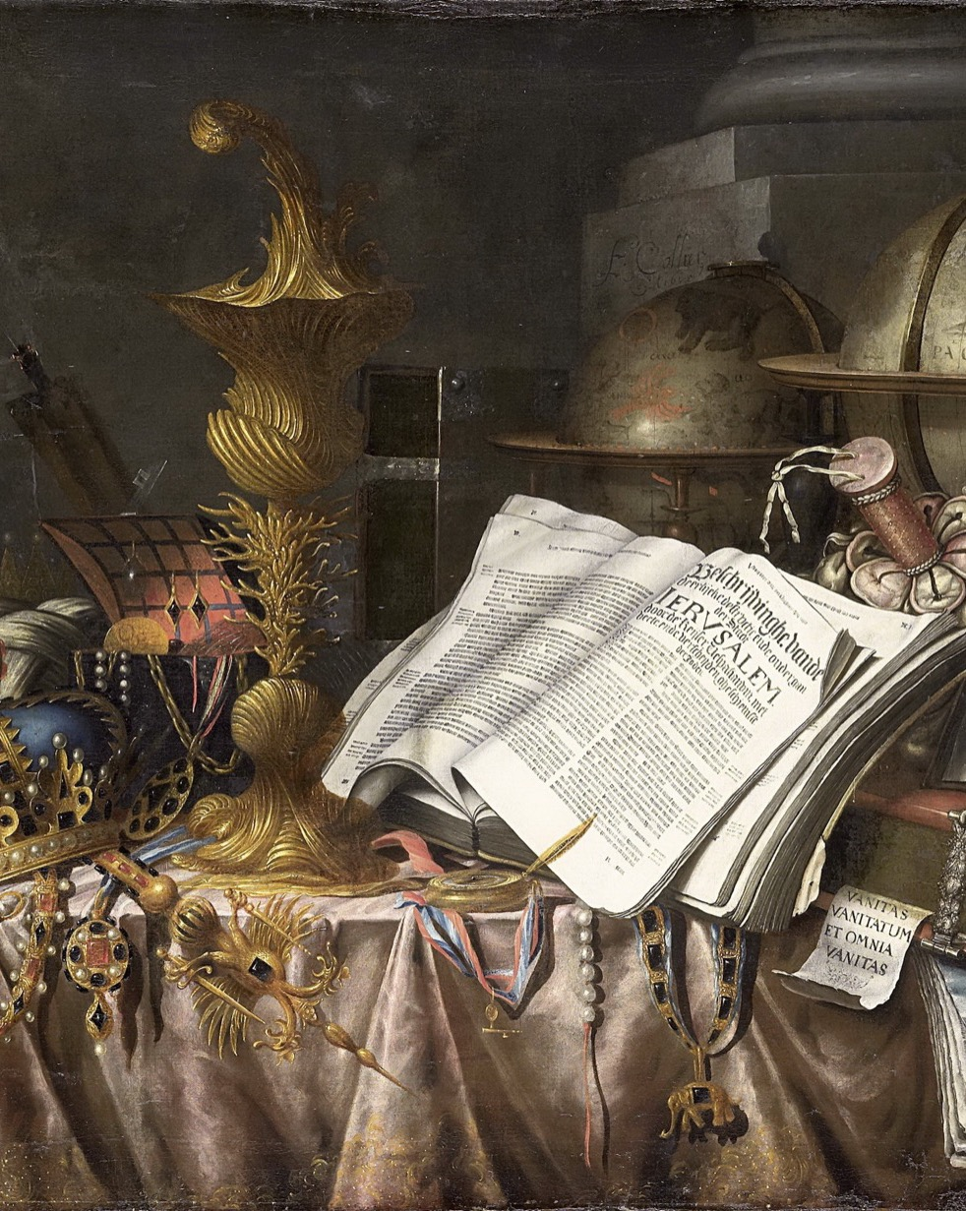
DAY TWO · THE ETHICS OF ABUNDANCE
What did it
cost, who paid
The abundance in a still life is never free. Trace it back: whose labour, whose land, whose hunger elsewhere is the condition of this fullness on the table.
Edwaert Collier, Vanitas Still Life, 1662
Notes:
Still life and the ethics of abundance: what did this cost, who paid.

Slide 6
“
Vanity of vanities;
all is vanity.
Ecclesiastes 1:2, the text beneath every vanitas

Slide 7
DAY THREE · THE REFLECTION
YOUR OWN TABLE
Not a memory piece
Write your own table the way you would read a painting: who sits, who cooks, who is quiet, what is never served. The easy version turns it into nostalgia. The real one keeps looking after the warm feeling runs out.
ART APPRECIATION · SEMESTER I
02
Notes:
The your-table reflection, finished Wed. Name the memory-piece trap on the sheet itself.

Slide 8
DAY FIVE · SEMINAR
GENEROSITY OR OBLIGATION
Is hospitality a gift?
01
02
The generous reading
The other reading
To feed a guest is to give freely, expecting nothing. The host is diminished by nothing and the guest owes nothing back.
Or hospitality is a debt machine: every meal received must one day be returned, and the one who cannot return it is placed below the one who gave.
ART APPRECIATION · SEMESTER I
03
Notes:
LB4 posted for whoever is present. G12 is not penalised for being at Seniors' Day; say so before anyone asks.

Slide 9
HOW IT RUNS
FIVE SESSIONS, EACH COMPLETE IN ITSELF
The week, day by day
MON 26 OCT
Shared-lunch prep: the meal as artwork
TUE 27 OCT
Still life and the ethics of abundance
WED 28 OCT
Your own table (the reflection, finished)
THU 29 OCT
What a shared meal makes visible
FRI 30 OCT
Seminar: hospitality, gift or debt (LB4)
ART APPRECIATION · SEMESTER I
04

Slide 10
NEXT
Heda and the
Image of Work
Lesson 08. The still life as inventory, and the moral image of work.
ART APPRECIATION · SEMESTER I
05

