Slide 1
VIII
ART APPRECIATION · UNIT III
Heda and the
Image of Work
Food, the Table and Ethics · Lesson 08
Seven teaching days · Monday 2 to Friday 13 November
Notes:
It reads as one lesson and it will not feel like one: a Mon-Tue stub, the room empties for Juniors Days, then a full week.

Slide 2
VIII
THE INVENTORY
Name every object,
and who owns it.
Notes:
Days one and two are the same painting twice. Students will complain on day two and then see something. Hold it.

Slide 3
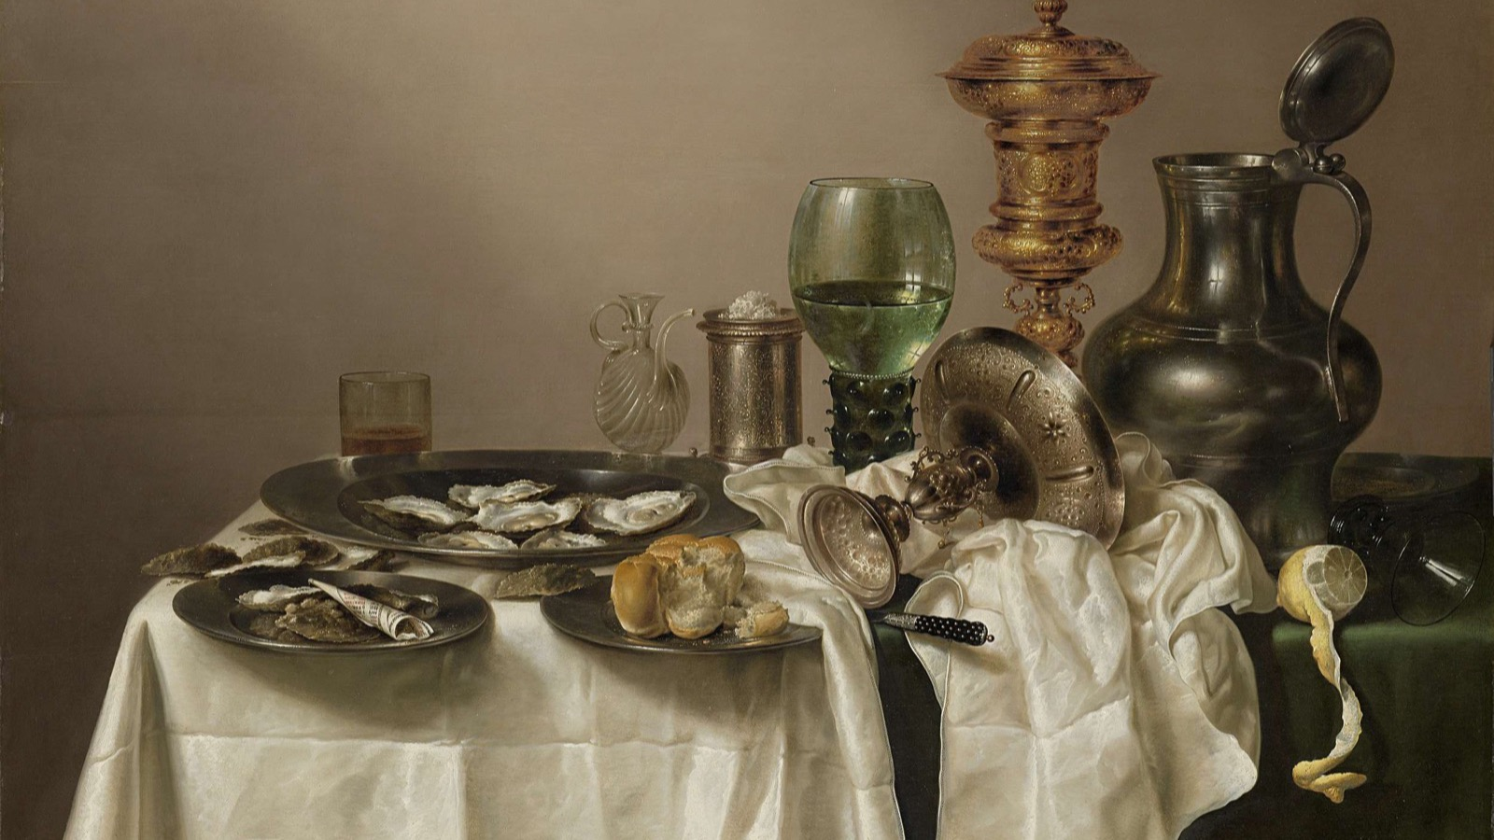
DAY ONE · THE STILL LIFE AS INVENTORY
Not a meal but a ledger: name every object, and name who owns it.
Willem Claesz. Heda, Still Life with a Gilt Cup, 1635
Notes:
The half-peeled lemon, the tipped tazza, the watch. Each is a possession, and the painting is a record of them.

Slide 4
“
Oil painting, before it was anything else, was a celebration of private property. As an art-form it derived from the principle that you are what you have.
John Berger, Ways of Seeing, 1972

Slide 5
ASSESSMENT · A3
ANNOUNCED DAY TWO
The Unit 3 essay
Announced Tuesday 3 November, in the first ten minutes.
Sits Tuesday 17 November, on the double: one claim about food, the table and ethics, argued from the pictures.
Tuesday 3 November is the last session both halves of the class attend before the deadline. If that Tuesday goes, A3 moves, not the announcement.
ART APPRECIATION · SEMESTER I
01
Notes:
Fourteen days before Thu 19 Nov is a Juniors Day, so Tue 3 Nov is the last both-cohort session. 16 days notice under the one-week rule.

Slide 6
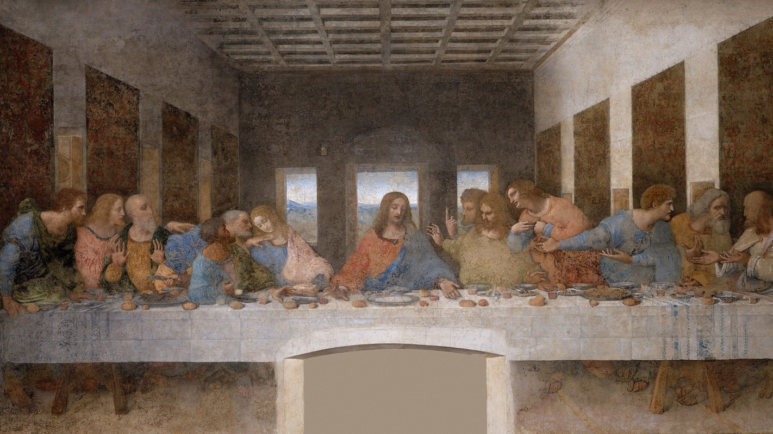
DAY THREE · THE CHOSEN MOMENT
Find the instant Leonardo chose, and say why that one and not the one before.
Leonardo da Vinci, The Last Supper, 1495 to 1498
Notes:
The moment is the announcement of the betrayal. Show a pre-Leonardo Last Supper so the choice of moment reads as a choice.

Slide 7
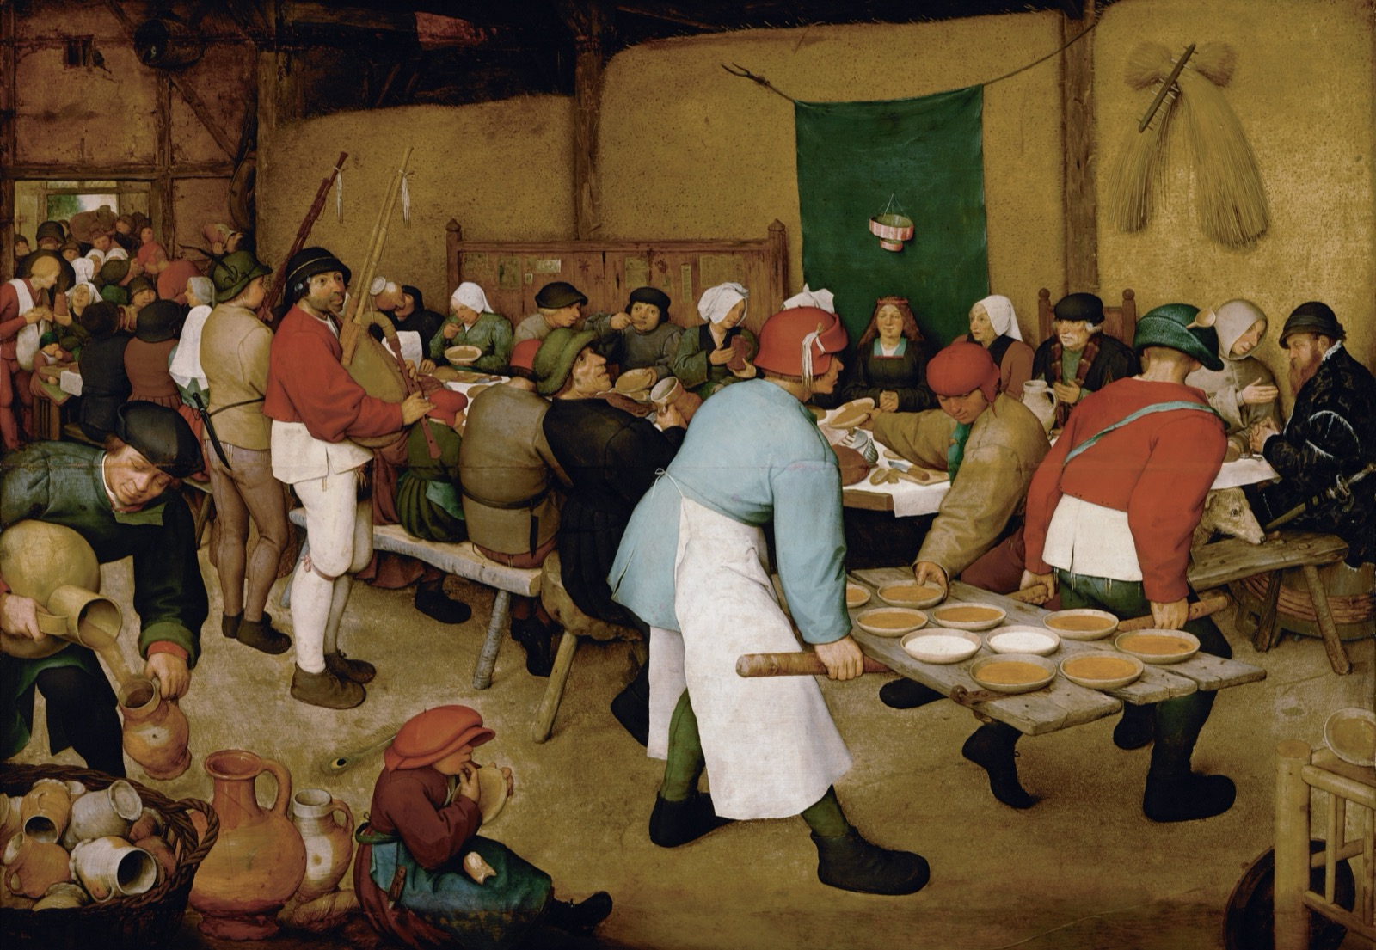
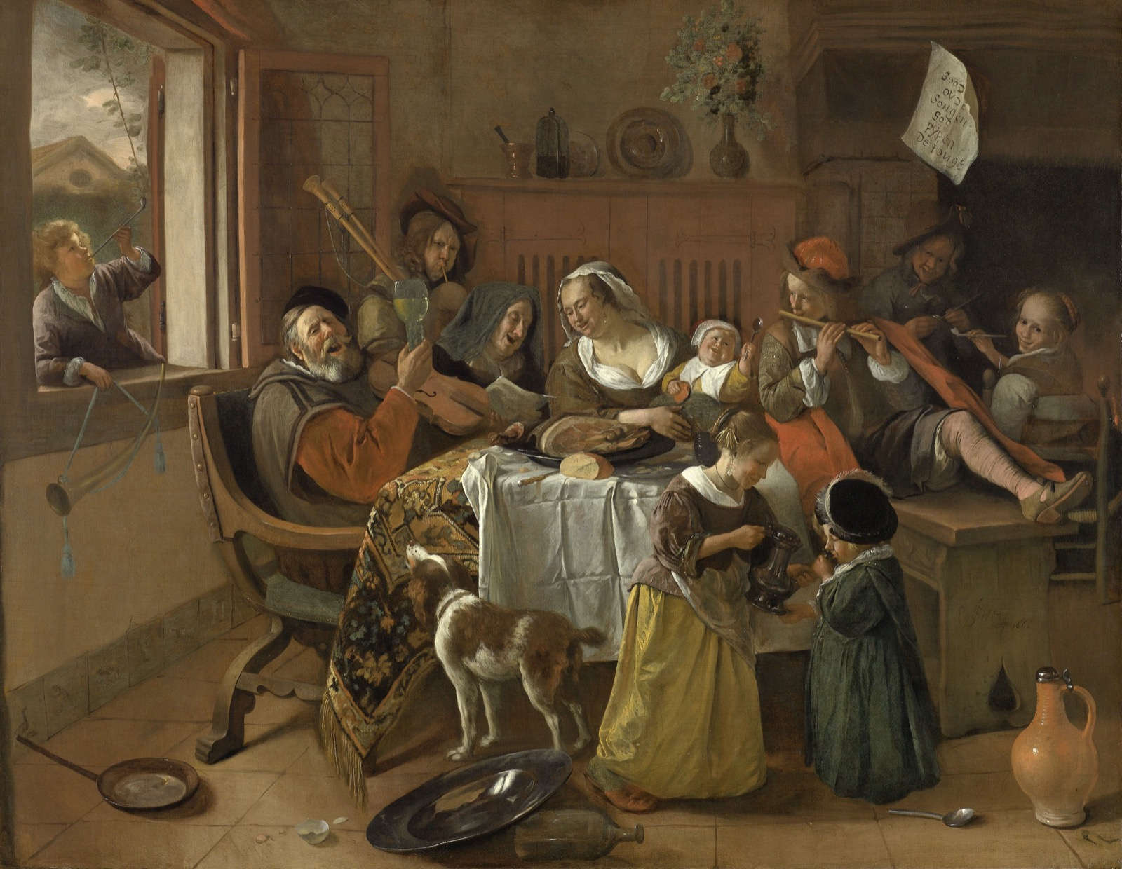
DAY FOUR · THE DISORDERLY TABLE
TAKEN SERIOUSLY, NOT AS COMEDY
When the table breaks its rules
Bruegel, The Peasant Wedding, 1567
Jan Steen, The Merry Family, 1668
Disorder is a subject, not a joke. Ask what a painter gains by showing the meal falling apart.
Notes:
The disorderly table taken seriously as a subject rather than comedy.

Slide 8
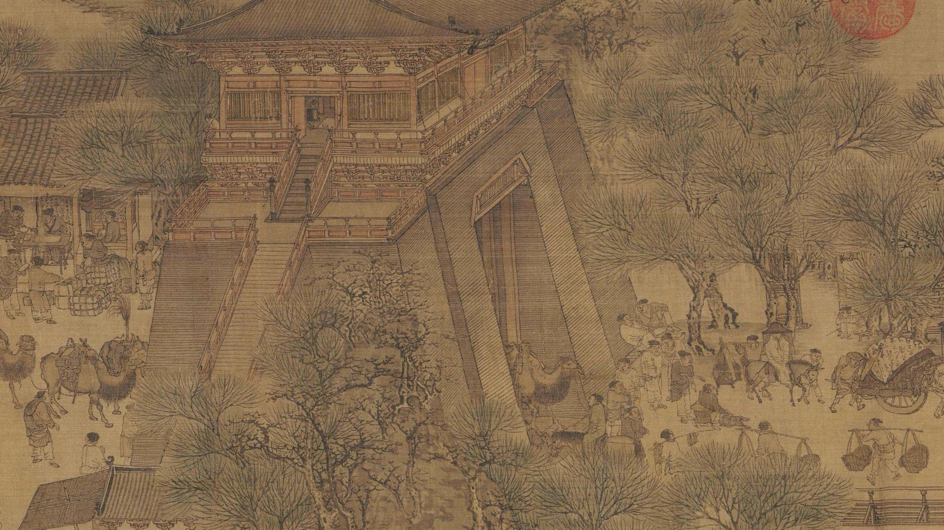
DAY FIVE · ALONG THE SCROLL
Follow a city through its food along thirty feet of scroll. On a screen it is a different work.
Zhang Zeduan, Along the River During the Qingming Festival, 12th c. (detail)
Notes:
The Qingming scroll wants physical length. Unroll a printed strip long enough to walk; on a screen the goal line becomes a lie.

Slide 9
DAY SIX · THE IMAGE OF WORK
WHEN, AND FOR WHOM
When did work become worth painting?
01
02
The old rule
The turn
For centuries, labour appeared only at the edges: the servant, the harvester, the kitchen hand, kept small and to the side of the important people.
Then work moves to the centre and is painted for its own sake. Ask who wanted that picture, and what it let them feel about the people in it.
ART APPRECIATION · SEMESTER I
02

Slide 10
DAY SEVEN · CS4
THE HEDA PARAGRAPH
Earn every adjective
Write one paragraph on the Heda that earns every adjective in it. Then swap, and cut one adjective from a classmate's, the one that names a feeling instead of a fact. Direct practice for A3.
ART APPRECIATION · SEMESTER I
03
Notes:
CS4 collected Fri 13 Nov: one paragraph that earns every adjective in it.

Slide 11
HOW IT RUNS
SEVEN TEACHING DAYS
Across ten calendar days
MON 2 NOV
Heda: the still life as inventory
TUE 3 NOV
A3 announced; Heda again, further (LB5)
MON 9 NOV
Leonardo: the moment he chose
TUE 10 NOV
Bruegel and Steen: the disorderly table
WED 11 NOV
The Qingming scroll, food along its length
THU 12 NOV
The moral image of work
FRI 13 NOV
Write the Heda paragraph (CS4)
ART APPRECIATION · SEMESTER I
04

Slide 12
NEXT
Food, the Table
and Ethics
Lesson 09. Cassatt, Rosler, Weems, and the essay.
ART APPRECIATION · SEMESTER I
05

