Slide 1
IX
ART APPRECIATION · UNIT III
Food, the Table
and Ethics
The Unit 3 essay, and the hand-off into mediation · Lesson 09
Five sessions · Monday 16 to Friday 20 November · A3 on the Tuesday double
Notes:
Three artists in three days, each of whom does something the paintings could not. Rosler lands on the second viewing; show it twice.

Slide 2
IX
THE ESSAY
Argue from the
pictures, not
from the ethics.
Notes:
A3: one claim about food and ethics, argued from the pictures themselves, not from the ethics.

Slide 3
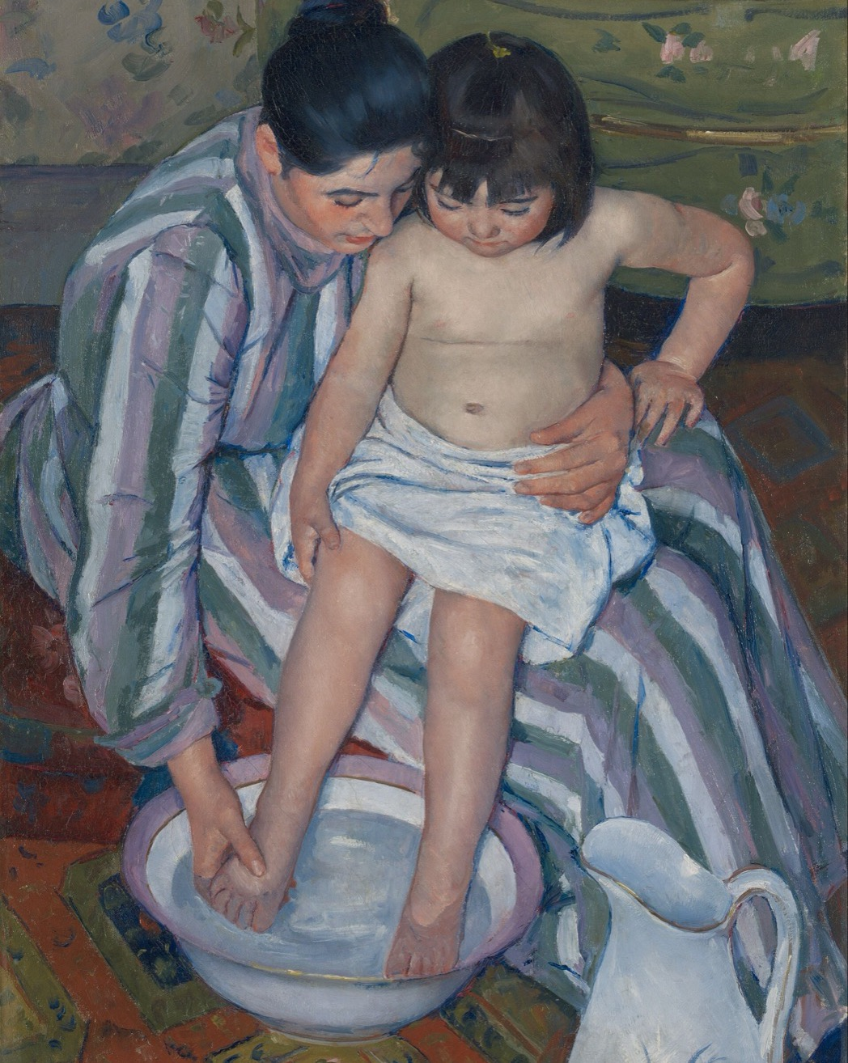
DAY ONE · CASSATT
The interior
as a workplace
Read one domestic interior as a place of labour, not of leisure. The bath is work: the bent back, the firm grip, the concentration. Domestic labour is labour, and the painting knows it.
Mary Cassatt, The Child's Bath, 1893 · public domain
Notes:
Cassatt, one domestic interior, read as a workplace: domestic labour as labour.

Slide 4
DAY TWO · MARTHA ROSLER
SHOWN IN CLASS, NOT HERE
Semiotics of the Kitchen
Video, 6 minutes, 1975
A woman stands in a kitchen and names its tools, A to Z. Apron. Bowl. Chopper. With each letter the gesture sharpens, until the demonstration turns into something closer to rage. Watch a kitchen become an alphabet.
Six minutes, once through, then again. It lands on the second viewing, not the first.
ART APPRECIATION · SEMESTER I
01

Slide 5
DAY THREE · CARRIE MAE WEEMS
SHOWN IN CLASS, NOT HERE
The Kitchen Table Series
Photographs, 1990
The same table, the same bare overhead light, photographed again and again: love, argument, solitude, a daughter, a mirror. What a table does when it is the same table every time.
Weems needs the sequence. One image is a portrait; six is an argument.
ART APPRECIATION · SEMESTER I
02

Slide 6
ASSESSMENT · A3
THE UNIT 3 ESSAY
One claim, from the pictures
Sits Tuesday 17 November, on the double: in class, 40 minutes.
One claim about food, the table and ethics, argued from the pictures themselves and not from the ethics. The pictures are the evidence; the ethics is what they let you see.
Announced Tuesday 3 November in Lesson 08. The Fridays this unit carry the loosest sessions on purpose, so nothing assessed rides on one.
ART APPRECIATION · SEMESTER I
03

Slide 7
DAY FIVE · THE HAND-OFF
INTO MEDIATION
A food image nobody eats
01
02
The painted meal
The food image
In Heda or Peeters the food was real: eaten, owned, or wasted by someone. The picture records a thing that was.
The advertisement is cooked to be photographed, never eaten: glue for milk, motor oil for syrup. It sells the desire and withholds the meal. This is where Unit 4 begins.
ART APPRECIATION · SEMESTER I
04

Slide 8
“
Publicity is the culture
of the consumer society.
John Berger, Ways of Seeing, 1972 · the bridge into Unit 4

Slide 9
HOW IT RUNS
FIVE SESSIONS
The week, day by day
MON 16 NOV
Cassatt: the interior as a workplace
TUE 17 NOV
Rosler, Semiotics of the Kitchen
WED 18 NOV
Weems, the Kitchen Table Series, in sequence
THU 19 NOV
A3 sits: the essay on food and ethics
FRI 20 NOV
Hyperreality and the food image; into Unit 4
ART APPRECIATION · SEMESTER I
05

Slide 10
NEXT · UNIT IV
Berger and the
Reproduction
Lesson 10. Images, mediation and modernity.
ART APPRECIATION · SEMESTER I
06

