Slide 1
X
ART APPRECIATION · UNIT IV
Berger and the
Reproduction
Images, Mediation and Modernity · Lesson 10
Seven days across two split weeks · Monday 23 November to Tuesday 1 December
Notes:
Content front-loaded into days one to three. Homework: Ways of Seeing, episode one or the first essay.

Slide 2
X
THE ARGUMENT
A reproduction is
not a neutral copy.
Notes:
Berger's argument stated flat on day one, then the first objection taken seriously.

Slide 3
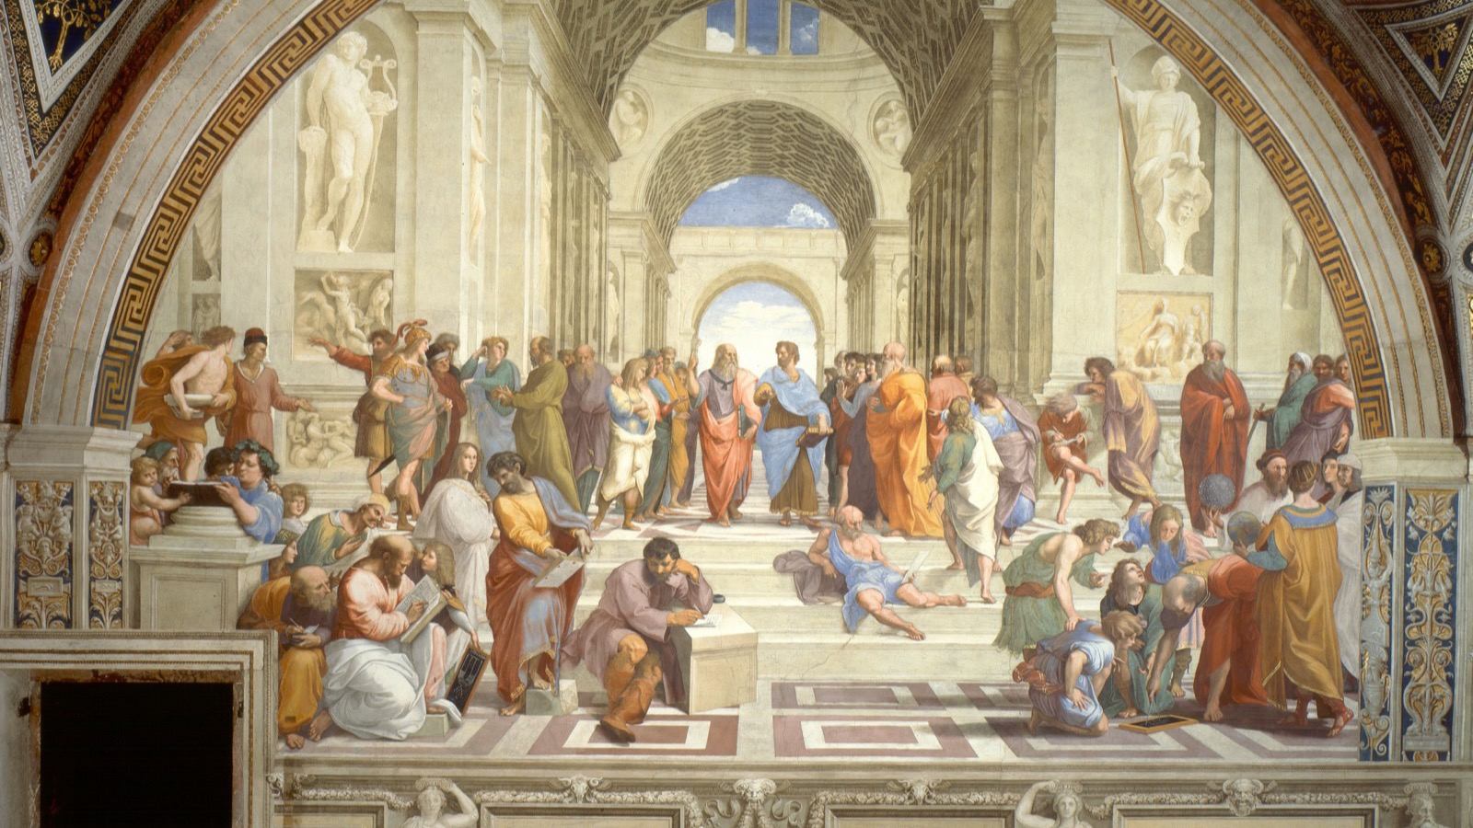
YOU HAVE SEEN THIS A HUNDRED TIMES
On a mug, a phone, a textbook, a poster. Almost never the wall in Rome that is the thing itself.
Raphael, The School of Athens, 1509 to 1511, fresco
Notes:
The reproduction is how you know it. The original is silent and still in a way the copies never are.

Slide 4
“
When the camera reproduces a painting, it destroys the uniqueness of its image.
John Berger, Ways of Seeing, 1972

Slide 5
DAY TWO · ONE PAINTING
FOUR CONTEXTS
Change the frame, change the meaning
01
Gallery wall
02
Phone screen
Silent, still, one of a kind. You queue to stand in front of the thing itself.
Thumb-sized, scrolled past, one image among ten thousand that day.
03
Textbook page
04
Advertisement
Captioned and dated, made to prove a point in someone else's argument.
Cropped and tinted, borrowing the painting's authority to sell you something.
ART APPRECIATION · SEMESTER I
01

Slide 6
“
The way we see things is affected by what we know or what we believe.
John Berger, Ways of Seeing, 1972

Slide 7
DAY FIVE · THE DELIVERABLE
THE CAPTION THAT CHANGES THE PICTURE
Two captions, one image
Write the caption that bends the picture to a lie, then write the honest one beside it. The image did not change. Everything you were told to see in it did. That gap is the whole unit.
ART APPRECIATION · SEMESTER I
02
Notes:
Write the caption that changes the picture, then write the honest one. Both halves of the class do this.

Slide 8
DAY SIX · GODARD
SHOWN IN CLASS, NOT HERE
An image that refuses to add up
Goodbye to Language, one extract, under ten minutes
Sit with an image that will not resolve, and stay with it. The goal is not to understand the film. It is to feel what it is like when an image refuses the meaning you keep trying to give it.
A provocation, kept short. The full film would take three sessions this lesson does not have.
ART APPRECIATION · SEMESTER I
03

Slide 9

DAY SEVEN · THE FLOATING WORLD
A market, not a mood: prints pulled by the hundred, cheap, current, made to circulate.
Kitagawa Utamaro, Two Women by a Bamboo Blind, c. 1797
Notes:
The floating world as a market, not a mood. Ukiyo-e was reproducible from the start, which is why Benjamin arrives next as a description of something already seen.

Slide 10
ASSESSMENT · A4
ANNOUNCED DAY SEVEN
The Unit 4 synthesis
Announced Tuesday 1 December, in the first ten minutes.
Sits Tuesday 15 December: a constellation that argues across the whole unit, built and defended in class. The second constellation of the year, and it should be visibly better than the first.
Tuesday 1 December is the last session both halves attend before the deadline. If it goes, A4 moves, not the announcement.
ART APPRECIATION · SEMESTER I
04

Slide 11
HOW IT RUNS
SEVEN DAYS, CLASS SPLIT IN BOTH WEEKS
Front-loaded on purpose
MON 23 NOV
Berger's argument: a reproduction is not neutral
TUE 24 NOV
One painting, four contexts
WED 25 NOV
Seminar: what was lost, what was gained (LB6)
THU 26 NOV
A reproduction read as an object of its own
FRI 27 NOV
The caption exercise (the deliverable)
MON 30 NOV
Godard: an image that refuses to add up
TUE 1 DEC
A4 announced; the floating world as market (LB7)
ART APPRECIATION · SEMESTER I
05

Slide 12
NEXT
Aura and the
Poor Image
Lesson 11. Benjamin, Steyerl, and making an image worse on purpose.
ART APPRECIATION · SEMESTER I
06

