Slide 1
XI
ART APPRECIATION · UNIT IV
Aura and the
Poor Image
Images, Mediation and Modernity · Lesson 11
Four sessions · Monday 7 to Thursday 10 December · the tightest lesson of the term
Notes:
Ukiyo-e first, so Benjamin arrives as a description of something already seen. Then Steyerl, who is the one they will actually use.

Slide 2
XI
DAY ONE
A print is many,
not one.
Notes:
A print is already many, which makes Benjamin arrive as a description rather than as theory.

Slide 3
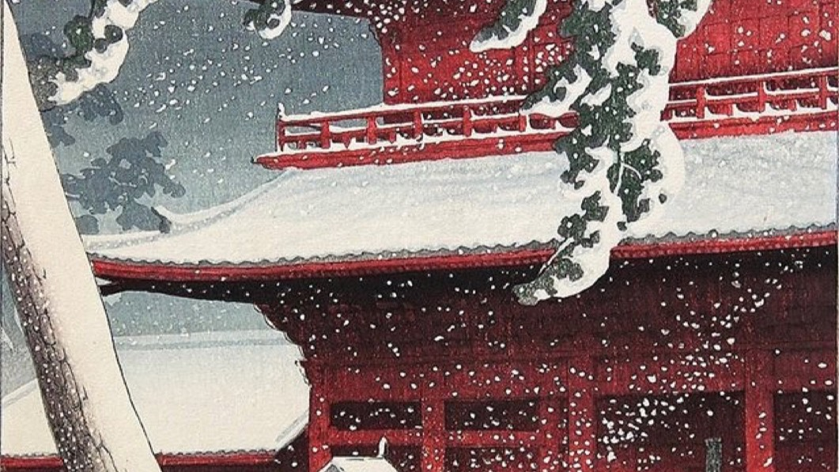
THE PRINT, MADE FOR A MARKET
No original hides behind these. The block is the maker; every good impression is the work.
Hasui Kawase, Zojo-ji Temple in Shiba, 1925, woodblock print
Notes:
A print is many, not one; the market that made them. There is no unique original to lose.

Slide 4
“
That which withers in the age of mechanical reproduction is the aura of the work of art.
Walter Benjamin, The Work of Art in the Age of Mechanical Reproduction, 1935

Slide 5
DAY TWO · BENJAMIN
AURA, DEFINED TO ARGUE WITH
What exactly withers?
01
02
The aura
What reproduction takes
The here and now of the original: this canvas, in this room, with this history, that you had to travel to and stand before. Its presence cannot be copied.
The copy has no here and no now. It meets you anywhere, on any screen. What it gains in reach it loses in presence, and that lost presence is the aura.
ART APPRECIATION · SEMESTER I
01

Slide 6
DAY THREE · STEYERL
THE ONE THEY WILL USE
The poor image, defended
01
02
The loss
What circulation gives
Blurred, compressed, wrong colour, watermarked, ripped from somewhere else. By every standard of quality it is a failure.
But it moves. It is shared, remixed, seen by millions the pristine file never reaches. The poor image trades resolution for a life. Ask what that life is worth.
ART APPRECIATION · SEMESTER I
02

Slide 7
“
The poor image is a copy in motion.
Hito Steyerl, In Defense of the Poor Image, 2009

Slide 8
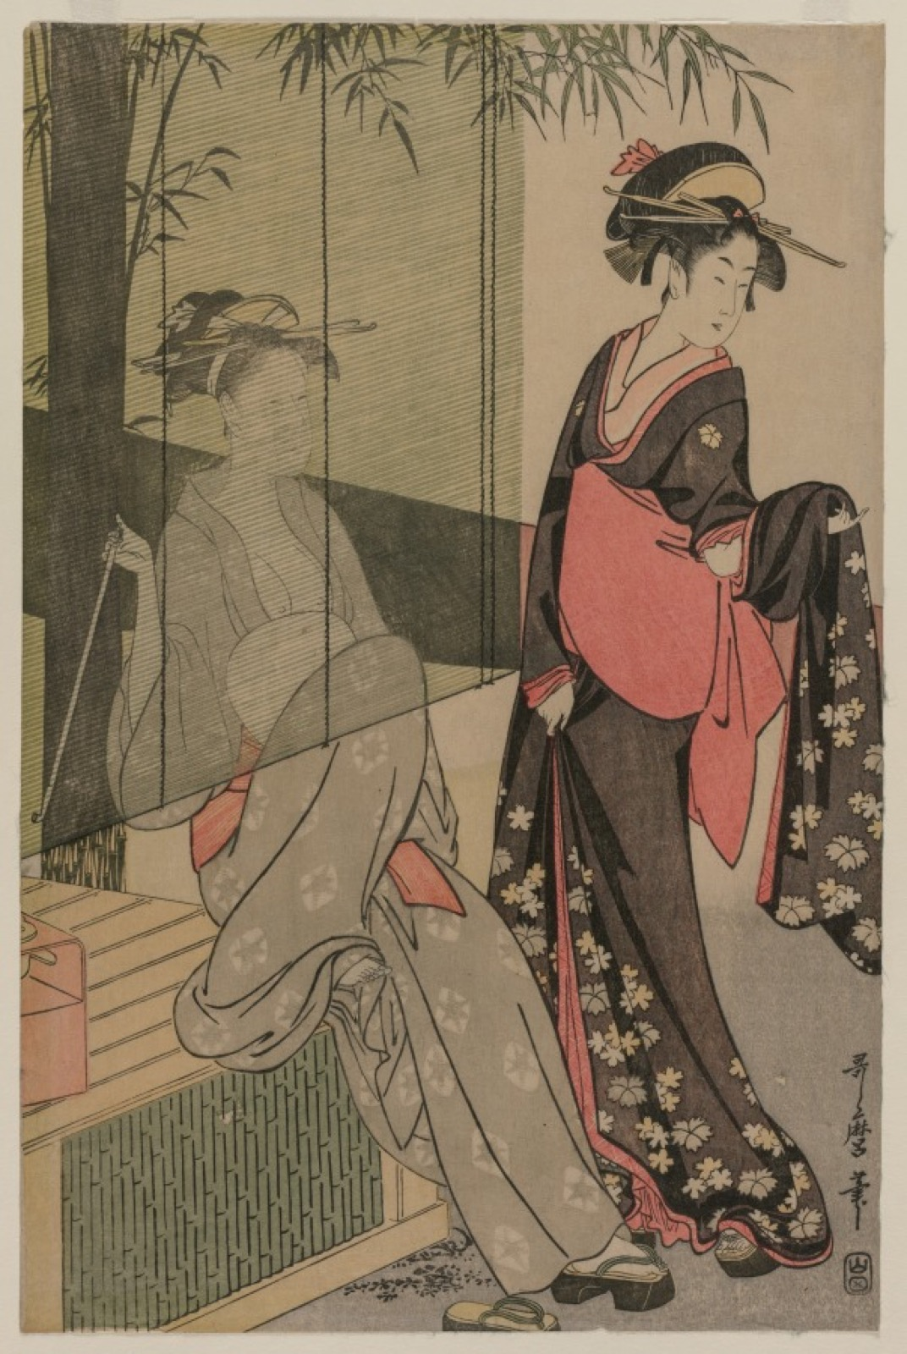
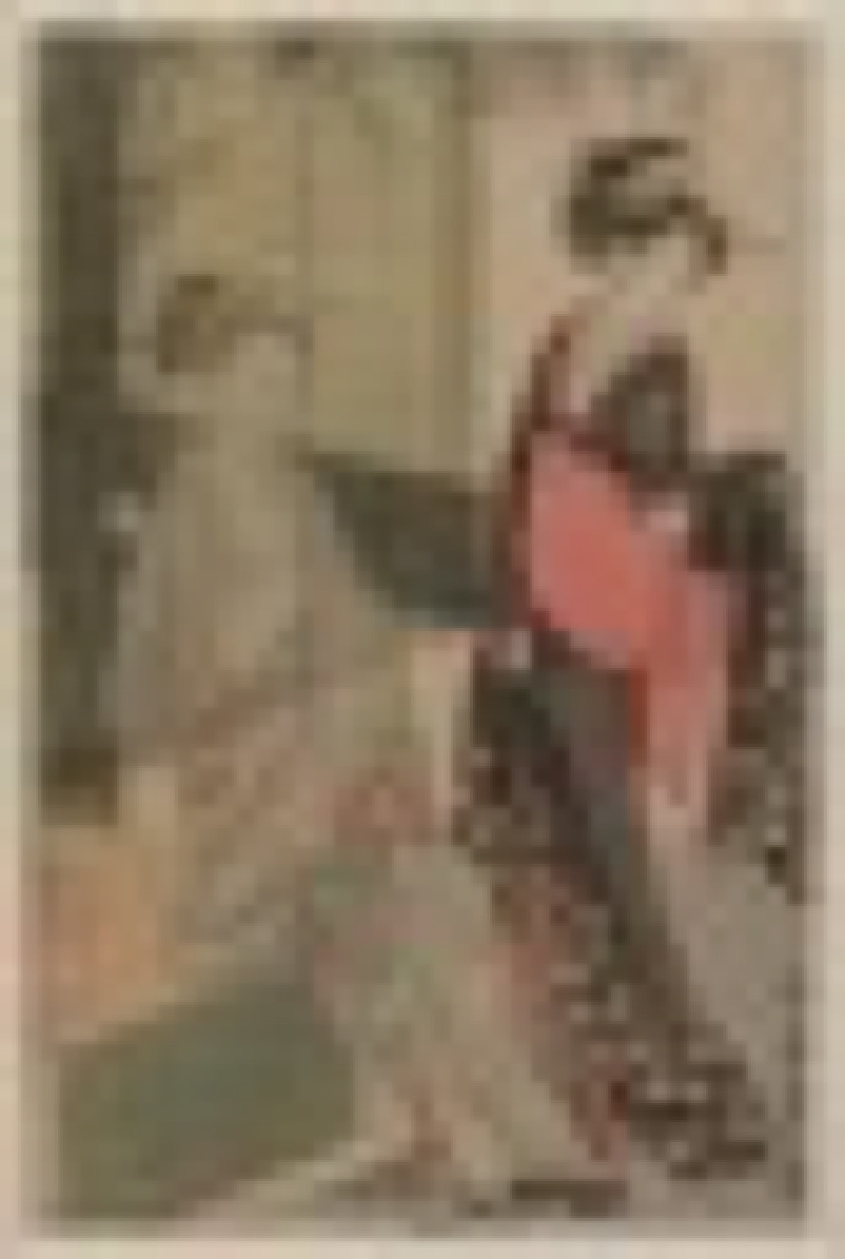
DAY FOUR · THE LAB
MAKE IT WORSE ON PURPOSE
The same image, five routes down
The file
Compressed, re-photographed, screenshotted, re-uploaded
Degrade, compress, re-photograph, screenshot the screenshot. Then fifteen minutes writing exactly what changed, not that it got worse. CS5.
Notes:
The only session all term where they make something worse on purpose. The fifteen minutes of writing is the graded part.

Slide 9
HOW IT RUNS
FOUR SESSIONS
The week, day by day
MON 7 DEC
Ukiyo-e: a print is many, not one
TUE 8 DEC
Aura, defined precisely enough to argue with
WED 9 DEC
Steyerl: defend the poor image
THU 10 DEC
The poor-image lab; write what changed (CS5)
ART APPRECIATION · SEMESTER I
03

Slide 10
NEXT
Photography
and After
Lesson 12. The claim to truth, Sontag, and A4.
ART APPRECIATION · SEMESTER I
04

