Slide 1
XII
ART APPRECIATION · UNIT IV
Photography
and After
Images, Mediation and Modernity · Lesson 12
Six sessions · Friday 11 to Friday 18 December · A4, the last submission of the term
Notes:
A4 is the last thing submitted this semester, clearing the ~1 January cutoff by a fortnight. Nothing here can be handed in late.

Slide 2
XII
DAY TWO
Why do we believe
a photograph?
Notes:
Photography and the claim to truth: why we believe photographs, and whether we should.

Slide 3
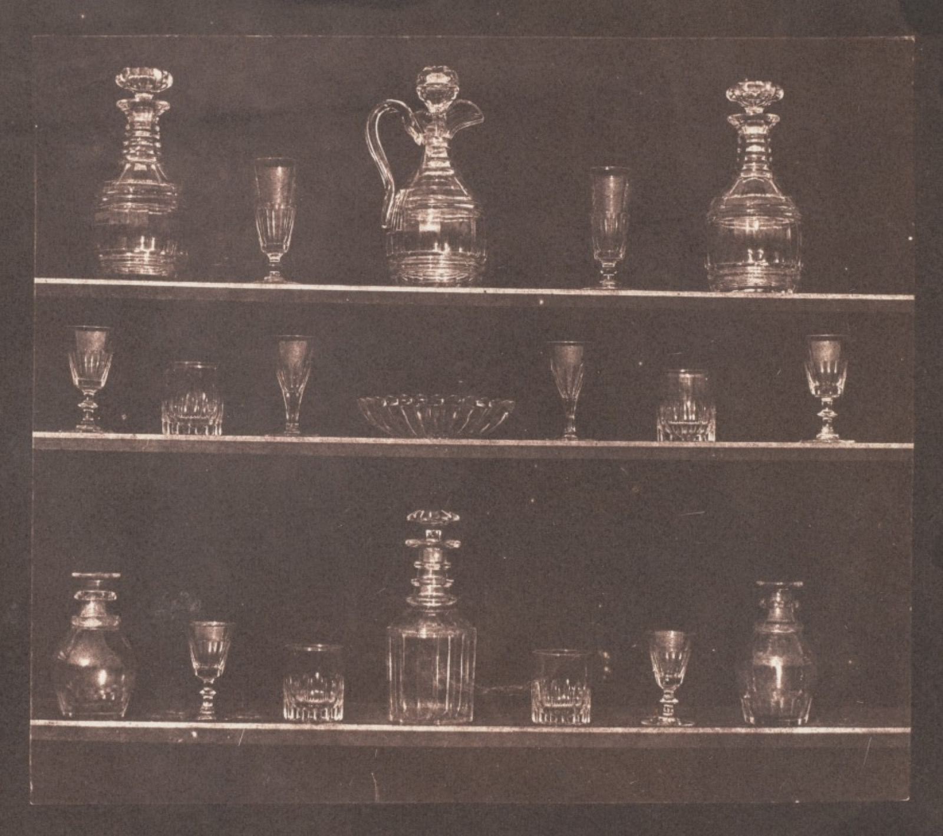
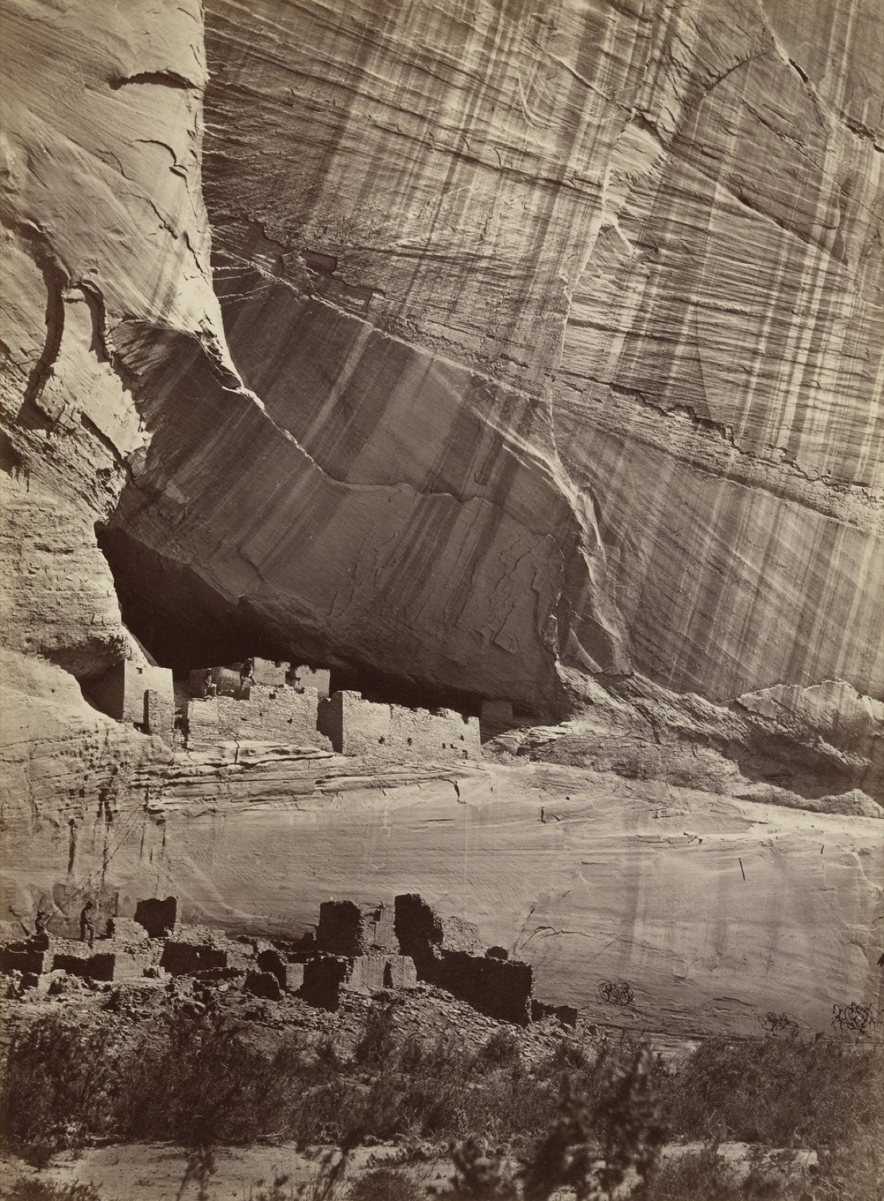
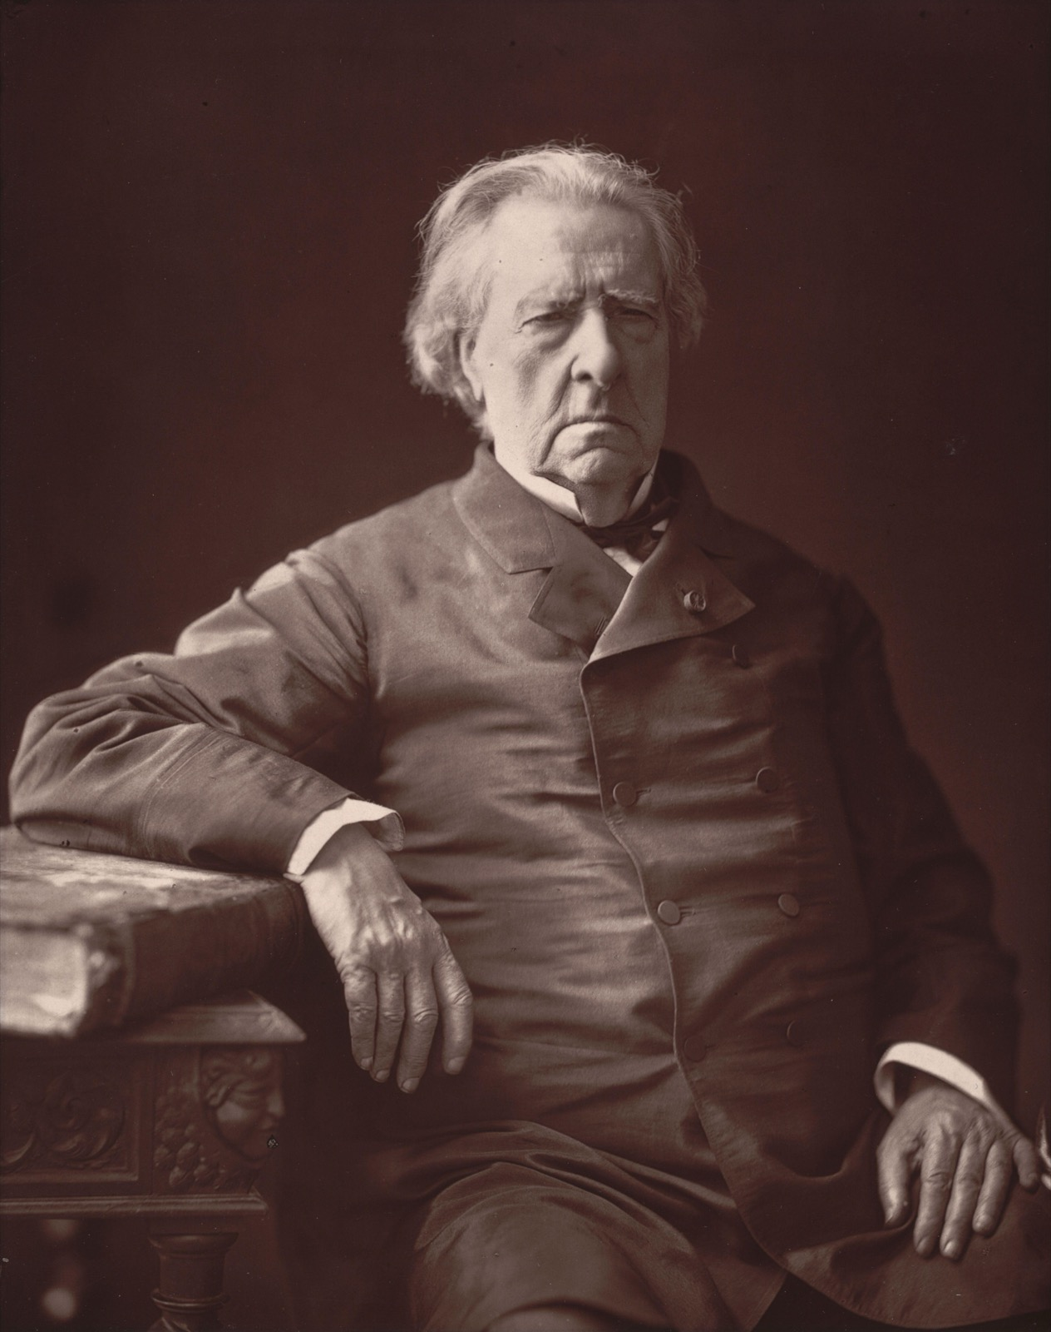
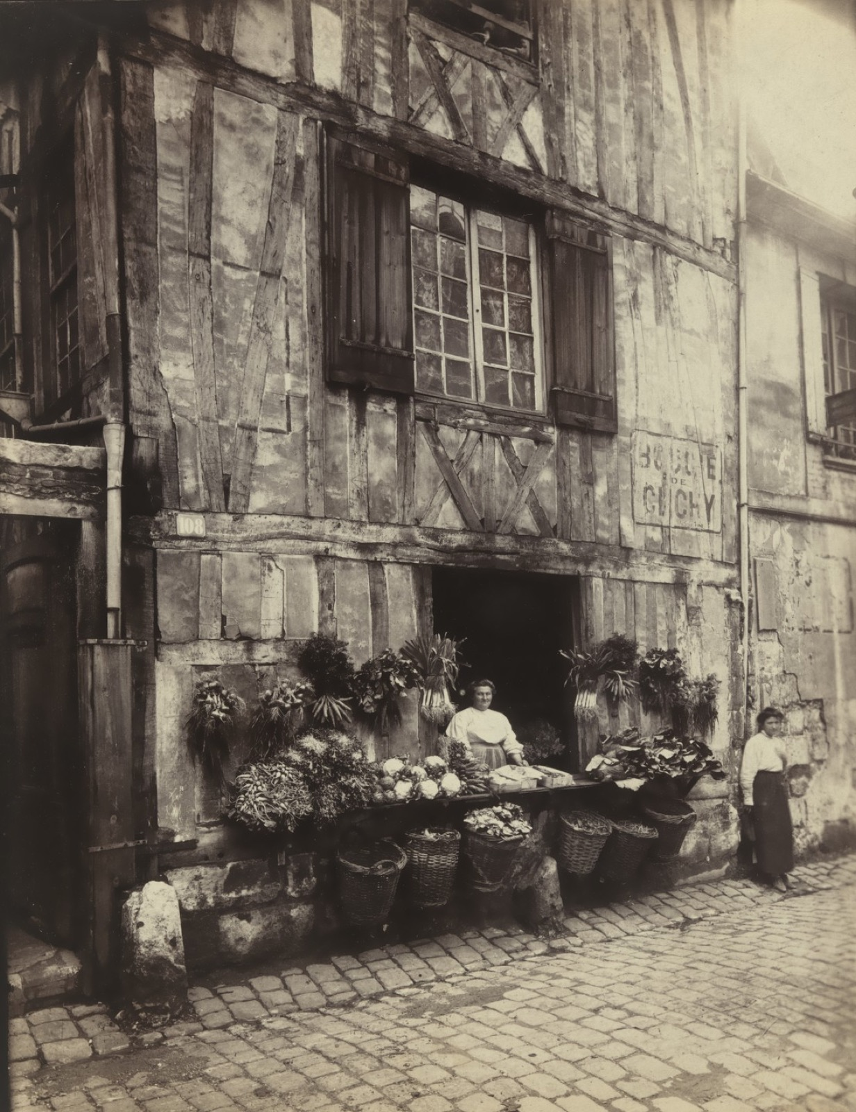
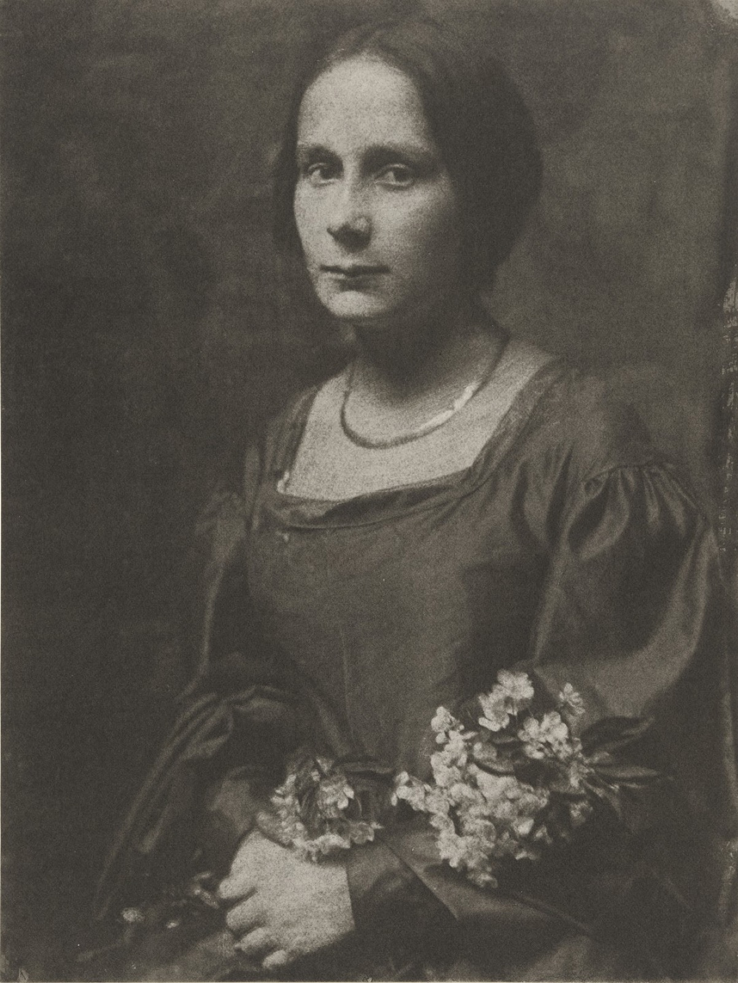
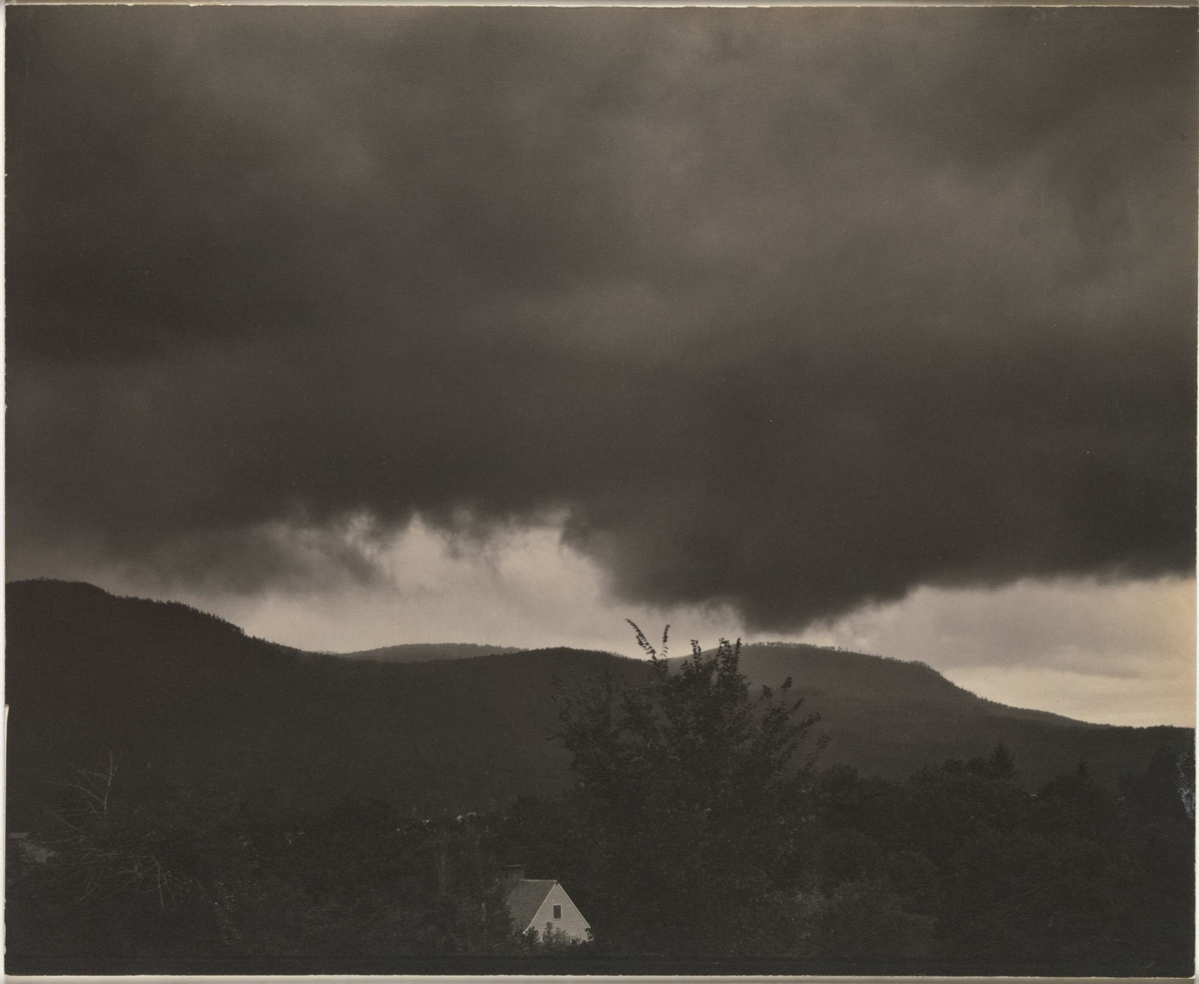
THE RECORD
EIGHTY YEARS OF THE TRUTH
Each one claimed to show the world
Talbot, O'Sullivan, Nadar, Atget, Kasebier, Stieglitz. A still life, a ruin, a face, a street, a mother, a cloud, all held to be simply true.
Notes:
Every one of these was received as a straightforward record. Ask of each what was chosen, framed, and left out.

Slide 4
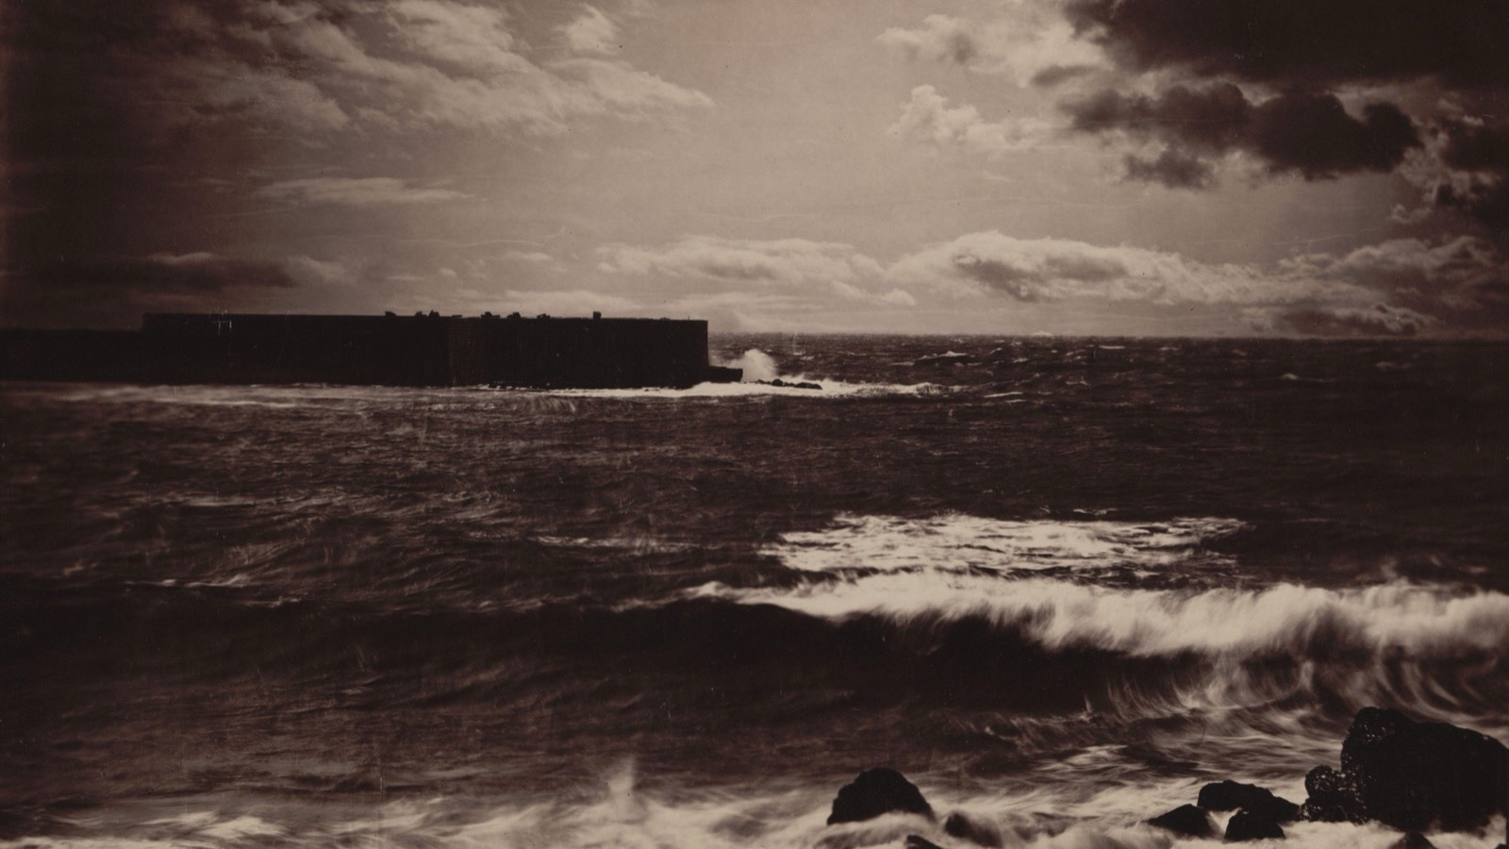
THE CLAIM TO TRUTH
One seascape, printed from two negatives, sky joined to sea. A true-looking moment that never happened.
Gustave Le Gray, The Great Wave, Sete, 1857
Notes:
Why we believe photographs: because they seem to record. Le Gray combined two negatives, so this truthful sea is a construction.

Slide 5
DAY TWO · BELIEF
AND WHETHER TO KEEP IT
The photograph seems not to argue
01
02
Why we believe it
Why we should not
It looks like a trace of light off a real thing, made by a machine, not a hand. It seems to record rather than to claim.
Someone chose the moment, the frame, the crop, the print. The survey of the West was staged; Le Gray's sea was two negatives. The record is always an argument that hides its arguing.
ART APPRECIATION · SEMESTER I
01

Slide 6
“
To photograph is to appropriate the thing photographed.
Susan Sontag, On Photography, 1977

Slide 7
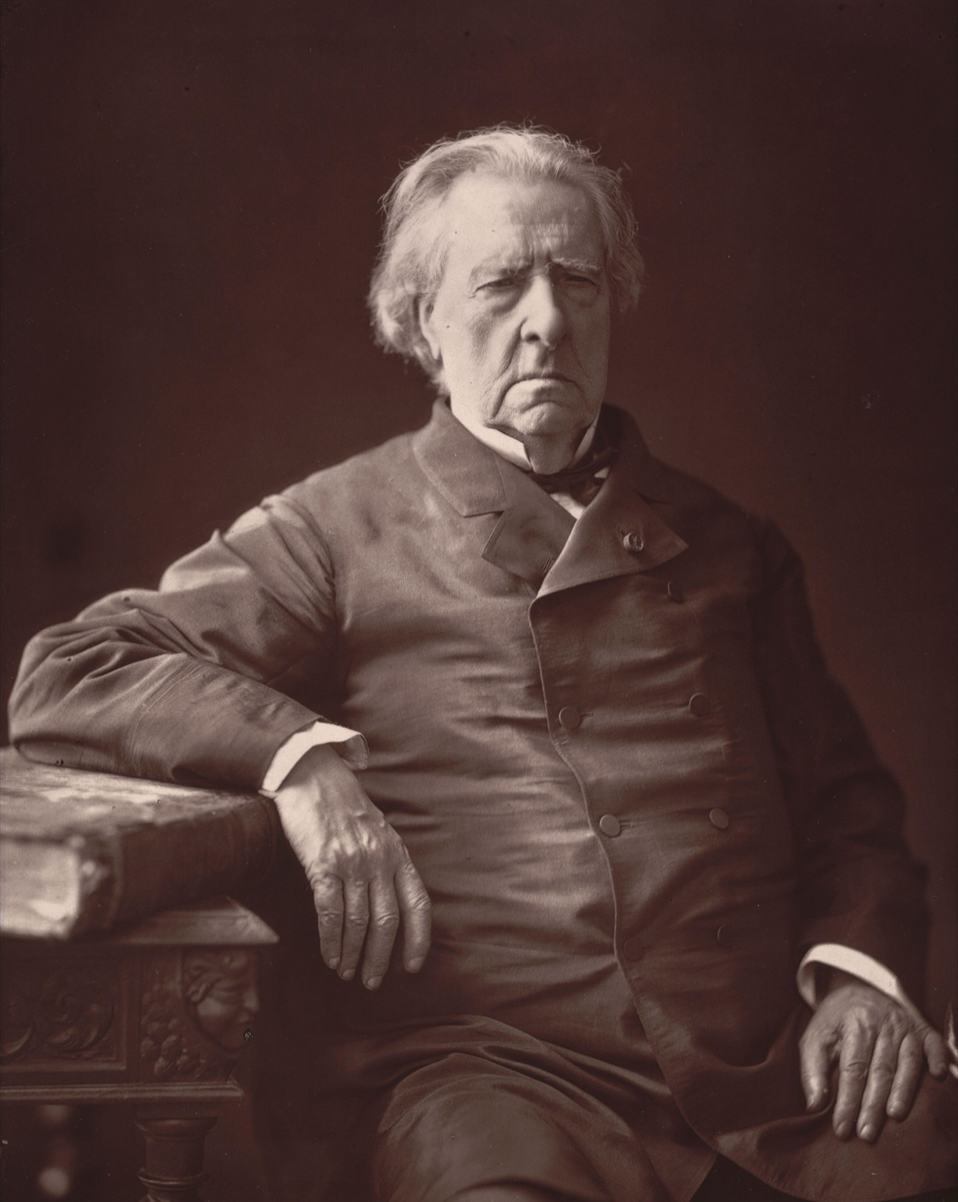
DAY THREE · SONTAG
Not a window,
an act
To photograph someone is to do something to them: to hold them, keep them, put them into a relation that feels like knowledge and works like power. Take the charge seriously before you decide whether it is fair.
Nadar, Baron Isidore Taylor, c. 1865
Notes:
Sontag: photographing as an act on the world; the charge taken seriously, not just repeated.

Slide 8
“
To collect photographs is to collect the world.
Susan Sontag, On Photography, 1977

Slide 9
DAY FOUR · GREENBERG
FIND WHERE THE LINE STOPS
Avant-garde and kitsch
01
02
The line
The test
Greenberg splits art in two: the avant-garde, which is difficult and about itself, against kitsch, which is easy, pre-digested, made to sell.
Do not agree with it. Find the exact place it stops holding: the kitsch that turned out to matter, the avant-garde that was only difficult. The line is useful right up to where it breaks.
ART APPRECIATION · SEMESTER I
02

Slide 10
ASSESSMENT · A4
THE LAST SUBMISSION OF THE TERM
The second constellation
Sits Tuesday 15 December, on the double: build the constellation, write the argument, 40 minutes.
Argue across the whole unit, not a selection of favourites. It is the second constellation of the year, and it should be visibly better than the first. The Unit 1 boards go back on the wall so the distance is plain.
Announced Tuesday 1 December in Lesson 10. The synthesis debrief is in-lesson the next day, while the work is still live.
ART APPRECIATION · SEMESTER I
03

Slide 11
HOW IT RUNS
SIX SESSIONS
The fortnight, day by day
FRI 11 DEC
What the poor image gains
MON 14 DEC
Photography and the claim to truth
TUE 15 DEC
Sontag: photographing as an act
WED 16 DEC
Avant-garde and kitsch; Unit 1 boards return
THU 17 DEC
A4 sits: the synthesis constellation
FRI 18 DEC
Synthesis debrief, while the work is live
ART APPRECIATION · SEMESTER I
04

Slide 12
NEXT
The Artworld
and the Brief
Lesson 13. Danto, Duchamp, and what makes something art.
ART APPRECIATION · SEMESTER I
05

