Slide 1
XIII
ART APPRECIATION · UNIT IV
The Artworld
and the Brief
Images, Mediation and Modernity · Lesson 13
Three sessions · Monday 21 to Wednesday 23 December · then the retrospective
Notes:
The end of the story the course has been telling since the caves. Duchamp and Warhol are the punchline, and the students have been waiting for them.

Slide 2
XIII
THE QUESTION
What makes it art
when looking
cannot tell you?
Notes:
The whole course has led here: from images you could read by looking, to objects you cannot.

Slide 3
“
To see something as art requires something the eye cannot descry, an atmosphere of artistic theory, a knowledge of the history of art: an artworld.
Arthur Danto, The Artworld, 1964

Slide 4
DAY ONE · DANTO
THE END OF ART
Art needs more than eyes
01
02
What the eye gives
What the eye cannot
Colour, shape, surface, resemblance. Everything a camera could record. For most of history this was enough to tell art from not-art.
But a signed urinal looks exactly like a plumbing-supply urinal. What separates them is invisible: a theory, a history, an institution that says this one is art. Danto calls that the artworld.
ART APPRECIATION · SEMESTER I
01

Slide 5
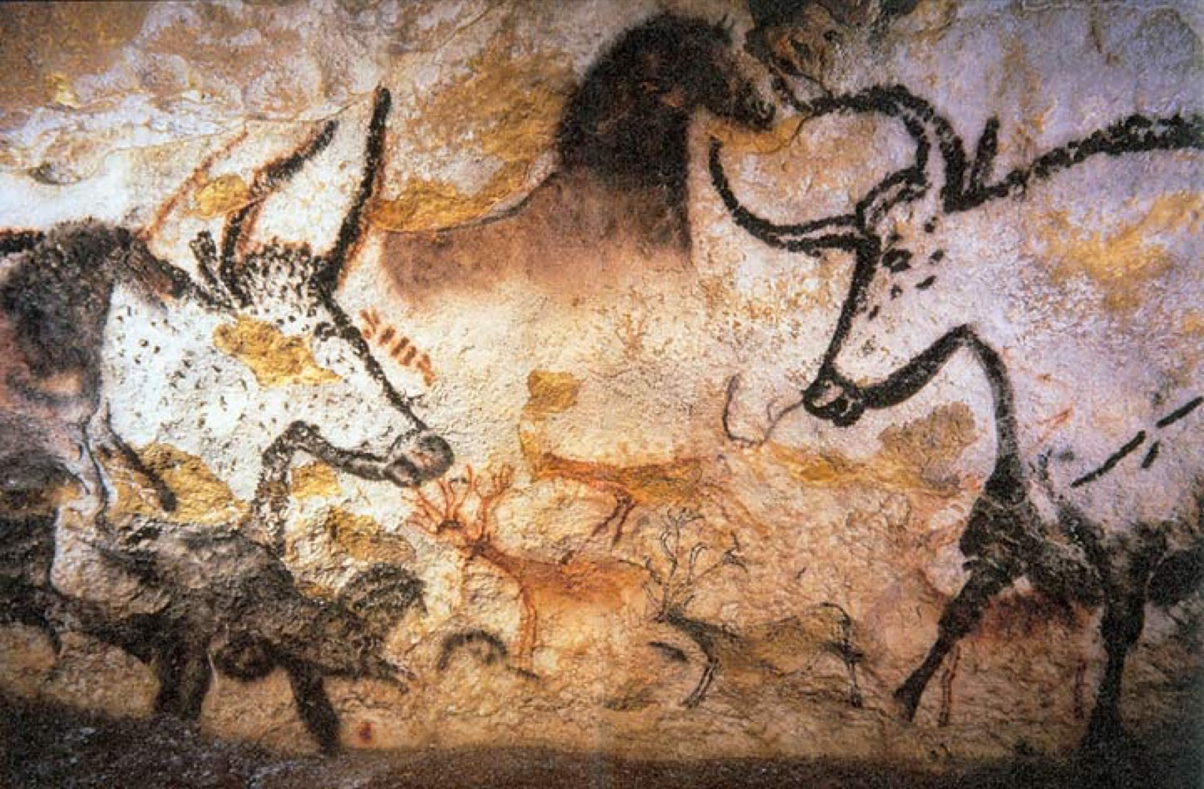
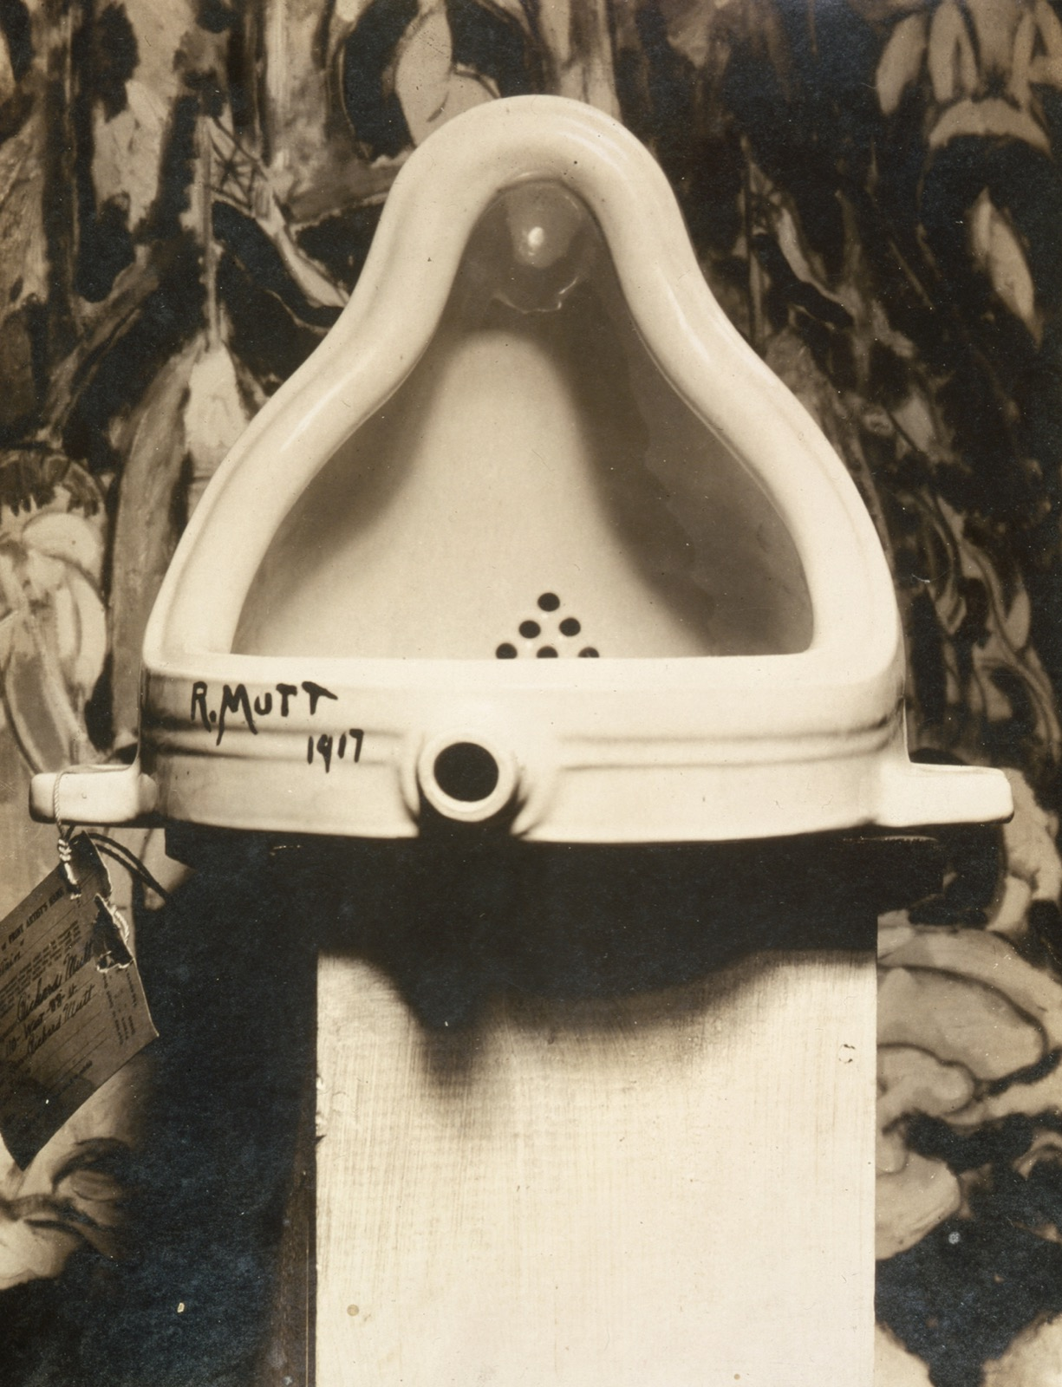
THE WHOLE STORY
FROM THE WALL TO THE READYMADE
Seventeen thousand years apart
Lascaux, c. 17,000 years ago
Duchamp, Fountain, 1917, photographed by Stieglitz · public domain
A urinal, laid on its back, signed R. Mutt, submitted as sculpture. Looking will not settle whether it is art. That is exactly the point.
Notes:
Follow the object out of the studio and into the institution. The question that began on a cave wall ends here, unresolved by looking.

Slide 6
DAY TWO · INTO THE INSTITUTION
WHO DECIDED, AND WHERE
The object leaves the studio
01
02
Duchamp's move
Warhol's world
He did not make the urinal. He chose it, titled it, and sent it to an exhibition. The art is the decision and the placing, not the hand.
Then a box of soap pads, a print of a soup can, sold as art because the artworld received them as art. After this, anything can be art, and the only question left is who gets to decide.
ART APPRECIATION · SEMESTER I
02

Slide 7
DAY THREE · THE BRIEF
BREAK HOMEWORK AND ANNOUNCEMENT IN ONE
Three works that changed how you see
Set Wednesday 23 December, the last session before the break.
Over the holiday, choose three works from the whole semester that changed how you see, and write why for each. Three to four hours, not more. This one page is also the retrospective brief: the announcement covers the whole break, so it cannot slip.
The retrospective sits Thursday 7 January, in class, and is the 20 percent End of Term. One page carried into the holiday, not two.
ART APPRECIATION · SEMESTER I
03
Notes:
The break homework and the retrospective brief are the same document. Do not issue two.

Slide 8
HOW IT RUNS
THREE SESSIONS, THEN CHRISTMAS
The week, day by day
MON 21 DEC
Danto: the artworld and the end of art
TUE 22 DEC
Warhol, Duchamp, pluralism; into the institution (LB8)
WED 23 DEC
Retrospective announced; the break homework set
ART APPRECIATION · SEMESTER I
04

Slide 9
NEXT · UNIT V
The Retrospective
A semester of looking, read back as one argument.
ART APPRECIATION · SEMESTER I
05

