Slide 1
XIV
ART APPRECIATION · UNIT V
The
Retrospective
Semester Close · Lesson 14
Five sessions · Monday 4 to Friday 8 January · the last week of the semester
Notes:
The third constellation of the year, and the one where the method finally looks like a method rather than a rule.

Slide 2
XIV
THE TASK
Read the whole
semester back
as one argument.
Notes:
Everything they have made is available. The Unit 1 boards and the Unit 4 syntheses go up on the walls before Monday.

Slide 3
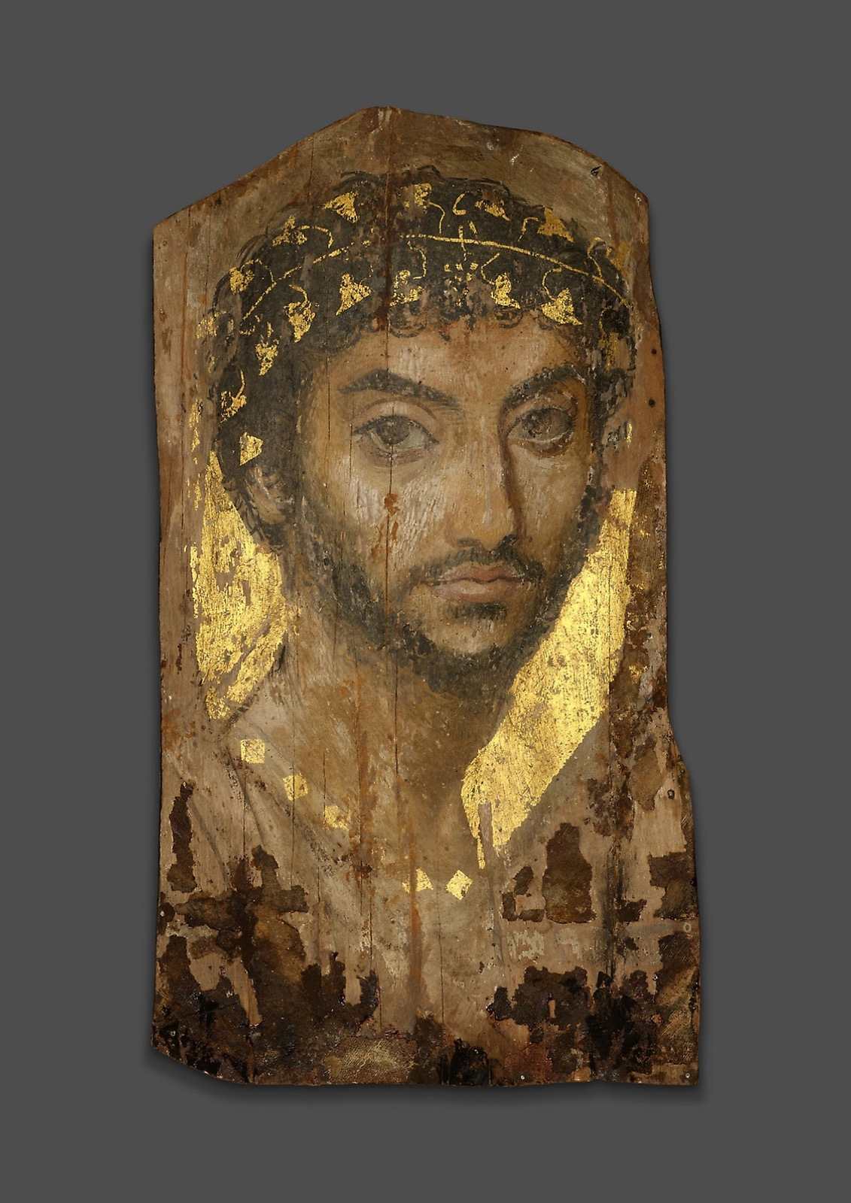
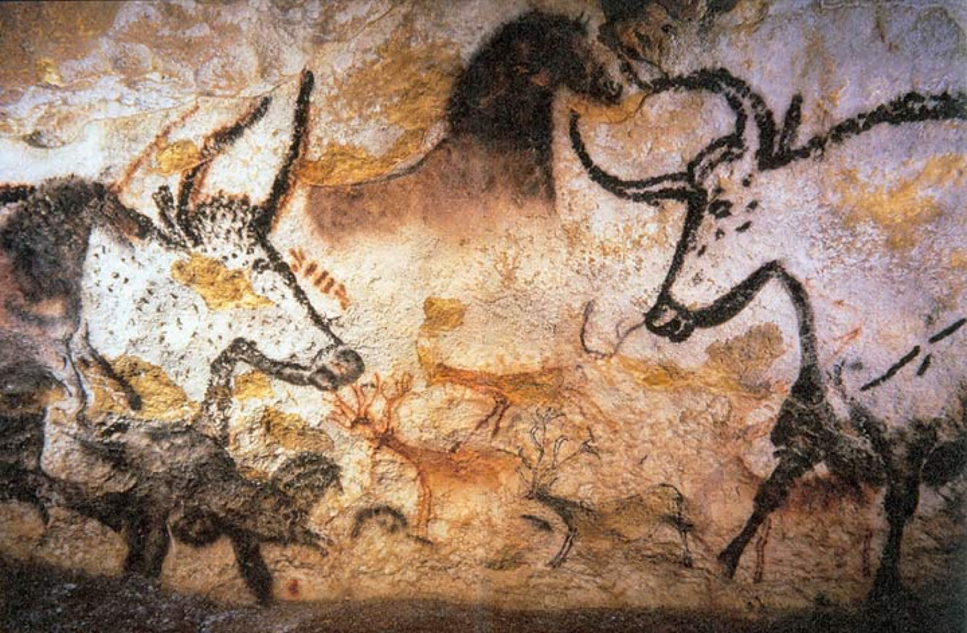
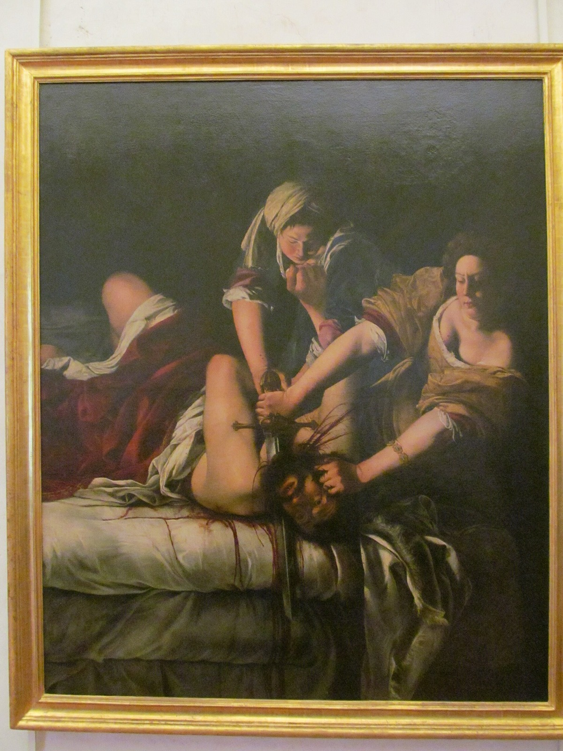
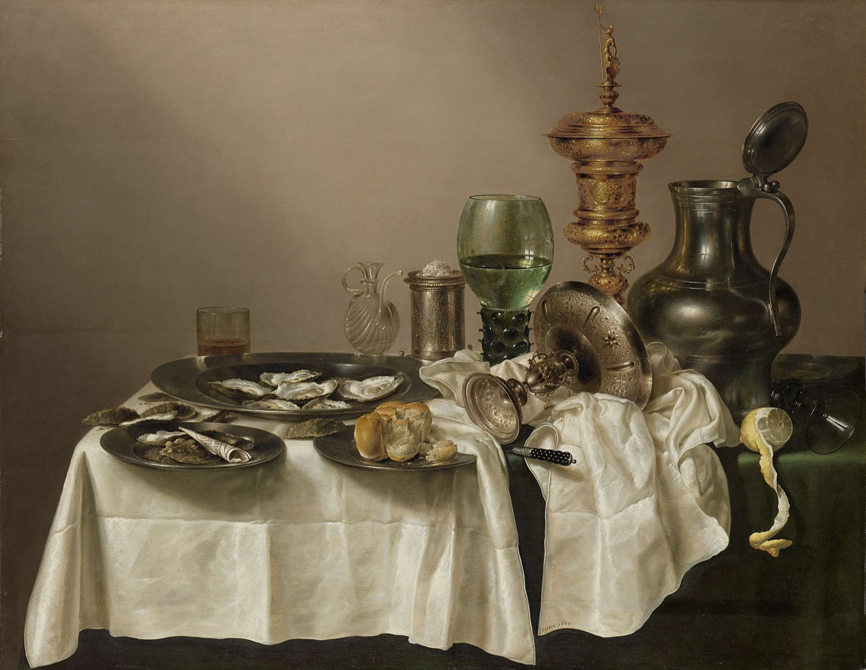
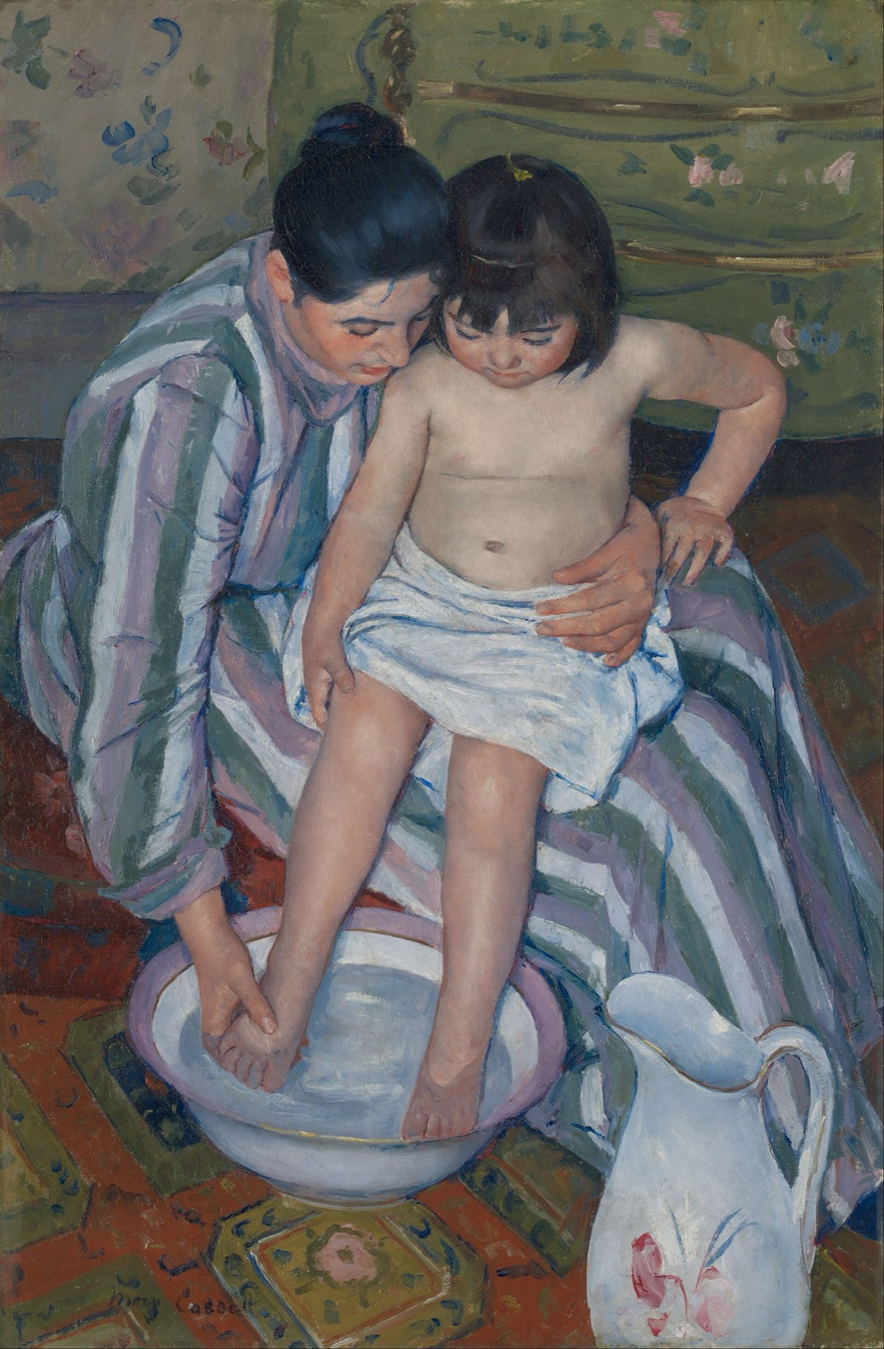
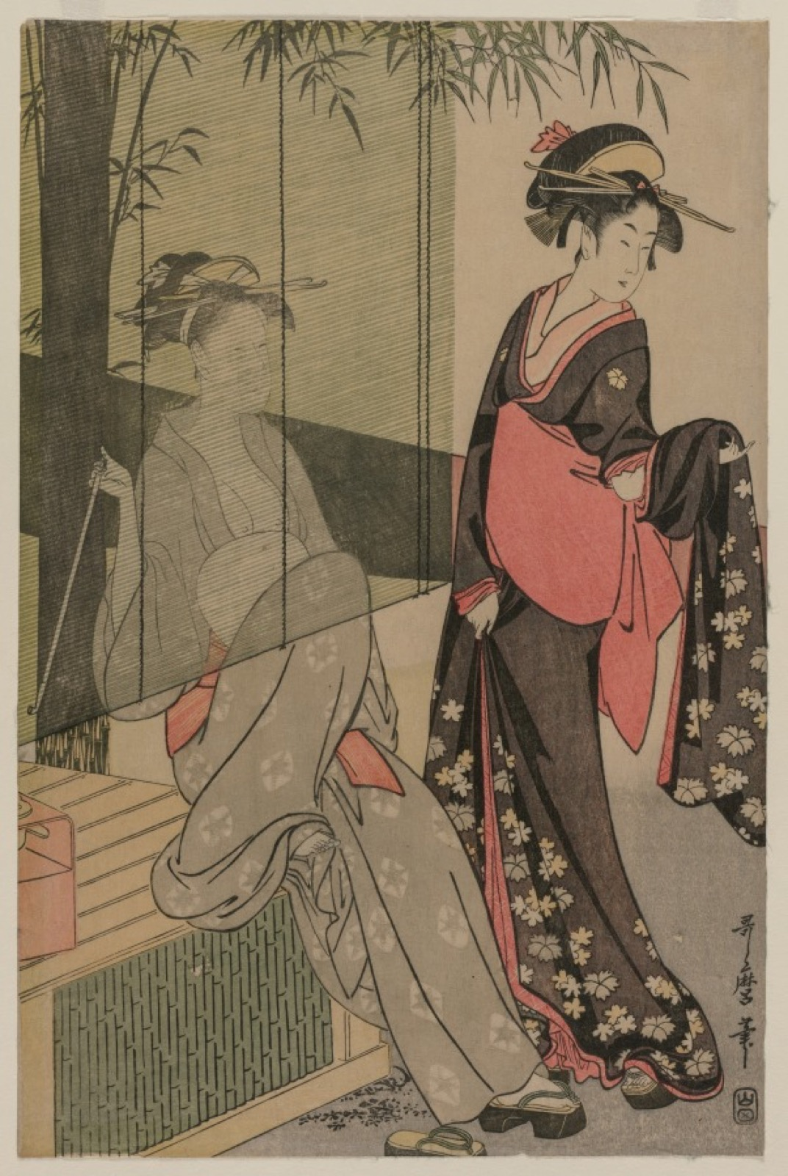
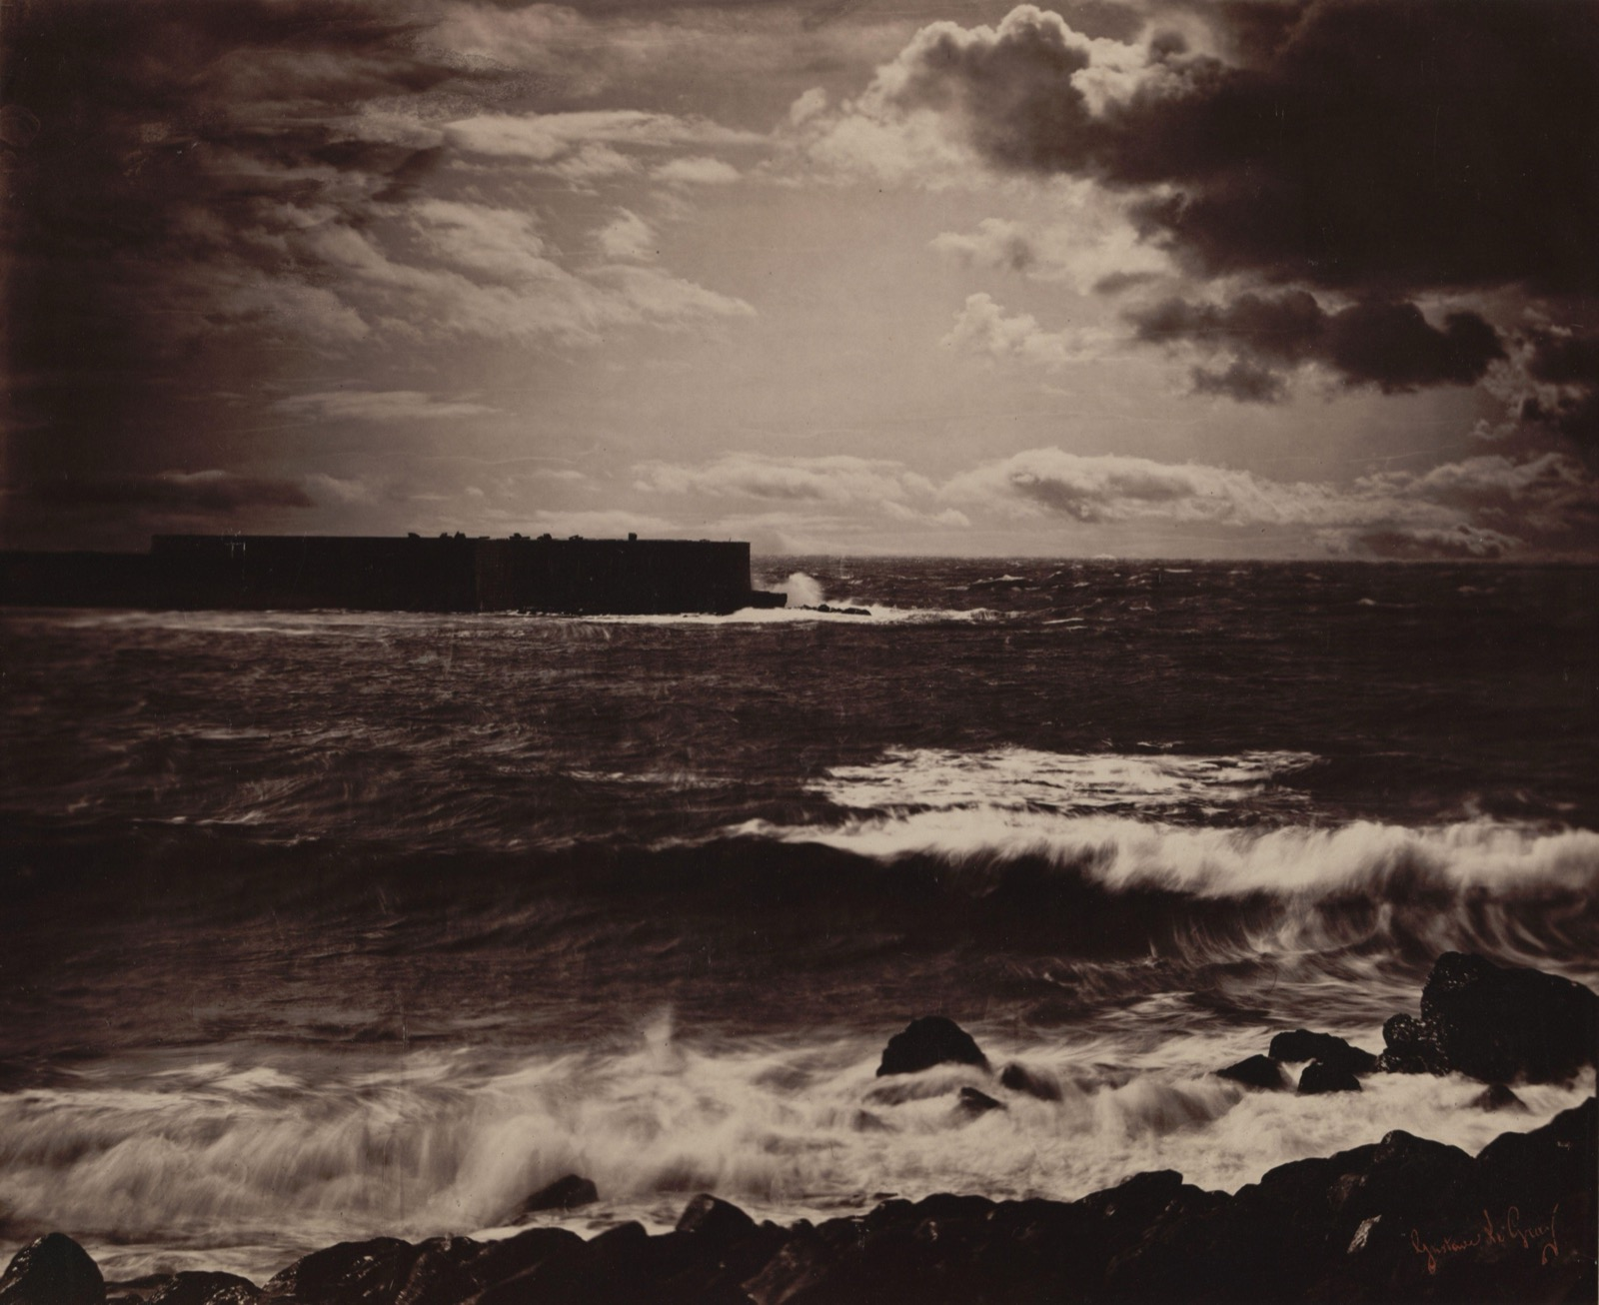
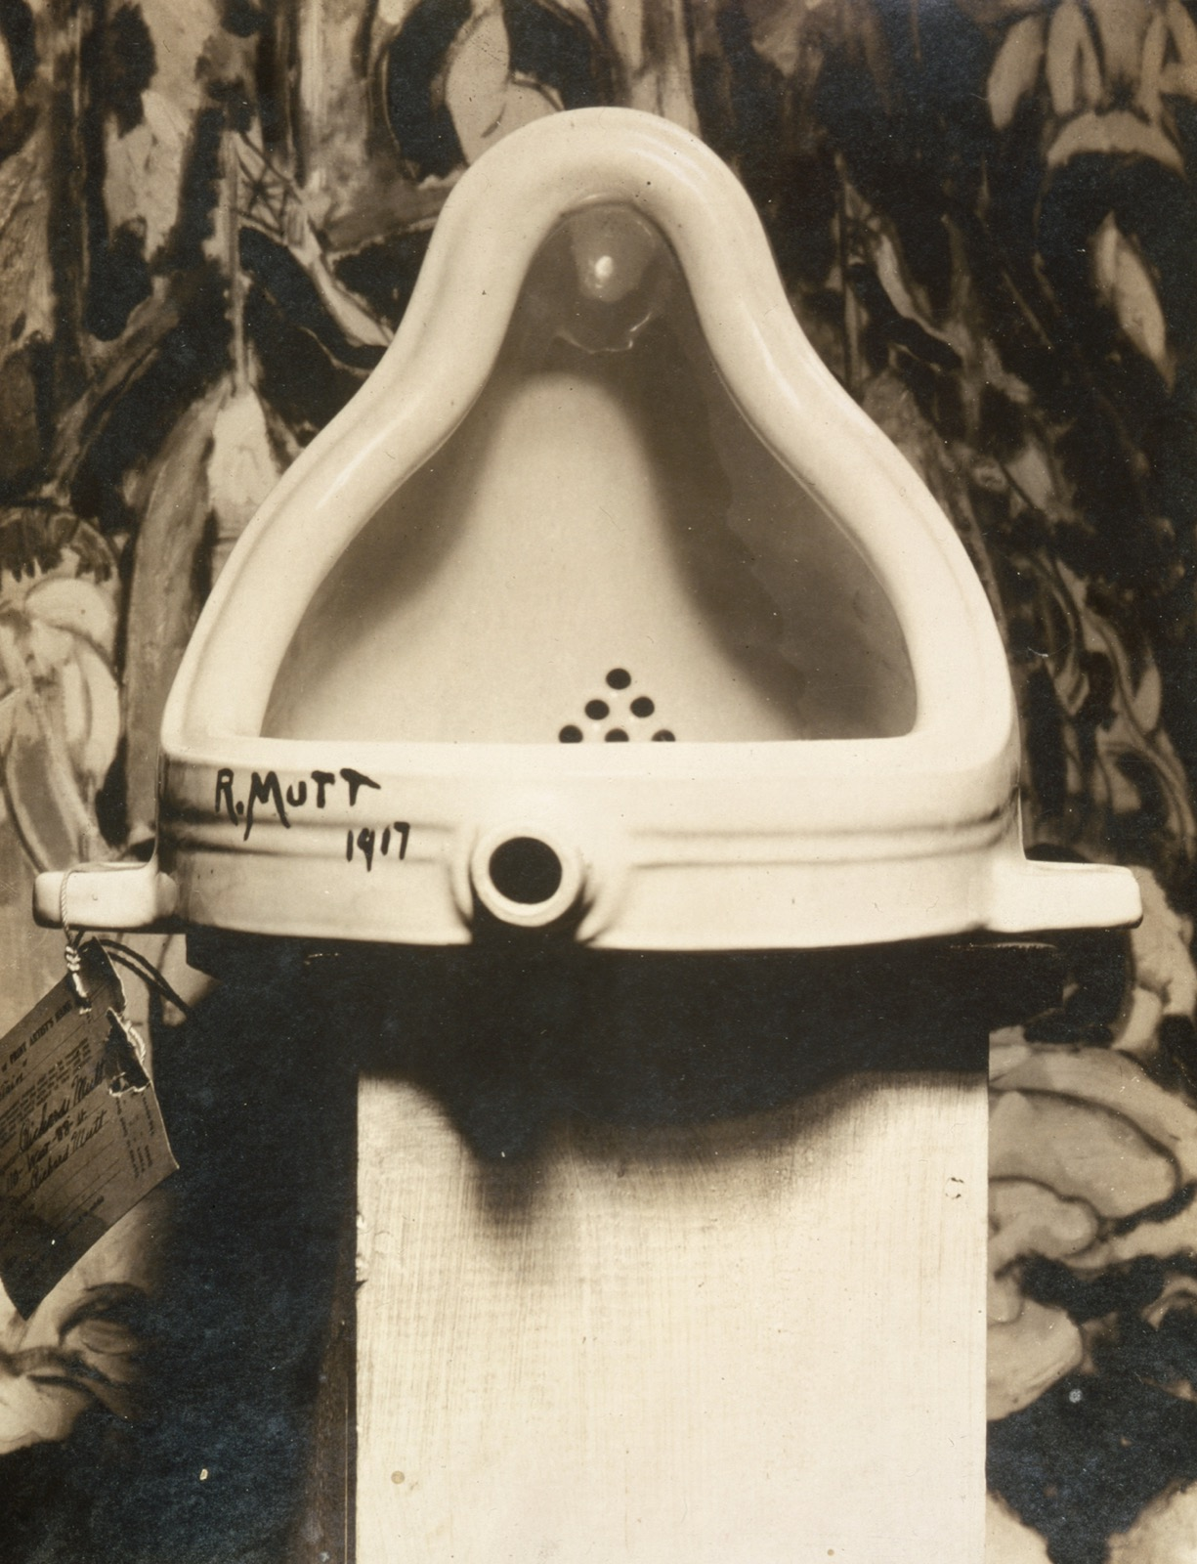
THE YEAR
FIVE UNITS, ON ONE WALL
Everything, before you arrange it
Origins, narrative, the table, mediation, and the readymade. The retrospective asks what one argument runs through all of them.
Notes:
Inventory only on day one. Everything on the wall, 35 minutes, no arranging.

Slide 4
“
We only see what we look at.
To look is an act of choice.
John Berger, Ways of Seeing, 1972 · and the retrospective is all choice

Slide 5
DAY ONE · INVENTORY
NO ARRANGING YET
Look before you build
Everything you made this term goes on the wall, and for thirty-five minutes you only look. No arranging, no grouping, no deciding. Once you begin arranging you stop seeing, and the retrospective is made of seeing.
ART APPRECIATION · SEMESTER I
01
Notes:
Students will start arranging within four minutes. Stop them.

Slide 6
DAY TWO · THE BREAK WORKS
DEFENDED, NOT CONCEDED
Three works, and why
01
02
From the holiday
Hold the line
You chose three works that changed how you see, with reasons. Now say them out loud to someone who chose three others.
They will not just agree, and you must not just fold. A reason you cannot defend to a person who saw differently was never really a reason. Find the one that holds.
ART APPRECIATION · SEMESTER I
02

Slide 7
ASSESSMENT · END OF TERM
TWENTY PER CENT
A semester of looking, as one layout
Sits Thursday 7 January, in class, 40 minutes.
Build one constellation from the whole term that makes a single argument, with the argument in the layout, before a word of explanation. Announced Wednesday 23 December; the criteria came with it. This is the End of Term, and there is no exam the following week.
Sat in class rather than in the exam window, on the teacher's stated decision. An open item: confirm with department.
ART APPRECIATION · SEMESTER I
03

Slide 8
HOW IT RUNS
THE LAST WEEK
The week, day by day
MON 4 JAN
Inventory: everything on the wall, no arranging
TUE 5 JAN
Defend the three break works to someone who differs
WED 6 JAN
Constellation workshop: test it while it can change
THU 7 JAN
The retrospective sits (End of Term, 20%)
FRI 8 JAN
Read the room; name the Semester 2 question
ART APPRECIATION · SEMESTER I
04

Slide 9
NEXT
Return
Lesson 15. Work returned, and the trailer for Semester 2.
ART APPRECIATION · SEMESTER I
05

