Slide 1
XV
ART APPRECIATION · UNIT V
Return
Semester Close · Lesson 15
Three return days · Tuesday 19 to Thursday 21 January · after the grades
Notes:
Three days after the exam window and the grades deadline. Nothing here carries weight into the S1 grade, and the students know it. That is not a reason to waste them.

Slide 2
XV
THE RETURN
The only unhurried
time in the year.
Notes:
The only unhurried time to talk to eleven people one at a time about what they actually made.

Slide 3
DAYS ONE AND TWO
ONE AT A TIME
Eight minutes, one real thing
Work is returned, and while everyone else re-reads their own against the criteria, we talk one to one. Eleven students across two days is about eight minutes each: enough for one real conversation if it is prepared, useless if it is not. Know the one thing you will say to each of them before Tuesday.
ART APPRECIATION · SEMESTER I
01

Slide 4
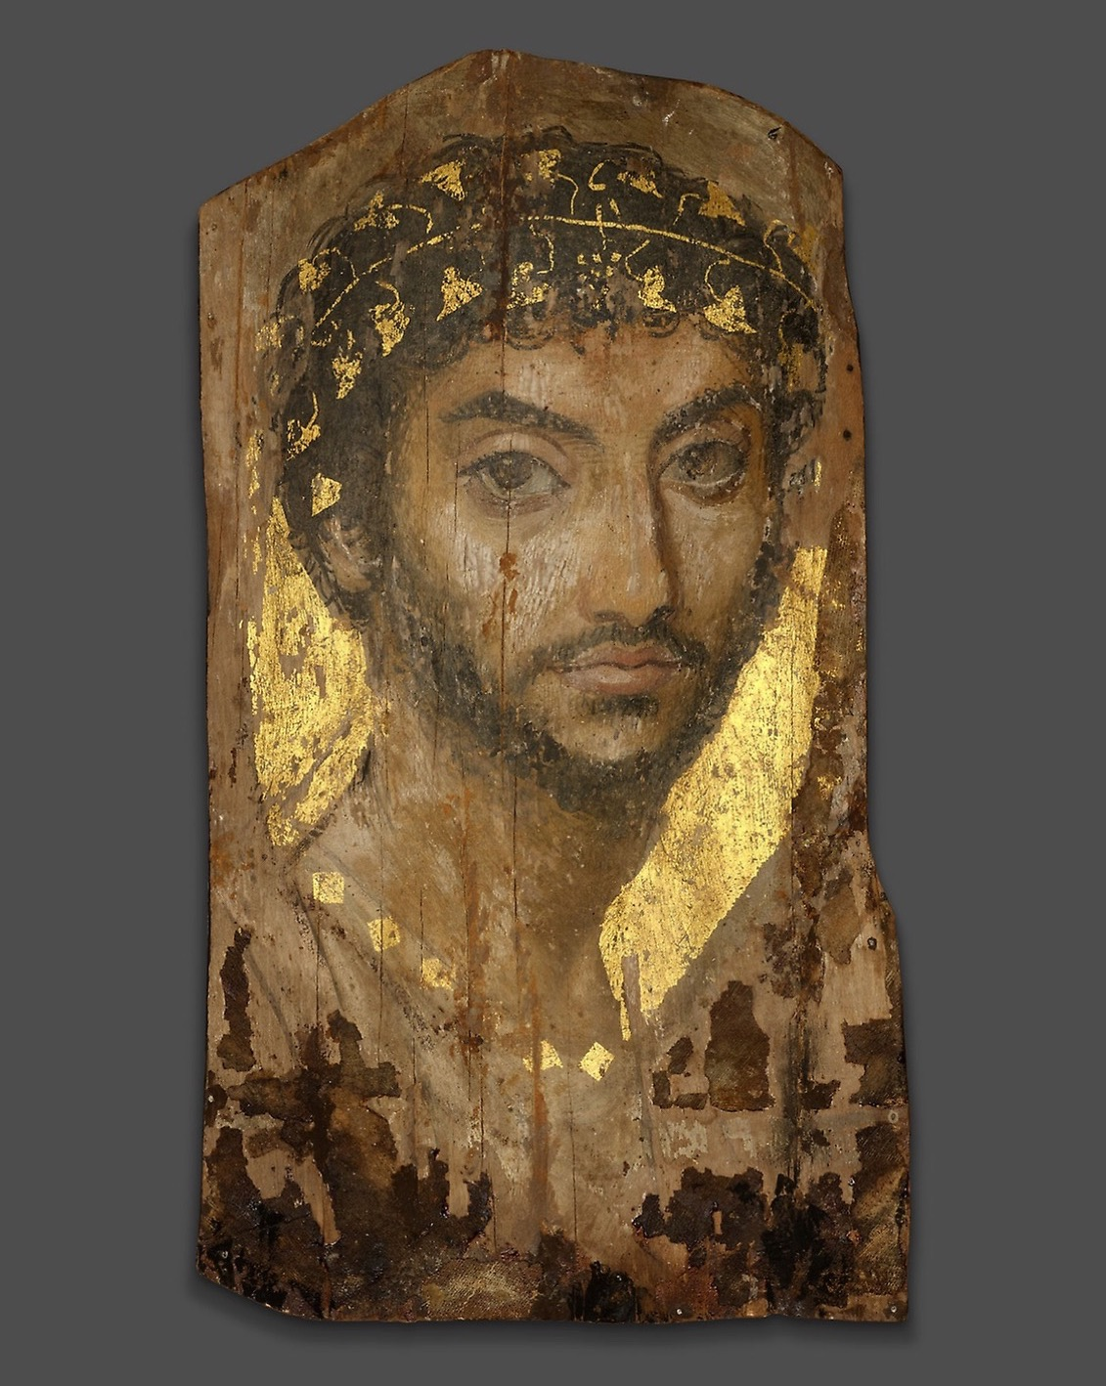
ONE LAST LOOK
Where we
began
The first thing you looked at was a face painted to survive. A semester later you can read what a picture decided, and defend the reading to someone who saw it differently. Keep that. It is the whole of the method.
Mummy Portrait of a Man, Roman Egypt, c. 101 CE · where the course began
Notes:
A quiet bookend to Lesson 01. The Fayum face opened the course; it is worth closing the loop before the pivot to Semester 2.

Slide 5
DAY THREE · THE TRAILER
A GENUINELY DIFFERENT COURSE
From the picture to the price
01
02
What this term was
What Semester 2 is
Reading images: what a picture decided, and how to argue it from the picture itself. The eye, trained.
The structures around the picture: patronage, the market, who decides what is worth money and what is allowed to be seen. It ends on the Atlas Book. Write one goal, about a practice, not a grade.
ART APPRECIATION · SEMESTER I
02
Notes:
Day three is the only trailer Semester 2 gets. It is a genuinely different course. Say that. LB9 posts here and counts toward Semester 2, not this one.

Slide 6
HOW IT RUNS
THREE UNCODED RETURN DAYS
After the grades
TUE 19 JAN
Work returned; one-to-one feedback begins (LB9)
WED 20 JAN
One-to-one continued; grades and comments due
THU 21 JAN
Semester 2 trailer; write the goal
ART APPRECIATION · SEMESTER I
03

Slide 7
SEMESTER 2
The Art World
Patronage, the market, and who decides. See you there.
ART APPRECIATION · SEMESTER I
04

