Slide 1
Finish Presentation
Ho Minh Tam – Engineer - TFT

Slide 2
Web Application - QUIZ
Ho Minh Tam – Engineer - TFT

Slide 3
Objective
Introduction Spring Framework
Integrate Hibernate and Spring.
Knowledge apply Spring to real program

Slide 4
Content
Spring Framework Introduction
Architecture Overview
Product Overview

Slide 5
Spring Framework

Slide 6
Spring Framework
Spring is an open-source and Lightweight framework created to address the complexity of enterprise application development.
Management of Objects within an Application.
Can be Used with JEE and Java
Spring provides a light weight solution for building enterprise ready applications.
Provide Spring Container
Application Context(In Web-Layer)
Bean Factory(In Stand-Alone)
Notes:
The Spring Framework is an application framework and inversion of control container for the Java platform.
The framework's core features can be used by any Java application, but there are extensions for building web applications on top of the Java EE platform. Although the framework does not impose any specific programming model, it has become popular in the Java community as an alternative to, replacement for, or even addition to the Enterprise JavaBeans (EJB) model. The Spring Framework is open source.

Slide 7
Management of Objects within an Application.
Can be Used with JEE and Java
Provide Spring Container
Application Context(In Web-Layer)
Bean Factory(In Stand-Alone)
Spring provides a light weight solution for building enterprise ready applications.
Spring can be used for both standalone application (Java SE )& web application (Java EE )
Spring is Open Source
Multi – tier Framework

Slide 8
Spring Framework
Features
Management of Objects
Open Source
Promotes Dependency Injection
Promotes Loose Coupling
Lightweight & Non-intrusive

Slide 9
Architecture

Slide 10
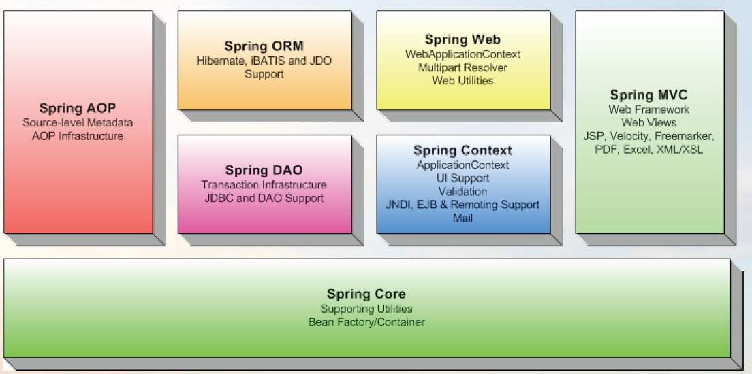
Architecture Overview
Notes:
Core module : is the core container will create the objects, wire them together, configure them, and manage their complete lifecycle from cradle to grave.
Spring’s AOP module : transactions and security
Spring’s JDBC , Data Access Objects (DAO) : module abstracts, provide transaction management services for objects in a Spring application.
MVC framework : Supports Apache Struts, JSF, WebWork, and Tapestry etc. It also has its own MVC frameworks
ORM(Object-relational mapping) : support builds on the DAO support, providing a convenient way
to build DAOs for several ORM solutions.
Spring doesn’t attempt to implement its own ORM solution, provide hooks into several popular ORM frameworks, including Hibernate, Java Persistence API, Java Data Objects,

Slide 11

Spring Core
The Core package is the most fundamental part of the framework and provides the IoC and Dependency Injection features.
Notes:
The container defines how beans are created, configured, and managed.
Core module is the core container will create the objects, wire them together, configure them, and manage their complete lifecycle from cradle to grave.

Slide 12
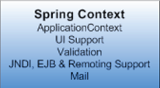
Spring Context
The Context package:- it provides a way to access objects in a framework-style manner in a fashion somewhat reminiscent of a JNDI-registry.
Notes:
The core module’s BeanFactory makes Spring a container, but the context module is what makes it a framework.
Support for internationalization (I18N) messages, application lifecycle events, and validation. In addition, this module supplies many enterprise services such as email, JNDI access, EJB integration, remoting, and scheduling.

Slide 13
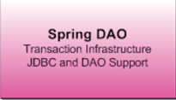
Spring DAO
The DAO package provides a JDBC-abstraction layer that removes the need to do tedious JDBC coding and parsing of database-vendor specific error codes.
Notes:
Spring’s JDBC and Data Access Objects (DAO) module abstracts away the boilerplate code so that you can keep your database code clean and simple, and prevents problems that result from a failure to close database resources.
In addition, this module uses Spring’s AOP module to provide transaction management services for objects in a Spring application.

Slide 14

Spring ORM
The ORM package provides integration layers for popular object-relational mapping APIs, including JPA, JDO, Hibernate, and iBatis.
Notes:
Spring’s ORM support builds on the DAO support, providing a convenient way to build DAOs for several ORM solutions.
Spring doesn’t attempt to implement its own ORM solution, but does provide hooks into several popular ORM frameworks, including Hibernate, Java Persistence API, Java Data Objects, and iBATIS SQL Maps.
Spring’s transaction management supports each of these ORM frameworks as well as JDBC.

Slide 15
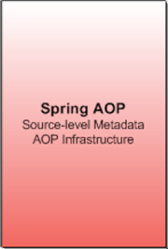
Spring AOP
Spring's AOP package provides an AOP Alliance-compliant aspect-oriented programming implementation allowing you to define
Notes:
Spring provides rich support for aspect-oriented programming in its AOP module.
This module serves as the basis for developing your own aspects for your Spring enabled application. Like DI, AOP supports loose coupling of application objects.
With AOP, however, applicationwide concerns (such as transactions and security) are decoupled from the objects to which they are applied.

Slide 16

Spring Web
Spring's Web package provides basic web-oriented integration features, such as multipart file-upload functionality, the initialization of the IoC container using servlet listeners and a web-oriented application context.
Notes:
Spring's Web package provides basic web-oriented integration features, such as multipart file-upload functionality, the initialization of the IoC container using servlet listeners and a web-oriented application context.

Slide 17
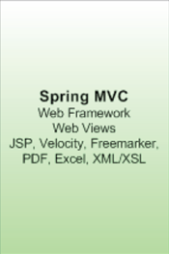
Spring MVC
Spring's MVC package provides a Model-View-Controller (MVC) implementation for web-applications.
Notes:
Supports Apache Struts, JSF, WebWork, and Tapestry etc.
It also has its own MVC frameworks

Slide 18
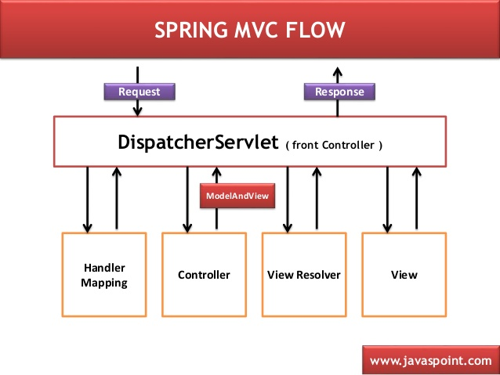

Slide 19
Integrate Hibernate and Spring

Slide 20
Hibernate application
In hibernate framework, we provide all the database information hibernate.cfg.xml file.
Example: connection database, mapping, …

Slide 21
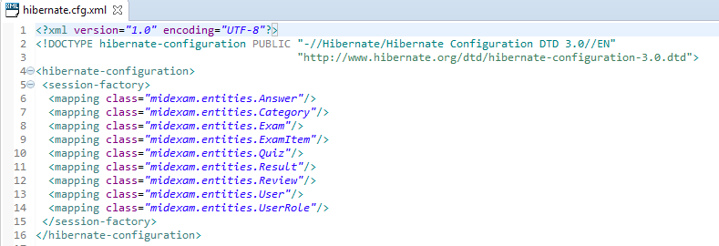
Using Hibernate framework

Slide 22
Integrate Hibernate and Spring
Spring handle everything : connection, transaction, security, …
Using spring-database.xml or dispatcher-servlet.xml
Hibernate use for mapping

Slide 23
Integrate Hibernate and Spring

Slide 24
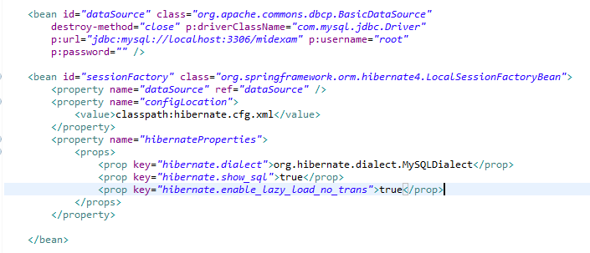
Spring Database

Slide 25
Project - QUIZ

Slide 26
PROJECT
Requirement
Database Structure
Site Map
Function
Applied framework

Slide 27
PROJECT - Requirement
Questions bank to manage Courses, Exams ,Questions
Take a Test
Do a Quiz
View Results
Tracking Result
User Management
Using Hibernate and Spring framework

Slide 28
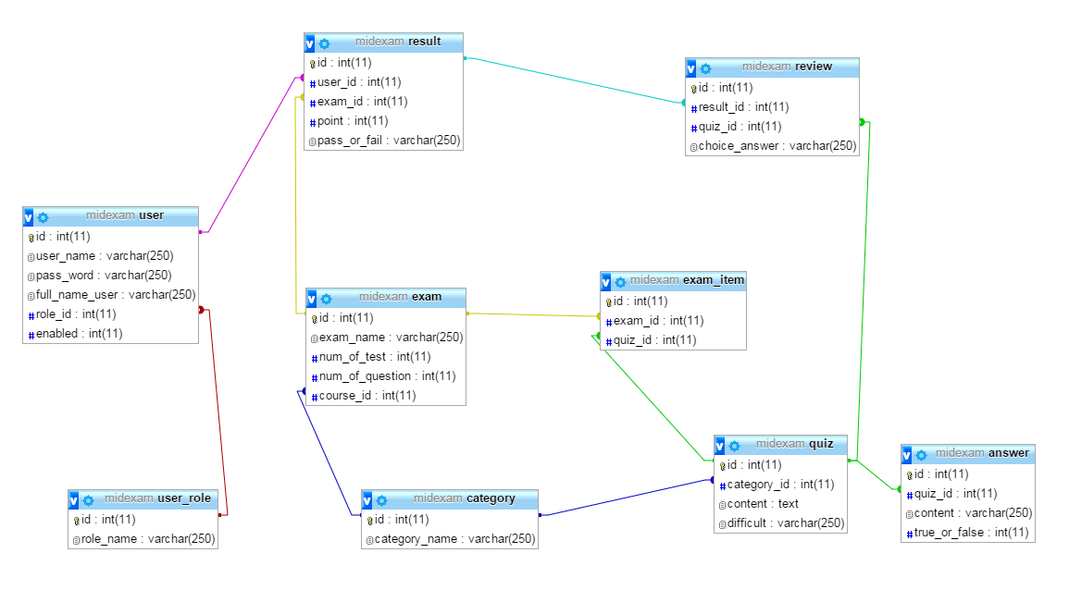
PROJECT - Database Structure

Slide 29
PROJECT - Site Map

Slide 30
PROJECT - Function

Slide 33
PROJECT - Applied framework
Hibernate, Spring Core - AOP - DAO - ORM – MVC
CSS : Bootstrap
Security : authorization
MVC : structure of project
Database : DAO
Form : form Edit, Add
ORM : Integrate with hibernate

Slide 34
MYSELF
Strength
Hard work
Ready to learn new technology
Accept the challenge
Sociable
Weak
Late deadline
Lack of practical experience
Rarely use Junit Test

Slide 35
How to improve myself
More training, hard working
Think out of a box
Learn from colleagues, senior engineer, consultant, …

Slide 36
DEMO

Slide 37
Thank you!

