Slide 1
Title Layout
Ho Minh Tam – Engineer - TFT

Slide 2
Objective
Introduction Spring Framework
Architecture of Spring
Knowledge apply Spring to real program

Slide 3
Content
Spring Framework Introduction
Architecture Overview
Product Overview

Slide 4
Spring Framework

Slide 5
Spring is an open-source and Lightweight framework created to address the complexity of enterprise application development.
Notes:
The Spring Framework is an application framework and inversion of control container for the Java platform.
The framework's core features can be used by any Java application, but there are extensions for building web applications on top of the Java EE platform. Although the framework does not impose any specific programming model, it has become popular in the Java community as an alternative to, replacement for, or even addition to the Enterprise JavaBeans (EJB) model. The Spring Framework is open source.

Slide 6
Management of Objects within an Application.
Can be Used with JEE and Java
Provide Spring Container
Application Context(In Web-Layer)
Bean Factory(In Stand-Alone)
Spring provides a light weight solution for building enterprise ready applications.
Spring can be used for both standalone application (Java SE )& web application (Java EE )
Spring is Open Source
Multi – tier Framework

Slide 7
Features
Management of Objects
Open Source
Promotes Dependency Injection
Promotes Loose Coupling
Lightweight & Non-intrusive

Slide 8
Architecture

Slide 9
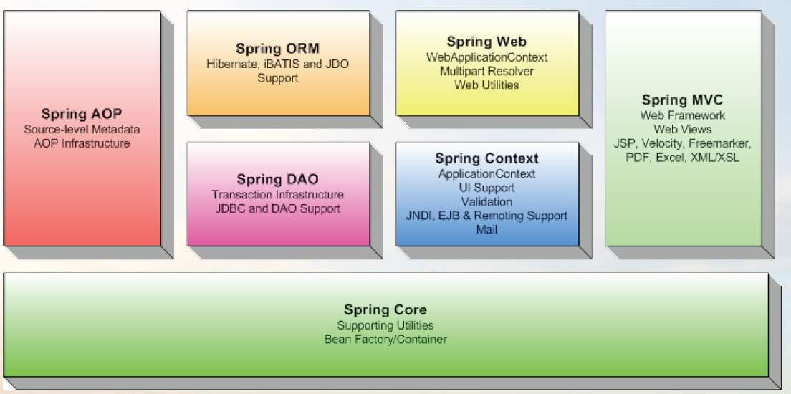
Architecture Overview

Slide 10

Spring Core
The Core package is the most fundamental part of the framework and provides the IoC and Dependency Injection features.
Notes:
The container defines how beans are created, configured, and managed.
Core module is the core container will create the objects, wire them together, configure them, and manage their complete lifecycle from cradle to grave.

Slide 11
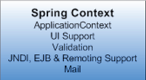
Spring Context
The Context package:- it provides a way to access objects in a framework-style manner in a fashion somewhat reminiscent of a JNDI-registry.
Notes:
The core module’s BeanFactory makes Spring a container, but the context module is what makes it a framework.
Support for internationalization (I18N) messages, application lifecycle events, and validation. In addition, this module supplies many enterprise services such as email, JNDI access, EJB integration, remoting, and scheduling.

Slide 12
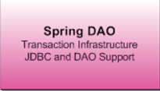
Spring DAO
The DAO package provides a JDBC-abstraction layer that removes the need to do tedious JDBC coding and parsing of database-vendor specific error codes.
Notes:
Spring’s JDBC and Data Access Objects (DAO) module abstracts away the boilerplate code so that you can keep your database code clean and simple, and prevents problems that result from a failure to close database resources.
In addition, this module uses Spring’s AOP module to provide transaction management services for objects in a Spring application.

Slide 13
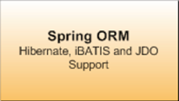
Spring ORM
The ORM package provides integration layers for popular object-relational mapping APIs, including JPA, JDO, Hibernate, and iBatis.
Notes:
Spring’s ORM support builds on the DAO support, providing a convenient way to build DAOs for several ORM solutions.
Spring doesn’t attempt to implement its own ORM solution, but does provide hooks into several popular ORM frameworks, including Hibernate, Java Persistence API, Java Data Objects, and iBATIS SQL Maps.
Spring’s transaction management supports each of these ORM frameworks as well as JDBC.

Slide 14
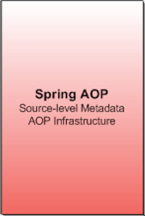
Spring AOP
Spring's AOP package provides an AOP Alliance-compliant aspect-oriented programming implementation allowing you to define
Notes:
Spring provides rich support for aspect-oriented programming in its AOP module.
This module serves as the basis for developing your own aspects for your Spring enabled application. Like DI, AOP supports loose coupling of application objects.
With AOP, however, applicationwide concerns (such as transactions and security) are decoupled from the objects to which they are applied.

Slide 15
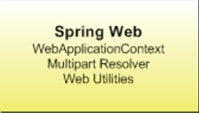
Spring Web
Spring's Web package provides basic web-oriented integration features, such as multipart file-upload functionality, the initialization of the IoC container using servlet listeners and a web-oriented application context.
Notes:
Spring's Web package provides basic web-oriented integration features, such as multipart file-upload functionality, the initialization of the IoC container using servlet listeners and a web-oriented application context.

Slide 16
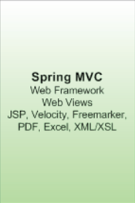
Spring MVC
Spring's MVC package provides a Model-View-Controller (MVC) implementation for web-applications.
Notes:
Supports Apache Struts, JSF, WebWork, and Tapestry etc.
It also has its own MVC frameworks

Slide 17
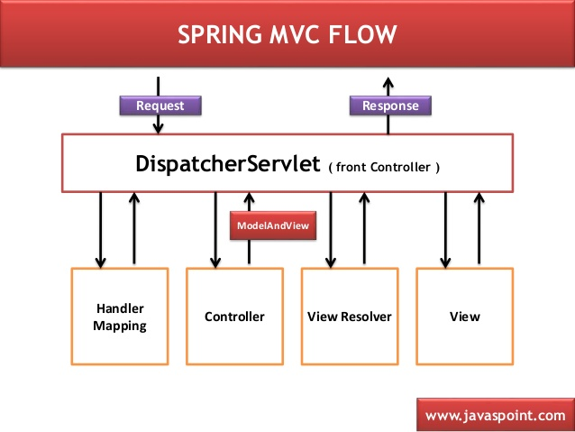

Slide 18
Product

Slide 20
Thank you!

