Slide 1
Classifying Interaction Processes: Comparison of Naïve Bayes and Recurrent Neural Network-Long Short Term Memory (RNN-LSTM) Classifiers
Erika Yoojung Oh

Slide 2
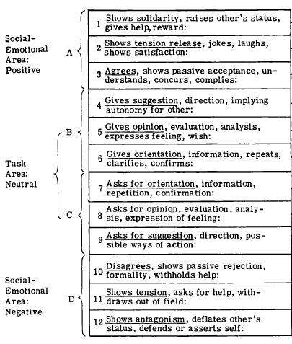
Theoretical Framework
Bales (1950) suggested a theoretical framework for categorizing communication processes
There are a total of 12 states, which can be simplified to 3 states: Positive socioemotional, Task-focused (neutral), and Negative socioemotional

Slide 3
Task Description
Buildings text classifiers based on Bales’ (1950) theoretical discussion of coding communication processes into 3 categories
Training & Comparing the performance of two classifiers: Naïve Bayes and RNN-LSTM
Using two types of word embedding models (GloVe and Custom)
Classifiers were trained for each category to simplify the training process. Thus I did NOT use a multi-label classification task.

Slide 4
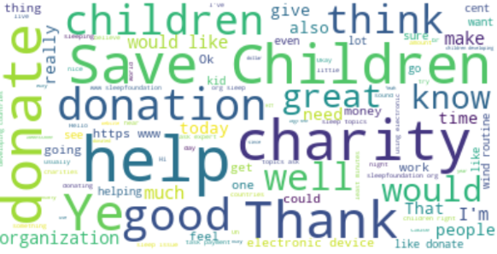
Data Description
In this project, two datasets (from different tasks) were used
Dataset1: Persuasion task dataset
Two people were assigned to a chatroom where one had to persuade the other person to donate to a children’s charity.
Dataset2: Advice-giving task dataset
Two people were assigned to a chatroom where one had to give sleep-related advice to the other person.
A total of 1427 items (manually labeled utterances) were used as training dataset
A word cloud of most used words in the dataset

Slide 5
Naïve Bayes
Simple but powerful linear classifier
Baseline Classifier
Removed stop words
Laplace (add-one) smoothing
80% train, 20% test

Slide 6
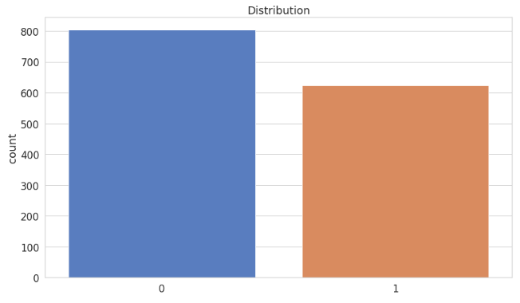
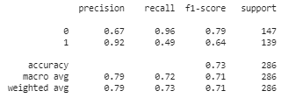
Naïve Bayes
Positive Socio-emotional Category
Balanced dataset
Accuracy: .73; F1-score (macro): .71

Slide 7
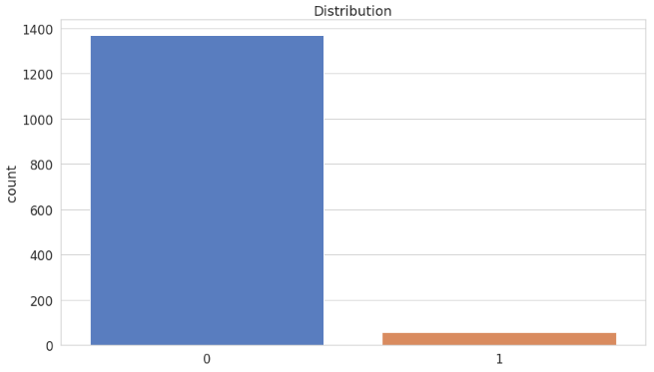
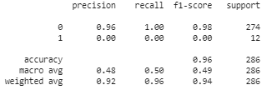
Naïve Bayes
Negative Socio-emotional Category
Highly unbalanced dataset
Accuracy: .96; F1-score (macro): .49
The classifier did not correctly categorize 12 negative comments

Slide 8
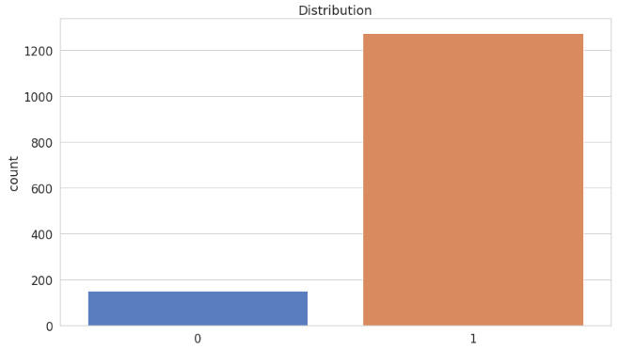
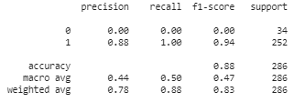
Naïve Bayes
Task-Focused Category
Highly unbalanced dataset
Accuracy: .88; F1-score (macro): .47
The classifier did not correctly categorize 34 non-task focused comments

Slide 9
RNN-LSTM
Question 1. What would happen when we use neural network model (RNN-LSTM)?
Question 2. How would word embedding play a role?
Glove embedding (glove.6B.100d.txt)
Custom embedding (trained with 46840 examples)
word2vec; skip-gram; 100 dimensions
Embedding layer – LSTM layer (100 hidden units) – Dense layer
Early stopping – avoid overfitting
80% train, 20% test

Slide 10
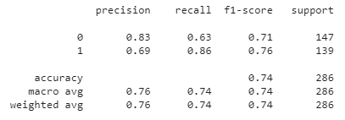
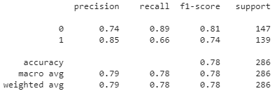


RNN-LSTM Comparison of pre-trained embedding vs. Custom word embedding
Positive Socioemotional Category
Overall, custom word embedding performed better
Pre-trained embedding (GloVe)
Custom word embedding*

Slide 11
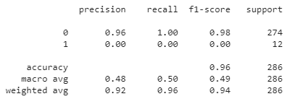
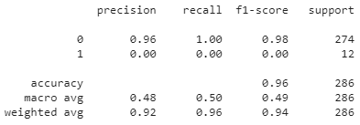


RNN-LSTM Comparison of pre-trained embedding vs. Custom word embedding
Negative Socioemotional Category
Both models could not correctly categorize 12 negative comments in the test dataset
Pre-trained embedding (GloVe)
Custom word embedding*

Slide 12
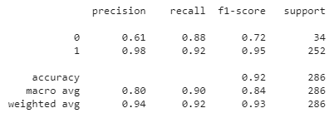
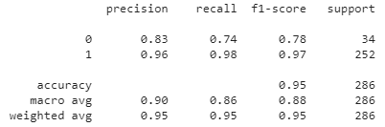


RNN-LSTM Comparison of pre-trained embedding vs. Custom word embedding
Task-Focused Category
Overall, custom word embedding performed better
Pre-trained embedding (GloVe)
Custom word embedding*

Slide 13
Summary of Findings
Overall, RNN-LSTM models performed better than Naïve Bayes Classifier
Pre-trained GloVe embedding and custom embedding showed similar performance, but custom embedding performed slightly better
Categories | Naïve Bayes (Baseline) | RNN-LSTM (GloVe) | RNN-LSTM (Custom)
Positive Socio-emotional | Accuracy: .73 F1-score (macro): .71 | Accuracy: .74 F1-score (macro): .74 | Accuracy: .78 F1-score (macro): .78
Negative Socio-emotional | Accuracy: .96 F1-score (macro): .49 | Accuracy: .96 F1-score (macro): .49 | Accuracy: .96 F1-score (macro): .49
Task-Focused | Accuracy: .88 F1-score (macro): .47 | Accuracy: .92 F1-score (macro): .84 | Accuracy: .95 F1-score (macro): .88

Slide 14
Discussion
In the study, there were 2 unbalanced categories (negative socioemotional, task-focused). Naïve Bayes model did not perform well in both categories, whereas RNN-LSTM did not perform well only in one category (negative).
Then, how can/should we deal with unbalanced data?
Increasing the size of training dataset?
Using different datasets? Or models?

Slide 15
Thank you!

