Slide 1

Developing Mobile Applications using
Jason Chiu, Nidhi Shah, and Kevin Oh

Slide 2
Introducing “PhoneGap”
PhoneGap is free and open source framework developed by Nitobi software and IBM.
It helps you to create mobile apps using standardized web APIs for popular platforms.
It uses Web technologies like HTML, JavaScript, and CSS.
PhoneGap applications are able to interact with mobile device hardware, such as the Accelerometer or GPS.
PhoneGap applications are built and packaged like native applications.

Slide 3
Why PhoneGap?
PhoneGap apps work on cross-platform technologies.
One app fits all.
Seamless Integration across all mobile devices.
PhoneGap apps are standards compliant.
Write once, run on many platforms.
Lower barrier of entry for app programmers.
Reduced number of required skills to build apps.
Reduced development & long term maintenance cost.

Slide 4
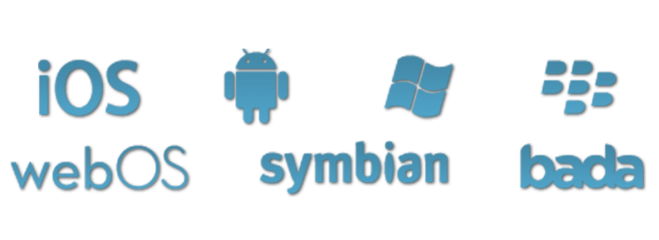
What platforms support PhoneGap?

Slide 5
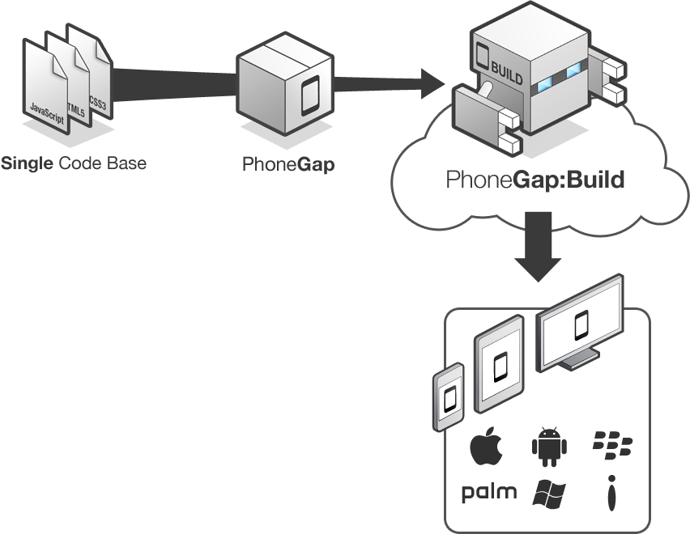
How does PhoneGap Work?
Include web code in a native app project:
- assets/www/js/, css/, images/, etc.
Native code loads a URL to the web code through the device’s internal browser:
- Extend a CordovaWebViewClient
- super.loadUrl( “file:///android_asset/www/login.html” );
Apache Cordova exposes native device APIs through JavaScript:
- navigator.device.capture.captureImage( captureSuccess(), captureError(), [options] );

Slide 6
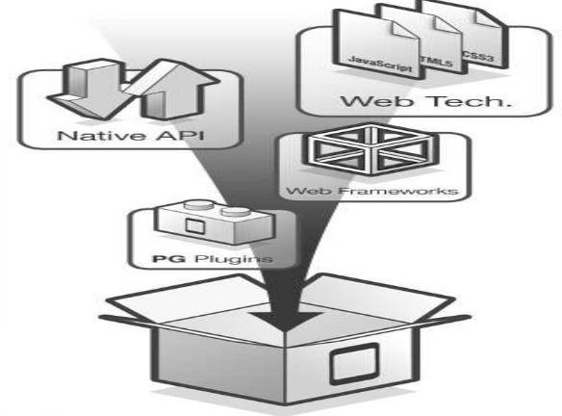
PhoneGap’s BUILD service?
Developers can use BUILD services of PhoneGap to develop apps for the app-stores of Apple, Android, Palm, Symbian and BlackBerry, etc.

Slide 7
Getting Started with Development
Integrated Development Environment
Java IDE like Eclipse or IntelliJ for Android
Xcode for iOS
Mobile Platform SDK
Apache Cordova
Mobile Devices
Recommended for deployment/testing
Emulators are alternative but not a true test
Getting Started guide available on phonegap.com
Notes:
http://docs.phonegap.com/en/2.8.0/guide_getting-started_index.md.html#Getting%20Started%20Guides

Slide 8
Advantages of PhoneGap
Allows developers to leverage their existing skills of HTML, JavaScript and CSS.
Reduces training time.
Enables a quick-to-market stance in companies ready to adopt it.
PhoneGap apps install just like a native application, and are ready for the app-store discoverability.
PhoneGap follows a plugin architecture, which means that access to native device APIs can be extended in a modular way.

Slide 9
Advantages of PhoneGap (continued)
You can use the single codebase for your cross platform applications.
You can leverage the hardware specific features such as Geolocation, Vibration, Accelerometer, Contact Support and Sound.
PhoneGap is open source and free, so there are no licensing costs.
Open Source community is actively contributing new modules which can potentially save you time and money.

Slide 10
Disadvantages of PhoneGap
Since PhoneGap is designed to support multiple platforms, it will not have the new features available as soon as they are available in the SDK.
Several platform core features may still not be available via PhoneGap.
The strength of being open source – and leveraging the talents of a wide array of contributors – is both a blessing and curse.
If you need to extend your app with a custom Cordova/PhoneGap plugin, odds are you will find one. Yet it may be out of date and not support the target platforms you need.

Slide 11
Disadvantages of PhoneGap (continued)
There may be challenges with the support and maintenance with those modules.
The plugin architecture works well if you can find the plugins you need or if your web developers are capable of changing gears to write their own custom plugin(s) as needed.
Native UI will always outperform a hybrid solution. The web developers will need to have knowledge of which web UI frameworks are mobile-friendly.
Have to pay close attention to performance.

Slide 12
Any Questions?
Notes:
http://phonegap.com/about/faq/

