Slide 1

Basic Details of the Team and Problem Statement
Ministry/Organization Name/Student Innovation: Government of Himachal Pradesh
PS Code:SIH1383
Problem Statement Title: Optimizing Doctor Availability and Appointment Allocation in Hospitals through Digital Technology and Al Integration.
Team Name: Billing Way
Team Leader Name: Naman Kanwar
Institute Code (AISHE):
Institute Name: Netaji Subhas University Of Technology
Theme Name: Medtech/Biotech/ Healthtech

Slide 2
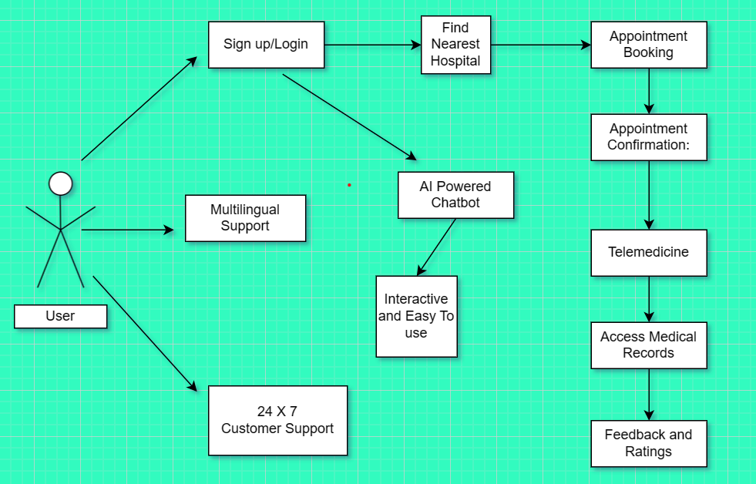
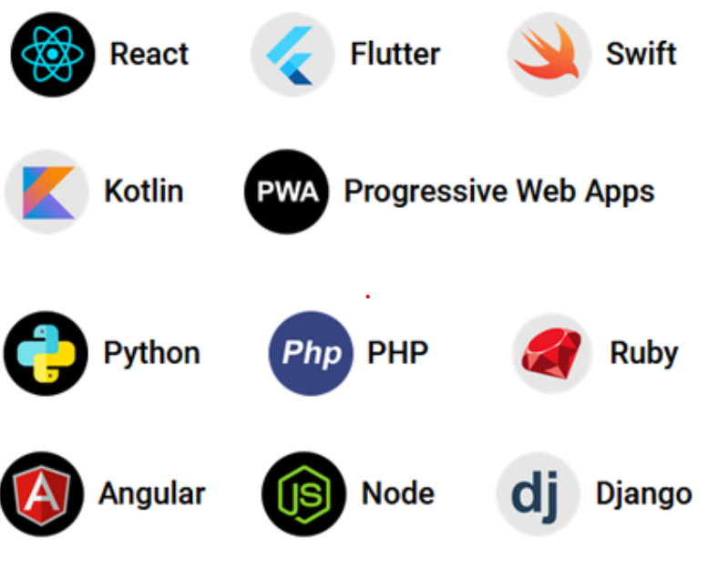
Idea/Approach Details
Describe your idea/Solution/Prototype here:
Improve Patient Access to Healthcare: Ensure that patients can easily and conveniently schedule appointments with healthcare providers and reduce waiting times and delays.
Enhance Doctor Efficiency: Optimize doctor schedules to make the best use of their time and expertise. Minimize idle time and maximize patient interactions.
Reduce Administrative Burden: Streamline appointment scheduling and allocation processes to reduce the administrative workload on hospital staff.
Personalize Healthcare Services: Utilize AI to personalize appointment scheduling based on patient preferences, medical history, and urgency. Match patients with the most suitable healthcare providers.
Enhance Patient Satisfaction: Improving communication, and offering convenient digital solutions. Gather patient feedback to make continuous improvements.
Technology stack used

Slide 3
Idea/Approach Details
Describe your Use Cases here
Describe your Dependencies / Show stopper here
Create account or login through your account on our platform.
Search for nearest hospitals using the map provided within the app.
Check Doctor availability and doctor time schedules in the chosen healthcare institutions through the app.
Book your appointment with ease by entering your personal details and completing the payment.
Receive the appointment confirmation message on your mobile.
Access your medical records from medical history section on the app.
Interact with our AI powered chatbot supported with machine learning for any help while navigating through our app.
A Multilingual android and web based application supporting 10 different languages which serves the term- “Optimizing Doctor Availability and Appointment Allocation in Hospitals through Digital Technology and Al Integration”.
A revolutionary step to make healthcare access easy and comfortable to the citizens through AI and Machine learning(ML) techniques.
Patients get real time information on doctor availability and schedules right from the comfort of their homes.
Confirm appointment and generate digital payment receipt after successful payment.
Users can create a digital database of all their medical records and access them anytime and anywhere.

Slide 4
Team Member Details
Team Leader Name: NAMAN KANWAR
Branch (Btech): Stream (IT): Year (II):
Team Member 1 Name: VASU SHARMA
Branch (Btech): Stream (IT): Year (II):
Team Member 2 Name: NEHA YADAV
Branch (Btech): Stream (IT): Year (II):
Team Member 3 Name: MANAS SAH
Branch (Btech): Stream (IT): Year (II):
Team Member 4 Name: ISHITA SRIVASTAVA
Branch (Btech): Stream (CIOT): Year (II):
Team Member 5 Name: MUSKAAN
Branch (Btech): Stream (ECE): Year (I):

