Slide 1
On Check : Accounting System
Prince Raj Shrestha
Ronak Maharjan

Slide 2

Introduction
On Check is a system build using java, enabling the company to record, track and manage all necessary accounting of the business
It also helps in creation of report and book keeping of the business

Slide 3

Problem Statement
Accounting errors and Time Efficiency
Use of Traditional Book Keeping system
Data unsecure and unstructured
Chances of data loss

Slide 4

Objectives
Enables company to track and manage all necessary accounting of the business
Automate reporting and documentation
Simplified data structure with better security

Slide 5
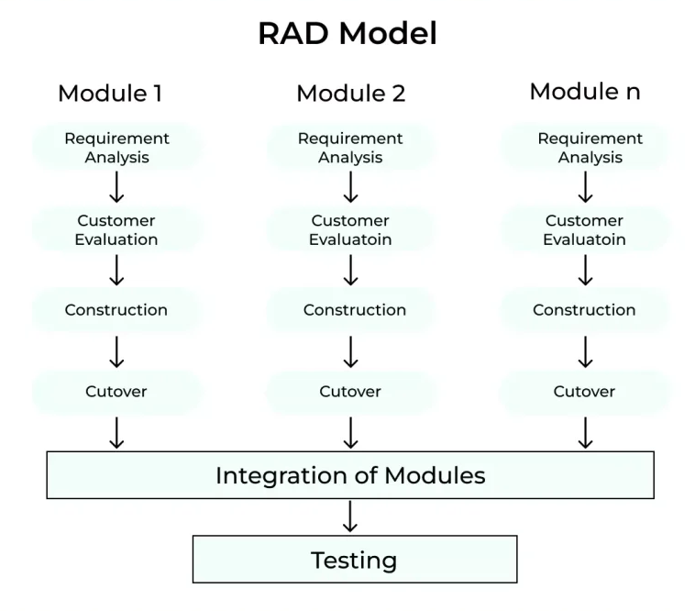
Methodology
On Check application is built under Rapid Application Development(RAD) as it is very easy to use method.
In RAD, the project is divided into different modules which can be worked on by different member of team leading to an effective team work

Slide 6

Tools Used
Frontend :
Java
JavaFX
CSS
Backend:
Java
MySQL
CASE Tools used throughout the process:
Vs-code
Draw.io
XAMPP
dbdiagram.io
Ms. Word
Ms. PowerPoint

Slide 7
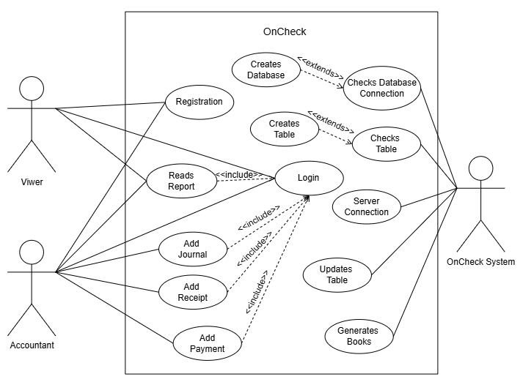
Use-case Diagram

Slide 8
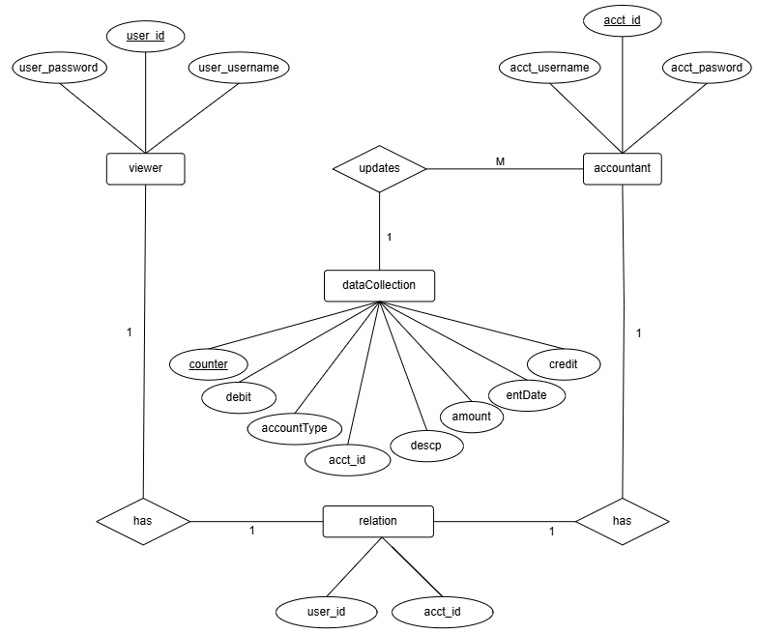
E-R model

Slide 9
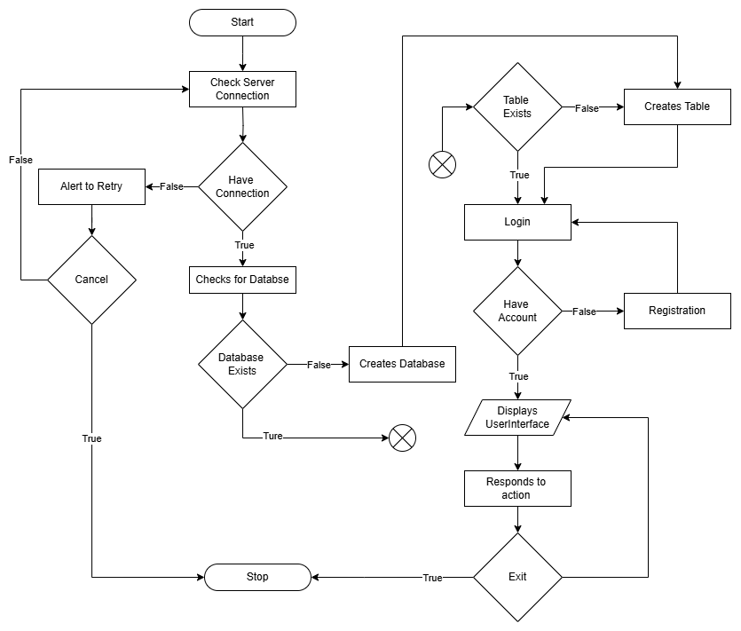
Flowchart

Slide 10
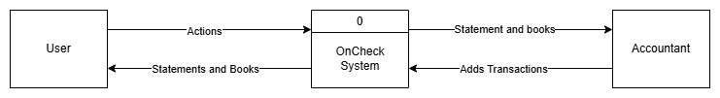
Context Diagram:

Slide 11
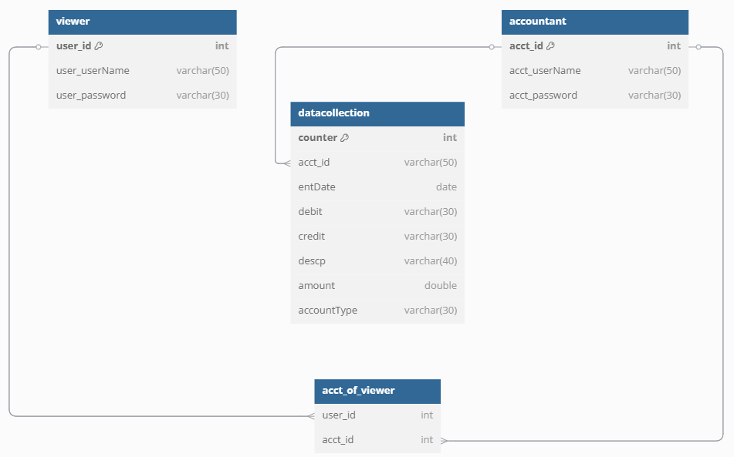
Database Schema

Slide 12
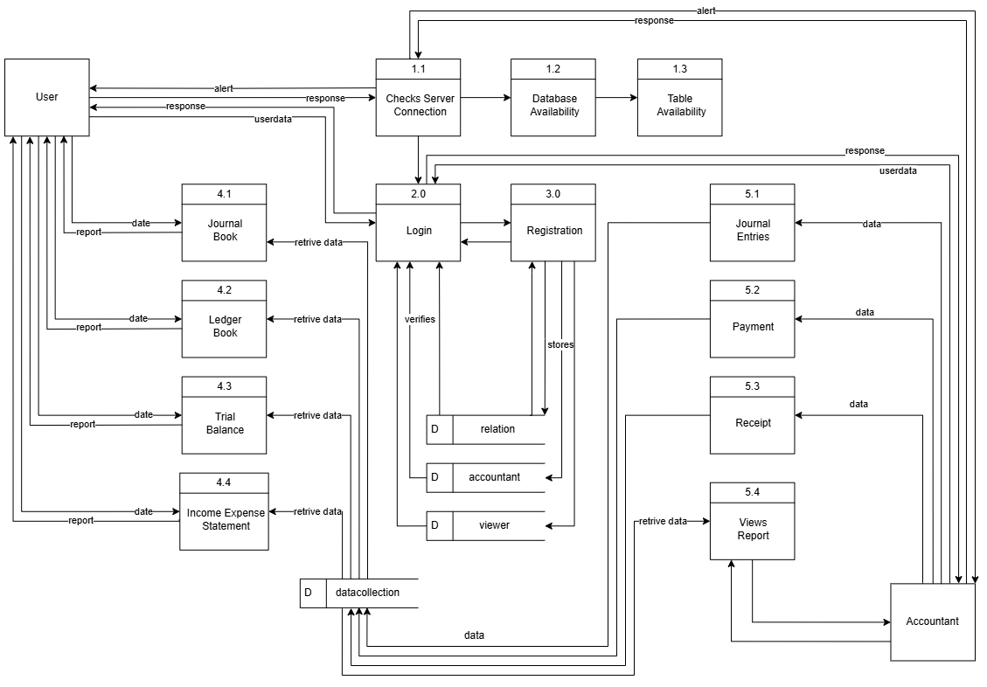
Physical DFD:

Slide 13

Modules:
Create Account and Login
Journal Entry Report
Ledger Report
Trial Balance Report
Income and Expenses Statement Report
Transactions

Slide 14
Conclusion
Project “On Check” provides financial management for small businesses(retail business) and individuals by automating transaction tracking, simplifying budgeting, and generating essential financial reports.

