Slide 1
Contrastive learning(대조 학습)
Sang Yup Lee

Slide 2
Contrastive learning
주요 특징
Self-supervised representation learning
Contrastive learning is an approach to learning that focuses on extracting meaningful representations by contrasting positive and negative pairs of instances.
주요 알고리즘
SimCLR
Chen, T., Kornblith, S., Norouzi, M., & Hinton, G. (2020, November). A simple framework for contrastive learning of visual representations. In International conference on machine learning (pp. 1597-1607). PMLR.
SimCSE
Gao, T., Yao, X., & Chen, D. (2021). Simcse: Simple contrastive learning of sentence embeddings. arXiv preprint arXiv:2104.08821.

Slide 3
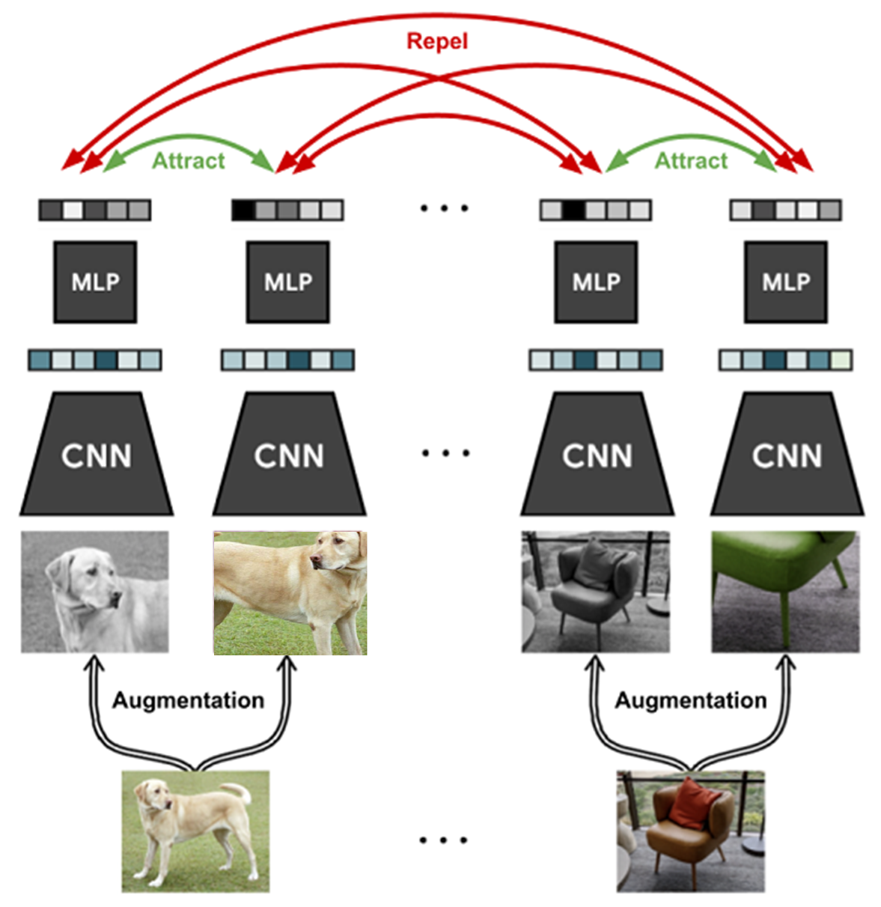
SimCLR
구조
Downstream tasks

Slide 4

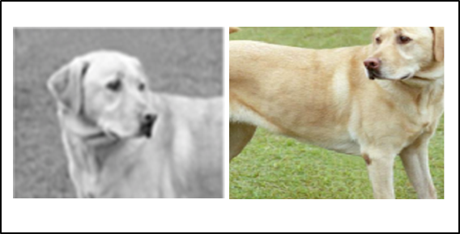


SimCLR
Anchor image
Positive pair
Negative pair

Slide 5
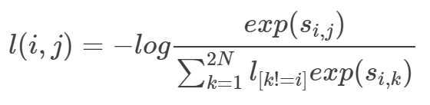


SimCLR
Noise Contrastive Estimation Loss
Loss
Loss( , )
esim( , )
= -log( )
esim( , ) +
esim( , )+
esim( , )

Slide 6
SimCLR
Total loss
Loss( , )+
Loss( , )+
Loss( , )+
Loss( , )
2x2

Slide 7
Q & A

