Slide 1
Azure Ignite 2025
Sample slide deck generated with python-pptx

Slide 2
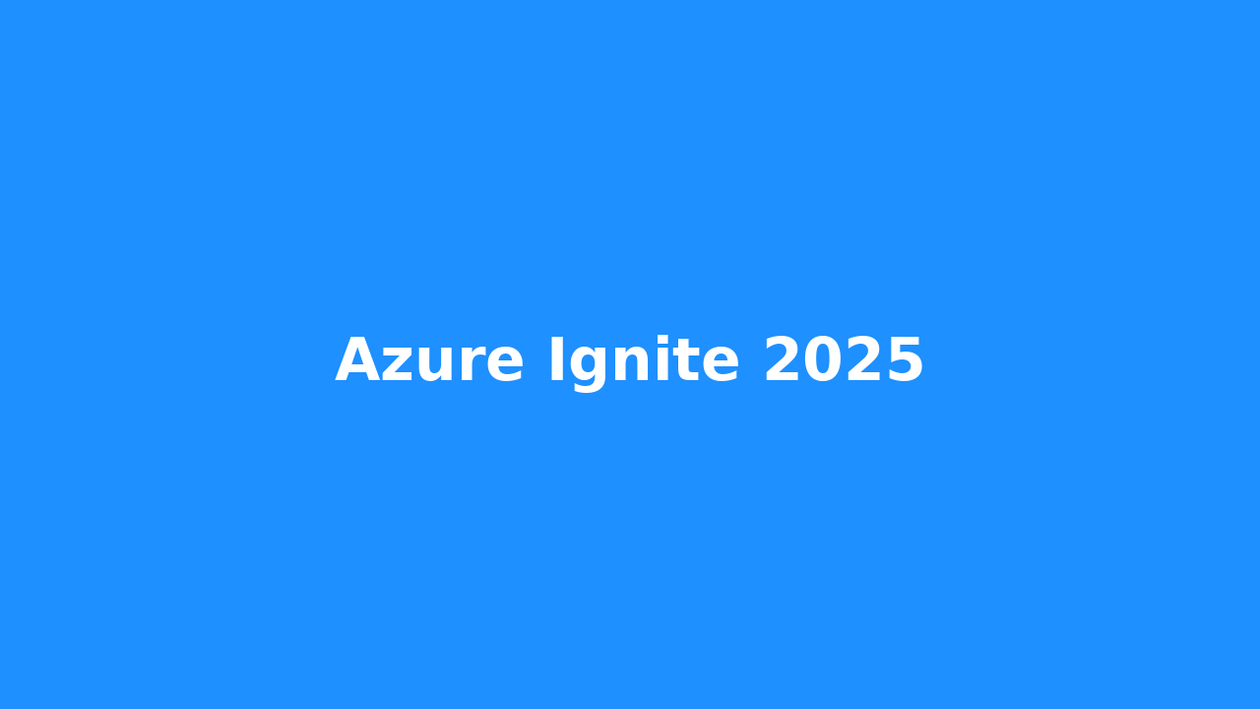
Event Highlights

Slide 3
Key Takeaways
- Cloud-native innovations
  - Scalable architectures
- Cost optimization strategies

Slide 4
Agenda
1. Keynotes
2. Workshops
3. Demos
4. Q&A
5. Networking

