Slide 1
RUNTIME VERIFICATION FOR SPATIO-TEMPORAL PROPERTIES OVER IOT NETWORKS
Oihana Garcia Anakabe
2021/2022
Partial release of the project
DEGREE IN COMPUTER ENGINEERING
Notes:
My name
Presentation of the partial release of the Project
RUNTIME VERIFICATION FOR SPATIO-TEMPORAL PROPERTIES OVER IOT NETWORKS

Slide 2
Introduction
IoT (Internet of Things): Connecting millions of smart devices and sensors and making them accessible via internet.
This field is growing rapidly: In 2022 it is estimated that there will be 42.56 billion connected devices.
Notes:
Let’s start with the introduction.
Internet of Things, is the area of computer science, that collects the challenges of connecting millions of smart devices and sensors, and making them accessible via internet.
As you can see in the right chart, this field is growing rapidly, it is estimated that by the end of this year there will be 42.56 billion connected devices.

Slide 3
Introduction
Cyber Physical Systems (CPS): Can exploit an IoT infrastructure, physical systems are monitored and/or controlled by a computational core.
"Cyber-Physical Systems are engineering, physical and biological systems whose operations are integrated, monitored, and/or controlled by a computational core. Components are networked at every scale. Computing is deeply embedded into every physical component, possibly even into materials. The computational core is an embedded system, usually demands real-time response, and is most often distributed. The behavior of a cyber-physical system is a fully-integrated hybridisation of computational (logical) and physical action."
(Helen Gill, US National Science Foundation)
Monitoring is an activity related to the wider category of Runtime Verification (RV).
Notes:
One system that can exploit an IoT infrastructure, is Cyber Physical Systems (CPS), where physical systems are monitored and controlled by a computational core
The following definition is the most famous one for this term:
Here we can find some keywords that are crucial in this work: monitored, network, physical component, real-time and logical
Monitoring is an activity related to Runtime Verification (RV), which purpose is to observe information from a system on runtime, and analyse it to detect if it satisfies or no some properties.

Slide 4
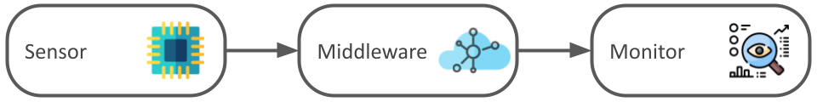
Project goals
IoT devices (Thingy52) are spatially distributed.
Set up an MQTT broker for the communication
Fully develop the middleware.
Feed live data into moonlight and monitor it in real-time
Analyze and comprehend STREL and the MoonLight monitor
Notes:
This project focuses precisely on the monitoring on CPS over IoT
The IoT devices are in the physical part spatially distributed.
One main task of the project is to connect the sensors with the monitor so they can share information
For this reason, a MQTT broker will be implemented and also
A middleware, that is completely developed from scratch.
Finally, this data will be sent to MoonLight.
An important goal is to make the monitor be able to receive live data and monitor everything in real-time.
For the monitoring of spatio-temporal properties, STREL will be used, a logic-based specification language. So one personal goal is to comprehend STREL and Moonlight

Slide 5
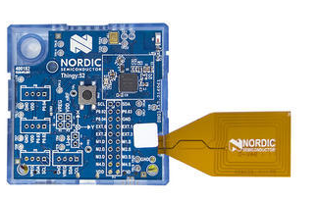
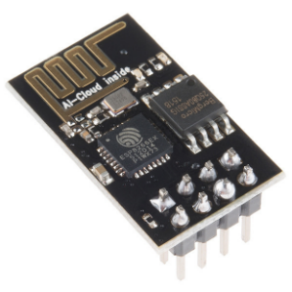

Resources and materials
Main resources:
Thingy52
ESP 01
MoonLight
monitor
Notes:
These are the resources to be used
Thingy52: It has environmental sensors, a microphone, nine-axis motion sensing… The communication is via Bluetooth Low Energy.
ESP 01: Integrated Wi-Fi solution.
Moonlight monitor: light-weight Java-tool for monitoring. As previously mentioned, the properties are written with STREL, the Reach and Escape Logic.
I am using other resources apart from these ones: like Jlink to program the sensors or Intellij IDEA for the code.
Wi-Fi SoC (system on a chip)

Slide 6
Project information
The project duration is eight months, from November 2021 to June 2022.
These are some milestones of the project:
11/11/2021
First follow up meeting
10/01/2022
Middleware first aproximation
10/02/2022
Partial release
04/04/2022
Project beta release
30/06/2022
Final
Notes:
This is a brief approximation of the project organization.
We had the first meeting in November and after reading some literature, I started to work in the middleware. In January, I can say that I did the first approximation of the middleware.
Some days ago, I delivered the document of the partial release.
Half of the time of the project has already passed, but there is still the other half to follow working.
In April I have planned to have a beta release of the project
And finally, on June I will finish everything.

Slide 7
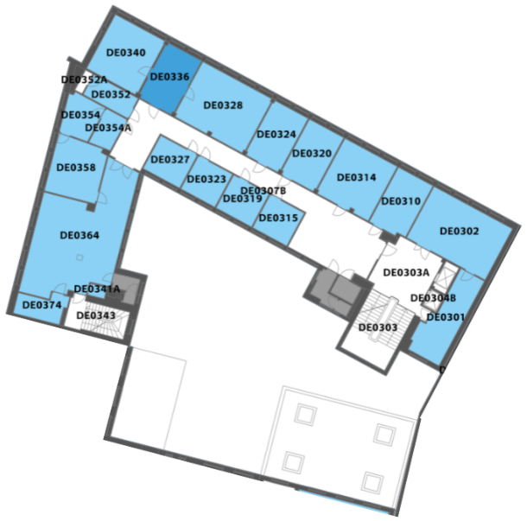
Use case - Domotics / Smart Home Automation
Environmental data that can be collected in the department:
1. Temperature
2. Humidity
3. Air pressure
4. Air quality (CO2 and TVOC)
5. Light intensity
6. Sound
Notes:
This is the defined use case for the Project.
A smart home consists of increasing comfort or minimizing the wastage of electrical power by controlling some house variables.
In this case, environmental data will be collected in the department. There you can see the list of variables that can be collected. I will start with the temperature, humidity and air quality and see which other variables to add later.
The Spatial Model will be constructed based our department, that’s the map that you can see on the right side.

Slide 8
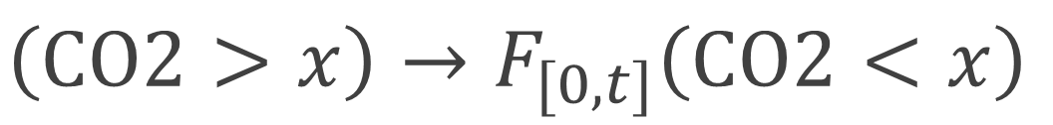
Use case - Domotics / Smart Home Automation
The environmental conditions must be adequate:
The temperature must be lower than 22ºC and higher than 15ºC
If the CO2 level is higher than X, after some time interval it must decrease to an adequate level (lower than X).
If the sound in one room is higher than X, the sound in the adjacent rooms should be less than X
$$\left(CO2>x\right)→F_{[0, t]}\left(CO2<x\right)$$
Notes:
In this slide, we can see the fist approximation of the properties.
For example, the temperature must be adequate, between 15 and 22 degrees.
The second property integrates the temporal aspect, If the carbon dioxide level is higher than a value, after some time interval it must decrease to an adequate level. Bellow, you can see how would look like the formula of this property.
The third one involves the spatial property. If the sound in one room is higher than X, the sound in the adjacent rooms should be less than X decibels.

Slide 9
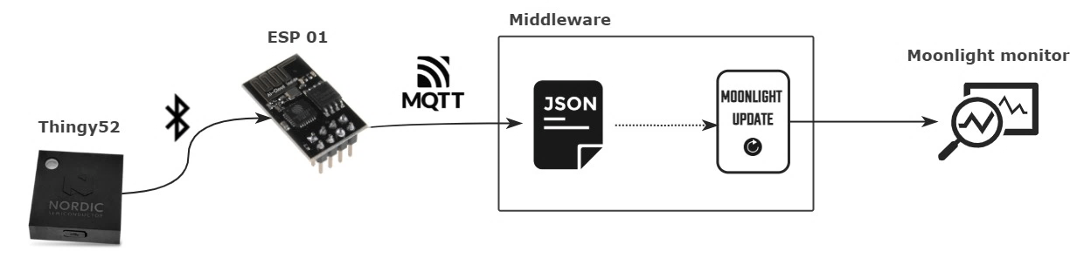
Communication and monitor
In the physical part, there are two types of devices:
Thingy52’s sensors collect data from the environment
ESP01 receives the file, and it publishes to the MQTT broker
Regarding the monitoring segment:
The middleware converts the JSON files to a moonlight signal
The monitor will consist of an online monitoring (i.e., the monitoring is performed incrementally)
Notes:
Communication and monitor
In the physical part, there are two types of devices. First, the Thingy52’s sensors collect data from the environment. Then, the information is sent via Bluetooth Low Energy. The ESP01 receives the file, and it publishes to the MQTT broker, where the middleware is consuming the messages.
Regarding the monitoring segment, the middleware is responsible for converting the JSON files consumed in the broker to a moonlight signal.
The monitoring will be online, in other words, the monitoring is performed incrementally. So this JSON is converted to an increment or “update” (the class defined in moonlight).
After the preprocessing, Moonlight has to monitor and check if the properties are satisfied. But to be able to do that, firstly moonlight must be able to get continuous streams. This project involves extending moonlight to be capable of doing this things.

Slide 10
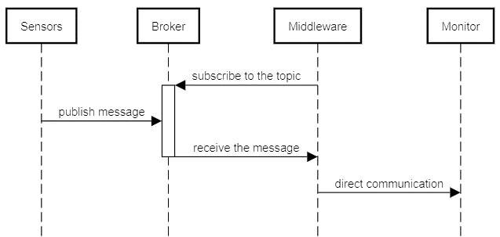
MQTT prototype
MQTT protocol will be in charge of transporting messages between the middleware and sensors.
Notes:
MQTT protocol will be in charge of transporting messages between the middleware and sensors. This protocol uses the publish/subscribe architecture, the sensor’s role is publisher, and the middleware is the subscriber.
The broker used in this project will be Mosquitto.
This is the UML sequence diagram:

Slide 11
Work done until now
Literature review (Internet of Things, Runtime Verification, Cyber-physical systems and STREL).
Start developing the moonlight interface and the middleware.
Start developing the Thingy52.
In conclusion, I have the base and the structure of the project well defined. This should make the development go faster to achieve the objectives.
Notes:
Work done until now
First, I read some articles to get familiarized with the topics involved in the project (i.e., Internet of Things, Runtime Verification, Cyber-physical systems and STREL).
Then, I started developing the moonlight interface and the middleware. For now, they receive some numbers from an online broker and monitor whether they satisfy some test specifications. With this, I learnt about moonlight signals, updates and the overall workflow.
Regarding the Thingy52. For now, the sensor gets the temperature, humidity and air quality.
Also, it is prepared to transmit the information using Bluetooth beacon.
In conclusion, I think that I have a well-defined base. So this should make the development go faster to achieve all the objectives.
(beacon. Broadcast their identifier to nearby devices.)
(Bluetooth LE -> the meters depends a lot in the environment, battery… 2-5 meters)

Slide 12
Problems and solutions
Past problems:
Future problems: This is the first time moonlight will be working end-to-end.
We expect some bugs in the moonlight monitor.
Problem | Problems with Zephyr and Windows. I kept hitting obstacles and the initialization process was dragging on.
Solution | Used a Linux Virtual Box Machine
Notes:
Throughout the project, some things have taken longer than expected and vice versa.
For example, I started setting up the Zephyr development environment on Windows but I kept hitting obstacles. So I decided to use my Linux Virtual Box Machine.
This is the first time that the Moonlight monitor will monitor live data. Therefore, because is the first attempt to get moonlight working from end-to-end, we expect some bugs in the moonlight monitor.
(Zephyr OS is based on a small-footprint kernel designed for use on resource-constrained and embedded system)

Slide 13

Future developments of the project
Adding other use cases will do the project more complete.
The domotics/office use case:
Interaction with the hardware.
Properties do not allow interesting observations
Wiener Linien use case: They have an API that makes the public data accessible in real-time.
Adds additional value to the project.
Interesting data to monitor and there are more diverse specifications to use.
See that with minor changes the monitor can handle a completely different use case.
Notes:
Adding other use cases will do the project more complete.
The domotics use case satisfies the knowledge and the interaction that I will gain with the hardware.
However, the properties do not allow interesting observations. The temperature, humidity and air quality do not change much along space and time.
For this reason, Wiener Linien use case would be interesting to do.
This company runs most of the public transit network in Vienna. And they have an API that makes the public data accessible in real-time. Therefore, this use case would consist in exploiting data to control the transit.
This would provide additional value to the project.
It is interesting to monitor and there are more diverse specifications to use.
Finally, it will be good to work with different data and see that with minor changes the monitor can handle a completely different use case.
Recapitulating, The domotics use case offers the opportunity to work with sensors and the second one will demonstrate the scalability of the project.

Slide 14
Contributions of the traineeships to studies
One competence to be acquired is:
The project involves all the processes from the hardware to the monitor, so I can gain a lot of knowledge and experience
T1IT06 | Ability to create and develop centralized or distributed computer systems or architectures integrating hardware, software and networks.
Notes:
This project is helping to improve several aspects of my studies.
One defined competence to acquire is the next one: as you can see, this project integrates hardware, software and networks.
So, I am working with different devices.
I am understanding better the communication protocols.
Finally, I am gaining knowledge working and extending moonlight.
To summarize, I am approaching different fields and gaining a lot of experience while implementing this project.

Slide 15
Thank you Eskerrik asko
Notes:
Thank you, eskerrik asko
I will be happy to listen or answer any questions or suggestions that you have

