Slide 1

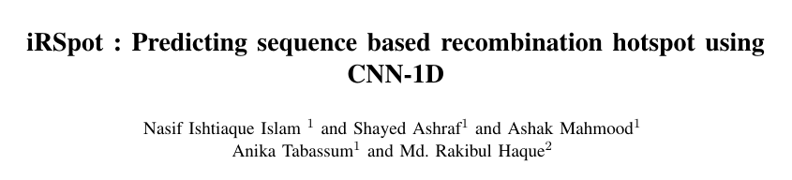
CSI-416
Pattern Recognition Laboratory
Final Presentation
Team name: black_crow
Course Teacher

Slide 2
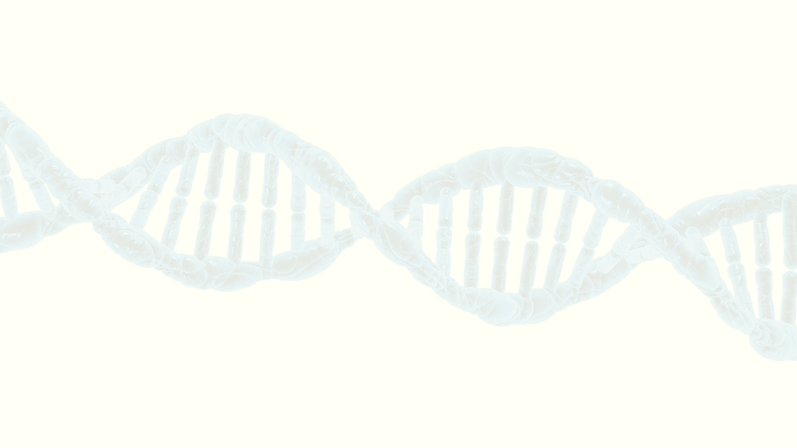
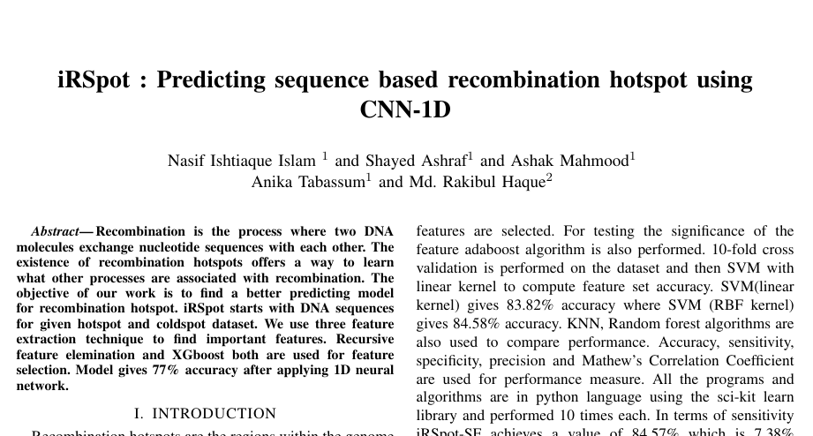
Introduction
What is recombination?
Recombination is the process where two DNA molecules exchange nucleotide sequences with each other.
Importance of recombination:
Recombination provides knowledge about DNA sequence variation and patterns along human chromosomes and this may help to map the position of alleles that cause various diseases.
Recombination hotspot gives useful insights into the basic function of inheritance and the study of genetic diversity.
Figure 1: Report Front Page
black_crow
1
DEPARTMENT OF CSE, UIU

Slide 3
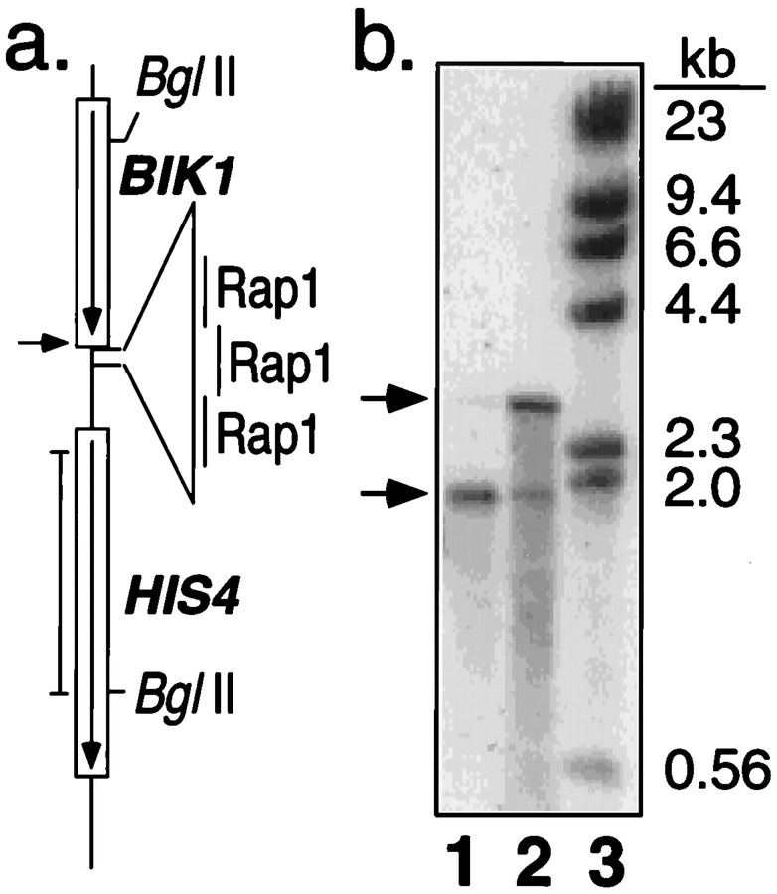
Introduction
Hotspot and Coldspot?
In genomic regions:
Hotspots higher frequencies of recombination
Coldspots lower frequencies of recombination
Recombination hotspot plays a vital part in evolutionary development.
Figure 2: Hotspot-Coldspot (Image from Internet)
2
black_crow
DEPARTMENT OF CSE, UIU

Slide 4
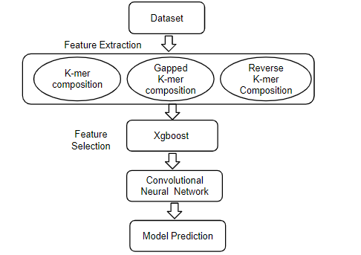
Methodology
Three methods are used for feature extraction on our project: K-mer composition, Gapped K-mer composition, Reverse complement K-mer composition.
Used XGBoost and Recursive Feature Elimination (Decision Tree Classifier) technique to eliminate less important features.
SVC, Gaussian NB, RF, AdaBoost, LR, KNN, Decision Tree and CNN(1D) algorithms are also used to compare performance.
All the programs and algorithms are in python language using the sci-kit learn library. In terms of specificity our model achieves a value of 89.97%.
Figure 3: Model Architecture
3
black_crow
DEPARTMENT OF CSE, UIU

Slide 5
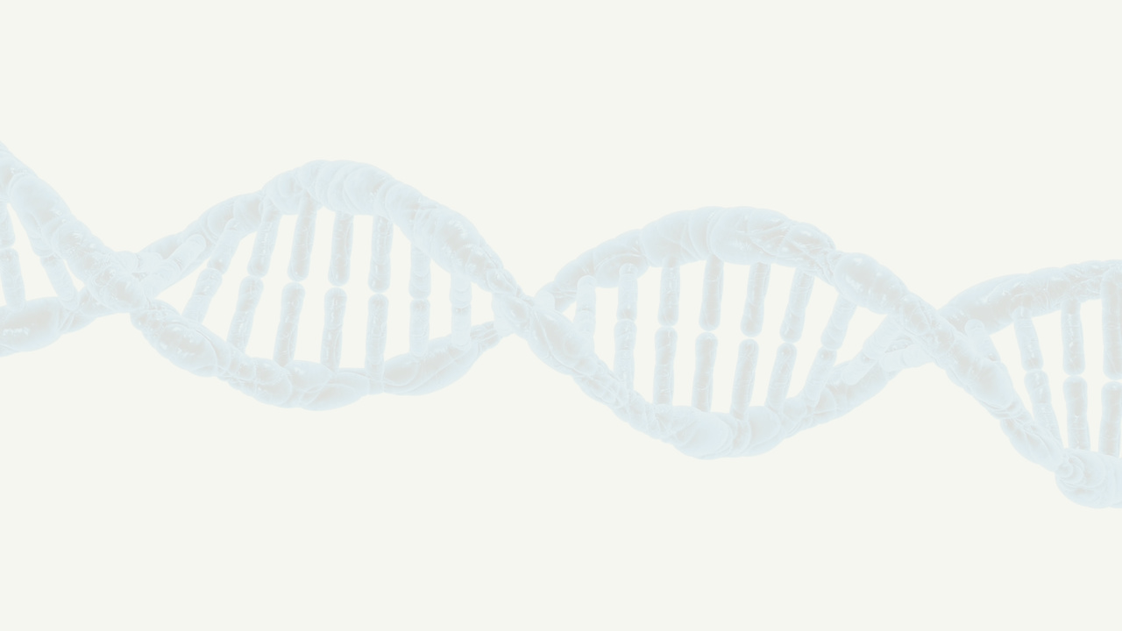
Methodology - (Feature Extraction)
Dataset Description: The datasets used here is yeast dataset consisting of DNA sequences of nucleotides with both positive and negative instances. The positive instances are denoted as hotspot and negative are as coldspots. Dataset has 490 DNA segments of hotspot samples(positive) and 591 DNA segments(negative) of coldspot samples. The basic symbols of DNA sequences are A, T, C, G. This dataset represents the set of these sequences. Dataset is slightly imbalanced with less number of positive samples.
K-mer: K-mer is the substring of any length k in a sequence. Counting K-mer is an essential technique in many bioinformatics methods. In our p, we calculated till 4-mer and extracted 340 features from K-mer. Then we calculated the occurrence of specific K-mer.
Gapped K-mer : In order to find a tradeoff between the sparse feature space problem and more sequence composition information, the gapped K-mer has been proposed. Gapped K-mer allows several gaps to exist in K-mers. We extracted till 5 gaps, total 80 features using this technique.
Reverse K-mer: Counting K-mer on opposite direction is called Reverse K-mer. In our model we used till 4-mer in reverse order and extracted 340 feature. It's also detect the genome sequences of hidden patterns.
Using these three techniques we extracted total 760 features from our datasets.
4
black_crow
DEPARTMENT OF CSE, UIU

Slide 6
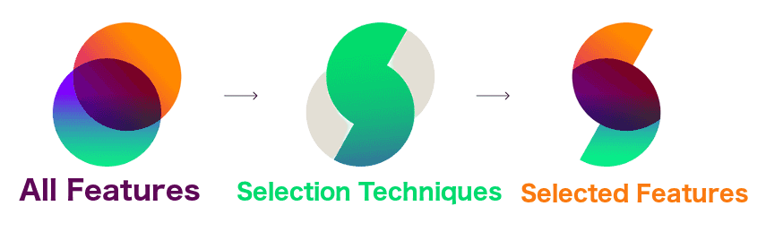
Methodology - (Feature Selection)
Figure 4: Feature Selection (Image from Internet)
XGBoost: XGBoost is an implementation of gradient boosted decision trees designed for speed and performance. It is a feature selection technique to reduce unnecessary features. In our implementation we used Xgboost and selected top 40% (304) features and XGBoost classifier gives 74.46% accuracy on selected features.
Recursive Feature elimination (RFE): Recursive feature elimination (RFE) is a feature selection method that removes the insignificant features according to their importance and then remove them recursively. Among 760 features we selected 50% (380) features using RFE and Desicion Tree Classifier gives 69% accuracy on selected features.
5
black_crow
DEPARTMENT OF CSE, UIU

Slide 7
Methodology - (Algorithms)
After feature selection, we performed rigorous experiments on the dataset for selecting the most robust classification algorithm for our feature set. Eight different classifiers were investigated in our experi-ments: Decision Tree (DT) , Logistic Regression (LR), K-Nearest Neighbor (KNN), AdaBoost, Gaussian Naive Bayes (NB), Random Forest (RF), Support Vector Classifier with rbf kernel(SVC) and 1D-Convolutional Neural Network(CNN-1D).
In terms of Accuracy, worst performed classifier was Decision Tree and best performed classifier is CNN-1D. (figure-5)
DT
LR
KNN
AdaBoost
NB
RF
SVC
CNN-1D
0
20
40
60
80
Figure 5: Algorithms accuracy
6
black_crow
DEPARTMENT OF CSE, UIU

Slide 8
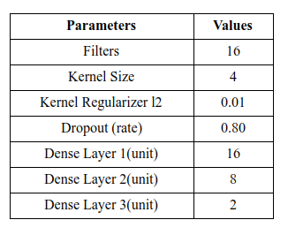
Methodology - (CNN-1D)
CNN-1D model description:
To reduce overfitting we've used Dropout and Regularization.
We've also used Batch Normalizer to normalize our data on every step.
Finally, Softmax function gives us result on probability format.
Figure 6: Used Parameters (CNN-1D)
7
black_crow
DEPARTMENT OF CSE, UIU

Slide 9
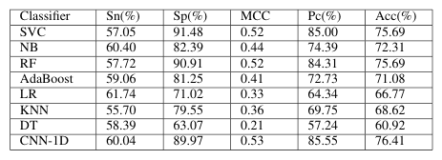

Result Analysis - (Algorithms)
DT was the poor performer in terms of MCC and accuracy. But SVC and RF performs well in terms of Sp and Sn respectively. These two algorithms also performs well in terms of MCC.
However, we selected CNN-1D as the best performing classifier and suitable for our method as its accuracy was highest of 76.41% and superior to RF in terms of MCC and Pc which are 0.53 and 85.55% respectively.
Figure 7: Comparison of performances of different classification algorithms
8
black_crow
DEPARTMENT OF CSE, UIU

Slide 10
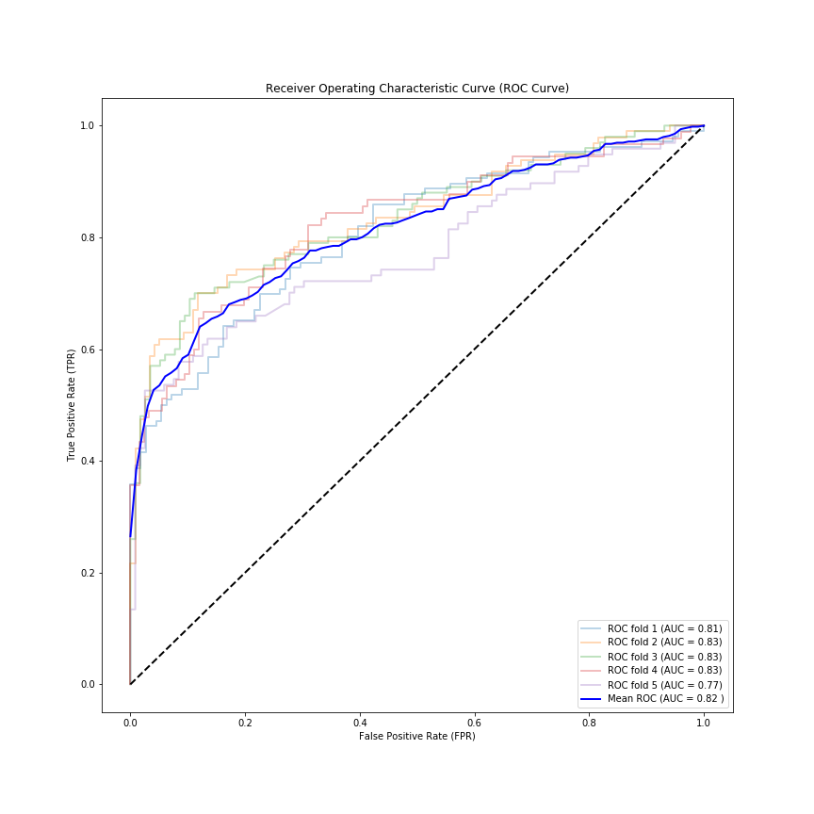
Result Analysis - (CNN-1D ROC Curve)
In Machine Learning, performance measurement is an essential task. So when it comes to a classification problem, we can count on an AUC - ROC Curve. When we need to check or visualize the performance of the multi - class classification problem, we use AUC (Area Under The Curve) ROC (Receiver Operating Characteristics) curve. It is one of the most important evaluation metrics for checking any classification model’s performance. Figure-8 shows the performance of our CNN-1D model.
Figure 8: CNN-1D ROC curve
9
black_crow
DEPARTMENT OF CSE, UIU

Slide 11
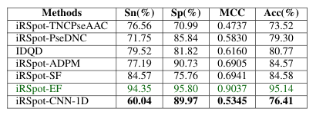
Result Analysis - (State-of-the-art-predictors)
Now, we will compare the performance of iRecSpot-CNN-1D with other state-of-the-art predictors who used the same datasets. We have
chosen six previous predictors for the purpose of comparison. They are: iRSpot-TNCPseAAC, iRSpot-PseDNC, IDQD, iRSpot-ADPM, iRSpot-SF and iRSpot-EF.
Results in terms of Sensitivity ( Sn), Specificity (Sp),
Accuracy (Acc) and MCC are reported in Figure 9.
From the results shown in Figure 9, it is evident that our proposed method iRecSpot-CNN-1D could not outperforms all these methods in terms of all the evaluation metrics considered for the experiments and, classification methods and feature selection approaches employed by other state-of-the-art pre-dictors is also given in 9.
Figure 9: Comparison of performances of iRecSpot-CNN-1D with other state-of-the-art predictors
10
black_crow
DEPARTMENT OF CSE, UIU

Slide 12
Conclusion
In this project, we have worked on a predictor, iRecSpot-CNN-1D to efficiently identify recombination spots employing a set of novel features in combination with a coherent feature selection approach. In total, seven hundred sixty features were generated by the three feature generation method. Our features As iRecSpot-CNN-1D trying to accomplish to identify recombination spots better than any other existing methods, it may play a significant role in genetics and cell biology.
Furthermore, the simplicity and the efficiency of the method is very promising as a bioinformatics approach to reveal the mechanism of recombination and genome variation. We are trying more optimization approaches to generate features.
11
black_crow
DEPARTMENT OF CSE, UIU

Slide 13
Q&A
12
black_crow
DEPARTMENT OF CSE, UIU

Slide 14
Thank You
13
black_crow
DEPARTMENT OF CSE, UIU

