Slide 1
Lab 6
Data 8 Spring 2017

Slide 2
Programming concepts review

Slide 3
for loops
A structure that allows you to repeat a process multiple times.
It does not return anything. Simply imagine that the block of code inside the for loop is executed multiple times

Slide 4
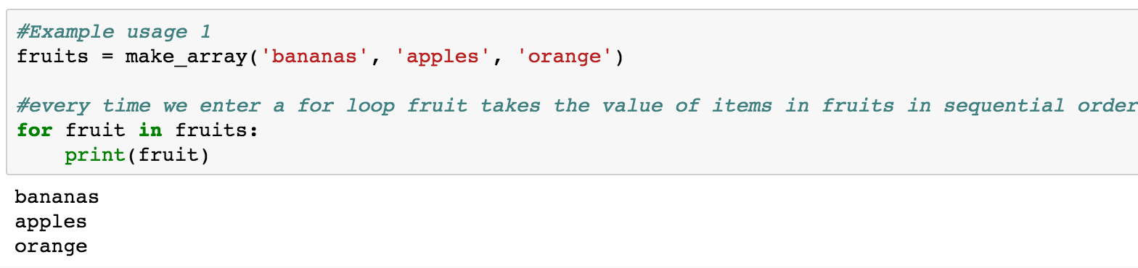
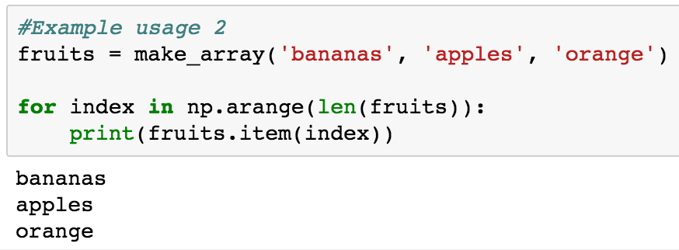
How you use it

Slide 5
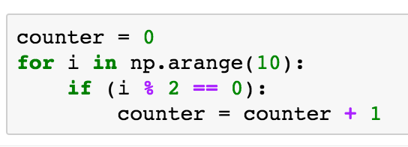
What does this piece of code do?

Slide 6
Solution
I want to count how many even numbers exist between 0 and 9.
Step 1: Initialize a counter variable (count)
Step 2: Every time I see an even number, increment the count variable by one.
Explanation: Every time I see an even number, I add one to my count variable hence the value of my count variable in the end will be the number of evens.
Is there another way you could have solved the problem using a for loop?

Slide 7
group
group is a table operation. You can not use it on arrays. (Why?)
What are the arguments a group takes?
<table_name>.group(_______ , _______)
<table_name>.group(<column_to_group_by>,<aggregation_function>)
What does it return?
A table (always remember to save this table to a variable otherwise it will the lost)

Slide 8
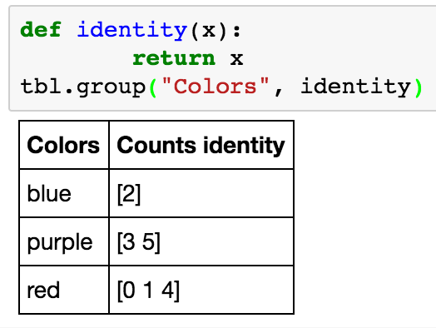
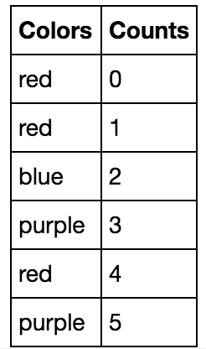
Example
Step1:
I have the following table:
Step2:
Under the hood:

Slide 9
Apply
apply is a table operation (we can not use it on arrays)
What are the arguments a apply takes?
<table_name>.apply(_______ , _______)
<table_name>.apply(<fuction_to_apply>,<column_name>)
What does it return?
An array (you have to put it back in the table if you want to do so)

Slide 10

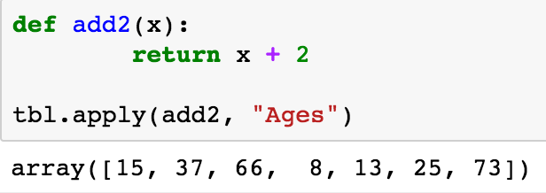
Example
Step1:
I have the following table:
Step2:
Apply the add2 function:

Slide 11
Some terminology
Parameter
A number that is a characteristic of a population
e.g. The average age all the people around the world is X.
Statistic
A number that is a characteristic of a sample
E.g. If we think of this class as a sample of the total population then the average age of everyone in the class is Y.
We can use a statistic as an estimate for the parameter of a population

