Slide 1
Midterm questions
March 16th 2017

Slide 2
Midterm Survey
We are trying to make this class better and more enjoyable and we need your help!
https://goo.gl/forms/rr74Qz5gMhAtkZ1E3

Slide 3
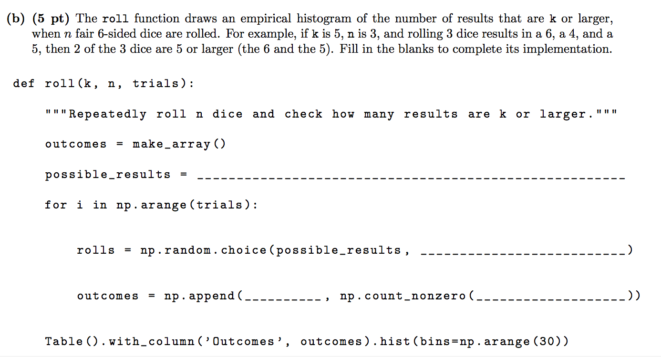
Hypothesis testing
make_array(1,2,3,4,5,6) (what you are sampling from)
n
(how many times you are sampling)
outcomes
(array that holds you test statistic)
rolls >= k
(test statistic)

Slide 4
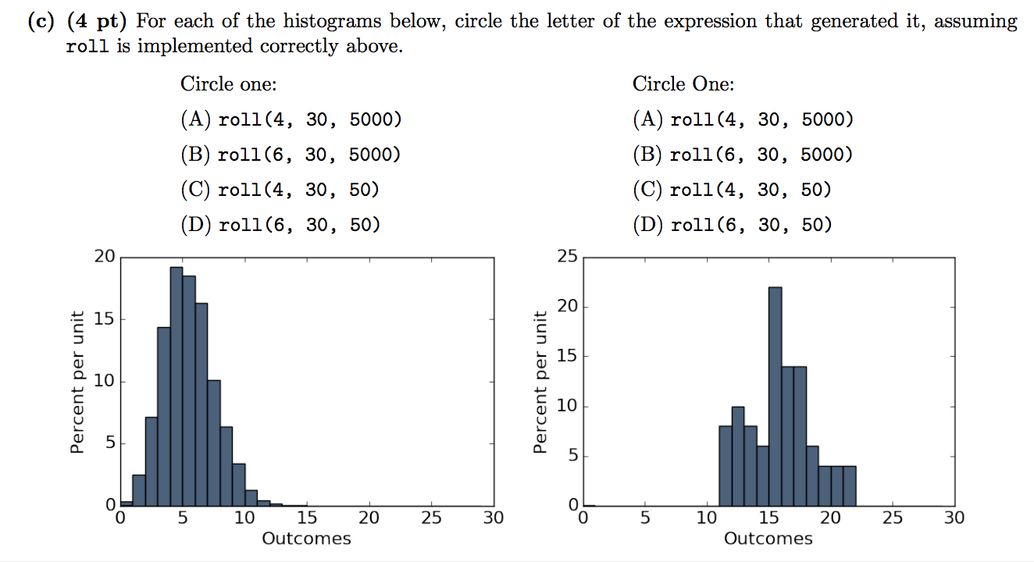

Slide 5
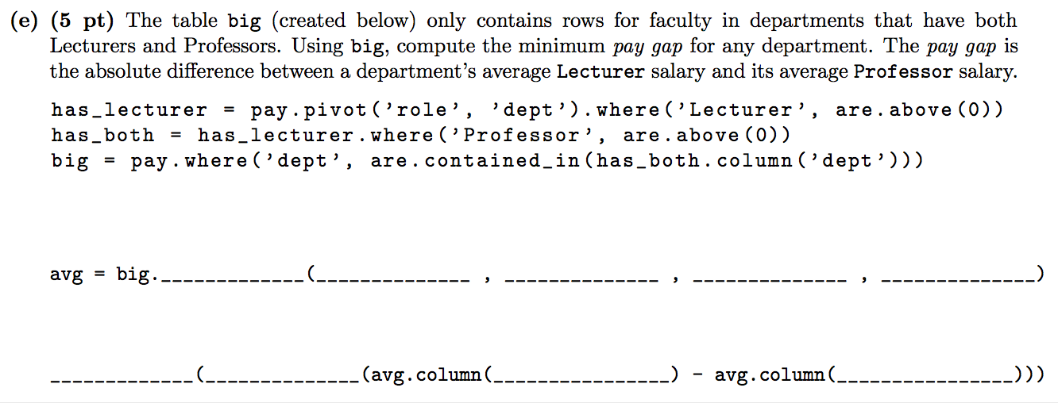
Unpacking coding questions
Where to start: Which function that I know of takes in 4 arguments?
pivot
“role”
“dept”
“salary”
“np.mean”
<columns>
<rows>
<values>
<aggregation>
min
abs
“Lecturer”
“Professor”
Let’s say I have no idea what I am supposed to pivot by. But the second line looks easier. The question tells me that they want me to calculate the absolute difference between Professors and Lecturers in each dpt.
So based on my last line, I want to construct a table with columns [“Lecturer”, “Professor”, …] and rows that correspond to the average salary for each department.

Slide 6
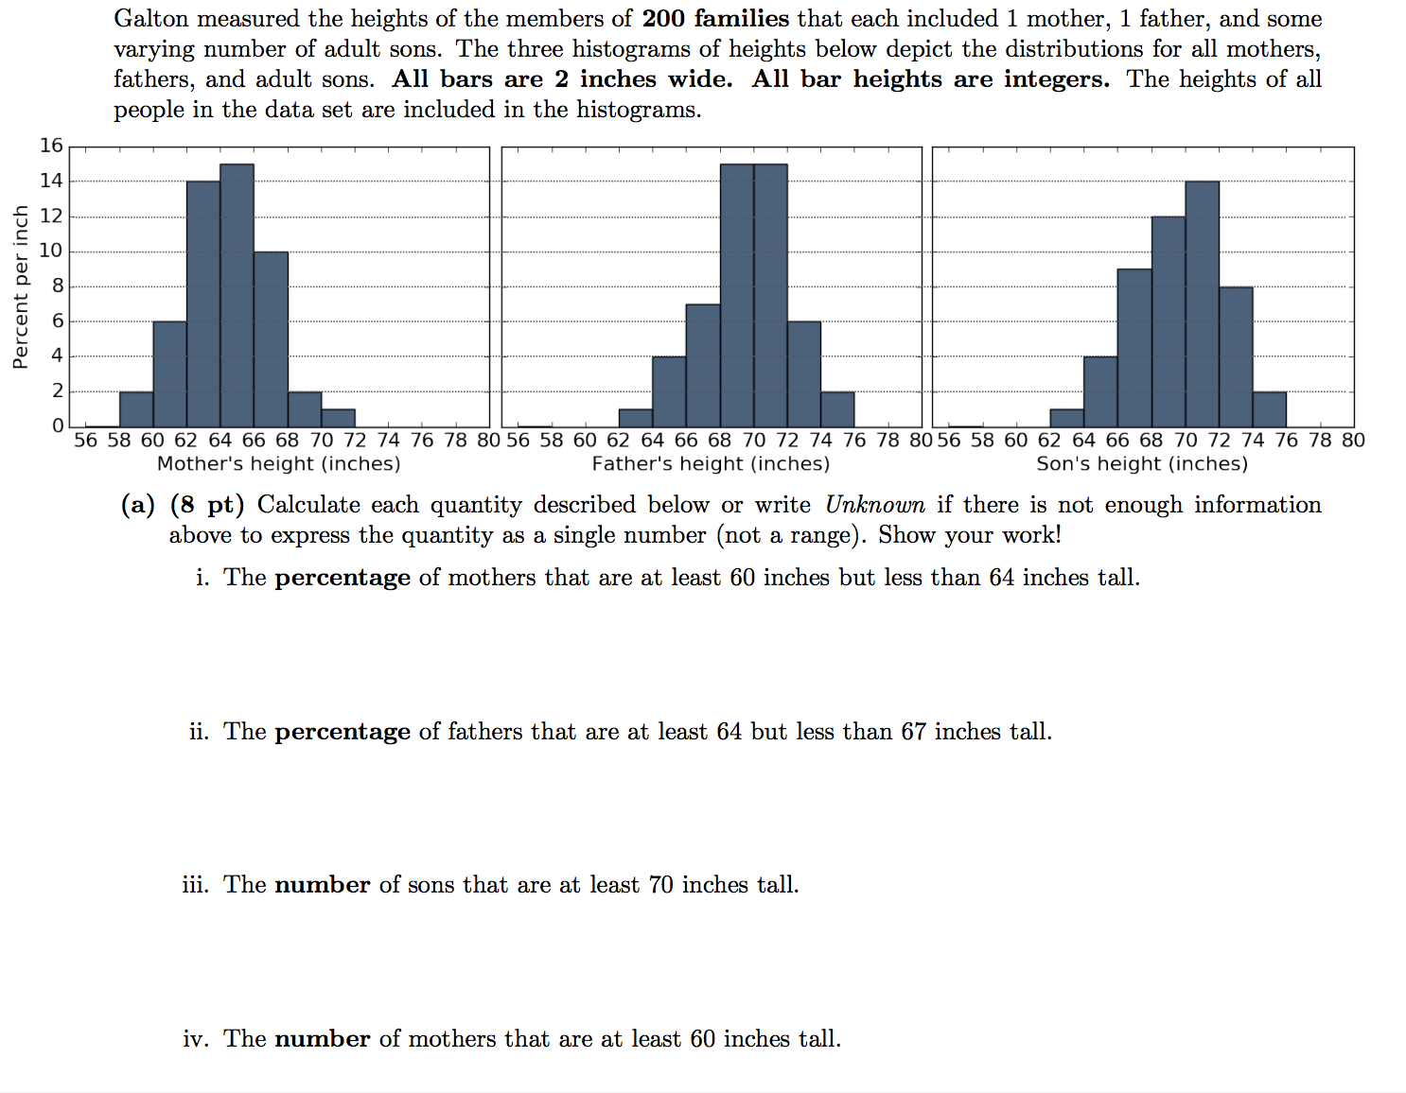
Histograms
0.06 * 2 + + 0.14*2 = 0.40 = 40%
How is this question different from above?
Unknown:
We can find the proportion of sons but do we know the total number of sons in our dataset?
Unknown:
Remember: 1) Finding the complement is sometimes easier
2) The area under any histogram is always 1.

Slide 7
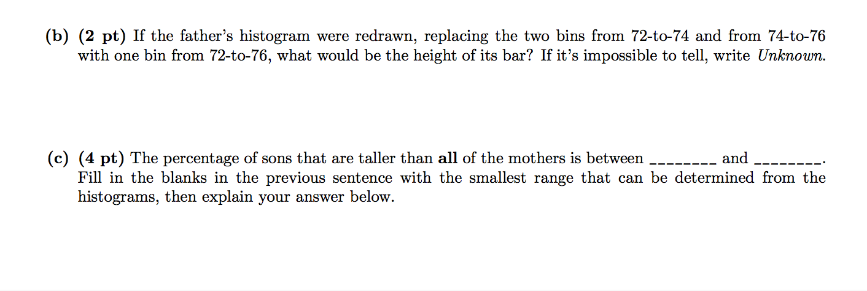
Remember:
Area = bin_width * density In this case the new bin should contain the same percentage of points as the original two combined
In the mothers’ histogram the largest bin is 70-72. But since we don’t know exactly what the mothers’ heights in that bin is we have to establish some bounds.
The shortest the tallest mother could be is 70. The tallest is 72. Why?
So now let’s go back to the sons’ histogram and find the proportion of sons above
those bounds just as in the previous exercises.

