Slide 1
The Effect of Environment on Color Naming Schemes
Ameena Golding, Max McArthur, Vasilis Oikonomou

Slide 2
Introduction
Question: Do color naming schemes of different languages depend on the distribution of colors in the environment where the language was developed?
Null hypothesis: Distribution of colors in immediate environment is the same as distribution of colors in Munsell space partitioning.
→ Predictions
Hypothesis
Methodology
Findings
Q&A

Slide 3

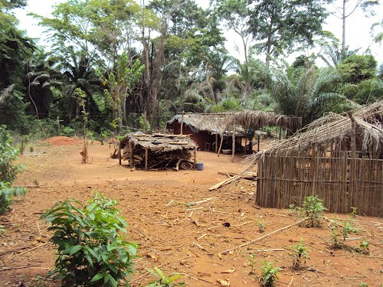
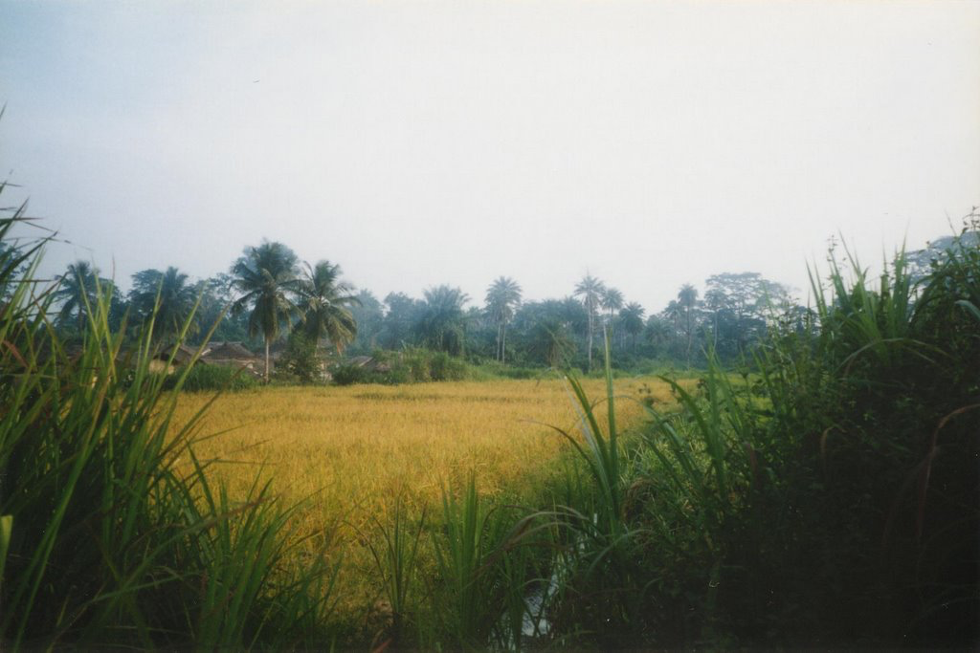
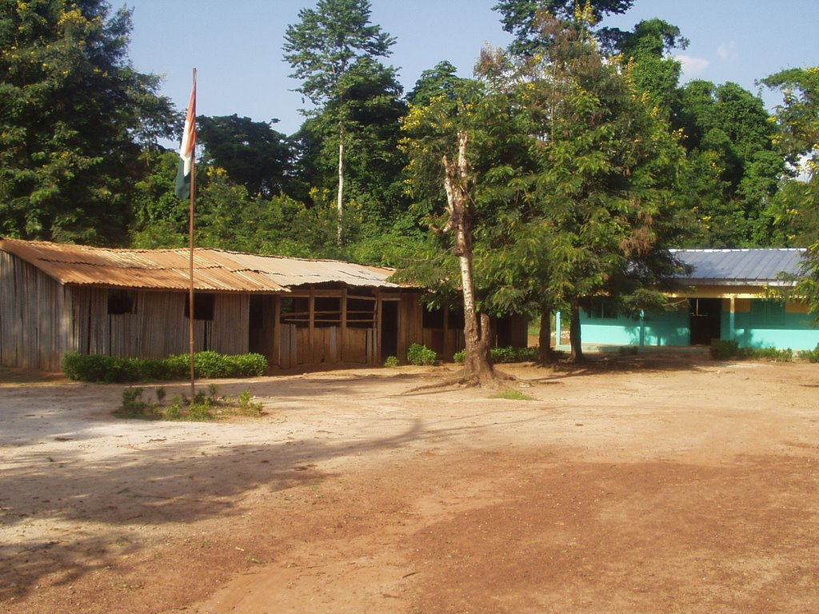
Example
Ivory Coast
Hypothesis
Methodology
Findings
Q&A

Slide 4
Example
Observations
All pictures contain primarily green and yellow. Shouldn’t that be somehow reflected on the naming patterns of the speakers? YES
HOW?
Intuitive explanation: If you see a lot of green and almost no purple, wouldn’t it make sense that you name more chips as green than purple? YES
Implications: There should be a hierarchy of colors not only in the order that they appear but also in the proportions in which they appear.
Question: Can you spot any problems with this approach?
What about red, black and white?
Hypothesis
Methodology
Findings
Q&A
Notes:
Answer to question: How about red-white-black
Essentially we claim that you use the term for more “important colors more often” but you associate the importance of a color based on how often it appears. But this is a false assumption.
There could be other factors that determine the importance of a color in the minds of people e.g. red → blood, death
white → some psychological effect
black → night, dark, fear

Slide 5
Step by step process
Image collection
Determine foci based on speaker responses (in RGB)
For each pixel in each image, find the focus point closer to its RGB value
Find the proportion of colors in the images
Compare to the proportion of colors in the partition of the Munsell space
Hypothesis
Methodology
Findings
Q&A

Slide 6
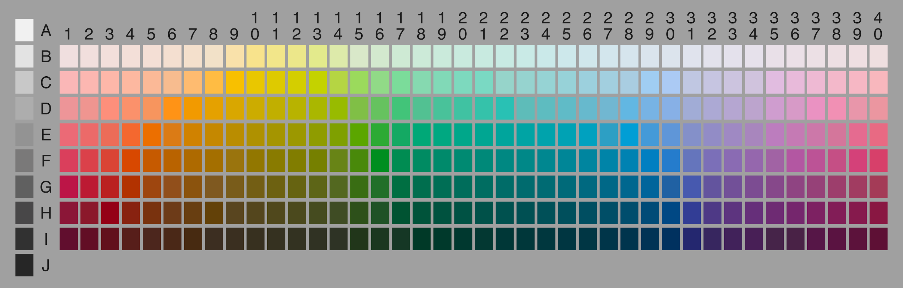
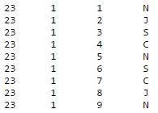
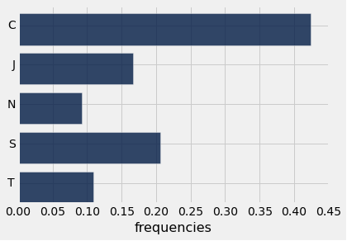
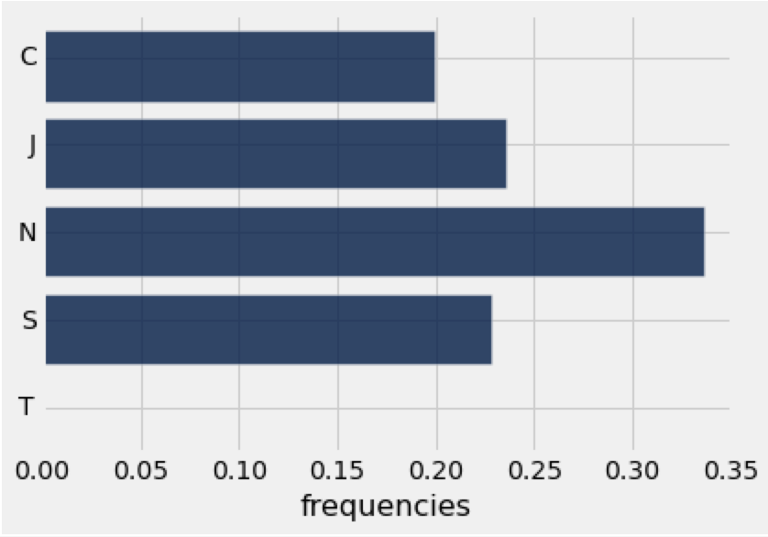
Process Overview
Empirical Data Collection
Theoretical Data Collection
proportions
(term.txt)
TVD Analysis
proportions
Hypothesis
Methodology
Findings
Q&A

Slide 7
Results - Main Findings
Note that in this experiment we want to confirm the null! We want to see a high p-value
Observed results Predictions
p-value = 0
White-Black → sometimes overestimated
Red → underestimated as predicted
Interesting observation: Very consistent TVD value observed. (Around 0.2 to 0.3)
Hypothesis
Methodology
Findings
Q&A

Slide 8
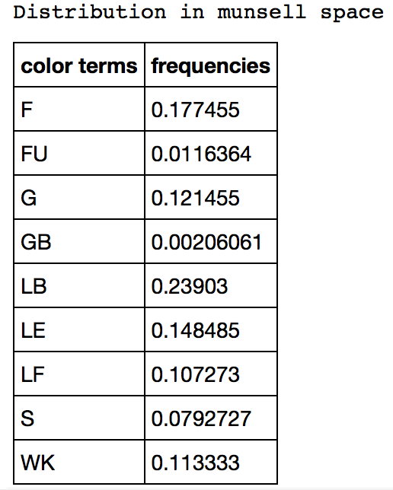
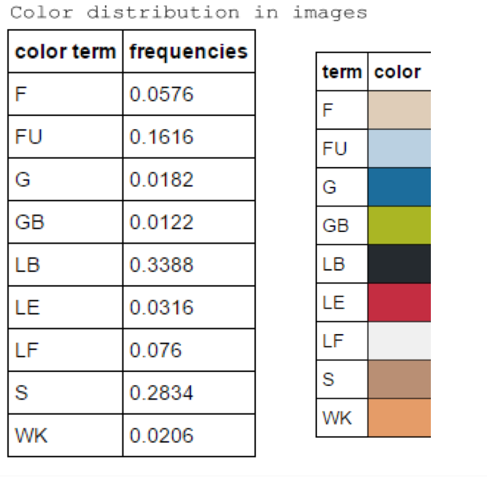




Example - Abidji/Ivory Coast
overestimated:
unusual
Hypothesis
Methodology
Findings
Q&A

Slide 9
Conclusion - Improvements
Based on our results, we cannot confirm our null hypothesis as it was initially intended.
Possible improvements:
Develop a more sophisticated approach to assigning each pixel to the correct focus point(instead of just averaging the RGB values of the best examples and then using the Euclidean distance)
Find a way of accounting for special case colors (black, red and white) to avoid severe underestimations or overestimations
Compare naming schemes between languages for evidence of our hypothesis instead of looking one language at a time
Hypothesis
Methodology
Findings
Q&A

Slide 10
Acknowledgements
- We would like to thank Jessie Salas for helping us solidify our initial idea

Slide 11
Questions?

