Slide 2
Analysis

Slide 3
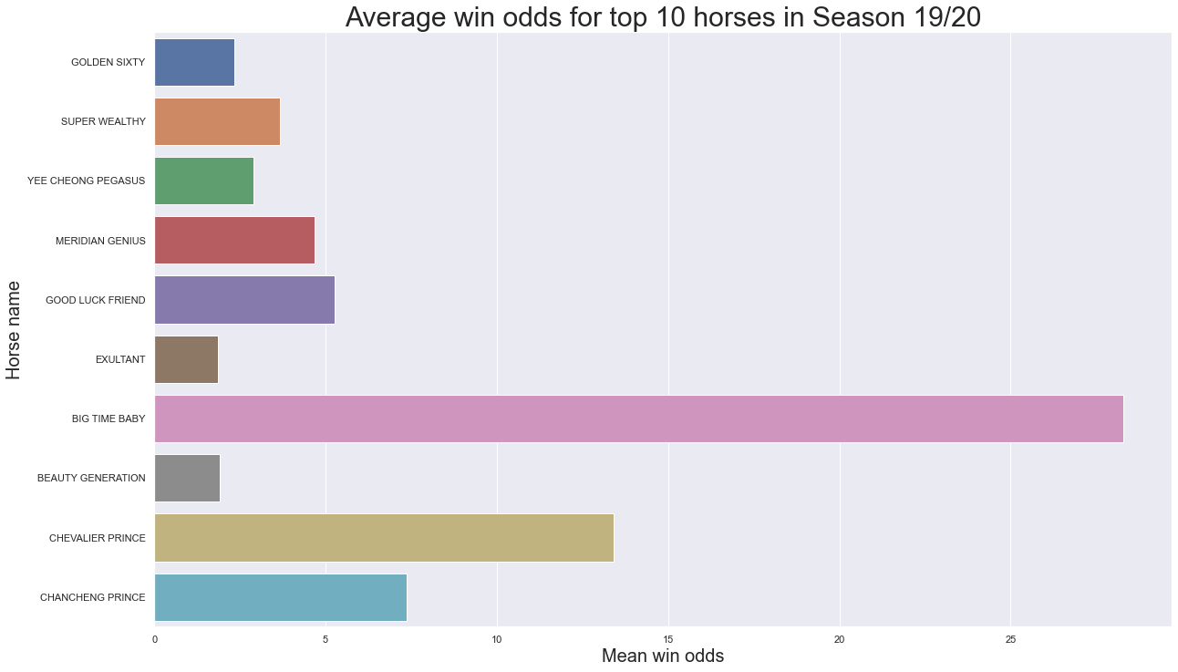
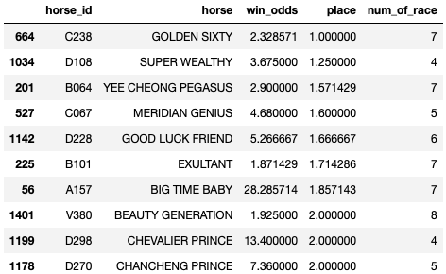
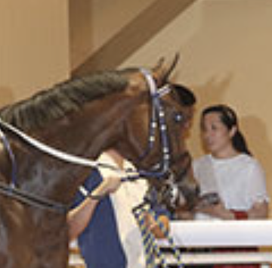

Average win odds for top 10 horses in Season 19/20
Big TIme Baby (仁者荃心) is worth investing!

Slide 4
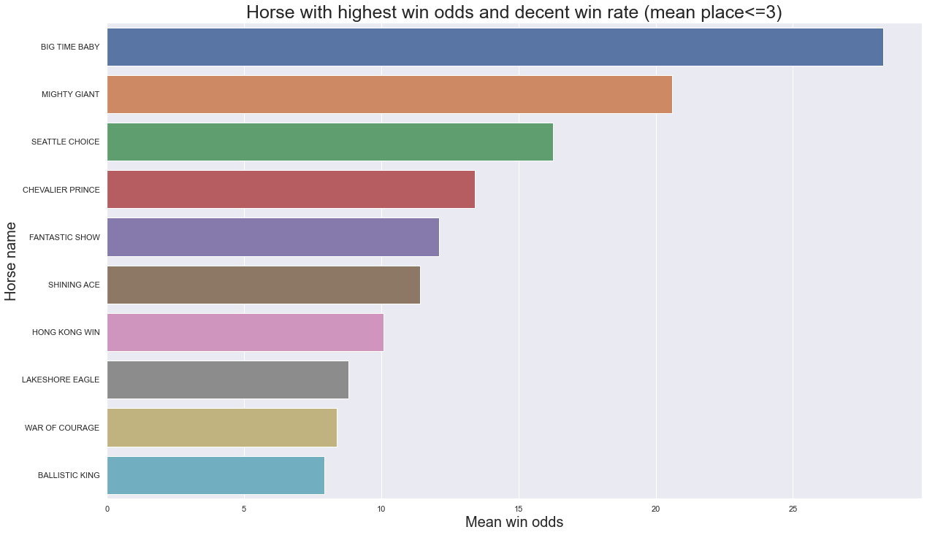
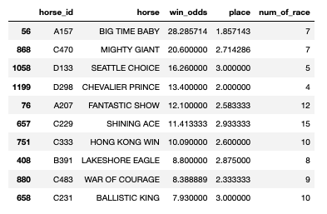
Horse with highest win odds and decent win rate (mean place <= 3)
Good Choices for place:
Big Time Baby (仁者荃心)
Mighty Giant (高大威猛)
Seattle Choice (翡翠精選)
Chevalier Prince (超勁勇士)
Fantastic Show (爆騷)

Slide 5
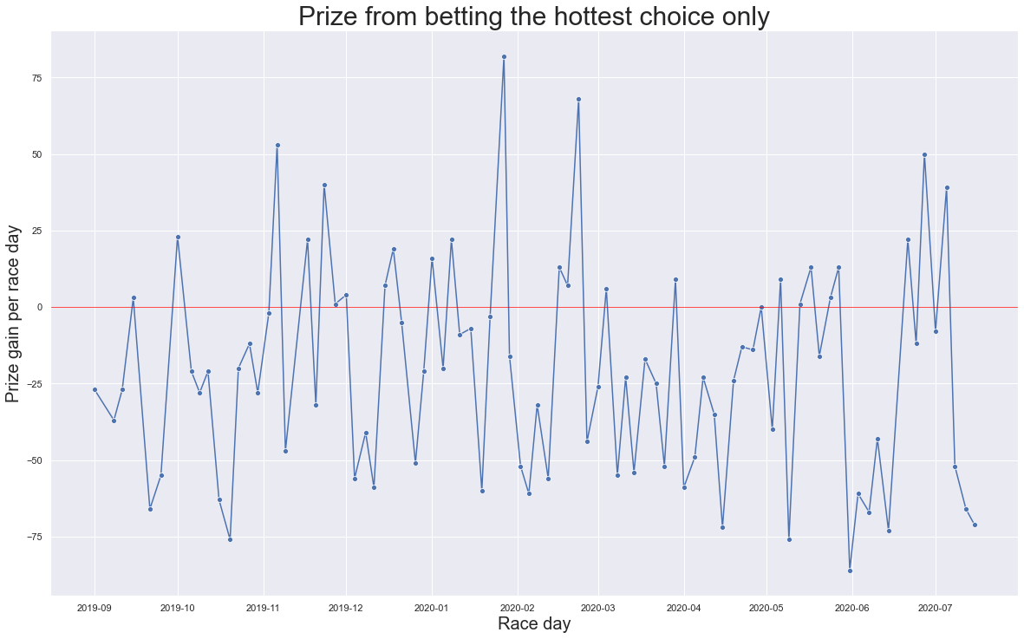
Prize you can win by betting the hottest choice
Result:
Total number of race | $828
Amount of each bet | $10
Prize gained | $6458
Net Amount | -$1822
Accuracy | 29.2%

Slide 6
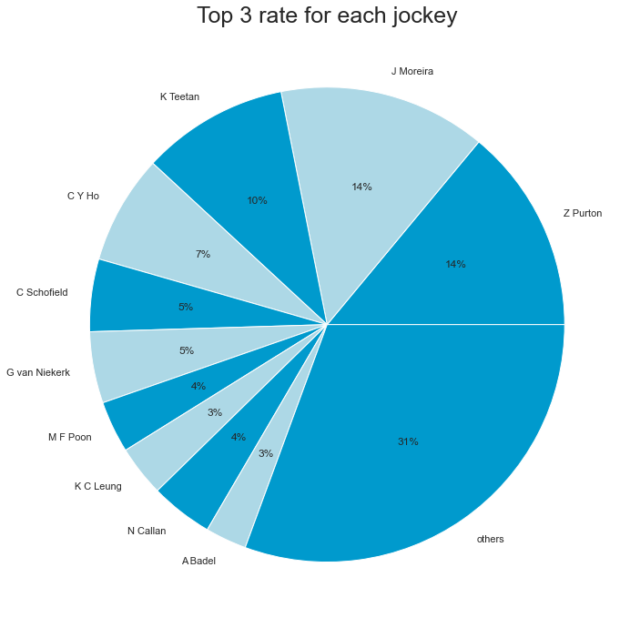
Top 3 rate for all jockeys
Top 3 rate = counts of getting top 3 / total number of race of that rocky
Total number of jockeys | 50
Top 3 rate for top 10 jockeys | 69%
Top 3 rate for top 3 jockeys | 38%

Slide 7

Challenges and Next Steps:
Challenges:
HTML code
Different number of race
Next Steps:
Feature engineering
Data preprocessing
Build machine learning models:
Linear regression/DNN
Schedule retraining

Slide 8
Play Responsibly
No person under 18 is allowed to bet or enter premises where bets are accepted.
The maximum penalty for betting with illegal or overseas bookmakers is 9 months' imprisonment and a HK$30,000 fine.
Don't gamble your life away. Call Ping Wo Fund hotline 1834 633 if you need help or counselling.

