Slide 1
Data Preprocessing and Linear Regression

Slide 2
Data Preprocessing
Processing the data to yield a better result in ML model
Excluding the outliers from the dataset
Shuffling the data
Feature extraction
Splitting the data

Slide 3
Linear Regression
Modeling the dependent variable based on a single independent variable
The linear function to predict the target data
Resulting minimum root mean square error between prediction function and the target data

Slide 4
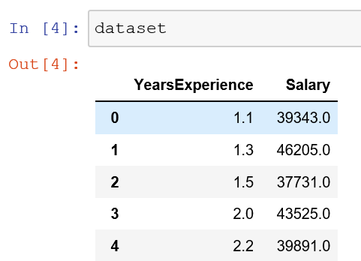
# Load Data
import pandas as pd
dataset = pd.read_csv('project_1_dataset.csv')

Slide 5
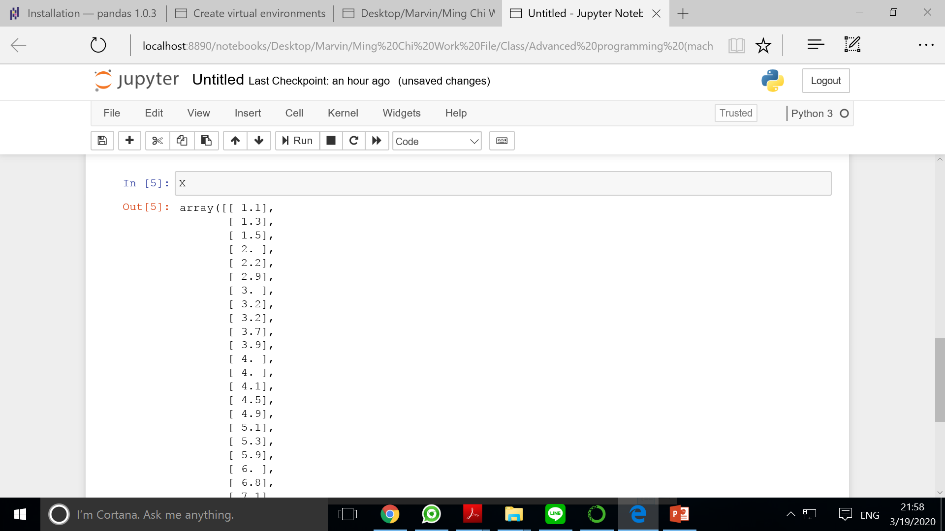
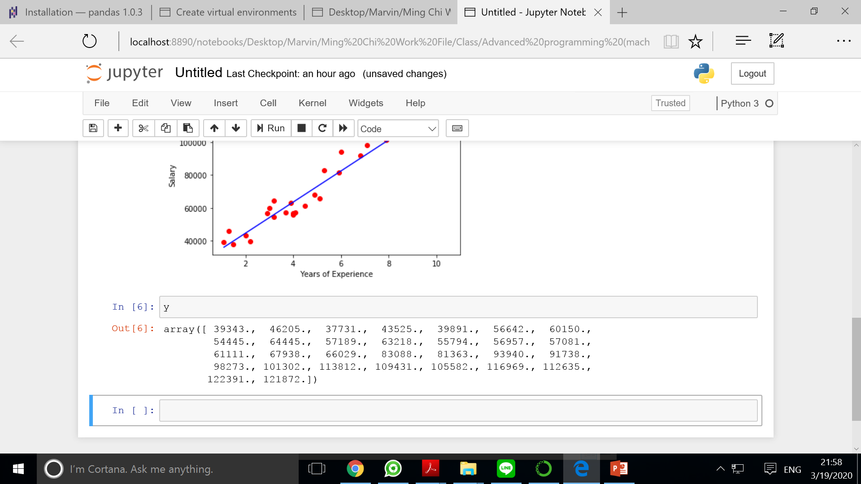
# Separate feature and target
X = dataset.iloc[:, :-1].values
y = dataset.iloc[:,1].values

Slide 6
# Splitting the data
from sklearn.model_selection import train_test_split
X_train,X_test,y_train,y_test = train_test_split(X, y, random_state=0)

Slide 7
# Fit Simple Linear Regression to Training Data
from sklearn.linear_model import LinearRegression
regressor = LinearRegression()
regressor.fit(X_train, y_train)
# Make Prediction with training data
y_pred = regressor.predict(X_train)

Slide 8
# Visualize training set results
import matplotlib.pyplot as plt
# Inverse the scaling
X = scaler.inverse_transform(X)
# Plot the actual data points of training set
plt.scatter(X, y, color = 'red')

Slide 9
# Visualize training set results
import matplotlib.pyplot as plt
# Plot the actual data points of training set
plt.scatter(X_train, y_train, color = 'red')
# Plot the regression line
plt.plot(X_train,y_pred,color='blue')
plt.title('Salary vs Experience (training set)')
plt.xlabel('Years of Experience')
plt.ylabel('Salary')
plt.show()

Slide 10
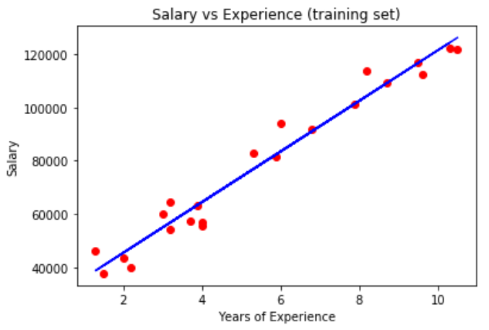

Slide 11
#score the accuracy of regression for test data
print("score: {}".format(regressor.score(X_test,y_test)))
score: 0.9097963370710402

