Slide 1
SAL IC 데모 B’D manual
Mar. 05, 2025
주식회사 글로벌 테크놀로지

Slide 2
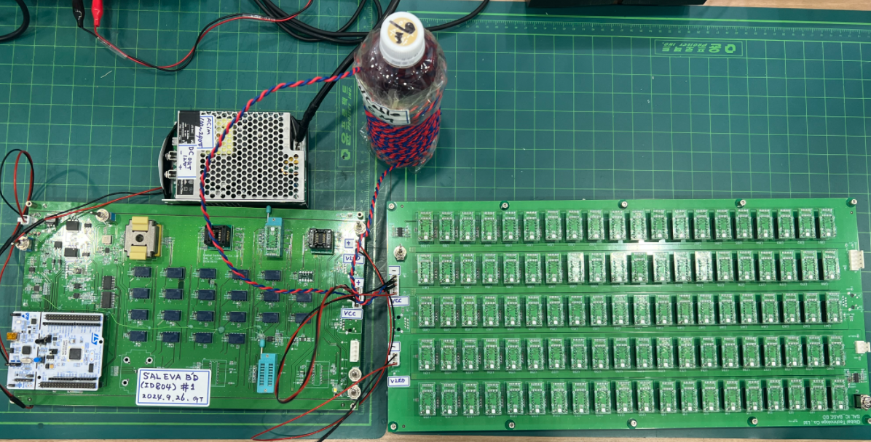
B’D Conection
Power supply
Control B’D
EVA B’D

Slide 3
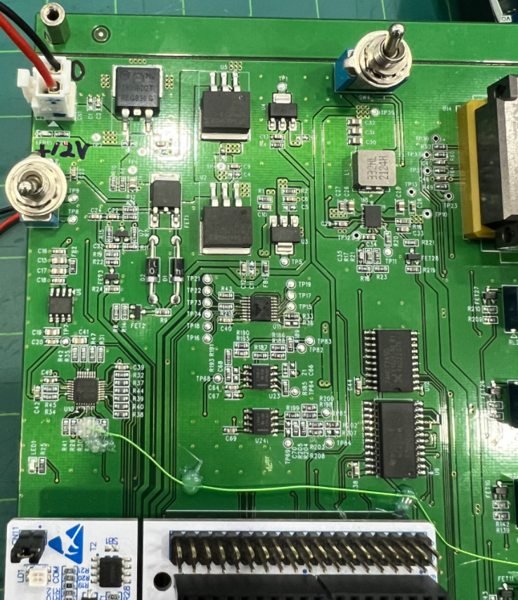
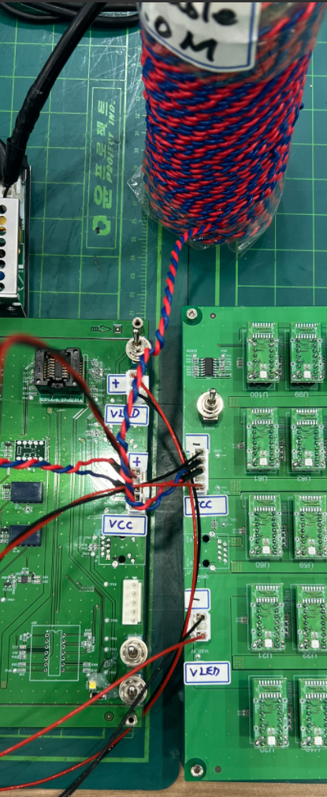
B’D Conection
12V
GND
Vled(+5V), GND
CAN Cable
Vcc(+5V), GND
CAN Cable
Vcc(+5V), GND

Slide 4
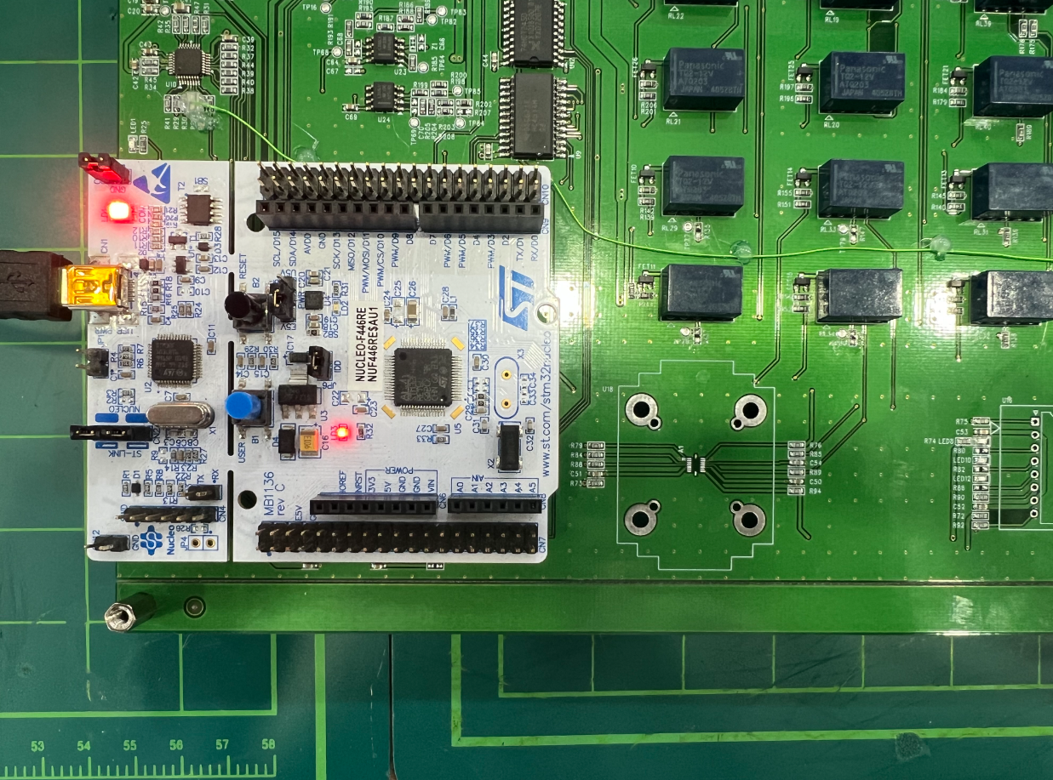
B’D Switch
기능: 전원 off switch
기능
1) 전원 on & SAL initial (0.5초 이상 push)
2) Demo pattern change (짧게 push)

Slide 5
SAL SINGLE-ENDED

Slide 6
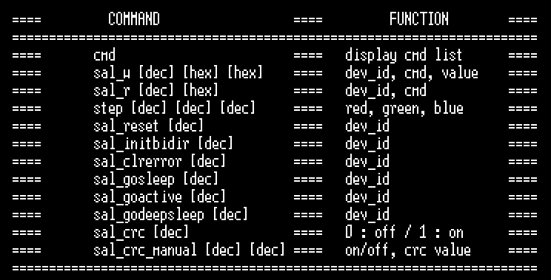
Single-Ended F/W command List
Serial – “?” or “help” (show F/W command list)

Slide 7
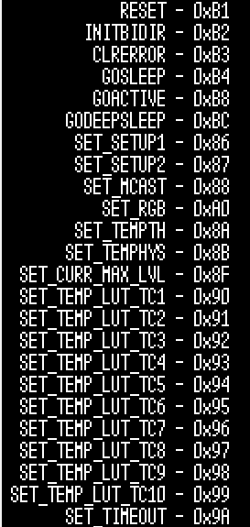
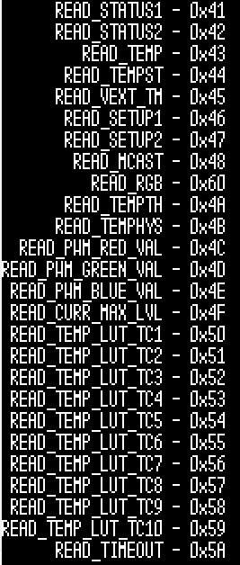
Single-Ended F/W command List
Serial – “cmd” (show SAL command list)

Slide 8


Single-Ended F/W command List
Serial – “sal_w [dec] [hex] [hex]” (write)
dev_id
cmd
value
0 : broadcast
1 ~ n : dev_id
Serial – “sal_r [dec] [hex]” (read)
SAL에 변경한 값이 읽어짐
dev_id
cmd
0 : broadcast
1 ~ n : dev_id
※ SAL Read 시 주의점
- 아래와 같이 “spi rx timeout” 메시지가 나온 경우 통신 error가 발생, read 재시도 필요

Slide 9



Single-Ended F/W command List
Serial – “sal_reset [dec]”
dev_id
0 : broadcast
1 ~ n : dev_id
Serial – “sal_initbidir [dec]”
dev_id
0 : broadcast
1 ~ n : dev_id
Serial – “sal_clrerror [dec]”
dev_id
0 : broadcast
1 ~ n : dev_id

Slide 10



Single-Ended F/W command List
Serial – “sal_gosleep [dec]”
dev_id
0 : broadcast
1 ~ n : dev_id
Serial – “sal_goactive [dec]”
dev_id
0 : broadcast
1 ~ n : dev_id
Serial – “sal_godeepsleep [dec]”
dev_id
0 : broadcast
1 ~ n : dev_id

Slide 11
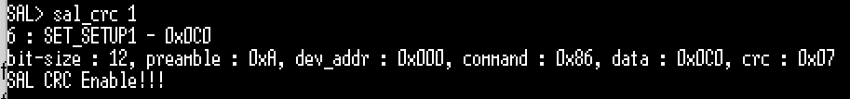
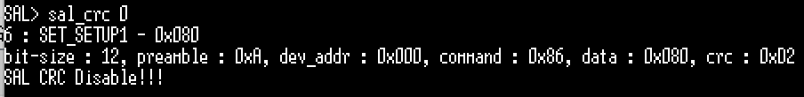


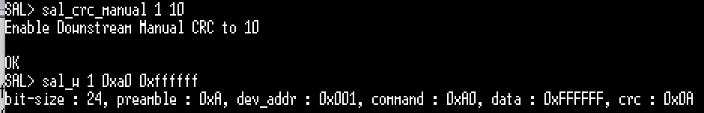
Single-Ended F/W command List
Serial – “sal_crc [dec]”
1 : sal crc enable
0 : sal crc disable
Serial – “sal_crc_manual [dec] [dec]”
1 : manual crc enable
0 : manual crc disable
Value to be crc @ downstream
0 ~ 255
1) Manual crc : disable (crc8 rule에 맞게 계산된 값이 data frame에 사용됨)
2) Manual crc : enable, crc = 10으로 강제 설정
3) 강제 설정한 값 (crc = 10)으로 data frame에 사용됨

Slide 12


Single-Ended F/W command List
Serial – “sal_preamble [dec]”
0 ~ 15

Slide 13
SAL TEST MODE (I2C)

Slide 14
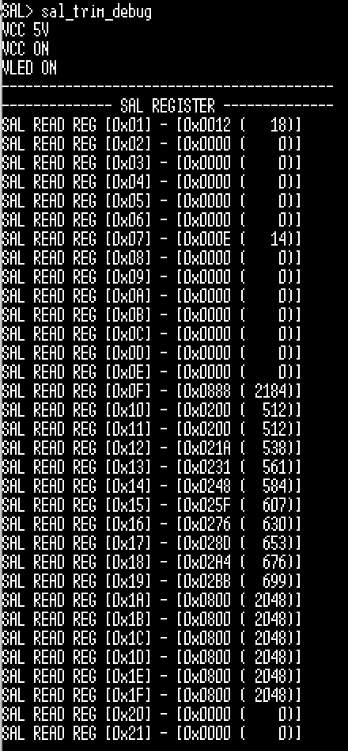
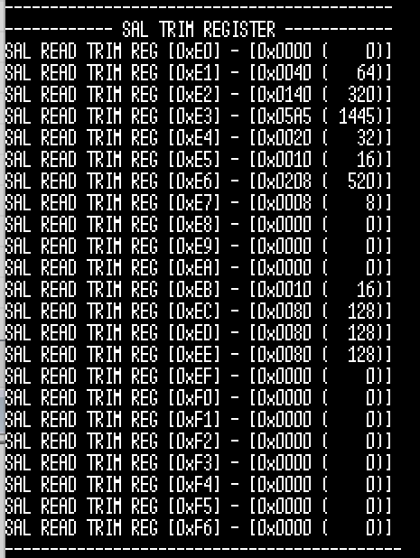
Test Mode (I2C) F/W command List
Serial – “sal_trim_debug”
→ vcc & vled on
→ test_e : 1, otp_protect : 0xA5A (disable)

Slide 15




Test Mode (I2C) F/W command List
Serial – “sal_wt [hex] [hex]”
addr
value
Serial – “sal_rt [hex]”
SAL에 변경한 값이 읽어짐
addr
※ SAL I2C Error 발생 시
- I2C Error가 발생하면 아래와 같은 메시지 로그가 표시된다.

Slide 16
F/W Download

Slide 17
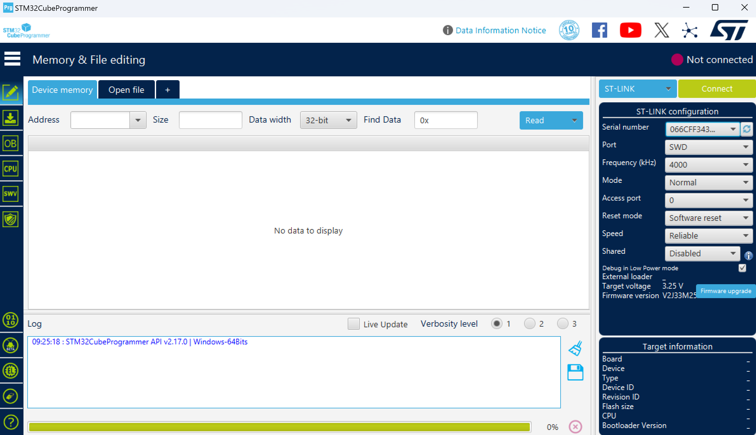
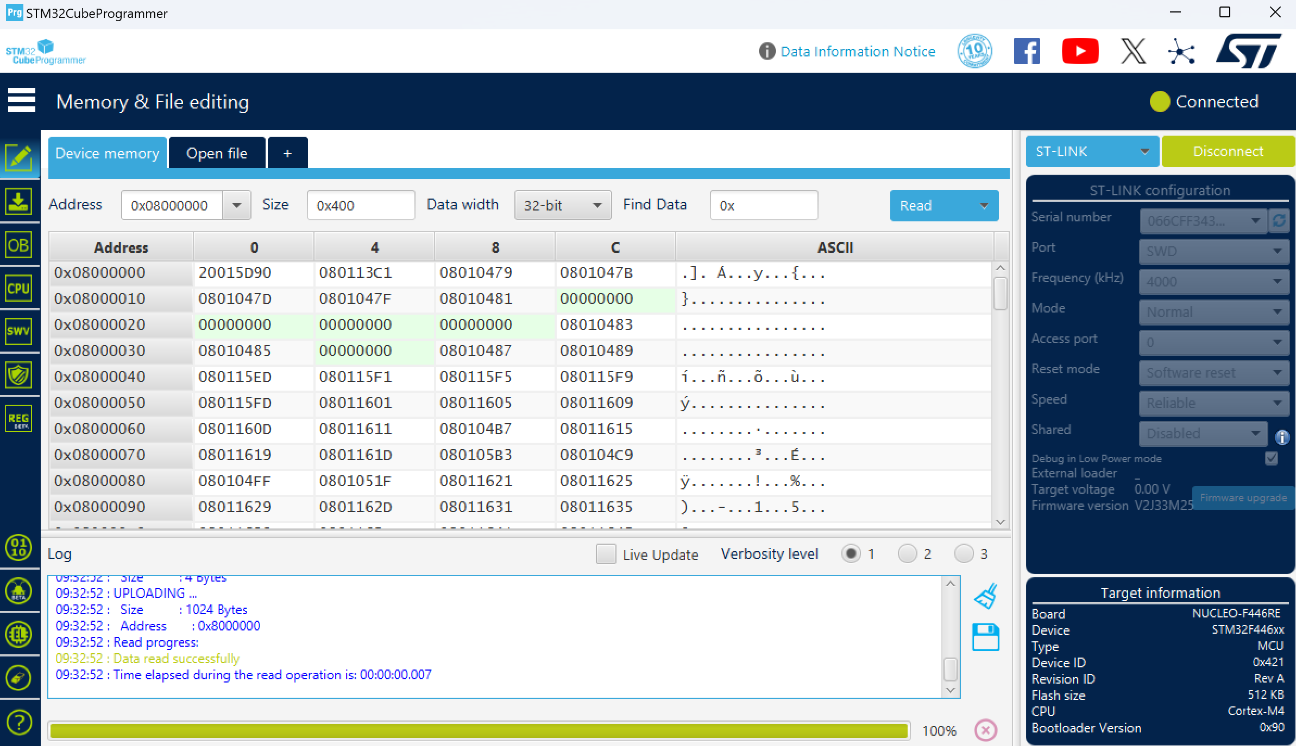
F/W Download
Run STM32CubeProgrammer
Turn on Jig Power
Press “Connect” BTN

Slide 18
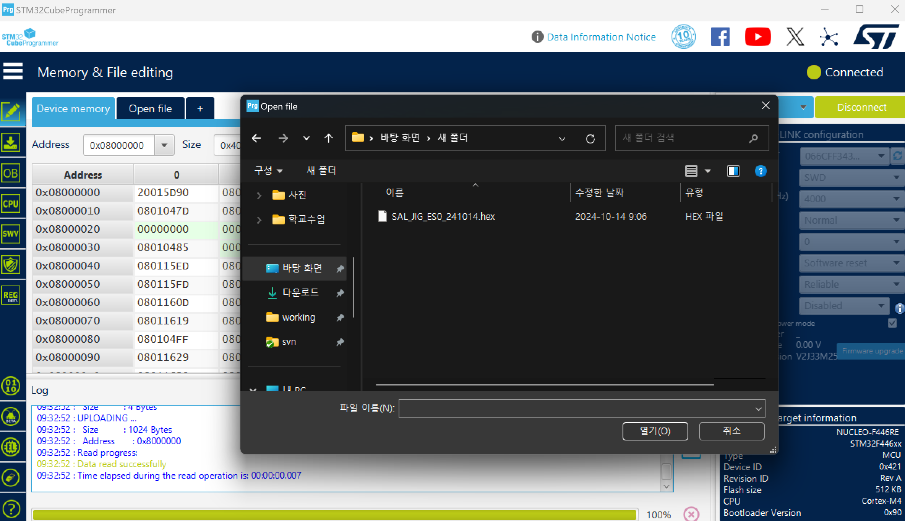
F/W Download
3) Click “Open file” & open released “sal_es0_xxxxxx.hex”

Slide 19
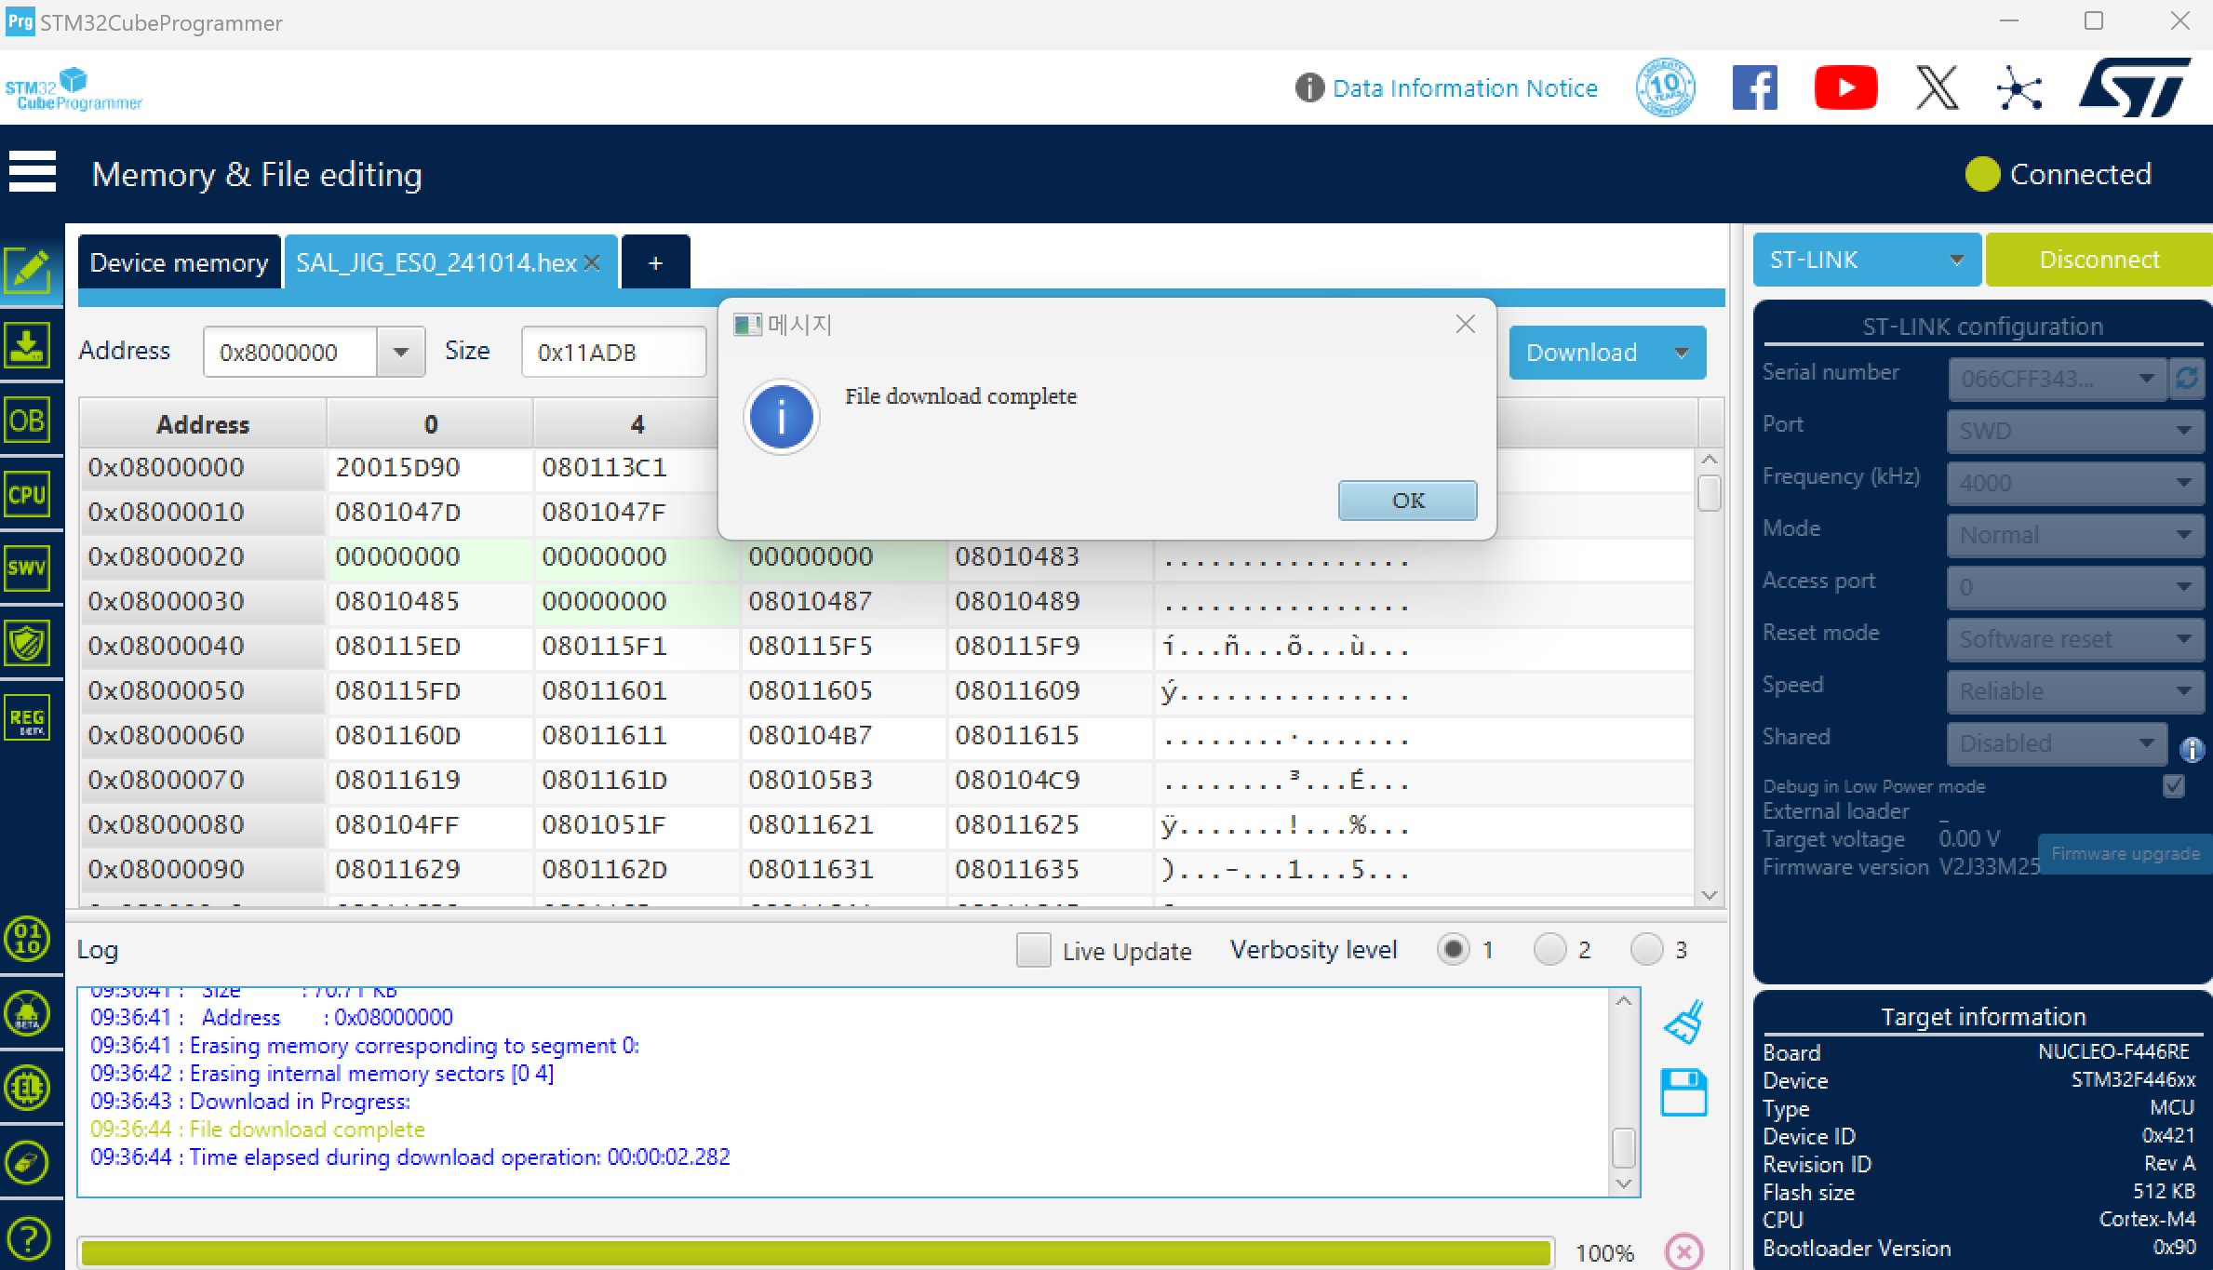
F/W Download
4) Click “Download” -> “OK” -> “Disconnect” & turn off Jig Power

