Slide 1
ID601 TEST Plan 통합
-
2026.09.18

Slide 2
Test Definition
Register Set Definition
Register Set | Applicable Test | Register Configuration ( REG_NAME( ADDR ) = DATA )
 |  | Seq | REG NAME | ADDR | DATA | Seq | REG NAME | ADDR | DATA
Analog Test Mode | Trimming, Fault, Verify | 1 | RESET | 0x00 | 0x800 | 2 | FAULT_CTRL | 0x06 | 0x000
 |  | 3 | FLLCNT1 | 0x22 | 0xDCD | 4 | CHOP_EN | 0x26 | 0x03F
 |  | 5 | TM ENTRY |  |  | 6 | OP_MODE | 0x3F | 0x864
 |  | 7 | OTP_PROTECT | 0x3E | 0xA5A
FLL Test Mode | FLL | 1 | RESET | 0x00 | 0x800 | 2 | CHOP_EN | 0x26 | 0x03F
 |  | 3 | OSC_FLL_MAN2 | 0x29 | 0x008 | 4 | TM ENTRY
 |  | 5 | OP_MODE | 0x3F | 0x874
Pin Group Definition
Pin Group | PIN NAME
SIGPINS | TEST | DIO | DDIO | SVI | SVO
IOUTPINS | IOUT_CH 1~12
VSSPINS | VSS1~5
VDDPINS | VDD1~2

Slide 3
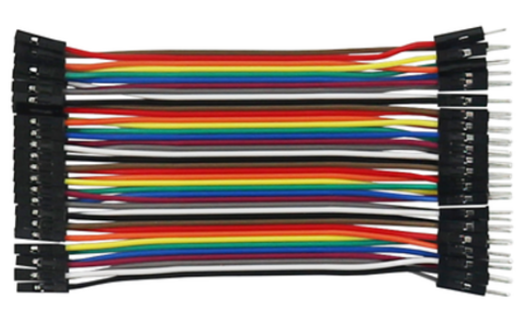

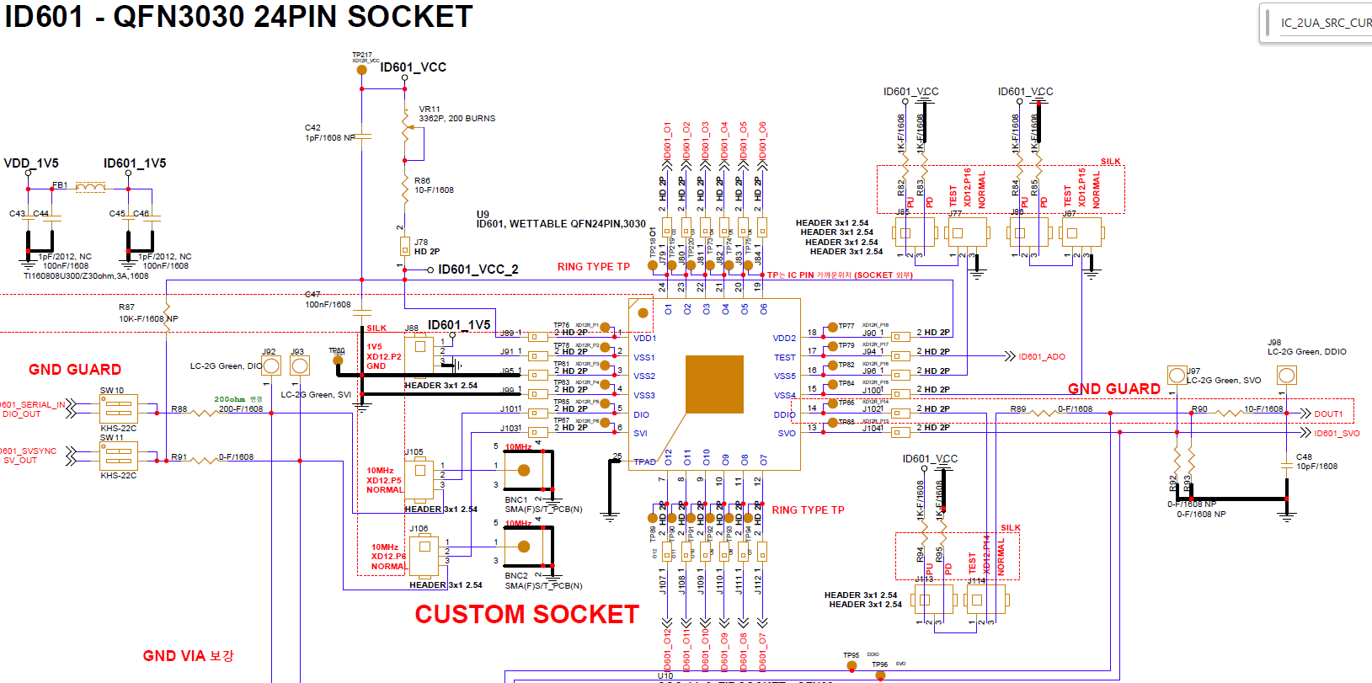
Lab Test Guide
테스트 항목 별 HW 셋팅은 QFN3030 Type 기준으로 설명됩니다.
회로도
암-수 점퍼케이블을 사용하면 편리합니다.

Slide 4
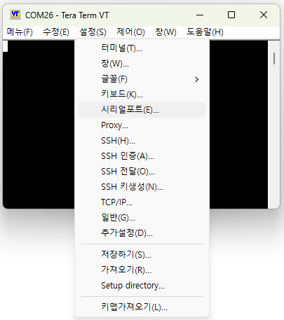
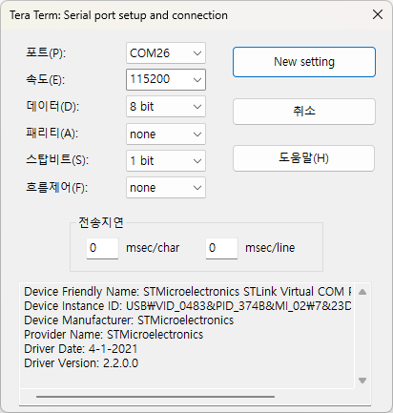
Lab Test Guide
Teraterm 셋팅 가이드
Jig 보드 연결
- 보드와 USB 연결, 전원 공급 후 설정 -> 시리얼포트 순서로 클릭한다.
Jig 보드 연결
- 아래 이미지를 참고하여 셋팅한다.
- ※ 포트: PC, USB 포트 순서 등 환경에 따라 다를 수 있음..

Slide 5
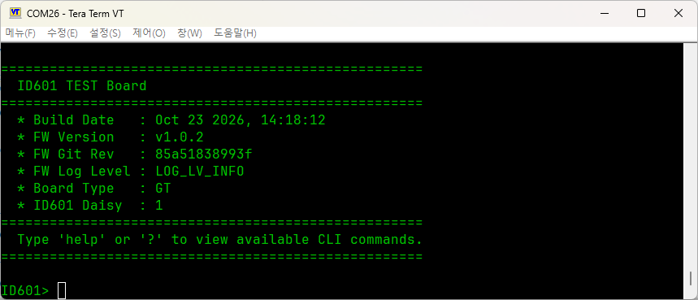
Lab Test Guide
CLI 배너 설명
Version code (버전코드와 함께 오류 접수)
“GT” 아닐 시 오류 접수
초기 ID601 daisy length

Slide 6
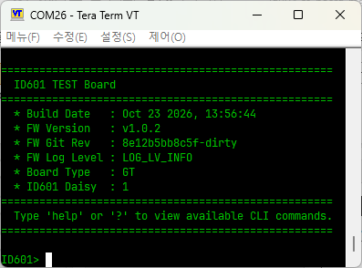
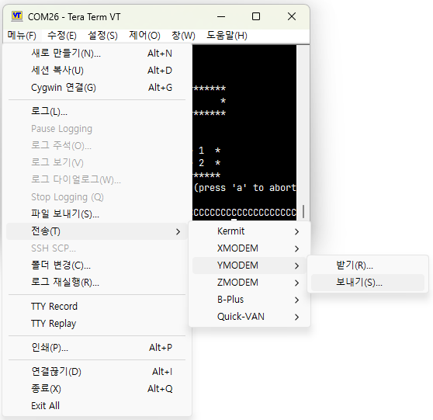
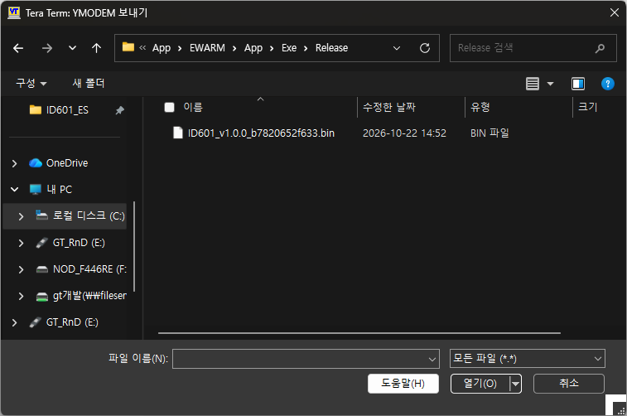
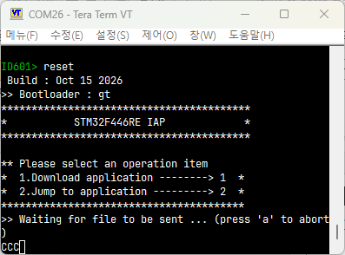
Lab Test Guide
펌웨어 업데이트
Jig 보드 연결
- 보드와 USB 연결, 전원 공급 후 다음의 Info 메시지를 확인한다.
2. 부트로더 진입
- “reset” + 엔터 명령어 입력 후 3초 이내 “gt” + “1”를 입력한다
펌웨어 다운로드 모드 진입
- 메뉴 -> 전송 -> YMODEM -> 보내기 순서로 클릭한다.
펌웨어 다운로드
- 전달받은 ID601_vx.x.x.xxxxxxxxx.bin 파일을 선택한다.
※ 파일명이 위 양식과 다르다면, 오류를 접수해주세요.

Slide 7
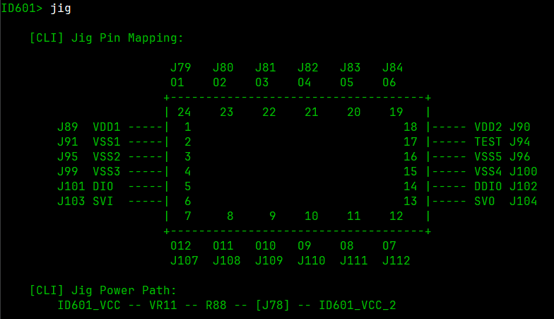
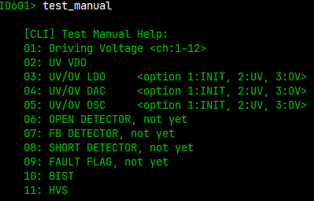
Lab Test Guide
“jig” 커맨드로 ID601 QFN3030 Type 기준의 IC 주변 Jumper 정보를 볼 수 있습니다.
Jig 보드의 기능을 활용하여 자동으로 계측이 불가능한 항목은 “test_manual” 커맨드로 테스트를 통해 시험을 시작할 수 있습니다.
“test_manual” 지원하는 테스트 명령어를 볼 수 있습니다.

Slide 8
TM ENTRY
TM ENTRY
Verification Method | Simulation
Validation environment | PT / FT / LAB
Preconditions(TEST Condition) | Temp(T_{A}) = -40℃ / 27℃ / 125℃
Simulation Procedure | Set follow register sequence (DIO). (After ID GEN, any state) - tmode_entry1 : WR_PROTECT(0x24) = 0xA5A - tmode_entry2 : WR_PROTECT(0x24) = 0x5A5 TM_ENTRY : Write tmode_entry1 → tmode_entry2 consecutively. Enter TM mode.
Expected Results. | Enter TM mode
완료

Slide 9
Pin Description
Pin Description
Pin No | Pin Name | I/O | Description | Pin No | Pin Name | I/O | Description
1 | VDD | - | Supply voltage | 13 | SVO | O | External sync. Output. External svsync (+vsync).
2 | VSS | - | Ground | 14 | DDIO | I/O | Daisied Data In/Out. Internal PD, 48KΩ.
3 | VSS | - | Ground | 15 | VSS | - | Ground
4 | VSS | - | Ground | 16 | VSS | - | Ground
5 | DIO | I/O | Data In/Out. Internal PD, 48KΩ. | 17 | VSS | - | Ground
6 | SVI | I | External sync. Input. External svsync (+vsync). | 18 | VDD | - | Supply voltage
7 | O12 | O | Current Sink 12. If unused, connect to GND. | 19 | O6 | O | Current Sink 6. If unused, connect to GND.
8 | O11 | O | Current Sink 11. If unused, connect to GND. | 20 | O5 | O | Current Sink 5. If unused, connect to GND.
9 | O10 | O | Current Sink 10. If unused, connect to GND. | 21 | O4 | O | Current Sink 4. If unused, connect to GND.
10 | O9 | O | Current Sink 9. If unused, connect to GND. | 22 | O3 | O | Current Sink 3. If unused, connect to GND.
11 | O8 | O | Current Sink 8. If unused, connect to GND. | 23 | O2 | O | Current Sink 2. If unused, connect to GND.
12 | O7 | O | Current Sink 7. If unused, connect to GND. | 24 | O1 | O | Current Sink 1. If unused, connect to GND.

Slide 10
Open/Short Test (1)
OS_VSS
Verification Method | Simulation
Validation environment | PT / FT
Preconditions(TEST Condition) | Temp(T_{A}) = -40℃ / 27℃ / 125℃
Simulation Procedure | Pin setting : All pins except pin under test = 0V. Current setting : VSSPINS = 100uA (Source). OS_VSS : Measure VSSPINS voltage.
Expected Results. | OS_VSS MIN / TYP / MAX = -0.2 / 0 / 0.25 V
Skip
OSN
Verification Method | Simulation
Validation environment | PT / FT
Preconditions(TEST Condition) | Temp(T_{A}) = -40℃ / 27℃ / 125℃
Simulation Procedure | Pin setting : All pins except pin under test = 0V. Current setting : SIGPINS, IOUTPINS = -100uA (Sink). OSN : Measure SIGPINS, IOUTPINS voltage.
Expected Results. | OSN MIN / TYP / MAX = -0.9 / -0.6 / -0.3 V
Skip

Slide 11
Open/Short Test (2)
OSP
Verification Method | Simulation
Validation environment | PT / FT
Preconditions(TEST Condition) | Temp(T_{A}) = -40℃ / 27℃ / 125℃
Simulation Procedure | Pin setting : All pins except pin under test = 0V. Current setting : SIGPINS = 100uA (Source). OSP : Measure SIGPINS voltage.
Expected Results. | OSP MIN / TYP / MAX = 0.3 / 0.6 / 0.9 V
Skip
OS_VDD
Verification Method | Simulation
Validation environment | PT / FT
Preconditions(TEST Condition) | Temp(T_{A}) = -40℃ / 27℃ / 125℃
Simulation Procedure | Pin setting : All pins except pin under test = 0V. Current setting : VDDPINS = -100uA (Sink). OS_VDD : Measure VDDPINS voltage.
Expected Results. | OS_VDD MIN / TYP / MAX = -0.8 / -0.5 / -0.2 V
Skip

Slide 12
Leakage Test (1)
IIL1
Verification Method | Simulation
Validation environment | PT / FT / LAB
Preconditions(TEST Condition) | VDD Voltage 3.6V, Temp(T_{A}) = -40℃ / 27℃ / 125℃
Simulation Procedure | Pin setting : SIGPINS under test = 0V / Other input pins = 3.6V. IIL1 : Measure SIGPINS under test current.
Expected Results. | IIL1 MIN / TYP / MAX = -500 / 0 / 500 nA
진행 대기
IIH1
Verification Method | Simulation
Validation environment | PT / FT / LAB
Preconditions(TEST Condition) | VDD Voltage 3.6V, Temp(T_{A}) = -40℃ / 27℃ / 125℃
Simulation Procedure | Pin setting : SIGPINS under test = 3.6V / Other input pins = 0V. IIH1 : Measure SIGPINS under test current.
Expected Results. | IIH1 (TEST) MIN / TYP / MAX = -500 / 0 / 500 nA IIH1 (DIO, DDIO, SVI, SVO) MIN / TYP / MAX = 150 / 180 / 210 uA
진행 대기

Slide 13
Leakage Test (2)
IOZL1
Verification Method | Simulation
Validation environment | PT / FT / LAB
Preconditions(TEST Condition) | VDD Voltage 3.6V, Temp(T_{A}) = -40℃ / 27℃ / 125℃
Simulation Procedure | Pin setting : IOUTPINS = 0V. IOZL1 : Measure IOUTPINS current in parallel.
Expected Results. | IOZL1 MIN / TYP / MAX = -2 / 0 / 10 nA
진행 대기
IOZH1
Verification Method | Simulation
Validation environment | PT / FT / LAB
Preconditions(TEST Condition) | VDD Voltage 3.6V, Temp(T_{A}) = -40℃ / 27℃ / 125℃
Simulation Procedure | Pin setting : IOUTPINS = 3.6V. IOZH1 : Measure IOUTPINS current in parallel.
Expected Results. | IOZH1 MIN / TYP / MAX = -2 / 0 / 10 nA
진행 대기

Slide 14
IDD Test
IDDS1
Verification Method | Simulation
Validation environment | PT / FT / LAB
Preconditions(TEST Condition) | VDD Voltage 3.6V, Temp(T_{A}) = -40℃ / 27℃ / 125℃
Simulation Procedure | Pin setting : SIGPINS = 0V / All other signal pins = Open. IDDS1 : Measure VDD current after 10~100ms.
Expected Results. | IDDS1 MIN / TYP / MAX = / /
완료
IDDD1
Verification Method | Simulation
Validation environment | PT / FT / LAB
Preconditions(TEST Condition) | VDD Voltage 3.6V, Temp(T_{A}) = -40℃ / 27℃ / 125℃
Simulation Procedure | Pin setting : SIGPINS ( except DIO ) = 0V. Pattern : DIO Dynamic condition pattern looping. IDDD1 : Measure VDD current after 10~100ms.
Expected Results. | IDDD1 MIN / TYP / MAX = / /
완료

Slide 15
IDDQ Test
IDDQ_A1
Verification Method | Simulation
Validation environment | PT
Preconditions(TEST Condition) | VDD Voltage 3.6V, Temp(T_{A}) = -40℃ / 27℃ / 125℃
Simulation Procedure | SCAN Mode condition : VDD1P5 = 1.5V / STEST = VDD / SRSTN = 0V → VDD. Pin setting : SIGPINS ( except DIO ) = 0V / All other signal pins = Open. Pattern : SCAN Mode through DIO. IDDQ_A1 : Measure VDD current after 10~100ms.
Expected Results. | IDDQ_A1 MIN / TYP / MAX = / / mA
Skip
IDDQ_D1
Verification Method | Simulation
Validation environment | PT
Preconditions(TEST Condition) | VDD Voltage 3.6V, Temp(T_{A}) = -40℃ / 27℃ / 125℃
Simulation Procedure | SCAN Mode condition : VDD1P5 = 1.5V / STEST = VDD / SRSTN = 0V → VDD. Pin setting : SIGPINS ( except DIO ) = 0V. Pattern : SCAN Mode through DIO / Dynamic condition pattern looping. IDDQ_D1 : Measure VDD1P5 current after 10~100ms.
Expected Results. | IDDQ_D1 MIN / TYP / MAX = / / mA
Skip

Slide 16
SCAN Function Test
SCAN
Verification Method | Simulation
Validation environment | PT
Preconditions(TEST Condition) | VDD Voltage 5V, Temp(T_{A}) = -40℃ / 27℃ / 125℃
Simulation Procedure | Pin setting : DIN VIH = 5V / VIL = 0V. SCAN : Run SCAN pattern and check result.
Expected Results. | SCAN = Pass ( SCAN FUNCTION Test )
Skip

Slide 17
OTP_INIT_CHECK (1)
OTP_INIT
Verification Method | Simulation
Validation environment | PT / FT / LAB
Preconditions(TEST Condition) | VDD Voltage 3.3V ( 2ms sloped power-up ), DIO VIH = 3.3V / VIL = 0V, Temp(T_{A}) = -40℃ / 27℃ / 125℃
Simulation Procedure | Wait 5~10ms for internal logic initialization. Normal register initial check setting (DIO). - RESET(0x00) = 0x800 - ID GEN : cmd = 4b'1000 OTP_INIT : Read register 0x01~0x3F and compare with default.
Expected Results. | OTP_INIT = Pass ( 0x01~0x3F data[11:0] = default )
완료

Slide 18
OTP_INIT_CHECK (2)
OTP_INIT_M
Verification Method | Simulation
Validation environment | PT / FT / LAB
Preconditions(TEST Condition) | VDD Voltage 3.3V ( 2ms sloped power-up ), DIO VIH = 3.3V / VIL = 0V, Temp(T_{A}) = -40℃ / 27℃ / 125℃
Simulation Procedure | Mirror register initial check setting (DIO). - ID GEN : cmd = 4b'1000 - OP_MODE(0x3F) = 0x801 OTP_INIT_M : Read register 0x00~0x1E and compare with default.
Expected Results. | OTP_INIT_M = Pass ( 0x00~0x1E data[11:0] = default )
완료

Slide 19
OTP_INIT_CHECK (3)
Normal Register
Mirror Register
Register | Address | default
LD_CTRL | 0x01 | 0x000
LD_SIZE | 0x02 | 0x000
PWMCLK_DIV1/2 | 0x03 | 0x000
PWMCLK_DIV2/3 | 0x04 | 0x000
CH_EN | 0x05 | 0x000
FAULT_CTRL | 0x06 | 0x03F
FB_LEVEL | 0x07 | 0x000
SHORT_LEVEL | 0x08 | 0x000
FAULT_STATUS0 | 0x09 | 0x000
FAULT_STATUS1 | 0x0A | 0x000
FAULT_STATUS2 | 0x0B | 0x000
FAULT_STATUS3 | 0x0C | 0x000
MAX_CURR_LEVEL | 0x0D | 0x000
MAX_CURR_VREF1 | 0x0E | 0x000
MAX_CURR_VREF2 | 0x0F | 0x000
MAX_CURR_VREF3 | 0x10 | 0x000
CHx_LD_TYPE | 0x11 | 0x000
DELAY_CH1/2 | 0x12 | 0x000
DELAY_CH3/4 | 0x13 | 0x000
DELAY_CH5/6 | 0x14 | 0x000
DELAY_CH7/8 | 0x15 | 0x000
DELAY_CH9/10 | 0x16 | 0x000
DELAY_CH11/12 | 0x17 | 0x000
FAULT_CONFIG | 0x18 | 0x31F
BIST | 0x19 | 0x000
TEST_MODE0 | 0x1A | 0x000
TEST_MODE1 | 0x1B | 0x000
Register | Address | default
SERIAL_CLK_GEN | 0x1C | 0x318
SERIAL_LATENCY | 0x1D | 0x080
V_MASK | 0x1E | 0x000
SV_MASK | 0x1F | 0x000
RSTCNT | 0x20 | 0x000
TIMEOUT | 0x21 | 0x3FF
FLLCNT1 | 0x22 | 0x000
FLLCNT2 | 0x23 | 0xC32
WR_PROTECT | 0x24 | 0x555
NF_CTRL | 0x25 | 0x000
CHOP_EN | 0x26 | 0x000
TEMP | 0x27 | 0x029
OSC_FLL_MAN1 | 0x28 | 0x000
OSC_FLL_MAN2 | 0x29 | 0x808
OSC_SPREAD | 0x2A | 0x000
CLK_GATE_EN | 0x2B | 0x017
VREF_FIX1 | 0x2C | 0x000
VREF_FIX2 | 0x2D | 0x000
VREF_FIX3 | 0x2E | 0x000
TEST_ANA_EN | 0x39 | 0x000
OTP_ACCESS1 | 0x3A | 0x000
OTP_ACCESS2 | 0x3B | 0x3FF
OTP_WRITE | 0x3C | 0x004
OTP_RD/PROG | 0x3D | 0x000
OTP_PROTECT | 0x3E | 0x5A5
OP_MODE | 0x3F | 0x004
Register | Address | default
OTP_MIRROR0 | 0x00 | 0x000
OTP_MIRROR1 | 0x01 | 0x210
OTP_MIRROR2 | 0x02 | 0x210
OTP_MIRROR3 | 0x03 | 0x810
OTP_MIRROR4 | 0x04 | 0x810
OTP_MIRROR5 | 0x05 | 0x080
OTP_MIRROR6 | 0x06 | 0x000
OTP_MIRROR7 | 0x07 | 0x000
OTP_MIRROR8 | 0x08 | 0x000
OTP_MIRROR9 | 0x09 | 0x000
OTP_MIRROR10 | 0x0A | 0x000
OTP_MIRROR11 | 0x0B | 0x000
OTP_MIRROR12 | 0x0C | 0x000
OTP_MIRROR13 | 0x0D | 0x000
OTP_MIRROR14 | 0x0E | 0x000
OTP_MIRROR15 | 0x0F | 0x000
OTP_MIRROR16 | 0x10 | 0x000
OTP_MIRROR17 | 0x11 | 0x000
OTP_MIRROR18 | 0x12 | 0x040
OTP_MIRROR19 | 0x13 | 0x040
OTP_MIRROR20 | 0x14 | 0x040
OTP_MIRROR21 | 0x15 | 0x040
OTP_MIRROR22 | 0x16 | 0x040
OTP_MIRROR23 | 0x17 | 0x040
OTP_MIRROR24 | 0x18 | 0x040
OTP_MIRROR25 | 0x19 | 0x040
OTP_MIRROR26 | 0x1A | 0x040
OTP_MIRROR27 | 0x1B | 0x040
OTP_MIRROR28 | 0x1C | 0x040
OTP_MIRROR29 | 0x1D | 0x040
VERSION | 0x1E | 0x000

Slide 20
Trim : IREF Test
IREF
Verification Method | Simulation
Validation environment | PT / LAB
Preconditions(TEST Condition) | VDD Voltage 3.3V, Temp = 27℃ , Analog Test Mode
Simulation Procedure | IREF trim register setting (DIO). - TEST_ANA_EN(0x39) = 0x000 - IREF_CTL(mirror)(0x01)[9:5] = 5-bit trim code IREF_TRIM : Measure TEST pin current. Trim sweep : Until IREF_TRIM meets target. Final code save : IREF_CTL(mirror)(0x01)[9:5].
Expected Results. | IREF_TRIM MIN / TYP / MAX = 9.7 / 10 / 10.3 uA
완료
IREF2
Verification Method | Simulation
Validation environment | PT / LAB
Preconditions(TEST Condition) | VDD Voltage 3.3V, Temp = 27℃ , Analog Test Mode
Simulation Procedure | IREF2 trim register setting (DIO). - TEST_ANA_EN(0x39) = 0x001 - IREF2_CTL(mirror)(0x02)[9:5] = 5-bit trim code IREF2_TRIM : Measure TEST pin current. Trim sweep : Until IREF2_TRIM meets target. Final code save : IREF2_CTL(mirror)(0x02)[9:5].
Expected Results. | IREF2_TRIM MIN / TYP / MAX = 9.7 / 10 / 10.3 uA
완료

Slide 21
Trim : LDO Test (1)
LDO_DET
Verification Method | Simulation
Validation environment | PT / LAB
Preconditions(TEST Condition) | VDD Voltage 3.3V, Temp = 27℃ , Analog Test Mode
Simulation Procedure | LDO(DET) trim register setting (DIO). - TEST_ANA_EN(0x39) = 0x002 - LDO_BGR2_CTL(mirror)(0x03)[4:0] = 5-bit trim code LDO_DET_TRIM : Measure TEST pin voltage. Trim sweep : Until LDO_DET_TRIM meets target. Final code save : LDO_BGR2_CTL(mirror)(0x03)[4:0].
Expected Results. | LDO_DET_TRIM MIN / TYP / MAX = 1.425 / 1.5 / 1.575 V
완료
LDO_DIG
Verification Method | Simulation
Validation environment | PT / LAB
Preconditions(TEST Condition) | VDD Voltage 3.3V, Temp = 27℃ , Analog Test Mode
Simulation Procedure | LDO(DIG) trim register setting (DIO). - TEST_ANA_EN(0x39) = 0x003 - LDO_CTL(mirror)(0x05)[3:0] = 4-bit trim code LDO_DIG_TRIM : Measure TEST pin voltage. Trim sweep : Until LDO_DIG_TRIM meets target. Final code save : LDO_CTL(mirror)(0x05)[3:0].
Expected Results. | LDO_DIG_TRIM MIN / TYP / MAX = 1.425 / 1.5 / 1.575 V
완료

Slide 22
Trim : LDO Test (2)
LDO_DAC
Verification Method | Simulation
Validation environment | PT / LAB
Preconditions(TEST Condition) | VDD Voltage 3.3V, Temp = 27℃ , Analog Test Mode
Simulation Procedure | LDO(DAC) trim register setting (DIO). - TEST_ANA_EN(0x39) = 0x004 - LDO_DAC_CTL(mirror)(0x04)[11:7] = 5-bit trim code LDO_DAC_TRIM : Measure TEST pin voltage. Trim sweep : Until LDO_DAC_TRIM meets target. Final code save : LDO_DAC_CTL(mirror)(0x04)[11:7].
Expected Results. | LDO_DAC_TRIM MIN / TYP / MAX = 1.425 / 1.5 / 1.575 V
완료
LDO_FLL
Verification Method | Simulation
Validation environment | PT / LAB
Preconditions(TEST Condition) | VDD Voltage 3.3V, Temp = 27℃ , Analog Test Mode
Simulation Procedure | LDO(FLL) trim register setting (DIO). - TEST_ANA_EN(0x39) = 0x005 - LDO_OSC_CTL(mirror)(0x05)[7:4] = 4-bit trim code LDO_FLL_TRIM : Measure TEST pin voltage. Trim sweep : Until LDO_FLL_TRIM meets target. Final code save : LDO_OSC_CTL(mirror)(0x05)[7:4].
Expected Results. | LDO_FLL_TRIM MIN / TYP / MAX = 1.425 / 1.5 / 1.575 V
완료

Slide 23
Trim : OVER TEMP Test
OFS_TEMP
Verification Method | Simulation
Validation environment | PT / LAB
Preconditions(TEST Condition) | VDD Voltage 3.3V, Temp = 27℃ , Analog Test Mode
Simulation Procedure | OVER TEMP trim register setting (DIO). - OFS_TEMP(mirror)(0x03)[11:8] = 4-bit trim code V1(MEAS). - TEST_ANA_EN(0x39) = 0x008 - Measure TEST pin voltage V2(MEAS). - TEST_ANA_EN(0x39) = 0x009 - Measure TEST pin voltage OV_TEMP TRIM : V2(MEAS) − V1(MEAS). Trim sweep : Until OV_TEMP TRIM meets target. Final code save : OFS_TEMP(mirror)(0x03)[11:8].
Expected Results. | OV_TEMP TRIM MIN / TYP / MAX = - / 209.4 / - mV
완료

Slide 24
Trim : OSC Test
OSC_RCTL
Verification Method | Simulation
Validation environment | PT / LAB
Preconditions(TEST Condition) | VDD Voltage 3.3V, Temp = 27℃ , Analog Test Mode
Simulation Procedure | OSC trim register setting (DIO). - OP_MODE (0x3F) = 0x874 - TEST_ANA_EN(0x39) = 0x000 - OSC_FLL_MAN2(0x29) = 0x808 - OSC_RCTL(mirror)(0x04)[4:0] = 5-bit trim code OSC_TRIM : Measure SVO pin frequency. Trim sweep : Until OSC_TRIM meets target. Final code save : OSC_RCTL(mirror)(0x04)[4:0].
Expected Results. | OSC_TRIM MIN / TYP / MAX = 0.757 / 0.797 / 0.837 MHz
완료

Slide 25
Trim : GAIN Test
GAIN_CH
Verification Method | Simulation
Validation environment | PT / LAB
Preconditions(TEST Condition) | VDD Voltage 3.3V, VLED Voltage 1V, Temp = 27℃ , Analog Test Mode
Simulation Procedure | GAIN trim register setting (DIO). - OP_MODE (0x3F) = 0x864 - CH_EN(0x05) = 0x001, 0x002, … , 0x400, 0x800 (12 One hot, 1 Ch Only) - MAX_CURR_LEVEL(0x0D) = 0x111 - MAX_CURR_VREF1(0x0E) : P1 = 0x12C / P2 = 0x514 - MAX_CURR_VREF2(0x0F) : P1 = 0x12C / P2 = 0x514 - MAX_CURR_VREF3(0x10) : P1 = 0x12C / P2 = 0x514 - GAIN_CH(N)(mirror)(0x12 ~ 0x1D)[6:0] = 7-bit trim code P1 current : Measure IOUT sink current. P2 current : Measure IOUT sink current. GAIN_TRIM : Calculate ( P2 – P1 ). Trim sweep : Until GAIN_TRIM meets target. Final code save : GAIN_CH(N)(mirror)(0x12 ~ 0x1D)[6:0]. Channel repeat : IOUT_CH1~12, one channel at a time.
Expected Results. | GAIN_TRIM MIN / TYP / MAX = 1.856 / 1.954 / 2.052 mA
완료

Slide 26
Trim : OFFSET Test
OFS_CH
Verification Method | Simulation
Validation environment | PT / LAB
Preconditions(TEST Condition) | VDD Voltage 3.3V, VLED Voltage 1V, Temp = 27℃ , Analog Test Mode
Simulation Procedure | OFFSET trim register setting (DIO) - CH_EN(0x05) = 0x001, 0x002, … , 0x400, 0x800 (12 One hot, 1 Ch Only) - MAX_CURR_LEVEL(0x0D) = 0x111 - MAX_CURR_VREF1(0x0E) : P3 = 0x0C8 / P4 = 0x12C - MAX_CURR_VREF2(0x0F) : P3 = 0x0C8 / P4 = 0x12C - MAX_CURR_VREF3(0x10) : P3 = 0x0C8 / P4 = 0x12C - OFS_CH(N)(mirror)(0x06 ~ 0x11)[8:0] = 9-bit trim code P3 current : Measure IOUT sink current. P4 current : Measure IOUT sink current. OFFSET_TRIM : Calculate ( P3 + P4 ) / 2 Trim sweep : Until OFFSET_TRIM meets target. Final code save : OFS_CH(N)(mirror)(0x06 ~ 0x11)[8:0]. Channel repeat : IOUT_CH1~12, one channel at a time.
Expected Results. | OFFSET_TRIM MIN / TYP / MAX = 0.464 / 0.488 / 0.512 mA
완료

Slide 27
EFUSE
EFUSE
Verification Method | Simulation
Validation environment | PT / LAB
Preconditions(TEST Condition) | All trim tests completed, Power up, VDD Voltage 3.3V, VDD rising time : 300us, Temp = 27℃
Simulation Procedure | ※ OTP writing is allowed only once. Voltage setting : VDD 3.3V → 5.5V / I/O = 5.5V (No Power OFF). - DIO VIH = 5.5V / VIL = 0V. eFuse register setting (DIN). - OP_MODE(0x3F) = 0x800 - OTP_RD/PROG(0x3D) = 0x001 (otp_pg_start) eFuse write : Copy final trim codes to eFuse. Power cycle : Power OFF → ON (VDD = 5V). Code download : eFuse codes to register. Code compare : before eFuse vs. after eFuse. EFUSE : Target value maintained.
Expected Results. | EFUSE = Pass
완료

Slide 28
Verify : IREF Test
IREF_VFY
Verification Method | Simulation
Validation environment | PT / FT / LAB
Preconditions(TEST Condition) | VDD Voltage 3.3V, Temp = 27℃ , Analog Test Mode
Simulation Procedure | IREF verify register setting (DIO). - TEST_ANA_EN(0x39) = 0x000 IREF_VFY : Measure TEST pin current.
Expected Results. | IREF_VFY MIN / TYP / MAX = 9.7 / 10 / 10.3 uA
완료
IREF2_VFY
Verification Method | Simulation
Validation environment | PT / FT / LAB
Preconditions(TEST Condition) | VDD Voltage 3.3V, Temp = 27℃ , Analog Test Mode
Simulation Procedure | IREF2 verify register setting (DIO). - TEST_ANA_EN(0x39) = 0x001 IREF2_VFY : Measure TEST pin current.
Expected Results. | IREF2_VFY MIN / TYP / MAX = 9.7 / 10 / 10.3 uA
완료

Slide 29
Verify : LDO Test (1)
LDO_DET_VFY
Verification Method | Simulation
Validation environment | PT / FT / LAB
Preconditions(TEST Condition) | VDD Voltage 3.3V, Temp = 27℃ , Analog Test Mode
Simulation Procedure | LDO(DET) verify register setting (DIO). - TEST_ANA_EN(0x39) = 0x002 LDO_DET_VFY : Measure TEST pin voltage.
Expected Results. | LDO_DET_VFY MIN / TYP / MAX = 1.455 / 1.5 / 1.545 V
완료
LDO_DIG_VFY
Verification Method | Simulation
Validation environment | PT / FT / LAB
Preconditions(TEST Condition) | VDD Voltage 3.3V, Temp = 27℃ , Analog Test Mode
Simulation Procedure | LDO(DIG) verify register setting (DIO). - TEST_ANA_EN(0x39) = 0x003 LDO_DIG_VFY : Measure TEST pin voltage.
Expected Results. | LDO_DIG_VFY MIN / TYP / MAX = 1.455 / 1.5 / 1.545 V
완료

Slide 30
Verify : LDO Test (2)
LDO_DAC_VFY
Verification Method | Simulation
Validation environment | PT / FT / LAB
Preconditions(TEST Condition) | VDD Voltage 3.3V, Temp = 27℃ , Analog Test Mode
Simulation Procedure | LDO(DAC) verify register setting (DIO). - TEST_ANA_EN(0x39) = 0x004 LDO_DAC_VFY : Measure TEST pin voltage.
Expected Results. | LDO_DAC_VFY MIN / TYP / MAX = 1.455 / 1.5 / 1.545 V
완료
LDO_FLL_VFY
Verification Method | Simulation
Validation environment | PT / FT / LAB
Preconditions(TEST Condition) | VDD Voltage 3.3V, Temp = 27℃ , Analog Test Mode
Simulation Procedure | LDO(FLL) verify register setting (DIO). - TEST_ANA_EN(0x39) = 0x005 LDO_FLL_VFY : Measure TEST pin voltage.
Expected Results. | LDO_FLL_VFY MIN / TYP / MAX = 1.455 / 1.5 / 1.545 V
완료

Slide 31
Verify : BGR Test
BGR_VFY
Verification Method | Simulation
Validation environment | PT / FT / LAB
Preconditions(TEST Condition) | VDD Voltage 3.3V, Temp = 27℃ , Analog Test Mode
Simulation Procedure | BGR verify register setting (DIO). - TEST_ANA_EN(0x39) = 0x006 BGR_VFY : Measure TEST pin voltage.
Expected Results. | BGR_VFY MIN / TYP / MAX = 1.197 / 1.234 / 1.271 V
완료
BGR2_VFY
Verification Method | Simulation
Validation environment | PT / FT / LAB
Preconditions(TEST Condition) | VDD Voltage 3.3V, Temp = 27℃ , Analog Test Mode
Simulation Procedure | BGR2 verify register setting (DIO). - TEST_ANA_EN(0x39) = 0x007 BGR2_VFY : Measure TEST pin voltage.
Expected Results. | BGR2_VFY MIN / TYP / MAX = 1.220 / 1.258 / 1.295 V
완료

Slide 32
Verify : OSC Test
OSC_VFY
Verification Method | Simulation
Validation environment | PT / FT / LAB
Preconditions(TEST Condition) | VDD Voltage 3.3V, Temp = 27℃ , Analog Test Mode
Simulation Procedure | OSC verify register setting (DIO). - OP_MODE (0x3F) = 0x874 - TEST_ANA_EN(0x39) = 0x000 - OSC_FLL_MAN2(0x29) = 0x808 OSC_VFY : Measure SVO pin frequency (/64).
Expected Results. | OSC_VFY MIN / TYP / MAX = 0.757 / 0.797 / 0.837 MHz (51/64)
완료

Slide 33
Verify : FLL_LOCK_P1_TEST
FLL_LOCK
Verification Method | Simulation
Validation environment | PT / FT / LAB
Preconditions(TEST Condition) | VDD Voltage 3.3V, Temp = 27℃ , FLL Test Mode
Simulation Procedure | FLL mode register setting (DIO). - FLLCNT1(0x22) = P1 : 0xB0B / P2 : 0x090 / P3 : 0xDCD - FLLCNT2(0x23) = P1 : 0xC28 / P2 : 0xC3D / P3 : 0xC32 Pattern : Input DIN Pin Vsync Command (1011), Vsync 120Hz input. FLL_P# : Measure SVO pin frequency after 200ms (1/64 divided).
Expected Results. | FLL_P# MIN / TYP / MAX - FLLCNT1 / FLLCNT2 = 0xB0B / 0xC28 : FLL_P1 = 0.622 / 0.625 / 0.628 MHz (40M) - FLLCNT1 / FLLCNT2 = 0x090 / 0xC3D : FLL_P2 = 0.933 / 0.938 / 0.942 MHz (60M) - FLLCNT1 / FLLCNT2 = 0xDCD / 0xC32 : FLL_P3 = 0.777 / 0.781 / 0.785 MHz (50M)
완료

Slide 34
Verify : IOUT_3Point Test
IOUT_3POINT
Verification Method | Simulation
Validation environment | PT / FT / LAB
Preconditions(TEST Condition) | VDD Voltage 3.3V, VLED Voltage 1V, Temp = 27℃ , Analog Test Mode
Simulation Procedure | IOUT 3Point register setting (DIO). - OP_MODE (0x3F) = 0x864 - CH_EN(0x05) = 0x001, 0x002, … , 0x400, 0x800 (12 One hot, 1 Ch Only) - MAX_CURR_LEVEL(0x0D) = 0x111 - MAX_CURR_VREF1(0x0E) = P1 : 0x12C / P2 : 0x2BC / P3 : 0xBB8 - MAX_CURR_VREF2(0x0F) = P1 : 0x12C / P2 : 0x2BC / P3 : 0xBB8 - MAX_CURR_VREF3(0x10) = P1 : 0x12C / P2 : 0x2BC / P3 : 0xBB8 IOUT_3P_P#_VFY1 : Measure IOUT sink current. Channel repeat : IOUT_CH1~12, one channel at a time.
Expected Results. | IOUT_3P_P#_VFY1 MIN / TYP / MAX - MAX_CURR_VREF# = 0x12C : IOUT_3P_P1_VFY1 = 0.577 / 0.586 / 0.595 mA (300) - MAX_CURR_VREF# = 0x2BC : IOUT_3P_P2_VFY1 = 1.347 / 1.368 / 1.389 mA (700) - MAX_CURR_VREF# = 0xBB8 : IOUT_3P_P3_VFY1 = 5.773 / 5.861 / 5.949 mA (3000)
완료

Slide 35
Verify : IOUT_Sweep Test
IOUT_SWEEP
Verification Method | Simulation
Validation environment | LAB
Preconditions(TEST Condition) | VDD Voltage 3.3V, VLED Voltage 1V, Temp = 27℃ , Analog Test Mode
Simulation Procedure | IOUT Sweep register setting (DIO). - CH_EN(0x05) = 0x001, 0x002, … , 0x400, 0x800 (12 One hot, 1 Ch Only) - MAX_CURR_LEVEL(0x0D) = 0x000, 0x111, 0x222, … , 0xDDD, 0xEEE, 0xFFF (16 Level) - MAX_CURR_VREF1(0x0E) = 0x12C - MAX_CURR_VREF2(0x0F) = 0x12C - MAX_CURR_VREF3(0x10) = 0x12C IOUT_1P_P# : Measure IOUT sink current. Channel repeat : IOUT_CH1~12, one channel at a time.
Expected Results. | IOUT_1P_P# MIN / TYP / MAX - MAX_CURR_LEVEL = 0x000 : IOUT_1P_P1 = 0.289 / 0.293 / 0.297 mA - MAX_CURR_LEVEL = 0x111 : IOUT_1P_P2 = 0.577 / 0.586 / 0.595 mA - MAX_CURR_LEVEL = 0x222 : IOUT_1P_P3 = 0.866 / 0.879 / 0.892 mA - MAX_CURR_LEVEL = 0x333 : IOUT_1P_P4 = 1.154 / 1.172 / 1.19 mA - MAX_CURR_LEVEL = 0x444 : IOUT_1P_P5 = 1.443 / 1.465 / 1.487 mA - MAX_CURR_LEVEL = 0x555 : IOUT_1P_P6 = 1.732 / 1.758 / 1.784 mA - MAX_CURR_LEVEL = 0x666 : IOUT_1P_P7 = 2.02 / 2.051 / 2.082 mA - MAX_CURR_LEVEL = 0x777 : IOUT_1P_P8 = 2.309 / 2.344 / 2.379 mA - MAX_CURR_LEVEL = 0x888 : IOUT_1P_P9 = 2.597 / 2.637 / 2.677 mA - MAX_CURR_LEVEL = 0x999 : IOUT_1P_P10 = 2.886 / 2.93 / 2.974 mA - MAX_CURR_LEVEL = 0xAAA : IOUT_1P_P11 = 3.175 / 3.223 / 3.271 mA - MAX_CURR_LEVEL = 0xBBB : IOUT_1P_P12 = 3.463 / 3.516 / 3.569 mA - MAX_CURR_LEVEL = 0xCCC : IOUT_1P_P13 = 3.753 / 3.81 / 3.867 mA - MAX_CURR_LEVEL = 0xDDD : IOUT_1P_P14 = 4.041 / 4.103 / 4.165 mA - MAX_CURR_LEVEL = 0xEEE : IOUT_1P_P15 = 4.33 / 4.396 / 4.462 mA - MAX_CURR_LEVEL = 0xFFF : IOUT_1P_P16 = 4.619 / 4.689 / 4.759 mA
완료

Slide 36
DRIVING VOLTAGE
DRV_VOL
Verification Method | Simulation
Validation environment | PT / LAB
Preconditions(TEST Condition) | VDD Voltage 3.3V, Temp = 27℃ , Analog Test Mode
Simulation Procedure | Driving voltage register setting (DIO). - CH_EN(0x05) = 0x001, 0x002, … , 0x400, 0x800 (12 One hot, 1 Ch Only) - MAX_CURR_LEVEL(0x0D) = 0x111 - MAX_CURR_VREF1(0x0E) = 0xFFF - MAX_CURR_VREF2(0x0F) = 0xFFF - MAX_CURR_VREF3(0x10) = 0xFFF P1 current : Measure IOUT sink current at VLED = 0.5V. P2 current : Measure IOUT sink current at VLED = 1.5V. DRV_VOL : Calculate ( P2 − P1 ) / P2. Channel repeat : IOUT_CH1~12, one channel at a time.
Expected Results. | DRV_VOL MIN / TYP / MAX = - / - / 1 % ( @ IOUT : 8mA )
완료

Slide 37
DRIVING VOLTAGE (Lab Guide)
DRV_VOL
Verification Method | Simulation
Preconditions(Jumper Condition) | 모든 점퍼 연결
CLI Procedure | Analog Test Mode, Driving voltage register setting: test_manual 1 테스트 채널의 점퍼((J79 ~ J84, J107 ~ J112 중 하나) 분리. (점퍼 분리 전 CLI 로그를 보고 ID601 동작 유무를 검토하세요.) 파워 서플라이, 전류계를 활용하여 전압에 따른 전류를 측정
Expected Results. | DRV_VOL MIN / TYP / MAX = - / - / 1 % ( @ IOUT : 8mA )
ID601> test_manual 1 1
[ID601] Daisy length set to 134332620.
[ID601] TM Entry mode entered
[ID601] Analog Test mode entered
[TEST]: ID601 Iout One Channel Started. channel=1, max_curr_lvl=1, vref=4095
ID601>
[IOUT] CH=1, ADC=1969, V=300.446 mV, Iout=8.011882 mA
[IOUT] CH=1, ADC=1969, V=300.446 mV, Iout=8.011882 mA

Slide 38
UV Voltage VDD Test
UV_VDD_R_LV
Verification Method | Simulation
Validation environment | PT / LAB
Preconditions(TEST Condition) | VDD Voltage 2.4V, Temp(T_{A}) = -40 / 27 / 125℃ , Analog Test Mode
Simulation Procedure | UV VDD register setting (DIO). - TEST_ANA_EN(0x39) = 0x00A VDD sweep : 2.4V → 2.8V. UV_VDD_R_LV : Record VDD at TEST pin ‘H' → ‘L' transition.
Expected Results. | UV_VDD_R_LV MIN / TYP / MAX = 2.5 / 2.6 / 2.7 V
완료
UV_VDD_F_LV
Verification Method | Simulation
Validation environment | PT / LAB
Preconditions(TEST Condition) | VDD Voltage 3.0V, Temp(T_{A}) = -40 / 27 / 125℃ , Analog Test Mode
Simulation Procedure | UV VDD register setting (DIO). - TEST_ANA_EN(0x39) = 0x00A VDD sweep : 3.0V → 2.4V. UV_VDD_F_LV : Record VDD at TEST pin ‘L' → ‘H' transition.
Expected Results. | UV_VDD_F_LV MIN / TYP / MAX = 2.2 / 2.6 / 3.0 V
완료

Slide 39
UV Voltage VDD Test (Lab Guide)
UV_VDD_R_LV
Verification Method | Simulation
Preconditions(Jumper Condition) | J78 분리. 나머지 연결
CLI Procedure | J78 점퍼 분리 후 ID601_VCC_2 노드에 3.3V를 직접 인가. Analog Test Mode, UV VDD register setting: test_manual 2 VDD = 2.4V, 0.1V 단위로 증가시키며 TEST Pin 레벨 전환(H->L) 지점을 확인.
Expected Results. | UV_VDD_R_LV MIN / TYP / MAX = 2.5 / 2.6 / 2.7 V
ID601> test_manual 2
[ID601] Daisy length set to 1.
[ID601] TM Entry mode entered
[ID601] Analog Test mode entered
[CLI] [Write] [General]: IC:1, Addr:0x39, Data:10(0x00A)
UV_VDD_F_LV
Verification Method | Simulation
Preconditions(Jumper Condition) | J78 분리. 나머지 연결
CLI Procedure | J78 점퍼 분리 후 ID601_VCC_2 노드에 3.3V를 직접 인가한다. Analog Test Mode, UV VDD register setting: test_manual 2 VDD = 3.0V, 0.1V 단위로 감소시키며 TEST Pin 레벨 전환(L->H) 지점을 확인.
Expected Results. | UV_VDD_R_LV MIN / TYP / MAX = 2.5 / 2.6 / 2.7 V
ID601> test_manual 2
[ID601] Daisy length set to 1.
[ID601] TM Entry mode entered
[ID601] Analog Test mode entered
[CLI] [Write] [General]: IC:1, Addr:0x39, Data:10(0x00A)

Slide 40
UV/OV Voltage LDO Test (1)
INIT_LDO
Verification Method | Simulation
Validation environment | PT / LAB
Preconditions(TEST Condition) | VDD Voltage 3.3V, Temp(T_{A}) = -40 / 27 / 125℃ , Analog Test Mode
Simulation Procedure | UV/OV LDO register setting (DIO). - TEST_ANA_EN(0x39) = 0x00D TEST pin setting : 1.5V. Clear flag : Read FAULT_STATUS1(0x0A) INIT_LDO : Read flag FAULT_STATUS1(0x0A)[2:1].
Expected Results. | INIT_LDO = 00 (Pass)
완료
UV_LDO
Verification Method | Simulation
Validation environment | PT / LAB
Preconditions(TEST Condition) | VDD Voltage 3.3V, Temp(T_{A}) = -40 / 27 / 125℃ , Analog Test Mode
Simulation Procedure | UV/OV LDO register setting (DIO). - OP_MODE(0x3F) = 0x86C - TEST_ANA_EN(0x39) = 0x00D - TEST_MODE0(0x1A) = 0x00A TEST pin setting : 1.5V. Clear flag : Read FAULT_STATUS1(0x0A) TEST pin sweep : 1.5V → 1.0V. LDODIG_UV Level : TEST voltage when SVO pin is from ‘L’ to ‘H’. UV_LDO : Read flag FAULT_STATUS1(0x0A)[2:1].
Expected Results. | LDODIG_UV MIN / TYP / MAX = 1.25 / 1.35 / 1.45 V UV_LDO = 01 (Pass)
완료

Slide 41
UV/OV Voltage LDO Test (2)
OV_LDO
Verification Method | Simulation
Validation environment | PT / LAB
Preconditions(TEST Condition) | VDD Voltage 3.3V, Temp(T_{A}) = -40 / 27 / 125℃ , Analog Test Mode
Simulation Procedure | UV/OV LDO register setting (DIO). - OP_MODE(0x3F) = 0x86C - TEST_ANA_EN(0x39) = 0x00D - TEST_MODE0(0x1A) = 0x009 TEST pin setting : 1.5V. Clear flag : Read FAULT_STATUS1(0x0A) TEST pin sweep : 1.5V → 1.8V. LDODIG_OV Level : TEST voltage when SVO pin is from ‘L’ to ‘H’. OV_LDO : Read flag FAULT_STATUS1(0x0A)[2:1].
Expected Results. | LDODIG_OV MIN / TYP / MAX = 1.55 / 1.65 / 1.75 V OV_LDO = 10 (Pass)
완료

Slide 42
UV/OV Voltage LDO Test (1) (Lab Guide)
INIT_LDO
Verification Method | Simulation
Preconditions(Jumper Condition) | J94 분리. 나머지 연결
CLI Procedure | J94 점퍼 분리 Analog Test Mode, UV/OV LDO register setting: test_manual 3 1 TEST Pin 1.5V Clear & Read flag (Status): id601_read 1 1 0x0a
Expected Results. | INIT_LDO = 00 (Pass)
ID601> test_manual 3 1
[ID601] Daisy length set to 1.
[ID601] TM Entry mode entered
[ID601] Analog Test mode entered
[CLI] [Write] [General]: IC:1, Addr:0x39, Data:13(0x00D)
ID601> id601_read 1 1 0x0a
[CLI] [Read] [General]: IC:1, Addr:10, Data:2(0x002)
ID601> id601_read 1 1 0x0a
[CLI] [Read] [General]: IC:1, Addr:10, Data:0(0x000)

Slide 43
UV/OV Voltage LDO Test (1) (Lab Guide)
UV_LDO
Verification Method | Simulation
Preconditions(Jumper Condition) | J94 분리. 나머지 연결
CLI Procedure | J94 점퍼 분리 Analog Test Mode, UV/OV LDO register setting: test_manual 3 2 TEST Pin 1.5V, -0.1V Clear & Read flag (Status): id601_read 1 1 0x0a
Expected Results. | LDODIG_UV MIN / TYP / MAX = 1.25 / 1.35 / 1.45 V UV_LDO = 01 (Pass)
ID601> test_manual 3 2
[ID601] Daisy length set to 1.
[ID601] TM Entry mode entered
[ID601] Analog Test mode entered
[CLI] [Write] [General]: IC:1, Addr:0x39, Data:13(0x00D)
[CLI] [Write] [General]: IC:1, Addr:0x3F, Data:2156(0x86C)
[CLI] [Write] [General]: IC:1, Addr:0x1A, Data:10(0x00A)
ID601> id601_read 1 1 0x0a
[CLI] [Read] [General]: IC:1, Addr:0x0A, Data:0(0x000)
ID601> id601_read 1 1 0x0a
[CLI] [Read] [General]: IC:1, Addr:0x0A, Data:2(0x002)

Slide 44
UV/OV Voltage LDO Test (2) (Lab Guide)
OV_LDO
Verification Method | Simulation
Preconditions(Jumper Condition) | J94 분리. 나머지 연결
CLI Procedure | J94 점퍼 분리 Analog Test Mode, UV/OV LDO register setting: test_manual 3 2 TEST Pin 1.5V, +0.1V Clear & Read flag (Status): id601_read 1 1 0x0a
Expected Results. | LDODIG_OV MIN / TYP / MAX = 1.55 / 1.65 / 1.75 V OV_LDO = 10 (Pass)
ID601> test_manual 3 3
[ID601] Daisy length set to 1.
[ID601] TM Entry mode entered
[ID601] Analog Test mode entered
[CLI] [Write] [General]: IC:1, Addr:0x39, Data:13(0x00D)
[CLI] [Write] [General]: IC:1, Addr:0x3F, Data:2156(0x86C)
[CLI] [Write] [General]: IC:1, Addr:0x1A, Data:9(0x009)
ID601> id601_read 1 1 0x0a
[CLI] [Read] [General]: IC:1, Addr:0x0A, Data:0(0x000)
ID601> id601_read 1 1 0x0a
[CLI] [Read] [General]: IC:1, Addr:0x0A, Data:4(0x004)

Slide 45
UV/OV Voltage LDO_DAC Test (1)
INIT_LDO_DAC
Verification Method | Simulation
Validation environment | PT / LAB
Preconditions(TEST Condition) | VDD Voltage 3.3V, Temp(T_{A}) = -40 / 27 / 125℃ , Analog Test Mode
Simulation Procedure | UV/OV LDO_DAC register setting (DIO). - TEST_ANA_EN(0x39) = 0x00E TEST pin setting : 1.5V. Clear flag : Read FAULT_STATUS1(0x0A) INIT_LDO_DAC : Read flag FAULT_STATUS1(0x0A)[6:5].
Expected Results. | INIT_LDO_DAC = 00 (Pass)
완료
UV_LDO_DAC
Verification Method | Simulation
Validation environment | PT / LAB
Preconditions(TEST Condition) | VDD Voltage 3.3V, Temp(T_{A}) = -40 / 27 / 125℃ , Analog Test Mode
Simulation Procedure | UV/OV LDO_DAC register setting (DIO). - OP_MODE(0x3F) = 0x86C - TEST_ANA_EN(0x39) = 0x00E - TEST_MODE0(0x1A) = 0x00E TEST pin setting : 1.5V. Clear flag : Read FAULT_STATUS1(0x0A) TEST pin sweep : 1.5V → 1.0V. VREF_UV Level : TEST voltage when SVO pin is from ‘L’ to ‘H’. UV_LDO_DAC : Read flag FAULT_STATUS1(0x0A)[6:5].
Expected Results. | VREF_UV MIN / TYP / MAX = 1.25 / 1.35 / 1.45 V UV_LDO_DAC = 01 (Pass)
완료

Slide 46
UV/OV Voltage LDO_DAC Test (2)
OV_LDO_DAC
Verification Method | Simulation
Validation environment | PT / LAB
Preconditions(TEST Condition) | VDD Voltage 3.3V, Temp(T_{A}) = -40 / 27 / 125℃ , Analog Test Mode
Simulation Procedure | UV/OV LDO_DAC register setting (DIO). - OP_MODE(0x3F) = 0x86C - TEST_ANA_EN(0x39) = 0x00E - TEST_MODE0(0x1A) = 0x00D TEST pin setting : 1.5V. Clear flag : Read FAULT_STATUS1(0x0A) TEST pin sweep : 1.5V → 1.8V. VREF_OV Level : TEST voltage when SVO pin is from ‘L’ to ‘H’. OV_LDO_DAC : Read flag FAULT_STATUS1(0x0A)[6:5].
Expected Results. | VREF_OV MIN / TYP / MAX = 1.55 / 1.65 / 1.75 V OV_LDO_DAC = 10 (Pass)
완료

Slide 47
UV/OV Voltage LDO_DAC Test (1) (Lab Guide)
INIT_LDO_DAC
Verification Method | Simulation
Preconditions(Jumper Condition) | J94 분리. 나머지 연결
CLI Procedure | J94 점퍼 분리 Analog Test Mode, UV/OV LDO_DAC register setting: test_manual 4 1 TEST Pin 1.5V Clear & Read flag (Status): id601_read 1 1 0x0a
Expected Results. | INIT_LDO_DAC = 00 (Pass)
ID601> test_manual 4 1
[ID601] Daisy length set to 1.
[ID601] TM Entry mode entered
[ID601] Analog Test mode entered
[CLI] [Write] [General]: IC:1, Addr:0x39, Data: 14(0x00E)
ID601> id601_read 1 1 0x0a
[CLI] [Read] [General]: IC:1, Addr:0x0A, Data: 32(0x020)
ID601> id601_read 1 1 0x0a
[CLI] [Read] [General]: IC:1, Addr:0x0A, Data: 0(0x000)

Slide 48
UV/OV Voltage LDO_DAC Test (1) (Lab Guide)
UV_LDO_DAC
Verification Method | Simulation
Preconditions(Jumper Condition) | J94 분리. 나머지 연결
CLI Procedure | J94 점퍼 분리 Analog Test Mode, UV/OV LDO_DAC register setting: test_manual 4 2 TEST Pin 1.5V, -0.1V Clear & Read flag (Status): id601_read 1 1 0x0a
Expected Results. | VREF_UV MIN / TYP / MAX = 1.25 / 1.35 / 1.45 V UV_LDO_DAC = 01 (Pass)
ID601> test_manual 4 2
[ID601] Daisy length set to 1.
[ID601] TM Entry mode entered
[ID601] Analog Test mode entered
[CLI] [Write] [General]: IC:1, Addr:0x39, Data: 14(0x00E)
[CLI] [Write] [General]: IC:1, Addr:0x3F, Data:2156(0x86C)
[CLI] [Write] [General]: IC:1, Addr:0x1A, Data: 14(0x00E)
ID601> id601_read 1 1 0x0a
[CLI] [Read] [General]: IC:1, Addr:0x0A, Data: 32(0x020)
ID601> id601_read 1 1 0x0a
[CLI] [Read] [General]: IC:1, Addr:0x0A, Data: 32(0x020)

Slide 49
UV/OV Voltage LDO_DAC Test (2) (Lab Guide)
OV_LDO_DAC
Verification Method | Simulation
Preconditions(Jumper Condition) | J94 분리. 나머지 연결
CLI Procedure | J94 점퍼 분리 Analog Test Mode, UV/OV LDO_DAC register setting: test_manual 4 3 TEST Pin 1.5V, +0.1V Clear & Read flag (Status): id601_read 1 1 0x0a
Expected Results. | VREF_OV MIN / TYP / MAX = 1.55 / 1.65 / 1.75 V OV_LDO_DAC = 10 (Pass)
ID601> test_manual 4 3
[ID601] Daisy length set to 1.
[ID601] TM Entry mode entered
[ID601] Analog Test mode entered
[CLI] [Write] [General]: IC:1, Addr:0x39, Data: 14(0x00E)
[CLI] [Write] [General]: IC:1, Addr:0x3F, Data:2156(0x86C)
[CLI] [Write] [General]: IC:1, Addr:0x1A, Data: 13(0x00D)
ID601> id601_read 1 1 0x0a
[CLI] [Read] [General]: IC:1, Addr:0x0A, Data: 32(0x020)
ID601> id601_read 1 1 0x0a
[CLI] [Read] [General]: IC:1, Addr:0x0A, Data: 64(0x040)

Slide 50
UV/OV Voltage LDO_OSC Test (1)
INIT_LDO_OSC
Verification Method | Simulation
Validation environment | PT / LAB
Preconditions(TEST Condition) | VDD Voltage 3.3V, Temp(T_{A}) = -40 / 27 / 125℃ , Analog Test Mode
Simulation Procedure | UV/OV LDO_OSC register setting (DIO). - TEST_ANA_EN(0x39) = 0x00F TEST pin setting : 1.5V. Clear flag : Read FAULT_STATUS1(0x0A) INIT_LDO_OSC : Read flag FAULT_STATUS1(0x0A)[4:3].
Expected Results. | INIT_LDO_OSC = 00 (Pass)
완료
UV_LDO_OSC
Verification Method | Simulation
Validation environment | PT / LAB
Preconditions(TEST Condition) | VDD Voltage 3.3V, Temp(T_{A}) = -40 / 27 / 125℃ , Analog Test Mode
Simulation Procedure | UV/OV LDO_OSC register setting (DIO). - OP_MODE(0x3F) = 0x86C - TEST_ANA_EN(0x39) = 0x00F - TEST_MODE0(0x1A) = 0x00B TEST pin setting : 1.5V. Clear flag : Read FAULT_STATUS1(0x0A) TEST pin sweep : 1.5V → 1.0V. LDOOSC_UV Level : TEST voltage when SVO pin is from ‘L’ to ‘H’. UV_LDO_OSC : Read flag FAULT_STATUS1(0x0A)[4:3].
Expected Results. | LDOOSC_UV MIN / TYP / MAX = 1.25 / 1.35 / 1.45 V UV_LDO_OSC = 10 (Pass) ※ OSC LDO UV/OV signals are cross-connected in ID601. DMUX_SEL and FLAG bit are reversed.
완료

Slide 51
UV/OV Voltage LDO_OSC Test (2)
OV_LDO_OSC
Verification Method | Simulation
Validation environment | PT / LAB
Preconditions(TEST Condition) | VDD Voltage 3.3V, Temp(T_{A}) = -40 / 27 / 125℃ , Analog Test Mode
Simulation Procedure | UV/OV LDO_OSC register setting (DIO). - OP_MODE(0x3F) = 0x86C - TEST_ANA_EN(0x39) = 0x00F - TEST_MODE0(0x1A) = 0x00C TEST pin setting : 1.5V. Clear flag : Read FAULT_STATUS1(0x0A) TEST pin sweep : 1.5V → 1.8V. LDOOSC_OV Level : TEST voltage when SVO pin is from ‘L’ to ‘H’. OV_LDO_OSC : Read flag FAULT_STATUS1(0x0A)[4:3].
Expected Results. | LDOOSC_OV MIN / TYP / MAX = 1.55 / 1.65 / 1.75 V OV_LDO_OSC = 01 (Pass) ※ OSC LDO UV/OV signals are cross-connected in ID601. DMUX_SEL and FLAG bit are reversed.
완료

Slide 52
UV/OV Voltage LDO_OSC Test (1) (Lab Guide)
INIT_LDO_OSC
Verification Method | Simulation
Preconditions(Jumper Condition) | J94 분리. 나머지 연결
CLI Procedure | J94 점퍼 분리 Analog Test Mode, UV/OV LDO_OSC register setting: test_manual 5 1 TEST Pin 1.5V Clear & Read flag (Status): id601_read 1 1 0x0a
Expected Results. | INIT_LDO_OSC = 00 (Pass)
ID601> test_manual 5 1
[ID601] Daisy length set to 1.
[ID601] TM Entry mode entered
[ID601] Analog Test mode entered
[CLI] [Write] [General]: IC:1, Addr:0x39, Data: 15(0x00F)
ID601> id601_read 1 1 0x0a
[CLI] [Read] [General]: IC:1, Addr:0x0A, Data: 16(0x010)
ID601> id601_read 1 1 0x0a
[CLI] [Read] [General]: IC:1, Addr:0x0A, Data: 0(0x000)

Slide 53
UV/OV Voltage LDO_OSC Test (1) (Lab Guide)
UV_LDO_OSC
Verification Method | Simulation
Preconditions(Jumper Condition) | J94 분리. 나머지 연결
CLI Procedure | J94 점퍼 분리 Analog Test Mode, UV/OV LDO_OSC register setting: test_manual 5 2 TEST Pin 1.5V, -0.1V Clear & Read flag (Status): id601_read 1 1 0x0a
Expected Results. | LDOOSC_UV MIN / TYP / MAX = 1.25 / 1.35 / 1.45 V UV_LDO_OSC = 10 (Pass) ※ OSC LDO UV/OV signals are cross-connected in ID601. DMUX_SEL and FLAG bit are reversed.
ID601> test_manual 5 2
[ID601] Daisy length set to 1.
[ID601] TM Entry mode entered
[ID601] Analog Test mode entered
[CLI] [Write] [General]: IC:1, Addr:0x39, Data: 15(0x00F)
[CLI] [Write] [General]: IC:1, Addr:0x3F, Data:2156(0x86C)
[CLI] [Write] [General]: IC:1, Addr:0x1A, Data: 11(0x00B)
ID601> id601_read 1 1 0x0a
[CLI] [Read] [General]: IC:1, Addr:0x0A, Data: 16(0x010)
ID601> id601_read 1 1 0x0a
[CLI] [Read] [General]: IC:1, Addr:0x0A, Data: 16(0x010)

Slide 54
UV/OV Voltage LDO_OSC Test (2) (Lab Guide)
OV_LDO_OSC
Verification Method | Simulation
Preconditions(Jumper Condition) | J94 분리. 나머지 연결
CLI Procedure | J94 점퍼 분리 Analog Test Mode, UV/OV LDO_OSC register setting: test_manual 5 3 TEST Pin 1.5V, +0.1V Clear & Read flag (Status): id601_read 1 1 0x0a
Expected Results. | LDOOSC_OV MIN / TYP / MAX = 1.55 / 1.65 / 1.75 V OV_LDO_OSC = 01 (Pass) ※ OSC LDO UV/OV signals are cross-connected in ID601. DMUX_SEL and FLAG bit are reversed.
ID601> test_manual 5 3
[ID601] Daisy length set to 1.
[ID601] TM Entry mode entered
[ID601] Analog Test mode entered
[CLI] [Write] [General]: IC:1, Addr:0x39, Data: 15(0x00F)
[CLI] [Write] [General]: IC:1, Addr:0x3F, Data:2156(0x86C)
[CLI] [Write] [General]: IC:1, Addr:0x1A, Data: 12(0x00C)
ID601> id601_read 1 1 0x0a
[CLI] [Read] [General]: IC:1, Addr:0x0A, Data: 0(0x000)
ID601> id601_read 1 1 0x0a
[CLI] [Read] [General]: IC:1, Addr:0x0A, Data: 8(0x008)

Slide 55
Open Detection Level Test
VREF
Verification Method | Simulation
Validation environment | LAB
Preconditions(TEST Condition) | VDD Voltage 3.3V, Temp(T_{A}) = -40 / 27 / 125℃ , Analog Test Mode
Simulation Procedure | Open detection register setting (DIO). - OP_MODE(0x3F) = 0x86C - CH_EN(0x05) = 0x001, 0x002, … , 0x400, 0x800 (12 One hot, 1 Ch Only) - FAULT_CTRL(0x06) = 0x03C - TEST_ANA_EN(0x39) = 0x019 O1 pin sweep : 0.45V → 0.05V. OPEN VREF : Measure TEST pin voltage. Channel repeat : O1~O12, one channel at a time.
Expected Results. | OPEN VREF MIN / TYP / MAX = - / 0.25 / - V
진행 대기

Slide 56
Open Detection Level Test
HYS
Verification Method | Simulation
Validation environment | LAB
Preconditions(TEST Condition) | VDD Voltage 3.3V, Temp(T_{A}) = -40 / 27 / 125℃ , Analog Test Mode
Simulation Procedure | Open detection register setting (DIO). - CH_EN(0x05) = 0x001, 0x002, … , 0x400, 0x800 (12 One hot, 1 Ch Only) - FAULT_CTRL(0x06) = 0x03C - TEST_ANA_EN(0x39) = 0x019 OPEN_FALL : Sweep O1 0.5V → 0V. Record voltage at OPEN_FLAG(0x09[3]) 'L' → 'H' transition. OPEN_RISE : Sweep O1 0V → 0.5V. Record voltage at OPEN_FLAG(0x09[3]) 'H' → 'L' transition. OPEN HYS : Calculate OPEN_RISE − OPEN_FALL. Channel repeat : O1~O12, one channel at a time.
Expected Results. | OPEN HYS MIN / TYP / MAX = - / 0.075 / - V
진행 대기
Function
Verification Method | Simulation
Validation environment | LAB
Preconditions(TEST Condition) | VDD Voltage 3.3V, O1~12 Voltage 1.5V, Temp(T_{A}) = -40 / 27 / 125℃, Normal operation.
Simulation Procedure | Follow Fault_OPEN Level item from 1 to 3. I_O# : Measure O# pin current. Read OPEN register setting(DIO) : - FAULT_STATUS0(0x09) I_O# : Measure O# pin current. Channel repeat : O1~O12, one channel at a time.
Expected Results. | O# current is 0A FAULT_STATUS0 = 0x000 O# current is set-up current.
진행 대기

Slide 57
FB Detection Level Test (1)
Level
Verification Method | Simulation
Validation environment | LAB
Preconditions(TEST Condition) | VDD Voltage 3.3V, Temp(T_{A}) = -40 / 27 / 125℃ , Analog Test Mode
Simulation Procedure | FB detection register setting (DIO). - CH_EN(0x05) = 0x001, 0x002, … , 0x400, 0x800 (12 One hot, 1 Ch Only) - FAULT_CTRL(0x06) = 0x03C - FB_LEVEL(0x07) = 0x000, 0x049, 0x092, 0x0DB, 0x124, 0x16D, 0x1B6, 0x1FF - TEST_ANA_EN(0x39) = FB1 : 0x016 / FB2 : 0x017 / FB3 : 0x018 FB# VREF : Measure TEST pin voltage. Channel repeat : O1~O12, one channel at a time.
Expected Results. | FB# VREF MIN / TYP / MAX - FB_LEVEL = 0x000 : FB# VREF = - / 0.45 / - V - FB_LEVEL = 0x049 : FB# VREF = - / 0.55 / - V - FB_LEVEL = 0x092 : FB# VREF = - / 0.65 / - V - FB_LEVEL = 0x0DB : FB# VREF = - / 0.75 / - V - FB_LEVEL = 0x124 : FB# VREF = - / 0.90 / - V - FB_LEVEL = 0x16D : FB# VREF = - / 1.05 / - V - FB_LEVEL = 0x1B6 : FB# VREF = - / 1.20 / - V - FB_LEVEL = 0x1FF : FB# VREF = - / 1.35 / - V
진행 대기

Slide 58
FB Detection Level Test (2)
HYS
Verification Method | Simulation
Validation environment | LAB
Preconditions(TEST Condition) | VDD Voltage 3.3V, Temp(T_{A}) = -40 / 27 / 125℃ , Analog Test Mode
Simulation Procedure | FB detection register setting (DIO). - CH_EN(0x05) = 0x001, 0x002, … , 0x400, 0x800 (12 One hot, 1 Ch Only) - FAULT_CTRL(0x06) = 0x03C - FB_LEVEL(0x07) = 0x000, 0x049, 0x092, 0x0DB, 0x124, 0x16D, 0x1B6, 0x1FF - TEST_ANA_EN(0x39) = FB1 : 0x016 / FB2 : 0x017 / FB3 : 0x018 - OP_MODE(0x3F) = FB1 : 0x864 / FB2 : 0x8A4 / FB3 : 0x8E4 FB#_FALL : Sweep O1 1.5V → 0V. Record voltage at FB_FLAG(0x09[#]) 'L' → 'H' transition. ( FB_FLAG(0x09) = FB1 : [0] / FB2 : [1] / FB3 : [2] ) FB#_RISE : Sweep O1 0V → 1.5V. Record voltage at FB_FLAG(0x09[#]) 'H' → 'L' transition. FB# HYS : Calculate FB#_RISE − FB#_FALL. Channel repeat : O1~O12, one channel at a time.
Expected Results. | FB# HYS MIN / TYP / MAX = - / 0.025 / - V
진행 대기

Slide 59
SHORT Detection Level Test (1)
Level
Verification Method | Simulation
Validation environment | LAB
Preconditions(TEST Condition) | VDD Voltage 3.3V, Temp(T_{A}) = -40 / 27 / 125℃ , Analog Test Mode
Simulation Procedure | SHORT detection register setting (DIO). - CH_EN(0x05) = 0x001, 0x002, … , 0x400, 0x800 (12 One hot, 1 Ch Only) - FAULT_CTRL(0x06) = 0x03C - SHORT_LEVEL(0x08) = 0x000, 0x049, 0x092, 0x0DB, 0x124, 0x16D, 0x1B6, 0x1FF - TEST_ANA_EN(0x39) = SHORT1 : 0x01A / SHORT2 : 0x01B / SHORT3 : 0x01C SHORT# VREF : Measure TEST pin voltage. Channel repeat : O1~O12, one channel at a time.
Expected Results. | SHORT# VREF MIN / TYP / MAX - SHORT_LEVEL = 0x000 : SHORT# VREF = 2.8 / 3.5 / 4.2 V - SHORT_LEVEL = 0x049 : SHORT# VREF = 5.2 / 6.5 / 7.8 V - SHORT_LEVEL = 0x092 : SHORT# VREF = 7.6 / 9.5 / 11.4 V - SHORT_LEVEL = 0x0DB : SHORT# VREF = 10 / 12.5 / 15 V - SHORT_LEVEL = 0x124 : SHORT# VREF = 13.2 / 16.5 / 19.8 V - SHORT_LEVEL = 0x16D : SHORT# VREF = 13.2 / 16.5 / 19.8 V - SHORT_LEVEL = 0x1B6 : SHORT# VREF = 13.2 / 16.5 / 19.8 V - SHORT_LEVEL = 0x1FF : SHORT# VREF = 13.2 / 16.5 / 19.8 V
진행 대기

Slide 60
SHORT Detection Level Test (2)
HYS
Verification Method | Simulation
Validation environment | LAB
Preconditions(TEST Condition) | VDD Voltage 3.3V, Temp(T_{A}) = -40 / 27 / 125℃ , Analog Test Mode
Simulation Procedure | SHORT detection register setting (DIO). - CH_EN(0x05) = 0x001, 0x002, … , 0x400, 0x800 (12 One hot, 1 Ch Only) - FAULT_CTRL(0x06) = 0x03C - SHORT_LEVEL(0x08) = 0x000, 0x049, 0x092, 0x0DB, 0x124, 0x16D, 0x1B6, 0x1FF - TEST_ANA_EN(0x39) = SHORT1 : 0x01A / SHORT2 : 0x01B / SHORT3 : 0x01C - OP_MODE(0x3F) = SHORT1 : 0x864 / SHORT2 : 0x8A4 / SHORT3 : 0x8E4 SHORT#_FALL : Sweep O1 1.5V → 0V. Record voltage at SHORT_FLAG(0x09[4]) 'L' → 'H' transition. SHORT#_RISE : Sweep O1 0V → 1.5V. Record voltage at SHORT_FLAG(0x09[4]) 'H' → 'L' transition. SHORT# HYS : Calculate SHORT#_RISE − SHORT#_FALL. Channel repeat : O1~O12, one channel at a time.
Expected Results. | SHORT# HYS MIN / TYP / MAX = - / 0.065 / - V
진행 대기
Function
Verification Method | Simulation
Validation environment | LAB
Preconditions(TEST Condition) | VDD Voltage 3.3V, O1~12 Voltage 1.5V, Temp(T_{A}) = -40 / 27 / 125℃, Normal operation.
Simulation Procedure | Follow Fault_SHORT Level item from 1 to 3. I_O# : Measure O# pin current. Read SHORT register setting(DIO) - FAULT_STATUS0(0x09) I_O# : Measure O# pin current. Channel repeat : O1~O12, one channel at a time.
Expected Results. | O# current is 0A FAULT_STATUS0 = 0x000 O# current is set-up current.
진행 대기

Slide 61
Fault Flag(Initial) Test (1)
FAULT_INIT
Verification Method | Simulation
Validation environment | PT / FT / LAB
Preconditions(TEST Condition) | VDD Voltage 3.3V, VLED Voltage 0.05V, Temp(T_{A}) = -40 / 27 / 125℃ , Analog Test Mode
Simulation Procedure | Fault flag register setting (DIO). - CH_EN(0x05) = 0xFFF - FAULT_CTRL(0x06) = 0x03C - FB_LEVEL(0x07) = 0x16D - OP_MODE(0x3F) = FB1 : 0x864 / FB2 : 0x8A4 / FB3 : 0x8E4 FAULT_INIT : Read flag FAULT_STATUS0(0x09)[4:0]. FB mode repeat : FB1~FB3, one mode at a time.
Expected Results. | FAULT_INIT (0x09[4:3]) = 01 (Pass) FAULT_INIT (0x09[2:0]) : FB3([2]) / FB2([1]) / FB1([0]) = 1 (Pass)
진행 대기
FAULT_OPEN
Verification Method | Simulation
Validation environment | PT / FT / LAB
Preconditions(TEST Condition) | VDD Voltage 3.3V, VLED Voltage 0.7V, Temp(T_{A}) = -40 / 27 / 125℃ , Analog Test Mode
Simulation Procedure | Fault flag register setting (DIO). - CH_EN(0x05) = 0xFFF - FAULT_CTRL(0x06) = 0x03C - FB_LEVEL(0x07) = 0x16D - OP_MODE(0x3F) = FB1 : 0x864 / FB2 : 0x8A4 / FB3 : 0x8E4 FAULT_OPEN : Read flag FAULT_STATUS0(0x09)[4:0]. FB mode repeat : FB1~FB3, one mode at a time.
Expected Results. | FAULT_OPEN (0x09[4:3]) = 00 (Pass) FAULT_OPEN (0x09[2:0]) : FB3([2]) / FB2([1]) / FB1([0]) = 1 (Pass)
진행 대기

Slide 62
Fault Flag(Initial) Test (2)
FAULT_FB
Verification Method | Simulation
Validation environment | PT / FT / LAB
Preconditions(TEST Condition) | VDD Voltage 3.3V, VLED Voltage 2V, Temp(T_{A}) = -40 / 27 / 125℃ , Analog Test Mode
Simulation Procedure | Fault flag register setting (DIO). - CH_EN(0x05) = 0xFFF - FAULT_CTRL(0x06) = 0x03C - FB_LEVEL(0x07) = 0x16D - OP_MODE(0x3F) = FB1 : 0x864 / FB2 : 0x8A4 / FB3 : 0x8E4 FAULT_FB : Read flag FAULT_STATUS0(0x09)[4:0]. FB mode repeat : FB1~FB3, one mode at a time.
Expected Results. | FAULT_FB (0x09[4:3]) = 00 (Pass) FAULT_FB (0x09[2:0]) : FB3([2]) / FB2([1]) / FB1([0]) = 0 (Pass)
진행 대기
FAULT_SHORT
Verification Method | Simulation
Validation environment | PT / FT / LAB
Preconditions(TEST Condition) | VDD Voltage 3.3V, VLED Voltage 5V, Temp(T_{A}) = -40 / 27 / 125℃ , Analog Test Mode
Simulation Procedure | Fault flag register setting (DIO). - CH_EN(0x05) = 0xFFF - FAULT_CTRL(0x06) = 0x03C - FB_LEVEL(0x07) = 0x16D - OP_MODE(0x3F) = FB1 : 0x864 / FB2 : 0x8A4 / FB3 : 0x8E4 FAULT_SHORT : Read flag FAULT_STATUS0(0x09)[4:0]. FB mode repeat : FB1~FB3, one mode at a time.
Expected Results. | FAULT_SHORT (0x09[4:3]) = 10 (Pass) FAULT_SHORT (0x09[2:0]) : FB3([2]) / FB2([1]) / FB1([0]) = 0 (Pass)
진행 대기

Slide 63
BIST (Build in Self TEST)
BIST
Verification Method | Simulation
Validation environment | PT / FT / LAB
Preconditions(TEST Condition) | VDD Voltage 3.3V, Temp(T_{A}) = -40 / 27 / 125℃ , Analog Test Mode
Simulation Procedure | BIST register setting (DIO). - FAULT_CTRL(0x06) = 0x000 - BIST(0x19) = 0x800 BIST : Read flag BIST(0x19) after 50μs.
Expected Results. | BIST(0x19) = 0x002. it is passed. (Fail : BIST(0x19) = 0x003)
완료

Slide 64
BIST (Build in Self TEST) (Lab Guide)
BIST
Verification Method | Simulation
Preconditions(Jumper Condition) | 모든 점퍼 연결
CLI Procedure | Analog Test Mode, BIST register setting, Read flag: test_manual 10
Expected Results. | BIST(0x19) = 0x002. it is passed. (Fail : BIST(0x19) = 0x003)
ID601> test_manual 10
[ID601] Daisy length set to 1.
[ID601] TM Entry Init OK
[ID601] Analog Test Mode OK
[CLI] [Write] [General]: IC:1, Addr:0x06, Data: 0(0x000)
[CLI] [Write] [General]: IC:1, Addr:0x19, Data:2048(0x800)
[CLI] [BIST] Addr:0x19, Data: 2(0x002) (O)

Slide 65
HVS
HVS
Verification Method | Simulation
Validation environment | PT / LAB
Preconditions(TEST Condition) | Temp(T_{A}) = -40 / 27 / 125℃
Simulation Procedure | HVS : Force VDD = 6.2V for 0.5s. Re-Check TEST item : IIL, IIH, IOZL, IOZH, IDDS, IDDD, IDDQ_A, IDDQ_D, IOUT_3P_P1_VFY, IOUT_3P_P2_VFY, IOUT_3P_P3_VFY Name the result : (ITEM)2 Δ_(ITEM) : Calculate ( 1ST result − 2ND result ) / 1ST result × 100.
Expected Results. | Δ_(ITEM) MIN / TYP / MAX = -5 / 0 / 5 %
완료

Slide 66
HVS
HVS
Verification Method | Simulation
Preconditions(Jumper Condition) | 모든 점퍼 연결 + J225 연결, R156 확인
CLI Procedure | VDD제어, Analog Test Mode, 테스트 실행: test_manual 11
Expected Results. | Δ_(ITEM) MIN / TYP / MAX = -5 / 0 / 5 %
ID601> test_manual 11
[ID601] Set HVS flag: true.
[RTOS] Test Task Started
ID601>
[GPIO] Check R156, J225
[GPIO] HVS : 12k, CLOSED
[GPIO] Normal: 4.99k, OPEN

Slide 67
OTP_Write (e-fuse)
OTP
Verification Method | Simulation
Validation environment | PT / LAB
Preconditions(TEST Condition) | VDD Voltage 3.3V -> 5.5V Power up Temp(T_{A}) = -40℃/27℃/125℃
Simulation Procedure | Set register for OTP_Write (e-fuse) - TEST CONTROL (0xF0) = 0x0008 - OTP RD/PROG (0xF3) = 0x0001 Keep SCLK more than 2000 cycles Power OFF(Erased data in register area Power ON(3.3V) -> e-fused codes are downloaded to register area
Expected Results. | OTP programming is completed and e-fused codes are downloaded to register area after Power ON.
완료

Slide 68
PWM Test (TBD)
Verification Method | Simulation
Preconditions(TEST Condition)
Simulation Procedure
Expected Results.

