Slide 1

Global Technologies
IC603
The controller for constant current drivers
16 Channels
General Description
The IC603 is a local dimming controller featuring 16 channels to drive its companion chips, ID601 series LED drivers that act as the constant current sink for RGB LED back-lighting solution. This controller interfaces with ID601 series drivers through one serial line to send and receive the data to be needed for local dimming.
The IC603 supports an SPI interface for communication with the host. Multiple IC603 devices can share the SPI bus, with each device selected by an individual Chip Select (CS) signal, allowing flexible expansion for large-scale local dimming applications.
For raising up dimming controllability, IC603 supports the FB signal to efficiently control the LED power supply voltage and two interrupt pins, nINT_FAULT to indicate the fault events like as the thermal status, the open detection, the short detection and the feedback status, and nINT_LD to indicate the room of internal buffers for dimming data.
Application
RGB Backlight for Automotive Display.
  (Cluster, Center Information Display, Entertainment)
LED Backlight for TV and Monitor.
Ordering Information
Product ID | Package | Body Size
IC603 | QFN8080-68L | 8.0x8.0x0.75mm

Slide 2
IC603
Feature
ISO 26262 compliant ( Up to ASIL-B )
AEC-Q100 Qualified for Automotive Applications
Grade 1: 125°C Ambient Operating Temperature
16 channels local dimming controller for the ID601 RGB series LED drivers
Flexible sizing for each channel
up to 31 daisied LED drivers per channel
up to 255 blocks dimming zone per channel
up to 4,080 blocks dimming zone per IC603
SPI interface
up to 30MHz
support 16-bit CRC for data validation
Configurable serial communication baud-rate speed
Internal OSC 35MHz with spread function for EMI reduction
Configurable MCLK, using a external MCLK or internal OSC MCLK
Configurable serial data out skew between each channel for EMI reduction
Frame synchronization support
Fault events support of drivers through the interrupt function
Over-temperature event
Open detection
Short detection
FB status for VLED power efficiency
V₁₅ OV/UV detection
VSYNC missing detection
Open detection for External P-MOSFET
Short detection for External P-MOSFET
12-bit DAC 3 channel for VLED control by FB
Configurable Auto-controllability
Supply voltage 3.0V ~ 5.5V
Compact QFN8080-68 pin package

Slide 3
IC603
Block Diagram
Figure 1. Functional Block Diagram
Application Circuit
Figure 2. Application Circuit

Slide 4
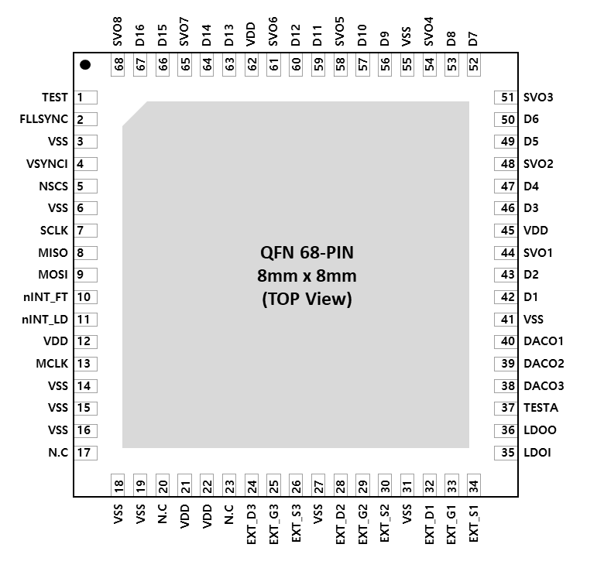
IC603
Pin diagram (Top View)
Pin description
Figure 3. Pin Map
Pin Name | Pin No. | I/O | Type | Description | Remark
TEST | 1 | I | Digital | For only TEST mode | Internal PD, 23KΩ
FLLSYNC | 2 | I | Digital | Frequency Locked Loop Sync | Internal PD, 23KΩ
VSS | 3 | I | GND | Digital GND
VSYNCI | 4 | I | Digital | Frame synchronization | Short high pulse type recommended
NSCS | 5 | I | Digital | SPI Chip Select
VSS | 6 | I | GND | Digital GND
SCLK | 7 | I | Digital | SPI clock
MISO | 8 | O | Digital | SPI MISO

Slide 5
IC603
Pin description
Pin Name | Pin No. | I/O | Type | Description | Remark
MOSI | 9 | I | Digital | SPI MOSI
NINT_FT | 10 | O | Digital | Interrupt for the fault events | Open-drain, 10kΩ PU
NINT_LD | 11 | O | Digital | Interrupt for the dimming data room | Open-drain, 10kΩ PU
VDD | 12 | I | Power | Digital VDD
MCLK | 13 | I | Digital | Master Clock | if not used, connect to GND. Internal PD, 23KΩ
VSS | 14 | I | GND | Digital GND
VSS | 15 | I | GND | Digital GND
VSS | 16 | I | GND | Digital GND
N.C | 17 | - | - | reserved
VSS | 18 | I | GND | Digital GND
VSS | 19 | I | GND | Digital GND
N.C | 20 | - | - | reserved
VDD | 21 | I | Power | Digital VDD
VDD | 22 | I | Power | Digital VDD
N.C | 23 | - | - | reserved
EXT_D3 | 24 | O | Digital | Low-side discharge output | External switch drain
EXT_G3 | 25 | O | Digital | High-side gate drive output | External switch gate
EXT_S3 | 26 | I | Digital | High-side supply | External switch source
VSS | 27 | I | GND | Digital GND
EXT_D2 | 28 | O | Digital | Low-side discharge output | External switch drain
EXT_G2 | 29 | O | Digital | High-side gate drive output | External switch gate
EXT_S2 | 30 | I | Digital | High-side supply | External switch source
VSS | 31 | I | GND | Digital GND
EXT_D1 | 32 | O | Digital | Low-side discharge output | External switch drain
EXT_G1 | 33 | O | Digital | High-side gate drive output | External switch gate
EXT_S1 | 34 | I | Digital | High-side supply | External switch source

Slide 6
IC603
Pin description
Pin Name | Pin No. | I/O | Type | Description | Remark
LDOI | 35 | I | Power | LDO feedback from LDOOUT | attach 1uF
LDOO | 36 | O | Power | Internal LDO out to LDOIN | connect to LDOIN
TESTA | 37 | O | Digital | For only Analog TEST mode | 0Ω PD
DACO3 | 38 | O | Analog | DAC for VLED control
DACO2 | 39 | O | Analog | DAC for VLED control
DACO1 | 40 | O | Analog | DAC for VLED control
VSS | 41 | I | GND | Digital GND
D1 | 42 | I/O | Digital | Data In/Out | if not used, leave to open. Internal PD, 23KΩ.
D2 | 43 | I/O | Digital | Data In/Out | if not used, leave to open. Internal PD, 23KΩ.
SVO1 | 44 | O | Digital | Sub Vsync. Output
VDD | 45 | I | Power | Digital VDD
D3 | 46 | I/O | Digital | Data In/Out | if not used, leave to open. Internal PD, 23KΩ.
D4 | 47 | I/O | Digital | Data In/Out | if not used, leave to open. Internal PD, 23KΩ.
SVO2 | 48 | O | Digital | Sub Vsync. Output
D5 | 49 | I/O | Digital | Data In/Out | if not used, leave to open. Internal PD, 23KΩ.
D6 | 50 | I/O | Digital | Data In/Out | if not used, leave to open. Internal PD, 23KΩ.
SVO3 | 51 | O | Digital | Sub Vsync. Output
D7 | 52 | I/O | Digital | Data In/Out | if not used, leave to open. Internal PD, 23KΩ.
D8 | 53 | I/O | Digital | Data In/Out | if not used, leave to open. Internal PD, 23KΩ.
SVO4 | 54 | O | Digital | Sub Vsync. Output
VSS | 55 | I | GND | Digital GND
D9 | 56 | I/O | Digital | Data In/Out | if not used, leave to open. Internal PD, 23KΩ.
D10 | 57 | I/O | Digital | Data In/Out | if not used, leave to open. Internal PD, 23KΩ.
SVO5 | 58 | O | Digital | Sub Vsync. Output
D11 | 59 | I/O | Digital | Data In/Out | if not used, leave to open. Internal PD, 23KΩ.
D12 | 60 | I/O | Digital | Data In/Out | if not used, leave to open. Internal PD, 23KΩ.

Slide 7
IC603
Pin description
Pin Name | Pin No. | I/O | Type | Description | Remark
SVO6 | 61 | O | Digital | Sub Vsync. Output
VDD | 62 | I | Power | Digital VDD
D13 | 63 | I/O | Digital | Data In/Out | if not used, leave to open. Internal PD, 23KΩ.
D14 | 64 | I/O | Digital | Data In/Out | if not used, leave to open. Internal PD, 23KΩ.
SVO7 | 65 | O | Digital | Sub Vsync. Output
D15 | 66 | I/O | Digital | Data In/Out | if not used, leave to open. Internal PD, 23KΩ.
D16 | 67 | I/O | Digital | Data In/Out | if not used, leave to open. Internal PD, 23KΩ.
SVO8 | 68 | O | Digital | Sub Vsync. Output
Table 1. Pin Description

Slide 8
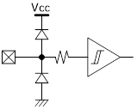

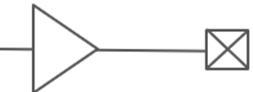
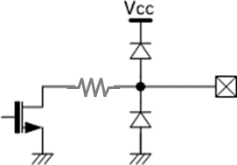
IC603
Equivalent Circuits of individual pins
Pad Name | I/O | Internal Circuit | Description
nSCS | I |  | SPI Chip Select
SCLK | I |  | SPI Clock Input
MOSI | I |  | SPI MOSI
MISO | O |  | SPI MISO
MCLK | I |  | Master Clock
VSYNC | I |  | Frame Sync
nINT_FT | O |  | Interrupt for Fault (Open-drain)
V_{DD}
V_{DD}
V_{DD}
V_{DD}
V_{DD}
V_{DD}
V_{DD}

Slide 9
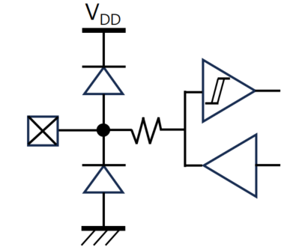
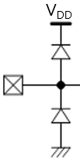
IC603
Equivalent Circuits of individual pins
Pad Name | I/O | Internal Circuit | Description
nINT_LD | O |  | Interrupt for LD (Open-drain)
D | I/O |  | Data In/Out
TEST | I |  | For test only
LDO_{IN} | I |  | Internal LDO In
LDO_{OUT} | O |  | Internal LDO Out
V_{DD}
V_{DD}

Slide 10
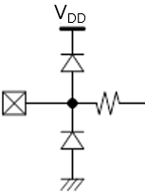
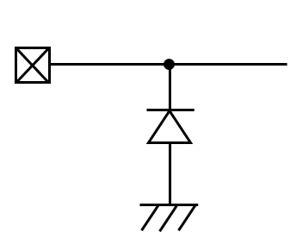
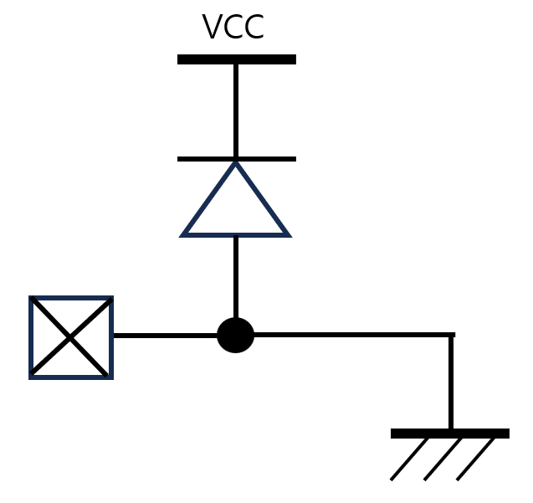
IC603
Equivalent Circuits of individual pins
Pad Name | I/O | Internal Circuit | Description
DACO | O |  | DAC Out
EXT_D | O |  | External Transistor Drain
EXT_G | O |  | External Transistor Gate
EXT_S | I |  | External Transistor Source
V_{DD} | I |  | Digital Power
V_{SS} | I |  | Digital GND
V_{DD}
Figure 4. Equivalent Circuits of individual pins

Slide 11
IC603
Absolute Maximum Ratings (Ta = 25℃ unless otherwise noted)
Parameter | Symbol | Value | Unit
Supply voltage | V_{DD} | -0.3 ~ 6.0 | V
MCLK to GND voltage | V_{MCLK} | -0.3 ~ V_{DD}+0.5 | V
VSYNC to GND voltage | V_{VSYNC} | -0.3 ~ V_{DD}+0.5 | V
nSCS to GND voltage | V_{SCS} | -0.3 ~ V_{DD}+0.5 | V
SCLK to GND voltage | V_{SCLK} | -0.3 ~ V_{DD}+0.5 | V
MOSI to GND voltage | V_{MOSI} | -0.3 ~ V_{DD}+0.5 | V
MISO to GND voltage | V_{MISO} | -0.3 ~ V_{DD}+0.5 | V
D voltage | V_{DIO} | -0.3 ~ V_{DD}+0.5 | V
Storage Temperature | T_{stg} | ~ 165 | ℃
Reflow Temperature |  | ~ 260 | ℃
Table 2. Maximum Absolute ratings
ESD Ratings
Parameter | Symbol | Value | Unit | Remark
Electrostatic Discharge HBM | ESD_{HBM} | ±2000 | V | AEC Q100-002
Electrostatic Discharge CDM | ESD_{CDM} | ±500 | V | AEC Q100-011
Electrostatic Discharge CDM (corner pins) | ESD_{CDM} | ±750 | V | AEC Q100-011
Table 3. ESD ratings
Recommended Operating Condition
Parameter | Symbol | Value | Unit
V_{DD} Supply voltage range | V_{DD} | 4.5 ~ 5.5 | V
 | V_{LED} |  | V
Ambient temperature | T_{A} | -40 ~ 125 | ℃
Junction temperature | T_{J} | -40 ~ 150 | ℃
Table 4. Recommended Operating Condition

Slide 12
IC603
Thermal Information
Parameter | Symbol | Value | Unit
Junction to Ambient | R_{θJA} | 68 ¹⁾ | ℃/W
Junction to Case | R_{θJC} | 10 ¹⁾ | ℃/W
Power Dissipation on package | P_{TOT} | 1.03 ¹⁾ | W
Ambient temperature | T_{A} | -40 ~ 125 | ℃
Junction temperature | T_{J} | -40 ~ 150 | ℃
Storage temperature | T_{STG} | -45 ~ 150 | ℃
Relative Humidity(non-condensing) | RH_{NC} | 5 ~ 85 | %
Moisture Sensitivity Level | MSL | 3 ²⁾ | level
Table 5. Thermal Information
Note :
1) Surface mounted on FR-4 substrate PC Board 1” x 1” inch 2-oz copper plate, T_{A} = 55℃
2) Maximum Floor Life-time of 168 hr

Slide 13
IC603
Electrical Characteristic (V_{DD} =3.3V, Ta=25.0℃ unless otherwise noted)
Characteristics | Symbol | Condition | Value |  |  | Unit
 |  |  | min | typ | max
Supply
Operating voltage | V_{DD} |  | 3.0 | 3.3 | 3.6 | V
Operating Current | I_{DD} |  | - | 6.95 | - | mA
Quiescent current | I_{S} |  | - | 2.80 | - | mA
MCLK (external)
Frequency | F_{MCLK} |  | ¹⁾ | - | 35 | MHz
Duty |  | @ 1.5V level | 45 | 50 | 55 | %
Jitter | △F_{MCLK} |  | -1 |  | 1 | %
MCLK (internal OSC)
Frequency | F_{MCLK} |  | - | 35 | - | MHz
Duty |  |  | - | - | -
Jitter | △F_{MCLK} |  | - | - | - | %
MCLK (Serial data OSC ¹⁾ )
Frequency | F_{MCLK} |  | - | 35 | - | MHz
Duty |  |  | - | - | -
Jitter | △F_{MCLK} |  | - | - | - | %
Input
nSCS Input Voltage | V_{SCSL} | Chip Select, low level | - | - | 0.8 | V
 | V_{SCSH} | Chip Select, high level | 2.0 | - | V_{DD} | V
SCLK Input Voltage | V_{SCLKL} | SPI Clock, low level | - | - | 0.8 | V
 | V_{SCLKH} | SPI Clock, high level | 2.0 | - | V_{DD} | V
MOSI Input Voltage | V_{MOSIL} | MOSI, low level | - | - | 0.8 | V
 | V_{MOSIH} | MOSI, high level | 2.0 | - | V_{DD} | V
VSYNC Input Voltage | V_{VSYNCL} | VSYNC low level | - | - | 0.8 | V
 | V_{VSYNCH} | VSYNC high level | 2.0 | - | V_{DD} | V
FBI Input Voltage | V_{VSYNCL} | FBI low level | - | - | 0.8 | V
 | V_{VSYNCH} | FBI high level | 2.0 | - | V_{DD} | V
Output
MISO Output voltage | V_{MISOL} | MISO, low level | - | - | 0.5 | V
 | V_{MISOH} | MISO, high level | V_{DD}*0.8 | - | V_{DD} | V
Note :
1) Serial data out OSC need to set faster than internal OSC for transferring data stable.

Slide 14
IC603
Electrical Characteristic (V_{DD} =3.3V, Ta=25.0℃ unless otherwise noted)
Characteristics | Symbol | Condition | Value |  |  | Unit
 |  |  | min | typ | max
Bi-direction
D_{IO} | V_{IL} V_{IH} | Input logic low level | - | - | 0.8 | V
 |  | Input logic high level | 3.0 | - | V_{DD}
 | V_{OL} V_{OH} | Output logic low level | - | - | 0.5 | V
 |  | Output logic high level | V_{DD}*0.8 | - | V_{DD}
 | R_{PD} | Internal pull-down resistance | - | 22 | - | KΩ
Bi-direction : Input signal decoding capability
Logical long time ²⁾ | T_{1H}, T_{0L} |  | 6 | - | 63 | MCLK
Logical short time ²⁾ | T_{1L}, T_{0H} |  | 3 | - | 32 | MCLK
DAC
DACO | Operating voltage | V_{DD} | 3.0 | - | 5.5 | V
 | Resolution | Available Min value decimal 100 Available Max value decimal 4,000 |  | - | 12 | Bit
 | Output voltage |  | 0.1 | - | 2.0 | V
 | Code error | △V_{out} | - | ±3 | ±5 | %
V_{DD} Ramp-up and V_{LED} Start
V_{DD} Ramp-up time | T_{VDD} | from 0 to stable V_{DD} |  |  | 2.0 | ms
Internal Initialization after V_{DD}, 5V stable
Internal Initial time | T_{INIT} | after V_{DD} | 100 |  |  | ms
Allowed 1st access | T_{FACC} | after T_{INIT} is completed | 5 |  |  | ms
Logic ‘1’
T_{1L}
Logic ‘0’
T_{1H}
T_{0H}
T_{0L}
Table 6. DC Electrical Characteristic
Note : 1) It is recommended the minimum MCLK should not be more than twice as slow as the SCLK for stable fast-
readout. If MCLK will be more than twice as slow as SCLK, then an appropriate latency is needed between
the first 16 SCLKs for a command and the second 16 SCLKs for readout.
2) The conditions, T_{1H} ≥ T_{0H} * 2, T_{0L} ≥ T_{1L} * 2, (T_{1H} + T_{0H}) = (T_{0L} + T_{1L}) < 80 are normally recommended.
However, the value depends on the baud-rate of the ID601.
Important statement
Global Technologies reserves the right to change the above-mentioned information without prior notice.

Slide 15
IC603
Power Sequence
V_{DD}
V_{DD} stable
T_{VDD}
T_{INIT}
T_{FACC}
Access to IC603
accessible
Set-up to ID601
ID601 setup for dimming
V_{LED}
T_{SU_DIM}
Figure 5. Power up sequence and ramp-up time

Slide 16
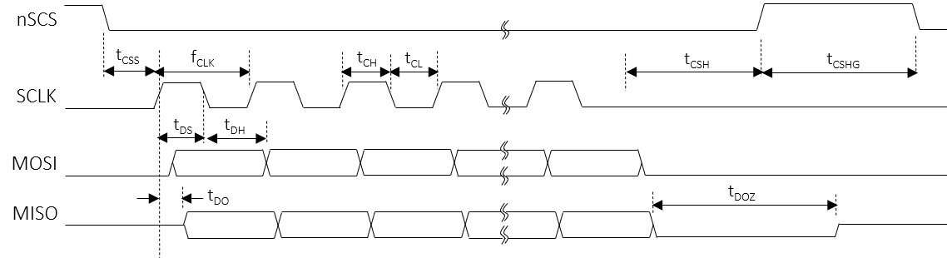
IC603
AC Characteristics (V_{DD} =3.3V, Ta=25.0℃ unless otherwise noted)
Characteristics | Symbol | Condition | Value |  |  | Unit
 |  |  | min | typ | max
Serial Peripheral Interface
SCLK frequency | f_{CLK} |  | - | - | 30 | MHz
SCLK duty | t_{CLK_DUTY} |  | 48 | - | 52 | %
SCLK high time | t_{CH} |  | 8 | - | - | ns
SCLK low time | t_{CL} |  | 8 | - | - | ns
SCLK dependent time
nSCS setup to the first rising SCLK | t_{CSS} |  | 50 | - | - | ns
nSCS hold time from the last falling SCLK | t_{CSH} |  | 3 | - | - | MCLK
nSCS high latency time | t_{CSHG} |  | 3 | - | - | MCLK
MOSI setup time | t_{DS} |  | 5 | - | - | ns
MOSI hold time | t_{DH} |  | 2 | - | - | ns
MISO delay from the rising edge SCLK | t_{DO} |  | - | - | 12 | ns
MISO high-Z from the nSCS de-assertion | t_{DOZ} |  | - | - | 1 | MCLK
Note (3) It should be careful that the t_{CO_DELAY,} t_{SKEW,} t_{OCH} and t_{DO} are accumulated by the number of daisy devices if the
daisy chain connection is used. So, for the read transaction, the proper timing should be considered in daisy
chain.
Table 7. AC Electrical Characteristic
Figure 6. SPI timing sequence

Slide 17
IC603
Functional Description
1. SPI Interface
The local dimming data is transmitted through a Serial Peripheral Interface (SPI). The SPI is configured to operate as an SPI slave and supports clock frequencies of up to 30 MHz.
SPI Chip Select Structure
Multiple SPI slave devices are supported. Each device has an independent Chip Select (CS) signal, allowing the SPI master to communicate with each device individually.
Figure 7. SPI Chip Select
SPI Protocol
The IC603 has 3 types of the SPI Interface protocol, the register-read, the register-write and the LD data-transfer. The SPI protocol’s format consists of a 16-bit command and a 16-bit register data or a series of 24(or 16)-bit LD data following the 16-bit command.
[Command format]
 | Bit15 | Bit14 | Bit14 | Bit13 | Bit12 | Bit11 | Bit10 | Bit9 | Bit8 | Bit7 | Bit6 | Bit5 | Bit4 | Bit3 | Bit2 | Bit1 | Bit0
 | Command code [1:0] |  |  | Address [7:0] |  |  |  |  |  |  |  | Burst size [5:0]
Register-read | 0 |  | 1 | address [7:0] |  |  |  |  |  |  |  | Burst size [5:0]
Register-write | 1 |  | 0 | address [7:0] |  |  |  |  |  |  |  | Burst size [5:0]
 | Bit15 | Bit14 | Bit14 | Bit13 | Bit12 | Bit11 | Bit10 | Bit9 | Bit8 | Bit7 | Bit6 | Bit5 | Bit4 | Bit3 | Bit2 | Bit1 | Bit0
LD-transfer | 1 | 1 | 1 | don’t care |  |  |  | Line size [9:0]
[Data format]
 | Bit15 | Bit14 | Bit13 | Bit12 | Bit11 | Bit10 | Bit9 | Bit8 | Bit7 | Bit6 | Bit5 | Bit4 | Bit3 | Bit2 | Bit1 | Bit0
 | Data [15:0] |  | Address [7:0] |  |  |  |  |  |  |  | Burst size [5:0]
Register-RW | Register data [15:0] |  | Start address [7:0] |  |  |  |  |  |  |  | Burst size [5:0]
LD transfer | 16 bits / block

Slide 18
IC603
Functional Description
SPI LD transfer sequence
The SPI sequence for the LD transfer is as 16bits only. The LD width depends on the LD_WIDTH value of the CHANNEL ENABLE 2 register. If the LD_WIDTH = 2’b01, then the LD data size of one block zone transferred through the SPI becomes 16 bits. Even if the transmitted width is 16 bits, the valid bits are actually 11 bits to 16 bits depending on LD_WIDTH setting.
LD_WIDTH [1:0] | LD width | LD format | Valid bits
2’b01 | 12 bits | PWM 12-bit | PWM 12-bit
2’b10 | 14 bits | PWM 14-bit | PWM 14-bit
2’b11 | 16 bits | LD 16-bit | LD 16-bit
Table 6. LD data size according to LD_WIDTH
The burst size unit means the amount of LD data corresponding to one line and the one line of LD data corresponds to the total LD data of all activated channels, and the number of active channel is determined by the CH_SIZE value of the ENABLE CHANNEL 2 register. Here, the CH_SIZE value should be equal to the number of activated channels by the CHx_EN of the ENABLE CHANNEL 1/2 registers.
Burst size unit = 1-line LD data = CH_SIZE * LD data size
nSCS
Burst size = n
Burst size 2
Burst size 1
Command
LD
ch1
= 1-Line size
LD
chx
LD
ch1
LD
ch2
MOSI
LD
ch2
LD
chx
LD
chx
Command
LD
ch1
LD
ch2
LD width
SDO
CH_SIZE = x
Command
LD
ch1
LD
ch2
Figure 10. The SPI LD transfer in daisied 2 devices

Slide 19
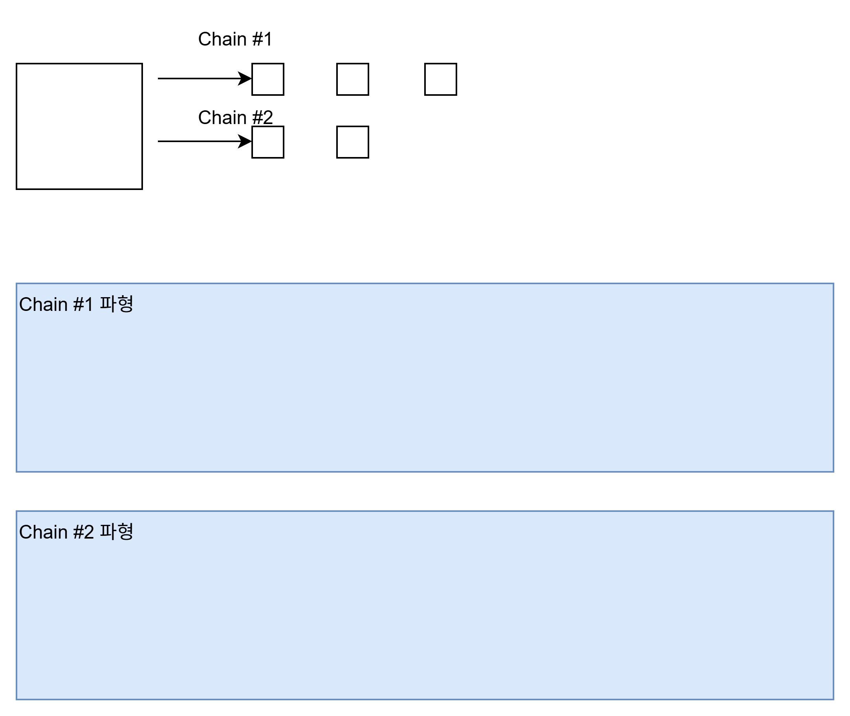
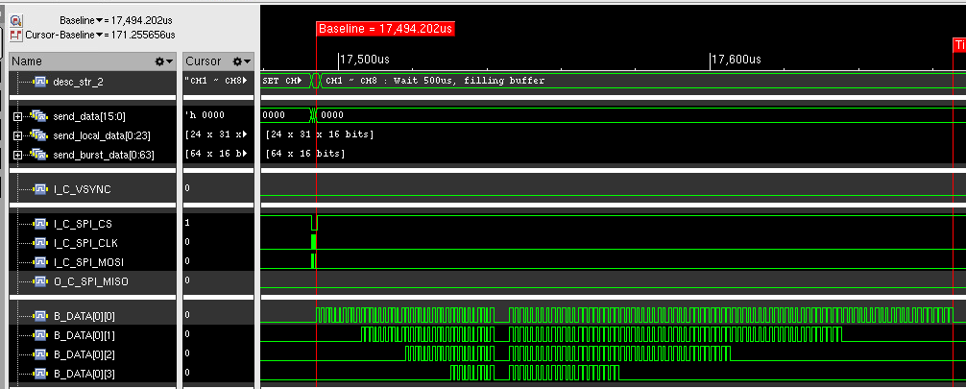
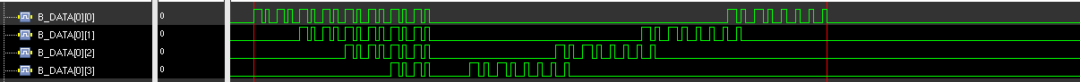
IC603
Functional Description
2. Serial Interface
The IC603 has a total of 16 channels for serial daisy connections with a total of 31 ID601 devices. Each channel can transmit the data to the ID601 and receive the data from the ID601 through one line daisied to the ID601 devices. The IC603 has a total of 6 instructions for transferring the data to the ID601 and 3 instructions for receiving the data from the ID601.
Ch1
D_{IO}
D_{DIO}
D_{DIO}
D_{DIO}
IC603
ID601
#1
D_{IO}
D_{IO}
ID601
#2
ID601
#31
Ch16
Figure 11. The daisied scheme
The commands are listed as shown in the Table 7. and described in more detail below.
Instruction | Transaction direction | Data direction | Description
 | Command | Data
Global-write | IC603 → ID601 | IC603 → ID601 | Global-write command the same register data between the ID601 devices
Local-write | IC603 → ID601 | IC603 → ID601 | Local-write command the different register data between the ID601 devices
LD-transfer | IC603 → ID601 | IC603 → ID601 | Local Dimming data-transfer command to the ID601 devices
ID-gen | IC603 → ID601 | - | ID generation command of the ID601 devices in daisied each channel
Sync-gen | IC603 → ID601 | - | Sync-generation command to the ID601 devices
Sync-auto-gen | IC603 → ID601 | - | Automatically sync-generation command sync on the ID601 devices
Local-read | IC603 → ID601 | ID601 → IC603 | Local-read command to the ID601 devices and read-back from the ID601 devices
Fault-read | IC603 → ID601 | ID601 → IC603 | Fault-read command to the ID601 devices and read-back from the ID601 devices
Fault-auto-read | IC603 → ID601 | ID601 → IC603 | Automatically fault-read command to the ID601 devices and read-back from the ID601 devices
Table 7. Instruction list

Slide 20
IC603
Functional Description
ID-generation
The ID-GEN COMMAND register is used to set a unique ID for each device and each device’s ID helps identifying when each device should react on a read-back operation. Therefore, after POR this command should be transacted at the first time for proper operation of the ID601 devices before transacting other commands. If the START bit of ID-GEN COMMAND register is set, then all activated channels begin issuing the command signals to all ID601s daisied in each channel and the command signal streams repeat continuously for the number of daisied devices.
The number of daisied devices is determined by the DAISY SIZE register of each channel. After the command signal streams are completed, all devices will have their own ID respectively. The ID is numbered in opposite direction of daisied line. It is careful that the writing data is transferred from the first located device, the last number ID, to the last located device, the first number ID, in daisied line but the reading data is received from the last located device to the first located device sequentially.
Ch1
D_{IO}
D_{DIO}
D_{DIO}
D_{DIO}
IC603
ID601
#1
ID=31
D_{IO}
D_{IO}
ID601
#2
ID=30
ID601
#31
ID=1
Ch16
V_{DD}
nSCS
Initialization to the ID601-12
MOSI
ID-GEN COMMAND
transmit
CH1
CH2
CHx
Figure 12. The sequence of ID-GEN command

Slide 21
IC603
Functional Description
Global-write
The Global-write command is used to write the register data to the ID601 only if all ID601 devices daisied to a channel of the IC603 have the same register data. If the register data to be written to the ID601s are different each other, at that time the Local-write command should be used. For executing the Global-write command properly, the GLOBAL-WRITE DATA register should be firstly written with desired value and then the START bit of the GLOBAL-WRITE COMMAND register should be set with desired address in order to begin transacting this command.
Figure 13. The sequence of Global-write command
The GLOBAL-WRITE COMMAND register consists of 6 bits of ADDRESS field and 1 bit of START. The ADDRESS is the register address of the ID601 to be accessed. If the START bit is set with the ADDRESS together, the Global writing command begins issuing simultaneously in all activated channels, and the command streams repeat continuously for the number of daisied ID601s. The number of daisied devices can be determined by the DAISY SIZE register of each channel. The max number of daisied devices per channel is 31.

Slide 22
IC603
Functional Description
Local-write
The Local-write command is used to write the register data to the ID601 in case that all ID601 devices daisied to a channel of the IC603 have the different register data each other. If the register data to be written to the ID601 are same, at that time the Global-write command is more useful for fast transaction time. For proper execution of the Local-write command, the LOCAL-RW DATA registers should be firstly written with desired value and then, the START bit of the LOCAL-WRITE COMMAND register should be set with desired address for beginning this command. It is careful that the LOCAL-RW POINTER RESET register must be set necessarily to 1 for the next transaction after the current Local -write command execution is completed or before the next Local-write command will start again.
nSCS
MOSI
LOCAL-RW DATA
transmit
LOCAL-WRITE COMMAND
transmit
LOCAL-RW POINTER RESET
transmit
CH1
Address
Data
CH2
CHx
Local-write Done
Figure 14. The sequence of Local-write command
The LOCAL-WRITE COMMAND register consists of ADDRESS 6 bits, CH_SEG 2 bits and START 1 bit. The ADDRESS is the register address of the ID601 to be accessed. If the START bit is set with the ADDRESS together, the Local-write command begins the execution simultaneously in all activated channels, and the command streams repeat continuously for the number of daisied ID601. The number of daisied devices can be determined by the DAISY SIZE register of each channel. The max number of daisied devices per channel is 31. The channel segment bits, CH_SEG, are used to decide on which channels are activated for this command, because this command can be performed 8 channels at a time.
The LOCAL-RW DATA registers are divided into a total of 8 port group and each port has a total of 16 registers. The first data register in the port is mapped to the first located ID601 in daisied order and the second data register is mapped to the second located ID601, and so on. Although the data registers in a port are a total 16, the IC603 can support over 16 daisied devices in a channel by using the LOCAL-WR TRANSFER POINTER and LOCAL-RW DIFFERENCE POINTER. The LOCAL-WR TRANSFER DIFF POINTER of the LOCAL-RW DIFFERENCE POINTER shows how many data remain in the LOCAL-RW DATA buffers. A value of 0 means that the LOCAL-RW DATA buffers are empty, so you must continue to fill up before they are empty. A value greater than 16 means that the buffer has been overwritten, so you must wait until the pointer value is less than 16.
CH_SEG[1:0] | Channel to be activated | LOCAL-RW DATA 1 ~ 16
 |  | PORT1 | PORT2 | PORT3 | PORT4 | PORT5 | PORT6 | PORT7 | PORT8
2’b00 | Ch 1 ~ Ch 8 | Ch 1 | Ch 2 | Ch 3 | Ch 4 | Ch 5 | Ch 6 | Ch 7 | Ch 8
2’b01 | Ch 9 ~ Ch 16 | Ch 9 | Ch 10 | Ch 11 | Ch 12 | Ch 13 | Ch 14 | Ch 15 | Ch 16
Table 8. The LOCAL-RW DATA mapping according to the CH_SEG

Slide 23
IC603
Functional Description
Local-RW DATA structure for access
 | ID601 drivers daisied in each channel
 | # 1 |  |  |  |  |  |  |  |  |  | # 1
 | # 2 |  | # 1 |  |  |  | # 1 |  | # 1 |  | # 2
 | # 3 |  | # 2 |  | # 1 |  | # 2 |  | # 2 |  | # 3 |  |  |  | # 1
 | # 4 |  | # 3 |  | # 2 |  | # 3 |  | # 3 |  | # 4 |  | # 1 |  | # 2
 | # 19 |  | # n-1 |  | # k-1 |  | # n-1 |  | # n-1 |  | # m-1 |  | # l-1 |  | # k-1
 | # 20 |  | # n |  | # k |  | # n |  | # n |  | # m |  | # l |  | # k
CH_SEG
2’b00 |  | Channel 1 |  | Channel 2 |  | Channel 3 |  | Channel 4 |  | Channel 5 |  | Channel 6 |  | Channel 7 |  | Channel 8
2’b01 |  | Channel 9 |  | Channel 10 |  | Channel 11 |  | Channel 12 |  | Channel 13 |  | Channel 14 |  | Channel 15 |  | Channel 16
Local-W
Local-R
Address |  | PORT 1 |  | PORT 2 |  | PORT 3 |  | PORT 4 |  | PORT 5 |  | PORT 6 |  | PORT 7 |  | PORT 8
0x70~0x77 |  | LOCAL RW DATA 1 |  | LOCAL RW DATA 1 |  | LOCAL RW DATA 1 |  | LOCAL RW DATA 1 |  | LOCAL RW DATA 1 |  | LOCAL RW DATA 1 |  | LOCAL RW DATA 1 |  | LOCAL RW DATA 1
0x78~0x7F |  | LOCAL RW DATA 2 |  | LOCAL RW DATA 2 |  | LOCAL RW DATA 2 |  | LOCAL RW DATA 2 |  | LOCAL RW DATA 2 |  | LOCAL RW DATA 2 |  | LOCAL RW DATA 2 |  | LOCAL RW DATA 2
0x80~0x87 |  | LOCAL RW DATA 3 |  | LOCAL RW DATA 3 |  | LOCAL RW DATA 3 |  | LOCAL RW DATA 3 |  | LOCAL RW DATA 3 |  | LOCAL RW DATA 3 |  | LOCAL RW DATA 3 |  | LOCAL RW DATA 3
0xE8~0xEF |  | LOCAL RW DATA 16 |  | LOCAL RW DATA 16 |  | LOCAL RW DATA 16 |  | LOCAL RW DATA 16 |  | LOCAL RW DATA 16 |  | LOCAL RW DATA 16 |  | LOCAL RW DATA 16 |  | LOCAL RW DATA 16
0x70~0x77 |  | LOCAL RW DATA 1 |  | LOCAL RW DATA 1 |  | LOCAL RW DATA 1 |  | LOCAL RW DATA 1 |  | LOCAL RW DATA 1 |  | LOCAL RW DATA 1 |  | LOCAL RW DATA 1 |  | LOCAL RW DATA 1
0x78~0x7F |  | LOCAL RW DATA 2 |  | LOCAL RW DATA 2 |  | LOCAL RW DATA 2 |  | LOCAL RW DATA 2 |  | LOCAL RW DATA 2 |  | LOCAL RW DATA 2 |  | LOCAL RW DATA 2 |  | LOCAL RW DATA 2
0x80~0x87 |  | LOCAL RW DATA 3
0x88~0x8F |  | LOCAL RW DATA 4
Physical size
Virtual space¹⁾
 | 1st dev | 2nd dev |  | 16th dev |  | 20th dev
ID601s daisied | ID #20 | ID #19 |  | ID #5 |  | ID #1
PORT1 | LOCAL RW DATA 1 | LOCAL RW DATA 2 |  | LOCAL RW DATA 16 |  | LOCAL RW DATA 4
write
 | 20th dev | 19th dev |  | 5th dev |  | 1st dev
ID601s daisied | ID #1 | ID #2 |  | ID #16 |  | ID #20
PORT1 | LOCAL RW DATA 1 | LOCAL RW DATA 2 |  | LOCAL RW DATA 16 |  | LOCAL RW DATA 4
read-back
Figure 15. LOCAL-RW DATA mapping structure and data flow
Note 1) Virtual space registers can be used over 16 daisy devices, it shares read data time dependently. So it needs to be considered to read 17th daisy
device data after read 1st daisy device complete not to lose data of 1st one.

Slide 24
IC603
Functional Description
Sync-generation
The Sync-generation command is used to synchronize the frame sync time for all daisied devices simultaneously. This command execution can be done by two methods, the one is by setting the START bit of the SYNC-GEN COMMAND register and the other is by setting the SYNC_AUTO_EN bit of the COMMAND AUTO ENABLE register.
If the SYNC_AUTO_EN bit is set, the Sync-generation command is automatically executed at the moment of receiving the VSYNC input. It is recommended to use this function, but it should be careful that The synchronization time of the ID601 devices may be as late as the number of ID601 devices than the time the VSYNC was received, so the VSYNC should arrive as soon as it is late. This command streams repeat continuously for the number of daisied devices in each channel.
VSYNC
nSCS
MOSI
SYNC-GEN COMMAND
transmit
SYNC-GEN
SYNC-AUTO-GEN
CH1
CH2
CHx
Figure 16. The sequence of SYNC-GEN command
Fault-read
The Fault-read command is used to read-out the fault information of all daisied devices simultaneously. This command execution can be done by two methods, the one is by setting the START bit of the FAULT-GEN COMMAND register and the other is by setting the FAULT_AUTO_EN bit of the COMMAND AUTO ENABLE register.
If the FAULT_AUTO_EN bit is set, the Fault-read command is automatically executed after the completion of the Sync auto-gen command at the moment of receiving the VSYNC input. The fault data to be read-back from all ID601 devices in each channel is stored into the corresponding channel’s GLOBAL FAULT-READ DATA register, respectively.
Figure 17. The sequence of FAULT-READ command

Slide 25
IC603
Functional Description
Local-read
The Local-read command is used to read the register data from all ID601 devices daisied in a channel of the IC603. Unlike the Local-write or Global-write command, the Local-read command can be used to read the register data of the ID601 devices regardless of whether the data is the same or different. The data to be read-out from the ID601 devices are stored into the LOCAL-RW DATA registers sequentially like the Figure 15. The START bit of the LOCAL-READ COMMAND register should be set with desired address to be read-out for beginning this command. It is careful that the LOCAL-RW POINTER RESET register must be set necessarily to 1 for the next transaction after the current Local read command execution is completed or before the next Local-read command will start again.
nSCS
SPI Read
MOSI
LOCAL-READ COMMAND
transmit
LOCAL-RW POINTER RESET
transmit
MISO
LOCAL-READ COMMAND
LOCAL-READ-BACK
CH1
Addr
Data
CH2
CHx
Local-Read Done
Figure 18. The sequence of Local-read command
The LOCAL-READ COMMAND register consists of ADDRESS 6 bits, CH_SEG 2 bits and START 1 bit. The ADDRESS is the register address of the ID601 to be accessed. If the START bit is set with the ADDRESS together, the Local-read command begins the execution simultaneously in all activated channels, and the command streams repeat continuously for the number of daisied ID601s. The number of daisied devices can be determined by the DAISY SIZE register of each channel. The max number of daisied devices per channel is 31. The channel segment bits, CH_SEG, are used to decide on which channels are activated for this command, because this command can be performed 8 channels at a time.
The LOCAL-RW DATA registers are divided into a total of 8 port group and each port has a total of 16 registers. Unlike the Local-write command, the first data register in the port is mapped to the last located ID601 in daisied order and the second data register is mapped to the second located ID601 from the back, and so on. Although the data registers in a port are a total 16, the IC603 can support over 16 daisied devices in a channel by using the LOCAL-READ RECEIVE POINTER and LOCAL-RW DIFFERENCE POINTER. The LOCAL-RD RECEIVE DIFF POINTER of the LOCAL-RW DIFFERENCE POINTER shows how many data are filled up in the LOCAL-RW DATA buffers. A value of 0 means that the LOCAL-RW DATA buffers are empty, so you must wait for the buffers to be refilled, and if the value is greater than 16, it means that the LOCAL-RW DATA buffers have been overwritten, so you must drag out the buffers before they are overflowed. Refer to the Table 8. and the Figure 15. for the mapping scheme.

Slide 26
IC603
Functional Description
Sequence of Local Dimming data transfer
The Local Dimming data of the next frame should be transmitted to the IC603 through the SPI and the IC603 should complete to transfer the LD data to the ID601 devices before assertion of the next frame sync. And then, the LD data will be started dimming-out by the ID601 devices at the next frame sync. The LD_WR_POINTER of the LD WR POINTER register will be increased one by one in line unit whenever the LD data are written to the IC603 LD data buffers through the SPI and see the Figure 10. for the amount of one line LD. The LD_RD_POINTER will be increased one by one whenever the IC603 transmits the amount of one LD data to the ID601 devices. The LD_DIFF_POINTER is a value of the LD_WR_POINTER minus the LD_RD_POINTER, so the value is useful to check how many LD data remains in the internal LD buffers.
If the LD_TARNS_START_POINTER value becomes equal to the LD_DIFF_POINTER, then the IC603 starts sending the LD data to the ID601 devices automatically until the LD_DIFF_POINTER value becomes to 0.
VSYNC
#1
#2
SPI I/F
LD Data transfer
(frame #1-1)
LD Data transfer
(frame #1-2)
LD Data transfer
(frame #1-n)
LD Data transfer
(frame #2-1)
LD_WR_POINTER=k
LD_WR_POINTER=m
LD_DIFF_POINTER=m-n
D_{IO} #x
LD TRANSFER
(frame #1)
Local dimming out
(of ID601)
LD_TRANS_START_POINTER=k
LD_RD_POINTER=n
Local dimming out
(frame #1)
Figure 19. The sequence of Local dimming Data transfer

Slide 27
IC603
Functional Description
Local Dimming data buffer
The total number of Local Dimming data buffers is 32 per channel and 1 buffer can contain one block data which consists of PAM and PWM data. The size of PAM and PWM data depends on the LD_WIDTH of CHANNEL ENABLE 2 register and refer to previous chapter for more details. Even if the physical buffer size is limited to 32, the IC603 can support to transfer up to 255 blocks by using the LD WRITE POINTER, LD READ POINTER and LD DIFFERENCE POINTER. You can continue to send the LD data so that the LD DIFFERENCE POINTER does not become 0. The number of daisied devices of each channel can be different from each other by separately setting the DAISY SIZE register of each channel. The below shows the scheme of LD buffers and the mapping to the daisied device. For more information refer to the example on the next page.
ID601 drivers daisied in each channel
# m
# m-1 |  | # n
# m-2 |  | # n-1 |  |  |  | # l
# m-3 |  | # n-2 |  | # k |  | # l-1
# 2 |  | # 2 |  | # 2 |  | # 2
# 1 |  | # 1 |  | # 1 |  | # 1
max DAISIED_DEV_CH_SIZEx = 31
max DAISY_SIZE_CHx = 31
Channel 1 |  | Channel 2 |  | Channel 3 |  | Channel x
Block 1 | LD buffer 1 |  | LD buffer 1 |  | LD buffer 1 |  | LD buffer 1
Block 2 | LD buffer 2 |  | LD buffer 2 |  | LD buffer 2 |  | LD buffer 2
Block 3 | LD buffer 3 |  | LD buffer 3 |  | LD buffer 3 |  | LD buffer 3
Block 32 | LD buffer 32 |  | LD buffer 32 |  | LD buffer 32 |  | LD buffer 32
Physical size=54
Block 33 | LD buffer 33 |  | LD buffer 33 |  | LD buffer 33 |  | LD buffer 33
Block 34 | LD buffer 34 |  | LD buffer 34 |  | LD buffer 34 |  | LD buffer 34
Block 35 | LD buffer 35 |  | LD buffer 35 |  | LD buffer 35 |  | LD buffer 35
Block 127 | LD buffer 127 |  | LD buffer 127 |  | LD buffer 127 |  | LD buffer 127
The amount of SPI one Line LD
Available whole size = 255
max BLOCK_SIZE_CHx = 255
Virtual space=233
LD_SIZE= x
Figure 20. The scheme of Local dimming Data buffers

Slide 28
IC603
Functional Description
Local Dimming data transfer
The below example shows how to set properly the registers relevant to the Local Dimming data transfer. The LD_SIZE of the CHANNEL ENABLE 2 register determines how many channels among a total of 16 channels of IC603 will be activated, and if 20 channels will be used, then the LD_SIZE is 0x14 and available channels become from the channel 1 to channel 20, so it should be careful that the order of channels to be selected must be a direction that sequentially increases from 1 to 16. The DAISY_SIZE_CHx of the DAISY SIZE registers determines how many ID601 devices will be daisied in the channel x, and if 10 ID601 devices are daisied in a channel x, then the DAISY_ SIZE_CHx should be set to 0xA. The DAISIED_DEV_CH_SIZE determines how many channels of the ID601 will be used, so if the value is 0x4, the ID601 devices daisied in a channel x will capture only 4 LD data and then bypass the flowing LD data streams to the next ID601 devices and the remainder of the multiples of 4 be delivered lastly to a las ID601 device. It should be careful that all devices except for the last device must have the same value of DAISIED_ DEV_CH_SIZE. The BLOCK_SIZE_CHx determines the total number of LD data to be transferred to a channel x.
ID601 drivers daisied in each channel
# 10 |  |  |  |  |  | # 10
# 9 |  | # 9 |  |  |  | # 9
# 8 |  | # 8 |  |  |  | # 8
# 7 |  | # 7 |  | # 7 |  | # 7
# 2 |  | # 2 |  | # 2 |  | # 2
# 1 |  | # 1 |  | # 1 |  | # 1
DAISIED_DEV_CH_SIZEx = 4
DAISY_SIZE_CHx=10
Channel 1 |  | Channel 2 |  | Channel 3 |  | Channel x
The amount of
SPI one Line LD
Block 1 | LD 1 |  | LD 1 |  | LD 1 |  | LD 1
Block 2 | LD 2 |  | LD 2 |  | LD 2 |  | LD 2
Block 3 | LD 3 |  | LD 3 |  | LD 3 |  | LD 3
Block 4 | LD 4 |  | LD 4 |  | LD 4 |  | LD 4
Block 5 | LD 5 |  | LD 5 |  | LD 5 |  | LD 5
Block 27 | LD 27 |  | LD 27 |  | LD 27 |  | LD 27
Block 28 | LD 28 |  | LD 28 |  | LD 28 |  | LD 28
Block 29 | LD 29 |  | LD 29 |  | 0 |  | LD 29
Block 30 | LD 30 |  | LD 30 |  | 0 |  | LD 30
Block 31 | LD 31 |  | LD 31 |  | 0 |  | LD 31
Block 32 | LD 32 |  | LD 32 |  | 0 |  | LD 32
Block 33 | LD 33 |  | LD 33 |  | 0 |  | LD 33
Block 34 | LD 34 |  | LD 34 |  | 0 |  | LD 34
Block 35 | LD 35 |  | 0 |  | 0 |  | LD 35
Block 36 | LD 36 |  | 0 |  | 0 |  | LD 36
Block 37 | LD 37 |  | 0 |  | 0 |  | LD 37
Block 38 | LD 38 |  | 0 |  | 0 |  | 0
Block 39 | LD 39 |  | 0 |  | 0 |  | 0
Block 40 | na |  | na |  | na |  | na
①
②
Physical size=32
DAISIED_DEV_CH_SIZEx= 4
DAISIED_DEV_CH_SIZEx= 4
BLOCK_SIZE_CHx=37
Virtual space
SPI LD Burst transmit sequence
39
LD_SIZE= x
Figure 21. The example of Local dimming Data-transfer

Slide 29
IC603
Functional Description
Spread clock scheme of Serializer
The internal all logics are operated with an internal MCLK clock except for the 16 Serializers. All serializers uses a Serializer clock which is configured to spread clock for reduction of EMI. All Serializers have 2 modes to reduce the EMI radiation, one is to use the spread clock, and the other is to use the output skew function between each Serializer’s output. In addition, it is possible to use 2 modes at the same time. The spread amount is showed in the Table 10. below.
The clock to all Serializers can be configured through 2 bits, the OSC_SPREAD_EN and the SERIALIZER_CLK_SEL. All Serializers’ output skew between each Serializer’s output can be configured by the SERIALIZER_SKEW_EN bit. The skew is different from all Serializers.
※ auto-changed to External MCLK
if it is entered
OSC_SPREAD_EN
Default : OSC
SERIALIZER_SKEW_EN
Int.OSC
25MHz
0
Internal MCLK
External MCLK
1
0
Serializer clk
Serializer CH1
Skew
Logic1
D1
1
Serializer CH2
Skew
Logic2
D2
SERIALIZER_CLK_SEL
Serializer CH16
Skew
Logic16
D16
Figure 22. The scheme of the spread clock
Spread range [%] | SPREAD_D [1:0]
SPREAD_A [2:0] | 0 | 1 | 2 | 3
0 | 0.14 | 0.28 | 0.55 | 1.10
1 | 0.15 | 0.31 | 0.61 | 1.22
2 | 0.17 | 0.34 | 0.68 | 1.35
3 | 0.19 | 0.38 | 0.76 | 1.51
4 | 0.22 | 0.43 | 0.86 | 1.72
5 | 0.25 | 0.50 | 1.00 | 1.99
6 | 0.30 | 0.59 | 1.18 | 2.36
7 | 0.36 | 0.73 | 1.45 | 2.90
Spread speed [KHz] | SPREAD_D [1:0]
SPREAD SPEED | 0 | 1 | 2 | 3
0 | 781.3 | 390.6 | 195.3 | 97.7
1 | 781.3 | 781.3 | 390.6 | 195.3
2 | 1562.5 | 1562.5 | 781.3 | 390.6
3 | 3125.0 | 3125.0 | 1562.5 | 781.3
Table 9. The configuration of the spread range and speed

Slide 30
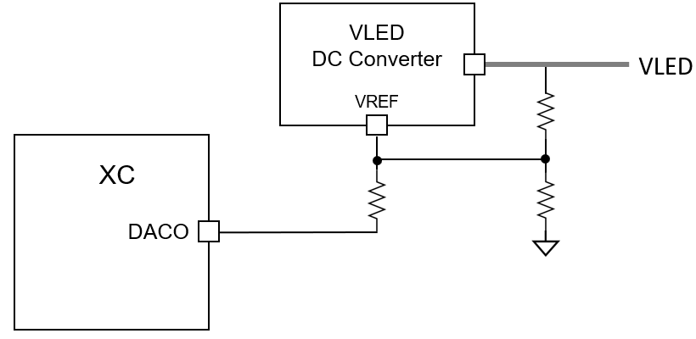
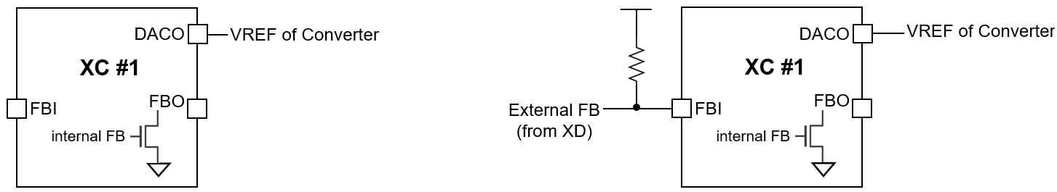
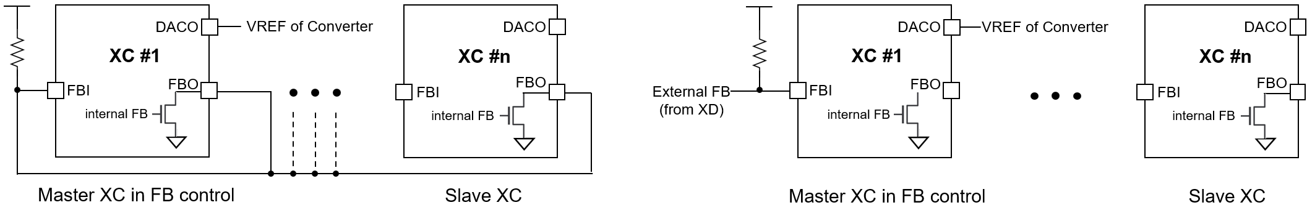
IC603
Functional Description
The FB connection for using several IC603s
The IC603 supports an internal FB status which indicates whether the VLED is enough or not. The internal FB status can be got from the readout information through the FAULT-(AUTO)-READ command. The internal FB status is driven on the FBO pin to inform other IC603s of the own FB status. Instead of the internal FB status from the command, the IC603s can use directly an external FB signals from the ID601 devices to control the VLED like below Figure 24. The internal FB status has a value which is latched for one frame, so if the ID601 will sense the FB assertion condition at least once for one frame, the readout information from the command will contain the momorized status latched for one frame.
If multiple IC603s are used, it needs to decide which IC603 is used as a master to control the VLED. Several examples are shown below, and the proper scheme can be chosen according to applications along with the DAC_FB_MODE bit.
Figure 23. The DACO connection to the VLED DC Converter’s VREF
(a) using an internal FB
(b) using an external FB
Figure 24. The scheme in using single IC603
(a) using internal FBs of multiple IC603s
(b) using an external FB
Figure 25. The scheme in using multiple IC603s

Slide 31
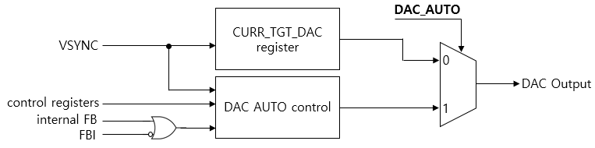
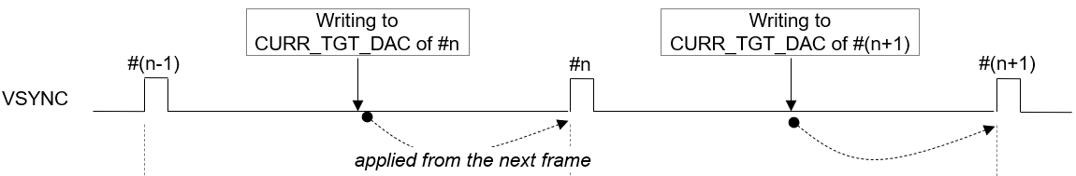
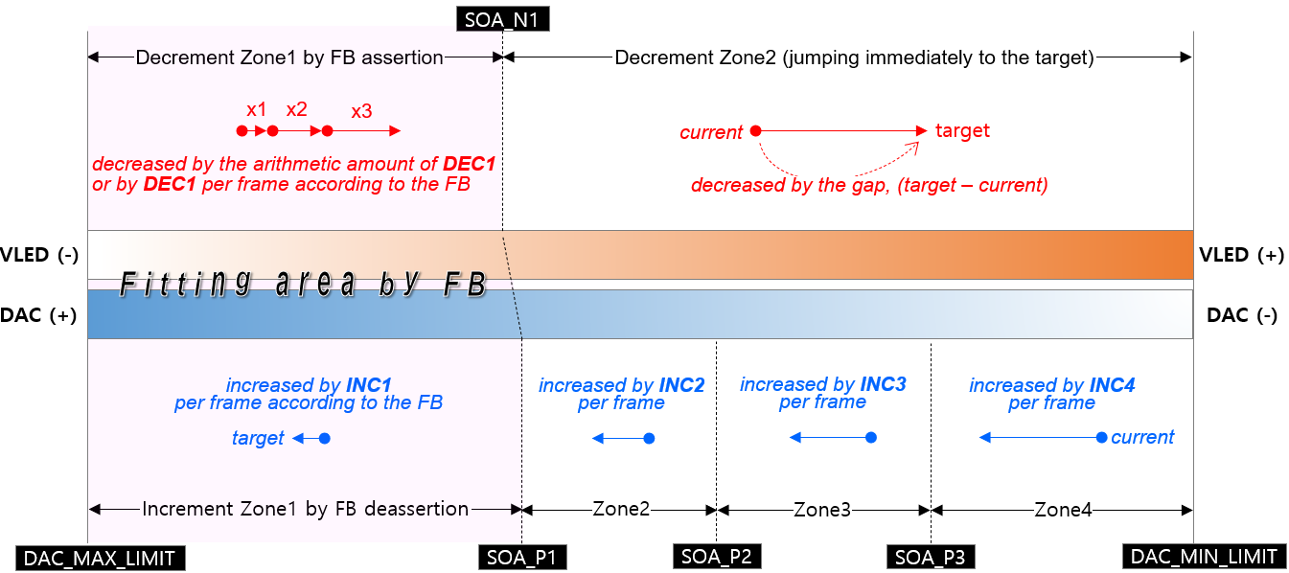
IC603
Functional Description
DAC control for adjusting VLED
The IC603 has one DAC channel to adjust the VLED for efficient power consumption. The DAC out can be directly connected to a reference input of the VLED converter. The DAC has a 12-bit resolution at the max 3.3V level and can be configured to 2 modes according to the DAC_AUTO bit, the MANUAL mode or the AUTO control. In MANUAL mode, the value written to the CURR_TGT_DAC register will be out directly at incoming VSYNC signal. In AUTO mode, the DAC out is automatically controlled according to several registers’ set values. The major difference between the AUTO and MANUAL mode is that the AUTO mode uses the FB status to control efficiently in order to minimize the power consumption. The proper value to be written to the CURR_TGT_DAC can be get from the calculation of the sum of all LEDs’ V_{F} in room temperature plus the minimum required V_{HD} of ID601. In case of low high ambient temperature, the DAC out will be re-act rapidly according the FB status. The operating conditions in the AUTO mode can be set through several registers. Refer to the register’s description part for details along with Figure 27. below.
Figure 26. The scheme of the DAC output
Figure 27. The effective timing of writing the CURR_TGT_DAC
Figure 28. The scheme of the DAC AUTO control mode

Slide 32
IC603
3. Register Map
The SPI interface protocol consists of two segments, the command 16-bit followed by the register’s data 16-bit or a series of local dimming data.
Command packet format
B15 | B14 | B13 | B12 | B11 | B10 | B9 | B8 | B7 | B6 | B5 | B4 | B3 | B2 | B1 | B0
COMMAND CODE |  | START ADDRESS [7:0] |  |  |  |  |  |  |  | BURST SIZE [5:0]
Bits | Fields | Descriptions
15:14 | COMMAND CODE | 2’b00 : No operation. 2’b01 : Register Read. 2’b10 : Register Write. 2’b11 : Local dimming data transfer.
13:6 | START ADDRESS | The start address of registers to access.
5:0 | BURST SIZE | Amount of data to be transmitted or received. In case of accessing the registers, the number means how many registers will be accessed for one time. In case of transmitting the LD data, the number means how many lines’ LD data will be transmitted for one time, where one line means the number of enabled channels. If 20 channels are activated and the BURST SIZE is 10, and then the total amount of LD data to be transmitted becomes 20 * 10 * LD width/block [bit].
Data packet format
B15 | B14 | B13 | B12 | B11 | B10 | B9 | B8 | B7 | B6 | B5 | B4 | B3 | B2 | B1 | B0
DATA [15:0]
Bits | Fields | Descriptions
15:0 | DATA [15:0] | In case of COMMAND CODE : | In case of COMMAND CODE :
 |  | 2’b01 2’b10 2’b11 | A register’s data to read. A register’s data to write. A series of the LD, local dimming data. Be careful that the data size and width to transfer the local dimming data are different from the register access. Refer to previous SPI protocol

Slide 33
IC603
SOFT RESET
Addr | Default | B15 | B14 | B13 | B12 | B11 | B10 | B9 | B8 | B7 | B6 | B5 | B4 | B3 | B2 | B1 | B0
‘h00 | 0x0030 | x | x | x | x | x | x | x | x | x | VSYNC_RST3 | VSYNC_RST2 | VSYNC_RST1 | x | RST3 | RST2 | RST1
Bits | Fields | Descriptions
6 | VSYNC_RST3 | Not used
5 | VSYNC_RST2 | If this bit is set, all de-serializers’ sm are reset at VSYNC rising. Normally, no need to use this bit.
4 | VSYNC_RST1 | If this bit is set, all serializers’ sm are reset at VSYNC rising. Normally, no need to use this bit.
2 | RST3 | Reset to all types of buffer, the frame buffers, the global and local r/w registers and the global fault read registers. Auto-cleared. Normally, no need to use this bit.
1 | RST2 | Reset to all serializers’ and de-serializers’ state machine including the timeout error flag, Auto-cleared. Normally, no need to use this bit.
0 | RST1 | Reset to all logics, Auto-cleared (No need to clear after set) It need to set this bit after POR to ensure IC603 reset again.
GLOBAL-WRITE COMMAND
Addr | Default | B15 | B14 | B13 | B12 | B11 | B10 | B9 | B8 | B7 | B6 | B5 | B4 | B3 | B2 | B1 | B0
‘h01 | 0x0000 | ENABLE | x | x | x | x | x | x | x | x | x | ADDR [5:0]
Bits | Fields | Descriptions
15 | ENABLE | 0 | No operation.
 |  | 1 | Start executing the global-write command with the GLOBAL WRITE DATA register, together, and this bit is auto-cleared after completing this execution. For correct operation, It needs to set the GLOBAL WRITE DATA register with desired value before setting this bit. The global-writing can be used in case that the target registers’ values of all ID601 daisied devices are all the same. If the values are different from each other, then the local-write command should be used instead of the global-write command.
5:0 | ADDR | The same target address of all ID601 daisied devices to write.

Slide 34
IC603
LOCAL-WRITE COMMAND
Addr | Default | B15 | B14 | B13 | B12 | B11 | B10 | B9 | B8 | B7 | B6 | B5 | B4 | B3 | B2 | B1 | B0
‘h02 | 0x000 | ENABLE | x | x | x | x | x | CH_SEG [1:0] |  | x | x | ADDR [5:0]
Bits | Fields | Descriptions
15 | ENABLE | 0 | No operation.
 |  | 1 | Start executing the local-write command with the LOCAL RW DATA registers together, and this bit is auto-cleared after completing this execution. For correct operation, It needs to set the LOCAL RW DATA registers with desired values before setting this bit. The local-write command is used in case that the target registers’ values of all ID601 daisied devices are different from each other.
9:8 | CH_SEG | These bits are used to designate which channels are activated for this command.
 |  |  | 2’b00 The channel 1 from 8 are activated. 2’b01 The channel 9 from 16 are activated. 2’b10 No allocated. 2’b11 No allocated.
 |  | Refer to previous chapter. how to allocate the LOCAL RW DATA registers according to CH_SEG [1:0].
5:0 | ADDR | The same target address of all ID601 daisied devices to write
LOCAL-READ COMMAND
Addr | Default | B15 | B14 | B13 | B12 | B11 | B10 | B9 | B8 | B7 | B6 | B5 | B4 | B3 | B2 | B1 | B0
‘h03 | 0x0000 | ENABLE | x | x | x | x | x | CH_SEG [1:0] |  | x | x | ADDR [5:0]
Bits | Fields | Descriptions
15 | ENABLE | 0 |  | No operation.
 |  | 1 |  | Start executing the local-read command with the LOCAL RW DATA registers together, and this bit is auto-cleared after completing this execution. For correct operation, It needs to set the LOCAL RW DATA registers with desired values before setting this bit. The local-read command is used to read out the target registers’ values of all ID601 daisied devices.
9:8 | CH_SEG | These bits are used to designate which channels are activated for this command
 |  |  | 2’b00 The channel 1 from 8 are activated. 2’b01 The channel 9 from 16 are activated. 2’b10 No allocated. 2’b11 No allocated.
 |  | Refer to previous chapter. how to allocate the LOCAL RW DATA registers according to CH_SEG.
5:0 | ADDR | The same target address of all ID601 daisied devices to read out.

Slide 35
IC603
ID-GEN COMMAND
Addr | Default | B15 | B14 | B13 | B12 | B11 | B10 | B9 | B8 | B7 | B6 | B5 | B4 | B3 | B2 | B1 | B0
‘h04 | 0x0000 | ENABLE | x | x | x | x | x | x | x | x | x | x | x | x | x | x | x
Bits | Fields | Descriptions
15 | ENABLE | 0 1 | No operation. Start executing the id-generating command to all ID601 daisied devices and this bit is auto-cleared after completing this execution. All ID601 daisied devices connected in each channel will have their own ID number after completing the id-generating command. This command is needed to read-out the ID601 drivers’ registers data correctly in sequential, so, this command should be executed before executing the local-reading or the fault-reading command. It is recommended that the id-generating command should be executed firstly on system initialization.
FAULT-READ COMMAND
Addr | Default | B15 | B14 | B13 | B12 | B11 | B10 | B9 | B8 | B7 | B6 | B5 | B4 | B3 | B2 | B1 | B0
‘h05 | 0x0000 | ENABLE | x | x | x | x | x | x | x | x | x | x | x | x | x | FT_MODE[1:0]
Bits | Fields | Descriptions
15 | ENABLE | 0 1 |  |  | No operation. Start executing the fault-reading command to all ID601 daisied devices to monitor the fault event like as the thermal occurrence, the short status, the open status and the fb status of the ID601 devices and this bit is auto-cleared after completing this execution. This command can be also auto-executed at the VSYNC rising edge if the FAULT_ AUTO_EN bit in the COMMAND AUTO ENABLE register is set.
1:0 | FT_MODE |  |  |  | Interrupt source selector for bit2~5 at address ‘h17.
 | int_fb_source |  |  |  | This bit shows the FB status from all ID601s daisied to the active channels after the FAULT-(AUTO)-READ execution. This bit value will be kept the current level until newly updated from a next FAULT-(AUTO)-READ execution even if this register has been read-out.
 | int_open_source |  |  |  | This bit shows the OPEN status from all ID601s daisied to active channels after the FAULT-(AUTO)-READ execution. This bit value will be kept the current level until newly updated from a next FAULT-(AUTO)-READ execution even if this register has been read-out.
 | int_short_source |  |  |  | This bit shows the SHORT status from all ID601s daisied to active channels after the FAULT-(AUTO)-READ execution. This bit value will be kept the current level until newly updated from a next FAULT-(AUTO)-READ execution even if this register has been read-out.
ft_mode | bit5 | bit4 | bit3 | bit2
0 | int_thermal_source | int_short_source | int_open_source | int_fb_source1
1 | int_fault_source | int_fb_source3 | int_fb_source2 | int_fb_source1
2 | int_fault_source | int_open_source | int_fb_source2 | int_fb_source1

Slide 36
IC603
Bits | Fields | Descriptions
 | int_thermal_source |  |  |  | This bit shows the THERMAL status from all ID601s daisied to active channels after the FAULT-(AUTO)-READ execution. This bit value will be kept the current level until newly updated from a next FAULT-(AUTO)-READ execution even if this register has been read-out.
 | int_fault_source |  |  |  | If this bit is set, the nINT_FAULT pin will be asserted to the active-low. This bit represents several interrupt sources, INT_FB_SRC, INT_OPEN_SRC, INT_SHORT _SRC, INT_TML_SRC, INT_LOCAL_REC_FAIL_ SRC, INT_FAULT_AUTO_REC_FAIL _SRC, INT_FAULT_REC_FAIL_SRC, INT_TIMEOUT_ERR_SRC, INT_PARITY _ERR _SRC, INT_ACC_CNT_ERR_SRC and INT_OVUV_ERR_SRC if their own interrupt enable bits are set. If the corresponding interrupt enable bit is set and the interrupt source is asserted, then, this bit will be asserted through nINT_FAULT pin. This bit is auto-cleared after this INTERRUPT STATUS register is read-out.
LD-TRANSFER COMMAND
Addr | Default | B15 | B14 | B13 | B12 | B11 | B10 | B9 | B8 | B7 | B6 | B5 | B4 | B3 | B2 | B1 | B0
‘h06 | 0x0000 | ENABLE | x | x | x | x | x | x | x | x | x | x | x | x | LD_TYPE[2:0]
Bits | Fields | Descriptions
15 | ENABLE | 0 1 | No operation. Start executing the local dimming data transfer command to all ID601 daisied devices in order to transfer the LD data in burst from the IC603 to the ID601 drivers and this bit is auto-cleared after the completion. This command can be also auto-executed immediately after the amount of LD data to be transferred to the IC603 through the SPI interface is reached to the value of the LD_RD_START_POINTER of the LD START POINTER/TH register.
2:0 | LD_TYPE |  | ‘h1 : 1 LD type : This type is for mono ‘h2 : 2 LD type : This type is for 2-color mode ‘h3 : 3 LD type : This type is for RGB 3-color LD_TYPE is multiplied LD data number to transfer LD data to ID601 device. The color switching signal which is SVO, the number of it should be controlled by SV_NO_TYPE on address’h41. The value of SV_NO_TYPE is also number of colors which is connected ID601 channel, but these two values doesn’t have to be the same value. Because it can be set only 2 color switching in the 3 colors LED assembled ID601.

Slide 37
IC603
SYNC-GEN COMMAND
Addr | Default | B15 | B14 | B13 | B12 | B11 | B10 | B9 | B8 | B7 | B6 | B5 | B4 | B3 | B2 | B1 | B0
‘h07 | 0x0000 | ENABLE | x | x | x | x | x | x | x | x | x | x | x | x | x | SYNC_MODE[1:0]
Bits | Fields | Descriptions
15 | ENABLE | 0 1 | No operation. Start executing the sync-gen command to all ID601 daisied devices in order to make the frame synchronization to the drivers and this bit is auto-cleared after this execution. This command can be also auto-executed at the VSYNC rising edge, if the SYNC_ AUTO_EN bit in the COMMAND AUTO ENABLE register is set. It is recommended that the SYNC_AUTO_EN bit is set for good local dimming.
1:0 | SYNC_MODE |  | SVO signal mode selector ‘h1 : svo only ( need to turn on vsync command ) ‘h2 : vo signal add on svo signal ‘h3 : rso signal only

Slide 38
IC603
COMMAND AUTO ENABLE
Addr | Default | B15 | B14 | B13 | B12 | B11 | B10 | B9 | B8 | B7 | B6 | B5 | B4 | B3 | B2 | B1 | B0
‘h08 | 0x0011 | x | x | x | x | x | x | x | x | x | x | x | FAULT AUTO_EN | x | x | x | SYNC_AUTO_EN
Bits | Fields | Descriptions
4 | FAULT_AUTO_EN | 0 1 | No operation. Start executing the fault-reading command automatically. If this bit is set, the fault-reading command is auto-executed in two conditions. The first is occurred at the time of VSYNC rising edge and the second condition is occurred at the time of expiration of the FAULT AUTO READ TIMER register for the number of occurrence of the FAULT AUTO READ EVENT register.
0 | SYNC_AUTO_EN | 0 1 | No operation. Start executing the sync-gen command automatically. If this bit is set, the sync-gen command is auto-executed at the time of VSYNC rising edge.
LD-WRITE POINTER
Addr | Default | B15 | B14 | B13 | B12 | B11 | B10 | B9 | B8 | B7 | B6 | B5 | B4 | B3 | B2 | B1 | B0
‘h09 | 0x0000 | x | x | x | x | x | x | x | LD_WR_POINTER [8:0] | x | x | x | x | x | x | x | x
Bits | Fields | Descriptions
8:0 | LD_WR_POINTER | This register value represents the number of times the local dimming data are written into the internal LD buffers through the SPI interface. The number increases one by one whenever the local dimming data corresponding to (the number of enabled channels * one LD data width) are transferred to the internal LD buffers. This pointer value is reset at the VSYNC rising.

Slide 39
IC603
LD-READ POINTER
Addr | Default | B15 | B14 | B13 | B12 | B11 | B10 | B9 | B8 | B7 | B6 | B5 | B4 | B3 | B2 | B1 | B0
‘h0A | 0x0000 | x | x | x | x | x | x | x | LD_RD_POINTER [8:0] | x | x | x | x | x | x | x | x
Bits | Fields | Descriptions
8:0 | LD_RD_POINTER | This register value represents the number of times the local dimming data are read-out to transfer the data from the internal LD buffers to the ID601 drivers. The number increases one by one whenever the local dimming data corresponding to the one block LD data of the ID601 drivers are read-out. This pointer value is reset at the VSYNC rising.
LD-DIFFERENCE POINTER
Addr | Default | B15 | B14 | B13 | B12 | B11 | B10 | B9 | B8 | B7 | B6 | B5 | B4 | B3 | B2 | B1 | B0
‘h0B | 0x0000 | x | x | x | x | x | x | x | x | x | x | LD_DIFF_POINTER [5:0]
Bits | Fields | Descriptions
5:0 | LD_DIFF_POINTER | This value is useful to monitor how much the LD data remains in the internal LD buffers for checking overrun or underrun. = LD_WR_POINTER – LD_RD_POINTER
LD-TRANSFER START POINTER / THRESHOLD
Addr | Default | B15 | B14 | B13 | B12 | B11 | B10 | B9 | B8 | B7 | B6 | B5 | B4 | B3 | B2 | B1 | B0
‘h0C | 0x0000 | x | x | LD_TRANS_START_POINTER [5:0] | x | x | x | x | x | INT_LD_SIGN | x | LD_DIFF_THRESHOLD [5:0]
Bits | Fields | Descriptions
13:8 | LD_TRANS_START_POINTER | The LD_TRANS_START_POINTER determines when the transmit from the internal LD buffers to the ID601 drivers will begin. If the value is set to 8, then the transmit will begin as soon as the number of times the data through the SPI interface becomes 8. Once the transmit is stated, the transaction will be continued until the number of transmit reaches to the BLOCK_SIZE value of the BLOCK SIZE registers.
7 | INT_LD_SIGN | Don’t set this bit.
5:0 | LD_DIFF_THRESHOLD | The LD_DIFF_THRESHOLD is used to set in which condition the nINT_LD output signal will be issued to the host. Whenever the LD_DIFF_POINTER is equal to or smaller than the LD_DIFF_THRESHOLD, then the nINT_LD signal will be issued. This feature helps to check how much LD data remains in the internal LD buffer for monitoring overruns or underruns of the LD data.

Slide 40
IC603
LOCAL-WR TRANSFER POINTER
Addr | Default | B15 | B14 | B13 | B12 | B11 | B10 | B9 | B8 | B7 | B6 | B5 | B4 | B3 | B2 | B1 | B0
‘h0D | 0x0000 | x | x | LOCAL_WR_OUT_POINTER [5:0] | x | x | x | x | x | x | x | LOCAL_WR_TRANS_POINTER [5:0]
Bits | Fields | Descriptions
13:8 | LOCAL_WR_OUT_POINTER | This register value represents the number of times the data from the LOCAL RW DATA registers are read-out to write the data to the ID601 drivers’ registers. The number increases one by one whenever the data are read-out from the LOCAL RW DATA registers.
5:0 | LOCAL_WR_TRANS_POINTER | This register value represents the number of times the data to be transferred to the ID601 drivers are written to the LOCAL RW DATA registers through the SPI interface. The number increased one by one whenever the data are written to the LOCAL RW DATA registers.
LOCAL-RD RECEIVE POINTER
Addr | Default | B15 | B14 | B13 | B12 | B11 | B10 | B9 | B8 | B7 | B6 | B5 | B4 | B3 | B2 | B1 | B0
‘h0E | 0x0000 | x | x | LOCAL_RD_OUT_POINTER [5:0] | x | x | x | x | x | x | x | LOCAL_RD_REC_POINTER [5:0]
Bits | Fields | Descriptions
13:8 | LOCAL_RD_OUT_POINTER | This register value represents the number of times the data transferred from the ID601 drivers are read out from the LOCAL RW DATA registers for transferring the data through the SPI interface. The number increases one by one whenever the data are read-out from the LOCAL RW DATA registers.
5:0 | LOCAL_RD_REC_POINTER | This register value represents the number of times the data to be transferred through the SPI interface are written from the ID601 drivers to the LOCAL RW DATA registers. The number increased one by one whenever the data are written to the LOCAL RW DATA registers.
LOCAL-RW DIFFERENCE POINTER
Addr | Default | B15 | B14 | B13 | B12 | B11 | B10 | B9 | B8 | B7 | B6 | B5 | B4 | B3 | B2 | B1 | B0
‘h0F | 0x0000 | x | x | LOCAL_RD_DIFF_POINTER [5:0] | x | x | x | x | x | x | x | LOCAL_WR_DIFF_POINTER [5:0]
Bits | Fields | Descriptions
13:8 | LOCAL_RD_DIFF_POINTER | This value is useful to monitor how much the data from the ID601 drivers remains in the LOCAL RW DATA registers for checking overrun or underrun. = LOCAL_RD_REC_POINTER – LOCAL_RD_OUT_POINTER
5:0 | LOCAL_WR_DIFF_POINTER | This value is useful to monitor how much the data to be transferred to the ID601 remains in the LOCAL RW DATA registers for checking overrun or underrun. = LOCAL_WR_TRANS_POINTER – LOCAL_WR_OUT_POINTER

Slide 41
IC603
LOCAL-RW POINTER RESET
Addr | Default | B15 | B14 | B13 | B12 | B11 | B10 | B9 | B8 | B7 | B6 | B5 | B4 | B3 | B2 | B1 | B0
‘h10 | 0x0000 | x | x | x | x | x | x | x | LOCAL_RD_POINTER_RST | x | x | x | x | x | x | x | LOCAL_WR_POINTER_RST
Bits | Fields | Descriptions
8 | LOCAL_RD_POINTER_RST | 0 1 | No operation The LOCAL_RD_OUT_POINTER and the LOCAL_RD_REC_POINTER are reset. This bit is auto-cleared. After completing the Local read command, the relevant pointer value must be cleared by this bit before the next Local read command.
0 | LOCAL_WR_POINTER_RST | 0 1 | No operation The LOCAL_WR_OUT_POINTER and the LOCAL_WR_TRANS_POINTER are reset. This bit is auto-cleared. After completing the Local write command, the relevant pointer value must be cleared by this bit before the next Local write command.
FAULT-AUTO-READ INTERVAL
Addr | Default | B15 | B14 | B13 | B12 | B11 | B10 | B9 | B8 | B7 | B6 | B5 | B4 | B3 | B2 | B1 | B0
‘h11 | 0x0000 | FAULT_AUTO_RD_INTERVAL [15:0] | x | LOCAL_RD_OUT_POINTER [5:0] | x | x | x | x | x | x | x | LOCAL_RD_REC_POINTER [5:0]
Bits | Fields | Descriptions
15:0 | FAULT_AUTO_RD_INTERVAL | This register determines the execution interval for the fault auto-read commands. Counted in MCLK units.
FAULT-AUTO-READ EVENT
Addr | Default | B15 | B14 | B13 | B12 | B11 | B10 | B9 | B8 | B7 | B6 | B5 | B4 | B3 | B2 | B1 | B0
‘h12 | 0x0000 | FAULT_AUTO_RD_EVENT [7:0] | x | x | x | x | x | x | x | x | x | x | x | x | x | x | FAULT_AUTO_RD_INTERVAL[16]
Bits | Fields | Descriptions
15:8 | FAULT_AUTO_RD_EVENT | This register determines the execution times for the fault auto-read commands. The value is reset at VSYNC rising edge.
0 | FAULT_AUTO_RD_INTERVAL | The MSB bit of the FAULT_AUTO_RD_INTERVAL [16:0]

Slide 42
IC603
INTERRUPT ENABLE
Addr | Default | B15 | B14 | B13 | B12 | B11 | B10 | B9
‘h13 | 0xFF8F | INT_BGR_OVUV_EN | INT_LDO_OVUV_EN | INT_OSC_ERR_EN | INT_GATE_SHORT_EN | INT_CTRL_MISMATCH_EN | INT_SPI_CRC_EN | INT_SER_CRC_EN
Addr | Default | B8 | B7 | B6 | B5
‘h13 | 0xFF8F | INT_TIMEOUT_ERR_EN | INT_VS_MISS_EN
Addr | Default | B4 | B3 | B2 | B1 | B0
‘h13 | 0xFF8F | INT_LD_EN | INT_SOURCE4_EN | INT_SOURCE3_EN | INT_SOURCE2_EN | INT_SOURCE1_EN
Bits | Fields | Descriptions
15 | INT_BGR_OVUV_EN | This bit enables to issue the interrupt through the nINT_FAULT pin in case that the BGR OVUV.
14 | INT_LDO_OVUV_EN | This bit enables to issue the interrupt through the nINT_FAULT pin in case that the LDO OVUV.
13 | INT_OSC_ERR_EN | This bit enables to issue the interrupt through the nINT_FAULT pin in case that the SPI CRC Error.
12 | INT_GATE_SHORT_EN | This bit enables to issue the interrupt through the nINT_FAULT pin in case that the GATE short.
11 | INT_CTRL_MISMATCH_EN | This bit enables to issue the interrupt through the nINT_FAULT pin in case that the GATE control mismatch.
10 | INT_SPI_CRC_EN | This bit enables to issue the interrupt through the nINT_FAULT pin in case that the SPI CRC Error.
9 | INT_SER_CRC_EN | This bit enables to issue the interrupt through the nINT_FAULT pin in case that the Serial communication CRC Error.
8 | INT_TIMEOUT_ERR_EN | This bit enables to issue the interrupt through the nINT_FAULT pin in case that the timer will be expired during the execution for read-back commands. The expired time is MCLK * 32,767.
7 | INT_VS_MISS_EN | This bit enables to issue the interrupt through the nINT_FAULT pin in case that the VS miss
4 | INT_LD_EN | This bit enables to issue the interrupt through the nINT_FAULT pin in case that the LD_DIFF_POINTER is equal to or smaller than the LD_DIFF_THRESOLD during the execution of the LD transfer to the XDRs.
3 | INT_SOURCE4_EN | This bit enables to issue the interrupt through the nINT_FAULT pin in case that the interrupt source 4.
2 | INT_SOURCE3_EN | This bit enables to issue the interrupt through the nINT_FAULT pin in case that the interrupt source 3.
1 | INT_SOURCE2_EN | This bit enables to issue the interrupt through the nINT_FAULT pin in case that the interrupt source 2.
0 | INT_SOURCE1_EN | This bit enables to issue the interrupt through the nINT_FAULT pin in case that the interrupt source 1.

Slide 43
IC603
COMMAND STATUS 1
Addr | Default | B15 | B14 | B13 | B12
‘h14 | 0x0000 | LOCAL_RD_DONE | LOCAL_RD_DOING | LOCAL_WR_DONE | LOCAL_WR_DOING
Addr | Default | B11 | B10 | B9 | B8 | B7 | B6
‘h14 | 0x0000 | GLOBAL_WR_DONE | GOLBAL_WR_DOING | LD_TRANS_DONE | LD_TRANS_DOING | FAULT_DONE | FAULT_DOING
Addr | Default | B5 | B4 | B3 | B2 | B1 | B0
‘h14 | 0x0000 | FAULT_AUTO_DONE | FAULT_AUTO_DOING | SYNC_AUTO_DONE | SYNC_AUTO_DOING | SYNC_DONE | SYNC_DOING
Bits | Fields | Descriptions
15 | LOCAL_RD_DONE | This bit is set after the execution for the local-reading command is completed.
14 | LOCAL_RD_DOING | This bit is set while the local-reading command is working until it is complete.
13 | LOCAL_WR_DONE | This bit is set after the execution for the local-writing command is completed.
12 | LOCAL_WR_DOING | This bit is set while the local-writing command is working until it is complete.
11 | GLOBAL_WR_DONE | This bit is set after the execution for the global-writing command is completed.
10 | GLOBAL_WR_DOING | This bit is set while the global-writing command is working until it is complete.
9 | LD_TRANS_DONE | This bit is set after the execution for the LD transferring command is completed.
8 | LD_TRANS_DOING | This bit is set while the LD transferring command is working until it is complete.
7 | FAULT_DONE | This bit is set after the execution for the fault-reading command is completed.
6 | FAULT_DOING | This bit is set while the fault-reading command is working until it is complete.
5 | FAULT_AUTO_DONE | This bit is set after the execution for the fault auto-reading command is completed.
4 | FAULT_AUTO_DOING | This bit is set while the fault auto-reading command is working until it is complete.
3 | SYNC_AUTO_DONE | This bit is set after the execution for the sync auto-gen command is completed.
2 | SYNC_AUTO_DOING | This bit is set while the sync auto-gen command is working until it is complete.
1 | SYNC_DONE | This bit is set after the execution for the sync-gen command is completed.
0 | SYNC_DOING | This bit is set while the sync-gen command is working until it is complete.

Slide 44
IC603
COMMAND STATUS 2
Addr | Default | B15 | B14 | B13 | B12 | B11 | B10 | B9 | B8 | B7 | B6 | B5 | B4 | B3 | B2 | B1 | B0
‘h15 | 0x0000 | x | x | x | x | x | x | x | x | x | x | x | x | x | x | ID_GEN_DONE | ID_GEN_DOING
Bits | Fields | Descriptions
1 | ID_GEN_DONE | This bit is set after the execution for the id-gen command is completed.
0 | ID_GEN_DOING | This bit is set while the id-gen command is working until it is complete.
RECEIVE STATUS
Addr | Default | B15 | B14 | B13 | B12
‘h16 | 0x0000 | x | FAULT_REC_FAIL | FAULT_AUTO_REC_FAIL | LOCAL_REC_FAIL
Addr | Default | B11 | B10 | B9 | B8 | B7 | B6 | B5 | B4
‘h16 | 0x0000 | x | x | x | TIMEOUT_ERR | x | x | FAULT_REC_DONE | FAULT_REC_DOING
Addr | Default | B3 | B2 | B1 | B0
‘h16 | 0x0000 | FAULT_AUTO_REC_DONE | FAULT_AUTO_REC_DOING | LOCAL_REC_DONE | LOCAL_REC_DOING
Bits | Fields | Descriptions
14 | FAULT_REC_FAIL | This bit is set if any violation happens while the fault-receiving job is working.
13 | FAULT_AUTO_REC_FAIL | This bit is set if any violation happens while the fault auto-receiving job is working.
12 | LOCAL_REC_FAIL | This bit is set if any violation happens while the local read-receiving job is working.
5 | FAULT_REC_DONE | This bit is set after the fault-receiving job is completed.
4 | FAULT_REC_DOING | This bit is set while the fault-receiving job is working until it is complete.
3 | FAULT_AUTO_REC_DONE | This bit is set after the fault auto-receiving job is completed.
2 | FAULT_AUTO_REC_DOING | This bit is set while the fault auto-receiving job is working until it is complete.
1 | LOCAL_REC_DONE | This bit is set after the local read-receiving job is completed.
0 | LOCAL_REC_DOING | This bit is set while the local read-receiving job is working until it is complete.

Slide 45
IC603
INTERRUPT SOURCE STATUS
Addr | Default | B15 | B14 | B13 | B12 | B11
‘h17 | 0x0000 | INT_BGR_ERR_SRC | INT_LDO_ERR_SRC | INT_OSC_ERR_SRC | INT_GATE_ERR_SRC | INT_CTRL_MISMATCH_ERR_SRC
Addr | Default | B10 | B9 | B8 | B7
‘h17 | 0x0000 | INT_SPI_CRC_ERR_SRC | INT_SER_CRC_ERR_SRC | INT_TIMEOUT_ERR_SOURCE | INT_VS_MISS_SOURCE
Addr | Default | B6 | B5 | B4 | B3 | B2 | B1 | B0
‘h17 | 0x0000 | INT_LD_SOURCE | INT_SOURCE4 | INT_SOURCE3 | INT_SOURCE2 | INT_SOURCE1 | INT_LD | INT_FAULT
Bits | Fields | Descriptions
15 | INT_BGR_ERR_SRC | This bit shows whether the BGR error condition. This bit is auto-cleared after the readout of INTERRUPT STATUS register.
14 | INT_LDO_ERR_SRC | This bit shows whether the LDO error condition. This bit is auto-cleared after the readout of INTERRUPT STATUS register.
13 | INT_OSC_ERR_SRC | This bit shows whether the OSC error condition. This bit is auto-cleared after the readout of INTERRUPT STATUS register.
12 | INT_GATE_ERR_SRC | This bit shows whether the GATE error condition. This bit is auto-cleared after the readout of INTERRUPT STATUS register.
11 | INT_CTRL_MISMATCH_ERR_SRC | This bit shows whether the GATE control mismatch error condition. This bit is auto-cleared after the readout of INTERRUPT STATUS register.
10 | INT_SPI_CRC_ERR_SRC | This bit shows whether the SPI CRC error condition. This bit is auto-cleared after the readout of INTERRUPT STATUS register.
9 | INT_SER_CRC_ERR_SRC | This bit shows whether the Serial Communication CRC error condition. This bit is auto-cleared after the readout of INTERRUPT STATUS register.
8 | INT_TIMEOUT_ERR_SRORCE | This bit shows whether the timeout has been happened while the read-back commands are working. This bit is auto-cleared after the readout of INTERRUPT STATUS register.

Slide 46
IC603
INTERRUPT SOURCE STATUS
Addr | Default | B15 | B14 | B13 | B12 | B11
‘h17 | 0x0000 | INT_BGR_ERR_SRC | INT_LDO_ERR_SRC | INT_OSC_ERR_SRC | INT_GATE_ERR_SRC | INT_CTRL_MISMATCH_ERR_SRC
Addr | Default | B10 | B9 | B8 | B7
‘h17 | 0x0000 | INT_SPI_CRC_ERR_SRC | INT_SER_CRC_ERR_SRC | INT_TIMEOUT_ERR_SOURCE | INT_VS_MISS_SOURCE
Addr | Default | B6 | B5 | B4 | B3 | B2 | B1 | B0
‘h17 | 0x0000 | INT_LD_SOURCE | INT_SOURCE4 | INT_SOURCE3 | INT_SOURCE2 | INT_SOURCE1 | INT_LD | INT_FAULT
Bits | Fields | Descriptions
7 | INT_VS_MISS_SOURCE | This bit shows whether the VS MISS condition. This bit is auto-cleared after the readout of INTERRUPT STATUS register.
6 | INT_LD_SOURCE | update
5 | INT_SOURCE4 | This bit indicate int_thermal_source from XD device for ft_mode 0 and int_fault_source for ft_mode 1,2.
4 | INT_SOURCE3 | This bit indicate int_shour_source from XDR device for ft_mode 0 and int_fb_source3 for ft_mode 1 and int_open_source for ft_mode2.
3 | INT_SOURCE2 | This bit indicate int_fb_source2 from XDR device for ft_mode 1,2 and int_open_source for ft_mode 0.
2 | INT_SOURCE1 | This bit indicate int_fb_source1 from XDR device for ft_mode 0~2.
1 | INT_LD | If this bit is set, the nINT_LD pin will be asserted to the active-low. This bit represents an interrupt sources, INT_LD_TRAN_SRC if its interrupt enable bits is set. If the INT_LD_EN bit is set and INT_LD_ TRAN_SRC is asserted, then, this bit will be asserted through nINT_LD pin. This bit is auto-cleared after this INTERRUPT STATUS register is read-out.
0 | INT_FAULT | If this bit is set, the nINT_FAULT pin will be asserted to the active-low. This bit represents several interrupt sources, INT_FB_SRC, INT_OPEN_SRC, INT_SHORT _SRC, INT_TML_SRC, INT_LOCAL_REC_FAIL_ SRC, INT_FAULT_AUTO_REC_FAIL _SRC, INT_FAULT_REC_FAIL_SRC, INT_TIMEOUT_ERR_SRC, INT_PARITY _ERR _SRC, INT_ACC_CNT_ERR_SRC and INT_OVUV_ERR_SRC if their own interrupt enable bits are set. If the corresponding interrupt enable bit is set and the interrupt source is asserted, then, this bit will be asserted through nINT_FAULT pin. This bit is auto-cleared after this INTERRUPT STATUS register is read-out.

Slide 47
IC603
ERROR STATUS
Addr | Default | B15 | B14 | B13 | B12 | B11 | B10
‘h18 | 0x0000 | X | X | X | X | X | X
Addr | Default | B9 | B8 | B7 | B6
‘h18 | 0x0000 | GATE3_EXT_OPEN | GATE2_EXT_OPEN | GATE1_EXT_OPEN | GATE3_EXT_SHORT
Addr | Default | B5 | B4 | B3 | B2 | B1 | B0
‘h18 | 0x0000 | GATE2_EXT_SHORT | GATE1_EXT_SHORT | LDO_OV_DET | LDO_UV_DET | BGR_OV_DET | BGR_UV_DET
Bits | Fields | Descriptions
9 | GATE3_EXT_OPEN
8 | GATE2_EXT_OPEN
7 | GATE1_EXT_OPEN
6 | GATE3_EXT_SHORT
5 | GATE2_EXT_SHORT
4 | GATE1_EXT_SHORT
3 | LDO_OV_DET
2 | LDO_UV_DET
1 | BGR_OV_DET
0 | BGR_UV_DET

Slide 48
IC603
SER CRC ERROR STATUS
Addr | Default | B15 | B14 | B13 | B12 | B11
‘h19 | 0x0000 | CH16_CRC_ERR | CH15_CRC_ERR | CH14_CRC_ERR | CH13_CRC_ERR | CH12_CRC_ERR
Addr | Default | B10 | B9 | B8 | B7 | B6
‘h19 | 0x0000 | CH11_CRC_ERR | CH10_CRC_ERR | CH9_CRC_ERR | CH8_CRC_ERR | CH7_CRC_ERR
Addr | Default | B5 | B4 | B3 | B2 | B1 | B0
‘h19 | 0x0000 | CH6_CRC_ERR | CH5_CRC_ERR | CH4_CRC_ERR | CH3_CRC_ERR | CH2_CRC_ERR | CH1_CRC_ERR
Bits | Fields | Descriptions
15 | CH16_CRC_ERR | This bit will be set when serial communication CRC error occurs while ID601 communication on CH16 in case of INT_SER_CRC_ERR_EN is set.
14 | CH15_CRC_ERR | This bit will be set when serial communication CRC error occurs while ID601 communication on CH15 in case of INT_SER_CRC_ERR_EN is set.
13 | CH14_CRC_ERR | This bit will be set when serial communication CRC error occurs while ID601 communication on CH14 in case of INT_SER_CRC_ERR_EN is set.
12 | CH13_CRC_ERR | This bit will be set when serial communication CRC error occurs while ID601 communication on CH13 in case of INT_SER_CRC_ERR_EN is set.
11 | CH12_CRC_ERR | This bit will be set when serial communication CRC error occurs while ID601 communication on CH12 in case of INT_SER_CRC_ERR_EN is set.
10 | CH11_CRC_ERR | This bit will be set when serial communication CRC error occurs while ID601 communication on CH11 in case of INT_SER_CRC_ERR_EN is set.
9 | CH10_CRC_ERR | This bit will be set when serial communication CRC error occurs while ID601 communication on CH10 in case of INT_SER_CRC_ERR_EN is set.
8 | CH9_CRC_ERR | This bit will be set when serial communication CRC error occurs while ID601 communication on CH9 in case of INT_SER_CRC_ERR_EN is set.
7 | CH8_CRC_ERR | This bit will be set when serial communication CRC error occurs while ID601 communication on CH8 in case of INT_SER_CRC_ERR_EN is set.
6 | CH7_CRC_ERR | This bit will be set when serial communication CRC error occurs while ID601 communication on CH7 in case of INT_SER_CRC_ERR_EN is set.
5 | CH6_CRC_ERR | This bit will be set when serial communication CRC error occurs while ID601 communication on CH6 in case of INT_SER_CRC_ERR_EN is set.
4 | CH5_CRC_ERR | This bit will be set when serial communication CRC error occurs while ID601 communication on CH5 in case of INT_SER_CRC_ERR_EN is set.
3 | CH4_CRC_ERR | This bit will be set when serial communication CRC error occurs while ID601 communication on CH4 in case of INT_SER_CRC_ERR_EN is set.
2 | CH3_CRC_ERR | This bit will be set when serial communication CRC error occurs while ID601 communication on CH3 in case of INT_SER_CRC_ERR_EN is set.
1 | CH2_CRC_ERR | This bit will be set when serial communication CRC error occurs while ID601 communication on CH2 in case of INT_SER_CRC_ERR_EN is set.
0 | CH1_CRC_ERR | This bit will be set when serial communication CRC error occurs while ID601 communication on CH1 in case of INT_SER_CRC_ERR_EN is set.

Slide 49
IC603
TIMEOUT ERROR STATUS
Addr | Default | B15 | B14 | B13 | B12 | B11
‘h1A | 0x0000 | CH16_TIMEOUT_ERR | CH15_TIMEOUT_ERR | CH14_TIMEOUT_ERR | CH13_TIMEOUT_ERR | CH12_TIMEOUT_ERR
Addr | Default | B10 | B9 | B8 | B7 | B6
‘h1A | 0x0000 | CH11_TIMEOUT_ERR | CH10_TIMEOUT_ERR | CH9_TIMEOUT_ERR | CH8_TIMEOUT_ERR | CH7_TIMEOUT_ERR
Addr | Default | B5 | B4 | B3 | B2 | B1 | B0
‘h1A | 0x0000 | CH6_TIMEOUT_ERR | CH5_TIMEOUT_ERR | CH4_TIMEOUT_ERR | CH3_TIMEOUT_ERR | CH2_TIMEOUT_ERR | CH1_TIMEOUT_ERR
Bits | Fields | Descriptions
15 | CH16_TIMEOUT_ERR | This bit is set if the timer will be expired while the execution of read-back due to no response from the ID601 devices on CH16.
14 | CH15_TIMEOUT_ERR | This bit is set if the timer will be expired while the execution of read-back due to no response from the ID601 devices on CH16.
13 | CH14_TIMEOUT_ERR | This bit is set if the timer will be expired while the execution of read-back due to no response from the ID601 devices on CH16.
12 | CH13_TIMEOUT_ERR | This bit is set if the timer will be expired while the execution of read-back due to no response from the ID601 devices on CH16.
11 | CH12_TIMEOUT_ERR | This bit is set if the timer will be expired while the execution of read-back due to no response from the ID601 devices on CH16.
10 | CH11_TIMEOUT_ERR | This bit is set if the timer will be expired while the execution of read-back due to no response from the ID601 devices on CH16.
9 | CH10_TIMEOUT_ERR | This bit is set if the timer will be expired while the execution of read-back due to no response from the ID601 devices on CH16.
8 | CH9_TIMEOUT_ERR | This bit is set if the timer will be expired while the execution of read-back due to no response from the ID601 devices on CH16.
7 | CH8_TIMEOUT_ERR | This bit is set if the timer will be expired while the execution of read-back due to no response from the ID601 devices on CH16.
6 | CH7_TIMEOUT_ERR | This bit is set if the timer will be expired while the execution of read-back due to no response from the ID601 devices on CH16.
5 | CH6_TIMEOUT_ERR | This bit is set if the timer will be expired while the execution of read-back due to no response from the ID601 devices on CH16.
4 | CH5_TIMEOUT_ERR | This bit is set if the timer will be expired while the execution of read-back due to no response from the ID601 devices on CH16.
3 | CH4_TIMEOUT_ERR | This bit is set if the timer will be expired while the execution of read-back due to no response from the ID601 devices on CH16.
2 | CH3_TIMEOUT_ERR | This bit is set if the timer will be expired while the execution of read-back due to no response from the ID601 devices on CH16.
1 | CH2_TIMEOUT_ERR | This bit is set if the timer will be expired while the execution of read-back due to no response from the ID601 devices on CH16.
0 | CH1_TIMEOUT_ERR | This bit is set if the timer will be expired while the execution of read-back due to no response from the ID601 devices on CH16.

Slide 50
IC603
BIST CONTROL AND STATUS
Addr | Default | B15 | B14 | B13 | B12 | B11 | B10 | B9 | B8
‘h1B | 0x0000 | BIST_START | x | x | x | x | x | x | x
Addr | Default | B7 | B6 | B5 | B4 | B3 | B2 | B1 | B0
‘h1B | 0x0000 | x | x | x | x | x | BIST_BUSY | BIST_DONE | BIST_ERR
Bits | Fields | Descriptions
15 | BIST_START
2 | BIST_BUSY
1 | BIST_DONE
0 | BIST_ERR
COMM FAULT CONTROL
Addr | Default | B15 | B14 | B13 | B12 | B11 | B10 | B9 | B8
‘h1C | 0x0000 | x | x | x | x | x | x | x | x
Addr | Default | B7 | B6 | B5 | B4 | B3 | B2 | B1 | B0
‘h1C | 0x0000 | x | x | x | x | FLL_MISS_EN | VS_MISS_EN | SER_CRC_EN | SPI_CRC_EN
Bits | Fields | Descriptions
3 | FLL_MISS_EN
2 | VS_MISS_EN
1 | SER_CRC_EN
0 | SPI_CRC_EN

Slide 51
IC603
CLK CONTROL 1
Addr | Default | B15 | B14 | B13 | B12 | B11 | B10 | B9 | B8
‘h1D | 0x0000 | X | SPREAD1_SPD [2:0] |  |  | BUF_READ_SPRD | x | SVO_CLK_SEL | OTP_CLK_SEL
Addr | Default | B7 | B6 | B5 | B4 | B3 | B2 | B1 | B0
‘h1D | 0x0000 | x | SPRD1_GAIN [2:0] |  |  | SERIALIZE_SPRD_EN | OSC1_SPREAD_EN | SERIALIZER_SKEW_EN | x
Bits | Fields | Descriptions
14:12 | SPREAD1_SPD | Refer to the Table 9.
11 | BUF_READ_SPRD | ‘0’ Internal OSC1 ‘1’ Operating CLK
9 | SVO_CLK_SEL | ‘0’ Operating CLK ‘1’ Internal OSC1 Must be set as ‘1’ if not use External MCLK
8 | OPT_CLK_SEL | ‘0’ Internal OSC2 ‘1’ External MCLK Must be set as ‘1’ if not use External MCLK
6:4 | SPRD1_GAIN | Internal OSC clock spread period. Refer to the Table 9. ‘00’ x1, ‘01’ x2, ‘10’ x4, ‘11’ x8
3 | SERIAL_SPRD_EN | ‘0’ Internal OSC1 ‘1’ Operating CLK
2 | OSC1_SPREAD_EN | Spread of internal OSC clock. (The external MCLK can not be spread) Refer to the Figure 22. for the clock scheme. ‘0’ Not Spread ‘1’ Spread
1 | SERIALIZER_SKEW_EN | ‘0’ Skew disabled between Serializers ‘1’ Skew enabled
CLK CONTROL 2
Addr | Default | B15 | B14 | B13 | B12 | B11 | B10 | B9 | B8
‘h1E | 0x0000 | x | SPREAD2_SPD [2:0] |  |  | x | x | x | x
Addr | Default | B7 | B6 | B5 | B4 | B3 | B2 | B1 | B0
‘h1E | 0x0000 | x | SPRD2_GAIN [2:0] |  |  | x | OSC2_SPREAD_EN | x | MCLK_MODE
Bits | Fields | Descriptions
14:12 | SPREAD2_SPD | Refer to the Table 9.
6:4 | SPRD2_GAIN | Internal OSC clock spread period. Refer to the Table 9. ‘00’ x1, ‘01’ x2, ‘10’ x4, ‘11’ x8
2 | OSC2_SPREAD_EN | Spread of internal OSC clock. (The external MCLK can not be spread) Refer to the Figure 22. for the clock scheme. ‘0’ Not Spread ‘1’ Spread
0 | MCLK_MODE | ‘0’ Internal OSC (Default) ‘1’ External MCLK (auto-changed if the ext. MCLK is entered)

Slide 52
IC603
SERIALIZER BAUDRATE GEN
Addr | Default | B15 | B14 | B13 | B12 | B11 | B10 | B9 | B8 | B7 | B6 | B5 | B4 | B3 | B2 | B1 | B0
‘h1F | 0x0C18 | x | SERIAL_CLK_LOW [6:0] |  |  |  |  |  |  | x | SERIAL_CLK_HIGH [6:0] |  |  |  | x | x
Bits | Fields | Descriptions
14:8 | SERIAL_CLK_LOW | These bits determine the number of MCLK of V_{DD} level in logic low value ‘0’ or the number of MCLK of 0 level in logic high value ‘1’ when the IC603 is driving the D_{IO} pin to the ID601s. For more details, refer to Table. 4, Logic low time.
6:0 | SERIAL_CLK_HIGH | These bits determine the number of MCLK of V_{DD} level in logic high value ‘1’ or the number of MCLK of 0 level in logic low value ‘0’ when the IC603 is driving the D_{IO} pin to the ID601s. For more details, refer to Table. 4, Logic low time.
LATENCY
Addr | Default | B15 | B14 | B13 | B12 | B11 | B10 | B9 | B8 | B7 | B6 | B5 | B4 | B3 | B2 | B1 | B0
‘h20 | 0x70C0 | SERIAL_LATENCY [7:0] |  |  |  |  |  |  |  | CMD_LATENCY [7:0]
Bits | Fields | Descriptions
15:8 | SERIAL_LATENCY | This determines the interval time between the successive data packets incoming from the ID601s. That means the interval time between the last bit of n^{th} ID601 device’s data packet and the first bit of (n+1)^{th} ID601 device’s data packet incoming from the daisied ID601s to the IC603. The setting value should be larger than the 1-bit serial data length time at which the daisied ID601 devices are sending to the IC603. So, the proper value depends on the serial baudrate of the ID601s and can be set between (1-bit time + 3 MCLKs) and (1-bit time + 5 MCLKs). If the proper value will be set, then the serial data value will be broken. It is careful that this register value should be changed to the proper value firstly in case that the Serializer Output Baudrate of ID601 is changed to slow down.
7:0 | CMD_LATENCY | This determines the interval time between the end of the current serial data out stream and the start of a new next serial data out stream to the ID601s. It is careful that this value should be at least 1.5 times larger than the SERIAL LATENCY value of ID601.

Slide 53
IC603
TIMEOUT
Addr | Default | B15 | B14 | B13 | B12 | B11 | B10 | B9 | B8 | B7 | B6 | B5 | B4 | B3 | B2 | B1 | B0
‘h21 | 0xFFFF | TIMEOUT [16:1]
Bits | Fields | Descriptions
15:0 | TIMEOUT | This register determines how many clock cycles to wait after starting read operation to ID601 device.
DAISIED DEVICE CHANNEL SIZE 1
Addr | Default | B15 | B14 | B13 | B12 | B11 | B10 | B9 | B8 | B7 | B6 | B5 | B4 | B3 | B2 | B1 | B0
‘h22 | 0x0000 | x |  | x | x | x | x |  | x | x | x | DAISIED_DEV_CH_SIZE1 [5:0] |  | x | x
Bits | Fields | Descriptions
5:0 | DAISY_DEV_ CH_SIZE 1 | This register determines how many channels of the ID601s daisied are activated. Every ID601s daisied must have the same number of active channels but the last device in daisy can have the different number of active channels. The DAISIED_DEV_CH_SIZE1 register value will have the same effect on all other channels.

Slide 54
IC603
DAISY SIZE 1
Addr | Default | B15 | B14 | B13 | B12 | B11 | B10 | B9 | B8 | B7 | B6 | B5 | B4 | B3 | B2 | B1 | B0
‘h23 | 0x0000 | x | DAISY_SIZE_CH3 [4:0] | x | x | x | x | DAISY_SIZE_CH2 [4:0] | x | x | x | x | DAISY_SIZE_CH1 [4:0] | x | x
DAISY SIZE 2
Addr | Default | B15 | B14 | B13 | B12 | B11 | B10 | B9 | B8 | B7 | B6 | B5 | B4 | B3 | B2 | B1 | B0
‘h24 | 0x0000 | x | DAISY_SIZE_CH6 [4:0] | x | x | x | x | DAISY_SIZE_CH5 [4:0] | x | x | x | x | DAISY_SIZE_CH4 [4:0] | x | x
DAISY SIZE 3
Addr | Default | B15 | B14 | B13 | B12 | B11 | B10 | B9 | B8 | B7 | B6 | B5 | B4 | B3 | B2 | B1 | B0
‘h25 | 0x0000 | x | DAISY_SIZE_CH9 [4:0] | x | x | x | x | DAISY_SIZE_CH8 [4:0] | x | x | x | x | DAISY_SIZE_CH7 [4:0] | x | x
DAISY SIZE 4
Addr | Default | B15 | B14 | B13 | B12 | B11 | B10 | B9 | B8 | B7 | B6 | B5 | B4 | B3 | B2 | B1 | B0
‘h26 | 0x0000 | x | DAISY_SIZE_CH12 [4:0] | x | x | x | x | DAISY_SIZE_CH11 [4:0] | x | x | x | x | DAISY_SIZE_CH10 [4:0] | x | x
DAISY SIZE 5
Addr | Default | B15 | B14 | B13 | B12 | B11 | B10 | B9 | B8 | B7 | B6 | B5 | B4 | B3 | B2 | B1 | B0
‘h27 | 0x0000 | x | DAISY_SIZE_CH15 [4:0] | x | x | x | x | DAISY_SIZE_CH14 [4:0] | x | x | x | x | DAISY_SIZE_CH13 [4:0] | x | x
DAISY SIZE 6
Addr | Default | B15 | B14 | B13 | B12 | B11 | B10 | B9 | B8 | B7 | B6 | B5 | B4 | B3 | B2 | B1 | B0
‘h28 | 0x0000 | x | x | x | x | x | x | x | x | x | x | x | DAISY_SIZE_CH16 [4:0] | x | x
Bits | Fields | Descriptions
14:10 9:5 4:0 | DAISY_SIZE_CHx | This register should be set with a valid number for correct operating. The number means how many ID60112 drivers are daisied in the corresponding channel. The maximum 31 ID60112 drivers per channel can be daisied.

Slide 55
IC603
BLOCK SIZE 1
Addr | Default | B15 | B14 | B13 | B12 | B11 | B10 | B9 | B8 | B7 | B6 | B5 | B4 | B3 | B2 | B1 | B0
‘h29 | 0x0000 | BLOCK_SIZE_CH2 [7:0] | x | x | x | x | x | x | x | BLOCK_SIZE_CH1 [7:0] | x | x | x | x | x | x | x
BLOCK SIZE 2
Addr | Default | B15 | B14 | B13 | B12 | B11 | B10 | B9 | B8 | B7 | B6 | B5 | B4 | B3 | B2 | B1 | B0
‘h2A | 0x0000 | BLOCK_SIZE_CH4 [7:0] | x | x | x | x | x | x | x | BLOCK_SIZE_CH3 [7:0] | x | x | x | x | x | x | x
BLOCK SIZE 3
Addr | Default | B15 | B14 | B13 | B12 | B11 | B10 | B9 | B8 | B7 | B6 | B5 | B4 | B3 | B2 | B1 | B0
‘h2B | 0x0000 | BLOCK_SIZE_CH6 [7:0] | x | x | x | x | x | x | x | BLOCK_SIZE_CH5 [7:0] | x | x | x | x | x | x | x
BLOCK SIZE 4
Addr | Default | B15 | B14 | B13 | B12 | B11 | B10 | B9 | B8 | B7 | B6 | B5 | B4 | B3 | B2 | B1 | B0
‘h2C | 0x0000 | BLOCK_SIZE_CH8 [7:0] | x | x | x | x | x | x | x | BLOCK_SIZE_CH7 [7:0] | x | x | x | x | x | x | x
BLOCK SIZE 5
Addr | Default | B15 | B14 | B13 | B12 | B11 | B10 | B9 | B8 | B7 | B6 | B5 | B4 | B3 | B2 | B1 | B0
‘h2D | 0x0000 | BLOCK_SIZE_CH10 [7:0] | x | x | x | x | x | x | x | BLOCK_SIZE_CH9[7:0] | x | x | x | x | x | x | x
BLOCK SIZE 6
Addr | Default | B15 | B14 | B13 | B12 | B11 | B10 | B9 | B8 | B7 | B6 | B5 | B4 | B3 | B2 | B1 | B0
‘h2E | 0x0000 | BLOCK_SIZE_CH12 [7:0] | x | x | x | x | x | x | x | BLOCK_SIZE_CH11 [7:0] | x | x | x | x | x | x | x
BLOCK SIZE 7
Addr | Default | B15 | B14 | B13 | B12 | B11 | B10 | B9 | B8 | B7 | B6 | B5 | B4 | B3 | B2 | B1 | B0
‘h2F | 0x0000 | BLOCK_SIZE_CH14 [7:0] | x | x | x | x | x | x | x | BLOCK_SIZE_CH13 [7:0] | x | x | x | x | x | x | x
BLOCK SIZE 8
Addr | Default | B15 | B14 | B13 | B12 | B11 | B10 | B9 | B8 | B7 | B6 | B5 | B4 | B3 | B2 | B1 | B0
‘h30 | 0x0000 | BLOCK_SIZE_CH16 [7:0] | x | x | x | x | x | x | x | BLOCK_SIZE_CH15 [7:0] | x | x | x | x | x | x | x

Slide 56
IC603
CHANNEL ENABLE 1
Addr | Default | B15 | B14 | B13 | B12 | B11 | B10 | B9 | B8
‘h35 | 0x0000 | CH16_EN | CH15_EN | CH14_EN | CH13_EN | CH12_EN | CH11_EN | CH10_EN | CH9_EN
Addr | Default | B7 | B6 | B5 | B4 | B3 | B2 | B1 | B0
‘h35 | 0x0000 | CH8_EN | CH7_EN | CH6_EN | CH5_EN | CH4_EN | CH3_EN | CH2_EN | CH1_EN
Bits | Fields | Descriptions
15:0 | CHx_EN | These bits should be set if the corresponding channels are to be used, but can not be set if any channel is not used. The number of enabled channels in these registers does not need to match the LD_SIZE value. It is careful that the number of enabled channels should be the same as the LD_SIZE value, but the number can be smaller than the LD_SIZE value like the special mapping below.
CH1_EN | CH2_EN | CH3_EN | CH4_EN | CH5_EN | CH6_EN | CH7_EN | CH8_EN~CH16_EN
1 | 0 | 1 | 1 | 0 | 1 | 1 | all 0
the number of
enabled channels = 5
the amount of LD data to be transmitted through SPI
LD_SIZE = 7
wherein, the LD data of the disabled channels, CH2 and CH5, can be any value
CHANNEL ENABLE 2
Addr | Default | B15 | B14 | B13 | B12 | B11 | B10 | B9 | B8
‘h36 | 0x0000 | LD_WIDTH [1:0] | CH15_EN | x | CH_SIZE [4:0] | CH12_EN | CH11_EN | CH10_EN | CH9_EN
Addr | Default | B7 | B6 | B5 | B4 | B3 | B2 | B1 | B0
‘h36 | 0x0000 | x | x | x | x | x | x | x | x
Bits | Fields | Descriptions
15:14 | LD_WIDTH | These bits represent the number of bits contained in one LD data in one block zone. 2’b00 : 24 bits/block (even if the 24 bits/block are transferred in SPI interface, the valid bits are PAM 8 bits and PWM 14 bits) 2’b01 : 24 bits/block, PAM 10 bits + PWM 11 bits. 2’b10 : 24 bits/block, PAM 10 bits + PWM 12 bits. 2’b11 : 16 bits/block
12:8 | CH_SIZE | This value determines the amount of LD data size of one line to be transmitted through the SPI interface. This value is not needed to match with the number of enabled channels in the CHANNEL ENABLE register, but it keeps in mind that the LD data to be transmitted will be mapped sequentially from channel 1 to channel n regardless of the corresponded CHx_EN bit activation.

Slide 57
IC603
FLLCNT1-1
Addr | Default | B15 | B14 | B13 | B12 | B11 | B10 | B9 | B8 | B7 | B6 | B5 | B4 | B3 | B2 | B1 | B0
‘h37 | 0x0000 | FLL1_CNT [15:0]
Bits | Fields | Descriptions
15:0 | FLL1_CNT [15:0] | This determines the FLL1 target frequency value.
FLLCNT1-2
Addr | Default | B15 | B14 | B13 | B12 | B11 | B10 | B9 | B8
‘h38 | 0x0000 | FLL1_EN | FLL1_SYNC | FLL1_RANGE[1:0] |  | x | x | FLL1_ERR_RANGE[1:0]
Addr | Default | B7 | B6 | B5 | B4 | B3 | B2 | B1 | B0
‘h38 | 0x0000 | x | x | x | x | FLL1_CNT[19:16]
Bits | Fields | Descriptions
15 | FLL1_EN | This bit enables the FLL1 function. The FLL1 continues to calibrate the MCLK frequency to exactly match the PWM frequency with the time of one frame. 1 Enable FLL1 function (= The MCLK is unlocking, so calibrated to the target frequency) 0 Disable FLL function (= The MCLK is locking at the current frequency) It is needed that this bit should be set to 0 just before the first vsync starts to be entered to the IC603 and set to 1 just before the vsync is not asserted if the vsync will be not supplied any more to the IC603 .
14 | FLL1_SYNC | Locking sync pad input selection ‘0’ FLLSYNC ‘1’ VSYNCI
13:12 | FLL1_RANGE | It is recommended to use the default value.
9:8 | FLL1_ERR_RANGE | Error clamping range between measured counting and FLL1_CNT within fll sync duration.
3:0 | FLL1_CNT [19:16] | This determines the FLL1 target frequency value.

Slide 58
IC603
FLLCNT2-1
Addr | Default | B15 | B14 | B13 | B12 | B11 | B10 | B9 | B8 | B7 | B6 | B5 | B4 | B3 | B2 | B1 | B0
‘h39 | 0x0000 | FLL2_CNT [15:0]
Bits | Fields | Descriptions
15:0 | FLL2_CNT [15:0] | This determines the FLL2 target frequency value.
FLLCNT2-2
Addr | Default | B15 | B14 | B13 | B12 | B11 | B10 | B9 | B8
‘h3A | 0x0000 | FLL2_EN | FLL2_SYNC | FLL2_RANGE[1:0] |  | x | x | FLL2_ERR_RANGE[1:0]
Addr | Default | B7 | B6 | B5 | B4 | B3 | B2 | B1 | B0
‘h3A | 0x0000 | x | x | x | x | FLL2_CNT[19:16]
Bits | Fields | Descriptions
15 | FLL2_EN | This bit enables the FLL2 function. The FLL2 continues to calibrate the MCLK frequency to exactly match the PWM frequency with the time of one frame. 1 Enable FLL2 function (= The MCLK is unlocking, so calibrated to the target frequency) 0 Disable FLL function (= The MCLK is locking at the current frequency) It is needed that this bit should be set to 0 just before the first vsync starts to be entered to the IC603 and set to 1 just before the vsync is not asserted if the vsync will be not supplied any more to the IC603 .
14 | FLL2_SYNC | Locking sync pad input selection ‘0’ FLLSYNC ‘1’ VSYNCI
13:12 | FLL2_RANGE | It is recommended to use the default value.
9:8 | FLL2_ERR_RANGE | Error clamping range between measured counting and FLL1_CNT within fll sync duration.
3:0 | FLL2_CNT [19:16] | This determines the FLL2 target frequency value.

Slide 59
IC603
GATE CONTROL and VO DELAY
Addr | Default | B15 | B14 | B13 | B12 | B11 | B10 | B9 | B8
‘h3B | 0x0700 | x | GATE3_H_EN | GATE2_H_EN | GATE1_H_EN | x | GATE3_L_EN | GATE2_L_EN | GATE1_L_EN
Addr | Default | B7 | B6 | B5 | B4 | B3 | B2 | B1 | B0
‘h3B | 0x0700 | VO_DELAY[7:0]
Bits | Fields | Descriptions
14 | GATE3H_EN | ‘1’ activate GATE3H signal ‘0’ stuck to gnd
13 | GATE2H_EN | ‘1’ activate GATE3H signal ‘0’ stuck to gnd
12 | GATE2H_EN | ‘1’ activate GATE3H signal ‘0’ stuck to gnd
10 | GATE3L_EN | ‘1’ activate GATE3L signal ‘0’ stuck to gnd
9 | GATE2L_EN | ‘1’ activate GATE3L signal ‘0’ stuck to gnd
8 | GATE2L_EN | ‘1’ activate GATE3L signal ‘0’ stuck to gnd
7:0 | VO_DELAY | SVO output delay time from sync command
VO OFF/ON
Addr | Default | B15 | B14 | B13 | B12 | B11 | B10 | B9 | B8 | B7 | B6 | B5 | B4 | B3 | B2 | B1 | B0
‘h3C | 0x0000 | VO_OFF [7:0] |  |  |  |  |  |  |  | VO_ON [7:0]
Bits | Fields | Descriptions
15:8 | VO_OFF | Vsync pulse off time in front of sub vsync output from SVO
7:0 | VO_ON | Vsync pulse on time in front of sub vsync output from SVO

Slide 60
IC603
SVO ON
Addr | Default | B15 | B14 | B13 | B12 | B11 | B10 | B9 | B8 | B7 | B6 | B5 | B4 | B3 | B2 | B1 | B0
‘h3D | 0x0000 |  |  |  |  | SVO_ON [11:0]
Bits | Fields | Descriptions
11:0 | SVO_ON | Sub vsync on duration
SVO1 OFF
Addr | Default | B15 | B14 | B13 | B12 | B11 | B10 | B9 | B8 | B7 | B6 | B5 | B4 | B3 | B2 | B1 | B0
‘h3E | 0x0000 | SVO1_OFF [15:0]
Bits | Fields | Descriptions
15:0 | SVO1_OFF | Sub vsync off duration related GATE1 signal
SVO2 OFF
Addr | Default | B15 | B14 | B13 | B12 | B11 | B10 | B9 | B8 | B7 | B6 | B5 | B4 | B3 | B2 | B1 | B0
‘h3F | 0x0000 | SVO2_OFF [15:0]
Bits | Fields | Descriptions
15:0 | SVO2_OFF | Sub vsync off duration related GATE2 signal
SVO3 OFF
Addr | Default | B15 | B14 | B13 | B12 | B11 | B10 | B9 | B8 | B7 | B6 | B5 | B4 | B3 | B2 | B1 | B0
‘h40 | 0x0000 | SVO3_OFF [15:0]
Bits | Fields | Descriptions
15:0 | SVO3_OFF | Sub vsync off duration related GATE3 signal

Slide 61
IC603
SVO NUMBER
Addr | Default | B15 | B14 | B13 | B12 | B11 | B10 | B9 | B8 | B7 | B6 | B5 | B4 | B3 | B2 | B1 | B0
‘h41 | 0x0000 | x | x | x | x | x | SV_NO_TYPE [1:0] |  | x | x | x | SV_NO [5:0]
Bits | Fields | Descriptions
10:9 | SV_NO_TYPE | ‘d2 : svo_off 2/3 active ‘d3 : svo_off 1/2/3 active
5:0 | SV_NO | Sub vsync repeat number
DAC NF CONTROL
Addr | Default | B15 | B14 | B13 | B12 | B11 | B10 | B9 | B8 | B7 | B6 | B5 | B4 | B3 | B2 | B1 | B0
‘h42 | 0x3070 | x | x | DAC_LVL[1:0] |  | x | x | x | x | x | SHORT_SEL[2:0] |  |  | x | x | X | DGRJT_EN
Bits | Fields | Descriptions
13:12 | DAC_LVL | DAC level for FB control output
6:4 | SHORT_SEL
0 | DGRJT_EN | ‘0’ data glitch rejection disable ‘1’ data glitch rejection enable

Slide 62
IC603
DAC CONTROL
Addr | Default | B15 | B14 | B13 | B12 | B11 | B10
‘h43 | 0x0707 | DAC_THERMAL_OFF | DAC3_HOLD_EN | DAC2_HOLD_EN | DAC1_HOLD_EN | x | DAC3_DEC1_MODE
Addr | Default | B9 | B8 | B7 | B6 | B5 | B4
‘h43 | 0x0707 | DAC2_DEC1_MODE | DAC1_DEC1_MODE | DAC3_FB_MODE | DAC2_FB_MODE | DAC1_FB_MODE | DAC_SYNC_MODE
Addr | Default | B3 | B2 | B1 | B0
‘h43 | 0x0707 | DAC_AUTO_TYPE | DAC3_AUTO | DAC2_AUTO | DAC1_AUTO
Bits | Fields | Descriptions
15 | DAC_THERMAL_OFF | This bit enables the DAC OUT to the initial value if the thermal event from ID601s is occurred.
14 | DAC3_HOLD_EN | This bit enables to fix the DAC OUT to the current value. This can be activated in case that (CURR_TGT_DAC - current DAC OUT) value successively stays below DAC_INC_HOLD_THRESHOLD for DAC_INC_HOLD_LIMIT number which is counted per frame. This function makes the DAC OUT stay at current DAC value even though the dimming data is all zero.
13 | DAC2_HOLD_EN | This bit enables to fix the DAC OUT to the current value. This can be activated in case that (CURR_TGT_DAC - current DAC OUT) value successively stays below DAC_INC_HOLD_THRESHOLD for DAC_INC_HOLD_LIMIT number which is counted per frame. This function makes the DAC OUT stay at current DAC value even though the dimming data is all zero.
12 | DAC1_HOLD_EN | This bit enables to fix the DAC OUT to the current value. This can be activated in case that (CURR_TGT_DAC - current DAC OUT) value successively stays below DAC_INC_HOLD_THRESHOLD for DAC_INC_HOLD_LIMIT number which is counted per frame. This function makes the DAC OUT stay at current DAC value even though the dimming data is all zero.
10 | DAC3_DEC1_MODE | 0 1 | The DAC OUT is decreased by the DAC_DEC1 whenever the FB is asserted. The DAC OUT is decreased by the arithmetic exponential value of DAC_DEC1 whenever the FB from the ID601s is asserted.
9 | DAC2_DEC1_MODE | 0 1 | The DAC OUT is decreased by the DAC_DEC1 whenever the FB is asserted. The DAC OUT is decreased by the arithmetic exponential value of DAC_DEC1 whenever the FB from the ID601s is asserted.
8 | DAC1_DEC1_MODE | 0 1 | The DAC OUT is decreased by the DAC_DEC1 whenever the FB is asserted. The DAC OUT is decreased by the arithmetic exponential value of DAC_DEC1 whenever the FB from the ID601s is asserted.
7 | DAC3_FB_MODE | 0 1 | The DAC OUT change results from the internal FB status. The DAC OUT change results from the external FBI pin status.
6 | DAC2_FB_MODE | 0 1 | The DAC OUT change results from the internal FB status. The DAC OUT change results from the external FBI pin status.
5 | DAC1_FB_MODE | 0 1 | The DAC OUT change results from the internal FB status. The DAC OUT change results from the external FBI pin status.
4 | DAC_SYNC_MODE | 0 1 | The DAC OUT is synchronized when the SYNC commands are completed to send out to the ID601s. The DAC OUT is synchronized at the VSYNCI input of the IC603.

Slide 63
IC603
DAC CONTROL
Addr | Default | B15 | B14 | B13 | B12 | B11 | B10
‘h43 | 0x0707 | DAC_THERMAL_OFF | DAC3_HOLD_EN | DAC2_HOLD_EN | DAC1_HOLD_EN | x | DAC3_DEC1_MODE
Addr | Default | B9 | B8 | B7 | B6 | B5 | B4
‘h43 | 0x0707 | DAC2_DEC1_MODE | DAC1_DEC1_MODE | DAC3_FB_MODE | DAC2_FB_MODE | DAC1_FB_MODE | DAC_SYNC_MODE
Addr | Default | B3 | B2 | B1 | B0
‘h43 | 0x0707 | DAC_AUTO_TYPE | DAC3_AUTO | DAC2_AUTO | DAC1_AUTO
Bits | Fields | Descriptions
3 | DAC_AUTO_TYPE | The DAC output fit with multiple step and apply increment step as DAC_INC3. The DAC output fit with simple step and apply increment step as DAC_INC4.
2 | DAC3_AUTO | 0 1 | The DAC OUT outputs the same value as the CURR_TGT_DAC at frame sync. The DAC OUT outputs the automatically optimized value according to the FB status. The DAC OUT will be calculated every frame along with the relevant registers’ set value.
1 | DAC2_AUTO | 0 1 | The DAC OUT outputs the same value as the CURR_TGT_DAC at frame sync. The DAC OUT outputs the automatically optimized value according to the FB status. The DAC OUT will be calculated every frame along with the relevant registers’ set value.
0 | DAC1_AUTO | 0 1 | The DAC OUT outputs the same value as the CURR_TGT_DAC at frame sync. The DAC OUT outputs the automatically optimized value according to the FB status. The DAC OUT will be calculated every frame along with the relevant registers’ set value.

Slide 64
IC603
CURRENT TARGET DAC1
Addr | Default | B15 | B14 | B13 | B12 | B11 | B10 | B9 | B8 | B7 | B6 | B5 | B4 | B3 | B2 | B1 | B0
‘h44 | 0x0FA0 | x | x | x | x | CURR_TGT_DAC1 [11:0]
Bits | Fields | Descriptions
11:0 | CURR_TGT_DAC1 | This register determines the target DAC value of the corresponding frame. This value is effective from a next frame sync, so this value should be set before a next frame sync. The written value can be visible after a next frame sync is occurred. The target value can be calculated from (LED V_{F} + min V_{HD} of the ID601). The initial value at the soft reset, RST1 bit=1, is the same as the DAC_MAX_LIMIT.
CURRENT TARGET DAC2
Addr | Default | B15 | B14 | B13 | B12 | B11 | B10 | B9 | B8 | B7 | B6 | B5 | B4 | B3 | B2 | B1 | B0
‘h45 | 0x0FA0 | x | x | x | x | CURR_TGT_DAC2 [11:0]
Bits | Fields | Descriptions
11:0 | CURR_TGT_DAC2 | This register determines the target DAC value of the corresponding frame. This value is effective from a next frame sync, so this value should be set before a next frame sync. The written value can be visible after a next frame sync is occurred. The target value can be calculated from (LED V_{F} + min V_{HD} of the ID601). The initial value at the soft reset, RST1 bit=1, is the same as the DAC_MAX_LIMIT.
CURRENT TARGET DAC3
Addr | Default | B15 | B14 | B13 | B12 | B11 | B10 | B9 | B8 | B7 | B6 | B5 | B4 | B3 | B2 | B1 | B0
‘h46 | 0x0FA0 | x | x | x | x | CURR_TGT_DAC3 [11:0]
Bits | Fields | Descriptions
11:0 | CURR_TGT_DAC3 | This register determines the target DAC value of the corresponding frame. This value is effective from a next frame sync, so this value should be set before a next frame sync. The written value can be visible after a next frame sync is occurred. The target value can be calculated from (LED V_{F} + min V_{HD} of the ID601). The initial value at the soft reset, RST1 bit=1, is the same as the DAC_MAX_LIMIT.

Slide 65
IC603
PREVIOUS TARGET DAC1
Addr | Default | B15 | B14 | B13 | B12 | B11 | B10 | B9 | B8 | B7 | B6 | B5 | B4 | B3 | B2 | B1 | B0
‘h47 | 0x0FA0 | x | x | x | x | PREV_TGT_DAC1 [11:0]
Bits | Fields | Descriptions
11:0 | PREV_TGT_DAC1 | This register shows the target DAC value of the previous frame. This value is also valid just after a next frame sync is asserted. The initial value at the soft reset, RST1 bit=1, is the DAC_MAX_LIMIT.
PREVIOUS TARGET DAC2
Addr | Default | B15 | B14 | B13 | B12 | B11 | B10 | B9 | B8 | B7 | B6 | B5 | B4 | B3 | B2 | B1 | B0
‘h48 | 0x0FA0 | x | x | x | x | PREV_TGT_DAC2 [11:0]
Bits | Fields | Descriptions
11:0 | PREV_TGT_DAC2 | This register shows the target DAC value of the previous frame. This value is also valid just after a next frame sync is asserted. The initial value at the soft reset, RST1 bit=1, is the DAC_MAX_LIMIT.
PREVIOUS TARGET DAC3
Addr | Default | B15 | B14 | B13 | B12 | B11 | B10 | B9 | B8 | B7 | B6 | B5 | B4 | B3 | B2 | B1 | B0
‘h49 | 0x0FA0 | x | x | x | x | PREV_TGT_DAC3 [11:0]
Bits | Fields | Descriptions
11:0 | PREV_TGT_DAC3 | This register shows the target DAC value of the previous frame. This value is also valid just after a next frame sync is asserted. The initial value at the soft reset, RST1 bit=1, is the DAC_MAX_LIMIT.

Slide 66
IC603
DAC1 OUT
Addr | Default | B15 | B14 | B13 | B12 | B11 | B10 | B9 | B8 | B7 | B6 | B5 | B4 | B3 | B2 | B1 | B0
‘h4A | 0x0FA0 | x | x | x | x | DAC1_OUT [11:0]
Bits | Fields | Descriptions
11:0 | DAC1_OUT | This value shows the current DAC out value. The initial value after POR is the DAC_MAX_LIMIT.
DAC2 OUT
Addr | Default | B15 | B14 | B13 | B12 | B11 | B10 | B9 | B8 | B7 | B6 | B5 | B4 | B3 | B2 | B1 | B0
‘h4B | 0x0FA0 | x | x | x | x | DAC2_OUT [11:0]
Bits | Fields | Descriptions
11:0 | DAC2_OUT | This value shows the current DAC out value. The initial value after POR is the DAC_MAX_LIMIT.
DAC3 OUT
Addr | Default | B15 | B14 | B13 | B12 | B11 | B10 | B9 | B8 | B7 | B6 | B5 | B4 | B3 | B2 | B1 | B0
‘h4C | 0x0FA0 | x | x | x | x | DAC3_OUT [11:0]
Bits | Fields | Descriptions
11:0 | DAC3_OUT | This value shows the current DAC out value. The initial value after POR is the DAC_MAX_LIMIT.

Slide 67
IC603
DAC1 STATE
Addr | Default | B15 | B14 | B13 | B12 | B11 | B10 | B9 | B8 | B7 | B6 | B5 | B4 | B3 | B2 | B1 | B0
‘h4D | 0x0000 | x | x | x | x | x | x | x | x | DAC1_STATE [3:0] |  |  |  | DAC1_ST_EN [3:0]
Bits | Fields | Descriptions
7:4 | DAC1_STATE | This is for test only.
3:0 | DAC1_ST_EN | This is for test only.
DAC2 STATE
Addr | Default | B15 | B14 | B13 | B12 | B11 | B10 | B9 | B8 | B7 | B6 | B5 | B4 | B3 | B2 | B1 | B0
‘h4E | 0x0000 | x | x | x | x |  |  |  |  | DAC2_STATE [3:0] |  |  |  | DAC2_ST_EN [3:0]
Bits | Fields | Descriptions
7:4 | DAC2_STATE | This is for test only.
3:0 | DAC2_ST_EN | This is for test only.
DAC3 STATE
Addr | Default | B15 | B14 | B13 | B12 | B11 | B10 | B9 | B8 | B7 | B6 | B5 | B4 | B3 | B2 | B1 | B0
‘h4F | 0x0000 | x | x | x | x |  |  |  |  | DAC3_STATE [3:0] |  |  |  | DAC3_ST_EN [3:0]
Bits | Fields | Descriptions
7:4 | DAC3_STATE | This is for test only.
3:0 | DAC3_ST_EN | This is for test only.

Slide 68
IC603
DAC INCREMENT 1
Addr | Default | B15 | B14 | B13 | B12 | B11 | B10 | B9 | B8 | B7 | B6 | B5 | B4 | B3 | B2 | B1 | B0
‘h50 | 0x40C2 | DAC1_INC3 [5:0] |  |  |  |  |  | DAC1_INC2 [4:0] |  |  |  |  | DAC1_INC1 [4:0]
Bits | Fields | Descriptions
15:10 | DAC1_INC3 | This value determines the amount of the DAC OUT increasement in case that the current DAC OUT stays within the range, (CURR_TGT_DAC – SOA_P3) ≤ the current DAC OUT < (CURR_TGT_DAC – SOA_P2) without any FB assertion. The increment value is added whenever the FB is not asserted every frame. Refer to the Figure 28.
9:5 | DAC1_INC2 | This value determines the amount of the DAC OUT increasement in case that the current DAC OUT stays within the range, (CURR_TGT_DAC – SOA_P2) ≤ the current DAC OUT < (CURR_TGT_DAC – SOA_P1) without any FB assertion. The increment value is added whenever the FB is not asserted every frame. Refer to the Figure 28.
4:0 | DAC1_INC1 | This value determines the amount of the DAC OUT increasement in case that the current DAC OUT stays within the range, the current DAC OUT ≥ (CURR_TGT_DAC – SOA_P1) without any FB assertion. The increment value is added whenever the FB is not asserted every frame. Refer to the Figure 28.

Slide 69
IC603
DAC1 INCREMENT 2 & HOLD_LIMIT
Addr | Default | B15 | B14 | B13 | B12 | B11 | B10 | B9 | B8 | B7 | B6 | B5 | B4 | B3 | B2 | B1 | B0
‘h51 | 0x0820 | DAC1_INC_HOLD_LIMIT [8:0] |  |  |  |  |  |  |  |  | DAC1_INT4 [6:0]
Bits | Fields | Descriptions
15:7 | DAC1_INC_HOLD_ LIMIT | This value determines the number of frames without the FB assertion in which the current DAC stays within the range, (CURR_TGR_DAC – the current DAC) < DAC_INC _HOLD_THRESHOLD. If the counted value is same as this value, then the DAC OUT will be held at the current DAC value so that the DAC OUT will be not increased any more. This function is useful in case that the PWM data are kept to 0 for a lot of frames.
6:0 | DAC1_INT4 | This value determines the amount of the DAC OUT increasement in case that the current DAC OUT stays within the range, the current DAC OUT < (CURR_TGT_DAC – SOA_P3) without any FB assertion. The increment value is added whenever the FB is not asserted every frame. Refer to the Figure 28.
DAC1 DECREMENT & INC WAIT
Addr | Default | B15 | B14 | B13 | B12 | B11 | B10 | B9 | B8 | B7 | B6 | B5 | B4 | B3 | B2 | B1 | B0
‘h52 | 0x0400 | x | DAC1_DEC1 [6:0] |  |  |  |  |  |  | x | DAC1_INC1_WAIT [6:0]
Bits | Fields | Descriptions
14:8 | DAC1_DEC1 | This value determines the amount of the DAC OUT decrement whenever the FB is asserted. The DAC_DEC1_MODE bit allows two modes choice, one is to decrease by the amount of DAC_DEC1, and the other is to decrease by the amount of arithmetic exponential of DAC_DEC1. Refer to the Figure 28.
6:0 | DAC1_INC1_WAIT | This value determines the number of frames that the DAC OUT increment execution will wait with the FB deassertion. In case the value is set to 2, then the DAC OUT will be increased by the DAC_INC1 at the third frame if three successive frames are kept without the FB assertion. If the value is set to 0, then the DAC OUT will be increased immediately whenever the frame is without a FB assertion.
DAC1 INCREMENT HOLD THRESHOLD
Addr | Default | B15 | B14 | B13 | B12 | B11 | B10 | B9 | B8 | B7 | B6 | B5 | B4 | B3 | B2 | B1 | B0
‘h53 | 0x020A | x | x | x | x | x | x | SIGNED | DAC1_INC_HOLD_THRESHOLD [8:0]
Bits | Fields | Descriptions
9 | SIGNED | The signed bit of the DAC_INC_HOLD_THRESHOLD. The negative value can be set to ‘1’.
8:0 | DAC1_INC_HOLD_ THRESHOLD | This determines the range that the DAC_INC_HOLD_LIMIT counter will work. Refer to the DAC_INC_HOLD_LIMIT and the DAC_HOLD_EN bit in details.

Slide 70
IC603
DAC1 FB VALID TIMER
Addr | Default | B15 | B14 | B13 | B12 | B11 | B10 | B9 | B8 | B7 | B6 | B5 | B4 | B3 | B2 | B1 | B0
‘h54 | 0x0000 | DAC1_FB_VAILD_TIMER [17:2]
Bits | Fields | Descriptions
15:0 | DAC1_FB_VAILD_ TIMER | This determines when the FB status is valid. This is the interval time from the frame sync to the FB valid. The setting value in this register is counted as much as (the value x MCLK x 4).
DAC1 MIN LIMIT
Addr | Default | B15 | B14 | B13 | B12 | B11 | B10 | B9 | B8 | B7 | B6 | B5 | B4 | B3 | B2 | B1 | B0
‘h55 | 0x0190 | x | x | x | x | DAC1_MIN_LIMIT [11:0]
Bits | Fields | Descriptions
11:0 | DAC1_MIN_LIMIT | This determines the minimum value of the DAC OUT. The value can not be set to less than decimal 100.
DAC1 MAX LIMIT
Addr | Default | B15 | B14 | B13 | B12 | B11 | B10 | B9 | B8 | B7 | B6 | B5 | B4 | B3 | B2 | B1 | B0
‘h56 | 0x0FA0 | x | x | x | x | DAC1_MAX_LIMIT [11:0]
Bits | Fields | Descriptions
11:0 | DAC1_MAX_LIMIT | This determines the maximum value of the DAC OUT. The value can not be set to more than decimal 4,000.

Slide 71
IC603
DAC2 INCREMENT 1
Addr | Default | B15 | B14 | B13 | B12 | B11 | B10 | B9 | B8 | B7 | B6 | B5 | B4 | B3 | B2 | B1 | B0
‘h57 | 0x40C2 | DAC2_INC3 [5:0] |  |  |  |  |  | DAC2_INC2 [4:0] |  |  |  |  | DAC2_INC1 [4:0]
Bits | Fields | Descriptions
15:10 | DAC2_INC3 | This value determines the amount of the DAC OUT increasement in case that the current DAC OUT stays within the range, (CURR_TGT_DAC – SOA_P3) ≤ the current DAC OUT < (CURR_TGT_DAC – SOA_P2) without any FB assertion. The increment value is added whenever the FB is not asserted every frame. Refer to the Figure 28.
9:5 | DAC2_INC2 | This value determines the amount of the DAC OUT increasement in case that the current DAC OUT stays within the range, (CURR_TGT_DAC – SOA_P2) ≤ the current DAC OUT < (CURR_TGT_DAC – SOA_P1) without any FB assertion. The increment value is added whenever the FB is not asserted every frame. Refer to the Figure 28.
4:0 | DAC2_INC1 | This value determines the amount of the DAC OUT increasement in case that the current DAC OUT stays within the range, the current DAC OUT ≥ (CURR_TGT_DAC – SOA_P1) without any FB assertion. The increment value is added whenever the FB is not asserted every frame. Refer to the Figure 28.

Slide 72
IC603
DAC2 INCREMENT 2 & HOLD_LIMIT
Addr | Default | B15 | B14 | B13 | B12 | B11 | B10 | B9 | B8 | B7 | B6 | B5 | B4 | B3 | B2 | B1 | B0
‘h58 | 0x0820 | DAC2_INC_HOLD_LIMIT [8:0] |  |  |  |  |  |  |  |  | DAC2_INT4 [6:0]
Bits | Fields | Descriptions
15:7 | DAC2_INC_HOLD_ LIMIT | This value determines the number of frames without the FB assertion in which the current DAC stays within the range, (CURR_TGR_DAC – the current DAC) < DAC_INC _HOLD_THRESHOLD. If the counted value is same as this value, then the DAC OUT will be held at the current DAC value so that the DAC OUT will be not increased any more. This function is useful in case that the PWM data are kept to 0 for a lot of frames.
6:0 | DAC2_INT4 | This value determines the amount of the DAC OUT increasement in case that the current DAC OUT stays within the range, the current DAC OUT < (CURR_TGT_DAC – SOA_P3) without any FB assertion. The increment value is added whenever the FB is not asserted every frame. Refer to the Figure 28.
DAC2 DECREMENT & INC WAIT
Addr | Default | B15 | B14 | B13 | B12 | B11 | B10 | B9 | B8 | B7 | B6 | B5 | B4 | B3 | B2 | B1 | B0
‘h59 | 0x0400 | x | DAC2_DEC1 [6:0] |  |  |  |  |  |  | x | DAC2_INC1_WAIT [6:0]
Bits | Fields | Descriptions
14:8 | DAC2_DEC1 | This value determines the amount of the DAC OUT decrement whenever the FB is asserted. The DAC_DEC1_MODE bit allows two modes choice, one is to decrease by the amount of DAC_DEC1, and the other is to decrease by the amount of arithmetic exponential of DAC_DEC1. Refer to the Figure 28.
6:0 | DAC2_INC1_WAIT | This value determines the number of frames that the DAC OUT increment execution will wait with the FB deassertion. In case the value is set to 2, then the DAC OUT will be increased by the DAC_INC1 at the third frame if three successive frames are kept without the FB assertion. If the value is set to 0, then the DAC OUT will be increased immediately whenever the frame is without a FB assertion.
DAC2 INCREMENT HOLD THRESHOLD
Addr | Default | B15 | B14 | B13 | B12 | B11 | B10 | B9 | B8 | B7 | B6 | B5 | B4 | B3 | B2 | B1 | B0
‘h5A | 0x020A | x | x | x | x | x | x | SIGNED | DAC2_INC_HOLD_THRESHOLD [8:0]
Bits | Fields | Descriptions
9 | SIGNED | The signed bit of the DAC_INC_HOLD_THRESHOLD. The negative value can be set to ‘1’.
8:0 | DAC2_INC_HOLD_ THRESHOLD | This determines the range that the DAC_INC_HOLD_LIMIT counter will work. Refer to the DAC_INC_HOLD_LIMIT and the DAC_HOLD_EN bit in details.

Slide 73
IC603
DAC2 FB VALID TIMER
Addr | Default | B15 | B14 | B13 | B12 | B11 | B10 | B9 | B8 | B7 | B6 | B5 | B4 | B3 | B2 | B1 | B0
‘h5B | 0x0000 | DAC2_FB_VAILD_TIMER [17:2]
Bits | Fields | Descriptions
15:0 | DAC2_FB_VAILD_ TIMER | This determines when the FB status is valid. This is the interval time from the frame sync to the FB valid. The setting value in this register is counted as much as (the value x MCLK x 4).
DAC2 MIN LIMIT
Addr | Default | B15 | B14 | B13 | B12 | B11 | B10 | B9 | B8 | B7 | B6 | B5 | B4 | B3 | B2 | B1 | B0
‘h5C | 0x0190 | x | x | X | x | DAC2_MIN_LIMIT [11:0]
Bits | Fields | Descriptions
11:0 | DAC2_MIN_LIMIT | This determines the minimum value of the DAC OUT. The value can not be set to less than decimal 100.
DAC2 MAX LIMIT
Addr | Default | B15 | B14 | B13 | B12 | B11 | B10 | B9 | B8 | B7 | B6 | B5 | B4 | B3 | B2 | B1 | B0
‘h5D | 0x0FA0 | x | x | X | x | DAC2_MAX_LIMIT [11:0]
Bits | Fields | Descriptions
11:0 | DAC2_MAX_LIMIT | This determines the maximum value of the DAC OUT. The value can not be set to more than decimal 4,000.

Slide 74
IC603
DAC3 INCREMENT 1
Addr | Default | B15 | B14 | B13 | B12 | B11 | B10 | B9 | B8 | B7 | B6 | B5 | B4 | B3 | B2 | B1 | B0
‘h5E | 0x40C2 | DAC3_INC3 [5:0] |  |  |  |  |  | DAC3_INC2 [4:0] |  |  |  |  | DAC3_INC1 [4:0]
Bits | Fields | Descriptions
15:10 | DAC3_INC3 | This value determines the amount of the DAC OUT increasement in case that the current DAC OUT stays within the range, (CURR_TGT_DAC – SOA_P3) ≤ the current DAC OUT < (CURR_TGT_DAC – SOA_P2) without any FB assertion. The increment value is added whenever the FB is not asserted every frame. Refer to the Figure 28.
9:5 | DAC3_INC2 | This value determines the amount of the DAC OUT increasement in case that the current DAC OUT stays within the range, (CURR_TGT_DAC – SOA_P2) ≤ the current DAC OUT < (CURR_TGT_DAC – SOA_P1) without any FB assertion. The increment value is added whenever the FB is not asserted every frame. Refer to the Figure 28.
4:0 | DAC3_INC1 | This value determines the amount of the DAC OUT increasement in case that the current DAC OUT stays within the range, the current DAC OUT ≥ (CURR_TGT_DAC – SOA_P1) without any FB assertion. The increment value is added whenever the FB is not asserted every frame. Refer to the Figure 28.

Slide 75
IC603
DAC3 INCREMENT 2 & HOLD_LIMIT
Addr | Default | B15 | B14 | B13 | B12 | B11 | B10 | B9 | B8 | B7 | B6 | B5 | B4 | B3 | B2 | B1 | B0
‘h5F | 0x0820 | DAC3_INC_HOLD_LIMIT [8:0] |  |  |  |  |  |  |  |  | DAC3_INT4 [6:0]
Bits | Fields | Descriptions
15:7 | DAC3_INC_HOLD_ LIMIT | This value determines the number of frames without the FB assertion in which the current DAC stays within the range, (CURR_TGR_DAC – the current DAC) < DAC_INC _HOLD_THRESHOLD. If the counted value is same as this value, then the DAC OUT will be held at the current DAC value so that the DAC OUT will be not increased any more. This function is useful in case that the PWM data are kept to 0 for a lot of frames.
6:0 | DAC3_INT4 | This value determines the amount of the DAC OUT increasement in case that the current DAC OUT stays within the range, the current DAC OUT < (CURR_TGT_DAC – SOA_P3) without any FB assertion. The increment value is added whenever the FB is not asserted every frame. Refer to the Figure 28.
DAC3 DECREMENT & INC WAIT
Addr | Default | B15 | B14 | B13 | B12 | B11 | B10 | B9 | B8 | B7 | B6 | B5 | B4 | B3 | B2 | B1 | B0
‘h60 | 0x0400 | x | DAC3_DEC1 [6:0] |  |  |  |  |  |  | x | DAC3_INC1_WAIT [6:0]
Bits | Fields | Descriptions
14:8 | DAC3_DEC1 | This value determines the amount of the DAC OUT decrement whenever the FB is asserted. The DAC_DEC1_MODE bit allows two modes choice, one is to decrease by the amount of DAC_DEC1, and the other is to decrease by the amount of arithmetic exponential of DAC_DEC1. Refer to the Figure 28.
6:0 | DAC3_INC1_WAIT | This value determines the number of frames that the DAC OUT increment execution will wait with the FB deassertion. In case the value is set to 2, then the DAC OUT will be increased by the DAC_INC1 at the third frame if three successive frames are kept without the FB assertion. If the value is set to 0, then the DAC OUT will be increased immediately whenever the frame is without a FB assertion.
DAC3 INCREMENT HOLD THRESHOLD
Addr | Default | B15 | B14 | B13 | B12 | B11 | B10 | B9 | B8 | B7 | B6 | B5 | B4 | B3 | B2 | B1 | B0
‘h61 | 0x020A | x | x | x | x | x | x | SIGNED | DAC3_INC_HOLD_THRESHOLD [8:0]
Bits | Fields | Descriptions
9 | SIGNED | The signed bit of the DAC_INC_HOLD_THRESHOLD. The negative value can be set to ‘1’.
8:0 | DAC3_INC_HOLD_ THRESHOLD | This determines the range that the DAC_INC_HOLD_LIMIT counter will work. Refer to the DAC_INC_HOLD_LIMIT and the DAC_HOLD_EN bit in details.

Slide 76
IC603
DAC3 FB VALID TIMER
Addr | Default | B15 | B14 | B13 | B12 | B11 | B10 | B9 | B8 | B7 | B6 | B5 | B4 | B3 | B2 | B1 | B0
‘h62 | 0x0000 | DAC3_FB_VAILD_TIMER [17:2]
Bits | Fields | Descriptions
15:0 | DAC3_FB_VAILD_ TIMER | This determines when the FB status is valid. This is the interval time from the frame sync to the FB valid. The setting value in this register is counted as much as (the value x MCLK x 4).
DAC3 MIN LIMIT
Addr | Default | B15 | B14 | B13 | B12 | B11 | B10 | B9 | B8 | B7 | B6 | B5 | B4 | B3 | B2 | B1 | B0
‘h63 | 0x0190 | x | x | X | x | DAC3_MIN_LIMIT [11:0]
Bits | Fields | Descriptions
11:0 | DAC3_MIN_LIMIT | This determines the minimum value of the DAC OUT. The value can not be set to less than decimal 100.
DAC3 MAX LIMIT
Addr | Default | B15 | B14 | B13 | B12 | B11 | B10 | B9 | B8 | B7 | B6 | B5 | B4 | B3 | B2 | B1 | B0
‘h64 | 0x0FA0 | x | x | X | x | DAC3_MAX_LIMIT [11:0]
Bits | Fields | Descriptions
11:0 | DAC3_MAX_LIMIT | This determines the maximum value of the DAC OUT. The value can not be set to more than decimal 4,000.

Slide 77
IC603
OSC FLL MAN_A1
Addr | Default | B15 | B14 | B13 | B12 | B11 | B10 | B9 | B8
‘h65 | 0x8020 | OSC_MAN_EN_A | x | x | x | x | x | x | DAC_RNG_A
Addr | Default | B7 | B6 | B5 | B4 | B3 | B2 | B1 | B0
‘h65 | 0x8020 | x | x | FLT_CTL_A [1:0] |  | x | x | FLT_GAIN_A [1:0]
Bits | Fields | Descriptions
15 | OSC_MAN_EN_A | This determines the FLL_A target frequency value in manual mode.
8 | DAC_RNG_A | It is recommended to use the default value.
5:4 | FLT_CTL_A | It is recommended to set to 1.
1:0 | FLT_GAIN_A | It is recommended to use the default value.
OSC FLL MAN_A2
Addr | Default | B15 | B14 | B13 | B12 | B11 | B10 | B9 | B8 | B7 | B6 | B5 | B4 | B3 | B2 | B1 | B0
‘h66 | 0x8000 | OSC_FLL_MAN_A [15:0]
Bits | Fields | Descriptions
15:0 | OSC_FLL_MAN_A | This determines the FLL_A target frequency value in manual mode.

Slide 78
IC603
OSC FLL MAN_B1
Addr | Default | B15 | B14 | B13 | B12 | B11 | B10 | B9 | B8
‘h67 | 0x8020 | OSC_MAN_EN_B | x | x | x | x | x | x | DAC_RNG_B
Addr | Default | B7 | B6 | B5 | B4 | B3 | B2 | B1 | B0
‘h67 | 0x8020 | x | x | FLT_CTL_B [1:0] |  | x | x | FLT_GAIN_B [1:0]
Bits | Fields | Descriptions
15 | OSC_MAN_EN_B | This determines the FLL_B target frequency value in manual mode.
8 | DAC_RNG_B | It is recommended to use the default value.
5:4 | FLT_CTL_B | It is recommended to set to 1.
1:0 | FLT_GAIN_B | It is recommended to use the default value.
OSC FLL MAN_B2
Addr | Default | B15 | B14 | B13 | B12 | B11 | B10 | B9 | B8 | B7 | B6 | B5 | B4 | B3 | B2 | B1 | B0
‘h68 | 0x8000 | OSC_FLL_MAN_B [15:0]
Bits | Fields | Descriptions
15:0 | OSC_FLL_MAN_B | This determines the FLL_B target frequency value in manual mode.

Slide 79
IC603
GLOBAL WRITE DATA
Addr | Default | B15 | B14 | B13 | B12 | B11 | B10 | B9 | B8 | B7 | B6 | B5 | B4 | B3 | B2 | B1 | B0
‘h69 | 0x0000 | x | x | x | x | DATA [11:0]
Bits | Fields | Descriptions
11:0 | GLOBAL_WR_ DATA | This register represents the data to be written to the ID60112 drivers daisied. This register should be written with desired value before the global-writing command is executed.
GLOBAL FAULT-READ DATA 1
Addr | Default | B15 | B14 | B13 | B12 | B11 | B10 | B9 | B8 | B7 | B6 | B5 | B4 | B3 | B2 | B1 | B0
‘h6A | 0x0000 | FAULT_CH4 [3:0] | x | x | x | FAULT_CH3 [3:0] | x | x | x | FAULT_CH2 [3:0] | x | x |  | FAULT_CH1 [3:0] | x | x | x
GLOBAL FAULT-READ DATA 2
Addr | Default | B15 | B14 | B13 | B12 | B11 | B10 | B9 | B8 | B7 | B6 | B5 | B4 | B3 | B2 | B1 | B0
‘h6B | 0x0000 | FAULT_CH8 [3:0] | x | x | x | FAULT_CH7 [3:0] | x | x | x | FAULT_CH6 [3:0] | x | x |  | FAULT_CH5 [3:0] | x | x | x
GLOBAL FAULT-READ DATA 3
Addr | Default | B15 | B14 | B13 | B12 | B11 | B10 | B9 | B8 | B7 | B6 | B5 | B4 | B3 | B2 | B1 | B0
‘h6C | 0x0000 | FAULT_CH12 [3:0] | x | x | x | FAULT_CH11 [3:0] | x | x | x | FAULT_CH10 [3:0] | x | x |  | FAULT_CH9 [3:0] | x | x | x
GLOBAL FAULT-READ DATA 4
Addr | Default | B15 | B14 | B13 | B12 | B11 | B10 | B9 | B8 | B7 | B6 | B5 | B4 | B3 | B2 | B1 | B0
‘h6D | 0x0000 | FAULT_CH16 [3:0] | x | x | x | FAULT_CH15 [3:0] | x | x | x | FAULT_CH14 [3:0] | x | x |  | FAULT_CH13 [3:0] | x | x | x
Bits | Fields | Descriptions
15:12 11:8 7:4 3:0 | FAULT_CHx | These bits represent the fault status from all ID60112 drivers daisied in each channel. FAULT_CHx [3] : The THERMAL status, all bits from each channel are OR-ed. FAULT_CHx [2] : The SHORT status, all bits from each channel are OR-ed. FAULT_CHx [1] : The OPEN status, all bits from each channel are OR-ed. FAULT_CHx [0] : The FB status, all bits from each channel are OR-ed. The value will be kept the current state until the value is newly updated from a next FAULT-(AUTO)-READ execution. The OR-ed signal of the FAULT_CHx [0] is driven directly to the FB pin and the pattern depends on the FB_PWM_EN bit.

Slide 80
IC603
TM KEY
Addr | Default | B15 | B14 | B13 | B12 | B11 | B10 | B9 | B8 | B7 | B6 | B5 | B4 | B3 | B2 | B1 | B0
‘h6E | 0x0000 | TM_KEY[15:0]
Bits | Fields | Descriptions
15:0 | TM_KEY | Test Mode entrance write 0x0A5A -> write 0x05A5
ADR_EXT
Addr | Default | B15 | B14 | B13 | B12 | B11 | B10 | B9 | B8 | B7 | B6 | B5 | B4 | B3 | B2 | B1 | B0
‘h6F | 0x0000 |  |  |  |  |  |  |  |  |  |  |  |  |  |  |  | ADR_EXT
Bits | Fields | Descriptions
0 | ADR_EXT | This bit is for use extension register address group2. ‘0’ : group1 ‘1’ : group2 Please access registers with careful selection between two groups.

Slide 81
IC603
PORT1 LOCAL-RW DATA 1 ~ PORT8 LOCAL RW DATA 1
Addr | Default | B15 | B14 | B13 | B12 | B11 | B10 | B9 | B8 | B7 | B6 | B5 | B4 | B3 | B2 | B1 | B0
‘h70~’h77 | 0x0000 | x | x | x | x | PORT1_LOCAL_RW_DATA 1 [11:0] ~ PORT8_LOCAL_RW_DATA 1 [11:0] |  | x | x |  | x | x |  |  | x | x | x
PORT1 LOCAL-RW DATA 2 ~ PORT8 LOCAL RW DATA 2
Addr | Default | B15 | B14 | B13 | B12 | B11 | B10 | B9 | B8 | B7 | B6 | B5 | B4 | B3 | B2 | B1 | B0
‘h78~’h7F | 0x0000 | x | x | x | x | PORT1_LOCAL_RW_DATA 2 [11:0] ~ PORT8_LOCAL_RW_DATA 2 [11:0] |  | x | x |  | x | x |  |  | x | x | x
PORT1 LOCAL-RW DATA 3 ~ PORT8 LOCAL RW DATA 3
Addr | Default | B15 | B14 | B13 | B12 | B11 | B10 | B9 | B8 | B7 | B6 | B5 | B4 | B3 | B2 | B1 | B0
‘h80~’h87 | 0x0000 | x | x | x | x | PORT1_LOCAL_RW_DATA 3 [11:0] ~ PORT8_LOCAL_RW_DATA 3 [11:0] |  | x | x |  | x | x |  |  | x | x | x
PORT1 LOCAL-RW DATA 4 ~ PORT8 LOCAL RW DATA 4
Addr | Default | B15 | B14 | B13 | B12 | B11 | B10 | B9 | B8 | B7 | B6 | B5 | B4 | B3 | B2 | B1 | B0
‘h88~’h8F | 0x0000 | x | x | x | x | PORT1_LOCAL_RW_DATA 4 [11:0] ~ PORT8_LOCAL_RW_DATA 4 [11:0] |  | x | x |  | x | x |  |  | x | x | x
PORT1 LOCAL-RW DATA 5 ~ PORT8 LOCAL RW DATA 5
Addr | Default | B15 | B14 | B13 | B12 | B11 | B10 | B9 | B8 | B7 | B6 | B5 | B4 | B3 | B2 | B1 | B0
‘h90~’h97 | 0x0000 | x | x | x | x | PORT1_LOCAL_RW_DATA 5 [11:0] ~ PORT8_LOCAL_RW_DATA 5 [11:0] |  | x | x |  | x | x |  |  | x | x | x
PORT1 LOCAL-RW DATA 6 ~ PORT8 LOCAL RW DATA 6
Addr | Default | B15 | B14 | B13 | B12 | B11 | B10 | B9 | B8 | B7 | B6 | B5 | B4 | B3 | B2 | B1 | B0
‘h98~’h9F | 0x0000 | x | x | x | x | PORT1_LOCAL_RW_DATA 6 [11:0] ~ PORT8_LOCAL_RW_DATA 6 [11:0] |  | x | x |  | x | x |  |  | x | x | x
PORT1 LOCAL-RW DATA 7 ~ PORT8 LOCAL RW DATA 7
Addr | Default | B15 | B14 | B13 | B12 | B11 | B10 | B9 | B8 | B7 | B6 | B5 | B4 | B3 | B2 | B1 | B0
‘hA0~’hA7 | 0x0000 | x | x | x | x | PORT1_LOCAL_RW_DATA 7 [11:0] ~ PORT8_LOCAL_RW_DATA 7 [11:0] |  | x | x |  | x | x |  |  | x | x | x
PORT1 LOCAL-RW DATA 8 ~ PORT8 LOCAL RW DATA 8
Addr | Default | B15 | B14 | B13 | B12 | B11 | B10 | B9 | B8 | B7 | B6 | B5 | B4 | B3 | B2 | B1 | B0
‘hA8~’hAF | 0x0000 | x | x | x | x | PORT1_LOCAL_RW_DATA 8 [11:0] ~ PORT8_LOCAL_RW_DATA 8 [11:0] |  | x | x |  | x | x |  |  | x | x | x
PORT1 LOCAL-RW DATA 9 ~ PORT8 LOCAL RW DATA 9
Addr | Default | B15 | B14 | B13 | B12 | B11 | B10 | B9 | B8 | B7 | B6 | B5 | B4 | B3 | B2 | B1 | B0
‘hB0~’hB7 | 0x0000 | x | x | x | x | PORT1_LOCAL_RW_DATA 9 [11:0] ~ PORT8_LOCAL_RW_DATA 9 [11:0] |  | x | x |  | x | x |  |  | x | x | x
PORT1 LOCAL-RW DATA 10 ~ PORT8 LOCAL RW DATA 10
Addr | Default | B15 | B14 | B13 | B12 | B11 | B10 | B9 | B8 | B7 | B6 | B5 | B4 | B3 | B2 | B1 | B0
‘hB8~’hBF | 0x0000 | x | x | x | x | PORT1_LOCAL_RW_DATA 10 [11:0] ~ PORT8_LOCAL_RW_DATA 10 [11:0] |  | x | x |  | x | x |  |  | x | x | x

Slide 82
IC603
PORT1 LOCAL-RW DATA 11 ~ PORT8 LOCAL RW DATA 11
Addr | Default | B15 | B14 | B13 | B12 | B11 | B10 | B9 | B8 | B7 | B6 | B5 | B4 | B3 | B2 | B1 | B0
‘hC0~’hC7 | 0x0000 | x | x | x | x | PORT1_LOCAL_RW_DATA 11 [11:0] ~ PORT8_LOCAL_RW_DATA 11 [11:0] |  | x | x |  | x | x |  |  | x | x | x
PORT1 LOCAL-RW DATA 12 ~ PORT8 LOCAL RW DATA 12
Addr | Default | B15 | B14 | B13 | B12 | B11 | B10 | B9 | B8 | B7 | B6 | B5 | B4 | B3 | B2 | B1 | B0
‘hC8~’hCF | 0x0000 | x | x | x | x | PORT1_LOCAL_RW_DATA 12 [11:0] ~ PORT8_LOCAL_RW_DATA 12 [11:0] |  | x | x |  | x | x |  |  | x | x | x
PORT1 LOCAL-RW DATA 13 ~ PORT8 LOCAL RW DATA 13
Addr | Default | B15 | B14 | B13 | B12 | B11 | B10 | B9 | B8 | B7 | B6 | B5 | B4 | B3 | B2 | B1 | B0
‘hD0~’hD7 | 0x0000 | x | x | x | x | PORT1_LOCAL_RW_DATA 13 [11:0] ~ PORT8_LOCAL_RW_DATA 13 [11:0] |  | x | x |  | x | x |  |  | x | x | x
PORT1 LOCAL-RW DATA 14 ~ PORT8 LOCAL RW DATA 14
Addr | Default | B15 | B14 | B13 | B12 | B11 | B10 | B9 | B8 | B7 | B6 | B5 | B4 | B3 | B2 | B1 | B0
‘hD8~’hDF | 0x0000 | x | x | x | x | PORT1_LOCAL_RW_DATA 14 [11:0] ~ PORT8_LOCAL_RW_DATA 14 [11:0] |  | x | x |  | x | x |  |  | x | x | x
PORT1 LOCAL-RW DATA 15 ~ PORT8 LOCAL RW DATA 15
Addr | Default | B15 | B14 | B13 | B12 | B11 | B10 | B9 | B8 | B7 | B6 | B5 | B4 | B3 | B2 | B1 | B0
‘hE0~’hE7 | 0x0000 | x | x | x | x | PORT1_LOCAL_RW_DATA 15 [11:0] ~ PORT8_LOCAL_RW_DATA 15 [11:0] |  | x | x |  | x | x |  |  | x | x | x
PORT1 LOCAL-RW DATA 16 ~ PORT8 LOCAL RW DATA 16
Addr | Default | B15 | B14 | B13 | B12 | B11 | B10 | B9 | B8 | B7 | B6 | B5 | B4 | B3 | B2 | B1 | B0
‘hE8~’hEF | 0x0000 | x | x | x | x | PORT1_LOCAL_RW_DATA 16 [11:0] ~ PORT8_LOCAL_RW_DATA 16[11:0] |  | x | x |  | x | x |  |  | x | x | x
Bits | Fields | Descriptions
11:0 | PORT_{X}_LOCAL_ RW_DATA_{Y} | These registers are used to contain the data to be written/read to/from the ID60112 drivers daisied to each channel for accessing the ID60112 drivers’ registers. These registers should be written before executing the relevant commands, the local-reading or local-writing command. It needs to be careful to use that these registers are differently mapped according to the CH_SEG [1:0] of the LOCAL WRITE/READ COMMAND registers CH_SEG = 2’b00 : PORT1 to PORT8 are mapped to the channel 1 to 8 in order. CH_SEG = 2’b01 : PORT1 to PORT8 are mapped to the channel 9 to 16 in order. The data order to be transferred to the ID60112 drivers daisied in a channel_{X} : PORT_{X}_LOCAL_RW_DATA₁ to the 1st driver, PORT_{X}_LOCAL_RW_DATA₂ to the 2nd driver, ….. The data order to be received from the ID60112 drivers daisied in a channel_{X} : PORT_{X}_LOCAL_RW_DATA₁ from the last driver, PORT_{X}_LOCAL_RW_DATA₂ from the (last -1) driver, ….. Refer to the Fig 15. for detail.

Slide 83
IC603
These registers can not go outside the Global Technologies.
TEST CONTROL
Addr | Default | B15 | B14 | B13 | B12 | B11
‘hF0 | 0x0000 | TESTMODE | CHOP_EN_OSC | x | TM_OSC_S_STUCK | TM_OSC_M_STUCK
Addr | Default | B10 | B9 | B8 | B7 | B6
‘hF0 | 0x0000 | DACO3_DIRECT | DACO2_DIRECT | DACO1_DIRECT | CHOP_EN | CHOP_EN_OSCLDO
Addr | Default | B5 | B4 | B3 | B2 | B1 | B0
‘hF0 | 0x0000 | CHOP_EN_BGR | MCLK1_O | TEST_EN | TM_GATE_CTRL_INPUT_FLIP | MCLK_SEL | MCLK32_O
Bits | Fields | Descriptions
15 | TESTMODE
14 | CHOP_EN_OSC | This bit is for use extension register address group2.
12 | TM_OSC_S_STUCK
11 | TM_OSC_M_STUCK
10 | DACO3_DIRECT | If TEST_EN=1 and DACO3_DIRECT=1, then the written value of the CURR_TGT_DAC3 will be immediately out to an analog DAC3 module without any synchronization.
9 | DACO2_DIRECT | If TEST_EN=1 and DACO2_DIRECT=1, then the written value of the CURR_TGT_DAC2 will be immediately out to an analog DAC3 module without any synchronization.
8 | DACO1_DIRECT | If TEST_EN=1 and DACO1_DIRECT=1, then the written value of the CURR_TGT_DAC1 will be immediately out to an analog DAC3 module without any synchronization.
7 | CHOP_EN | The CHOP_EN determinant OSC CHOPPING enable. 0 disable 1 enable
6 | CHOP_EN_OSCLDO | The CHOP_EN_OSCLDO determinant LDO for OSC CHOPPING enable. 0 disable 1 enable
5 | CHOP_EN_BGR | The CHOP_EN_BGR determinant BGR CHOPPING enable. 0 disable 1 enable
4 | MCLK1_O | If TEST_EN=1 and MCLK1_O=1 and MCLK32_O=0, then the internal OSC clock will be driven on pin SCLK. If SPREAD_EN is set, then the spread clock of internal OSC will be driven.
3 | TEST_EN
2 | TM_GATE_CTRL_INPUT_FLIP
1 | MCLK_SEL | This bit select OSC clock source for SVO8 out for TEST_EN=1.
0 | MCLK32_O | If TEST_EN=1 and MCLK1_O=0 and MCLK32_O=1, then the clock which divides the internal OSC into 64 will be driven on pin SVO8. This is used to trim the internal OSC, 35MHz, so it is careful that SPREAD_EN should be disabled on trimming so that the internal OSC clock can be trimmed to exact 35MHz without any jitters.

Slide 84
IC603
These registers can not go outside the Global Technologies.
OTP PG ACCESS
Addr | Default | B15 | B14 | B13 | B12 | B11 | B10 | B9 | B8 | B7 | B6 | B5 | B4 | B3 | B2 | B1 | B0
‘hF1 | 0x03FF | OTP_PG_ACC_CYCLE [15:0]
Bits | Fields | Descriptions
15:0 | OTP_PG_ACC_CYCLE
OTP WRITE
Addr | Default | B15 | B14 | B13 | B12 | B11 | B10 | B9 | B8 | B7 | B6 | B5 | B4 | B3 | B2 | B1 | B0
‘hF2 | 0x0004 | OTP_PG_DONE | x | x | x | x | x | x | x | x | x | OTP_RD[1:0] |  | OTP_WSEL [3:0]
Bits | Fields | Descriptions
15 | OTP_PG_DONE | OTP write done flag register, need to be set after OTP program.
5:4 | OTP_RD[1:0] | OTP read margin check register
3:0 | OTP_WSEL | OTP write current strength control register
OTP RD/PROG
Addr | Default | B15 | B14 | B13 | B12 | B11 | B10 | B9 | B8 | B7 | B6 | B5 | B4 | B3 | B2 | B1 | B0
‘hF3 | 0x0000 | x | x | x | x | x | x | x | x | x | x | x | x | x | x | OTP_RD_S | OTP_PG_S
Bits | Fields | Descriptions
1 | OTP_RD_S | OTP Read transaction Start. It is recommended that this bit is set once during initialization process after POR so that it is helpful to avoid any fail of the OTP auto-downloading just after POR.
0 | OTP_PG_S | OTP Program transaction Start.

Slide 85
XC24R
These registers can not go outside the Global Technologies.
TEST MUX SEL
Addr | Default | B15 | B14 | B13 | B12 | B11 | B10 | B9 | B8
‘hF4 | 0x0000 | GATE_TEST | GATE3_MAN | GATE2_MAN | GATE1_MAN | x | GATE3_OFF_MAN | GATE2_OFF_MAN | GATE1_OFF_MAN
Addr | Default | B7 | B6 | B5 | B4 | B3 | B2 | B1 | B0
‘hF4 | 0x0000 | DMUX_SEL[3:0] |  |  |  | TEST_ANA_EN[3:0]
Bits | Fields | Descriptions
15 | GATE_TEST
14 | GATE3_MAN
13 | GATE2_MAN
12 | GATE1_MAN
10 | GATE3_OFF_MAN
9 | GATE2_OFF_MAN
8 | GATE1_OFF_MAN
7:4 | DMUX_SEL | Digital mux en/signal selection bits
3:0 | ANA_TEST_EN | OTP Program transaction Start.

Slide 86
XC24R
These registers can not go outside the Global Technologies.
MIRROR1
Addr | Default | B15 | B14 | B13 | B12 | B11 | B10 | B9 | B8 | B7 | B6 | B5 | B4 | B3 | B2 | B1 | B0
‘hF5 | 0x1000 | x | x | x | BGR_TC[4:0] |  |  |  |  | x | x | x | VCTL_LDO[4:0]
Bits | Fields | Descriptions
12:8 | BGR_TC | BGR temperature compensation bit
4:0 | VCTL_LDO | LDO trimming bit
MIRROR2
Addr | Default | B15 | B14 | B13 | B12 | B11 | B10 | B9 | B8 | B7 | B6 | B5 | B4 | B3 | B2 | B1 | B0
‘hF6 | 0x0010 | x | x | x | x | x | x | x | x | x | x | x | IREF_CTL[4:0]
Bits | Fields | Descriptions
3:0 | IREF_CTL
MIRROR3
Addr | Default | B15 | B14 | B13 | B12 | B11 | B10 | B9 | B8 | B7 | B6 | B5 | B4 | B3 | B2 | B1 | B0
‘hF7 | 0x1010 | x | x | x | BGRW_TC[4:0] |  |  |  |  | x | x | x | VCTL_LDO_BGR2[4:0]
Bits | Fields | Descriptions
12:8 | BGR2_TC | BGR temperature compensation bit
4:0 | VCTL_LDO_BGR2 | LDO trimming bit
MIRROR4
Addr | Default | B15 | B14 | B13 | B12 | B11 | B10 | B9 | B8 | B7 | B6 | B5 | B4 | B3 | B2 | B1 | B0
‘hF8 | 0x0010 | x | x | x | x | x | x | x | x | x | x | x | IREF2_CTL[4:0]
Bits | Fields | Descriptions
3:0 | IREF2_CTL

Slide 87
XC24R
These registers can not go outside the Global Technologies.
MIRROR5
Addr | Default | B15 | B14 | B13 | B12 | B11 | B10 | B9 | B8 | B7 | B6 | B5 | B4 | B3 | B2 | B1 | B0
‘hF9 | 0x2000 | x | x | DAC_CTL[5:0] |  |  |  |  |  | DAC1_OFS[7:0]
Bits | Fields | Descriptions
13:8 | DAC_CTL | LDO for DAC trimming bit
7:0 | DAC1_OFS | DAC1 offset compensation bit
MIRROR6
Addr | Default | B15 | B14 | B13 | B12 | B11 | B10 | B9 | B8 | B7 | B6 | B5 | B4 | B3 | B2 | B1 | B0
‘hFA | 0x0000 | DAC3_OFS[7:0] |  |  |  |  |  |  |  | DAC2_OFS[7:0]
Bits | Fields | Descriptions
15:8 | DAC3_OFS | DAC3 offset compensation bit
7:0 | DAC2_OFS | DAC2 offset compensation bit
MIRROR7
Addr | Default | B15 | B14 | B13 | B12 | B11 | B10 | B9 | B8 | B7 | B6 | B5 | B4 | B3 | B2 | B1 | B0
‘hFB | 0x1010 | x | x | x | LDO_OSC_CTL[4:0] |  |  |  |  | x | x | x | OSC_RCTL[4:0]
Bits | Fields | Descriptions
12:8 | LDO_OSC_CTL | LDO for OSC trimming bit
4:0 | OSC_RCTL | OSC1 frequency trimming bit
MIRROR8
Addr | Default | B15 | B14 | B13 | B12 | B11 | B10 | B9 | B8 | B7 | B6 | B5 | B4 | B3 | B2 | B1 | B0
‘hFC | 0x1010 | VERSION[1:0] |  | OTP_CHECKSUM[5:0] |  |  |  |  |  | x | x | x | OSC_RCTL2[4:0]
Bits | Fields | Descriptions
15:14 | VERSION | Version indicator
13:8 | OTP_CHECKSUM | All OTP bits’ checksum value (Exclusive ORing)
4:0 | OSC_RCTL2 | OSC2 frequency trimming bit
MIRROR9
Addr | Default | B15 | B14 | B13 | B12 | B11 | B10 | B9 | B8 | B7 | B6 | B5 | B4 | B3 | B2 | B1 | B0
‘hFD | 0x0000 | x | x | x | x | x | x | x | x | x | x | x | x | VGS_CTL[3:0]
Bits | Fields | Descriptions
3:0 | VGS_CTL

Slide 88
XC24R
REGISTER GROUP2
DAC1 FB VALID CNT
Addr | Default | B15 | B14 | B13 | B12 | B11 | B10 | B9 | B8 | B7 | B6 | B5 | B4 | B3 | B2 | B1 | B0
‘h00 | 0x0000 | DAC1_FB_VALID_CNT[17:2]
Bits | Fields | Descriptions
15:0 | DAC1_FB_VALID_CNT | This is for test only. This value shows the counted value, MCLK x 4, for one frame.
DAC1 INC HOLD/WAIT CNT
Addr | Default | B15 | B14 | B13 | B12 | B11 | B10 | B9 | B8 | B7 | B6 | B5 | B4 | B3 | B2 | B1 | B0
‘h01 | 0x0000 | DAC1_INC_HOLD_LIMIT_CNT[8:0] |  |  |  |  |  |  |  |  | DAC1_INC1_WAIT_CNT[6:0]
Bits | Fields | Descriptions
15:7 | DAC1_INC_HOLD_LIMIT_CNT | This is for test only.
6:0 | DAC1_INC1_WAIT_CNT | This is for test only.
1R2
Addr | Default | B15 | B14 | B13 | B12 | B11 | B10 | B9 | B8 | B7 | B6 | B5 | B4 | B3 | B2 | B1 | B0
‘h02 | 0x0000 |  |  |  | SIGNED | IR2[11:0]
Bits | Fields | Descriptions
12 | SIGNED | The signed bit of the R2. This is for test only.
11:0 | IR2 | = (CURR_TGT_DAC – the current DAC)

Slide 89
XC24R
REGISTER GROUP2
SOA1_N11 & N1
Addr | Default | B15 | B14 | B13 | B12 | B11 | B10 | B9 | B8 | B7 | B6 | B5 | B4 | B3 | B2 | B1 | B0
‘h03 | 0x1908 | SOA_N11 [8:0] |  |  |  |  |  |  |  |  | SOA_N1 [6:0]
Bits | Fields | Descriptions
15:7 | SOA_N11 | This determines the condition whether the DAC OUT will be changed to the CURR_TGT_DAC or kept to the current DAC value in case that the condition ((CURR_TGT_DAC – PREV_TGT_DAC) + SOA_N11) < 0 is met. If the current DAC is smaller than the CURR_TGT_DAC, then the DAC OUT will be kept to the current DAC, and if not so, the current DAC will be changed to the CURR_TGT_DAC value. Normally, this function will work when the condition, ((CURR_TGT_DAC – PREV_TGT_ DAC) + SOA_N1) < 0), is occurred while the DAC OUT is increasing.
6:0 | SOA_N1 | This determines the condition whether the DAC OUT will be immediately decreased by the amount of (CURR_TGT_DAC – the current DAC) or not. Whenever the condition, ((CURR_TGT_DAC – PREV_TGT_DAC) + SOA_N1) < 0, is occurred, the DAC OUT will be immediately decreased by the amount of (CURR_TGT_DAC – the current DAC). Normally, this is working that the current frame’s target is less than the previous frame’s target by the SOA_N1. Refer to the Figure 28.
SOA1_P2 & P1
Addr | Default | B15 | B14 | B13 | B12 | B11 | B10 | B9 | B8 | B7 | B6 | B5 | B4 | B3 | B2 | B1 | B0
‘h04 | 0xC07D | SOA_P2 [3:0] |  |  |  | x | x | x | SOA1_P1 [8:0]
Bits | Fields | Descriptions
15:12 | SOA_P2 | This determines the extent to which the DAC OUT will be increased. Refer to the DAC INCREMENT 1 & 2 registers and Figure 28. in details.
8:0 | SOA1_P1 | This determines the extent to which the DAC OUT will be increased. Refer to the DAC INCREMENT 1 & 2 registers and Figure 28. in details.
SOA1_P3 & P2
Addr | Default | B15 | B14 | B13 | B12 | B11 | B10 | B9 | B8 | B7 | B6 | B5 | B4 | B3 | B2 | B1 | B0
‘h05 | 0x7D12 | SOA1_P3 [9:0] |  |  |  |  |  |  |  |  |  | SOA1_P2 [9:4]
Bits | Fields | Descriptions
15:6 | SOA1_P3 | It must be careful that this register is prohibited from being written. This determines the extent to which the DAC OUT will be increased. Refer to the DAC INCREMENT 1 & 2 registers and Figure 28. in details.
5:0 | SOA1_P2 | This determines the extent to which the DAC OUT will be increased. Refer to the DAC INCREMENT 1 & 2 registers and Figure 28. in details.

Slide 90
XC24R
REGISTER GROUP2
DAC2 FB VALID CNT
Addr | Default | B15 | B14 | B13 | B12 | B11 | B10 | B9 | B8 | B7 | B6 | B5 | B4 | B3 | B2 | B1 | B0
‘h06 | 0x0000 | DAC2_FB_VALID_CNT[17:2]
Bits | Fields | Descriptions
15:0 | DAC2_FB_VALID_CNT | This is for test only. This value shows the counted value, MCLK x 4, for one frame.
DAC2 INC HOLD/WAIT CNT
Addr | Default | B15 | B14 | B13 | B12 | B11 | B10 | B9 | B8 | B7 | B6 | B5 | B4 | B3 | B2 | B1 | B0
‘h07 | 0x0000 | DAC2_INC_HOLD_LIMIT_CNT[8:0] |  |  |  |  |  |  |  |  | DAC2_INC1_WAIT_CNT[6:0]
Bits | Fields | Descriptions
15:7 | DAC2_INC_HOLD_LIMIT_CNT | This is for test only.
6:0 | DAC2_INC1_WAIT_CNT | This is for test only.
2R2
Addr | Default | B15 | B14 | B13 | B12 | B11 | B10 | B9 | B8 | B7 | B6 | B5 | B4 | B3 | B2 | B1 | B0
‘h08 | 0x0000 |  |  |  | SIGNED | 2R2[11:0]
Bits | Fields | Descriptions
12 | SIGNED | The signed bit of the R2. This is for test only.
11:0 | 2R2 | = (CURR_TGT_DAC – the current DAC)

Slide 91
XC24R
REGISTER GROUP2
SOA2_N11 & N1
Addr | Default | B15 | B14 | B13 | B12 | B11 | B10 | B9 | B8 | B7 | B6 | B5 | B4 | B3 | B2 | B1 | B0
‘h09 | 0x1908 | SOA2_N11 [8:0] |  |  |  |  |  |  |  |  | SOA2_N1 [6:0]
Bits | Fields | Descriptions
15:7 | SOA2_N11 | This determines the condition whether the DAC OUT will be changed to the CURR_TGT_DAC or kept to the current DAC value in case that the condition ((CURR_TGT_DAC – PREV_TGT_DAC) + SOA_N11) < 0 is met. If the current DAC is smaller than the CURR_TGT_DAC, then the DAC OUT will be kept to the current DAC, and if not so, the current DAC will be changed to the CURR_TGT_DAC value. Normally, this function will work when the condition, ((CURR_TGT_DAC – PREV_TGT_ DAC) + SOA_N1) < 0), is occurred while the DAC OUT is increasing.
6:0 | SOA2_N1 | This determines the condition whether the DAC OUT will be immediately decreased by the amount of (CURR_TGT_DAC – the current DAC) or not. Whenever the condition, ((CURR_TGT_DAC – PREV_TGT_DAC) + SOA_N1) < 0, is occurred, the DAC OUT will be immediately decreased by the amount of (CURR_TGT_DAC – the current DAC). Normally, this is working that the current frame’s target is less than the previous frame’s target by the SOA_N1. Refer to the Figure 28.
SOA2_P2 & P1
Addr | Default | B15 | B14 | B13 | B12 | B11 | B10 | B9 | B8 | B7 | B6 | B5 | B4 | B3 | B2 | B1 | B0
‘h0A | 0xC07D | SOA2_P2 [3:0] |  |  |  | x | x | x | SOA2_P1 [8:0]
Bits | Fields | Descriptions
15:12 | SOA2_P2 | This determines the extent to which the DAC OUT will be increased. Refer to the DAC INCREMENT 1 & 2 registers and Figure 28. in details.
8:0 | SOA2_P1 | This determines the extent to which the DAC OUT will be increased. Refer to the DAC INCREMENT 1 & 2 registers and Figure 28. in details.
SOA2_P3 & P2
Addr | Default | B15 | B14 | B13 | B12 | B11 | B10 | B9 | B8 | B7 | B6 | B5 | B4 | B3 | B2 | B1 | B0
‘h0B | 0x7D12 | SOA2_P3 [9:0] |  |  |  |  |  |  |  |  |  | SOA2_P2 [9:4]
Bits | Fields | Descriptions
15:6 | SOA2_P3 | It must be careful that this register is prohibited from being written. This determines the extent to which the DAC OUT will be increased. Refer to the DAC INCREMENT 1 & 2 registers and Figure 28. in details.
5:0 | SOA2_P2 | This determines the extent to which the DAC OUT will be increased. Refer to the DAC INCREMENT 1 & 2 registers and Figure 28. in details.

Slide 92
XC24R
REGISTER GROUP2
DAC3 FB VALID CNT
Addr | Default | B15 | B14 | B13 | B12 | B11 | B10 | B9 | B8 | B7 | B6 | B5 | B4 | B3 | B2 | B1 | B0
‘h0C | 0x0000 | DAC3_FB_VALID_CNT[17:2]
Bits | Fields | Descriptions
15:0 | DAC3_FB_VALID_CNT | This is for test only. This value shows the counted value, MCLK x 4, for one frame.
DAC3 INC HOLD/WAIT CNT
Addr | Default | B15 | B14 | B13 | B12 | B11 | B10 | B9 | B8 | B7 | B6 | B5 | B4 | B3 | B2 | B1 | B0
‘h0D | 0x0000 | DAC3_INC_HOLD_LIMIT_CNT[8:0] |  |  |  |  |  |  |  |  | DAC3_INC1_WAIT_CNT[6:0]
Bits | Fields | Descriptions
15:7 | DAC3_INC_HOLD_LIMIT_CNT | This is for test only.
6:0 | DAC3_INC1_WAIT_CNT | This is for test only.
3R2
Addr | Default | B15 | B14 | B13 | B12 | B11 | B10 | B9 | B8 | B7 | B6 | B5 | B4 | B3 | B2 | B1 | B0
‘h0E | 0x0000 | x | x | x | SIGNED | 3R2[11:0]
Bits | Fields | Descriptions
12 | SIGNED | The signed bit of the R2. This is for test only.
11:0 | 3R2 | = (CURR_TGT_DAC – the current DAC)

Slide 93
XC24R
REGISTER GROUP2
SOA3_N11 & N1
Addr | Default | B15 | B14 | B13 | B12 | B11 | B10 | B9 | B8 | B7 | B6 | B5 | B4 | B3 | B2 | B1 | B0
‘h0F | 0x1908 | SOA3_N11 [8:0] |  |  |  |  |  |  |  |  | SOA3_N1 [6:0]
Bits | Fields | Descriptions
15:7 | SOA3_N11 | This determines the condition whether the DAC OUT will be changed to the CURR_TGT_DAC or kept to the current DAC value in case that the condition ((CURR_TGT_DAC – PREV_TGT_DAC) + SOA_N11) < 0 is met. If the current DAC is smaller than the CURR_TGT_DAC, then the DAC OUT will be kept to the current DAC, and if not so, the current DAC will be changed to the CURR_TGT_DAC value. Normally, this function will work when the condition, ((CURR_TGT_DAC – PREV_TGT_ DAC) + SOA_N1) < 0), is occurred while the DAC OUT is increasing.
6:0 | SOA3_N1 | This determines the condition whether the DAC OUT will be immediately decreased by the amount of (CURR_TGT_DAC – the current DAC) or not. Whenever the condition, ((CURR_TGT_DAC – PREV_TGT_DAC) + SOA_N1) < 0, is occurred, the DAC OUT will be immediately decreased by the amount of (CURR_TGT_DAC – the current DAC). Normally, this is working that the current frame’s target is less than the previous frame’s target by the SOA_N1. Refer to the Figure 28.
SOA3_P2 & P1
Addr | Default | B15 | B14 | B13 | B12 | B11 | B10 | B9 | B8 | B7 | B6 | B5 | B4 | B3 | B2 | B1 | B0
‘h10 | 0xC07D | SOA3_P2 [3:0] |  |  |  | x | x | x | SOA3_P1 [8:0]
Bits | Fields | Descriptions
15:12 | SOA3_P2 | This determines the extent to which the DAC OUT will be increased. Refer to the DAC INCREMENT 1 & 2 registers and Figure 28. in details.
8:0 | SOA3_P1 | This determines the extent to which the DAC OUT will be increased. Refer to the DAC INCREMENT 1 & 2 registers and Figure 28. in details.
SOA3_P3 & P2
Addr | Default | B15 | B14 | B13 | B12 | B11 | B10 | B9 | B8 | B7 | B6 | B5 | B4 | B3 | B2 | B1 | B0
‘h11 | 0x7D12 | SOA3_P3 [9:0] |  |  |  |  |  |  |  |  |  | SOA3_P2 [9:4]
Bits | Fields | Descriptions
15:6 | SOA3_P3 | It must be careful that this register is prohibited from being written. This determines the extent to which the DAC OUT will be increased. Refer to the DAC INCREMENT 1 & 2 registers and Figure 28. in details.
5:0 | SOA3_P2 | This determines the extent to which the DAC OUT will be increased. Refer to the DAC INCREMENT 1 & 2 registers and Figure 28. in details.

Slide 94
XC24R
REGISTER GROUP2
GATE POL
Addr | Default | B15:B8 | B7 | B6 | B5 | B4 | B3 | B2 | B1 | B0
‘h12 | 0x0070 | x | x | GATE3_POL | GATE2_POL | GATE1_POL | x | GATE3L_POL | GATE2L_POL | GATE1L_POL
Bits | Fields | Descriptions
6 | GATE3_POL
5 | GATE2_POL
4 | GATE1_POL
2 | GATE3L_POL
1 | GATE2L_POL
0 | GATE1L_POL
GATE1 OFS
Addr | Default | B15 | B14 | B13 | B12 | B11 | B10 | B9 | B8 | B7 | B6 | B5 | B4 | B3 | B2 | B1 | B0
‘h13 | 0x7F7F | GATE1_OFS2[7:0] |  |  |  |  |  |  |  | GATE1_OFS1
Bits | Fields | Descriptions
15:8 | GATE1_OFS2
7:0 | GATE1_OFS1
GATE2 OFS
Addr | Default | B15 | B14 | B13 | B12 | B11 | B10 | B9 | B8 | B7 | B6 | B5 | B4 | B3 | B2 | B1 | B0
‘h14 | 0x7F7F | GATE2_OFS2[7:0] |  |  |  |  |  |  |  | GATE2_OFS1
Bits | Fields | Descriptions
15:8 | GATE2_OFS2
7:0 | GATE2_OFS1
GATE3 OFS
Addr | Default | B15 | B14 | B13 | B12 | B11 | B10 | B9 | B8 | B7 | B6 | B5 | B4 | B3 | B2 | B1 | B0
‘h15 | 0x7F7F | GATE3_OFS2[7:0] |  |  |  |  |  |  |  | GATE3_OFS1
Bits | Fields | Descriptions
15:8 | GATE3_OFS2
7:0 | GATE3_OFS1

Slide 95
XC24R
REGISTER GROUP2
SV VAR SIZE
Addr | Default | B15 | B14 | B13 | B12 | B11 | B10 | B9 | B8 | B7 | B6 | B5 | B4 | B3 | B2 | B1 | B0
‘h16 | 0x0000 | SV_VAR_SIZE1[7:0] |  |  |  |  |  |  |  | x
Bits | Fields | Descriptions
15:8 | SV_VA_SIZE1
SV VAR SIZE2
Addr | Default | B15 | B14 | B13 | B12 | B11 | B10 | B9 | B8 | B7 | B6 | B5 | B4 | B3 | B2 | B1 | B0
‘h17 | 0x0000 | SV_VAR_SIZE3[7:0] |  |  |  |  |  |  |  | SV_VAR_SIZE2[7:0]
Bits | Fields | Descriptions
15:8 | SV_VAR_SIZE3
7:0 | SV_VAR_SIZE2

Slide 96
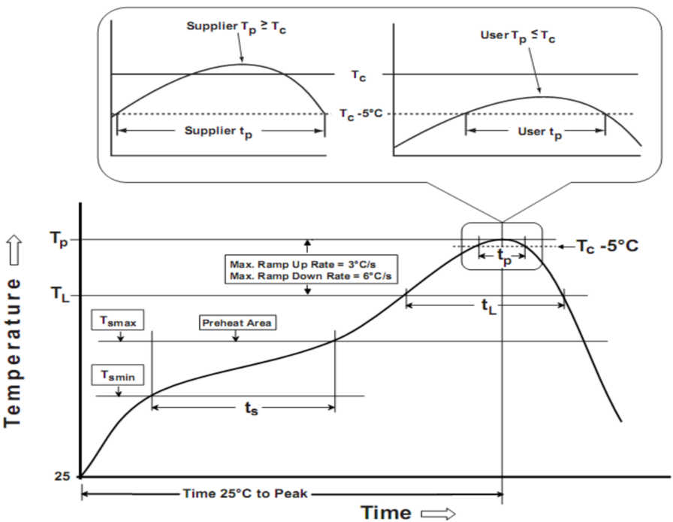
IC603
Soldering Temperature Reflow Profile
Figure 29. Reflow Soldering information
Parameter | Pb-free soldering conditions
Average ramp-up rate (217 ℃ to Peak) | 3℃/second max.
Time of Preheat temp (from 150 ℃ to 200 ℃) | 60 ~ 120 second
Time to be maintained above 217 ℃ | 60 ~ 150 second
Peak temperature | 260 ℃
Time within 5 ℃ of actual peak temp | 30 second
Ramp-down rate | 6 ℃/second max.
Time from 25℃ to peak temp | 8 minutes max.
Table 10. Reflow Soldering Parameter
Note:
1. The reflow peak soldering temperature is peak 260°C and it is specified based on IPC/JEDEC J-STD- 020 “
Moisture/Reflow Sensitivity Classification for Non-Hermetic Solid State Surface Mount Devices”
2. Tolerance for peak proﬁle temperature (Tp) is deﬁned as a supplier minimum and a user maximum.
3. This document should serve as recommendation only. Other parameters may also affect soldering, so these profiles
do not guarantee absolute success.
4. Soldering profiles should be determined by reference to the solder and solder paste manufacturer's specifications, unless they conflict with the recommendations in this document.
5. The soldering profile and footprint information specified in this datasheet are general recommendations and are provided for reference only. The design, control, and quality assurance of the actual soldering process are the sole responsibility of the customer. The supplier assumes no responsibility for the soldering process or its results.
Important statement
Global Technologies reserves the right to change the above-mentioned information without prior notice.

Slide 97

IC603
Body TOP Marking
< JSICAT marking >
IC603
XXXXX
CBA2J
YWCD@
TOP VIEW
Fix. Code IC Part Name: IC603
Assembly production Code : CBA2J
        ※ Example code :2025. 07. 07
        wafer Lot #6-10
Package Drawings Markings
Y → Year code
Row No. | Marking | Definition
1 | XXXXX | Fixed Code: IC603
2 | abc | Internal code
3 | YWCD@ | Y: Year Code W: Week Code C: Wafer Code D: Traceability Wafer lot Code @: Assembly plant Code
Wafer Lot | 2024 |  | 2025 |  | 2026 |  | 2027 |  | …
 | 1-6 | 7-12 | 1-6 | 7-12 | 1-6 | 7-12 | 1-6 | 7-12 | 1-6 | 7-12
Code | - | A | B | C | D | E | F | G | … | …
W → Week code , A=W1, B=W2,….
Wafer Lot | W 1 | W 2 | W3 | W4 | … | W27 | W28 | … | W53
Code | A | B | C | D | … | A | B | … | A
C → Wafer lot, Each wafer Lot is represented by a character (Ex: A, B, C, …).
These character cycle once a week.
Wafer Lot | Lot 1 | Lot 2 | Lot 3 | Lot 4 | Lot 5 | Lot 6 | Lot 7 | Lot 8 | …
Code | A | B | C | D | E | F | G | H | …
        ** Font Type : Arial
        Marking text tolerance : ±0.05mm
D → Traceability Code Wafer lot NO. :
A big assembly Lot consists of three wafers. Each big assembly Lot.
Lot is represented by a character (Ex: 1,2,3,…)
Wafer Lot No | 1-5 | 6-10 | 11-15 | 16-20 | 21-25
Code | 1 | 2 | 3 | 4 | 5
@ → Assembly plant code
 | JSICAT | SEMTECH | 3rd plant | 4th Plant
Code | J | S | * | *

Slide 98
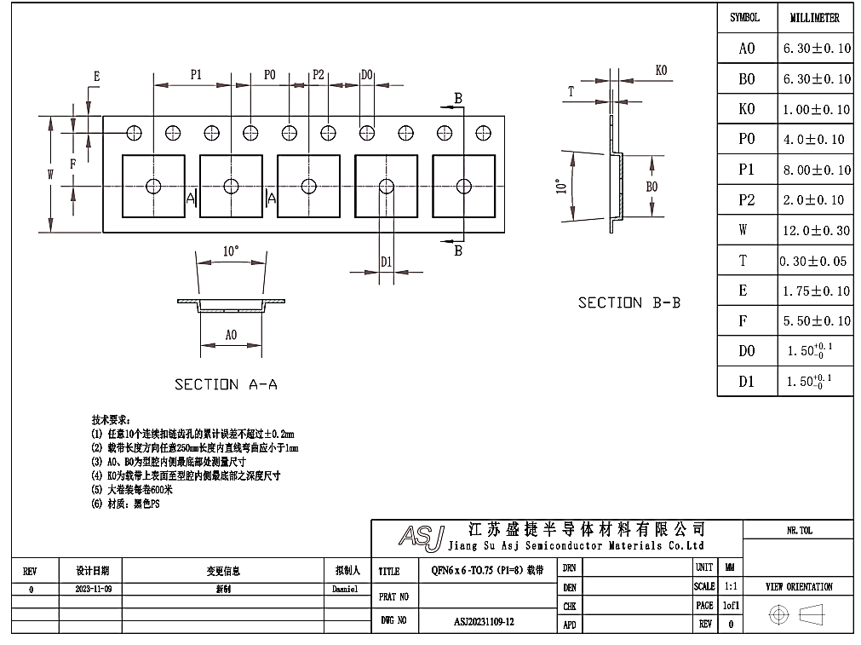

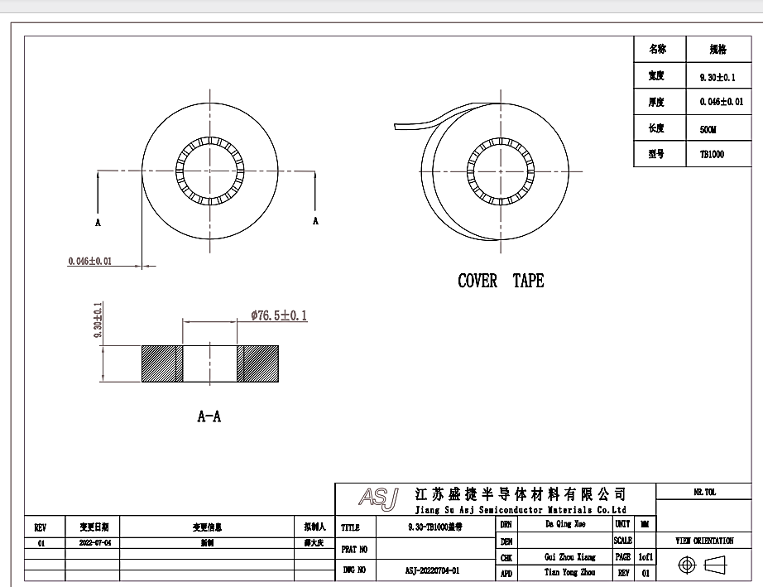
IC603
Embossed tape and reel data [TBD]
1) JSICAT [TBD]
Figure 30. Tape and reel specification

Slide 99
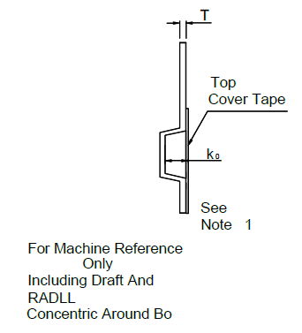
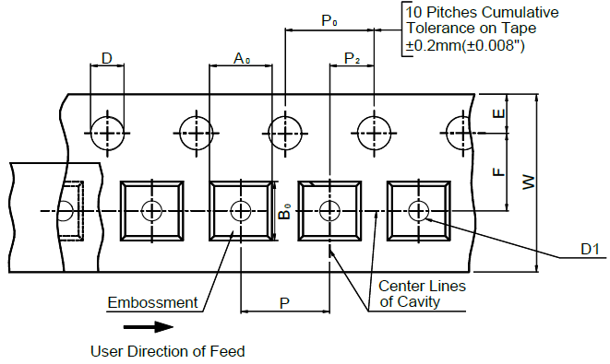
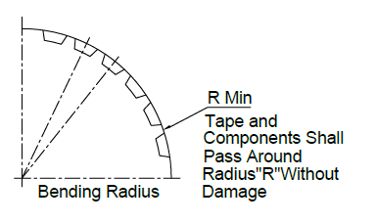
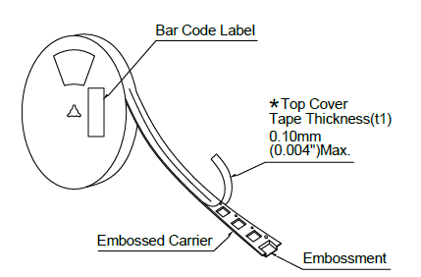
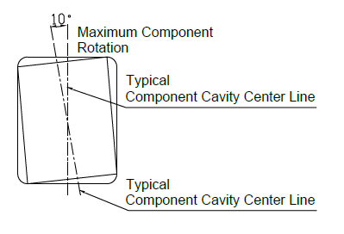
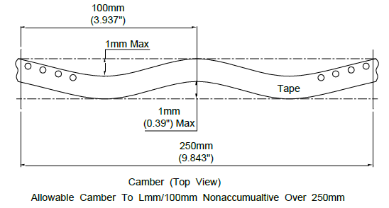
IC603
2) Semtech [TBD]
Package | Tape Size | D | D1 | E | F | P | P₀ | P₂
QFP7070 | 12mm | 1.55±0.1mm (0.063±0.004”) | 1.55±0.1mm (0.063±0.004”) | 1.75±0.1mm (0.069±0.004”) | 5.5±0.1mm (0.217±0.004”) | 8±0.1mm (0.315±0.004”) | 4±0.1mm (0.157±0.004”) | 2±0.1mm (0.079±0.004”)
Package | R Min. | T | W | A0 | B0 | K0
QFP7070 | 25mm (0.98”) | 0.20±0.05mm (0.008±0.002”) | 12mm±0.1mm (0.472±0.004”) | 6.2±0.1 mm (0.244±0.004”) | 6.2±0.1mm (0.244±0.004”) | 0.95±0.1mm (0.037±0.004”)
Figure 31. Tape and reel specification
Note :
1. Metric dimensions govern-English are in parentheses for reference only.
2. The clearance between the components and the cavity must be within 0.05 mm min. to 0.5 mm max.
3. The component cannot rotate more than 10︒ within the determined cavity.

Slide 100
IC603
Package specification [TBD]
QFP 7070-64L Package Outline
TOP VIEW
BOTTOM VIEW
SIDE VIEW
Symbol | Dimensions in mm
 | Min | Typ | Max
A | 0.70 | 0.75 | 0.80
A1 | 0.00 | 0.02 | 0.05
A3 | 0.203 REF
D | 7.90 | 8.00 | 8.10
E | 7.90 | 8.00 | 8.10
D1 | 6.10 | 6.20 | 6.30
E1 | 6.10 | 6.20 | 6.30
k | 0.20
b | 0.15 | 0.20 | 0.25
e | 0.30 | 0.40 | 0.50
Nd | 6.40 BSC
Ne | 6.40 BSC
L | 0.35 | 0.40 | 0.45
Note
All Dimensions Do Not Include mold flash or Protrusions.
Figure 32. Package Outline

Slide 101
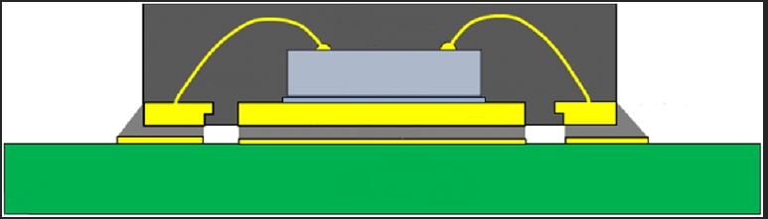
IC603
QFP 7070-64L Section Image [TBD]
QFP 7070-64L Section Image
SIDE VIEW
TBD
Lead frame
Die attach
Adhesive
Mold compound
Bonding wire
Die
PCB Substrate
Exposed PAD

Slide 102

IC603
Footprint [TBD]
Symbol | Dimensions in mm
 | Min | Nom | Max
B |  | 0.22
D |  | 7.80
D1 |  | 6.20
E |  | 7.80
E1 |  | 6.20
e |  | 0.40
K | 0.45
L |  | 0.7
Figure 33. Recommended Footprint
Note : The reflow peak soldering temperature is peak 260°C and it is specified based on IPC/JEDEC J-STD- 020
“Moisture/Reflow Sensitivity Classification for Non-Hermetic Solid State Surface Mount Devices”
is the trademark of Global Technologies Co., Ltd. or its subsidiaries in the Republic of Korea and/or other countries. The products of Global Technologies reserve the right to make changes without further notice to any products herein. Global Technologies makes no warranty, representation or guarantee regarding the suitability of its products for any particular purpose, nor does Global Technologies assume any liability arising out of the application or use of any product or circuit, and specifically disclaims any and all liability, including without limitation special, consequential or incidental damages. Global Technologies does not convey any license under its patent rights nor the rights of others.
is the trademark of Global Technologies Co., Ltd. or its subsidiaries in the Republic of Korea and/or other countries. Global Technologies owns the rights to a number of patents, trademarks, copyrights, trade secrets, and other intellectual property. Global Technologies reserves the right to make changes without further notice to any products herein. Global Technologies makes no warranty, representation or guarantee regarding the suitability of its products for any particular purpose, nor does Global Technologies assume any liability arising out of the application or use of any product or circuit, and specifically disclaims any and all liability, including without limitation special, consequential or incidental damages. Buyer is responsible for its products and applications using Global Technologies products, including compliance with all laws, regulations and safety requirements or standards, regardless of any support or applications information provided by Global Technologies. “Typical” parameters which may be provided in Global Technologies data sheets and/or specifications can and do vary in different applications and actual performance may vary over time. All operating parameters, including “Typical” must be validated for each customer application by customer’s technical experts. Global Technologies does not convey any license under its patent rights nor the rights of others. Global Technologies products are not designed, intended, or authorized for use as a critical component in life support systems or any FDA Class 3 medical devices or medical devices with a same or similar classification in a foreign jurisdiction or any devices intended for implantation in the human body. Should Buyer purchase or use Global Technologies products for any such unintended or unauthorized application, Buyer shall indemnify and hold Global Technologies and its officers, employees, subsidiaries, affiliates, and distributors harmless against all claims, costs, damages, and expenses, and reasonable attorney fees arising out of, directly or indirectly, any claim of personal injury or death associated with such unintended or unauthorized use, even if such claim alleges that Global Technologies was negligent regarding the design or manufacture of the part. Global Technologies is an Equal Opportunity/Affirmative Action Employer. This literature is subject to all applicable copyright laws and is not for resale in any manner.

