Slide 1

Global Technologies
XD12P
The LED Current Sink Driver IC
12 Channels
General Description
The XD12P is a 12-channel constant current sink driver for mini-LED Backlight display applications in AM direct driving methodology. It supports max 32mA and 40V at each channel output pin rating. This device can support max 14-bit PWM dimming resolution and a 12-bit DAC global brightness resolution.
The self-protections features, LED open/short detection and thermal shutdown, are embedded. In addition, a Feedback control for adjusting a VLED power is included.
It is used with a XC24 controller as a companion chip. A lot of the XD12P can be daisied to a XC24 channels and controlled through a serial interface by a XC24 controller.
Application
LED back-lighting with local dimming

Slide 2
XD12P
Features
Bi-directional 1-wire interface and configurable transmit rate
Daisied connection between devices and pin layout suitable for single layer PCB
12 independent channels in a package
Maximum 40V headroom voltage
Configurable max current level (4/8/12/16/24/32mA)
12-bit DAC global max current control
12-bit or 14-bit PWM brightness control
Configurable dimming directions, Head shift lighting and Tail shift lighting
Sync controllability between daisied devices
Sink current accuracy ±1% (@ trimmed point)
Configurable LED SHORT and OPEN detection level
Configurable FEEDBACK level
Configurable Over-Temperature shutdown @ Typical 135℃
Configurable Over/Under-Voltage of internal LDO
Supply voltage 4.5 ~ 5.5V
24-PIN QFN 3030 package
Latch-up Immunity, I_{LATCH} (JEDEC JESD78D Nov 2011) : ±100mA
ESD protection, ESD_{HBM} (JEDEC JS-001-2017 Human Body Model) : ±2KV

Slide 3
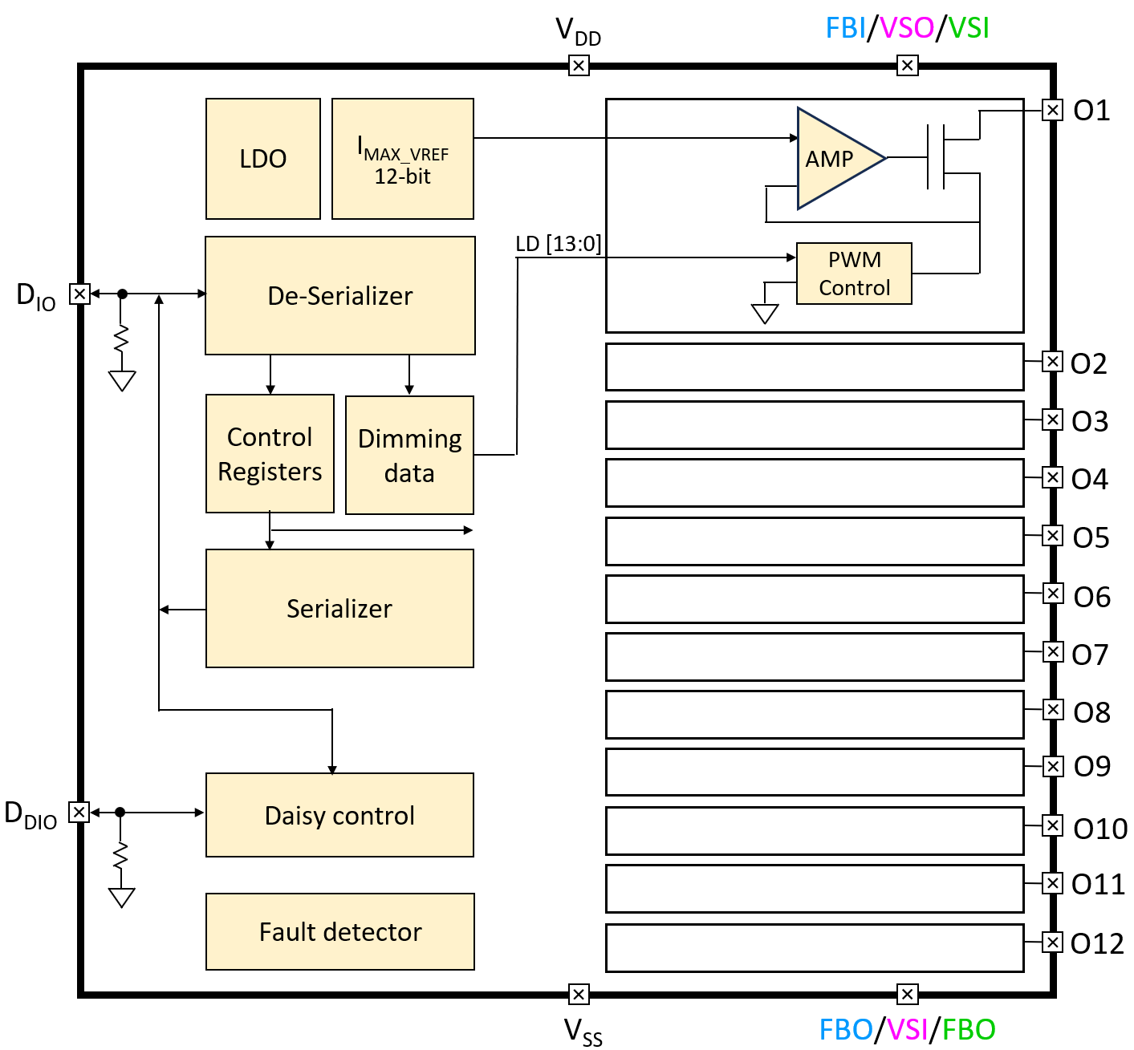
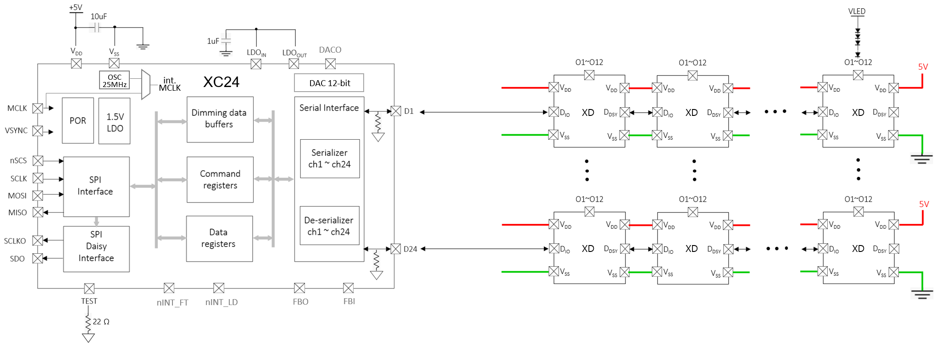
XD12P
Block Diagram
Figure 1. Block Diagram
Application Circuit
Figure 2. Application scheme

Slide 4
XD12P
Pin diagram (Top View)
18
17
16
15
14
13
V_{DD}
V_{DD}
V_{SS}
V_{SS}
FBI/
VSO/
VSI
D_{DIO}
O11
O12
O9
O10
20
21
22
O7
23
T-Pad
8
O8
9
10
11
19
24
7
O6
12
O5
O3
O4
O1
V_{DD}
V_{SS}
V_{SS}
V_{SS}
FBO/
VSI/
FBO
D_{IO}
O2
1
2
3
4
5
6
Figure 3. Pin diagram
Pin description
Pin Name | Pin No. | I/O | Type | Description | Remark
V_{DD} | 1 | - | Power | Supply voltage
V_{SS} | 2 | - | GND | Ground
V_{SS} | 3 | - | GND | Ground
V_{SS} | 4 | - | GND | Ground
FBO/VSI/FBO ¹⁾ | 5 | I/O | Digital | FBO/ VSI/ FBO (Configurable through IO_MODE) | FBO is Open-drain output If not used, connect to GND
D_{IO} | 6 | I/O | Digital | Data In/Out | Internal PD, 48KΩ
O2 | 7 | O | Current Load | Current Sink 2 | If unused, connect to GND
O4 | 8 | O | Current Load | Current Sink 4 | If unused, connect to GND
O6 | 9 | O | Current Load | Current Sink 6 | If unused, connect to GND
O8 | 10 | O | Current Load | Current Sink 8 | If unused, connect to GND
O10 | 11 | O | Current Load | Current Sink 10 | If unused, connect to GND
O12 | 12 | O | Current Load | Current Sink 12 | If unused, connect to GND
D_{DIO} | 13 | I/O | Digital | Daisied Data In/Out | Internal PD, 48KΩ
FBI/VSO/VSI ¹⁾ | 14 | I/O | Digital | FBI/ VSO/ VSI (Configurable through IO_MODE) | If not used, connect to GND

Slide 5

XD12P
Pin description
Pin Name | Pin No. | I/O | Type | Description | Remark
V_{SS} | 15 | - | GND | Ground
V_{SS} | 16 | - | GND | Ground
V_{DD} | 17 | - | Power | Supply Voltage
V_{DD} | 18 | - | Power | Supply Voltage
O11 | 19 | O | Current Load | Current Sink 11 | If unused, connect to GND
O9 | 20 | O | Current Load | Current Sink 9 | If unused, connect to GND
O7 | 21 | O | Current Load | Current Sink 7 | If unused, connect to GND
O5 | 22 | O | Current Load | Current Sink 5 | If unused, connect to GND
O3 | 23 | O | Current Load | Current Sink 3 | If unused, connect to GND
O1 | 24 | O | Current Load | Current Sink 1 | If unused, connect to GND
Note : 1) The pin function can be configured through the IO_MODE register bits. If the pin will be used as the FBO,
then the pin acts as an Open-drain output. (external PU resistor should be attached)
Table 1. Pin Description
Equivalent Circuits of individual pins
Pad Name | I/O | Internal Circuit | Description
D_{IO} | I/O |  | Data In/Out
D_{DIO} | I/O |  | Daisied Data In/Out

Slide 6
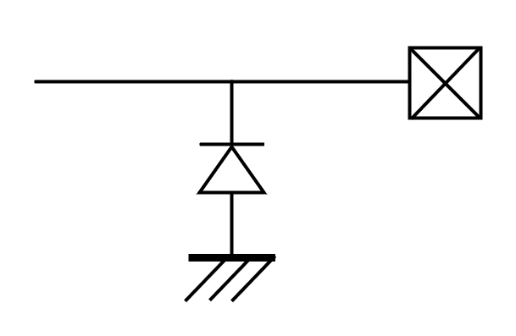

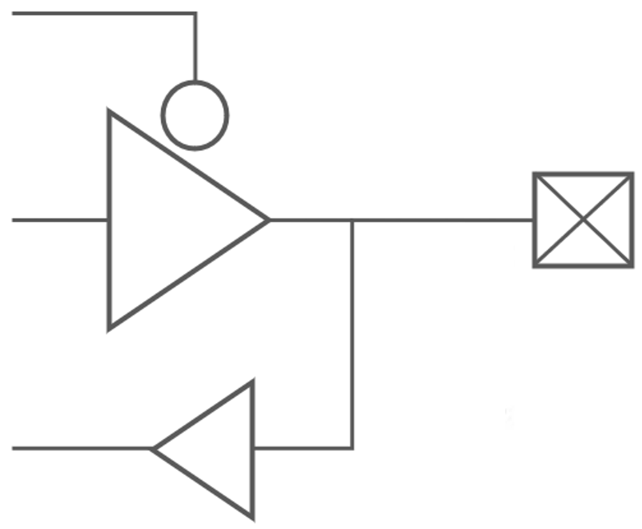
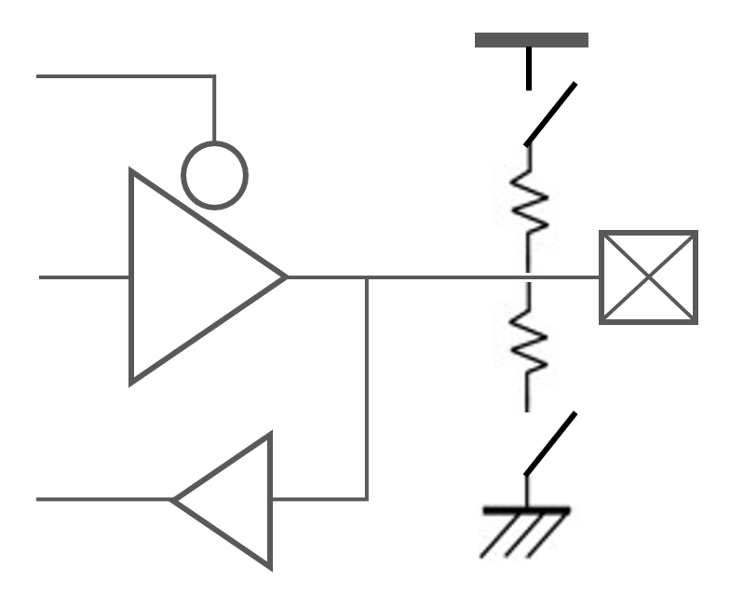
XD12P
Equivalent Circuits of individual pins
Pad Name | I/O | Internal Circuit | Description
O1 ~ O12 | Current Sink |  | Current Load
VDD | - |  | Supply voltage
VSS | - |  | GND
FBO/VSI/FBO | I/O |  | 1. FB (daisied) Output (OD) 2. VSYNC (daisied) Input 3. FB Output (Open-drain) ※ if not used, connect to GND
FBI/VSO/VSI | I/O |  | 1. FB (daisied) Input 2. VSYNC (daisied) Output 3. VSYNC Input ※ if not used, connect to GND
V_{DD}
Figure. 4 Equivalent Circuits of individual pins

Slide 7
XD12P
Maximum Absolute ratings (Ta = 25℃ unless otherwise noted)
Parameter | Symbol | Value | Unit
Supply voltage | V_{DD} | -0.3 ~ 6.5 | V
Sink output pin voltage | V_{O} | 40 | V
Sink output current | I_{O} | 32 | mA
D_{IO} to GND | V_{DIO} | -0.3 ~ V_{DD}+0.3 | V
D_{DIO} to GND | V_{DDIO} | -0.3 ~ V_{DD}+0.3 | V
Thermal Resistance
Junction to Ambient | R_{θJA} | TBD ¹⁾ | ℃/W
Junction to Case | R_{θJC} | TBD ¹⁾ | ℃/W
Power Dissipation on package | P_{TOT} | TBD ¹⁾ | W
Ambient temperature | T_{A} | -20 ~ 85 | ℃
Operating Junction temperature | T_{J} | -20 ~ 125 | ℃
Storage temperature | T_{STG} | -45 ~ 150 | ℃
Relative Humidity (non-condensing) | RH_{NC} | 5 ~ 85 | %
Moisture Sensitivity Level | MSL | Maximum Floor Life-time of 168 hr | 3
Table 2. Maximum Absolute ratings
Note :
1) Surface mounted on FR-4 substrate PC Board 1” x 1” inch 2-oz copper plate
2) Stresses beyond the Maximum Absolute ratings may cause permanent damage to the device
3) Exposure to absolute maximum rating conditions for extended periods may affect device reliability.
ESD & Latch-up Ratings
Parameter | Symbol | Value | Unit | Remark
Electrostatic Discharge HBM | ESD_{HBM} | ±2000 | V | Norm: JS-001-2017
Electrostatic Discharge CDM | ESD_{CDM} | ±500 | V | Norm: JEDEC JESD22-C101F Oct 2013
Input Current (latch-up immunity) | I_{LU} | ±100 | mA | Norm: JEDEC JESD78D Nov 2011
Table 3. ESD & Latch-up

Slide 8
XD12P
Electrical Characteristic (V_{DD} =5.0V, Ta=25.0℃ unless otherwise noted)
Characteristics | Symbol | Condition | Value |  |  | Unit
 |  |  | min | typ | max
Supply voltage
Operating voltage | V_{DD}¹⁾ |  | 4.5 | 5.0 | 5.5 | V
Supply current
Quiescent Current | I_{s} | Standby state, No LED current | - | TBD | - | uA
Operating Current 1 | I_{DD1} | All output 100% duty sink = 4mA | - | 2.75 | - | mA
Operating Current 2 | I_{DD2} | All output 100% duty sink = 8mA | - | 2.89 | - | mA
Operating Current 3 | I_{DD3} | All output 100% duty sink = 12mA | - | 3.00 | - | mA
Operating Current 4 | I_{DD4} | All output 100% duty sink = 16mA | - | 3.20 | - | mA
Operating Current 5 | I_{DD5} | All output 100% duty sink = 24mA | - | 3.42 | - | mA
Operating Current 6 | I_{DD6} | All output 100% duty sink = 32mA | - | 3.70 | - | mA
Oscillator
Internal MCLK | f_{OSC} |  | - | 40 | - | MHz
In/Out
D_{IO}, D_{DIO} | V_{IL} V_{IH} | Input logic low level | - | - | 0.8 | V
 |  | Input logic high level | 3.0 | - | V_{DD}
 | V_{OL} V_{OH} | Output logic low level | - | - | 0.8 | V
 |  | Output logic high level | V_{DD} * 0.8 | - | V_{DD}
 | R_{PD} | Internal pull-down resistance | - | 48 | - | KΩ
Logic high time ²⁾ | T_{1H}, T_{0L} | as a receiver | 6 | - | 63 | MCLK
Logic low time ²⁾ | T_{1L}, T_{0H} | as a receiver | 3 | - | 32 | MCLK
Propagation delay | T_{D_DS} | Downstream (D_{IO} to D_{DIO}) | - | 9.0 | 14 | ns
Propagation output skew³⁾ | T_{DSKEW_DS} | D_{DDIO} T_{1H}=T_{1H}-T_{DSKEW_DS} @downstrm | - | 1.5 | 2.6 | ns
Propagation delay | T_{D_US} | Upstream (D_{DIO} to D_{IO}) | - | 9.5 | 14.5 | ns
Propagation output skew³⁾ | T_{DSKEW_US} | D_{DIO} T_{1H}=T_{1H}-T_{DSKEW_US} @upstream | - | 1.4 | 2.3 | ns
T_{1H}
Logic ‘1’
T_{0H}
T_{1L}
Logic ‘0’
T_{0L}
Note : 1) The operation below V_{DD}, 5V will limit a maximum LED sinking current and affect a current variation.
2) The conditions, ①T_{1H} ≥ T_{0H}* 2 ② T_{0L} ≥ T_{1L}* 2 ③ (T_{1H} +T_{0H}) = (T_{0L}+T_{1L}) ≤ 95, are recommended.
3) On downstreaming (or upstreaming), the T_{1H} of D_{DDIO} (or T_{1H} of D_{DIO}) is shorted as many as T_{DSKEW_DS} (or
T_{DSKEW_US}), but the total of 1 bit cycle will remain the same. So, the proper value for T_{1H} and T_{0L} must be
carefully determined based on the daisy size.

Slide 9
XD12P
Electrical Characteristic (V_{DD} =5.0V, Ta=25.0℃ unless otherwise noted)
Characteristics | Symbol | Condition | Value |  |  | Unit
 |  |  | min | typ | max
Output
Driving voltage | V_{O} | Headroom voltage V_{HD} : 0.18V@ I_{O} 4mA, 0.21V@ I_{O} 8mA 0.24V@ I_{O} 12mA, 0.27V@ I_{O} 16mA 0.32V@ I_{O} 24mA, 0.38V@ I_{O} 32mA | V_{HD} | - | 40 | V
Short detection voltage ⁴⁾ | V_{SD} | Short detection level V_{SD} : 3b’000=3V, 3b’001=4V 3b’010=6V, 3b’011=8V 3b’100=12V, 3b’101=16V 3b’110=24V, 3b’111=36V | V_{SD} | - | - | V
Open detection voltage ⁴⁾ | V_{OD} |  | - | - | 0.25 | V
Sink current | I_{O} | Device max current level : I_{O} 3’b000 = 4mA, 3’b001 = 8mA 3’b010 = 12mA, 3’b011 = 16mA 3’b100 = 24mA, 3’b101 = 32mA | - | - | 32 | mA
Current accuracy ⁵⁾ | % | to a trimmed point * 0.6 | - | TBD | - | %
 |  | @ a trimmed point | - | TBD | - | %
 |  | a trimmed point to I_{MAX} | - | TBD | - | %
LED off current | I_{OFF} | Vo = 40V | - | - | 300 | nA
Feedback
FB threshold voltage (Logically ORed for 12-ch) | V_{FBA} | FB level V_{FBA} : 3’b000 = 0.40V, 3’b001 = 0.50V 3’b010 = 0.60V, 3’b011 = 0.70V | - | V_{FBA} | - | V
FB hysteresis voltage | V_{FBH} |  | 40 | 60 | 110 | mV
Thermal protection
Thermal cut off @TJ | TCUT | OFS_TEMP [3:0] = 0x8 | - | 135 | - | ℃
Thermal cut off hysteresis @TJ | THYS |  | 10 | 20 | 30 | ℃
Note : 4) If LED open or short event is happened, the corresponding channel will be turned-off under the function
enabled. If the thermal is happened, all channels output will be turned-off under the function enabled.
5) Under satisfying the power dissipation specification.

Slide 10
XD12P
Electrical Characteristic (V_{DD} =5.0V, Ta=25.0℃ unless otherwise noted)
Characteristics | Symbol | Condition | Value |  |  | Unit
 |  |  | min | typ | max
V_{DD} Ramp up and V_{LED} Start
V_{DD} Ramp up time | T_{VDD} | from 0 to stable 5V | - | - | 1.2 | ms
V_{LED} Start time | T_{SU_DIM} | after T_{SU_DIM} is completed | ⁶⁾ | - | - | ms
Initialization after V_{DD}, 5V stable
Internal Initial time | T_{INIT} | from stable 5V | 10 | - | - | ms
Allowed 1st command | T_{FCMD} | after T_{INIT} is completed | 5 | - | - | ms
Timeout : Internal timer starts after completing to receive a read-back command and stops after first response bit from a last daisied device. This depends on the frequency of MCLK.
Internal Timeout ⁷⁾ | T_{TIMEOUT} |  | - | 131,071 | - | MCLK
VSYNC daisy out @ EXT_VS_E = 1
VSYNCO delay | T_{VSOD} | from VSYNCI to VSYNCO | - | 5.0 | 9.0 | ns
Note : 6) The time depends on the system configuration, the daisied XD number and Baud-rate.
7) If the timeout will be expired, the internal communication logic will go to an initial state, so new command
transaction will be possible. The timeout function is configurable.
Table 4. Electrical Characteristic
Important statement
Global Technologies reserves the right to change the above-mentioned information without prior notice.
Power Sequence
V_{DD}
5V stable
1st Command to XD
T_{VDD}
T_{INIT}
T_{FCMD}
accessible
Set-up for dimming
XD setup for dimming
V_{LED}
T_{SU_DIM}
Figure 5. Power up sequence and Ramp-up time

Slide 11
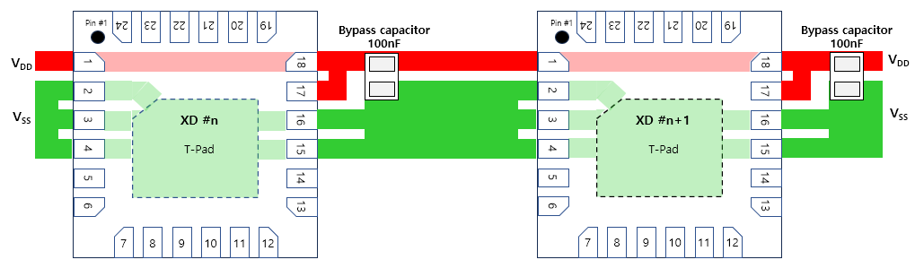
XD12P
Layout for Power Lane for single-layer PCB
As shown in the figure below, it is recommended that a bypass capacitor should be placed as close to the pin 18 and 17 as possible in below.

Slide 12
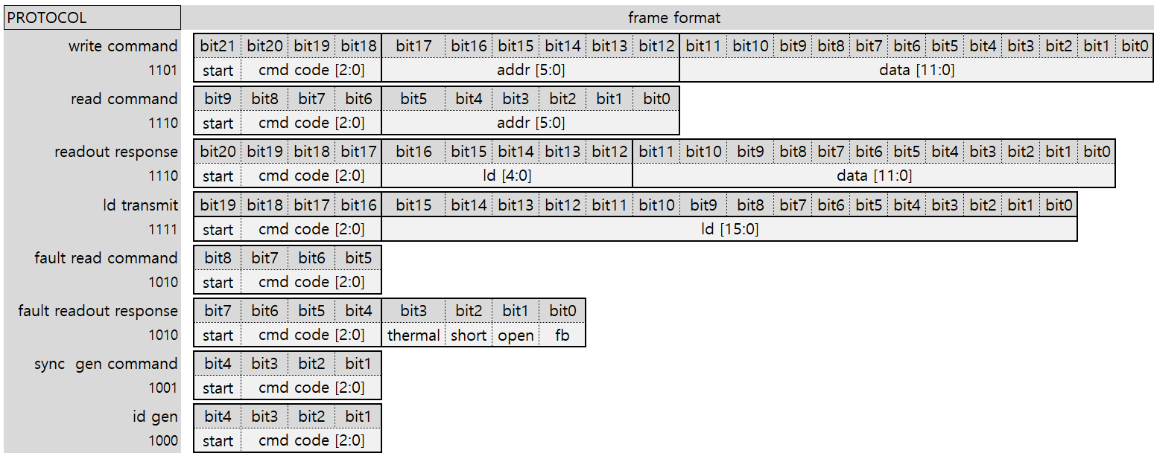
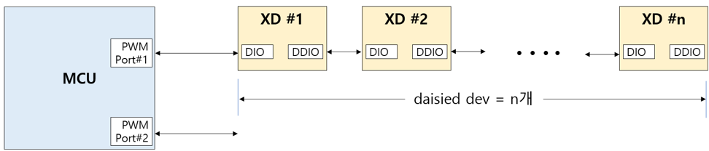
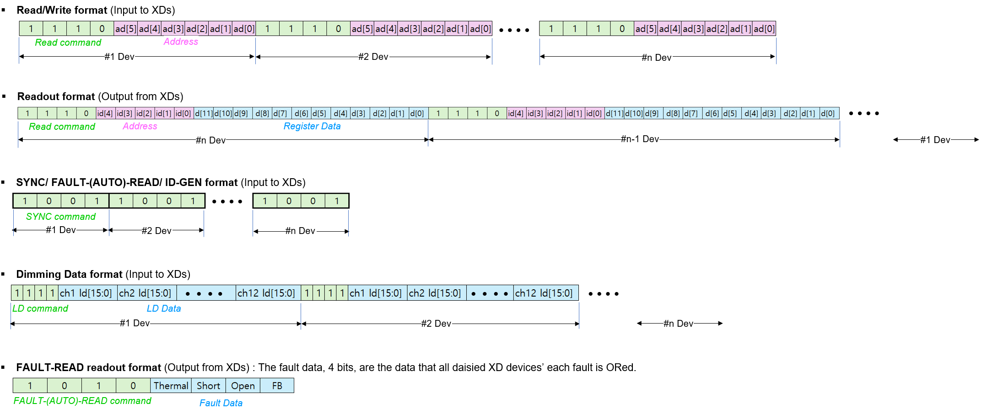
XD12P
Functional Description
Serial Communication Protocol
The XD can be controlled with several commands through a XC controller or directly by a Micom. The access protocol and frame format are as follows and if several XD is connected in daisy, the commands should be repeated successively as many as the XD number in daisy chain.
Table 5. Serial communication protocol
The serial communication protocol and the packet formats are shown in below for more details.

Slide 13
XD12P
Functional Description
PWM Configuration
The PWM behavior depends on the PWM configuration set to the PWM_RES and SCAN_NO [2:0] as shown in the Table 6.
x
don’t care
valid bit
PWM_RES | SCAN_NO [2:0] | sub- frame # | LD Data [15:0] |  |  |  |  |  |  |  |  |  |  |  |  |  |  |  | step # /sub-frame | pwm freq hz@120
 |  |  | D15 | D14 | D13 | D12 | D11 | D10 | D9 | D8 | D7 | D6 | D5 | D4 | D3 | D2 | D1 | D0
0 (12-bit) | 0 | 1 | x | x | x | x | 11 | 10 | 9 | 8 | 7 | 6 | 5 | 4 | 3 | 2 | 1 | 0 | 4,095 | 120
 | 1 | 2 | x | x | x | x | x | 10 | 9 | 8 | 7 | 6 | 5 | 4 | 3 | 2 | 1 | 0 | 2,047 | 240
 | 2 | 4 | x | x | x | x | x | x | 9 | 8 | 7 | 6 | 5 | 4 | 3 | 2 | 1 | 0 | 1,023 | 480
 | 3 | 8 | x | x | x | x | x | x | x | 8 | 7 | 6 | 5 | 4 | 3 | 2 | 1 | 0 | 511 | 960
 | 4 | 16 | x | x | x | x | x | x | x | x | 7 | 6 | 5 | 4 | 3 | 2 | 1 | 0 | 255 | 1,920
 | 5 | 32 | x | x | x | x | x | x | x | x | x | 6 | 5 | 4 | 3 | 2 | 1 | 0 | 127 | 3,840
1 (14-bit) | 0 | 1 | x | x | 13 | 12 | 11 | 10 | 9 | 8 | 7 | 6 | 5 | 4 | 3 | 2 | 1 | 0 | 16,383 | 120
 | 1 | 2 | x | x | x | 12 | 11 | 10 | 9 | 8 | 7 | 6 | 5 | 4 | 3 | 2 | 1 | 0 | 8,191 | 240
 | 2 | 4 | x | x | x | x | 11 | 10 | 9 | 8 | 7 | 6 | 5 | 4 | 3 | 2 | 1 | 0 | 4,095 | 480
 | 3 | 8 | x | x | x | x | x | 10 | 9 | 8 | 7 | 6 | 5 | 4 | 3 | 2 | 1 | 0 | 2,047 | 960
 | 4 | 16 | x | x | x | x | x | x | 9 | 8 | 7 | 6 | 5 | 4 | 3 | 2 | 1 | 0 | 1,023 | 1,920
 | 5 | 32 | x | x | x | x | x | x | x | 8 | 7 | 6 | 5 | 4 | 3 | 2 | 1 | 0 | 511 | 3,840
Table 6. PWM Configuration

Slide 14
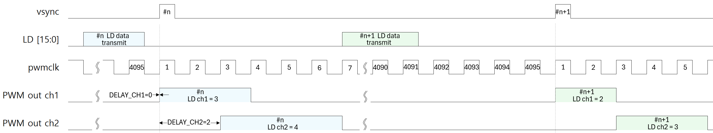
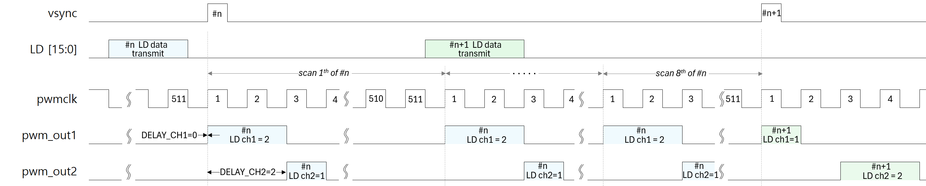
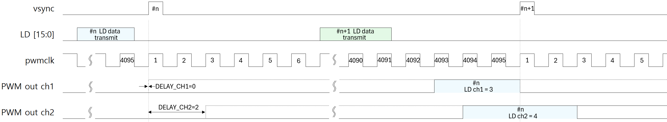
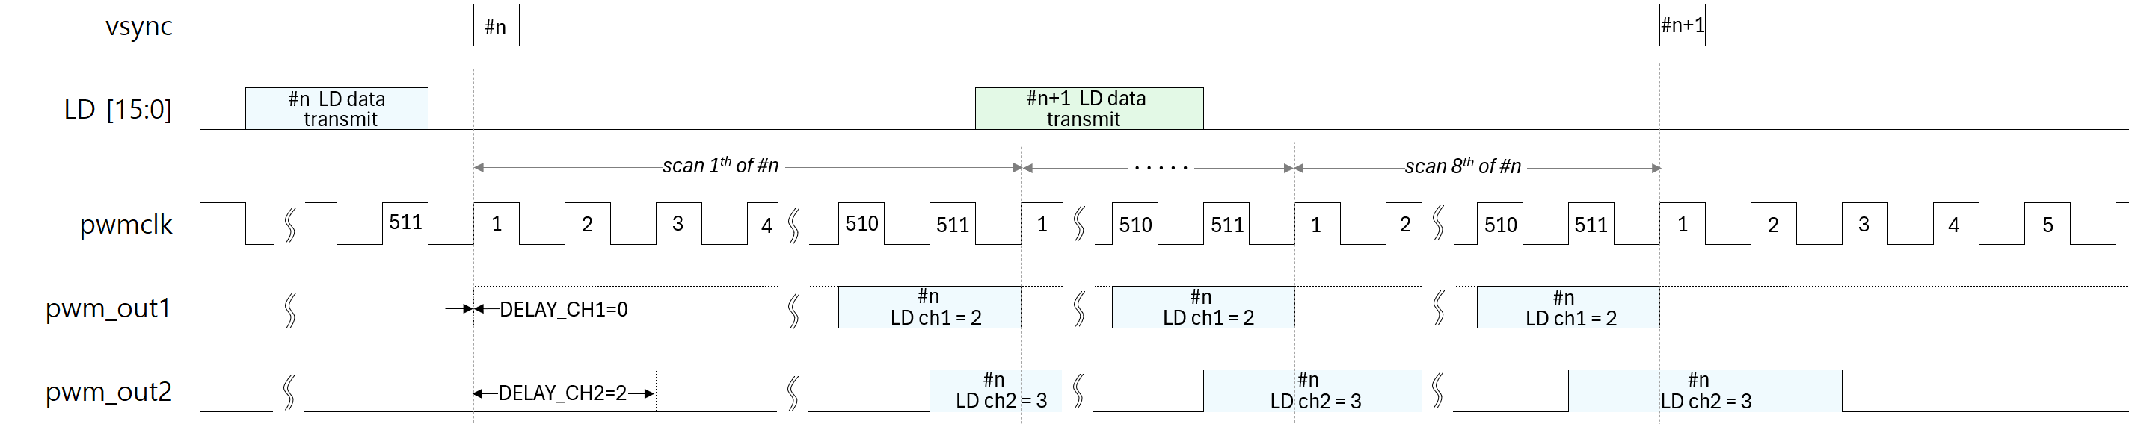
XD12P
Functional Description
Local dimming
The Local dimming sequences according to the PWM configuration are shown as follows below, and has two dimming out directions, Head Shift Lighting and Tail Shift Lighting. The set of PWM frequency (pwmclk) according to the Frame frequency can be shown in the Table 7.
Figure. 6 Head Shift Lighting @ PWM_RES=0, SCAN_NO[2:0]=0
Figure. 7 Head Shift Lighting @ PWM_RES=0, SCAN_NO[2:0]=3
Figure. 8 Tail Shift Lighting @ PWM_RES=0, SCAN_NO[2:0]=0
Figure. 9 Tail Shift Lighting @ PWM_RES=0, SCAN_NO[2:0]=3

Slide 15
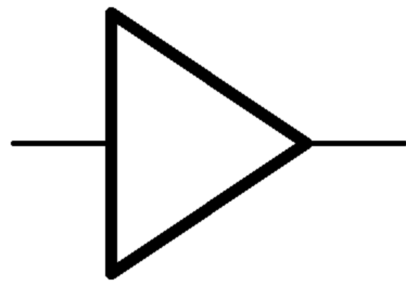

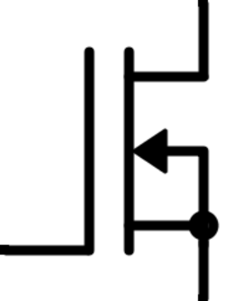


XD12P
Functional Description
Optional external VSYNC and FB
The XD has 3 external signal IO modes which can be configured through the IO_MODE bits in the LD CONTROL register. This function of each mode and the connection scheme is shown as follows.
IO_MODE [1:0] | Description | FBI | FBO | VSI | VSO | Remark
00 | NOP (default) | - | - | - | - | The pins, 5 and 14, can be connected to GND. The FB and VSYNC signal can be replaced by the communication method.
01 | VSYNC daisy mode | - | - | used | used | The FB signal can be replaced by the communication method.
10 | FB daisy mode | used | used | - | - | The VSYNC signal can be replaced by the communication method.
11 | VSYNC and FB non-daisy mode | - | used | - | used | The VSYNC and FB signal can be replaced by the communication method.
XD #n
XD #(n+1)
#n VSI
5
IO_MODE
14
#n VSO
5
IO_MODE
14
#(n+1) VSO
Figure 10. External VSYNC In and Out Scheme
XD #n
XD #(n+1)
#n FBO
5
internal FB
14
#n FBI
5
internal FB
14
#(n+1) FBI
IO_MODE
IO_MODE
Figure 11. External FBI and FBO Scheme
XD
FBO
5
internal FB
14
VSI
IO_MODE
Figure 12. External FBO and VSI Scheme

Slide 16
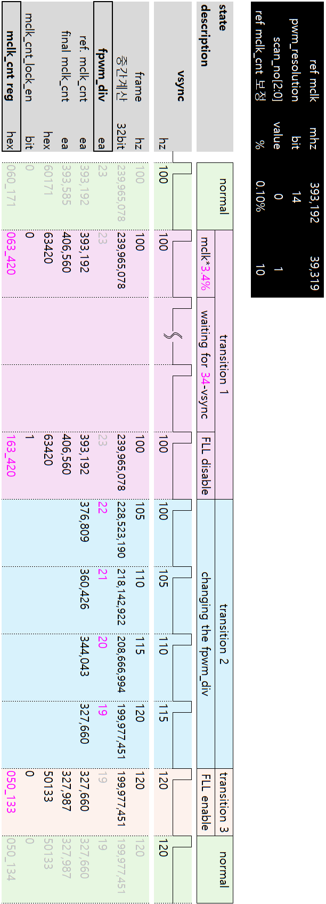
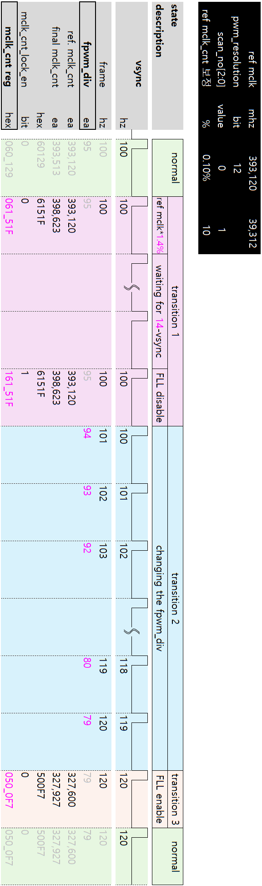
XD12P
Functional Description
Transition a frame frequency without a flicker
Figure 14. PWM 14-bit
Figure 13. PWM 12-bit

Slide 17
XD12P
Register Map
RESET / ID
Acc | Addr | Default | B11 | B10 | B9 | B8 | B7 | B6 | B5 | B4 | B3 | B2 | B1 | B0
R/W | 0x00 | 0x000 | RST | VS_RST | E_RST | x | x | x | x | ID [4:0]
Bits | Fields |  | Descriptions
11 | RST | 0 1 | NOP All internal logics are initialized to a default state and this bit will be auto-cleared after internal initialization.
10 | VS_RST | 0 1 | NOP If this bit is set, then the serializer and de-serializer of XD will be initialized to a default state at every vsync. This bit set does not affect all internal registers and buffers. This bit can’t be set at the same time as the E_RST bit.
9 | E_RST | 0 1 | NOP If this bit is set, then the serializer and de-serializer of XD will be initialized to a default state at the last third pwm clock. This function starts from the first vsync input. So, it is careful that the XD access at the back of the frame should be avoided for proper operation. This bit set does not affect all internal registers and buffers. This bit can’t be set at the same time as the VS_RST bit.
4:0 | ID |  | These bits are read only. If the XD12P will receive the ID-Gen command from the XC24 controller, then the ID value is automatically generated. The ID value is needed for proper reading, so, the ID-Gen command must be firstly executed by the XC24 controller before executing any commands. If all XD12P drivers daisied will receive the ID-Gen command, the last-located device will have the first number of ID, and the first located device will have the last number of ID, that is, the number of daisied devices. The ID value can not be written by a Host.

Slide 18
XD12P
LD CONTROL
Acc | Addr | Default | B11 | B10 | B9 | B8 | B7 | B6 | B5 | B4 | B3 | B2 | B1 | B0
R/W | 0x01 | 0x000 | LD_SIZE [3:0] |  |  |  | IO_MODE [1:0] |  | SCAN_NO [2:0] |  |  | OVER_TO_E | PWM_RES | LD_DIR
Bits | Fields | Descriptions
 |  | This register determines the dimming sequence. Even if the LD_DIR, PWM_RES, OVER_TO_E and SCAN_NO value will be changed in the middle of the current frame, the value will affect the dimming sequence from the next frame after completing the current frame process.
11:8 | LD_SIZE | This value determines how many LD data will be transmitted for one time. This value is not needed to match with the number of enabled channels in the CHANNEL ENABLE register. It keeps in mind that the LD data to be transmitted will be mapped sequentially from channel 1 to channel n regardless of the corresponded CHx_EN bit activation.
7:6 | IO_MODE | These bits determine the FB and VSYNC functional usage as a pin. Refer to below table.
5:3 | SCAN_NO | This value determines the number of scanning within a frame. The scanning number is one if the value is zero. In case the value is greater than 0, the larger the value, the smaller the PWM depth. The available value is from 0 to 5, and the relationship between the set value vs the scanning number and the PWM depth can be showed in below Table 6.
2 | OVER_TO_E | Over Turn-On Enable. This bit is an optional and recommended to decide the set according to the dimming performance from internal PWM clock. It is useful in case the PWM clock is faster than ideal frequency under full PWM data.
1 | PWM_RES | This bit determines the PWM resolution. 0 12-bit PWM resolution (max steps 4,095) 1 14-bit PWM resolution (max steps 16,383)
0 | LD_DIR | This bit determines the direction of modulated edge with increasing on time from a vsync. 0 Head Shift Lighting 1 Tail Shift Lighting
Value | Description | FBI | FBO | VSI | VSO | Remark
00 | NOP (default) | - | - | - | - | VSYNC and FB can be got through a communication. These pins, 5 and 14, can be connected to GND.
01 | VSYNC daisied | - | - | used | used | External VSYNC-In signal scheme in a daisy chain FB can be got through a communication.
10 | FB daisied | used | used | - | - | External FB-Out signal scheme in a daisy chain VSYNC-In can be got through a communication.
11 | VSYNC and FB individual drive | - | used | used | - | External VSYNC-In and FB-Out are used individually, not in daisy chain.

Slide 19
XD12P
FPWM DIVIDER
Acc | Addr | Default | B11 | B10 | B9 | B8 | B7 | B6 | B5 | B4 | B3 | B2 | B1 | B0
R/W | 0x02 | 0x000 | x | x | x | x | FPWM_DIV [7:0]
Bits | Fields | Descriptions
7:0 | FPWM_DIV | This register determines the PWM reference clock. The PWM reference clock can be created by dividing the MCLK frequency by the setting value + 1. Even if the setting value will be changed in the middle of the frame, the value will be applied immediately from the next vsync assertion. The setting value according to the frame frequency is guided as shown Table 7 below. Refer to the Tabel 6. for other relevant sets.
PWM_RES | Register | 50Hz | 60Hz | 100Hz | 120Hz | 144Hz | 165Hz | 240Hz | 800Hz | 960Hz
0 | FPWM_DIV | 191 | 159 | 95 | 79 | 67 | 59 | 39 | 95 | 79
 | MCLK_LOCK_CNT | 786,869 | 655,724 | 393,434 | 327,862 | 278,683 | 245,897 | 163,931 | 392,762 | 327,302
1 | FPWM_DIV | 47 | 39 | 23 | 19 | 16 | 14 | 9 | 23 | 19
 | MCLK_LOCK_CNT | 787,013 | 655,844 | 393,507 | 327,922 | 278,734 | 245,942 | 163,961 | 393,338 | 327,782
Table 7. FPWM Configuration
CHANNEL ENABLE
Acc | Addr | Default | B11 | B10 | B9 | B8 | B7 | B6 | B5 | B4 | B3 | B2 | B1 | B0
R/W | 0x03 | 0x000 | CH12_EN | CH11_EN | CH10_EN | CH9_EN | CH8_EN | CH7_EN | CH6_EN | CH5_EN | CH4_EN | CH3_EN | CH2_EN | CH1_EN
Bits | Fields | Descriptions
11:0 | CHx_EN | These bits should be set if the corresponding channels are to be used. The number of enabled channels in these registers does not need to match the LD_SIZE value. It is careful that the number of enabled channels should be the same as the LD_SIZE value, but the number can be smaller than the LD_SIZE value like the special mapping below.
CH1_EN | CH2_EN | CH3_EN | CH4_EN | CH5_EN | CH6_EN | CH7_EN | CH8_EN~CH12_EN
1 | 0 | 1 | 1 | 0 | 1 | 1 | all 0
the number of
enabled channels = 5
the amount of LD data to be transmitted for one time
LD_SIZE = 7
wherein, the LD data of the disabled channels, CH2 and CH5, can be any value

Slide 20
XD12P
FAULT STATUS
Acc | Addr | Default | B11 | B10 | B9 | B8 | B7 | B6 | B5 | B4 | B3 | B2 | B1 | B0
RO | 0x05 | 0x000 | MISS_VS | x | OV15 | UV15 | x | x | x | x | THERMAL | SHORT | OPEN | FB
Bits | Fields | Descriptions
11 | MISS_VS | The MISS_VS bit indicates whether the vsync missing event happens, and auto-cleared after readout this register.
9 | OV15 | The OV15 indicates whether the internal LDO keeps over 1.8V for 100us or not, and auto-cleared after a readout this register.
8 | UV15 | The UV15 indicates whether the internal LDO keeps under 1.2V for 100us or not, and auto-cleared after a readout this register.
3 | THERMAL | The THERMAL bit indicates whether the THERMAL event due to overheating happens, and this bit will keep asserted as long as the THERMAL event is not cleared. The event threshold can be set by the OFS_TEMP in the TEMP register. If the T_OFF_E bit of the FAULT CONTROL register is set, all output sink drivers will be turned-off as long as the event is asserted, and turned-on again after internal temperature goes down below the set level of the OFS_TEMP. This bit involves other fault events in the readout information, MISS_VS, OV15 and UV15 at the FAULT_(AUTO)_READ transaction.
2 | SHORT | The SHORT bit indicates whether the SHORT event happens. The event can be detected in case some channel’s headroom goes above the set value in the SHORT_LEVEL of FAULT LEVEL register and its channel’s PWM out is ON status. If the S_OFF_E bit of the FAULT CONTROL register is set, the output of the channels in which the event occurs is turned off. This bit is auto-cleared after readout but set again as long as the event is not cleared.
1 | OPEN | The OPEN bit indicates whether the OPEN event happens. The event can be detected in case some channel’s headroom goes below 0.25V and its channel’s PWM out is OFF status. If the O_OFF_E bit of the FAULT CONTROL register is set, the output of the channels in which the event occurs is turned off. This bit is auto-cleared after readout but set again as long as the event is not cleared.
0 | FB | The FB bit indicates whether the output channels’ headroom voltage is below the value set by FB_LEVEL of the FAULT LEVEL register due to insufficient VLED. This bit is set whenever the FB event occurs in even one of the activated channels and will be auto-cleared after readout this register. This bit will be set again after readout as long as the FB condition is still valid. If the O_FB_E of FAULT CONTROL register is set, the FB event will happen in case the OPEN event is not asserted.
FAULT LEVEL
Acc | Addr | Default | B11 | B10 | B9 | B8 | B7 | B6 | B5 | B4 | B3 | B2 | B1 | B0
R/W | 0x06 | 0x000 | x | DEV_MAX_CURR_LEVEL [2:0] | x | x | x | SHORT_LEVEL [2:0] | x | x | O_SLEW | FB_LEVEL [2:0] | FB_LEVEL [1:0]
Bits | Fields | Descriptions
10:8 | DEV_MAX_CURR_ LEVEL | The DEV_MAX_CURR_LEVEL determines the physical maximum current level of the device. The max dimming sink-current set by the MAX_CURR_VREF can not be beyond the DEV_MAX_CURR_LEVEL. 3b’000 : max 4mA 3b’001 : max 8mA 3b’010 : max 12mA 3b’011 : max 16mA 3b’100 : max 24mA 3b’101 : max 32mA 3b’010 : max 20mA 3b’011 : max 28mA
6:4 | SHORT_LEVEL | The SHORT_LEVEL determines the level at which a SHORT event occurs. 3b’000 : > 3V 3b’001 : > 4V 3b’010 : > 6V 3b’011 : > 8V 3b’100 : > 12V 3b’101 : > 16V 3b’110 : > 24V 3b’111 : > 36V
3 | O_SLEW | ‘0’ Fast ‘1’ Slow
2:0 | FB_LEVEL | The FB_LEVEL determines the level at which a FB event occurs. 3b’000 : < 0.40V 3b’001 : < 0.50V 3b’010 : < 0.60V 3b’011 : < 0.70V 3b’000 : < 0.20V 3b’001 : < 0.30V

Slide 21
XD12P
FAULT CONTROL
Acc | Addr | Default | B11 | B10 | B9 | B8 | B7 | B6 | B5 | B4 | B3 | B2 | B1 | B0
R/W | 0x07 | 0x800 | TIMEOUT_E | OVUV15_EN | x | MS_VS_LOCK | MS_VS_DIMM | MS_VS_DET_E | O_FB_E | O_DET_E | S_DET_E | T_OFF_E | S_OFF_E | O_OFF_E
Bits | Fields | Descriptions
11 | TIMEOUT_E | If this bit is set, the internal timeout timer starts counting after some read-back command stream is done and stops after the XD responds own information to the front XD. If the timer will be expired due to any no response, internal communication logics will be recovered to the standby state. The timeout counter is expired at approximately 3.2ms upon receiving the read command. Recommended to be set.
10 | OVUV15_EN | This enables the detection of OV15 and UV15 of the internal LDO output.
8 | MS_VS_LOCK | Under the MS_VS_LOCK = 1 and the MS_VS_DET_E = 1, if the vsync missing event happens, then the dimming will be automatically fixed to PWM full value and the VREF FIX value until receiving a vsync.
7 | MS_VS_DIMM | Under the MS_VS_DIMM = 1 and the MS_VS_DET_E = 1, if the vsync missing event happens, then the dimming out will be automatically fixed to the middle level brightness until receiving a vsync.
6 | MS_VS_DET_E | This bit enables to detect whether the vsync input is missed or not. If the vsync is not supplied within about 26ms, then the vsync missing event is asserted internally. This event assertion can be readout through the FALUT STATUS register.
5 | O_FB_E | This bit setting makes the FB possible to be asserted in only case the corresponding channel’s OPEN event is not happen. If this bit is 0, then the FB can be asserted owing to the OPEN event.
4 | O_DET_E | This bit setting enables to detect the OPEN event, and the event can be detected in only case the corresponding channel’s PWM output is OFF status and its channel’s headroom is below 0.25V.
3 | S_DET_E | This bit setting enables to detect the SHORT event, and the event can be detected in only case the corresponding channel’s PWM output is ON status and its channel’s headroom is above the set value in the SHORT_LEVEL register.
2 | T_OFF_E | This bit setting makes all channels’ output be off in case the THERMAL event happens, and all channels will be activated again after the THERMAL event is cleared.
1 | S_OFF_E | This bit setting makes the SHORTed channel’s output be off in case the SHORT event happens.
0 | O_OFF_E | This bit setting makes the OPENed channel’s output be off in case the OPEN event happens.

Slide 22
XD12P
MAX CURRENT VREF
Acc | Addr | Default | B11 | B10 | B9 | B8 | B7 | B6 | B5 | B4 | B3 | B2 | B1 | B0
R/W | 0x08 | 0x000 | MAX_CURR_VREF [11:0] | x | x | x | x | x | x | x | x | x | RST2 | RST1
Bits | Fields | Descriptions
11:0 | MAX_CURR_VREF | The MAX_CURR_VREF determines the maximum current value of a frame to be dimmed. If the max current level is set to 8mA, then the MAX_CURR_VREF value is proportional to the max current level, and so this value decides the max current reference of all blocks being dimmed for a frame. The setting value will come into effect at the next vsync assertion even if the value is set during current dimming frame earlier than the next vsync.
DELAY CH EXTEND
Acc | Addr | Default | B11 | B10 | B9 | B8 | B7 | B6 | B5 | B4 | B3 | B2 | B1 | B0
R/W | 0x09 | 0x000 | DELAY_CH6 [13:12] |  | DELAY_CH5 [13:12] |  | DELAY_CH4 [13:12] |  | DELAY_CH3 [13:12] |  | DELAY_CH2 [13:12] |  | DELAY_CH1 [13:12]
Acc | Addr | Default | B11 | B10 | B9 | B8 | B7 | B6 | B5 | B4 | B3 | B2 | B1 | B0
R/W | 0x0A | 0x000 | DELAY_CH12 [13:12] |  | DELAY_CH11 [13:12] |  | DELAY_CH10 [13:12] |  | DELAY_CH9 [13:12] |  | DELAY_CH8 [13:12] |  | DELAY_CH7 [13:12]
Bits | Fields | Descriptions
11:0 | DELAY_CHx [13:12] | This register includes the MSB 2 bits of each channel’s DELAY_CHx [13:0] value. The DELAY_CHx determines from which PWM position the dimming out starts. If this is set to n, then the dimming out starts at (n+1)^{th} PWM position. Normally, the setting value can not exceed the max PWM resolution.

Slide 23
XD12P
DELAY CH1
Acc | Addr | Default | B11 | B10 | B9 | B8 | B7 | B6 | B5 | B4 | B3 | B2 | B1 | B0
R/W | 0x0B | 0x000 | DELAY_CH1 [11:0]
DELAY CH2
Acc | Addr | Default | B11 | B10 | B9 | B8 | B7 | B6 | B5 | B4 | B3 | B2 | B1 | B0
R/W | 0x0C | 0x000 | DELAY_CH2 [11:0]
DELAY CH3
Acc | Addr | Default | B11 | B10 | B9 | B8 | B7 | B6 | B5 | B4 | B3 | B2 | B1 | B0
R/W | 0x0D | 0x000 | DELAY_CH3 [11:0]
DELAY CH4
Acc | Addr | Default | B11 | B10 | B9 | B8 | B7 | B6 | B5 | B4 | B3 | B2 | B1 | B0
R/W | 0x0E | 0x000 | DELAY_CH4 [11:0]
DELAY CH5
Acc | Addr | Default | B11 | B10 | B9 | B8 | B7 | B6 | B5 | B4 | B3 | B2 | B1 | B0
R/W | 0x0F | 0x000 | DELAY_CH5 [11:0]
DELAY CH6
Acc | Addr | Default | B11 | B10 | B9 | B8 | B7 | B6 | B5 | B4 | B3 | B2 | B1 | B0
R/W | 0x10 | 0x000 | DELAY_CH6 [11:0]
DELAY CH7
Acc | Addr | Default | B11 | B10 | B9 | B8 | B7 | B6 | B5 | B4 | B3 | B2 | B1 | B0
R/W | 0x11 | 0x000 | DELAY_CH7 [11:0]
DELAY CH8
Acc | Addr | Default | B11 | B10 | B9 | B8 | B7 | B6 | B5 | B4 | B3 | B2 | B1 | B0
R/W | 0x12 | 0x000 | DELAY_CH8 [11:0]
DELAY CH9
Acc | Addr | Default | B11 | B10 | B9 | B8 | B7 | B6 | B5 | B4 | B3 | B2 | B1 | B0
R/W | 0x13 | 0x000 | DELAY_CH9 [11:0]
DELAY CH10
Acc | Addr | Default | B11 | B10 | B9 | B8 | B7 | B6 | B5 | B4 | B3 | B2 | B1 | B0
R/W | 0x14 | 0x000 | DELAY_CH10 [11:0]
DELAY CH11
Acc | Addr | Default | B11 | B10 | B9 | B8 | B7 | B6 | B5 | B4 | B3 | B2 | B1 | B0
R/W | 0x15 | 0x000 | DELAY_CH11 [11:0]
DELAY CH12
Acc | Addr | Default | B11 | B10 | B9 | B8 | B7 | B6 | B5 | B4 | B3 | B2 | B1 | B0
R/W | 0x16 | 0x000 | DELAY_CH12 [11:0]

Slide 24
XD12P
SERIALIZER OUTPUT BAUDRATE
Acc | Addr | Default | B11 | B10 | B9 | B8 | B7 | B6 | B5 | B4 | B3 | B2 | B1 | B0
R/W | 0x25 | 0x318 | SERIAL_CLK_LOW [5:0] |  |  |  |  |  | SERIAL_CLK_HIGH [5:0] |  |  | x | x | x
Bits | Fields | Descriptions
11:6 | SERIAL_CLK_LOW | These bits determine the number of MCLK of V_{DD} level in logic low value ‘0’ or the number of MCLK of 0 level in logic high value ‘1’ when the XD12P is driving the D_{IO} pin on read-back. For more details, refer to Table. 4, Logic low time.
5:0 | SERIAL_CLK_HIGH | These bits determine the number of MCLK of V_{DD} level in logic high value ‘1’ or the number of MCLK of 0 level in logic low value ‘0’ when the XD12P is driving the D_{IO} pin on read-back. For more details, refer to Table. 4, Logic high time.
SERIAL LATENCY
Acc | Addr | Default | B11 | B10 | B9 | B8 | B7 | B6 | B5 | B4 | B3 | B2 | B1 | B0
R/W | 0x26 | 0x0C8 | x | x | x | x | SERIAL_LATENCY [7:0]
Bits | Fields | Descriptions
7:0 | SERIAL_LAT | This determines the interval time between the successive data packets incoming from the XC. That means the interval time between the last bit of n^{th} XD device’s data packet and the first bit of (n+1)^{th} XD device’s data packet incoming from the XC. The setting value should be larger than the 1-bit serial data length time at which the XC is sending to the daisied XDs. So, the proper value depends on the serial baudrate of the XC and can be set between (1-bit time + 3 MCLKs) and (1-bit time + 5 MCLKs). If the proper value will be set, then the serial data value will be broken. It is careful that this register value should be changed to the proper value firstly in case that the Serializer Output Baudrate of XC is changed to slow down.

Slide 25
XD12P
MCLK LOCK
Acc | Addr | Default | B11 | B10 | B9 | B8 | B7 | B6 | B5 | B4 | B3 | B2 | B1 | B0
R/W | 0x27 | 0xFB0 | MCLK_LOCK_CNT [11:0]
Acc | Addr | Default | B11 | B10 | B9 | B8 | B7 | B6 | B5 | B4 | B3 | B2 | B1 | B0
R/W | 0x28 | 0x84F | MCLK_LOCK_E | x | FLL_RANGE [1:0] |  | MCLK_LOCK_CNT [19:12]
Bits | Fields | Descriptions
11:0 7:0 | MCLK_LOCK_CNT | This determines the FLL target frequency value. The proper value according to the frame frequency is showed in the Table .
11 | MCLK_LOCK_E | This bit enables the FLL function. The FLL continues to calibrate the MCLK frequency to exactly match the PWM frequency with the time of one frame. 0 Enable FLL function (= The MCLK is unlocking, so calibrated to the target frequency) 1 Disable FLL function (= The MCLK is locking at the current frequency) It is needed that this bit should be set to 0 just before the first vsync starts to be entered to the XD and set to 1 just before the vsync is not asserted if the vsync will be not supplied any more to the XD.
9:8 | FLL_RANGE | It is recommended to use the default value.
TEMP
Acc | Addr | Default | B11 | B10 | B9 | B8 | B7 | B6 | B5 | B4 | B3 | B2 | B1 | B0
R/W | 0x29 | 0x820 | OFS_TEMP ]3:0] |  |  |  | x | DAC_RNG | FLT_CTL [1:0] |  | x | x | FLT_GAIN [1:0]
Bits | Fields | Descriptions
11:8 | OFS_TEMP | This determines the temperature level at which the thermal event occurs. The thermal threshold temperature may vary slightly from the set value. The thermal event threshold temperature according to the OFS_TEMP value is mapped as follows. 96/ 102/ 107/ 112/ 117/ 122/ 127/ 132/ 137(default) / 142/ 147/ 151/ 157/ 161/ 166/ 171℃
6 | DAC_RNG | It is recommended to use the default value.
5:4 | FLT_CTL | It is recommended to set to 1.
1:0 | FLT_GAIN | It is recommended to use the default value.
OSC FLL MANUAL
Acc | Addr | Default | B11 | B10 | B9 | B8 | B7 | B6 | B5 | B4 | B3 | B2 | B1 | B0
R/W | 0x2A | 0x000 | OSC_FLL_MAN [11:0]
Acc | Addr | Default | B11 | B10 | B9 | B8 | B7 | B6 | B5 | B4 | B3 | B2 | B1 | B0
R/W | 0x2B | 0x808 | OSC_MAN_E |  |  |  |  |  |  |  | OSC_FLL_MAN [15:12]
Bits | Fields | Descriptions
11 | OSC_MAN_E | Enable the manual mode of the FLL module. It is careful that this bit must be cleared during the initialization after POR.
11:0 3:0 | OSC_FLL_MAN | This determines the FLL target frequency value in manual mode.

Slide 26
XD12P
OSC FLL MONITOR
Acc | Addr | Default | B11 | B10 | B9 | B8 | B7 | B6 | B5 | B4 | B3 | B2 | B1 | B0
RO | 0x2C | 0x000 | x | x | x | x | x | OSC_FLL_FLT [6:0]
Bits | Fields | Descriptions
6:0 | OSC_FLL_FLT
WR PROTECT
Acc | Addr | Default | B11 | B10 | B9 | B8 | B7 | B6 | B5 | B4 | B3 | B2 | B1 | B0
RW | 0x2D | 0xD55 | PCK_MODE | PCK_SYNC_E | REG_WR_PROTECT [9:0]
Bits | Fields | Descriptions
11 | PCK_MODE | PWM CLOCK MODE 0 Each channel uses a common pwm clock.(Recommended) 1 Each channel uses an independent own pwm clock. It should be careful this bit must be cleared before the frame frequency transition with a flicker-less is started and be set after the frame frequency transition is completed.
10 | PCK_SYNC_E | PWM CLOCK SYNC ENABLE. If this bit is set, then the PWM clock for each channel is created in synchronization with vsync. 0 SYNC Disable (Recommended) 1 SYNC Enable
9:0 | REG_WR_PROTECT | This feature is used to protect write access to all internal registers except the MAX_ CURR_REF register. The set value, 0x155, means that the write access to all internal registers is allowable. The all set values other than 0x155 will prohibit all write accesses to all internal registers except the MAX_CURR_REF register.
VREF FIX
Acc | Addr | Default | B11 | B10 | B9 | B8 | B7 | B6 | B5 | B4 | B3 | B2 | B1 | B0
R/W | 0x2F | 0x000 | VREF_FIX [11:0]
Bits | Fields | Descriptions
11:0 | VREF_FIX | It determines the fixed VREF out value instead of the MAX_CURR_VREF when the vsync miss is detected under the MISS_VS_DIMM=1 and the MISS_VS_DET_E=1. At the same time, the LD PWM data is out with full value.

Slide 27
XD12P
These registers can not go outside the Global Technologies.
OP MODE
Acc | Addr | Default | B11 | B10 | B9 | B8 | B7 | B6 | B5 | B4 | B3 | B2 | B1 | B0
R/W | 0x3F | 0x000 | TEST_EN | DDIO_DIS | TEST_ANA_EN[1:0] |  | x | PWM_FULL_O | MCLK32_O | VREF_O | x | x | x | ADDR_EXT
Bits | Fields |  | Descriptions
11 | TEST_EN | 0 1 | NOP It is used to test the device for trimming. To use the PWM_FULL_O, MCLK_O and VREF_O function, this bit should be set firstly and cleared lastly after these functions are used.
10 | DDIO_DIS | 0 1 | NOP Under TEST_EN=1, the D_{DIO} pin’s output will be disabled so that the read access of registers is possible without any mulfunction even though the MCLK32 clock is driven on the D_{DIO} pin.
9:8 | TEST_ANA_EN
6 | PWM_FULL_O | 0 1 | NOP Under TEST_EN =1, the enabled channels’ PWM out keeps active state regardless of the vsync.
5 | MCLK32_O | 0 1 | NOP Under TEST_EN =1, the clock obtained by dividing MCLK by 32 is output to DDIO pin.
4 | VREF_O | 0 1 | NOP Under TEST_EN =1, the MAX_CURR_VREF register value is continuously output to all internal current control logics regardless of the vsync.
0 | ADDR_EXT | 0 1 | This bit is used to select which register groups, the general registers or the OTP mirror registers, will be accessed. The OTP control registers address, 0x3A ~ 0x3F, can be commonly accessed regardless of this bit. The general registers can be accessed except for the OTP mirror registers. The OTP mirror registers can be accessed except for the general registers.
OTP ACCESS
Acc | Addr | Default | B11 | B10 | B9 | B8 | B7 | B6 | B5 | B4 | B3 | B2 | B1 | B0
R/W | 0x3A | 0x000 | x | x | x | x | x | x | x | x | OTP_PG_ACCESS_CYCLE [15:12] | x | x
Acc | Addr | Default | B11 | B10 | B9 | B8 | B7 | B6 | B5 | B4 | B3 | B2 | B1 | B0
R/W | 0x3B | 0x3FF | OTP_PG_ACCESS_CYCLE [11:0] | x | x | x | x | x | x | I_{D} [4:0] | x | x | RST2 | RST1
OTP WRITE
Acc | Addr | Default | B11 | B10 | B9 | B8 | B7 | B6 | B5 | B4 | B3 | B2 | B1 | B0
R/W | 0x3C | 0x004 | x | x | x | x | x | x | x | x | OTP_WSEL [3:0] | SHORT | OPEN | FB
OTP RD/PROG
Acc | Addr | Default | B11 | B10 | B9 | B8 | B7 | B6 | B5 | B4 | B3 | B2 | B1 | B0
R/W | 0x3D | 0x000 | x | x | x | x | x | x | x | x | x | x | OTP_RD_START | OTP_PG_START
OTP PROTECT
Acc | Addr | Default | B11 | B10 | B9 | B8 | B7 | B6 | B5 | B4 | B3 | B2 | B1 | B0
R/W | 0x3E | 0x5A5 | PROTECT_EN/DIS [11:0] ※ enable (0x5A5), disable (0xA5A), need to disable for writing | x | x | x | x | x | x | I_{D} [4:0] | x | x | RST2 | RST1

Slide 28
XD12P
These registers can not go outside the Global Technologies.
These registers are the OTP Mirror registers.
OTP CRC
Acc | Addr | Default | B11 | B10 | B9 | B8 | B7 | B6 | B5 | B4 | B3 | B2 | B1 | B0
R/W | 0x00 | 0x000 | x | x | x | x | OTP_CRC_CHECKSUM [7:0] | x | x | x | x | x | x | x
OSC
Acc | Addr | Default | B11 | B10 | B9 | B8 | B7 | B6 | B5 | B4 | B3 | B2 | B1 | B0
R/W | 0x01 | 0x020 | x | x | x | x | x | x | OSC [5:0]
VREF CTL
Acc | Addr | Default | B11 | B10 | B9 | B8 | B7 | B6 | B5 | B4 | B3 | B2 | B1 | B0
R/W | 0x02 | 0x020 | x | x | x | x | x | x | VREF_CTL [5:0] |  | x | x

Slide 29
XD12P
These registers can not go outside the Global Technologies.
ICTL_L_CH 1
Acc | Addr | Default | B11 | B10 | B9 | B8 | B7 | B6 | B5 | B4 | B3 | B2 | B1 | B0
R/W | 0x03 | 0x40 | x | x | x | x | x | ICTL_L_CH1 [6:0] | x | x | x | x
ICTL_L_CH 2
Acc | Addr | Default | B11 | B10 | B9 | B8 | B7 | B6 | B5 | B4 | B3 | B2 | B1 | B0
R/W | 0x04 | 0x40 | x | x | x | x | x | ICTL_L_CH2 [6:0] | x | x | x | x
ICTL_L_CH 3
Acc | Addr | Default | B11 | B10 | B9 | B8 | B7 | B6 | B5 | B4 | B3 | B2 | B1 | B0
R/W | 0x05 | 0x40 | x | x | x | x | x | ICTL_L_CH3 [6:0] | x | x | x | x
ICTL_L_CH 4
Acc | Addr | Default | B11 | B10 | B9 | B8 | B7 | B6 | B5 | B4 | B3 | B2 | B1 | B0
R/W | 0x06 | 0x40 | x | x | x | x | x | ICTL_L_CH4 [6:0] | x | x | x | x
ICTL_L_CH 5
Acc | Addr | Default | B11 | B10 | B9 | B8 | B7 | B6 | B5 | B4 | B3 | B2 | B1 | B0
R/W | 0x07 | 0x40 | x | x | x | x | x | ICTL_L_CH5 [6:0] | x | x | x | x
ICTL_L_CH 6
Acc | Addr | Default | B11 | B10 | B9 | B8 | B7 | B6 | B5 | B4 | B3 | B2 | B1 | B0
R/W | 0x08 | 0x40 | x | x | x | x | x | ICTL_L_CH6 [6:0] | x | x | x | x
ICTL_L_CH 7
Acc | Addr | Default | B11 | B10 | B9 | B8 | B7 | B6 | B5 | B4 | B3 | B2 | B1 | B0
R/W | 0x09 | 0x40 | x | x | x | x | x | ICTL_L_CH7 [6:0] | x | x | x | x
ICTL_L_CH 8
Acc | Addr | Default | B11 | B10 | B9 | B8 | B7 | B6 | B5 | B4 | B3 | B2 | B1 | B0
R/W | 0x0A | 0x40 | x | x | x | x | x | ICTL_L_CH8 [6:0] | x | x | x | x
ICTL_L_CH 9
Acc | Addr | Default | B11 | B10 | B9 | B8 | B7 | B6 | B5 | B4 | B3 | B2 | B1 | B0
R/W | 0x0B | 0x40 | x | x | x | x | x | ICTL_L_CH9 [6:0] | x | x | x | x
ICTL_L_CH 10
Acc | Addr | Default | B11 | B10 | B9 | B8 | B7 | B6 | B5 | B4 | B3 | B2 | B1 | B0
R/W | 0x0C | 0x40 | x | x | x | x | x | ICTL_L_CH10 [6:0] | x | x | x | x
ICTL_L_CH 11
Acc | Addr | Default | B11 | B10 | B9 | B8 | B7 | B6 | B5 | B4 | B3 | B2 | B1 | B0
R/W | 0x0D | 0x40 | x | x | x | x | x | ICTL_L_CH11 [6:0] | x | x | x | x
ICTL_L_CH 12
Acc | Addr | Default | B11 | B10 | B9 | B8 | B7 | B6 | B5 | B4 | B3 | B2 | B1 | B0
R/W | 0x0E | 0x40 | x | x | x | x | x | ICTL_L_CH12 [6:0] | x | x | x | x

Slide 30
XD12P
These registers can not go outside the Global Technologies.
ICTL_H_CH 1
Acc | Addr | Default | B11 | B10 | B9 | B8 | B7 | B6 | B5 | B4 | B3 | B2 | B1 | B0
R/W | 0x1B | 0x40 | x | x | x | x | x | ICTL_H_CH1 [6:0] | x | x | x | x
ICTL_H_CH 2
Acc | Addr | Default | B11 | B10 | B9 | B8 | B7 | B6 | B5 | B4 | B3 | B2 | B1 | B0
R/W | 0x1C | 0x40 | x | x | x | x | x | ICTL_H_CH2 [6:0] | x | x | x | x
ICTL_H_CH 3
Acc | Addr | Default | B11 | B10 | B9 | B8 | B7 | B6 | B5 | B4 | B3 | B2 | B1 | B0
R/W | 0x1D | 0x40 | x | x | x | x | x | ICTL_H_CH3 [6:0] | x | x | x | x
ICTL_H_CH 4
Acc | Addr | Default | B11 | B10 | B9 | B8 | B7 | B6 | B5 | B4 | B3 | B2 | B1 | B0
R/W | 0x1E | 0x40 | x | x | x | x | x | ICTL_H_CH4 [6:0] | x | x | x | x
ICTL_H_CH 5
Acc | Addr | Default | B11 | B10 | B9 | B8 | B7 | B6 | B5 | B4 | B3 | B2 | B1 | B0
R/W | 0x1F | 0x40 | x | x | x | x | x | ICTL_H_CH5 [6:0] | x | x | x | x
ICTL_H_CH 6
Acc | Addr | Default | B11 | B10 | B9 | B8 | B7 | B6 | B5 | B4 | B3 | B2 | B1 | B0
R/W | 0x20 | 0x40 | x | x | x | x | x | ICTL_H_CH6 [6:0] | x | x | x | x
ICTL_H_CH 7
Acc | Addr | Default | B11 | B10 | B9 | B8 | B7 | B6 | B5 | B4 | B3 | B2 | B1 | B0
R/W | 0x21 | 0x40 | x | x | x | x | x | ICTL_H_CH7 [6:0] | x | x | x | x
ICTL_H_CH 8
Acc | Addr | Default | B11 | B10 | B9 | B8 | B7 | B6 | B5 | B4 | B3 | B2 | B1 | B0
R/W | 0x22 | 0x40 | x | x | x | x | x | ICTL_H_CH8 [6:0] | x | x | x | x
ICTL_H_CH 9
Acc | Addr | Default | B11 | B10 | B9 | B8 | B7 | B6 | B5 | B4 | B3 | B2 | B1 | B0
R/W | 0x23 | 0x40 | x | x | x | x | x | ICTL_H_CH9 [6:0] | x | x | x | x
ICTL_H_CH 10
Acc | Addr | Default | B11 | B10 | B9 | B8 | B7 | B6 | B5 | B4 | B3 | B2 | B1 | B0
R/W | 0x24 | 0x40 | x | x | x | x | x | ICTL_H_CH10 [6:0] | x | x | x | x
ICTL_H_CH 11
Acc | Addr | Default | B11 | B10 | B9 | B8 | B7 | B6 | B5 | B4 | B3 | B2 | B1 | B0
R/W | 0x25 | 0x40 | x | x | x | x | x | ICTL_H_CH11 [6:0] | x | x | x | x
ICTL_H_CH 12
Acc | Addr | Default | B11 | B10 | B9 | B8 | B7 | B6 | B5 | B4 | B3 | B2 | B1 | B0
R/W | 0x26 | 0x40 | x | x | x | x | x | ICTL_H_CH12 [6:0] | x | x | x | x

Slide 31

XD12P
Soldering Temperature Reflow Profile
Figure 15. Reflow Soldering information
Parameter | Pb-free soldering conditions
Average ramp-up rate (217 ℃ to Peak) | 3℃/second max.
Time of Preheat temp (from 150 ℃ to 200 ℃) | 60 ~ 120 second
Time to be maintained above 217 ℃ | 60 ~ 150 second
Peak temperature | 260 ℃
Time within 5 ℃ of actual peak temp | 30 second
Ramp-down rate | 6 ℃/second max.
Time from 25℃ to peak temp | 8 minutes max.
Table 8. Reflow Soldering Parameter
Note:
1. The reflow peak soldering temperature is peak 260°C and it is specified based on IPC/JEDEC J-STD- 020 “
Moisture/Reflow Sensitivity Classification for Non-Hermetic Solid State Surface Mount Devices”
2. Tolerance for peak proﬁle temperature (Tp) is deﬁned as a supplier minimum and a user maximum.
3. This document should serve as recommendation only. Other parameters may also affect soldering, so these profiles
do not guarantee absolute success.
4. Soldering profiles should be determined by reference to the solder and solder paste manufacturer's specifications, unless they conflict with the recommendations in this document.
5. The soldering profile and footprint information specified in this datasheet are general recommendations and are provided for reference only. The design, control, and quality assurance of the actual soldering process are the sole responsibility of the customer. The supplier assumes no responsibility for the soldering process or its results.
Important statement
Global Technologies reserves the right to change the above-mentioned information without prior notice.

Slide 32
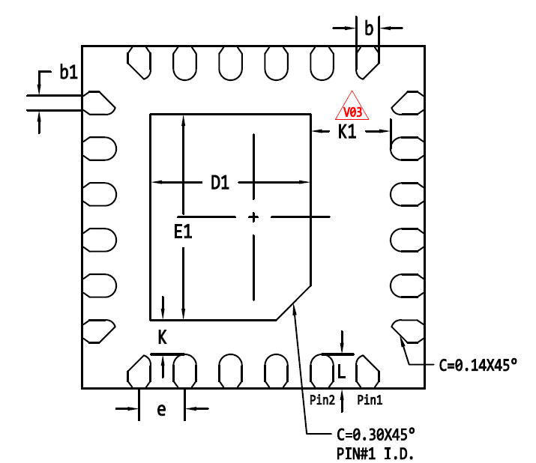
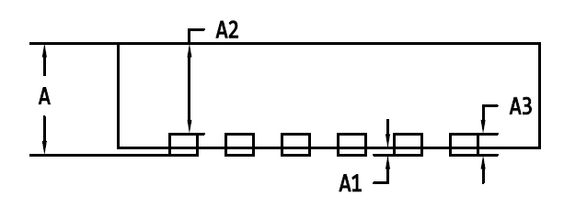
XD12P
Package specification
QFN 3030-24L Package Outline
TOP VIEW
BOTTOM VIEW
E
Pin #1
D
SIDE VIEW
Symbol | Dimensions in mm
 | Min | Typ | Max
A | 0.50 | 0.55 | 0.60
A1 | 0.00 | - | 0.05
A2 | 0.45 REF
A3 | 0.152 REF
b | 0.15 | 0.20 | 0.25
b1 | 0.08 | 0.13 | 0.18
D | 2.90 | 3.00 | 3.10
D1 | 1.35 | 1.40 | 1.45
E | 2.90 | 3.00 | 3.10
E1 | 1.75 | 1.80 | 1.85
e | 0.40 BSC
K | 0.25 | 0.30 | 0.35
K1 | 0.65 | 0.70 | 0.75
L | 0.25 | 0.30 | 0.35
Note
All Dimensions Do Not Include mold flash or Protrusions.
Figure 16. Package Outline

Slide 33
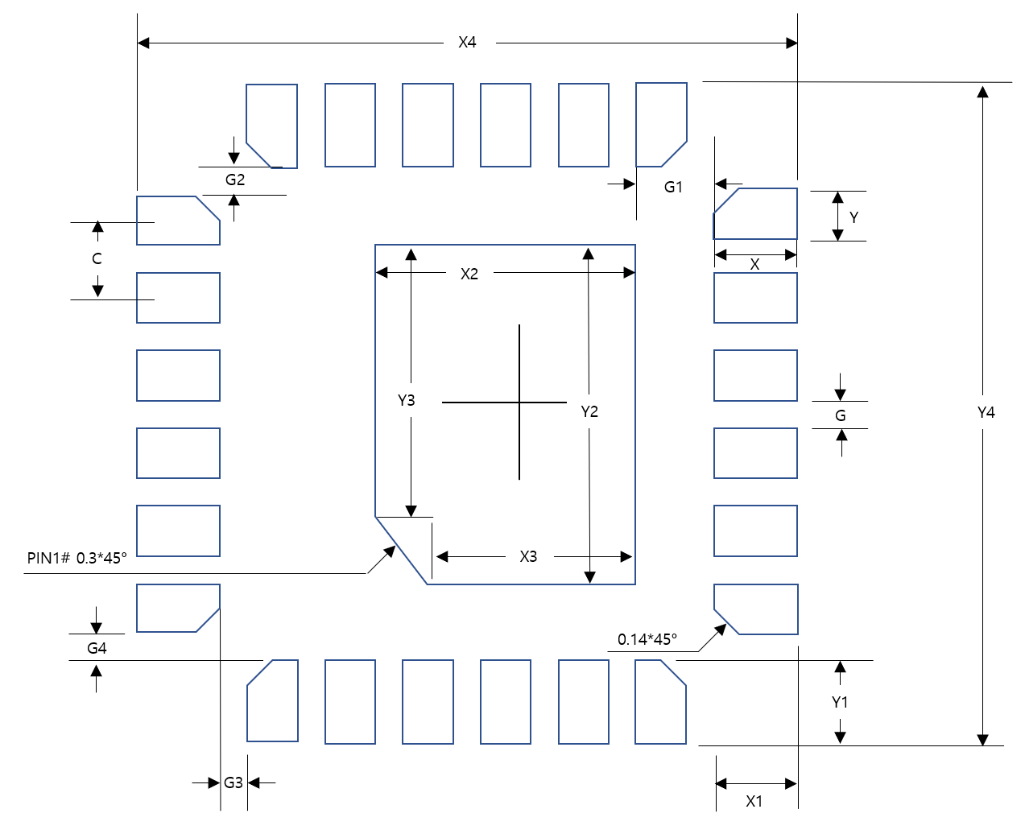

XD12P
Recommended Footprint
Symbol | Dimensions in mm
 | Value | Margin (Typ+)
X | 0.5 | +0.2
Y | 0.2 | 0
C | 0.4 | 0
X1 | 0.5 | +0.2
Y1 | 0.5 | +0.2
X2 | 1.4 | +0.1
Y2 | 1.9 | +0.1
X3 | 1.1 | +0.1
Y3 | 1.6 | +0.1
X4 | 3.4 | +0.2
Y4 | 3.4 | +0.2
G | 0.2 | 0
G1 | 0.3 | 0
G2 | 0.1 | 0
G3 | 0.1 | 0
G4 | 0.1 | 0
Figure 17. Recommended Footprint
Note: The reflow peak soldering temperature is peak 260°C and it is specified based on IPC/JEDEC J-STD- 020
“Moisture/Reflow Sensitivity Classification for Non-Hermetic Solid State Surface Mount Devices”
is the trademark of Global Technologies Co., Ltd. or its subsidiaries in the Republic of Korea and/or other countries. The products of Global Technologies reserve the right to make changes without further notice to any products herein. Global Technologies makes no warranty, representation or guarantee regarding the suitability of its products for any particular purpose, nor does Global Technologies assume any liability arising out of the application or use of any product or circuit, and specifically disclaims any and all liability, including without limitation special, consequential or incidental damages. Global Technologies does not convey any license under its patent rights nor the rights of others.
is the trademark of Global Technologies Co., Ltd. or its subsidiaries in the Republic of Korea and/or other countries. Global Technologies owns the rights to a number of patents, trademarks, copyrights, trade secrets, and other intellectual property. Global Technologies reserves the right to make changes without further notice to any products herein. Global Technologies makes no warranty, representation or guarantee regarding the suitability of its products for any particular purpose, nor does Global Technologies assume any liability arising out of the application or use of any product or circuit, and specifically disclaims any and all liability, including without limitation special, consequential or incidental damages. Buyer is responsible for its products and applications using Global Technologies products, including compliance with all laws, regulations and safety requirements or standards, regardless of any support or applications information provided by Global Technologies. “Typical” parameters which may be provided in Global Technologies data sheets and/or specifications can and do vary in different applications and actual performance may vary over time. All operating parameters, including “Typical” must be validated for each customer application by customer’s technical experts. Global Technologies does not convey any license under its patent rights nor the rights of others. Global Technologies products are not designed, intended, or authorized for use as a critical component in life support systems or any FDA Class 3 medical devices or medical devices with a same or similar classification in a foreign jurisdiction or any devices intended for implantation in the human body. Should Buyer purchase or use Global Technologies products for any such unintended or unauthorized application, Buyer shall indemnify and hold Global Technologies and its officers, employees, subsidiaries, affiliates, and distributors harmless against all claims, costs, damages, and expenses, and reasonable attorney fees arising out of, directly or indirectly, any claim of personal injury or death associated with such unintended or unauthorized use, even if such claim alleges that Global Technologies was negligent regarding the design or manufacture of the part. Global Technologies is an Equal Opportunity/Affirmative Action Employer. This literature is subject to all applicable copyright laws and is not for resale in any manner.

