Slide 1

Global Technologies
XC24
The controller for constant current drivers
24 Channels
General Description
The XC24 is a local dimming controller featuring 24 channels to drive its companion chips, XD series LED drivers that act as the constant current sink for White LED back-lighting solution. This controller interfaces with XD series drivers through one serial line to send and receive the data to be needed for local dimming.
The XC24 supports the SPI interface to communicate with the host, and the SPI interface can be daisy-chained, so it is effective to expand to support a large number of dimming areas.
For raising up dimming controllability, XC24 supports the FB signal to efficiently control the LED power supply voltage and two interrupt pins, nINT_FAULT to indicate the fault events like as the thermal status, the open detection, the short detection and the feedback status, and nINT_LD to indicate the room of internal buffers for dimming data.
Application
LED back-lighting with local dimming control

Slide 2
XC24
Feature
24 channels local dimming controller for the XD series LED drivers
Flexible sizing for each channel
up to 31 daisied LED drivers per channel
up to 255 blocks dimming zone per channel
up to 6,120 blocks dimming zone per XC24
SPI interface
up to 30MHz
support daisy-chain connection
support to detect the packet broken by the access counter and parity bit
Configurable the serial communication baud-rate speed
Internal OSC 25MHz with spread function for EMI reduction
Configurable MCLK, using a external MCLK or internal OSC MCLK
Configurable the serial data out skew between each channel for EMI reduction
Frame synchronization support
Fault events support of drivers through the interrupt function
Over-temperature event
Open detection
Short detection
FB status for VLED power efficiency
V_{DD}, V₁₅ OV/UV detection
VSYNC missing detection
12-bit ADC one channel for VLED control by FB
Configurable Auto-controllability
TTL-level input range
Supply voltage 4.5V ~ 5.5V
48-PIN QFN 6060 Package
Latch-up Immunity ILATCH: JEDEC JESD78D Nov 2011: ±100mA
ESD, HBM protection (Norm: MIL 883 E Method 3015 Human Body Model): ±2kV

Slide 3
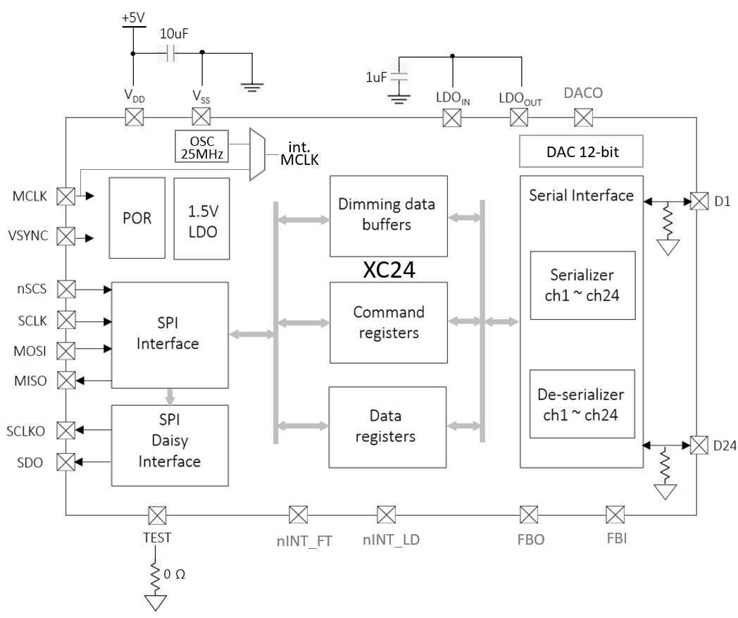
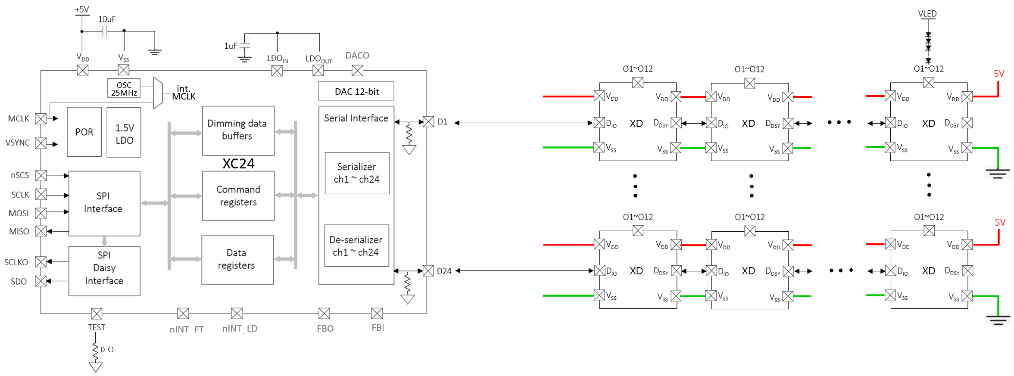
XC24
Block Diagram
Figure 1. Block Diagram
Application Circuit
Figure 2. Application Circuit

Slide 4
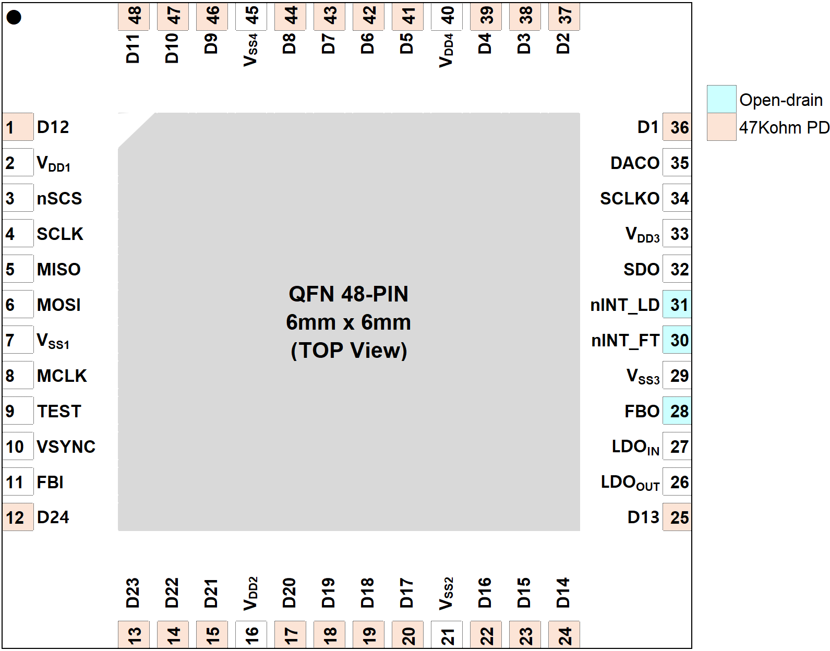
XC24
Pin diagram (Top View)
Figure 3. Pin diagram
Pin description
Pin Name | Pin No. | I/O | Type | Description | Remark
D12 | 1 | I/O | Digital | Data In/Out | if not used, leave to open
V_{DD1} | 2 | I | Power | Digital V_{DD}
nSCS | 3 | I | Digital | SPI Chip Select
SCLK | 4 | I | Digital | SPI SCLK
MISO | 5 | O | Digital | SPI MISO
MOSI | 6 | I | Digital | SPI MOSI
V_{SS1} | 7 | I | GND | Digital GND
MCLK | 8 | I | Digital | Master Clock | if not used, 22Ω PD

Slide 5
XC24
Pin description
Pin Name | Pin No. | I/O | Type | Description | Remark
TEST | 9 | I | Digital | For only TEST mode | 0Ω PD
VSYNC | 10 | I | Digital | Frame synchronization
FBI | 11 | I | Digital | Feedback for VLED control | in case of using multiple XCs
D24 | 12 | I/O | Digital | Data In/Out | if not used, leave to open
D23 | 13 | I/O | Digital | Data In/Out | if not used, leave to open
D22 | 14 | I/O | Digital | Data In/Out | if not used, leave to open
D21 | 15 | I/O | Digital | Data In/Out | if not used, leave to open
V_{DD2} | 16 | I | Power | Digital V_{DD}
D20 | 17 | I/O | Digital | Data In/Out | if not used, leave to open
D19 | 18 | I/O | Digital | Data In/Out | if not used, leave to open
D18 | 19 | I/O | Digital | Data In/Out | if not used, leave to open
D17 | 20 | I/O | Digital | Data In/Out | if not used, leave to open
V_{SS2} | 21 | I | GND | Digital GND
D16 | 22 | I/O | Digital | Data In/Out | if not used, leave to open
D15 | 23 | I/O | Digital | Data In/Out | if not used, leave to open
D14 | 24 | I/O | Digital | Data In/Out | if not used, leave to open
D13 | 25 | I/O | Digital | Data In/Out | if not used, leave to open
LDO_{OUT} | 26 | O | Power | Internal LDO out to LDO_{IN} | connect to LDO_{IN}
LDO_{IN} | 27 | I | Power | LDO feedback from LDO_{OUT} | attach 1uF
FBO | 28 | O | Digital | Feedback for VLED control | Open-drain, 10kΩ PU
V_{SS3} | 29 | I | GND | Digital GND
nINT_FT | 30 | O | Digital | Interrupt for the fault events | Open-drain, 10kΩ PU
nINT_LD | 31 | O | Digital | Interrupt for the dimming data room | Open-drain, 10kΩ PU
SDO | 32 | O | Digital | SPI MOSI daisied out | if not used, 10kΩ PD
V_{DD3} | 33 | I | Power | Digital V_{DD}
SCLKO | 34 | O | Digital | SPI SCLK daisied out | if not used, 10kΩ PD

Slide 6
XC24
Pin description
Pin Name | Pin No. | I/O | Type | Description | Remark
DACO | 35 | O | Analog | DAC for VLED control
D1 | 36 | I/O | Digital | Data In/Out | if not used, leave to open
D2 | 37 | I/O | Digital | Data In/Out | if not used, leave to open
D3 | 38 | I/O | Digital | Data In/Out | if not used, leave to open
D4 | 39 | I/O | Digital | Data In/Out | if not used, leave to open
V_{DD4} | 40 | I | Power | Digital V_{DD}
D5 | 41 | I/O | Digital | Data In/Out | if not used, leave to open
D6 | 42 | I/O | Digital | Data In/Out | if not used, leave to open
D7 | 43 | I/O | Digital | Data In/Out | if not used, leave to open
D8 | 44 | I/O | Digital | Data In/Out | if not used, leave to open
V_{SS4} | 45 | I | GND | Digital GND
D9 | 46 | I/O | Digital | Data In/Out | if not used, leave to open
D10 | 47 | I/O | Digital | Data In/Out | if not used, leave to open
D11 | 48 | I/O | Digital | Data In/Out | if not used, leave to open
Table 1. Pin Description

Slide 7
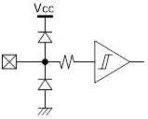
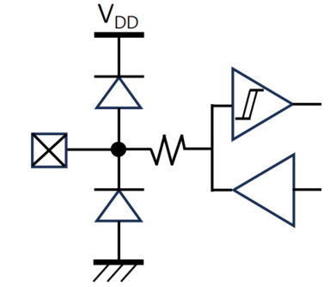

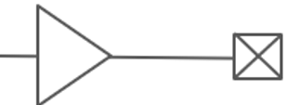
XC24
Equivalent Circuits of individual pins
Pad Name | I/O | Internal Circuit | Description
nSCS | I |  | SPI Chip Select
SCLK | I |  | SPI Clock Input
MOSI | I |  | SPI MOSI
MISO | O |  | SPI MISO
SCLKO | O |  | SCLK Daisy Out
SDO | O |  | MOSI Daisy Out
MCLK | I |  | Mater Clock
V_{DD}
V_{DD}
V_{DD}
V_{DD}
V_{DD}
V_{DD}

Slide 8
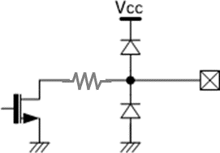
XC24
Equivalent Circuits of individual pins
Pad Name | I/O | Internal Circuit | Description
VSYNC | I |  | Frame Sync
nINT_FT | O |  | Interrupt for Fault (Open-drain)
nINT_LD | O |  | Interrupt for LD (Open-drain)
FBO | O |  | Feedback Output for VLED (Open-drain)
FBI | I |  | Feedback Input for VLED
D | I/O |  | Data In/Out
TEST | I |  | For test only
V_{DD}
V_{DD}
V_{DD}
V_{DD}
V_{DD}
V_{DD}

Slide 9
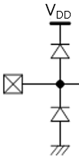
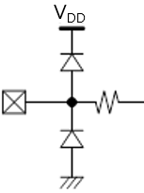
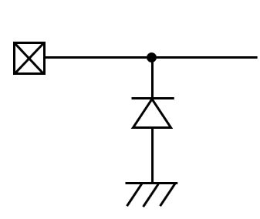

XC24
Equivalent Circuits of individual pins
Pad Name | I/O | Internal Circuit | Description
LDO_{IN} |  |  | Internal LDO In
LDO_{OUT} | I |  | Internal LDO Out
DACO | O |  | DAC Out
V_{DD} | O |  | Digital Power
V_{SS} | - |  | Digital GND
V_{DD}
Figure 4. Equivalent Circuits of individual pins

Slide 10
XC24
Maximum Absolute ratings (Ta = 25℃ unless otherwise noted)
Parameter | Symbol | Value | Unit
Supply voltage | V_{DD} | -0.3 ~ 6.0 | V
MCLK to GND voltage | V_{MCLK} | -0.3 ~ V_{DD}+0.5 | V
VSYNC to GND voltage | V_{VSYNC} | -0.3 ~ V_{DD}+0.5 | V
nSCS to GND voltage | V_{SCS} | -0.3 ~ V_{DD}+0.5 | V
SCLK to GND voltage | V_{SCLK} | -0.3 ~ V_{DD}+0.5 | V
MOSI to GND voltage | V_{MOSI} | -0.3 ~ V_{DD}+0.5 | V
MISO to GND voltage | V_{MISO} | -0.3 ~ V_{DD}+0.5 | V
SCLKO to GND voltage | V_{SCLK} | -0.3 ~ V_{DD}+0.5 | V
SDO to GND voltage | V_{SDO} | -0.3 ~ V_{DD}+0.5 | V
D voltage | V_{DIO} | -0.3 ~ V_{DD}+0.5 | V
Ambient temperature | T_{A} | -20 ~ 85 | ℃
Junction temperature | T_{J} | -20 ~ 125 | ℃
Storage temperature | T_{STG} | -45 ~ 150 | ℃
Relative Humidity(non-condensing) | RH_{NC} | 5 ~ 85 | %
Moisture Sensitivity | MSL | Maximum Floor Life-time | 3
Notes : Stresses beyond those listed under Absolute Maximum Ratings may cause permanent damage to the device
Table 2. Maximum Absolute ratings
Electrostatic Discharge
Parameter | Symbol | Value | Unit | Remark
Electrostatic Discharge HBM ; Contact | ESDHBM | ±2K | V | C=100 pF, R=1.5 kΩ
Electrostatic Discharge CDM ; Contact | ESDCDM | ±500 | V | R=1 Ω
Table 3. Electrostatic Discharge

Slide 11
XC24
Electrical Characteristic (V_{DD} =5.0V, Ta=25.0℃ unless otherwise noted)
Characteristics | Symbol | Condition | Value |  |  | Unit
 |  |  | min | typ | max
Supply
Operating voltage | V_{DD} |  | 4.5 | - | 5.5 | V
Operating Current | I_{DD} |  | - | TBD | - | mA
Quiescent current | I_{DDD} |  | - | TBD | - | mA
MCLK (external)
Frequency | F_{MCLK} |  | ¹⁾ | - | 25 | MHz
Duty |  | @ 1.5V level | 45 | 50 | 55 | %
Jitter | △F_{MCLK} |  | -1 |  | 1 | %
MCLK (internal OSC)
Frequency | F_{MCLK} |  | - | 25 | - | MHz
Duty |  |  | - | - | -
Jitter | △F_{MCLK} |  | - | - | - | %
Input
nSCS Input Voltage | V_{SCSL} | Chip Select, low level | - | - | 0.8 | V
 | V_{SCSH} | Chip Select, high level | 2.7 | - | V_{DD} | V
SCLK Input Voltage | V_{SCLKL} | SPI Clock, low level | - | - | 0.8 | V
 | V_{SCLKH} | SPI Clock, high level | 2.7 | - | V_{DD} | V
MOSI Input Voltage | V_{MOSIL} | MOSI, low level | - | - | 0.8 | V
 | V_{MOSIH} | MOSI, high level | 2.7 | - | V_{DD} | V
VSYNC Input Voltage | V_{VSYNCL} | VSYNC low level | - | - | 0.8 | V
 | V_{VSYNCH} | VSYNC high level | 2.7 | - | V_{DD} | V
FBI Input Voltage | V_{VSYNCL} | FBI low level | - | - | 0.8 | V
 | V_{VSYNCH} | FBI high level | 2.7 | - | V_{DD} | V
Output
MISO Output voltage | V_{MISOL} | MISO, low level | - | - | 0.8 | V
 | V_{MISOH} | MISO, high level | 2.7 | - | V_{DD} | V
SCLKO Output voltage | V_{SCLKOL} | SCLKO, low level | - | - | 0.8 | V
 | V_{SCLKOH} | SCLKO, high level | 2.7 | - | V_{DD} | V
SDO Output voltage | V_{SDOL} | SDO, low level | - | - | 0.8 | V
 | V_{SDOH} | SDO, high level | 2.7 | - | V_{DD} | V

Slide 12
XC24
Electrical Characteristic (V_{DD} =5.0V, Ta=25.0℃ unless otherwise noted)
Characteristics | Symbol | Condition | Value |  |  | Unit
 |  |  | min | typ | max
Bi-direction
D_{IO} | V_{IL} V_{IH} | Input logic low level | - | - | 0.8 | V
 |  | Input logic high level | 2.7 | - | V_{DD}
 | V_{OL} V_{OH} | Output logic low level | - | - | 0.8 | V
 |  | Output logic high level | 2.7 | - | V_{DD}
 | R_{PD} | Internal pull-down resistance | - | 48 | - | KΩ
Bi-direction : Input signal decoding capability
Logical high duration ²⁾ | T_{1H}, T_{0L} |  | 6 | - | 63 | MCLK
Logical low duration ²⁾ | T_{1L}, T_{0H} |  | 3 | - | 32 | MCLK
DAC
DACO | Operating voltage | V_{DD} | 4.5 | - | 5.5 | V
 | Resolution |  |  | - | 12 | Bit
 | Output voltage | 0V @ code 0 3.3 @ code 4,095 | 0 | - | 3.3 | V
 | Code error | △V_{out} | - | ±3 | ±5 | %
V_{DD} Ramp-up and V_{LED} Start
V_{DD} Ramp-up time | T_{VDD} | from 0 to stable 5V |  |  | 1.2 | ms
V_{LED} Start time | T_{SU_DIM} | after T_{SU_DIM} is completed | ³⁾ |  |  | ms
Internal Initialization after V_{DD}, 5V stable
Internal Initial time | T_{INIT} | after V_{DD}, 5V | 20 |  |  | ms
Allowed 1st access | T_{FACC} | after T_{INIT} is completed | 5 |  |  | ms
Logic ‘1’
T_{0H}
Logic ‘0’
T_{1H}
T_{1L}
T_{0L}
Note : 1) It is recommended the minimum MCLK should not be more than twice as slow as the SCLK for stable fast-
readout. If MCLK will be more than twice as slow as SCLK, then an appropriate latency is needed between
the first 16 SCLKs for a command and the second 16 SCLKs for readout.
2) The conditions, T_{1H} ≥ T_{0H} * 2, T_{0L} ≥ T_{1L} * 2, (T_{1H} + T_{0H}) = (T_{0L} + T_{1L}) ≤ 31 are recommended.
3) The time depends on the system configuration, the daisied XD number, SCLK, MCLK and Baud-rate.
Table 4. DC Electrical Characteristic
Important statement
Global Technologies reserves the right to change the above-mentioned information without prior notice.

Slide 13
XC24
Electrical Characteristic (V_{DD} =5.0V, Ta=25.0℃ unless otherwise noted)
Power Sequence
V_{DD}
5V stable
T_{VDD}
T_{INIT}
T_{FACC}
Access to XC
accessible
Set-up to XD
XD setup for dimming
V_{LED}
T_{SU_DIM}
Figure 5. Power up sequence and ramp-up time

Slide 14
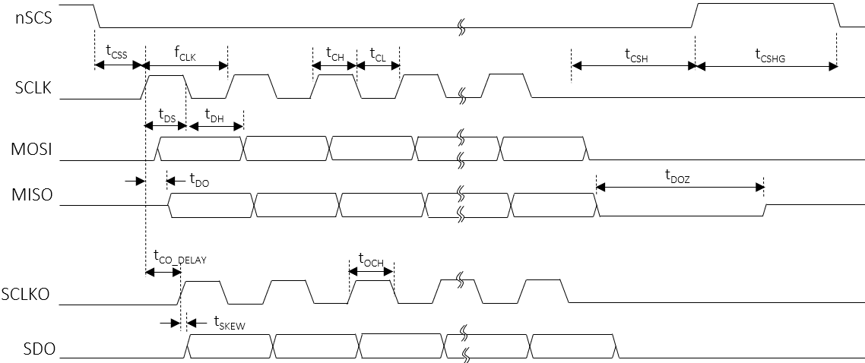
XC24
AC Characteristics (V_{DD S}=5.0V, Ta=25.0℃ unless otherwise noted)
Characteristics | Symbol | Condition | Value |  |  | Unit
 |  |  | min | typ | max
SCLK
SCLK frequency | f_{CLK} |  | - | Typ ¹⁾ | 30 | MHz
SCLK duty | t_{CLK_DUTY} |  | 48 | - | 52 | %
SCLK high time | t_{CH} |  | 8 | - | - | ns
SCLK low time | t_{CL} |  | 8 | - | - | ns
SCLKO
SCLK to SCLKO delay | T_{CO_DELAY} |  | - | - | 10.5 ⁽³⁾ | ns
The skew between SCLKO to SDO | t_{SKEW} |  | - | - | - 1.5 ⁽³⁾ | ns
SCLKO high time | t_{OCH} |  | t_{CH} - 1⁽³⁾ | - | - | ns
nSCS setup to the first rising SCLK | t_{CSS} |  | 50 | - | - | ns
nSCS hold time from the last falling SCLK | t_{CSH} |  | 3 | - | - | MCLK
nSCS high latency time | t_{CSHG} |  | 3 | - | - | MCLK
MOSI setup time | t_{DS} |  | 5 | - | - | ns
MOSI hold time | t_{DH} |  | 2 | - | - | ns
MISO delay from the rising edge SCLK | t_{DO} |  | - | - | 12 | ns
MISO high-Z from the nSCS de-assertion | t_{DOZ} |  | - | - | 1 | MCLK
Note (3) It should be careful that the t_{CO_DELAY,} t_{SKEW,} t_{OCH} and t_{DO} are accumulated by the number of daisy devices if the
daisy chain connection is used. So, for the read transaction, the proper timing should be considered in daisy
chain.
Table 5. AC Electrical Characteristic
Figure 6. SPI timing sequence

Slide 15
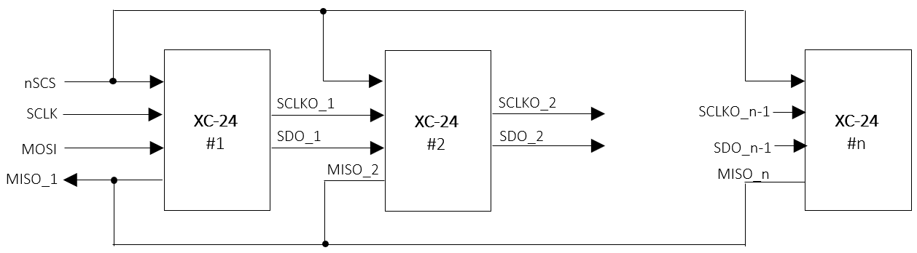
XC24
Functional Description
1. SPI Interface
For the local dimming data transmit a Serial Peripheral Interface is used. The SPI is configurated to work as SPI slave.
A Daisy Chain structure can be used to support large scale blocks array with several devices and operated up to 30MHz.
SPI Daisy Chain Structure
All SPI slaves share the Chip select signal, and these devices in Daisy chain can be treated as one big shift register. The devices can be enumerated as described below.
Figure 7. SPI daisy connection
SPI Protocol
The XC24 has 3 types of the SPI Interface protocol, the register-read, the register-write and the LD data-transfer. The SPI protocol’s format consists of a 16-bit command and a 16-bit register data or a series of 24(or 16)-bit LD data following the 16-bit command.
[Command format]
 | Bit15 | Bit14 | Bit14 | Bit13 | Bit12 | Bit11 | Bit10 | Bit9 | Bit8 | Bit7 | Bit6 | Bit5 | Bit4 | Bit3 | Bit2 | Bit1 | Bit0
 | Command code [1:0] |  |  | Address [7:0] |  |  |  |  |  |  |  | Burst size [5:0]
Register-read | 0 |  | 1 | Start address [7:0] |  |  |  |  |  |  |  | Burst size [5:0]
Register-write | 1 |  | 0 | Start address [7:0] |  |  |  |  |  |  |  | Burst size [5:0]
LD-transfer | 1 |  | 1 | don’t care |  |  |  |  |  |  |  | Line size [5:0]
[Data format]
 | Bit15 | Bit14 | Bit13 | Bit12 | Bit11 | Bit10 | Bit9 | Bit8 | Bit7 | Bit6 | Bit5 | Bit4 | Bit3 | Bit2 | Bit1 | Bit0
 | Data [15:0] |  | Address [7:0] |  |  |  |  |  |  |  | Burst size [5:0]
Register-RW | Register data [15:0] |  | Start address [7:0] |  |  |  |  |  |  |  | Burst size [5:0]
LD1 transfer | LD_WIDTH [1:0] = 2’b00 : 24 bits /block |  | 8’hxx |  |  |  |  |  |  |  | Line size [5:0]
LD2 transfer | LD_WIDTH [1:0] = 2’b01 : 24 bits /block |  | 8’hxx |  |  |  |  |  |  |  | Line size [5:0]
LD3 transfer | LD_WIDTH [1:0] = 2’b10 : 24 bits /block
LD4 transfer | LD_WIDTH [1:0] = 2’b11 : 16 bits /block

Slide 16
XC24
Functional Description
SPI read/write sequence in burst
The SPI access sequence is as follows, depending on the type of access. There is no difference between a single and
a burst access except for the number of data due to the burst size.
nSCS
SCLK
Start addr = 0xa
Burst size = n+1
a
a+1
a+n
b
b+1
b+m
MOSI
Command
Data
Data
Data
Command
Data
Data
Data
SCLKO
Command
b
b+1
b+m
SDO
Data
Data
Data
Figure 8. The SPI Burst write in daisied 2 devices
nSCS
SCLK
MOSI
Command
Command
Start addr = 0xa
Burst size = n+1
a
a+1
a+n
MISO
Data
Data
Data
SCLKO
SDO
Command
MISO
(dev#2)
b
b+1
b+m
Data
Data
Data
Figure 9. The SPI Burst read in daisied 2 devices

Slide 17
XC24
Functional Description
SPI LD transfer sequence
The SPI sequence for the LD transfer is as follows. The LD width depends on the LD_WIDTH value of the CHANNEL ENABLE 2 register. If the LD_WIDTH = 2’b00, then the LD data size of one block zone transferred through the SPI becomes 24 bits consisted of PAM 12 bits and PWM 12 bits. Even if the transmitted width is 24 bits, the valid bits are actually 20 bits, PAM 10 bits + PWM 10 bits. Therefore, the data size per block to be transmitted to the daisied devices is 20 bits.
LD_WIDTH [1:0] | LD width | LD format | Valid bits
2’b00 | 24 bits | PWM 8-bit + PAM 16-bit | PWM 8-bit + PAM 14-bit
2’b01 | 24 bits | PAM 12-bit + PWM 12-bit | PAM 10-bit + PWM 11-bit
2’b10 | 24 bits | PAM 12-bit + PWM 12-bit | PAM 10-bit + PWM 12-bit
2’b11 | 16 bits | LD 16-bit | LD 16-bit
Table 6. LD data size according to LD_WIDTH
The burst size unit means the amount of LD data corresponding to one line and the one line of LD data corresponds to the total LD data of all activated channels, and the number of active channel is determined by the CH_SIZE value of the ENABLE CHANNEL 2 register. Here, the CH_SIZE value should be equal to the number of activated channels by the CHx_EN of the ENABLE CHANNEL 1/2 registers.
Burst size unit = 1-line LD data = CH_SIZE * LD data size
nSCS
Burst size = n
Burst size 2
Burst size 1
Command
LD
ch1
= 1-Line size
LD
chx
LD
ch1
LD
ch2
MOSI
LD
ch2
LD
chx
LD
chx
Command
LD
ch1
LD
ch2
LD width
SDO
CH_SIZE = x
Command
LD
ch1
LD
ch2
Figure 10. The SPI LD transfer in daisied 2 devices

Slide 18
XC24
Functional Description
2. Serial Interface
The XC24 has a total of 24 channels for serial daisy connections with a total of 31 XD devices. Each channel can transmit the data to the XD and receive the data from the XD through one line daisied to the XD devices. The XC24 has a total of 6 instructions for transferring the data to the XD and 3 instructions for receiving the data from the XD.
Ch1
D_{IO}
D_{DIO}
D_{DIO}
D_{DIO}
XC24
XD
#1
D_{IO}
D_{IO}
XD
#2
XD
#31
Ch24
Figure 11. The daisied scheme
The commands are listed as shown in the Table 7. and described in more detail below.
Instruction | Transaction direction | Data direction | Description
 | Command | Data
Global-write | XC → XD | XC → XD | Global-write command the same register data between the XD devices
Local-write | XC → XD | XC → XD | Local-write command the different register data between the XD devices
LD-transfer | XC → XD | XC → XD | Local Dimming data-transfer command to the XD devices
ID-gen | XC → XD | - | ID generation command of the XD devices in daisied each channel
Sync-gen | XC → XD | - | Sync-generation command to the XD devices
Sync-auto-gen | XC → XD | - | Automatically sync-generation command sync on the XD devices
Local-read | XC → XD | XD → XC | Local-read command to the XD devices and read-back from the XD devices
Fault-read | XC → XD | XD → XC | Fault-read command to the XD devices and read-back from the XD devices
Fault-auto-read | XC → XD | XD → XC | Automatically fault-read command to the XD devices and read-back from the XD devices
Table 7. Instruction list

Slide 19
XC24
Functional Description
ID-generation
The ID-GEN COMMAND register is used to set a unique ID for each device and each device’s ID helps identifying when each device should react on a read-back operation. Therefore, after POR this command should be transacted at the first time for proper operation of the XD devices before transacting other commands. If the START bit of ID-GEN COMMAND register is set, then all activated channels begin issuing the command signals to all XDs daisied in each channel and the command signal streams repeat continuously for the number of daisied devices.
The number of daisied devices is determined by the DAISY SIZE register of each channel. After the command signal streams are completed, all devices will have their own ID respectively. The ID is numbered in opposite direction of daisied line. It is careful that the writing data is transferred from the first located device, the last number ID, to the last located device, the first number ID, in daisied line but the reading data is received from the last located device to the first located device sequentially.
Ch1
D_{IO}
D_{DIO}
D_{DIO}
D_{DIO}
XC24
XD
#1
ID=31
D_{IO}
D_{IO}
XD
#2
ID=30
XD
#31
ID=1
Ch24
V_{DD}
nSCS
Initialization to the XD-12
MOSI
ID-GEN COMMAND
transmit
CH1
CH2
CHx
Figure 12. The sequence of ID-GEN command

Slide 20
XC24
Functional Description
Global-write
The Global-write command is used to write the register data to the XD only if all XD devices daisied to a channel of the XC24 have the same register data. If the register data to be written to the XDs are different each other, at that time the Local-write command should be used. For executing the Global-write command properly, the GLOBAL-WRITE DATA register should be firstly written with desired value and then the START bit of the GLOBAL-WRITE COMMAND register should be set with desired address in order to begin transacting this command.
nSCS
MOSI
GLOBAL-WRITE DATA
transmit
GLOBAL-WRITE COMMAND
transmit
CH1
Address
Data
CH2
CHx
Figure 13. The sequence of Global-write command
The GLOBAL-WRITE COMMAND register consists of 6 bits of ADDRESS field and 1 bit of START. The ADDRESS is the register address of the XD to be accessed. If the START bit is set with the ADDRESS together, the Global writing command begins issuing simultaneously in all activated channels, and the command streams repeat continuously for the number of daisied XDs. The number of daisied devices can be determined by the DAISY SIZE register of each channel. The max number of daisied devices per channel is 31.

Slide 21
XC24
Functional Description
Local-write
The Local-write command is used to write the register data to the XD in case that all XD devices daisied to a channel of the XC24 have the different register data each other. If the register data to be written to the XD are same, at that time the Global-write command is more useful for fast transaction time. For proper execution of the Local-write command, the LOCAL-RW DATA registers should be firstly written with desired value and then, the START bit of the LOCAL-WRITE COMMAND register should be set with desired address for beginning this command. It is careful that the LOCAL-RW POINTER RESET register must be set necessarily to 1 for the next transaction after the current Local -write command execution is completed or before the next Local-write command will start again.
nSCS
MOSI
LOCAL-RW DATA
transmit
LOCAL-WRITE COMMAND
transmit
LOCAL-RW POINTER RESET
transmit
CH1
Address
Data
CH2
CHx
Local-write Done
Figure 14. The sequence of Local-write command
The LOCAL-WRITE COMMAND register consists of ADDRESS 6 bits, CH_SEG 2 bits and START 1 bit. The ADDRESS is the register address of the XD to be accessed. If the START bit is set with the ADDRESS together, the Local-write command begins the execution simultaneously in all activated channels, and the command streams repeat continuously for the number of daisied XD. The number of daisied devices can be determined by the DAISY SIZE register of each channel. The max number of daisied devices per channel is 31. The channel segment bits, CH_SEG, are used to decide on which channels are activated for this command, because this command can be performed 8 channels at a time.
The LOCAL-RW DATA registers are divided into a total of 8 port group and each port has a total of 16 registers. The first data register in the port is mapped to the first located XD12 in daisied order and the second data register is mapped to the second located XD, and so on. Although the data registers in a port are a total 16, the XC24 can support over 16 daisied devices in a channel by using the LOCAL-WR TRANSFER POINTER and LOCAL-RW DIFFERENCE POINTER. The LOCAL-WR TRANSFER DIFF POINTER of the LOCAL-RW DIFFERENCE POINTER shows how many data remain in the LOCAL-RW DATA buffers. A value of 0 means that the LOCAL-RW DATA buffers are empty, so you must continue to fill up before they are empty. A value greater than 16 means that the buffer has been overwritten, so you must wait until the pointer value is less than 16.
CH_SEG[1:0] | Channel to be activated | LOCAL-RW DATA 1 ~ 16
 |  | PORT1 | PORT2 | PORT3 | PORT4 | PORT5 | PORT6 | PORT7 | PORT8
2’b00 | Ch 1 ~ Ch 8 | Ch 1 | Ch 2 | Ch 3 | Ch 4 | Ch 5 | Ch 6 | Ch 7 | Ch 8
2’b01 | Ch 9 ~ Ch 16 | Ch 9 | Ch 10 | Ch 11 | Ch 12 | Ch 13 | Ch 14 | Ch 15 | Ch 16
2’b10 | Ch 17 ~ Ch 24 | Ch 17 | Ch 18 | Ch 19 | Ch 20 | Ch 21 | Ch 22 | Ch 23 | Ch 24
Table 8. The LOCAL-RW DATA mapping according to the CH_SEG

Slide 22
XC24
Functional Description
Local-RW DATA structure for access
 | XD drivers daisied in each channel
 | # 1 |  |  |  |  |  |  |  |  |  | # 1
 | # 2 |  | # 1 |  |  |  | # 1 |  | # 1 |  | # 2
 | # 3 |  | # 2 |  | # 1 |  | # 2 |  | # 2 |  | # 3 |  |  |  | # 1
 | # 4 |  | # 3 |  | # 2 |  | # 3 |  | # 3 |  | # 4 |  | # 1 |  | # 2
 | # m-1 |  | # n-1 |  | # k-1 |  | # n-1 |  | # n-1 |  | # m-1 |  | # l-1 |  | # k-1
 | # m |  | # n |  | # k |  | # n |  | # n |  | # m |  | # l |  | # k
CH_SEG
2’b00 |  | Channel 1 |  | Channel 2 |  | Channel 3 |  | Channel 4 |  | Channel 5 |  | Channel 6 |  | Channel 7 |  | Channel 8
2’b01 |  | Channel 9 |  | Channel 10 |  | Channel 11 |  | Channel 12 |  | Channel 13 |  | Channel 14 |  | Channel 15 |  | Channel 16
2’b10 |  | Channel 17 |  | Channel 18 |  | Channel 19 |  | Channel 20 |  | Channel 21 |  | Channel 22 |  | Channel 23 |  | Channel 24
Address |  | PORT 1 |  | PORT 2 |  | PORT 3 |  | PORT 4 |  | PORT 5 |  | PORT 6 |  | PORT 7 |  | PORT 8
0x70~0x77 |  | LOCAL RW DATA 1 |  | LOCAL RW DATA 1 |  | LOCAL RW DATA 1 |  | LOCAL RW DATA 1 |  | LOCAL RW DATA 1 |  | LOCAL RW DATA 1 |  | LOCAL RW DATA 1 |  | LOCAL RW DATA 1
0x78~0x7F |  | LOCAL RW DATA 2 |  | LOCAL RW DATA 2 |  | LOCAL RW DATA 2 |  | LOCAL RW DATA 2 |  | LOCAL RW DATA 2 |  | LOCAL RW DATA 2 |  | LOCAL RW DATA 2 |  | LOCAL RW DATA 2
0x80~0x87 |  | LOCAL RW DATA 3 |  | LOCAL RW DATA 3 |  | LOCAL RW DATA 3 |  | LOCAL RW DATA 3 |  | LOCAL RW DATA 3 |  | LOCAL RW DATA 3 |  | LOCAL RW DATA 3 |  | LOCAL RW DATA 3
0xE8~0xEF |  | LOCAL RW DATA 16 |  | LOCAL RW DATA 16 |  | LOCAL RW DATA 16 |  | LOCAL RW DATA 16 |  | LOCAL RW DATA 16 |  | LOCAL RW DATA 16 |  | LOCAL RW DATA 16 |  | LOCAL RW DATA 16
0x70~0x77 |  | LOCAL RW DATA 1 |  | LOCAL RW DATA 1 |  | LOCAL RW DATA 1 |  | LOCAL RW DATA 1 |  | LOCAL RW DATA 1 |  | LOCAL RW DATA 1 |  | LOCAL RW DATA 1 |  | LOCAL RW DATA 1
0x78~0x7F |  | LOCAL RW DATA 2 |  | LOCAL RW DATA 2 |  | LOCAL RW DATA 2 |  | LOCAL RW DATA 2 |  | LOCAL RW DATA 2 |  | LOCAL RW DATA 2 |  | LOCAL RW DATA 2 |  | LOCAL RW DATA 2
Physical size
Virtual space
 | 1st dev | 2nd dev |  | 16th dev |  | 20th dev
XDs daisied | ID #20 | ID #19 |  | ID #5 |  | ID #1
PORT1 | LOCAL RW DATA 1 | LOCAL RW DATA 2 |  | LOCAL RW DATA 16 |  | LOCAL RW DATA 4
write
 | 20th dev | 19th dev |  | 5th dev |  | 1st dev
XDs daisied | ID #1 | ID #2 |  | ID #16 |  | ID #20
PORT1 | LOCAL RW DATA 1 | LOCAL RW DATA 2 |  | LOCAL RW DATA 16 |  | LOCAL RW DATA 4
read-back
Figure 15. LOCAL-RW DATA mapping structure and data flow

Slide 23
XC24
Functional Description
Sync-generation
The Sync-generation command is used to synchronize the frame sync time for all daisied devices simultaneously. This command execution can be done by two methods, the one is by setting the START bit of the SYNC-GEN COMMAND register and the other is by setting the SYNC_AUTO_EN bit of the COMMAND AUTO ENABLE register.
If the SYNC_AUTO_EN bit is set, the Sync-generation command is automatically executed at the moment of receiving the VSYNC input. It is recommended to use this function, but it should be careful that The synchronization time of the XD devices may be as late as the number of XD devices than the time the VSYNC was received, so the VSYNC should arrive as soon as it is late. This command streams repeat continuously for the number of daisied devices in each channel.
VSYNC
nSCS
MOSI
SYNC-GEN COMMAND
transmit
SYNC-GEN
SYNC-AUTO-GEN
CH1
CH2
CHx
Figure 16. The sequence of SYNC-GEN command
Fault-read
The Fault-read command is used to read-out the fault information of all daisied devices simultaneously. This command execution can be done by two methods, the one is by setting the START bit of the FAULT-GEN COMMAND register and the other is by setting the FAULT_AUTO_EN bit of the COMMAND AUTO ENABLE register.
If the FAULT_AUTO_EN bit is set, the Fault-read command is automatically executed after the completion of the Sync auto-gen command at the moment of receiving the VSYNC input. The fault data to be read-back from all XD devices in each channel is stored into the corresponding channel’s GLOBAL FAULT-READ DATA register, respectively.
VSYNC
nSCS
MOSI
FAULT-READ COMMAND
transmit
FAULT-READ
SYNC-AUTO-GEN
FAULT-AUTO-READ
CH1
CH2
CHx
Figure 17. The sequence of FAULT-READ command

Slide 24
XC24
Functional Description
Local-read
The Local-read command is used to read the register data from all XD devices daisied in a channel of the XC24. Unlike the Local-write or Global-write command, the Local-read command can be used to read the register data of the XD devices regardless of whether the data is the same or different. The data to be read-out from the XD devices are stored into the LOCAL-RW DATA registers sequentially like the Figure 15. The START bit of the LOCAL-READ COMMAND register should be set with desired address to be read-out for beginning this command. It is careful that the LOCAL-RW POINTER RESET register must be set necessarily to 1 for the next transaction after the current Local read command execution is completed or before the next Local-read command will start again.
nSCS
SPI Read
MOSI
LOCAL-READ COMMAND
transmit
LOCAL-RW POINTER RESET
transmit
MISO
LOCAL-READ COMMAND
LOCAL-READ-BACK
CH1
Addr
Data
CH2
CHx
Local-Read Done
Figure 18. The sequence of Local-read command
The LOCAL-READ COMMAND register consists of ADDRESS 6 bits, CH_SEG 2 bits and START 1 bit. The ADDRESS is the register address of the XD to be accessed. If the START bit is set with the ADDRESS together, the Local-read command begins the execution simultaneously in all activated channels, and the command streams repeat continuously for the number of daisied XDs. The number of daisied devices can be determined by the DAISY SIZE register of each channel. The max number of daisied devices per channel is 31. The channel segment bits, CH_SEG, are used to decide on which channels are activated for this command, because this command can be performed 8 channels at a time.
The LOCAL-RW DATA registers are divided into a total of 8 port group and each port has a total of 16 registers. Unlike the Local-write command, the first data register in the port is mapped to the last located XD in daisied order and the second data register is mapped to the second located XD from the back, and so on. Although the data registers in a port are a total 16, the XC24 can support over 16 daisied devices in a channel by using the LOCAL-READ RECEIVE POINTER and LOCAL-RW DIFFERENCE POINTER. The LOCAL-RD RECEIVE DIFF POINTER of the LOCAL-RW DIFFERENCE POINTER shows how many data are filled up in the LOCAL-RW DATA buffers. A value of 0 means that the LOCAL-RW DATA buffers are empty, so you must wait for the buffers to be refilled, and if the value is greater than 16, it means that the LOCAL-RW DATA buffers have been overwritten, so you must drag out the buffers before they are overflowed. Refer to the Table 8. and the Figure 15. for the mapping scheme.

Slide 25
XC24
Functional Description
Sequence of Local Dimming data transfer
The Local Dimming data of the next frame should be transmitted to the XC24 through the SPI and the XC24 should complete to transfer the LD data to the XD devices before assertion of the next frame sync. And then, the LD data will be started dimming-out by the XD devices at the next frame sync. The LD_WR_POINTER of the LD WR POINTER register will be increased one by one in line unit whenever the LD data are written to the XC24 LD data buffers through the SPI and see the Figure 10. for the amount of one line LD. The LD_RD_POINTER will be increased one by one whenever the XC24 transmits the amount of one LD data to the XD devices. The LD_DIFF_POINTER is a value of the LD_WR_POINTER minus the LD_RD_POINTER, so the value is useful to check how many LD data remains in the internal LD buffers.
If the LD_TARNS_START_POINTER value becomes equal to the LD_DIFF_POINTER, then the XC24 starts sending the LD data to the XD devices automatically until the LD_DIFF_POINTER value becomes to 0.
VSYNC
#1
#2
SPI I/F
LD Data transfer
(frame #1-1)
LD Data transfer
(frame #1-2)
LD Data transfer
(frame #1-n)
LD Data transfer
(frame #2-1)
LD_WR_POINTER=k
LD_WR_POINTER=m
LD_DIFF_POINTER=m-n
D_{IO} #x
LD TRANSFER
(frame #1)
Local dimming out
(of XD-12)
LD_TRANS_START_POINTER=k
LD_RD_POINTER=n
Local dimming out
(frame #1)
Figure 19. The sequence of Local dimming Data transfer

Slide 26
XC24
Functional Description
Local Dimming data buffer
The total number of Local Dimming data buffers is 32 per channel and 1 buffer can contain one block data which consists of PAM and PWM data. The size of PAM and PWM data depends on the LD_WIDTH of CHANNEL ENABLE 2 register and refer to previous chapter for more details. Even if the physical buffer size is limited to 32, the XC24 can support to transfer up to 255 blocks by using the LD WRITE POINTER, LD READ POINTER and LD DIFFERENCE POINTER. You can continue to send the LD data so that the LD DIFFERENCE POINTER does not become 0. The number of daisied devices of each channel can be different from each other by separately setting the DAISY SIZE register of each channel. The below shows the scheme of LD buffers and the mapping to the daisied device. For more information refer to the example on the next page.
XD drivers daisied in each channel
# m
# m-1 |  | # n
# m-2 |  | # n-1 |  |  |  | # l
# m-3 |  | # n-2 |  | # k |  | # l-1
# 2 |  | # 2 |  | # 2 |  | # 2
# 1 |  | # 1 |  | # 1 |  | # 1
max DAISIED_DEV_CH_SIZEx = 31
max DAISY_SIZE_CHx = 31
Channel 1 |  | Channel 2 |  | Channel 3 |  | Channel x
Block 1 | LD buffer 1 |  | LD buffer 1 |  | LD buffer 1 |  | LD buffer 1
Block 2 | LD buffer 2 |  | LD buffer 2 |  | LD buffer 2 |  | LD buffer 2
Block 3 | LD buffer 3 |  | LD buffer 3 |  | LD buffer 3 |  | LD buffer 3
Block 32 | LD buffer 32 |  | LD buffer 32 |  | LD buffer 32 |  | LD buffer 32
Physical size=32
Block 33 | LD buffer 33 |  | LD buffer 33 |  | LD buffer 33 |  | LD buffer 33
Block 34 | LD buffer 34 |  | LD buffer 34 |  | LD buffer 34 |  | LD buffer 34
Block 35 | LD buffer 35 |  | LD buffer 35 |  | LD buffer 35 |  | LD buffer 35
Block 127 | LD buffer 127 |  | LD buffer 127 |  | LD buffer 127 |  | LD buffer 127
The amount of SPI one Line LD
Available whole size = 255
max BLOCK_SIZE_CHx = 255
Virtual space=233
LD_SIZE= x
Figure 20. The scheme of Local dimming Data buffers

Slide 27
XC24
Functional Description
Local Dimming data transfer
The below example shows how to set properly the registers relevant to the Local Dimming data transfer. The LD_SIZE of the CHANNEL ENABLE 2 register determines how many channels among a total of 24 channels of XC24 will be activated, and if 20 channels will be used, then the LD_SIZE is 0x14 and available channels become from the channel 1 to channel 20, so it should be careful that the order of channels to be selected must be a direction that sequentially increases from 1 to 24. The DAISY_SIZE_CHx of the DAISY SIZE registers determines how many XD devices will be daisied in the channel x, and if 10 XD devices are daisied in a channel x, then the DAISY_ SIZE_CHx should be set to 0xA. The DAISIED_DEV_CH_SIZE determines how many channels of the XD will be used, so if the value is 0x4, the XD devices daisied in a channel x will capture only 4 LD data and then bypass the flowing LD data streams to the next XD devices and the remainder of the multiples of 4 be delivered lastly to a las XD device. It should be careful that all devices except for the last device must have the same value of DAISIED_ DEV_CH_SIZE. The BLOCK_SIZE_CHx determines the total number of LD data to be transferred to a channel x.
XD drivers daisied in each channel
# 10 |  |  |  |  |  | # 10
# 9 |  | # 9 |  |  |  | # 9
# 8 |  | # 8 |  |  |  | # 8
# 7 |  | # 7 |  | # 7 |  | # 7
# 2 |  | # 2 |  | # 2 |  | # 2
# 1 |  | # 1 |  | # 1 |  | # 1
DAISIED_DEV_CH_SIZEx = 4
DAISY_SIZE_CHx=10
Channel 1 |  | Channel 2 |  | Channel 3 |  | Channel x
The amount of
SPI one Line LD
Block 1 | LD 1 |  | LD 1 |  | LD 1 |  | LD 1
Block 2 | LD 2 |  | LD 2 |  | LD 2 |  | LD 2
Block 3 | LD 3 |  | LD 3 |  | LD 3 |  | LD 3
Block 4 | LD 4 |  | LD 4 |  | LD 4 |  | LD 4
Block 5 | LD 5 |  | LD 5 |  | LD 5 |  | LD 5
Block 27 | LD 27 |  | LD 27 |  | LD 27 |  | LD 27
Block 28 | LD 28 |  | LD 28 |  | LD 28 |  | LD 28
Block 29 | LD 29 |  | LD 29 |  | 0 |  | LD 29
Block 30 | LD 30 |  | LD 30 |  | 0 |  | LD 30
Block 31 | LD 31 |  | LD 31 |  | 0 |  | LD 31
Block 32 | LD 32 |  | LD 32 |  | 0 |  | LD 32
Block 33 | LD 33 |  | LD 33 |  | 0 |  | LD 33
Block 34 | LD 34 |  | LD 34 |  | 0 |  | LD 34
Block 35 | LD 35 |  | 0 |  | 0 |  | LD 35
Block 36 | LD 36 |  | 0 |  | 0 |  | LD 36
Block 37 | LD 37 |  | 0 |  | 0 |  | LD 37
Block 38 | LD 38 |  | 0 |  | 0 |  | 0
Block 39 | LD 39 |  | 0 |  | 0 |  | 0
Block 40 | na |  | na |  | na |  | na
①
②
Physical size=32
DAISIED_DEV_CH_SIZEx= 4
DAISIED_DEV_CH_SIZEx= 4
BLOCK_SIZE_CHx=37
Virtual space
SPI LD Burst transmit sequence
39
LD_SIZE= x
Figure 21. The example of Local dimming Data-transfer

Slide 28
XC24
Functional Description
Spread clock scheme of Serializer
The internal all logics are operated with an internal MCLK clock except for the 24 Serializers. All serializers uses a Serializer clock which is configured to spread clock for reduction of EMI. All Serializers have 2 modes to reduce the EMI radiation, one is to use the spread clock, and the other is to use the output skew function between each Serializer’s output. In addition, it is possible to use 2 modes at the same time. The spread amount is showed in the Table 10. below.
The clock to all Serializers can be configured through 2 bits, the OSC_SPREAD_EN and the SERIALIZER_CLK_SEL. All Serializers’ output skew between each Serializer’s output can be configured by the SERIALIZER_SKEW_EN bit. The skew is different from all Serializers.
※ auto-changed to External MCLK
if it is entered
OSC_SPREAD_EN
Default : OSC
SERIALIZER_SKEW_EN
Int.OSC
25MHz
0
Internal MCLK
External MCLK
1
0
Serializer clk
Serializer CH1
Skew
Logic1
D1
1
Serializer CH2
Skew
Logic2
D2
SERIALIZER_CLK_SEL
Serializer CH24
Skew
Logic24
D24
Figure 22. The scheme of the spread clock
Spread range [%] | SPREAD_D [1:0]
SPREAD_A [2:0] | 0 | 1 | 2 | 3
0 | 0.14 | 0.28 | 0.55 | 1.10
1 | 0.15 | 0.31 | 0.61 | 1.22
2 | 0.17 | 0.34 | 0.68 | 1.35
3 | 0.19 | 0.38 | 0.76 | 1.51
4 | 0.22 | 0.43 | 0.86 | 1.72
5 | 0.25 | 0.50 | 1.00 | 1.99
6 | 0.30 | 0.59 | 1.18 | 2.36
7 | 0.36 | 0.73 | 1.45 | 2.90
Spread speed [KHz] | SPREAD_D [1:0]
SPREAD SPEED | 0 | 1 | 2 | 3
0 | 781.3 | 390.6 | 195.3 | 97.7
1 | 781.3 | 781.3 | 390.6 | 195.3
2 | 1562.5 | 1562.5 | 781.3 | 390.6
3 | 3125.0 | 3125.0 | 1562.5 | 781.3
Table 9. The configuration of the spread range and speed

Slide 29
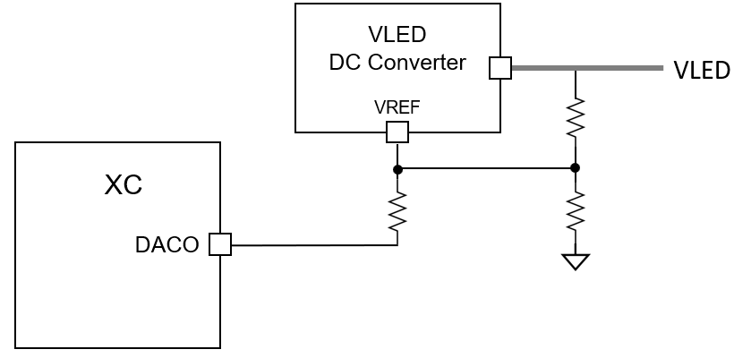
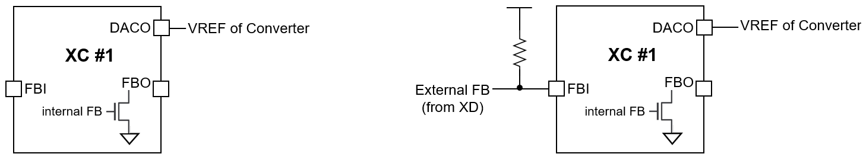
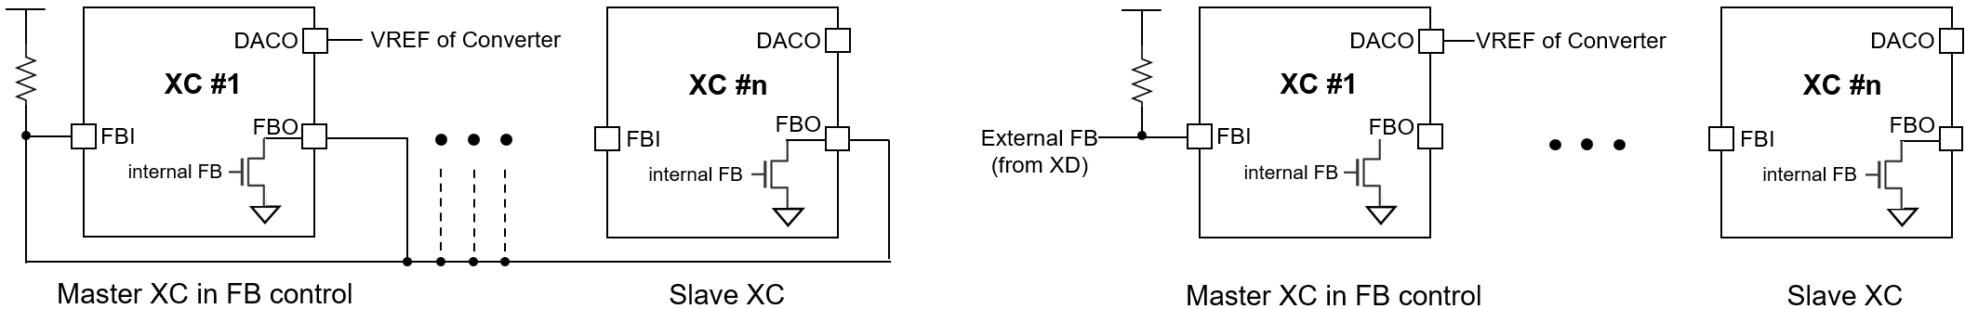
XC24
Functional Description
The FB connection for using several XCs
The XC24 supports an internal FB status which indicates whether the VLED is enough or not. The internal FB status can be got from the readout information through the FAULT-(AUTO)-READ command. The internal FB status is driven on the FBO pin to inform other XCs of the own FB status. Instead of the internal FB status from the command, the XCs can use directly an external FB signals from the XD devices to control the VLED like below Figure 24. The internal FB status has a value which is latched for one frame, so if the XD will sense the FB assertion condition at least once for one frame, the readout information from the command will contain the momorized status latched for one frame.
If multiple XCs are used, it needs to decide which XC is used as a master to control the VLED. Several examples are shown below, and the proper scheme can be chosen according to applications along with the DAC_FB_MODE bit.
Figure 23. The DACO connection to the VLED DC Converter’s VREF
(a) using an internal FB
(b) using an external FB
Figure 24. The scheme in using single XC
(a) using internal FBs of multiple XCs
(b) using an external FB
Figure 25. The scheme in using multiple XCs

Slide 30
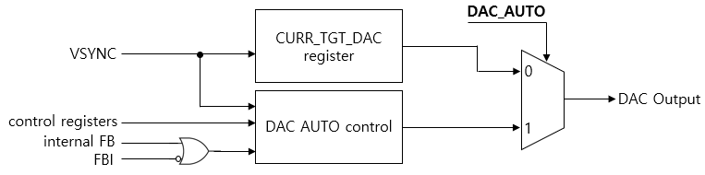
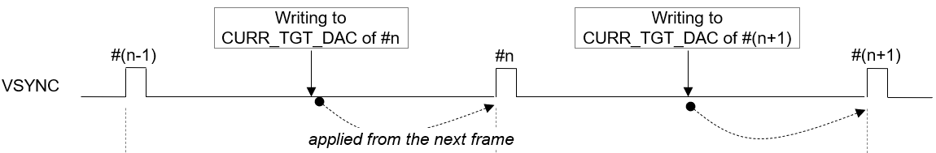
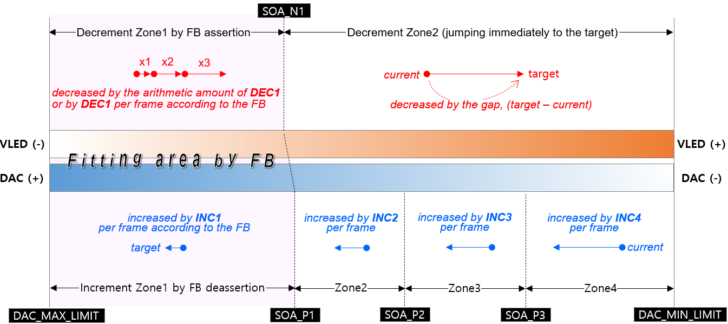
XC24
Functional Description
DAC control for adjusting VLED
The XC24 has one DAC channel to adjust the VLED for efficient power consumption. The DAC out can be directly connected to a reference input of the VLED converter. The DAC has a 12-bit resolution at the max 3.3V level and can be configured to 2 modes according to the DAC_AUTO bit, the MANUAL mode or the AUTO control. In MANUAL mode, the value written to the CURR_TGT_DAC register will be out directly at incoming VSYNC signal. In AUTO mode, the DAC out is automatically controlled according to several registers’ set values. The major difference between the AUTO and MANUAL mode is that the AUTO mode uses the FB status to control efficiently in order to minimize the power consumption. The proper value to be written to the CURR_TGT_DAC can be get from the calculation of the sum of all LEDs’ V_{F} in room temperature plus the minimum required V_{HD} of XD. In case of low high ambient temperature, the DAC out will be re-act rapidly according the FB status. The operating conditions in the AUTO mode can be set through several registers. Refer to the register’s description part for details along with Figure 27. below.
Figure 26. The scheme of the DAC output
Figure 27. The effective timing of writing the CURR_TGT_DAC
Figure 28. The scheme of the DAC AUTO control mode

Slide 31
XC24
3. Register Map
The SPI interface protocol consists of two segments, the command 16-bit followed by the register’s data 16-bit or a series of local dimming data.
Command packet format
B15 | B14 | B13 | B12 | B11 | B10 | B9 | B8 | B7 | B6 | B5 | B4 | B3 | B2 | B1 | B0
COMMAND CODE |  | START ADDRESS [7:0] |  |  |  |  |  |  |  | BURST SIZE [5:0]
Bits | Fields | Descriptions
15:14 | COMMAND CODE | 2’b00 : No operation. 2’b01 : Register Read. 2’b10 : Register Write. 2’b11 : Local dimming data transfer.
13:6 | START ADDRESS | The start address of registers to access.
5:0 | BURST SIZE | Amount of data to be transmitted or received. In case of accessing the registers, the number means how many registers will be accessed for one time. In case of transmitting the LD data, the number means how many lines’ LD data will be transmitted for one time, where one line means the number of enabled channels. If 20 channels are activated and the BURST SIZE is 10, and then the total amount of LD data to be transmitted becomes 20 * 10 * LD width/block [bit].
Data packet format
B15 | B14 | B13 | B12 | B11 | B10 | B9 | B8 | B7 | B6 | B5 | B4 | B3 | B2 | B1 | B0
DATA [15:0]
Bits | Fields | Descriptions
15:0 | DATA [15:0] | In case of COMMAND CODE : | In case of COMMAND CODE :
 |  | 2’b01 2’b10 2’b11 | A register’s data to read. A register’s data to write. A series of the LD, local dimming data. Be careful that the data size and width to transfer the local dimming data are different from the register access. Refer to previous SPI protocol

Slide 32
XC24
SOFT RESET
Addr | Default | B15 | B14 | B13 | B12 | B11 | B10 | B9 | B8 | B7 | B6 | B5 | B4 | B3 | B2 | B1 | B0
‘h00 | 0x0000 | x | x | x | x | x | x | x | x | x | x | VS_RST2 | VS_RST1 | x | RST3 | RST2 | RST1
Bits | Fields | Descriptions
5 | VS_RST2 | If this bit is set, all de-serializers’ sm are reset at VSYNC rising. Normally, no need to use this bit.
4 | VS_RST1 | If this bit is set, all serializers’ sm are reset at VSYNC rising. Normally, no need to use this bit.
2 | RST3 | Reset to all types of buffer, the frame buffers, the global and local r/w registers and the global fault read registers. Auto-cleared. Normally, no need to use this bit.
1 | RST2 | Reset to all serializers’ and de-serializers’ state machine including the timeout error flag, Auto-cleared. Normally, no need to use this bit.
0 | RST1 | Reset to all logics, Auto-cleared (No need to clear after set) It need to set this bit after POR to ensure XC24 reset again.
GLOBAL-WRITE COMMAND
Addr | Default | B15 | B14 | B13 | B12 | B11 | B10 | B9 | B8 | B7 | B6 | B5 | B4 | B3 | B2 | B1 | B0
‘h01 | 0x0000 | START | x | x | x | x | x | x | x | x | x | ADDRESS [5:0]
Bits | Fields | Descriptions
15 | START | 0 | No operation.
 |  | 1 | Start executing the global-write command with the GLOBAL WRITE DATA register, together, and this bit is auto-cleared after completing this execution. For correct operation, It needs to set the GLOBAL WRITE DATA register with desired value before setting this bit. The global-writing can be used in case that the target registers’ values of all XD daisied devices are all the same. If the values are different from each other, then the local-write command should be used instead of the global-write command.
5:0 | ADDRESS | The same target address of all XD daisied devices to write.

Slide 33
XC24
LOCAL-WRITE COMMAND
Addr | Default | B15 | B14 | B13 | B12 | B11 | B10 | B9 | B8 | B7 | B6 | B5 | B4 | B3 | B2 | B1 | B0
‘h02 | 0x000 | START | x | x | x | x | x | CH_SEG [1:0] |  | x | x | ADDR [5:0]
Bits | Fields | Descriptions
15 | START | 0 | No operation.
 |  | 1 | Start executing the local-write command with the LOCAL RW DATA registers together, and this bit is auto-cleared after completing this execution. For correct operation, It needs to set the LOCAL RW DATA registers with desired values before setting this bit. The local-write command is used in case that the target registers’ values of all XD daisied devices are different from each other.
9:8 | CH_SEG | These bits are used to designate which channels are activated for this command.
 |  |  | 2’b00 The channel 1 from 8 are activated. 2’b01 The channel 9 from 16 are activated. 2’b10 The channel 17 from 24 are activated. 2’b11 No allocated.
 |  | Refer to previous chapter. how to allocate the LOCAL RW DATA registers according to CH_SEG [1:0].
5:0 | ADDRESS | The same target address of all XD daisied devices to write
LOCAL-READ COMMAND
Addr | Default | B15 | B14 | B13 | B12 | B11 | B10 | B9 | B8 | B7 | B6 | B5 | B4 | B3 | B2 | B1 | B0
‘h03 | 0x0000 | START | x | x | x | x | x | CH_SEG [1:0] |  | x | x | ADDR [5:0]
Bits | Fields | Descriptions
15 | START | 0 |  | No operation.
 |  | 1 |  | Start executing the local-read command with the LOCAL RW DATA registers together, and this bit is auto-cleared after completing this execution. For correct operation, It needs to set the LOCAL RW DATA registers with desired values before setting this bit. The local-read command is used to read out the target registers’ values of all XD daisied devices.
9:8 | CH_SEG | These bits are used to designate which channels are activated for this command
 |  |  | 2’b00 : The channel 1 from 8 are activated. 2’b01 : The channel 9 from 16 are activated. 2’b10 : The channel 17 from 24 are activated. 2’b11 : No allocated.
 |  | Refer to previous chapter. how to allocate the LOCAL RW DATA registers according to CH_SEG.
5:0 | ADDRESS | The same target address of all XD daisied devices to read out.

Slide 34
XC24
ID-GEN COMMAND
Addr | Default | B15 | B14 | B13 | B12 | B11 | B10 | B9 | B8 | B7 | B6 | B5 | B4 | B3 | B2 | B1 | B0
‘h04 | 0x0000 | START | x | x | x | x | x | x | x | x | x | x | x | x | x | x | x
Bits | Fields | Descriptions
15 | START | 0 1 | No operation. Start executing the id-generating command to all XD daisied devices and this bit is auto-cleared after completing this execution. All XD daisied devices connected in each channel will have their own ID number after completing the id-generating command. This command is needed to read-out the XD drivers’ registers data correctly in sequential, so, this command should be executed before executing the local-reading or the fault-reading command. It is recommended that the id-generating command should be executed firstly on system initialization.
FAULT-READ COMMAND
Addr | Default | B15 | B14 | B13 | B12 | B11 | B10 | B9 | B8 | B7 | B6 | B5 | B4 | B3 | B2 | B1 | B0
‘h05 | 0x0000 | START | x | x | x | x | x | x | x | x | x | x | x | x | x | x | x
Bits | Fields | Descriptions
15 | START | 0 1 | No operation. Start executing the fault-reading command to all XD daisied devices to monitor the fault event like as the thermal occurrence, the short status, the open status and the fb status of the XD devices and this bit is auto-cleared after completing this execution. This command can be also auto-executed at the VSYNC rising edge if the FAULT_ AUTO_EN bit in the COMMAND AUTO ENABLE register is set.
LD-TRANSFER COMMAND
Addr | Default | B15 | B14 | B13 | B12 | B11 | B10 | B9 | B8 | B7 | B6 | B5 | B4 | B3 | B2 | B1 | B0
‘h06 | 0x0000 | START | x | x | x | x | x | x | x | x | x | x | x | x | x | x | x
Bits | Fields | Descriptions
15 | START | 0 1 | No operation. Start executing the local dimming data transfer command to all XD daisied devices in order to transfer the LD data in burst from the XC24 to the XD drivers and this bit is auto-cleared after the completion. This command can be also auto-executed immediately after the amount of LD data to be transferred to the XC24 through the SPI interface is reached to the value of the LD_RD_START_POINTER of the LD START POINTER/TH register.

Slide 35
XC24
SYNC-GEN COMMAND
Addr | Default | B15 | B14 | B13 | B12 | B11 | B10 | B9 | B8 | B7 | B6 | B5 | B4 | B3 | B2 | B1 | B0
‘h07 | 0x0000 | START | x | x | x | x | x | x | x | x | x | x | x | x | x | x | x
Bits | Fields | Descriptions
15 | START | 0 1 | No operation. Start executing the sync-gen command to all XD daisied devices in order to make the frame synchronization to the drivers and this bit is auto-cleared after this execution. This command can be also auto-executed at the VSYNC rising edge, if the SYNC_ AUTO_EN bit in the COMMAND AUTO ENABLE register is set. It is recommended that the SYNC_AUTO_EN bit is set for good local dimming.
COMMAND AUTO ENABLE
Addr | Default | B15 | B14 | B13 | B12 | B11 | B10 | B9 | B8 | B7 | B6 | B5 | B4 | B3 | B2 | B1 | B0
‘h08 | 0x0111 | x | x | x | x | x | x | x | TIMEOUT_EN | x | x | x | FAULT_AUTO_EN | x | x | x | SYNC_AUTO_EN
Bits | Fields | Descriptions
8 | TIMEOUT_EN | 0 1 | No operation The timeout function is activated during the execution of read-back commands. The timer starts from the end of completing whole command frame data out corresponding to all daisied device to first bit arrived time. The timer is expired at (MCLK * 32,767).
4 | FAULT_AUTO_EN | 0 1 | No operation. Start executing the fault-reading command automatically. If this bit is set, the fault-reading command is auto-executed in two conditions. The first is occurred at the time of VSYNC rising edge and the second condition is occurred at the time of expiration of the FAULT AUTO READ TIMER register for the number of occurrence of the FAULT AUTO READ EVENT register.
0 | SYNC_AUTO_EN | 0 1 | No operation. Start executing the sync-gen command automatically. If this bit is set, the sync-gen command is auto-executed at the time of VSYNC rising edge.
LD-WRITE POINTER
Addr | Default | B15 | B14 | B13 | B12 | B11 | B10 | B9 | B8 | B7 | B6 | B5 | B4 | B3 | B2 | B1 | B0
‘h0A | RO | x | x | x | x | x | x | x | LD_WR_POINTER [8:0] | x | x | x | x | x | x | x | x
Bits | Fields | Descriptions
8:0 | LD_WR_POINTER | This register value represents the number of times the local dimming data are written into the internal LD buffers through the SPI interface. The number increases one by one whenever the local dimming data corresponding to (the number of enabled channels * one LD data width) are transferred to the internal LD buffers. This pointer value is reset at the VSYNC rising. LD_WIDTH of the CHANNEL ENABLE 2 register : 2’b00 : one block LD data width = 24 bits 2’b01 : one block LD data width = 24 bits 2’b10 : one block LD data width = 24 bits 2’b11 : one block LD data width = 16 bits

Slide 36
XC24
LD-READ POINTER
Addr | Default | B15 | B14 | B13 | B12 | B11 | B10 | B9 | B8 | B7 | B6 | B5 | B4 | B3 | B2 | B1 | B0
‘h0B | RO | x | x | x | x | x | x | x | LD_RD_POINTER [8:0] | x | x | x | x | x | x | x | x
Bits | Fields | Descriptions
8:0 | LD_RD_POINTER | This register value represents the number of times the local dimming data are read-out to transfer the data from the internal LD buffers to the XD drivers. The number increases one by one whenever the local dimming data corresponding to the one block LD data of the XD drivers are read-out. This pointer value is reset at the VSYNC rising.
LD-DIFFERENCE POINTER
Addr | Default | B15 | B14 | B13 | B12 | B11 | B10 | B9 | B8 | B7 | B6 | B5 | B4 | B3 | B2 | B1 | B0
‘h0C | RO | x | x | x | x | x | x | x | x | x | x | LD_DIFF_POINTER [5:0]
Bits | Fields | Descriptions
5:0 | LD_DIFF_POINTER | This value is useful to monitor how much the LD data remains in the internal LD buffers for checking overrun or underrun. = LD_WR_POINTER – LD_RD_POINTER
LD-TRANSFER START POINTER / THRESHOLD
Addr | Default | B15 | B14 | B13 | B12 | B11 | B10 | B9 | B8 | B7 | B6 | B5 | B4 | B3 | B2 | B1 | B0
‘h0D | 0x0000 | x | x | LD_TRANS_START_POINTER [5:0] | x | x | x | x | x | INT_LD_SIGN | x | LD_DIFF_THRESHOLD [5:0]
Bits | Fields | Descriptions
13:8 | LD_TRANS_START_POINTER | The LD_TRANS_START_POINTER determines when the transmit from the internal LD buffers to the XD drivers will begin. If the value is set to 8, then the transmit will begin as soon as the number of times the data through the SPI interface becomes 8. Once the transmit is stated, the transaction will be continued until the number of transmit reaches to the BLOCK_SIZE value of the BLOCK SIZE registers.
7 | INT_LD_SIGN | Don’t set this bit.
5:0 | LD_DIFF_THRESHOLD | The LD_DIFF_THRESHOLD is used to set in which condition the nINT_LD output signal will be issued to the host. Whenever the LD_DIFF_POINTER is equal to or smaller than the LD_DIFF_THRESHOLD, then the nINT_LD signal will be issued. This feature helps to check how much LD data remains in the internal LD buffer for monitoring overruns or underruns of the LD data.

Slide 37
XC24
LOCAL-WR TRANSFER POINTER
Addr | Default | B15 | B14 | B13 | B12 | B11 | B10 | B9 | B8 | B7 | B6 | B5 | B4 | B3 | B2 | B1 | B0
‘h0E | RO | x | x | LOCAL_WR_OUT_POINTER [5:0] | x | x | x | x | x | x | x | LOCAL_WR_TRANS_POINTER [5:0]
Bits | Fields | Descriptions
13:8 | LOCAL_WR_OUT_POINTER | This register value represents the number of times the data from the LOCAL RW DATA registers are read-out to write the data to the XD drivers’ registers. The number increases one by one whenever the data are read-out from the LOCAL RW DATA registers.
5:0 | LOCAL_WR_TRANS_POINTER | This register value represents the number of times the data to be transferred to the XD drivers are written to the LOCAL RW DATA registers through the SPI interface. The number increased one by one whenever the data are written to the LOCAL RW DATA registers.
LOCAL-RD RECEIVE POINTER
Addr | Default | B15 | B14 | B13 | B12 | B11 | B10 | B9 | B8 | B7 | B6 | B5 | B4 | B3 | B2 | B1 | B0
‘h0F | RO | x | x | LOCAL_RD_OUT_POINTER [5:0] | x | x | x | x | x | x | x | LOCAL_RD_REC_POINTER [5:0]
Bits | Fields | Descriptions
13:8 | LOCAL_RD_OUT_POINTER | This register value represents the number of times the data transferred from the XD drivers are read out from the LOCAL RW DATA registers for transferring the data through the SPI interface. The number increases one by one whenever the data are read-out from the LOCAL RW DATA registers.
5:0 | LOCAL_RD_REC_POINTER | This register value represents the number of times the data to be transferred through the SPI interface are written from the XD drivers to the LOCAL RW DATA registers. The number increased one by one whenever the data are written to the LOCAL RW DATA registers.
LOCAL-RW DIFFERENCE POINTER
Addr | Default | B15 | B14 | B13 | B12 | B11 | B10 | B9 | B8 | B7 | B6 | B5 | B4 | B3 | B2 | B1 | B0
‘h10 | RO | x | x | LOCAL_RD_DIFF_POINTER [5:0] | x | x | x | x | x | x | x | LOCAL_WR_DIFF_POINTER [5:0]
Bits | Fields | Descriptions
13:8 | LOCAL_RD_DIFF_POINTER | This value is useful to monitor how much the data from the XD drivers remains in the LOCAL RW DATA registers for checking overrun or underrun. = LOCAL_RD_REC_POINTER – LOCAL_RD_OUT_POINTER
5:0 | LOCAL_WR_DIFF_POINTER | This value is useful to monitor how much the data to be transferred to the XD remains in the LOCAL RW DATA registers for checking overrun or underrun. = LOCAL_WR_TRANS_POINTER – LOCAL_WR_OUT_POINTER

Slide 38
XC24
LOCAL-RW POINTER RESET
Addr | Default | B15 | B14 | B13 | B12 | B11 | B10 | B9 | B8 | B7 | B6 | B5 | B4 | B3 | B2 | B1 | B0
‘h11 | 0x0000 | x | x | x | x | x | x | x | LOCAL_RD_POINTER_RST | x | x | x | x | x | x | x | LOCAL_WR_POINTER_RST
Bits | Fields | Descriptions
8 | LOCAL_RD_POINTER_RST | 0 1 | No operation The LOCAL_RD_OUT_POINTER and the LOCAL_RD_REC_POINTER are reset. This bit is auto-cleared. After completing the Local read command, the relevant pointer value must be cleared by this bit before the next Local read command.
0 | LOCAL_WR_POINTER_RST | 0 1 | No operation The LOCAL_WR_OUT_POINTER and the LOCAL_WR_TRANS_POINTER are reset. This bit is auto-cleared. After completing the Local write command, the relevant pointer value must be cleared by this bit before the next Local write command.
FAULT-AUTO-READ INTERVAL
Addr | Default | B15 | B14 | B13 | B12 | B11 | B10 | B9 | B8 | B7 | B6 | B5 | B4 | B3 | B2 | B1 | B0
‘h12 | 0x0000 | FAULT_AUTO_RD_INTERVAL [15:0] | x | LOCAL_RD_OUT_POINTER [5:0] | x | x | x | x | x | x | x | LOCAL_RD_REC_POINTER [5:0]
Bits | Fields | Descriptions
15:0 | FAULT_AUTO_RD_INTERVAL | This register determines the execution interval for the fault auto-read commands. Counted in MCLK units.
FAULT-AUTO-READ EVENT
Addr | Default | B15 | B14 | B13 | B12 | B11 | B10 | B9 | B8 | B7 | B6 | B5 | B4 | B3 | B2 | B1 | B0
‘h13 | 0x0000 | FAULT_AUTO_RD_EVENT [7:0] | x | x | x | x | x | x | x | x | x | x | x | x | x | x | FAULT_AUTO_RD_INTERVAL[16]
Bits | Fields | Descriptions
15:8 | FAULT_AUTO_RD_EVENT | This register determines the execution times for the fault auto-read commands. The value is reset at VSYNC rising edge.
0 | FAULT_AUTO_RD_INTERVAL | The MSB bit of the FAULT_AUTO_RD_INTERVAL [16:0]
SERIALIZER BAUDRATE GEN
Addr | Default | B15 | B14 | B13 | B12 | B11 | B10 | B9 | B8 | B7 | B6 | B5 | B4 | B3 | B2 | B1 | B0
‘h14 | 0x0A14 | x | SCK_LOW [6:0] |  |  |  |  |  |  | x | SCK_HIGH [6:0] |  |  |  | x | x
Bits | Fields | Descriptions
14:8 | SERIAL_CLK_LOW | These bits determine the number of MCLK of V_{DD} level in logic low value ‘0’ or the number of MCLK of 0 level in logic high value ‘1’ when the XC is driving the D_{IO} pin to the XDs. For more details, refer to Table. 4, Logic low time.
6:0 | SERIAL_CLK_HIGH | These bits determine the number of MCLK of V_{DD} level in logic high value ‘1’ or the number of MCLK of 0 level in logic low value ‘0’ when the XC is driving the D_{IO} pin to the XDs. For more details, refer to Table. 4, Logic low time.

Slide 39
XC24
INTERRUPT ENABLE
Addr | Default | B15 | B14 | B13 | B12 | B11 | B10 | B9
‘h15 | 0x0000 | INT_OV50_EN | INT_UV50_EN | INT_OV15_EN | INT_UV15_EN | x | INT_ACC_CNT_ERR_EN | INT_PARITY_ERR_EN
Addr | Default | B8 | B7 | B6 | B5
‘h15 | 0x0000 | INT_TIMEOUT_ERR_EN | INT_FAULT_RD_FAIL_EN | INT_FAULT_AUTO_RD_FAIL_EN | INT_RD_REC_FAIL_EN
Addr | Default | B4 | B3 | B2 | B1 | B0
‘h15 | 0x0000 | INT_LD_EN | INT_THERMAL_EN | INT_SHORT_EN | INT_OPEN_EN | INT_FB_EN
Bits | Fields | Descriptions
15 | INT_OV50_EN | This bit enables to issue the interrupt through the nINT_FAULT pin in case that the V_{DD}, 5V, will be go over the OV50_LEVEL value.
14 | INT_UV50_EN | This bit enables to issue the interrupt through the nINT_FAULT pin in case that the V_{DD}, 5V, will be go under the UV50_LEVEL value.
13 | INT_OV15_EN | This bit enables to issue the interrupt through the nINT_FAULT pin in case that the internal LDO, 1.5V, will be go over the OV50_LEVEL value.
12 | INT_UV15_EN | This bit enables to issue the interrupt through the nINT_FAULT pin in case that the internal LDO,1.5V, will be go under the UV50_LEVEL value.
10 | INT_ACC_CNT_ERR_EN | This bit enables to issue the interrupt through the nINT_FAULT pin in case that the SPI transaction counter value on SPI data will be different from the (ACC_COUNTER [7:0] + 1)
9 | INT_PARITY_ERR_EN | This bit enables to issue the interrupt through the nINT_FAULT pin in case that the SPI data stream’s parity is not an Odd value.
8 | INT_TIMEOUT_ERR_EN | This bit enables to issue the interrupt through the nINT_FAULT pin in case that the timer will be expired during the execution for read-back commands. The expired time is MCLK * 32,767.
7 | INT_FAULT_RD_FAIL_EN | This bit enables to issue the interrupt through the nINT_FAULT pin in case that any violation happens during the execution for the fault read-back from the XDs.
6 | INT_FAULT_AUTO_RD_ FAIL_EN | This bit enables to issue the interrupt through the nINT_FAULT pin in case that any violation happens during the execution for the fault auto-read-back from the XDs.
5 | INT_RD_REC_FAIL_EN | This bit enables to issue the interrupt through the nINT_FAULT pin in case that any violation happens during the execution for the local read-back from the XDs.
4 | INT_LD_EN | This bit enables to issue the interrupt through the nINT_FAULT pin in case that the LD_DIFF_POINTER is equal to or smaller than the LD_DIFF_THRESOLD during the execution of the LD transfer to the XDs.
3 | INT_THERMAL_EN | This bit enables to issue the interrupt through the nINT_FAULT pin in case that the thermal regulation happens among the XD drivers during dimming operation.
2 | INT_SHORT_EN | This bit enables to issue the interrupt through the nINT_FAULT pin in case that the short condition happens among the XD drivers during dimming operation.
1 | INT_OPEN_EN | This bit enables to issue the interrupt through the nINT_FAULT pin in case that the open condition happens among the XD drivers during dimming operation.
0 | INT_FB_EN | This bit enables to issue the interrupt through the nINT_FAULT pin in case that the fb condition happens among the XD drivers during dimming operation.

Slide 40
XC24
COMMAND STATUS 1
Addr | Default | B15 | B14 | B13 | B12
‘h16 | RO | LOCAL_RD_DONE | LOCAL_RD_DOING | LOCAL_WR_DONE | LOCAL_WR_DOING
Addr | Default | B11 | B10 | B9 | B8 | B7 | B6
‘h16 | RO | GLOBAL_WR_DONE | GOLBAL_WR_DOING | LD_TRANS_DONE | LD_TRANS_DOING | FAULT_DONE | FAULT_DOING
Addr | Default | B5 | B4 | B3 | B2 | B1 | B0
‘h16 | RO | FAULT_AUTO_DONE | FAULT_AUTO_DOING | SYNC_AUTO_DONE | SYNC_AUTO_DOING | SYNC_DONE | SYNC_DOING
Bits | Fields | Descriptions
15 | LOCAL_RD_DONE | This bit is set after the execution for the local-reading command is completed.
14 | LOCAL_RD_DOING | This bit is set while the local-reading command is working until it is complete.
13 | LOCAL_WR_DONE | This bit is set after the execution for the local-writing command is completed.
12 | LOCAL_WR_DOING | This bit is set while the local-writing command is working until it is complete.
11 | GLOBAL_WR_DONE | This bit is set after the execution for the global-writing command is completed.
10 | GLOBAL_WR_DOING | This bit is set while the global-writing command is working until it is complete.
9 | LD_TRANS_DONE | This bit is set after the execution for the LD transferring command is completed.
8 | LD_TRANS_DOING | This bit is set while the LD transferring command is working until it is complete.
7 | FAULT_DONE | This bit is set after the execution for the fault-reading command is completed.
6 | FAULT_DOING | This bit is set while the fault-reading command is working until it is complete.
5 | FAULT_AUTO_DONE | This bit is set after the execution for the fault auto-reading command is completed.
4 | FAULT_AUTO_DOING | This bit is set while the fault auto-reading command is working until it is complete.
3 | SYNC_AUTO_DONE | This bit is set after the execution for the sync auto-gen command is completed.
2 | SYNC_AUTO_DOING | This bit is set while the sync auto-gen command is working until it is complete.
1 | SYNC_DONE | This bit is set after the execution for the sync-gen command is completed.
0 | SYNC_DOING | This bit is set while the sync-gen command is working until it is complete.

Slide 41
XC24
COMMAND STATUS 2
Addr | Default | B15 | B14 | B13 | B12 | B11 | B10 | B9 | B8 | B7 | B6 | B5 | B4 | B3 | B2 | B1 | B0
‘h17 | RO | x | x | x | x | x | x | x | x | x | x | x | x | x | x | ID_GEN_DONE | ID_GEN_DOING
Bits | Fields | Descriptions
1 | ID_GEN_DONE | This bit is set after the execution for the id-gen command is completed.
0 | ID_GEN_DOING | This bit is set while the id-gen command is working until it is complete.
RECEIVE STATUS
Addr | Default | B15 | B14 | B13 | B12
‘h18 | RO | x | FAULT_REC_FAIL | FAULT_AUTO_REC_FAIL | LOCAL_REC_FAIL
Addr | Default | B11 | B10 | B9 | B8 | B7 | B6 | B5 | B4
‘h18 | RO | x | x | x | TIMEOUT_ERR | x | x | FAULT_REC_DONE | FAULT_REC_DOING
Addr | Default | B3 | B2 | B1 | B0
‘h18 | RO | FAULT_AUTO_REC_DONE | FAULT_AUTO_REC_DOING | LOCAL_REC_DONE | LOCAL_REC_DOING
Bits | Fields | Descriptions
14 | FAULT_REC_FAIL | This bit is set if any violation happens while the fault-receiving job is working.
13 | FAULT_AUTO_REC_FAIL | This bit is set if any violation happens while the fault auto-receiving job is working.
12 | LOCAL_REC_FAIL | This bit is set if any violation happens while the local read-receiving job is working.
8 | TIMEOUT_ERR | This bit is set if the timer will be expired while the execution of read-back due to no response from the XD devices. This bit is auto-cleared after the readout of the INTERRUPT STATUS register.
5 | FAULT_REC_DONE | This bit is set after the fault-receiving job is completed.
4 | FAULT_REC_DOING | This bit is set while the fault-receiving job is working until it is complete.
3 | FAULT_AUTO_REC_DONE | This bit is set after the fault auto-receiving job is completed.
2 | FAULT_AUTO_REC_DOING | This bit is set while the fault auto-receiving job is working until it is complete.
1 | LOCAL_REC_DONE | This bit is set after the local read-receiving job is completed.
0 | LOCAL_REC_DOING | This bit is set while the local read-receiving job is working until it is complete.

Slide 42
XC24
INTERRUPT SOURCE STATUS
Addr | Default | B15 | B14 | B13 | B12 | B11
‘h19 | RO | INT_OVUV_ERR_SRC | INT_ACC_CNT_ERR_SRC | INT_PARITY_ERR_SRC | INT_TIMEOUT_ERR_SRC | INT_FAULT_REC_FAIL_SRC
Addr | Default | B10 | B9 | B8 | B7
‘h19 | RO | INT_FAULT_AUTO_REC_FAIL_SRC | INT_RD_REC_FAIL_SRC | INT_LD_TRAN_SRC | INT_TML_SRC
Addr | Default | B6 | B5 | B4 | B3 | B2 | B1 | B0
‘h19 | RO | INT_SHORT_SRC | INT_OPEN_SRC | INT_FB_SRC | x | x | INT_LD | INT_FAULT
Bits | Fields | Descriptions
15 | INT_OVUV_ERR_ SRC | This bit shows whether the UV or OV detection condition of V_{DD} and internal LDO, respectively, has been happened while the XC is working. This bit is auto-cleared after the readout of INTERRUPT STATUS register.
14 | INT_ACC_CNT_ ERR_SRC | This bit shows whether the SPI access counter value on the SPI transaction from a Host has been different from the (ACC_COUNTER [7:0] + 1) while the SPI transactions are occurred. This bit is auto-cleared after the readout of INTERRUPT STATUS register.
13 | INT_PARITY_ ERR_SRC | This bit shows whether the SPI data stream’s parity value on the SPI transaction from a Host has been not an Odd parity while the SPI transactions are occurred. This bit is auto-cleared after the readout of INTERRUPT STATUS register.
12 | INT_TIMEOUT_ ERR_SRC | This bit shows whether the timeout has been happened while the read-back commands are working. This bit is auto-cleared after the readout of INTERRUPT STATUS register.
11 | INT_FAULT_ REC_FAIL_SRC | This bit shows whether any violation has been happened while the fault-receiving job is working. This bit value will remain at the same level until start of the next command even if this register has been read-out.
10 | INT_FAULT_AUTO_ REC_FAIL_SRC | This bit shows whether any violation has been happened while the fault auto-receiving job is working. This bit value will remain at the same level until start of the next command even if this register has been read-out.
9 | INT_RD_REC_ FAIL_SRC | This bit shows whether any violation has been happened while the local read-receiving job is working. This bit value will remain at the same level until start of the next command even if this register has been read-out.
8 | INT_LD_TRANS_ SRC | This bit shows whether the LD interrupt has been asserted while transferring the LD data to XD12 drivers through the XC24 controller. This bit value will remain at the same level until start of the next command even if this register has been read-out.
7 | INT_TML_SRC | This bit shows the THERMAL status from all XDs daisied to active channels after the FAULT-(AUTO)-READ execution. This bit value will be kept the current level until newly updated from a next FAULT-(AUTO)-READ execution even if this register has been read-out.
6 | INT_SHORT_SRC | This bit shows the SHORT status from all XDs daisied to active channels after the FAULT-(AUTO)-READ execution. This bit value will be kept the current level until newly updated from a next FAULT-(AUTO)-READ execution even if this register has been read-out.
5 | INT_OPEN_SRC | This bit shows the OPEN status from all XDs daisied to active channels after the FAULT-(AUTO)-READ execution. This bit value will be kept the current level until newly updated from a next FAULT-(AUTO)-READ execution even if this register has been read-out.

Slide 43
XC24
INTERRUPT SOURCE STATUS
Addr | Default | B15 | B14 | B13 | B12 | B11
‘h19 | RO | INT_OVUV_ERR_SRC | INT_ACC_CNT_ERR_SRC | INT_PARITY_ERR_SRC | INT_TIMEOUT_ERR_SRC | INT_FAULT_REC_FAIL_SRC
Addr | Default | B10 | B9 | B8 | B7
‘h19 | RO | INT_FAULT_AUTO_REC_FAIL_SRC | INT_RD_REC_FAIL_SRC | INT_LD_TRAN_SRC | INT_TML_SRC
Addr | Default | B6 | B5 | B4 | B3 | B2 | B1 | B0
‘h19 | RO | INT_SHORT_SRC | INT_OPEN_SRC | INT_FB_SRC | x | x | INT_LD | INT_FAULT
Bits | Fields | Descriptions
4 | INT_FB_SRC | This bit shows the FB status from all XDs daisied to the active channels after the FAULT-(AUTO)-READ execution. This bit value will be kept the current level until newly updated from a next FAULT-(AUTO)-READ execution even if this register has been read-out.
1 | INT_LD | If this bit is set, the nINT_LD pin will be asserted to the active-low. This bit represents an interrupt sources, INT_LD_TRAN_SRC if its interrupt enable bits is set. If the INT_LD_EN bit is set and INT_LD_ TRAN_SRC is asserted, then, this bit will be asserted through nINT_LD pin. This bit is auto-cleared after this INTERRUPT STATUS register is read-out.
0 | INT_FAULT | If this bit is set, the nINT_FAULT pin will be asserted to the active-low. This bit represents several interrupt sources, INT_FB_SRC, INT_OPEN_SRC, INT_SHORT _SRC, INT_TML_SRC, INT_LOCAL_REC_FAIL_ SRC, INT_FAULT_AUTO_REC_FAIL _SRC, INT_FAULT_REC_FAIL_SRC, INT_TIMEOUT_ERR_SRC, INT_PARITY _ERR _SRC, INT_ACC_CNT_ERR_SRC and INT_OVUV_ERR_SRC if their own interrupt enable bits are set. If the corresponding interrupt enable bit is set and the interrupt source is asserted, then, this bit will be asserted through nINT_FAULT pin. This bit is auto-cleared after this INTERRUPT STATUS register is read-out.

Slide 44
XC24
SPI FAULT STATUS & CONTROL
Addr | Default | B15 | B14 | B13 | B12 | B11 | B10 | B9 | B8 | B7 | B6
‘h1A | RO | ACC_COUNTER [7:0] |  |  |  |  |  |  |  | x | x
Addr | Default | B5 | B4 | B3 | B2 | B1 | B0
‘h1A | 0x0 | ACC_CNT_ERR | PARITY_ERR | x | x | ACC_CNT_ERR_DET_EN | PARITY_ERR_DET_EN
Bits | Fields | Descriptions
15:8 | ACC_COUNTER | These bits show how many times the access from a Host to a XC has been executed on SPI bus. Therefore, the next access number should be same as (previous ACC_COUNTER + 1). If this counter is expired, then the counter will be role-overed to ‘0’ as the next start value. If the value is not same under the SPI_ACC _CNT_ ERR_DET_EN set, then the INT_ACC_CNT_ERR_SRC bit will be set under the INT_ACC_CNT_ERR_EN set.
5 | ACC_CNT_ERR | Read-Only. This bit shows whether the access counter value error has been happened or not. Auto-cleared after a readout.
4 | PARITY_ERR | Read-Only. This bit shows whether the parity error has been happened or not. Auto-cleared after a readout
1 | ACC_CNT_ERR_DET_EN | This bit enables the detection whether the access count value from a Host on SPI transaction is correct.
0 | PARITY_ERR_DET_EN | This bit enables the detection whether the parity value of SPI data stream from a Host is correct. The parity is expressed with ODD parity for SPI data stream.
SPI Data Stream | 8-bit = ACC_COUNTER value | the 3rd bit of last byte = Parity bit
CLK CONTROL 1
Addr | Default | B15 | B14 | B13 | B12 | B11 | B10 | B9 | B8
‘h1B | 0x0000 | x | SPREAD_RANGE_A[2:0] |  |  | LD_B_RD_CLK_SEL | SERIALIZE_CLK_STATUS | SPREAD_RANGE_D[1:0]
Addr | Default | B7 | B6 | B5 | B4 | B3 | B2 | B1 | B0
‘h1B | 0x0000 | SPREAD_SPEED[1:0] |  | SPREAD_DIR[1:0] |  | SERIALIZE_CLK_SEL | OSC_SPREAD_EN | SERIALIZER_SKEW_EN | MCLK_MODE
Bits | Fields | Descriptions
14:12 | SPREAD_RANGE_A | Refer to the Table 9.
11 | LD_B_RD_CLK_SEL | ‘0’ Internal OSC ‘1’ External MCLK
10 | SERIALIZE_CLK_STS | Read-Only. ‘0’ Internal OSC ‘1’ External MCLK
9:8 | SPREAD_RANGE_D | Refer to the Table 9.
7:6 | SPREAD_SPEED | Internal OSC clock spread period. Refer to the Table 9. ‘00’ x1, ‘01’ x2, ‘10’ x4, ‘11’ x8
5:4 | SPREAD_DIR | ‘00’ +%, ‘01’ -%, ‘10’ ±%
3 | SERIALIZE_CLK_SEL | ‘0’ Internal OSC ‘1’ External MCLK
2 | OSC_SPREAD_EN | Spread of internal OSC clock. (The external MCLK can not be spread) Refer to the Figure 22. for the clock scheme. ‘0’ Not Spread ‘1’ Spread
1 | SERIALIZER_SKEW_EN | ‘0’ Skew disabled between Serializers ‘1’ Skew enabled
0 | MCLK_MODE (Read-Only) | ‘0’ Internal OSC (Default) ‘1’ External MCLK (auto-changed if the ext. MCLK is entered)

Slide 45
XC24
CLK CONTROL 2
Addr | Default | B15 | B14 | B13 | B12 | B11 | B10 | B9 | B8 | B7 | B6 | B5 | B4 | B3 | B2 | B1 | B0
‘h1C | 0x4040 | x | OSC_FORCE_STATIC [6:0] |  |  |  |  |  |  | x | Reserved
Bits | Fields | Descriptions
14:8 | OSC_FORCE_STATIC | Forcing the current OSC output clock to static state without variation when the OSC_SPREAD_EN bit is disabled. For test only.
6:0 | Reserved
VDD & LDO STATUS
Addr | Default | B15 | B14 | B13 | B12 | B11 | B10 | B9 | B8 | B7 | B6 | B5 | B4 | B3 | B2 | B1 | B0
‘h1D | RO | x | x | x | OV15_DET | x | x | x | UV50_DET | x | x | x | OV15_DET | x | x | x | UV15_DET
Bits | Fields | Descriptions
12 | OV50_DET | These bits will be set whenever the detection condition keeps for above 100us and will keep the assertion unless the detection condition is cleared.
8 | UV50_DET
4 | OV15_DET
0 | UV15_DET
VDD & LDO FAULT LEVEL
Addr | Default | B15 | B14 | B13 | B12 | B11 | B10 | B9 | B8 | B7 | B6 | B5 | B4 | B3 | B2 | B1 | B0
‘h1E | 0x4444 | x | OV50_LEVEL [2:0] |  |  | x | UV50_LEVEL [2:0] |  |  | x | OV15_LEVEL [2:0] |  |  | x | UV15_LEVEL [2:0]
Bits | Fields | Descriptions
 |  | This register determines the detection level, respectively.
14:12 | OV50_LEVEL | 3b’000 : > 5.42V 3b’001 : > 5.49V 3b’010 : > 5.63V 3b’011 : > 5.71V 3b’100 : > 5.78V 3b’101 : > 5.94V 3b’110 : > 6.03V 3b’111 : > 6.12V
10:8 | UV50_LEVEL | 3b’000 : < 3.78V 3b’001 : < 3.88V 3b’010 : < 3.99V 3b’011 : < 4.11V 3b’100 : < 4.19V 3b’101 : < 4.31V 3b’110 : < 4.40V 3b’111 : < 4.49V
6:4 | OV15_LEVEL | 3b’000 : > 1.62V 3b’001 : > 1.65V 3b’010 : > 1.68V 3b’011 : > 1.71V 3b’100 : > 1.74V 3b’101 : > 1.77V 3b’110 : > 1.80V 3b’111 : > 1.83V
2:0 | UV15_LEVEL | 3b’000 : < 1.19V 3b’001 : < 1.22V 3b’010 : < 1.25V 3b’011 : < 1.28V 3b’100 : < 1.32V 3b’101 : < 1.34V 3b’110 : < 1.36V 3b’111 : < 1.37V

Slide 46
XC24
LATENCY
Addr | Default | B15 | B14 | B13 | B12 | B11 | B10 | B9 | B8 | B7 | B6 | B5 | B4 | B3 | B2 | B1 | B0
‘h1F | 0x205A | SERIAL_LATENCY [7:0] |  |  |  |  |  |  |  | CMD_LATENCY [7:0]
Bits | Fields | Descriptions
15:8 | SERIAL_LATENCY | This determines the interval time between the successive data packets incoming from the XDs. That means the interval time between the last bit of n^{th} XD device’s data packet and the first bit of (n+1)^{th} XD device’s data packet incoming from the daisied XDs to the XC. The setting value should be larger than the 1-bit serial data length time at which the daisied XD devices are sending to the XC. So, the proper value depends on the serial baudrate of the XDs and can be set between (1-bit time + 3 MCLKs) and (1-bit time + 5 MCLKs). If the proper value will be set, then the serial data value will be broken. It is careful that this register value should be changed to the proper value firstly in case that the Serializer Output Baudrate of XD is changed to slow down.
7:0 | CMD_LATENCY | This determines the interval time between the end of the current serial data out stream and the start of a new next serial data out stream to the XDs. It is careful that this value should be larger than the SERIAL LATENCY value of XD.

Slide 47
XC24
DAISIED DEVICE CHANNEL SIZE 1
Addr | Default | B15 | B14 | B13 | B12 | B11 | B10 | B9 | B8 | B7 | B6 | B5 | B4 | B3 | B2 | B1 | B0
‘h20 | 0x0000 | x | DAISIED_DEV_CH_SIZE3 [4:0] | x | x | x | x | DAISIED_DEV_CH_SIZE2 [4:0] | x | x | x | x | DAISIED_DEV_CH_SIZE1 [4:0] | x | x
DAISIED DEVICE CHANNEL SIZE 2
Addr | Default | B15 | B14 | B13 | B12 | B11 | B10 | B9 | B8 | B7 | B6 | B5 | B4 | B3 | B2 | B1 | B0
‘h21 | 0x0000 | x | DAISIED_DEV_CH_SIZE6 [4:0] | x | x | x | x | DAISIED_DEV_CH_SIZE5 [4:0] | x | x | x | x | DAISIED_DEV_CH_SIZE4 [4:0] | x | x
DAISIED DEVICE CHANNEL SIZE 3
Addr | Default | B15 | B14 | B13 | B12 | B11 | B10 | B9 | B8 | B7 | B6 | B5 | B4 | B3 | B2 | B1 | B0
‘h22 | 0x0000 | x | DAISIED_DEV_CH_SIZE9 [4:0] | x | x | x | x | DAISIED_DEV_CH_SIZE8 [4:0] | x | x | x | x | DAISIED_DEV_CH_SIZE7 [4:0] | x | x
DAISIED DEVICE CHANNEL SIZE 4
Addr | Default | B15 | B14 | B13 | B12 | B11 | B10 | B9 | B8 | B7 | B6 | B5 | B4 | B3 | B2 | B1 | B0
‘h23 | 0x0000 | x | DAISIED_DEV_CH_SIZE12 [4:0] | x | x | x | x | DAISIED_DEV_CH_SIZE11 [4:0] | x | x | x | x | DAISIED_DEV_CH_SIZE10 [4:0] | x | x
DAISIED DEVICE CHANNEL SIZE 5
Addr | Default | B15 | B14 | B13 | B12 | B11 | B10 | B9 | B8 | B7 | B6 | B5 | B4 | B3 | B2 | B1 | B0
‘h24 | 0x0000 | x | DAISIED_DEV_CH_SIZE15 [4:0] | x | x | x | x | DAISIED_DEV_CH_SIZE14 [4:0] | x | x | x | x | DAISIED_DEV_CH_SIZE13 [4:0] | x | x
DAISIED DEVICE CHANNEL SIZE 6
Addr | Default | B15 | B14 | B13 | B12 | B11 | B10 | B9 | B8 | B7 | B6 | B5 | B4 | B3 | B2 | B1 | B0
‘h25 | 0x0000 | x | DAISIED_DEV_CH_SIZE18 [4:0] | x | x | x | x | DAISIED_DEV_CH_SIZE17 [4:0] | x | x | x | x | DAISIED_DEV_CH_SIZE16 [4:0] | x | x
DAISIED DEVICE CHANNEL SIZE 7
Addr | Default | B15 | B14 | B13 | B12 | B11 | B10 | B9 | B8 | B7 | B6 | B5 | B4 | B3 | B2 | B1 | B0
‘h26 | 0x0000 | x | DAISIED_DEV_CH_SIZE218 [4:0] | x | x | x | x | DAISIED_DEV_CH_SIZE20 [4:0] | x | x | x | x | DAISIED_DEV_CH_SIZE19 [4:0] | x | x
DAISIED DEVICE CHANNEL SIZE 8
Addr | Default | B15 | B14 | B13 | B12 | B11 | B10 | B9 | B8 | B7 | B6 | B5 | B4 | B3 | B2 | B1 | B0
‘h27 | 0x0000 | x | DAISIED_DEV_CH_SIZE24 [4:0] | x | x | x | x | DAISIED_DEV_CH_SIZE23 [4:0] | x | x | x | x | DAISIED_DEV_CH_SIZE22 [4:0] | x | x
Bits | Fields | Descriptions
4:0 | DAISY_DEV_ CH_SIZE 1 | This register determines how many channels of the XDs daisied are activated. Every XDs daisied must have the same number of active channels but the last device in daisy can have the different number of active channels. The DAISIED_DEV_CH_SIZE1 register value will have the same effect on all other channels.

Slide 48
XC24
DAISY SIZE 1
Addr | Default | B15 | B14 | B13 | B12 | B11 | B10 | B9 | B8 | B7 | B6 | B5 | B4 | B3 | B2 | B1 | B0
‘h30 | 0x0000 | x | DAISY_SIZE_CH3 [4:0] | x | x | x | x | DAISY_SIZE_CH2 [4:0] | x | x | x | x | DAISY_SIZE_CH1 [4:0] | x | x
DAISY SIZE 2
Addr | Default | B15 | B14 | B13 | B12 | B11 | B10 | B9 | B8 | B7 | B6 | B5 | B4 | B3 | B2 | B1 | B0
‘h31 | 0x0000 | x | DAISY_SIZE_CH6 [4:0] | x | x | x | x | DAISY_SIZE_CH5 [4:0] | x | x | x | x | DAISY_SIZE_CH4 [4:0] | x | x
DAISY SIZE 3
Addr | Default | B15 | B14 | B13 | B12 | B11 | B10 | B9 | B8 | B7 | B6 | B5 | B4 | B3 | B2 | B1 | B0
‘h32 | 0x0000 | x | DAISY_SIZE_CH9 [4:0] | x | x | x | x | DAISY_SIZE_CH8 [4:0] | x | x | x | x | DAISY_SIZE_CH7 [4:0] | x | x
DAISY SIZE 4
Addr | Default | B15 | B14 | B13 | B12 | B11 | B10 | B9 | B8 | B7 | B6 | B5 | B4 | B3 | B2 | B1 | B0
‘h33 | 0x0000 | x | DAISY_SIZE_CH12 [4:0] | x | x | x | x | DAISY_SIZE_CH11 [4:0] | x | x | x | x | DAISY_SIZE_CH10 [4:0] | x | x
DAISY SIZE 5
Addr | Default | B15 | B14 | B13 | B12 | B11 | B10 | B9 | B8 | B7 | B6 | B5 | B4 | B3 | B2 | B1 | B0
‘h34 | 0x0000 | x | DAISY_SIZE_CH15 [4:0] | x | x | x | x | DAISY_SIZE_CH14 [4:0] | x | x | x | x | DAISY_SIZE_CH13 [4:0] | x | x
DAISY SIZE 6
Addr | Default | B15 | B14 | B13 | B12 | B11 | B10 | B9 | B8 | B7 | B6 | B5 | B4 | B3 | B2 | B1 | B0
‘h35 | 0x0000 | x | DAISY_SIZE_CH18 [4:0] | x | x | x | x | DAISY_SIZE_CH17 [4:0] | x | x | x | x | DAISY_SIZE_CH16 [4:0] | x | x
DAISY SIZE 7
Addr | Default | B15 | B14 | B13 | B12 | B11 | B10 | B9 | B8 | B7 | B6 | B5 | B4 | B3 | B2 | B1 | B0
‘h36 | 0x0000 | x | DAISY_SIZE_CH21 [4:0] | x | x | x | x | DAISY_SIZE_CH20 [4:0] | x | x | x | x | DAISY_SIZE_CH19 [4:0] | x | x
DAISY SIZE 8
Addr | Default | B15 | B14 | B13 | B12 | B11 | B10 | B9 | B8 | B7 | B6 | B5 | B4 | B3 | B2 | B1 | B0
‘h37 | 0x0000 | x | DAISY_SIZE_CH24 [4:0] | x | x | x | x | DAISY_SIZE_CH23 [4:0] | x | x | x | x | DAISY_SIZE_CH22 [4:0] | x | x
Bits | Fields | Descriptions
14:10 9:5 4:0 | DAISY_SIZE_CHx | This register should be set with a valid number for correct operating. The number means how many XD12 drivers are daisied in the corresponding channel. The maximum 31 XD12 drivers per channel can be daisied.

Slide 49
XC24
BLOCK SIZE 1
Addr | Default | B15 | B14 | B13 | B12 | B11 | B10 | B9 | B8 | B7 | B6 | B5 | B4 | B3 | B2 | B1 | B0
‘h38 | 0x0000 | BLOCK_SIZE_CH2 [7:0] | x | x | x | x | x | x | x | BLOCK_SIZE_CH1 [7:0] | x | x | x | x | x | x | x
BLOCK SIZE 2
Addr | Default | B15 | B14 | B13 | B12 | B11 | B10 | B9 | B8 | B7 | B6 | B5 | B4 | B3 | B2 | B1 | B0
‘h39 | 0x0000 | BLOCK_SIZE_CH4 [7:0] | x | x | x | x | x | x | x | BLOCK_SIZE_CH3 [7:0] | x | x | x | x | x | x | x
BLOCK SIZE 3
Addr | Default | B15 | B14 | B13 | B12 | B11 | B10 | B9 | B8 | B7 | B6 | B5 | B4 | B3 | B2 | B1 | B0
‘h3A | 0x0000 | BLOCK_SIZE_CH6 [7:0] | x | x | x | x | x | x | x | BLOCK_SIZE_CH5 [7:0] | x | x | x | x | x | x | x
BLOCK SIZE 4
Addr | Default | B15 | B14 | B13 | B12 | B11 | B10 | B9 | B8 | B7 | B6 | B5 | B4 | B3 | B2 | B1 | B0
‘h3B | 0x0000 | BLOCK_SIZE_CH8 [7:0] | x | x | x | x | x | x | x | BLOCK_SIZE_CH7 [7:0] | x | x | x | x | x | x | x
BLOCK SIZE 5
Addr | Default | B15 | B14 | B13 | B12 | B11 | B10 | B9 | B8 | B7 | B6 | B5 | B4 | B3 | B2 | B1 | B0
‘h3C | 0x0000 | BLOCK_SIZE_CH10 [7:0] | x | x | x | x | x | x | x | BLOCK_SIZE_CH9[7:0] | x | x | x | x | x | x | x
BLOCK SIZE 6
Addr | Default | B15 | B14 | B13 | B12 | B11 | B10 | B9 | B8 | B7 | B6 | B5 | B4 | B3 | B2 | B1 | B0
‘h3D | 0x0000 | BLOCK_SIZE_CH12 [7:0] | x | x | x | x | x | x | x | BLOCK_SIZE_CH11 [7:0] | x | x | x | x | x | x | x
BLOCK SIZE 7
Addr | Default | B15 | B14 | B13 | B12 | B11 | B10 | B9 | B8 | B7 | B6 | B5 | B4 | B3 | B2 | B1 | B0
‘h3E | 0x0000 | BLOCK_SIZE_CH14 [7:0] | x | x | x | x | x | x | x | BLOCK_SIZE_CH13 [7:0] | x | x | x | x | x | x | x
BLOCK SIZE 8
Addr | Default | B15 | B14 | B13 | B12 | B11 | B10 | B9 | B8 | B7 | B6 | B5 | B4 | B3 | B2 | B1 | B0
‘h3F | 0x0000 | BLOCK_SIZE_CH16 [7:0] | x | x | x | x | x | x | x | BLOCK_SIZE_CH15 [7:0] | x | x | x | x | x | x | x
BLOCK SIZE 9
Addr | Default | B15 | B14 | B13 | B12 | B11 | B10 | B9 | B8 | B7 | B6 | B5 | B4 | B3 | B2 | B1 | B0
‘h40 | 0x0000 | BLOCK_SIZE_CH18 [7:0] | x | x | x | x | x | x | x | BLOCK_SIZE_CH17 [7:0] | x | x | x | x | x | x | x

Slide 50
XC24
BLOCK SIZE 10
Addr | Default | B15 | B14 | B13 | B12 | B11 | B10 | B9 | B8 | B7 | B6 | B5 | B4 | B3 | B2 | B1 | B0
‘h41 | 0x0000 | BLOCK_SIZE_CH20 [7:0] | x | x | x | x | x | x | x | BLOCK_SIZE_CH19 [7:0] | x | x | x | x | x | x | x
BLOCK SIZE 11
Addr | Default | B15 | B14 | B13 | B12 | B11 | B10 | B9 | B8 | B7 | B6 | B5 | B4 | B3 | B2 | B1 | B0
‘h42 | 0x0000 | BLOCK_SIZE_CH22 [7:0] | x | x | x | x | x | x | x | BLOCK_SIZE_CH21 [7:0] | x | x | x | x | x | x | x
BLOCK SIZE 12
Addr | Default | B15 | B14 | B13 | B12 | B11 | B10 | B9 | B8 | B7 | B6 | B5 | B4 | B3 | B2 | B1 | B0
‘h43 | 0x0000 | BLOCK_SIZE_CH24 [7:0] | x | x | x | x | x | x | x | BLOCK_SIZE_CH23 [7:0] | x | x | x | x | x | x | x
Bits | Fields | Descriptions
15:8 7:0 | BLOCK_SIZE_CHx | This register should be set with a valid number for correct operating. The number means how many block zones are daisied in the corresponding channel. The maximum 255 block zones per channel can be daisied.

Slide 51
XC24
CHANNEL ENABLE 1
Addr | Default | B15 | B14 | B13 | B12 | B11 | B10 | B9 | B8
‘h45 | 0x0000 | CH16_EN | CH15_EN | CH14_EN | CH13_EN | CH12_EN | CH11_EN | CH10_EN | CH9_EN
Addr | Default | B7 | B6 | B5 | B4 | B3 | B2 | B1 | B0
‘h45 | 0x0000 | CH8_EN | CH7_EN | CH6_EN | CH5_EN | CH4_EN | CH3_EN | CH2_EN | CH1_EN
Bits | Fields | Descriptions
15:0 | CHx_EN | These bits should be set if the corresponding channels are to be used, but can not be set if any channel is not used. The number of enabled channels in these registers does not need to match the LD_SIZE value. It is careful that the number of enabled channels should be the same as the LD_SIZE value, but the number can be smaller than the LD_SIZE value like the special mapping below.
CH1_EN | CH2_EN | CH3_EN | CH4_EN | CH5_EN | CH6_EN | CH7_EN | CH8_EN~CH24_EN
1 | 0 | 1 | 1 | 0 | 1 | 1 | all 0
the number of
enabled channels = 5
the amount of LD data to be transmitted through SPI
LD_SIZE = 7
wherein, the LD data of the disabled channels, CH2 and CH5, can be any value
CHANNEL ENABLE 2/ SIZE/ LD WIDTH
Addr | Default | B15 | B14 | B13 | B12 | B11 | B10 | B9 | B8
‘h46 | 0x0000 | LD_WIDTH [1:0] | CH15_EN | x | LD_SIZE [4:0] | CH12_EN | CH11_EN | CH10_EN | CH9_EN
Addr | Default | B7 | B6 | B5 | B4 | B3 | B2 | B1 | B0
‘h46 | 0x0000 | CH24_EN | CH23_EN | CH22_EN | CH21_EN | CH20_EN | CH19_EN | CH18_EN | CH17_EN
Bits | Fields | Descriptions
15:14 | LD_WIDTH | These bits represent the number of bits contained in one LD data in one block zone. 2’b00 : 24 bits/block (even if the 24 bits/block are transferred in SPI interface, the valid bits are PAM 8 bits and PWM 14 bits) 2’b01 : 24 bits/block, PAM 10 bits + PWM 11 bits. 2’b10 : 24 bits/block, PAM 10 bits + PWM 12 bits. 2’b11 : 16 bits/block
12:8 | LD_SIZE | This value determines the amount of LD data size of one line to be transmitted through the SPI interface. This value is not needed to match with the number of enabled channels in the CHANNEL ENABLE register, but it keeps in mind that the LD data to be transmitted will be mapped sequentially from channel 1 to channel n regardless of the corresponded CHx_EN bit activation.
7:0 | CHx_EN | The same as above CHANNEL ENABLE 1 register.

Slide 52
XC24
DAC CONTROL
Addr | Default | B15 | B14 | B13 | D12 | D11 | D10 | D9 | B8
‘h4D | 0x1301 | x | x | x | DAC_THERMAL_OFF | x | x | DAC_HOLD_EN | DAC_DEC1_MODE
Addr | Default | B7 | B6 | B5 | B4 | B3 | B2 | B1 | B0
‘h4D | 0x1301 | x | x | DAC_FB_MODE | DAC_SYNC_MODE | x | x | x | DAC_AUTO
Bits | Fields | Descriptions
12 | DAC_THERMAL_OFF | This bit enables the DAC OUT to the initial value if the thermal event from XDs is occurred.
9 | DAC_HOLD_EN | This bit enables to fix the DAC OUT to the current value. This can be activated in case that (CURR_TGT_DAC - current DAC OUT) value successively stays below DAC_INC_HOLD_THRESHOLD for DAC_INC_HOLD_LIMIT number which is counted per frame. This function makes the DAC OUT stay at current DAC value even though the dimming data is all zero.
8 | DAC_DEC1_MODE | 0 1 | The DAC OUT is decreased by the DAC_DEC1 whenever the FB is asserted. The DAC OUT is increased by the arithmetic exponential value of DAC_DEC1 whenever the FB from the XDs is asserted.
5 | DAC_FB_MODE | 0 1 | The DAC OUT change results from the internal FB status. The DAC OUT change results from the external FBI pin status.
4 | DAC_SYNC_MODE | 0 1 | The DAC OUT is synchronized when the SYNC commands are completed to send out to the XDs. The DAC OUT is synchronized at the VSYNCI input of the XC.
0 | DAC_AUTO | 0 1 | The DAC OUT outputs the same value as the CURR_TGT_DAC at frame sync. The DAC OUT outputs the automatically optimized value according to the FB status. The DAC OUT will be calculated every frame along with the relevant registers’ set value.
CURRENT TARGET DAC
Addr | Default | B15 | B14 | B13 | B12 | B11 | B10 | B9 | B8 | B7 | B6 | B5 | B4 | B3 | B2 | B1 | B0
‘h4F | 0x0FFF | x | x | x | x | CURR_TGT_DAC [11:0]
Bits | Fields | Descriptions
11:0 | CURR_TGT_DAC | This register determines the target DAC value of the corresponding frame. This value is effective from a next frame sync, so this value should be set before a next frame sync. The written value can be visible after a next frame sync is occurred. The target value can be calculated from (LED V_{F} + min V_{HD} of the XD). The initial value at the soft reset, RST1 bit=1, is the same as the DAC_MAX_LIMIT.

Slide 53
XC24
PREVIOUS TARGET DAC
Addr | Default | B15 | B14 | B13 | B12 | B11 | B10 | B9 | B8 | B7 | B6 | B5 | B4 | B3 | B2 | B1 | B0
‘h50 | RO | x | x | x | x | PREV_TGT_DAC [11:0]
Bits | Fields | Descriptions
11:0 | PREV_TGT_DAC | This register shows the target DAC value of the previous frame. This value is also valid just after a next frame sync is asserted. The initial value at the soft reset, RST1 bit=1, is the DAC_MAX_LIMIT.
DAC OUT
Addr | Default | B15 | B14 | B13 | B12 | B11 | B10 | B9 | B8 | B7 | B6 | B5 | B4 | B3 | B2 | B1 | B0
‘h51 | RO | x | x | x | x | DAC_OUT [11:0]
Bits | Fields | Descriptions
11:0 | DAC_OUT | This value shows the current DAC out value. The initial value after POR is the DAC_MAX_LIMIT.
DAC INCREMENT 1
Addr | Default | B15 | B14 | B13 | B12 | B11 | B10 | B9 | B8 | B7 | B6 | B5 | B4 | B3 | B2 | B1 | B0
‘h52 | 0x40C2 | DAC_INC3 [5:0] |  |  |  |  |  | DAC_INC2 [4:0] |  |  |  |  | DAC_INC1 [4:0]
Bits | Fields | Descriptions
15:10 | DAC_INC3 | This value determines the amount of the DAC OUT increasement in case that the current DAC OUT stays within the range, (CURR_TGT_DAC – SOA_P3) ≤ the current DAC OUT < (CURR_TGT_DAC – SOA_P2) without any FB assertion. The increment value is added whenever the FB is not asserted every frame. Refer to the Figure 28.
9:5 | DAC_INC2 | This value determines the amount of the DAC OUT increasement in case that the current DAC OUT stays within the range, (CURR_TGT_DAC – SOA_P2) ≤ the current DAC OUT < (CURR_TGT_DAC – SOA_P1) without any FB assertion. The increment value is added whenever the FB is not asserted every frame. Refer to the Figure 28.
4:0 | DAC_INC1 | This value determines the amount of the DAC OUT increasement in case that the current DAC OUT stays within the range, the current DAC OUT ≥ (CURR_TGT_DAC – SOA_P1) without any FB assertion. The increment value is added whenever the FB is not asserted every frame. Refer to the Figure 28.

Slide 54
XC24
DAC INCREMENT 2 & HOLD_LIMIT
Addr | Default | B15 | B14 | B13 | B12 | B11 | B10 | B9 | B8 | B7 | B6 | B5 | B4 | B3 | B2 | B1 | B0
‘h53 | 0x0820 | DAC_INC_HOLD_LIMIT [8:0] |  |  |  |  |  |  |  |  | DAC_INT4 [6:0]
Bits | Fields | Descriptions
15:7 | DAC_INC_HOLD_ LIMIT | This value determines the number of frames without the FB assertion in which the current DAC stays within the range, (CURR_TGR_DAC – the current DAC) < DAC_INC _HOLD_THRESHOLD. If the counted value is same as this value, then the DAC OUT will be held at the current DAC value so that the DAC OUT will be not increased any more. This function is useful in case that the PWM data are kept to 0 for a lot of frames.
6:0 | DAC_INT4 | This value determines the amount of the DAC OUT increasement in case that the current DAC OUT stays within the range, the current DAC OUT < (CURR_TGT_DAC – SOA_P3) without any FB assertion. The increment value is added whenever the FB is not asserted every frame. Refer to the Figure 28.
DAC DECREMENT & INC WAIT
Addr | Default | B15 | B14 | B13 | B12 | B11 | B10 | B9 | B8 | B7 | B6 | B5 | B4 | B3 | B2 | B1 | B0
‘h54 | 0x0400 | x | DAC_DEC1 [6:0] |  |  |  |  |  |  | x | DAC_INC1_WAIT [6:0]
Bits | Fields | Descriptions
14:8 | DAC_DEC1 | This value determines the amount of the DAC OUT decrement whenever the FB is asserted. The DAC_DEC1_MODE bit allows two modes choice, one is to decrease by the amount of DAC_DEC1, and the other is to decrease by the amount of arithmetic exponential of DAC_DEC1. Refer to the Figure 28.
6:0 | DAC_INC1_WAIT | This value determines the number of frames that the DAC OUT increment execution will wait with the FB deassertion. In case the value is set to 2, then the DAC OUT will be increased by the DAC_INC1 at the third frame if three successive frames are kept without the FB assertion. If the value is set to 0, then the DAC OUT will be increased immediately whenever the frame is without a FB assertion.
DAC INCREMENT HOLD THRESHOLD
Addr | Default | B15 | B14 | B13 | B12 | B11 | B10 | B9 | B8 | B7 | B6 | B5 | B4 | B3 | B2 | B1 | B0
‘h55 | 0x020A | x | x | x | x | x | x | SIGNED | DAC_INC_HOLD_THRESHOLD [8:0]
Bits | Fields | Descriptions
9 | SIGNED | The signed bit of the DAC_INC_HOLD_THRESHOLD. The negative value can be set to ‘1’.
8:0 | DAC_INC_HOLD_ THRESHOLD | This determines the range that the DAC_INC_HOLD_LIMIT counter will work. Refer to the DAC_INC_HOLD_LIMIT and the DAC_HOLD_EN bit in details.

Slide 55
XC24
SOA_N11 & N1
Addr | Default | B15 | B14 | B13 | B12 | B11 | B10 | B9 | B8 | B7 | B6 | B5 | B4 | B3 | B2 | B1 | B0
‘h56 | 0x1908 | SOA_N11 [8:0] |  |  |  |  |  |  |  |  | SOA_N1 [6:0]
Bits | Fields | Descriptions
15:7 | SOA_N11 | This determines the condition whether the DAC OUT will be changed to the CURR_TGT_DAC or kept to the current DAC value in case that the condition ((CURR_TGT_DAC – PREV_TGT_DAC) + SOA_N1) < 0 is met. If the current DAC is smaller than the CURR_TGT_DAC, then the DAC OUT will be kept to the current DAC, and if not so, the current DAC will be changed to the CURR_TGT_DAC value. Normally, this function will work when the condition, ((CURR_TGT_DAC – PREV_TGT_ DAC) + SOA_N1) < 0), is occurred while the DAC OUT is increasing.
6:0 | SOA_N1 | This determines the condition whether the DAC OUT will be immediately decreased by the amount of (CURR_TGT_DAC – the current DAC) or not. Whenever the condition, ((CURR_TGT_DAC – PREV_TGT_DAC) + SOA_N1) < 0, is occurred, the DAC OUT will be immediately decreased by the amount of (CURR_TGT_DAC – the current DAC). Normally, this is working that the current frame’s target is less than the previous frame’s target by the SOA_N1. Refer to the Figure 28.
SOA_P2 & P1
Addr | Default | B15 | B14 | B13 | B12 | B11 | B10 | B9 | B8 | B7 | B6 | B5 | B4 | B3 | B2 | B1 | B0
‘h57 | 0xC07D | SOA_P2 [3:0] |  |  |  | x | x | x | SOA_P1 [8:0]
Bits | Fields | Descriptions
15:12 | SOA_P2 | This determines the extent to which the DAC OUT will be increased. Refer to the DAC INCREMENT 1 & 2 registers and Figure 28. in details.
8:0 | SOA_P1 | This determines the extent to which the DAC OUT will be increased. Refer to the DAC INCREMENT 1 & 2 registers and Figure 28. in details.
SOA_P3 & P2
Addr | Default | B15 | B14 | B13 | B12 | B11 | B10 | B9 | B8 | B7 | B6 | B5 | B4 | B3 | B2 | B1 | B0
‘h58 | 0x7D12 | SOA_P3 [9:0] |  |  |  |  |  |  |  |  |  | SOA_P2 [5:0]
Bits | Fields | Descriptions
15:6 | SOA_P3 | This determines the extent to which the DAC OUT will be increased. Refer to the DAC INCREMENT 1 & 2 registers and Figure 28. in details.
5:0 | SOA_P2 | This determines the extent to which the DAC OUT will be increased. Refer to the DAC INCREMENT 1 & 2 registers and Figure 28. in details.

Slide 56
XC24
DAC FB VALID TIMER
Addr | Default | B15 | B14 | B13 | B12 | B11 | B10 | B9 | B8 | B7 | B6 | B5 | B4 | B3 | B2 | B1 | B0
‘h59 | 0x0000 | DAC_FB_VAILD_TIMER [17:2]
Bits | Fields | Descriptions
15:0 | DAC_FB_VAILD_ TIMER | This determines when the FB status is valid. This is the interval time from the frame sync to the FB valid. The setting value in this register is counted as much as (the value x MCLK x 4).
DAC MIN LIMIT
Addr | Default | B15 | B14 | B13 | B12 | B11 | B10 | B9 | B8 | B7 | B6 | B5 | B4 | B3 | B2 | B1 | B0
‘h5A | 0x0190 | x | x | X | x | DAC_MIN_LIMIT [11:0]
Bits | Fields | Descriptions
11:0 | DAC_MIN_LIMIT | This determines the minimum value of the DAC OUT.
DAC MAX LIMIT
Addr | Default | B15 | B14 | B13 | B12 | B11 | B10 | B9 | B8 | B7 | B6 | B5 | B4 | B3 | B2 | B1 | B0
‘h5B | 0x0FA0 | x | x | X | x | DAC_MAX_LIMIT [11:0]
Bits | Fields | Descriptions
11:0 | DAC_MAX_LIMIT | This determines the maximum value of the DAC OUT.
DAC STATE
Addr | Default | B15 | B14 | B13 | B12 | B11 | B10 | B9 | B8 | B7 | B6 | B5 | B4 | B3 | B2 | B1 | B0
‘h5C | RO | x | x | x | x | x | x | x | x | DAC_STATE [3:0] |  |  |  | DAC_ST_EN [3:0]
Bits | Fields | Descriptions
7:4 | DAC_STATE | This is for test only.
3:0 | DAC_ST_EN | This is for test only.

Slide 57
XC24
DAC FB VALID CNT
Addr | Default | B15 | B14 | B13 | B12 | B11 | B10 | B9 | B8 | B7 | B6 | B5 | B4 | B3 | B2 | B1 | B0
‘h5D | RO | DAC_FB_VAILD_CNT [17:2]
Bits | Fields | Descriptions
15:0 | DAC_FB_VAILD_CNT | This is for test only. This value shows the counted value, MCLK x 4, for one frame.
DAC INC HOLD/WAIT CNT
Addr | Default | B15 | B14 | B13 | B12 | B11 | B10 | B9 | B8 | B7 | B6 | B5 | B4 | B3 | B2 | B1 | B0
‘h5E | RO | DAC_INC_HOLD_LIMT_CNT [7:0] |  |  |  |  |  |  |  | x | DAC_INC1_WAIT_CNT [6:0]
Bits | Fields | Descriptions
15:8 | DAC_INC_HOLD_LIMIT_CNT | This is for test only.
6:0 | DAC_INC1_WAIT_CNT | This is for test only.
R2
Addr | Default | B15 | B14 | B13 | B12 | B11 | B10 | B9 | B8 | B7 | B6 | B5 | B4 | B3 | B2 | B1 | B0
‘h5F | RO | x | x | x | SIGNED | R2 [11:0]
Bits | Fields | Descriptions
12 | SIGNED | The signed bit of the R2. The negative value represents as ‘1’. This is for test only.
11:0 | R2 | = (CURR_TGT_DAC – the current DAC)

Slide 58
XC24
GLOBAL WRITE DATA
Addr | Default | B15 | B14 | B13 | B12 | B11 | B10 | B9 | B8 | B7 | B6 | B5 | B4 | B3 | B2 | B1 | B0
‘h60 | 0x0000 | x | x | x | x | GLOBAL_WR_DATA [11:0]
Bits | Fields | Descriptions
11:0 | GLOBAL_WR_ DATA | This register represents the data to be written to the XD12 drivers daisied. This register should be written with desired value before the global-writing command is executed.
GLOBAL FAULT-READ DATA 1
Addr | Default | B15 | B14 | B13 | B12 | B11 | B10 | B9 | B8 | B7 | B6 | B5 | B4 | B3 | B2 | B1 | B0
‘h61 | 0x0000 | FAULT_CH4 [3:0] | x | x | x | FAULT_CH3 [3:0] | x | x | x | FAULT_CH2 [3:0] | x | x |  | FAULT_CH1 [3:0] | x | x | x
GLOBAL FAULT-READ DATA 2
Addr | Default | B15 | B14 | B13 | B12 | B11 | B10 | B9 | B8 | B7 | B6 | B5 | B4 | B3 | B2 | B1 | B0
‘h62 | 0x0000 | FAULT_CH8 [3:0] | x | x | x | FAULT_CH7 [3:0] | x | x | x | FAULT_CH6 [3:0] | x | x |  | FAULT_CH5 [3:0] | x | x | x
GLOBAL FAULT-READ DATA 3
Addr | Default | B15 | B14 | B13 | B12 | B11 | B10 | B9 | B8 | B7 | B6 | B5 | B4 | B3 | B2 | B1 | B0
‘h63 | 0x0000 | FAULT_CH12 [3:0] | x | x | x | FAULT_CH11 [3:0] | x | x | x | FAULT_CH10 [3:0] | x | x |  | FAULT_CH9 [3:0] | x | x | x
GLOBAL FAULT-READ DATA 4
Addr | Default | B15 | B14 | B13 | B12 | B11 | B10 | B9 | B8 | B7 | B6 | B5 | B4 | B3 | B2 | B1 | B0
‘h64 | 0x0000 | FAULT_CH16 [3:0] | x | x | x | FAULT_CH15 [3:0] | x | x | x | FAULT_CH14 [3:0] | x | x |  | FAULT_CH13 [3:0] | x | x | x
GLOBAL FAULT-READ DATA 5
Addr | Default | B15 | B14 | B13 | B12 | B11 | B10 | B9 | B8 | B7 | B6 | B5 | B4 | B3 | B2 | B1 | B0
‘h65 | 0x0000 | FAULT_CH20 [3:0] | x | x | x | FAULT_CH19 [3:0] | x | x | x | FAULT_CH18 [3:0] | x | x |  | FAULT_CH17 [3:0] | x | x | x
GLOBAL FAULT-READ DATA 6
Addr | Default | B15 | B14 | B13 | B12 | B11 | B10 | B9 | B8 | B7 | B6 | B5 | B4 | B3 | B2 | B1 | B0
‘h66 | 0x0000 | FAULT_CH24 [3:0] | x | x | x | FAULT_CH23 [3:0] | x | x | x | FAULT_CH22 [3:0] | x | x |  | FAULT_CH21 [3:0] | x | x | x
Bits | Fields | Descriptions
15:12 11:8 7:4 3:0 | FAULT_CHx | These bits represent the fault status from all XD12 drivers daisied in each channel. FAULT_CHx [3] : The THERMAL status, all bits from each channel are OR-ed. FAULT_CHx [2] : The SHORT status, all bits from each channel are OR-ed. FAULT_CHx [1] : The OPEN status, all bits from each channel are OR-ed. FAULT_CHx [0] : The FB status, all bits from each channel are OR-ed. The value will be kept the current state until the value is newly updated from a next FAULT-(AUTO)-READ execution. The OR-ed signal of the FAULT_CHx [0] is driven directly to the FB pin and the pattern depends on the FB_PWM_EN bit.

Slide 59
XC24
PORT1 LOCAL-RW DATA 1 ~ PORT8 LOCAL RW DATA 1
Addr | Default | B15 | B14 | B13 | B12 | B11 | B10 | B9 | B8 | B7 | B6 | B5 | B4 | B3 | B2 | B1 | B0
‘h70~’h77 | 0x0000 | x | x | x | x | PORT1_LOCAL_RW_DATA 1 [11:0] ~ PORT8_LOCAL_RW_DATA 1 [11:0] |  | x | x |  | x | x |  |  | x | x | x
PORT1 LOCAL-RW DATA 2 ~ PORT8 LOCAL RW DATA 2
Addr | Default | B15 | B14 | B13 | B12 | B11 | B10 | B9 | B8 | B7 | B6 | B5 | B4 | B3 | B2 | B1 | B0
‘h78~’h7F | 0x0000 | x | x | x | x | PORT1_LOCAL_RW_DATA 2 [11:0] ~ PORT8_LOCAL_RW_DATA 2 [11:0] |  | x | x |  | x | x |  |  | x | x | x
PORT1 LOCAL-RW DATA 3 ~ PORT8 LOCAL RW DATA 3
Addr | Default | B15 | B14 | B13 | B12 | B11 | B10 | B9 | B8 | B7 | B6 | B5 | B4 | B3 | B2 | B1 | B0
‘h80~’h87 | 0x0000 | x | x | x | x | PORT1_LOCAL_RW_DATA 3 [11:0] ~ PORT8_LOCAL_RW_DATA 3 [11:0] |  | x | x |  | x | x |  |  | x | x | x
PORT1 LOCAL-RW DATA 4 ~ PORT8 LOCAL RW DATA 4
Addr | Default | B15 | B14 | B13 | B12 | B11 | B10 | B9 | B8 | B7 | B6 | B5 | B4 | B3 | B2 | B1 | B0
‘h88~’h8F | 0x0000 | x | x | x | x | PORT1_LOCAL_RW_DATA 4 [11:0] ~ PORT8_LOCAL_RW_DATA 4 [11:0] |  | x | x |  | x | x |  |  | x | x | x
PORT1 LOCAL-RW DATA 5 ~ PORT8 LOCAL RW DATA 5
Addr | Default | B15 | B14 | B13 | B12 | B11 | B10 | B9 | B8 | B7 | B6 | B5 | B4 | B3 | B2 | B1 | B0
‘h90~’h97 | 0x0000 | x | x | x | x | PORT1_LOCAL_RW_DATA 5 [11:0] ~ PORT8_LOCAL_RW_DATA 5 [11:0] |  | x | x |  | x | x |  |  | x | x | x
PORT1 LOCAL-RW DATA 6 ~ PORT8 LOCAL RW DATA 6
Addr | Default | B15 | B14 | B13 | B12 | B11 | B10 | B9 | B8 | B7 | B6 | B5 | B4 | B3 | B2 | B1 | B0
‘h98~’h9F | 0x0000 | x | x | x | x | PORT1_LOCAL_RW_DATA 6 [11:0] ~ PORT8_LOCAL_RW_DATA 6 [11:0] |  | x | x |  | x | x |  |  | x | x | x
PORT1 LOCAL-RW DATA 7 ~ PORT8 LOCAL RW DATA 7
Addr | Default | B15 | B14 | B13 | B12 | B11 | B10 | B9 | B8 | B7 | B6 | B5 | B4 | B3 | B2 | B1 | B0
‘hA0~’hA7 | 0x0000 | x | x | x | x | PORT1_LOCAL_RW_DATA 7 [11:0] ~ PORT8_LOCAL_RW_DATA 7 [11:0] |  | x | x |  | x | x |  |  | x | x | x
PORT1 LOCAL-RW DATA 8 ~ PORT8 LOCAL RW DATA 8
Addr | Default | B15 | B14 | B13 | B12 | B11 | B10 | B9 | B8 | B7 | B6 | B5 | B4 | B3 | B2 | B1 | B0
‘hA8~’hAF | 0x0000 | x | x | x | x | PORT1_LOCAL_RW_DATA 8 [11:0] ~ PORT8_LOCAL_RW_DATA 8 [11:0] |  | x | x |  | x | x |  |  | x | x | x
PORT1 LOCAL-RW DATA 9 ~ PORT8 LOCAL RW DATA 9
Addr | Default | B15 | B14 | B13 | B12 | B11 | B10 | B9 | B8 | B7 | B6 | B5 | B4 | B3 | B2 | B1 | B0
‘hB0~’hB7 | 0x0000 | x | x | x | x | PORT1_LOCAL_RW_DATA 9 [11:0] ~ PORT8_LOCAL_RW_DATA 9 [11:0] |  | x | x |  | x | x |  |  | x | x | x
PORT1 LOCAL-RW DATA 10 ~ PORT8 LOCAL RW DATA 10
Addr | Default | B15 | B14 | B13 | B12 | B11 | B10 | B9 | B8 | B7 | B6 | B5 | B4 | B3 | B2 | B1 | B0
‘hB8~’hBF | 0x0000 | x | x | x | x | PORT1_LOCAL_RW_DATA 10 [11:0] ~ PORT8_LOCAL_RW_DATA 10 [11:0] |  | x | x |  | x | x |  |  | x | x | x

Slide 60
XC24
PORT1 LOCAL-RW DATA 11 ~ PORT8 LOCAL RW DATA 11
Addr | Default | B15 | B14 | B13 | B12 | B11 | B10 | B9 | B8 | B7 | B6 | B5 | B4 | B3 | B2 | B1 | B0
‘hC0~’hC7 | 0x0000 | x | x | x | x | PORT1_LOCAL_RW_DATA 11 [11:0] ~ PORT8_LOCAL_RW_DATA 11 [11:0] |  | x | x |  | x | x |  |  | x | x | x
PORT1 LOCAL-RW DATA 12 ~ PORT8 LOCAL RW DATA 12
Addr | Default | B15 | B14 | B13 | B12 | B11 | B10 | B9 | B8 | B7 | B6 | B5 | B4 | B3 | B2 | B1 | B0
‘hC8~’hCF | 0x0000 | x | x | x | x | PORT1_LOCAL_RW_DATA 12 [11:0] ~ PORT8_LOCAL_RW_DATA 12 [11:0] |  | x | x |  | x | x |  |  | x | x | x
PORT1 LOCAL-RW DATA 13 ~ PORT8 LOCAL RW DATA 13
Addr | Default | B15 | B14 | B13 | B12 | B11 | B10 | B9 | B8 | B7 | B6 | B5 | B4 | B3 | B2 | B1 | B0
‘hD0~’hD7 | 0x0000 | x | x | x | x | PORT1_LOCAL_RW_DATA 13 [11:0] ~ PORT8_LOCAL_RW_DATA 13 [11:0] |  | x | x |  | x | x |  |  | x | x | x
PORT1 LOCAL-RW DATA 14 ~ PORT8 LOCAL RW DATA 14
Addr | Default | B15 | B14 | B13 | B12 | B11 | B10 | B9 | B8 | B7 | B6 | B5 | B4 | B3 | B2 | B1 | B0
‘hD8~’hDF | 0x0000 | x | x | x | x | PORT1_LOCAL_RW_DATA 14 [11:0] ~ PORT8_LOCAL_RW_DATA 14 [11:0] |  | x | x |  | x | x |  |  | x | x | x
PORT1 LOCAL-RW DATA 15 ~ PORT8 LOCAL RW DATA 15
Addr | Default | B15 | B14 | B13 | B12 | B11 | B10 | B9 | B8 | B7 | B6 | B5 | B4 | B3 | B2 | B1 | B0
‘hE0~’hE7 | 0x0000 | x | x | x | x | PORT1_LOCAL_RW_DATA 15 [11:0] ~ PORT8_LOCAL_RW_DATA 15 [11:0] |  | x | x |  | x | x |  |  | x | x | x
PORT1 LOCAL-RW DATA 16 ~ PORT8 LOCAL RW DATA 16
Addr | Default | B15 | B14 | B13 | B12 | B11 | B10 | B9 | B8 | B7 | B6 | B5 | B4 | B3 | B2 | B1 | B0
‘hE8~’hEF | 0x0000 | x | x | x | x | PORT1_LOCAL_RW_DATA 16 [11:0] ~ PORT8_LOCAL_RW_DATA 16[11:0] |  | x | x |  | x | x |  |  | x | x | x
Bits | Fields | Descriptions
11:0 | PORT_{X}_LOCAL_ RW_DATA_{Y} | These registers are used to contain the data to be written/read to/from the XD12 drivers daisied to each channel for accessing the XD12 drivers’ registers. These registers should be written before executing the relevant commands, the local-reading or local-writing command. It needs to be careful to use that these registers are differently mapped according to the CH_SEG [1:0] of the LOCAL WRITE/READ COMMAND registers CH_SEG = 2’b00 : PORT1 to PORT8 are mapped to the channel 1 to 8 in order. CH_SEG = 2’b01 : PORT1 to PORT8 are mapped to the channel 9 to 16 in order. CH_SEG = 2’b10 : PORT1 to PORT8 are mapped to the channel 17 to 24 in order. The data order to be transferred to the XD12 drivers daisied in a channel_{X} : PORT_{X}_LOCAL_RW_DATA₁ to the 1st driver, PORT_{X}_LOCAL_RW_DATA₂ to the 2nd driver, ….. The data order to be received from the XD12 drivers daisied in a channel_{X} : PORT_{X}_LOCAL_RW_DATA₁ from the last driver, PORT_{X}_LOCAL_RW_DATA₂ from the (last -1) driver, ….. Refer to the Fig 15. for detail.

Slide 61
XC24
These registers can not go outside the Global Technologies.
TEST CONTROL
Addr | Default | B15 | B14 | B13 | B12 | B11 | B10 | B9 | B8 | B7 | B6 | B5 | B4 | B3 | B2 | B1 | B0
‘hF0 | 0x0000 | TEST_EN | x | x | x | x | x | x | DACO_DIRECT | x | x | x | MCLK1_O | x | x | x | MCLK32_O
Bits | Fields | Descriptions
15 | TEST_EN | Used for test only
8 | DACO_DIRECT | If TEST_EN=1 and DACO_DIRECT=1, then the written value of the CURR_TGT_DAC will be immediately out to an analog DAC module without any synchronization.
4 | MCLK1_O | If TEST_EN=1 and MCLK1_O=1 and MCLK32_O=0, then the internal OSC clock will be driven on pin SCLKO. If SPREAD_EN is set, then the spread clock of internal OSC will be driven.
0 | MCKL32_O | If TEST_EN=1 and MCLK1_O=0 and MCLK32_O=1, then the clock which divides the internal OSC into 32 will be driven on pin SCLKO. This is used to trim the internal OSC, 25MHz, so it is careful that SPREAD_EN should be disabled on trimming so that the internal OSC clock can be trimmed to exact 25MHz without any jitters.
OTP PG ACCESS
Addr | Default | B15 | B14 | B13 | B12 | B11 | B10 | B9 | B8 | B7 | B6 | B5 | B4 | B3 | B2 | B1 | B0
‘hF1 | 0x03FF | OTP_PG_ACC_CYCLE [15:0]
Bits | Fields | Descriptions
15:0 | OTP_PG_ACC_CYCLE
OTP WRITE
Addr | Default | B15 | B14 | B13 | B12 | B11 | B10 | B9 | B8 | B7 | B6 | B5 | B4 | B3 | B2 | B1 | B0
‘hF2 | 0x0004 | x | x | x | x | x | x | x | x | x | x | x | x | OTP_WSEL [3:0]
Bits | Fields | Descriptions
3:0 | OTP_WSEL
OTP RD/PROG
Addr | Default | B15 | B14 | B13 | B12 | B11 | B10 | B9 | B8 | B7 | B6 | B5 | B4 | B3 | B2 | B1 | B0
‘hF3 | 0x0000 | x | x | x | x | x | x | x | x | x | x | x | x | x | x | OTP_RD_S | OTP_PG_S
Bits | Fields | Descriptions
1 | OTP_RD_S | OTP Read transaction Start. It is recommended that this bit is set once during initialization process after POR so that it is helpful to avoid any fail of the OTP auto-downloading just after POR.
0 | OTP_PG_S | OTP Program transaction Start.

Slide 62
XC24
OTP PROTECT
Addr | Default | B15 | B14 | B13 | B12 | B11 | B10 | B9 | B8 | B7 | B6 | B5 | B4 | B3 | B2 | B1 | B0
‘hF4 | 0x05A5 | x | x | x | x | PROTECT [11:0]
Bits | Fields | Descriptions
11:0 | PROTECT | If the value, 0x05A5, is set, then the OTP access is protected. If the value, 0x0A5A is set, then the OTP access is allowed, and the OTP checksum function is disabled temporarily in this status so that all OTP MIRROR registers’ value can be changed without any limitation.
MIRROR1
Addr | Default | B15 | B14 | B13 | B12 | B11 | B10 | B9 | B8 | B7 | B6 | B5 | B4 | B3 | B2 | B1 | B0
‘hF5 | 0x4008 | x | OSC_FCTL [6:0] |  |  |  |  |  |  | x | x | x | x | VCTL_LDO [3:0]
Bits | Fields | Descriptions
14:8 | OSC_FCTL | The OSC trimming value.
3:0 | VCTL_LDO | The internal LDO trimming value.
MIRROR2
Addr | Default | B15 | B14 | B13 | B12 | B11 | B10 | B9 | B8 | B7 | B6 | B5 | B4 | B3 | B2 | B1 | B0
‘hF6 | 0x2000 | x | x | DAC_GAIN[5:0] |  |  |  |  |  | DAC_OFS[7:0]
Bits | Fields | Descriptions
13:8 | DAC_GAIN | DAC gain value.
7:0 | DAC_OFS | The DAC_OFS [7] is signed bit of the DAC_OFS [6:0] which are the magnitude value of the DAC OFFSET.
MIRROR3
Addr | Default | B15 | B14 | B13 | B12 | B11 | B10 | B9 | B8 | B7 | B6 | B5 | B4 | B3 | B2 | B1 | B0
‘hF7 | 0x0000 | X | x | x | x | x | x | x | x | x | x | OTP_CHECKSUM[5:0]
Bits | Fields | Descriptions
5:0 | OTP_CHECKSUM | All OTP bits’ checksum value (Exclusive ORing)

Slide 63

XC24
Soldering Temperature Reflow Profile
Figure 29. Reflow Soldering information
Parameter | Pb-free soldering conditions
Average ramp-up rate (217 ℃ to Peak) | 3℃/second max.
Time of Preheat temp (from 150 ℃ to 200 ℃) | 60 ~ 120 second
Time to be maintained above 217 ℃ | 60 ~ 150 second
Peak temperature | 260 ℃
Time within 5 ℃ of actual peak temp | 30 second
Ramp-down rate | 6 ℃/second max.
Time from 25℃ to peak temp | 8 minutes max.
Table 10. Reflow Soldering Parameter
Note:
1. The reflow peak soldering temperature is peak 260°C and it is specified based on IPC/JEDEC J-STD- 020 “
Moisture/Reflow Sensitivity Classification for Non-Hermetic Solid State Surface Mount Devices”
2. Tolerance for peak proﬁle temperature (Tp) is deﬁned as a supplier minimum and a user maximum.
3. This document should serve as recommendation only. Other parameters may also affect soldering, so these profiles
do not guarantee absolute success.
4. Soldering profile should be determined by the manufacturer of the solder paste, providing there is no contradiction
with the recommendations in this document.
Important statement
Global Technologies reserves the right to change the above-mentioned information without prior notice.

Slide 64
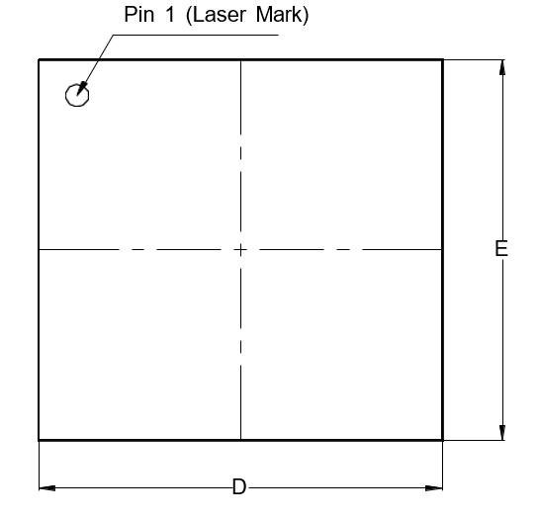
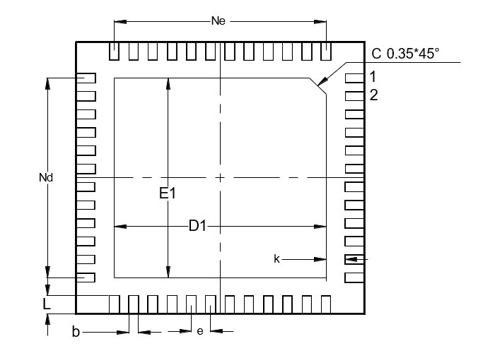
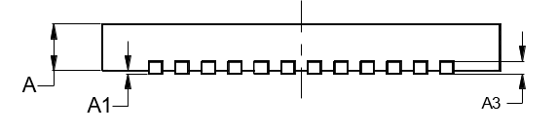
XC24
Package specification
QFN 6060-48L Package Outline
TOP VIEW
BOTTOM VIEW
Symbol | Dimensions in mm
 | Min | Typ | Max
A | 0.70 | 0.75 | 0.80
A1 | 0.00 | 0.02 | 0.05
A3 | 0.203 REF
D | 5.90 | 6.00 | 6.10
E | 5.90 | 6.00 | 6.10
D1 | 4.30 | 4.40 | 4.50
E1 | 4.30 | 4.40 | 4.50
k | 0.40 BSC
b | 0.14 | 0.20 | 0.25
e | 0.40 BSC
Nd | 4.40 BSC
Ne | 4.40 BSC
L | 0.35 | 0.40 | 0.45
SIDE VIEW
Figure 30. Package Outline

Slide 65

XC24
Footprint
PIN #1 0.400x45’’
e
Symbol | Dimensions in mm
 | Min | Nom | Max
A | 0.7 | 0.75 | 0.8
A1 | 0.00 | 0.02 | 0.05
A2 | 0.203 REF
B | 0.25 | 0.26 | 0.27
D |  | 6.4
D1 | 4.30 | 4.40 | 4.50
E1 | 4.30 | 4.40 | 4.50
E |  | 6.4
e | 0.40 BSC
K | 0.40 BSC
L |  | 0.60
K
D1
D
E1
L
B
E
Figure 31. Recommended Footprint
Note : The reflow peak soldering temperature is peak 260°C and it is specified based on IPC/JEDEC J-STD- 020
“Moisture/Reflow Sensitivity Classification for Non-Hermetic Solid State Surface Mount Devices”
is the trademark of Global Technologies Co., Ltd. or its subsidiaries in the Republic of Korea and/or other countries. The products of Global Technologies reserve the right to make changes without further notice to any products herein. Global Technologies makes no warranty, representation or guarantee regarding the suitability of its products for any particular purpose, nor does Global Technologies assume any liability arising out of the application or use of any product or circuit, and specifically disclaims any and all liability, including without limitation special, consequential or incidental damages. Global Technologies does not convey any license under its patent rights nor the rights of others.
is the trademark of Global Technologies Co., Ltd. or its subsidiaries in the Republic of Korea and/or other countries. Global Technologies owns the rights to a number of patents, trademarks, copyrights, trade secrets, and other intellectual property. Global Technologies reserves the right to make changes without further notice to any products herein. Global Technologies makes no warranty, representation or guarantee regarding the suitability of its products for any particular purpose, nor does Global Technologies assume any liability arising out of the application or use of any product or circuit, and specifically disclaims any and all liability, including without limitation special, consequential or incidental damages. Buyer is responsible for its products and applications using Global Technologies products, including compliance with all laws, regulations and safety requirements or standards, regardless of any support or applications information provided by Global Technologies. “Typical” parameters which may be provided in Global Technologies data sheets and/or specifications can and do vary in different applications and actual performance may vary over time. All operating parameters, including “Typical” must be validated for each customer application by customer’s technical experts. Global Technologies does not convey any license under its patent rights nor the rights of others. Global Technologies products are not designed, intended, or authorized for use as a critical component in life support systems or any FDA Class 3 medical devices or medical devices with a same or similar classification in a foreign jurisdiction or any devices intended for implantation in the human body. Should Buyer purchase or use Global Technologies products for any such unintended or unauthorized application, Buyer shall indemnify and hold Global Technologies and its officers, employees, subsidiaries, affiliates, and distributors harmless against all claims, costs, damages, and expenses, and reasonable attorney fees arising out of, directly or indirectly, any claim of personal injury or death associated with such unintended or unauthorized use, even if such claim alleges that Global Technologies was negligent regarding the design or manufacture of the part. Global Technologies is an Equal Opportunity/Affirmative Action Employer. This literature is subject to all applicable copyright laws and is not for resale in any manner.

