Slide 1
ID804 I2C
Consol manual
Aug. 31, 2026
Global Technologies

Slide 2
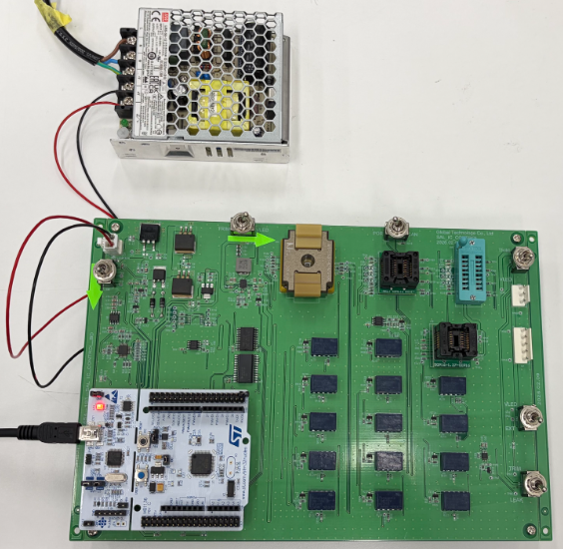
Board Connection
Power Supply
- 12V, 1A
- YH396-02V
USB Cable
- MCU <-> PC
- MICRO-B to USB-B

Slide 3
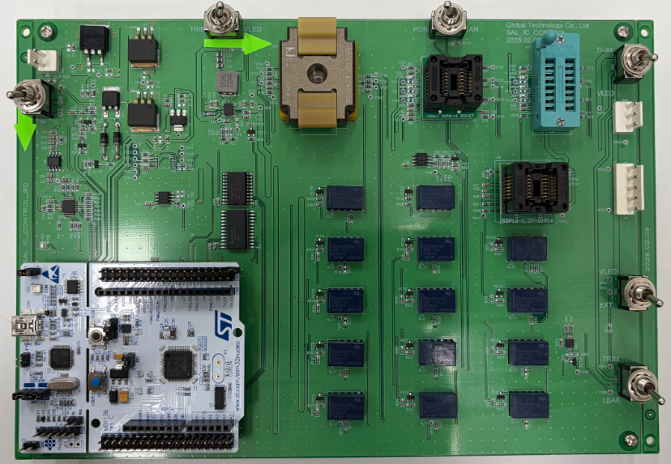
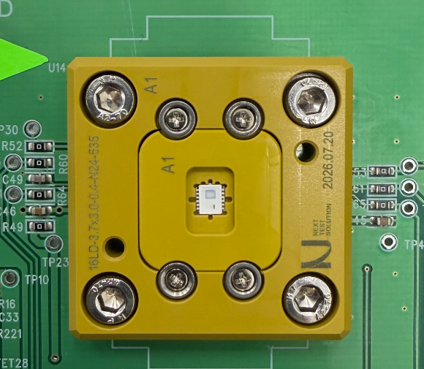
Board Connection
Switch Lever:
RIGHT →
Switch Lever:
LEFT ←
ID804
Switch Lever:
DOWN ↓
Switch Lever:
DOWN ↓
Switch Lever:
DOWN ↓
Switch Lever:
DOWN ↓

Slide 4
Command Interface

Slide 5
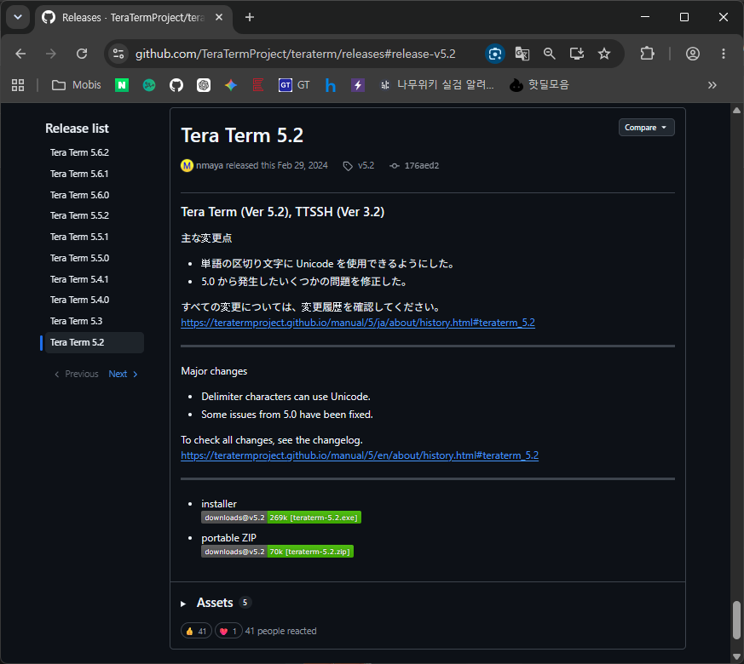
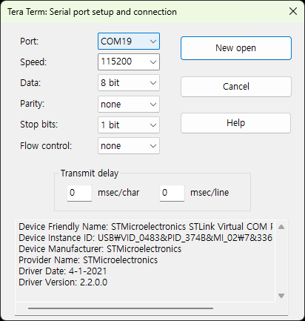
Serial Terminal Program
TeraTerm: https://github.com/TeraTermProject/teraterm/releases#release-v5.2

Slide 6
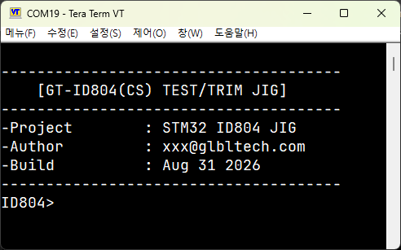
Command Interface
Follow the steps below, then check the terminal program screen.
1. Install the IC. (Ensure the IC is oriented correctly.)
2. Connect the PC to the MCU using a USB cable.
3. Apply 12 V power to the JIG board.

Slide 7
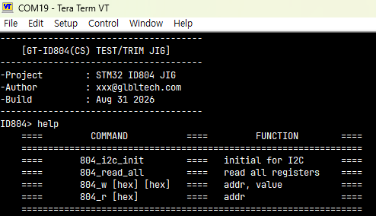
Command Interface
To see possible command, enter “help”

Slide 8
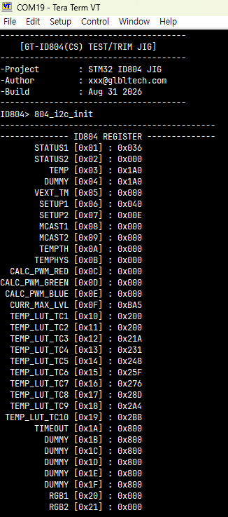
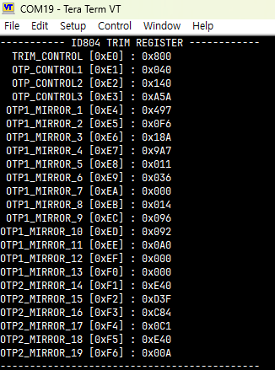
Command Interface
Serial – “804_i2c_init”
- Supply VDD & VLED
- Read all register & Dump

Slide 9




Command Interface
Serial – “804_w [hex] [hex]”
※ ID804 I2C Error
If an I2C Error occurs:
- The following message log will be displayed.
addr
value
The written value can be read back successfully.
Serial – “804_r [hex]”
addr

Slide 10
F/W Download

Slide 11
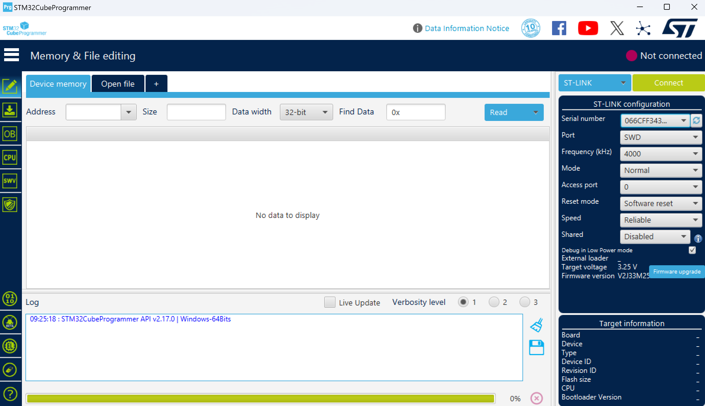
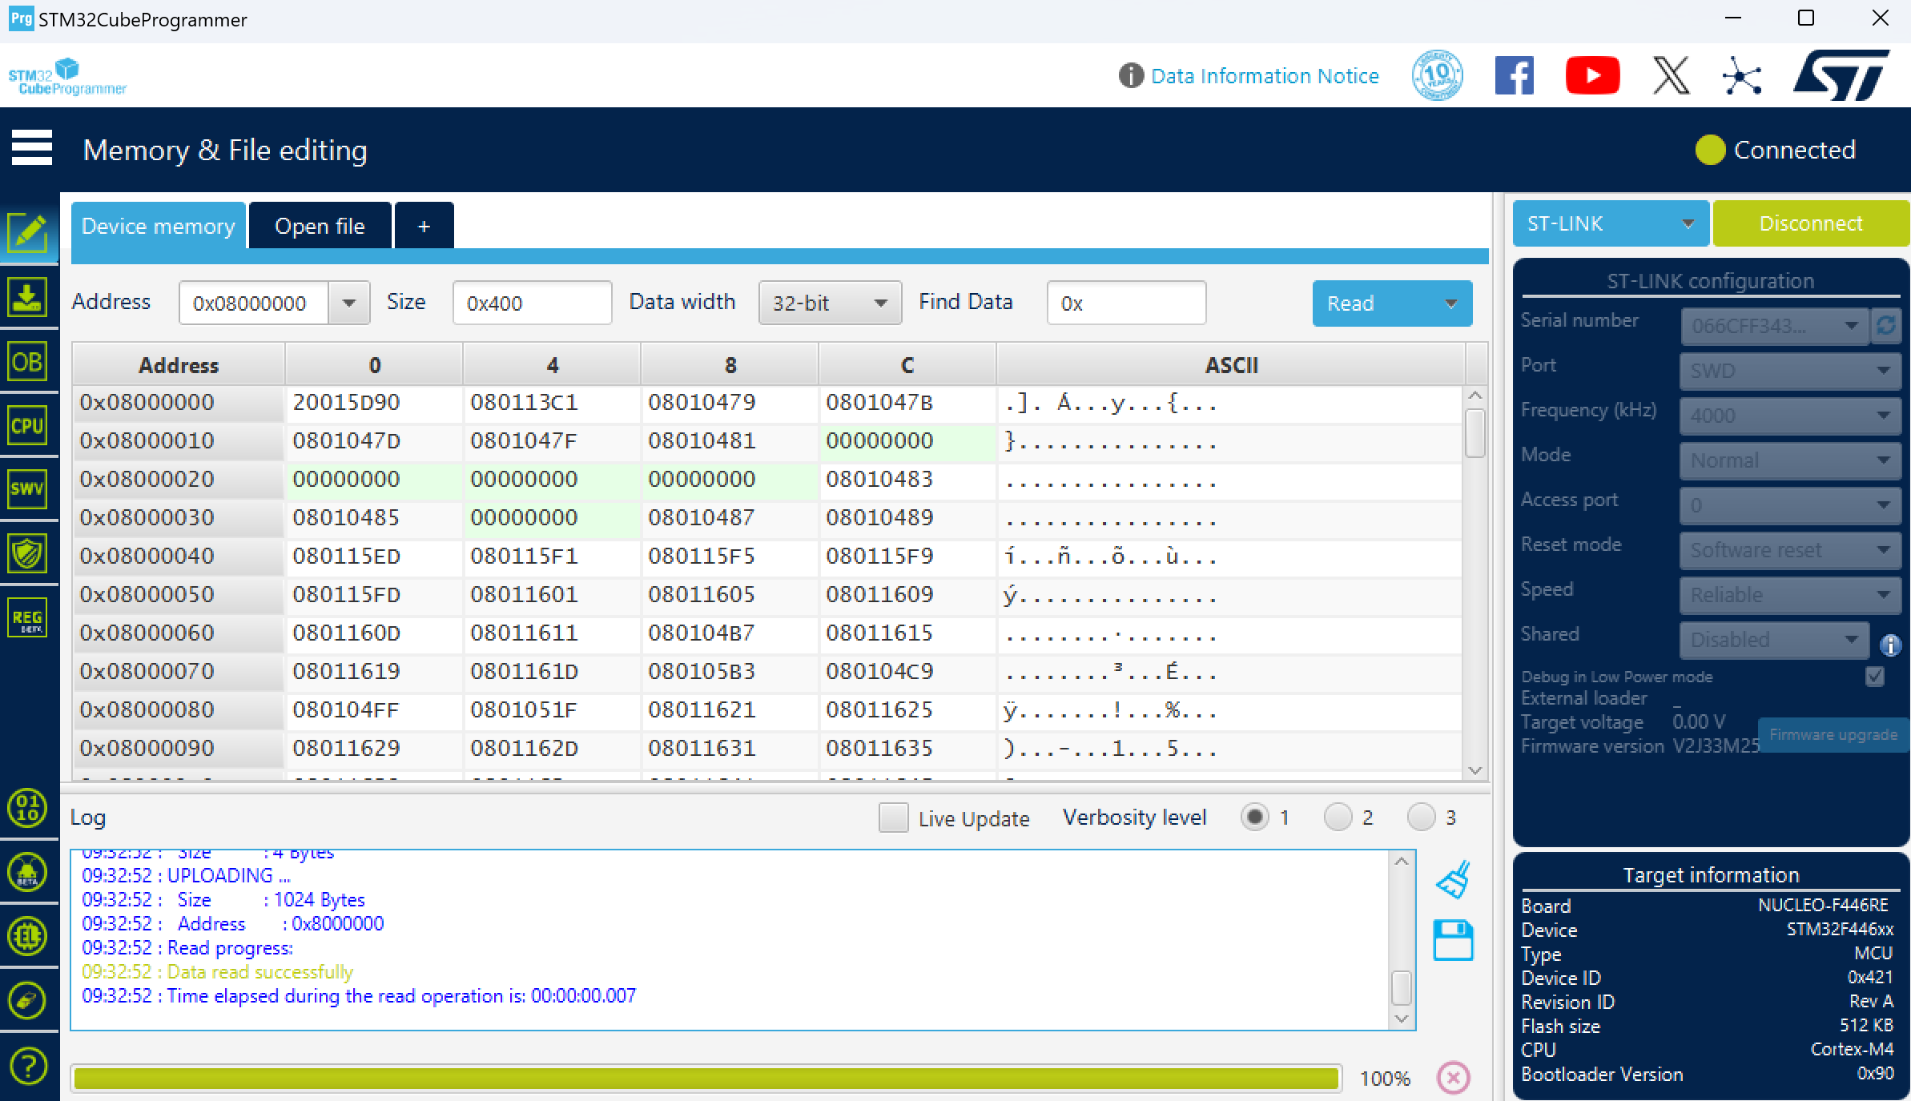
F/W Download
Run STM32CubeProgrammer
Turn on Jig Power
Press “Connect” BTN

Slide 12
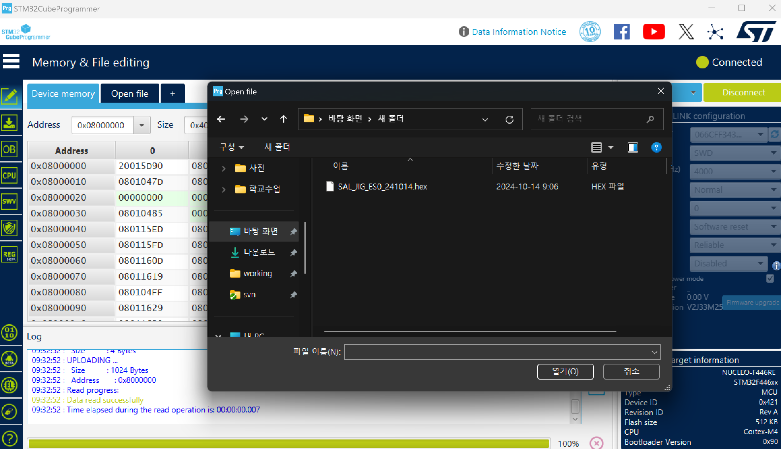
F/W Download
3) Click “Open file” & open released “sal_es0_xxxxxx.hex”

Slide 13
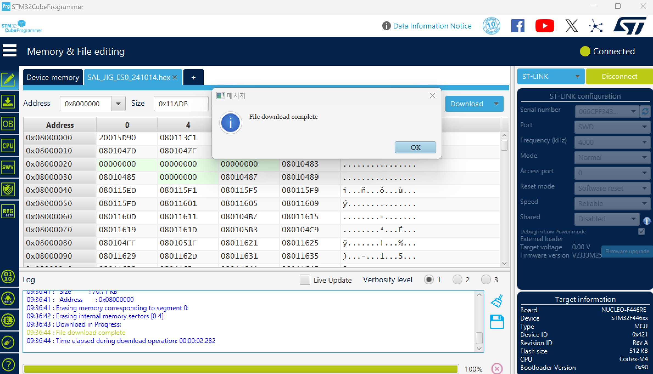
F/W Download
4) Click “Download” -> “OK” -> “Disconnect” & turn off Jig Power

