Slide 1
XDIC12P PWM Trimming Sequence (GT1005A7R0)
2025. 8

Slide 2
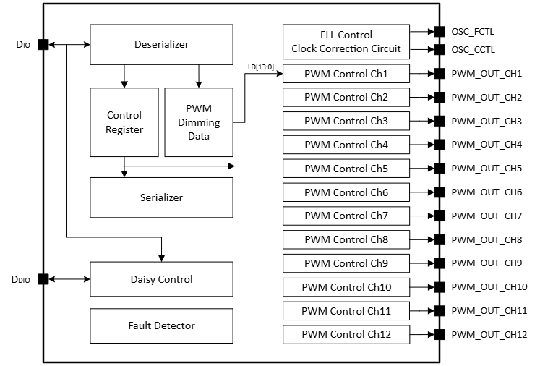
Block Diagram

Slide 3
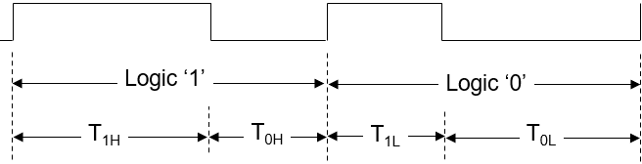
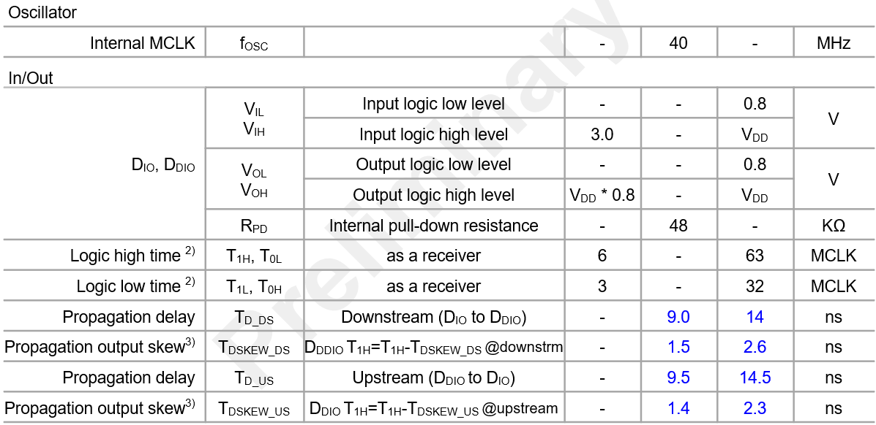
Serial Interface

Slide 4
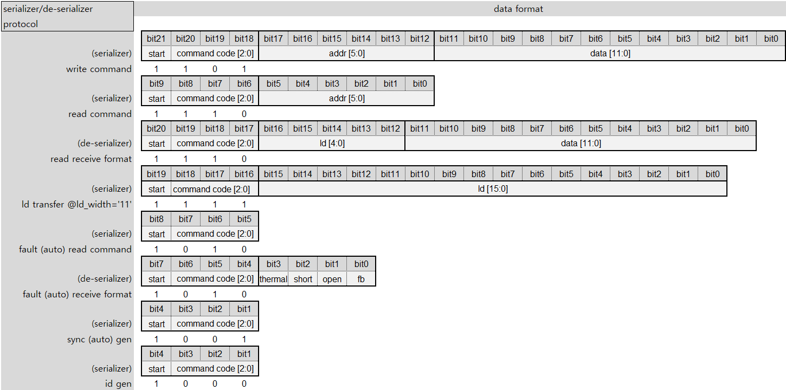
Serializer/De-serializer Protocol
Support ld transfer @id_width=’11’ only

Slide 5
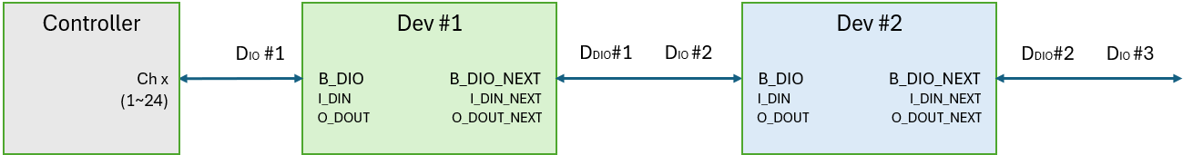
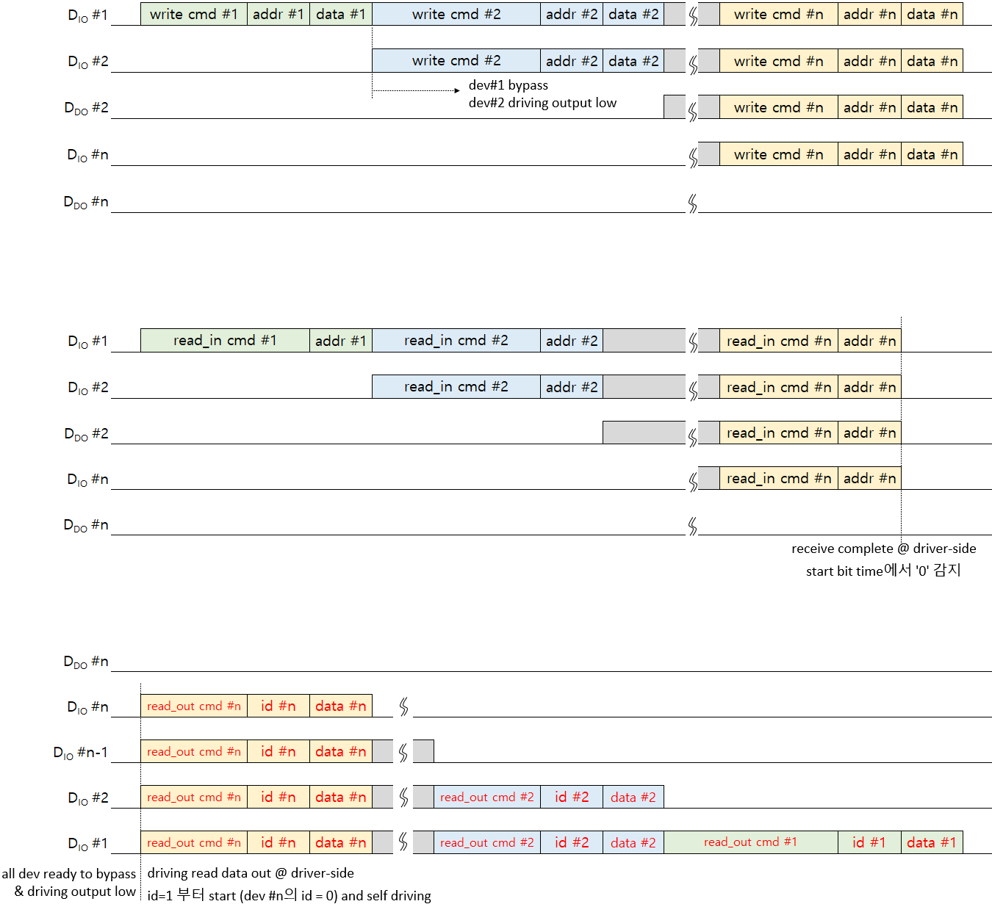
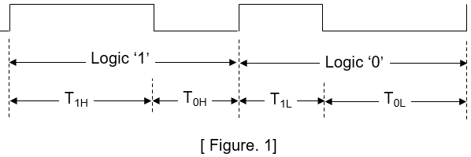
Serializer/De-serializer Protocol

Slide 6
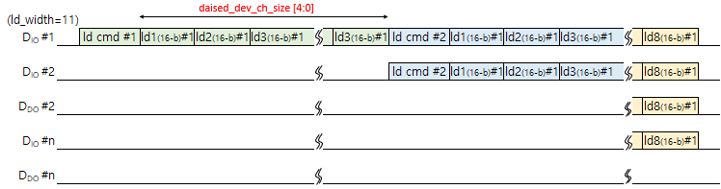
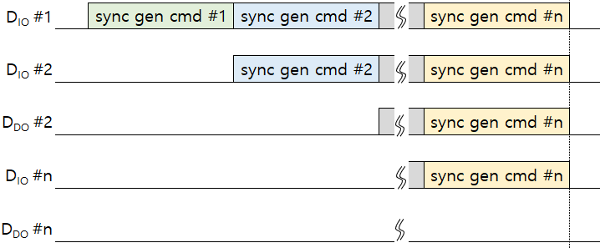
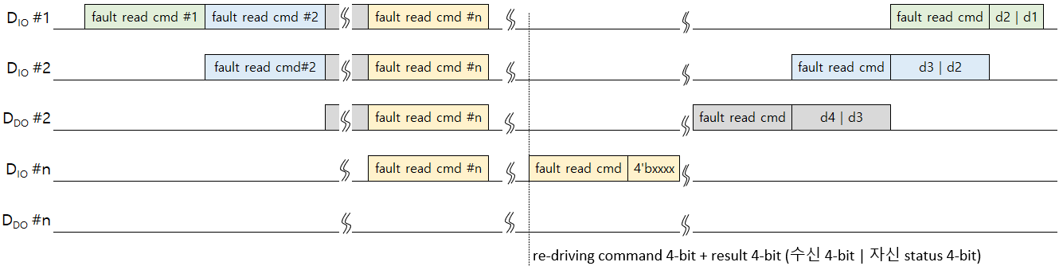
Serializer/De-serializer Protocol

Slide 7
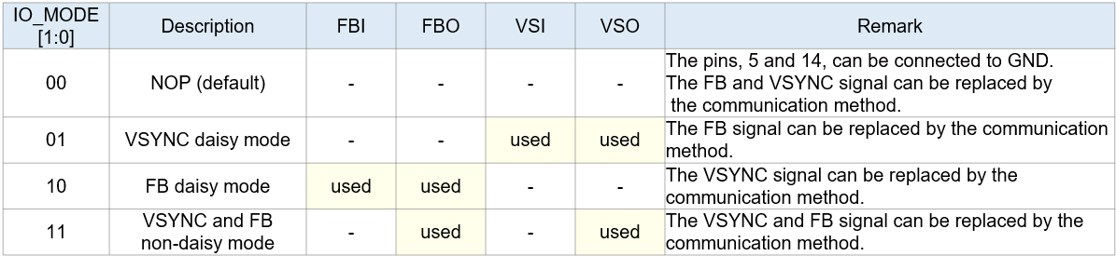
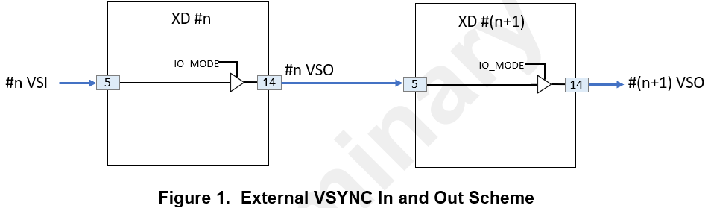
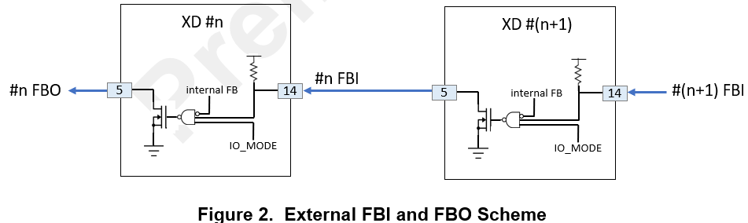
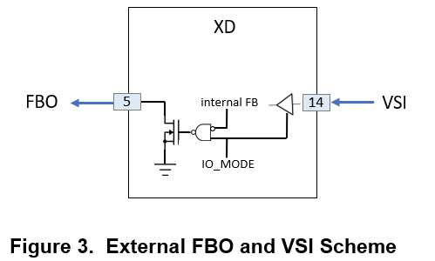
Optional external VSYNC and FB

Slide 8
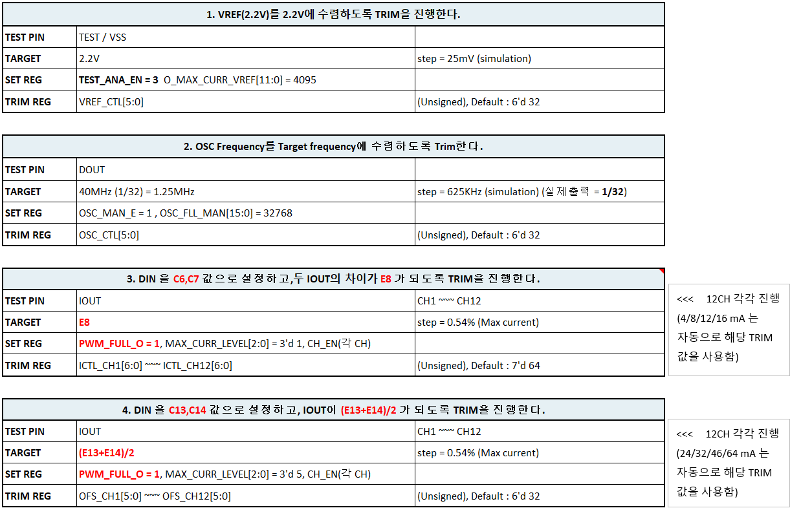
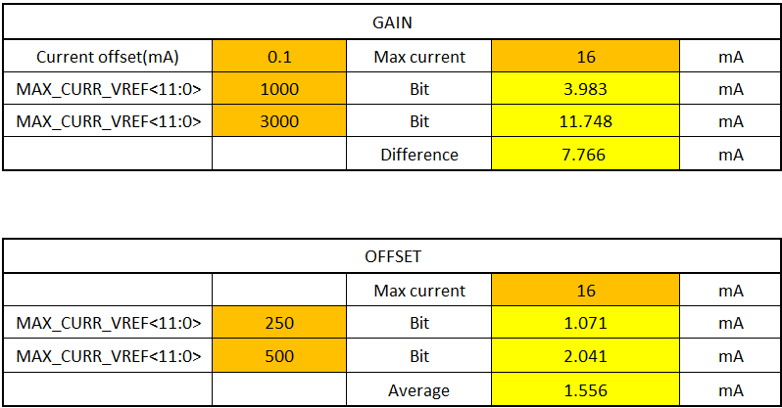
OTP Trimming Sequence

Slide 9
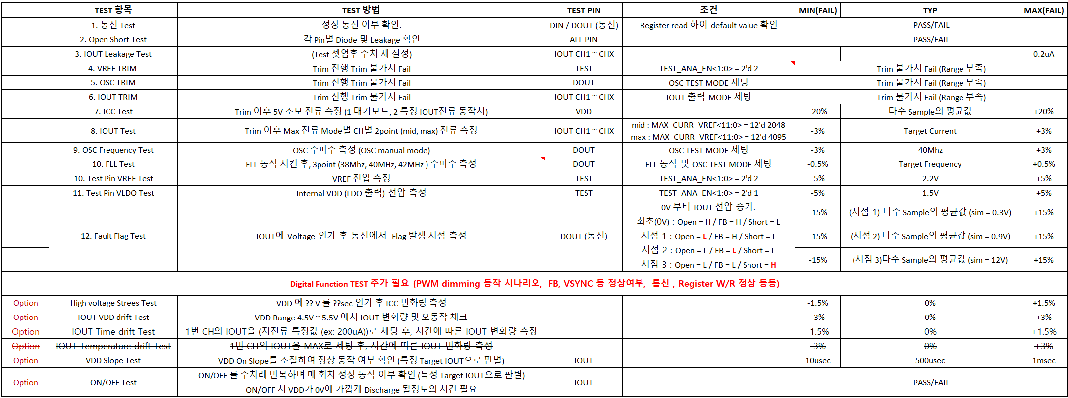
OTP Trimming Sequence

Slide 10
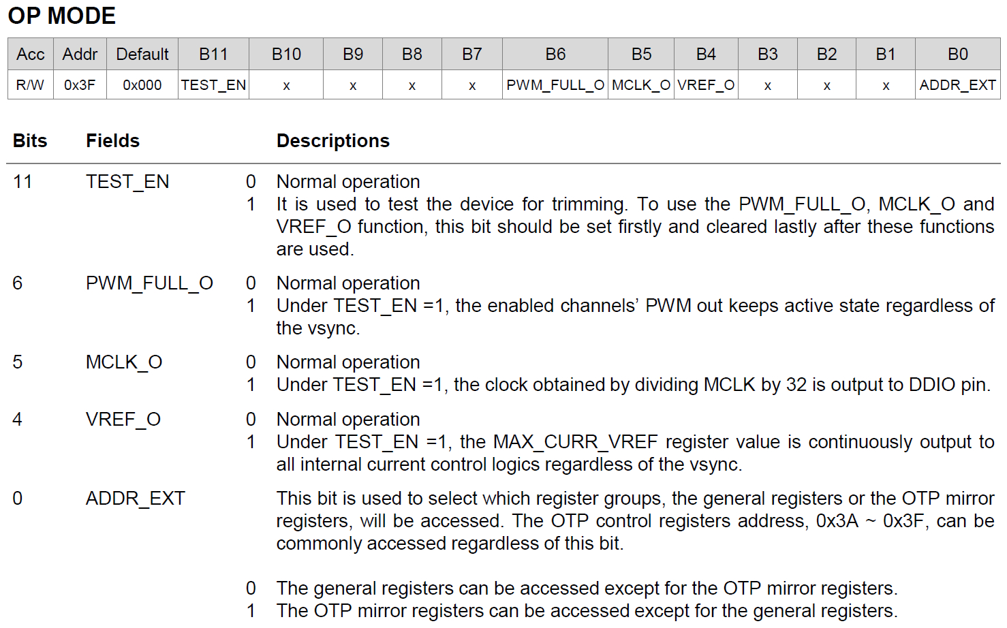
OTP Trimming Sequence
If (TEST_EN == 1 && PWM_FULL_O ==1 && CHx_EN == 1), O_PWM_CHx == 1
If (TEST_EN == 1 && VREF_O == 1), O_MAX_CURR_VREF == MAX_CURR_VREF
When TEST_EN == 1, No OTP Read operation.
When trimming, keep the CONTROL, FPWM_DIV, and MCLK_LOCK1/2 register at default value without any changes.

Slide 11
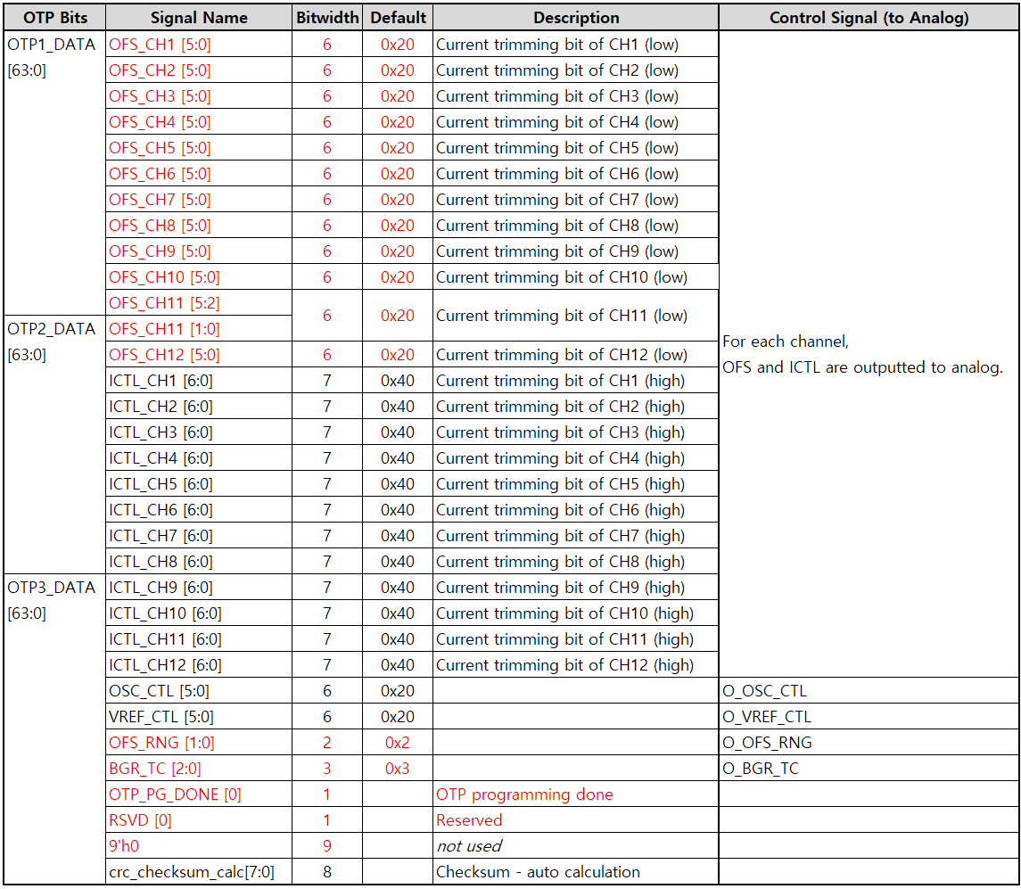
OTP Trimming Signal

Slide 12
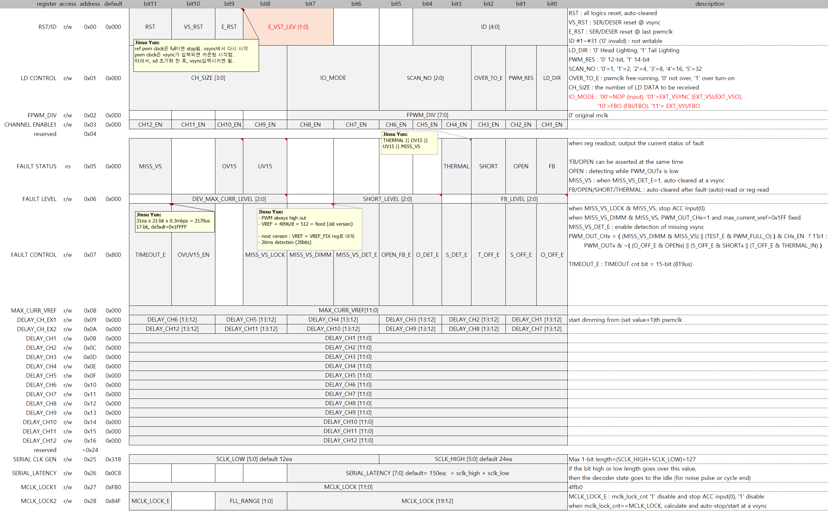
Register

Slide 13
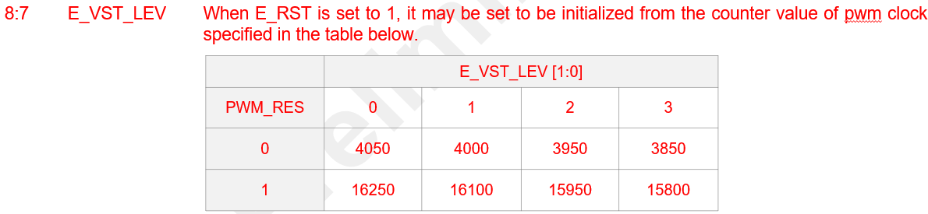
Register

Slide 14
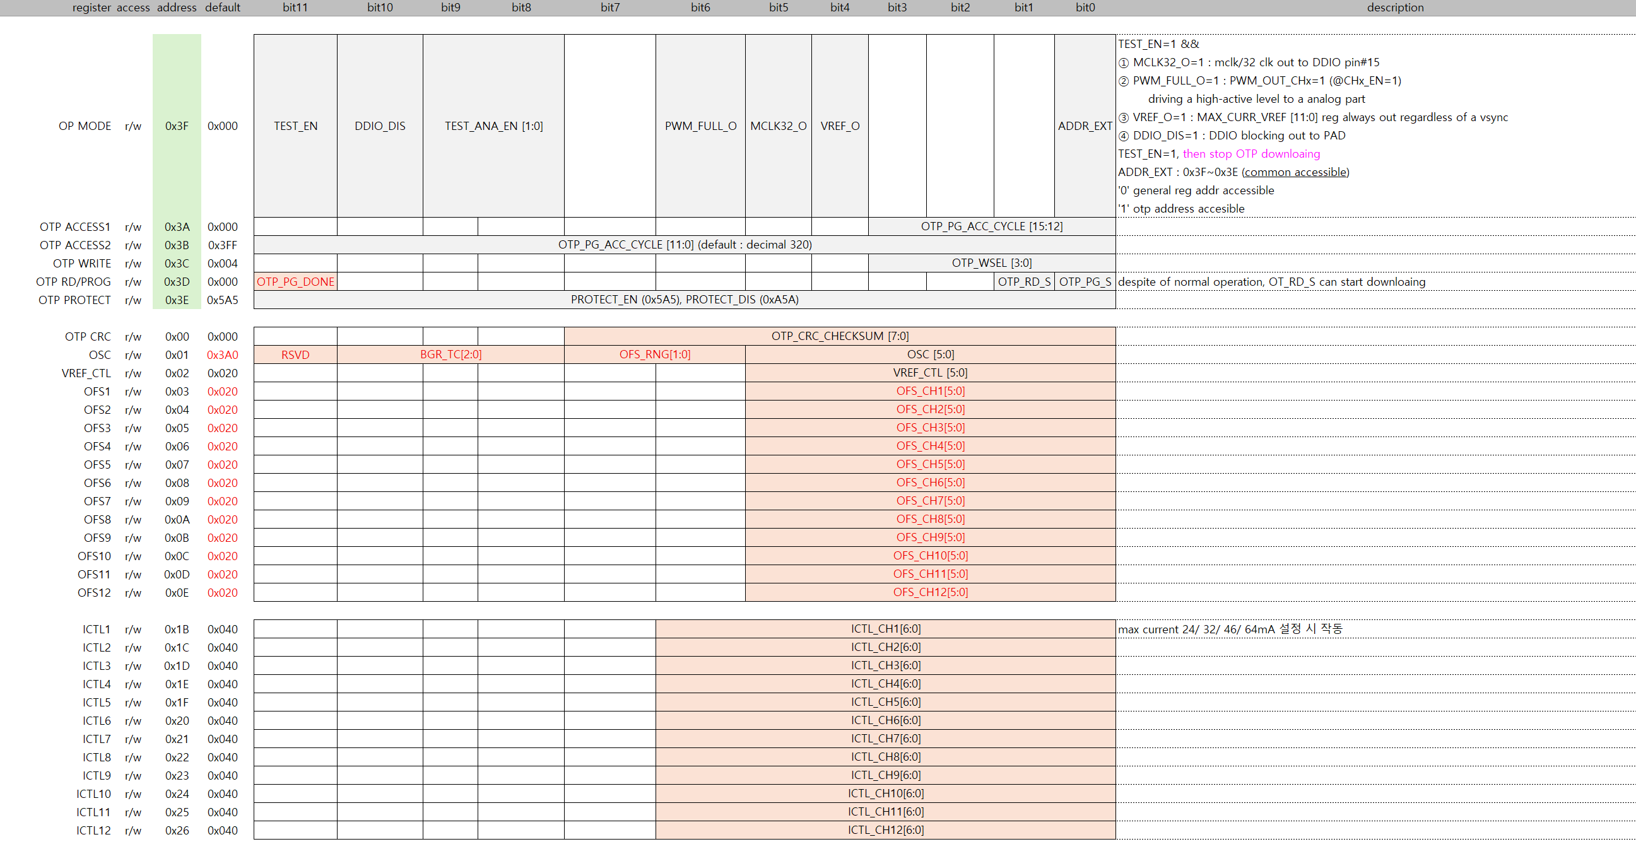
Register
OTP_PG_DONE : eFUSE 가 programming 되면, OTP_PG_DONE 이 ‘0’에서 ‘1’ 로 변경됨.

