Slide 1

CQ24
CONFIDENTIAL
<Preliminary>
Global Technologies
The Controller for Voltage to Current Driver
24 Channels
General Description
The CQ24 is a high-performance local dimming dedicated controller featuring 24 channels to drive its companion chips, AQ06 and AQ08 LED drivers that act as the voltage-based low side current sink for White LED back-lighting solution.
This controller can show high-quality local dimming performance in active-matrix type together with AQ06 or AQ08 driver and can drive maximum 128 sub-frames for high-resolution back-lighting.
The SPI input data of each CQ24 can support to be connected in a daisy chain method for large scale back-light LED block array and perate up to maximum 30MHz.
Each channel is quipped with a 12-bit DAC for fine current dimming and its independent 12-bit global reference DAC to set each frame’s max current level so that those combination can support maximum 16,383-step current dimming control.
The main clock can be supported internally or an external clock source.
Application
LED back-lighting with dimming control
Dated 30-Nov 23 Rev. 01
Page 1
http://www.glbltech.com/

Slide 2
CQ24
<Preliminary>
Feature
24-channel local dimming controller for LED drive ICs
High-speed sub-frame based dimming control
Max 128 sub-frames
Supporting 960hz/800hz
Supporting flexible line delay
High-quality current dimming control
2-type current dimming : duty-based accumulated stepping and duty-based linear stepping
Supporting max 16,383 steps
Supporting the flexible max current control with a global 12-bit Reference DAC
Supporting the fine current control with an independent 12-bit DAC
Channel-to Channel accuracy ±2% at analog output voltage 2.0V
High-speed local dimming data transfer through SPI Interface
Operating max 30MHz
Supporting the daisy chain connection at max frequency speed
Various main clock source
Internal DPLL : Reference clock source 16.128MHz locked by a VSYNC. (not recommended)
The external clock source up to 30MHz (depends on the system design specification)
TTL-level input range
Supply voltage 4.5V ~ 5.5V
68pin QFN Package
Latch-up Immunity ILATCH: JEDEC JESD78D Nov 2011: ±100mA
ESD, HBM protection (Norm: MIL 883 E Method 3015 Human Body Model): ±2kV
CONFIDENTIAL
Dated 30-Nov 23 Rev. 01
Page 2
http://www.glbltech.com/

Slide 3
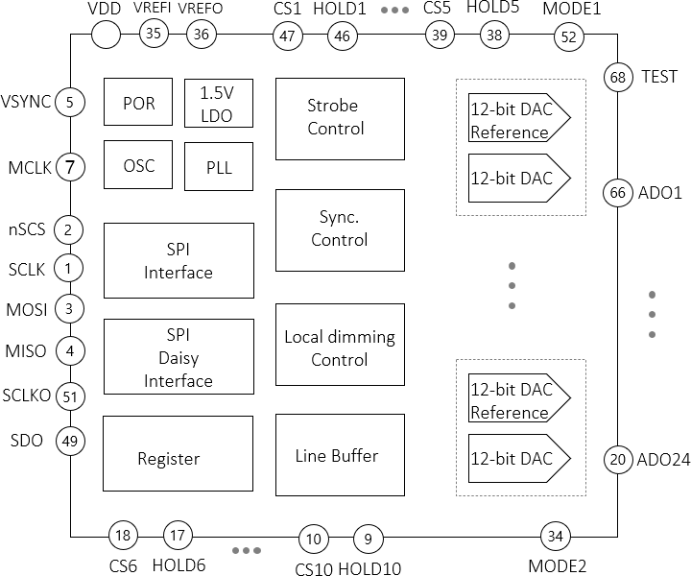
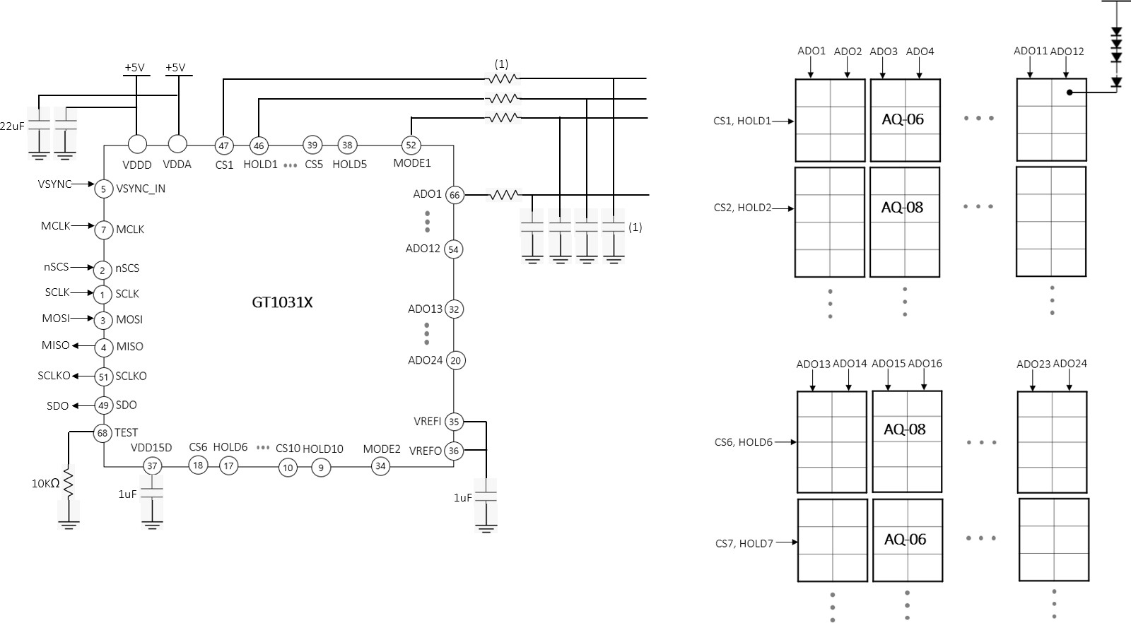
CQ24
<Preliminary>
Block Diagram
VDDD
Fig 1. Block diagram
Application Circuit
(2)
(2)
CQ24
Fig 2. Application Circuit diagram
Note :
The values depend on the system design factors, the dimming speed, the fan-out, the PCB layout condition, etc.
The assignment of ADO channels and CS/HOLD channels depends on the drive mode, single and dual drive.
CONFIDENTIAL
Dated 30-Nov 23 Rev. 01
Page 3
http://www.glbltech.com/

Slide 4
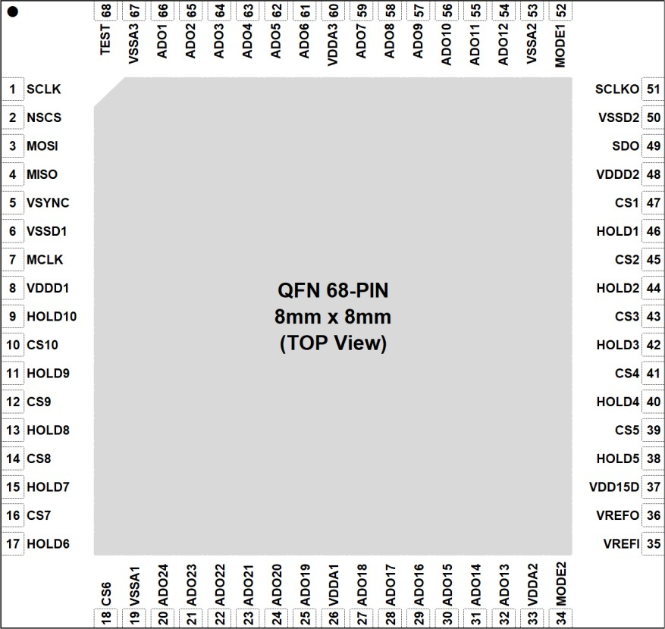
CQ24
<Preliminary>
Pin out description (Top View)
Pin description
Fig 3. Pin diagram
Pin Name | Pin No. | I/O | Type | Description | Remark
SCLK | 1 | I | Digital | SPI Clock
nSCS | 2 | I | Digital | SPI Chip Select
MOSI | 3 | I | Digital | SPI MOSI
MISO | 4 | O | Digital | SPI MISO | Unused : 10KΩ PD
VSYNC | 5 | I | Digital | Frame synchronization
VSSD1 | 6 | - | GND | Digital GND
MCLK | 7 | I | Digital | Master Clock | Unused : 10KΩ PD
VDDD1 | 8 | - | Power | Digital VDD
HOLD10 | 9 | O | Digital | Strobe to AQ series
CS10 | 10 | O | Digital | Chip Select to AQ series
HOLD9 | 11 | O | Digital | Strobe to AQ series
CS9 | 12 | O | Digital | Chip Select to AQ series
CONFIDENTIAL
Table 1. Pin description
Dated 30-Nov 23 Rev. 01
Page 4
http://www.glbltech.com/

Slide 5
CQ24
<Preliminary>
Pin description
Pin Name | Pin No. | I/O | Type | Description | Remark
HOLD8 | 13 | O | Digital | Strobe to AQ series
CS8 | 14 | O | Digital | Chip Select to AQ series
HOLD7 | 15 | O | Digital | Strobe to AQ series
CS7 | 16 | O | Digital | Chip Select to AQ series
HOLD6 | 17 | O | Digital | Strobe to AQ series
CS6 | 18 | O | Digital | Chip Select to AQ series
VSSA1 | 19 | - | GND | Analog GND
ADO24 | 20 | O | Analog | Analog Data Out
ADO23 | 21 | O | Analog | Analog Data Out
ADO22 | 22 | O | Analog | Analog Data Out
ADO21 | 23 | O | Analog | Analog Data Out
ADO20 | 24 | O | Analog | Analog Data Out
ADO19 | 25 | O | Analog | Analog Data Out
VDDA1 | 26 | - | Power | Analog VDD
ADO18 | 27 | O | Analog | Analog Data Out
ADO17 | 28 | O | Analog | Analog Data Out
ADO16 | 29 | O | Analog | Analog Data Out
ADO15 | 30 | O | Analog | Analog Data Out
ADO14 | 31 | O | Analog | Analog Data Out
ADO13 | 32 | O | Analog | Analog Data Out
VDDA2 | 33 | - | Power | Analog VDD
MODE2 | 34 | O | Analog | Mode Level Out
VREFI | 35 | I | Power | VREF input | Must Attach 1uF
VREFO | 36 | O | Power | VREF output | Connect to VREFI
VDD15D | 37 | - | Power | Internal LDO 1.5V Out, Attach 1uF | Must Attach 1uF
HOLD5 | 38 | O | Digital | Strobe to AQ series
CS5 | 39 | O | Digital | Chip Select to AQ series
HOLD4 | 40 | O | Digital | Strobe to AQ series
CS4 | 41 | O | Digital | Chip Select to AQ series
HOLD3 | 42 | O | Digital | Strobe to AQ series
CS3 | 43 | O | Digital | Chip Select to AQ series
CONFIDENTIAL
Dated 30-Nov 23 Rev. 01
Page 5
http://www.glbltech.com/

Slide 6
CQ24
<Preliminary>
Pin description
Pin Name | Pin No. | I/O | Type | Description | If unused, to be
HOLD2 | 44 | O | Digital | Strobe to AQ series
CS2 | 45 | O | Digital | Chip Select to AQ series
HOLD1 | 46 | O | Digital | Strobe to AQ series
CS1 | 47 | O | Digital | Chip Select to AQ series
VDDD2 | 48 | - | Power | Digital VDD
SDO | 49 | O | Digital | SPI Daisy Data Out | Unused : 10K PD
VSSD2 | 50 | - | GND | Digital GND
SCLKO | 51 | O | Digital | SPI Daisy Clock Out | Unused : 10K PD
MODE1 | 52 | O | Analog | Mode Level Out
VSSA2 | 53 | - | GND | Analog GND
ADO12 | 54 | O | Analog | Analog Data Out
ADO11 | 55 | O | Analog | Analog Data Out
ADO10 | 56 | O | Analog | Analog Data Out
ADO9 | 57 | O | Analog | Analog Data Out
ADO8 | 58 | O | Analog | Analog Data Out
ADO7 | 59 | O | Analog | Analog Data Out
VDDA3 | 60 | - | Power | Analog VDD
ADO6 | 61 | O | Analog | Analog Data Out
ADO5 | 62 | O | Analog | Analog Data Out
ADO4 | 63 | O | Analog | Analog Data Out
ADO3 | 64 | O | Analog | Analog Data Out
ADO2 | 65 | O | Analog | Analog Data Out
ADO1 | 66 | O | Analog | Analog Data Out
VSSA3 | 67 | - | GND | Analog GND
TEST | 68 | I | Test | Test Enable | Must 10KΩ PD
CONFIDENTIAL
Dated 30-Nov 23 Rev. 01
Page 6
http://www.glbltech.com/

Slide 7
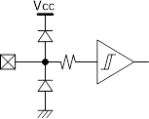
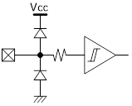
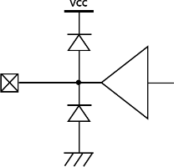
CQ24
<Preliminary>
Equivalent Circuits of individual pins
Pad Name | I/O | Internal Circuit | Description
nSCS | I |  | SPI Chip Select
SCLK | I |  | SPI Clock Input
MOSI | I |  | SPI MOSI
VSYNC | I |  | Frame Sync.
MCLK | I |  | Mater Clock
SCLKO | O |  | SPI Daisy Clock Out
SDO | O |  | SPI Daisy Data Out
VDDD
VDDD
VDDD
VDDD
VDDD
VDDD
VDDD
CONFIDENTIAL
Table 2. Equivalent Circuits of Individual Pins
Dated 30-Nov 23 Rev. 01
Page 7
http://www.glbltech.com/

Slide 8
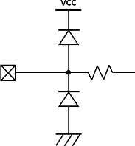
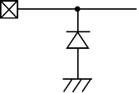
CQ24
<Preliminary>
Equivalent Circuits of individual pins
Pad Name | I/O | Internal Circuit | Description
CS 0~10 | O |  | Chip Select to AQ Series
HOLD 0~10 | O |  | Strobe to AQ Series
MODE1/2 | O |  | MODE Level
ADO 1~24 | O |  | Analog Data Out
VDDD | - |  | Digital VDD
VDDA | - |  | Analog VDD
VDDD
VDDD
VDDD
VDDD
CONFIDENTIAL
Dated 30-Nov 23 Rev. 01
Page 8
http://www.glbltech.com/

Slide 9
CQ24
<Preliminary>
Maximum Absolute ratings (Ta = 25℃ unless otherwise noted)
Parameter | Symbol | Value | Unit
Supply voltage | VDDD, VDDA | -0.3 ~ 7.0 | V
MCLK to GND voltage | VMCLK | -0.3 ~ 3.3V+0.3 | V
VSYNC to GND voltage | VVSYNC | -0.3 ~ 3.3V+0.3 | V
nSCS to GND voltage | VSPI_ENB | -0.3 ~ 3.3V+0.3 | V
SCLK to GND voltage | VSCLK | -0.3 ~ 3.3V+0.3 | V
MOSI to GND voltage | VMOSI | -0.3 ~ 3.3V+0.3 | V
MISO to GND voltage | VMISO | -0.3 ~ VDDD+0.5 | V
SCLKO to GND voltage | VSCLK | -0.3 ~ VDDD+0.5 | V
SDO to GND voltage | VSDO | -0.3 ~ VDDD+0.5 | V
CS to GND voltage | VCS | -0.3 ~ VDDD+0.5 | V
HOLD to GND voltage | VHOLD | -0.3 ~ VDDD+0.5 | V
ADO to GND voltage | VADO | -0.3 ~ VDDD+0.5 | V
MODE to GND voltage | VMODE | -0.3 ~ VDDD+0.5 | V
Operating temperature | TO | -20 ~ 85 | ℃
Junction temperature | TJ | -20 ~ 150 | ℃
Storage temperature | TSTG | -45 ~ 150 | ℃
Relative Humidity(non-condensing) | RHNC | 5 ~ 85 | %
Moisture Sensitivity | MSL | Maximum Floor Life-time | 3
Table 3. Maximum Absolute ratings
Notes : Stresses beyond those listed under Absolute Maximum Ratings may cause permanent damage to the device
Electrostatic Discharge
Parameter | Symbol | Value | Unit | Remark
Electrostatic Discharge HBM ; Contact | ESDHBM | ±2K | V | C=100 pF, R=1.5 kΩ
Electrostatic Discharge CDM ; Contact | ESDCDM | ±500 | V | R=1 Ω
CONFIDENTIAL
Table 4. Electrostatic Discharge
Dated 30-Nov 23 Rev. 01
Page 9
http://www.glbltech.com/

Slide 10
CQ24
<Preliminary>
Electrical Characteristic (V_{DDD}/V_{DDS} =5.0V, Ta=25.0℃ unless otherwise noted)
Characteristics | Symbol | Condition | Value |  |  | Unit
 |  |  | min | typ | max
Supply
Operating voltage | VDDD, VDDA |  | 4.5 | - | 5.5 | V
Operating Current | IDDD |  | - | - | - | mA
Operating Current | IDDA |  | - | 7.2 | - | mA
Quiescent current | IDDD, IDDA |  | - | 1.9 | - | mA
Input
nSCS Input Voltage | VSCSL | Chip Select, low level | - | - | 0.8 | V
 | VSCSH | Chip Select, high level | 2.0 | - | VDDD | V
SCLK Input Voltage | VSCLKL | SPI Clock, low level | - | - | 0.8 | V
 | VSCLKH | SPI Clock, high level | 2.0 | - | VDDD | V
MOSI Input Voltage | VMOSIL | MOSI, low level | - | - | 0.8 | V
 | VMOSIH | MOSI, high level | 2.0 | - | VDDD | V
VSYNC Input Voltage | VVSYNCL | VSYNC low level | - | - | 0.8 | V
 | VVSYNCH | VSYNC high level | 2.0 | - | VDDD | V
Output
MISO Output voltage | VMISOL | MISO, low level | - | - | 0.8 | V
 | VMISOH | MISO, high level | 2.0 | - | VDDD | V
SCLKO Output voltage | VSCLKOL | SCLKO, low level | - | - | 0.8 | V
 | VSCLKOH | SCLKO, high level | 2.0 | - | VDDD | V
SDO Output voltage | VSDOL | SDO, low level | - | - | 0.8 | V
 | VSDOH | SDO, high level | 2.0 | - | VDDD | V
CS output voltage | VCSL | CS, low level | - | - | 0.8 | V
 | VCSL | CS, high level | 2.0 | - | VDDD | V
HOLD output voltage | VHOLDL | HOLD, low level | - | - | 0.8 | V
 | VHOLDH | HOLD, high level | 2.0 | - | VDDD | V
Table 5. Electrical Characteristics
CONFIDENTIAL
Dated 30-Nov 23 Rev. 01
Page 10
http://www.glbltech.com/

Slide 11
CQ24
<Preliminary>
Electrical Characteristic (V_{DDD}/V_{DDS}=5.0V, Ta=25.0℃ unless otherwise noted)
Characteristics | Symbol | Condition | Value |  |  | Unit
 |  |  | min | typ | max
MODE output voltage | VMODE | MODE level1, 0.5V | 0.15 | 0.5 | 0.85 | V
 |  | MODE leve2l, 1.5V | 1.15 | 1.5 | 1.85 | V
 |  | MODE level3, 2.5V | 2.15 | 2.5 | 2.85 | V
 |  | MODE level4, 3.5V | 3.15 | 3.5 | 3.85 | V
ADO output voltage Range | VADO | ADO output level | 0.0 | - | VDDA | V
ADO output voltage Variation | VADO | ADO output level 0.3V | 0.279 | 0.3 | 0.321 | V
Accuracy | △VADO | Accuracy of output 0.3V | -7 | - | +7 | %
ADO output voltage Variation | VADO | ADO output level 1.0V | 0.97 | 1.0 | 1.03 | V
Accuracy | △VADO | Accuracy of output 1.0V | -3 | - | +3 | %
ADO output voltage Variation | VADO | ADO output level 2.0V | 1.96 | 2.0 | 2.04 | V
Accuracy | △VADO | Accuracy of output 2.0V | -2 | - | +2 | %
Internal MCLK
PLL Reference Clock | FPLL_REF | T.B.D | - | 16.128 | - | MHz
PLL output frequency | FINT_MCLK | T.B.D | - | 16.128 ⁽¹⁾ | - | MHz
Variation | △FINT_MCLK | T.B.D | -1 | - | +1 | %
External MCLK
External Clock frequency | ^{F}EXT_MCLK | T.B.D | - | 16.128 ⁽²⁾ | 30 | MHz
Variation | ^{△F}EXT_MCLK | T.B.D | -1 | - | +1 | %
Note (1) The PLL output frequency depends on the VSYNC input period and the MCLK LOCK CONTER register value.
(2) The External MCLK frequency depends on the system operation specification like the VSYNC input period, the SVSYNC_SIZE and SHSYNC_SIZE register value.
CONFIDENTIAL
Dated 30-Nov 23 Rev. 01
Page 11
http://www.glbltech.com/

Slide 12
CQ24
<Preliminary>
Electrical Characteristic (V_{DDD}/V_{DDS}=5.0V, Ta=25.0℃ unless otherwise noted)
Characteristics | Symbol | Condition | Value |  |  | Unit
 |  |  | min | typ | max
Static performance
Resolution |  |  |  | 12 |  | bit
Monotonicity |  |  |  | 12 |  | Bit
Integral nonlinearity | INL |  | 0 | ±2 | ±4 | LSB
Differential nonlinearity | DNL |  |  | ±0.5 | ±0.75 | LSB
Zero code error | ZE | DIN = 12’d 0 |  | 2.5 | 5 | mV
Full scale error | FSE | DIN = 12’d 4095 |  | ±0.25 | ±0.5 | FSR
Gain error | GE |  |  | ±0.25 | ±0.5 | FSR
DC output impedance | Zout |  |  | 160 |  | Ω
Power Sequence
V_{DD}
Target Voltage
Operation
Command accessible
Ramp time < 300us
Stabilizing time > 5ms
Fig 4. Power Sequence
CONFIDENTIAL
Dated 30-Nov 23 Rev. 01
Page 12
http://www.glbltech.com/

Slide 13
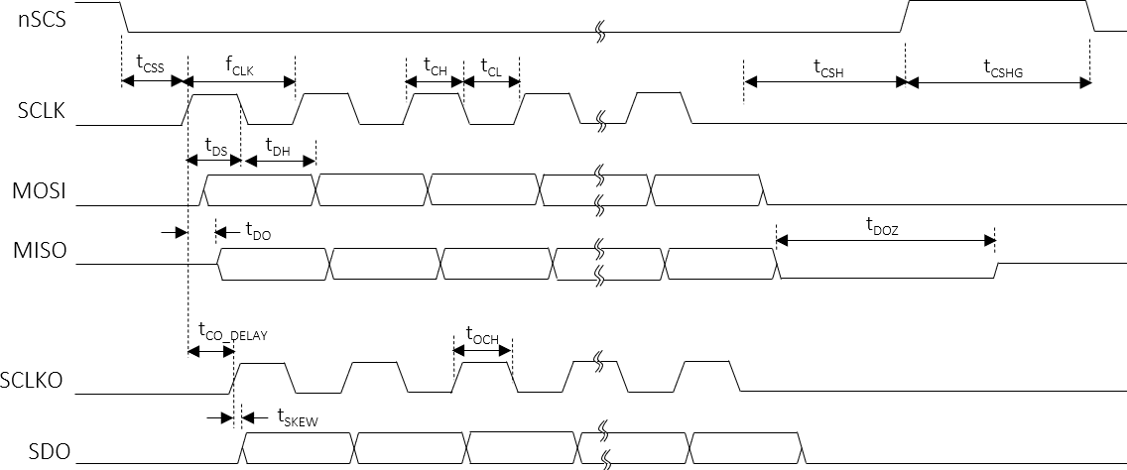
CQ24
<Preliminary>
AC Characteristics (V_{DDD}/V_{DDS}=5.0V, Ta=25.0℃ unless otherwise noted)
Characteristics | Symbol | Condition | Value |  |  | Unit
 |  |  | min | typ | max
SCLK
SCLK frequency | fCLK |  | - | - | 30 | MHz
SCLK duty | tCLK_DUTY |  | 49 | - | 51 | %
SCLK high time | tCH |  | 8 | - | - | ns
SCLK low time | tCL |  | 8 | - | - | ns
SCLKO
SCLK to SCLKO delay | ^{T}CO_DELAY |  | - | - | 11 | ns
The skew between SCLKO to SDO | ^{t}SKEW |  | - | - | 0.053 ⁽³⁾ | ns
SCLKO high time | tOCH |  | tCH -0.056 ⁽³ | - | - | ns
nSCS setup to the first rising SCLK | tCSS |  | 20 | - | - | ns
nSCS hold time from the last falling SCLK | tCSH |  | 3 | - | - | MCLK
nSCS high latency time | tCSHG |  | 3 | - | - | MCLK
MOSI setup time | tDS |  | 7 | - | - | ns
MOSI hold time | tDH |  | 3 | - | - | ns
MISO delay from the rising edge SCLK | tDO |  | - | - | 10 | ns
MISO high-Z from the nSCS de-assertion | tDOZ |  | 2 | - | - | MCLK
Table 6. AC Electrical Characteristics
Note (3) It should be careful that the t_{SKEW} and t_{OCH} are accumulated by the number of daisy devices if the daisy connection is used. So, for the read and write transaction the proper timing should be considered in daisy.
Fig 5. SPI Interface timing Sequence
CONFIDENTIAL
Dated 30-Nov 23 Rev. 01
Page 13
http://www.glbltech.com/

Slide 14
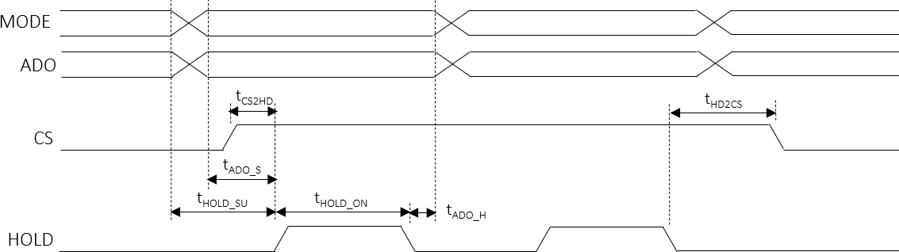
CQ24
<Preliminary>
AC Characteristics (V_{DDD}/V_{DDS}=5.0V, Ta=25.0℃ unless otherwise noted)
Characteristics | Symbol | Condition | Value |  |  | Unit
 |  |  | min | typ | max
AQ06/08 devices latch signals
CS setup to HOLD | tCS2HD |  | 500 | - | - | ns
CS hold from HOLD de-assertion | tHD2CS |  | 500 | - | - | ns
Analog data output
MODE/ADO setup to HOLD rising | tADO_S |  | 150 | - | - | ns
MODE/ADO hold from HOLD falling | tADO_H |  | 250 | - | ₋ (4) | ns
HOLD_SU and HOLD_ON register
HOLD SU time | tHOLD_SU |  | - | - | ₋ (4) | ns
HOLD ON time | tHOLD_ON |  | 1.8 | - | ₋ (4) | us
Note (4) The total time of t_{HOLD_SU} + t_{HOLD_ON} + t_{ADO_H}, can not be over the SHSYNC_PERIOD value and the value depends on the system operation specification.
Fig 6. Devices Latch signal timing Sequence
CONFIDENTIAL
Dated 30-Nov 23 Rev. 01
Page 14
http://www.glbltech.com/

Slide 15
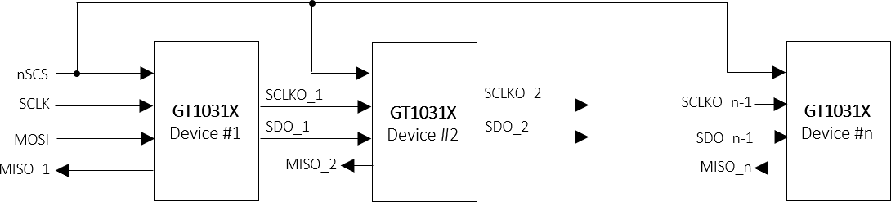
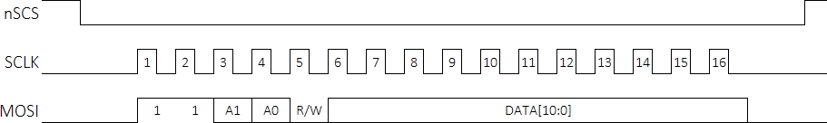
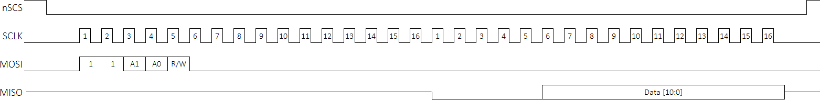
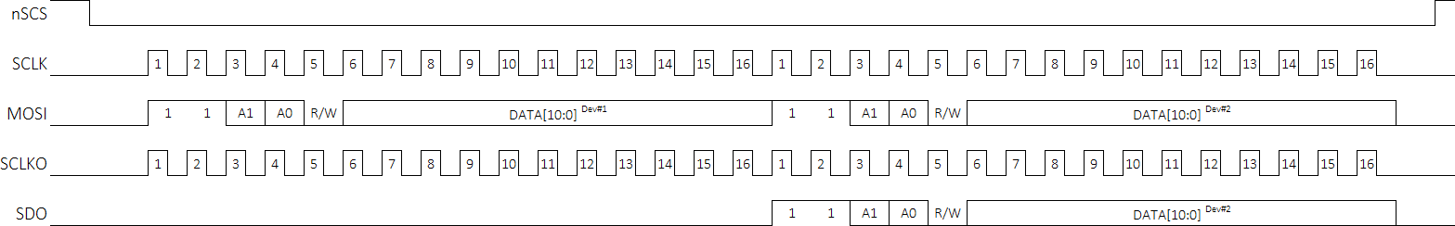
CQ24
<Preliminary>
Functional Description
1. SPI Interface
For the local dimming data transmit a Serial Peripheral Interface is used. The SPI is configurated to work as SPI slave. A Daisy Chain structure can be used to support large scale blocks array with several devices and operated up to 30MHz.
SPI Daisy Chain Structure
All SPI slaves share the Chip select (nSCS) signal, and these devices in daisy chain can be treated as one big shift register. The devices can be enumerated as described below. To read each device, it should be need to control the MISO signals individually from each device under BROADCAST mode.
CQ24
CQ24
CQ24
Fig 7. Devices SPI Daisy Chain connection
SPI Protocol Timing
The CQ24 has 4 types of SPI Interface protocol, CMD1, CMD2, CMD3 and CMD4.
Type1 : CMD1
The tyep1, CMD1 protocol is used to access four 11-bit registers and consists of the command 2 bits, 2’b11, address 2 bits, R/W 1 bit (‘0’ to write, ‘1’ to read) and its register value, data 11 bits .
[Figure.8-1] CMD1 Write
[Figure.8-2] CMD1 Read
[Figure.8-3] CMD1 Write through Daisy connection
CONFIDENTIAL
Dated 30-Nov 23 Rev. 01
Page 15
http://www.glbltech.com/

Slide 16
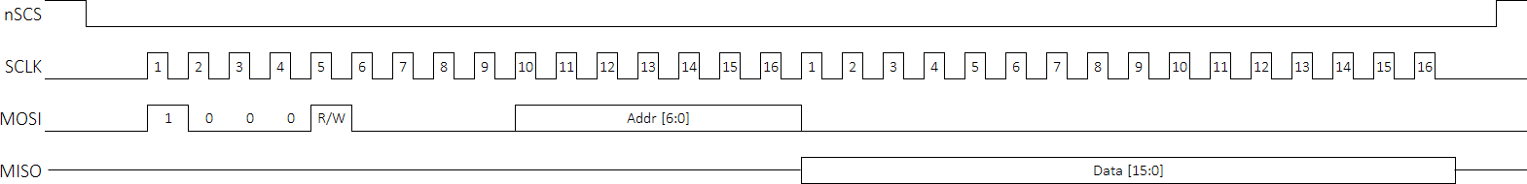
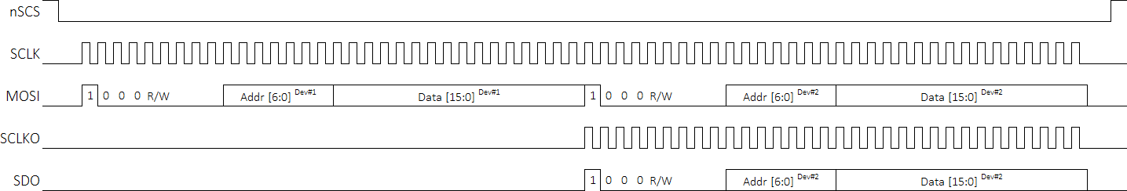
CQ24
<Preliminary>
Type2 : CMD2
The tyep2, CMD2 protocol is used to access 16-bit registers and consists of the command 2 bits, 2’b10, address 7 bits, R/W 1 bit (‘0’ to write, ‘1’ to read) and its register value, data 16 bits.
[Figure. 9-1] CMD2 Write
[Figure. 9-2] CMD2 Read
[Figure. 9-3] CMD2 Write through Daisy connection
CONFIDENTIAL
Dated 30-Nov 23 Rev. 01
Page 16
http://www.glbltech.com/

Slide 17
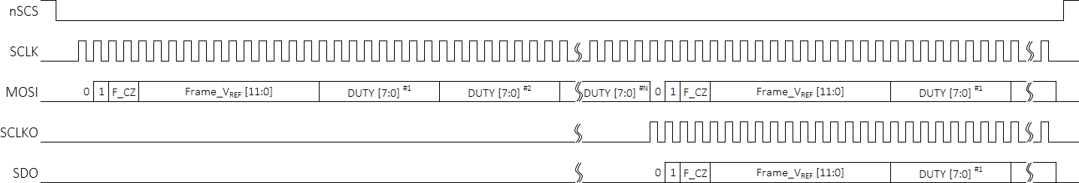
CQ24
<Preliminary>
Type3 : CMD3
The tyep3, CMD3 protocol is used to transfer the local dimming, DUTY data, and consists of the command 2 bits, b’01, and the frame header 14 bits. The frame header consist of Frame_CZ 2 bits and Frame_VREF 12 bits. The Frame_CZ are used to configure the LED Driver, AQ06/08 devices, at initialization after POR and then to present AQ series with proper CZ levels for good local dimming operation. The Frame_VREF are used to set the maximum current level of each frame’s period. The frame header is followed by DUTY data that determine On-time duration of the set current value. The whole DUTY data of one frame should be transferred on one time and if several devices are connected in a daisy, the nSCS should be asserted to active level until all devices’ DUTY data is completed to transfer. The order of DUTY data transmit is transferred in block order in the scan direction.
[Figure. 10-1] CMD3 DUTY data transfer
※ Notes:
The upper subscripts #1, #2 and #N mean the DUTY of #1 block, #2 and #N block, respectively. The N means the number of whole blocks which are mapped by one CQ24 device. The transferred order is described later again.
[Figure. 10-2] CMD3 DUTY data transfer in daisy connection
CONFIDENTIAL
Dated 30-Nov 23 Rev. 01
Page 17
http://www.glbltech.com/

Slide 18
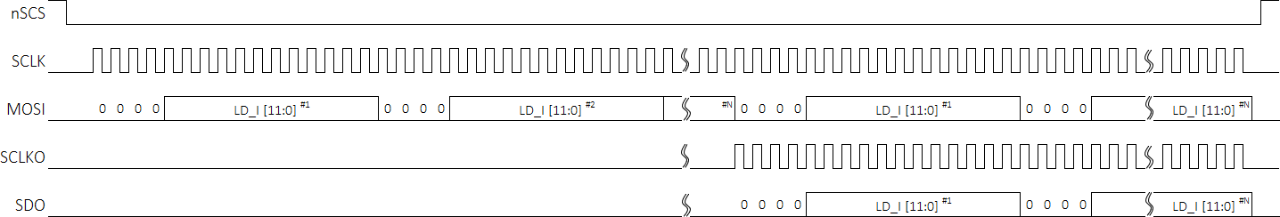
CQ24
<Preliminary>
Type4: CMD4
The type4, CMD4 protocol is used to transfer the local dimming, LD_I data, and consists of the command 2 bits, b’00, and LD_I data 12 bits. The LD_I data means the current data of a block and the whole LD_I data of one frame should be transferred at once and if several devices are connected in a daisy chain, then the nSCS should be asserted to active Level until all devices’ DUTY data is completed to transfer. The order of LD_I data transmit is transferred in block order in the scan direction.
[Figure. 11-1] CMD4 LD_I data transfer
※ Notes:
The upper subscripts #1, #2 mean the LD_I data of #1 block and # block, respectively. The N means the number of whole blocks
which are mapped by one CQ24 device. The transferred order is described at next page.
[Figure. 11-2] CMD4 LD_I data transfer in daisy connection
CONFIDENTIAL
Dated 30-Nov 23 Rev. 01
Page 18
http://www.glbltech.com/

Slide 19
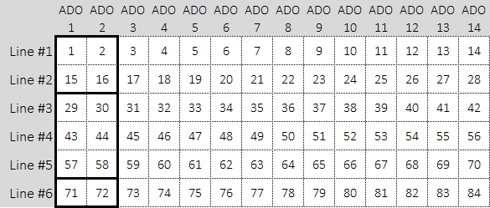
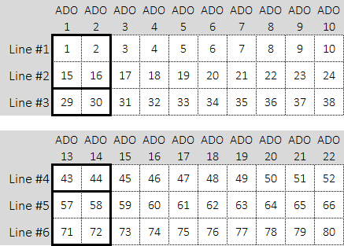
CQ24
<Preliminary>
2. Local dimming
The CQ24 can support maximum 128 times of sub-frame for one frame period,100~120hz.
The channels’ mapping method to LED block array
There are two ways for the output channels’ mapping to LED blocks according to the drive modes, single and dual drive. In single drive mode, the output channels can be sequentially mapped to the local dimming blocks’ order like Figure.5-1. In dual drive mode, the two lines’ local dimming data out are driven out at the same time and should be careful to output channels’ mapping unlike the single the single drive. Whole 24 channels are divided into 2 segments, channel 1~12 and channel 13~24 in dual drive mode, so the two segment should be assigned sequentially to the local dimming blocks like Figure.5-2. At this time, it needs to be careful that the SHSYNC_SIZE is also different from each other, and the max value of the SHSYNC_SIZE is 18 regardless of the drive mode.
SHSYNC_SIZE=6
[Figure. 12-1] The ADO channels’ mapping to the blocks in single drive mode
SHSYNC_SIZE=3
SHSYNC_SIZE=3
[Figure. 12-2] The ADO channels’ mapping to the blocks in dual drive mode
CONFIDENTIAL
Dated 30-Nov 23 Rev. 01
Page 19
http://www.glbltech.com/

Slide 20
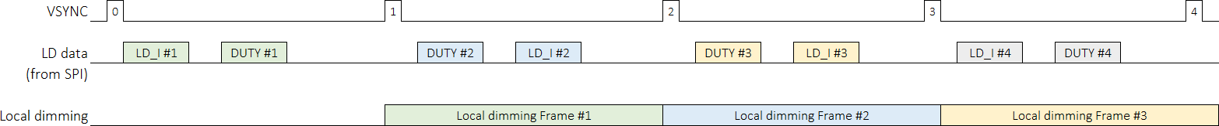
CQ24
<Preliminary>
The transfer sequence of the frame data
The local dimming data of one frame, the LD_I and the DUTY, should be transferred before the next frame starts. The below shows the sequence of transfer. The order of transfer of LD_I and DUTY is unrelated each other.
[Figure. 13-1] The sequence of local dimming data transfer
The transfer order of local dimming data
The local dimming data, the LD_I and the DUTY should be transferred as below order within one frame period. It should be careful to be different between the single drive and the dual drive mode. In single drive, the LD_I and DUTY data should be transferred in order of the block number within one line, and then the amount of next line should be transferred sequentially in line by line in the manner of below the Figure. 5-2. In dual drive, the LD_I and DUTY data should be transferred in the manner of below the Figure. 5-3. Regardless of the drive modes, the transfer order is actually the same in the manner which the first data to be out should be transferred at first, and so on.
①
②
①
③
②
④
[Figure. 13-2] The transfer order in single drive
[Figure. 13-3] The transfer order in dual drive
CONFIDENTIAL
Dated 30-Nov 23 Rev. 01
Page 20
http://www.glbltech.com/

Slide 21
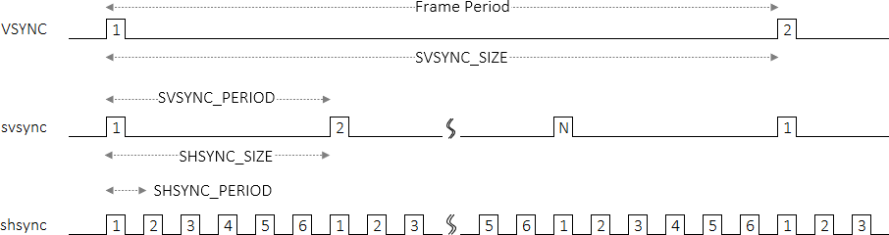
CQ24
<Preliminary>
The synchronization signals
The internal synchronization signals, svsync and shsync, are generated by set of the SVSYNC_PERIOD, the SHSYNC_PERIOD, the SVSYNC_PERIOD and the SHSYNC_PERIOD register which are counted with internal or external MCLK.
First, it needs to determine how many sub-frames are generated for one source frame period, 100 ~ 960hz. If the target of sub-frame number is determined, this number can be set to the SVSYNC_SIZE register. Second, it needs to determine how many lines are dimmed for one sub-frame period that may correspond to total line numbers. If the target of sub-hsync numbers is determined, the value can be set to the SHSYNC_SIZE register.
After determining the SVSYNC_SIZE and SHSYNC_SIZE, the SVSYNC_PERIOD and the SHSYNC_PERIOD can be determined in MCLK time domain. The SVSYNC_PERIOD can be obtained by dividing the source frame period by the set value of the SVSYNC_SIZE and then dividing the value by MCLK period In the same manner, the SHSYNC_PERIOD can be also determined by dividing the SVSYNC_PERIOD by the SHSYNC_SIZE and then by dividing the value by MCLK period.
[Figure. 14] The internal local dimming synchronization signals
The local dimming modes
The local dimming sequence consists of 3 types, NORMAL, X8 and X2 mode which can be selected by set of some bit of the MODE CONTROL register of CMD1. At NORMAL mode, the local dimming data out is performed one time for one frame period and at X8 mode, the local dimming data out is performed 8 times repeatedly for one frame period and at X2 mode, the local dimming data out is performed 2 times repeatedly for one frame period. The X8 mode can be used as 800 or 960hz and X2 mode as 240hz.
The local dimming drive method has 2 types, single drive and dual drive which can be selected by DRV_MODE bit of the MODE CONTROL register. At single drive mode, the dimming out is performed one line at a time, and at dual drive mode, the dimming out is performed two lines at a time simultaneously. So, the dual drive mode is much effective than the single drive mode in terms of dimming out speed. The output channels’ mapping method is different from each other, so need to be careful and explained later.
CONFIDENTIAL
Dated 30-Nov 23 Rev. 01
Page 21
http://www.glbltech.com/

Slide 22
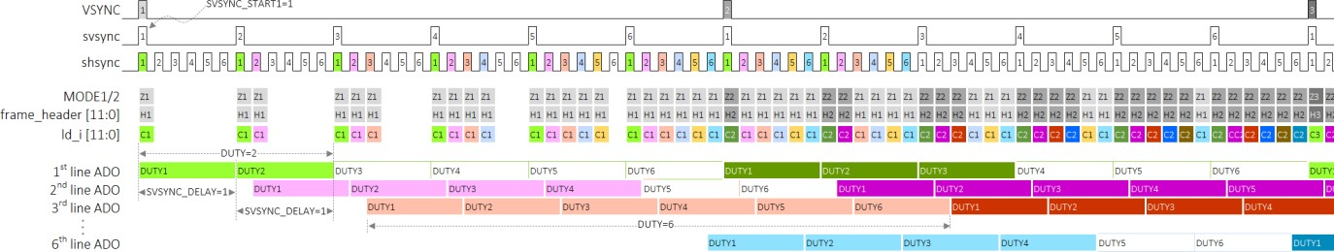
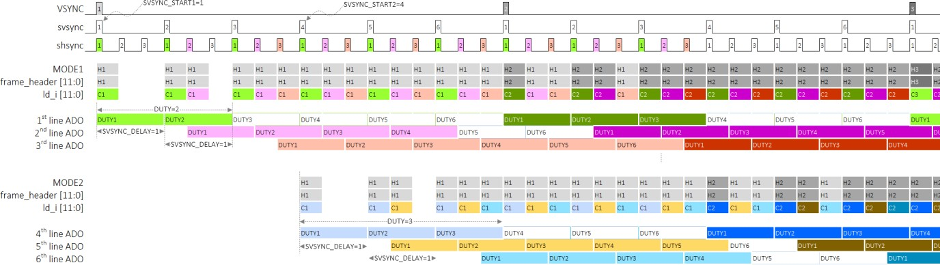
CQ24
<Preliminary>
The local dimming data out at NORMAL mode
Below shows the local dimming normal mode in single and dual drive, respectively.
[Figure. 15-1] The Normal dimming out sequence in single drive mode
At single drive mode, local dimming data out is performed one line at a time according to internal sync signals, the svsync and the shsync. The data out starts from the designated svsync order which is set by SVSYNC_START1 register. From the svsync set by SVSYNC_START1, the first line data out starts and then the next line data out starts after the number of svsync set by SVSYNC_DELAY and then this sequence is repeated until the last line.
[Figure. 15-2] The Normal dimming out sequence in dual drive mode
At dual drive mode, local dimming data out is performed 2 lines at a time simultaneously according to internal sync signals, the svsync and the shsync. The data out of two lines starts at a same time from the designated svsync order which is set by SVSYNC_START1 and SVSYNC_START2 register. From the svsync set by SVSYNC_START1, the data out of the first line corresponding to half of total lines starts and from the svsync set by SVSYNC_START2, the data out of the first line corresponding to other half lines starts and the data out of the next two lines start respectively after the number of svsync set by SVSYNC_DELAY
CONFIDENTIAL
Dated 30-Nov 23 Rev. 01
Page 22
http://www.glbltech.com/

Slide 23
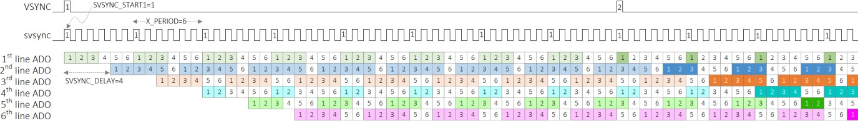
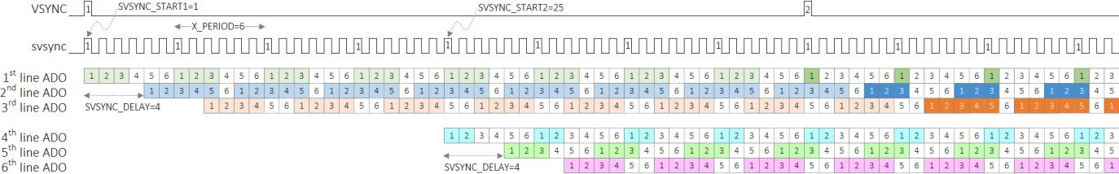
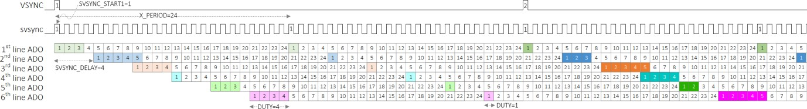
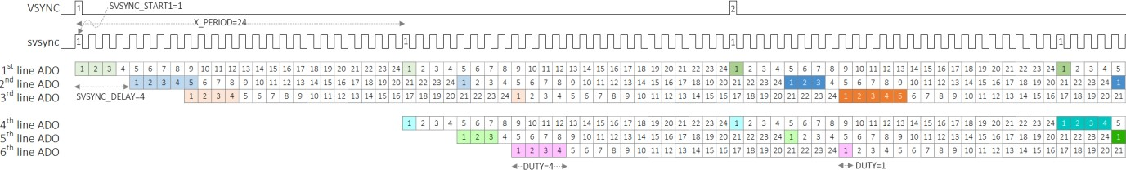
CQ24
<Preliminary>
The local dimming data out at X8 mode
The mode is used for 800 and 960Hz and its local dimming out is performed 8 times repeatedly within one frame period. The rest is almost the same as the normal mode and the X_PERIOD should be set to a proper value, SVSYNC_SIZE/8.
[Figure. 16-1] The X8 local dimming out sequence in single drive mode
[Figure. 16-2] The X8 local dimming out sequence in dual drive mode
The local dimming data out at X2 mode
[Figure. 17-1] The X2 local dimming out sequence in single drive mode
[Figure. 17-2] The X2 Local dimming out sequence in dual drive mode
CONFIDENTIAL
Dated 30-Nov 23 Rev. 01
Page 23
http://www.glbltech.com/

Slide 24
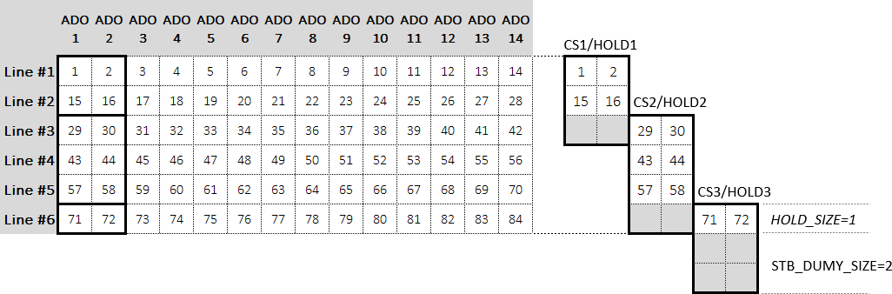

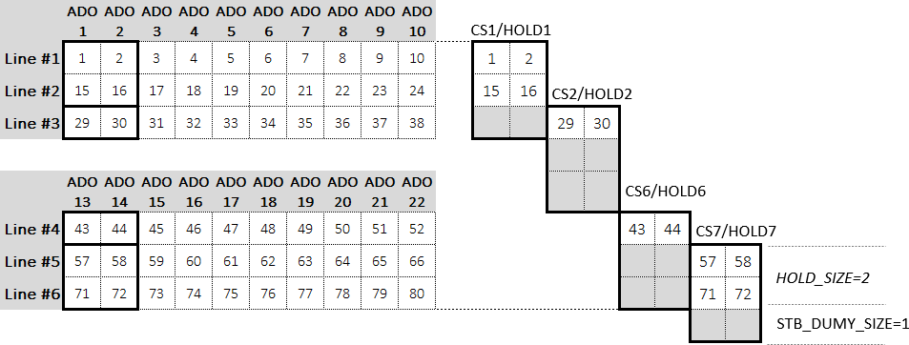
CQ24
<Preliminary>
The assignment of CS/HOLD to AQ series
The CS/HOLD signals has two functions. The first is used to configure the AQ series at the initialization after POR in order to set the AQ series internally to fix those operation modes, 1*6 and 2*3, 2*4, and 1*8 array structure. The second is used to strobe the valid data input to AQ series during the local dimming. The CS/HOLD mapping to the AQ series is different from the drive modes, single and dual drive. The strobe channel number should be assigned sequentially, CS1/HOLD1 from CS10/HOLD10, to the AQ series drivers in single drive mode like Figure 11-1, but it should be careful in dual drive mode. In dual drive mode, the strobe channel number should be divided into two group, CS1/HOLD1 to CS5/HOLD5 and CS6/HOLD6 to CS10/HOLD10, and then should be assigned sequentially in each group like Figure 11-2.
CQ24
AQ06/08
[Figure. 18-1] The CS/HOLD assignment in single drive mode
CQ24
AQ06/08
[Figure. 18-2] The CS/HOLD assignment in dual drive mode
CONFIDENTIAL
Dated 30-Nov 23 Rev. 01
Page 24
http://www.glbltech.com/

Slide 25
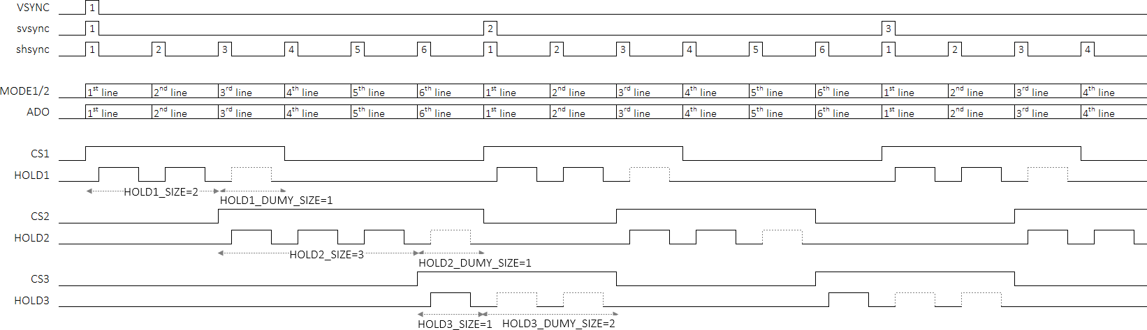
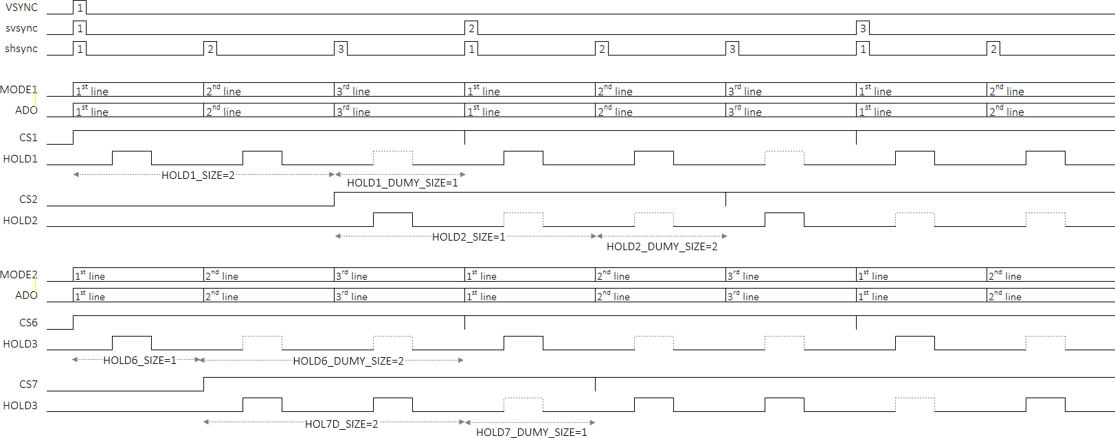
CQ24
<Preliminary>
The generation of CS/HOLD
The HOLDn_SIZE means how many times valid HOLD signal should be asserted for one CS period and depends on how the AQ series is configured and mapped to the block array. The HOLDn_DUMY_SIZE means how many times invalid HOLD signal should be asserted virtually for one CS period, and this can be used in only case that there is any unused block of the AQ series in local dimming. Refer to the Figure 11-1 and the Figure 11-2.
[Figure. 19-1] The CS/HOLD sequence in single drive mode
[Figure. 19-2] The CS/HOLD sequence in dual drive mode
CONFIDENTIAL
Dated 30-Nov 23 Rev. 01
Page 25
http://www.glbltech.com/

Slide 26
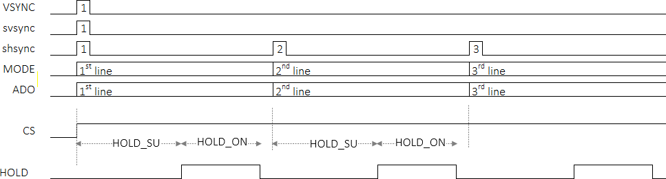
CQ24
<Preliminary>
The set time of CS/HOLD
The HOLD_SU and HOLD_ON can be used to adjust the start time of assertion and the on-time of assertion, respectively. The set value depends on the system design environment, the local dimming speed, fan-out and propagation delay in line. The hold time of MODE and ADO level should be needed to latch stable value from HOLD_ON de-assertion
[Figure. 20] The set of HOLD timing
CONFIDENTIAL
Dated 30-Nov 23 Rev. 01
Page 26
http://www.glbltech.com/

Slide 27
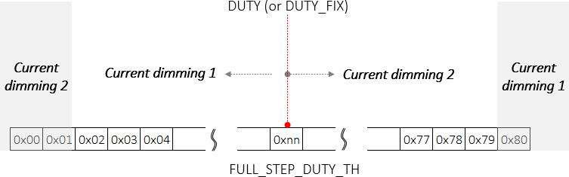
CQ24
<Preliminary>
The current dimming
There are two types of current dimming method, one is that the current step is accomplished to accumulate the same amount of step over whole duty period in the Figure.15-1 and the other is that the current step is accomplished to accumulate different amount of step in each duty period in the Figure.15-2. The first is named as the current dimming 1 and the second, the current dimming 2.
The decision can be performed with setting the FULL_STEP_DUTY_TH register. If the DUTY data (or DUTY_FIX register value) is smaller than the FULL_STEP_DUTY_TH , then the current dimming 1 is applied for local dimming and if the DUTY data is great than or the same as the FULL_STEP_DUTY_TH , then the current dimming 2 is applied for local dimming. It can be determined according to the system situation.
If the FULL_STEP_DUTY_TH is set to 0, the current dimming 2 is always activated regardless of the DUTY data, and if it is set to the same value as the SVSYNC_SIZE, then the current dimming 1 is always activated.
[Figure. 21] The decision of current dimming method
CONFIDENTIAL
Dated 30-Nov 23 Rev. 01
Page 27
http://www.glbltech.com/

Slide 28
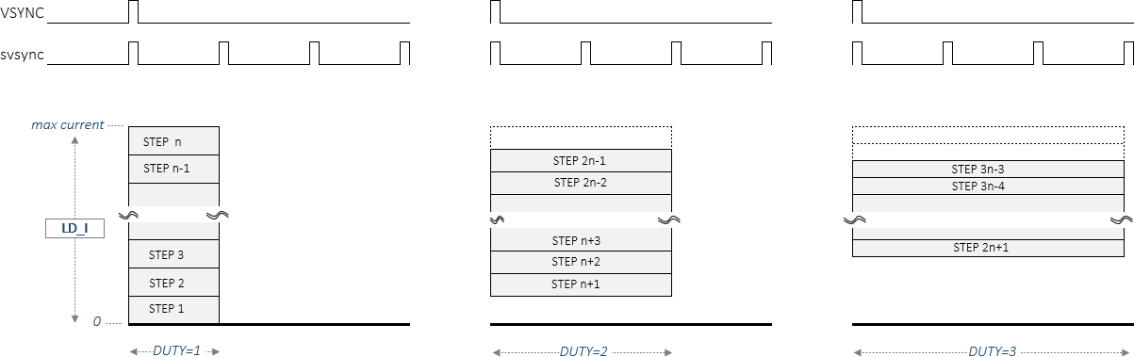
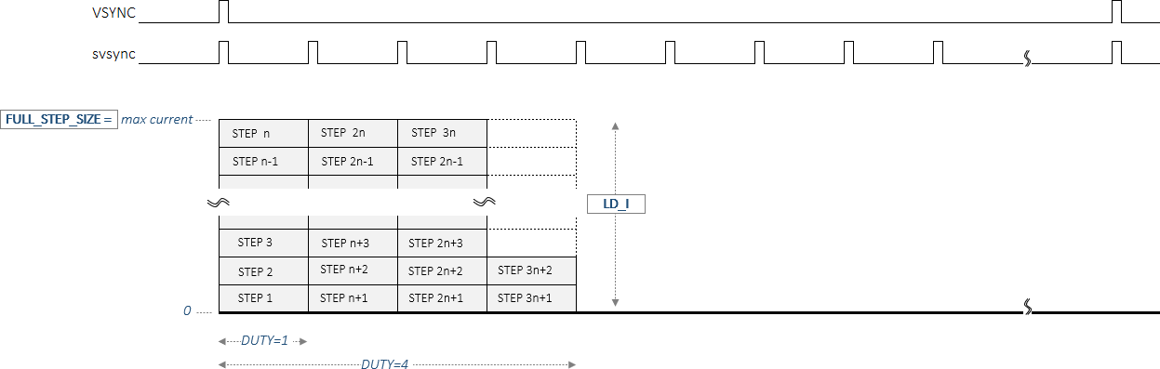
CQ24
<Preliminary>
The current dimming 1 and 2
The current dimming 1
The current step size is decided by the FULL_STEP_SIZE/the number of step in a DUTY and the step size is same for overall DUTY period. The FULL_STEP_SIZE means the max current of the frame period and is decided by the Frame_VREF of the frame header transferred together with the DUTY data.
[Figure. 22-1] The current dimming 1
The current dimming 2
The current step size is decided by the LD_I data and DUTY data and the size is different from each DUTY. The max current is decided with the Frame_VREF [11:0] transferred with the DUTY data
[Figure. 22-2] The current dimming 2
CONFIDENTIAL
Dated 30-Nov 23 Rev. 01
Page 28
http://www.glbltech.com/

Slide 29
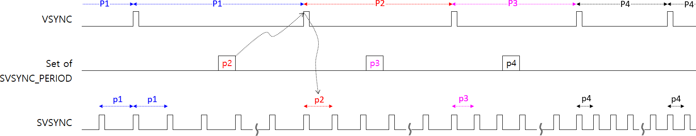
CQ24
<Preliminary>
The change of the frame period
Below explains the case how to switch the frame period without the insertion of the black screen. This can be achieved by gradually changing the SVSYNC PERIOD value up or down according to the desired appropriate frame period. After the register is set to the desired value, the SVSYNC PERIOD begins to change when VSYNC is received. Therefore, the desired SVSYNC PERIOD must be set before VSYNC to be desired to change. Since SVSYNC PERIODE is counted by MCLK, the minimum variation in the frame cycle can be changed in units of MCLK.
P1 period = SVSYNC_PERIOD p1 * SVSYNC_SIZE
P2 period = SVSYNC_PERIOD p2 * SVSYNC_SIZE
P3 period = SVSYNC_PERIOD p3 * SVSYNC_SIZE
P4 period = SVSYNC_PERIOD p4 * SVSYNC_SIZE
Suppose that the SVSYNC_SIZE is 128 and MCLK is 16.128mhz and the frame period changes from 50hz to 60hz. The maximum number of variation in the frame period is 210, so it is possible to gradually change the frame period over 210 times.
The maximum number of variation = (50hz – 60hz) / SVSYNC_SIZE / MCLK
[Figure. 23] The change of the frame period
CONFIDENTIAL
Dated 30-Nov 23 Rev. 01
Page 29
http://www.glbltech.com/

Slide 30
CQ24
<Preliminary>
3. Register Map
There is 2 types of the register group, CMD1 which consists of 11 bits data and CMD2 which consists of 16 bits data.
CMD1 registers
C1 [15:14] | Addr [13:12] | R/W | Data [10:0]
Bits | Fields | Descriptions
15:14 | Command Type | 2’b11 to access the CMD1 registers
13:12 | Address | 2’b00 : SOFT RESET register 2’b01 : MODE CONTROL register 2’b10 : FIX CONTROL register 2’b11 : CS/HOLD FIX CHANNEL register
11 | Read / Write | Write : ‘0’, Read : ‘1’
10:0 | Data | Refer to each register’s description
SOFT RESET
A[1:0] | Default | D10 | D9 | D8 | D7 | D6 | D5 | D4 | D3 | D2 | D1 | D0
‘2b00 | 0 | x | x | Broadcast | x | x | x | x | x | RST3 | RST2 | RST1
Bits | Fields | Descriptions
8 | Broadcast | Broadcast Enable in SPI Daisy connection. It can show very fast transfer to all daisied devices at one time but can be used in case the data and address to be transferred are all the same for all devices. And this is needed to read each device’s register value in daisy connection.
2 | RST3 | Reset to only the frame buffers. Auto-cleared.
1 | RST2 | Reset to the internal state machines and the frame buffers (except for registers), Auto-cleared.
0 | RST1 | Reset to all logics, Not Auto-cleared.
CONFIDENTIAL
Dated 30-Nov 23 Rev. 01
Page 30
http://www.glbltech.com/

Slide 31
CQ24
<Preliminary>
MODE CONTROL
A[1:0] | Default | D10 | D9 | D8 | D7 | D6 | D5 | D4 | D3 | D2 | D1 | D0
‘2b01 | 0 | INT_CLK | VS_FT_EN | VS_COMP_EN | FRAME_KEEP | X2 | X8 | NORMAL | x | x | x | DRV_MODE
Bits | Fields | Descriptions
10 | INT_CLK | ‘0’ ‘1’ | The external clock source is used for the main clock, MCLK. The internal clock out from PLL is used for the main clock. The PLL reference clock source is 16.128MHz.
9 | VS_FT_EN | ‘0’ ‘1’ | No operation. The VSYNC input is masked from 1st svsync assertion to last shsync assertion of the last svsync for avoiding the VSYNC noise.
8 | VS_COMP_EN | ‘0’ ‘1’ | No operation. The VSYNC can be sensed within special time zone at high level of VSYNC. Impossible to use this bit when VSYNC_OFFSET is set to some value or if the VSYNC period is changed frequently like frame frequency switch to 50/60hz. Recommended to not use under VSYNC delay mode.
7 | FRAME_KEEP | ‘0’ ‘1’ | The LD mode operating currently will be changed immediately as soon as VSYNC is sensed. The LD mode operating currently mode will be changed gradually in line order after previous LD mode is completed at the time of the VSYNC sensing and recommended to set 1.
6 | X2 | ‘1’ | X2 local dimming enabled.
5 | X8 | ‘1’ | X8 local dimming enabled.
4 | NORMAL | ‘1’ | NORMAL local dimming enabled.
0 | DRV_MODE | ‘0’ ‘1’ | Single drive mode enabled. Dual drive mode enabled.
CONFIDENTIAL
Dated 30-Nov 23 Rev. 01
Page 31
http://www.glbltech.com/

Slide 32
CQ24
<Preliminary>
FIX CONTROL
A[1:0] | Default | D10 | D9 | D8 | D7 | D6 | D5 | D4 | D3 | D2 | D1 | D0
‘2b10 | 0 | DUP_O | x | LD_FORCE | x | LD_I_FIX | DUTY_FIX | HEADER_FIX | CS_OUT | HOLD_OUT | x | CS/HD_FIX
Bits | Fields | Descriptions
10 | DUP_O | ‘1’ | Duplicated Output enable. Several internal signals are duplicated on some output pins for debugging the svsync on CS10, the shsync on HOLD10, the vsync edge on CS9, the internal or external MCLK on HOLD9.
8 | LD_FORCE | ‘1’ | Always driver the LD_I [11:0] & FRAME_HEADER [14:0] register’s value continuously to DACs regardless of the DUTY data under no VSYNC input.
6 | LD_I_FIX | ‘1’ | The LD_I [11:0] register’s value is used for the local dimming, not the LD_I data transferred from SPI interface.
5 | DUTY_FIX | ‘1’ | The DUTY [7:0] register’s value is used for the local dimming, not the DUTY data transferred from SPI interface.
4 | HEADER_FIX | ‘1’ | The FRAME_HEADER [14:0] register’s value is used for the local dimming, not the frame header data transferred from SPI interface.
3 | CS_OUT | ‘0’ ‘1’ | This is activated only under set of CS/HD_FIX bit. All CS pins activated in CS/HOLD FIX CHANNEL register are driven to 0. All CS pins activated in CS/HOLD FIX CHANNEL register are driven to 1.
2 | HOLD_OUT | ‘0’ ‘1’ | This is activated only under set of CS/HD_FIX bit. All HOLD pins activated in CS/HOLD FIX CHANNEL register are driven to 0. All HOLD pins activated in CS/HOLD FIX CHANNEL register are driven to 1.
0 | CS/HD_FIX | ‘1’ | This is used to configure the AQ06/AQ08 LED drivers at initialization after POR. CS_OUT and HOLD_OUT are activated.
CS/HOLD FIX CHANNEL
A[1:0] | Default | D10 | D9 | D8 | D7 | D6 | D5 | D4 | D3 | D2 | D1 | D0
‘2b11 | 0 | x | FIX_CH10 | FIX_CH9 | FIX_CH8 | FIX_CH7 | FIX_CH6 | FIX_CH5 | FIX_CH4 | FIX_CH3 | FIX_CH2 | FIX_CH1
Bits | Fields | Descriptions
9:0 | FIX_CHx | ‘0’ ‘1’ | No operation CSx/HOLDx pins’ output are activated under the set of CS/HD_FIX bit.
CONFIDENTIAL
Dated 30-Nov 23 Rev. 01
Page 32
http://www.glbltech.com/

Slide 33
CQ24
<Preliminary>
CMD2 registers
C1 [15:14] | x | x | R/W | x | x | x | x | Addr [6:0]
Data [15:0]
Bits | Fields | Descriptions
15:14 | Command Type | ‘2b10 to access the CMD1 registers
11 | Read / Write | Write : ‘0’, Read : ‘1’
6:0 | Address | CMD2 type registers’ address
Bits | Fields | Descriptions
15:0 | Data [15:0] | CMD2 type registers’ data
FRAME SIZE
A[6:0] | Default | D15 | D14 | D13 | D12 | D11 | D10 | D9 | D8 | D7 | D6 | D5 | D4 | D3 | D2 | D1 | D0
‘h00 | 0 | x | x | SHSYNC_SIZE [5:0] |  |  |  |  |  | SVSYNC_SIZE [7:0]
Bits | Fields | Descriptions
13:8 | SHSYNC_SIZE | The number of the shsync within one svsync period. This is the same as line numbers. It needs to be careful the value is different with the drive mode, single or dual.
7:0 | SVSYNC_SIZE | The number of the svsync within one source frame period. The maximum number don’t be over 0x80. (decimal 128)
FRAME START TIME
A[6:0] | Default | D15 | D14 | D13 | D12 | D11 | D10 | D9 | D8 | D7 | D6 | D5 | D4 | D3 | D2 | D1 | D0
‘h01 | 0 | x | SVSYNC_START2 [6:0] |  |  |  |  |  |  | x | SVSYNC_START1 [6:0]
Bits | Fields | Descriptions
14:8 | SVSYNC_START1 | This value designates at which svsync the first line’s local dimming starts in single drive mode. In case of dual drive mode, this value designates at which svsync the first line’s local dimming corresponding to a first half of total lines starts. Normally recommended to set 1.
6:0 | SVSYNC_START2 | This value designates at which svsync the first line’s local dimming corresponding to a second half of total lines starts in dual drive mode. This is used only in dual drive mode.
CONFIDENTIAL
Dated 30-Nov 23 Rev. 01
Page 33
http://www.glbltech.com/

Slide 34
CQ24
<Preliminary>
CHANNEL SIZE and SVSYNC DELAY
A[6:0] | Default | D15 | D14 | D13 | D12 | D11 | D10 | D9 | D8 | D7 | D6 | D5 | D4 | D3 | D2 | D1 | D0
‘h02 | 0 | x | x | x | OUTPUT CH_SIZE [4:0] |  |  |  |  | x | x | x | SVSYNC_DELAY [4:0]
Bits | Fields | Descriptions
12:8 | OUTPUT CH_SIZE | This is used to set how many channels are used.
4:0 | SVSYNC_DELAY | This means the interval of svsync between lines’ start of the local dimming out.
SVSYNC OFFSET
A[6:0] | Default | D15 | D14 | D13 | D12 | D11 | D10 | D9 | D8 | D7 | D6 | D5 | D4 | D3 | D2 | D1 | D0
‘h03 | 0 | x | SVSYNC_OFFSET [14:0]
Bits | Fields | Descriptions
14:0 | SVSYNC_OFFSET | The internal svsync starts asserting just after this register’s value expires from VSYNC. This value is counted by MCLK. Normally recommended to set 0.
SVSYNC PERIOD
A[6:0] | Default | D15 | D14 | D13 | D12 | D11 | D10 | D9 | D8 | D7 | D6 | D5 | D4 | D3 | D2 | D1 | D0
‘h04 | 0 | x | SVSYNC_PERIOD [14:0]
Bits | Fields | Descriptions
14:0 | SVSYNC_PERIOD | Means the period of one svsync. This value is counted by MCLK. = the source frame period / SVSYNC_SIZE
SHSYNC PERIOD
A[6:0] | Default | D15 | D14 | D13 | D12 | D11 | D10 | D9 | D8 | D7 | D6 | D5 | D4 | D3 | D2 | D1 | D0
‘h05 | 0 | x | SHSYNC_PERIOD [14:0]
Bits | Fields | Descriptions
14:0 | SHSYNC_PERIOD | Means the period of one shsync. This value is counted by MCLK. = SVSYNC_PERIOD / SHSYNC_SIZE
CONFIDENTIAL
Dated 30-Nov 23 Rev. 01
Page 34
http://www.glbltech.com/

Slide 35
CQ24
<Preliminary>
HOLD SIZE
A[6:0] | Default | D15 | D14 | D13 | D12 | D11 | D10 | D9 | D8 | D7 | D6 | D5 | D4 | D3 | D2 | D1 | D0
‘h06 | 0 | HOLD4_SIZE [3:0] |  |  |  | HOLD3_SIZE [3:0] |  |  |  | HOLD2_SIZE [3:0] |  |  |  | HOLD1_SIZE [3:0]
A[6:0] | Default | D15 | D14 | D13 | D12 | D11 | D10 | D9 | D8 | D7 | D6 | D5 | D4 | D3 | D2 | D1 | D0
‘h07 | 0 | HOLD8_SIZE [3:0] |  |  |  | HOLD7_SIZE [3:0] |  |  |  | HOLD6_SIZE [3:0] |  |  |  | HOLD5_SIZE [3:0]
A[6:0] | Default | D15 | D14 | D13 | D12 | D11 | D10 | D9 | D8 | D7 | D6 | D5 | D4 | D3 | D2 | D1 | D0
‘h08 | 0 | x | x | x | x | x | x | x | x | HOLD10_SIZE 10 [3:0] |  |  |  | HOLD9_SIZE [3:0]
Bits | Fields | Descriptions
 | HOLDx_SIZE | This is used to designate the value how many times valid HOLD signal should be asserted for one CS period. It is equipped to be able to set each HOLD channel, respectively and depends on the number of used channels of AQ series. Refer to the Figure 11 and Figure 12.
HOLD DUMMY SIZE
A[6:0] | Default | D15 | D14 | D13 | D12 | D11 | D10 | D9 | D8 | D7 | D6 | D5 | D4 | D3 | D2 | D1 | D0
‘h09 | 0 | x | HOLD5_DUMY_SIZE[2:0] |  |  | HOLD4_DUMY_SIZE[2:0] |  |  | HOLD3_DUMY_SIZE[2:0] |  |  | HOLD2_DUMY_SIZE[2:0] |  |  | HOLD1_DUMY_SIZE[2:0]
A[6:0] | Default | D15 | D14 | D13 | D12 | D11 | D10 | D9 | D8 | D7 | D6 | D5 | D4 | D3 | D2 | D1 | D0
‘h0A | 0 | x | HOLD10_DUMY_SIZE[2:0] |  |  | HOLD9_DUMY_SIZE[2:0] |  |  | HOLD8_DUMY_SIZE[2:0] |  |  | HOLD7_DUMY_SIZE[2:0] |  |  | HOLD6_DUMY_SIZE[2:0]
Bits | Fields | Descriptions
14:0 | HOLDx_DUMY_SIZE | This is used to designate the value how many times invalid HOLD signal should be asserted for one CS period. It is equipped to be able to set each HOLD channel, respectively and depends on the number of unused channels of AQ series. Refer to the Figure 11 and Figure 12.
CONFIDENTIAL
Dated 30-Nov 23 Rev. 01
Page 35
http://www.glbltech.com/

Slide 36
CQ24
<Preliminary>
HOLD SETUP TIME
A[6:0] | Default | D15 | D14 | D13 | D12 | D11 | D10 | D9 | D8 | D7 | D6 | D5 | D4 | D3 | D2 | D1 | D0
‘h0B | 0 | x | x | x | x | x | x | HOLD_SU [9:0]
Bits | Fields | Descriptions
9:0 | HOLD_SU | This means the interval time from the point of outputting ADO signal to the point of rising-edge of HOLD signal to validate AQ series to be sensed on stable level. This is counted by MCLK. Refer to the Figure 13.
HOLD ON TIME
A[6:0] | Default | D15 | D14 | D13 | D12 | D11 | D10 | D9 | D8 | D7 | D6 | D5 | D4 | D3 | D2 | D1 | D0
‘h0C | 0 | x | x | x | x | x | x | x | HOLD_ON [8:0]
Bits | Fields | Descriptions
8:0 | HOLD_ON | This means the high active time of HOLD signal and depends on AQ06/08 specification including external environment in signal propagation line. This is counted by MCLK. Refer to the Figure 13.
X PERIOD
A[6:0] | Default | D15 | D14 | D13 | D12 | D11 | D10 | D9 | D8 | D7 | D6 | D5 | D4 | D3 | D2 | D1 | D0
‘h0D | 0 | x | x | x | x | x | x | x | x | x | X_PERIOD [6:0]
Bits | Fields | Descriptions
6:0 | X_PERIOD | This means the value how many svsync exist within one X period in X8 and X2. This can be obtained (SVSYNC_SIZE / 8) in X8 mode, (SVSYNC_SIZE / 2) in X2 mode.
CONFIDENTIAL
Dated 30-Nov 23 Rev. 01
Page 36
http://www.glbltech.com/

Slide 37
CQ24
<Preliminary>
VSYNC COMPENSATION TIME 1
A[6:0] | Default | D15 | D14 | D13 | D12 | D11 | D10 | D9 | D8 | D7 | D6 | D5 | D4 | D3 | D2 | D1 | D0
‘h0E | 0 | x | x | x | x | VSYNC_COMP 1 [11:0]
Bits | Fields | Descriptions
11:0 | VSYNC_COMP 1 | This is counted by MCLK. Don’t use in VSYNC delay mode.
VSYNC COMPENSATION TIME 2
A[6:0] | Default | D15 | D14 | D13 | D12 | D11 | D10 | D9 | D8 | D7 | D6 | D5 | D4 | D3 | D2 | D1 | D0
‘h0F | 0 | x | x | x | x | x | x | VSYNC_COMP 2 [9:0]
Bits | Fields | Descriptions
9:0 | VSYNC_COMP 2 | This is counted by MCLK. Don’t use in VSYNC delay mode.
CONFIDENTIAL
Dated 30-Nov 23 Rev. 01
Page 37
http://www.glbltech.com/

Slide 38
CQ24
<Preliminary>
FRAME HEADER FIX
A[6:0] | Default | D15 | D14 | D13 | D12 | D11 | D10 | D9 | D8 | D7 | D6 | D5 | D4 | D3 | D2 | D1 | D0
‘h10 | 0 | x | x | FRAME_CZ[1:0] |  | FRAME_VREF [11:0]
Bits | Fields | Descriptions
13:12 | FRAME_CZ | This has two functions, to configure AQ series at initialization after POR and to inform AQ06/08 of the current zoom value during the local dimming. 2’b00 : The MODE 1/2 pins drive the voltage level, 0.5V 2’b01 : The MODE 1/2 pins drive the voltage level, 1.5V 2’b10 : The MODE 1/2 pins drive the voltage level, 2.5V 2’b11 : The MODE 1/2 pins drive the voltage level, 3.5V
11:0 | FRAME_VREF | Limit the maximum current during a frame period in case FRAME_HEADER_FIX bit is set. Normally, the frame header value transferred through SPI with the DUTY data together is used for the local dimming
DUTY FIX
A[6:0] | Default | D15 | D14 | D13 | D12 | D11 | D10 | D9 | D8 | D7 | D6 | D5 | D4 | D3 | D2 | D1 | D0
‘h11 | 0 | x | x | x | x | x | x | x | x | DUTY_FIX [7:0]
Bits | Fields | Descriptions
7:0 | DUTY_FIX | If the DUTY_FIX bit of FIX CONTROL register is set, then the DUTY FIX register’s value is used for the local dimming duty data regardless of the transferred duty data through SPI. The dimming duration is the source frame period * (DUTY_FIX / SVSYNC_SIZE). The maximum value limits to decimal 128.
LD_I FIX
A[6:0] | Default | D15 | D14 | D13 | D12 | D11 | D10 | D9 | D8 | D7 | D6 | D5 | D4 | D3 | D2 | D1 | D0
‘h12 | 0 | x | x | x | x | LD_I_FIX [11:0]
Bits | Fields | Descriptions
11:0 | LD_I_FIX | If the LD_I_FIX bit of FIX CONTROL register is set, then the LD_I FIX register’s value is used for the local dimming current data regardless of the transferred LD_I data through SPI. The dimming current is FRAME_VREF * (LD_I_FIX / 4095). The maximum value is decimal 4095.
CONFIDENTIAL
Dated 30-Nov 23 Rev. 01
Page 38
http://www.glbltech.com/

Slide 39
CQ24
<Preliminary>
STROBE DUPLICATED CHANNEL ENABLE
A[6:0] | Default | D15 | D14 | D13 | D12 | D11 | D10 | D9 | D8 | D7 | D6 | D5 | D4 | D3 | D2 | D1 | D0
‘h13 | 0 | x | x | x | x | x | x | CH10 | CH9 | CH8 | CH7 | CH6 | CH5 | CH4 | CH3 | CH2 | CH1
Bits | Fields | Descriptions
9:0 | CHx | ‘0’ ‘1’ | No operation Activates the strobe duplicated channels. The CHx corresponds to STB_DUP_CHx, where x=1~10. If CH1 bit is set, then STB_DUP_CH1 is activated.
STROBE DUPLICATED CHANNEL
A[6:0] | Default | D15 | D14 | D13 | D12 | D11 | D10 | D9 | D8 | D7 | D6 | D5 | D4 | D3 | D2 | D1 | D0
‘h14 | 0 | STB_DUP_CH4 [3:0] |  |  |  | STB_DUP_CH3 [3:0] |  |  |  | STB_DUP_CH2 [3:0] |  |  |  | STB_DUP_CH1 [3:0]
A[6:0] | Default | D15 | D14 | D13 | D12 | D11 | D10 | D9 | D8 | D7 | D6 | D5 | D4 | D3 | D2 | D1 | D0
‘h15 | 0 | STB_DUP_CH8 [3:0] |  |  |  | STB_DUP_CH7 [3:0] |  |  |  | STB_DUP_CH6 [3:0] |  |  |  | STB_DUP_CH5 [3:0]
A[6:0] | Default | D15 | D14 | D13 | D12 | D11 | D10 | D9 | D8 | D7 | D6 | D5 | D4 | D3 | D2 | D1 | D0
‘h16 | 0 | x | x | x | x | x | x | x | x | STB_DUP_CH10 [3:0] |  |  |  | STB_DUP_CH9 [3:0]
Bits | Fields | Descriptions
 | STB_DUP_CHx[y] | The strobe channel signals, CSy and HOLDy, can be duplicated to the strobe channel, CSx and HOLDx, respectively. This is useful in case of heavy fan-out of AQ06/08. If CH7 bit of the STROBE DUPLICATE CHANNEL ENABLE is set to 1, then STB_DUP_CH7[3:0] is activated, and if the value is set to 0x2, then the strobe channel 2 signals (CS2, HOLD2) are duplicated to the strobe channel 7 (CS7, HOLD7).
CONFIDENTIAL
Dated 30-Nov 23 Rev. 01
Page 39
http://www.glbltech.com/

Slide 40
CQ24
<Preliminary>
FULL STEP SIZE
A[6:0] | Default | D15 | D14 | D13 | D12 | D11 | D10 | D9 | D8 | D7 | D6 | D5 | D4 | D3 | D2 | D1 | D0
‘h17 | 0 | x | x | x | x | FULL_STEP_SIZE [11:0]
Bits | Fields | Descriptions
11:0 | FULL_STEP_SIZE | This is used only in the current dimming mode 2, not the current dimming 1. Expressed by maximum PWM value of one sub-frame. Refer to the Figure.14/15, for details.
FULL STEP DUTY THRESHOLD
A[6:0] | Default | D15 | D14 | D13 | D12 | D11 | D10 | D9 | D8 | D7 | D6 | D5 | D4 | D3 | D2 | D1 | D0
‘h18 | 0 | x | x | x | x | x | x | x | x | FULL_STEP_DUTY_TH [7:0]
Bits | Fields | Descriptions
7:0 | FULL_STEP_DUTY_TH | This is used to decide which the current dimming mode is selected during the local dimming. Refer to the Figure 14/15, for details.
DUTY(or DUTY_FIX)
Current Dimming Mode=0
Current Dimming Mode=1
0x00
FULL STEP DUTY THRESHOLD
0x80
OUTPUT CHANNEL ENABLE
A[6:0] | Default | D15 | D14 | D13 | D12 | D11 | D10 | D9 | D8 | D7 | D6 | D5 | D4 | D3 | D2 | D1 | D0
‘h19 | 0 | CH16 | CH15 | CH14 | CH13 | CH12 | CH11 | CH10 | CH9 | CH8 | CH7 | CH6 | CH5 | CH4 | CH3 | CH2 | CH1
A[6:0] | Default | D15 | D14 | D13 | D12 | D11 | D10 | D9 | D8 | D7 | D6 | D5 | D4 | D3 | D2 | D1 | D0
‘h1A | 0 | x | x | x | x | x | x | x | x | CH24 | CH23 | CH22 | CH21 | CH20 | CH19 | CH18 | CH17
Bits | Fields | Descriptions
 | CHx | ‘0’ ‘1’ | The channel’s output (ADOx) goes to 0. If there are unused channels, then recommended to set to 0. The channel’s output (ADOx) is driven to some level which depends on the local dimming data.
CONFIDENTIAL
Dated 30-Nov 23 Rev. 01
Page 40
http://www.glbltech.com/

Slide 41
CQ24
<Preliminary>
MCLK LOCK COUNTER
A[6:0] | Default | D15 | D14 | D13 | D12 | D11 | D10 | D9 | D8 | D7 | D6 | D5 | D4 | D3 | D2 | D1 | D0
‘h1B | 0 | MCLK_LOCK_CNT [15:0]
A[6:0] | Default | D15 | D14 | D13 | D12 | D11 | D10 | D9 | D8 | D7 | D6 | D5 | D4 | D3 | D2 | D1 | D0
‘h1C | 0 | x | x | x | x | x | x | x | x | x | x | x | MCLK_LOCK_CNT [20:16]
Bits | Fields | Descriptions
20:0 | MCLK LOCK COUNTER | PLL lock counter. The reference clock source is internal OSC, 16.128MHz. This is enabled under the INT_CLK bit is set and synchronized by VSYNC. = VSYNC period / 16.128MHz Be careful when using it if the frame period is switched, 50↔ 60hz
CONFIDENTIAL
Dated 30-Nov 23 Rev. 01
Page 41
http://www.glbltech.com/

Slide 42
CQ24
<Preliminary>
[Appendix]
The trimming registers
These registers are not available to the users. Restricted to send out from GT.
TRIM CONTROL
A[6:0] | Default | D15 | D14 | D13 | D12 | D11 | D10 | D9 | D8 | D7 | D6 | D5 | D4 | D3 | D2 | D1 | D0
‘h30 | 0 | OTP_PG_ACCESS_CYCLE [11:0] |  |  |  |  |  |  |  |  |  |  |  | OTP_RD_RE_CYCLE [3:0]
OTP WRITE CONTROL
A[6:0] | Default | D15 | D14 | D13 | D12 | D11 | D10 | D9 | D8 | D7 | D6 | D5 | D4 | D3 | D2 | D1 | D0
‘h31 | 0 | x | x | x | x | x | x | x | x | x | x | x | x | OTP_WSEL [3:0]
OTP READ/PROGRAM CONTROL
A[6:0] | Default | D15 | D14 | D13 | D12 | D11 | D10 | D9 | D8 | D7 | D6 | D5 | D4 | D3 | D2 | D1 | D0
‘h32 | 0 | x | x | x | x | x | x | x | x | x | x | x | x | x | x | OTP_RD_START | OTP_PG_START
OTP PROTECTION
A[6:0] | Default | D15 | D14 | D13 | D12 | D11 | D10 | D9 | D8 | D7 | D6 | D5 | D4 | D3 | D2 | D1 | D0
‘h33 | 0x5A5A | 0xA5A5 = Protect Disable, 0x5A5A = Protect Enable
OTP CRC CHECKSUM
A[6:0] | Default | D15 | D14 | D13 | D12 | D11 | D10 | D9 | D8 | D7 | D6 | D5 | D4 | D3 | D2 | D1 | D0
‘h39 | 0 | OTP_CRC_CHECKSUM [15:0]
MODE DAC OFFSET
A[6:0] | Default | D15 | D14 | D13 | D12 | D11 | D10 | D9 | D8 | D7 | D6 | D5 | D4 | D3 | D2 | D1 | D0
‘h3A | ‘d31 | x | x | x | x | x | x | x | x | x | x | MODE_OFS [5:0]
V_ANA GAIN
A[6:0] | Default | D15 | D14 | D13 | D12 | D11 | D10 | D9 | D8 | D7 | D6 | D5 | D4 | D3 | D2 | D1 | D0
‘h40 | ‘d511 | x | x | x | x | x | x | V_ANA_GAIN [9:0]
CONFIDENTIAL
Dated 30-Nov 23 Rev. 01
Page 42
http://www.glbltech.com/

Slide 43
CQ24
<Preliminary>
DAC OFFSET CHANNEL 1 ~ 24
A[6:0] | Default | D15 | D14 | D13 | D12 | D11 | D10 | D9 | D8 | D7 | D6 | D5 | D4 | D3 | D2 | D1 | D0
‘h41 | 0 | x | x | x | DAC_LOFS_CH1 [3:0] |  |  |  | SIGN | DAC_OFS_CH1 [7:0]
‘h42 | 0 | x | x | x | DAC_LOFS_CH2 [3:0] |  |  |  | SIGN | DAC_OFS_CH2 [7:0]
‘h43 | 0 | x | x | x | DAC_LOFS_CH3 [3:0] |  |  |  | SIGN | DAC_OFS_CH3 [7:0]
‘h44 | 0 | x | x | x | DAC_LOFS_CH4 [3:0] |  |  |  | SIGN | DAC_OFS_CH4 [7:0]
‘h45 | 0 | x | x | x | DAC_LOFS_CH5 [3:0] |  |  |  | SIGN | DAC_OFS_CH5 [7:0]
‘h46 | 0 | x | x | x | DAC_LOFS_CH6 [3:0] | SIGN | DAC_OFS_CH6 [7:0]
‘h47 | 0 | x | x | x | DAC_LOFS_CH7 [3:0] | SIGN | DAC_OFS_CH7 [7:0]
‘h48 | 0 | x | x | x | DAC_LOFS_CH8 [3:0] | SIGN | DAC_OFS_CH8 [7:0]
‘h49 | 0 | x | x | x | DAC_LOFS_CH9 [3:0] | SIGN | DAC_OFS_CH9 [7:0]
‘h4A | 0 | x | x | x | DAC_LOFS_CH10 [3:0] | SIGN | DAC_OFS_CH10 [7:0]
‘h4B | 0 | x | x | x | DAC_LOFS_CH11 [3:0] | SIGN | DAC_OFS_CH11 [7:0]
‘h4C | 0 | x | x | x | DAC_LOFS_CH12 [3:0] | SIGN | DAC_OFS_CH12 [7:0]
‘h4D | 0 | x | x | x | DAC_LOFS_CH13 [3:0] | SIGN | DAC_OFS_CH13 [7:0]
‘h4E | 0 | x | x | x | DAC_LOFS_CH14 [3:0] | SIGN | DAC_OFS_CH14 [7:0]
‘h4F | 0 | x | x | x | DAC_LOFS_CH15 [3:0] | SIGN | DAC_OFS_CH15 [7:0]
‘h50 | 0 | x | x | x | DAC_LOFS_CH16 [3:0] | SIGN | DAC_OFS_CH16 [7:0]
‘h51 | 0 | x | x | x | DAC_LOFS_CH17 [3:0] | SIGN | DAC_OFS_CH17 [7:0]
‘h52 | 0 | x | x | x | DAC_LOFS_CH1018 [3:0] | SIGN | DAC_OFS_CH18 [7:0]
‘h53 | 0 | x | x | x | DAC_LOFS_CH19 [3:0] | SIGN | DAC_OFS_CH19 [7:0]
‘h54 | 0 | x | x | x | DAC_LOFS_CH20 [3:0] | SIGN | DAC_OFS_CH20 [7:0]
‘h55 | 0 | x | x | x | DAC_LOFS_CH21 [3:0] | SIGN | DAC_OFS_CH21 [7:0]
‘h56 | 0 | x | x | x | DAC_LOFS_CH22 [3:0] | SIGN | DAC_OFS_CH22 [7:0]
‘h57 | 0 | x | x | x | DAC_LOFS_CH23 [3:0] | SIGN | DAC_OFS_CH23 [7:0]
‘h58 | 0 | x | x | x | DAC_LOFS_CH24 [3:0] | SIGN | DAC_OFS_CH24 [7:0]
CONFIDENTIAL
Dated 30-Nov 23 Rev. 01
Page 43
http://www.glbltech.com/

Slide 44
CQ24
<Preliminary>
VREF OFFSET CHANNEL 1 ~ 24
A[6:0] | Default | D15 | D14 | D13 | D12 | D11 | D10 | D9 | D8 | D7 | D6 | D5 | D4 | D3 | D2 | D1 | D0
‘h59 | 0 | x | x | x | VREF_LOFS_CH1 [3:0] |  |  |  | SIGN | VREF_OFS_CH1 [7:0]
‘h5A | 0 | x | x | x | VREF_LOFS_CH2 [3:0] |  |  |  | SIGN | VREF_OFS_CH2 [7:0]
‘h5B | 0 | x | x | x | VREF_LOFS_CH3 [3:0] |  |  |  | SIGN | VREF_OFS_CH3 [7:0]
‘h5C | 0 | x | x | x | VREF_LOFS_CH4 [3:0] |  |  |  | SIGN | VREF_OFS_CH4 [7:0]
‘h5D | 0 | x | x | x | VREF_LOFS_CH5 [3:0] |  |  |  | SIGN | VREF_OFS_CH5 [7:0]
‘h5E | 0 | x | x | x | VREF_LOFS_CH6 [3:0] | SIGN | VREF_OFS_CH6 [7:0]
‘h5F | 0 | x | x | x | VREF_LOFS_CH7 [3:0] | SIGN | VREF_OFS_CH7 [7:0]
‘h60 | 0 | x | x | x | VREF_LOFS_CH8 [3:0] | SIGN | VREF_OFS_CH8 [7:0]
‘h61 | 0 | x | x | x | VREF_LOFS_CH9 [3:0] | SIGN | VREF_OFS_CH9 [7:0]
‘h62 | 0 | x | x | x | VREF_LOFS_CH10 [3:0] | SIGN | VREF_OFS_CH10 [7:0]
‘h63 | 0 | x | x | x | VREF_LOFS_CH11 [3:0] | SIGN | VREF_OFS_CH11 [7:0]
‘h64 | 0 | x | x | x | VREF_LOFS_CH12 [3:0] | SIGN | VREF_OFS_CH12 [7:0]
‘h65 | 0 | x | x | x | VREF_LOFS_CH13 [3:0] | SIGN | VREF_OFS_CH13 [7:0]
‘h66 | 0 | x | x | x | VREF_LOFS_CH14 [3:0] | SIGN | VREF_OFS_CH14 [7:0]
‘h67 | 0 | x | x | x | VREF_LOFS_CH15 [3:0] | SIGN | VREF_OFS_CH15 [7:0]
‘h68 | 0 | x | x | x | VREF_LOFS_CH16 [3:0] | SIGN | VREF_OFS_CH16 [7:0]
‘h69 | 0 | x | x | x | VREF_LOFS_CH17 [3:0] | SIGN | VREF_OFS_CH17 [7:0]
‘h6A | 0 | x | x | x | VREF_LOFS_CH18 [3:0] | SIGN | VREF_OFS_CH18 [7:0]
‘h6B | 0 | x | x | x | VREF_LOFS_CH19 [3:0] | SIGN | VREF_OFS_CH19 [7:0]
‘h6C | 0 | x | x | x | VREF_LOFS_CH20 [3:0] | SIGN | VREF_OFS_CH20 [7:0]
‘h6D | 0 | x | x | x | VREF_LOFS_CH21 [3:0] | SIGN | VREF_OFS_CH21 [7:0]
‘h6E | 0 | x | x | x | VREF_LOFS_CH22 [3:0] | SIGN | VREF_OFS_CH22 [7:0]
‘h6F | 0 | x | x | x | VREF_LOFS_CH23 [3:0] | SIGN | VREF_OFS_CH23 [7:0]
‘h70 | 0 | x | x | x | VREF_LOFS_CH24 [3:0] | SIGN | VREF_OFS_CH24 [7:0]
CONFIDENTIAL
Dated 30-Nov 23 Rev. 01
Page 44
http://www.glbltech.com/

Slide 45
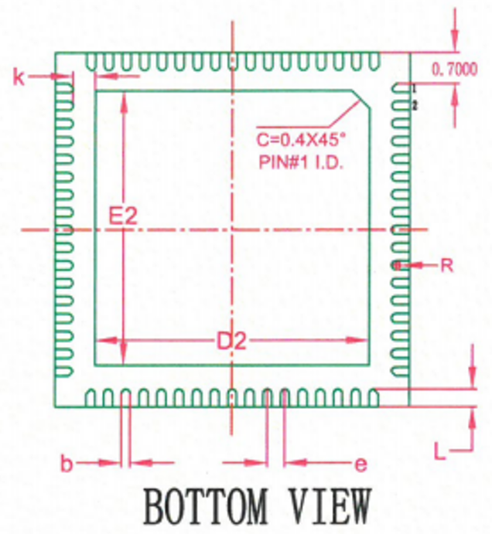
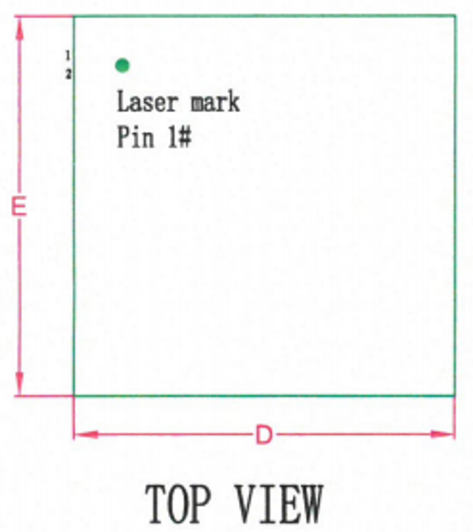
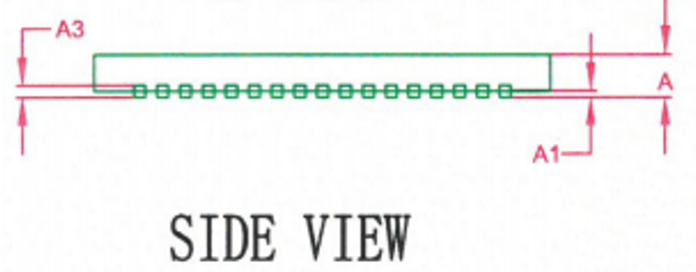
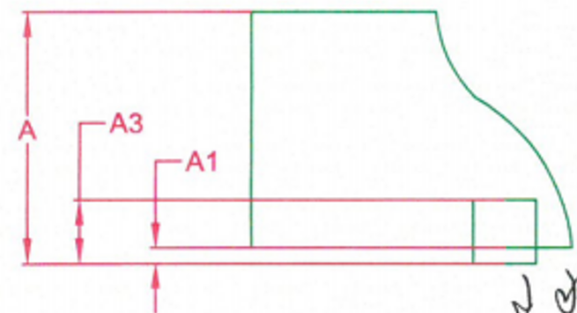

CQ24
<Preliminary>
Physical Dimensions
QFN 8080-68H Package Outline
SYMBOL | MILLIMETER
 | Min. | Typ. | Max.
A | 0.70 | 0.75 | 0.80
A1 | 0.00 | 0.02 | 0.05
A3 | 0.203REF
b | 0.15 | 0.20 | 0.25
D | 7.90 | 8.00 | 8.10
E | 7.90 | 8.00 | 8.10
D2 | 6.10 | 6.20 | 6.30
E2 | 6.10 | 6.20 | 6.30
e | 0.30 | 0.40 | 0.50
k | 0.20 | - | -
L | 0.35 | 0.40 | 0.45
R | 0.09 | - | -
Fig 24. Package Outline
Note
1.These Dimension do not include mold protrusion
2.Dimensions in millimeters
CONFIDENTIAL
Dated 30-Nov 23 Rev. 01
Page 45
http://www.glbltech.com/

Slide 46
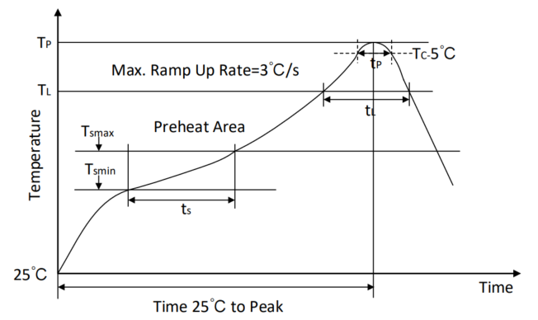
CQ24
<Preliminary>
Soldering Temperature Reflow Profile
Fig 25. Reflow Soldering information
Table 7. Reflow Soldering Parameter
Parameter | Pb-free soldering conditions
Average ramp-up rate (217 ℃ to Peak) | 3℃/second max.
Time of Preheat temp (from 150 ℃ to 200 ℃) | 60 ~ 120 second
Time to be maintained above 217 ℃ | 60 ~ 150 second
Peak temperature | 260 +5/-0 ℃
Time within 5 ℃ of actual peak temp | 30 second
Ramp-down rate | 6 ℃/second max.
Time from 25℃ to peak temp | 8 minutes max.
Important statement
Global Technologies reserves the right to change the above-mentioned information without prior notice.
CONFIDENTIAL
Dated 30-Nov 23 Rev. 01
Page 46
http://www.glbltech.com/

Slide 47
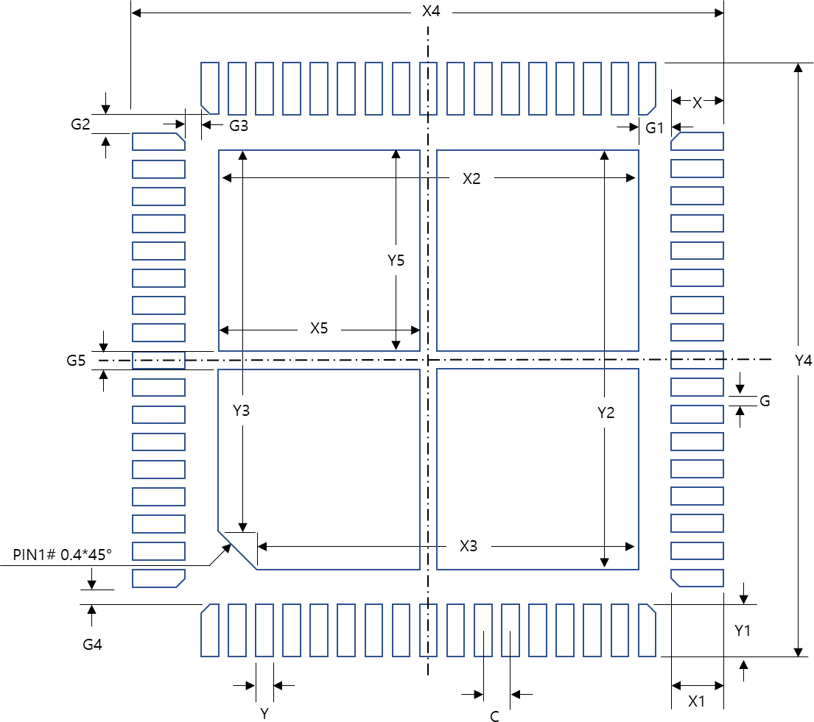

CQ24
<Preliminary>
Recommended Footprint
Dim | Value(mm) | Margin(Typ+)
X | 0.6 | +0.2
Y | 0.2 | 0
C | 0.4 | 0
X1 | 0.5 | +0.1
Y1 | 0.5 | +0.1
X2 | 6.4 | +0.2
Y2 | 6.4 | +0.2
X3 | 6.0 | +0.2
Y3 | 6.0 | +0.2
X4 | 8.2 | +0.2
Y4 | 8.2 | +0.2
Y5 | 3.1 | +0.1
Y5 | 3.1 | +0.1
G | 0.2 | 0
G1 | 0.5 | 0
G2 | 0.3 | 0
G3 | 0.3 | 0
G4 | 0.3 | 0
G5 | 0.2 | 0
Fig 26. Suggested Footprint
Note: The reflow peak soldering temperature is peak 260°C and it is specified based on IPC/JEDEC J-STD- 020 “Moisture/Reflow Sensitivity Classification for Non-Hermetic Solid State Surface Mount Devices”
is the trademark of Global Technologies Co., Ltd. or its subsidiaries in the Republic of Korea and/or other countries. The products of Global Technologies reserve the right to make changes without further notice to any products herein. Global Technologies makes no warranty, representation or guarantee regarding the suitability of its products for any particular purpose, nor does Global Technologies assume any liability arising out of the application or use of any product or circuit, and specifically disclaims any and all liability, including without limitation special, consequential or incidental damages. Global Technologies does not convey any license under its patent rights nor the rights of others.
is the trademark of Global Technologies Co., Ltd. or its subsidiaries in the Republic of Korea and/or other countries. Global Technologies owns the rights to a number of patents, trademarks, copyrights, trade secrets, and other intellectual property. Global Technologies reserves the right to make changes without further notice to any products herein. Global Technologies makes no warranty, representation or guarantee regarding the suitability of its products for any particular purpose, nor does Global Technologies assume any liability arising out of the application or use of any product or circuit, and specifically disclaims any and all liability, including without limitation special, consequential or incidental damages. Buyer is responsible for its products and applications using Global Technologies products, including compliance with all laws, regulations and safety requirements or standards, regardless of any support or applications information provided by Global Technologies. “Typical” parameters which may be provided in Global Technologies data sheets and/or specifications can and do vary in different applications and actual performance may vary over time. All operating parameters, including “Typical” must be validated for each customer application by customer’s technical experts. Global Technologies does not convey any license under its patent rights nor the rights of others. Global Technologies products are not designed, intended, or authorized for use as a critical component in life support systems or any FDA Class 3 medical devices or medical devices with a same or similar classification in a foreign jurisdiction or any devices intended for implantation in the human body. Should Buyer purchase or use Global Technologies products for any such unintended or unauthorized application, Buyer shall indemnify and hold Global Technologies and its officers, employees, subsidiaries, affiliates, and distributors harmless against all claims, costs, damages, and expenses, and reasonable attorney fees arising out of, directly or indirectly, any claim of personal injury or death associated with such unintended or unauthorized use, even if such claim alleges that Global Technologies was negligent regarding the design or manufacture of the part. Global Technologies is an Equal Opportunity/Affirmative Action Employer. This literature is subject to all applicable copyright laws and is not for resale in any manner.
CONFIDENTIAL
Dated 30-Nov 23 Rev. 01
Page 47
http://www.glbltech.com/

