Slide 1
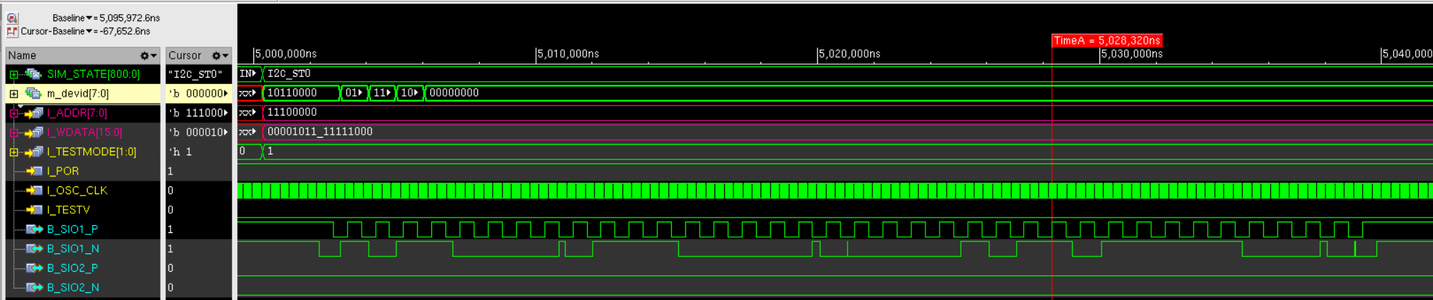
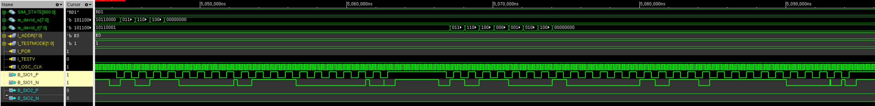
I2C Write Example
Device ID(0xB0)
Slave ACK
Register Address(0xE0)
Slave
ACK
Register Data(0x0B)
Slave
ACK
Register Data(0xF8)
Slave
NACK
I2C Read Example
Device ID(0xB0)
Slave ACK
Register Address(0xE0)
Slave NACK
Device ID(0xB1)
Master ACK
Register Data(0x0B)
Master ACK
Register Data(0xF8)
Master NACK

Slide 2
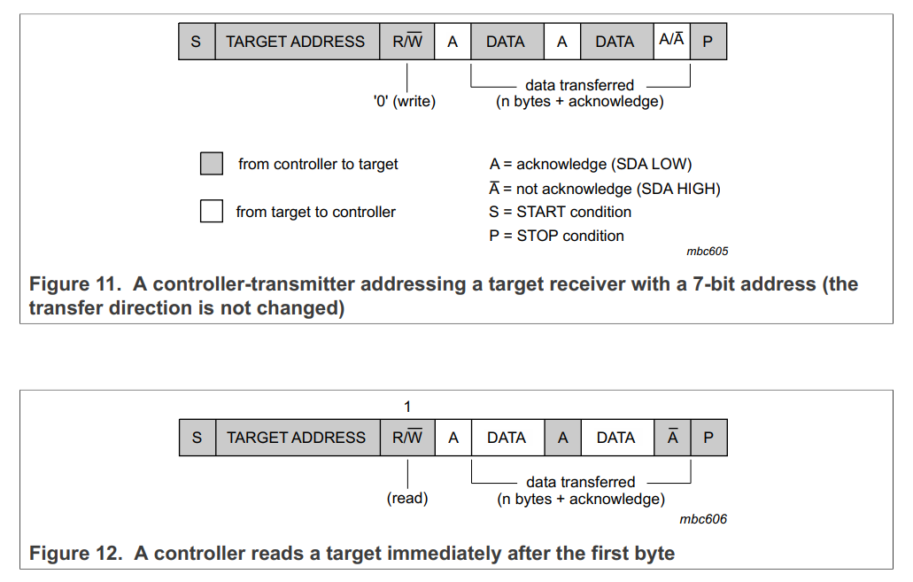

Slide 3
I2C Write Example
Device ID(0xB0)
Slave ACK
Register Address(0xE0)
Slave
ACK
Register Data(0x0B)
Slave
ACK
Register Data(0xF8)
Slave
NACK
Write Device ID: 8’b1011_0000

Slide 4
I2C Read Example
Device ID(0xB0)
Slave ACK
Register Address(0xE0)
Slave NACK
Device ID(0xB1)
Master ACK
Register Data(0x0B)
Master ACK
Register Data(0xF8)
Master NACK
Write Device ID: 8’b1011_0000
Read Device ID: 8’b1011_0001

