Slide 1
XDIC 4CH PWM Trimming (Digital Part) (GT1007A5R0)
2025. 3.

Slide 2
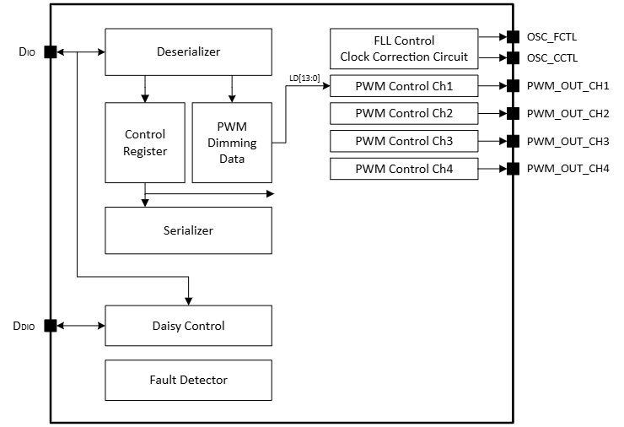
XDIC 4CH PWM
Block Diagram

Slide 3
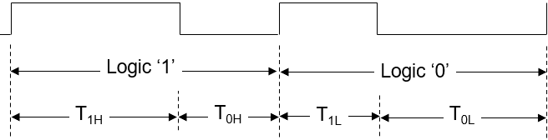
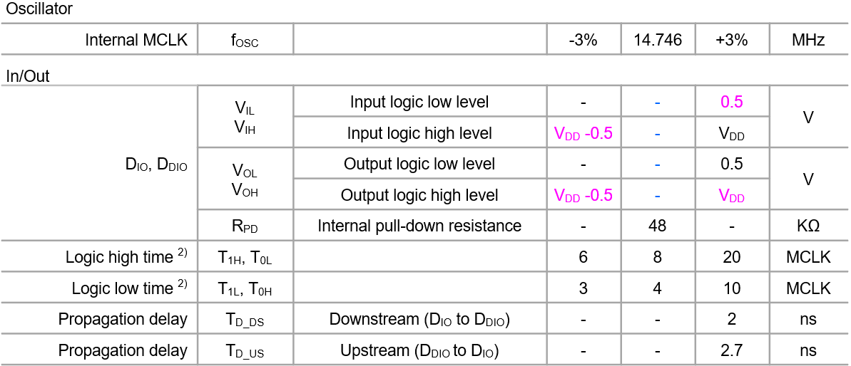
Serial Interface

Slide 4
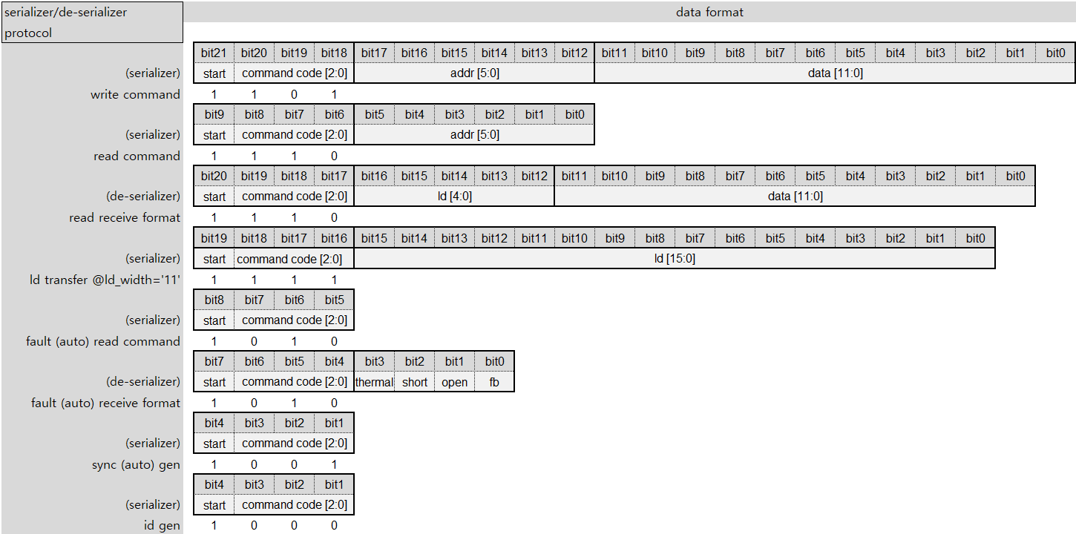
Serializer/De-serializer Protocol
Support ld transfer @id_width=’11’ only

Slide 5
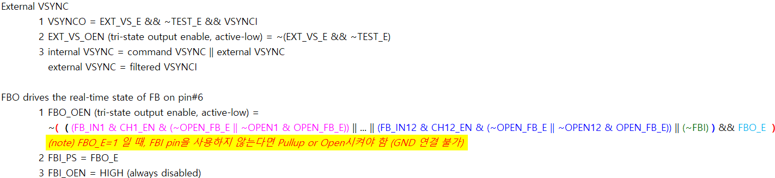
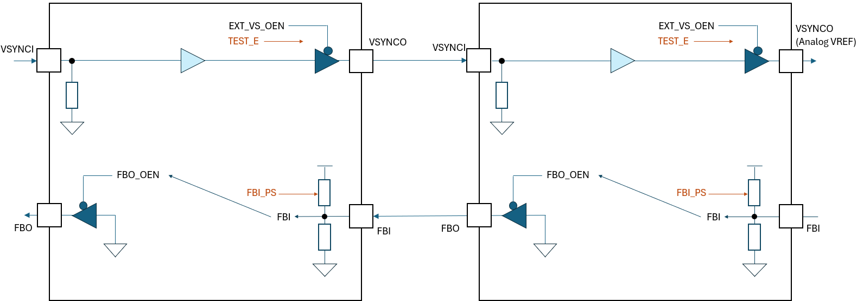
XDIC 4CH PWM
External VSYNC and Daisy Feedback Input

Slide 6
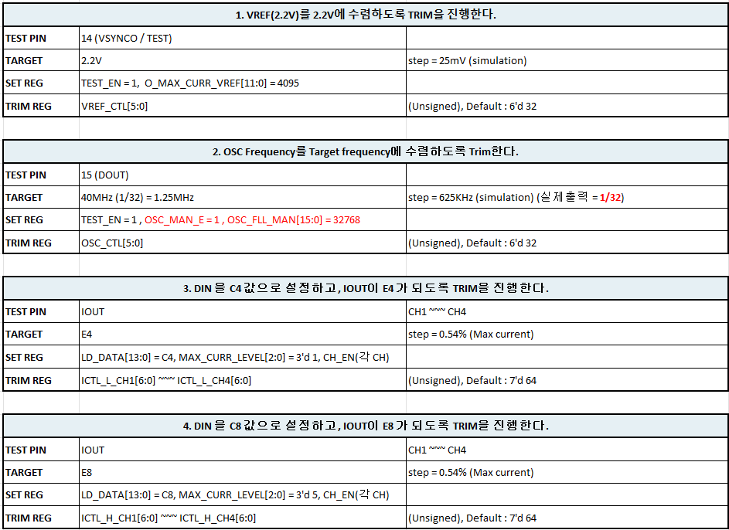
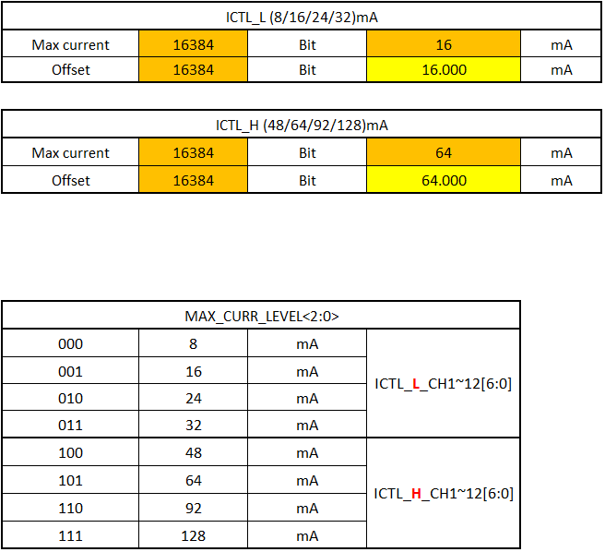
OTP Trimming Sequence

Slide 7
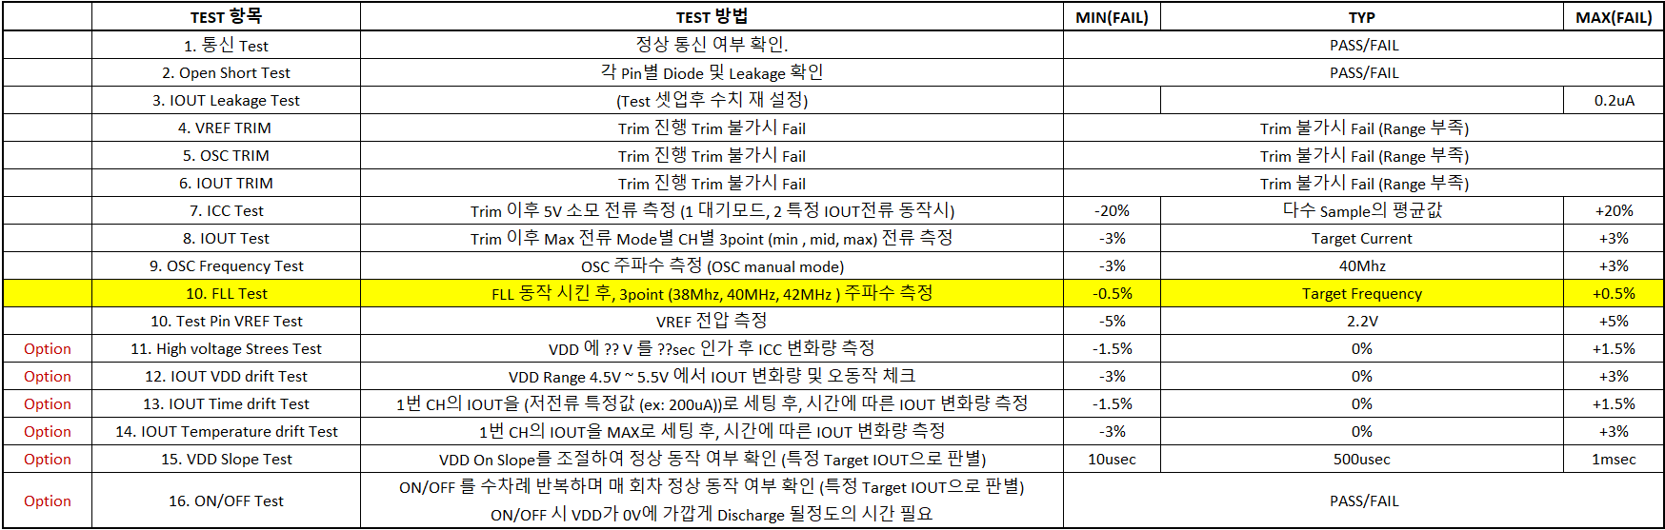
OTP Trimming Sequence

Slide 8
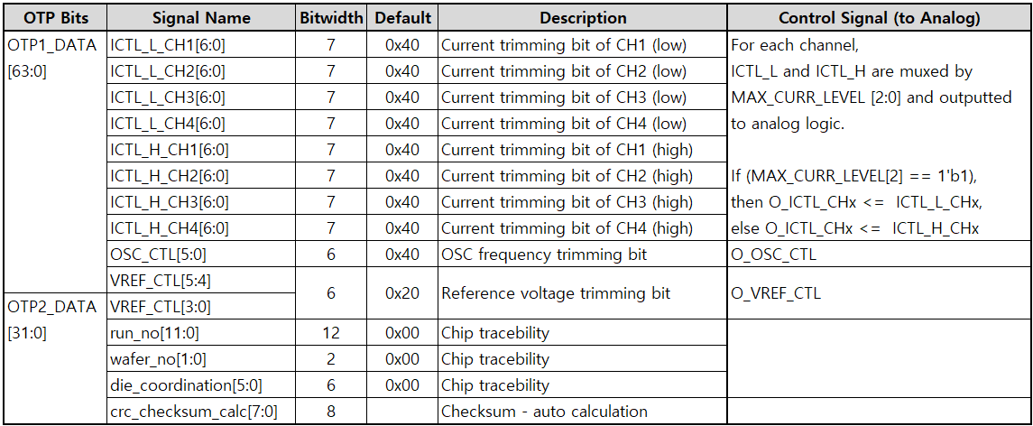
OTP Trimming Signal

Slide 9
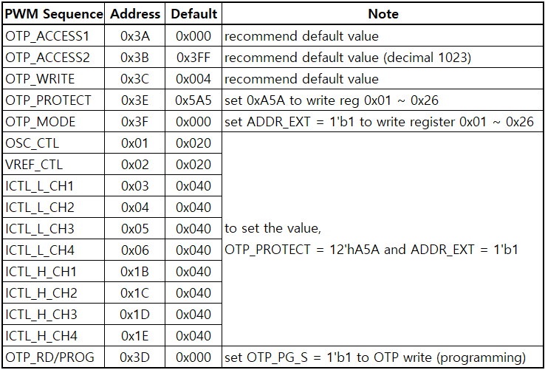
OTP Write Sequence
Before setting the OTP_PG_S field of 0x3D address to ‘1’,
set the appropriate value in the register from 0x01 to 0x26 address.
If the OTP_PG_S field is set to ‘1’, data from 0x01 to 0x26 address is written to the OTP.
To set the register from 0x01 to 0x26 address,
the OTP_PROTECT register of 0x3E address should be set to “0xA5A” and the ADDR_EXT field of the 0x3F address should be set ‘1’.
It is recommended that the OTP_ACCESS1, OTP_ACCESS2, and OTP_WRITE registers use default values.
0x3A : OTP_PG_ACCESS_CYCLE[15:12] = 0
0x3B : OTP_PG_ACCESS_CYCLE[11:0] = 0x3FF (decimal 1023)
0x3C : OTP_WSEL[3:0] = 0x4
…
…
0x3D : OTP_PG_S = 1 (OTP write)

Slide 10
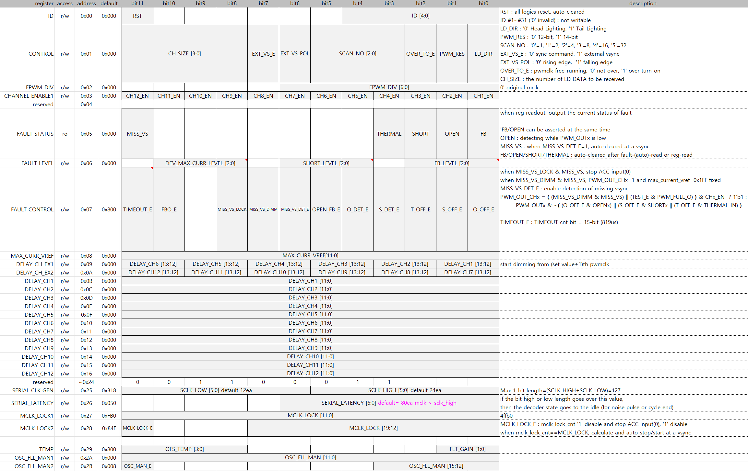
Register

Slide 11
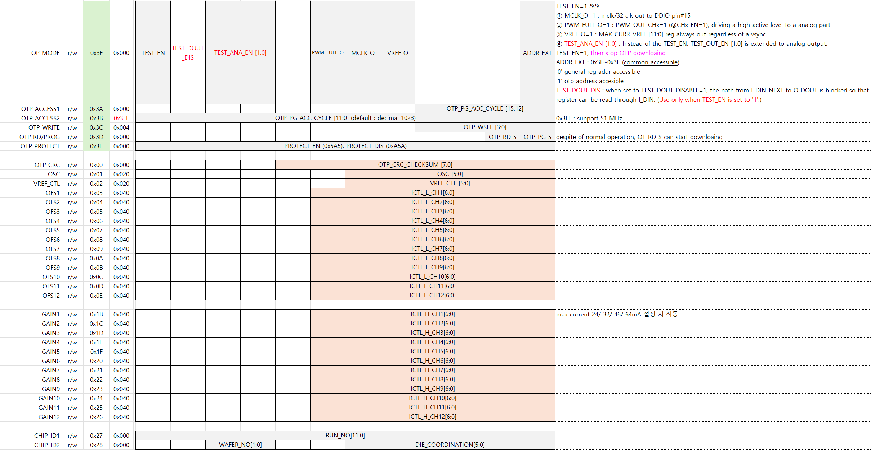
Register

