Slide 1

Confidential
Global Technologies
XC-24
The local dimming controller for current drivers
24 Channels
General Description
The XC-24 is a local dimming controller featuring 24 channels to drive its companion chips, XD-12 LED drivers that act as the voltage-based low side current sink for White LED back-lighting solution.
This controller interfaces with XD-12 drivers through one serial line to send and receive the data to be needed for local dimming.
The XC-24 supports the SPI interface to communicate with the host,
and the SPI interface can be daisy-chained, so it is effective to expand to support a large number of dimming areas.
For raising up dimming controllability, XC-24 supports the FB signal to efficiently control the LED power supply voltage and two interrupt pins, nINT_FAULT to indicate the fault events like as the thermal status, the open detection, the short detection and the feedback status, and nINT_LD to indicate the room of internal buffers for dimming data.
The XC-24 can support BIST functionality to ensure Back Light Unit is
properly assembled.
Application
LED back-lighting with local dimming control
Dated July/21/23 Rev. 0.0
http://www.glbltech.com/

Slide 2
XC-24
Global Technologies
Feature
24 channels local dimming controller for the XD-12 LED drivers
Flexible sizing for each channel
up to 31 daisied drivers per channel
up to 127 blocks per channel
SPI interface
up to 30MHz
support daisy-chain connection
Flexible the baud-rate speed
Frame synchronization support : VSYNC 50 ~ 144Hz
Fault events support of drivers
Over temperature event
Open detection
Short detection
FB status
TTL-level input range
Supply voltage 4.5V ~ 5.5V
48-pin QFN 6060 Package
Latch-up Immunity ILATCH: JEDEC JESD78D Nov 2011: ±100mA
ESD, HBM protection (Norm: MIL 883 E Method 3015 Human Body Model): ±2kV
Confidential
http://www.glbltech.com/

Slide 3
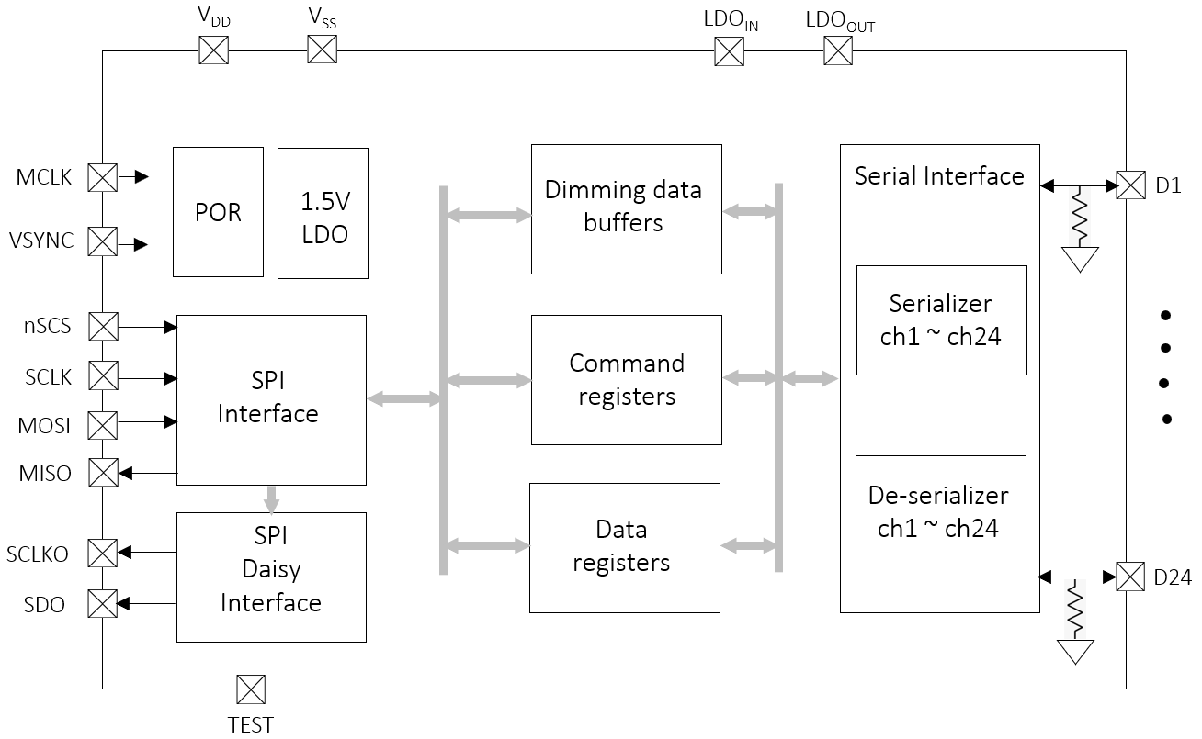
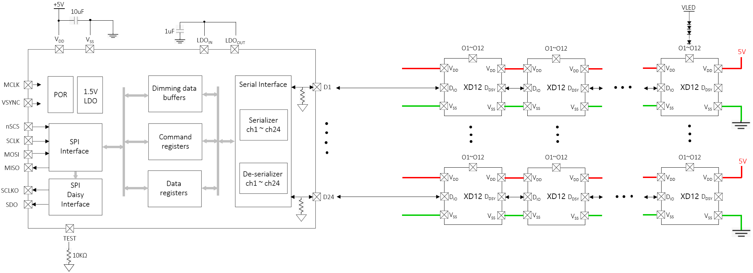
XC-24
Global Technologies
Block Diagram
Application Circuit
Confidential
http://www.glbltech.com/

Slide 4
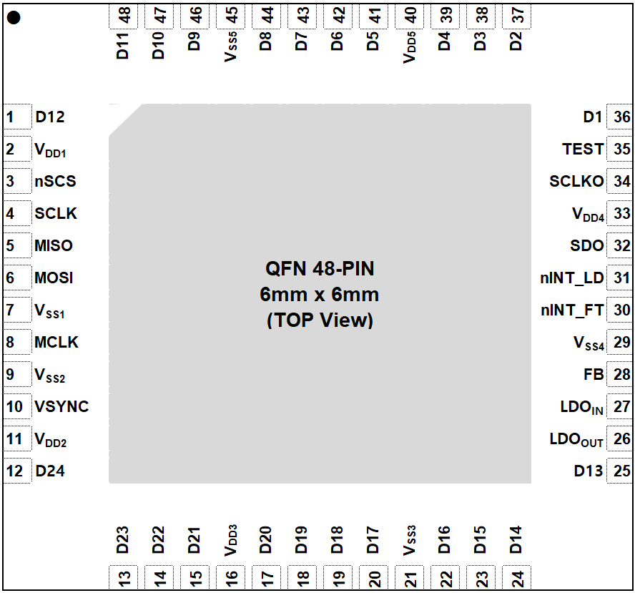
XC-24
Global Technologies
Pin out description (Top View)
Pin description
Pin Name | Pin No. | I/O | Type | Description | Remark
D12 | 1 | I/O | Digital | Data in/out
V_{DD1} | 2 | I | Power | Digital V_{DD}
nSCS | 3 | I | Digital | SPI Chip Select
SCLK | 4 | I | Digital | SPI SCLK
MISO | 5 | O | Digital | SPI MISO
MOSI | 6 | I | Digital | SPI MOSI
V_{SS1} | 7 | I | GND | Digital GND
MCLK | 8 | I | Digital | Master Clock
Confidential
Dated April/12/23 Rev. 0.0
http://www.glbltech.com/

Slide 5
XC-24
Global Technologies
Pin description
Pin Name | Pin No. | I/O | Type | Description | Remark
V_{SS2} | 9 | I | GND | Digital GND
VSYNC | 10 | I | Digital | Frame synchronization
V_{DD2} | 11 | I | Power | Digital V_{DD}
D24 | 12 | I/O | Digital | Data in/out
D23 | 13 | I/O | Digital | Data in/out
D22 | 14 | I/O | Digital | Data in/out
D21 | 15 | I/O | Digital | Data in/out
V_{DD3} | 16 | I | Power | Digital V_{DD}
D20 | 17 | I/O | Digital | Data in/out
D19 | 18 | I/O | Digital | Data in/out
D18 | 19 | I/O | Digital | Data in/out
D17 | 20 | I/O | Digital | Data in/out
V_{SS3} | 21 | I | GND | Digital GND
D16 | 22 | I/O | Digital | Data in/out
D15 | 23 | I/O | Digital | Data in/out
D14 | 24 | I/O | Digital | Data in/out
D13 | 25 | I/O | Digital | Data in/out
LDO_{IN} | 26 | I | Power | LDO feedback from LDO_{OUT} | Attach 1uF
LDO_{OUT} | 27 | O | Power | Internal LDO out to LDO_{IN} | Connect to LDO_{IN}
FB | 28 | O | Digital | Feedback for LED power supply | Open-drain, 10kΩ PU
V_{SS4} | 29 | I | GND | Digital GND
nINT_FT | 30 | O | Digital | Interrupt for fault events | Open-drain, 10kΩ PU
nINT_LD | 31 | O | Digital | Interrupt for dimming data room | Open-drain, 10kΩ PU
SDO | 32 | O | Digital | SPI MOSI daisied out | Unused : 10kΩ PD
V_{DD4} | 33 | I | Power | Digital V_{DD}
SCLKO | 34 | O | Digital | SPI SCLK daisied out | Unused : 10kΩ PD
Confidential
http://www.glbltech.com/

Slide 6
XC-24
Global Technologies
Pin description
Pin Name | Pin No. | I/O | Type | Description | Remark
TEST | 35 | I | Digital | TEST mode pin | 10kΩ PD
D1 | 36 | I/O | Digital | Data in/out
D2 | 37 | I/O | Digital | Data in/out
D3 | 38 | I/O | Digital | Data in/out
D4 | 39 | I/O | Digital | Data in/out
V_{DD5} | 40 | I | Power | Digital V_{DD}
D5 | 41 | I/O | Digital | Data in/out
D6 | 42 | I/O | Digital | Data in/out
D7 | 43 | I/O | Digital | Data in/out
D8 | 44 | I/O | Digital | Data in/out
V_{SS5} | 45 | I | GND | Digital GND
D9 | 46 | I/O | Digital | Data in/out
D10 | 47 | I/O | Digital | Data in/out
D11 | 48 | I/O | Digital | Data in/out
Confidential
http://www.glbltech.com/

Slide 7
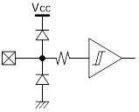
XC-24
Global Technologies
Equivalent Circuits of individual pins
Pad Name | I/O | Internal Circuit | Description
nSCS | I |  | SPI Chip Select
SCLK | I |  | SPI Clock Input
MOSI | I |  | SPI MOSI
MISO | O |  | Frame Sync.
SCLKO | O |  | SCLK Daisy Out
SDO | O |  | MOSI Daisy Out
MCLK | I |  | Mater Clock
Confidential
http://www.glbltech.com/

Slide 8
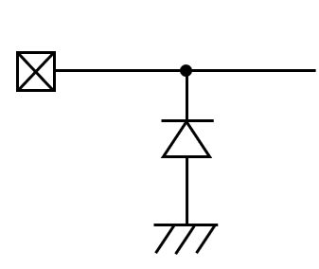
XC-24
Global Technologies
Equivalent Circuits of individual pins
Pad Name | I/O | Internal Circuit | Description
VSYNC | I |  | Frame Sync.
nINT_FB | O |  | SPI Chip Select
nINT_LD | O |  | SPI Clock Input
FB | O |  | SPI MOSI
D | I/O |  | Data In/Out
V_{DD} | - |  | Digital Power
V_{SS} | - |  | Digital GND
Confidential
http://www.glbltech.com/

Slide 9
XC-24
Global Technologies
Maximum Absolute ratings (Ta = 25℃ unless otherwise noted)
Parameter | Symbol | Value | Unit
Supply voltage | V_{DDD}, V_{DDA} | -0.3 ~ 7.0 | V
MCLK to GND voltage | V_{MCLK} | -0.3 ~ 3.3V+0.3 | V
VSYNC to GND voltage | V_{VSYNC} | -0.3 ~ 3.3V+0.3 | V
nSCS to GND voltage | V_{SPI_ENB} | -0.3 ~ 3.3V+0.3 | V
SCLK to GND voltage | V_{SCLK} | -0.3 ~ 3.3V+0.3 | V
MOSI to GND voltage | V_{MOSI} | -0.3 ~ 3.3V+0.3 | V
MISO to GND voltage | V_{MISO} | -0.3 ~ V_{DDD}+0.5 | V
SCLKO to GND voltage | V_{SCLK} | -0.3 ~ V_{DDD}+0.5 | V
SDO to GND voltage | V_{SDO} | -0.3 ~ V_{DDD}+0.5 | V
CS to GND voltage | V_{CS} | -0.3 ~ V_{DDD}+0.5 | V
HOLD to GND voltage | V_{HOLD} | -0.3 ~ V_{DDD}+0.5 | V
ADO to GND voltage | V_{ADO} | -0.3 ~ V_{DDD}+0.5 | V
MODE to GND voltage | V_{MODE} | -0.3 ~ V_{DDD}+0.5 | V
Ambient temperature | T_{A} | -20 ~ 85 | ℃
Junction temperature | T_{J} | -20 ~ 125 | ℃
Storage temperature | T_{STG} | -45 ~ 150 | ℃
Relative Humidity(non-condensing) | RH_{NC} | 5 ~ 85 | %
Moisture Sensitivity | MSL | Maximum Floor Life-time | 3
Notes : Stresses beyond those listed under Absolute Maximum Ratings may cause permanent damage to the device
Electrostatic Discharge
Parameter | Symbol | Value | Unit | Remark
Electrostatic Discharge HBM ; Contact | ESDHBM | ±2K | V | C=100 pF, R=1.5 kΩ
Electrostatic Discharge CDM ; Contact | ESDCDM | ±500 | V | R=1 Ω
Confidential
http://www.glbltech.com/

Slide 10
XC-24
Global Technologies
Electrical Characteristic (V_{DD} =5.0V, Ta=25.0℃ unless otherwise noted)
Characteristics | Symbol | Condition | Value |  |  | Unit
 |  |  | min | typ | max
Supply
Operating voltage | V_{DDD}, V_{DDA} |  | 4.5 | - | 5.5 | V
Operating Current | I_{DDD} |  | - | - | - | mA
Operating Current | I_{DDA} |  | - | 7.2 | - | mA
Quiescent current | I_{DDD}, I_{DDA} |  | - | 1.9 | - | mA
Input
nSCS Input Voltage | V_{SCSL} | Chip Select, low level | - | - | 0.8 | V
 | V_{SCSH} | Chip Select, high level | 2.0 | - | V_{DDD} | V
SCLK Input Voltage | V_{SCLKL} | SPI Clock, low level | - | - | 0.8 | V
 | V_{SCLKH} | SPI Clock, high level | 2.0 | - | V_{DDD} | V
MOSI Input Voltage | V_{MOSIL} | MOSI, low level | - | - | 0.8 | V
 | V_{MOSIH} | MOSI, high level | 2.0 | - | V_{DDD} | V
VSYNC Input Voltage | V_{VSYNCL} | VSYNC low level | - | - | 0.8 | V
 | V_{VSYNCH} | VSYNC high level | 2.0 | - | V_{DDD} | V
Output
MISO Output voltage | V_{MISOL} | MISO, low level | - | - | 0.8 | V
 | V_{MISOH} | MISO, high level | 2.0 | - | V_{DDD} | V
SCLKO Output voltage | V_{SCLKOL} | SCLKO, low level | - | - | 0.8 | V
 | V_{SCLKOH} | SCLKO, high level | 2.0 | - | V_{DDD} | V
SDO Output voltage | V_{SDOL} | SDO, low level | - | - | 0.8 | V
 | V_{SDOH} | SDO, high level | 2.0 | - | V_{DDD} | V
CS output voltage | V_{CSL} | CS, low level | - | - | 0.8 | V
 | V_{CSL} | CS, high level | 2.0 | - | V_{DDD} | V
HOLD output voltage | V_{HOLDL} | HOLD, low level | - | - | 0.8 | V
 | V_{HOLDH} | HOLD, high level | 2.0 | - | V_{DDD} | V
Confidential
http://www.glbltech.com/

Slide 11
XC-24
Global Technologies
Electrical Characteristic (V_{DD} =5.0V, Ta=25.0℃ unless otherwise noted)
Characteristics | Symbol | Condition | Value |  |  | Unit
 |  |  | min | typ | max
MODE output voltage | V_{MODE} | MODE level1, 0.5V | 0.15 | 0.5 | 0.85 | V
 |  | MODE leve2l, 1.5V | 1.15 | 1.5 | 1.85 | V
 |  | MODE level3, 2.5V | 2.15 | 2.5 | 2.85 | V
 |  | MODE level4, 3.5V | 3.15 | 3.5 | 3.85 | V
ADO output voltage | V_{ADO} | ADO output level | 0.0 | - | V_{DDA} | V
Accuracy | △V_{ADO} | Accuracy of output @ the target level | -2.0 | - | +2.0 | %
Variation |  | Delta between channels @ the target level | -2.0 | - | +2.0 | %
Internal MCLK
PLL Reference Clock | F_{PLL_REF} | T.B.D | - | 16.128 | - | MHz
PLL output frequency | F_{INT_MCLK} | T.B.D | - | 16.128 ⁽¹⁾ | - | MHz
Variation | △F_{INT_MCLK} | T.B.D | -1 | - | +1 | %
External MCLK
External Clock frequency | F_{EXT_MCLK} | T.B.D | - | 16.128 ⁽²⁾ | 30 | MHz
Variation | △F_{EXT_MCLK} | T.B.D | -1 | - | +1 | %
Static performance
Resolution |  |  |  | 12 |  | bit
Monotonicity |  |  |  | 12 |  | Bit
Integral nonlinearity | INL |  | 0 | ±2 | ±4 | LSB
Differential nonlinearity | DNL |  |  | ±0.5 | ±0.75 | LSB
Zero code error | ZE | DIN = 12’d 0 |  | 2.5 | 5 | mV
Full scale error | FSE | DIN = 12’d 4095 |  | ±0.25 | ±0.5 | FSR
Gain error | GE |  |  | ±0.25 | ±0.5 | FSR
DC output impedance | Zout |  |  | 160 |  | Ω
Note (1) The PLL output frequency depends on the VSYNC input period and the MCLK LOCK CONTER register value.
(2) The External MCLK frequency depends on the system operation specification like the VSYNC input period,
the SVSYNC_SIZE and SHSYNC_SIZE register value.
Confidential
http://www.glbltech.com/

Slide 12
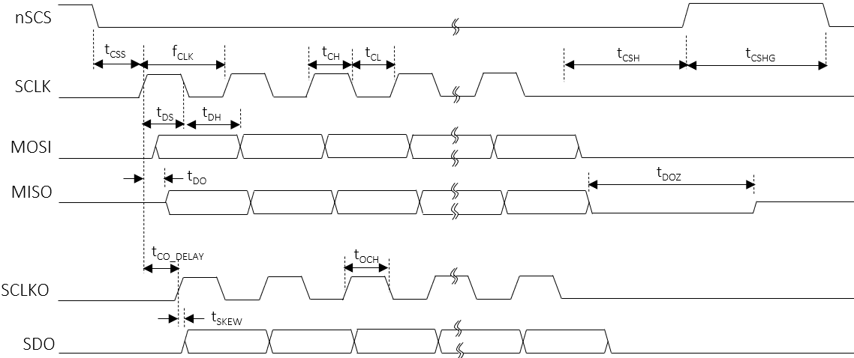
XC-24
Global Technologies
AC Characteristics (V_{DD S}=5.0V, Ta=25.0℃ unless otherwise noted)
Characteristics | Symbol | Condition | Value |  |  | Unit
 |  |  | min | typ | max
SCLK
SCLK frequency | f_{CLK} |  | - | - | 30 | MHz
SCLK duty | t_{CLK_DUTY} |  | 49 | - | 51 | %
SCLK high time | t_{CH} |  | 8 | - | - | ns
SCLK low time | t_{CL} |  | 8 | - | - | ns
SCLKO
SCLK to SCLKO delay | T_{CO_DELAY} |  | - | - | 6 ⁽³⁾ | ns
The skew between SCLKO to SDO | t_{SKEW} |  | - | - | -1 ⁽³⁾ | ns
SCLKO high time | t_{OCH} |  | t_{CH} - 1⁽³⁾ | - | - | ns
nSCS setup to the first rising SCLK | t_{CSS} |  | 20 | - | - | ns
nSCS hold time from the last falling SCLK | t_{CSH} |  | 3 | - | - | MCLK
nSCS high latency time | t_{CSHG} |  | 3 | - | - | MCLK
MOSI setup time | t_{DS} |  | 7 | - | - | ns
MOSI hold time | t_{DH} |  | 3 | - | - | ns
MISO delay from the rising edge SCLK | t_{DO} |  | - | - | 6 | ns
MISO high-Z from the nSCS de-assertion | t_{DOZ} |  | - | - | 1 | MCLK
Note (3) It should be careful that the t_{SKEW} and t_{OCH} are accumulated by the number of daisy devices if the daisy chain
connection is used. So, for the read and write transaction, the proper timing should be considered in daisy
chain.
Confidential
http://www.glbltech.com/

Slide 13
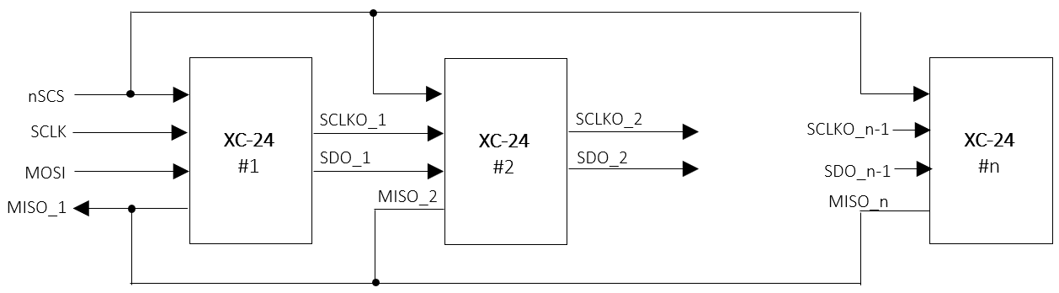
XC-24
Global Technologies
Functional Description
1. SPI Interface
For the local dimming data transmit a Serial Peripheral Interface is used. The SPI is configurated to work as SPI slave.
A Daisy Chain structure can be used to support large scale blocks array with several devices and operated up to 30MHz.
SPI Daisy Chain Structure
All SPI slaves share the Chip select signal, and these devices in Daisy chain can be treated as one big shift register. The devices are automatically enumerated as described below.
Figure 1. SPI daisy connection
SPI Protocol
The XQ-24 has 3 types of the SPI Interface protocol, the register-read, the register-write and the LD data-transfer.
The SPI protocol’s format consists of a 16-bit command and a 16-bit register data or a series of 24(or 16)-bit LD data
following the 16-bit command.
[Command format]
 | Bit15 | Bit14 | Bit14 | Bit13 | Bit12 | Bit11 | Bit10 | Bit9 | Bit8 | Bit7 | Bit6 | Bit5 | Bit4 | Bit3 | Bit2 | Bit1 | Bit0
 | Command code [1:0] |  |  | Address [7:0] |  |  |  |  |  |  |  | Burst size [5:0]
Register-read | 0 |  | 1 | Start address [7:0] |  |  |  |  |  |  |  | Burst size [5:0]
Register-write | 1 |  | 0 | Start address [7:0] |  |  |  |  |  |  |  | Burst size [5:0]
LD-transfer | 1 |  | 1 | 8’hxx |  |  |  |  |  |  |  | Line size [5:0]
[Data format]
 | Bit15 | Bit14 | Bit13 | Bit12 | Bit11 | Bit10 | Bit9 | Bit8 | Bit7 | Bit6 | Bit5 | Bit4 | Bit3 | Bit2 | Bit1 | Bit0
 | Data [15:0] |  | Address [7:0] |  |  |  |  |  |  |  | Burst size [5:0]
Register-RW | Register data [15:0] |  | Start address [7:0] |  |  |  |  |  |  |  | Burst size [5:0]
LD1 transfer | LD_WIDTH [1:0] = 2’b00 : 24 bits /block |  | 8’hxx |  |  |  |  |  |  |  | Line size [5:0]
LD2 transfer | LD_WIDTH [1:0] = 2’b01 : 24 bits /block |  | 8’hxx |  |  |  |  |  |  |  | Line size [5:0]
LD3 transfer | LD_WIDTH [1:0] = 2’b10 : 24 bits /block
LD4 transfer | LD_WIDTH [1:0] = 2’b11 : 16 bits /block
Figure 2. SPI protocol format
Confidential
http://www.glbltech.com/

Slide 14
XC-24
Global Technologies
Functional Description
SPI read/write sequence in burst
The SPI access sequence is as follows, depending on the type of access. There is no difference between a single and
a burst access except for the number of data due to the burst size.
nSCS
SCLK
Start addr = 0xa
Burst size = n
a
a+1
a+n
b
b+1
b+m
MOSI
Command
Data
Data
Data
Command
Data
Data
Data
SCLKO
b
b+1
b+m
SDO
Command
Data
Data
Data
Figure 3. The SPI Burst write in daisied 2 devices
nSCS
SCLK
MOSI
Command
Command
Start addr = 0xa
Burst size = n
a
a+1
a+n
MISO
Data
Data
Data
SCLKO
SDO
Command
MISO
(dev#2)
b
b+1
b+m
Data
Data
Data
Figure 4. The SPI Burst read in daisied 2 devices
Confidential
http://www.glbltech.com/

Slide 15
XC-24
Global Technologies
Functional Description
SPI LD transfer sequence
The SPI sequence for the LD transfer is as follows. The LD width depends on the LD_WIDTH value of the CHANNEL
ENABLE 2 register. If the LD_WIDTH = 2’b00, then the LD data size of one block zone transferred through the SPI
becomes 24 bits consisted of PAM 12 bits and PWM 12 bits. Even if the transmitted width is 24 bits, the valid bits are
actually 20 bits, PAM 10 bits + PWM 10 bits. Therefore, the data size per block to be transmitted to the daisied devices
is 20 bits.
LD_WIDTH [1:0] | LD width | LD format | Valid bits
2’b00 | 24 bits | PAM 12-bit + PWM 12-bit | PAM 10-bit + PWM 10-bit
2’b01 | 24 bits | PAM 12-bit + PWM 12-bit | PAM 10-bit + PWM 11-bit
2’b10 | 24 bits | PAM 12-bit + PWM 12-bit | PAM 10-bit + PWM 12-bit
2’b11 | 16 bits | LD 16-bit | LD 16-bit
Table 1. LD data size according to LD_WIDTH
The burst size unit means the amount of LD data corresponding to one line and the one line of LD data corresponds to
the total LD data of all activated channels, and the number of active channel is determined by the CH_SIZE value of the
ENABLE CHANNEL 2 register. Here, the CH_SIZE value should be equal to the number of activated channels by the
CHx_EN of the ENABLE CHANNEL 1/2 registers.
Burst size unit = 1-line LD data = CH_SIZE * LD data size
nSCS
Burst size = n
Burst size 2
Burst size 1
Command
LD
ch1
1-Line size
LD
chx
LD
ch1
LD
ch2
LD
chx
LD
chx
Command
LD
ch1
LD
ch2
MOSI
LD
ch2
LD width
SDO
CH_SIZE = x
Command
LD
ch1
LD
ch2
Figure 5. The SPI LD transfer in daisied 2 devices
Confidential
http://www.glbltech.com/

Slide 16
XC-24
Global Technologies
Functional Description
2. Serial Interface
The XC-24 has a total of 24 channels for serial daisy connections with a total of 31 XD-12 devices. Each channel can
transmit the data to the XD-12 and receive the data from the XD-12 through one line daisied to the XD-12 devices.
The XD-24 has a total of 5 instructions for transferring the data to the XD-12 and 3 instructions for receiving the data
from the XD-12.
Ch1
D_{IO}
D_{DIO}
D_{DIO}
D_{DIO}
XC-24
XD-12
#1
D_{IO}
D_{IO}
XD-12
#2
XD-12
#31
Ch24
Figure 6. The daisied scheme
The commands are listed as shown in the Table 2. and described in more detail below.
Instruction | Transaction direction | Data direction | Description
 | Command | Data
Global write | XC → XD | XC → XD | Global-write command the same register data between the XD devices
Local write | XC → XD | XC → XD | Local-write command the different register data between the XD devices
LD transfer | XC → XD | XC → XD | Local Dimming data-transfer command to the XD devices
ID gen | XC → XD | - | ID generation command of the XD devices in daisied each channel
Sync gen | XC → XD | - | Sync-generation command to the XD devices
Sync auto-gen | XC → XD | - | Automatically sync-generation command sync on the XD devices
Local read | XC → XD | XD → XC | Local-read command to the XD devices and read-back from the XD devices
Fault read | XC → XD | XD → XC | Fault-read command to the XD devices and read-back from the XD devices
Fault auto-read | XC → XD | XD → XC | Automatically fault-read command to the XD devices and read-back from the XD devices
Table 2. Instruction list
Confidential
http://www.glbltech.com/

Slide 17
XC-24
Global Technologies
Functional Description
ID-generation
The ID-GEN COMMAND register is used to set a unique ID for each device and each device’s ID helps identifying when
each device should react on a read-back operation. Therefore, after POR this command should be transacted at the first time for proper operation of the XD-12 devices before transacting other commands. If the START bit of ID-GEN COMMAND register is set, then all activated channels begin issuing the command signals to all XD-12 daisied in each
channel and the command signal streams repeat continuously for the number of daisied devices.
The number of daisied devices is determined by the DAISY SIZE register of each channel. After the command signal streams are completed, all devices will have their own ID respectively. The ID is numbered in opposite direction of daisied line. It is careful that the writing data is transferred from the first located device, the last number ID, to the last
located device, the first number ID, in daisied line but the reading data is received from the last located device to the first located device sequentially.
Ch1
D_{IO}
D_{DIO}
D_{DIO}
D_{DIO}
XC-24
XD-12
#1
ID=31
D_{IO}
D_{IO}
XD-12
#2
ID=30
XD-12
#31
ID=1
Ch24
V_{DD}
nSCS
Initialization to the XD-12
MOSI
ID-GEN COMMAND
transmit
CH1
CH2
CHx
Figure 7. The sequence of ID-GEN command
Confidential
http://www.glbltech.com/

Slide 18
XC-24
Global Technologies
Functional Description
Global-write
The Global-write command is used to write the register data to the XD-12 only if all XD-12 devices daisied to a channel
of the XC-24 have the same register data. If the register data to be written to the XD-12 are different each other, at that
time the Local-write command should be used. For executing the Global-write command properly, the GLOBAL-WRITE
DATA register should be firstly written with desired value and then the START bit of the GLOBAL-WRITE COMMAND
register should be set with desired address in order to begin transacting this command.
nSCS
MOSI
GLOBAL-WRITE DATA
transmit
GLOBAL-WRITE COMMAND
transmit
CH1
Address
Data
CH2
CHx
Figure 8. The sequence of Global-write command
The GLOBAL-WRITE COMMAND register consists of 6 bits of ADDRESS field and 1 bit of START. The ADDRESS is
the register address of the XD-12 to be accessed. If the START bit is set with the ADDRESS together, the Global-writing command begins issuing simultaneously in all activated channels, and the command streams repeat continuously for the number of daisied XD-12. The number of daisied devices can be determined by the DAISY SIZE register of each channel. The max number of daisied devices per channel is 31.
Confidential
http://www.glbltech.com/

Slide 19
XC-24
Global Technologies
Functional Description
Local-write
The Local-write command is used to write the register data to the XD-12 in case that all XD-12 devices daisied to a
channel of the XC-24 have the different register data each other. If the register data to be written to the XD-12 are same,
at that time the Global-write command is more useful for fast transaction time. For proper execution of the Local-write command, the LOCAL-RW DATA registers should be firstly written with desired value and then, the START bit of the
LOCAL-WRITE COMMAND register should be set with desired address for beginning this command. It is careful that
the LOCAL-RW POINTER RESET register must be reset necessarily to 0 for the next transaction after the Local-write
command is completed.
nSCS
MOSI
LOCAL-RW DATA
transmit
LOCAL-WRITE COMMAND
transmit
LOCAL-RW POINTER RESET
transmit
CH1
Address
Data
CH2
CHx
Figure 9. The sequence of Local-write command
The LOCAL-WRITE COMMAND register consists of ADDRESS 6 bits, CH_SEG 2 bits and START 1 bit. The ADDRESS
is the register address of the XD-12 to be accessed. If the START bit is set with the ADDRESS together, the Local-write command begins the execution simultaneously in all activated channels, and the command streams repeat continuously
for the number of daisied XD-12. The number of daisied devices can be determined by the DAISY SIZE register of each channel. The max number of daisied devices per channel is 31. The channel segment bits, CH_SEG, are used to decide
on which channels are activated for this command, because this command can be performed 8 channels at a time.
The LOCAL-RW DATA registers are divided into a total of 8 port group and each port has a total of 16 registers. The first
data register in the port is mapped to the first located XD-12 in daisied order and the second data register is mapped to the second located XD-12, and so on. Although the data registers in a port are a total 16, the XC-24 can support over 16
daisied devices in a channel by using the LOCAL-WR TRANSFER POINTER and LOCAL-RW DIFFERENCE POINTER. The LOCAL-WR TRANSFER DIFF POINTER of the LOCAL-RW DIFFERENCE POINTER shows how many data remain
in the LOCAL-RW DATA buffers. A value of 0 means that the LOCAL-RW DATA buffers are empty, so you must continue
to fill up before they are empty. A value greater than 16 means that the buffer has been overwritten, so you must wait until the pointer value is less than 16.
CH_SEG[1:0] | Channel to be activated | LOCAL-RW DATA 1 ~ 16
 |  | PORT1 | PORT2 | PORT3 | PORT4 | PORT5 | PORT6 | PORT7 | PORT8
2’b00 | Ch 1 ~ Ch 8 | Ch 1 | Ch 2 | Ch 3 | Ch 4 | Ch 5 | Ch 6 | Ch 7 | Ch 8
2’b01 | Ch 9 ~ Ch 16 | Ch 9 | Ch 10 | Ch 11 | Ch 12 | Ch 13 | Ch 14 | Ch 15 | Ch 16
2’b10 | Ch 17 ~ Ch 24 | Ch 17 | Ch 18 | Ch 19 | Ch 20 | Ch 21 | Ch 22 | Ch 23 | Ch 24
Table 3. The LOCAL-RW DATA mapping according to the CH_SEG
Confidential
http://www.glbltech.com/

Slide 20
XC-24
Global Technologies
Functional Description
Local-RW DATA structure for access
 | XD-12 drivers daisied in each channel
 | # 1 |  |  |  |  |  |  |  |  |  | # 1
 | # 2 |  | # 1 |  |  |  | # 1 |  | # 1 |  | # 2
 | # 3 |  | # 2 |  | # 1 |  | # 2 |  | # 2 |  | # 3 |  |  |  | # 1
 | # 4 |  | # 3 |  | # 2 |  | # 3 |  | # 3 |  | # 4 |  | # 1 |  | # 2
 | # m-1 |  | # n-1 |  | # k-1 |  | # n-1 |  | # n-1 |  | # m-1 |  | # l-1 |  | # k-1
 | # m |  | # n |  | # k |  | # n |  | # n |  | # m |  | # l |  | # k
CH_SEG
2’b00 |  | Channel 1 |  | Channel 2 |  | Channel 3 |  | Channel 4 |  | Channel 5 |  | Channel 6 |  | Channel 7 |  | Channel 8
2’b01 |  | Channel 9 |  | Channel 10 |  | Channel 11 |  | Channel 12 |  | Channel 13 |  | Channel 14 |  | Channel 15 |  | Channel 16
2’b10 |  | Channel 17 |  | Channel 18 |  | Channel 19 |  | Channel 20 |  | Channel 21 |  | Channel 22 |  | Channel 23 |  | Channel 24
Address |  | PORT 1 |  | PORT 2 |  | PORT 3 |  | PORT 4 |  | PORT 5 |  | PORT 6 |  | PORT 7 |  | PORT 8
0x70~0x77 |  | LOCAL RW DATA 1 |  | LOCAL RW DATA 1 |  | LOCAL RW DATA 1 |  | LOCAL RW DATA 1 |  | LOCAL RW DATA 1 |  | LOCAL RW DATA 1 |  | LOCAL RW DATA 1 |  | LOCAL RW DATA 1
0x78~0x7F |  | LOCAL RW DATA 2 |  | LOCAL RW DATA 2 |  | LOCAL RW DATA 2 |  | LOCAL RW DATA 2 |  | LOCAL RW DATA 2 |  | LOCAL RW DATA 2 |  | LOCAL RW DATA 2 |  | LOCAL RW DATA 2
0x80~0x87 |  | LOCAL RW DATA 3 |  | LOCAL RW DATA 3 |  | LOCAL RW DATA 3 |  | LOCAL RW DATA 3 |  | LOCAL RW DATA 3 |  | LOCAL RW DATA 3 |  | LOCAL RW DATA 3 |  | LOCAL RW DATA 3
0xE8~0xEF |  | LOCAL RW DATA 16 |  | LOCAL RW DATA 16 |  | LOCAL RW DATA 16 |  | LOCAL RW DATA 16 |  | LOCAL RW DATA 16 |  | LOCAL RW DATA 16 |  | LOCAL RW DATA 16 |  | LOCAL RW DATA 16
0x70~0x77 |  | LOCAL RW DATA 1 |  | LOCAL RW DATA 1 |  | LOCAL RW DATA 1 |  | LOCAL RW DATA 1 |  | LOCAL RW DATA 1 |  | LOCAL RW DATA 1 |  | LOCAL RW DATA 1 |  | LOCAL RW DATA 1
0x78~0x7F |  | LOCAL RW DATA 2 |  | LOCAL RW DATA 2 |  | LOCAL RW DATA 2 |  | LOCAL RW DATA 2 |  | LOCAL RW DATA 2 |  | LOCAL RW DATA 2 |  | LOCAL RW DATA 2 |  | LOCAL RW DATA 2
Physical
size
 | 1st dev | 2nd dev |  | 16th dev |  | 20th dev
XD-12 daisied | ID #20 | ID #19 |  | ID #5 |  | ID #1
PORT1 | LOCAL RW DATA 1 | LOCAL RW DATA 2 |  | LOCAL RW DATA 16 |  | LOCAL RW DATA 4
write
 | 20th dev | 19th dev |  | 5th dev |  | 1st dev
XD-12 daisied | ID #1 | ID #2 |  | ID #16 |  | ID #20
PORT1 | LOCAL RW DATA 1 | LOCAL RW DATA 2 |  | LOCAL RW DATA 16 |  | LOCAL RW DATA 4
read-back
Figure 10. LOCAL-RW DATA mapping structure and data flow
Confidential
http://www.glbltech.com/

Slide 21
XC-24
Global Technologies
Functional Description
Sync-generation
The Sync-generation command is used to synchronize the frame sync time for all daisied devices simultaneously. This command execution can be done by two methods, the one is by setting the START bit of the SYNC-GEN COMMAND
register and the other is by setting the SYNC_AUTO_EN bit of the COMMAND AUTO ENABLE register.
If the SYNC_AUTO_EN bit is set, the Sync-generation command is automatically executed at the moment of receiving
the VSYNC input. It is recommended to use this function, but it should be careful that The synchronization time of the XD-12 devices may be as late as the number of XD-12 devices than the time the VSYNC was received, so the VSYNC
should arrive as soon as it is late. This command streams repeat continuously for the number of daisied devices in each
channel.
VSYNC
nSCS
MOSI
SYNC-GEN COMMAND
transmit
SYNC-GEN
SYNC-AUTO-GEN
CH1
CH2
CHx
Figure 11. The sequence of SYNC-GEN command
Fault-read
The Fault-read command is used to read-out the fault information of all daisied devices simultaneously. This command execution can be done by two methods, the one is by setting the START bit of the FAULT-GEN COMMAND register and the other is by setting the FAULT_AUTO_EN bit of the COMMAND AUTO ENABLE register.
If the FAULT_AUTO_EN bit is set, the Fault-read command is automatically executed after the completion of the Sync- auto-gen command at the moment of receiving the VSYNC input. The fault data to be read-back from all XD-12 devices
in each channel is stored into the corresponding channel’s GLOBAL FAULT-READ DATA register, respectively.
VSYNC
nSCS
MOSI
FAULT-READ COMMAND
transmit
FAULT-READ
SYNC-AUTO-GEN
FAULT-AUTO-READ
CH1
CH2
CHx
Figure 12. The sequence of FAULT-READ command
Confidential
http://www.glbltech.com/

Slide 22
XC-24
Global Technologies
Functional Description
Local-read
The Local-read command is used to read the register data from all XD-12 devices daisied in a channel of the XC-24.
Unlike the Local-write or Global-write command, the Local-read command can be used to read the register data of the
XD-12 devices regardless of whether the data is the same or different. The data to be read-out from the XD-12 devices
are stored into the LOCAL-RW DATA registers sequentially like the Figure 10. The START bit of the LOCAL-READ COMMAND register should be set with desired address to be read-out for beginning this command. It is careful that
the LOCAL-RW POINTER RESET register must be reset necessarily to 0 for the next transaction after the Local-read
command is completed.
nSCS
MOSI
LOCAL-READ COMMAND
transmit
LOCAL-RW POINTER RESET
transmit
MISO
LOCAL-READ COMMAND
LOCAL-READ-BACK
CH1
Addr
Data
CH2
CHx
Figure 13. The sequence of Local-read command
The LOCAL-READ COMMAND register consists of ADDRESS 6 bits, CH_SEG 2 bits and START 1 bit. The ADDRESS
is the register address of the XD-12 to be accessed. If the START bit is set with the ADDRESS together, the Local-read command begins the execution simultaneously in all activated channels, and the command streams repeat continuously
for the number of daisied XD-12. The number of daisied devices can be determined by the DAISY SIZE register of each channel. The max number of daisied devices per channel is 31. The channel segment bits, CH_SEG, are used to decide
on which channels are activated for this command, because this command can be performed 8 channels at a time.
The LOCAL-RW DATA registers are divided into a total of 8 port group and each port has a total of 16 registers. Unlike the Local-write command, the first data register in the port is mapped to the last located XD-12 in daisied order and the
second data register is mapped to the second located XD-12 from the back, and so on. Although the data registers in a port are a total 16, the XC-24 can support over 16 daisied devices in a channel by using the LOCAL-READ RECEIVE
POINTER and LOCAL-RW DIFFERENCE POINTER. The LOCAL-RD RECEIVE DIFF POINTER of the LOCAL-RW DIFFERENCE POINTER shows how many data are filled up in the LOCAL-RW DATA buffers. A value of 0 means that
the LOCAL-RW DATA buffers are empty, so you must wait for the buffers to be refilled, and if the value is greater than 16,
it means that the LOCAL-RW DATA buffers have been overwritten, so you must drag out the buffers before they are overflowed. Refer to the Table 3. and the Figure 10. for the mapping scheme.
Confidential
http://www.glbltech.com/

Slide 23
XC-24
Global Technologies
Functional Description
Sequence of Local Dimming data transfer
The Local Dimming data of the next frame should be transmitted to the XC-24 through the SPI and the XC-24 should
complete to transfer the LD data to the XD-12 devices before assertion of the next frame sync. And then, the LD data
will be started to dimming-out by the XC-12 devices at the next frame sync. The LD_WR_POINTER of the LD WR POINTER register will be increased one by one in line unit whenever the LD data are written to the XC-24 LD data buffers through the SPI and see the Figure 5. for the amount of one line LD. The LD_RD_POINTER will be increased one by one whenever the XC-24 transmits the amount of one LD data to the XD-12 devices. The LD_DIFF_POINTER
is a value of the LD_WR_POINTER minus the LD_RD_POINTER, so the value is useful to check how many LD data
remains in the internal LD buffers.
If the LD_TANS_START_POINTER value becomes equal to the LD_DIFF_POINTER, then the XC-24 starts sending
the LD data to the XD-12 devices automatically until the LD_DIFF_POINTER value becomes to 0.
VSYNC
#1
#2
SPI I/F
LD Data transfer
(frame #1-1)
LD Data transfer
(frame #1-2)
LD Data transfer
(frame #1-n)
LD Data transfer
(frame #2-1)
LD_WR_POINTER=k
LD_WR_POINTER=m
LD_DIFF_POINTER=m-n
D_{IO} #x
LD TRANSFER
(frame #1)
Local dimming out
(of XD-12)
LD_TRANS_START_POINTER=k
LD_RD_POINTER=n
Local dimming out
(frame #1)
Figure 14. The sequence of Local dimming Data transfer
Confidential
http://www.glbltech.com/

Slide 24
XC-24
Global Technologies
Functional Description
Local Dimming data buffer
The total number of Local Dimming data buffers is 32 per channel and 1 buffer can contain one block data which consists of PAM and PWM data. The size of PAM and PWM data depends on the LD_WIDTH of CHANNEL ENABLE 2 register and refer to previous chapter for more details. Even if the physical buffer size is limited to 32, the XC-24 can
support to transfer over 256 blocks by using the LD WRITE POINTER, LD READ POINTER and LD DIFFERENCE POINTER. You can continue to send the LD data so that the LD DIFFERENCE POINTER does not become 0.
The number of daisied devices of each channel can be different from each other by separately setting the DAISY SIZE register of each channel. The below shows the scheme of LD buffers and the mapping to the daisied device. For more
information refer to the example on the next page.
XD-12 drivers daisied in each channel
# m
# m-1 |  | # n
# m-2 |  | # n-1 |  |  |  | # l
# m-3 |  | # n-2 |  | # k |  | # l-1
# 2 |  | # 2 |  | # 2 |  | # 2
# 1 |  | # 1 |  | # 1 |  | # 1
Channel 1 |  | Channel 2 |  | Channel 3 |  | Channel x
Block 1 | LD buffer 1 |  | LD buffer 1 |  | LD buffer 1 |  | LD buffer 1
Block 2 | LD buffer 2 |  | LD buffer 2 |  | LD buffer 2 |  | LD buffer 2
Block 3 | LD buffer 3 |  | LD buffer 3 |  | LD buffer 3 |  | LD buffer 3
Block 32 | LD buffer 32 |  | LD buffer 32 |  | LD buffer 32 |  | LD buffer 32
Physical
size
Block 33 | LD buffer 33 |  | LD buffer 33 |  | LD buffer 33 |  | LD buffer 33
Block 34 | LD buffer 34 |  | LD buffer 34 |  | LD buffer 34 |  | LD buffer 34
Block 35 | LD buffer 35 |  | LD buffer 35 |  | LD buffer 35 |  | LD buffer 35
Block 127 | LD buffer 127 |  | LD buffer 127 |  | LD buffer 127 |  | LD buffer 127
Figure 15. The scheme of Local dimming Data buffers
Confidential
http://www.glbltech.com/

Slide 25
XC-24
Global Technologies
Functional Description
Local Dimming data transfer
The below example shows how to set properly the registers relevant to the Local Dimming data transfer.
The CH_SIZE of the CHANNEL ENABLE 2 register determines how many channels among a total of 24 channels of
XC-24 will be activated, and if 20 channels will be used, then the CH_SIZE is 0x14 and available channels become
from the channel 1 to channel 20, so it should be careful that the order of channels to be selected must be a direction
that sequentially increases from 1 to 24. The DAISY_SIZE_CHx of the DAISY SIZE registers determines how many
XD-12 devices will be daisied in the channel x, and if 10 XD-12 devices are daisied in a channel x, then the DAISY_
SIZE_CHx should be set to 0xA. The DAISIED_DEV_CH_SIZE determines how many channels of the XD-12 will be
used, so if the value is 0x4, the XD-12 devices daisied in a channel x will capture only 4 LD data and then bypass the flowing LD data streams to the next XD-12 devices and the remainder of the multiples of 4 be delivered lastly to a las
XD-12 device. It should be careful that all devices except for the last device must have the same value of DAISIED_
DEV_CH_SIZE. The BLOCK_SIZE_CHx determines the total number of LD data to be transferred to a channel x.
XD-12 drivers daisied in each channel
# 10 |  |  |  |  |  | # 10
# 9 |  | # 9 |  |  |  | # 9
# 8 |  | # 8 |  |  |  | # 8
# 7 |  | # 7 |  | # 7 |  | # 7
# 2 |  | # 2 |  | # 2 |  | # 2
# 1 |  | # 1 |  | # 1 |  | # 1
DAISY_SIZE_CHx=10
Channel 1 |  | Channel 2 |  | Channel 3 |  | Channel x
DAISIED_DEV_CH_SIZE= 4
Block 1 | LD 1 |  | LD 1 |  | LD 1 |  | LD 1
Block 2 | LD 2 |  | LD 2 |  | LD 2 |  | LD 2
Block 3 | LD 3 |  | LD 3 |  | LD 3 |  | LD 3
Block 4 | LD 4 |  | LD 4 |  | LD 4 |  | LD 4
Block 5 | LD 5 |  | LD 5 |  | LD 5 |  | LD 5
Block 27 | LD 27 |  | LD 27 |  | LD 27 |  | LD 27
Block 28 | LD 28 |  | LD 28 |  | LD 28 |  | LD 28
Block 29 | LD 29 |  | LD 29 |  | 0 |  | LD 29
Block 30 | LD 30 |  | LD 30 |  | 0 |  | LD 30
Block 31 | LD 31 |  | LD 31 |  | 0 |  | LD 31
Block 32 | LD 32 |  | LD 32 |  | 0 |  | LD 32
Block 33 | LD 33 |  | LD 33 |  | 0 |  | LD 33
Block 34 | LD 34 |  | LD 34 |  | 0 |  | LD 34
Block 35 | LD 35 |  | 0 |  | 0 |  | LD 35
Block 36 | LD 36 |  | 0 |  | 0 |  | LD 36
Block 37 | LD 37 |  | 0 |  | 0 |  | LD 37
Block 38 | LD 38 |  | 0 |  | 0 |  | 0
Block 39 | LD 39 |  | 0 |  | 0 |  | 0
Block 40 | 0 |  | 0 |  | 0 |  | 0
①
②
Physical
size
BLOCK_SIZE_CHx=37
SPI transfer data sequence and direction
39
CH_SIZE= x
Figure 16. The example of Local dimming Data-transfer
Confidential
http://www.glbltech.com/

Slide 26
XC-24
Global Technologies
3. Register Map
The SPI interface protocol consists of two segments, the command 16-bit followed by the register’s data 16-bit or
a series of local dimming data.
Command format
B15 | B14 | B13 | B12 | B11 | B10 | B9 | B8 | B7 | B6 | B5 | B4 | B3 | B2 | B1 | B0
COMMAND CODE |  | START ADDRESS [7:0] |  |  |  |  |  |  |  | BURST SIZE [5:0]
Bits | Fields | Descriptions
15:14 | COMMAND CODE | 2’b00 : No operation. 2’b01 : Register Read. 2’b10 : Register Write. 2’b11 : Local dimming data transfer.
13:6 | START ADDRESS | The start address of registers to access.
5:0 | BURST SIZE | Amount of data to transfer or receive. In case of accessing the registers, the number 1 means one packet of 16-bit data. In case of transferring the Local dimming data, the number 1 means one packet of (LD size * enabled channel numbers). The LD size and enabled channel numbers depend on the LD_WIDTH[1:0] and its bits of CHANNEL ENABLE 1 and 2 registers.
Data format
B15 | B14 | B13 | B12 | B11 | B10 | B9 | B8 | B7 | B6 | B5 | B4 | B3 | B2 | B1 | B0
DATA [15:0]
Bits | Fields | Descriptions
15:0 | DATA [15:0] | In case of COMMAND CODE : 2’b01 : A register’s data to read. 2’b10 : A register’s data to write. 2’b11 : A series of local dimming data. Be careful that the data size and width to transfer the local dimming data are different from the register access. Refer to previous chapter 2. SPI protocol.
Confidential
http://www.glbltech.com/

Slide 27
XC-24
Global Technologies
SOFT RESET
Addr | Default | B15 | B14 | B13 | B12 | B11 | B10 | B9 | B8 | B7 | B6 | B5 | B4 | B3 | B2 | B1 | B0
‘h00 | 0 | x | x | x | x | x | x | x | x | x | x | VS_RST2 | VS_RST1 | x | RST3 | RST2 | RST1
Bits | Fields | Descriptions
5 | VS_RST2 | If this bit is set, all de-serializers’ sm are reset at VSYNC rising. Normally, no need to use this bit.
4 | VS_RST1 | If this bit is set, all serializers’ sm are reset at VSYNC rising. Normally, no need to use this bit.
2 | RST3 | Reset to all types of buffer, the frame buffers, the global and local r/w registers and the global fault read registers. Auto-cleared. Normally, no need to use this bit.
1 | RST2 | Reset to all serializers’ and de-serializers’ state machine, Auto-cleared Normally, no need to use this bit.
0 | RST1 | Reset to all logics, Auto-cleared (No need to clear after set) It need to set this bit after POR to ensure XC-24 reset.
GLOBAL-WRITE COMMAND
Addr | Default | B15 | B14 | B13 | B12 | B11 | B10 | B9 | B8 | B7 | B6 | B5 | B4 | B3 | B2 | B1 | B0
‘h01 | 0 | START | x | x | x | x | x | x | x | x | x | ADDR [5:0]
Bits | Fields | Descriptions
15 | START | ‘0’ No operation. ‘1’ Start executing the global-write command with the GLOBAL WRITE DATA register, together, and this bit is auto-cleared after completing this execution. For correct operation, It needs to set the GLOBAL WRITE DATA register with desired value before setting this bit. The global-writing can be used in case that the target registers’ values of all XD-12 daisied devices are all the same. If the values are different from each other, then the local-write command should be used instead of the global-write command.
5:0 | ADDRESS [5:0] | The same target address of all XD-12 daisied devices to write.
Confidential
http://www.glbltech.com/

Slide 28
XC-24
Global Technologies
LOCAL-WRITE COMMAND
Addr | Default | B15 | B14 | B13 | B12 | B11 | B10 | B9 | B8 | B7 | B6 | B5 | B4 | B3 | B2 | B1 | B0
‘h02 | 0 | START | x | x | x | x | x | CH_SEG [1:0] |  | x | x | ADDR [5:0]
Bits | Fields | Descriptions
15 | START | ‘0’ No operation. ‘1’ Start executing the local-write command with the LOCAL RW DATA registers together, and this bit is auto-cleared after completing this execution. For correct operation, It needs to set the LOCAL RW DATA registers with desired values before setting this bit. The local-write command is used in case that the target registers’ values of all XD-12 daisied devices are different from each other.
9:8 | CH_SEG [1:0] | These bits are used to designate which channels are activated for this command. 2’b00 : The channel 1 from 8 are activated. 2’b01 : The channel 9 from 16 are activated. 2’b10 : The channel 17 from 24 are activated. 2’b11 : No allocated. Refer to previous chapter. how to allocate the LOCAL RW DATA registers according to CH_SEG [1:0].
5:0 | ADDRESS [5:0] | The same target address of all XD-12 daisied devices to write
LOCAL-READ COMMAND
Addr | Default | B15 | B14 | B13 | B12 | B11 | B10 | B9 | B8 | B7 | B6 | B5 | B4 | B3 | B2 | B1 | B0
‘h03 | 0 | START | x | x | x | x | x | CH_SEG [1:0] |  | x | x | ADDR [5:0]
Bits | Fields | Descriptions
15 | START | ‘0’ No operation. ‘1’ Start executing the local-read command with the LOCAL RW DATA registers together, and this bit is auto-cleared after completing this execution. For correct operation, It needs to set the LOCAL RW DATA registers with desired values before setting this bit. The local-read command is used to read out the target registers’ values of all XD-12 daisied devices.
9:8 | CH_SEG [1:0] | These bits are used to designate which channels are activated for this command. 2’b00 : The channel 1 from 8 are activated. 2’b01 : The channel 9 from 16 are activated. 2’b10 : The channel 17 from 24 are activated. 2’b11 : No allocated. Refer to previous chapter. how to allocate the LOCAL RW DATA registers according to CH_SEG [1:0].
5:0 | ADDRESS [5:0] | The same target address of all XD-12 daisied devices to read out.
Confidential
http://www.glbltech.com/

Slide 29
XC-24
Global Technologies
ID-GEN COMMAND
Addr | Default | B15 | B14 | B13 | B12 | B11 | B10 | B9 | B8 | B7 | B6 | B5 | B4 | B3 | B2 | B1 | B0
‘h04 | 0 | START | x | x | x | x | x | x | x | x | x | x | x | x | x | x | x
Bits | Fields | Descriptions
15 | START | ‘0’ No operation. ‘1’ Start executing the id-generating command to all XD-12 daisied devices and this bit is auto-cleared after completing this execution. All XD-12 daisied devices connected in each channel will have their own ID number after completing the id-generating command. This command is needed to read-out the XD-12 drivers’ registers data correctly in sequential, so, this command should be executed before executing the local-reading or the fault-reading command. It is recommended that the id-generating command should be executed firstly on system initialization.
FAULT-READ COMMAND
Addr | Default | B15 | B14 | B13 | B12 | B11 | B10 | B9 | B8 | B7 | B6 | B5 | B4 | B3 | B2 | B1 | B0
‘h05 | 0 | START | x | x | x | x | x | x | x | x | x | x | x | x | x | x | x
Bits | Fields | Descriptions
15 | START | ‘0’ No operation. ‘1’ Start executing the fault-reading command to all XD-12 daisied devices to monitor the fault event like as the thermal occurrence, the short status, the open status and the fb status of the XD-12 devices and this bit is auto-cleared after completing this execution. This command can be also auto-executed at the VSYNC rising edge if the FAULT_ AUTO_EN bit in the COMMAND AUTO ENABLE register is set.
LD-TRANSFER COMMAND
Addr | Default | B15 | B14 | B13 | B12 | B11 | B10 | B9 | B8 | B7 | B6 | B5 | B4 | B3 | B2 | B1 | B0
‘h06 | 0 | START | x | x | x | x | x | x | x | x | x | x | x | x | x | x | x
Bits | Fields | Descriptions
15 | START | ‘0’ No operation. ‘1’ Start executing the local dimming data transfer command to all XD-12 daisied devices in order to transfer the LD data in burst from the XC-24 to the XD-12 drivers and this bit is auto-cleared after the completion. This command can be also auto-executed immediately after the amount of LD data t be transferred to the XC-24 through the SPI interface is reached to the value of the LD_RD_START_POINTER of the LD START POINTER/TH register.
Confidential
http://www.glbltech.com/

Slide 30
XC-24
Global Technologies
SYNC-GEN COMMAND
Addr | Default | B15 | B14 | B13 | B12 | B11 | B10 | B9 | B8 | B7 | B6 | B5 | B4 | B3 | B2 | B1 | B0
‘h07 | 0 | START | x | x | x | x | x | x | x | x | x | x | x | x | x | x | x
Bits | Fields | Descriptions
15 | ENABLE | ‘0’ No operation. ‘1’ Start executing the sync-gen command to all XD-12 daisied devices in order to make the frame synchronization to the drivers and this bit is auto-cleared after this execution. This command can be also auto-executed at the VSYNC rising edge, if the SYNC_ AUTO_EN bit in the COMMAND AUTO ENABLE register is set. It is recommended that the SYNC_AUTO_EN bit is set for good local dimming.
COMMAND AUTO ENABLE
Addr | Default | B15 | B14 | B13 | B12 | B11 | B10 | B9 | B8 | B7 | B6 | B5 | B4 | B3 | B2 | B1 | B0
‘h08 | 0 | x | x | x | x | x | x | x | x | x | x | x | FAULT_AUTO_EN | x | x | x | SYNC_AUTO_EN
Bits | Fields | Descriptions
4 | FAULT_AUTO_EN | ‘0’ No operation. ‘1’ Start executing the fault-reading command automatically. If this bit is set, the fault-reading command is auto-executed in two conditions. The first is occurred at the time of VSYNC rising edge and the second condition is occurred at the time of expiration of the FAULT AUTO READ TIMER register for the number of occurrence of the FAULT AUTO READ EVENT register.
0 | SYNC_AUTO_EN | ‘0’ No operation. ‘1’ Start executing the sync-gen command automatically. If this bit is set, the sync-gen command is auto-executed at the time of VSYNC rising edge.
LD-WRITE POINTER
Addr | Default | B15 | B14 | B13 | B12 | B11 | B10 | B9 | B8 | B7 | B6 | B5 | B4 | B3 | B2 | B1 | B0
‘h0A | RO | x | x | x | x | x | x | x | LD_WR_POINTER [8:0] | x | x | x | x | x | x | x | x
Bits | Fields | Descriptions
8:0 | LD_WR_POINTER | This register value represents the number of times the local dimming data are written into the internal LD buffers through the SPI interface. The number increases one by one whenever the local dimming data corresponding to (the number of enabled channels * one LD data width) are transferred to the internal LD buffers. This pointer value is reset at the VSYNC rising. LD_WIDTH of the CHANNEL ENABLE 2 register : 2’b00 : one block LD data width = 24 bits 2’b01 : one block LD data width = 24 bits 2’b10 : one block LD data width = 24 bits 2’b11 : one block LD data width = 16 bits
Confidential
http://www.glbltech.com/

Slide 31
XC-24
Global Technologies
LD-READ POINTER
Addr | Default | B15 | B14 | B13 | B12 | B11 | B10 | B9 | B8 | B7 | B6 | B5 | B4 | B3 | B2 | B1 | B0
‘h0B | RO | x | x | x | x | x | x | x | LD_RD_POINTER [8:0] | x | x | x | x | x | x | x | x
Bits | Fields | Descriptions
8:0 | LD_RD_POINTER | This register value represents the number of times the local dimming data are read-out to transfer the data from the internal LD buffers to the XD-12 drivers. The number increases one by one whenever the local dimming data corresponding to the one block LD data of the XD-12 drivers are read-out. This pointer value is reset at the VSYNC rising.
LD-DIFFERENCE POINTER
Addr | Default | B15 | B14 | B13 | B12 | B11 | B10 | B9 | B8 | B7 | B6 | B5 | B4 | B3 | B2 | B1 | B0
‘h0C | RO | x | x | x | x | x | x | x | x | x | x | LD_DIFF_POINTER [5:0]
Bits | Fields | Descriptions
5:0 | LD_DIFF_POINTER | This value is useful to monitor how much the LD data remains in the internal LD buffers for checking overrun or underrun. = LD_WR_POINTER – LD_RD_POINTER
LD-TRANSFER START POINTER / THRESHOLD
Addr | Default | B15 | B14 | B13 | B12 | B11 | B10 | B9 | B8 | B7 | B6 | B5 | B4 | B3 | B2 | B1 | B0
‘h0D | 0 | x | x | LD_TRANS_START_POINTER [5:0] | x | x | x | x | x | INT_LD_SIGN | x | LD_DIFF_THRESHOLD [5:0]
Bits | Fields | Descriptions
13:8 | LD_TRANS_ START_POINTER | The LD_TRANS_START_POINTER determines when the transmit from the internal LD buffers to the XD-12 drivers will begin. If the value is set to 8, then the transmit will begin as soon as the number of times the data through the SPI interface becomes 8. Once the transmit is stated, the transaction will be continued until the number of transmit reaches to the BLOCK_SIZE value of the BLOCK SIZE registers.
7 | INT_LD_SIGN | Don’t set this bit.
5:0 | LD_DIFF_ THRESHOLD | The LD_DIFF_THRESHOLD is used to set in which condition the nINT_LD output signal will be issued to the host. Whenever the LD_DIFF_POINTER is equal to or smaller than the LD_DIFF_THRESHOLD, then the nINT_LD signal will be issued. This feature helps to check how much LD data remains in the internal LD buffer for monitoring overruns or underruns of the LD data.
Confidential
http://www.glbltech.com/

Slide 32
XC-24
Global Technologies
LOCAL-WR TRANSFER POINTER
Addr | Default | B15 | B14 | B13 | B12 | B11 | B10 | B9 | B8 | B7 | B6 | B5 | B4 | B3 | B2 | B1 | B0
‘h0E | RO | x | x | LOCAL_WR_OUT_POINTER [5:0] | x | x | x | x | x | x | x | LOCAL_WR_TRANS_POINTER [5:0]
Bits | Fields | Descriptions
12:8 | LOCAL_WR_ OUT_POINTER | This register value represents the number of times the data from the LOCAL RW DATA registers are read-out to write the data to the XD-12 drivers’ registers. The number increases one by one whenever the data are read-out from the LOCAL RW DATA registers.
5:0 | LOCAL_WR_ TRANS_POINTER | This register value represents the number of times the data to be transferred to the XD-12 drivers are written to the LOCAL RW DATA registers through the SPI interface. The number increased one by one whenever the data are written to the LOCAL RW DATA registers.
LOCAL-RD RECEIVE POINTER
Addr | Default | B15 | B14 | B13 | B12 | B11 | B10 | B9 | B8 | B7 | B6 | B5 | B4 | B3 | B2 | B1 | B0
‘h0F | RO | x | x | LOCAL_RD_OUT_POINTER [5:0] | x | x | x | x | x | x | x | LOCAL_RD_REC_POINTER [5:0]
Bits | Fields | Descriptions
12:8 | LOCAL_RD_ OUT_POINTER | This register value represents the number of times the data transferred from the XD-12 drivers are read out from the LOCAL RW DATA registers for transferring the data through the SPI interface. The number increases one by one whenever the data are read-out from the LOCAL RW DATA registers.
5:0 | LOCAL_RD_ REC_POINTER | This register value represents the number of times the data to be transferred through the SPI interface are written from the XD-12 drivers to the LOCAL RW DATA registers. The number increased one by one whenever the data are written to the LOCAL RW DATA registers.
LOCAL-RW DIFFERENCE POINTER
Addr | Default | B15 | B14 | B13 | B12 | B11 | B10 | B9 | B8 | B7 | B6 | B5 | B4 | B3 | B2 | B1 | B0
‘h10 | RO | x | x | LOCAL_RD_DIFF_POINTER [5:0] | x | x | x | x | x | x | x | LOCAL_WR_DIFF_POINTER [5:0]
Bits | Fields | Descriptions
12:8 | LOCAL_RD_ DIFF_POINTER | This value is useful to monitor how much the data from the XD-12 drivers remains in the LOCAL RW DATA registers for checking overrun or underrun. = LOCAL_RD_REC_POINTER – LOCAL_RD_OUT_POINTER
5:0 | LOCAL_WR_ DIFF_POINTER | This value is useful to monitor how much the data to be transferred to the XD-12 drivers remains in the LOCAL RW DATA registers for checking overrun or underrun. = LOCAL_WR_TRANS_POINTER – LOCAL_WR_OUT_POINTER
Confidential
http://www.glbltech.com/

Slide 33
XC-24
Global Technologies
LOCAL-RW POINTER RESET
Addr | Default | B15 | B14 | B13 | B12 | B11 | B10 | B9 | B8 | B7 | B6 | B5 | B4 | B3 | B2 | B1 | B0
‘h11 | 0 | x | x | x | x | x | x | x | LOCAL_RD_POINTER_RST | x | x | x | x | x | x | x | LOCAL_WR_POINTER_RST
Bits | Fields | Descriptions
8 | LOCAL_RD_ POINTER_RST | ‘0’ No operation ‘1’ The LOCAL_RD_OUT_POINTER and the LOCAL_RD_REC_POINTER are reset. This bit is auto-cleared.
0 | LOCAL_WR_ POINTER_RST | ‘0’ No operation ‘1’ The LOCAL_WR_OUT_POINTER and the LOCAL_WR_TRANS_POINTER are reset. This bit is auto-cleared.
FAULT-AUTO-READ TIMER
Addr | Default | B15 | B14 | B13 | B12 | B11 | B10 | B9 | B8 | B7 | B6 | B5 | B4 | B3 | B2 | B1 | B0
‘h12 | RO | FAULT_AUTO_RD_TIMER [15:0] | x | LOCAL_RD_OUT_POINTER [5:0] | x | x | x | x | x | x | x | LOCAL_RD_REC_POINTER [5:0]
Bits | Fields | Descriptions
15:0 | FAULT_AUTO_ RD_INTERVAL | This register determines the execution interval for the fault auto-read commands. Counted in MCLK units.
FAULT-AUTO-READ EVENT
Addr | Default | B15 | B14 | B13 | B12 | B11 | B10 | B9 | B8 | B7 | B6 | B5 | B4 | B3 | B2 | B1 | B0
‘h13 | 0 | FAULT_AUTO_RD_EVENT [7:0] | x | x | x | x | x | x | x | x | x | x | x | x | x | x | FAULT_AUTO_RD_INTERVAL [16]
Bits | Fields | Descriptions
15:8 | FAULT_AUTO_ RD_EVENT | This register determines the execution times for the fault auto-read commands. The value is reset at VSYNC rising edge.
0 | FAULT_AUTO_ RD_INTERVAL | The last bit of the FAULT_AUTO_RD_TIMER [16:0]
Confidential
http://www.glbltech.com/

Slide 34
XC-24
Global Technologies
SERIALIZER CLOCK GEN
Addr | Default | B15 | B14 | B13 | B12 | B11 | B10 | B9 | B8 | B7 | B6 | B5 | B4 | B3 | B2 | B1 | B0
‘h14 | 0 | x | x | x | x | x | x | x | x | x | SCK_LOW [2:0] | x | x | SCK_HIGH [3:0] | x | x
Bits | Fields | Descriptions
6:4 | SCK_LOW | This register determines the high pulse duration in case the serial data-out drives the low state. Counted in MCLK units.
3:0 | SCK_HIGH | This register determines the high pulse duration in case the serial data-out drives the high state. Counted in MCLK units.
INTERRUPT ENABLE
Addr | Default | B15 | B14 | B13 | B12 | B11 | B10 | B9 | B8 | B7 | B6
‘h15 | 0 | x | x | x | x | x | x | x | x | INT_FAULT_RD_FAIL_EN | INT_FAULT_AUTO_RD_FAIL_EN_
Addr | Default | B5 | B4 | B3 | B2 | B1 | B0
‘h15 | 0 | INT_RD_REC_FAIL_EN | INT_LD_EN | INT_THERMAL_EN | INT_SHORT_EN | INT_OPEN_EN | INT_FB_EN
Bits | Fields | Descriptions
7 | INT_FAULT_RD_ FAIL_EN | ‘0’ No operation ‘1’ This bit enables to issue the interrupt through the nINT_FAULT pin in case that any violation happens during the execution for the fault read-back from the XD-12 drivers.
6 | INT_FAULT_ AUTO_RD_ FAIL_EN | ‘0’ No operation ‘1’ This bit enables to issue the interrupt through the nINT_FAULT pin in case that any violation happens during the execution for the fault auto-read-back from the XD-12 drivers.
5 | INT_RD_REC_ FAIL_EN | ‘0’ No operation ‘1’ This bit enables to issue the interrupt through the nINT_FAULT pin in case that any violation happens during the execution for the local read-back from the XD-12 drivers.
4 | INT_LD_EN | ‘0’ No operation ‘1’ This bit enables to issue the interrupt through the nINT_FAULT pin in case that the LD_DIFF_POINTER is equal to or smaller than the LD_DIFF_THRESOLD during the execution of the LD transfer to the XD-12 drivers.
3 | INT_THERMAL_EN | ‘0’ No operation ‘1’ This bit enables to issue the interrupt through the nINT_FAULT pin in case that the thermal regulation happens among the XD-12 drivers during dimming operation.
2 | INT_SHORT_EN | ‘0’ No operation ‘1’ This bit enables to issue the interrupt through the nINT_FAULT pin in case that the short condition happens among the XD-12 drivers during dimming operation.
1 | INT_OPEN_EN | ‘0’ No operation ‘1’ This bit enables to issue the interrupt through the nINT_FAULT pin in case that the open condition happens among the XD-12 drivers during dimming operation.
0 | INT_FB_EN | ‘0’ No operation ‘1’ This bit enables to issue the interrupt through the nINT_FAULT pin in case that the fb condition happens among the XD-12 drivers during dimming operation.
Confidential
http://www.glbltech.com/

Slide 35
XC-24
Global Technologies
COMMAND STATUS 1
Addr | Default | B15 | B14 | B13 | B12
‘h16 | 0 | LOCAL_RD_DONE | LOCAL_RD_DOING | LOCAL_WR_DONE | LOCAL_WR_DOING
Addr | Default | B11 | B10 | B9 | B8 | B7 | B6
‘h16 | 0 | GLOBAL_WR_DONE | GOLBAL_WR_DOING | LD_TRANS_DONE | LD_TRANS_DOING | FAULT_DONE | FAULT_DOING
Addr | Default | B5 | B4 | B3 | B2 | B1 | B0
‘h16 | 0 | FAULT_AUTO_DONE | FAULT_AUTO_DOING | SYNC_AUTO_DONE | SYNC_AUTO_DOING | SYNC_DONE | SYNC_DOING
Bits | Fields | Descriptions
15 | LOCAL_RD_ DONE | This bit is set after the execution for the local-reading command is completed.
14 | LOCAL_RD_ DOING | This bit is set while the local-reading command is working until it is complete.
13 | LOCAL_WR_ DONE | This bit is set after the execution for the local-writing command is completed.
12 | LOCAL_WR_ DOING | This bit is set while the local-writing command is working until it is complete.
11 | GLOBAL_WR_ DONE | This bit is set after the execution for the global-writing command is completed.
10 | GLOBAL_WR_ DOING | This bit is set while the global-writing command is working until it is complete.
9 | LD_TRANS_ DONE | This bit is set after the execution for the LD transferring command is completed.
8 | LD_TRANS_ DOING | This bit is set while the LD transferring command is working until it is complete.
7 | FAULT_DONE | This bit is set after the execution for the fault-reading command is completed.
6 | FAULT_DOING | This bit is set while the fault-reading command is working until it is complete.
5 | FAULT_AUTO_ DONE | This bit is set after the execution for the fault auto-reading command is completed.
4 | FAULT_AUTO_ DOING | This bit is set while the fault auto-reading command is working until it is complete.
3 | SYNC_AUTO_ DONE | This bit is set after the execution for the sync auto-gen command is completed.
2 | SYNC_AUTO_ DOING | This bit is set while the sync auto-gen command is working until it is complete.
1 | SYNC_DONE | This bit is set after the execution for the sync-gen command is completed.
0 | SYNC_DOING | This bit is set while the sync-gen command is working until it is complete.
Confidential
http://www.glbltech.com/

Slide 36
XC-24
Global Technologies
COMMAND STATUS 2
Addr | Default | B15 | B14 | B13 | B12 | B11 | B10 | B9 | B8 | B7 | B6 | B5 | B4 | B3 | B2 | B1 | B0
‘h17 | 0 | x | x | x | x | x | x | x | x | x | x | x | x | x | x | ID_GEN_DONE | ID_GEN_DOING
Bits | Fields | Descriptions
1 | ID_GEN_DONE | This bit is set after the execution for the id-gen command is completed.
0 | ID_GEN_DOING | This bit is set while the id-gen command is working until it is complete.
RECEIVE STATUS
Addr | Default | B15 | B14 | B13 | B12 | B11 | B10 | B9 | B8 | B7 | B6 | B5
‘h18 | 0 | x | FAULT_REC_FAIL | FAULT_AUTO_REC_FAIL | LOCAL_REC_FAIL | x | x | x | x | x | x | FAULT_REC_DONE
Addr | Default | B4 | B3 | B2 | B1 | B0
‘h18 | 0 | FAULT_REC_DOING | FAULT_AUTO_REC_DONE | FAULT_AUTO_REC_DOING | LOCAL_REC_DONE | LOCAL_REC_DOING
Bits | Fields | Descriptions
14 | FAULT_REC_FAIL | This bit is set if any violation happens while the fault-receiving job is working.
13 | FAULT_AUTO_REC_FAIL | This bit is set if any violation happens while the fault auto-receiving job is working.
12 | LOCAL_REC_FAIL | This bit is set if any violation happens while the local read-receiving job is working.
5 | FAULT_REC_DONE | This bit is set after the fault-receiving job is completed.
4 | FAULT_REC_ DOING | This bit is set while the fault-receiving job is working until it is complete.
3 | FAULT_AUTO_ REC_DONE | This bit is set after the fault auto-receiving job is completed.
2 | FAULT_AUTO_ REC_DOING | This bit is set while the fault auto-receiving job is working until it is complete.
1 | LOCAL_REC_ DONE | This bit is set after the local read-receiving job is completed.
0 | LOCAL_REC_ DOING | This bit is set while the local read-receiving job is working until it is complete.
Confidential
http://www.glbltech.com/

Slide 37
XC-24
Global Technologies
INTERRUPT STATUS
Addr | Default | B15 | B14 | B13 | B12 | B11 | B10 | B9
‘h19 | 0 | x | x | x | x | INT_FAULT_REC_FAIL_SRC | INT_FAULT_AUTO_REC_FAIL_SRC | INT_LOCAL_REC_FAIL_SRC
Addr | Default | B8 | B7 | B6 | B5 | B4 | B3 | B2 | B1 | B0
‘h19 | 0 | INT_LD_TRAN_SRC | INT_TML_SRC | INT_SHORT_SRC | INT_OPEN_SRC | INT_FB_SRC | x | x | INT_LD | INT_FAULT
Bits | Fields | Descriptions
11 | INT_FAULT_REC_ FAIL_SRC | This bit shows whether any violation has been happened or not while the fault-receiving job is working until it is complete. This bit value remains at the level even if this register is read-out.
10 | INT_FAULT_AUTO_REC_FAIL_SRC | This bit shows whether any violation has been happened or not while the fault auto- receiving job is working until it is complete. This bit value remains at the level even if this register is read-out.
9 | INT_LOCAL_REC_ FAIL_SRC | This bit shows whether any violation has been happened or not while the local read- receiving job is working until it is complete. This bit value remains at the level even if this register is read-out.
8 | INT_LD_TRANS_ SRC | This bit shows whether the LD interrupt has been asserted or not while transferring the LD data to XD-12 drivers through the XC-24 controller. This bit value remains at the level even if this register is read-out.
7 | INT_TML_SRC | This bit shows the thermal status from all XD-12 drivers daisied to enabled channels after completing the fault (auto-) reading command. This bit value remains at the level even if this register is read-out.
6 | INT_SHORT_SRC | This bit shows the short status from all XD-12 drivers daisied to enabled channels after completing the fault (auto-) reading command. This bit value remains at the level even if this register is read-out.
5 | INT_OPEN_SRC | This bit shows the open status from all XD-12 drivers daisied to enabled channels after completing the fault (auto-) reading command. This bit value remains at the level even if this register is read-out.
4 | INT_FB_SRC | This bit shows the fb status from all XD-12 drivers daisied to enabled channels after completing the fault (auto-) reading command. This bit value remains at the level even if this register is read-out.
1 | INT_LD | This high-active bit indicates the nINT_LD pin has been asserted to the low-active level. The INT_LD represents an interrupt sources, INT_LD_TRAN_SRC, if its interrupt enable bits is set. If the INT_LD_EN bit is set and the INT_LD_TRAN_SRC is asserted, then, this bit will be asserted through nINT_LD pin. This bit is auto-cleared after this INTERRUPT STATUS register is read-out.
0 | INT_FAULT | This high-active bit indicates the nINT_FAULT pin has been asserted to the low-active level. The INT_FAULT represents several interrupt sources, INT_FB_SRC, INT_OPEN_SRC, INT_SHORT_SRC, INT_TML_SRC, INT_LOCAL_REC_FAIL_SRC, INT_FAULT_AUTO_REC_FAIL_SRC and INT_FAULT_REC_FAIL_SRC, if their own interrupt enable bits are set. If the corresponding interrupt enable bit is set and the interrupt source is asserted, then, this bit will be asserted through nINT_FAULT pin. This bit is auto-cleared after this INTERRUPT STATUS register is read-out.
Confidential
http://www.glbltech.com/

Slide 38
XC-24
Global Technologies
DAISY SIZE 1
Addr | Default | B15 | B14 | B13 | B12 | B11 | B10 | B9 | B8 | B7 | B6 | B5 | B4 | B3 | B2 | B1 | B0
‘h30 | 0 | x | DAISY_SIZE_CH3 [4:0] | x | x | x | x | DAISY_SIZE_CH2 [4:0] | x | x | x | x | DAISY_SIZE_CH1 [4:0] | x | x
DAISY SIZE 2
Addr | Default | B15 | B14 | B13 | B12 | B11 | B10 | B9 | B8 | B7 | B6 | B5 | B4 | B3 | B2 | B1 | B0
‘h31 | 0 | x | DAISY_SIZE_CH6 [4:0] | x | x | x | x | DAISY_SIZE_CH5 [4:0] | x | x | x | x | DAISY_SIZE_CH4 [4:0] | x | x
DAISY SIZE 3
Addr | Default | B15 | B14 | B13 | B12 | B11 | B10 | B9 | B8 | B7 | B6 | B5 | B4 | B3 | B2 | B1 | B0
‘h32 | 0 | x | DAISY_SIZE_CH9 [4:0] | x | x | x | x | DAISY_SIZE_CH8 [4:0] | x | x | x | x | DAISY_SIZE_CH7 [4:0] | x | x
DAISY SIZE 4
Addr | Default | B15 | B14 | B13 | B12 | B11 | B10 | B9 | B8 | B7 | B6 | B5 | B4 | B3 | B2 | B1 | B0
‘h33 | 0 | x | DAISY_SIZE_CH12 [4:0] | x | x | x | x | DAISY_SIZE_CH11 [4:0] | x | x | x | x | DAISY_SIZE_CH10 [4:0] | x | x
DAISY SIZE 5
Addr | Default | B15 | B14 | B13 | B12 | B11 | B10 | B9 | B8 | B7 | B6 | B5 | B4 | B3 | B2 | B1 | B0
‘h34 | 0 | x | DAISY_SIZE_CH15 [4:0] | x | x | x | x | DAISY_SIZE_CH14 [4:0] | x | x | x | x | DAISY_SIZE_CH13 [4:0] | x | x
DAISY SIZE 6
Addr | Default | B15 | B14 | B13 | B12 | B11 | B10 | B9 | B8 | B7 | B6 | B5 | B4 | B3 | B2 | B1 | B0
‘h35 | 0 | x | DAISY_SIZE_CH18 [4:0] | x | x | x | x | DAISY_SIZE_CH17 [4:0] | x | x | x | x | DAISY_SIZE_CH16 [4:0] | x | x
DAISY SIZE 7
Addr | Default | B15 | B14 | B13 | B12 | B11 | B10 | B9 | B8 | B7 | B6 | B5 | B4 | B3 | B2 | B1 | B0
‘h36 | 0 | x | DAISY_SIZE_CH21 [4:0] | x | x | x | x | DAISY_SIZE_CH20 [4:0] | x | x | x | x | DAISY_SIZE_CH91 [4:0] | x | x
DAISY SIZE 8
Addr | Default | B15 | B14 | B13 | B12 | B11 | B10 | B9 | B8 | B7 | B6 | B5 | B4 | B3 | B2 | B1 | B0
‘h37 | 0 | x | DAISY_SIZE_CH24 [4:0] | x | x | x | x | DAISY_SIZE_CH23 [4:0] | x | x | x | x | DAISY_SIZE_CH22 [4:0] | x | x
Bits | Fields | Descriptions
14:10 | DAISY_SIZE_CHx | This register should be set with a valid number for correct operating. The number means how many XD-12 drivers are daisied in those channel. The maximum 31 XD-12 drivers per channel can be daisied.
9:5 | DAISY_SIZE_CHx | The same as above.
4:0 | DAISY_SIZE_CHx | The same as above.
Confidential
http://www.glbltech.com/

Slide 39
XC-24
Global Technologies
BLOCK SIZE 1
Addr | Default | B15 | B14 | B13 | B12 | B11 | B10 | B9 | B8 | B7 | B6 | B5 | B4 | B3 | B2 | B1 | B0
‘h38 | 0 | BLOCK_SIZE_CH2 [7:0] | x | x | x | x | x | x | x | BLOCK_SIZE_CH1 [7:0] | x | x | x | x | x | x | x
BLOCK SIZE 2
Addr | Default | B15 | B14 | B13 | B12 | B11 | B10 | B9 | B8 | B7 | B6 | B5 | B4 | B3 | B2 | B1 | B0
‘h39 | 0 | BLOCK_SIZE_CH4 [7:0] | x | x | x | x | x | x | x | BLOCK_SIZE_CH3 [7:0] | x | x | x | x | x | x | x
BLOCK SIZE 3
Addr | Default | B15 | B14 | B13 | B12 | B11 | B10 | B9 | B8 | B7 | B6 | B5 | B4 | B3 | B2 | B1 | B0
‘h3A | 0 | BLOCK_SIZE_CH6 [7:0] | x | x | x | x | x | x | x | BLOCK_SIZE_CH5 [7:0] | x | x | x | x | x | x | x
BLOCK SIZE 4
Addr | Default | B15 | B14 | B13 | B12 | B11 | B10 | B9 | B8 | B7 | B6 | B5 | B4 | B3 | B2 | B1 | B0
‘h3B | 0 | BLOCK_SIZE_CH8 [7:0] | x | x | x | x | x | x | x | BLOCK_SIZE_CH7 [7:0] | x | x | x | x | x | x | x
BLOCK SIZE 5
Addr | Default | B15 | B14 | B13 | B12 | B11 | B10 | B9 | B8 | B7 | B6 | B5 | B4 | B3 | B2 | B1 | B0
‘h3C | 0 | BLOCK_SIZE_CH10 [7:0] | x | x | x | x | x | x | x | BLOCK_SIZE_CH9[7:0] | x | x | x | x | x | x | x
BLOCK SIZE 6
Addr | Default | B15 | B14 | B13 | B12 | B11 | B10 | B9 | B8 | B7 | B6 | B5 | B4 | B3 | B2 | B1 | B0
‘h3D | 0 | BLOCK_SIZE_CH12 [7:0] | x | x | x | x | x | x | x | BLOCK_SIZE_CH11 [7:0] | x | x | x | x | x | x | x
BLOCK SIZE 7
Addr | Default | B15 | B14 | B13 | B12 | B11 | B10 | B9 | B8 | B7 | B6 | B5 | B4 | B3 | B2 | B1 | B0
‘h3E | 0 | BLOCK_SIZE_CH14 [7:0] | x | x | x | x | x | x | x | BLOCK_SIZE_CH13 [7:0] | x | x | x | x | x | x | x
BLOCK SIZE 8
Addr | Default | B15 | B14 | B13 | B12 | B11 | B10 | B9 | B8 | B7 | B6 | B5 | B4 | B3 | B2 | B1 | B0
‘h3F | 0 | BLOCK_SIZE_CH16 [7:0] | x | x | x | x | x | x | x | BLOCK_SIZE_CH15 [7:0] | x | x | x | x | x | x | x
BLOCK SIZE 9
Addr | Default | B15 | B14 | B13 | B12 | B11 | B10 | B9 | B8 | B7 | B6 | B5 | B4 | B3 | B2 | B1 | B0
‘h40 | 0 | BLOCK_SIZE_CH18 [7:0] | x | x | x | x | x | x | x | BLOCK_SIZE_CH17 [7:0] | x | x | x | x | x | x | x
Confidential
http://www.glbltech.com/

Slide 40
XC-24
Global Technologies
BLOCK SIZE 10
Addr | Default | B15 | B14 | B13 | B12 | B11 | B10 | B9 | B8 | B7 | B6 | B5 | B4 | B3 | B2 | B1 | B0
‘h41 | 0 | BLOCK_SIZE_CH20 [7:0] | x | x | x | x | x | x | x | BLOCK_SIZE_CH19 [7:0] | x | x | x | x | x | x | x
BLOCK SIZE 11
Addr | Default | B15 | B14 | B13 | B12 | B11 | B10 | B9 | B8 | B7 | B6 | B5 | B4 | B3 | B2 | B1 | B0
‘h42 | 0 | BLOCK_SIZE_CH22 [7:0] | x | x | x | x | x | x | x | BLOCK_SIZE_CH21 [7:0] | x | x | x | x | x | x | x
BLOCK SIZE 12
Addr | Default | B15 | B14 | B13 | B12 | B11 | B10 | B9 | B8 | B7 | B6 | B5 | B4 | B3 | B2 | B1 | B0
‘h43 | 0 | BLOCK_SIZE_CH24 [7:0] | x | x | x | x | x | x | x | BLOCK_SIZE_CH23 [7:0] | x | x | x | x | x | x | x
Bits | Fields | Descriptions
15:8 | BLOCK_SIZE_CHx | This register should be set with a valid number for correct operating. The number means how many block zones are daisied in those channel. The maximum 127 block zones per channel can be daisied.
7:0 | BLOCK_SIZE_CHx | The same as above.
DAISIED DEVICE CHANNEL SIZE
Addr | Default | B15 | B14 | B13 | B12 | B11 | B10 | B9 | B8 | B7 | B6 | B5 | B4 | B3 | B2 | B1 | B0
‘h44 | 0 | x | x | x | x | x | x | x | x | x | x | x | DASIED_DEV_CH_SIZE [4:0] | x | x | x | x
Bits | Fields | Descriptions
4:0 | DAISIED_DEV_ CH_SIZE | This register should be set with a valid number for correct operating. The number means how many channels of the XD-12 drivers are to be activated.
Confidential
http://www.glbltech.com/

Slide 41
XC-24
Global Technologies
CHANNEL ENABLE 1
Addr | Default | B15 | B14 | B13 | B12 | B11 | B10 | B9 | B8
‘h45 | 0 | CH16_EN | CH15_EN | CH14_EN | CH13_EN | CH12_EN | CH11_EN | CH10_EN | CH9_EN
Addr | Default | B7 | B6 | B5 | B4 | B3 | B2 | B1 | B0
‘h45 | 0 | CH7_EN | CH6_EN | CH5_EN | CH4_EN | CH3_EN | CH2_EN | CH1_EN | CH0_EN
Bits | Fields | Descriptions
15:0 | CHx_EN | This bit should be set if each corresponding channel is to be activated for the local dimming operation. If any channel is not used, then don’t set its bit.
CHANNEL ENABLE 2/ SIZE/ LD WIDTH
Addr | Default | B15 | B14 | B13 | B12 | B11 | B10 | B9 | B8
‘h46 | 0 | LD_WIDTH [1:0] | CH15_EN | x | CH_SIZE [4:0] | CH12_EN | CH11_EN | CH10_EN | CH9_EN
Addr | Default | B7 | B6 | B5 | B4 | B3 | B2 | B1 | B0
‘h46 | 0 | CH24_EN | CH23_EN | CH22_EN | CH21_EN | CH20_EN | CH19_EN | CH18_EN | CH17_EN
Bits | Fields | Descriptions
15:14 | LD_WIDTH | These bits represent the number of bits contained in one LD data in one block zone. 2’b00 : 24 bits/block even if the 24 bits/block are transferred in SPI interface, the valid bits are PAM 10 bits and PWM 10 bits. 2’b01 : 24 bits/block, PAM 10 bits + PWM 11 bits. 2’b10 : 24 bits/block, PAM 10 bits + PWM 12 bits. 2’b11 : 16 bits/block
12:8 | CH_SIZE | These bits represent how many channels are activated.
7:0 | CHx_EN | The same as above CHANNEL ENABLE 1 register.
GLOBAL-WRITE DATA
Addr | Default | B15 | B14 | B13 | B12 | B11 | B10 | B9 | B8 | B7 | B6 | B5 | B4 | B3 | B2 | B1 | B0
‘h60 | 0 | x | x | x | x | GLOBAL_WR_DATA [11:0]
Bits | Fields | Descriptions
11:0 | GLOBAL_WR_ DATA | This register represents the data to be written to the XD-12 drivers daisied. This register should be written with desired value before the global-writing command is executed.
Confidential
http://www.glbltech.com/

Slide 42
XC-24
Global Technologies
GLOBAL FAULT-READ DATA 1
Addr | Default | B15 | B14 | B13 | B12 | B11 | B10 | B9 | B8 | B7 | B6 | B5 | B4 | B3 | B2 | B1 | B0
‘h61 | 0 | FAULT_CH4 [3:0] | x | x | x | FAULT_CH3 [3:0] | x | x | x | FAULT_CH2 [3:0] | x | x |  | FAULT_CH1 [3:0] | x | x | x
GLOBAL FAULT-READ DATA 2
Addr | Default | B15 | B14 | B13 | B12 | B11 | B10 | B9 | B8 | B7 | B6 | B5 | B4 | B3 | B2 | B1 | B0
‘h62 | 0 | FAULT_CH8 [3:0] | x | x | x | FAULT_CH7 [3:0] | x | x | x | FAULT_CH6 [3:0] | x | x |  | FAULT_CH5 [3:0] | x | x | x
GLOBAL FAULT-READ DATA 3
Addr | Default | B15 | B14 | B13 | B12 | B11 | B10 | B9 | B8 | B7 | B6 | B5 | B4 | B3 | B2 | B1 | B0
‘h63 | 0 | FAULT_CH12 [3:0] | x | x | x | FAULT_CH11 [3:0] | x | x | x | FAULT_CH10 [3:0] | x | x |  | FAULT_CH9 [3:0] | x | x | x
GLOBAL FAULT-READ DATA 4
Addr | Default | B15 | B14 | B13 | B12 | B11 | B10 | B9 | B8 | B7 | B6 | B5 | B4 | B3 | B2 | B1 | B0
‘h64 | 0 | FAULT_CH16 [3:0] | x | x | x | FAULT_CH15 [3:0] | x | x | x | FAULT_CH14 [3:0] | x | x |  | FAULT_CH13 [3:0] | x | x | x
GLOBAL FAULT-READ DATA 5
Addr | Default | B15 | B14 | B13 | B12 | B11 | B10 | B9 | B8 | B7 | B6 | B5 | B4 | B3 | B2 | B1 | B0
‘h65 | 0 | FAULT_CH20 [3:0] | x | x | x | FAULT_CH19 [3:0] | x | x | x | FAULT_CH18 [3:0] | x | x |  | FAULT_CH17 [3:0] | x | x | x
GLOBAL FAULT-READ DATA 6
Addr | Default | B15 | B14 | B13 | B12 | B11 | B10 | B9 | B8 | B7 | B6 | B5 | B4 | B3 | B2 | B1 | B0
‘h66 | 0 | FAULT_CH24 [3:0] | x | x | x | FAULT_CH23 [3:0] | x | x | x | FAULT_CH22 [3:0] | x | x |  | FAULT_CH21 [3:0] | x | x | x
Bits | Fields | Descriptions
15:12 11:8 7:4 3:0 | FAULT_CHx | These bits represent the fault status from all XD-12 drivers daisied in each channel. FAULT_CHx [3] : The thermal status, all bits from each channel are OR-ed. FAULT_CHx [2] : The short status, all bits from each channel are OR-ed. FAULT_CHx [1] : The open status, all bits from each channel are OR-ed. FAULT_CHx [0] : The fb status, all bits from each channel are OR-ed. The FAULT_CHx [3:1] are auto-cleared after reading the INTERRUPT register, but the FAULT_CHx [0] remains at the level even if the INTERRUPT register is read-out. And the FAULT_CHx [0] value is driven directly to the FB pin.
Confidential
http://www.glbltech.com/

Slide 43
XC-24
Global Technologies
PORT1 LOCAL-RW DATA 1 ~ PORT8 LOCAL RW DATA 1
Addr | Default | B15 | B14 | B13 | B12 | B11 | B10 | B9 | B8 | B7 | B6 | B5 | B4 | B3 | B2 | B1 | B0
‘h70~’h77 | 0 | x | x | x | x | PORT1_LOCAL_RW_DATA 1 [11:0] ~ PORT8_LOCAL_RW_DATA 1 [11:0] |  | x | x |  | x | x |  |  | x | x | x
PORT1 LOCAL-RW DATA 2 ~ PORT8 LOCAL RW DATA 2
Addr | Default | B15 | B14 | B13 | B12 | B11 | B10 | B9 | B8 | B7 | B6 | B5 | B4 | B3 | B2 | B1 | B0
‘h78~’h7F | 0 | x | x | x | x | PORT1_LOCAL_RW_DATA 2 [11:0] ~ PORT8_LOCAL_RW_DATA 2 [11:0] |  | x | x |  | x | x |  |  | x | x | x
PORT1 LOCAL-RW DATA 3 ~ PORT8 LOCAL RW DATA 3
Addr | Default | B15 | B14 | B13 | B12 | B11 | B10 | B9 | B8 | B7 | B6 | B5 | B4 | B3 | B2 | B1 | B0
‘h70~’h77 | 0 | x | x | x | x | PORT1_LOCAL_RW_DATA 3 [11:0] ~ PORT8_LOCAL_RW_DATA 3 [11:0] |  | x | x |  | x | x |  |  | x | x | x
PORT1 LOCAL-RW DATA 4 ~ PORT8 LOCAL RW DATA 4
Addr | Default | B15 | B14 | B13 | B12 | B11 | B10 | B9 | B8 | B7 | B6 | B5 | B4 | B3 | B2 | B1 | B0
‘h78~’h7F | 0 | x | x | x | x | PORT1_LOCAL_RW_DATA 4 [11:0] ~ PORT8_LOCAL_RW_DATA 4 [11:0] |  | x | x |  | x | x |  |  | x | x | x
PORT1 LOCAL-RW DATA 5 ~ PORT8 LOCAL RW DATA 5
Addr | Default | B15 | B14 | B13 | B12 | B11 | B10 | B9 | B8 | B7 | B6 | B5 | B4 | B3 | B2 | B1 | B0
‘h80~’h87 | 0 | x | x | x | x | PORT1_LOCAL_RW_DATA 5 [11:0] ~ PORT8_LOCAL_RW_DATA 5 [11:0] |  | x | x |  | x | x |  |  | x | x | x
PORT1 LOCAL-RW DATA 6 ~ PORT8 LOCAL RW DATA 6
Addr | Default | B15 | B14 | B13 | B12 | B11 | B10 | B9 | B8 | B7 | B6 | B5 | B4 | B3 | B2 | B1 | B0
‘h88~’h8F | 0 | x | x | x | x | PORT1_LOCAL_RW_DATA 6 [11:0] ~ PORT8_LOCAL_RW_DATA 6 [11:0] |  | x | x |  | x | x |  |  | x | x | x
PORT1 LOCAL-RW DATA 7 ~ PORT8 LOCAL RW DATA 7
Addr | Default | B15 | B14 | B13 | B12 | B11 | B10 | B9 | B8 | B7 | B6 | B5 | B4 | B3 | B2 | B1 | B0
‘h90~’h97 | 0 | x | x | x | x | PORT1_LOCAL_RW_DATA 7 [11:0] ~ PORT8_LOCAL_RW_DATA 7 [11:0] |  | x | x |  | x | x |  |  | x | x | x
PORT1 LOCAL-RW DATA 8 ~ PORT8 LOCAL RW DATA 8
Addr | Default | B15 | B14 | B13 | B12 | B11 | B10 | B9 | B8 | B7 | B6 | B5 | B4 | B3 | B2 | B1 | B0
‘h98~’h9F | 0 | x | x | x | x | PORT1_LOCAL_RW_DATA 8 [11:0] ~ PORT8_LOCAL_RW_DATA 8 [11:0] |  | x | x |  | x | x |  |  | x | x | x
PORT1 LOCAL-RW DATA 9 ~ PORT8 LOCAL RW DATA 9
Addr | Default | B15 | B14 | B13 | B12 | B11 | B10 | B9 | B8 | B7 | B6 | B5 | B4 | B3 | B2 | B1 | B0
‘hA0~’hA7 | 0 | x | x | x | x | PORT1_LOCAL_RW_DATA 9 [11:0] ~ PORT8_LOCAL_RW_DATA 9 [11:0] |  | x | x |  | x | x |  |  | x | x | x
PORT1 LOCAL-RW DATA 10 ~ PORT8 LOCAL RW DATA 10
Addr | Default | B15 | B14 | B13 | B12 | B11 | B10 | B9 | B8 | B7 | B6 | B5 | B4 | B3 | B2 | B1 | B0
‘hB8~’hBF | 0 | x | x | x | x | PORT1_LOCAL_RW_DATA 10 [11:0] ~ PORT8_LOCAL_RW_DATA 10 [11:0] |  | x | x |  | x | x |  |  | x | x | x
Confidential
http://www.glbltech.com/

Slide 44
XC-24
Global Technologies
PORT1 LOCAL-RW DATA 11 ~ PORT8 LOCAL RW DATA 11
Addr | Default | B15 | B14 | B13 | B12 | B11 | B10 | B9 | B8 | B7 | B6 | B5 | B4 | B3 | B2 | B1 | B0
‘hC0~’hC7 | 0 | x | x | x | x | PORT1_LOCAL_RW_DATA 11 [11:0] ~ PORT8_LOCAL_RW_DATA 11 [11:0] |  | x | x |  | x | x |  |  | x | x | x
PORT1 LOCAL-RW DATA 12 ~ PORT8 LOCAL RW DATA 12
Addr | Default | B15 | B14 | B13 | B12 | B11 | B10 | B9 | B8 | B7 | B6 | B5 | B4 | B3 | B2 | B1 | B0
‘hC8~’hCF | 0 | x | x | x | x | PORT1_LOCAL_RW_DATA 12 [11:0] ~ PORT8_LOCAL_RW_DATA 12 [11:0] |  | x | x |  | x | x |  |  | x | x | x
PORT1 LOCAL-RW DATA 13 ~ PORT8 LOCAL RW DATA 13
Addr | Default | B15 | B14 | B13 | B12 | B11 | B10 | B9 | B8 | B7 | B6 | B5 | B4 | B3 | B2 | B1 | B0
‘hD0~’hD7 | 0 | x | x | x | x | PORT1_LOCAL_RW_DATA 13 [11:0] ~ PORT8_LOCAL_RW_DATA 13 [11:0] |  | x | x |  | x | x |  |  | x | x | x
PORT1 LOCAL-RW DATA 14 ~ PORT8 LOCAL RW DATA 14
Addr | Default | B15 | B14 | B13 | B12 | B11 | B10 | B9 | B8 | B7 | B6 | B5 | B4 | B3 | B2 | B1 | B0
‘hD8~’hDF | 0 | x | x | x | x | PORT1_LOCAL_RW_DATA 14 [11:0] ~ PORT8_LOCAL_RW_DATA 14 [11:0] |  | x | x |  | x | x |  |  | x | x | x
PORT1 LOCAL-RW DATA 15 ~ PORT8 LOCAL RW DATA 15
Addr | Default | B15 | B14 | B13 | B12 | B11 | B10 | B9 | B8 | B7 | B6 | B5 | B4 | B3 | B2 | B1 | B0
‘hE0~’hE7 | 0 | x | x | x | x | PORT1_LOCAL_RW_DATA 15 [11:0] ~ PORT8_LOCAL_RW_DATA 15 [11:0] |  | x | x |  | x | x |  |  | x | x | x
PORT1 LOCAL-RW DATA 16 ~ PORT8 LOCAL RW DATA 16
Addr | Default | B15 | B14 | B13 | B12 | B11 | B10 | B9 | B8 | B7 | B6 | B5 | B4 | B3 | B2 | B1 | B0
‘hE8~’hEF | 0 | x | x | x | x | PORT1_LOCAL_RW_DATA 16 [11:0] ~ PORT8_LOCAL_RW_DATA 16[11:0] |  | x | x |  | x | x |  |  | x | x | x
Bits | Fields | Descriptions
11:0 | PORT_{X}_LOCAL_ RW_DATA_{Y} | These registers are used to contain the data to be written/read to/from the XD-12 drivers daisied to each channel for accessing the XD-12 drivers’ registers. These registers should be written before executing the relevant commands, the local-reading or local-writing command. It needs to be careful to use that these registers are differently mapped according to the CH_SEG [1:0] of the LOCAL WRITE/READ COMMAND registers CH_SEG = 2’b00 : PORT1 to PORT8 are mapped to the channel 1 to 8 in order. CH_SEG = 2’b01 : PORT1 to PORT8 are mapped to the channel 9 to 16 in order. CH_SEG = 2’b10 : PORT1 to PORT8 are mapped to the channel 17 to 24 in order. The data order to be transferred to the XD-12 drivers daisied in a channel_{X} : PORT_{X}_LOCAL_RW_DATA₁ to the 1st driver, PORT_{X}_LOCAL_RW_DATA₂ to the 2nd driver, ….. The data order to be received from the XD-12 drivers daisied in a channel_{X} : PORT_{X}_LOCAL_RW_DATA₁ from the last driver, PORT_{X}_LOCAL_RW_DATA₂ from the (last -1) driver, ….. Refer to Chapter. in detail.
Confidential
http://www.glbltech.com/

Slide 45
Confidential
http://www.glbltech.com/

Slide 46
Confidential
http://www.glbltech.com/

Slide 47
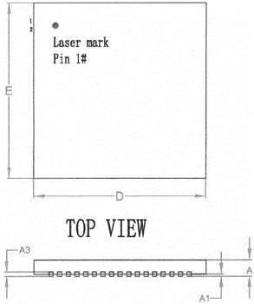
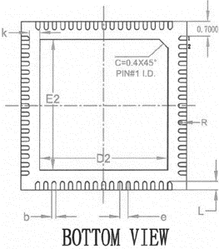
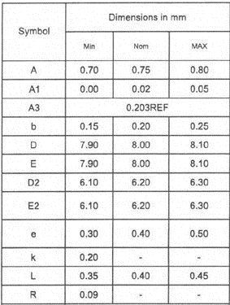
XC-24
Global Technologies
Package specification
Confidential
http://www.glbltech.com/

Slide 48
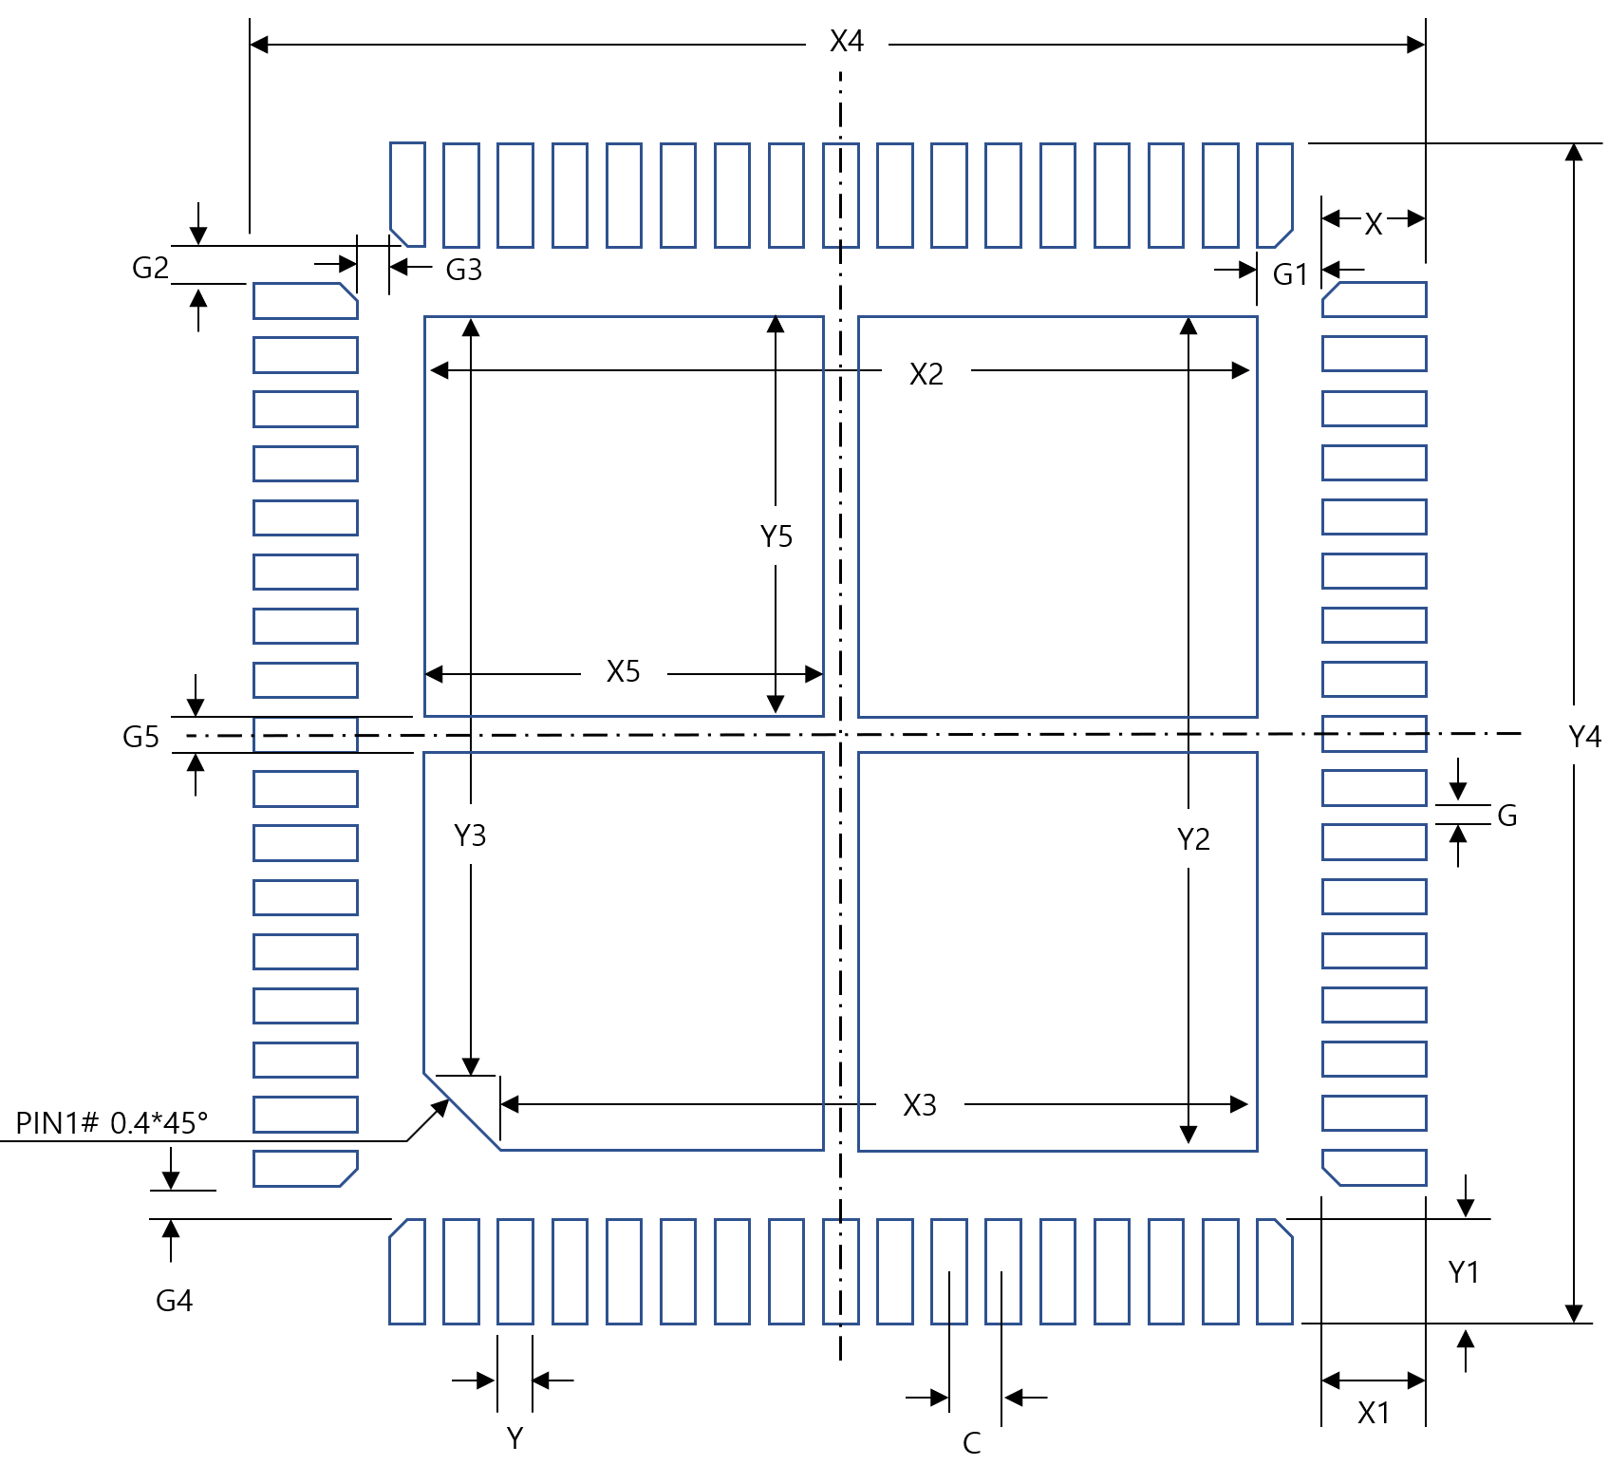
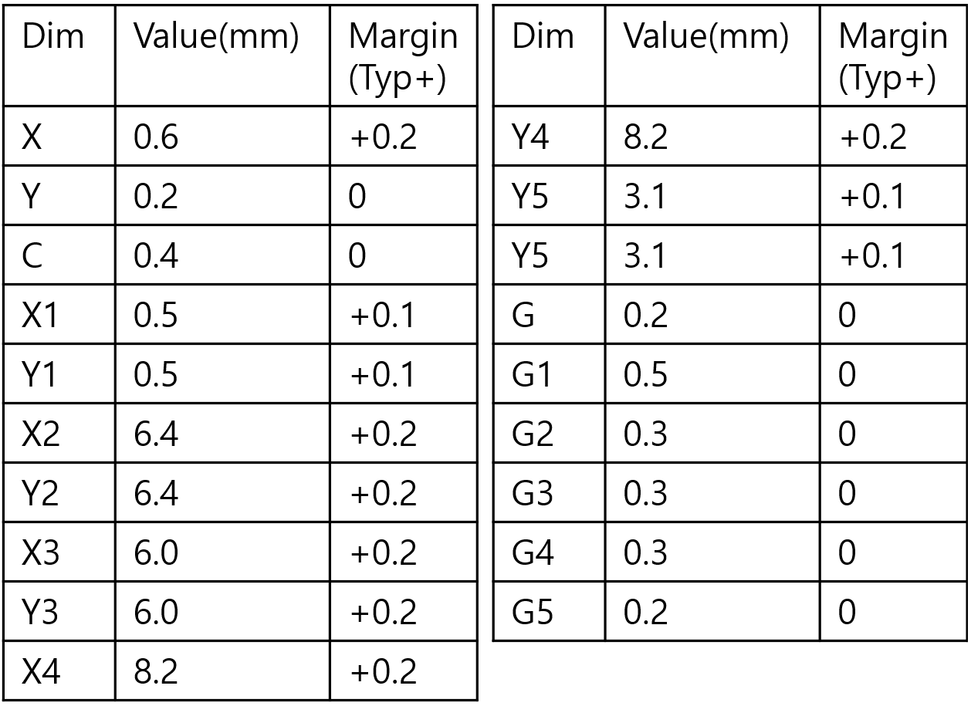
XC-24
Global Technologies
Footprint
Confidential
http://www.glbltech.com/

Slide 49

XC-24
Global Technologies
Global Technologies and are trademarks of Solution Korea Company or its subsidiaries in the Republic of Korea and/or other countries. The products of Global Technologies reserve the right to make changes without further notice to any `products herein. Global Technologies makes no warranty, representation or guarantee regarding the suitability of its products for any particular purpose, nor does Global Technologies assume any liability arising out of the application or use of any product or circuit, and specifically disclaims any and all liability, including without limitation special, consequential or incidental damages. Global Technologies does not convey any license under its patent rights nor the rights of others.
Global Technologies and are trademarks of Solution Korea Company or its subsidiaries in the Republic of Korea and/or other countries. Global Technologies owns the rights to a number of patents, trademarks, copyrights, trade secrets, and other intellectual property. Global Technologies reserves the right to make changes without further notice to any products herein. Global Technologies makes no warranty, representation or guarantee regarding the suitability of its products for any particular purpose, nor does Global Technologies assume any liability arising out of the application or use of any product or circuit, and specifically disclaims any and all liability, including without limitation special, consequential or incidental damages. Buyer is responsible for its products and applications using Global Technologies products, including compliance with all laws, regulations and safety requirements or standards, regardless of any support or applications information provided by Global Technologies. “Typical” parameters which may be provided in Global Technologies data sheets and/or specifications can and do vary in different applications and actual performance may vary over time. All operating parameters, including “Typical” must be validated for each customer application by customer’s technical experts. Global Technologies does not convey any license under its patent rights nor the rights of others. Global Technologies products are not designed, intended, or authorized for use as a critical component in life support systems or any FDA Class 3 medical devices or medical devices with a same or similar classification in a foreign jurisdiction or any devices intended for implantation in the human body. Should Buyer purchase or use Global Technologies products for any such unintended or unauthorized application, Buyer shall indemnify and hold Global Technologies and its officers, employees, subsidiaries, affiliates, and distributors harmless against all claims, costs, damages, and expenses, and reasonable attorney fees arising out of, directly or indirectly, any claim of personal injury or death associated with such unintended or unauthorized use, even if such claim alleges that Global Technologies was negligent regarding the design or manufacture of the part. Global Technologies is an Equal Opportunity/Affirmative Action Employer. This literature is subject to all applicable copyright laws and is not for resale in any manner.
Confidential
http://www.glbltech.com/

