Slide 1

Confidential
Global Technologies
XD-12
The LED Current Sink Driver IC
12 Channels
General Description
The XD-12 is a compact IC featuring 12-channel current sink control driver optimized for LED lighting solution. The XD-12 driver is used together with the XC-24 controller as a companion chip. A lot of the XD-12 drivers can be daisied each other to the XC-24 channels and controlled through a serial interface by the XC-24 controller.
The XD-12 has a feedback control for a LED power efficiently, and self-protection features like as a thermal-regulation, a temperature-protection, a LED open and a short monitoring.
Application
LED back-lighting with local dimming control
Dated July/21/23 Rev. 0.0
http://www.glbltech.com/

Slide 2
XD-12
Global Technologies
Feature
12 independent dimming control channels in a package
Maximum 45V headroom voltage
Maximum 32mA sink current per channel
5 control levels for device max current limit, 4mA, 8mA, 16mA, 24mA and 32mA
12-bit global max current control level for each device max current limit
10-bit PAM current control for global max current level
12-,11-,10-bit PWM current dimming control
Sync control between ICs
Max frame refresh rate 30KHz @ 4095-step
Flicker-less frame frequency switching
Bi-directional one line interface being capable of daisy connection for dimming operation
Fault detection facilities, thermal, short and open event
LED 3-bit short & 2-bit feedback control level
Auto thermal regulation & over temperature protection
Supply voltage 5.0V
24-PIN QFN 3030 package
Latch-up Immunity, I_{LATCH} (JEDEC JESD78D Nov 2011) : ±100mA
ESD protection, ESD_{HBM} (Norm: MIL 883 E Method 3015 Human Body Model) : ±2kV
Confidential
http://www.glbltech.com/

Slide 3
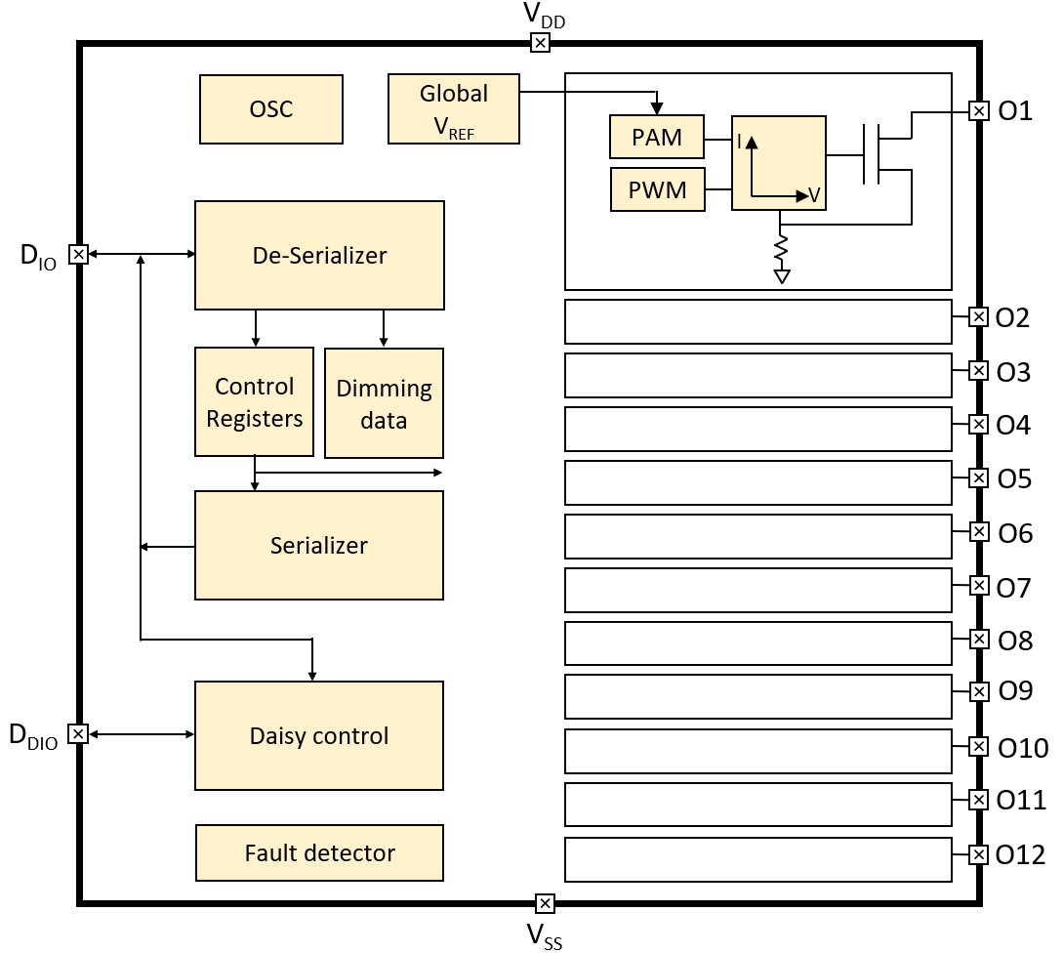
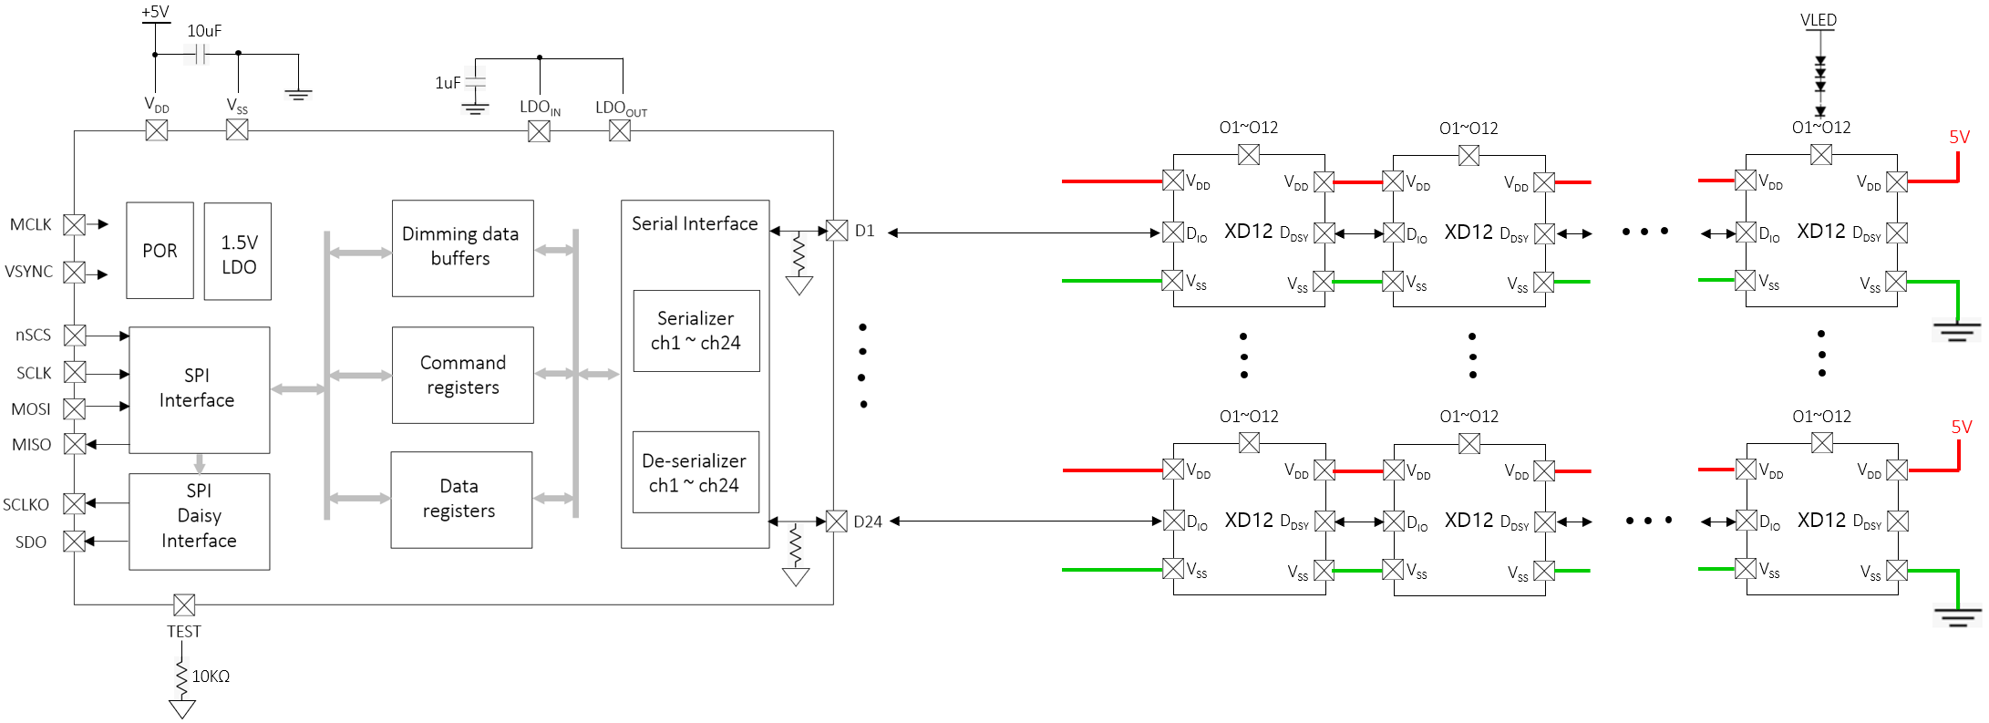
XD-12
Global Technologies
Block Diagram
Application Circuit
Confidential
http://www.glbltech.com/

Slide 4
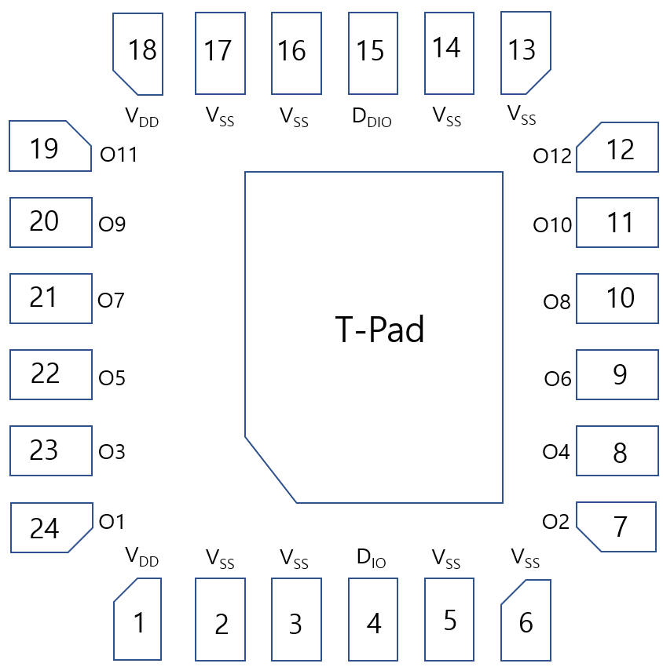
XD-12
Global Technologies
Pin diagram (Top View)
Pin description
Pin Name | Pin No. | I/O | Type | Description | Remark
V_{DD} | 1 | - | Power | Supply voltage
V_{SS} | 2 | - | GND | Ground
V_{SS} | 3 | - | GND | Ground
D_{IO} | 4 | I/O | Digital | Data In/Out | Internal PD, 48KΩ
V_{SS} | 5 | - | GND | Ground
V_{SS} | 6 | - | GND | Ground
O2 | 7 | O | Current Load | Current Sink 2 | If unused, connect to GND
O4 | 8 | O | Current Load | Current Sink 4 | If unused, connect to GND
O6 | 9 | O | Current Load | Current Sink 6 | If unused, connect to GND
O8 | 10 | O | Current Load | Current Sink 8 | If unused, connect to GND
O10 | 11 | O | Current Load | Current Sink 10 | If unused, connect to GND
O12 | 12 | O | Current Load | Current Sink 12 | If unused, connect to GND
V_{SS} | 13 | - | GND | Ground
V_{SS} | 14 | - | GND | Ground
Confidential
Dated April/12/23 Rev. 0.0
http://www.glbltech.com/

Slide 5
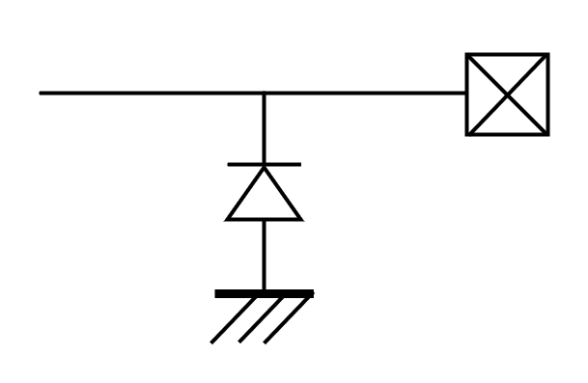
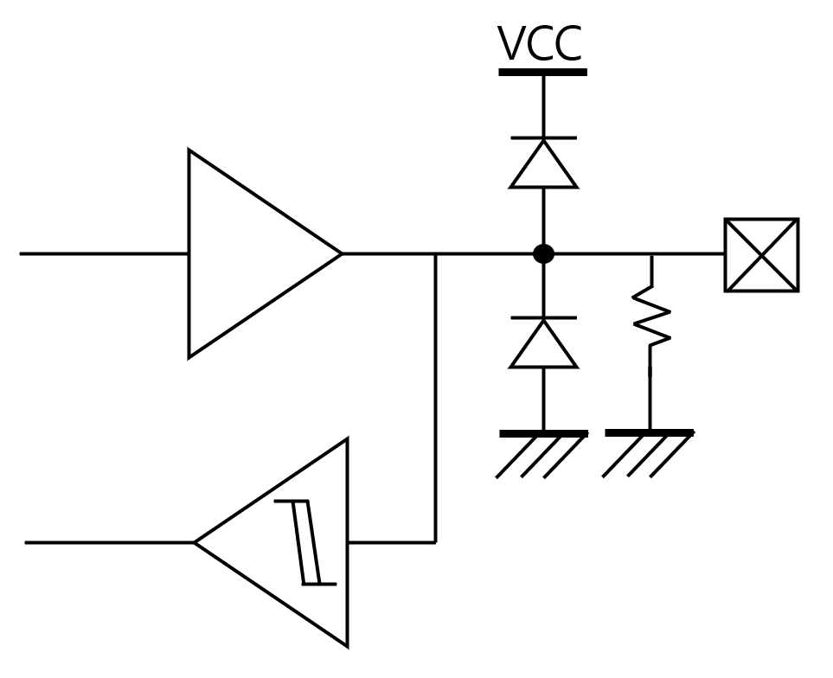
XD-12
Global Technologies
Pin description
Pin Name | Pin No. | I/O | Type | Description | Remark
D_{DIO} | 15 | I/O | Digital | Daisied Data In/Out | Internal PD, 48KΩ
V_{SS} | 16 | - | GND | Ground
V_{SS} | 17 | - | GND | Ground
V_{DD} | 18 | - | Power | Supply Voltage
O11 | 19 | O | Current Load | Current Sink 11 | If unused, connect to GND
O9 | 20 | O | Current Load | Current Sink 9 | If unused, connect to GND
O7 | 21 | O | Current Load | Current Sink 7 | If unused, connect to GND
O5 | 22 | O | Current Load | Current Sink 5 | If unused, connect to GND
O3 | 23 | O | Current Load | Current Sink 3 | If unused, connect to GND
O1 | 24 | O | Current Load | Current Sink 1 | If unused, connect to GND
Equivalent Circuits of individual pins
Pad Name | I/O | Internal Circuit | Description
V_{DD} | - |  | Supply voltage
D_{IO} | I/O |  | Data In/Out
D_{DIO} | I/O |  | Daisied Data In/Out
Confidential
http://www.glbltech.com/

Slide 6
XD-12
Global Technologies
Maximum Absolute ratings (Ta = 25℃ unless otherwise noted)
Parameter | Symbol | Value | Unit
Supply voltage | V_{DD} | -0.3 ~ 6.5 | V
Sink output pin voltage | V_{O} | 45 | V
Sink output current | I_{O} | 32 | mA
D_{IO} to GND | V_{DIO} | -0.3 ~ V_{DD}+0.3 | V
D_{DIO} to GND | V_{DDIO} | -0.3 ~ V_{DD}+0.3 | V
Thermal Resistance
Junction to Ambient | R_{θJA} | x ¹⁾ | ℃/W
Junction to Case | R_{θJC} | x ¹⁾ | ℃/W
Power Dissipation on package | P_{TOT} | x ¹⁾ | W
Junction temperature | T_{J} | -20 ~ 150 | ℃
Storage temperature | T_{STG} | -45 ~ 150 | ℃
Relative Humidity (non-condensing) | RH_{NC} | 5 ~ 85 | %
Moisture Sensitivity | MSL | Maximum Floor Life-time | 3
Stresses beyond the Maximum Absolute ratings may cause permanent damage to the device
Note : 1) Surface mounted on FR-4 substrate PC Board 1” x 1” inch 2-oz copper plate
Electrostatic Discharge
Parameter | Symbol | Value | Unit | Remark
Electrostatic Discharge HBM ; Contact | ESD_{HBM} | ±2K | V | C=100 pF, R=1.5 kΩ
Electrostatic Discharge CDM ; Contact | ESD_{CDM} | ±500 | V | R=1 Ω
Confidential
http://www.glbltech.com/

Slide 7
XD-12
Global Technologies
Electrical Characteristic (V_{DD} =5.0V, Ta=25.0℃ unless otherwise noted)
Characteristics | Symbol | Condition | Value |  |  | Unit
 |  |  | min | typ | max
Supply voltage
Operating voltage | V_{DD}¹⁾ |  | 4.5 | 5.0 | 5.5 | V
Supply current
Quiescent Current | I_{s} | Standby state, No LED current | - | - | 3 | mA
Operating Current 5 | I_{DD5} | All output sink current = 32mA | - | - | 22 | mA
Operating Current 4 | I_{DD4} | All output sink current = 24mA | - | - | 15 | mA
Operating Current 3 | I_{DD3} | All output sink current = 16mA | - | - | 11 | mA
Operating Current 2 | I_{DD2} | All output sink current = 8mA | - | - | 7 | mA
Operating Current 1 | I_{DD1} | All output sink current = 4mA | - | - | 4 | mA
In/Out
D_{IO}, D_{DIO} | V_{IL} V_{IH} | Input logic low level | - | - | 0.5 | V
 |  | Input logic high level | V_{DD} -0.5 | - | V_{DD}
 | V_{OL} V_{OH} | Output logic low level | - | - | 0.5 | V
 |  | Output logic high level | V_{DD} -0.5 | - | V_{DD}
 | R_{PD} | Internal pull-down resistance | - | 48 | - | KΩ
Logic high time | T_{1H}, T_{0L} |  | - | 8 | - | MCLK
Logic low time | T_{1L}, T_{0H} |  | - | 5 | - | MCLK
Output
Driving voltage | V_{O} | Headroom voltage V_{HD} : 0.65V@ I_{O}=4~16mA 0.80V@ I_{O}=16~32mA | V_{HD} | - | 40 | V
Short detection voltage ²⁾ | V_{SD} | Short detection level V_{SD} : 3b’000 : 2V, 3b’100 : 21V 3b’001 : 4V, 3b’101 : 24V 3b’010 : 7V, 3b’110 : 30V 3b’011 : 12V, 3b’111 : 38V | V_{SD} | - | - | V
Open detection voltage | V_{OD} |  | - | - | 0.2 | V
Sink current | I_{O} | Device max current level : 3’b000 = 4mA, 3’b001 = 8mA 3’b010 = 16mA, 3’b011 = 24mA 3’b100 = 32mA | - | - | 32 | mA
Trimmed current accuracy | %_{ACC} | 200uA @ I_{O} = 4mA 400uA @ I_{O} = 8mA 600uA @ I_{O} = 16mA 800uA @ I_{O} = 24mA 1mA @ I_{O} = 32mA | -3% | - | +3%
LED off current | I_{OFF} | Vo = 40V | - | - | 300 | nA
Confidential
http://www.glbltech.com/

Slide 8
XD-12
Global Technologies
Electrical Characteristic (V_{DD} =5.0V, Ta=25.0℃ unless otherwise noted)
Characteristics | Symbol | Condition | Value |  |  | Unit
 |  |  | min | typ | max
Oscillator
Internal MCLK | f_{OSC} |  | 14.45 | 14.75 | 15.05 | MHz
Feedback
FB threshold voltage | V_{FBA} | Logically ORed for 12-channel FB level V_{FB}: 2’b00 : V_{FBA} = 0.6V 2’b01 : V_{FBA} = 0.8V 2’b10 : V_{FBA} = 1.0V 2’b11 : V_{FBA} = 1.2V | - | V_{FBA} | - | V
FB hysteresis voltage | V_{FBH} |  | 40 | 60 | 110 | mV
Thermal protection
Automatic Thermal Regulation Range @T_{J} | T_{ATR} |  | 105 | - | ≈140 | ℃
Thermal shut down @Tj | T_{OTP} | I_{O} off | - | 140 | - | ℃
Thermal shut down hysteresis @Tj | T_{HYS} |  | 10 | 20 | 30 | ℃
Logic ‘1’
Logic ‘0’
T_{1H}
T_{0H}
T_{1L}
T_{0L}
Note : 1) The operation below V_{DD}, 5V will limit a maximum LED sinking current and affect a current variation.
2) LED short detection logic circuit will cut-off the LED sinking current when it is detected.
3) Based on internal circuit simulation result.
Confidential
http://www.glbltech.com/

Slide 9
XD-12
Global Technologies
Confidential
http://www.glbltech.com/

Slide 10
XD-12
Global Technologies
Register Map
RESET
Acc | Addr | Default | B11 | B10 | B9 | B8 | B7 | B6 | B5 | B4 | B3 | B2 | B1 | B0
R/W | 0x00 | 0x0 | x | x | x | x | x | x | x | x | x | x | RST2 | RST1
Bits | Fields | Descriptions
1 | RST2 | ‘1’ All logics are reset and auto-cleared after setting to 1.
0 | RST1 | ‘1’ The internal LD data buffers are reset and auto-cleared after setting to 1.
ID
Acc | Addr | Default | B11 | B10 | B9 | B8 | B7 | B6 | B5 | B4 | B3 | B2 | B1 | B0
R/W | 0x01 | 0x0 | x | x | x | x | x | x | x | ID [4:0] | x | x | RST2 | RST1
Bits | Fields | Descriptions
4:0 | ID | If the XD-12 will receive the ID-Gen command from the XC-24 controller, then the ID value will be automatically generated. The ID value is needed for proper reading, so, the ID-Gen command must be firstly executed by the XC-24 controller before executing any commands. If all XD-12 drivers daisied will receive the ID-Gen command, the last-located device will have the first number of ID, and the first located device will have the last number of ID, that is, the number of daisied devices.
CONTROL
Acc | Addr | Default | B11 | B10 | B9 | B8 | B7 | B6 | B5 | B4 | B3 | B2 | B1 | B0
R/W | 0x02 | 0x0 | x | LD_WIDTH [1:0] | x | x | x | x | X_ITERATION [5:0] | x | x | x | RST2 | RST1
Bits | Fields | Descriptions
10:9 | LD_WIDTH | The LD_WIDTH determines the PWM data size among the LD data transferred from the XC-24 controller. ‘00’ PWM data size is 10 bits ‘01’ PWM data size is 11 bits ‘10’ PWM data size is 12 bits
5:0 | X_ITERATION | The X_ITERATION determines how many times the X_SIZE will be repeated for one frame period. It should be careful that the real executed value is the set value of X_ITERATION + 1. The set value will come into effect at the next internal vsync assertion even if the value is set during current dimming operation earlier than the next vsync. For more details, refer to the Fig 1.
Confidential
http://www.glbltech.com/

Slide 11
XD-12
Global Technologies
PWM_SIZE
Acc | Addr | Default | B11 | B10 | B9 | B8 | B7 | B6 | B5 | B4 | B3 | B2 | B1 | B0
R/W | 0x03 | 0x0 | PWM_SIZE [11:0] | x | x | x | x | x | x | x | x | x | RST2 | RST1
Bits | Fields | Descriptions
11:0 | PWM_SIZE | The PWM_SIZE determines a total number of pwm clocks for one frame period. It should be careful that the real executed value is the set value of PWM_SIZE + 1. The set value will come into effect at the next internal vsync assertion even if the value is set during current dimming operation earlier than the next vsync. For more details, refer to the Fig 1.
PWM_PERIOD
Acc | Addr | Default | B11 | B10 | B9 | B8 | B7 | B6 | B5 | B4 | B3 | B2 | B1 | B0
R/W | 0x04 | 0x0 | PWM_PERIOD [11:0] | x | x | x | x | x | x | x | x | x | RST2 | RST1
Bits | Fields | Descriptions
11:0 | PWM_PERIOD | The PWM_PERIOD determines the interval time between pwm clocks in units of MCLK. The set value will come into effect at the next internal vsync assertion even if the value is set during current dimming operation earlier than the next vsync. For more details, refer to the Fig 1.
X_SIZE
Acc | Addr | Default | B11 | B10 | B9 | B8 | B7 | B6 | B5 | B4 | B3 | B2 | B1 | B0
R/W | 0x05 | 0x0 | X_SIZE [11:0] | x | x | x | x | x | x | x | x | x | RST2 | RST1
Bits | Fields | Descriptions
11:0 | X_SIZE | The X_SIZE determines a total number of pwm clocks during local dimming period within one frame period. The local dimming period, X_SIZE, can be repeated the number of X_ ITERATION within one frame period. It should be careful that the real executed value is the set value of X_SIZE + 1. The set value will come into effect at the next internal vsync assertion even if the value is set during current dimming operation earlier than the next vsync. For more details, refer to the Fig 1.
Confidential
http://www.glbltech.com/

Slide 12
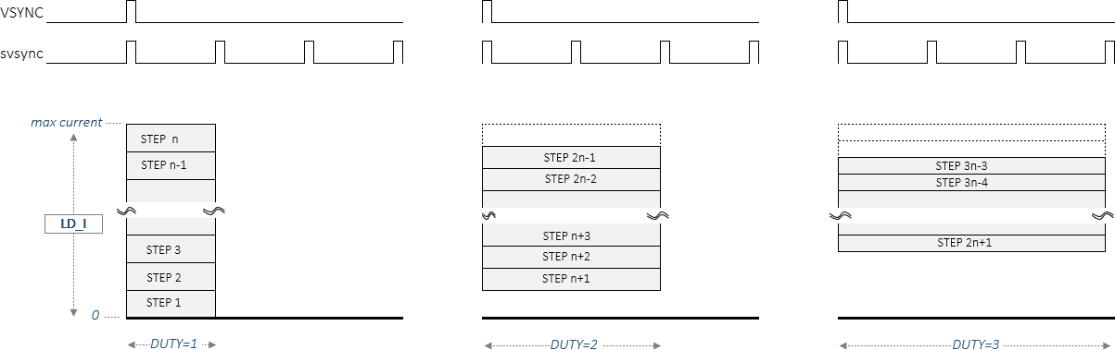
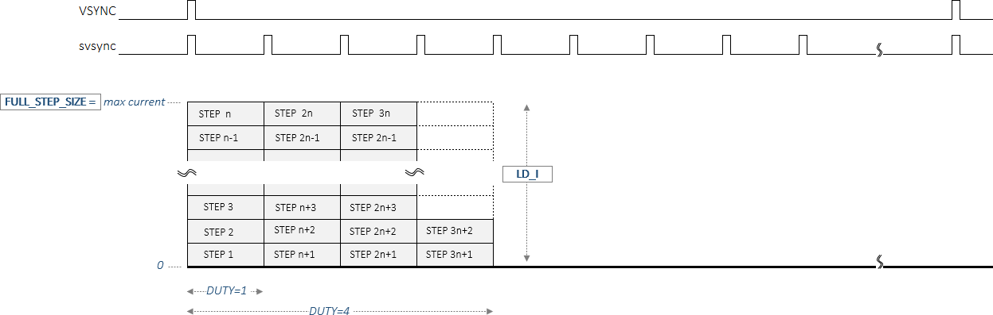
XD-12
Global Technologies
PAM_FIX
Acc | Addr | Default | B11 | B10 | B9 | B8 | B7 | B6 | B5 | B4 | B3 | B2 | B1 | B0
R/W | 0x06 | 0x0 | x | x | PAM_FIX [9:0] | x | x | x | x | x | x | x | RST2 | RST1
Bits | Fields | Descriptions
9:0 | PAM_FIX | The PWM_FIX register is used to successively output a fixed value written in this register instead of PWM data of LD data, regardless of the synchronization signal, when the TEST_EN bit is set.
CURRENT DIMM THRESHOLD
Acc | Addr | Default | B11 | B10 | B9 | B8 | B7 | B6 | B5 | B4 | B3 | B2 | B1 | B0
R/W | 0x07 | 0x0 | CURR_DIMM_TH [11:0] | x | x | x | x | x | x | x | x | x | RST2 | RST1
Bits | Fields | Descriptions
11:0 | CURR_DIMM_TH | The CURR_DIMM_TH register determines whether current dimming method 1 is used during the local dimming operation or current dimming method 2. CURR_DIMM_TH = 0x0 : current dimming method 2 CURR_DIMM_TH = 0xFFF : current dimming method 1 CURR_DIMM_TH ≤ PWM data : current dimming method 2 CURR_DIMM_TH > PWM data : current dimming method 1
MAX_CURR_VREF
PAM data
< current dimming method 1 >
MAX_CURR_VREF
PAM data
< current dimming method 2 >
Confidential
http://www.glbltech.com/

Slide 13
XD-12
Global Technologies
MAX CURRENT VREF
Acc | Addr | Default | B11 | B10 | B9 | B8 | B7 | B6 | B5 | B4 | B3 | B2 | B1 | B0
R/W | 0x08 | 0x8 | MAX_CURR_VREF [11:0] | x | x | x | x | x | x | x | x | x | RST2 | RST1
Bits | Fields | Descriptions
11:0 | MAX_CURR_VREF | The MAX_CURR_VREF determines the maximum current value corresponding to the current dimming frame. The set value will come into effect at the next internal vsync assertion even if the value is set during current dimming operation earlier than the next vsync.
CHANNEL ENABLE
Acc | Addr | Default | B11 | B10 | B9 | B8 | B7 | B6 | B5 | B4 | B3 | B2 | B1 | B0
R/W | 0x09 | 0x0 | CH12_EN | CH11_EN | CH10_EN | CH9_EN | CH8_EN | CH7_EN | CH6_EN | CH5_EN | CH4_EN | CH3_EN | CH2_EN | CH1_EN
Bits | Fields | Descriptions
11:0 | CHx_EN | The CHx_EN determines which channel is active. If 9 channels are used, then you must set CH1_EN to CH9_EN bit.
Confidential
http://www.glbltech.com/

Slide 14
XD-12
Global Technologies
FAULT STATUS
Acc | Addr | Default | B11 | B10 | B9 | B8 | B7 | B6 | B5 | B4 | B3 | B2 | B1 | B0
R/W | 0x0A | 0x0 | x | x | x | x | x | x | x | x | THERMAL | SHORT | OPEN | FB
Bits | Fields | Descriptions
3 | THERMAL | The THERMAL bit indicates whether the XD-12 device has internally caused a thermal regulation event due to overheating due to high current for a long time. After this event has happened, this bit will be reset if internal thermal event is cleared again. This bit is set when a thermal event occurs in even one of the activated channels.
2 | SHORT | The SHORT bit indicated whether the XD-12 output pin is short to a VLED line due to any soldering condition. The detection level can be set by the SHORT_LEVEL of the FAULT LEVEL register and the activating level can be set by the SHORT ENABLE LEVEL register. After this event has happened, this bit will be reset if the event condition is cleared again. This bit is set when a short event occurs in even one of the activated channels.
1 | OPEN | The OPEN bit indicated whether the XD-12 output pin is open, even though the channel output is activated. The open level is fixed to 0.2V. After this event has happened, this bit will be reset if the event condition is cleared again. This bit is set when an open event occurs in even one of the activated channels.
0 | FB | The FB bit indicated whether the XD-12 output pin’s headroom voltage is under the value set by FB_LEVEL of the FAULT LEVEL register. After this event has happened, this bit will be reset if the event condition is cleared again. This bit is set when an fb event occurs in even one of the activated channels.
FAULT LEVEL
Acc | Addr | Default | B11 | B10 | B9 | B8 | B7 | B6 | B5 | B4 | B3 | B2 | B1 | B0
R/W | 0x0B | 0x0 | x | DEV_MAX_CURR_LEVEL [2:0] | x | x | x | SHORT_LEVEL [2:0] | x | x | x | x | FB_LEVEL [1:0]
Bits | Fields | Descriptions
10:8 | DEV_MAX_CURR_LEVEL | The DEV_MAX_CURR_LEVEL determines the physical maximum current level of device. The maximum current set by the MAX_CURR_VREF can not be beyond the DEV_MAX_CURR_LEVEL. 3b’000 : max 4mA 3b’011 : max 24mA 3b’001 : max 8mA 3b’100 : max 32mA 3b’010 : max 16mA 3b’101 : max 64mA
6:4 | SHORT_LEVEL | The SHORT_LEVEL determines the level at which a short event occurs. 3b’000 : above 2V 3b’100 : above 21V 3b’001 : above 4V 3b’101 : above 24V 3b’010 : above 7V 3b’110 : above 28V 3b’011 : above 12V 3b’111 : above 38V
1:0 | FB_LEVEL | The FB_LEVEL determines the level at which a fb event occurs. 2b’00 : below 0.6V 2b’01 : below 0.8V 2b’10 : below 1.0V 2b’11 : below 1.2V
Confidential
http://www.glbltech.com/

Slide 15
XD-12
Global Technologies
DELAY_CH1
Acc | Addr | Default | B11 | B10 | B9 | B8 | B7 | B6 | B5 | B4 | B3 | B2 | B1 | B0
R/W | 0x0C | 0x0 | DELAY_CH1 [11:0]
DELAY_CH2
Acc | Addr | Default | B11 | B10 | B9 | B8 | B7 | B6 | B5 | B4 | B3 | B2 | B1 | B0
R/W | 0x0D | 0x0 | DELAY_CH2 [11:0]
DELAY_CH3
Acc | Addr | Default | B11 | B10 | B9 | B8 | B7 | B6 | B5 | B4 | B3 | B2 | B1 | B0
R/W | 0x0E | 0x0 | DELAY_CH3 [11:0]
DELAY_CH4
Acc | Addr | Default | B11 | B10 | B9 | B8 | B7 | B6 | B5 | B4 | B3 | B2 | B1 | B0
R/W | 0x0F | 0x0 | DELAY_CH4 [11:0]
DELAY_CH5
Acc | Addr | Default | B11 | B10 | B9 | B8 | B7 | B6 | B5 | B4 | B3 | B2 | B1 | B0
R/W | 0x10 | 0x0 | DELAY_CH5 [11:0]
DELAY_CH6
Acc | Addr | Default | B11 | B10 | B9 | B8 | B7 | B6 | B5 | B4 | B3 | B2 | B1 | B0
R/W | 0x11 | 0x0 | DELAY_CH6 [11:0]
DELAY_CH7
Acc | Addr | Default | B11 | B10 | B9 | B8 | B7 | B6 | B5 | B4 | B3 | B2 | B1 | B0
R/W | 0x12 | 0x0 | DELAY_CH7 [11:0]
DELAY_CH8
Acc | Addr | Default | B11 | B10 | B9 | B8 | B7 | B6 | B5 | B4 | B3 | B2 | B1 | B0
R/W | 0x13 | 0x0 | DELAY_CH8 [11:0]
DELAY_CH9
Acc | Addr | Default | B11 | B10 | B9 | B8 | B7 | B6 | B5 | B4 | B3 | B2 | B1 | B0
R/W | 0x14 | 0x0 | DELAY_CH9 [11:0]
DELAY_CH10
Acc | Addr | Default | B11 | B10 | B9 | B8 | B7 | B6 | B5 | B4 | B3 | B2 | B1 | B0
R/W | 0x15 | 0x0 | DELAY_CH10 [11:0]
Confidential
http://www.glbltech.com/

Slide 16
XD-12
Global Technologies
DELAY_CH11
Acc | Addr | Default | B11 | B10 | B9 | B8 | B7 | B6 | B5 | B4 | B3 | B2 | B1 | B0
R/W | 0x16 | 0x0 | DELAY_CH11 [11:0]
DELAY_CH12
Acc | Addr | Default | B11 | B10 | B9 | B8 | B7 | B6 | B5 | B4 | B3 | B2 | B1 | B0
R/W | 0x17 | 0x0 | DELAY_CH12 [11:0]
Bits | Fields | Descriptions
11:0 | DELAY_CHx | The DELAY_CHx determines which pwm clock to start dimming out from. For more details, refer to the Fig 1.
SERIAL CLOCK GEN
Acc | Addr | Default | B11 | B10 | B9 | B8 | B7 | B6 | B5 | B4 | B3 | B2 | B1 | B0
R/W | 0x18 | 0x058 | x | x | x | x | SERIAL_CLK_LOW [3:0] | x | x | x | SERIAL_CLK_HIGH [3:0] | SHORT | OPEN | FB
Bits | Fields | Descriptions
7:4 | SERIAL_CLK_LOW | These bits determine the number of MCLK of V_{DD} level in logic low value ‘0’ or the number of MCLK of zero level in logic high value ‘1’ when the XD-12 drivers the D_{IO} pin on reading.
3:0 | SERIAL_CLK_HIGH | These bits determine the number of MCLK of V_{DD} level in logic high value ‘1’ or the number of MCLK of zero level in logic low value ‘0’ when the XD-12 drivers the D_{IO} pin on reading.
SHORT ENABLE LEVEL
Acc | Addr | Default | B11 | B10 | B9 | B8 | B7 | B6 | B5 | B4 | B3 | B2 | B1 | B0
R/W | 0x19 | 0x0 | x |  | SHORT_EN_LEVEL [9:0] | x | SERIAL_CLK_LOW [3:0] | x | x | x | SERIAL_CLK_HIGH [3:0] | SHORT | OPEN | FB
Bits | Fields | Descriptions
9:0 | SHORT_EN_LEVEL | The SHORT_EN_LEVEL determines the activation level of the short function. The short function is activated the condition, PAM data > SHORT_EN_LEVEL.
Confidential
http://www.glbltech.com/

Slide 17
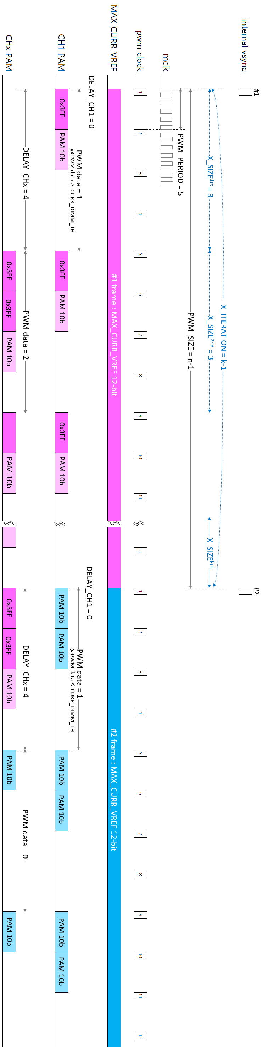
XD-12
Global Technologies
Fig 1. The local dimming scheme
Confidential
http://www.glbltech.com/

Slide 18
XD-12
Global Technologies
These registers can not go outside the Global Technologies.
TRIM CONTROL 1
Acc | Addr | Default | B11 | B10 | B9 | B8 | B7 | B6 | B5 | B4 | B3 | B2 | B1 | B0
R/W | 0x20 | 0x0 | TEST_EN | x | x | x | x | x | x | x | OTP_PG_ACCESS_CYCLE [15:12] | SHORT | OPEN | FB
Bits | Fields | Descriptions
11 | TEST_EN | ‘0’ Normal operation ‘1’ There are two purposes to use this pin as below. 1. The MCLK divided by 8 is output to the D_{DIO} pin for trimming the internal OSC. 2. The analog value of the MAX_CURR_VREF is output to the pin 17 for trimming the level.
TRIM CONTROL 2
Acc | Addr | Default | B11 | B10 | B9 | B8 | B7 | B6 | B5 | B4 | B3 | B2 | B1 | B0
R/W | 0x21 | 0x320 | OTP_PG_ACCESS_CYCLE [11:0] | x | x | x | x | x | x | I_{D} [4:0] | x | x | RST2 | RST1
TRIM CONTROL 3
Acc | Addr | Default | B11 | B10 | B9 | B8 | B7 | B6 | B5 | B4 | B3 | B2 | B1 | B0
R/W | 0x22 | 0x04 | x | x | x | x | x | x | x | x | OTP_WSEL [3:0] | SHORT | OPEN | FB
TRIM CONTROL 4
Acc | Addr | Default | B11 | B10 | B9 | B8 | B7 | B6 | B5 | B4 | B3 | B2 | B1 | B0
R/W | 0x23 | 0x04 | OFS_TEMP [3:0] | x | x | x | x | x | x | x | x | x | OTP_RD_START | OTP_PG_START
TRIM CONTROL 5
Acc | Addr | Default | B11 | B10 | B9 | B8 | B7 | B6 | B5 | B4 | B3 | B2 | B1 | B0
R/W | 0x24 | 0x0 | PROTECT_EN/DIS [11:0] ※ enable (0x5A5), disable (0xA5A) | x | x | x | x | x | x | I_{D} [4:0] | x | x | RST2 | RST1
TRIM CONTROL 6
Acc | Addr | Default | B11 | B10 | B9 | B8 | B7 | B6 | B5 | B4 | B3 | B2 | B1 | B0
R/W | 0x25 | 0x0 | OTP_CRC_CHECKSUM [11:0] | x | x | x | x | x | x | I_{D} [4:0] | x | x | RST2 | RST1
Confidential
http://www.glbltech.com/

Slide 19
XD-12
Global Technologies
OSC
Acc | Addr | Default | B11 | B10 | B9 | B8 | B7 | B6 | B5 | B4 | B3 | B2 | B1 | B0
R/W | 0x26 | 0x200 | x | x | OSC_CTL [9:0] | x | x | x | x | x | x | x | RST2 | RST1
VREF CONTROL
Acc | Addr | Default | B11 | B10 | B9 | B8 | B7 | B6 | B5 | B4 | B3 | B2 | B1 | B0
R/W | 0x27 | 0x01F | x | x | x | x | x | x | VREF_CTL [5:0] | x | x | x | RST2 | RST1
OFS1
Acc | Addr | Default | B11 | B10 | B9 | B8 | B7 | B6 | B5 | B4 | B3 | B2 | B1 | B0
R/W | 0x28 | 0x400 | x | OFS_CH1 [10:0] | x | x | x | x | x | x | x | x | RST2 | RST1
OFS2
Acc | Addr | Default | B11 | B10 | B9 | B8 | B7 | B6 | B5 | B4 | B3 | B2 | B1 | B0
R/W | 0x29 | 0x400 | x | OFS_CH2 [10:0] | x | x | x | x | x | x | x | x | RST2 | RST1
OFS3
Acc | Addr | Default | B11 | B10 | B9 | B8 | B7 | B6 | B5 | B4 | B3 | B2 | B1 | B0
R/W | 0x2A | 0x400 | x | OFS_CH3 [10:0] | x | x | x | x | x | x | x | x | RST2 | RST1
OFS4
Acc | Addr | Default | B11 | B10 | B9 | B8 | B7 | B6 | B5 | B4 | B3 | B2 | B1 | B0
R/W | 0x2B | 0x400 | x | OFS_CH4 [10:0] | x | x | x | x | x | x | x | x | RST2 | RST1
OFS5
Acc | Addr | Default | B11 | B10 | B9 | B8 | B7 | B6 | B5 | B4 | B3 | B2 | B1 | B0
R/W | 0x2C | 0x400 | x | OFS_CH5 [10:0] | x | x | x | x | x | x | x | x | RST2 | RST1
OFS6
Acc | Addr | Default | B11 | B10 | B9 | B8 | B7 | B6 | B5 | B4 | B3 | B2 | B1 | B0
R/W | 0x2D | 0x400 | x | OFS_CH6 [10:0] | x | x | x | x | x | x | x | x | RST2 | RST1
OFS7
Acc | Addr | Default | B11 | B10 | B9 | B8 | B7 | B6 | B5 | B4 | B3 | B2 | B1 | B0
R/W | 0x2E | 0x400 | x | OFS_CH7 [10:0] | x | x | x | x | x | x | x | x | RST2 | RST1
OFS8
Acc | Addr | Default | B11 | B10 | B9 | B8 | B7 | B6 | B5 | B4 | B3 | B2 | B1 | B0
R/W | 0x2F | 0x400 | x | OFS_CH8 [10:0] | x | x | x | x | x | x | x | x | RST2 | RST1
OFS9
Acc | Addr | Default | B11 | B10 | B9 | B8 | B7 | B6 | B5 | B4 | B3 | B2 | B1 | B0
R/W | 0x30 | 0x400 | x | OFS_CH9 [10:0] | x | x | x | x | x | x | x | x | RST2 | RST1
OFS10
Acc | Addr | Default | B11 | B10 | B9 | B8 | B7 | B6 | B5 | B4 | B3 | B2 | B1 | B0
R/W | 0x31 | 0x400 | x | OFS_CH10 [10:0] | x | x | x | x | x | x | x | x | RST2 | RST1
OFS11
Acc | Addr | Default | B11 | B10 | B9 | B8 | B7 | B6 | B5 | B4 | B3 | B2 | B1 | B0
R/W | 0x32 | 0x400 | x | OFS_CH11 [10:0] | x | x | x | x | x | x | x | x | RST2 | RST1
OFS12
Acc | Addr | Default | B11 | B10 | B9 | B8 | B7 | B6 | B5 | B4 | B3 | B2 | B1 | B0
R/W | 0x33 | 0x400 | x | OFS_CH12 [10:0] | x | x | x | x | x | x | x | x | RST2 | RST1
Confidential
http://www.glbltech.com/

Slide 20
XD-12
Global Technologies
GAIN1
Acc | Addr | Default | B11 | B10 | B9 | B8 | B7 | B6 | B5 | B4 | B3 | B2 | B1 | B0
R/W | 0x34 | 0x80 | x | x | x | x | GAIN_CH1 [7:0] | x | x | x | x | x | RST2 | RST1
GAIN2
Acc | Addr | Default | B11 | B10 | B9 | B8 | B7 | B6 | B5 | B4 | B3 | B2 | B1 | B0
R/W | 0x35 | 0x80 | x | x | x | x | GAIN_CH2 [7:0] | x | x | x | x | x | RST2 | RST1
GAIN3
Acc | Addr | Default | B11 | B10 | B9 | B8 | B7 | B6 | B5 | B4 | B3 | B2 | B1 | B0
R/W | 0x36 | 0x80 | x | x | x | x | GAIN_CH3 [7:0] | x | x | x | x | x | RST2 | RST1
GAIN4
Acc | Addr | Default | B11 | B10 | B9 | B8 | B7 | B6 | B5 | B4 | B3 | B2 | B1 | B0
R/W | 0x37 | 0x80 | x | x | x | x | GAIN_CH4 [7:0] | x | x | x | x | x | RST2 | RST1
GAIN5
Acc | Addr | Default | B11 | B10 | B9 | B8 | B7 | B6 | B5 | B4 | B3 | B2 | B1 | B0
R/W | 0x38 | 0x80 | x | x | x | x | GAIN_CH5 [7:0] | x | x | x | x | x | RST2 | RST1
GAIN6
Acc | Addr | Default | B11 | B10 | B9 | B8 | B7 | B6 | B5 | B4 | B3 | B2 | B1 | B0
R/W | 0x39 | 0x80 | x | x | x | x | GAIN_CH6 [7:0] | x | x | x | x | x | RST2 | RST1
GAIN7
Acc | Addr | Default | B11 | B10 | B9 | B8 | B7 | B6 | B5 | B4 | B3 | B2 | B1 | B0
R/W | 0x3A | 0x80 | x | x | x | x | GAIN_CH7 [7:0] | x | x | x | x | x | RST2 | RST1
GAIN8
Acc | Addr | Default | B11 | B10 | B9 | B8 | B7 | B6 | B5 | B4 | B3 | B2 | B1 | B0
R/W | 0x3B | 0x80 | x | x | x | x | GAIN_CH8 [7:0] | x | x | x | x | x | RST2 | RST1
GAIN9
Acc | Addr | Default | B11 | B10 | B9 | B8 | B7 | B6 | B5 | B4 | B3 | B2 | B1 | B0
R/W | 0x3C | 0x80 | x | x | x | x | GAIN_CH9 [7:0] | x | x | x | x | x | RST2 | RST1
GAIN10
Acc | Addr | Default | B11 | B10 | B9 | B8 | B7 | B6 | B5 | B4 | B3 | B2 | B1 | B0
R/W | 0x3D | 0x80 | x | x | x | x | GAIN_CH10 [7:0] | x | x | x | x | x | RST2 | RST1
GAIN11
Acc | Addr | Default | B11 | B10 | B9 | B8 | B7 | B6 | B5 | B4 | B3 | B2 | B1 | B0
R/W | 0x3E | 0x80 | x | x | x | x | GAIN_CH11 [7:0] | x | x | x | x | x | RST2 | RST1
GAIN12
Acc | Addr | Default | B11 | B10 | B9 | B8 | B7 | B6 | B5 | B4 | B3 | B2 | B1 | B0
R/W | 0x3F | 0x80 | x | x | x | x | GAIN_CH12 [7:0] | x | x | x | x | x | RST2 | RST1
Confidential
http://www.glbltech.com/

Slide 21
XD-12
Global Technologies
Confidential
http://www.glbltech.com/

Slide 22
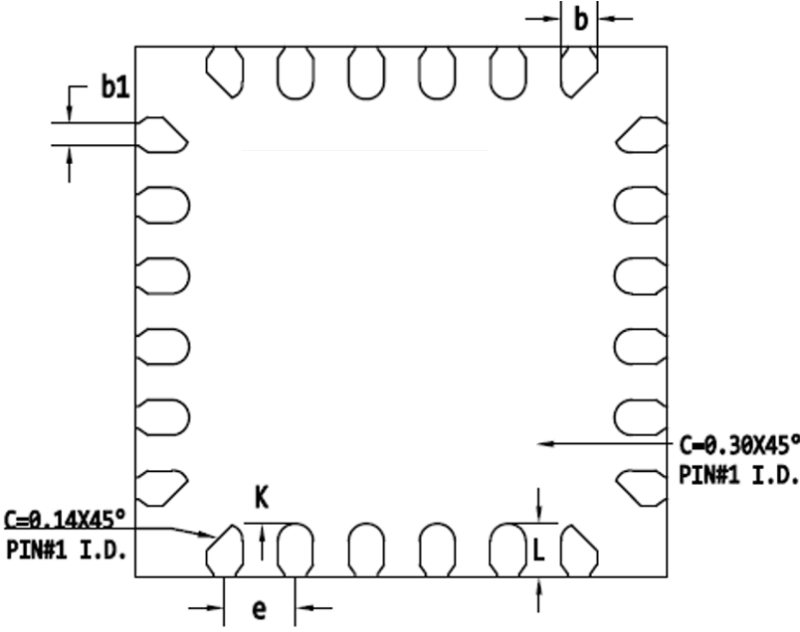
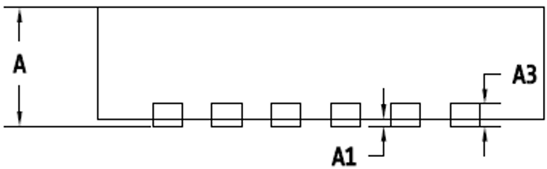
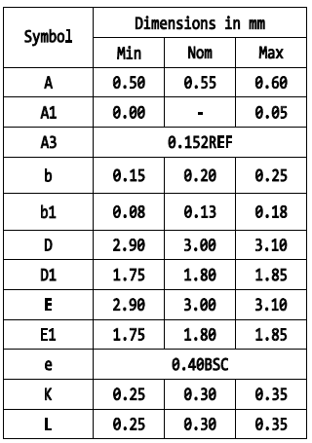
XD-12
Global Technologies
Package specification
TOP VIEW
BOTTOM VIEW
E
D1
Pin #1
E1
D
1.25
1.30
1.35
Confidential
http://www.glbltech.com/

Slide 23
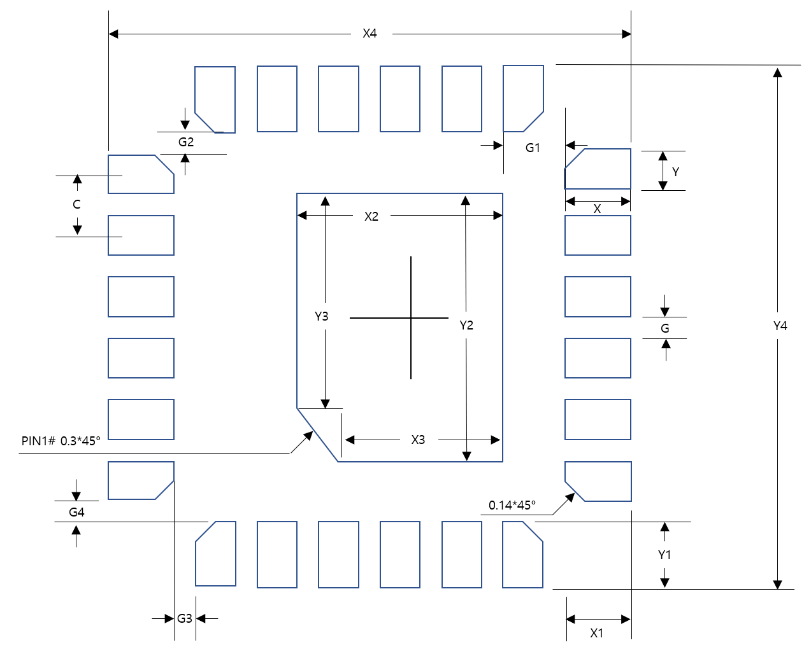
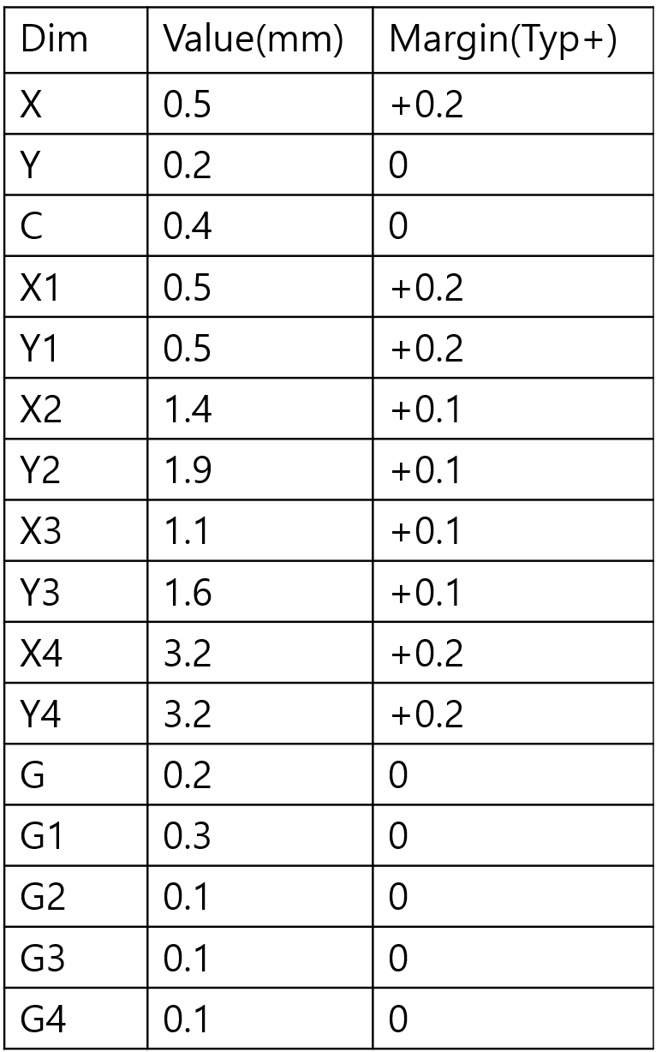
XD-12
Global Technologies
Footprint
Confidential
http://www.glbltech.com/

Slide 24

XD-12
Global Technologies
Global Technologies and are trademarks of Solution Korea Company or its subsidiaries in the Republic of Korea and/or other countries. The products of Global Technologies reserve the right to make changes without further notice to any `products herein. Global Technologies makes no warranty, representation or guarantee regarding the suitability of its products for any particular purpose, nor does Global Technologies assume any liability arising out of the application or use of any product or circuit, and specifically disclaims any and all liability, including without limitation special, consequential or incidental damages. Global Technologies does not convey any license under its patent rights nor the rights of others.
Global Technologies and are trademarks of Solution Korea Company or its subsidiaries in the Republic of Korea and/or other countries. Global Technologies owns the rights to a number of patents, trademarks, copyrights, trade secrets, and other intellectual property. Global Technologies reserves the right to make changes without further notice to any products herein. Global Technologies makes no warranty, representation or guarantee regarding the suitability of its products for any particular purpose, nor does Global Technologies assume any liability arising out of the application or use of any product or circuit, and specifically disclaims any and all liability, including without limitation special, consequential or incidental damages. Buyer is responsible for its products and applications using Global Technologies products, including compliance with all laws, regulations and safety requirements or standards, regardless of any support or applications information provided by Global Technologies. “Typical” parameters which may be provided in Global Technologies data sheets and/or specifications can and do vary in different applications and actual performance may vary over time. All operating parameters, including “Typical” must be validated for each customer application by customer’s technical experts. Global Technologies does not convey any license under its patent rights nor the rights of others. Global Technologies products are not designed, intended, or authorized for use as a critical component in life support systems or any FDA Class 3 medical devices or medical devices with a same or similar classification in a foreign jurisdiction or any devices intended for implantation in the human body. Should Buyer purchase or use Global Technologies products for any such unintended or unauthorized application, Buyer shall indemnify and hold Global Technologies and its officers, employees, subsidiaries, affiliates, and distributors harmless against all claims, costs, damages, and expenses, and reasonable attorney fees arising out of, directly or indirectly, any claim of personal injury or death associated with such unintended or unauthorized use, even if such claim alleges that Global Technologies was negligent regarding the design or manufacture of the part. Global Technologies is an Equal Opportunity/Affirmative Action Employer. This literature is subject to all applicable copyright laws and is not for resale in any manner.
Confidential
http://www.glbltech.com/

