Slide 1
XDIC PWM Trimming Sequence (GT1005A5R0)
2025. 3

Slide 2
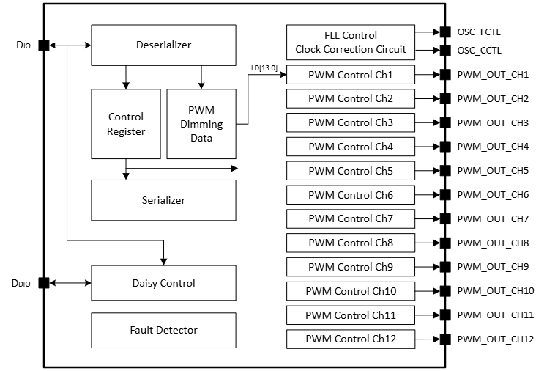
Block Diagram

Slide 3
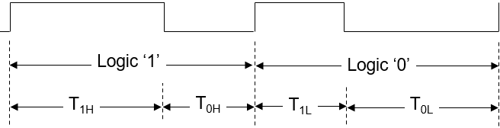
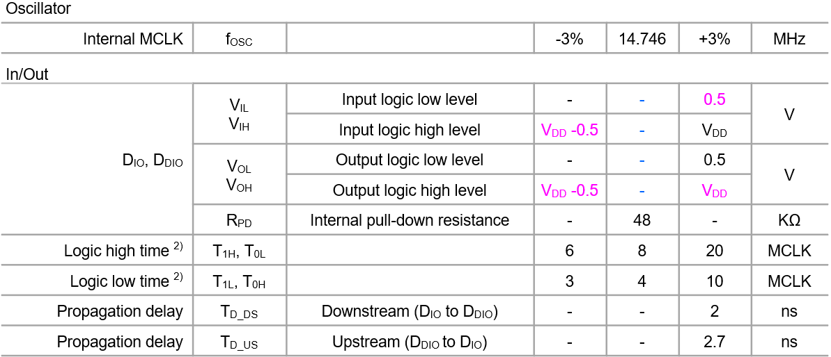
Serial Interface

Slide 4
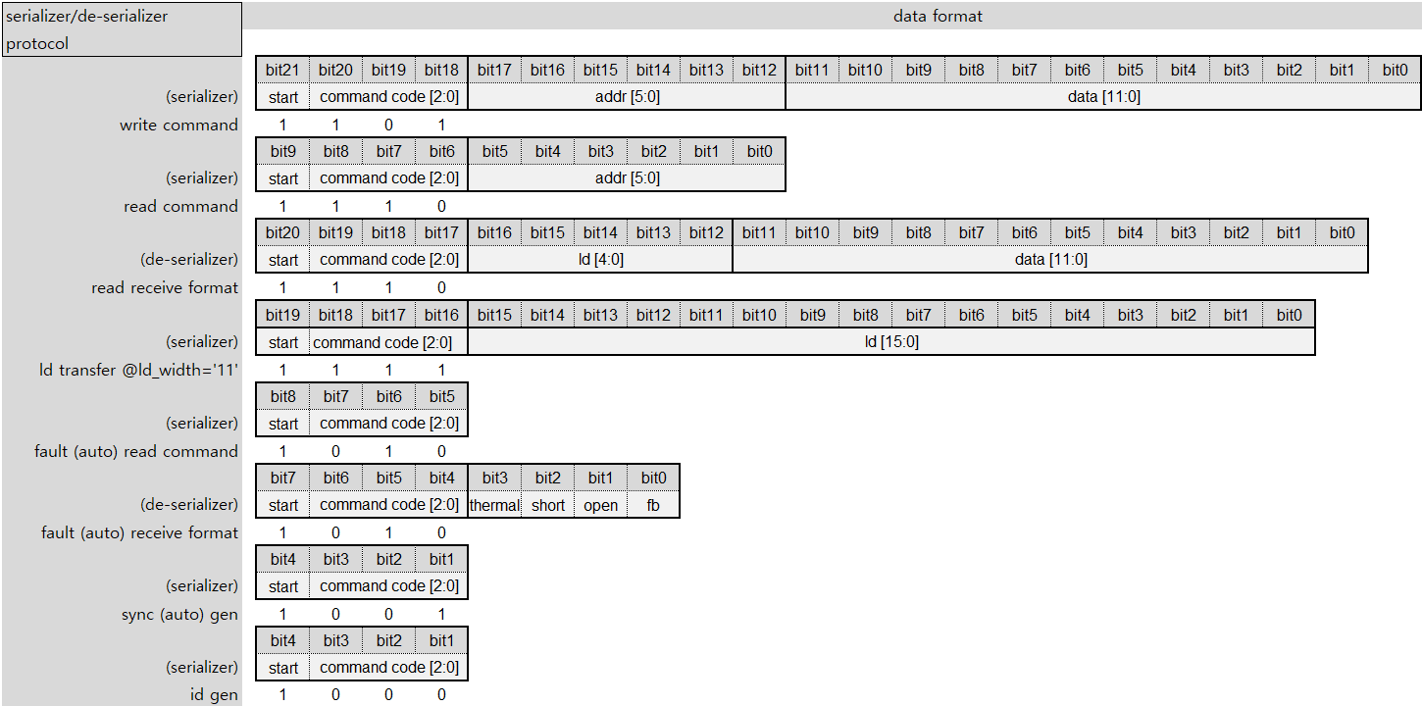
Serializer/De-serializer Protocol
Support ld transfer @id_width=’11’ only

Slide 5
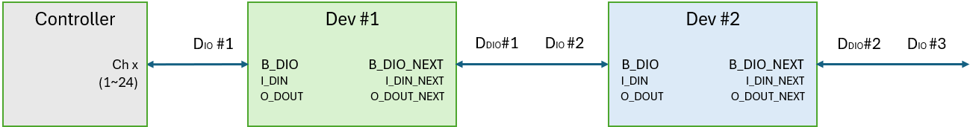
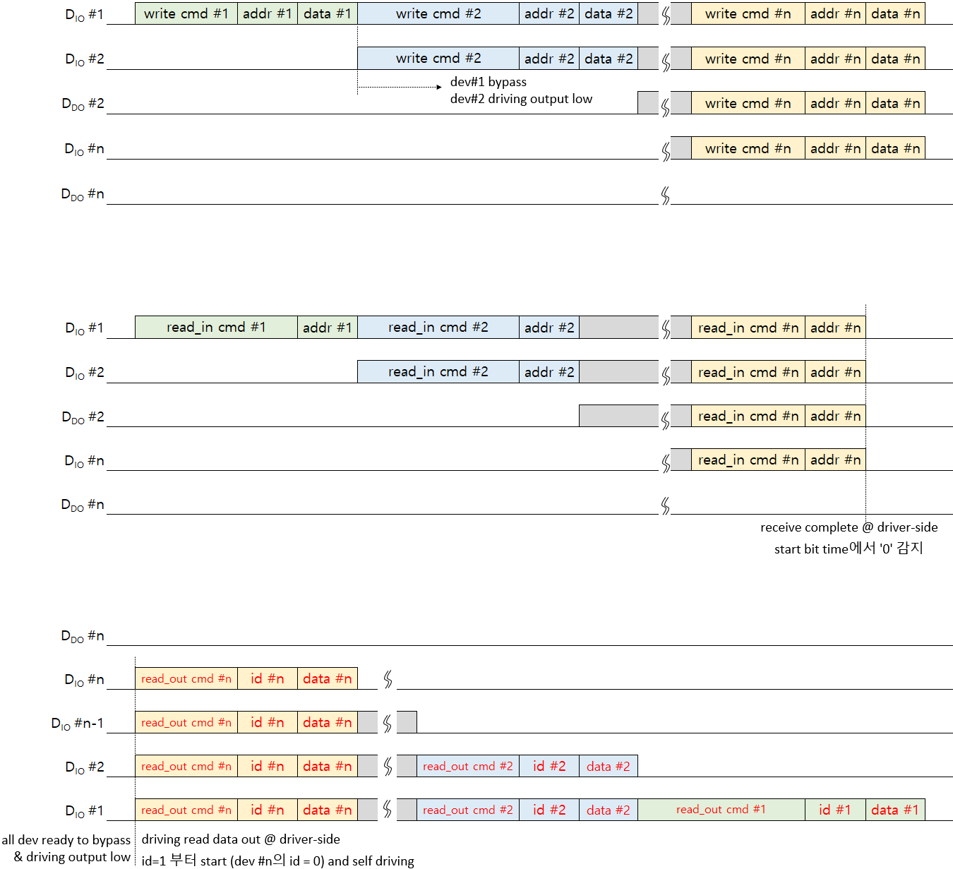
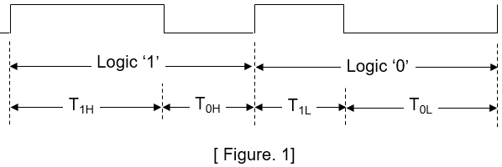
Serializer/De-serializer Protocol

Slide 6
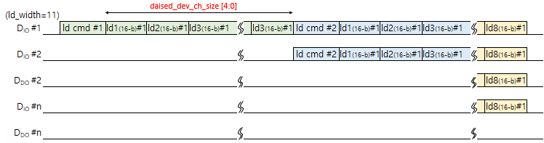
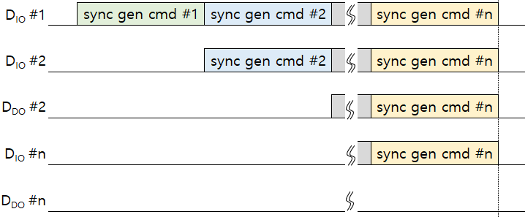
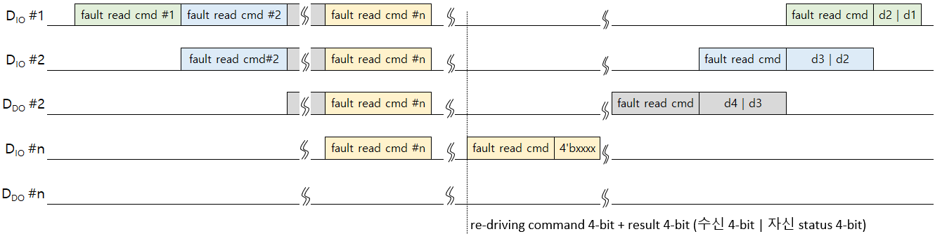
Serializer/De-serializer Protocol

Slide 7
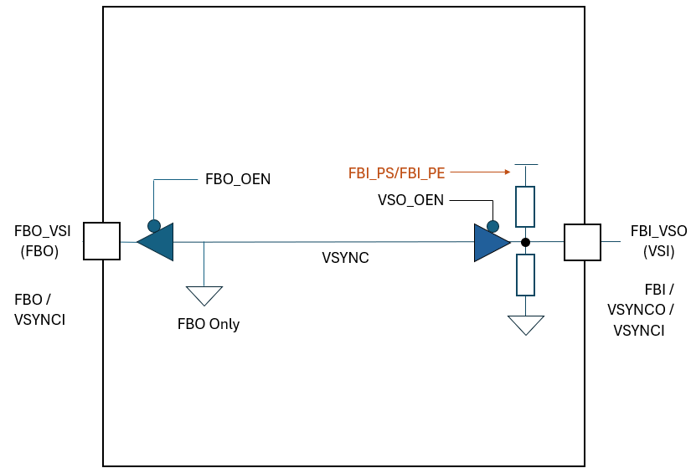
External VSYNC and Daisy Feedback
PAD mode setting (IO_MODE[1:0])
2’b00 : NOP
2’b01 : VSYNC mode
VSYNCI (FBO_VSI) / VSYNCO (FBI_VSO)
2’b10 : FB mode
FBO (FBO_VSI) / FBI (FBI_VSO)
2’b11 : FBO_VSYNCI mode
FBO (FBO_VSI) / VSYNCI(FBI_VSO)

Slide 8
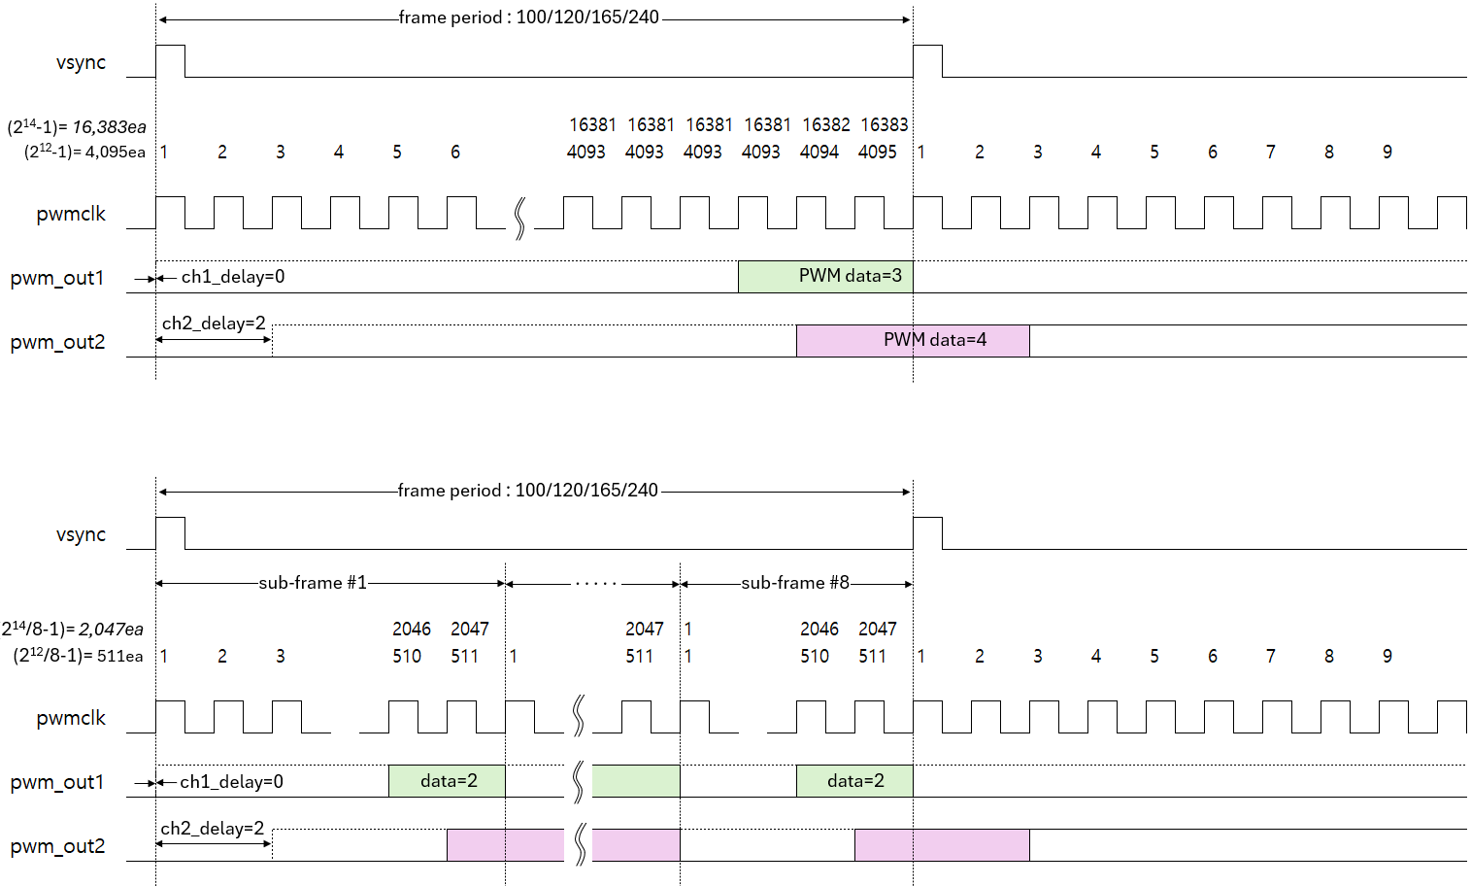
Local Dimming
Tail-lightening

Slide 9
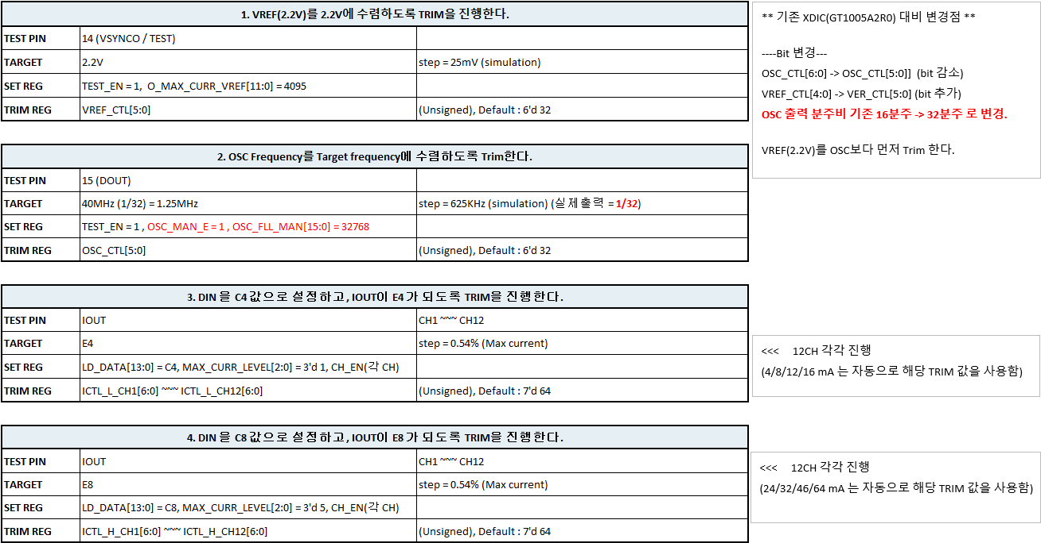
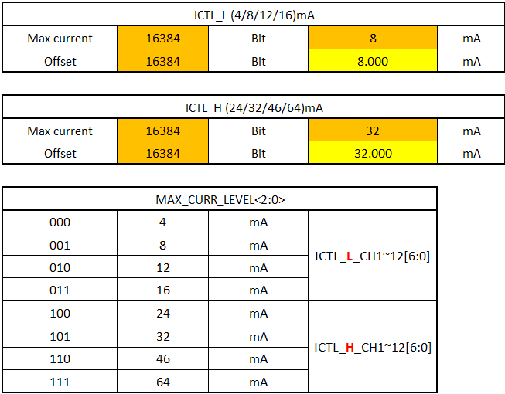
OTP Trimming Sequence

Slide 10
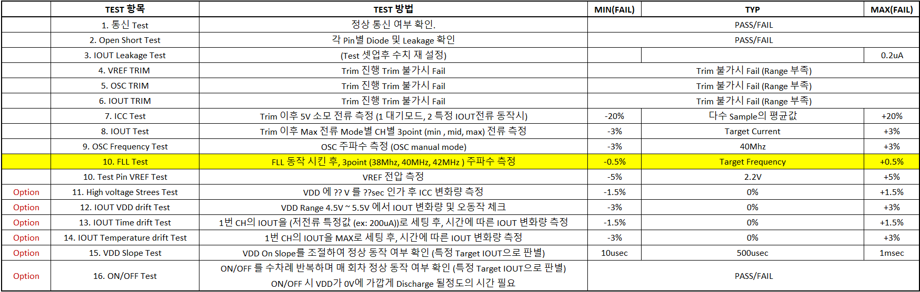
OTP Trimming Sequence

Slide 11
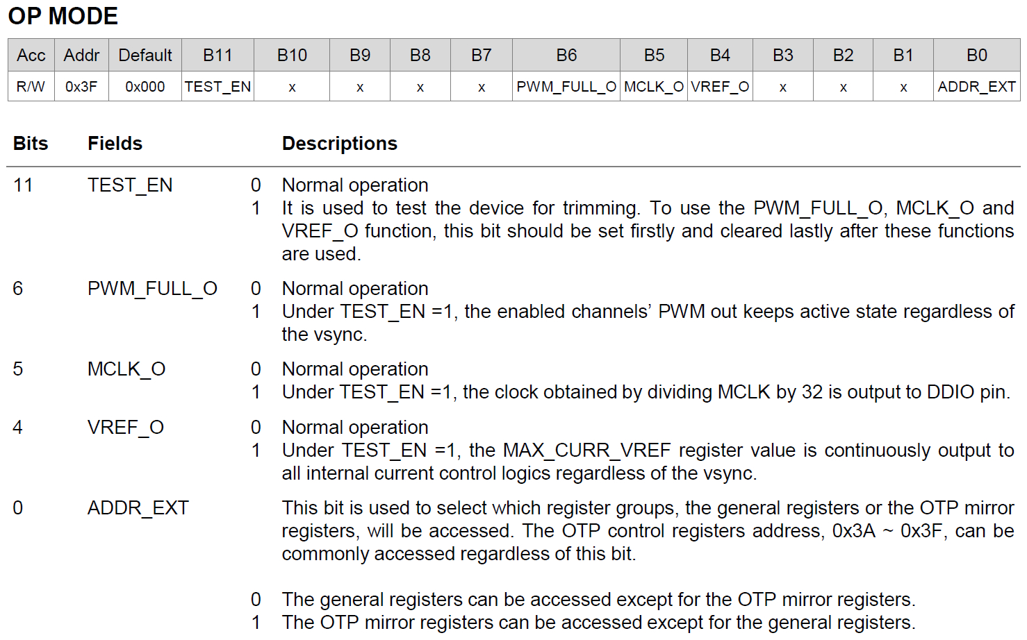
OTP Trimming Sequence
If (TEST_EN == 1 && PWM_FULL_O ==1 && CHx_EN == 1), O_PWM_CHx == 1
If (TEST_EN == 1 && VREF_O == 1), O_MAX_CURR_VREF == MAX_CURR_VREF
When TEST_EN == 1, No OTP Read operation.
When trimming, keep the CONTROL, FPWM_DIV, and MCLK_LOCK1/2 register at default value without any changes.

Slide 12
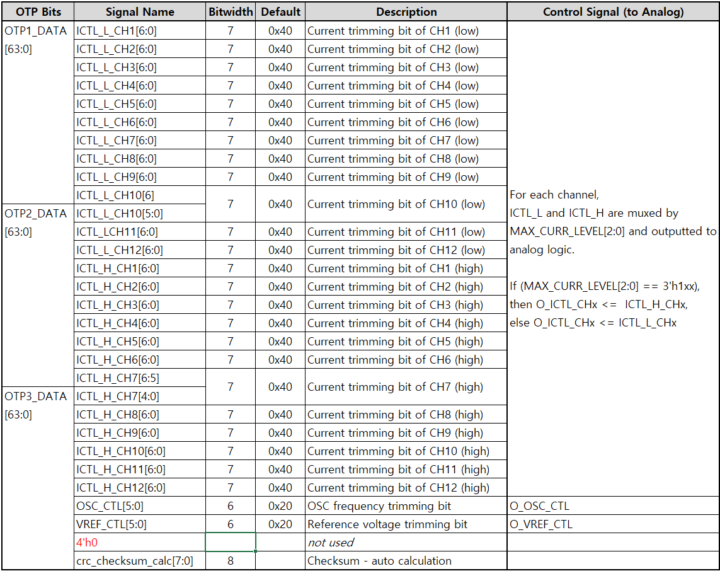
OTP Trimming Signal

Slide 13
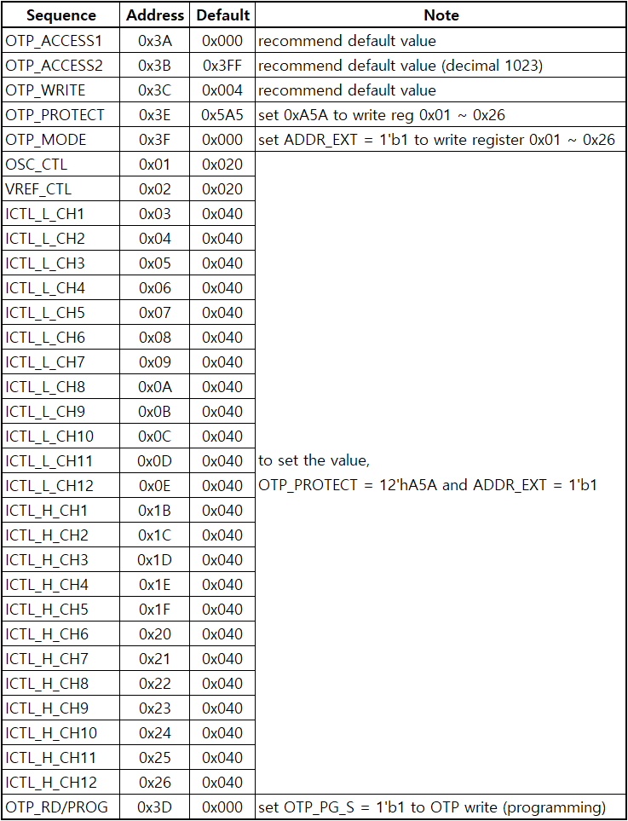
OTP Write Sequence
Before setting the OTP_PG_S field of 0x3D address to ‘1’,
set the appropriate value in the register from 0x01 to 0x26 address.
If the OTP_PG_S field is set to ‘1’, data from 0x01 to 0x26 address is written to the OTP.
To set the register from 0x01 to 0x26 address,
the OTP_PROTECT register of 0x3E address should be set to “0xA5A” and the ADDR_EXT field of the 0x3F address should be set ‘1’.
It is recommended that the OTP_ACCESS1, OTP_ACCESS2, and OTP_WRITE registers use default values.
0x3A : OTP_PG_ACCESS_CYCLE[15:12] = 0
0x3B : OTP_PG_ACCESS_CYCLE[11:0] = 0x3FF (decimal 1023)
0x3C : OTP_WSEL[3:0] = 0x4
…
…
0x3D : OTP_PG_S = 1 (OTP write)

Slide 14
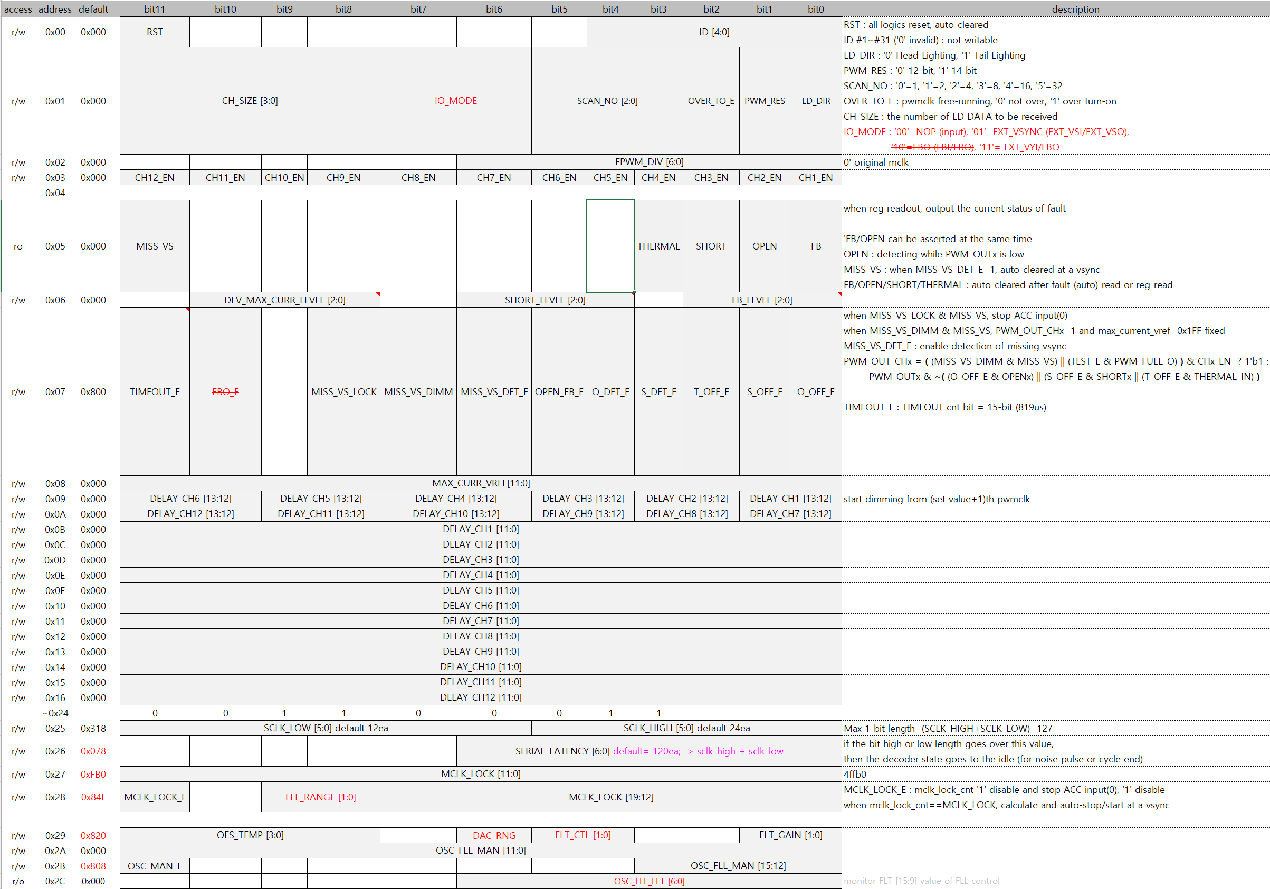
Register

Slide 15
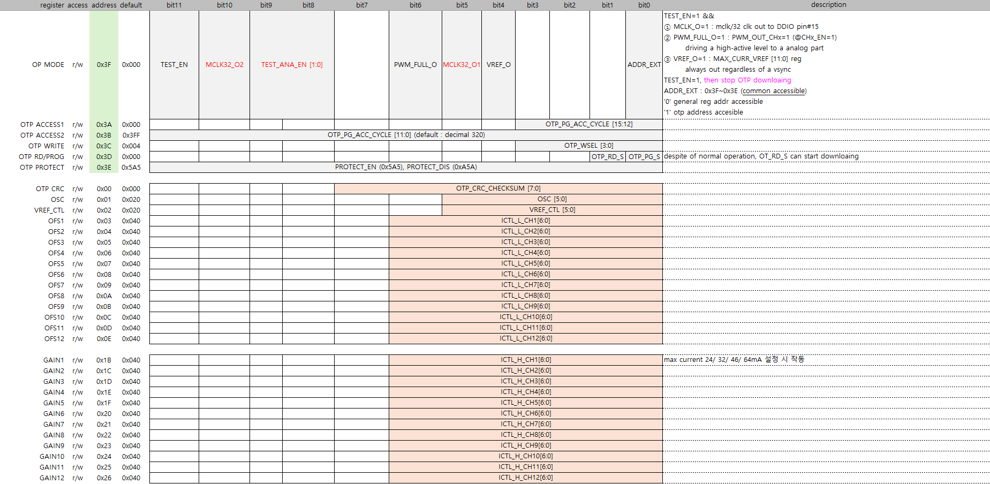
Register

