Slide 1
XDIC12R Trimming Sequence (GT1009A0R0)
2026. 1

Slide 2
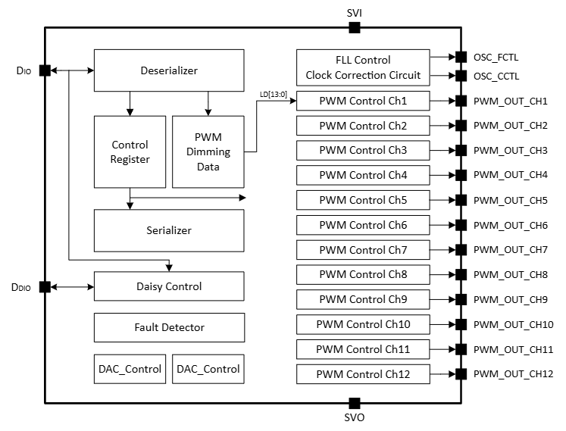
Block Diagram

Slide 3
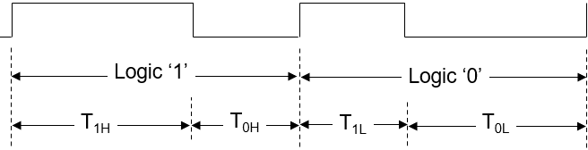
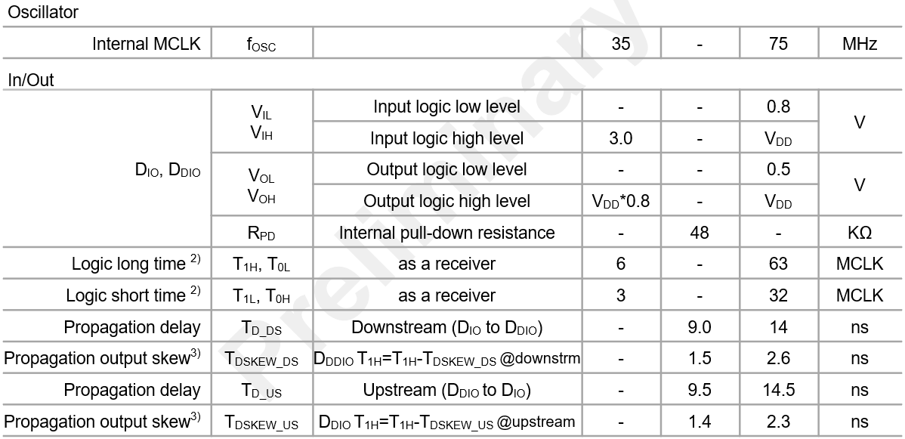
Serial Interface

Slide 4
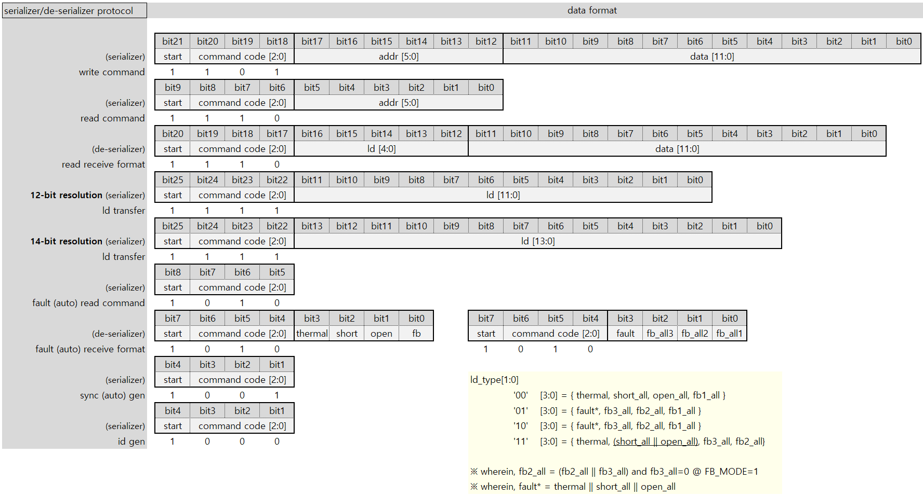
Serializer/De-serializer Protocol

Slide 5
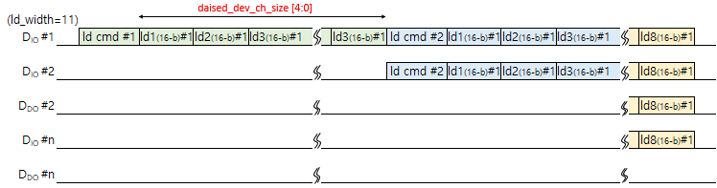
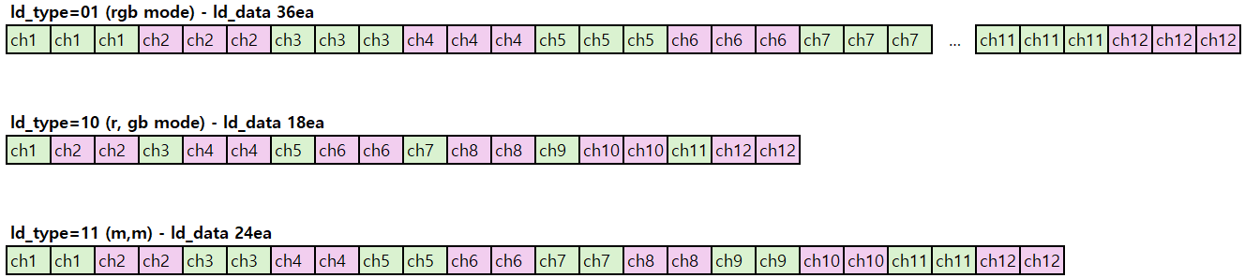
LD_DATA Transfer

Slide 6
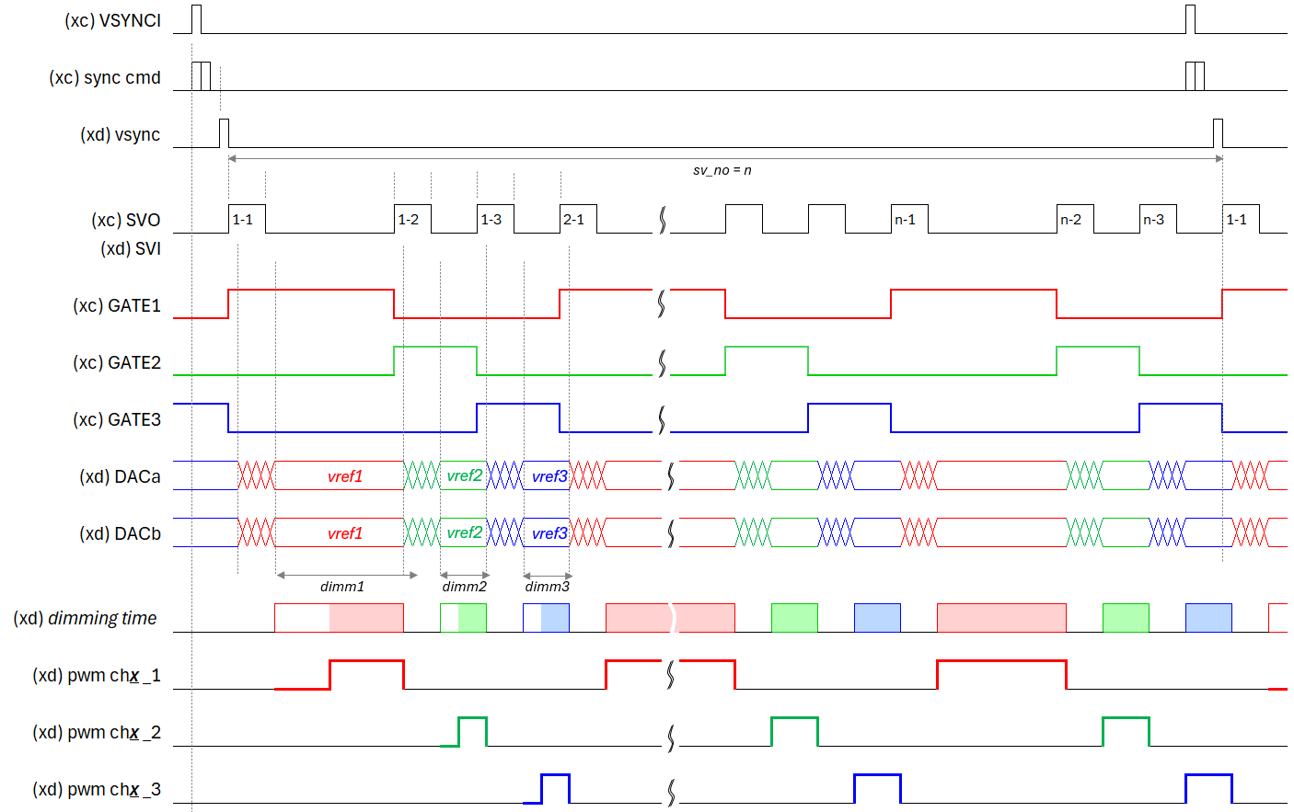
Dimming - Type1(LED1+LED2+LED3), Normal mode, Tail (VSYNC cmd + SVSYNC)

Slide 7
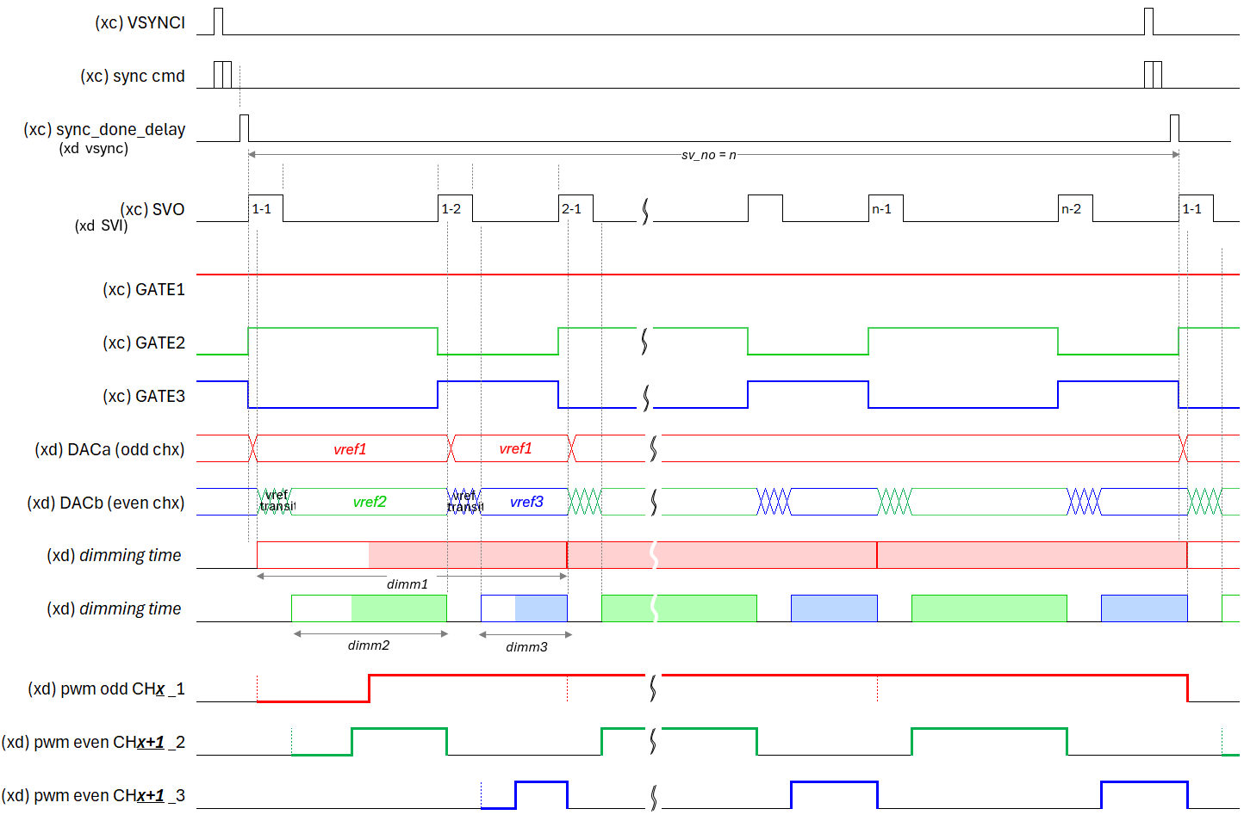
Dimming - Type2(LED1,LED2+LED3), Normal mode, Tail (VSYNC cmd + SVSYNC)

Slide 8
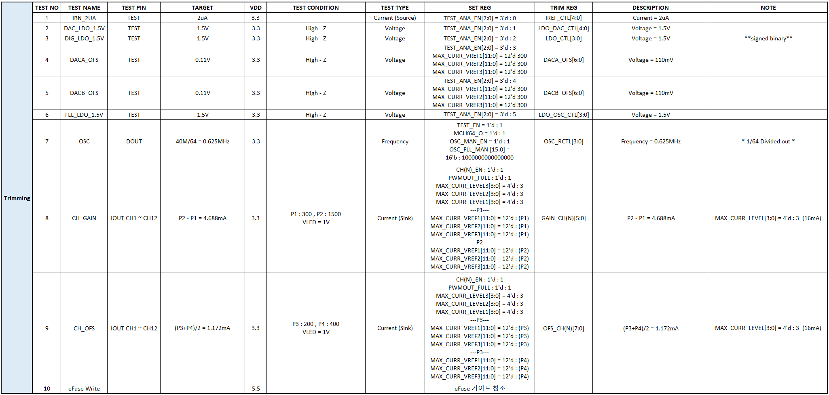
Trimming Sequence
**signed binary**
**signed binary**

Slide 9
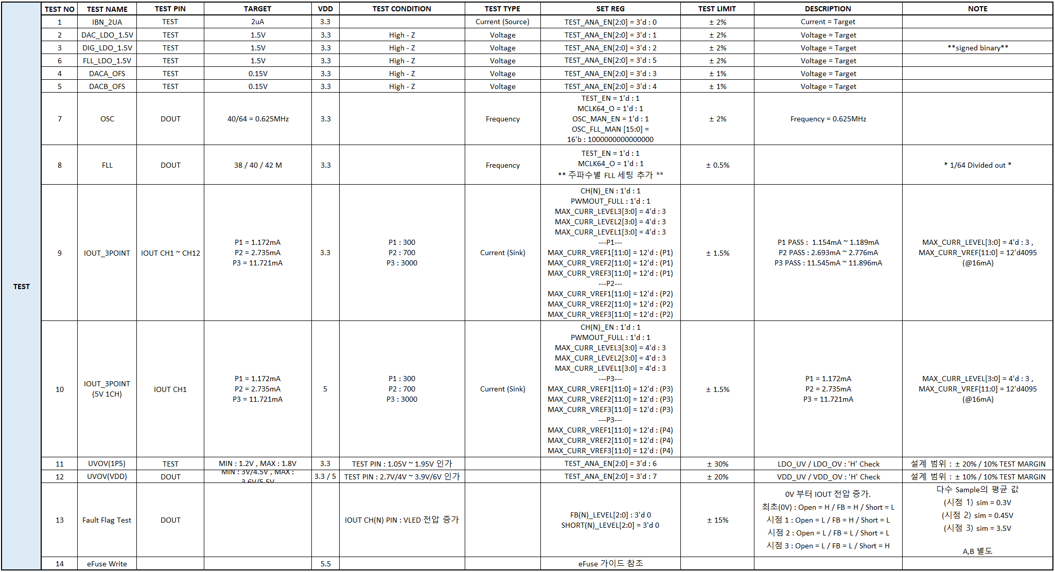
Trimming Sequence
**signed binary**
**signed binary**

Slide 10
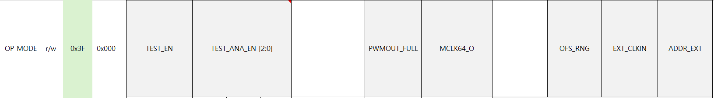
Trimming Sequence
When TEST_EN = 1,
trim DACA_OFS using MAX_CURR_VREF1 (0x0B) and TEST_ANA_EN[2:0] = 3’d3.
trim DACB_OFS using MAX_CURR_VREF1 (0x0B) and TEST_ANA_EN[2:0] = 3’d4.
when set MCLK64_O = 1, mclk/64 clock out to DDIO.
when set PWMOUT_FULL = 1, PWM_OUT_CHx = 1 (@CHx_EN=1) driving a high-active level to analog
when using test equipment, set the EXT_CLKIN = 1 and use an external clock.

Slide 11
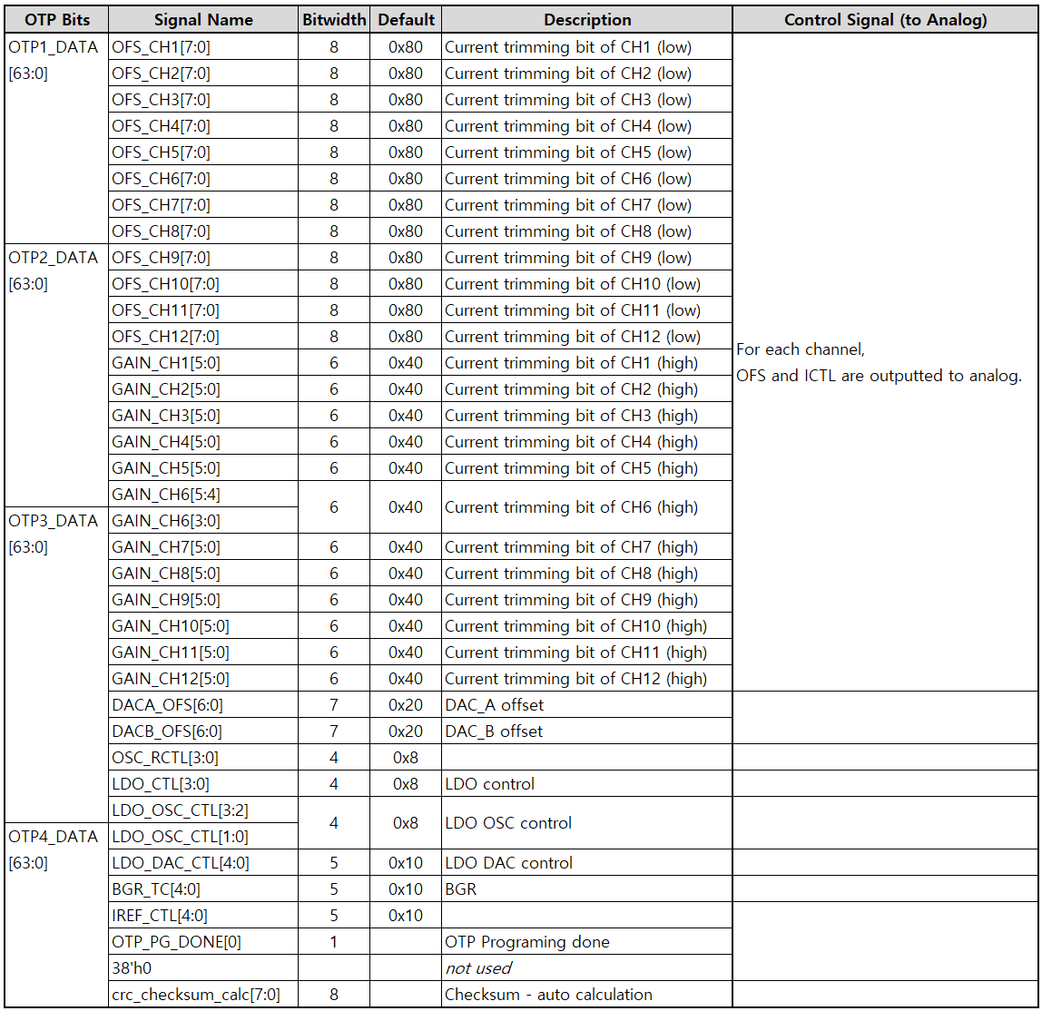
OTP Trimming Signal

Slide 12
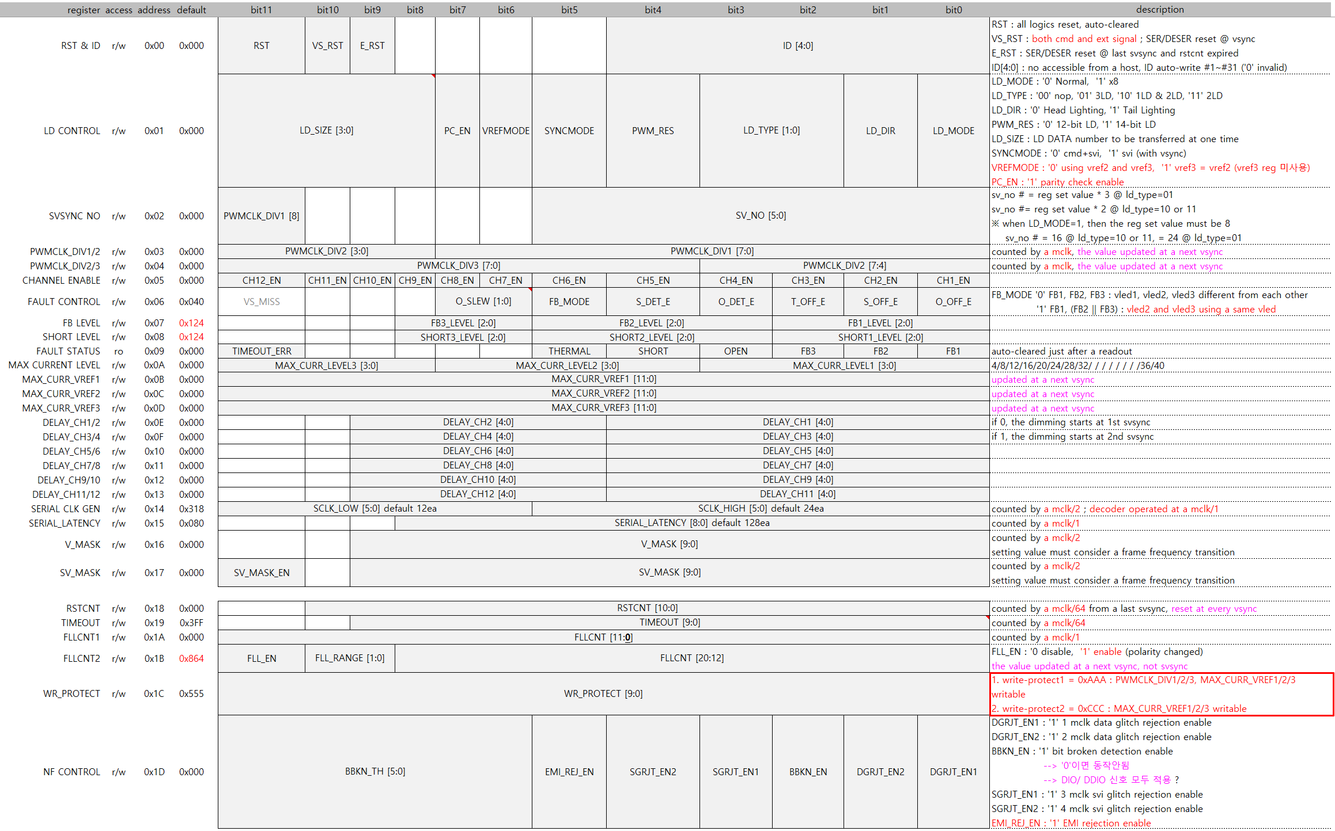
Register

Slide 13
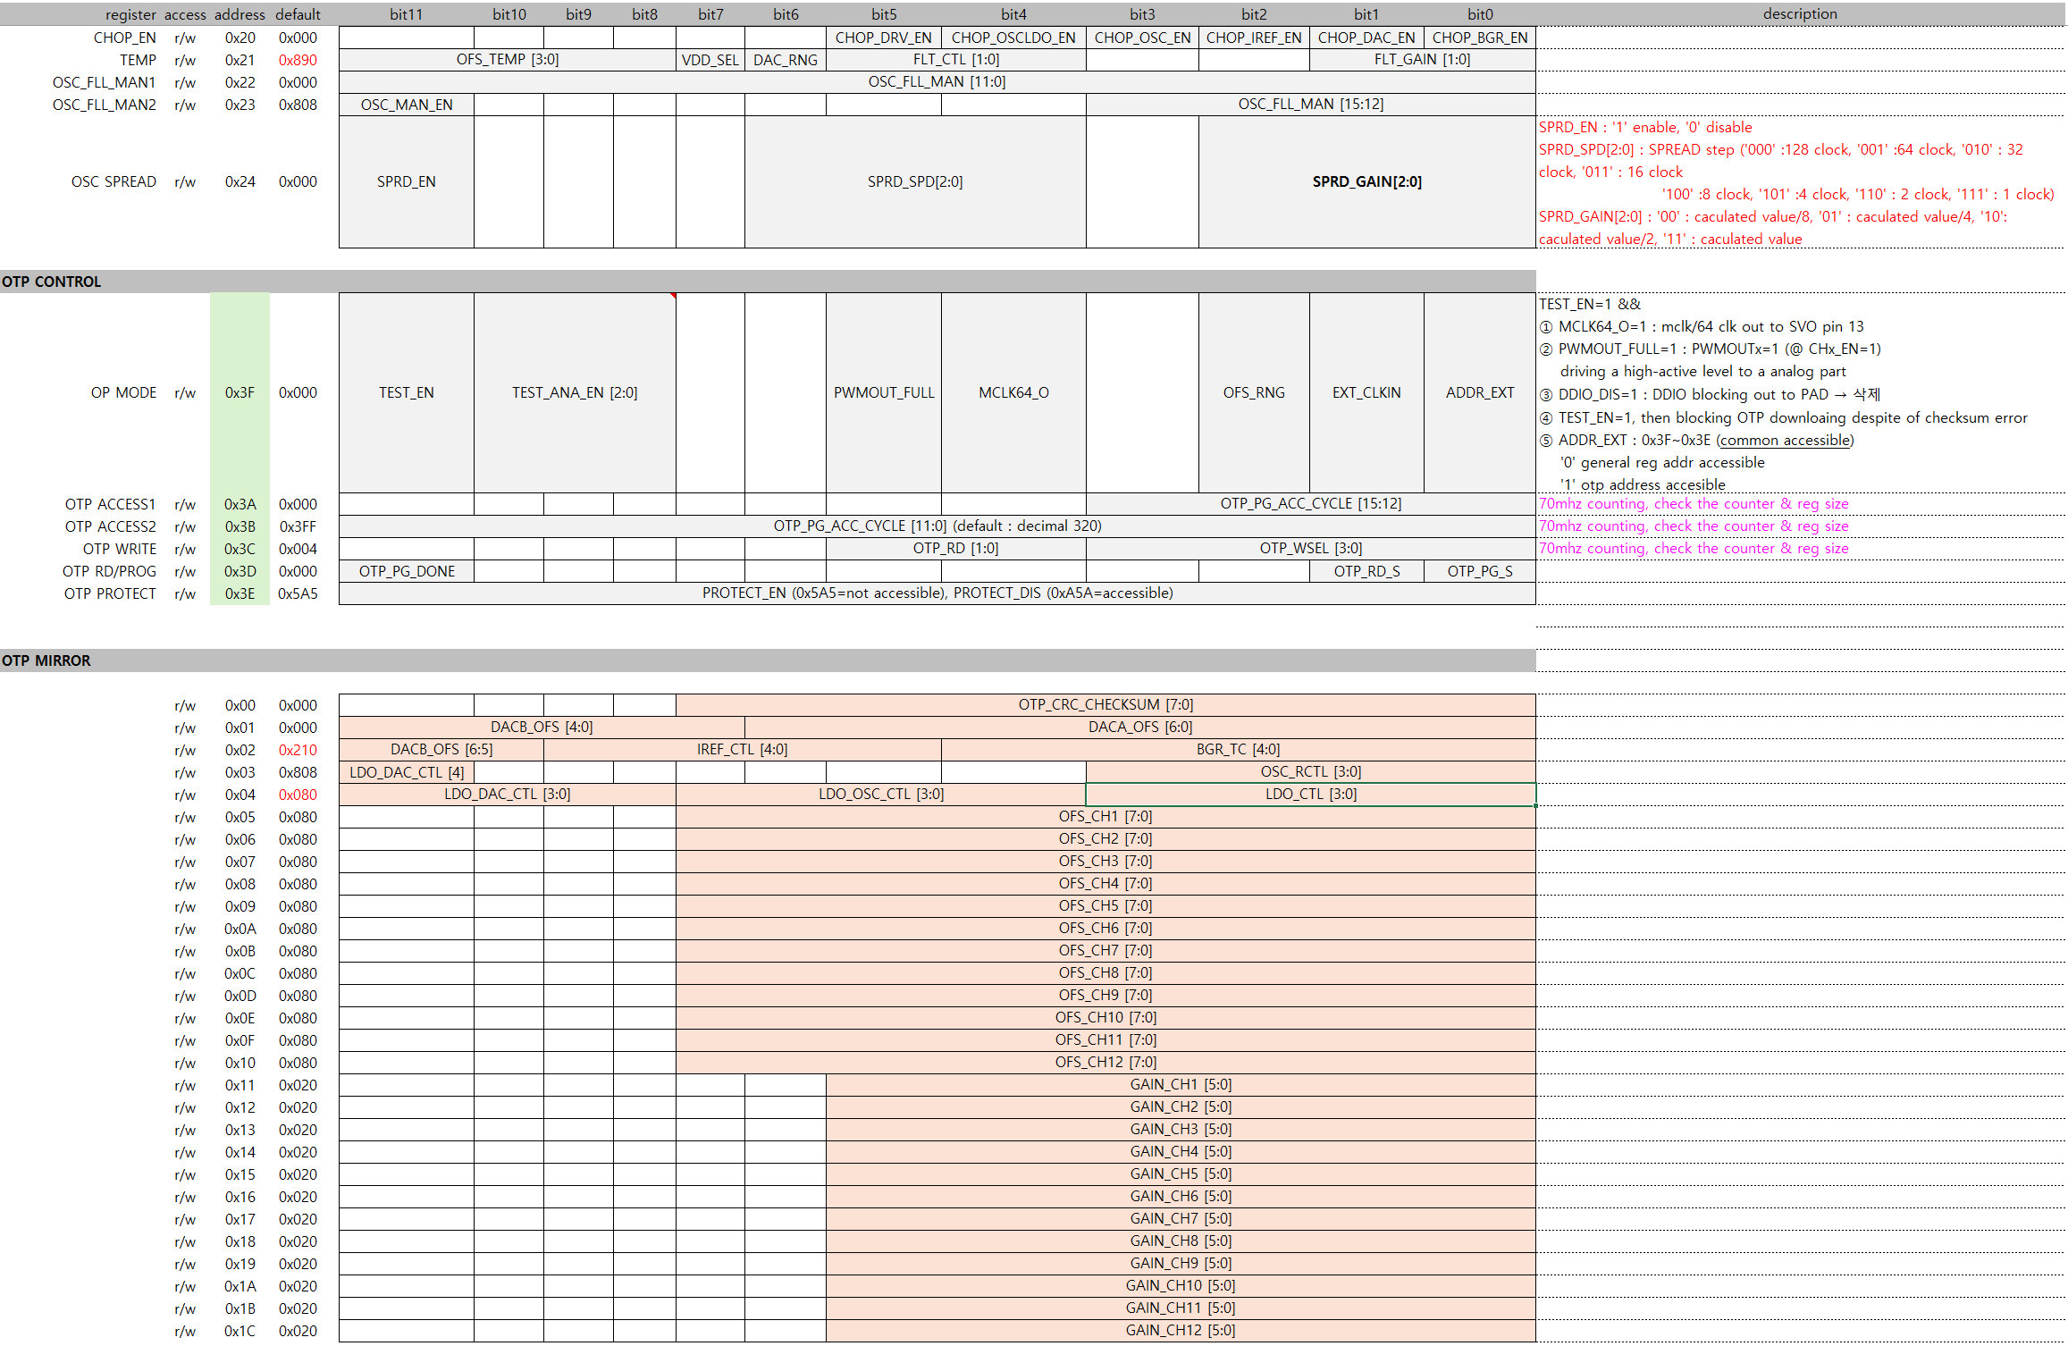
0x890 -> 0x810 VDD Typical 3.3V 변경으로 인해 VDD_SEL 1’b1 -> 1’b0로 변경
Register
DACA_OFS / DACB_OFS Signed bit
MSB [6] 부호 0 : ‘+’ 1 : ‘-’

