Slide 1
■ This document is a ‘FT test plan’ for ‘GT1009A1R0’.
Unauthorized reproduction or redistribution is prohibited without Global Technology’s written permission.
■ Issue • Revision History
Issue Date | 2026. 05. 20. | Dept. | Development | Name | MK CHO
■ Revision History
Rev. No. | Date | Summary | Name
0.0 | ’26. 05. 20. | Preliminary | MK CHO

Slide 2
Contents
1. General Description
Bonding Diagram
PKG Outline
Pin Description
Test Circuit (FT Board Schematic)
Test Flow
Serial Communication Protocol
Individual Test Plan
Confidential

Slide 3
General Description
The XD12R is a 12-channel constant current sink RGB(CM) LED driver for display backlight systems.
While conventional RGB backlight systems require separate three channels for red, green, and blue LED pixels, the XD12R achieves multiplexed driving for full-color RGB backlight pixels with one or two channels.
This approach allows single-layer BLU implementation, significantly reducing PCB layers.
Each channel supports up to 40mA of output current and a maximum output voltage of 40V and can time-share up to three LEDs per channel.
This device can support max 14-bit PWM dimming resolution and a 12-bit DAC global brightness resolution and max. 5-colors.
To ensure stable, flicker-free RGB time-sequential operation, the device features optimized subframe timing control and precise current regulation to effectively suppress flickering caused by rapid color transitions.
Integrated self-protection features include LED open/short detection and overheating shutdown. A feedback control function is also included to optimize the VLED voltage during LED operation, improving power efficiency.
The XD12R can be controlled with several commands through a XC24R controller or directly by a MCU. Multiple XD12R devices can be daisy-chained and controlled via a serial interface from a single XC24R, enabling scalable, high-channel-count RGB LED backlight systems for large-area displays.
Confidential

Slide 4
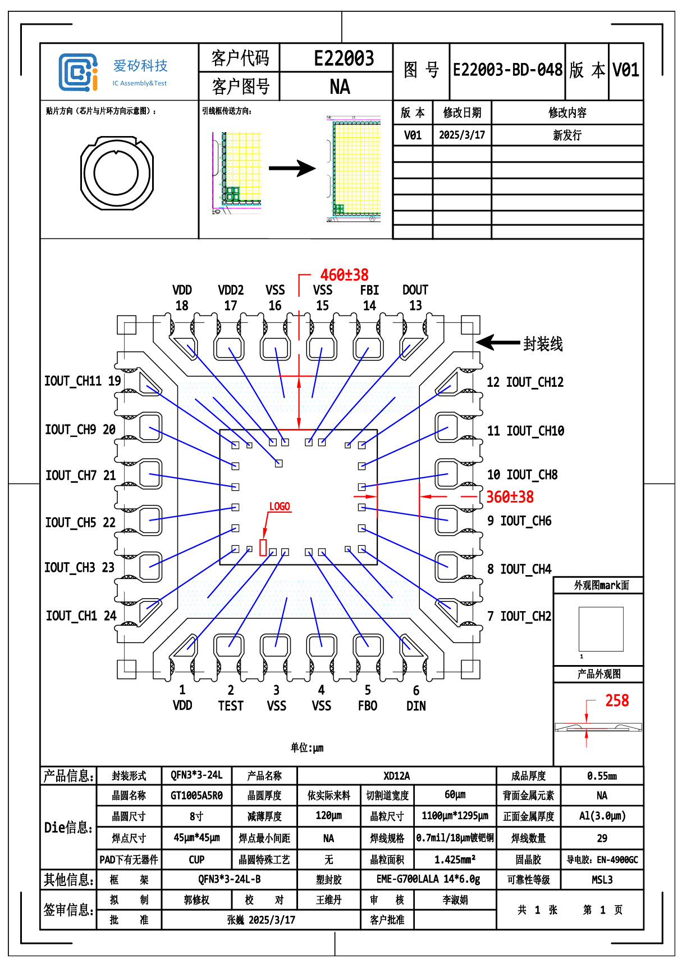
2. Bonding Diagram
TBD
Confidential

Slide 5
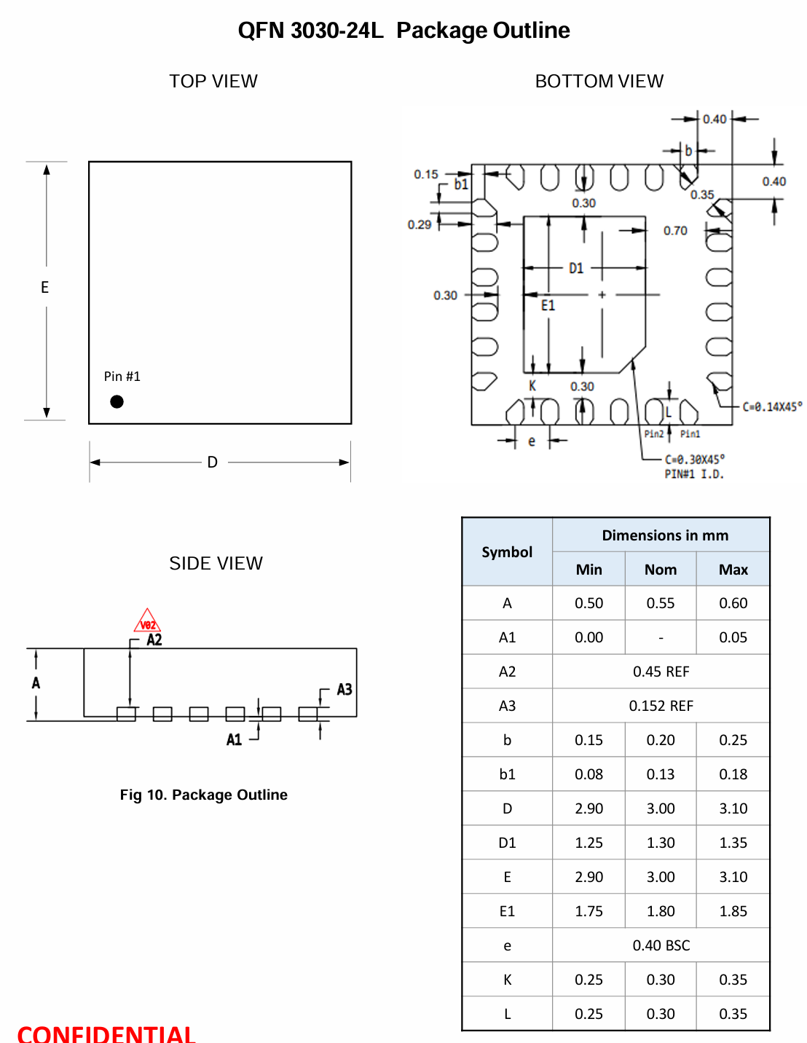
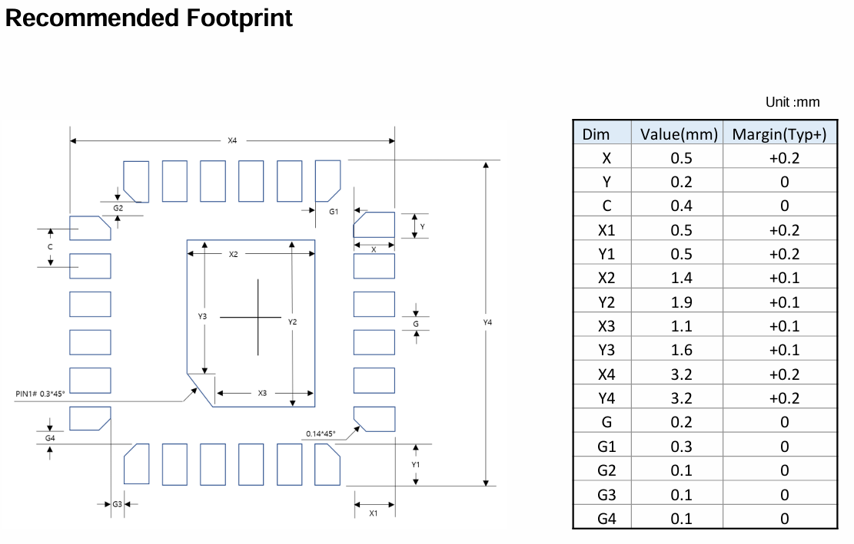
3. Package Outline
TBD
Confidential

Slide 6
4. Pin Description
Pin Name | Pin No. | I/O | Type | Description | Remark
V_{DD} | 1 | - | Power | Supply voltage
TEST | 2 | - | BIDIR | Ground
V_{SS} | 3 | - | GND | Ground
V_{SS} | 4 | - | GND | Ground
D_{IO} | 5 | I/O | BIDIR | Data In/Out | Internal PD, 48KΩ
SVI | 6 | I | DIGITAL INPUT | External sync. Input | External svsync (+vsync) daisy chain connected
O12 | 7 | O | Current Load | Current Sink 12 | If unused, connect to GND
O11 | 8 | O | Current Load | Current Sink 11 | If unused, connect to GND
O10 | 9 | O | Current Load | Current Sink 10 | If unused, connect to GND
O9 | 10 | O | Current Load | Current Sink 9 | If unused, connect to GND
O8 | 11 | O | Current Load | Current Sink 8 | If unused, connect to GND
O7 | 12 | O | Current Load | Current Sink 7 | If unused, connect to GND
SVO | 13 | I/O | BIDIR | External sync. Output | External svsync (+vsync) daisy chain connected
D_{DIO} | 14 | I/O | Digital | Daisied Data In/Out | Internal PD, 48KΩ
Confidential

Slide 7
5. Test Circuit (Load Board Schematic)
Please refer to separate materials.
Confidential

Slide 8
6. Probe Test Flow (Ta=90ºC)
No. | Test Items | Symbol | Measure Pin | Min | Typ | Max | Unit | Remark
1 | OS_VSS | PWR_OS | VSS | -0.2 | 0 | 0.2 | V | -
2 | OSN/OSP | OSN/OSP | ALLPINS | -0.9 / 0.3 | -0.6 / 0.6 | -0.3 / 0.9 | V | -
3 | OS_VDD | PWR_OS | VDD | -0.8 | -0.5 | -0.2 | V | -
4 | Input Leak Current (Low) | IIL | TEST, DIN, SVI, SVO | -1 | 0 | 1 | uA | -
 |  |  | DOUT | -1.2 | 0 | 1 | uA | -
 | Input Leak Current (High) | IIH | TEST, SVO | -1 | 0 | 1 | uA | -
 |  |  | DIN, DOUT, SVI | 55 | 65 | 90 | uA | -
 | Output Hi-Z Leak Current (Low/High) | IOZL/IOZH | IOUT_CH1~12 | -0.2 | 0 | 0.2 | uA | -
5 | OTP Init Check | OTP Init | ALLPINS | - |  | - | - | -
6 | SCAN TEST | SCAN
AC value check 필요
Confidential

Slide 9
6. Package Test Flow (Ta=25ºC)
No. | Test Items | Symbol | Measure Pin | Min | Typ | Max | Unit | Remark
1 | OS_VSS | PWR_OS | VSS | -0.2 | 0 | 0.2 | V | -
2 | OSN/OSP | OSN/OSP | ALLPINS | -0.9 / 0.3 | -0.6 / 0.6 | -0.3 / 0.9 | V | -
3 | OS_VDD | PWR_OS | VDD | -0.8 | -0.5 | -0.2 | V | -
4 | Input Leak Current (Low) | IIL | TEST, DIN, SVI, SVO | -1 | 0 | 1 | uA | -
 |  |  | DOUT | -1.2 | 0 | 1 | uA | -
 | Input Leak Current (High) | IIH | TEST, SVO | -1 | 0 | 1 | uA | -
 |  |  | DIN, DOUT, SVI | 55 | 65 | 90 | uA | -
 | Output Hi-Z Leak Current (Low/High) | IOZL/IOZH | IOUT_CH1~12 | -0.2 | 0 | 0.2 | uA | -
5 | OTP Init Check | OTP Init | ALLPINS | - |  | - | - | -
6 | VREF Trim | VREF_Trim | TEST | 2.183 | 2.2 | 2.295 | V | 0.77%/4.32%
7 | OSC Trim | OSC_Trim | DOUT | 1.205 | 1.23 | 1.255 | MHz | 2%
8 | IOUT_OFS Trim | IOUT_OFS Trim | IOUT_CH1~12 | 3.806 | 3.907 | 4.009 | mA | 2.6%
9 | ICTL_GA_Trim | ICTL_GA_Trim | IOUT_CH1~12 | 0.974 | 1 | 1.026 | mA | 2.6%
10 | OTP_Write | OTP_WRITE | - | - | - | - | - | -
11 | VREF Verify | VREF_VFY | TEST | 2.156 | 2.2 | 2.244 | V | 2%
12 | OSC Verify | OSC_VFY | DOUT | 1.205 | 1.23 | 1.255 | MHz | 2%
13 | IOUT_L_Verify | IOUT_L_VFY1/ IOUT_L_VFY2/ IOUT_L_VFY3/ | IOUT_CH[1:12] | 0.373/ 1.010/ 3.931 | 0.383/ 1.037/ 4.036 | 0.393/ 1.064/ 4.141 | mA | 4mA
14 | IOUT_H_Verify | IOUT_H_VFY1/ IOUT_H_VFY2/ IOUT_H_VFY3/ | IOUT_CH[1:12] | 2.142/ 5.747/ 22.188 | 2.199/ 5.900/ 22.780 | 2.256/ 6.053/ 23.372 | mA | 24mA
15 | LDO (no trim) | LDO | TEST | 1.425 | 1.5 | 1.575 | V | 5%/6%
16 | FLL (Freq Locked Loop) | FLL | DOUT | 1.15 | 1.24 | 1.29 | MHz | Devided by 32
17 | Fault Flag (Open) | FAULT_OPEN | DOUT | 0.2 | 0.4 | 0.45 | V
18 | Fault Flag (FB) | FAULT_FB | DOUT | 0.8 | 1.2 | 1.6 | V
19 | Fault Flag (Short) | FAULT_SHORT | DOUT | 3 | 4 | - | V
20 | PWM_DUTY | PWM_DUTY | IOUT_CH1~12 | 1.8 3.8 5.8 7.8 | 2.0 4.0 6.0 8.0 | 2.2 4.2 6.2 8.25 | mA | 25%/ 50%/ 75%/ 100%
 | PWM_DIFF | PWM_DIFF | IOUT_CH1~12 | -0.5% | 0.0 | 0.5% | % | -
21 | Static IDD | SIDD | VDD | 2 | 3 | 4.8 | mA | -
22 | Dynamic IDD | DIDD | VDD | 2 | 3 | 5.1 | mA | -
23 | VDD On/Off Repeat (VREF Verify) | VDD_ON/OFF | TEST | 2.156 | 2.2 | 2.244 | V | After On/Off 3 times
AC value check 필요
Confidential

Slide 10
7. Individual Test Plan
No | Item | Symbol | Test PIN | MIN | TYP | MAX | Unit | REMARK
1 | Power Open/Short | OS_VSS | VSS1~4 | -0.2 | 0.0 | 0.25 | V
2 | Open/Short (NMOS) | OSN | ALLPINS | -0.9 | -0.6 | -0.3 | V
3 | Open/Short (PMOS) | OSP | TEST, SVI, SVO DIN, DOUT | 0.3 | 0.6 | 0.9 | V
4 | Power Open/Short | OS_VDD | VDD1~3 | -0.8 | -0.5 | -0.2 | V
[Test Method]
VDD and all signal pins : 0V Force
Measure signal pins and VDD pins after sourcing or sinking current (with PMU)
OS_VSS : source current 100uA OSN : sink current -100uA
OSP : source current 100uA
OS_VDD : sink current -100uA
ALLPINS : TEST, DIN, SVI, SVO, DOUT, IOUT_CH[1:12]
VDD
Confidential

Slide 11
Leakage Test
NO | Item | Symbol | Test Pin | MIN | TYP | MAX | Unit | REMARK
5 | Input Leak Current (Low) 1 | IIL1 | TEST, DIN, DOUT SVI, SVO | -500 | 0 | 500 | nA
6 | Input Leak Current (High) 1 | IIH1 | TEST, SVO | -500 | 0 | 500 | nA
7 |  |  | DIN, DOUT, SVI | 55 | 65 | 90 | uA
8 | Output Hi-Z Leak Current (Low) 1 | IOZL1 | IOUT_CH1~12 | -10 | 0 | 10 | nA
9 | Output Hi-Z Leak Current (High) 1 | IOZH1 | IOUT_CH1~12 | -5 | 0 | 10 | nA
[Test Method]
IIL
- Force VDD 5.5V
- Force 5.5V for TEST, DIN, DOUT, SVI, and SVO
- Force 0V to ‘Pin under Test’ and measure current
IIH
- Force VDD 5.5V;
- Force 0V for TEST, DIN, DOUT, SVI, and SVO
- Force 5.5V to ‘Pin under Test’ and measure current
3. IOZL
- Force VDD : 5.5V & IOUT_CH1~12 : 0V
- Measure current by parallel
4. IOZH
- Force VDD : 5.5V & IOUT_CH1~12 : 5.5V
- Measure current by parallel
Confidential

Slide 12
NO | Characteristics | Symbol | Test PIN | MIN | TYP | MAX | Unit | REMARK
6 | LDO_Voltage | VLDO | TEST | 1.45 | 1.5 | 1.7 | V | 3.3% / 13.3%
 | LDO Code0 ~ 9 | VC00~VC09 | TEST | 1.2 | - | 1.6 | V | Apply limit only to Code0
 | LDO_DIFF | LDO_DIFF | TEST | 0.006 | - | - | V | -
[Test Method]
VDD=5V, DIN(vih=5v, vil=0)
Set only Red Shaded Register (Apply ‘DIN’ pin via test pattern) → Measure LDO Voltage (from TEST pin)
Set Blue & Red Shaded Register → 0.5ms → Measure LDO Voltage (code 0 to 9)
Calculate the difference voltage.
Setting : VREF & LDO and Measure LDO
cmd | addr | data | command | remark
 |  |  |  | TEST 1 | TEST2 | TEST3
4b'1101 | 0x00 | 0x800 | RESET |  | LDO_0 start
4b'1000 | - | - | ID GEN
4b’1101 | 0x03 | 0xFFF | CHANNEL ENABLE
4b’1101 | 0x06 | 0x170 | FAULT LEVEL
4b’1101 | 0x08 | 0xFFF | MAX CURR VREF
4b’1101 | 0x25 | 0x35A | SERIAL CLOCK GEN
4b’1101 | 0x26 | 0x03C | SERIAL LATENCY
4b’1101 | 0x3F | 0xF10 | OP MODE
4b’1101 | 0x3E | 0xA5A | OTP PROTECT
4b’1101 | 0x3F | 0xF11 | OP MODE | addr_ext
4b’1101 | 0X02 | 0x00 ~ 0x09 | Sweep LDO code0 ~ 9
4b’1101 | 0x00 | 0x800 | RESET | LDO_V start
4b'1000 |  |  | ID GEN
4b’1101 | 0x03 | 0xFFF | CHANNEL ENABLE | Ch enable
4b’1101 | 0x06 | 0x170 | FAULT LEVEL | 8mA
4b’1101 | 0x08 | 0xFFF | MAX CURR VREF
4b’1101 | 0x25 | 0x35A | SERIAL CLOCK GEN
4b’1101 | 0x26 | 0x03C | SERIAL LATENCY
4b’1101 | 0x3F | 0xD00 | OP MODE | LDO[01]
4b’1101 | 0x3E | 0xA5A | OTP PROTECT
4b’1101 | 0x3F | 0xD01 | OP MODE | addr_ext
Measure ‘TEST’ pin : LDO Voltage measure test end |  |  |  | LDO_V end | skip
Delay 0.5ms & Measure ‘TEST’ pin : LDO voltage measurement test finished according to code |  |  |  |  | LDO 0 end
(Vcode2 - Vcode0) and (Vcode4 - Vcode2) and (V code6 - Vcode4) and (Vcode8 - Vcode6) Calculate the difference voltage in these four cases |  |  |  |  |  | LDO DIFF
Confidential

Slide 13
기본 function setup
SVI 입력 / external clock 입력
OSC 주파수 | 20 | ns
SV_NO | 16 | #
SV_width(high) | 0.005 | ms
1-frame time | 8.3333 | ms
active total (time-div.) | 8.1733 | ms
active total (no-time-div.) | 8.2533 | ms
1-time division active time (time-div.) | 0.255415625 | ms
1-time division active time (no-time-div.) | 0.51583125 | ms
FPWM_DIV2/3 resolution | 0.124714661 | us
FPWM_DIV1 resolution | 0.251870728 | us
FPWM_DIV2 개수 | 5
FPWM_DIV3 개수 | 5
FPWM_DIV1 개수 | 11

Slide 14
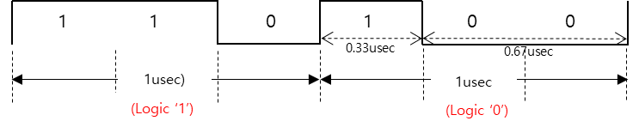
7. Serial Communication Protocol
* Serial Protocol Setup Sequence (= OTP Initial Check)
Power On (VDD 5V, DIN : VIH=5V, VIL=0V)
Wait 50 ~ 100ms
Set ‘ID GEN’ : 4b’1000
Set ‘read command’ (cmd, addr) : 4b’1110 + addr[5:0]
→ (automatically output) Readout response (cmd, id, data[11:0]) : 4b’1110 + 5b’00001 + data[11:0]
As shown in the above figure, 'DIN' input high (1), input low (0) waveforms must be applied.
Since it is difficult to process input '1' or '0' in one line of the test vector,
it should be processed in multiple lines within the test vector according to the ratio.
- input high (1) : 110
- input low (0) : 100
When one line of the test vector represents 1 cycle length, set one line to 3MHz.
Confidential

Slide 15

# To detect ICs that do not operate properly when ramp power is applied, a 2msec
sloped power-up time should be applied from 'OTP INIT CHECK' to the last item.
NO | Characteristics | Symbol
10 | OTP INIT Check | OTP_INIT
* Protocol Setup Sequence
1. Force VDD = 5V, DIN (VIH=5V, VIL=0V)
Wait 5 ~ 10ms
3. Set registers
- Set ‘RESET’
- Set ‘ID GEN’ (cmd_code)
- Set ‘read command’ (cmd_code, addr)
After E-fuse, OTP_Init_Check should be excluded.
cmd | addr | data | register
4b’1101 | 0x00 | 0x800 | RESET
4b'1000 | - | - | ID GEN
4b’1110 | 0x02 ~ 0x3E | check default (12-bit data) | read command
* Address to check : 0x02 ~ 0x3E
(refer to upper block in next page)
Set ‘write command’ for ‘RESET’ (4b’1101 + 0x00 (addr) + 0x800 (data))
Input ‘4b’1000’ for ‘ID GEN’
When you set 'read command’ (4b’1110 + addr[5:0]),
the value of that address is automatically output as 'readout response’ (4b’1110 + 00001(id[4:0]) + data[11:0]).
You need to read 'data[11:0]'.
input
 | B9 | B8 | B7 | B6 | B5 | B4 | B3 | B2 | B1 | B0
read command | 1 | 1 | 1 | 0 | addr[5:0]
 | B20 | B19 | B18 | B17 | B16 | B15 | B14 | B13 | B12 | B11 | B10 | B9 | B8 | B7 | B6 | B5 | B4 | B3 | B2 | B1 | B0
readout response | 1 | 1 | 1 | 0 | 0 | 0 | 0 | 0 | 1 | data[11:0]
output
* Mirror Register Check
cmd | addr | data | register
4b’1101 | 0x00 | 0x800 | RESET
4b'1000 | - | - | ID GEN
4b’1101 | 0x3F | 0x801 | test_en, addr_ext
4b’1110 | 0x00 ~0x26 | check default (12-bit data) | read command
* Mirror Register Address to check : 0x00 ~ 0x26
(refer to lower block in next page)
Confidential

Slide 16
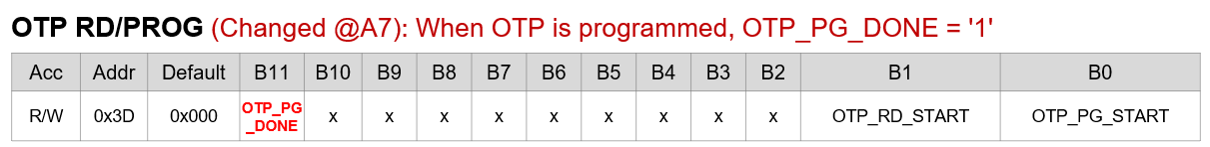
NO | Characteristics | Symbol | Test PIN | MIN | TYP | MAX | Unit | REMARK
7 | OTP INIT Check | OTP_INIT
Register | Acc | Addr | Default | Decimal
LD CONTROL | R/W | 0x01 | 0x000 | 0
PWM DIVIDER | R/W | 0x02 | 0x000 | 0
PWMCLK_DIV1/2 | R/W | 0x03 | 0x000 | 0
PWMCLK_DIV2/3 | R/W | 0x04 | 0x000 | 0
CHANNEL ENABLE | R/W | 0x05 | 0x000 | 0
FAULT CONTROL | R/W | 0x06 | 0x000 | 0
CHx_LD_TYPE0 | R/W | 0x07 | 0x000 | 0
CHx_LD_TYPE1 | R/W | 0x08 | 0x000 | 0
FAULT STATUS | RO | 0x09 | 0x000 | 0
MAX CURRENT VREF1 | R/W | 0x0A | 0x000 | 0
MAX CURRENT VREF2 | R/W | 0x0B | 0x000 | 0
MAX CURRENT VREF3 | R/W | 0x0C | 0x000 | 0
MAX CURRENT VREF4 | R/W | 0x0D | 0x000 | 0
MAX CURRENT VREF5 | R/W | 0x0E | 0x000 | 0
DELAY_CH1/2 | R/W | 0x10 | 0x000 | 0
DELAY_CH3/4 | R/W | 0x11 | 0x000 | 0
DELAY_CH5/6 | R/W | 0x12 | 0x000 | 0
DELAY_CH7/8 | R/W | 0x13 | 0x000 | 0
DELAY_CH9/10 | R/W | 0x14 | 0x000 | 0
DELAY_CH11/12 | R/W | 0x15 | 0x000 | 0
FB_LEVEL | R/W | 0x16 | 0x000 | 0
FB/SHORT_LEVEL | R/W | 0x17 | 0x000 | 0
SHORT_LEVEL | R/W | 0x18 | 0x000 | 0
MAX_CURRENT_LEVEL0 | R/W | 0x19 | 0x000 | 0
MAX_CURRENT_LEVEL1 | R/W | 0x1A | 0x000 | 0
PARITY & RD_EN | R/W | 0x1B | 0x000 | 0
SERIALIZER OUT RATE | R/W | 0x1C | 0x318 | 792
SERIAL_LATENCY | R/W | 0x1D | 0x080 | 128
V_MASK | R/W | 0x1E | 0x000 | 0
SV_MASK | R/W | 0x1F | 0x000 | 0
RSTCNT | R/W | 0x20 | 0x000 | 0
TIMEOUT | R/W | 0x21 | 0x7FF | 32767
MCLK LOCK1 | R/W | 0x22 | 0x000 | 0
MCLK LOCK2 | R/W | 0x23 | 0xC32 | 3122
WR_PROTECT | R/W | 0x24 | 0x555 | 1365
NF CONTROL | R/W | 0x25 | 0x000 | 0
CHOP_EN | R/W | 0x26 | 0x000 | 0
TEMP | R/W | 0x27 | 0x829 | 2089
OSC FLL MANUAL1 | R/W | 0x28 | 0x000 | 0
OSC FLL MANUAL2 | R/W | 0x29 | 0x808 | 2056
OSC_SPREAD | R/W | 0x2A | 0x000 | 00
CLOCK GATE EN | R/W | 0x2B | 0x017 | 23
OTP ACCESS1 | R/W | 0x3A | 0x000 | 0
OTP ACCESS2 | R/W | 0x3B | 0x3FF | 1023
OTP WRITE | R/W | 0x3C | 0x004 | 4
OTP RD/PROG | R/W | 0x3D | 0x000 | 0
OTP PROTECT | R/W | 0x3E | 0x5A5 | 1445
OP MODE | R/W | 0x3F | 0x000 | 0
MIRROR Registers
Register | Acc | Addr | Default | Decimal
OTP CRC | R/W | 0x00 | 0x000 | 0
IREF / BGR | R/W | 0x01 | 0x210 | 528
LDO_DAC / OSC_RCTL | R/W | 0x02 | 0x810 | 2064
LDO_OSC / LDO_CTL | R/W | 0x03 | 0x080 | 128
OFS_CH1 | R/W | 0x04 | 0x000 | 0
OFS_CH 2 | R/W | 0x05 | 0x000 | 0
OFS_CH 3 | R/W | 0x06 | 0x000 | 0
OFS_CH 4 | R/W | 0x07 | 0x000 | 0
OFS_CH 5 | R/W | 0x08 | 0x000 | 0
OFS_CH 6 | R/W | 0x09 | 0x000 | 0
OFS_CH 7 | R/W | 0x0A | 0x000 | 0
OFS_CH 8 | R/W | 0x0B | 0x000 | 0
OFS_CH 9 | R/W | 0x0C | 0x000 | 0
OFS_CH 10 | R/W | 0x0D | 0x000 | 0
OFS_CH 11 | R/W | 0x0E | 0x000 | 0
OFS_CH 12 | R/W | 0x0F | 0x000 | 0
GAIN_CH 1 | R/W | 0x10 | 0x040 | 64
GAIN_CH 2 | R/W | 0x11 | 0x040 | 64
GAIN_CH 3 | R/W | 0x12 | 0x040 | 64
GAIN_CH 4 | R/W | 0x13 | 0x040 | 64
GAIN_CH 5 | R/W | 0x14 | 0x040 | 64
GAIN_CH 6 | R/W | 0x15 | 0x040 | 64
GAIN_CH 7 | R/W | 0x16 | 0x040 | 64
GAIN_CH 8 | R/W | 0x17 | 0x040 | 64
GAIN_CH 9 | R/W | 0x18 | 0x040 | 64
GAIN_CH 10 | R/W | 0x19 | 0x040 | 64
GAIN_CH 11 | R/W | 0x1A | 0x040 | 64
GAIN_CH 12 | R/W | 0x1B | 0x040 | 64
CHIP_VERSION0 | R/W | 0x1C | 0x000 | 0
CHIP_VERSION1 | R/W | 0x1D | 0x000 | 0
Confidential

Slide 17
NO | Characteristics | Symbol | Test PIN | MIN | TYP | MAX | Unit | REMARK
11 | VREF Trim | VREF_Trim | TEST | 2.183 | 2.200 | 2.295 | V | 0.77% / 4.32%
VREF_Trim
cmd | Addr[5:0] | Data[11:0] | register | remark
4b'1101 | 0x00 | 0x800 | RESET | write command first
4b'1000 | - | - | ID GEN
4b'1101 | 0x05 | 0xFFF | CHANNEL ENABLE
4b'1101 | 0x0A | 0xFFF | MAX_CURR1_VREF
4b'1101 | 0x0B | 0xFFF | MAX_CURR2_VREF
4b'1101 | 0x0C | 0xFFF | MAX_CURR3_VREF
4b'1101 | 0x0D | 0xFFF | MAX_CURR4_VREF
4b'1101 | 0x0E | 0xFFF | MAX_CURR5_VREF
4b'1101 | 0x19 | 0x111 | MAX_CURRENT_LEVEL0
4b'1101 | 0x1A | 0x011 | MAX_CURRENT_LEVEL1
4b'1101 | 0x16 | 0x000 | FB_LEVEL
4b'1101 | 0x17 | 0xFF8 | FB/SHORT_LEVEL
4b'1101 | 0x18 | 0x07F | SHORT_LEVEL
4b'1101 | 0x25 | 0x35A | SERIAL CLOCK GEN
4b'1101 | 0x26 | 0x03C | SERIAL LATENCY
4b'1101 | 0x3F | 0xF10 | OP MODE | test_en, test_ana_en,sw_sel,pwm_full
4b'1101 | 0x3E | 0xA5A | OTP PROTECT | write enable
4b'1101 | 0x3F | 0xF11 | OP MODE | test_en,ddio_dis,vref_o,addr_ext
4b'1101 | 0x01 | 0x7A0 | OSC | BGR_TC 7
4b'1101 | 0x02 | 0x00 ~ 0x3F | sweep VREF_CTL[5:0] 0x020 (default)
 |  |  | define trim code
Confidential

Slide 18
NO | Characteristics | Symbol | Test PIN | MIN | TYP | MAX | Unit | REMARK
12 | OSC Trim | OSC_TRIM | DOUT | 1.205 | 1.230 | 1.255 | MHz | 2%
※ Caution
ALL ‘trims’ should be independently controlled by site. Do NOT VDD Reset during Trimming.
Test Condition
Force VDD 5V, DIN (VIH = 5V, VIL = 0V)
Set registers (Apply ‘DIN’ pin by test pattern)
Save a sweep code that outputs the closest to the target
* OSC Internal Freq. : 39.3Mhz
→ Real Output Freq : 1.23Mhz
Change OSC Register as A7R2->A7R3
(0x3A0 → 0x7A0)
OSC_Trim |  | Continued from previous trim item
cmd | addr | data | Register | remark
4b'1101 | 0x00 | 0x800 | RESET
4b'1000 | - | - | ID GEN
4b'1101 | 0x03 | 0xFFF | CHANNEL ENABLE
4b'1101 | 0x06 | 0x170 | FAULT LEVEL
4b'1101 | 0x08 | 0xFFF | MAX_CURR_VREF
4b'1101 | 0x25 | 0x35A | SERIAL CLOCK GEN
4b'1101 | 0x26 | 0x03C | SERIAL LATENCY
4b'1101 | 0x3F | 0xC20 | OP MODE | test_en, ddio_dis, mclk32_o
4b'1101 | 0x2A | 0x000 | OSC_FLL_MAN1
4b'1101 | 0x2B | 0x808 | OSC_FLL_MAN2
4b'1101 | 0x3E | 0xA5A | OTP PROTECT
4b'1101 | 0x3F | 0xC21 | OP MODE | test_en,ddio_dis,mclk32_o,addr_ext
4b'1101 | 0x01 | 0x7A0 | OSC | BGR_TC 7
4b'1101 | 0x01 | 0x00 ~ 0x3F | sweep OSC[5:0] 0x020 (default)
 |  |  | define trim code

Slide 19
NO | Characteristics | Symbol | Test PIN | MIN | TYP | MAX | Unit | REMARK
13 | ICTL_GA_Trim | ICTL_GA_Trim | IOUT_CH1~12 | 3.806 | 3.907 | 4.009 | mA | 2.6%
※ Caution
ALL ‘trims’ should be independently controlled by site. Do NOT VDD Reset during Trimming.
Force VDD 5V, IOUT_CH1~12 : 5V
Set registers (Apply ‘DIN’ pin by test pattern)
Save a sweep code that outputs the closest to the target
ICTL_GA_Trim
cmd | addr | data | register | remark
4b'1101 | 0x00 | 0x800 | RESET
4b'1000 | - | - | ID GEN
4b'1101 | 0x03 | 0xFFF | CHANNEL ENABLE
4b'1101 | 0x25 | 0x35A | SERIAL CLOCK GEN
4b'1101 | 0x26 | 0x03C | SERIAL LATENCY
4b'1101 | 0x3F | 0xC40 | OP MODE | test_en, ddio_dis, pwm_full
4b'1101 | 0x06 | 0x170 | FAULT LEVEL | max 8mA
4b'1101 | 0x08 | 0x3E8 | MAX_CURR_VREF | (decimal: 1000)
4b'1101 | 0x3E | 0xA5A | OTP PROTECT
4b'1101 | 0x3F | 0xC41 | OP MODE | test_en,ddio_dis,pwm_full,addr_ext
4b'1101 | CHxx 0x1B~26 | 0x00 ~ 0x7F | Sweep ICTL_CH**[6:0] 0x040 (default)
 |  |  | Meas. current (C1)
4b'1101 | 0x3F | 0xC40 | OP MODE | test_en, ddio_dis, pwm_full
4b'1101 | 0x08 | 0xBB8 | MAX_CURR_VREF | (decimal: 3000)
4b'1101 | 0x3E | 0xA5A | OTP PROTECT
4b'1101 | 0x3F | 0xC41 | OP MODE | test_en,ddio_dis,pwm_full,addr_ext
4b'1101 | CHxx 0x1B~26 | 0x00 ~ 0x7F | Sweep ICTL_CH**[6:0] 0x040 (default)
 |  |  | Meas. current (C2)
 |  |  | define trim code for ‘C2-C1’ | Calculate ‘C2-C1’
Change
GA_P1
Change
GA_P2
Confidential

Slide 20
NO | Characteristics | Symbol | Test PIN | MIN | TYP | MAX | Unit | REMARK
14 | ICTL_OFS_Trim | ICTL_OFS_Trim | IOUT_CH1~12 | 0.974 | 1.000 | 1.026 | mA | 2.6%
※ Caution
ALL ‘trims’ should be independently controlled by site. Do NOT VDD Reset during Trimming.
Force VDD 5V, IOUT_CH1~12 : 5V
Set registers (Apply ‘DIN’ pin by test pattern)
Save a sweep code that outputs the closest to the target
ICTL_OFS_Trim |  | Continued from previous trim item
cmd | addr | data | register | remark
4b'1101 | 0x00 | 0x800 | RESET
4b'1000 | - | - | ID GEN
4b'1101 | 0x03 | 0xFFF | CHANNEL ENABLE
4b'1101 | 0x25 | 0x35A | SERIAL CLOCK GEN
4b'1101 | 0x26 | 0x03C | SERIAL LATENCY
4b'1101 | 0x3F | 0xC40 | OP MODE | test_en, ddio_dis, pwm_full
4b'1101 | 0x06 | 0x170 | FAULT LEVEL | max 8mA
4b'1101 | 0x08 | 0x15E | MAX_CURR_VREF | (decimal: 350)
4b'1101 | 0x3E | 0xA5A | OTP PROTECT
4b'1101 | 0x3F | 0xC41 | OP MODE | test_en,ddio_dis,pwm_full,addr_ext
4b'1101 | CHxx 0x03~0E | 0x00 ~ 0x3F | Sweep ICTL_OFS_CH**[5:0] 0x020 (default) | Change [6:0] → [5:0]
 |  |  | Meas. current (C1)
4b'1101 | 0x3F | 0xC40 | OP MODE | test_en, ddio_dis, pwm_full
4b'1101 | 0x08 | 0x258 | MAX_CURR_VREF | (decimal: 600)
4b'1101 | 0x3E | 0xA5A | OTP PROTECT
4b'1101 | 0x3F | 0xC41 | OP MODE | test_en,ddio_dis,pwm_full,addr_ext
4b'1101 | CHxx 0x03~0E | 0x00 ~ 0x3F | Sweep ICTL_OFS_CH**[5:0] 0x020 (default) | Change [6:0] → [5:0]
 |  |  | Meas. current (C2)
 |  |  | define trim code for ‘(C1+C2) / 2’ | Calculate ‘(C1+C2) / 2’
Change
OFS_P1
Change
OFS_P2
Confidential

Slide 21
NO | Characteristics | Symbol | Test PIN | MIN | TYP | MAX | Unit | REMARK
15 | OTP_Write (e-fuse) | - | - | - | - | - | -
* Remember : OTP writing is allowed only once.
* If you write data into OTP multiple times,
the trimmed data will be modified and the output will change.
[Test Method]
OTP Write
: When all trims are completed, perform e-fusing (=write) on all activated site
(1) (No Power OFF) Apply VDD 5.0V → 5.5V, DIN (VIH = 5.5V, VIL = 0V)
(2) Set registers (Force ‘DIN’ pin by test pattern)
(3) Wait time 10ms before next step
E-Fusing
cmd | addr | data | command | remark
4b'1000 | - | - | ID GEN
4b'1101 | 0x03 | 0xFFF | CHANNEL ENABLE
4b'1101 | 0x06 | 0x170 | FAULT LEVEL
4b'1101 | 0x08 | 0xCCC | MAX_CURR_VREF | retaining
4b'1101 | 0x25 | 0x35A | SERIAL CLOCK GEN
4b'1101 | 0x26 | 0x03C | SERIAL LATENCY
4b'1101 | 0x3F | 0xC00 | OP MODE
4b'1101 | 0x3D | 0x001 | OTP RD/PROG | otp_pg_start
Register Map |  | Address | B11 | B10 | B9 | B8 | B7 | B6 | B5 | B4 | B3 | B2 | B1 | B0 | Value
R/W | OP MODE | 0x3F | 1 (TEST_EN) | 1 (DDIO_DIS) | 0 | 0 | 0 | 0 | 0 | 0 | 0 | 0 | 0 | 0 (ADDR_EXT) | 0xC00
R/W | OTP RD/PROG | 0x3D | 0 | 0 | 0 | 0 | 0 | 0 | 0 | 0 | 0 | 0 | 0 | 1 (OTP_PG) | 0x001
< E-Fusing Test Flow >
(1) Apply VDD & I/O upto 5.5V (No Power OFF)
(2) Set register : addr 0x3F, data 0xC00; addr 0x3D, data 0x001
→ last searching (trimmed) codes are copied to e-fusing area (OTP written status)
(3) Power OFF (-> Erased date in register area) and Power ON (5V)
→ e-fused codes are downloaded to register area
(4) (Verify) Must be same (2)’s code and (3)’s code, output is same as the target value
Confidential
Confidential

Slide 22
NO | Characteristics | Symbol | Test PIN | MIN | TYP | MAX | Unit | REMARK
16 | VREF Verify | VREF_VFY | TEST | 2.156 | 2.2 | 2.244 | V | 2%
Strenghen test limits
[Test Method]
* VREF Verify :
(1) Force VDD 5V, DIN (VIH = 5V, VIL = 0V)
(2) Set registers (Force/Compare ‘DIN’ pin by test pattern)
VREF_VFY
cmd | addr | data | register
4b'1101 | 0x00 | 0x800 | RESET
4b'1000 | - | - | ID GEN
4b'1101 | 0x03 | 0xFFF | CHANNEL ENABLE
4b'1101 | 0x06 | 0x170 | FAULT LEVEL
4b'1101 | 0x08 | 0xFFF | MAX_CURR_VREF
4b'1101 | 0x25 | 0x35A | SERIAL CLOCK GEN
4b'1101 | 0x26 | 0x03C | SERIAL LATENCY
4b'1101 | 0x3F | 0xF11 | OP MODE
4b'1110 | 0x02 | vref_ctl[5:0] | read command
 |  |  | wait 10ms
 |  | 'TEST' | meas voltage
Register Map |  | Address | B11 | 10 | B9 | B8 | B7 | B6 | B5 | B4 | B3 | B2 | B1 | B0 | Value
R/W | MAX CURRENT VREF | 0x08 | 1 | 1 | 1 | 1 | 1 | 1 | 1 | 1 | 1 | 1 | 1 | 1 | 0xFFF
R/W | OP MODE | 0x3F | 1 (TEST_EN) | 1 (DDIO_DIS) | 1 (TST_ANA1) | 1 (TST_ANA0) | 0 | 0 | 0 (MCLK32_O) | 1 (VREF_O) | 0 | 0 | 0 | 1 (ADDR_EXT) | 0xF11
R/W | VREF_CTL | 0x02 | 0 | 0 | 0 | 0 | 0 | 0 | VREF_CTL[5:0] |  |  |  |  |  | 0x000
R/W | OSC | 0x01 | 0 | 0 | 0 | 0 | 0 | 0 | OSC[5:0] |  |  |  |  |  | 0x000
TEST_ANA_EN<1:0> | '00' | high-Z
 | '01 or 10' | LDO (1.5V)
 | '11' | VREF(2.2V)

Slide 23
NO | Characteristics | Symbol | Test PIN | MIN | TYP | MAX | Unit | REMARK
17 | OSC Verify | OSC_VFY | DOUT | 1.205 | 1.230 | 1.255 | MHz | 2%
Strenghen test limits
[Test Method]
* OSC Verify :
(1) Force VDD 5V, DIN (VIH = 5V, VIL = 0V)
(2) Set registers (Force/Compare ‘DIN’ pin by test pattern)
OSC_VFY
cmd | addr | data | register | remark
4b'1101 | 0x00 | 0x800 | RESET
4b'1000 | - | - | ID GEN
4b'1101 | 0x03 | 0xFFF | CHANNEL ENABLE
4b'1101 | 0x06 | 0x170 | FAULT LEVEL
4b'1101 | 0x08 | 0xFFF | MAX_CURR_VREF
4b'1101 | 0x25 | 0x35A | SERIAL CLOCK GEN
4b'1101 | 0x26 | 0x03C | SERIAL LATENCY
4b'1101 | 0x3F | 0xC20 | OP MODE
4b'1101 | 0x2A | 0x000 | OSC_FLL_MAN1
4b'1101 | 0x2B | 0x808 | OSC_FLL_MAN2
4b'1101 | 0x3F | 0xC21 | OP MODE
4b'1110 | 0x01 | osc[5:0] | read command
 |  |  | wait 10ms
 |  | 'DOUT' | meas freq.
Register Map |  | Address | B11 | 10 | B9 | B8 | B7 | B6 | B5 | B4 | B3 | B2 | B1 | B0 | Value
R/W | OP MODE | 0x3F | 1 (TEST_EN) | 1 (DDIO_DIS) | 0 (TST_ANA1) | 0 (TST_ANA0) | 0 | 0 | 1 (MCLK32_O) | 0 (VREF_O) | 0 | 0 | 0 | 1 (ADDR_EXT) | 0xC21
R/W | VREF_CTL | 0x02 | 0 | 0 | 0 | 0 | 0 | 0 | VREF_CTL[5:0] |  |  |  |  |  | 0x000
R/W | OSC | 0x01 | 0 | 0 | 0 | 0 | 0 | 0 | OSC[5:0] |  |  |  |  |  | 0x000
TEST_ANA_EN<1:0> | '00' | high-Z
 | '01 or 10' | LDO (1.5V)
 | '11' | VREF(2.2V)

Slide 24
NO | Characteristics | Symbol | Test PIN | MIN | TYP | MAX | Unit | REMARK
18 | IOUT_L Verify 1 | ICTL1_L_VFY1 | IOUT_CH[1:12] | 0.373 | 0.383 | 0.393 | mA | 2.6% (350) (RANK 1)
 | IOUT_L Verify 1 | ICTL1_L_VFY2 | IOUT_CH[1:12] | 1.010 | 1.037 | 1.064 | mA | 2.6% 1000) (RANK 1)
 | IOUT_L Verify 1 | ICTL1_L_VFY3 | IOUT_CH[1:12] | 3.931 | 4.036 | 4.141 | mA | 2.6% (4000) (RANK 1)
 |  |  |  | 0.370 | 0.383 | 0.396 | mA | 3.5% (RANK 2)
 |  |  |  | 1.001 | 1.037 | 1.073 | mA | 3.5% (RANK 2)
 |  |  |  | 3.895 | 4.036 | 4.177 | mA | 3.5% (RANK 2)
[Test Method]
* OFS Verify :
(1) Force VDD 5V, DIN (VIH = 5V, VIL = 0V)
(2) Set registers (Force/Compare ‘DIN’ pin by test pattern)
OFS_Verify |  | Continued from previous trim item
cmd | addr | data | register | remark
4b'1101 | 0x00 | 0x800 | RESET
4b'1000 | - | - | ID GEN
4b'1101 | 0x03 | 0xFFF | CHANNEL ENABLE
4b'1101 | 0x25 | 0x35A | SERIAL CLOCK GEN
4b'1101 | 0x26 | 0x03C | SERIAL LATENCY
4b'1101 | 0x3F | 0xC40 | OP MODE | test_en, ddio_dis, pwm_full
4b'1101 | 0x06 | 0x070 | FAULT LEVEL | max 4mA
4b'1101 | 0x08 | 0x15E | MAX_CURR_VREF | (decimal: 350)
4b'1101 | 0x3E | 0xA5A | OTP PROTECT
4b'1101 | 0x3F | 0xC41 | OP MODE | test_en,ddio_dis,pwm_full,addr_ext
4b’1110 | CHxx 0x03~0E | ICTL_CH**[6:0] | Read command
 |  |  | Meas. current (C1)
4b'1101 | 0x3F | 0xC40 | OP MODE | test_en, ddio_dis, pwm_full
4b'1101 | 0x08 | 0x3EB | MAX_CURR_VREF | (decimal: 1000)
4b'1101 | 0x3E | 0xA5A | OTP PROTECT
4b'1101 | 0x3F | 0xC41 | OP MODE | test_en,ddio_dis,pwm_full,addr_ext
4b’1110 | CHxx 0x03~0E | ICTL_CH**[6:0] | Read command
 |  |  | Meas. current (C2)
4b'1101 | 0x3F | 0xC40 | OP MODE | test_en, ddio_dis, pwm_full
4b'1101 | 0x08 | 0xFA0 | MAX_CURR_VREF | (decimal: 4000)
4b'1101 | 0x3E | 0xA5A | OTP PROTECT
4b'1101 | 0x3F | 0xC41 | OP MODE | test_en,ddio_dis,pwm_full,addr_ext
4b’1110 | CHxx 0x03~0E | ICTL_CH**[6:0] | Read command
 |  |  | Meas. current (C3) | Target : 8.000ma

Slide 25
NO | Characteristics | Symbol | Test PIN | MIN | TYP | MAX | Unit | REMARK
19 | IOUT_H Verify 1 | ICTL1_H_VFY1 | IOUT_CH[1:12] | 2.142 | 2.199 | 2.256 | mA | 2.6% (350) (RANK 1)
 | IOUT_H Verify 1 | ICTL1_H_VFY2 | IOUT_CH[1:12] | 5.747 | 5.900 | 6.053 | mA | 2.6% (1000) (RANK 1)
 | IOUT_H Verify 1 | ICTL1_H_VFY3 | IOUT_CH[1:12] | 22.188 | 22.780 | 23.372 | mA | 2.6% (4000) (RANK 1)
 |  |  |  | 2.122 | 2.199 | 2.276 | mA | 3.5% (RANK 2)
 |  |  |  | 5.694 | 5.900 | 6.107 | mA | 3.5% (RANK 2)
 |  |  |  | 21.983 | 22.780 | 23.577 | mA | 3.5% (RANK 2)
[Test Method]
* GAIN Verify :
(1) Force VDD 5V, DIN (VIH = 5V, VIL = 0V)
(2) Set registers (Force/Compare ‘DIN’ pin by test pattern)
GAIN_Verify
cmd | addr | data | register | remark
4b'1101 | 0x00 | 0x800 | RESET
4b'1000 | - | - | ID GEN
4b'1101 | 0x03 | 0xFFF | CHANNEL ENABLE
4b'1101 | 0x25 | 0x35A | SERIAL CLOCK GEN
4b'1101 | 0x26 | 0x03C | SERIAL LATENCY
4b'1101 | 0x3F | 0xC40 | OP MODE | test_en, ddio_dis, pwm_full
4b'1101 | 0x06 | 0x470 | FAULT LEVEL | max 24mA
4b'1101 | 0x08 | 0x15E | MAX_CURR_VREF | (decimal: 350)
4b'1101 | 0x3E | 0xA5A | OTP PROTECT
4b'1101 | 0x3F | 0xC41 | OP MODE | test_en,ddio_dis,pwm_full,addr_ext
4b’1110 | CHxx 0x03~0E | ICTL_CH**[6:0] | Read command
 |  |  | Meas. current (C1)
4b'1101 | 0x3F | 0xC40 | OP MODE | test_en, ddio_dis, pwm_full
4b'1101 | 0x08 | 0x3EB | MAX_CURR_VREF | (decimal: 1000)
4b'1101 | 0x3E | 0xA5A | OTP PROTECT
4b'1101 | 0x3F | 0xC41 | OP MODE | test_en,ddio_dis,pwm_full,addr_ext
4b’1110 | CHxx 0x03~0E | ICTL_CH**[6:0] | Read command
 |  |  | Meas. current (C2)
4b'1101 | 0x3F | 0xC40 | OP MODE | test_en, ddio_dis, pwm_full
4b'1101 | 0x08 | 0xFA0 | MAX_CURR_VREF | (decimal: 4000)
4b'1101 | 0x3E | 0xA5A | OTP PROTECT
4b'1101 | 0x3F | 0xC41 | OP MODE | test_en,ddio_dis,pwm_full,addr_ext
4b’1110 | CHxx 0x03~0E | ICTL_CH**[6:0] | Read command
 |  |  | Meas. current (C3)

Slide 26
NO | Characteristics | Symbol | Test PIN | MIN | TYP | MAX | Unit | REMARK
17 | IOUT_L Verify | OFS_VFY11 | IOUT_CH[1:12] | - | 0.791 | - | mA | 2.6% (240)
 | IOUT_L Verify | OFS_VFY21 | IOUT_CH[1:12] | - | 1.758 | - | mA | 2.6% (573)
 | IOUT_L Verify | OFS_VFY31 | IOUT_CH[1:12] | - | 5.861 | - | mA | 2.6% (1987)
 | IOUT_L Verify | OFS_VFY41 | IOUT_CH[1:12] | - | 8.791 | - | mA | 2.6% (2997)
Excluded from Mass Production Test Program (2026.03.05)
Newly added item (2025.12.12)
OFS_Verify |  | Continued from previous trim item
cmd | addr | data | register | remark
4b'1101 | 0x00 | 0x800 | RESET
4b'1000 | - | - | ID GEN
4b'1101 | 0x03 | 0xFFF | CHANNEL ENABLE
4b'1101 | 0x25 | 0x35A | SERIAL CLOCK GEN
4b'1101 | 0x26 | 0x03C | SERIAL LATENCY
4b'1101 | 0x3F | 0xC40 | OP MODE | test_en, ddio_dis, pwm_full
4b'1101 | 0x06 | 0x270 | FAULT LEVEL | max 12mA
4b'1101 | 0x08 | 0x0F0 | MAX_CURR_VREF | (decimal: 240)
4b'1101 | 0x3E | 0xA5A | OTP PROTECT
4b'1101 | 0x3F | 0xC41 | OP MODE | test_en,ddio_dis,pwm_full,addr_ext
4b’1110 | CHxx 0x03~0E | ICTL_CH**[6:0] | Read command
 |  |  | Meas. current (C1) | Target :0.791mA
4b'1101 | 0x3F | 0xC40 | OP MODE | test_en, ddio_dis, pwm_full
4b'1101 | 0x08 | 0x23D | MAX_CURR_VREF | (decimal: 573)
4b'1101 | 0x3E | 0xA5A | OTP PROTECT
4b'1101 | 0x3F | 0xC41 | OP MODE | test_en,ddio_dis,pwm_full,addr_ext
4b’1110 | CHxx 0x03~0E | ICTL_CH**[6:0] | Read command
 |  |  | Meas. current (C2) | Target : 1.758mA
4b'1101 | 0x3F | 0xC40 | OP MODE | test_en, ddio_dis, pwm_full
4b'1101 | 0x08 | 0x7C3 | MAX_CURR_VREF | (decimal: 1987)
4b'1101 | 0x3E | 0xA5A | OTP PROTECT
4b'1101 | 0x3F | 0xC41 | OP MODE | test_en,ddio_dis,pwm_full,addr_ext
4b’1110 | CHxx 0x03~0E | ICTL_CH**[6:0] | Read command
 |  |  | Meas. current (C3) | Target : 5.861mA
4b'1101 | 0x3F | 0xC40 | OP MODE | test_en, ddio_dis, pwm_full
4b'1101 | 0x08 | 0xBB5 | MAX_CURR_VREF | (decimal: 2997)
4b'1101 | 0x3E | 0xA5A | OTP PROTECT
4b'1101 | 0x3F | 0xC41 | OP MODE | test_en,ddio_dis,pwm_full,addr_ext
4b’1110 | CHxx 0x03~0E | ICTL_CH**[6:0] | Read command
 |  |  | Meas. current (C4) | Target : 8.791mA

Slide 27
NO | Characteristics | Symbol | Test PIN | MIN | TYP | MAX | Unit | REMARK
18 | IOUT_H Verify | GAIN_VFY11 | IOUT_CH[1:12] | - | 2.110 | - | mA | 2.6% (242)
 | IOUT_H Verify | GAIN_VFY21 | IOUT_CH[1:12] | - | 4.689 | - | mA | 2.6% (582)
 | IOUT_H Verify | GAIN_VFY31 | IOUT_CH[1:12] | - | 15.629 | - | mA | 2.6% (2024)
 | IOUT_H Verify | GAIN_VFY41 | IOUT_CH[1:12] | - | 23.443 | - | mA | 2.6% (3054)
Excluded from Mass Production Test Program (2026.03.05)
Newly added item (2025.12.12)
GAIN_Verify
cmd | addr | data | register | remark
4b'1101 | 0x00 | 0x800 | RESET
4b'1000 | - | - | ID GEN
4b'1101 | 0x03 | 0xFFF | CHANNEL ENABLE
4b'1101 | 0x25 | 0x35A | SERIAL CLOCK GEN
4b'1101 | 0x26 | 0x03C | SERIAL LATENCY
4b'1101 | 0x3F | 0xC40 | OP MODE | test_en, ddio_dis, pwm_full
4b'1101 | 0x06 | 0x570 | FAULT LEVEL | max 32mA
4b'1101 | 0x08 | 0x0F2 | MAX_CURR_VREF | (decimal: 242)
4b'1101 | 0x3E | 0xA5A | OTP PROTECT
4b'1101 | 0x3F | 0xC41 | OP MODE | test_en,ddio_dis,pwm_full,addr_ext
4b’1110 | CHxx 0x03~0E | ICTL_CH**[6:0] | Read command
 |  |  | Meas. current (C1) | Target : 2.110mA
4b'1101 | 0x3F | 0xC40 | OP MODE | test_en, ddio_dis, pwm_full
4b'1101 | 0x08 | 0x246 | MAX_CURR_VREF | (decimal: 582)
4b'1101 | 0x3E | 0xA5A | OTP PROTECT
4b'1101 | 0x3F | 0xC41 | OP MODE | test_en,ddio_dis,pwm_full,addr_ext
4b’1110 | CHxx 0x03~0E | ICTL_CH**[6:0] | Read command
 |  |  | Meas. current (C2) | Target : 4.689mA
4b'1101 | 0x3F | 0xC40 | OP MODE | test_en, ddio_dis, pwm_full
4b'1101 | 0x08 | 0x7E8 | MAX_CURR_VREF | (decimal: 2024)
4b'1101 | 0x3E | 0xA5A | OTP PROTECT
4b'1101 | 0x3F | 0xC41 | OP MODE | test_en,ddio_dis,pwm_full,addr_ext
4b’1110 | CHxx 0x03~0E | ICTL_CH**[6:0] | Read command
 |  |  | Meas. current (C3) | Target : 15.629mA
4b'1101 | 0x3F | 0xC40 | OP MODE | test_en, ddio_dis, pwm_full
4b'1101 | 0x08 | 0xBEE | MAX_CURR_VREF | (decimal: 3054)
4b'1101 | 0x3E | 0xA5A | OTP PROTECT
4b'1101 | 0x3F | 0xC41 | OP MODE | test_en,ddio_dis,pwm_full,addr_ext
4b’1110 | CHxx 0x03~0E | ICTL_CH**[6:0] | Read command
 |  |  | Meas. current (C4) | Target : 23.443mA

Slide 28
NO | Characteristics | Symbol | Test PIN | MIN | TYP | MAX | Unit | REMARK
20 | LDO (no trim) | LDO | TEST | 1.425 | 1.5 | 1.59 | V | 5%
[Test Method]
Force VDD 5V, DIN (VIH = 5V, VIL = 0V)
Set registers (Apply ‘DIN’ pin via test pattern)
Measure Voltage (from TEST pin)
LDO_NoTrim
cmd | addr | data | command | remark
4b'1101 | 0x00 | 0x800 | RESET
4b'1000 | - | - | ID GEN
4b'1101 | 0x03 | 0xFFF | CHANNLE ENABLE
4b'1101 | 0x06 | 0x170 | FAULT LEVEL
4b'1101 | 0x08 | 0xFFF | MAX_CURR_VREF
4b'1101 | 0x25 | 0x35A | SERIAL CLOCK GEN
4b'1101 | 0x26 | 0x03C | SERIAL LATENCY
4b'1101 | 0x3F | 0xD00 | OP MODE | test_en, ddio_dis, tst_ana_en(01)
4b'1101 | 0x3E | 0xA5A | OTP PROTECT
4b'1101 | 0x3F | 0xD01 | OP MODE | test_en, ddio_dis, tst_ana_en(01), addr_ext
 |  |  | meas voltage ('TEST' pin)
Confidential

Slide 29
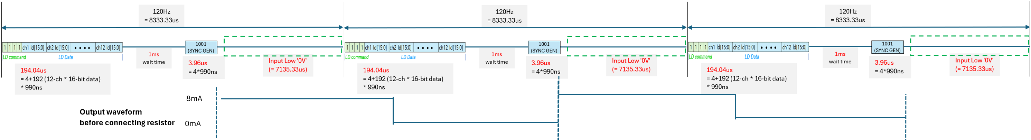
NO | Characteristics | Symbol | Test PIN | MIN | TYP | MAX | Unit | REMARK
21 | FLL (Freq Locked Loop) | FLL | DOUT | 1.15 | 1.23 | 1.29 | MHz | Divided by 32
[Test Method]
Force VDD 5V, DIN (VIH = 5V, VIL = 0V)
2. Set registers
FLL
cmd | addr | data | register | remark
4b'1101 | 0x00 | 0x800 | RESET
4b'1000 | - | - | ID GEN
4b'1101 | 0x03 | 0xFFF | CHANNEL ENABLE
4b'1101 | 0x06 | 0x170 | FAULT LEVEL
4b'1101 | 0x08 | 0xFFF | MAX_CURR_VREF
4b'1101 | 0x25 | 0x35A | SERIAL CLOCK GEN
4b'1101 | 0x26 | 0x03C | SERIAL LATENCY
4b'1101 | 0x3F | 0xC20 | OP MODE | test_en, ddio_dis, mclk32_o
4b'1101 | 0x2A | 0x000 | OSC_FLL_MAN1
4b'1101 | 0x2B | 0x008 | OSC_FLL_MAN2
4b'1101 | 0x27 | 0xFB0 | MCLK LOCK1 | 1.229MHz (Replace data for measuring other freq.)
4b'1101 | 0x28 | 0x04F | MCLK LOCK2
4b'1101 | 0x01 | 0xC00 | LD CONTROL | ch_size, io_mode, scan_no, over, pwm_res, ld_dir
4b'1101 | 0x02 | 0x04F | FPWM DIVIDER | pwm_res=0, 120Hz
4b'1111 | - | 0x0FFF | LD TRANSMIT | repeat (16-bit * 12-chan) until next ‘SYNC GEN’
 |  |  | wait time (1ms)
4b'1001 | - | - | SYNC GEN | (if need) repeat every 120Hz (VSYNC cycle)
 |  |  | meas DOUT Freq | target 1.23MHz (Internal: 39.3MHz)
3. FLL
- (if need) Repeat “LD TRANSMIT’ and ‘SYNC GEN’ through ‘DIN’ pin (refer to upper picture)
- Measure ‘DOUT’ frequency after wait time

Slide 30
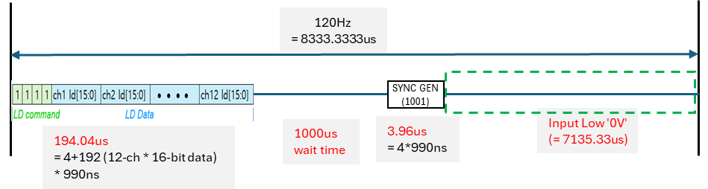
NO | Characteristics | Symbol | Test PIN | MIN | TYP | MAX | Unit | REMARK
22 | FAULT_OPEN_LEVEL | F_OPEN | DIN (fault bit) | 0.2 | 0.4 | 0.45 | V
 | FAULT_FB_LEVEL | F_FB | DIN (fault bit) |  | 0.9 |  | V
 | FAULT_SHORT_LEVEL | F_SHORT | DIN (fault bit) |  | 12 |  | V
[Test Method]
Force VDD 5V, DIN (VIH = 5V, VIL = 0V)
2. Set registers
Open_Level
cmd | addr | data | command | remark
4b'1101 | 0x00 | 0x800 | RESET
4b'1000 | - | - | ID GEN
4b'1101 | 0x03 | 0xFFF | CHANNEL ENABLE
4b'1101 | 0x06 | Refer to Right | FAULT LEVEL | 8mA; open:0.4V, fb:0.85V, short:4V(s100), 12V(acco) S100 : 0x114 / Acco : 0x144
4b'1101 | 0x07 | 0x018 | FAULT CONTROL | fb/open/short (0x038 → 0x018)
4b'1101 | 0x08 | 0xFFF | MAX_CURR_VREF
4b'1101 | 0x25 | 0x35A | SERIAL CLOCK GEN
4b'1101 | 0x26 | 0x03C | SERIAL LATENCY
4b'1101 | 0x2A | 0x000 | OSC_FLL_MAN1
4b'1101 | 0x2B | 0x808 | OSC_FLL_MAN2 | FLL manual mode (O)
4b'1101 | 0x27 | 0xFB0 | MCLK LOCK1
4b'1101 | 0x28 | 0x84F | MCLK LOCK2 | enable FLL function
4b'1101 | 0x01 | 0xC00 | LD CONTROL | ch_size, io_mode, scan_no, over, pwm_res, ld_dir
4b'1101 | 0x02 | 0x04F | FPWM DIVIDER | pwm_res=0, 120Hz
4b'1111 | - | 0x0000 | LD TRANSMIT | 16-bit * 12-chan (repeat 12 times)
 |  |  | wait time 1ms
4b'1001 | - | - | SYNC GEN | repeat 1 times
0V | - | - | - | apply 0V during 7.135ms
 |  |  | apply voltage
4b'1010 | - | - | fault read command | fault_status[3:0] (2: short, 1: open, 0: fb)
 |  |  | sweep voltage
* LD_TRANSMIT+SYNC_GEN(repeat 3 times) + apply voltage + read flag
(within 8ms; Valid time for check flag is 8ms)
* Apply 0.1V and 0.6V, check if flag is turned.
3. Open Level
- Force 0.1V (Channel under test) among IOUT_CH[1:12], other IOUT pins are 5V forced
- (one by one channel ) Check fault bit’s initial status (Short/Open/ FB/ Short = L/ H/ H)
- (one by one) Sweep Voltage 0.2~0.6V
and Check event level through ‘fault read command’ : ‘OPEN’ bit (H → L)
(Short/ Open/ FB/ Short = L/H/H → L/L/H; Target : 0.25V)
# When found rough target value, apply smaller voltage step size
When you set 'fault read command' (1010),
you can check the fault bits through 'fault readout response' (1010 + fault_bit[3:0]). (automatically output)
Confidential

Slide 31
NO | Characteristics | Symbol | Test PIN | MIN | TYP | MAX | Unit | REMARK
 | FAULT_OPEN_LEVEL | F_OPEN | DIN (fault bit) |  | 0.4 |  | V
23 | FAULT_FB_LEVEL | F_FB | DIN (fault bit) | 0.8 | 1.2 | 1.6 | V
 | FAULT_SHORT_LEVEL | F_SHORT | DIN (fault bit) |  | 12 |  | V
[Test Method]
Force VDD 5V, DIN (VIH = 5V, VIL = 0V)
2. Set registers
FB_Level
cmd | addr | data | command | remark
4b'1101 | 0x00 | 0x800 | RESET
4b'1000 | - | - | ID GEN
4b'1101 | 0x03 | 0xFFF | CHANNEL ENABLE
4b'1101 | 0x06 | 0x114 | FAULT LEVEL
4b'1101 | 0x07 | 0x018 | FAULT CONTROL | fb/open/short (0x038 → 0x018)
4b'1101 | 0x08 | 0xFFF | MAX_CURR_VREF | pwm on
4b'1101 | 0x25 | 0x35A | SERIAL CLOCK GEN
4b'1101 | 0x26 | 0x03C | SERIAL LATENCY
4b'1101 | 0x2A | 0x000 | OSC_FLL_MAN1
4b'1101 | 0x2B | 0x808 | OSC_FLL_MAN2 | FLL manual mode (O)
4b'1101 | 0x27 | 0xFB0 | MCLK LOCK1
4b'1101 | 0x28 | 0x84F | MCLK LOCK2 | enable FLL function
4b'1101 | 0x01 | 0xC00 | LD CONTROL | ch_size, io_mode, scan_no, over, pwm_res, ld_dir
4b'1101 | 0x02 | 0x04F | FPWM DIVIDER | pwm_res=0, 120Hz
4b'1111 | - | 0x0FFF | LD TRANSMIT | 16-bit * 12-chan (repeat 12 times)
 |  |  | wait time 1ms
4b'1001 | - | - | SYNC GEN | repeat 1 times
0V | - | - | - | apply 0V during 7.135ms
 |  |  | apply voltage
4b'1010 | - | - | fault read command | fault_status[3:0] (2: short, 1: open, 0: fb)
 |  |  | sweep voltage
* LD_TRANSMIT+SYNC_GEN(repeat 3 times) + apply voltage + read flag
(within 8ms; Valid time for check flag is 8ms)
* Apply 0.6V and 1.6V, check if flag is turned.
3. FB Level (contined from Open Level)
- Force 0.7V (Channel under test) among IOUT_CH[1:12], other IOUT pins are 5V forced
- (one by one channel) Sweep Voltage
and Check event level through ‘fault read command’ : ‘FB’ bit (L → H)
(Short/ Open/ FB = L/ L/ H → L/ L/ L; Target : 1.2V)
# When found rough target value, apply smaller voltage step size
When you set 'fault read command' (1010),
you can check the fault bits through 'fault readout response' (1010 + fault_bit[3:0]). (automatically output)
Confidential

Slide 32
NO | Characteristics | Symbol | Test PIN | MIN | TYP | MAX | Unit | REMARK
 | FAULT_OPEN_LEVEL | F_OPEN | DIN (fault bit) |  | 0.3 |  | V
 | FAULT_FB_LEVEL | F_FB | DIN (fault bit) |  | 0.9 |  | V
24 | FAULT_SHORT_LEVEL | F_SHORT | DIN (fault bit) |  | 4 |  | V
[Test Method]
Force VDD 5V, DIN (VIH = 5V, VIL = 0V)
2. Set registers
Short_Level
cmd | addr | data | command | remark
4b'1101 | 0x00 | 0x800 | RESET
4b'1000 | - | - | ID GEN
4b'1101 | 0x03 | 0xFFF | CHANNEL ENABLE
4b'1101 | 0x06 | 0x114 | FAULT LEVEL
4b'1101 | 0x07 | 0x018 | FAULT CONTROL | fb/open/short (0x038 → 0x018)
4b'1101 | 0x08 | 0xFFF | MAX_CURR_VREF | pwm on
4b'1101 | 0x25 | 0x35A | SERIAL CLOCK GEN
4b'1101 | 0x26 | 0x03C | SERIAL LATENCY
4b'1101 | 0x2A | 0x000 | OSC_FLL_MAN1
4b'1101 | 0x2B | 0x808 | OSC_FLL_MAN2 | FLL manual mode (O)
4b'1101 | 0x27 | 0xFB0 | MCLK LOCK1
4b'1101 | 0x28 | 0x84F | MCLK LOCK2 | enable FLL function
4b'1101 | 0x01 | 0xC00 | LD CONTROL | ch_size, io_mode, scan_no, over, pwm_res, ld_dir
4b'1101 | 0x02 | 0x04F | FPWM DIVIDER | pwm_res=0, 120Hz
4b'1111 | - | 0x0FFF | LD TRANSMIT | 16-bit * 12-chan (repeat 12 times)
 |  |  | wait time 1ms
4b'1001 | - | - | SYNC GEN | repeat 1 times
0V | - | - | - | apply 0V during 7.135ms
 |  |  | apply voltage
4b'1010 | - | - | fault read command | fault_status[3:0] (2: short, 1: open, 0: fb)
 |  |  | sweep voltage
* LD_TRANSMIT+SYNC_GEN(repeat 3 times) + apply voltage + read flag
(within 8ms; Valid time for check flag is 8ms)
* Apply 11V and 15V, check if flag is turned.
3. Short Level (contined from FB Level)
- Force 11V (Channel under test) among IOUT_CH[1:12], other IOUT pins are 5V forced
- (one by one channel) Sweep Voltage
and Check event level through ‘fault read command’ : ‘SHORT’ bit (L → H)
(Short/ Open/ FB = L / L/ L → H/ L/ L; Target : 4V)
# When found rough target value, apply smaller voltage step size
When you set 'fault read command' (1010),
you can check the fault bits through 'fault readout response' (1010 + fault_bit[3:0]). (automatically output)
Confidential

Slide 33
NO | Characteristics | Symbol | Test PIN | MIN | TYP | MAX | Unit | REMARK
25 | Standby Current 1 | SIDD | VDD | 2.4 | 3 | 3.5 | mA | Temporary @8mA
- SIDD
Force VDD 5V
Force 0V : TEST, SVI, SVO, DIN, DOUT
Open all signal pins
Measure VDD current after wait time (10~100ms)
NO | Characteristics | Symbol | Test PIN | MIN | TYP | MAX | Unit | REMARK
26 | Dynamic Current 1 | DIDD | VDD | 2.4 | 3 | 3.5 | mA | Temporrary @8mA
- DIDD
Force VDD 5V
Force 0V : TEST, SVI, SVO, DIN, DOUT
PWM test condtion and pattern looping
Measure VDD current after wait time (10~100ms)
Excluded from Mass Production Test Program (2026.04.01)
NO | Characteristics | Symbol | Test PIN | MIN | TYP | MAX | Unit | REMARK
27 | VDD On/Off Repeat (VREF Verify) | VDD_ON/OFF (VREF) | TEST | 2.156 | 2.2 | 2.244 | V | On/Off 3 times
(1) Power on/off 3 times
(2) Force VDD 5V, DIN (VIH = 5V, VIL = 0V)
(3) Set registers (Force/Compare ‘DIN’ pin by test pattern)
VREF_VFY
cmd | addr | data | register
4b'1101 | 0x00 | 0x800 | RESET
4b'1000 | - | - | ID GEN
4b'1101 | 0x03 | 0xFFF | CHANNEL ENABLE
4b'1101 | 0x06 | 0x170 | FAULT LEVEL
4b'1101 | 0x08 | 0xFFF | MAX_CURR_VREF
4b'1101 | 0x25 | 0x35A | SERIAL CLOCK GEN
4b'1101 | 0x26 | 0x03C | SERIAL LATENCY
4b'1101 | 0x3F | 0xF11 | OP MODE
4b'1110 | 0x02 | vref_ctl[5:0] | read command
 |  |  | wait 10ms
 |  | (old) 'VSYNCO' (new) 'TEST' | meas voltage
Confidential

Slide 34
NO | Characteristics | Symbol | Test PIN | MIN | TYP | MAX | Unit | REMARK
27 | Daisy Check | DAISY_CHK1 | DOUT | 600 | 666 | 700 | ns | -
 |  | DAISY_CHK2 | DOUT | 280 | 333 | 400 | ns | -
 |  | DAISY_CHK3 | DOUT | 280 | 333 | 400 | ns | -
 |  | DAISY_CHK4 | DOUT | 280 | 333 | 400 | ns | -
[Test Method]
Force VDD 5V, DIN (VIH = 5V, VIL = 0V)
Set registers
The ID_GEN signal entered into the DIN is output as DOUT at the same time,
Measurement of the width of the pulse appearing as 110 100 100 100 in DOUT.
Determine whether the '1' pulse width of the signal is appropriate for the target after comparing it to the limit value
(The target is 666ns, 333ns, 333ns, 333ns)
Daisy Check
cmd | addr | data | command | remark
4b'1101 | 0x00 | 0x800 | RESET
4b'1000 | - | - | ID GEN
Measure pulse width of DOUT |  |  |  | Measurement of the pulse width of the ID_GEN signal as output.
Confidential

Slide 35
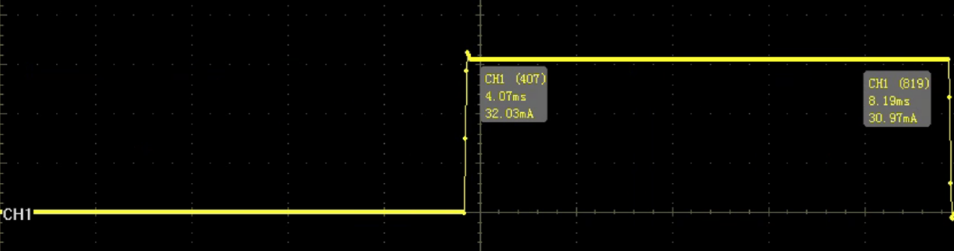
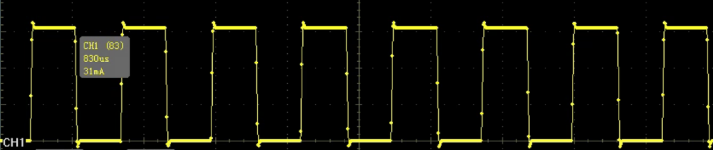
NO | Characteristics | Simbol | Test Pin | Decimal Code | Hexa Code | Bin Code | Duty | S100 |  |  | Acco
 |  |  |  |  |  |  |  | Low Limit[uS] | Duty Pulse Width[uS] | High Limit[uS] | Low Limit[mA] | Current Meas.[mA] | High Limit[mA]
28 | PWM_SCAN | PWM_SC1_CH1~12 | IOUT_CH1~12 | 1023 | 0x03FF | 0000 0011 1111 1111 | 50.00% | 495 | 520.83 | 546 | 1.9 | 2 | 2.1
 |  | PWM_SC2_CH1~12 | IOUT_CH1~12 | 1023 | 0x03FF | 0000 0011 1111 1111 | 50.00% | 495 | 520.83 | 546 | 1.9 | 2 | 2.1
 |  | PWM_SC3_CH1~12 | IOUT_CH1~12 | 1023 | 0x03FF | 0000 0011 1111 1111 | 50.00% | 495 | 520.83 | 546 | 1.9 | 2 | 2.1
 |  | PWM_SC4_CH1~12 | IOUT_CH1~12 | 1023 | 0x03FF | 0000 0011 1111 1111 | 50.00% | 495 | 520.83 | 546 | 1.9 | 2 | 2.1
 |  | PWM_SC5_CH1~12 | IOUT_CH1~12 | 1023 | 0x03FF | 0000 0011 1111 1111 | 50.00% | 495 | 520.83 | 546 | 1.9 | 2 | 2.1
 |  | PWM_SC6_CH1~12 | IOUT_CH1~12 | 1023 | 0x03FF | 0000 0011 1111 1111 | 50.00% | 495 | 520.83 | 546 | 1.9 | 2 | 2.1
 |  | PWM_SC7_CH1~12 | IOUT_CH1~12 | 1023 | 0x03FF | 0000 0011 1111 1111 | 50.00% | 495 | 520.83 | 546 | 1.9 | 2 | 2.1
 |  | PWM_SC8_CH1~12 | IOUT_CH1~12 | 1023 | 0x03FF | 0000 0011 1111 1111 | 50.00% | 495 | 520.83 | 546 | 1.9 | 2 | 2.1
[Test Method]
Force VDD 5V, DIN (VIH = 5V, VIL = 0V)
Set registers
cmd | Addr | data | command | PWM | remark
4b'1101 | 0x00 | 0x800 | RESET
4b'1000 | - | - | ID_GEN
4b'1101 | 0x03 | 0xFFF | CHANNEL_ENABLE |  | ch1~12 Enable
4b'1101 | 0x06 | 0x170 | FAULT_LEVEL |  | 8mA setting
4b'1101 | 0x07 | 0x818 | FAULT_CONTROL |  | O_DET_E, S_DET_E
4b'1101 | 0x08 | 0xFFF | MAX_CURRENT_VREF |  | Output Full Setting
4b'1101 | 0x25 | 0x35A | SERIAL_CLOCK_GEN
4b'1101 | 0x26 | 0x03C | SERIAL_LATENCY
4b'1101 | 0x27 | 0x134 | MCLK_LOCK_1 |  | refer to MCLK_LOCK_2
4b'1101 | 0x28 | 0x850 | MCLK_LOCK_2 |  | MCLK_LOCK_CNT_E=0 (FLL Enable. MCLK unlocking)
 |  |  |  |  | FLL Range : 0 (=default)
 |  |  |  |  | MCLK_LOCK_CNT=0x50+0x134=0x50134 (decimal : 327988)
 |  |  |  |  | => PWM RES=1, 120Hz , XD12 & XD04 : 327988 (=ideal+0.1% margin)
 |  |  |  |  | (=> ideal = 327660 (=39.3192/120Hz = 0x4FFB0)
4b'1101 | 0x2A | 0x000 | OSC_FLL_MAN_1
4b'1101 | 0x2B | 0x808 | OSC_FLL_MAN_2 |  | When using MCLK_LOCK frequency
 |  |  |  |  | -> Register OSC_FLL_MAN=0 in OSC_FLL_MAN2
 |  |  |  |  | Use register MCLK_LOCK_CNT_E=0 in MCLK_LOCK2
 |  |  |  |  | (FLL enable, MCLK unlock)
 |  |  |  |  | When using OSC_FLL_MAN frequency
 |  |  |  |  | -> Register OSC_FLL_MAN=1 in OSC_FLL_MAN2
 |  |  |  |  | Use register MCLK_LOCK_CNT_E=1 of MCLK_LOCK2
 |  |  |  |  | (FLL disable, MCLK locking)
4b'1101 | 0x2D | 0x155 | WR_PROTECT |  | PCK_MODE=0 (Each Channel : common PWM clock)
 |  |  |  |  | PCK_SYNC_E=0 (SYNC Disable)
 |  |  |  |  | REG_WR_PROTECT=0x155(write access to all internal registers is allowable)
4b'1101 | 0x01 | 0xC1B | LD_CONTROL | Tail mode & SCAN_NO | BIN : 1100 0001 1011 / LD_SIZE, SCAN_NO, PWM_RES, LD_DIR
4b'1101 | 0x02 | 0x013 | FPWM_DIVIDER |  | PWM_RES=1, 120Hz (decimal =19)
4b'1111 | - | Refer to the right | LD TRANSMIT | 120Hz process | 120Hz process for sending output : 3 repetitions required Duty 50.00% : 0x1FFF
wait time (1ms)
4b'1001 | - | - | SYNC GEN
wait time (7ms)
4b’1001 | - | - | SYNC GEN | Before each channel measurement, a SYNC_GEN signal is sent before proceeding with the measurement. | Before each channel measurement,
 |  |  |  |  | a SYNC_GEN signal is sent
 |  |  |  |  | before proceeding with the measurement.
 |  |  |  | Meas. 5 times
 |  |  |  | If it fails even once among the measured values, it is a FAIL.
DIFF | Four difference values were calculated from 5 measurements at 100% Duty using the formulas below: |  | Four difference values were calculated from 5 measurements at 100% Duty using the formulas below:
 | Diff_1={(1st - 2nd)/1st} x 100 [%] |  | Diff_1={(1st - 2nd)/1st} x 100 [%]
 | Diff_2={(1st - 3rd)/1st} x 100 [%] |  | Diff_2={(1st - 3rd)/1st} x 100 [%]
 | Diff_3={(1st - 4th)/1st} x 100 [%] |  | Diff_3={(1st - 4th)/1st} x 100 [%]
 | Diff_4={(1st - 5th)/1st} x 100 [%] |  | Diff_4={(1st - 5th)/1st} x 100 [%]
Loop 3
Confidential

Slide 36
NO | Characteristics | Symbol | Test Pin | Decimal Code | Hexa Code | Bin Code | Duty | Extend Register | S100 |  |  | Acco |  |  | Remark
 |  |  |  |  |  |  |  | (0x09 & 0x0A) | Low Limit[uS] | TYP [uS] | High Limit[uS] | Low Limit[mA] | Current Meas.[mA] | High Limit[mA]
29 | PWM_DELAY | PWM_DL1_CH1~12 | IOUT_CH1~12 | 2047 | 0x7FF | 0111 1111 1111 | 50% | 0x000 | 989 | 1040.67 | 1093 | 3.8 | 4 | 4.2 | Acco is set up in the code to measure after the target delay and check if the measured value is a 50% duty value.
 |  | PWM_DL1_DU1~12 |  |  |  |  |  |  | 3959 | 4167 | 4375
 |  | PWM_DL2_CH1~12 | IOUT_CH1~12 | 2047 | 0x7FF | 0111 1111 1111 | 50% | 0x555 | 2969 | 3125.00 | 3281 | 3.8 | 4 | 4.2
 |  | PWM_DL2_DU1~12 |  |  |  |  |  |  | 3959 | 4167 | 4375
 |  | PWM_DL3_CH1~12 | IOUT_CH1~12 | 2047 | 0x7FF | 0111 1111 1111 | 50% | 0xAAA | 4949 | 5209.33 | 5470 | 3.8 | 4 | 4.2
 |  | PWM_DL3_DU1~12 |  |  |  |  |  |  | 3959 | 4167 | 4375
 |  | PWM_DL4_CH1~12 | IOUT_CH1~12 | 2047 | 0x7FF | 0111 1111 1111 | 50% | 0xFFF | 6928 | 7292.67 | 7657 | 3.8 | 4 | 4.2
 |  | PWM_DL4_DU1~12 |  |  |  |  |  |  | 3959 | 4167 | 4375
cmd | Addr | data | command | PWM | remark
4b'1101 | 0x00 | 0x800 | RESET
4b'1000 | - | - | ID_GEN
4b'1101 | 0x03 | 0xFFF | CHANNEL_ENABLE |  | ch1~12 Enable
4b'1101 | 0x06 | 0x170 | FAULT_LEVEL |  | 8mA setting
4b'1101 | 0x07 | 0x818 | FAULT_CONTROL |  | O_DET_E, S_DET_E
4b'1101 | 0x08 | 0xFFF | MAX_CURRENT_VREF |  | Output Full Setting
4b'1101 | 0x25 | 0x35A | SERIAL_CLOCK_GEN
4b'1101 | 0x26 | 0x03C | SERIAL_LATENCY
4b'1101 | 0x27 | 0x134 | MCLK_LOCK_1 |  | refer to MCLK_LOCK_2
4b'1101 | 0x28 | 0x850 | MCLK_LOCK_2 |  | MCLK_LOCK_CNT_E=0 (FLL Enable. MCLK unlocking)
 |  |  |  |  | FLL Range : 0 (=default)
 |  |  |  |  | MCLK_LOCK_CNT=0x50+0x134=0x50134 (decimal : 327988)
 |  |  |  |  | => PWM RES=1, 120Hz , XD12 & XD04 : 327988 (=ideal+0.1% margin)
 |  |  |  |  | (=> ideal = 327660 (=39.3192/120Hz = 0x4FFB0)
4b'1101 | 0x2A | 0x000 | OSC_FLL_MAN_1
4b'1101 | 0x2B | 0x808 | OSC_FLL_MAN_2 |  | When using MCLK_LOCK frequency
 |  |  |  |  | -> Register OSC_FLL_MAN=0 in OSC_FLL_MAN2
 |  |  |  |  | Use register MCLK_LOCK_CNT_E=0 in MCLK_LOCK2
 |  |  |  |  | (FLL enable, MCLK unlock)
 |  |  |  |  | When using OSC_FLL_MAN frequency
 |  |  |  |  | -> Register OSC_FLL_MAN=1 in OSC_FLL_MAN2
 |  |  |  |  | Use register MCLK_LOCK_CNT_E=1 of MCLK_LOCK2
 |  |  |  |  | (FLL disable, MCLK locking)
4b'1101 | 0x2D | 0x155 | WR_PROTECT |  | PCK_MODE=0 (Each Channel : common PWM clock)
 |  |  |  |  | PCK_SYNC_E=0 (SYNC Disable)
 |  |  |  |  | REG_WR_PROTECT=0x155(write access to all internal registers is allowable)
4b'1101 | 0x01 | 0xC03 | LD_CONTROL | Tail mode | BIN : 1100 0000 0011 / LD_SIZE, SCAN_NO, PWM_RES, LD_DIR
4b'1101 | 0x02 | 0x013 | FPWM_DIVIDER |  | PWM_RES=1, 120Hz (decimal =19)
4b'1101 | 0x09 | 0x000 | DELAY CH EXTEND1
4b'1101 | 0x0A | 0x000 | DELAY CH EXTEND2
4b'1101 | 0x0B ~ 0x16 | 0x7FF | DELAY CH1~12
4b'1111 | - | Refer to the right | LD TRANSMIT | 120Hz process | 120Hz process for sending output : 3 repetitions required Duty 50% : 0x1FFF
wait time (1ms)
4b'1001 | - | - | SYNC GEN
wait time (7ms)
4b’1001 | - | - | SYNC GEN | Before each channel measurement, a SYNC_GEN signal is sent before proceeding with the measurement. | Before each channel measurement,
 |  |  |  |  | a SYNC_GEN signal is sent
 |  |  |  |  | before proceeding with the measurement.
 |  |  |  | Measure 1 Time | Considering the delay, it's best to capture two frames.
4b'1101 | 0x09 | 0x555 | DELAY CH EXTEND1
4b'1101 | 0x0A | 0x555 | DELAY CH EXTEND2
4b'1101 | 0x0B ~ 0x16 | 0x7FF | DELAY CH1~12
4b'1111 | - | Refer to the right | LD TRANSMIT | 120Hz process | 120Hz process for sending output : 3 repetitions required Duty 50% : 0x1FFF
wait time (1ms)
4b'1001 | - | - | SYNC GEN
wait time (7ms)
4b’1001 | - | - | SYNC GEN |  | Before each channel measurement,
 |  |  |  | Measure 1 Time | Considering the delay, it's best to capture two frames.
Confidential

Slide 37
NO | Characteristics | Symbol | Test Pin | Decimal Code | Hexa Code | Bin Code | Duty | Extend Register | S100 |  |  | Acco |  |  | Remark
 |  |  |  |  |  |  |  | (0x09 & 0x0A) | Low Limit[uS] | TYP [uS] | High Limit[uS] | Low Limit[mA] | Current Meas.[mA] | High Limit[mA]
29 | PWM_DELAY | PWM_DL1_CH1~12 | IOUT_CH1~12 | 2047 | 0x7FF | 0111 1111 1111 | 50% | 0x000 | 989 | 1040.67 | 1093 | 3.8 | 4 | 4.2 | Acco is set up in the code to measure after the target delay and check if the measured value is a 50% duty value.
 |  | PWM_DL1_DU1~12 |  |  |  |  |  |  | 3959 | 4167 | 4375
 |  | PWM_DL2_CH1~12 | IOUT_CH1~12 | 2047 | 0x7FF | 0111 1111 1111 | 50% | 0x555 | 2969 | 3125.00 | 3281 | 3.8 | 4 | 4.2
 |  | PWM_DL2_DU1~12 |  |  |  |  |  |  | 3959 | 4167 | 4375
 |  | PWM_DL3_CH1~12 | IOUT_CH1~12 | 2047 | 0x7FF | 0111 1111 1111 | 50% | 0xAAA | 4949 | 5209.33 | 5470 | 3.8 | 4 | 4.2
 |  | PWM_DL3_DU1~12 |  |  |  |  |  |  | 3959 | 4167 | 4375
 |  | PWM_DL4_CH1~12 | IOUT_CH1~12 | 2047 | 0x7FF | 0111 1111 1111 | 50% | 0xFFF | 6928 | 7292.67 | 7657 | 3.8 | 4 | 4.2
 |  | PWM_DL4_DU1~12 |  |  |  |  |  |  | 3959 | 4167 | 4375
cmd | Addr | data | command | PWM | remark
4b'1101 | 0x00 | 0x800 | RESET
4b'1000 | - | - | ID_GEN
4b'1101 | 0x03 | 0xFFF | CHANNEL_ENABLE |  | ch1~12 Enable
4b'1101 | 0x06 | 0x170 | FAULT_LEVEL |  | 8mA setting
4b'1101 | 0x07 | 0x818 | FAULT_CONTROL |  | O_DET_E, S_DET_E
4b'1101 | 0x08 | 0xFFF | MAX_CURRENT_VREF |  | Output Full Setting
4b'1101 | 0x25 | 0x35A | SERIAL_CLOCK_GEN
4b'1101 | 0x26 | 0x03C | SERIAL_LATENCY
4b'1101 | 0x27 | 0x134 | MCLK_LOCK_1 |  | refer to MCLK_LOCK_2
4b'1101 | 0x28 | 0x850 | MCLK_LOCK_2 |  | MCLK_LOCK_CNT_E=0 (FLL Enable. MCLK unlocking)
 |  |  |  |  | FLL Range : 0 (=default)
 |  |  |  |  | MCLK_LOCK_CNT=0x50+0x134=0x50134 (decimal : 327988)
 |  |  |  |  | => PWM RES=1, 120Hz , XD12 & XD04 : 327988 (=ideal+0.1% margin)
 |  |  |  |  | (=> ideal = 327660 (=39.3192/120Hz = 0x4FFB0)
4b'1101 | 0x2A | 0x000 | OSC_FLL_MAN_1
4b'1101 | 0x2B | 0x800 | OSC_FLL_MAN_2 |  | When using MCLK_LOCK frequency
 |  |  |  |  | -> Register OSC_FLL_MAN=0 in OSC_FLL_MAN2
 |  |  |  |  | Use register MCLK_LOCK_CNT_E=0 in MCLK_LOCK2
 |  |  |  |  | (FLL enable, MCLK unlock)
 |  |  |  |  | When using OSC_FLL_MAN frequency
 |  |  |  |  | -> Register OSC_FLL_MAN=1 in OSC_FLL_MAN2
 |  |  |  |  | Use register MCLK_LOCK_CNT_E=1 of MCLK_LOCK2
 |  |  |  |  | (FLL disable, MCLK locking)
4b'1101 | 0x2D | 0x155 | WR_PROTECT |  | PCK_MODE=0 (Each Channel : common PWM clock)
 |  |  |  |  | PCK_SYNC_E=0 (SYNC Disable)
 |  |  |  |  | REG_WR_PROTECT=0x155(write access to all internal registers is allowable)
4b'1101 | 0x01 | 0xC03 | LD_CONTROL | Tail mode | BIN : 1100 0000 0011 / LD_SIZE, SCAN_NO, PWM_RES, LD_DIR
4b'1101 | 0x02 | 0x013 | FPWM_DIVIDER |  | PWM_RES=1, 120Hz (decimal =19)
4b'1101 | 0x09 | 0xAAA | DELAY CH EXTEND1
4b'1101 | 0x0A | 0xAAA | DELAY CH EXTEND2
4b'1101 | 0x0B ~ 0x16 | 0x7FF | DELAY CH1~12
4b'1111 | - | Refer to the right | LD TRANSMIT | 120Hz process | 120Hz process for sending output : 3 repetitions required Duty 50% : 0x1FFF
wait time (1ms)
4b'1001 | - | - | SYNC GEN
wait time (7ms)
4b’1001 | - | - | SYNC GEN |  | Before each channel measurement,
 |  |  |  | Measure 1 Time | Considering the delay, it's best to capture two frames.
4b'1101 | 0x09 | 0xFFF | DELAY CH EXTEND1
4b'1101 | 0x0A | 0xFFF | DELAY CH EXTEND2
4b'1101 | 0x0B ~ 0x16 | 0x7FF | DELAY CH1~12
4b'1111 | - | Refer to the right | LD TRANSMIT | 120Hz process | 120Hz process for sending output : 3 repetitions required Duty 50% : 0x1FFF
wait time (1ms)
4b'1001 | - | - | SYNC GEN
wait time (7ms)
4b’1001 | - | - | SYNC GEN |  | Before each channel measurement,
 |  |  |  | Measure 1 Time | Considering the delay, it's best to capture two frames.
Confidential

Slide 38
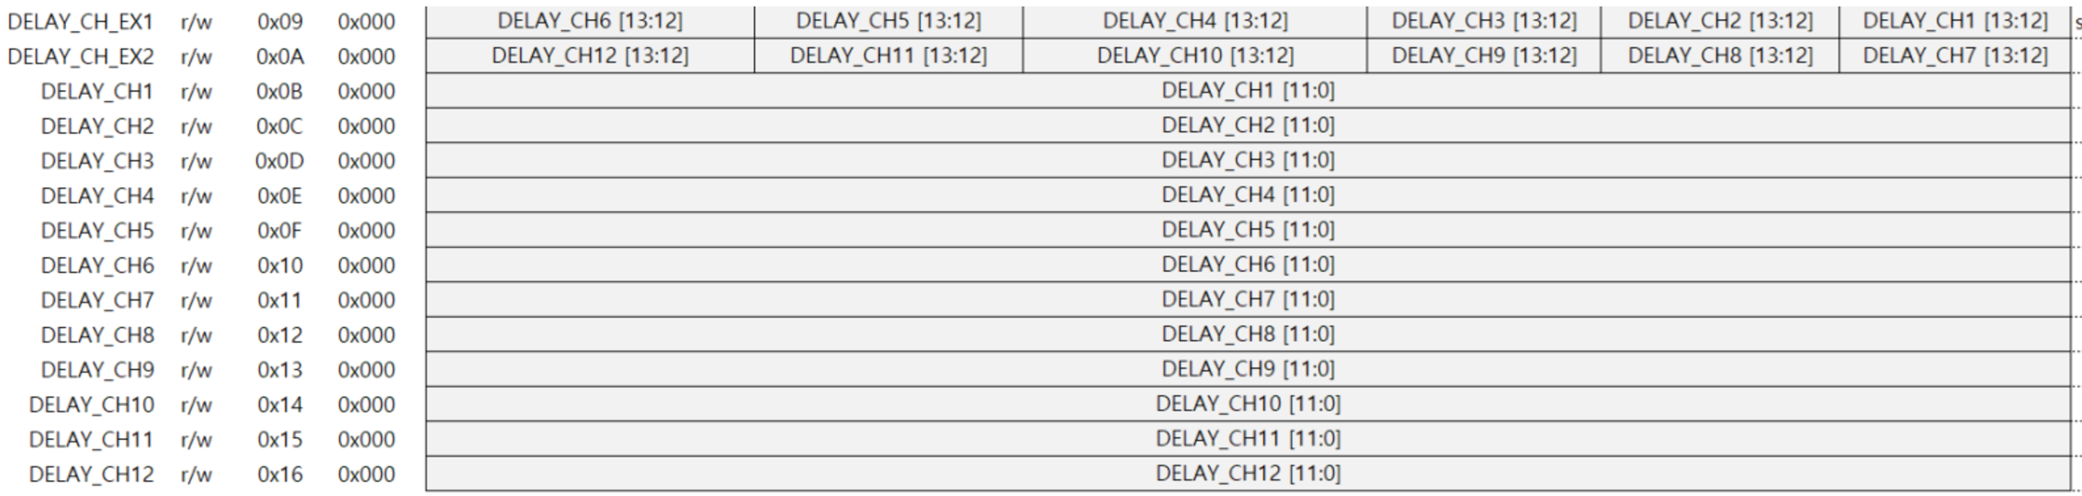
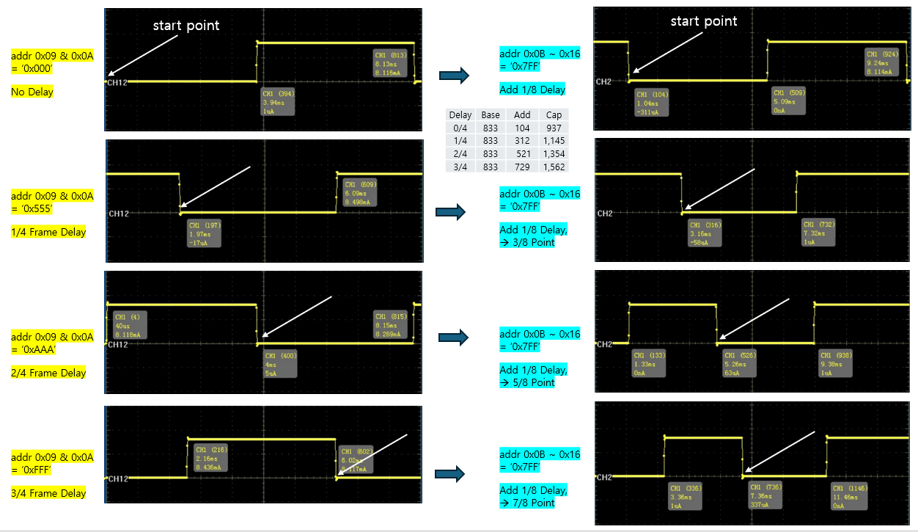
NO | Characteristics | Symbol | Test Pin | Decimal Code | Hexa Code | Bin Code | Duty | Extend Register | S100 |  |  | Acco |  |  | Remark
 |  |  |  |  |  |  |  | (0x09 & 0x0A) | Low Limit[uS] | TYP [uS] | High Limit[uS] | Low Limit[mA] | Current Meas.[mA] | High Limit[mA]
29 | PWM_DELAY | PWM_DL1_CH1~12 | IOUT_CH1~12 | 2047 | 0x7FF | 0111 1111 1111 | 50% | 0x000 | 989 | 1040.67 | 1093 | 3.8 | 4 | 4.2 | Acco is set up in the code to measure after the target delay and check if the measured value is a 50% duty value.
 |  | PWM_DL1_DU1~12 |  |  |  |  |  |  | 3959 | 4167 | 4375
 |  | PWM_DL2_CH1~12 | IOUT_CH1~12 | 2047 | 0x7FF | 0111 1111 1111 | 50% | 0x555 | 2969 | 3125.00 | 3281 | 3.8 | 4 | 4.2
 |  | PWM_DL2_DU1~12 |  |  |  |  |  |  | 3959 | 4167 | 4375
 |  | PWM_DL3_CH1~12 | IOUT_CH1~12 | 2047 | 0x7FF | 0111 1111 1111 | 50% | 0xAAA | 4949 | 5209.33 | 5470 | 3.8 | 4 | 4.2
 |  | PWM_DL3_DU1~12 |  |  |  |  |  |  | 3959 | 4167 | 4375
 |  | PWM_DL4_CH1~12 | IOUT_CH1~12 | 2047 | 0x7FF | 0111 1111 1111 | 50% | 0xFFF | 6928 | 7292.67 | 7657 | 3.8 | 4 | 4.2
 |  | PWM_DL4_DU1~12 |  |  |  |  |  |  | 3959 | 4167 | 4375
Base Waveform for Each Condition
Target Wavfrom for Each Condition
Confidential

Slide 39
Hold this Item
NO | Characteristics | Symbol | Test PIN | MIN | TYP | MAX | Unit | REMARK
26 | Daisy IO | DAISY_IO | DIN | - | - | - | - | -
[Test Method]
Force VDD 5V, DIN (VIH = 5V, VIL = 0V)
Input Register Signals to DIN Pin = [cmd+addr] + [cmd+addr]
Input Register Signals to DOUT Pin = [cmd+ld+data]
Verify Output from DIN Pin:Confirm the combined output = [cmd+ld+data] + [cmd+ld+data]
DAISY_IO
cmd | addr | data | command | remark
4b'1101 | 0x00 | 0x800 | RESET | Input this signal on the DIN pin
8b'10001000 | - | - | ID GEN | Input this signal on the DIN pin
4b'1110 | 0x07 | - | FAULT CONTROL | Input this signal on the DIN pin
4b'1110 | 0x07 | - | FAULT CONTROL | Input this signal on the DIN pin
4b'1110 | 5b'00001 | 0x800 | FAULT CONTROL | Input this signal on the DOUT pin
Measure the output of the DIN pin and compare it to the expected output below. 42bit Output = 1110 00001 1000 0000 0000 1110 00010 1000 0000 0000 Note: Since input is input to DOUT and output is output to DIN, measurement must be performed simultaneously with input.
Recommended test method 1) Make the expected 42bit Output into a pattern and determine pass/fail using a function test.
Recommended test method 2) The above signal converted to decimal = 3,861,177,444,352 Divide this value into three digits and distribute it as follows: DAISY_IO1=3 / DAISY_IO2=861 / DAISY_IO3=177 / DAISY_IO4=444 / DAISY_IO5=352
< Daisy Chain Protocol >
(#2) cmd + addr
Forward
(#1) cmd + addr
Tester
DIN
XD12(#2)
DOUT
DIN
XD12(#1)
(#1) cmd(4bit) + ld(00001) + data(12bit)
(#1) cmd(4bit) + ld(00001) + data(12bit)
(#2) cmd(4bit) + ld(00010) + data(12bit)
Reverse
Forward Path (Command Delivery): Tester transmits a sequence of cmd+addr (the signal for #2) followed by cmd+addr (the signal for #1) to the DIN pin of XD12(#2).
Reverse Path (Data Injection): The output of XD12(#1), consisting of cmd+id+data, is fed into the DOUT pin of XD12(#2).
Data Aggregation and Final Output: XD12(#2) appends its own output to the end of the XD12(#1) output. i.e. it transmits the combined packet “ [#1: cmd+id+data] + [#2: cmd+id+data] “ through the DIN pin.
Confidential

Slide 40
NO | Characteristics | Simbol | Test Pin | Duty | Decimal Code | Hexa Code | Bin Code | Duty | S100 |  |  | Acco
 |  |  |  |  |  |  |  |  | Low Limit[uS] | Duty Pulse Width[uS] | High Limit[uS] | Low Limit[mA] | Current Meas.[mA] | High Limit[mA]
30 | PWM Test | DUTY_0P_CH1~12 | IOUT_CH1~12 | 0.00% | 0 | 0X0000 | 0000 0000 0000 0000 | 0.00% | -2 | 0.0 | 2 | -0.060 | 0.0 | 0.060
 |  | DUTY_0P19_CH1~12 | IOUT_CH1~12 | 0.19% | 31 | 0x001F | 0000 0000 0001 1111 | 0.19% | 13 | 15.8 | 20 | Does not apply to Acco.
 |  | DUTY_1P56_CH1~12 | IOUT_CH1~12 | 1.56% | 255 | 0x00FF | 0000 0000 1111 1111 | 1.56% | 123 | 129.7 | 136 | 0.3mA (S사) 120us(J사) | 0.5mA (S사) 130us (J사) | 0.8 (S사) 140us(J사)
 |  | DUTY_6P24_CH1~12 | IOUT_CH1~12 | 6.24% | 1023 | 0x03FF | 0000 0011 1111 1111 | 6.24% | 494 | 520.4 | 546 | 1.78 | 1.93 | 2.089
 |  | DUTY_12P5_CH1~12 | IOUT_CH1~12 | 12.49% | 2047 | 0x07FF | 0000 0111 1111 1111 | 12.49% | 989 | 1041.2 | 1093 | 3.65 | 3.85 | 4.04
 |  | DUTY_25_CH1~12 | IOUT_CH1~12 | 25.00% | 4095 | 0x0FFF | 0000 1111 1111 1111 | 25.00% | 1979 | 2083.0 | 2187 | 7.30 | 7.69 | 8.07
 |  | DUTY_37P5_CH1~12 | IOUT_CH1~12 | 37.50% | 6143 | 0x17FF | 0001 0111 1111 1111 | 37.50% | 2968 | 3124.7 | 3281 | 10.869 | 11.5 | 12.381
 |  | DUTY_50_CH1~12 | IOUT_CH1~12 | 50.00% | 8191 | 0x1FFF | 0001 1111 1111 1111 | 50.00% | 3958 | 4166.4 | 4375 | 14.59 | 15.36 | 16.13
 |  | DUTY_62P5_CH1~12 | IOUT_CH1~12 | 62.50% | 10240 | 0x2800 | 0010 1000 0000 0000 | 62.50% | 4948 | 5208.7 | 5469 | 18.15 | 19.11 | 20.06
 |  | DUTY_75_CH1~12 | IOUT_CH1~12 | 75.00% | 12288 | 0x3000 | 0011 0000 0000 0000 | 75.00% | 5938 | 6250.4 | 6563 | 21.739 | 22.79 | 24.761
 |  | DUTY_87P5_CH1~12 | IOUT_CH1~12 | 87.51% | 14336 | 0x3800 | 0011 1000 0000 0000 | 87.51% | 6928 | 7292.1 | 7657 | 25.498 | 26.40 | 28.753
 |  | DUTY_93P76_CH1~12 | IOUT_CH1~12 | 93.76% | 15360 | 0x3C00 | 0011 1100 0000 0000 | 93.76% | 7422 | 7813.0 | 8204 | - | - | -
 |  | DUTY_100P_CH1~12 | IOUT_CH1~12 | 100.00% | 16383 | 0x3FFF | 0011 1111 1111 1111 | 100.00% | 7917 | 8333.3 | 8750 | 29.45 | 30.50 | 32.55
 |  | DUTY_DIFF_100P_CH1~12 | IOUT_CH1~12 | 100.00% | 16383 | 0x3FFF | 0011 1111 1111 1111 | 100.00% | -5% | 0 | 5% | -5% | 0 | 5%
 |  | I_100P_CH1~12 | IOUT_CH1~12 | 100.00% | 16383 | 0x3FFF | 0011 1111 1111 1111 | 100.00% | 29.45 [mA] | 31 [mA] | 32.55 [mA] | Does not apply to Acco.
[Test Method]
Force VDD 5.8V, DIN (VIH = 5V, VIL = 0V)
Change the voltage given to the channel (previously 5v) to 7v
Set registers
Measured after Trim
PWM
cmd | Addr | data | command | PWM | remark
4b'1101 | 0x00 | 0x800 | RESET
4b'1000 | - | - | ID_GEN
4b'1101 | 0x03 | 0xFFF | CHANNEL_ENABLE |  | ch1~12 Enable
4b'1101 | 0x06 | 0x570 | FAULT_LEVEL |  | 32mA setting (old = 0x170 8mA setting)
4b'1101 | 0x07 | 0x818 | FAULT_CONTROL |  | O_DET_E, S_DET_E
4b'1101 | 0x08 | 0xFFF | MAX_CURRENT_VREF |  | Output Full Setting
4b'1101 | 0x25 | 0x35A | SERIAL_CLOCK_GEN
4b'1101 | 0x26 | 0x03C | SERIAL_LATENCY
4b'1101 | 0x27 | 0x134 | MCLK_LOCK_1 |  | refer to MCLK_LOCK_2
4b'1101 | 0x28 | 0x050 | MCLK_LOCK_2 |  | MCLK_LOCK_CNT_E=0 (FLL Enable. MCLK unlocking)
 |  |  |  |  | FLL Range : 0 (=default)
 |  |  |  |  | MCLK_LOCK_CNT=0x50+0x134=0x50134 (decimal : 327988)
 |  |  |  |  | => PWM RES=1, 120Hz , XD12 & XD04 : 327988 (=ideal+0.1% margin)
 |  |  |  |  | (=> ideal = 327660 (=39.3192/120Hz = 0x4FFB0)
4b'1101 | 0x2A | 0x000 | OSC_FLL_MAN_1
4b'1101 | 0x2B | 0x000 | OSC_FLL_MAN_2 |  | When using MCLK_LOCK frequency
 |  |  |  |  | -> Register OSC_FLL_MAN=0 in OSC_FLL_MAN2
 |  |  |  |  | Use register MCLK_LOCK_CNT_E=0 in MCLK_LOCK2
 |  |  |  |  | (FLL enable, MCLK unlock)
 |  |  |  |  | When using OSC_FLL_MAN frequency
 |  |  |  |  | -> Register OSC_FLL_MAN=1 in OSC_FLL_MAN2
 |  |  |  |  | Use register MCLK_LOCK_CNT_E=1 of MCLK_LOCK2
 |  |  |  |  | (FLL disable, MCLK locking)
4b'1101 | 0x2D | 0x155 | WR_PROTECT |  | PCK_MODE=0 (Each Channel : common PWM clock)
 |  |  |  |  | PCK_SYNC_E=0 (SYNC Disable)
 |  |  |  |  | REG_WR_PROTECT=0x155(write access to all internal registers is allowable)
4b'1101 | 0x01 | 0xC03 | LD_CONTROL | Tail mode | LD_SIZE : 4, PWM_RES=1, LD_DIR
4b'1101 | 0x02 | 0x013 | FPWM_DIVIDER |  | PWM_RES=1, 120Hz (decimal =19)
4b'1111 | - | Refer to the right | LD TRANSMIT | 120Hz process | 120Hz process for sending output : 3 repetitions required - Duty 0.00% : 0x0000 / Duty 50.00% : 0x1FFF - Duty 0.19% : 0x001F / Duty 62.50% : 0x2800 - Duty 1.56% : 0x00FF / Duty 75.00% : 0x3000 - Duty 6.24% : 0x03FF / Duty 87.51% : 0x3800 - Duty 12.5% : 0x07FF / Duty 93.76% : 0x3C00 - Duty 25.0% : 0x0FFF / Duty 100.0% : 0x3FFF - Duty 37.5% : 0x17FF /
wait time (1ms)
4b'1001 | - | - | SYNC GEN
wait time (7ms)
4b’1001 | - | - | SYNC GEN | Before each channel measurement, a SYNC_GEN signal is sent before proceeding with the measurement. | Before each channel measurement,
 |  |  |  |  | a SYNC_GEN signal is sent
 |  |  |  |  | before proceeding with the measurement.
 |  |  |  | Meas. 5 times
 |  |  |  | If it fails even once among the measured values, it is a FAIL.
DIFF | Four difference values were calculated from 5 measurements at 100% Duty using the formulas below: |  | Four difference values were calculated from 5 measurements at 100% Duty using the formulas below:
 | Diff_1={(1st - 2nd)/1st} x 100 [%] |  | Diff_1={(1st - 2nd)/1st} x 100 [%]
 | Diff_2={(1st - 3rd)/1st} x 100 [%] |  | Diff_2={(1st - 3rd)/1st} x 100 [%]
 | Diff_3={(1st - 4th)/1st} x 100 [%] |  | Diff_3={(1st - 4th)/1st} x 100 [%]
 | Diff_4={(1st - 5th)/1st} x 100 [%] |  | Diff_4={(1st - 5th)/1st} x 100 [%]
Loop 3
Confidential

Slide 41
Leakage Test
NO | Item | Symbol | Test Pin | MIN | TYP | MAX | Unit | REMARK
31 | Output Hi-Z Leak Current (High) 2 | IOZH2 | IOUT_CH1~12 | -5 | 0 | 10 | nA
32 | Output Hi-Z Leak Current (Low) 2 | IOZL2 | IOUT_CH1~12 | -10 | 0 | 10 | nA
33 | Input Leak Current (Low) 2 | IIL2 | TEST, DIN, DOUT SVI, SVO | -500 | 0 | 500 | nA
34 | Input Leak Current (High) 2 | IIH2 | DIN, DOUT, SVI | 55 | 65 | 90 | uA
35 |  |  | TEST, SVO | -500 | 0 | 500 | nA
NO | Item | Symbol | Test Pin | MIN | TYP | MAX | Unit | REMARK
36 | △ IOZH | Delta_IOZH | IOUT_CH1~12 | -7 | 0 | 7 | nA | IOZH2 – IOZH1
37 | △ IOZL | Delta_IOZL | IOUT_CH1~12 | -3.5 | 0 | 3.5 | nA | IOZL2 – IOZL1
38 | △ IIL | Delta_IIL | DIN, DOUT, SVI | -300 | 0 | 300 | nA | IIL2 – IIL1
39 |  | Delta_IIL | TEST, SVO | -100 | 0 | 100 | nA | IIL2 – IIL1
40 | △ IIH | Delta_IIH | DIN, DOUT, SVI | -10 | 0 | 10 | uA | IIH2 – IIH1
41 |  | Delta_IIH | TEST, SVO | -100 | 0 | 100 | nA | IIH2 – IIH1
[Test Method]
IIL
- Force VDD 5.5V
- Force 5.5V for TEST, DIN, DOUT, SVI, and SVO
- Force 0V to ‘Pin under Test’ and measure current
IIH
- Force VDD 5.5V;
- Force 0V for TEST, DIN, DOUT, SVI, and SVO
- Force 5.5V to ‘Pin under Test’ and measure current
3. IOZL
- Force VDD : 5.5V & IOUT_CH1~12 : 0V
- Measure current by parallel
4. IOZH
- Force VDD : 5.5V & IOUT_CH1~12 : 5.5V
- Delay 500ms
- Measure current by parallel
Confidential

Slide 42
NO | Characteristics | Symbol | Test PIN | MIN | TYP | MAX | Unit | REMARK
30 | IOUT2_L Verify | ICTL2_L_VFY1 | IOUT_CH[1:12] | 0.363 | 0.383 | 0.402 | mA | 5% (350)
 | IOUT2_L Verify | ICTL2_L_VFY2 | IOUT_CH[1:12] | 0.985 | 1.037 | 1.089 | mA | 5% (1000)
 | IOUT2_L Verify | ICTL2_L_VFY3 | IOUT_CH[1:12] | 3.834 | 4.036 | 4.238 | mA | 5% (4000)
Excluded from Mass Production Test Program (2026.04.01)
[Test Method]
* OFS Verify :
(1) Force VDD 5V, DIN (VIH = 5V, VIL = 0V)
(2) Set registers (Force/Compare ‘DIN’ pin by test pattern)
OFS_Verify |  | Continued from previous trim item
cmd | addr | data | register | remark
4b'1101 | 0x00 | 0x800 | RESET
4b'1000 | - | - | ID GEN
4b'1101 | 0x03 | 0xFFF | CHANNEL ENABLE
4b'1101 | 0x06 | 0x170 | FAULT LEVEL
4b'1101 | 0x08 | 0xFFF | MAX_CURR_VREF
4b'1101 | 0x25 | 0x35A | SERIAL CLOCK GEN
4b'1101 | 0x26 | 0x03C | SERIAL LATENCY
4b'1101 | 0x3F | 0xC40 | OP MODE | test_en, ddio_dis, pwm_full
4b'1101 | 0x06 | 0x070 | FAULT LEVEL | max 4mA
4b'1101 | 0x08 | 0x15E | MAX_CURR_VREF | (decimal: 350)
4b'1101 | 0x3E | 0xA5A | OTP PROTECT
4b'1101 | 0x3F | 0xC41 | OP MODE | test_en,ddio_dis,pwm_full,addr_ext
4b’1110 | CHxx 0x03~0E | ICTL_CH**[6:0] | Read command
 |  |  | Meas. current (C1)
4b'1101 | 0x3F | 0xC40 | OP MODE | test_en, ddio_dis, pwm_full
4b'1101 | 0x08 | 0x3EB | MAX_CURR_VREF | (decimal: 1000)
4b'1101 | 0x3E | 0xA5A | OTP PROTECT
4b'1101 | 0x3F | 0xC41 | OP MODE | test_en,ddio_dis,pwm_full,addr_ext
4b’1110 | CHxx 0x03~0E | ICTL_CH**[6:0] | Read command
 |  |  | Meas. current (C2)
4b'1101 | 0x3F | 0xC40 | OP MODE | test_en, ddio_dis, pwm_full
4b'1101 | 0x08 | 0xFA0 | MAX_CURR_VREF | (decimal: 4000)
4b'1101 | 0x3E | 0xA5A | OTP PROTECT
4b'1101 | 0x3F | 0xC41 | OP MODE | test_en,ddio_dis,pwm_full,addr_ext
4b’1110 | CHxx 0x03~0E | ICTL_CH**[6:0] | Read command
 |  |  | Meas. current (C3) | Target : 8.000ma

Slide 43
NO | Characteristics | Symbol | Test PIN | MIN | TYP | MAX | Unit | REMARK
42 | IOUT2_H Verify 2 | ICTL2_H_VFY1 | IOUT_CH[1:12] | 2.089 | 2.199 | 2.309 | mA | 5% (350)
 | IOUT2_H Verify 2 | ICTL2_H_VFY2 | IOUT_CH[1:12] | 5.605 | 5.900 | 6.195 | mA | 5% (1000)
 | IOUT2_H Verify 2 | ICTL2_H_VFY3 | IOUT_CH[1:12] | 21.641 | 22.780 | 23.919 | mA | 5% (4000)
[Test Method]
* GAIN Verify :
(1) Force VDD 5V, DIN (VIH = 5V, VIL = 0V)
(2) Set registers (Force/Compare ‘DIN’ pin by test pattern)
GAIN_Verify
cmd | addr | data | register | remark
4b'1101 | 0x00 | 0x800 | RESET
4b'1000 | - | - | ID GEN
4b'1101 | 0x03 | 0xFFF | CHANNEL ENABLE
4b'1101 | 0x06 | 0x170 | FAULT LEVEL
4b'1101 | 0x08 | 0xFFF | MAX_CURR_VREF
4b'1101 | 0x25 | 0x35A | SERIAL CLOCK GEN
4b'1101 | 0x26 | 0x03C | SERIAL LATENCY
4b'1101 | 0x3F | 0xC40 | OP MODE | test_en, ddio_dis, pwm_full
4b'1101 | 0x06 | 0x470 | FAULT LEVEL | max 24mA
4b'1101 | 0x08 | 0x15E | MAX_CURR_VREF | (decimal: 350)
4b'1101 | 0x3E | 0xA5A | OTP PROTECT
4b'1101 | 0x3F | 0xC41 | OP MODE | test_en,ddio_dis,pwm_full,addr_ext
4b’1110 | CHxx 0x03~0E | ICTL_CH**[6:0] | Read command
 |  |  | Meas. current (C1)
4b'1101 | 0x3F | 0xC40 | OP MODE | test_en, ddio_dis, pwm_full
4b'1101 | 0x08 | 0x3EB | MAX_CURR_VREF | (decimal: 1000)
4b'1101 | 0x3E | 0xA5A | OTP PROTECT
4b'1101 | 0x3F | 0xC41 | OP MODE | test_en,ddio_dis,pwm_full,addr_ext
4b’1110 | CHxx 0x03~0E | ICTL_CH**[6:0] | Read command
 |  |  | Meas. current (C2)
4b'1101 | 0x3F | 0xC40 | OP MODE | test_en, ddio_dis, pwm_full
4b'1101 | 0x08 | 0xFA0 | MAX_CURR_VREF | (decimal: 4000)
4b'1101 | 0x3E | 0xA5A | OTP PROTECT
4b'1101 | 0x3F | 0xC41 | OP MODE | test_en,ddio_dis,pwm_full,addr_ext
4b’1110 | CHxx 0x03~0E | ICTL_CH**[6:0] | Read command
 |  |  | Meas. current (C3)

Slide 44
NO | Characteristics | Symbol | Test PIN | MIN | TYP | MAX | Unit | REMARK
43 | △IOUT2_H Verify 2 | IOUT2_H_P1_DELTA | IOUT_CH[1:12] | -1.5 | 0 | 1.5 | % | {(IOUT2 – IOUT1)/IOUT}*100
 | △IOUT2_H Verify 2 | IOUT2_H_P2_DELTA | IOUT_CH[1:12] | -1.5 | 0 | 1.5 | % | {(IOUT2 – IOUT1)/IOUT}*100
 | △IOUT2_H Verify 2 | IOUT2_H_P3_DELTA | IOUT_CH[1:12] | -1.5 | 0 | 1.5 | % | {(IOUT2 – IOUT1)/IOUT}*100
Excluded from Mass Production Test Program (2026.04.01)
NO | Characteristics | Symbol | Test PIN | MIN | TYP | MAX | Unit | REMARK
43 | Standby Current 2 | SIDD | VDD | 2.4 | 3 | 3.5 | mA | Temporary @8mA
- SIDD
Force VDD 5V
Open all signal pins
Measure VDD current after wait time (10~100ms)
NO | Characteristics | Symbol | Test PIN | MIN | TYP | MAX | Unit | REMARK
44 | Dynamic Current 2 | DIDD2 | VDD | 2.4 | 3 | 3.5 | mA | Temporrary @8mA
- DIDD
Force VDD 5V
PWM test condtion and pattern looping
Measure VDD current after wait time (10~100ms)
NO | Characteristics | Symbol | Test PIN | MIN | TYP | MAX | Unit | REMARK
45 | △Dynamic Current | DIDD_DELTA | VDD | -5 | 0 | 5 | % | Temporrary @8mA
Confidential

Slide 45
NO | Characteristics | Symbol | Test PIN | MIN | TYP | MAX | Unit | REMARK
46 | IOUT_OFF_L Verify | ICTL_OFF_L_VFY | IOUT_CH[1:10] | 0.985 | 1.037 | 1.089 | mA | 5% (1000)
 |  |  | IOUT_CH[11:12] | -0.1 | 0 | 0.1 | mA | - % (1000)
[Test Method]
* OFS Verify :
(1) Force VDD 5V, DIN (VIH = 5V, VIL = 0V)
(2) Set registers (Force/Compare ‘DIN’ pin by test pattern)
OFS_Verify |  | Continued from previous trim item
cmd | addr | data | register | remark
4b'1101 | 0x00 | 0x800 | RESET
4b'1000 | - | - | ID GEN
4b'1101 | 0x03 | 0x3FF | CHANNEL ENABLE
4b'1101 | 0x06 | 0x170 | FAULT LEVEL | 8mA
4b'1101 | 0x08 | 0xFFF | MAX_CURR_VREF
4b'1101 | 0x25 | 0x35A | SERIAL CLOCK GEN
4b'1101 | 0x26 | 0x03C | SERIAL LATENCY
4b'1101 | 0x3F | 0xC40 | OP MODE | test_en, ddio_dis, pwm_full
4b'1101 | 0x06 | 0x070 | FAULT LEVEL | max 4mA
4b'1101 | 0x08 | 0x15E | MAX_CURR_VREF | (decimal: 350)
4b'1101 | 0x3E | 0xA5A | OTP PROTECT
4b'1101 | 0x3F | 0xC41 | OP MODE | test_en,ddio_dis,pwm_full,addr_ext
4b’1110 | CHxx 0x03~0E | ICTL_CH**[6:0] | Read command
 |  |  | Meas. current (C1)
4b'1101 | 0x3F | 0xC40 | OP MODE | test_en, ddio_dis, pwm_full
4b'1101 | 0x08 | 0x3EB | MAX_CURR_VREF | (decimal: 1000)
4b'1101 | 0x06 | 0x070 | FAULT LEVEL | max 4mA
4b'1101 | 0x3E | 0xA5A | OTP PROTECT
4b'1101 | 0x3F | 0xC41 | OP MODE | test_en,ddio_dis,pwm_full,addr_ext
4b’1110 | CHxx 0x03~0E | ICTL_CH**[6:0] | Read command
 |  |  | Meas. current (C2)
4b'1101 | 0x3F | 0xC40 | OP MODE | test_en, ddio_dis, pwm_full
4b'1101 | 0x08 | 0xFA0 | MAX_CURR_VREF | (decimal: 4000)
4b'1101 | 0x3E | 0xA5A | OTP PROTECT
4b'1101 | 0x3F | 0xC41 | OP MODE | test_en,ddio_dis,pwm_full,addr_ext
4b’1110 | CHxx 0x03~0E | ICTL_CH**[6:0] | Read command
 |  |  | Meas. current (C3) | Target : 8.000ma

Slide 46
7. Individual Test Plan
No | Item | Symbol | Test PIN | MIN | TYP | MAX | Unit | REMARK
47 | Power Open/Short 2 | OS_VSS2 | VSS | -0.2 | 0.0 | 0.25 | V
48 | Open/Short (NMOS) 2 | OSN2 | ALLPINS | -0.9 | -0.6 | -0.3 | V
49 | Open/Short (PMOS) 2 | OSP2 | TEST, DIN, DIOUT, SVI, SVO | 0.3 | 0.6 | 0.9 | V
50 | Power Open/Short 2 | OS_VDD2 | VDD | -0.8 | -0.5 | -0.2 | V
[Test Method]
VDD and all signal pins : 0V Force
Measure signal pins and VDD pins after sourcing or sinking current (with PMU)
OS_VSS : source current 100uA OSN : sink current -100uA
OSP : source current 100uA
OS_VDD : sink current -100uA
ALLPINS : TEST, DIN, SVO, SVI, DOUT, IOUT_CH[1:12]
VDD
Confidential

