Slide 1

Global Technologies
ID601
The RGB LED Current Sink Driver IC
12 Channels
General Description
The ID601 is a 12-channel constant current sink RGB LED driver for display backlight systems.
While conventional RGB backlight systems require separate three channels for red, green, and blue LED pixels, the ID601 achieves multiplexed driving for full-color RGB backlight pixels with one or two channels.
This approach allows single-layer BLU implementation, significantly reducing PCB layers.
Each channel supports up to 64mA of output current and a maximum output voltage of 24V and can time-share up to three LEDs per channel.
This device can support max 14-bit PWM dimming resolution and a 12-bit DAC global brightness resolution.
To ensure stable, flicker-free RGB time-sequential operation, the device features optimized subframe timing control and precise current regulation to effectively suppress flickering caused by rapid color transitions.
Integrated self-protection features include LED open/short detection and overheating shutdown. is also included to optimize the VLED voltage feedback control function during LED operation, improving power efficiency.
The ID601 can be controlled with several commands through a IC603 controller or directly by a MCU. Multiple ID601 devices can be daisy-chained and controlled via a serial interface from a single IC603, enabling scalable, high-channel-count RGB LED backlight systems for large-area displays. The ID601 is ASIL-B compliant.
Application
RGB Backlight for Automotive Display.
  (Cluster, Center Information, Entertainment)
LED Backlight for TV and Monitor.
Ordering Information
Product ID | Package | Body Size
ID601 | QFN3030-24L | 3.0x3.0x0.55mm

Slide 2
ID601
Features
ISO 26262 compliant ( Up to ASIL-B )
AEC-Q100 Qualified for Automotive Applications
Grade 1: 125°C Ambient Operating Temperature
Support Flexible R/GB pad mapping for various LED pixel configuration
Bi-directional 1-wire daisy chain (max 31 serial) connection with configurable data rate
Support Interface CRC check function
12-channel output sink drivers with programmable max. current 64mA
12-bit global brightness control
Configurable 12-bit PWM or 14-bit PWM
Support internal OSC frequency spread function for EMI rejection
Programmable output headroom voltage detection for VLED voltage optimization
Configurable dimming directions, head shift lighting and tail shift lighting
Sync controllability between daisied devices via command or wire
Optimal IC pin configuration allows for single layer PCB
Supply voltage 3.0 ~ 5.5V
Maximum 24V output driver working (headroom) voltage
Fault events support of driver function
  Shorted or Open LEDs
  Thermal Warning / Shutdown
  Overvoltage/Undervoltage Detection on All Supplies
  Digital Input/Output Control Signal Monitoring
Built-in-Self-Test for Internal Fault Detection Comparators
Compact QFN3030-24 pin package

Slide 3
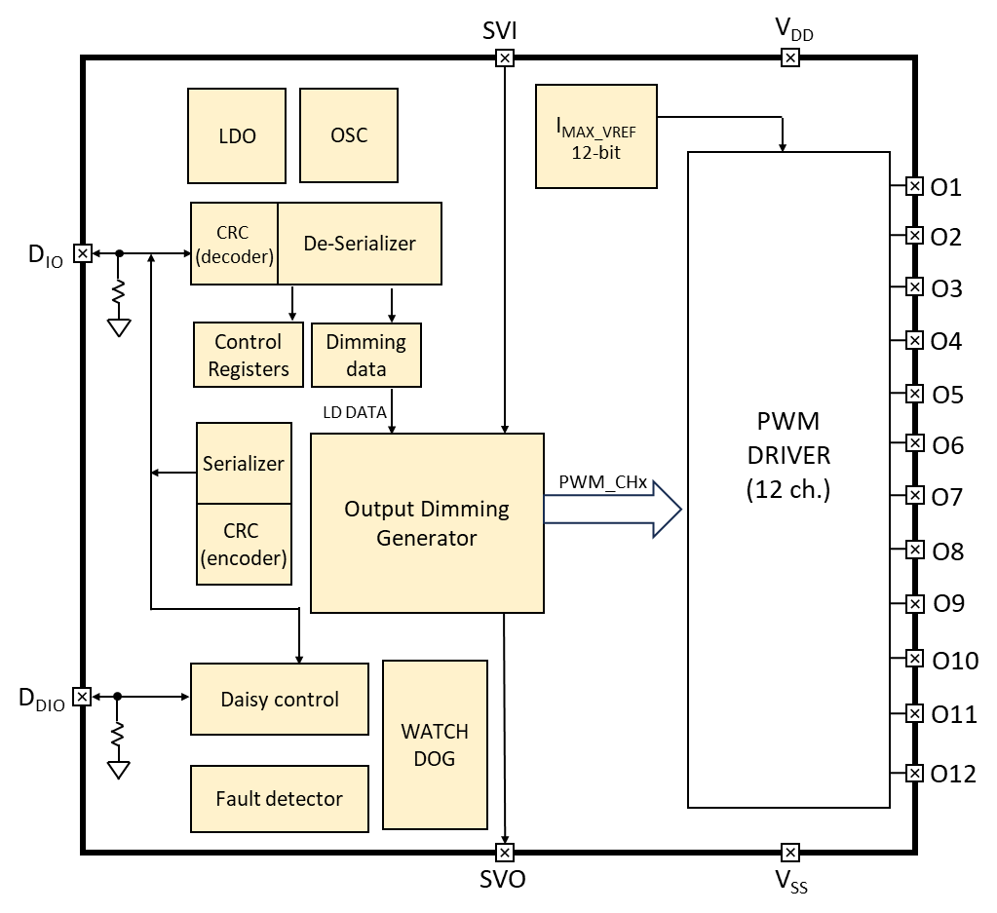
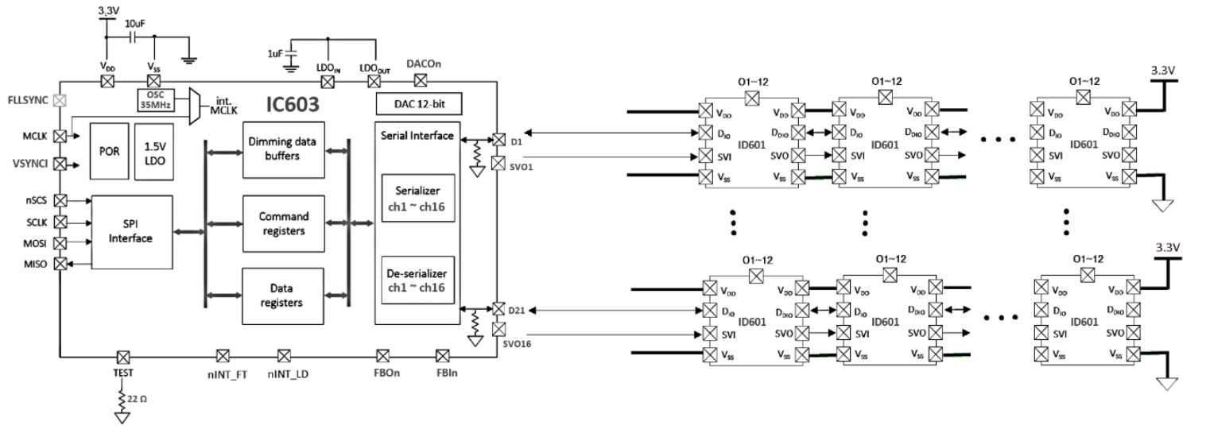
ID601
Block Diagram
Figure 1. Functional Block Diagram
Application Circuit
Figure 2. Application scheme

Slide 4
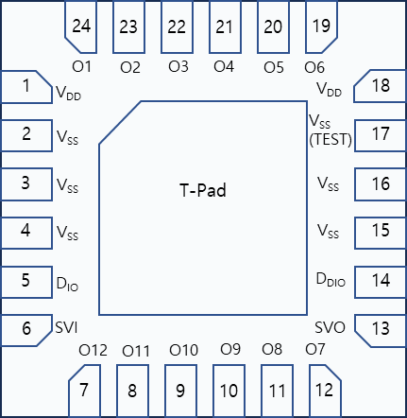
ID601
Pin diagram (Top View)
Figure 3. Pin Map
Pin description
Pin Name | Pin No. | I/O | Type | Description | Remark
V_{DD} | 1 | - | Power | Supply voltage
V_{SS} | 2 | - | GND | Ground
V_{SS} | 3 | - | GND | Ground
V_{SS} | 4 | - | GND | Ground
D_{IO} | 5 | I/O | Digital | Data In/Out | Internal PD, 23KΩ
SVI | 6 | I | Digital | External sync. Input | External svsync (+vsync) daisy chain connected Internal PD, 23KΩ
O12 | 7 | O | Current Load | Current Sink 12 | If unused, connect to GND
O11 | 8 | O | Current Load | Current Sink 11 | If unused, connect to GND
O10 | 9 | O | Current Load | Current Sink 10 | If unused, connect to GND
O9 | 10 | O | Current Load | Current Sink 9 | If unused, connect to GND
O8 | 11 | O | Current Load | Current Sink 8 | If unused, connect to GND
O7 | 12 | O | Current Load | Current Sink 7 | If unused, connect to GND
SVO | 13 | O | Digital | External sync. Output | External svsync (+vsync) daisy chain connected Internal PD, 23KΩ

Slide 5

ID601
Pin description
Pin Name | Pin No. | I/O | Type | Description | Remark
D_{DIO} | 14 | I/O | Digital | Daisied Data In/Out | Internal PD, 23KΩ
V_{SS} | 15 | - | GND | Ground
V_{SS} | 16 | - | GND | Ground
V_{SS} | 17 | - | GND | Ground | @ Test pin
V_{DD} | 18 | - | Power | Supply Voltage
O6 | 19 | O | Current Load | Current Sink 6 | If unused, connect to GND
O5 | 20 | O | Current Load | Current Sink 5 | If unused, connect to GND
O4 | 21 | O | Current Load | Current Sink 4 | If unused, connect to GND
O3 | 22 | O | Current Load | Current Sink 3 | If unused, connect to GND
O2 | 23 | O | Current Load | Current Sink 2 | If unused, connect to GND
O1 | 24 | O | Current Load | Current Sink 1 | If unused, connect to GND
Table 1. Pin Description
Equivalent Circuits of individual pins
Pad Name | I/O | Internal Circuit | Description
D_{IO} | I/O |  | Data In/Out
D_{DIO} | I/O |  | Daisied Data In/Out

Slide 6
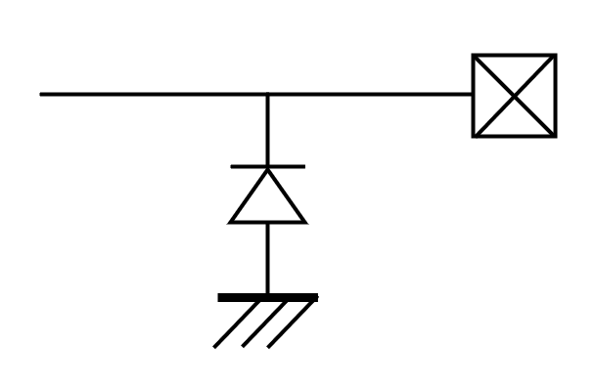
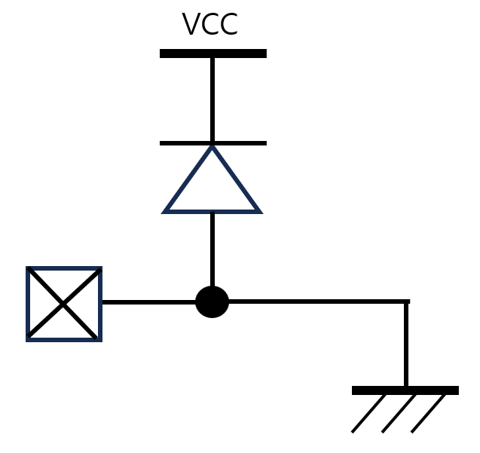
ID601
Equivalent Circuits of individual pins
Pad Name | I/O | Internal Circuit | Description
O1 ~ O12 | Current Sink |  | Current Load
VDD | - |  | Supply voltage
VSS | - |  | GND
SVI | I |  | Schmit trigger
SVO | O |  | TTL output
V_{DD}
Figure 4. Equivalent Circuits of individual pins

Slide 7
ID601
Absolute Maximum Ratings (Ta = 25℃ unless otherwise noted)
Parameter | Symbol | Value | Unit
Supply voltage | V_{DD} | -0.3 ~ 6.0 | V
Sink output pin voltage | V_{O} | -0.3 ~ 24 | V
Sink output current | I_{O} | 64 | mA
D_{IO} to GND | V_{DIO} | -0.3 ~ V_{DD}+0.3 | V
D_{DIO} to GND | V_{DDIO} | -0.3 ~ V_{DD}+0.3 | V
SVI to GND | V_{SVI} | -0.3 ~ V_{DD}+0.3 | V
SVO to GND | V_{SVO} | -0.3 ~ V_{DD}+0.3 | V
Storage Temperature | T_{stg} | ~ 165 | ℃
Reflow Temperature |  | ~ 260 | ℃
Table 2. Absolute Maximum Ratings
ESD Ratings
Parameter | Symbol | Value | Unit | Remark
Electrostatic Discharge HBM | ESD_{HBM} | ±2000 | V | AEC Q100-002
Electrostatic Discharge CDM | ESD_{CDM} | ±500 | V | AEC Q100-011
Electrostatic Discharge CDM (corner pins) | ESD_{CDM} | ±750 | V | AEC Q100-011
Table 3. ESD ratings
Recommended Operating Condition
Parameter | Symbol | Value | Unit
V_{DD} Supply voltage range | V_{DD} | 4.5 ~ 5.5 | V
Ambient temperature | T_{A} | -40 ~ 125 | ℃
Junction temperature | T_{J} | -40 ~ 150 | ℃
Table 4. Recommended Operating Condition

Slide 8
ID601
Thermal Information
Parameter | Symbol | Value | Unit
Junction to Ambient | R_{θJA} | 68 ¹⁾ | ℃/W
Junction to Case | R_{θJC} | 4.0 ¹⁾ | ℃/W
Power Dissipation on package | P_{TOT} | 1.0 ¹⁾ | W
Ambient temperature | T_{A} | -40 ~ 125 | ℃
Junction temperature | T_{J} | -40 ~ 150 | ℃
Storage temperature | T_{STG} | -45 ~ 150 | ℃
Relative Humidity(non-condensing) | RH_{NC} | 5 ~ 85 | %
Moisture Sensitivity Level | MSL | 3 ²⁾ | level
Table 5. Thermal Information
Note :
1) Surface mounted on FR-4 substrate PC Board 1” x 1” inch 2-oz copper plate, V_{HD}=2.0V I_{OUT}=64mA T_{A} = 55℃
2) Maximum Floor Life-time of 168 hr

Slide 9
ID601
Electrical Characteristic (V_{DD} =3.3V, Ta=25.0℃ unless otherwise noted)
Characteristics | Symbol | Condition | Value |  |  | Unit
 |  |  | min | typ | max
Supply voltage
Operating voltage | V_{DD}¹⁾ |  | 3.0 | - | 5.5 | V
Supply current
Quiescent Current | I_{s} | Standby state, No LED current | - | 2.00 | - | mA
Operating Current | I_{DD} | All output 100% Independent of duty sink | - | 3.00 | - | mA
Oscillator
Internal MCLK ²⁾ | f_{OSC} |  | 40 | - | 60 | MHz
In/Out
D_{IO}, D_{DIO} | V_{IL} V_{IH} | Input logic low level | - | - | 0.7 | V
 |  | Input logic high level | 2.5 | - | V_{DD}
 | V_{OL} V_{OH} | Output logic low level @ 4mA | - | - | 0.5 | V
 |  | Output logic high level @ 4mA | V_{DD}*0.8 | - | V_{DD}
 | R_{PD} | Internal pull-down resistance | - | 23 | - | KΩ
Logic long time ³⁾ | T_{1H}, T_{0L} | as a receiver | 6 | - | 63 | MCLK
Logic short time ³⁾ | T_{1L}, T_{0H} | as a receiver | 3 | - | 32 | MCLK
Propagation delay | T_{D_DS} | Downstream (D_{IO} to D_{DIO}) | - | 9.0 | 14 | ns
Propagation output skew⁴⁾ | T_{DSKEW_DS} | D_{DDIO} T_{1H}=T_{1H}-T_{DSKEW_DS} @downstrm | - | 1.5 | 2.6 | ns
Propagation delay | T_{D_US} | Upstream (D_{DIO} to D_{IO}) | - | 9.5 | 14.5 | ns
Propagation output skew⁴⁾ | T_{DSKEW_US} | D_{DIO} T_{1H}=T_{1H}-T_{DSKEW_US} @upstream | - | 1.4 | 2.3 | ns
Logic ‘1’
Logic ‘0’
T_{1H}
T_{1L}
T_{0H}
T_{0L}
Note : 1) The operation below V_{DD}, 3.3V will limit a maximum LED sinking current and affect a current variation.
2) Oscillator frequency tolerance can be controlled by FLL within 2%.
3) The conditions, ①T_{1H} ≥ T_{0H}* 2 ② T_{0L} ≥ T_{1L}* 2 ③ (T_{1H} +T_{0H}) = (T_{0L}+T_{1L}) < 90 are normally recommended.
However, the value depends on the baud-rate of the IC603.
4) On downstreaming (or upstreaming), the T_{1H} of D_{DDIO} (or T_{1H} of D_{DIO}) is shorted as many as T_{DSKEW_DS} (or T_{DSKEW_US}), but the total of 1 bit cycle will remain the same.
So, the proper value for T_{1H} and T_{0L} must be carefully determined based on the daisy size.

Slide 10
ID601
Electrical Characteristic (V_{DD} =3.3V, Ta=25.0℃ unless otherwise noted)
Characteristics | Symbol | Condition | Value |  |  | Unit
 |  |  | min | typ | max
Output
Driving voltage | V_{O} | Headroom voltage V_{HD} : 0.35V@ I_{O} 4mA, 0.40V@ I_{O} 8mA 0.44V@ I_{O} 12mA, 0.49V@ I_{O} 16mA 0.54V@ I_{O} 20mA, 0.59V@ I_{O} 24mA 0.64V@ I_{O} 28mA, 0.69V@ I_{O} 32mA 0.74V@ I_{O} 36mA, 0.79V@ I_{O} 40mA 0.85V@ I_{O} 44mA, 0.89V@ I_{O} 48mA 0.96V@ I_{O} 52mA, 1.00V@ I_{O} 56mA 1.10V@ I_{O} 60mA, 1.15V@ I_{O} 64mA | V_{HD} | - | 24 | V
Short detection voltage ⁴⁾ | V_{SD} | Short detection level V_{SD} : 3b’000=3.5V, 3b’001=6.5V 3b’010=9.5V, 3b’011=12.5V 3b’100=16.5V, 3b’101=16.5V 3b’110=16.5V, 3b’111=16.5V | - | V_{SD} | - | V
Short detection hysteresis voltage | V_{SDH} |  | - | 0.65 | - | V
Open detection voltage ⁴⁾ | V_{OD} |  | - | - | 0.35 | V
Open detection hysteresis voltage | V_{ODH} |  | - | 0.075 | - | V
Sink current | I_{O} | Device max current level : I_{O} 4’b0000 = 4mA, 4’b0001 = 8mA 4’b0010 = 12mA, 4’b0011 = 16mA 4’b0100 = 20mA, 4’b0101 = 24mA 4’b0110 = 28mA, 4’b0111 = 32mA 4’b1000 = 36mA, 4’b1001 = 40mA 4’b1010 = 44mA, 4’b1011 = 48mA 4’b1100 = 52mA, 4’b1101 = 56mA 4’b1110 = 60mA, 4’b1111 = 64mA | - | - | 64 | mA
Current accuracy ⁵⁾ | % | @ a trimmed point (Room temperature at 25℃) | -1.5 | - | +1.5 | %
Current dynamic range | % |  | 5 | - | 95 | %
LED off current | I_{OFF} | Vo = 24V | - | - | 300 | nA
Feedback
FB threshold voltage (Logically ORed for 12-ch) | V_{FBA} | FB level V_{FBA} : 3’b000 = 0.4V, 3’b001 = 0.5V 3’b010 = 0.6V, 3’b011 = 0.7V 3’b100 = 0.85V, 3’b101 = 1.0V 3’b110 = 1.15V, 3’b111 = 1.3V | - | V_{FBA} | - | V
FB hysteresis voltage | V_{FBH} |  | - | 60 | - | mV
Thermal protection
Thermal cut off @TJ | TCUT |  | 150 | - | - | ℃
Thermal cut off hysteresis @TJ | THYS |  | - | 20 | - | ℃

Slide 11
ID601
Note : 4) If LED open or short event is happened, the corresponding channel will be turned-off under the function
enabled. If the thermal is happened, all channels output will be turned-off under the function enabled.
5) Under satisfying the power dissipation specification.
Electrical Characteristic (V_{DD} =3.3V, Ta=25.0℃ unless otherwise noted)
Characteristics | Symbol | Condition | Value |  |  | Unit
 |  |  | min | typ | max
V_{DD} Ramp up
V_{DD} Ramp up time | T_{VDD} | from 0 to stable 3.3V | - | - | 2.0 | ms
Initialization after V_{DD}, 3.3V stable
Internal Initial time | T_{INIT} | from stable 3.3V | 100 | - | - | ms
Allowed 1st command | T_{FCMD} | after T_{INIT} is completed | 5 | - | - | ms
VSYNC daisy out @ SYNCMODE = 1
VSYNCO delay | T_{VSOD} | from VSYNCI to VSYNCO | - | 5.0 | 9.0 | ns
Table 6. Electrical Characteristic
Important statement
Global Technologies reserves the right to change the above-mentioned information without prior notice.
Power Sequence
V_{DD}
3.3V stable
1st Command to ID601
T_{VDD}
T_{INIT}
T_{FCMD}
accessible
Set-up for dimming
ID601 setup for dimming
V_{LED}
T_{SU_DIM}
Figure 5. Power up sequence and Ramp-up time

Slide 12
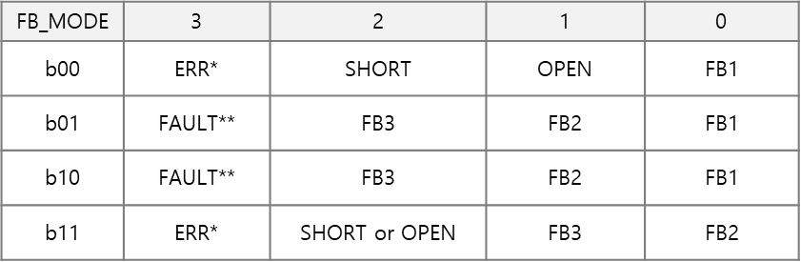
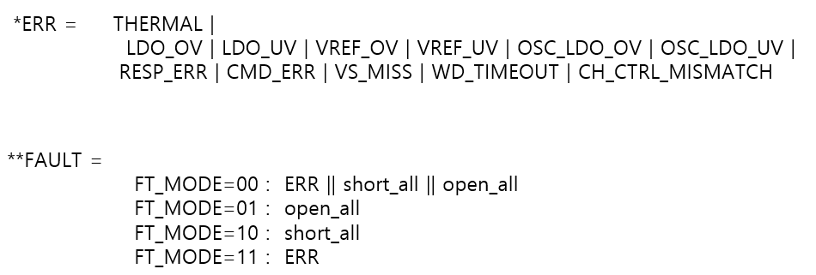
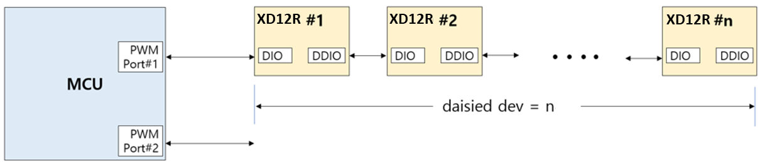
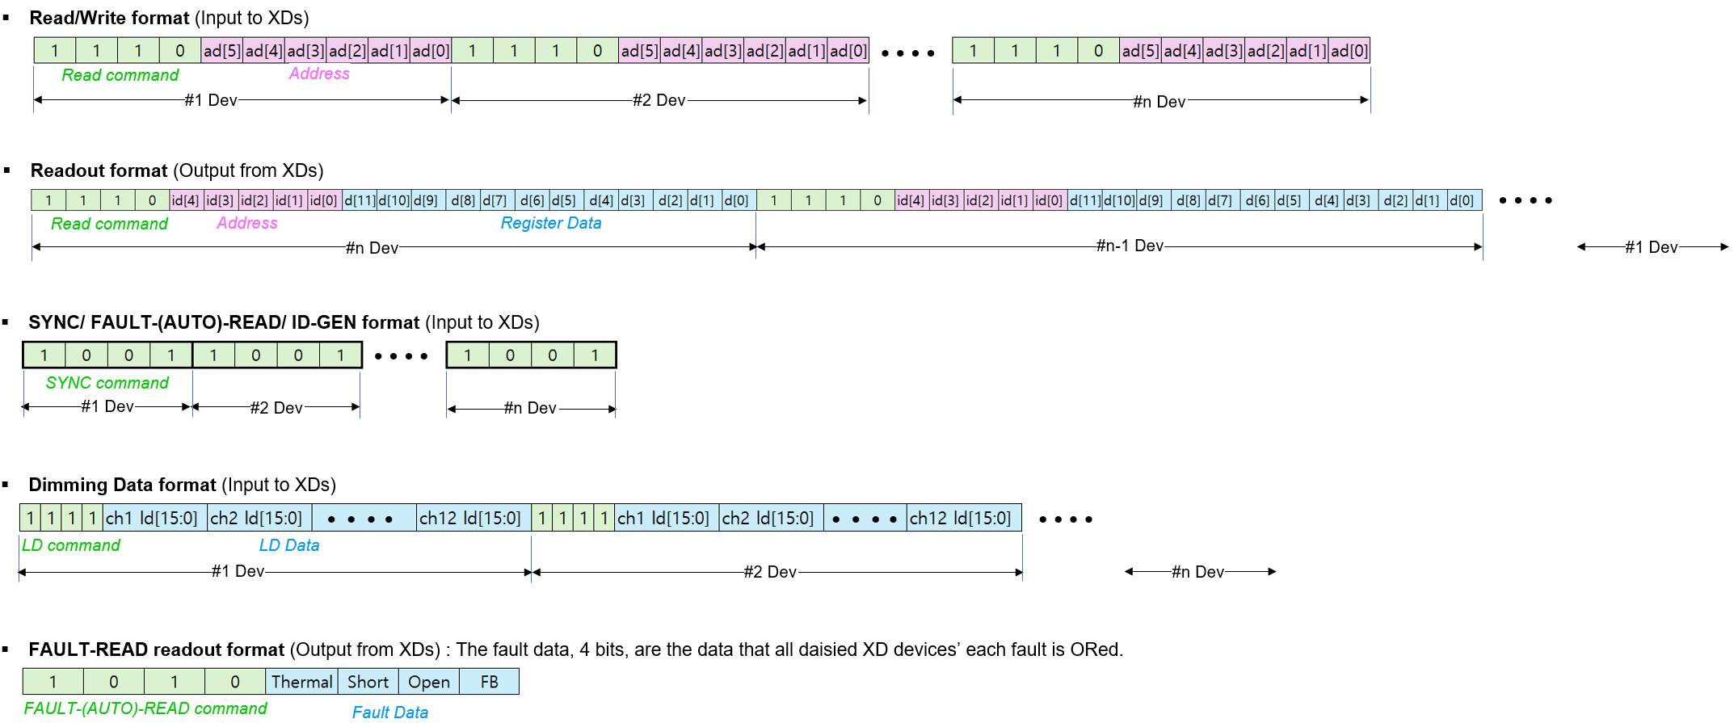
ID601
Functional Description
Serial Communication Protocol
The ID601 can be controlled with several commands through a IC603 controller or directly by MCU.
The access protocol and frame format are as follows and if several ID601 is connected in daisy, the commands should be repeated successively as many as the ID601 number in daisy chain.
Table 5. Serial communication protocol @ PC_EN = 0
The serial communication protocol and the packet formats are shown in below for more details.
ID601 #1
ID601 #2
ID601 #n
IC603
or
MCU
41
LD_TYP=01,PWM_RES=1
41
41
41
41
41

Slide 13
ID601
Functional Description
PWM Configuration
The PWM behavior depends on PWM configuration set to the PWM_RES and SUB-FRAME
(ex: LD_TYPE =1, svsync / 3) as shown in the Table 6. LD data is applied to the next frame.
PWM_ RES | sub- frame # | LD data[13:0]
 |  | D13 | D12 | D11 | D10 | D9 | D8 | D7 | D6 | D5 | D4 | D3 | D2 | D1 | D0
0 (12-bit) | 4 | x | x | 11 | 10 | 9 | 8 | 7 | 6 | 5 | 4 | 3 | 2 | 1 | 0
 | 8 | x | x | 11 | 10 | 9 | 8 | 7 | 6 | 5 | 4 | 3 | 2 | 1 | 0
 | 16 | x | x | 11 | 10 | 9 | 8 | 7 | 6 | 5 | 4 | 3 | 2 | 1 | 0
 | 32 | x | x | 11 | 10 | 9 | 8 | 7 | 6 | 5 | 4 | 3 | 2 | 1 | 0
1 (14-bit) | 4 | 13 | 12 | 11 | 10 | 9 | 8 | 7 | 6 | 5 | 4 | 3 | 2 | 1 | 0
 | 8 | 13 | 12 | 11 | 10 | 9 | 8 | 7 | 6 | 5 | 4 | 3 | 2 | 1 | 0
 | 16 | 13 | 12 | 11 | 10 | 9 | 8 | 7 | 6 | 5 | 4 | 3 | 2 | 1 | 0
 | 32 | 13 | 12 | 11 | 10 | 9 | 8 | 7 | 6 | 5 | 4 | 3 | 2 | 1 | 0
sub-frames # with max. duty
step # in sub-frame without max. duty
x
don’t care
Table 6. PWM Configuration
(example)
LD_TYPE = 1, LD_DIR = 1, SUB_FRAME = 4
RED : sub-frames # with max. duty = 3
GREEN : sub-frames # with max. duty = 2
BLUE : sub-frames # with max. duty = 1

Slide 14
ID601
Functional Description
RGB PWM Dimming
TYPE-1 (RGB)
The ID601 supports three LEDs(red, green, blue) dimming. Type-1 allows for time-division drive of three LEDs(red, green, blue) per channel. The three LEDs can be configured for different RGB colors, and the IC603 sets the time-division drive times for each RGB LED within a frame and transmits them to the ID601 as SVI signals.
The ID601 can independently control the current of each RGB LED by driving VREF1/2/3 at separate SVI intervals. Meanwhile, the IC603 provides external VLED selection signals (GATE1/2/3) for time-division drive.
LD_TYPE | LED Type | No. ch. per pixel | No. pixel per IC | Full-time driving | Time sequential driving
1 | RGB or BGB | 1 | 12 | - | LED1/LED2/LED3
2 | R-GB | 2 | 6 | LED1 | LED2/LED3
3 | GB | 1 | 12 | - | LED3/LED3
Table 7. ID601 driving type for LED backlight
VLED1
VLED2
VLED3
GATE1
GATE2
GATE3
CHx
CHx+1
ID601
Figure. 6 PWM Dimming sequence @ LD_DIR = 1, SYNCMODE = 0, TYPE-1

Slide 15
ID601
Functional Description
RGB PWM Dimming
TYPE-2 (R/GB, 6CH)
The ID601 supports three LEDs(red, green, blue) dimming. In Type-2 mode, odd channels independently drive one LED(red), while even channels support brightness control by time-divisionally driving two LEDs(green, blue).
Brightness control for odd channels is implemented within a single frame, regardless of the SVI value, while brightness control for even channels is implemented within two SVI intervals for two LEDs within a single frame.
VLED1 (: GATE1)
VLED2
VLED3
GATE2
GATE3
CHx
CHx+1
CHy
CHy+1
ID601
Figure. 7 PWM Dimming sequence @ LD_DIR = 1, SYNC_MODE = 0, TYPE-2

Slide 16
ID601
Functional Description
As shown in Table 8, the ID601 enables flexible channel mapping between time-division channels and non-time-division channels.
In the TYPE-1 case, all channels output time-division PWM regardless of CHx_LD_TYPE.
CHx_LD_TYPE (register) |  | 0 | 1 | 0 | 1 | 0 | 1 | 0 | 1 | 0 | 1 | 0 | 1
LD transmit sequence |  | 1 | 2 | 4 | 5 | 7 | 8 | 10 | 11 | 13 | 14 | 16 | 17
LD_SIZE(register) = 18 |  |  | 3 |  | 6 |  | 9 |  | 12 |  | 15 |  | 18
CHx_LD_TYPE (register |  | 0 | 1 | 1 | 0 | 1 | 0 | 0 | 1 | 0 | 1 | 1 | 0
LD transmit sequence |  | 1 | 2 | 4 | 6 | 7 | 9 | 10 | 11 | 13 | 14 | 16 | 18
LD_SIZE(register) = 18 |  |  | 3 | 5 |  | 8 |  |  | 12 |  | 15 | 17
CHx_LD_TYPE (register |  | 0 | 1 | 1 | 0 | 1 | 0 | 0 | 1 | 0 | 1 | x | x
LD transmit sequence |  | 1 | 2 | 4 | 6 | 7 | 9 | 10 | 11 | 13 | 14
LD_SIZE (register) = 15 |  |  | 3 | 5 |  | 8 |  |  | 12 |  | 15
 |  |  |  |  |  |  |  |  |  |  | x means the CHx_EN=0
Table 8. ID601 Flexible channel mapping

Slide 17
ID601
Functional Description
RGB PWM Dimming
TYPE-3 (GB, 12CH)
The ID601 supports two LEDs(green, blue) dimming.
Type-3 mode supports time-division dimming for two LEDs (green/blue) per channel.
VLED2
VLED3
GATE2
GATE3
CHx
CHy
ID601
Figure. 8 PWM Dimming sequence @ LD_DIR = 0, SYNC_MODE = 0, TYPE-3

Slide 18
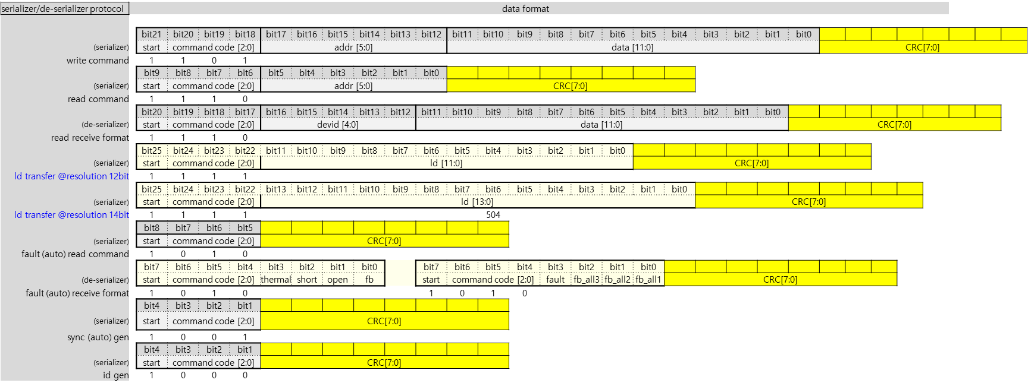
ID601
Functional Description
CRC
Serial communication command/response
CRC-8 SAE J1850 (0x1D poly, 0xFF init, 0xFF final XOR, non-reflected)
The CRC for the command is transmitted for each daily connected ID601 and compared with the CRC calculation result for the {command ~ data} bits.
If a CRC error occurs, a flag is printed and all commands except LD commands are ignored.
The CRC for the {command ~ data} bits is transmitted during local reads and fault reads.

Slide 19
ID601
Functional Description
Fault detection
# | Fault detection function | description
1 | RESP_ERR | This bit shows whether a timeout during read/fault response or CRC check failure during fault response have been occurred when CRC_EN is enabled. This bit is cleared by a read operation and not cleared by fault (auto) read operation.
2 | CMD_ERR | This bit shows whether a CRC error or invalid bit error in the command frame event have been occurred when CRC_EN is enabled. This bit is cleared by a read operation and not cleared by fault (auto) read operation.
3 | WD_TIMEOUT | This bit shows whether a watchdog timeout event has been occurred. This bit is cleared by a read operation and not cleared by fault (auto) read operation.
4 | VS_MISS | The VSYNC missing detection function is whether the vsync missing event happens
5 | CH_CTRL_MISMATCH | This bit shows whether a logic mismatch in channel control output event has been occurred. This bit is cleared by a read operation.
6 | VREF_OV | This bit shows whether a VREF OV event has been occurred. This bit is cleared by a read operation.
7 | VREF_UV | This bit shows whether a VREF UV event has been occurred. This bit is cleared by a read operation.
8 | OSC_LDO_OV | This bit shows whether a OSC_LDO_OV event has been occurred. This bit is cleared by a read operation.
9 | OSC_LDO_UV | This bit shows whether a OSC_LDO_UV event has been occurred. This bit is cleared by a read operation.
10 | LDO_OV | The LDO OV indicates whether the internal LDO has over-voltage or not.
11 | LDO_UV | The LDO UV indicates whether the internal LDO has under-voltage or not.
12 | THERMAL | Thermal detection function is whether the THERMAL event due to overheating happens.
13 | OPEN_CH1 ~ OPEN_CH12 | This bit shows whether a OPEN event has been occurred in corresponding channel. This bit is cleared by a read operation.
14 | SHORT_CH1 ~ SHORT_CH12 | This bit shows whether a SHORT event has been occurred in corresponding channel. This bit is cleared by a read operation.
Table 9. Fault detection function

Slide 20
ID601
Functional Description
Transition a frame frequency without a flicker
Figure 11. PWM 14-bit
Figure 10. PWM 12-bit

Slide 21
Functional Description
FLL function
The FLL continues to calibrate the MCLK frequency to exactly match the PWM frequency with the time of one frame.
FB function
This is a function that allows monitoring of each major fault.
SPREAD function
ID601 support internal OSC frequency spread function for EMI rejection.
Functional safety related
ID601 has a register Lock function.
The purpose of WR_PROTECT is to prevent registers from being unintentionally written.

Slide 22
ID601
Register Map
RESET / ID
Acc | Addr | Default | B11 | B10 | B9 | B8 | B7 | B6 | B5 | B4 | B3 | B2 | B1 | B0
R/W | 0x00 | 0x100 | RST | VS_RST | E_RST | LKG_E | x | x | x | ID [4:0]
Bits | Fields |  | Descriptions
11 | RST | 0 1 | NOP All internal logics are initialized to a default state and this bit will be auto-cleared after internal initialization.
10 | VS_RST | 0 1 | NOP If this bit is set, then the serializer and de-serializer of ID601 will be initialized to a default state at every vsync. This bit set does not affect all internal registers and buffers. This bit can’t be set at the same time as the E_RST bit.
9 | E_RST | 0 1 | NOP If this bit is set, then the serializer and de-serializer of ID601 will be initialized to a default state at the last third pwm clock. This function starts from the first vsync input. So, it is careful that the ID601 access at the back of the frame should be avoided for proper operation. This bit set does not affect all internal registers and buffers. This bit can’t be set at the same time as the VS_RST bit.
8 | LKG_E | 0 1 | NOP Enable leakage current mode for driver protection to prevent the VLED voltage from being directly applied to the driver output node
4:0 | ID |  | These bits are read only. If the ID601 will receive the ID-Gen command from the IC603 controller, then the ID value is automatically generated. The ID value is needed for proper reading, so, the ID-Gen command must be firstly executed by the IC603 controller before executing any commands. If all ID601 drivers daisied will receive the ID-Gen command, the last-located device will have the first number of ID, and the first located device will have the last number of ID, that is, the number of daisied devices. The ID value can not be written by a Host.

Slide 23
ID601
LD CONTROL
Acc | Addr | Default | B11 | B10 | B9 | B8 | B7 | B6 | B5 | B4 | B3 | B2 | B1 | B0
R/W | 0x01 | 0x000 | SV_NO [5:0] |  |  |  |  |  | LD_TYPE | DELAY_CH_EN | SYNCMODE | PWM_RES | LD_DIR | LD_MODE
Bits | Fields | Descriptions
 |  | This register determines the dimming sequence. Even if the LD_MODE and LD_DIR value will be changed in the middle of the current frame, the value will affect the dimming sequence from the next frame after completing the current frame process.
11:6 | SV_NO | This bit determines sub-frame NO. in 1-frame. 4 : #4 sub-frames 8 : #8 sub-frames 16 : #16 sub-frames 32 : #32 sub-frames Other register values ​​are unused.
5 | LD_TYPE | These bits determine the RGB PWM Dimming (LED1/2/3 PWM Dimming) 0 TYPE-2/3 1 TYPE-1
4 | DELAY_CH_EN | This bit determine the Ch. Delay value for LD_MODE 0 Ch. delay value in normal mode 1 Ratio of Ch. delay value in normal mode (Normal mode SVSYNC = 16, 1/2 of the set Ch. delay value)
3 | SYNCMODE | This value determines VSYNC input. 0 command 1 SVI
2 | PWM_RES | This bit determines the PWM resolution. 0 12-bit PWM resolution (max steps 4,095) 1 14-bit PWM resolution (max steps 16,383)
1 | LD_DIR | This bit determines the direction of modulated edge with increasing on time from a vsync. 0 Head Shift Lighting 1 Tail Shift Lighting
0 | LD_MODE | This bit determines the x8 mode. 0 Normal mode 1 x8 mode.
LD SIZE
Acc | Addr | Default | B11 | B10 | B9 | B8 | B7 | B6 | B5 | B4 | B3 | B2 | B1 | B0
R/W | 0x02 | 0x000 | x | x | x | x | x | x | LD_SIZE [5:0]
Bits | Fields | Descriptions
5:0 | LD_SIZE | This value determines how many LD data will be transmitted for one time. This value is not needed to match with the number of enabled channels in the CHANNEL ENABLE register. It keeps in mind that the LD data to be transmitted will be mapped sequentially from channel 1 to channel n regardless of the corresponded CHx_EN bit activation.

Slide 24
ID601
FPWM DIVIDER
Acc | Addr | Default | B11 | B10 | B9 | B8 | B7 | B6 | B5 | B4 | B3 | B2 | B1 | B0
R/W | 0x03 | 0x000 | FPWM_DIV2 [3:0] |  |  |  | FPWM_DIV1 [7:0]
Acc | Addr | Default | B11 | B10 | B9 | B8 | B7 | B6 | B5 | B4 | B3 | B2 | B1 | B0
R/W | 0x04 | 0x000 | FPWM_DIV3 [7:0] |  |  |  |  |  |  |  | FPWM_DIV2[7:4]
Bits | Fields | Descriptions
11:0 11:0 | FPWM_DIV1/2/3 | These registers determine the PWM reference clock. The PWM reference clock can be created by dividing the MCLK frequency by the setting value + 1. Even if the setting value will be changed in the middle of the frame, the value will be applied immediately from the next vsync assertion. Refer to the Tabel 6. for other relevant sets. FPWM_DIV1[7:0] : PWM reference clock for RED LED ( LED1 ) FPWM_DIV2[7:0] : PWM reference clock for GREEN LED ( LED2 ) FPWM_DIV3[7:0] : PWM reference clock for BLUE LED ( LED3 )
CHANNEL ENABLE
Acc | Addr | Default | B11 | B10 | B9 | B8 | B7 | B6 | B5 | B4 | B3 | B2 | B1 | B0
R/W | 0x05 | 0x000 | CH12_EN | CH11_EN | CH10_EN | CH9_EN | CH8_EN | CH7_EN | CH6_EN | CH5_EN | CH4_EN | CH3_EN | CH2_EN | CH1_EN
Bits | Fields | Descriptions
11:0 | CHx_EN | These bits should be set if the corresponding channels are to be used. The number of enabled channels in these registers does not need to match the LD_SIZE value. It is careful that the number of enabled channels should be the same as the LD_SIZE value, but the number can be smaller than the LD_SIZE value like the special mapping below.
CH1_EN | CH2_EN | CH3_EN | CH4_EN | CH5_EN | CH6_EN | CH7_EN | CH8_EN~CH12_EN
1 | 0 | 1 | 1 | 0 | 1 | 1 | all 0
the number of
enabled channels = 5
the amount of LD data to be transmitted for one time
LD_SIZE = 7
wherein, the LD data of the disabled channels, CH2 and CH5, can be any value

Slide 25
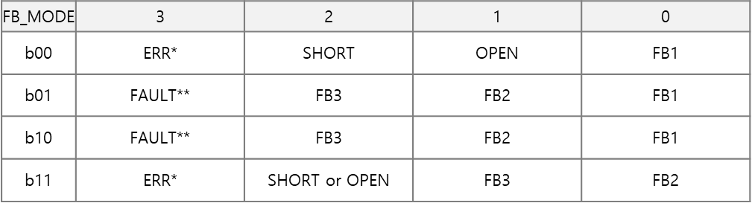
ID601
FAULT CONTROL
Acc | Addr | Default | B11 | B10 | B9 | B8 | B7 | B6 | B5 | B4 | B3 | B2 | B1 | B0
R/W | 0x06 | 0x03F | x | FT_MODE[1:0] |  | FB_MODE[1:0] |  | O_FB_E | T_DET_E | S_DET_E | O_DET_E | T_OFF_E | S_OFF_E | O_OFF_E
Bits | Fields | Descriptions
10:9 | FT_MODE | This bit determines for various faults ( open, short, fb, thermal etc ) 00 FAULT = ERR || short_all || open_all 01 FAULT = open_all 10 FAULT = short_all 11 FAULT = ERR *ERR = THERMAL | LDO_OV | LDO_UV | VREF_OV | VREF_UV | OSC_LDO_OV | OSC_LDO_UV | RESP_ERR | CMD_ERR | VS_MISS | WD_TIMEOUT | CH_CTRL_MISMATCH
8:7 | FB_MODE
6 | O_FB_E | This bit enables to detect the FB Open event.
5 | T_DET_E | This bit enables to detect the THERMAL event.
4 | S_DET_E | This bit setting enables to detect the SHORT event, and the event can be detected in only case the corresponding channel’s PWM output is ON status and its channel’s headroom is above the set value in the SHORT_LEVEL register.
3 | O_DET_E | Setting this bit will allow the OPEN event to be detected at the point where the PWM on that channel transitions from On to Off. This event will only be detected when the headroom for that channel is less than 0.25V.
2 | T_OFF_E | This bit setting makes all channels’ output be off in case the THERMAL event happens, and all channels will be activated again after the THERMAL event is cleared.
1 | S_OFF_E | This bit setting makes the SHORTed channel’s output be off in case the SHORT event happens.
0 | O_OFF_E | This bit setting makes the OPENed channel’s output be off in case the OPEN event happens.

Slide 26
ID601
FAULT LEVEL
Acc | Addr | Default | B11 | B10 | B9 | B8 | B7 | B6 | B5 | B4 | B3 | B2 | B1 | B0
R/W | 0x07 | 0x000 | x | x | x | FB3_LEVEL [2:0] |  |  | FB2_LEVEL [2:0] |  |  | FB1_LEVEL [2:0]
Acc | Addr | Default | B11 | B10 | B9 | B8 | B7 | B6 | B5 | B4 | B3 | B2 | B1 | B0
R/W | 0x08 | 0x000 | x | x | x | SHORT3_LEVEL [2:0] |  |  | SHORT2_LEVEL [2:0] |  |  | SHORT1_LEVEL [2:0]
Bits | Fields | Descriptions
8:0 | FB1/2/3_LEVEL | The FB_LEVEL determines the level at which a FB event occurs. 3b’000 : < 0.45V 3b’001 : < 0.55V 3b’010 : < 0.65V 3b’011 : < 0.75V 3’b100 : < 0.90V 3’b101 : < 1.05V 3’b110 : < 1.20V 3b’111 : < 1.35V FB1_LEVEL : FB LEVEL for LED1 FB2_LEVEL : FB LEVEL for LED2 FB3_LEVEL : FB_LEVEL for LED3
8:0 | SHORT1/2/3_LEVEL | The SHORT_LEVEL determines the level at which a SHORT event occurs. 3b’000 : > 3.5V 3b’001 : > 4.5V 3b’010 : > 6.5V 3b’011 : > 9.0V 3b’100 : > 13.5V 3b’101 : > 17.5V 3b’110 : > 26.0V 3b’111 : > 32.0V SHORT1_LEVEL : SHORT LEVEL for LED1 SHORT2_LEVEL : SHORT LEVEL for LED2 SHORT3_LEVEL : SHORT_LEVEL for LED3
FAULT STATUS0
Acc | Addr | Default | B11 | B10 | B9 | B8 | B7 | B6 | B5 | B4 | B3 | B2 | B1 | B0
RO | 0x09 | 0x000 | x | x | x | x | x | x | x | SHORT | OPEN | FB3 | FB2 | FB1
Bits | Fields | Descriptions
4 | SHORT | The SHORT bit indicates whether the SHORT event happens. The event can be detected in case some channel’s headroom goes above the set value in the SHORT_LEVEL of FAULT LEVEL register and its channel’s PWM out is ON status. If the S_OFF_E bit of the FAULT CONTROL register is set, the output of the channels in which the event occurs is turned off. This bit is auto-cleared after readout but set again as long as the event is not cleared.
3 | OPEN | The OPEN bit indicates whether the OPEN event happens. The event can be detected in case some channel’s headroom goes below 0.25V and its channel’s PWM out is OFF status. If the O_OFF_E bit of the FAULT CONTROL register is set, the output of the channels in which the event occurs is turned off. This bit is auto-cleared after readout but set again as long as the event is not cleared.
2:0 | FB1/2/3 | The FB bit indicates whether the output channels’ headroom voltage is below the value set by FB_LEVEL of the FAULT LEVEL register due to insufficient VLED. This bit is set whenever the FB event occurs in even one of the activated channels and will be auto-cleared after readout this register. This bit will be set again after readout as long as the FB condition is still valid. If the O_FB_E of FAULT CONTROL register is set, the FB event will happen in case the OPEN event is not asserted. FB1 : FB signal for LED1 FB2 : FB signal for LED2 FB3 : FB signal for LED3

Slide 27
ID601
FAULT STATUS1
Acc | Addr | Default | B11 | B10 | B9 | B8 | B7 | B6 | B5 | B4 | B3 | B2 | B1 | B0
RO | 0x0A | 0x000 | RESP_ERR | CMD_ERR | WD_TIMEOUT | VS_MISS | CH_CTRL_MISMATCH | VREF_OV | VREF_UV | OSC_LDO_OV | OSC_LDO_UV | LDO_OV | LDO_UV | THERMAL
Bits | Fields | Descriptions
11 | RESP_ERR | This bit shows whether a timeout during read/fault response or CRC check failure during fault response have been occurred when CRC_EN is enabled. This bit is cleared by a read operation and not cleared by fault (auto) read operation.
10 | CMD_ERR | This bit shows whether a CRC error or invalid bit error in the command frame event have been occurred when CRC_EN is enabled. This bit is cleared by a read operation and not cleared by fault (auto) read operation.
9 | WD_TIMEOUT | Flag for TIMEOUT. This bit shows whether a watchdog timeout event has been occurred. This bit is cleared by a read operation and not cleared by fault (auto) read operation.
8 | VS_MISS | Flag for Vsync missing
7 | CH_CTRL_MISMATCH | Flag for CH_CTRL_MISMATCH. This bit shows whether a logic mismatch in channel control output event has been occurred. This bit is cleared by a read operation.
6 | VREF_OV | Flag for VREF Over-Voltage. This bit shows whether a VREF OV event has been occurred. This bit is cleared by a read operation.
5 | VREF_UV | Flag for VREF Under-Voltage. This bit shows whether a VREF UV event has been occurred. This bit is cleared by a read operation.
4 | OSC_LDO_OV | This bit shows whether a OSC_LDO_OV event has been occurred. This bit is cleared by a read operation.
3 | OSC_LDO_UV | This bit shows whether a OSC_LDO_UV event has been occurred. This bit is cleared by a read operation.
2 | LDO_OV | Flag for LDO Over-Voltage
1 | LDO_UV | Flag for LDO Under-Voltage
0 | THERMAL | The THERMAL bit indicates whether the THERMAL event due to overheating happens, and this bit will keep asserted as long as the THERMAL event is not cleared. The event threshold can be set by the OFS_TEMP in the TEMP register. If the T_OFF_E bit of the FAULT CONTROL register is set, all output sink drivers will be turned-off as long as the event is asserted, and turned-on again after internal temperature goes down below the set level of the OFS_TEMP. This bit involves other fault events in the readout information, MISS_VS, OV15 and 15 at the FAULT_(AUTO)_READ transaction.

Slide 28
ID601
FAULT STATUS2
Acc | Addr | Default | B11 | B10 | B9 | B8 | B7 | B6 | B5 | B4 | B3 | B2 | B1 | B0
RO | 0x0B | 0x000 | OPEN_CH12 | OPEN_CH11 | OPEN_CH10 | OPEN_CH9 | OPEN_CH8 | OPEN_CH7 | OPEN_CH6 | OPEN_CH5 | OPEN_CH4 | OPEN_CH3 | OPEN_CH2 | OPEN_CH1
Bits | Fields | Descriptions
11:0 | OPEN_CHx | This bit indicates whether the OPEN event each Ch.
FAULT STATUS3
Acc | Addr | Default | B11 | B10 | B9 | B8 | B7 | B6 | B5 | B4 | B3 | B2 | B1 | B0
RO | 0x0C | 0x000 | SHORT_ CH12 | SHORT_ CH11 | SHORT_ CH10 | SHORT_CH9 | SHORT_CH8 | SHORT_CH7 | SHORT_CH6 | SHORT_CH5 | SHORT_CH4 | SHORT_CH3 | SHORT_CH2 | SHORT_CH1
Bits | Fields | Descriptions
11:0 | SHORT_CHx | This bit indicates whether the SHORT event each Ch.
MAX CURRENT LEVEL
Acc | Addr | Default | B11 | B10 | B9 | B8 | B7 | B6 | B5 | B4 | B3 | B2 | B1 | B0
R/W | 0x0D | 0x000 | MAX_CURR_LEVEL3 [3:0] |  |  |  | MAX_CURR_LEVEL2 [3:0] |  | x | x | MAX_CURR_LEVEL1 [3:0] |  | FB_LEVEL [1:0]
Bits | Fields | Descriptions
11:0 | MAX_CURR_ LEVEL3/2/1 | The MAX_CURR_LEVEL determines the physical maximum current level of the device. The max dimming sink-current set by the MAX_CURR_VREF can not be beyond the MAX_CURR_LEVEL.
Step current | Bit [3:0] | MAX_CURR_LEVEL#
4 mA / Step | 0000 | 4 mA
 | 0001 | 8 mA
 | …. | ….
 | 1111 | 64 mA
MAX CURRENT VREF
Acc | Addr | Default | B11 | B10 | B9 | B8 | B7 | B6 | B5 | B4 | B3 | B2 | B1 | B0
R/W | 0x0E | 0x000 | MAX_CURR_VREF1[11:0] | x | x | x | x | x | x | x | x | x | RST2 | RST1
Acc | Addr | Default | B11 | B10 | B9 | B8 | B7 | B6 | B5 | B4 | B3 | B2 | B1 | B0
R/W | 0x0F | 0x000 | MAX_CURR_VREF2[11:0] | x | x | x | x | x | x | x | x | x | RST2 | RST1
Acc | Addr | Default | B11 | B10 | B9 | B8 | B7 | B6 | B5 | B4 | B3 | B2 | B1 | B0
R/W | 0x10 | 0x000 | MAX_CURR_VREF3[11:0] | x | x | x | x | x | x | x | x | x | RST2 | RST1
Bits | Fields | Descriptions
11:0 | MAX_CURR_VREF1/2/3 | The MAX_CURR_VREF1/2/3 determines the maximum current value of a frame to be dimmed. If the max current level is set to 8mA, then the MAX_CURR_VREF value is proportional to the max current level, and so this value decides the max current reference of all blocks being dimmed for a frame. The setting value will come into effect at the next vsync assertion even if the value is set during current dimming frame earlier than the next vsync. MAX_CURR_VREF1 : MAX_CURR_VREF for LED1 MAX_CURR_VREF2 : MAX_CURR_VREF for LED2 MAX_CURR_VREF3 : MAX_CURR_VREF for LED3

Slide 29
ID601
CHx_LD_TYPE
Acc | Addr | Default | B11 | B10 | B9 | B8 | B7 | B6 | B5 | B4 | B3 | B2 | B1 | B0
R/W | 0x11 | 0x000 | CH12_LD _TYPE | CH11_LD _TYPE | CH10_LD _TYPE | CH9_LD _TYPE | CH8_LD _TYPE | CH7_LD _TYPE | CH6_LD _TYPE | CH5_LD _TYPE | CH4_LD _TYPE | CH3_LD _TYPE | CH2_LD _TYPE | CH1_LD _TYPE
Bits | Fields | Descriptions
11:0 | CHx_LD_TYPE | This bit determines whether it is time-sharing data or non-sharing data each CH. 0 non-sharing data 1 time-sharing data
DELAY CH
Acc | Addr | Default | B11 | B10 | B9 | B8 | B7 | B6 | B5 | B4 | B3 | B2 | B1 | B0
R/W | 0x12 | 0x000 | x | x | DELAY_CH2 [4:0] |  |  |  |  | DELAY_CH1 [4:0]
Acc | Addr | Default | B11 | B10 | B9 | B8 | B7 | B6 | B5 | B4 | B3 | B2 | B1 | B0
R/W | 0x13 | 0x000 | x | x | DELAY_CH4 [4:0] |  |  |  |  | DELAY_CH3 [4:0]
Acc | Addr | Default | B11 | B10 | B9 | B8 | B7 | B6 | B5 | B4 | B3 | B2 | B1 | B0
R/W | 0x14 | 0x000 | x | x | DELAY_CH6 [4:0] |  |  |  |  | DELAY_CH5 [4:0]
Acc | Addr | Default | B11 | B10 | B9 | B8 | B7 | B6 | B5 | B4 | B3 | B2 | B1 | B0
R/W | 0x15 | 0x000 | x | x | DELAY_CH8 [4:0] |  |  |  |  | DELAY_CH7 [4:0]
Acc | Addr | Default | B11 | B10 | B9 | B8 | B7 | B6 | B5 | B4 | B3 | B2 | B1 | B0
R/W | 0x16 | 0x000 | x | x | DELAY_CH10 [4:0] |  |  |  |  | DELAY_CH9 [4:0]
Acc | Addr | Default | B11 | B10 | B9 | B8 | B7 | B6 | B5 | B4 | B3 | B2 | B1 | B0
R/W | 0x17 | 0x000 | x | x | DELAY_CH12 [4:0] |  |  |  |  | DELAY_CH11 [4:0]
Bits | Fields | Descriptions
9:0 | DELAY_CHx | The DELAY_CHx determines from which PWM position the dimming out starts. If this is set to n, then the dimming out starts at (n+1)^{th} PWM position. Normally, the setting value can not exceed the max PWM resolution.

Slide 30
ID601
FAULT CONFIGURATION
Acc | Addr | Default | B11 | B10 | B9 | B8 | B7 | B6 | B5 | B4 | B3 | B2 | B1 | B0
R/W | 0x18 | 0x31F | CRC_EN | WD_DIMM_EN | WD_TIMECFG[1:0] |  | WD_EN | VS_MISS_DIMM_EN | VS_MISS_EN | CH_CTRL_MISMATCH_EN | VREF_OVUV_OFF_EN | VREF_OVUV_EN | OSC_LDO_OVUV_EN | LDO_OVUV_EN
Bits | Fields | Descriptions
11 | CRC_EN | This bit enables to detect the THERMAL event.
10 | WD_DIMM_EN | This bit enables the PWM dimming HIGH function in the watchdog timeout event
9:8 | WD_TIMCFG | This bit configures the watchdog timeout threshold 2’b00: 8,191 MCLK/64 2’b01: 16,383 MCLK/64 2’b10: 65,635 MCLK/64 2’b11: 262,143 MCLK/64 (default)
7 | WD_EN | This bit enables the watchdog timer function.
6 | VS_MISS_DIMM_EN | This bit enables the PWM dimming HIGH function in the vsync missing event.
5 | VS_MISS_EN | This bit enables the detection of vsync missing event.
4 | CH_CTRL_MISMATCH_EN | This bit enables the detection of mismatch between channel control input and output.
3 | VREF_OVUV_OFF_EN | This bit setting makes all channels’ output be off in case the VREF_OV or VREF_UV event happens, and all channels will be activated again after the event is cleared.
2 | VREF_OVUV_EN | This enables the detection of OV and UV of the VREF output
1 | OSC_LDO_OVUV_EN | This enables the detection of OV and UV of the OSC LDO output
0 | LDO_OVUV_EN | This enables the detection of OV and UV of the LDO output

Slide 31
ID601
BIST
Acc | Addr | Default | B11 | B10 | B9 | B8 | B7 | B6 | B5 | B4 | B3 | B2 | B1 | B0
R/W (R/O) | 0x19 | 0x000 | BIST_START | x | x | x | x | x | x | x | x | BIST_BUSY (R/O) | BIST_DONE (R/O) | BIST_ERR (R/O)
Bits | Fields | Descriptions
11 | BIST_START | When this bit is written to 1, it triggers the Comparator OV/UV Built-In Self test. This bit is automatically cleared after written.
2 | BIST_BUSY (R/O) | This bit shows whether BIST sequence is ongoing. This bit is automatically cleared after BIST is done.
1 | BIST_DONE (R/O) | This bit shows whether BIST sequence has been completed.
0 | BIST_ERR (R/O) | This bit shows whether a failure in BIST test has been occurred.

Slide 32
ID601
SERIALIZER OUTPUT BAUDRATE
Acc | Addr | Default | B11 | B10 | B9 | B8 | B7 | B6 | B5 | B4 | B3 | B2 | B1 | B0
R/W | 0x1C | 0x318 | SERIAL_CLK_LOW [5:0] |  |  |  |  |  | SERIAL_CLK_HIGH [5:0] |  |  | x | x | x
Bits | Fields | Descriptions
11:6 | SERIAL_CLK_LOW | These bits determine the number of MCLK of V_{DD} level in logic low value ‘0’ or the number of MCLK of 0 level in logic high value ‘1’ when the ID601 is driving the D_{IO} pin on read-back. For more details, refer to Table. 4, Logic low time. (unit MCLK/2)
5:0 | SERIAL_CLK_HIGH | These bits determine the number of MCLK of V_{DD} level in logic high value ‘1’ or the number of MCLK of 0 level in logic low value ‘0’ when the ID601 is driving the D_{IO} pin on read-back. For more details, refer to Table. 4, Logic high time. (unit MCLK/2)
SERIAL LATENCY
Acc | Addr | Default | B11 | B10 | B9 | B8 | B7 | B6 | B5 | B4 | B3 | B2 | B1 | B0
R/W | 0x1D | 0x080 | x | x | x | SERIAL_LATENCY [8:0]
Bits | Fields | Descriptions
8:0 | SERIAL_LAT | This determines the interval time between the successive data packets incoming from the IC603. That means the interval time between the last bit of n^{th} ID601 device’s data packet and the first bit of (n+1)^{th} ID601 device’s data packet incoming from the XC. The setting value should be larger than the 1-bit serial data length time at which the IC603 is sending to the daisied ID601 s. So, the proper value depends on the serial baudrate of the IC603 and can be set between (1-bit time + 3 MCLKs) and (1-bit time + 5 MCLKs). If the proper value will be set, then the serial data value will be broken. It is careful that this register value should be changed to the proper value firstly in case that the Serializer Output Baudrate of IC603 is changed to slow down.

Slide 33
ID601
V_MASK
Acc | Addr | Default | B11 | B10 | B9 | B8 | B7 | B6 | B5 | B4 | B3 | B2 | B1 | B0
R/W | 0x1E | 0x000 | x | x | V_MASK [9:0]
Bits | Fields | Descriptions
9:0 | V_MASK | The V_MASK determines internal VSYNC position. This register is only valid under (syncmode = 1). Refer the picture Figure 12 below. (unit MCLK/2)
Figure 12. Timing Diagram for VSYNC / SVSYNC generation ( @SYNC_MODE = 1)
SV_MASK
Acc | Addr | Default | B11 | B10 | B9 | B8 | B7 | B6 | B5 | B4 | B3 | B2 | B1 | B0
R/W | 0x1F | 0x000 | SV_MASK_EN | x | SV_MASK [9:0]
Bits | Fields | Descriptions
11 | SV_MASK_EN | The SV_MASK_EN determines SV_MASK function enable or disable. 0 disable, 1 enable
9:0 | SV_MASK | The SV_MASK determines internal SVSYNC rising / falling position. (unit MCLK/2)
RSTCNT
Acc | Addr | Default | B11 | B10 | B9 | B8 | B7 | B6 | B5 | B4 | B3 | B2 | B1 | B0
R/W | 0x20 | 0x000 | x | x | RSTCNT [9:0]
Bits | Fields | Descriptions
9:0 | RSTCNT | The RSTCNT determines RESET position for interface (decoder/encoder) The RSTCNT is counted by a MCLK/64 from a last svsync, reset at every vsync. (unit MCLK/64)
TIMEOUT
Acc | Addr | Default | B11 | B10 | B9 | B8 | B7 | B6 | B5 | B4 | B3 | B2 | B1 | B0
R/W | 0x21 | 0x3FF | x | TIMEOUT[10:0]
Bits | Fields | Descriptions
10:0 | TIMEOUT | The TIMEOUT is the READOUT output waiting time. If no readout is input for more than TIMEOUT, the read operation is stopped. (unit MCLK/64)

Slide 34
ID601
FLL CONTROL
Acc | Addr | Default | B11 | B10 | B9 | B8 | B7 | B6 | B5 | B4 | B3 | B2 | B1 | B0
R/W | 0x22 | 0x000 | FLLCNT [11:0]
Acc | Addr | Default | B11 | B10 | B9 | B8 | B7 | B6 | B5 | B4 | B3 | B2 | B1 | B0
R/W | 0x23 | 0xC32 | FLL_EN | FLL_RANGE[1:0] |  | x | FLLCNT[19:12]
Bits | Fields | Descriptions
11:0 7:0 | FLLCNT | This determines the FLL target frequency value. The FLLCNT is counted by an MCLK/64
11 | FLL_EN | This bit enables the FLL function. The FLL continues to calibrate the MCLK frequency to exactly match the PWM frequency with the time of one frame. 1 Enable FLL function (= The MCLK is unlocking, so calibrated to the target frequency) 0 Disable FLL function (= The MCLK is locking at the current frequency) It is needed that this bit should be set to 0 just before the first vsync starts to be entered to the ID601 and set to 1 just before the vsync is not asserted if the vsync will be not supplied any more to the ID601 .
10:9 | FLL_RANGE | It is recommended to use the default value.
WR_PROTECT
Acc | Addr | Default | B11 | B10 | B9 | B8 | B7 | B6 | B5 | B4 | B3 | B2 | B1 | B0
R/W | 0x24 | 0x555 | WR_PROTECT[11:0]
Bits | Fields | Descriptions
11:0 | WR_PROTECT | These bits are used REGISTER write enable. The purpose of WR_PROTECT is to prevent registers from being unintentionally written. 1. write-protect1 = 0xAAA : PWMCLK_DIV1/2/3, MAX_CURR_VREF1/2/3 writable 2. write-protect2 = 0xCCC : MAX_CURR_VREF1/2/3 writable 3. Other values : writable

Slide 35
ID601
NF_CONTROL
Acc | Addr | Default | B11 | B10 | B9 | B8 | B7 | B6 | B5 | B4 | B3 | B2 | B1 | B0
R/W | 0x25 | 0x000 | BBKN_TH[5:0] |  |  |  |  |  | EMI_REJ_EN | SGRJT_ EN2 | SGRJT_ EN1 | BBKN_ EN | DGRJT_EN2 | DGRJT_EN1
Bits | Fields | Descriptions
11:6 | BBKN_TH | The BBKN_TH is a register for detecting short DIN pulses. It is recommended to set BBKN_TH to the max. DIN that should be filtered. The BBKN_TH DIN pulses shorter than this register are not recognized as DIN pulses internally, and the corresponding command is ignored.
5 | EMI_REJ_EN | The EMI_REJ_EN determinant EMI rejection enable. This register is used to improve EMI by spreading the SVSYNC signal in 1-mclk unit. 0 disable 1 enable
4 | SGRJT_EN2 | The SGRJT_EN2 determinant SVI glitch within 4-MCLK rejection enable. 0 disable 1 enable
3 | SGRJT_EN1 | The SGRJT_EN1 determinant SVI glitch within 3-MCLK rejection enable. 0 disable 1 enable
2 | BBKN_EN | The BBKN_TH determinant BBKN_EN function enable. 0 disable 1 enable
1 | DGRJT_EN2 | The DGRJT_EN2 determinant DIN glitch within 4-MCLK rejection enable. 0 disable 1 enable
0 | DGRJT_EN1 | The DGRJT_EN1 determinant DIN glitch within 3-MCLK rejection enable. 0 disable 1 enable
CHOP_EN
Acc | Addr | Default | B11 | B10 | B9 | B8 | B7 | B6 | B5 | B4 | B3 | B2 | B1 | B0
R/W | 0x26 | 0x000 | x | x | x | x | x | x | CHOP_EN | CHOP_DRV_EN | CHOP_OSCLDO_EN | CHOP_OSC_EN | CHOP_DAC_EN | CHOP_BGR_EN
Bits | Fields | Descriptions
5 | CHOP_EN | Enable for the chopping clock generator
4 | CHOP_DRV_EN | The CHOP_DRV_EN is determinant DRIVER CHOPPING function. 0 disable 1 enable
3 | CHOP_OSCLDO_EN | The CHOP_OSCLDO_EN is determinant OSC LDO CHOPPING function. 0 disable 1 enable
2 | CHOP_OSC_EN | The CHOP_OSC_EN determinant OSC CHOPPING enable. 0 disable 1 enable
1 | CHOP_DAC_EN | The CHOP_DAC_EN determinant DAC CHOPPING enable. 0 disable 1 enable
0 | CHOP_BGR_EN | The CHOP_BGR_EN determinant BGR CHOPPING enable. 0 disable 1 enable

Slide 36
ID601
OFS_TEMP_ETC
Acc | Addr | Default | B11 | B10 | B9 | B8 | B7 | B6 | B5 | B4 | B3 | B2 | B1 | B0
R/W | 0x27 | 0x829 | OFS_TEMP [3:0] |  |  |  | OV_SWAP_EN | DAC_RNG | FLT_CTL [1:0] |  | O_SLEW[1:0] |  | FLT_GAIN [1:0]
Bits | Fields | Descriptions
11:8 | OFS_TEMP | This determines the temperature level at which the thermal event occurs. The thermal threshold temperature may vary slightly from the set value. The thermal event threshold temperature according to the OFS_TEMP value is mapped as follows. 93/ 99/ 103/ 109/ 113/ 117/ 123/ 127/ 133(default) / 137/ 143/ 147/ 151/ 157/ 161/ 165℃
7 | OV_SWAP_EN | Enable for comparator self-test
6 | DAC_RNG | It is recommended to use the default value.
5:4 | FLT_CTL | It is recommended to set to 1.
3:2 | O_SLEW | This bit determines slew control for PWM drivers. It is recommended to use the default value
1:0 | FLT_GAIN | It is recommended to use the default value.
OSC FLL MANUAL
Acc | Addr | Default | B11 | B10 | B9 | B8 | B7 | B6 | B5 | B4 | B3 | B2 | B1 | B0
R/W | 0x28 | 0x000 | OSC_FLL_MAN [11:0]
Acc | Addr | Default | B11 | B10 | B9 | B8 | B7 | B6 | B5 | B4 | B3 | B2 | B1 | B0
R/W | 0x29 | 0x808 | OSC_MAN_EN | x | x | x | x | x | OSC_FLL_ERR _RANGE[1:0] |  | OSC_FLL_MAN [15:12]
Bits | Fields | Descriptions
11:0 3:0 | OSC_FLL_MAN | This bit determines the FLL target frequency value in manual mode.
11 | OSC_MAN_EN | Enable the manual mode of the FLL module. It is careful that this bit must be cleared during the initialization after POR.
5:4 | OSC_FLL_ERR_RANGE | It is recommended to use the default value.
SPREAD
Acc | Addr | Default | B11 | B10 | B9 | B8 | B7 | B6 | B5 | B4 | B3 | B2 | B1 | B0
R/W | 0x2A | 0x000 | SPRD_EN | x | x | x | x | SPRD_SPD[2:0] |  |  | x | SPRD_GAIN[2:0]
Bits | Fields | Descriptions
11 | SPRD_EN | This determines SPREAD function enable. 0 disable 1 enable
6:4 | SPRD_SPD | This determines SPREAD step. ('000' :128 clock, '001' :64 clock, '010' : 32 clock, '011' : 16 clock '100’ : 8 clock, '101’ : 4 clock, '110’ : 2 clock, '111’ : 1 clock)
2:0 | SPRD_GAIN | This determines SPREAD gain. (‘000' : calculated value/8, ‘001' : calculated value/4, ‘010’ : calculated value/2, ‘011' : calculated value, ‘100’ : calculated value*2, ‘101’ : calculated value*4, ‘110’ : calculated value*8, ‘111’ : calculated value*16)

Slide 37
ID601
TEST MODE0
Acc | Addr | Default | B11 | B10 | B9 | B8 | B7 | B6 | B5 | B4 | B3 | B2 | B1 | B0
R/W | 0x1A | 0x000 | x | x | AMUX_SEL[3:0] |  |  |  |  | DMUX_SEL[4:0]
Bits | Fields | Descriptions
9:5 | AMUX_SEL | Analog mux en/signal selection bits
4:0 | DMUX_SEL | Digital mux en/signal selection bits
TEST MODE1
Acc | Addr | Default | B11 | B10 | B9 | B8 | B7 | B6 | B5 | B4 | B3 | B2 | B1 | B0
R/W | 0x1B | 0x000 | x | x | x | x | x | x | x | x | x | x | x | TM_CH_CTRL_INPUT_FLIP
Bits | Fields | Descriptions
0 | TM_CH_CTRL_INPUT_FLIP | This bit is intended for test mode and inverts the readback signals of both the channel output and the PWM output within the logic.

Slide 38
ID601
These registers can not go outside the Global Technologies.
OP MODE
Acc | Addr | Default | B11 | B10 | B9 | B8 | B7 | B6 | B5 | B4 | B3 | B2 | B1 | B0
R/W | 0x3F | 0x000 | TEST_EN | TEST_ANA_EN[2:0] |  |  | SW_SEL[1:0] |  | PWM_FULL_O | MCLK64_O | DTEST_MUX_EN | RD_EN | EXT_CLKIN | ADDR_EXT
Bits | Fields |  | Descriptions
11 | TEST_EN | 0 1 | NOP It is used to test the device for trimming. To use the PWM_FULL_O, MCLK_O and VREF_O function, this bit should be set firstly and cleared lastly after these functions are used.
10:8 | TEST_ANA_EN | 000 | Should be “000”
7:6 | SW_SEL | 000 | Should be “00”
5 | PWM_FULL_O | 0 1 | NOP Under TEST_EN =1, the enabled channels’ PWM out keeps active state regardless of the vsync.
4 | MCLK64_O | 0 1 | NOP Under TEST_EN =1, the clock obtained by dividing MCLK by 64 is output to DDIO pin.
3 | DTEST_MUX_EN | 0 1 | NOP Under TEST_EN =1, Digital mux signal selection bits for test.
2 | RD_EN | 0 1 | NOP This bit is used to enable Command Register data.
1 | EXT_CLKIN | 0 | This EXT_CLKIN is used under TEST_EN = 1. Should be “0”
0 | ADDR_EXT | 0 1 | This bit is used to select which register groups, the general registers or the OTP mirror registers, will be accessed. The OTP control registers address, 0x3E ~ 0x3F, can be commonly accessed regardless of this bit. The general registers can be accessed except for the OTP mirror registers. The OTP mirror registers can be accessed except for the general registers.
OTP ACCESS
Acc | Addr | Default | B11 | B10 | B9 | B8 | B7 | B6 | B5 | B4 | B3 | B2 | B1 | B0
R/W | 0x3A | 0x000 | x | x | x | x | x | x | x | x | OTP_PG_ACCESS_CYCLE [15:12] | x | x
Acc | Addr | Default | B11 | B10 | B9 | B8 | B7 | B6 | B5 | B4 | B3 | B2 | B1 | B0
R/W | 0x3B | 0x3FF | OTP_PG_ACCESS_CYCLE [11:0] | x | x | x | x | x | x | I_{D} [4:0] | x | x | RST2 | RST1
OTP WRITE
Acc | Addr | Default | B11 | B10 | B9 | B8 | B7 | B6 | B5 | B4 | B3 | B2 | B1 | B0
R/W | 0x3C | 0x004 | x | x | x | x | x | x | OTP_RD [1:0] |  | OTP_WSEL [3:0] | SHORT | OPEN | FB
OTP RD/PROG
Acc | Addr | Default | B11 | B10 | B9 | B8 | B7 | B6 | B5 | B4 | B3 | B2 | B1 | B0
R/W | 0x3D | 0x000 | OTP_PG_DONE | x | x | x | x | x | x | x | x | x | OTP_RD_START | OTP_PG_START
OTP PROTECT
Acc | Addr | Default | B11 | B10 | B9 | B8 | B7 | B6 | B5 | B4 | B3 | B2 | B1 | B0
R/W | 0x3E | 0x5A5 | PROTECT_EN/DIS [11:0] ※ enable (0x5A5), disable (0xA5A), need to disable for writing | x | x | x | x | x | x | I_{D} [4:0] | x | x | RST2 | RST1

Slide 39
ID601
These registers can not go outside the Global Technologies.
These registers are the OTP Mirror registers.
OTP CRC
Acc | Addr | Default | B11 | B10 | B9 | B8 | B7 | B6 | B5 | B4 | B3 | B2 | B1 | B0
R/W | 0x00 | 0x000 | x | x | x | x | OTP_CRC_CHECKSUM [7:0] | x | x | x | x | x | x | x
IREF_CTL / BGR_CTL
Acc | Addr | Default | B11 | B10 | B9 | B8 | B7 | B6 | B5 | B4 | B3 | B2 | B1 | B0
R/W | 0x01 | 0x210 | x | x | IREF_CTL[4:0] |  |  |  |  | BGR_TC[4:0]
LDO_DAC_CTL / OSC_RCTL
Acc | Addr | Default | B11 | B10 | B9 | B8 | B7 | B6 | B5 | B4 | B3 | B2 | B1 | B0
R/W | 0x02 | 0x810 | LDO_DAC_CTL[4:0] |  |  |  |  | x | x | OSC_RCTL[4:0] |  | x
LDO_OSC_CTL / LOD_CTL
Acc | Addr | Default | B11 | B10 | B9 | B8 | B7 | B6 | B5 | B4 | B3 | B2 | B1 | B0
R/W | 0x03 | 0x080 | x | x | x | x | LDO_OSC_CTL[3:0] |  |  |  | LDO_CTL[3:0] | x

Slide 40
ID601
These registers can not go outside the Global Technologies.
OFS_CH 1
Acc | Addr | Default | B11 | B10 | B9 | B8 | B7 | B6 | B5 | B4 | B3 | B2 | B1 | B0
R/W | 0x04 | 0x000 | x | x | x | OFS_CH1 [8:0] |  |  | x | x | x | x
OFS_CH 2
Acc | Addr | Default | B11 | B10 | B9 | B8 | B7 | B6 | B5 | B4 | B3 | B2 | B1 | B0
R/W | 0x05 | 0x000 | x | x | x | OFS_CH2 [8:0] |  |  | x | x | x | x
OFS_CH 3
Acc | Addr | Default | B11 | B10 | B9 | B8 | B7 | B6 | B5 | B4 | B3 | B2 | B1 | B0
R/W | 0x06 | 0x000 | x | x | x | OFS_CH3 [8:0] |  |  | x | x | x | x
OFS_CH 4
Acc | Addr | Default | B11 | B10 | B9 | B8 | B7 | B6 | B5 | B4 | B3 | B2 | B1 | B0
R/W | 0x07 | 0x000 | x | x | x | OFS_CH4 [8:0] |  |  | x | x | x | x
OFS_CH 5
Acc | Addr | Default | B11 | B10 | B9 | B8 | B7 | B6 | B5 | B4 | B3 | B2 | B1 | B0
R/W | 0x08 | 0x000 | x | x | x | OFS_CH5 [8:0] |  |  | x | x | x | x
OFS_CH 6
Acc | Addr | Default | B11 | B10 | B9 | B8 | B7 | B6 | B5 | B4 | B3 | B2 | B1 | B0
R/W | 0x09 | 0x000 | x | x | x | OFS_CH6 [8:0] |  |  | x | x | x | x
OFS_CH 7
Acc | Addr | Default | B11 | B10 | B9 | B8 | B7 | B6 | B5 | B4 | B3 | B2 | B1 | B0
R/W | 0x0A | 0x000 | x | x | x | OFS_CH7 [8:0] |  |  | x | x | x | x
OFS_CH 8
Acc | Addr | Default | B11 | B10 | B9 | B8 | B7 | B6 | B5 | B4 | B3 | B2 | B1 | B0
R/W | 0x0B | 0x000 | x | x | x | OFS_CH8 [8:0] |  |  | x | x | x | x
OFS_CH 9
Acc | Addr | Default | B11 | B10 | B9 | B8 | B7 | B6 | B5 | B4 | B3 | B2 | B1 | B0
R/W | 0x0C | 0x000 | x | x | x | OFS_CH9 [8:0] |  |  | x | x | x | x
OFS_CH 10
Acc | Addr | Default | B11 | B10 | B9 | B8 | B7 | B6 | B5 | B4 | B3 | B2 | B1 | B0
R/W | 0x0D | 0x000 | x | x | x | OFS_CH10 [8:0] |  |  | x | x | x | x
OFS_CH 11
Acc | Addr | Default | B11 | B10 | B9 | B8 | B7 | B6 | B5 | B4 | B3 | B2 | B1 | B0
R/W | 0x0E | 0x000 | x | x | x | OFS_CH11 [8:0] |  |  | x | x | x | x
OFS_CH 12
Acc | Addr | Default | B11 | B10 | B9 | B8 | B7 | B6 | B5 | B4 | B3 | B2 | B1 | B0
R/W | 0x0F | 0x000 | x | x | x | OFS_CH12 [8:0] |  |  | x | x | x | x

Slide 41
ID601
These registers can not go outside the Global Technologies.
GAIN_CH 1
Acc | Addr | Default | B11 | B10 | B9 | B8 | B7 | B6 | B5 | B4 | B3 | B2 | B1 | B0
R/W | 0x10 | 0x040 | x | x | x | x | x | GAIN_CH1 [6:0] |  | x | x | x
GAIN_CH 2
Acc | Addr | Default | B11 | B10 | B9 | B8 | B7 | B6 | B5 | B4 | B3 | B2 | B1 | B0
R/W | 0x11 | 0x040 | x | x | x | x | x | GAIN_CH2 [6:0] |  | x | x | x
GAIN_CH 3
Acc | Addr | Default | B11 | B10 | B9 | B8 | B7 | B6 | B5 | B4 | B3 | B2 | B1 | B0
R/W | 0x12 | 0x040 | x | x | x | x | x | GAIN_CH3 [6:0] |  | x | x | x
GAIN_CH 4
Acc | Addr | Default | B11 | B10 | B9 | B8 | B7 | B6 | B5 | B4 | B3 | B2 | B1 | B0
R/W | 0x13 | 0x040 | x | x | x | x | x | GAIN_CH4 [6:0] |  | x | x | x
GAIN_CH 5
Acc | Addr | Default | B11 | B10 | B9 | B8 | B7 | B6 | B5 | B4 | B3 | B2 | B1 | B0
R/W | 0x14 | 0x040 | x | x | x | x | x | GAIN_CH5 [6:0] |  | x | x | x
GAIN_CH 6
Acc | Addr | Default | B11 | B10 | B9 | B8 | B7 | B6 | B5 | B4 | B3 | B2 | B1 | B0
R/W | 0x15 | 0x040 | x | x | x | x | x | GAIN_CH6 [6:0] |  | x | x | x
GAIN_CH 7
Acc | Addr | Default | B11 | B10 | B9 | B8 | B7 | B6 | B5 | B4 | B3 | B2 | B1 | B0
R/W | 0x16 | 0x040 | x | x | x | x | x | GAIN_CH7 [6:0] |  | x | x | x
GAIN_CH 8
Acc | Addr | Default | B11 | B10 | B9 | B8 | B7 | B6 | B5 | B4 | B3 | B2 | B1 | B0
R/W | 0x17 | 0x040 | x | x | x | x | x | GAIN_CH8 [6:0] |  | x | x | x
GAIN_CH 9
Acc | Addr | Default | B11 | B10 | B9 | B8 | B7 | B6 | B5 | B4 | B3 | B2 | B1 | B0
R/W | 0x18 | 0x040 | x | x | x | x | x | GAIN_CH9 [6:0] |  | x | x | x
GAIN_CH 10
Acc | Addr | Default | B11 | B10 | B9 | B8 | B7 | B6 | B5 | B4 | B3 | B2 | B1 | B0
R/W | 0x19 | 0x040 | x | x | x | x | x | GAIN_CH10 [6:0] |  | x | x | x
GAIN_CH 11
Acc | Addr | Default | B11 | B10 | B9 | B8 | B7 | B6 | B5 | B4 | B3 | B2 | B1 | B0
R/W | 0x1A | 0x040 | x | x | x | x | x | GAIN_CH11 [6:0] |  | x | x | x
GAIN_CH 12
Acc | Addr | Default | B11 | B10 | B9 | B8 | B7 | B6 | B5 | B4 | B3 | B2 | B1 | B0
R/W | 0x1B | 0x040 | x | x | x | x | x | GAIN_CH12 [6:0] |  | x | x | x

Slide 42
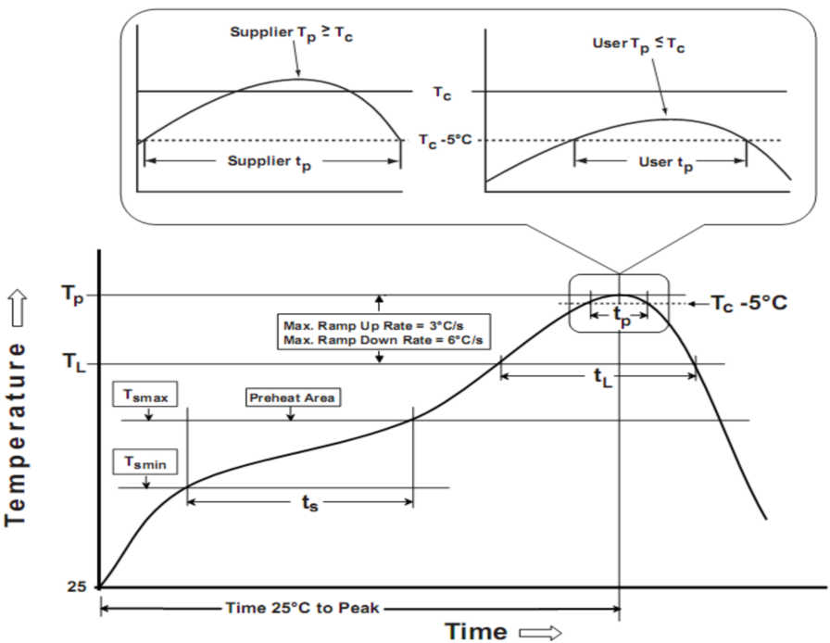
ID601
Soldering Temperature Reflow Profile
Figure 13. Reflow Soldering information
Parameter | Pb-free soldering conditions
Average ramp-up rate (217 ℃ to Peak) | 3℃/second max.
Time of Preheat temp (from 150 ℃ to 200 ℃) | 60 ~ 120 second
Time to be maintained above 217 ℃ | 60 ~ 150 second
Peak temperature | 260 ℃
Time within 5 ℃ of actual peak temp | 30 second
Ramp-down rate | 6 ℃/second max.
Time from 25℃ to peak temp | 8 minutes max.
Table 8. Reflow Soldering Parameter
Note:
1. The reflow peak soldering temperature is peak 260°C and it is specified based on IPC/JEDEC J-STD- 020 “
Moisture/Reflow Sensitivity Classification for Non-Hermetic Solid State Surface Mount Devices”
2. Tolerance for peak proﬁle temperature (Tp) is deﬁned as a supplier minimum and a user maximum.
3. This document should serve as recommendation only. Other parameters may also affect soldering, so these profiles
do not guarantee absolute success.
4. Soldering profiles should be determined by reference to the solder and solder paste manufacturer's specifications, unless they conflict with the recommendations in this document.
5. The soldering profile and footprint information specified in this datasheet are general recommendations and are provided for reference only. The design, control, and quality assurance of the actual soldering process are the sole responsibility of the customer. The supplier assumes no responsibility for the soldering process or its results.
Important statement
Global Technologies reserves the right to change the above-mentioned information without prior notice.

Slide 43

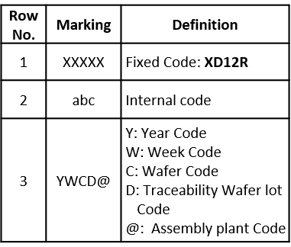





ID601
Body TOP Marking [TBD]
< JSICAT marking >
< SEMTECH marking >
ID601
ID601
AAA
XXXXX
AAA
abc
CBA2J
YWCD@
CBA2S
TOP VIEW
TOP VIEW
Fix. Code IC Part Name: ID601
Assembly production Code : CBA2J, CBA2S
        ※ Example code :2025. 07. 07
        wafer Lot #1-5
Package Drawings Markings
Y → Year code
ID601
W → Week code , A=W1, B=W2,….
C → Wafer lot, Each wafer Lot is represented by a character (Ex: A, B, C, …).
These character cycle once a week.
** Font Type : Arial
Marking text tolerance : ±0.05mm
D → Traceability Code Wafer lot NO. :
A big assembly Lot consists of three wafers. Each big assembly Lot.
Lot is represented by a character (Ex: 1,2,3,…)
@ → Assembly plant code

Slide 44
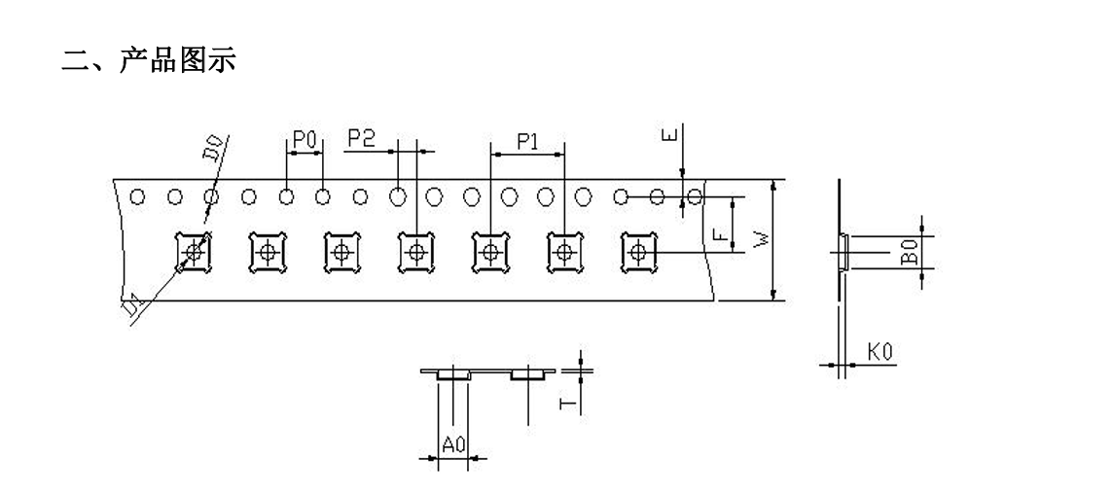

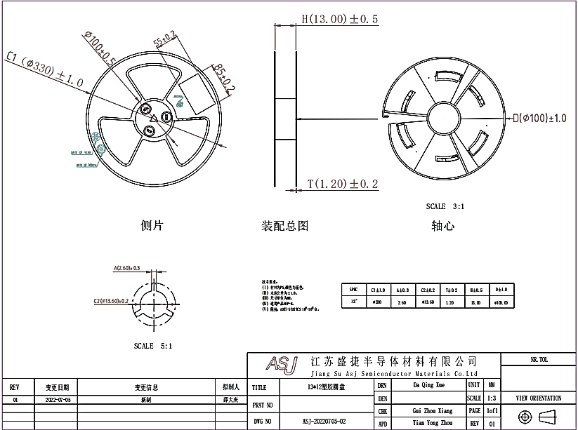
ID601
Embossed tape and reel data [TBD]
1) JSICAT
W | 12.00±0.10 | T | 0.20±0.05 | D1 | 1.55±0.10 | 单位 | Mm
E | 1.75±0.10 | F | 5.50±0.10 | D0 | 1.55±0.10 | 材质 | ABS
P0 | 4.00±0.10 | P1 | 8.00±0.10 | P2 | 2.00±0.10 | 品名 | TSSOP24pin
A0 | 3.18±0.10 | B0 | 3.22±0.10 | K0 | 0.75±0.10 | 制造商 | 新创源
Figure 14. Tape and reel specification

Slide 45
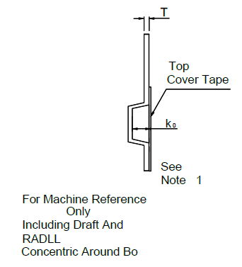
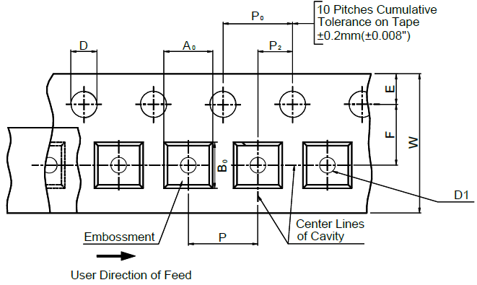
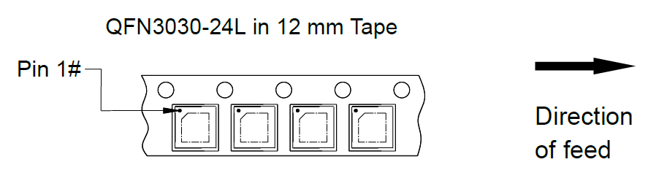
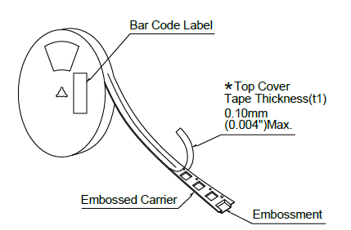
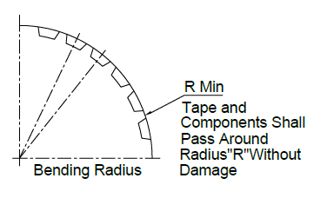
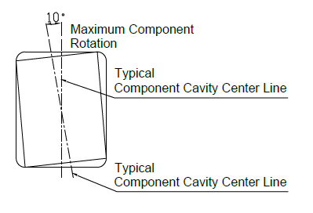
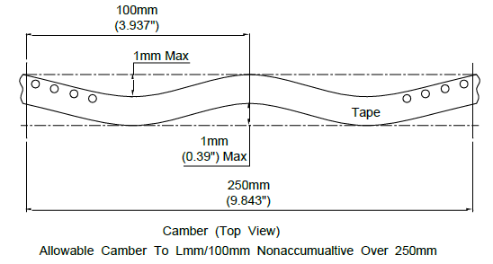
ID601
2) SEMTECH
Package | Tape Size | D | D1 | E | F | P | P₀ | P₂
TSSOP-24L | 12mm | 1.55±0.1mm (0.061±0.004”) | 1.55±0.1mm (0.061±0.004”) | 1.75±0.1mm (0.069±0.004”) | 5.5±0.1mm (0.217±0.004”) | 8±0.1mm (0.315±0.004”) | 4±0.1mm (0.157±0.004”) | 2±0.1mm (0.079±0.004”)
Package | R Min. | T | W | A0 | B0 | K0
TSSOP -24L | 25mm (0.98”) | 0.20±0.05mm (0.008±0.002”) | 12mm±0.1mm (0.472±0.004”) | 3.22±0.1 mm (0.127±0.004”) | 3.22±0.1mm (0.127±0.004”) | 0.75±0.1mm (0.03±0.004”)
Figure 15. Tape and reel specification
Note :
1. Metric dimensions govern-English are in parentheses for reference only.
2. The clearance between the components and the cavity must be within 0.05 mm min. to 0.5 mm max.
3. The component cannot rotate more than 10︒ within the determined cavity.

Slide 46
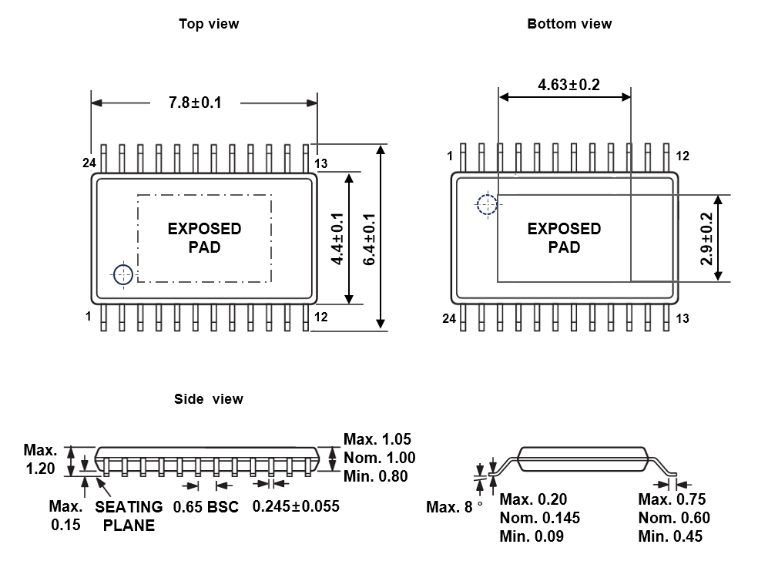
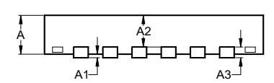
ID601
Package specification
TSSOP-24L Package Outline
TOP VIEW
BOTTOM VIEW
SIDE VIEW
Symbol | Dimensions in mm
 | Min | Typ | Max
A | 0.50 | 0.55 | 0.60
A1 | 0.00 | - | 0.05
A2 | 0.45 REF
A3 | 0.152 REF
b | 0.15 | 0.20 | 0.25
D | 2.90 | 3.00 | 3.10
D1 | 1.75 | 1.80 | 1.85
E | 2.90 | 3.00 | 3.10
E1 | 1.75 | 1.80 | 1.85
e | 0.40 BSC
K | 0.25 | 0.30 | 0.35
L | 0.25 | 0.30 | 0.35
Note
All Dimensions Do Not Include mold flash or Protrusions.
Figure 16. Package Outline

Slide 47
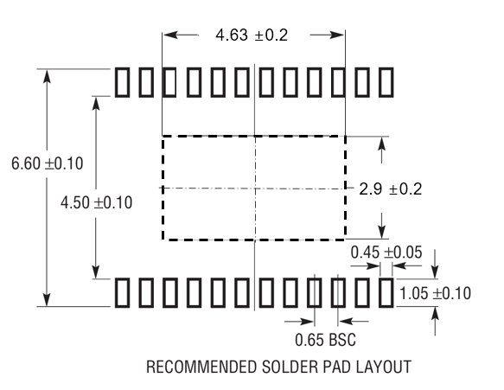

ID601
Recommended Footprint
Recommended Footprint
Symbol | Dimensions in mm
 | Value | Margin (Typ+)
X | 0.5 | +0.2
Y | 0.2 | 0
C | 0.4 | 0
X1 | 0.5 | +0.2
Y1 | 0.5 | +0.2
X2 | 1.8 | 0
Y2 | 1.8 | 0
X3 | 1.1 | +0.1
Y3 | 1.6 | +0.1
X4 | 3.4 | +0.2
Y4 | 3.4 | +0.2
G | 0.2 | 0
G1 | 0.3 | 0
G2 | 0.1 | 0
G3 | 0.1 | 0
G4 | 0.1 | 0
Figure 17. Recommended Footprint
Note: The reflow peak soldering temperature is peak 260°C and it is specified based on IPC/JEDEC J-STD- 020
“Moisture/Reflow Sensitivity Classification for Non-Hermetic Solid State Surface Mount Devices”
is the trademark of Global Technologies Co., Ltd. or its subsidiaries in the Republic of Korea and/or other countries. The products of Global Technologies reserve the right to make changes without further notice to any products herein. Global Technologies makes no warranty, representation or guarantee regarding the suitability of its products for any particular purpose, nor does Global Technologies assume any liability arising out of the application or use of any product or circuit, and specifically disclaims any and all liability, including without limitation special, consequential or incidental damages. Global Technologies does not convey any license under its patent rights nor the rights of others.
is the trademark of Global Technologies Co., Ltd. or its subsidiaries in the Republic of Korea and/or other countries. Global Technologies owns the rights to a number of patents, trademarks, copyrights, trade secrets, and other intellectual property. Global Technologies reserves the right to make changes without further notice to any products herein. Global Technologies makes no warranty, representation or guarantee regarding the suitability of its products for any particular purpose, nor does Global Technologies assume any liability arising out of the application or use of any product or circuit, and specifically disclaims any and all liability, including without limitation special, consequential or incidental damages. Buyer is responsible for its products and applications using Global Technologies products, including compliance with all laws, regulations and safety requirements or standards, regardless of any support or applications information provided by Global Technologies. “Typical” parameters which may be provided in Global Technologies data sheets and/or specifications can and do vary in different applications and actual performance may vary over time. All operating parameters, including “Typical” must be validated for each customer application by customer’s technical experts. Global Technologies does not convey any license under its patent rights nor the rights of others. Global Technologies products are not designed, intended, or authorized for use as a critical component in life support systems or any FDA Class 3 medical devices or medical devices with a same or similar classification in a foreign jurisdiction or any devices intended for implantation in the human body. Should Buyer purchase or use Global Technologies products for any such unintended or unauthorized application, Buyer shall indemnify and hold Global Technologies and its officers, employees, subsidiaries, affiliates, and distributors harmless against all claims, costs, damages, and expenses, and reasonable attorney fees arising out of, directly or indirectly, any claim of personal injury or death associated with such unintended or unauthorized use, even if such claim alleges that Global Technologies was negligent regarding the design or manufacture of the part. Global Technologies is an Equal Opportunity/Affirmative Action Employer. This literature is subject to all applicable copyright laws and is not for resale in any manner.

