Slide 1

Global Technologies
XC24R
The controller for constant current drivers
24 Channels
General Description
The XC24R is a local dimming controller featuring 24 channels to drive its companion chips, XD series LED drivers that act as the constant current sink for White LED back-lighting solution. This controller interfaces with XD series drivers through one serial line to send and receive the data to be needed for local dimming.
The XC24R supports the SPI interface to communicate with the host, and the SPI interface can be daisy-chained, so it is effective to expand to support a large number of dimming areas.
For raising up dimming controllability, XC24R supports the FB signal to efficiently control the LED power supply voltage and two interrupt pins, nINT_FAULT to indicate the fault events like as the thermal status, the open detection, the short detection and the feedback status, and nINT_LD to indicate the room of internal buffers for dimming data.
Application
LED back-lighting with local dimming control

Slide 2
XC24R
Feature
24 channels local dimming controller for the XD mono and RGB series LED drivers
Flexible sizing for each channel
up to 31 daisied LED drivers per channel
up to 255 blocks dimming zone per channel
up to 6,120 blocks dimming zone per XC24R
SPI interface
up to 30MHz
support daisy-chain connection
support to detect the packet broken by the access counter and parity bit
Configurable the serial communication baud-rate speed
Internal OSC 35MHz with spread function for EMI reduction
Configurable MCLK, using a external MCLK or internal OSC MCLK
Configurable the serial data out skew between each channel for EMI reduction
Frame synchronization support
Fault events support of drivers through the interrupt function
Over-temperature event
Open detection
Short detection
FB status for VLED power efficiency
V_{DD}, V₁₅ OV/UV detection
VSYNC missing detection
12-bit DAC 3 channel for VLED control by FB
Configurable Auto-controllability
TTL-level input range
Supply voltage 4.5V ~ 5.5V
68-PIN QFN 6060 Package
Latch-up Immunity ILATCH: JEDEC JESD78D Nov 2011: ±100mA
ESD protection, ESD_{HBM} (JEDEC JS-001-2017 Human Body Model) : ±2KV

Slide 3
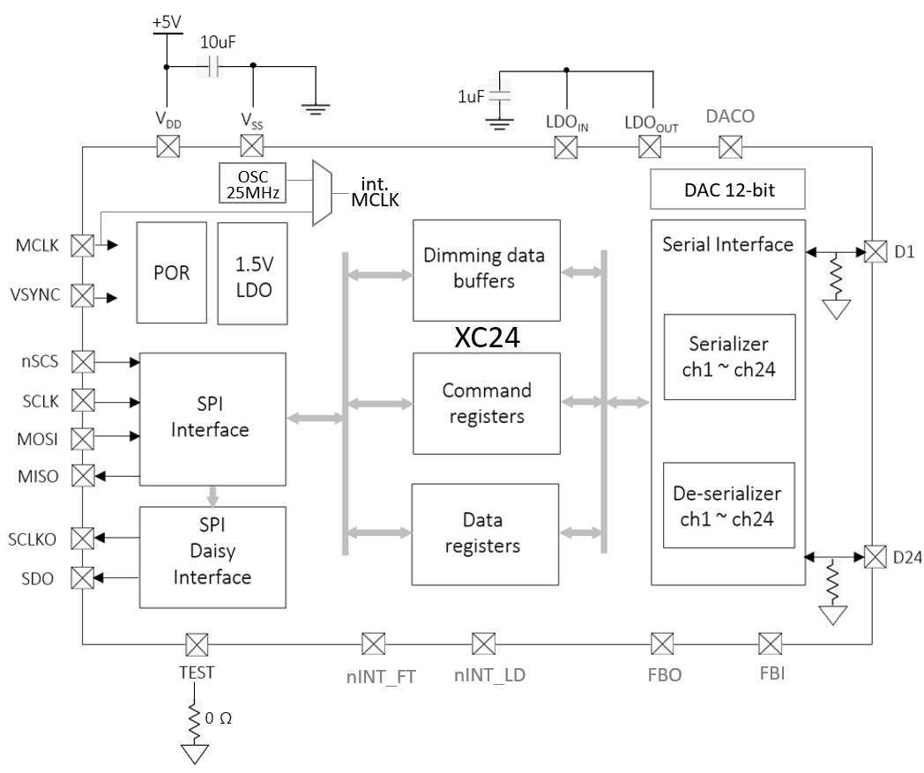
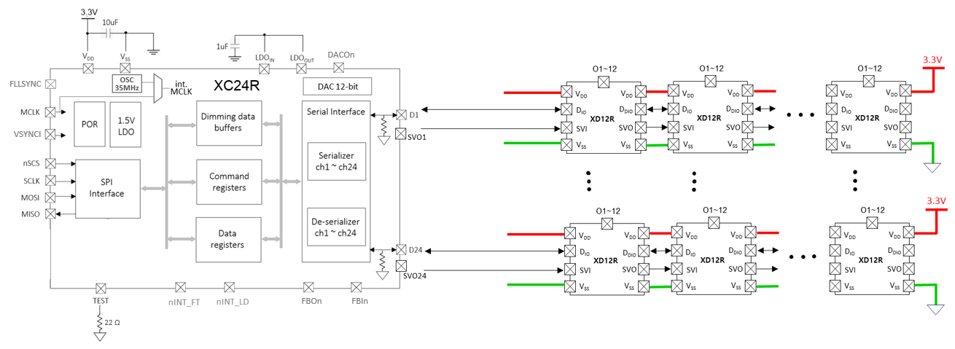
XC24R
Block Diagram
OSC
35MHz
XC24R
Figure 1. Block Diagram
Application Circuit
Figure 2. Application Circuit

Slide 4
XC24R
68
67
66
65
Pin diagram (Top View)
64
63
D6
VSS4
SVO2
D4
SVO3
D5
D3
VDD4
SVO1
SVO5
SVO4
D8
D11
D10
D7
D12
D9
62
61
SVO6
60
51
D2
1
59
TEST
QFN 68-PIN
8mm x 8mm
(TOP View)
D1
2
58
50
FLLSYNC
FBO1
3
57
49
VSYNCI
FBI1
4
56
48
NSCS
DACO1
5
55
47
VSS1
VDD3
6
54
46
SCLK
FBO2
7
53
45
MISO
FBI2
8
52
44
MOSI
DACO2
9
43
NINT_FT
10
18
42
FBO3
NINT_LD
11
19
41
FBI3
VDD1
12
20
40
VSS3
MCLK
13
D21
39
DACO3
21
D24
14
D20
38
LDOO
22
D23
15
D19
37
LDOI
23
SVO9
16
D18
36
H_G1
24
D22
17
VSS2
35
L_G1
25
D17
26
D16
27
SVO8
28
D15
29
D14
Figure 3. Pin diagram
30
D13
31
Pin description
VDD2
32
SVO7
33
Pin Name | Pin No. | I/O | Type | Description | Remark
SVO6 | 1 | O | Digital | Sub Vsync. Output
TEST | 2 | I | Digital | For only TEST mode | 0Ω PD
FLLSYNC | 3 | O | Digital | Frequency Locked Loop Sync
VSYNCI | 4 | I | Digital | Frame synchronization | Short high pulse type recommended
NSCS | 5 | I | Digital | SPI Chip Select
VSS1 | 6 | I | GND | Digital GND
SCLK | 7 | I | Digital | SPI clock
MISO | 8 | O | Digital | SPI MISO
L_G3
34
H_G3
L_G2
H_G2

Slide 5
XC24R
Pin description
Pin Name | Pin No. | I/O | Type | Description | Remark
MOSI | 9 | I | Digital | SPI MOSI
NINT_FT | 10 | O | Digital | Interrupt for the fault events | Open-drain, 10kΩ PU
NINT_LD | 11 | O | Digital | Interrupt for the dimming data room | Open-drain, 10kΩ PU
VDD1 | 12 | I | Power | Digital VDD
MCLK | 13 | I | Digital | Master Clock | if not used, connect to GND
D24 | 14 | I/O | Digital | Data In/Out | if not used, leave to open
D23 | 15 | I/O | Digital | Data In/Out | if not used, leave to open
SVO9 | 16 | O | Digital | Sub Vsync. Output
D22 | 17 | I/O | Digital | Data In/Out | if not used, leave to open
D21 | 18 | I/O | Digital | Data In/Out | if not used, leave to open
D20 | 19 | I/O | Digital | Data In/Out | if not used, leave to open
D19 | 20 | I/O | Digital | Data In/Out | if not used, leave to open
D18 | 21 | I/O | Digital | Data In/Out | if not used, leave to open
VSS2 | 22 | I | GND | Digital GND
D17 | 23 | I/O | Digital | Data In/Out | if not used, leave to open
D16 | 24 | I/O | Digital | Data In/Out | if not used, leave to open
SVO8 | 25 | O | Digital | Sub Vsync. Output
D15 | 26 | I/O | Digital | Data In/Out | if not used, leave to open
D14 | 27 | I/O | Digital | Data In/Out | if not used, leave to open
D13 | 28 | I/O | Digital | Data In/Out | if not used, leave to open
VDD2 | 29 | I | Power | Digital VDD
SVO7 | 30 | O | Digital | Sub Vsync. Output
L_G3 | 31 | O | Digital | VLED3 gate control Output
H_G3 | 32 | O | Digital | VLED3 gate control Output
L_G2 | 33 | O | Digital | VLED2 gate control Output
H_G2 | 34 | O | Digital | VLED2 gate control Output

Slide 6
XC24R
Pin description
Pin Name | Pin No. | I/O | Type | Description | Remark
L_G1 | 35 | O | Digital | VLED1 gate control Output
H_G1 | 36 | O | Digital | VLED1 gate control Output
LDOI | 37 | I | Power | LDO feedback from LDOOUT | attach 1uF
LDOO | 38 | O | Power | Internal LDO out to LDOIN | connect to LDOIN
DACO3 | 39 | O | Analog | DAC for VLED control
VSS3 | 40 | I | GND | Digital GND | for Analog test pin
FBI3 | 41 | I | Digital | Feedback for VLED control | in case of using multiple XCs
FBO3 | 42 | O | Digital | Feedback for VLED control | Open-drain, 10kΩ PU
DACO2 | 43 | O | Analog | DAC for VLED control
FBI2 | 44 | I | Digital | Feedback for VLED control | in case of using multiple XCs
FBO2 | 45 | O | Digital | Feedback for VLED control | Open-drain, 10kΩ PU
VDD3 | 46 | I | Power | Digital VDD
DACO1 | 47 | O | Analog | DAC for VLED control
FBI1 | 48 | I | Digital | Feedback for VLED control | in case of using multiple XCs
FBO1 | 49 | O | Digital | Feedback for VLED control | Open-drain, 10kΩ PU
D1 | 50 | I/O | Digital | Data In/Out | if not used, leave to open
D2 | 51 | I/O | Digital | Data In/Out | if not used, leave to open
SVO1 | 52 | O | Digital | Sub Vsync. Output
D3 | 53 | I/O | Digital | Data In/Out | if not used, leave to open
D4 | 54 | I/O | Digital | Data In/Out | if not used, leave to open
SVO2 | 55 | O | Digital | Sub Vsync. Output
VSS4 | 56 | I | GND | Digital GND
D5 | 57 | I/O | Digital | Data In/Out | if not used, leave to open
D6 | 58 | I/O | Digital | Data In/Out | if not used, leave to open
SVO3 | 59 | O | Digital | Sub Vsync. Output
D7 | 60 | I/O | Digital | Data In/Out | if not used, leave to open

Slide 7
XC24R
Pin description
Pin Name | Pin No. | I/O | Type | Description | Remark
D8 | 61 | I/O | Digital | Data In/Out | if not used, leave to open
SVO4 | 62 | O | Digital | Sub Vsync. Output
VDD4 | 63 | I | Power | Digital VDD
D9 | 64 | I/O | Digital | Data In/Out | if not used, leave to open
D10 | 65 | I/O | Digital | Data In/Out | if not used, leave to open
SVO5 | 66 | O | Digital | Sub Vsync. Output
D11 | 67 | I/O | Digital | Data In/Out | if not used, leave to open
D12 | 68 | I/O | Digital | Data In/Out | if not used, leave to open
Table 1. Pin Description

Slide 8
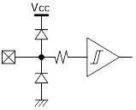

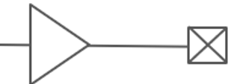
XC24R
Equivalent Circuits of individual pins
Pad Name | I/O | Internal Circuit | Description
nSCS | I |  | SPI Chip Select
SCLK | I |  | SPI Clock Input
MOSI | I |  | SPI MOSI
MISO | O |  | SPI MISO
SCLKO | O |  | SCLK Daisy Out
SDO | O |  | MOSI Daisy Out
MCLK | I |  | Mater Clock
V_{DD}
V_{DD}
V_{DD}
V_{DD}
V_{DD}
V_{DD}
V_{DD}

Slide 9
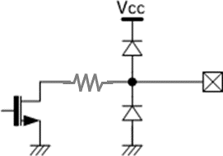
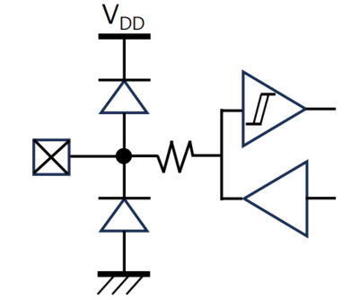
XC24R
Equivalent Circuits of individual pins
Pad Name | I/O | Internal Circuit | Description
VSYNC | I |  | Frame Sync
nINT_FT | O |  | Interrupt for Fault (Open-drain)
nINT_LD | O |  | Interrupt for LD (Open-drain)
FBO | O |  | Feedback Output for VLED (Open-drain)
FBI | I |  | Feedback Input for VLED
D | I/O |  | Data In/Out
TEST | I |  | For test only
V_{DD}
V_{DD}
V_{DD}
V_{DD}
V_{DD}
V_{DD}

Slide 10
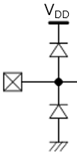
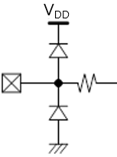
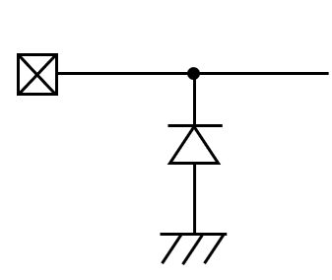

XC24R
Equivalent Circuits of individual pins
Pad Name | I/O | Internal Circuit | Description
LDO_{IN} | I |  | Internal LDO In
LDO_{OUT} | O |  | Internal LDO Out
DACO | O |  | DAC Out
V_{DD} | I |  | Digital Power
V_{SS} | I |  | Digital GND
V_{DD}
Figure 4. Equivalent Circuits of individual pins

Slide 11
XC24R
Maximum Absolute ratings (Ta = 25℃ unless otherwise noted)
Parameter | Symbol | Value | Unit
Supply voltage | V_{DD} | -0.3 ~ 6.0 | V
MCLK to GND voltage | V_{MCLK} | -0.3 ~ V_{DD}+0.5 | V
VSYNC to GND voltage | V_{VSYNC} | -0.3 ~ V_{DD}+0.5 | V
nSCS to GND voltage | V_{SCS} | -0.3 ~ V_{DD}+0.5 | V
SCLK to GND voltage | V_{SCLK} | -0.3 ~ V_{DD}+0.5 | V
MOSI to GND voltage | V_{MOSI} | -0.3 ~ V_{DD}+0.5 | V
MISO to GND voltage | V_{MISO} | -0.3 ~ V_{DD}+0.5 | V
SCLKO to GND voltage | V_{SCLK} | -0.3 ~ V_{DD}+0.5 | V
SDO to GND voltage | V_{SDO} | -0.3 ~ V_{DD}+0.5 | V
D voltage | V_{DIO} | -0.3 ~ V_{DD}+0.5 | V
Thermal Resistance
Junction to Ambient | R_{θJA} | 68 ¹⁾ | ℃/W
Junction to Case | R_{θJC} | 10 ¹⁾ | ℃/W
Power Dissipation on package | P_{TOT} | 1.03 ¹⁾ | W
Ambient temperature | T_{A} | -20 ~ 85 | ℃
Operating Junction temperature | T_{J} | -20 ~ 150 | ℃
Storage temperature | T_{STG} | -45 ~ 150 | ℃
Relative Humidity(non-condensing) | RH_{NC} | 5 ~ 85 | %
Moisture Sensitivity Level | MSL | Maximum Floor Life-time of 168 hr | 3
Table 2. Maximum Absolute ratings
Note :
1) Surface mounted on FR-4 substrate PC Board 1” x 1” inch 2-oz copper plate, T_{A} = 55℃
2) Stresses beyond the Maximum Absolute ratings may cause permanent damage to the device
3) Exposure to absolute maximum rating conditions for extended periods may affect device reliability.
ESD Ratings
Parameter | Symbol | Value | Unit | Remark
Electrostatic Discharge HBM | ESD_{HBM} | ±2000 | V | Norm: JEDEC JS-001-2017
Electrostatic Discharge CDM | ESD_{CDM} | ±500 | V | Norm: JEDEC JESD22-C101F Oct 2013
Table 3. ESD ratings

Slide 12
XC24R
Electrical Characteristic (V_{DD} =5.0V, Ta=25.0℃ unless otherwise noted)
Characteristics | Symbol | Condition | Value |  |  | Unit
 |  |  | min | typ | max
Supply
Operating voltage | V_{DD} |  | 4.5 | - | 5.5 | V
Operating Current | I_{DD} |  | - | 6.95 | - | mA
Quiescent current | I_{S} |  | - | 2.80 | - | mA
MCLK (external)
Frequency | F_{MCLK} |  | ¹⁾ | - | 25 | MHz
Duty |  | @ 1.5V level | 45 | 50 | 55 | %
Jitter | △F_{MCLK} |  | -1 |  | 1 | %
MCLK (internal OSC)
Frequency | F_{MCLK} |  | - | 25 | - | MHz
Duty |  |  | - | - | -
Jitter | △F_{MCLK} |  | - | - | - | %
Input
nSCS Input Voltage | V_{SCSL} | Chip Select, low level | - | - | 0.8 | V
 | V_{SCSH} | Chip Select, high level | 2.7 | - | V_{DD} | V
SCLK Input Voltage | V_{SCLKL} | SPI Clock, low level | - | - | 0.8 | V
 | V_{SCLKH} | SPI Clock, high level | 2.7 | - | V_{DD} | V
MOSI Input Voltage | V_{MOSIL} | MOSI, low level | - | - | 0.8 | V
 | V_{MOSIH} | MOSI, high level | 2.7 | - | V_{DD} | V
VSYNC Input Voltage | V_{VSYNCL} | VSYNC low level | - | - | 0.8 | V
 | V_{VSYNCH} | VSYNC high level | 2.7 | - | V_{DD} | V
FBI Input Voltage | V_{VSYNCL} | FBI low level | - | - | 0.8 | V
 | V_{VSYNCH} | FBI high level | 2.7 | - | V_{DD} | V
Output
MISO Output voltage | V_{MISOL} | MISO, low level | - | - | 0.5 | V
 | V_{MISOH} | MISO, high level | 2.7 | - | V_{DD} | V
SCLKO Output voltage | V_{SCLKOL} | SCLKO, low level | - | - | 0.5 | V
 | V_{SCLKOH} | SCLKO, high level | 2.7 | - | V_{DD} | V
SDO Output voltage | V_{SDOL} | SDO, low level | - | - | 0.5 | V
 | V_{SDOH} | SDO, high level | 2.7 | - | V_{DD} | V

Slide 13
XC24R
Electrical Characteristic (V_{DD} =5.0V, Ta=25.0℃ unless otherwise noted)
Characteristics | Symbol | Condition | Value |  |  | Unit
 |  |  | min | typ | max
Bi-direction
D_{IO} | V_{IL} V_{IH} | Input logic low level | - | - | 0.8 | V
 |  | Input logic high level | 3.0 | - | V_{DD}
 | V_{OL} V_{OH} | Output logic low level | - | - | 0.5 | V
 |  | Output logic high level | V_{DD}*0.8 | - | V_{DD}
 | R_{PD} | Internal pull-down resistance | - | 48 | - | KΩ
Bi-direction : Input signal decoding capability
Logical long time ²⁾ | T_{1H}, T_{0L} |  | 6 | - | 63 | MCLK
Logical short time ²⁾ | T_{1L}, T_{0H} |  | 3 | - | 32 | MCLK
DAC
DACO | Operating voltage | V_{DD} | 4.5 | - | 5.5 | V
 | Resolution | Available Min value decimal 100 Available Max value decimal 4,000 |  | - | 12 | Bit
 | Output voltage |  | 0.1 | - | 3.2 | V
 | Code error | △V_{out} | - | ±3 | ±5 | %
V_{DD} Ramp-up and V_{LED} Start
V_{DD} Ramp-up time | T_{VDD} | from 0 to stable 5V |  |  | 2.0 | ms
V_{LED} Start time | T_{SU_DIM} | after T_{SU_DIM} is completed | ³⁾ |  |  | ms
Internal Initialization after V_{DD}, 5V stable
Internal Initial time | T_{INIT} | after V_{DD}, 5V | 100 |  |  | ms
Allowed 1st access | T_{FACC} | after T_{INIT} is completed | 5 |  |  | ms
Logic ‘1’
T_{1L}
Logic ‘0’
T_{1H}
T_{0H}
T_{0L}
Table 4. DC Electrical Characteristic
Note : 1) It is recommended the minimum MCLK should not be more than twice as slow as the SCLK for stable fast-
readout. If MCLK will be more than twice as slow as SCLK, then an appropriate latency is needed between
the first 16 SCLKs for a command and the second 16 SCLKs for readout.
2) The conditions, T_{1H} ≥ T_{0H} * 2, T_{0L} ≥ T_{1L} * 2, (T_{1H} + T_{0H}) = (T_{0L} + T_{1L}) < 80 are normally recommended.
However, the value depends on the baud-rate of the XD..
3) The time depends on the system configuration, the daisied XD number, SCLK, MCLK and Baud-rate.
Important statement
Global Technologies reserves the right to change the above-mentioned information without prior notice.

Slide 14
XC24R
Electrical Characteristic (V_{DD} =5.0V, Ta=25.0℃ unless otherwise noted)
Power Sequence
V_{DD}
5V stable
T_{VDD}
T_{INIT}
T_{FACC}
Access to XC
accessible
Set-up to XD
XD setup for dimming
V_{LED}
T_{SU_DIM}
Figure 5. Power up sequence and ramp-up time

Slide 15
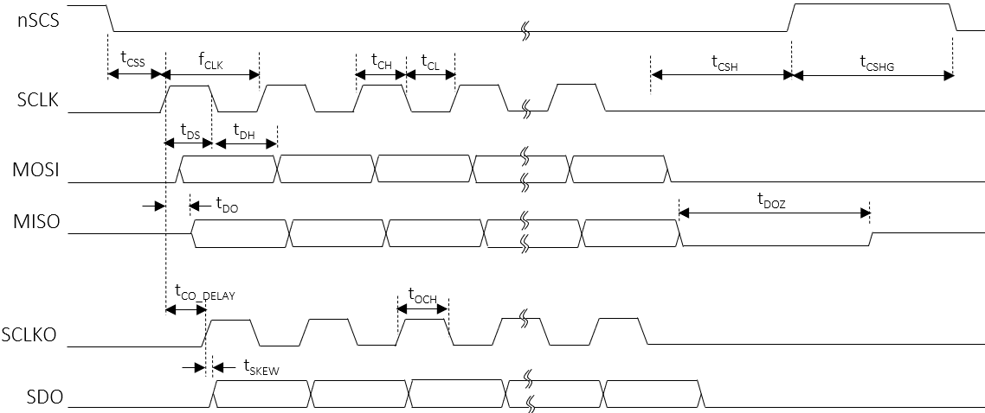
XC24R
AC Characteristics (V_{DD S}=5.0V, Ta=25.0℃ unless otherwise noted)
Characteristics | Symbol | Condition | Value |  |  | Unit
 |  |  | min | typ | max
SCLK
SCLK frequency | f_{CLK} |  | - | Typ ¹⁾ | 30 | MHz
SCLK duty | t_{CLK_DUTY} |  | 48 | - | 52 | %
SCLK high time | t_{CH} |  | 8 | - | - | ns
SCLK low time | t_{CL} |  | 8 | - | - | ns
SCLKO
SCLK to SCLKO delay | T_{CO_DELAY} |  | - | - | 10.5 ⁽³⁾ | ns
The skew between SCLKO to SDO | t_{SKEW} |  | - | - | - 1.5 ⁽³⁾ | ns
SCLKO high time | t_{OCH} |  | t_{CH} - 1⁽³⁾ | - | - | ns
nSCS setup to the first rising SCLK | t_{CSS} |  | 50 | - | - | ns
nSCS hold time from the last falling SCLK | t_{CSH} |  | 3 | - | - | MCLK
nSCS high latency time | t_{CSHG} |  | 3 | - | - | MCLK
MOSI setup time | t_{DS} |  | 5 | - | - | ns
MOSI hold time | t_{DH} |  | 2 | - | - | ns
MISO delay from the rising edge SCLK | t_{DO} |  | - | - | 12 | ns
MISO high-Z from the nSCS de-assertion | t_{DOZ} |  | - | - | 1 | MCLK
Note (3) It should be careful that the t_{CO_DELAY,} t_{SKEW,} t_{OCH} and t_{DO} are accumulated by the number of daisy devices if the
daisy chain connection is used. So, for the read transaction, the proper timing should be considered in daisy
chain.
Table 5. AC Electrical Characteristic
Figure 6. SPI timing sequence

Slide 16
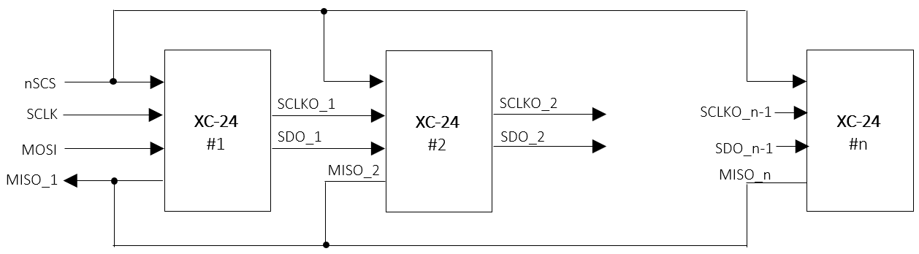
XC24R
Functional Description
1. SPI Interface
For the local dimming data transmit a Serial Peripheral Interface is used. The SPI is configurated to work as SPI slave.
A Daisy Chain structure can be used to support large scale blocks array with several devices and operated up to 30MHz.
SPI Daisy Chain Structure
All SPI slaves share the Chip select signal, and these devices in Daisy chain can be treated as one big shift register. The devices can be enumerated as described below.
Figure 7. SPI daisy connection
SPI Protocol
The XC24R has 3 types of the SPI Interface protocol, the register-read, the register-write and the LD data-transfer. The SPI protocol’s format consists of a 16-bit command and a 16-bit register data or a series of 24(or 16)-bit LD data following the 16-bit command.
[Command format]
 | Bit15 | Bit14 | Bit14 | Bit13 | Bit12 | Bit11 | Bit10 | Bit9 | Bit8 | Bit7 | Bit6 | Bit5 | Bit4 | Bit3 | Bit2 | Bit1 | Bit0
 | Command code [1:0] |  |  | Address [7:0] |  |  |  |  |  |  |  | Burst size [5:0]
Register-read | 0 |  | 1 | Start address [7:0] |  |  |  |  |  |  |  | Burst size [5:0]
Register-write | 1 |  | 0 | Start address [7:0] |  |  |  |  |  |  |  | Burst size [5:0]
LD-transfer | 1 |  | 1 | don’t care |  |  |  |  |  |  |  | Line size [5:0]
[Data format]
 | Bit15 | Bit14 | Bit13 | Bit12 | Bit11 | Bit10 | Bit9 | Bit8 | Bit7 | Bit6 | Bit5 | Bit4 | Bit3 | Bit2 | Bit1 | Bit0
 | Data [15:0] |  | Address [7:0] |  |  |  |  |  |  |  | Burst size [5:0]
Register-RW | Register data [15:0] |  | Start address [7:0] |  |  |  |  |  |  |  | Burst size [5:0]
LD1 transfer | LD_WIDTH [1:0] = 2’b00 : 24 bits /block |  | 8’hxx |  |  |  |  |  |  |  | Line size [5:0]
LD2 transfer | LD_WIDTH [1:0] = 2’b01 : 24 bits /block |  | 8’hxx |  |  |  |  |  |  |  | Line size [5:0]
LD3 transfer | LD_WIDTH [1:0] = 2’b10 : 24 bits /block
LD4 transfer | LD_WIDTH [1:0] = 2’b11 : 16 bits /block

Slide 17
XC24R
Functional Description
SPI read/write sequence in burst
The SPI access sequence is as follows, depending on the type of access. There is no difference between a single and
a burst access except for the number of data due to the burst size.
nSCS
SCLK
Start addr = 0xa
Burst size = n+1
a
a+1
a+n
b
b+1
b+m
MOSI
Command
Data
Data
Data
Command
Data
Data
Data
SCLKO
Command
b
b+1
b+m
SDO
Data
Data
Data
Figure 8. The SPI Burst write in daisied 2 devices
nSCS
SCLK
MOSI
Command
Command
Start addr = 0xa
Burst size = n+1
a
a+1
a+n
MISO
Data
Data
Data
SCLKO
SDO
Command
MISO
(dev#2)
b
b+1
b+m
Data
Data
Data
Figure 9. The SPI Burst read in daisied 2 devices

Slide 18
XC24R
Functional Description
SPI LD transfer sequence
The SPI sequence for the LD transfer is as follows. The LD width depends on the LD_WIDTH value of the CHANNEL ENABLE 2 register. If the LD_WIDTH = 2’b00, then the LD data size of one block zone transferred through the SPI becomes 24 bits consisted of PAM 12 bits and PWM 12 bits. Even if the transmitted width is 24 bits, the valid bits are actually 20 bits, PAM 10 bits + PWM 10 bits. Therefore, the data size per block to be transmitted to the daisied devices is 20 bits.
LD_WIDTH [1:0] | LD width | LD format | Valid bits
2’b00 | 24 bits | PWM 8-bit + PAM 16-bit | PWM 8-bit + PAM 14-bit
2’b01 | 24 bits | PAM 12-bit + PWM 12-bit | PAM 10-bit + PWM 11-bit
2’b10 | 24 bits | PAM 12-bit + PWM 12-bit | PAM 10-bit + PWM 12-bit
2’b11 | 16 bits | LD 16-bit | LD 16-bit
Table 6. LD data size according to LD_WIDTH
The burst size unit means the amount of LD data corresponding to one line and the one line of LD data corresponds to the total LD data of all activated channels, and the number of active channel is determined by the CH_SIZE value of the ENABLE CHANNEL 2 register. Here, the CH_SIZE value should be equal to the number of activated channels by the CHx_EN of the ENABLE CHANNEL 1/2 registers.
Burst size unit = 1-line LD data = CH_SIZE * LD data size
nSCS
Burst size = n
Burst size 2
Burst size 1
Command
LD
ch1
= 1-Line size
LD
chx
LD
ch1
LD
ch2
MOSI
LD
ch2
LD
chx
LD
chx
Command
LD
ch1
LD
ch2
LD width
SDO
CH_SIZE = x
Command
LD
ch1
LD
ch2
Figure 10. The SPI LD transfer in daisied 2 devices

Slide 19
XC24R
Functional Description
2. Serial Interface
The XC24R has a total of 24 channels for serial daisy connections with a total of 31 XD devices. Each channel can transmit the data to the XD and receive the data from the XD through one line daisied to the XD devices. The XC24R has a total of 6 instructions for transferring the data to the XD and 3 instructions for receiving the data from the XD.
Ch1
D_{IO}
D_{DIO}
D_{DIO}
D_{DIO}
XC24R
XD
#1
D_{IO}
D_{IO}
XD
#2
XD
#31
Ch24
Figure 11. The daisied scheme
The commands are listed as shown in the Table 7. and described in more detail below.
Instruction | Transaction direction | Data direction | Description
 | Command | Data
Global-write | XC → XD | XC → XD | Global-write command the same register data between the XD devices
Local-write | XC → XD | XC → XD | Local-write command the different register data between the XD devices
LD-transfer | XC → XD | XC → XD | Local Dimming data-transfer command to the XD devices
ID-gen | XC → XD | - | ID generation command of the XD devices in daisied each channel
Sync-gen | XC → XD | - | Sync-generation command to the XD devices
Sync-auto-gen | XC → XD | - | Automatically sync-generation command sync on the XD devices
Local-read | XC → XD | XD → XC | Local-read command to the XD devices and read-back from the XD devices
Fault-read | XC → XD | XD → XC | Fault-read command to the XD devices and read-back from the XD devices
Fault-auto-read | XC → XD | XD → XC | Automatically fault-read command to the XD devices and read-back from the XD devices
Table 7. Instruction list

Slide 20
XC24R
Functional Description
ID-generation
The ID-GEN COMMAND register is used to set a unique ID for each device and each device’s ID helps identifying when each device should react on a read-back operation. Therefore, after POR this command should be transacted at the first time for proper operation of the XD devices before transacting other commands. If the START bit of ID-GEN COMMAND register is set, then all activated channels begin issuing the command signals to all XDs daisied in each channel and the command signal streams repeat continuously for the number of daisied devices.
The number of daisied devices is determined by the DAISY SIZE register of each channel. After the command signal streams are completed, all devices will have their own ID respectively. The ID is numbered in opposite direction of daisied line. It is careful that the writing data is transferred from the first located device, the last number ID, to the last located device, the first number ID, in daisied line but the reading data is received from the last located device to the first located device sequentially.
Ch1
D_{IO}
D_{DIO}
D_{DIO}
D_{DIO}
XC24R
XD
#1
ID=31
D_{IO}
D_{IO}
XD
#2
ID=30
XD
#31
ID=1
Ch24
V_{DD}
nSCS
Initialization to the XD-12
MOSI
ID-GEN COMMAND
transmit
CH1
CH2
CHx
Figure 12. The sequence of ID-GEN command

Slide 21
XC24R
Functional Description
Global-write
The Global-write command is used to write the register data to the XD only if all XD devices daisied to a channel of the XC24R have the same register data. If the register data to be written to the XDs are different each other, at that time the Local-write command should be used. For executing the Global-write command properly, the GLOBAL-WRITE DATA register should be firstly written with desired value and then the START bit of the GLOBAL-WRITE COMMAND register should be set with desired address in order to begin transacting this command.
nSCS
MOSI
GLOBAL-WRITE DATA
transmit
GLOBAL-WRITE COMMAND
transmit
CH1
Address
Data
CH2
CHx
Figure 13. The sequence of Global-write command
The GLOBAL-WRITE COMMAND register consists of 6 bits of ADDRESS field and 1 bit of START. The ADDRESS is the register address of the XD to be accessed. If the START bit is set with the ADDRESS together, the Global writing command begins issuing simultaneously in all activated channels, and the command streams repeat continuously for the number of daisied XDs. The number of daisied devices can be determined by the DAISY SIZE register of each channel. The max number of daisied devices per channel is 31.

Slide 22
XC24R
Functional Description
Local-write
The Local-write command is used to write the register data to the XD in case that all XD devices daisied to a channel of the XC24R have the different register data each other. If the register data to be written to the XD are same, at that time the Global-write command is more useful for fast transaction time. For proper execution of the Local-write command, the LOCAL-RW DATA registers should be firstly written with desired value and then, the START bit of the LOCAL-WRITE COMMAND register should be set with desired address for beginning this command. It is careful that the LOCAL-RW POINTER RESET register must be set necessarily to 1 for the next transaction after the current Local -write command execution is completed or before the next Local-write command will start again.
nSCS
MOSI
LOCAL-RW DATA
transmit
LOCAL-WRITE COMMAND
transmit
LOCAL-RW POINTER RESET
transmit
CH1
Address
Data
CH2
CHx
Local-write Done
Figure 14. The sequence of Local-write command
The LOCAL-WRITE COMMAND register consists of ADDRESS 6 bits, CH_SEG 2 bits and START 1 bit. The ADDRESS is the register address of the XD to be accessed. If the START bit is set with the ADDRESS together, the Local-write command begins the execution simultaneously in all activated channels, and the command streams repeat continuously for the number of daisied XD. The number of daisied devices can be determined by the DAISY SIZE register of each channel. The max number of daisied devices per channel is 31. The channel segment bits, CH_SEG, are used to decide on which channels are activated for this command, because this command can be performed 8 channels at a time.
The LOCAL-RW DATA registers are divided into a total of 8 port group and each port has a total of 16 registers. The first data register in the port is mapped to the first located XD12 in daisied order and the second data register is mapped to the second located XD, and so on. Although the data registers in a port are a total 16, the XC24R can support over 16 daisied devices in a channel by using the LOCAL-WR TRANSFER POINTER and LOCAL-RW DIFFERENCE POINTER. The LOCAL-WR TRANSFER DIFF POINTER of the LOCAL-RW DIFFERENCE POINTER shows how many data remain in the LOCAL-RW DATA buffers. A value of 0 means that the LOCAL-RW DATA buffers are empty, so you must continue to fill up before they are empty. A value greater than 16 means that the buffer has been overwritten, so you must wait until the pointer value is less than 16.
CH_SEG[1:0] | Channel to be activated | LOCAL-RW DATA 1 ~ 16
 |  | PORT1 | PORT2 | PORT3 | PORT4 | PORT5 | PORT6 | PORT7 | PORT8
2’b00 | Ch 1 ~ Ch 8 | Ch 1 | Ch 2 | Ch 3 | Ch 4 | Ch 5 | Ch 6 | Ch 7 | Ch 8
2’b01 | Ch 9 ~ Ch 16 | Ch 9 | Ch 10 | Ch 11 | Ch 12 | Ch 13 | Ch 14 | Ch 15 | Ch 16
2’b10 | Ch 17 ~ Ch 24 | Ch 17 | Ch 18 | Ch 19 | Ch 20 | Ch 21 | Ch 22 | Ch 23 | Ch 24
Table 8. The LOCAL-RW DATA mapping according to the CH_SEG

Slide 23
XC24R
Functional Description
Local-RW DATA structure for access
 | XD drivers daisied in each channel
 | # 1 |  |  |  |  |  |  |  |  |  | # 1
 | # 2 |  | # 1 |  |  |  | # 1 |  | # 1 |  | # 2
 | # 3 |  | # 2 |  | # 1 |  | # 2 |  | # 2 |  | # 3 |  |  |  | # 1
 | # 4 |  | # 3 |  | # 2 |  | # 3 |  | # 3 |  | # 4 |  | # 1 |  | # 2
 | # m-1 |  | # n-1 |  | # k-1 |  | # n-1 |  | # n-1 |  | # m-1 |  | # l-1 |  | # k-1
 | # m |  | # n |  | # k |  | # n |  | # n |  | # m |  | # l |  | # k
CH_SEG
2’b00 |  | Channel 1 |  | Channel 2 |  | Channel 3 |  | Channel 4 |  | Channel 5 |  | Channel 6 |  | Channel 7 |  | Channel 8
2’b01 |  | Channel 9 |  | Channel 10 |  | Channel 11 |  | Channel 12 |  | Channel 13 |  | Channel 14 |  | Channel 15 |  | Channel 16
2’b10 |  | Channel 17 |  | Channel 18 |  | Channel 19 |  | Channel 20 |  | Channel 21 |  | Channel 22 |  | Channel 23 |  | Channel 24
Address |  | PORT 1 |  | PORT 2 |  | PORT 3 |  | PORT 4 |  | PORT 5 |  | PORT 6 |  | PORT 7 |  | PORT 8
0x70~0x77 |  | LOCAL RW DATA 1 |  | LOCAL RW DATA 1 |  | LOCAL RW DATA 1 |  | LOCAL RW DATA 1 |  | LOCAL RW DATA 1 |  | LOCAL RW DATA 1 |  | LOCAL RW DATA 1 |  | LOCAL RW DATA 1
0x78~0x7F |  | LOCAL RW DATA 2 |  | LOCAL RW DATA 2 |  | LOCAL RW DATA 2 |  | LOCAL RW DATA 2 |  | LOCAL RW DATA 2 |  | LOCAL RW DATA 2 |  | LOCAL RW DATA 2 |  | LOCAL RW DATA 2
0x80~0x87 |  | LOCAL RW DATA 3 |  | LOCAL RW DATA 3 |  | LOCAL RW DATA 3 |  | LOCAL RW DATA 3 |  | LOCAL RW DATA 3 |  | LOCAL RW DATA 3 |  | LOCAL RW DATA 3 |  | LOCAL RW DATA 3
0xE8~0xEF |  | LOCAL RW DATA 16 |  | LOCAL RW DATA 16 |  | LOCAL RW DATA 16 |  | LOCAL RW DATA 16 |  | LOCAL RW DATA 16 |  | LOCAL RW DATA 16 |  | LOCAL RW DATA 16 |  | LOCAL RW DATA 16
0x70~0x77 |  | LOCAL RW DATA 1 |  | LOCAL RW DATA 1 |  | LOCAL RW DATA 1 |  | LOCAL RW DATA 1 |  | LOCAL RW DATA 1 |  | LOCAL RW DATA 1 |  | LOCAL RW DATA 1 |  | LOCAL RW DATA 1
0x78~0x7F |  | LOCAL RW DATA 2 |  | LOCAL RW DATA 2 |  | LOCAL RW DATA 2 |  | LOCAL RW DATA 2 |  | LOCAL RW DATA 2 |  | LOCAL RW DATA 2 |  | LOCAL RW DATA 2 |  | LOCAL RW DATA 2
Physical size
Virtual space
 | 1st dev | 2nd dev |  | 16th dev |  | 20th dev
XDs daisied | ID #20 | ID #19 |  | ID #5 |  | ID #1
PORT1 | LOCAL RW DATA 1 | LOCAL RW DATA 2 |  | LOCAL RW DATA 16 |  | LOCAL RW DATA 4
write
 | 20th dev | 19th dev |  | 5th dev |  | 1st dev
XDs daisied | ID #1 | ID #2 |  | ID #16 |  | ID #20
PORT1 | LOCAL RW DATA 1 | LOCAL RW DATA 2 |  | LOCAL RW DATA 16 |  | LOCAL RW DATA 4
read-back
Figure 15. LOCAL-RW DATA mapping structure and data flow

Slide 24
XC24R
Functional Description
Sync-generation
The Sync-generation command is used to synchronize the frame sync time for all daisied devices simultaneously. This command execution can be done by two methods, the one is by setting the START bit of the SYNC-GEN COMMAND register and the other is by setting the SYNC_AUTO_EN bit of the COMMAND AUTO ENABLE register.
If the SYNC_AUTO_EN bit is set, the Sync-generation command is automatically executed at the moment of receiving the VSYNC input. It is recommended to use this function, but it should be careful that The synchronization time of the XD devices may be as late as the number of XD devices than the time the VSYNC was received, so the VSYNC should arrive as soon as it is late. This command streams repeat continuously for the number of daisied devices in each channel.
VSYNC
nSCS
MOSI
SYNC-GEN COMMAND
transmit
SYNC-GEN
SYNC-AUTO-GEN
CH1
CH2
CHx
Figure 16. The sequence of SYNC-GEN command
Fault-read
The Fault-read command is used to read-out the fault information of all daisied devices simultaneously. This command execution can be done by two methods, the one is by setting the START bit of the FAULT-GEN COMMAND register and the other is by setting the FAULT_AUTO_EN bit of the COMMAND AUTO ENABLE register.
If the FAULT_AUTO_EN bit is set, the Fault-read command is automatically executed after the completion of the Sync auto-gen command at the moment of receiving the VSYNC input. The fault data to be read-back from all XD devices in each channel is stored into the corresponding channel’s GLOBAL FAULT-READ DATA register, respectively.
VSYNC
nSCS
MOSI
FAULT-READ COMMAND
transmit
FAULT-READ
SYNC-AUTO-GEN
FAULT-AUTO-READ
CH1
CH2
CHx
Figure 17. The sequence of FAULT-READ command

Slide 25
XC24R
Functional Description
Local-read
The Local-read command is used to read the register data from all XD devices daisied in a channel of the XC24R. Unlike the Local-write or Global-write command, the Local-read command can be used to read the register data of the XD devices regardless of whether the data is the same or different. The data to be read-out from the XD devices are stored into the LOCAL-RW DATA registers sequentially like the Figure 15. The START bit of the LOCAL-READ COMMAND register should be set with desired address to be read-out for beginning this command. It is careful that the LOCAL-RW POINTER RESET register must be set necessarily to 1 for the next transaction after the current Local read command execution is completed or before the next Local-read command will start again.
nSCS
SPI Read
MOSI
LOCAL-READ COMMAND
transmit
LOCAL-RW POINTER RESET
transmit
MISO
LOCAL-READ COMMAND
LOCAL-READ-BACK
CH1
Addr
Data
CH2
CHx
Local-Read Done
Figure 18. The sequence of Local-read command
The LOCAL-READ COMMAND register consists of ADDRESS 6 bits, CH_SEG 2 bits and START 1 bit. The ADDRESS is the register address of the XD to be accessed. If the START bit is set with the ADDRESS together, the Local-read command begins the execution simultaneously in all activated channels, and the command streams repeat continuously for the number of daisied XDs. The number of daisied devices can be determined by the DAISY SIZE register of each channel. The max number of daisied devices per channel is 31. The channel segment bits, CH_SEG, are used to decide on which channels are activated for this command, because this command can be performed 8 channels at a time.
The LOCAL-RW DATA registers are divided into a total of 8 port group and each port has a total of 16 registers. Unlike the Local-write command, the first data register in the port is mapped to the last located XD in daisied order and the second data register is mapped to the second located XD from the back, and so on. Although the data registers in a port are a total 16, the XC24R can support over 16 daisied devices in a channel by using the LOCAL-READ RECEIVE POINTER and LOCAL-RW DIFFERENCE POINTER. The LOCAL-RD RECEIVE DIFF POINTER of the LOCAL-RW DIFFERENCE POINTER shows how many data are filled up in the LOCAL-RW DATA buffers. A value of 0 means that the LOCAL-RW DATA buffers are empty, so you must wait for the buffers to be refilled, and if the value is greater than 16, it means that the LOCAL-RW DATA buffers have been overwritten, so you must drag out the buffers before they are overflowed. Refer to the Table 8. and the Figure 15. for the mapping scheme.

Slide 26
XC24R
Functional Description
Sequence of Local Dimming data transfer
The Local Dimming data of the next frame should be transmitted to the XC24R through the SPI and the XC24R should complete to transfer the LD data to the XD devices before assertion of the next frame sync. And then, the LD data will be started dimming-out by the XD devices at the next frame sync. The LD_WR_POINTER of the LD WR POINTER register will be increased one by one in line unit whenever the LD data are written to the XC24R LD data buffers through the SPI and see the Figure 10. for the amount of one line LD. The LD_RD_POINTER will be increased one by one whenever the XC24R transmits the amount of one LD data to the XD devices. The LD_DIFF_POINTER is a value of the LD_WR_POINTER minus the LD_RD_POINTER, so the value is useful to check how many LD data remains in the internal LD buffers.
If the LD_TARNS_START_POINTER value becomes equal to the LD_DIFF_POINTER, then the XC24R starts sending the LD data to the XD devices automatically until the LD_DIFF_POINTER value becomes to 0.
VSYNC
#1
#2
SPI I/F
LD Data transfer
(frame #1-1)
LD Data transfer
(frame #1-2)
LD Data transfer
(frame #1-n)
LD Data transfer
(frame #2-1)
LD_WR_POINTER=k
LD_WR_POINTER=m
LD_DIFF_POINTER=m-n
D_{IO} #x
LD TRANSFER
(frame #1)
Local dimming out
(of XD-12)
LD_TRANS_START_POINTER=k
LD_RD_POINTER=n
Local dimming out
(frame #1)
Figure 19. The sequence of Local dimming Data transfer

Slide 27
XC24R
Functional Description
Local Dimming data buffer
The total number of Local Dimming data buffers is 32 per channel and 1 buffer can contain one block data which consists of PAM and PWM data. The size of PAM and PWM data depends on the LD_WIDTH of CHANNEL ENABLE 2 register and refer to previous chapter for more details. Even if the physical buffer size is limited to 32, the XC24R can support to transfer up to 255 blocks by using the LD WRITE POINTER, LD READ POINTER and LD DIFFERENCE POINTER. You can continue to send the LD data so that the LD DIFFERENCE POINTER does not become 0. The number of daisied devices of each channel can be different from each other by separately setting the DAISY SIZE register of each channel. The below shows the scheme of LD buffers and the mapping to the daisied device. For more information refer to the example on the next page.
XD drivers daisied in each channel
# m
# m-1 |  | # n
# m-2 |  | # n-1 |  |  |  | # l
# m-3 |  | # n-2 |  | # k |  | # l-1
# 2 |  | # 2 |  | # 2 |  | # 2
# 1 |  | # 1 |  | # 1 |  | # 1
max DAISIED_DEV_CH_SIZEx = 31
max DAISY_SIZE_CHx = 31
Channel 1 |  | Channel 2 |  | Channel 3 |  | Channel x
Block 1 | LD buffer 1 |  | LD buffer 1 |  | LD buffer 1 |  | LD buffer 1
Block 2 | LD buffer 2 |  | LD buffer 2 |  | LD buffer 2 |  | LD buffer 2
Block 3 | LD buffer 3 |  | LD buffer 3 |  | LD buffer 3 |  | LD buffer 3
Block 32 | LD buffer 32 |  | LD buffer 32 |  | LD buffer 32 |  | LD buffer 32
Physical size=32
Block 33 | LD buffer 33 |  | LD buffer 33 |  | LD buffer 33 |  | LD buffer 33
Block 34 | LD buffer 34 |  | LD buffer 34 |  | LD buffer 34 |  | LD buffer 34
Block 35 | LD buffer 35 |  | LD buffer 35 |  | LD buffer 35 |  | LD buffer 35
Block 127 | LD buffer 127 |  | LD buffer 127 |  | LD buffer 127 |  | LD buffer 127
The amount of SPI one Line LD
Available whole size = 255
max BLOCK_SIZE_CHx = 255
Virtual space=233
LD_SIZE= x
Figure 20. The scheme of Local dimming Data buffers

Slide 28
XC24R
Functional Description
Local Dimming data transfer
The below example shows how to set properly the registers relevant to the Local Dimming data transfer. The LD_SIZE of the CHANNEL ENABLE 2 register determines how many channels among a total of 24 channels of XC24R will be activated, and if 20 channels will be used, then the LD_SIZE is 0x14 and available channels become from the channel 1 to channel 20, so it should be careful that the order of channels to be selected must be a direction that sequentially increases from 1 to 24. The DAISY_SIZE_CHx of the DAISY SIZE registers determines how many XD devices will be daisied in the channel x, and if 10 XD devices are daisied in a channel x, then the DAISY_ SIZE_CHx should be set to 0xA. The DAISIED_DEV_CH_SIZE determines how many channels of the XD will be used, so if the value is 0x4, the XD devices daisied in a channel x will capture only 4 LD data and then bypass the flowing LD data streams to the next XD devices and the remainder of the multiples of 4 be delivered lastly to a las XD device. It should be careful that all devices except for the last device must have the same value of DAISIED_ DEV_CH_SIZE. The BLOCK_SIZE_CHx determines the total number of LD data to be transferred to a channel x.
XD drivers daisied in each channel
# 10 |  |  |  |  |  | # 10
# 9 |  | # 9 |  |  |  | # 9
# 8 |  | # 8 |  |  |  | # 8
# 7 |  | # 7 |  | # 7 |  | # 7
# 2 |  | # 2 |  | # 2 |  | # 2
# 1 |  | # 1 |  | # 1 |  | # 1
DAISIED_DEV_CH_SIZEx = 4
DAISY_SIZE_CHx=10
Channel 1 |  | Channel 2 |  | Channel 3 |  | Channel x
The amount of
SPI one Line LD
Block 1 | LD 1 |  | LD 1 |  | LD 1 |  | LD 1
Block 2 | LD 2 |  | LD 2 |  | LD 2 |  | LD 2
Block 3 | LD 3 |  | LD 3 |  | LD 3 |  | LD 3
Block 4 | LD 4 |  | LD 4 |  | LD 4 |  | LD 4
Block 5 | LD 5 |  | LD 5 |  | LD 5 |  | LD 5
Block 27 | LD 27 |  | LD 27 |  | LD 27 |  | LD 27
Block 28 | LD 28 |  | LD 28 |  | LD 28 |  | LD 28
Block 29 | LD 29 |  | LD 29 |  | 0 |  | LD 29
Block 30 | LD 30 |  | LD 30 |  | 0 |  | LD 30
Block 31 | LD 31 |  | LD 31 |  | 0 |  | LD 31
Block 32 | LD 32 |  | LD 32 |  | 0 |  | LD 32
Block 33 | LD 33 |  | LD 33 |  | 0 |  | LD 33
Block 34 | LD 34 |  | LD 34 |  | 0 |  | LD 34
Block 35 | LD 35 |  | 0 |  | 0 |  | LD 35
Block 36 | LD 36 |  | 0 |  | 0 |  | LD 36
Block 37 | LD 37 |  | 0 |  | 0 |  | LD 37
Block 38 | LD 38 |  | 0 |  | 0 |  | 0
Block 39 | LD 39 |  | 0 |  | 0 |  | 0
Block 40 | na |  | na |  | na |  | na
①
②
Physical size=32
DAISIED_DEV_CH_SIZEx= 4
DAISIED_DEV_CH_SIZEx= 4
BLOCK_SIZE_CHx=37
Virtual space
SPI LD Burst transmit sequence
39
LD_SIZE= x
Figure 21. The example of Local dimming Data-transfer

Slide 29
XC24R
Functional Description
Spread clock scheme of Serializer
The internal all logics are operated with an internal MCLK clock except for the 24 Serializers. All serializers uses a Serializer clock which is configured to spread clock for reduction of EMI. All Serializers have 2 modes to reduce the EMI radiation, one is to use the spread clock, and the other is to use the output skew function between each Serializer’s output. In addition, it is possible to use 2 modes at the same time. The spread amount is showed in the Table 10. below.
The clock to all Serializers can be configured through 2 bits, the OSC_SPREAD_EN and the SERIALIZER_CLK_SEL. All Serializers’ output skew between each Serializer’s output can be configured by the SERIALIZER_SKEW_EN bit. The skew is different from all Serializers.
※ auto-changed to External MCLK
if it is entered
OSC_SPREAD_EN
Default : OSC
SERIALIZER_SKEW_EN
Int.OSC
25MHz
0
Internal MCLK
External MCLK
1
0
Serializer clk
Serializer CH1
Skew
Logic1
D1
1
Serializer CH2
Skew
Logic2
D2
SERIALIZER_CLK_SEL
Serializer CH24
Skew
Logic24
D24
Figure 22. The scheme of the spread clock
Spread range [%] | SPREAD_D [1:0]
SPREAD_A [2:0] | 0 | 1 | 2 | 3
0 | 0.14 | 0.28 | 0.55 | 1.10
1 | 0.15 | 0.31 | 0.61 | 1.22
2 | 0.17 | 0.34 | 0.68 | 1.35
3 | 0.19 | 0.38 | 0.76 | 1.51
4 | 0.22 | 0.43 | 0.86 | 1.72
5 | 0.25 | 0.50 | 1.00 | 1.99
6 | 0.30 | 0.59 | 1.18 | 2.36
7 | 0.36 | 0.73 | 1.45 | 2.90
Spread speed [KHz] | SPREAD_D [1:0]
SPREAD SPEED | 0 | 1 | 2 | 3
0 | 781.3 | 390.6 | 195.3 | 97.7
1 | 781.3 | 781.3 | 390.6 | 195.3
2 | 1562.5 | 1562.5 | 781.3 | 390.6
3 | 3125.0 | 3125.0 | 1562.5 | 781.3
Table 9. The configuration of the spread range and speed

Slide 30
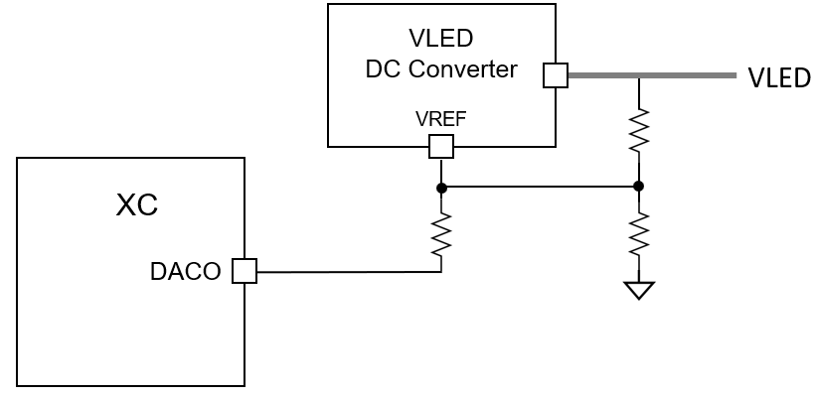
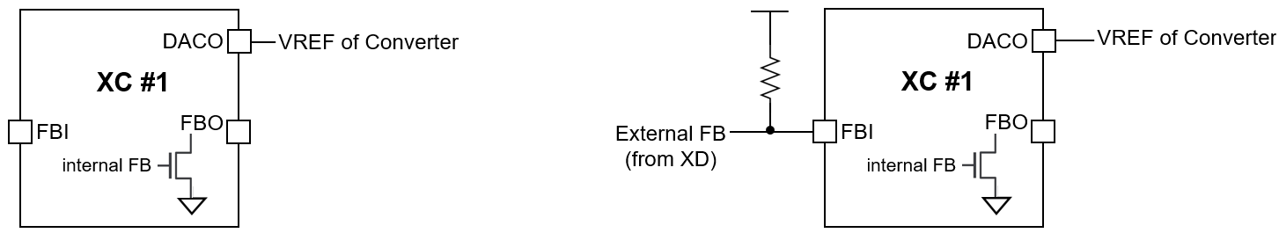
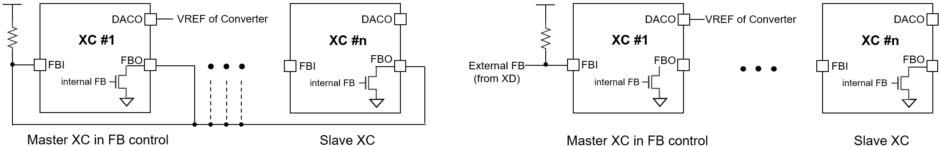
XC24R
Functional Description
The FB connection for using several XCs
The XC24R supports an internal FB status which indicates whether the VLED is enough or not. The internal FB status can be got from the readout information through the FAULT-(AUTO)-READ command. The internal FB status is driven on the FBO pin to inform other XCs of the own FB status. Instead of the internal FB status from the command, the XCs can use directly an external FB signals from the XD devices to control the VLED like below Figure 24. The internal FB status has a value which is latched for one frame, so if the XD will sense the FB assertion condition at least once for one frame, the readout information from the command will contain the momorized status latched for one frame.
If multiple XCs are used, it needs to decide which XC is used as a master to control the VLED. Several examples are shown below, and the proper scheme can be chosen according to applications along with the DAC_FB_MODE bit.
Figure 23. The DACO connection to the VLED DC Converter’s VREF
(a) using an internal FB
(b) using an external FB
Figure 24. The scheme in using single XC
(a) using internal FBs of multiple XCs
(b) using an external FB
Figure 25. The scheme in using multiple XCs

Slide 31
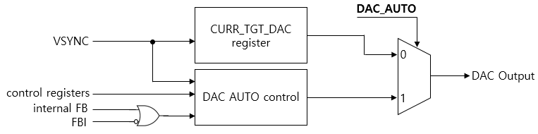
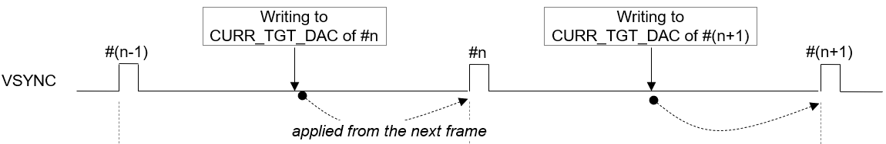
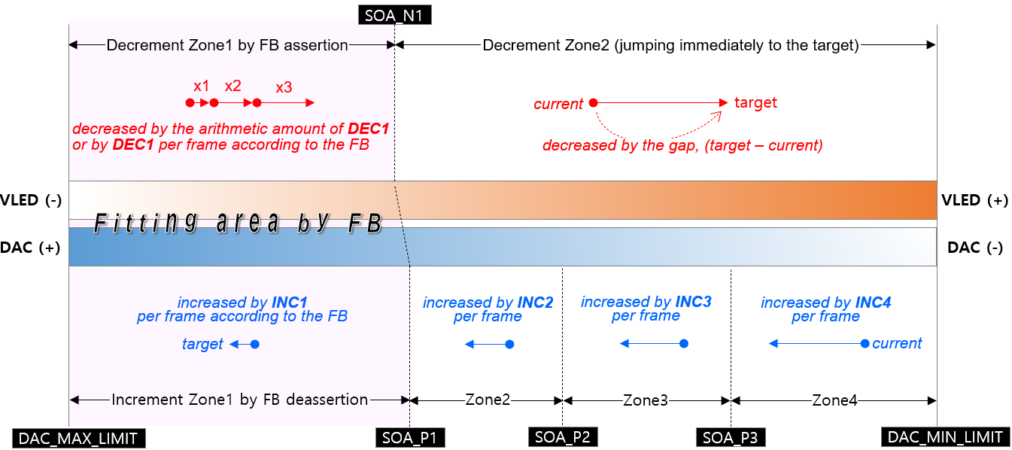
XC24R
Functional Description
DAC control for adjusting VLED
The XC24R has one DAC channel to adjust the VLED for efficient power consumption. The DAC out can be directly connected to a reference input of the VLED converter. The DAC has a 12-bit resolution at the max 3.3V level and can be configured to 2 modes according to the DAC_AUTO bit, the MANUAL mode or the AUTO control. In MANUAL mode, the value written to the CURR_TGT_DAC register will be out directly at incoming VSYNC signal. In AUTO mode, the DAC out is automatically controlled according to several registers’ set values. The major difference between the AUTO and MANUAL mode is that the AUTO mode uses the FB status to control efficiently in order to minimize the power consumption. The proper value to be written to the CURR_TGT_DAC can be get from the calculation of the sum of all LEDs’ V_{F} in room temperature plus the minimum required V_{HD} of XD. In case of low high ambient temperature, the DAC out will be re-act rapidly according the FB status. The operating conditions in the AUTO mode can be set through several registers. Refer to the register’s description part for details along with Figure 27. below.
Figure 26. The scheme of the DAC output
Figure 27. The effective timing of writing the CURR_TGT_DAC
Figure 28. The scheme of the DAC AUTO control mode

Slide 32
XC24R
3. Register Map
The SPI interface protocol consists of two segments, the command 16-bit followed by the register’s data 16-bit or a series of local dimming data.
Command packet format
B15 | B14 | B13 | B12 | B11 | B10 | B9 | B8 | B7 | B6 | B5 | B4 | B3 | B2 | B1 | B0
COMMAND CODE |  | START ADDRESS [7:0] |  |  |  |  |  |  |  | BURST SIZE [5:0]
Bits | Fields | Descriptions
15:14 | COMMAND CODE | 2’b00 : No operation. 2’b01 : Register Read. 2’b10 : Register Write. 2’b11 : Local dimming data transfer.
13:6 | START ADDRESS | The start address of registers to access.
5:0 | BURST SIZE | Amount of data to be transmitted or received. In case of accessing the registers, the number means how many registers will be accessed for one time. In case of transmitting the LD data, the number means how many lines’ LD data will be transmitted for one time, where one line means the number of enabled channels. If 20 channels are activated and the BURST SIZE is 10, and then the total amount of LD data to be transmitted becomes 20 * 10 * LD width/block [bit].
Data packet format
B15 | B14 | B13 | B12 | B11 | B10 | B9 | B8 | B7 | B6 | B5 | B4 | B3 | B2 | B1 | B0
DATA [15:0]
Bits | Fields | Descriptions
15:0 | DATA [15:0] | In case of COMMAND CODE : | In case of COMMAND CODE :
 |  | 2’b01 2’b10 2’b11 | A register’s data to read. A register’s data to write. A series of the LD, local dimming data. Be careful that the data size and width to transfer the local dimming data are different from the register access. Refer to previous SPI protocol

Slide 33
XC24R
SOFT RESET
Addr | Default | B15 | B14 | B13 | B12 | B11 | B10 | B9 | B8 | B7 | B6 | B5 | B4 | B3 | B2 | B1 | B0
‘h00 | 0x0030 | x | x | x | x | x | x | x | x | x | x | VSYNC_RST2 | VSYNC_RST1 | x | RST3 | RST2 | RST1
Bits | Fields | Descriptions
5 | VSYNC_RST2 | If this bit is set, all de-serializers’ sm are reset at VSYNC rising. Normally, no need to use this bit.
4 | VSYNC_RST1 | If this bit is set, all serializers’ sm are reset at VSYNC rising. Normally, no need to use this bit.
2 | RST3 | Reset to all types of buffer, the frame buffers, the global and local r/w registers and the global fault read registers. Auto-cleared. Normally, no need to use this bit.
1 | RST2 | Reset to all serializers’ and de-serializers’ state machine including the timeout error flag, Auto-cleared. Normally, no need to use this bit.
0 | RST1 | Reset to all logics, Auto-cleared (No need to clear after set) It need to set this bit after POR to ensure XC24R reset again.
GLOBAL-WRITE COMMAND
Addr | Default | B15 | B14 | B13 | B12 | B11 | B10 | B9 | B8 | B7 | B6 | B5 | B4 | B3 | B2 | B1 | B0
‘h01 | 0x0000 | ENABLE | x | x | x | x | x | x | x | x | x | ADDR [5:0]
Bits | Fields | Descriptions
15 | ENABLE | 0 | No operation.
 |  | 1 | Start executing the global-write command with the GLOBAL WRITE DATA register, together, and this bit is auto-cleared after completing this execution. For correct operation, It needs to set the GLOBAL WRITE DATA register with desired value before setting this bit. The global-writing can be used in case that the target registers’ values of all XD daisied devices are all the same. If the values are different from each other, then the local-write command should be used instead of the global-write command.
5:0 | ADDR | The same target address of all XD daisied devices to write.

Slide 34
XC24R
LOCAL-WRITE COMMAND
Addr | Default | B15 | B14 | B13 | B12 | B11 | B10 | B9 | B8 | B7 | B6 | B5 | B4 | B3 | B2 | B1 | B0
‘h02 | 0x000 | ENABLE | x | x | x | x | x | CH_SEG [1:0] |  | x | x | ADDR [5:0]
Bits | Fields | Descriptions
15 | ENABLE | 0 | No operation.
 |  | 1 | Start executing the local-write command with the LOCAL RW DATA registers together, and this bit is auto-cleared after completing this execution. For correct operation, It needs to set the LOCAL RW DATA registers with desired values before setting this bit. The local-write command is used in case that the target registers’ values of all XD daisied devices are different from each other.
9:8 | CH_SEG | These bits are used to designate which channels are activated for this command.
 |  |  | 2’b00 The channel 1 from 8 are activated. 2’b01 The channel 9 from 16 are activated. 2’b10 The channel 17 from 24 are activated. 2’b11 No allocated.
 |  | Refer to previous chapter. how to allocate the LOCAL RW DATA registers according to CH_SEG [1:0].
5:0 | ADDR | The same target address of all XD daisied devices to write
LOCAL-READ COMMAND
Addr | Default | B15 | B14 | B13 | B12 | B11 | B10 | B9 | B8 | B7 | B6 | B5 | B4 | B3 | B2 | B1 | B0
‘h03 | 0x0000 | ENABLE | x | x | x | x | x | CH_SEG [1:0] |  | x | x | ADDR [5:0]
Bits | Fields | Descriptions
15 | ENABLE | 0 |  | No operation.
 |  | 1 |  | Start executing the local-read command with the LOCAL RW DATA registers together, and this bit is auto-cleared after completing this execution. For correct operation, It needs to set the LOCAL RW DATA registers with desired values before setting this bit. The local-read command is used to read out the target registers’ values of all XD daisied devices.
9:8 | CH_SEG | These bits are used to designate which channels are activated for this command
 |  |  | 2’b00 : The channel 1 from 8 are activated. 2’b01 : The channel 9 from 16 are activated. 2’b10 : The channel 17 from 24 are activated. 2’b11 : No allocated.
 |  | Refer to previous chapter. how to allocate the LOCAL RW DATA registers according to CH_SEG.
5:0 | ADDR | The same target address of all XD daisied devices to read out.

Slide 35
XC24R
ID-GEN COMMAND
Addr | Default | B15 | B14 | B13 | B12 | B11 | B10 | B9 | B8 | B7 | B6 | B5 | B4 | B3 | B2 | B1 | B0
‘h04 | 0x0000 | ENABLE | x | x | x | x | x | x | x | x | x | x | x | x | x | x | x
Bits | Fields | Descriptions
15 | ENABLE | 0 1 | No operation. Start executing the id-generating command to all XD daisied devices and this bit is auto-cleared after completing this execution. All XD daisied devices connected in each channel will have their own ID number after completing the id-generating command. This command is needed to read-out the XD drivers’ registers data correctly in sequential, so, this command should be executed before executing the local-reading or the fault-reading command. It is recommended that the id-generating command should be executed firstly on system initialization.
FAULT-READ COMMAND
Addr | Default | B15 | B14 | B13 | B12 | B11 | B10 | B9 | B8 | B7 | B6 | B5 | B4 | B3 | B2 | B1 | B0
‘h05 | 0x0000 | ENABLE | x | x | x | x | x | x | x | x | x | x | x | x | x | FT_MODE[1:0]
Bits | Fields | Descriptions
15 | ENABLE | 0 1 |  |  | No operation. Start executing the fault-reading command to all XD daisied devices to monitor the fault event like as the thermal occurrence, the short status, the open status and the fb status of the XD devices and this bit is auto-cleared after completing this execution. This command can be also auto-executed at the VSYNC rising edge if the FAULT_ AUTO_EN bit in the COMMAND AUTO ENABLE register is set.
1:0 | FT_MODE |  |  |  | Interrupt source selector for bit2~5 at address ‘h17.
 | int_fb_source |  |  |  | This bit shows the FB status from all XDs daisied to the active channels after the FAULT-(AUTO)-READ execution. This bit value will be kept the current level until newly updated from a next FAULT-(AUTO)-READ execution even if this register has been read-out.
 | int_open_source |  |  |  | This bit shows the OPEN status from all XDs daisied to active channels after the FAULT-(AUTO)-READ execution. This bit value will be kept the current level until newly updated from a next FAULT-(AUTO)-READ execution even if this register has been read-out.
 | int_short_source |  |  |  | This bit shows the SHORT status from all XDs daisied to active channels after the FAULT-(AUTO)-READ execution. This bit value will be kept the current level until newly updated from a next FAULT-(AUTO)-READ execution even if this register has been read-out.
ft_mode | bit5 | bit4 | bit3 | bit2
0 | int_thermal_source | int_short_source | int_open_source | int_fb_source1
1 | int_fault_source | int_fb_source3 | int_fb_source2 | int_fb_source1
2 | int_fault_source | int_open_source | int_fb_source2 | int_fb_source1

Slide 36
XC24R
Bits | Fields | Descriptions
 | int_thermal_source |  |  |  | This bit shows the THERMAL status from all XDs daisied to active channels after the FAULT-(AUTO)-READ execution. This bit value will be kept the current level until newly updated from a next FAULT-(AUTO)-READ execution even if this register has been read-out.
 | int_fault_source |  |  |  | If this bit is set, the nINT_FAULT pin will be asserted to the active-low. This bit represents several interrupt sources, INT_FB_SRC, INT_OPEN_SRC, INT_SHORT _SRC, INT_TML_SRC, INT_LOCAL_REC_FAIL_ SRC, INT_FAULT_AUTO_REC_FAIL _SRC, INT_FAULT_REC_FAIL_SRC, INT_TIMEOUT_ERR_SRC, INT_PARITY _ERR _SRC, INT_ACC_CNT_ERR_SRC and INT_OVUV_ERR_SRC if their own interrupt enable bits are set. If the corresponding interrupt enable bit is set and the interrupt source is asserted, then, this bit will be asserted through nINT_FAULT pin. This bit is auto-cleared after this INTERRUPT STATUS register is read-out.
LD-TRANSFER COMMAND
Addr | Default | B15 | B14 | B13 | B12 | B11 | B10 | B9 | B8 | B7 | B6 | B5 | B4 | B3 | B2 | B1 | B0
‘h06 | 0x0000 | ENABLE | x | x | x | x | x | x | x | x | x | x | x | x | LD_TYPE[2:0]
Bits | Fields | Descriptions
15 | ENABLE | 0 1 | No operation. Start executing the local dimming data transfer command to all XD daisied devices in order to transfer the LD data in burst from the XC24R to the XD drivers and this bit is auto-cleared after the completion. This command can be also auto-executed immediately after the amount of LD data to be transferred to the XC24R through the SPI interface is reached to the value of the LD_RD_START_POINTER of the LD START POINTER/TH register.
2:0 | LD_TYPE |  | ‘h1 : 1 LD type ‘h2 : 2 LD type ‘h3 : 3 LD type ‘h4 : 4 LD type ‘h6 : 6 LD type

Slide 37
XC24R
SYNC-GEN COMMAND
Addr | Default | B15 | B14 | B13 | B12 | B11 | B10 | B9 | B8 | B7 | B6 | B5 | B4 | B3 | B2 | B1 | B0
‘h07 | 0x0000 | ENABLE | x | x | x | x | x | x | x | x | x | x | x | x | x | SYNC_MODE[1:0]
Bits | Fields | Descriptions
15 | ENABLE | 0 1 | No operation. Start executing the sync-gen command to all XD daisied devices in order to make the frame synchronization to the drivers and this bit is auto-cleared after this execution. This command can be also auto-executed at the VSYNC rising edge, if the SYNC_ AUTO_EN bit in the COMMAND AUTO ENABLE register is set. It is recommended that the SYNC_AUTO_EN bit is set for good local dimming.
1:0 | SYNC_MODE |  | SVO signal mode selector ‘h1 : svo only ( need to turn on vsync command ) ‘h2 : vo signal add on svo signal ‘h3 : rso signal only

Slide 38
XC24R
COMMAND AUTO ENABLE
Addr | Default | B15 | B14 | B13 | B12 | B11 | B10 | B9 | B8 | B7 | B6 | B5 | B4 | B3 | B2 | B1 | B0
‘h08 | 0x0111 | x | x | x | x | x | x | x | x | x | x | x | FAULT AUTO_EN | x | x | x | SYNC_AUTO_EN
Bits | Fields | Descriptions
4 | FAULT_AUTO_EN | 0 1 | No operation. Start executing the fault-reading command automatically. If this bit is set, the fault-reading command is auto-executed in two conditions. The first is occurred at the time of VSYNC rising edge and the second condition is occurred at the time of expiration of the FAULT AUTO READ TIMER register for the number of occurrence of the FAULT AUTO READ EVENT register.
0 | SYNC_AUTO_EN | 0 1 | No operation. Start executing the sync-gen command automatically. If this bit is set, the sync-gen command is auto-executed at the time of VSYNC rising edge.
LD-WRITE POINTER
Addr | Default | B15 | B14 | B13 | B12 | B11 | B10 | B9 | B8 | B7 | B6 | B5 | B4 | B3 | B2 | B1 | B0
‘h09 | Read only | x | x | x | x | x | x | x | LD_WR_POINTER [8:0] | x | x | x | x | x | x | x | x
Bits | Fields | Descriptions
8:0 | LD_WR_POINTER | This register value represents the number of times the local dimming data are written into the internal LD buffers through the SPI interface. The number increases one by one whenever the local dimming data corresponding to (the number of enabled channels * one LD data width) are transferred to the internal LD buffers. This pointer value is reset at the VSYNC rising. LD_WIDTH of the CHANNEL ENABLE 2 register : 2’b00 : one block LD data width = 24 bits 2’b01 : one block LD data width = 24 bits 2’b10 : one block LD data width = 24 bits 2’b11 : one block LD data width = 16 bits

Slide 39
XC24R
LD-READ POINTER
Addr | Default | B15 | B14 | B13 | B12 | B11 | B10 | B9 | B8 | B7 | B6 | B5 | B4 | B3 | B2 | B1 | B0
‘h0A | Read only | x | x | x | x | x | x | x | LD_RD_POINTER [8:0] | x | x | x | x | x | x | x | x
Bits | Fields | Descriptions
8:0 | LD_RD_POINTER | This register value represents the number of times the local dimming data are read-out to transfer the data from the internal LD buffers to the XD drivers. The number increases one by one whenever the local dimming data corresponding to the one block LD data of the XD drivers are read-out. This pointer value is reset at the VSYNC rising.
LD-DIFFERENCE POINTER
Addr | Default | B15 | B14 | B13 | B12 | B11 | B10 | B9 | B8 | B7 | B6 | B5 | B4 | B3 | B2 | B1 | B0
‘h0B | Read only | x | x | x | x | x | x | x | x | x | x | LD_DIFF_POINTER [5:0]
Bits | Fields | Descriptions
5:0 | LD_DIFF_POINTER | This value is useful to monitor how much the LD data remains in the internal LD buffers for checking overrun or underrun. = LD_WR_POINTER – LD_RD_POINTER
LD-TRANSFER START POINTER / THRESHOLD
Addr | Default | B15 | B14 | B13 | B12 | B11 | B10 | B9 | B8 | B7 | B6 | B5 | B4 | B3 | B2 | B1 | B0
‘h0C | 0x0000 | x | x | LD_TRANS_START_POINTER [5:0] | x | x | x | x | x | INT_LD_SIGN | x | LD_DIFF_THRESHOLD [5:0]
Bits | Fields | Descriptions
13:8 | LD_TRANS_START_POINTER | The LD_TRANS_START_POINTER determines when the transmit from the internal LD buffers to the XD drivers will begin. If the value is set to 8, then the transmit will begin as soon as the number of times the data through the SPI interface becomes 8. Once the transmit is stated, the transaction will be continued until the number of transmit reaches to the BLOCK_SIZE value of the BLOCK SIZE registers.
7 | INT_LD_SIGN | Don’t set this bit.
5:0 | LD_DIFF_THRESHOLD | The LD_DIFF_THRESHOLD is used to set in which condition the nINT_LD output signal will be issued to the host. Whenever the LD_DIFF_POINTER is equal to or smaller than the LD_DIFF_THRESHOLD, then the nINT_LD signal will be issued. This feature helps to check how much LD data remains in the internal LD buffer for monitoring overruns or underruns of the LD data.

Slide 40
XC24R
LOCAL-WR TRANSFER POINTER
Addr | Default | B15 | B14 | B13 | B12 | B11 | B10 | B9 | B8 | B7 | B6 | B5 | B4 | B3 | B2 | B1 | B0
‘h0D | Read only | x | x | LOCAL_WR_OUT_POINTER [5:0] | x | x | x | x | x | x | x | LOCAL_WR_TRANS_POINTER [5:0]
Bits | Fields | Descriptions
13:8 | LOCAL_WR_OUT_POINTER | This register value represents the number of times the data from the LOCAL RW DATA registers are read-out to write the data to the XD drivers’ registers. The number increases one by one whenever the data are read-out from the LOCAL RW DATA registers.
5:0 | LOCAL_WR_TRANS_POINTER | This register value represents the number of times the data to be transferred to the XD drivers are written to the LOCAL RW DATA registers through the SPI interface. The number increased one by one whenever the data are written to the LOCAL RW DATA registers.
LOCAL-RD RECEIVE POINTER
Addr | Default | B15 | B14 | B13 | B12 | B11 | B10 | B9 | B8 | B7 | B6 | B5 | B4 | B3 | B2 | B1 | B0
‘h0E | Read only | x | x | LOCAL_RD_OUT_POINTER [5:0] | x | x | x | x | x | x | x | LOCAL_RD_REC_POINTER [5:0]
Bits | Fields | Descriptions
13:8 | LOCAL_RD_OUT_POINTER | This register value represents the number of times the data transferred from the XD drivers are read out from the LOCAL RW DATA registers for transferring the data through the SPI interface. The number increases one by one whenever the data are read-out from the LOCAL RW DATA registers.
5:0 | LOCAL_RD_REC_POINTER | This register value represents the number of times the data to be transferred through the SPI interface are written from the XD drivers to the LOCAL RW DATA registers. The number increased one by one whenever the data are written to the LOCAL RW DATA registers.
LOCAL-RW DIFFERENCE POINTER
Addr | Default | B15 | B14 | B13 | B12 | B11 | B10 | B9 | B8 | B7 | B6 | B5 | B4 | B3 | B2 | B1 | B0
‘h0F | Read only | x | x | LOCAL_RD_DIFF_POINTER [5:0] | x | x | x | x | x | x | x | LOCAL_WR_DIFF_POINTER [5:0]
Bits | Fields | Descriptions
13:8 | LOCAL_RD_DIFF_POINTER | This value is useful to monitor how much the data from the XD drivers remains in the LOCAL RW DATA registers for checking overrun or underrun. = LOCAL_RD_REC_POINTER – LOCAL_RD_OUT_POINTER
5:0 | LOCAL_WR_DIFF_POINTER | This value is useful to monitor how much the data to be transferred to the XD remains in the LOCAL RW DATA registers for checking overrun or underrun. = LOCAL_WR_TRANS_POINTER – LOCAL_WR_OUT_POINTER

Slide 41
XC24R
LOCAL-RW POINTER RESET
Addr | Default | B15 | B14 | B13 | B12 | B11 | B10 | B9 | B8 | B7 | B6 | B5 | B4 | B3 | B2 | B1 | B0
‘h10 | 0x0000 | x | x | x | x | x | x | x | LOCAL_RD_POINTER_RST | x | x | x | x | x | x | x | LOCAL_WR_POINTER_RST
Bits | Fields | Descriptions
8 | LOCAL_RD_POINTER_RST | 0 1 | No operation The LOCAL_RD_OUT_POINTER and the LOCAL_RD_REC_POINTER are reset. This bit is auto-cleared. After completing the Local read command, the relevant pointer value must be cleared by this bit before the next Local read command.
0 | LOCAL_WR_POINTER_RST | 0 1 | No operation The LOCAL_WR_OUT_POINTER and the LOCAL_WR_TRANS_POINTER are reset. This bit is auto-cleared. After completing the Local write command, the relevant pointer value must be cleared by this bit before the next Local write command.
FAULT-AUTO-READ INTERVAL
Addr | Default | B15 | B14 | B13 | B12 | B11 | B10 | B9 | B8 | B7 | B6 | B5 | B4 | B3 | B2 | B1 | B0
‘h11 | 0x0000 | FAULT_AUTO_RD_INTERVAL [15:0] | x | LOCAL_RD_OUT_POINTER [5:0] | x | x | x | x | x | x | x | LOCAL_RD_REC_POINTER [5:0]
Bits | Fields | Descriptions
15:0 | FAULT_AUTO_RD_INTERVAL | This register determines the execution interval for the fault auto-read commands. Counted in MCLK units.
FAULT-AUTO-READ EVENT
Addr | Default | B15 | B14 | B13 | B12 | B11 | B10 | B9 | B8 | B7 | B6 | B5 | B4 | B3 | B2 | B1 | B0
‘h12 | 0x0000 | FAULT_AUTO_RD_EVENT [7:0] | x | x | x | x | x | x | x | x | x | x | x | x | x | x | FAULT_AUTO_RD_INTERVAL[16]
Bits | Fields | Descriptions
15:8 | FAULT_AUTO_RD_EVENT | This register determines the execution times for the fault auto-read commands. The value is reset at VSYNC rising edge.
0 | FAULT_AUTO_RD_INTERVAL | The MSB bit of the FAULT_AUTO_RD_INTERVAL [16:0]

Slide 42
XC24R
INTERRUPT ENABLE
Addr | Default | B15 | B14 | B13 | B12 | B11 | B10 | B9
‘h13 | 0x0000 | INT_OV50_EN | INT_UV50_EN | INT_OV15_EN | INT_UV15_EN | INT_CMD_PC_EN | INT_ACC_CNT_ERR_EN | INT_SPI_PC_EN
Addr | Default | B8 | B7 | B6 | B5
‘h13 | 0x0000 | INT_TIMEOUT_ERR_EN | INT_FAULT_RD_FAIL_EN | INT_FAULT_AUTO_RD_FAIL_EN | INT_RD_REC_FAIL_EN
Addr | Default | B4 | B3 | B2 | B1 | B0
‘h13 | 0x0000 | INT_LD_EN | INT_THERMAL_EN | INT_SHORT_EN | INT_OPEN_EN | INT_FB_EN
Bits | Fields | Descriptions
15 | INT_OV50_EN | This bit enables to issue the interrupt through the nINT_FAULT pin in case that the V_{DD}, 5V, will be go over the OV50_LEVEL value.
14 | INT_UV50_EN | This bit enables to issue the interrupt through the nINT_FAULT pin in case that the V_{DD}, 5V, will be go under the UV50_LEVEL value.
13 | INT_OV15_EN | This bit enables to issue the interrupt through the nINT_FAULT pin in case that the internal LDO, 1.5V, will be go over the OV50_LEVEL value.
12 | INT_UV15_EN | This bit enables to issue the interrupt through the nINT_FAULT pin in case that the internal LDO,1.5V, will be go under the UV50_LEVEL value.
11 | INT_CMD_PC_EN | This bit enables to issue the interrupt through the CHx_PAR_ERR in case that parity error occurs while XD communication.
10 | INT_ACC_CNT_ERR_EN | This bit enables to issue the interrupt through the nINT_FAULT pin in case that the SPI transaction counter value on SPI data will be different from the (ACC_COUNTER [7:0] + 1)
9 | INT_SPI_PC_EN | This bit enables to issue the interrupt through the nINT_FAULT pin in case that the SPI data stream’s parity is not an Odd value.
8 | INT_TIMEOUT_ERR_EN | This bit enables to issue the interrupt through the nINT_FAULT pin in case that the timer will be expired during the execution for read-back commands. The expired time is MCLK * 32,767.
7 | INT_FAULT_RD_FAIL_EN | This bit enables to issue the interrupt through the nINT_FAULT pin in case that any violation happens during the execution for the fault read-back from the XDs.
6 | INT_FAULT_AUTO_RD_FAIL_EN | This bit enables to issue the interrupt through the nINT_FAULT pin in case that any violation happens during the execution for the fault auto-read-back from the XDs.
5 | INT_RD_REC_FAIL_EN | This bit enables to issue the interrupt through the nINT_FAULT pin in case that any violation happens during the execution for the local read-back from the XDs.
4 | INT_LD_EN | This bit enables to issue the interrupt through the nINT_FAULT pin in case that the LD_DIFF_POINTER is equal to or smaller than the LD_DIFF_THRESOLD during the execution of the LD transfer to the XDs.
3 | INT_THERMAL_EN | This bit enables to issue the interrupt through the nINT_FAULT pin in case that the thermal regulation happens among the XD drivers during dimming operation.
2 | INT_SHORT_EN | This bit enables to issue the interrupt through the nINT_FAULT pin in case that the short condition happens among the XD drivers during dimming operation.
1 | INT_OPEN_EN | This bit enables to issue the interrupt through the nINT_FAULT pin in case that the open condition happens among the XD drivers during dimming operation.
0 | INT_FB_EN | This bit enables to issue the interrupt through the nINT_FAULT pin in case that the fb condition happens among the XD drivers during dimming operation.

Slide 43
XC24R
COMMAND STATUS 1
Addr | Default | B15 | B14 | B13 | B12
‘h14 | Read only | LOCAL_RD_DONE | LOCAL_RD_DOING | LOCAL_WR_DONE | LOCAL_WR_DOING
Addr | Default | B11 | B10 | B9 | B8 | B7 | B6
‘h14 | Read only | GLOBAL_WR_DONE | GOLBAL_WR_DOING | LD_TRANS_DONE | LD_TRANS_DOING | FAULT_DONE | FAULT_DOING
Addr | Default | B5 | B4 | B3 | B2 | B1 | B0
‘h14 | Read only | FAULT_AUTO_DONE | FAULT_AUTO_DOING | SYNC_AUTO_DONE | SYNC_AUTO_DOING | SYNC_DONE | SYNC_DOING
Bits | Fields | Descriptions
15 | LOCAL_RD_DONE | This bit is set after the execution for the local-reading command is completed.
14 | LOCAL_RD_DOING | This bit is set while the local-reading command is working until it is complete.
13 | LOCAL_WR_DONE | This bit is set after the execution for the local-writing command is completed.
12 | LOCAL_WR_DOING | This bit is set while the local-writing command is working until it is complete.
11 | GLOBAL_WR_DONE | This bit is set after the execution for the global-writing command is completed.
10 | GLOBAL_WR_DOING | This bit is set while the global-writing command is working until it is complete.
9 | LD_TRANS_DONE | This bit is set after the execution for the LD transferring command is completed.
8 | LD_TRANS_DOING | This bit is set while the LD transferring command is working until it is complete.
7 | FAULT_DONE | This bit is set after the execution for the fault-reading command is completed.
6 | FAULT_DOING | This bit is set while the fault-reading command is working until it is complete.
5 | FAULT_AUTO_DONE | This bit is set after the execution for the fault auto-reading command is completed.
4 | FAULT_AUTO_DOING | This bit is set while the fault auto-reading command is working until it is complete.
3 | SYNC_AUTO_DONE | This bit is set after the execution for the sync auto-gen command is completed.
2 | SYNC_AUTO_DOING | This bit is set while the sync auto-gen command is working until it is complete.
1 | SYNC_DONE | This bit is set after the execution for the sync-gen command is completed.
0 | SYNC_DOING | This bit is set while the sync-gen command is working until it is complete.

Slide 44
XC24R
COMMAND STATUS 2
Addr | Default | B15 | B14 | B13 | B12 | B11 | B10 | B9 | B8 | B7 | B6 | B5 | B4 | B3 | B2 | B1 | B0
‘h15 | Read only | x | x | x | x | x | x | x | x | x | x | x | x | x | x | ID_GEN_DONE | ID_GEN_DOING
Bits | Fields | Descriptions
1 | ID_GEN_DONE | This bit is set after the execution for the id-gen command is completed.
0 | ID_GEN_DOING | This bit is set while the id-gen command is working until it is complete.
RECEIVE STATUS
Addr | Default | B15 | B14 | B13 | B12
‘h16 | Read only | x | FAULT_REC_FAIL | FAULT_AUTO_REC_FAIL | LOCAL_REC_FAIL
Addr | Default | B11 | B10 | B9 | B8 | B7 | B6 | B5 | B4
‘h16 | Read only | x | x | x | TIMEOUT_ERR | x | x | FAULT_REC_DONE | FAULT_REC_DOING
Addr | Default | B3 | B2 | B1 | B0
‘h16 | Read only | FAULT_AUTO_REC_DONE | FAULT_AUTO_REC_DOING | LOCAL_REC_DONE | LOCAL_REC_DOING
Bits | Fields | Descriptions
14 | FAULT_REC_FAIL | This bit is set if any violation happens while the fault-receiving job is working.
13 | FAULT_AUTO_REC_FAIL | This bit is set if any violation happens while the fault auto-receiving job is working.
12 | LOCAL_REC_FAIL | This bit is set if any violation happens while the local read-receiving job is working.
8 | TIMEOUT_ERR | This bit is set if the timer will be expired while the execution of read-back due to no response from the XD devices. This bit is auto-cleared after the readout of the INTERRUPT STATUS register.
5 | FAULT_REC_DONE | This bit is set after the fault-receiving job is completed.
4 | FAULT_REC_DOING | This bit is set while the fault-receiving job is working until it is complete.
3 | FAULT_AUTO_REC_DONE | This bit is set after the fault auto-receiving job is completed.
2 | FAULT_AUTO_REC_DOING | This bit is set while the fault auto-receiving job is working until it is complete.
1 | LOCAL_REC_DONE | This bit is set after the local read-receiving job is completed.
0 | LOCAL_REC_DOING | This bit is set while the local read-receiving job is working until it is complete.

Slide 45
XC24R
INTERRUPT SOURCE STATUS
Addr | Default | B15 | B14 | B13 | B12 | B11
‘h17 | Read only | INT_OVUV_ERR_SRC | INT_ACC_CNT_ERR_SRC | INT_PARITY_ERR_SRC | INT_TIMEOUT_ERR_SRC | INT_FAULT_REC_FAIL_SRC
Addr | Default | B10 | B9 | B8 | B7
‘h17 | Read only | INT_FAULT_AUTO_REC_FAIL_SRC | INT_RD_REC_FAIL_SRC | INT_LD_TRAN_SRC | X
Addr | Default | B6 | B5 | B4 | B3 | B2 | B1 | B0
‘h17 | Read only | X | INT_SOURCE4 | INT_SOURCE3 | INT_SOURCE2 | INT_SOURCE1 | INT_LD | INT_FAULT
Bits | Fields | Descriptions
15 | INT_OVUV_ERR_SRC | This bit shows whether the UV or OV detection condition of V_{DD} and internal LDO, respectively, has been happened while the XC is working. This bit is auto-cleared after the readout of INTERRUPT STATUS register.
14 | INT_ACC_CNT_ERR_SRC | This bit shows whether the SPI access counter value on the SPI transaction from a Host has been different from the (ACC_COUNTER [7:0] + 1) while the SPI transactions are occurred. This bit is auto-cleared after the readout of INTERRUPT STATUS register.
13 | INT_PARITY_ERR_SRC | This bit shows whether the SPI data stream’s parity value on the SPI transaction from a Host has not been equal to XC internal parity status while the SPI transactions are occurred. This bit is auto-cleared after the readout of INTERRUPT STATUS register. XC internal parity is ‘1’ when the number of ‘1’ is odd for SPI write data.
12 | INT_TIMEOUT_ERR_SRC | This bit shows whether the timeout has been happened while the read-back commands are working. This bit is auto-cleared after the readout of INTERRUPT STATUS register.
11 | INT_FAULT_REC_FAIL_SRC | This bit shows whether any violation has been happened while the fault-receiving job is working. This bit value will remain at the same level until start of the next command even if this register has been read-out.
10 | INT_FAULT_AUTO_REC_FAIL_SRC | This bit shows whether any violation has been happened while the fault auto-receiving job is working. This bit value will remain at the same level until start of the next command even if this register has been read-out.
9 | INT_RD_REC_FAIL_SRC | This bit shows whether any violation has been happened while the local read-receiving job is working. This bit value will remain at the same level until start of the next command even if this register has been read-out.
8 | INT_LD_TRAN_SRC | This bit shows whether the LD interrupt has been asserted while transferring the LD data to XD12 drivers through the XC24R controller. This bit value will remain at the same level until start of the next command even if this register has been read-out.

Slide 46
XC24R
INTERRUPT SOURCE STATUS
Addr | Default | B15 | B14 | B13 | B12 | B11
‘h17 | Read only | INT_OVUV_ERR_SRC | INT_ACC_CNT_ERR_SRC | INT_PARITY_ERR_SRC | INT_TIMEOUT_ERR_SRC | INT_FAULT_REC_FAIL_SRC
Addr | Default | B10 | B9 | B8 | B7
‘h17 | Read only | INT_FAULT_AUTO_REC_FAIL_SRC | INT_RD_REC_FAIL_SRC | INT_LD_TRAN_SRC | X
Addr | Default | B6 | B5 | B4 | B3 | B2 | B1 | B0
‘h17 | Read only | X | INT_SOURCE4 | INT_SOURCE3 | INT_SOURCE2 | INT_SOURCE1 | INT_LD | INT_FAULT
Bits | Fields | Descriptions
5 | INT_SOURCE4 | This bit indicate int_thermal_source from XD device for ft_mode 0 and int_fault_source for ft_mode 1,2.
4 | INT_SOURCE3 | This bit indicate int_shour_source from XD device for ft_mode 0 and int_fb_source3 for ft_mode 1 and int_open_source for ft_mode2.
3 | INT_SOURCE2 | This bit indicate int_fb_source2 from XD device for ft_mode 1,2 and int_open_source for ft_mode 0.
2 | INT_SOURCE1 | This bit indicate int_fb_source1 from XD device for ft_mode 0~2.
1 | INT_LD | If this bit is set, the nINT_LD pin will be asserted to the active-low. This bit represents an interrupt sources, INT_LD_TRAN_SRC if its interrupt enable bits is set. If the INT_LD_EN bit is set and INT_LD_ TRAN_SRC is asserted, then, this bit will be asserted through nINT_LD pin. This bit is auto-cleared after this INTERRUPT STATUS register is read-out.
0 | INT_FAULT | If this bit is set, the nINT_FAULT pin will be asserted to the active-low. This bit represents several interrupt sources, INT_FB_SRC, INT_OPEN_SRC, INT_SHORT _SRC, INT_TML_SRC, INT_LOCAL_REC_FAIL_ SRC, INT_FAULT_AUTO_REC_FAIL _SRC, INT_FAULT_REC_FAIL_SRC, INT_TIMEOUT_ERR_SRC, INT_PARITY _ERR _SRC, INT_ACC_CNT_ERR_SRC and INT_OVUV_ERR_SRC if their own interrupt enable bits are set. If the corresponding interrupt enable bit is set and the interrupt source is asserted, then, this bit will be asserted through nINT_FAULT pin. This bit is auto-cleared after this INTERRUPT STATUS register is read-out.

Slide 47
XC24R
CMD PARITY ERR STATUS1
Addr | Default | B15 | B14 | B13 | B12 | B11
‘h18 | Read only | CH16_PAR_ERR | CH15_PAR_ERR | CH14_PAR_ERR | CH13_PAR_ERR | CH12_PAR_ERR
Addr | Default | B10 | B9 | B8 | B7
‘h18 | Read only | CH11_PAR_ERR | CH10_PAR_ERR | CH9_PAR_ERR | CH8_PAR_ERR
Addr | Default | B6 | B5 | B4 | B3 | B2 | B1 | B0
‘h18 | Read only | CH7_PAR_ERR | CH6_PAR_ERR | CH5_PAR_ERR | CH4_PAR_ERR | CH3_PAR_ERR | CH2_PAR_ERR | CH1_PAR_ERR
Bits | Fields | Descriptions
15 | CH16_PAR_ERR | This bit will be set when parity error occurs while XD communication on CH16 in case of INT_CMD_PC_EN is set.
14 | CH15_PAR_ERR | This bit will be set when parity error occurs while XD communication on CH15 in case of INT_CMD_PC_EN is set.
13 | CH14_PAR_ERR | This bit will be set when parity error occurs while XD communication on CH14 in case of INT_CMD_PC_EN is set.
12 | CH13_PAR_ERR | This bit will be set when parity error occurs while XD communication on CH13 in case of INT_CMD_PC_EN is set.
11 | CH12_PAR_ERR | This bit will be set when parity error occurs while XD communication on CH12 in case of INT_CMD_PC_EN is set.
10 | CH11_PAR_ERR | This bit will be set when parity error occurs while XD communication on CH11 in case of INT_CMD_PC_EN is set.
9 | CH10_PAR_ERR | This bit will be set when parity error occurs while XD communication on CH10 in case of INT_CMD_PC_EN is set.
8 | CH9_PAR_ERR | This bit will be set when parity error occurs while XD communication on CH9 in case of INT_CMD_PC_EN is set.
7 | CH8_PAR_ERR | This bit will be set when parity error occurs while XD communication on CH8 in case of INT_CMD_PC_EN is set.
6 | CH7_PAR_ERR | This bit will be set when parity error occurs while XD communication on CH7 in case of INT_CMD_PC_EN is set.
5 | CH6_PAR_ERR | This bit will be set when parity error occurs while XD communication on CH6 in case of INT_CMD_PC_EN is set.
4 | CH5_PAR_ERR | This bit will be set when parity error occurs while XD communication on CH5 in case of INT_CMD_PC_EN is set.
3 | CH4_PAR_ERR | This bit will be set when parity error occurs while XD communication on CH4 in case of INT_CMD_PC_EN is set.
2 | CH3_PAR_ERR | This bit will be set when parity error occurs while XD communication on CH3 in case of INT_CMD_PC_EN is set.
1 | CH2_PAR_ERR | This bit will be set when parity error occurs while XD communication on CH2 in case of INT_CMD_PC_EN is set.
0 | CH1_PAR_ERR | This bit will be set when parity error occurs while XD communication on CH1 in case of INT_CMD_PC_EN is set.

Slide 48
XC24R
CMD PARITY ERR STATUS2
Addr | Default | B15 | B14 | B13 | B12 | B11
‘h19 | Read only | OV50_DET | UV50_DET | OV15_DET | UV15_DET | x
Addr | Default | B10 | B9 | B8 | B7 | B6
‘h19 | Read only | x | x | x | CH24_PAR_ERR | CH23_PAR_ERR
Addr | Default | B5 | B4 | B3 | B2 | B1 | B0
‘h19 | Read only | CH22_PAR_ERR | CH21_PAR_ERR | CH20_PAR_ERR | CH19_PAR_ERR | CH18_PAR_ERR | CH17_PAR_ERR
Bits | Fields | Descriptions
15 | OV50_DET | These bits will be set whenever the detection condition keeps for above 100us and will keep the assertion unless the detection condition is cleared.
14 | UV50_DET
13 | OV15_DET
12 | UV15_DET
7 | CH24_PAR_ERR | This bit will be set when parity error occurs while XD communication on CH24 in case of INT_CMD_PC_EN is set.
6 | CH23_PAR_ERR | This bit will be set when parity error occurs while XD communication on CH23 in case of INT_CMD_PC_EN is set.
5 | CH22_PAR_ERR | This bit will be set when parity error occurs while XD communication on CH22 in case of INT_CMD_PC_EN is set.
4 | CH21_PAR_ERR | This bit will be set when parity error occurs while XD communication on CH21 in case of INT_CMD_PC_EN is set.
3 | CH20_PAR_ERR | This bit will be set when parity error occurs while XD communication on CH20 in case of INT_CMD_PC_EN is set.
2 | CH19_PAR_ERR | This bit will be set when parity error occurs while XD communication on CH19 in case of INT_CMD_PC_EN is set.
1 | CH18_PAR_ERR | This bit will be set when parity error occurs while XD communication on CH18 in case of INT_CMD_PC_EN is set.
0 | CH17_PAR_ERR | This bit will be set when parity error occurs while XD communication on CH17 in case of INT_CMD_PC_EN is set.

Slide 49
XC24R
SPI FAULT STATUS & CONTROL
Addr | Default | B15 | B14 | B13 | B12 | B11 | B10 | B9 | B8 | B7 | B6
‘h1A | Read only | ACC_COUNTER [7:0] |  |  |  |  |  |  |  | x
Addr | Default | B5 | B4 | B3 | B2 | B1 | B0
‘h1A | Read only | ACC_CNT_ERR_STATUS | PARITY_ERR_STATUS | x | x | SPI_ACC_CNT_ERR_DET_EN | SPI_PARITY_ERR_DET_EN
Bits | Fields | Descriptions
15:8 | ACC_COUNTER | These bits show how many times the access from a Host to a XC has been executed on SPI bus. Therefore, the next access number should be same as (previous ACC_COUNTER + 1). If this counter is expired, then the counter will be roll-overed to ‘0’ as the next start value. If the value is not same as XC internal frame counter, then the INT_ACC_CNT_ERR_SRC bit will be set under the INT_ACC_CNT_ERR_EN set. XC internal frame counter reset as ‘0’ when power off-on and increase by 1 for any SPI commands
5 | ACC_CNT_ERR_STATUS | Read-Only. This bit shows whether the access counter value error has been happened or not. Auto-cleared after readout INTERRUPT SOURCE STATUS.
4 | PARITY_ERR_STATUS | Read-Only. This bit shows whether the parity error has been happened or not. Auto-cleared after readout INTERRUPT SOURCE STATUS.
1 | SPI_ACC_CNT_ERR_DET_EN | This bit enables the detection whether the access count value from a Host on SPI transaction is correct.
0 | SPI_PARITY_ERR_DET_EN | This bit enables the detection whether the access count value and parity from a Host on SPI transaction is correct. Extended 16bits of SPI write frame is as below.
SPI Data Stream | 8-bit = ACC_COUNTER value | the 3rd bit of last byte = Parity bit
CLK CONTROL 1
Addr | Default | B15 | B14 | B13 | B12 | B11 | B10 | B9 | B8
‘h1B | 0x0000 | X | SPREAD1_SPD [2:0] |  |  | CH_CLK_SEL | x | SVO_CLK_SEL | OP_CLK_SEL
Addr | Default | B7 | B6 | B5 | B4 | B3 | B2 | B1 | B0
‘h1B | 0x0000 | x | SPRD1_GAIN [2:0] |  |  | SERIALIZE_CLK_SEL | OSC_SPREAD_EN | SERIALIZER_SKEW_EN | x
Bits | Fields | Descriptions
14:12 | SPREAD1_SPD | Refer to the Table 9.
11 | CH_CLK_SEL | ‘0’ Internal OSC ‘1’ External MCLK
9 | SVO_CLK_SEL | ‘0’ Operating CLK ‘1’ Internal OSC Must be set as ‘1’ if not use External MCLK
8 | OP_CLK_SEL | ‘0’ External MCLK ‘1’ Internal OSC Must be set as ‘1’ if not use External MCLK
6:4 | SPRD1_GAIN | Internal OSC clock spread period. Refer to the Table 9. ‘00’ x1, ‘01’ x2, ‘10’ x4, ‘11’ x8
3 | SERIALIZE_CLK_SEL | ‘0’ Internal OSC ‘1’ External MCLK
2 | OSC_SPREAD_EN | Spread of internal OSC clock. (The external MCLK can not be spread) Refer to the Figure 22. for the clock scheme. ‘0’ Not Spread ‘1’ Spread
1 | SERIALIZER_SKEW_EN | ‘0’ Skew disabled between Serializers ‘1’ Skew enabled

Slide 50
XC24R
CLK CONTROL 2
Addr | Default | B15 | B14 | B13 | B12 | B11 | B10 | B9 | B8
‘h1C | 0x0000 | x | SPREAD2_SPD [2:0] |  |  | x | x | x | x
Addr | Default | B7 | B6 | B5 | B4 | B3 | B2 | B1 | B0
‘h1C | 0x0000 | x | SPRD2_GAIN [2:0] |  |  | x | OSC2_SPREAD_EN | x | MCLK_MODE
Bits | Fields | Descriptions
14:12 | SPREAD2_SPD | Refer to the Table 9.
6:4 | SPRD2_GAIN | Internal OSC clock spread period. Refer to the Table 9. ‘00’ x1, ‘01’ x2, ‘10’ x4, ‘11’ x8
2 | OSC2_SPREAD_EN | Spread of internal OSC clock. (The external MCLK can not be spread) Refer to the Figure 22. for the clock scheme. ‘0’ Not Spread ‘1’ Spread
0 | MCLK_MODE | ‘0’ Internal OSC (Default) ‘1’ External MCLK (auto-changed if the ext. MCLK is entered)

Slide 51
XC24R
SERIALIZER BAUDRATE GEN
Addr | Default | B15 | B14 | B13 | B12 | B11 | B10 | B9 | B8 | B7 | B6 | B5 | B4 | B3 | B2 | B1 | B0
‘h1D | 0x0C18 | x | SERIAL_CLK_LOW [6:0] |  |  |  |  |  |  | x | SERIAL_CLK_HIGH [6:0] |  |  |  | x | x
Bits | Fields | Descriptions
14:8 | SERIAL_CLK_LOW | These bits determine the number of MCLK of V_{DD} level in logic low value ‘0’ or the number of MCLK of 0 level in logic high value ‘1’ when the XC is driving the D_{IO} pin to the XDs. For more details, refer to Table. 4, Logic low time.
6:0 | SERIAL_CLK_HIGH | These bits determine the number of MCLK of V_{DD} level in logic high value ‘1’ or the number of MCLK of 0 level in logic low value ‘0’ when the XC is driving the D_{IO} pin to the XDs. For more details, refer to Table. 4, Logic low time.
LATENCY
Addr | Default | B15 | B14 | B13 | B12 | B11 | B10 | B9 | B8 | B7 | B6 | B5 | B4 | B3 | B2 | B1 | B0
‘h1E | 0x70C0 | SERIAL_LATENCY [7:0] |  |  |  |  |  |  |  | CMD_LATENCY [7:0]
Bits | Fields | Descriptions
15:8 | SERIAL_LATENCY | This determines the interval time between the successive data packets incoming from the XDs. That means the interval time between the last bit of n^{th} XD device’s data packet and the first bit of (n+1)^{th} XD device’s data packet incoming from the daisied XDs to the XC. The setting value should be larger than the 1-bit serial data length time at which the daisied XD devices are sending to the XC. So, the proper value depends on the serial baudrate of the XDs and can be set between (1-bit time + 3 MCLKs) and (1-bit time + 5 MCLKs). If the proper value will be set, then the serial data value will be broken. It is careful that this register value should be changed to the proper value firstly in case that the Serializer Output Baudrate of XD is changed to slow down.
7:0 | CMD_LATENCY | This determines the interval time between the end of the current serial data out stream and the start of a new next serial data out stream to the XDs. It is careful that this value should be at least 1.5 times larger than the SERIAL LATENCY value of XD.

Slide 52
XC24R
TIMEOUT
Addr | Default | B15 | B14 | B13 | B12 | B11 | B10 | B9 | B8 | B7 | B6 | B5 | B4 | B3 | B2 | B1 | B0
‘h1F | 0x7FFF | TIMEOUT [16:1]
Bits | Fields | Descriptions
15:0 | TIMEOUT | This register determines how many clock cycles to wait after starting read operation to XD device.
DAISIED DEVICE CHANNEL SIZE 1
Addr | Default | B15 | B14 | B13 | B12 | B11 | B10 | B9 | B8 | B7 | B6 | B5 | B4 | B3 | B2 | B1 | B0
‘h20 | 0x0000 | x |  | x | x | x | x |  | x | x | x | x | DAISIED_DEV_CH_SIZE1 [4:0] | x | x
Bits | Fields | Descriptions
4:0 | DAISY_DEV_ CH_SIZE 1 | This register determines how many channels of the XDs daisied are activated. Every XDs daisied must have the same number of active channels but the last device in daisy can have the different number of active channels. The DAISIED_DEV_CH_SIZE1 register value will have the same effect on all other channels.

Slide 53
XC24R
DAISY SIZE 1
Addr | Default | B15 | B14 | B13 | B12 | B11 | B10 | B9 | B8 | B7 | B6 | B5 | B4 | B3 | B2 | B1 | B0
‘h21 | 0x0000 | x | DAISY_SIZE_CH3 [4:0] | x | x | x | x | DAISY_SIZE_CH2 [4:0] | x | x | x | x | DAISY_SIZE_CH1 [4:0] | x | x
DAISY SIZE 2
Addr | Default | B15 | B14 | B13 | B12 | B11 | B10 | B9 | B8 | B7 | B6 | B5 | B4 | B3 | B2 | B1 | B0
‘h22 | 0x0000 | x | DAISY_SIZE_CH6 [4:0] | x | x | x | x | DAISY_SIZE_CH5 [4:0] | x | x | x | x | DAISY_SIZE_CH4 [4:0] | x | x
DAISY SIZE 3
Addr | Default | B15 | B14 | B13 | B12 | B11 | B10 | B9 | B8 | B7 | B6 | B5 | B4 | B3 | B2 | B1 | B0
‘h23 | 0x0000 | x | DAISY_SIZE_CH9 [4:0] | x | x | x | x | DAISY_SIZE_CH8 [4:0] | x | x | x | x | DAISY_SIZE_CH7 [4:0] | x | x
DAISY SIZE 4
Addr | Default | B15 | B14 | B13 | B12 | B11 | B10 | B9 | B8 | B7 | B6 | B5 | B4 | B3 | B2 | B1 | B0
‘h24 | 0x0000 | x | DAISY_SIZE_CH12 [4:0] | x | x | x | x | DAISY_SIZE_CH11 [4:0] | x | x | x | x | DAISY_SIZE_CH10 [4:0] | x | x
DAISY SIZE 5
Addr | Default | B15 | B14 | B13 | B12 | B11 | B10 | B9 | B8 | B7 | B6 | B5 | B4 | B3 | B2 | B1 | B0
‘h25 | 0x0000 | x | DAISY_SIZE_CH15 [4:0] | x | x | x | x | DAISY_SIZE_CH14 [4:0] | x | x | x | x | DAISY_SIZE_CH13 [4:0] | x | x
DAISY SIZE 6
Addr | Default | B15 | B14 | B13 | B12 | B11 | B10 | B9 | B8 | B7 | B6 | B5 | B4 | B3 | B2 | B1 | B0
‘h26 | 0x0000 | x | DAISY_SIZE_CH18 [4:0] | x | x | x | x | DAISY_SIZE_CH17 [4:0] | x | x | x | x | DAISY_SIZE_CH16 [4:0] | x | x
DAISY SIZE 7
Addr | Default | B15 | B14 | B13 | B12 | B11 | B10 | B9 | B8 | B7 | B6 | B5 | B4 | B3 | B2 | B1 | B0
‘h27 | 0x0000 | x | DAISY_SIZE_CH21 [4:0] | x | x | x | x | DAISY_SIZE_CH20 [4:0] | x | x | x | x | DAISY_SIZE_CH19 [4:0] | x | x
DAISY SIZE 8
Addr | Default | B15 | B14 | B13 | B12 | B11 | B10 | B9 | B8 | B7 | B6 | B5 | B4 | B3 | B2 | B1 | B0
‘h28 | 0x0000 | x | DAISY_SIZE_CH24 [4:0] | x | x | x | x | DAISY_SIZE_CH23 [4:0] | x | x | x | x | DAISY_SIZE_CH22 [4:0] | x | x
Bits | Fields | Descriptions
14:10 9:5 4:0 | DAISY_SIZE_CHx | This register should be set with a valid number for correct operating. The number means how many XD12 drivers are daisied in the corresponding channel. The maximum 31 XD12 drivers per channel can be daisied.

Slide 54
XC24R
BLOCK SIZE 1
Addr | Default | B15 | B14 | B13 | B12 | B11 | B10 | B9 | B8 | B7 | B6 | B5 | B4 | B3 | B2 | B1 | B0
‘h29 | 0x0000 | BLOCK_SIZE_CH2 [7:0] | x | x | x | x | x | x | x | BLOCK_SIZE_CH1 [7:0] | x | x | x | x | x | x | x
BLOCK SIZE 2
Addr | Default | B15 | B14 | B13 | B12 | B11 | B10 | B9 | B8 | B7 | B6 | B5 | B4 | B3 | B2 | B1 | B0
‘h2A | 0x0000 | BLOCK_SIZE_CH4 [7:0] | x | x | x | x | x | x | x | BLOCK_SIZE_CH3 [7:0] | x | x | x | x | x | x | x
BLOCK SIZE 3
Addr | Default | B15 | B14 | B13 | B12 | B11 | B10 | B9 | B8 | B7 | B6 | B5 | B4 | B3 | B2 | B1 | B0
‘h2B | 0x0000 | BLOCK_SIZE_CH6 [7:0] | x | x | x | x | x | x | x | BLOCK_SIZE_CH5 [7:0] | x | x | x | x | x | x | x
BLOCK SIZE 4
Addr | Default | B15 | B14 | B13 | B12 | B11 | B10 | B9 | B8 | B7 | B6 | B5 | B4 | B3 | B2 | B1 | B0
‘h2C | 0x0000 | BLOCK_SIZE_CH8 [7:0] | x | x | x | x | x | x | x | BLOCK_SIZE_CH7 [7:0] | x | x | x | x | x | x | x
BLOCK SIZE 5
Addr | Default | B15 | B14 | B13 | B12 | B11 | B10 | B9 | B8 | B7 | B6 | B5 | B4 | B3 | B2 | B1 | B0
‘h2D | 0x0000 | BLOCK_SIZE_CH10 [7:0] | x | x | x | x | x | x | x | BLOCK_SIZE_CH9[7:0] | x | x | x | x | x | x | x
BLOCK SIZE 6
Addr | Default | B15 | B14 | B13 | B12 | B11 | B10 | B9 | B8 | B7 | B6 | B5 | B4 | B3 | B2 | B1 | B0
‘h2E | 0x0000 | BLOCK_SIZE_CH12 [7:0] | x | x | x | x | x | x | x | BLOCK_SIZE_CH11 [7:0] | x | x | x | x | x | x | x
BLOCK SIZE 7
Addr | Default | B15 | B14 | B13 | B12 | B11 | B10 | B9 | B8 | B7 | B6 | B5 | B4 | B3 | B2 | B1 | B0
‘h2F | 0x0000 | BLOCK_SIZE_CH14 [7:0] | x | x | x | x | x | x | x | BLOCK_SIZE_CH13 [7:0] | x | x | x | x | x | x | x
BLOCK SIZE 8
Addr | Default | B15 | B14 | B13 | B12 | B11 | B10 | B9 | B8 | B7 | B6 | B5 | B4 | B3 | B2 | B1 | B0
‘h30 | 0x0000 | BLOCK_SIZE_CH16 [7:0] | x | x | x | x | x | x | x | BLOCK_SIZE_CH15 [7:0] | x | x | x | x | x | x | x
BLOCK SIZE 9
Addr | Default | B15 | B14 | B13 | B12 | B11 | B10 | B9 | B8 | B7 | B6 | B5 | B4 | B3 | B2 | B1 | B0
‘h31 | 0x0000 | BLOCK_SIZE_CH18 [7:0] | x | x | x | x | x | x | x | BLOCK_SIZE_CH17 [7:0] | x | x | x | x | x | x | x

Slide 55
XC24R
BLOCK SIZE 10
Addr | Default | B15 | B14 | B13 | B12 | B11 | B10 | B9 | B8 | B7 | B6 | B5 | B4 | B3 | B2 | B1 | B0
‘h32 | 0x0000 | BLOCK_SIZE_CH20 [7:0] | x | x | x | x | x | x | x | BLOCK_SIZE_CH19 [7:0] | x | x | x | x | x | x | x
BLOCK SIZE 11
Addr | Default | B15 | B14 | B13 | B12 | B11 | B10 | B9 | B8 | B7 | B6 | B5 | B4 | B3 | B2 | B1 | B0
‘h33 | 0x0000 | BLOCK_SIZE_CH22 [7:0] | x | x | x | x | x | x | x | BLOCK_SIZE_CH21 [7:0] | x | x | x | x | x | x | x
BLOCK SIZE 12
Addr | Default | B15 | B14 | B13 | B12 | B11 | B10 | B9 | B8 | B7 | B6 | B5 | B4 | B3 | B2 | B1 | B0
‘h34 | 0x0000 | BLOCK_SIZE_CH24 [7:0] | x | x | x | x | x | x | x | BLOCK_SIZE_CH23 [7:0] | x | x | x | x | x | x | x
Bits | Fields | Descriptions
15:8 7:0 | BLOCK_SIZE_CHx | This register should be set with a valid number for correct operating. The number means how many block zones are daisied in the corresponding channel. The maximum 255 block zones per channel can be daisied.

Slide 56
XC24R
CHANNEL ENABLE 1
Addr | Default | B15 | B14 | B13 | B12 | B11 | B10 | B9 | B8
‘h35 | 0x0000 | CH16_EN | CH15_EN | CH14_EN | CH13_EN | CH12_EN | CH11_EN | CH10_EN | CH9_EN
Addr | Default | B7 | B6 | B5 | B4 | B3 | B2 | B1 | B0
‘h35 | 0x0000 | CH8_EN | CH7_EN | CH6_EN | CH5_EN | CH4_EN | CH3_EN | CH2_EN | CH1_EN
Bits | Fields | Descriptions
15:0 | CHx_EN | These bits should be set if the corresponding channels are to be used, but can not be set if any channel is not used. The number of enabled channels in these registers does not need to match the LD_SIZE value. It is careful that the number of enabled channels should be the same as the LD_SIZE value, but the number can be smaller than the LD_SIZE value like the special mapping below.
CH1_EN | CH2_EN | CH3_EN | CH4_EN | CH5_EN | CH6_EN | CH7_EN | CH8_EN~CH24_EN
1 | 0 | 1 | 1 | 0 | 1 | 1 | all 0
the number of
enabled channels = 5
the amount of LD data to be transmitted through SPI
LD_SIZE = 7
wherein, the LD data of the disabled channels, CH2 and CH5, can be any value
CHANNEL ENABLE 2
Addr | Default | B15 | B14 | B13 | B12 | B11 | B10 | B9 | B8
‘h36 | 0x0000 | LD_WIDTH [1:0] | CH15_EN | x | CH_SIZE [4:0] | CH12_EN | CH11_EN | CH10_EN | CH9_EN
Addr | Default | B7 | B6 | B5 | B4 | B3 | B2 | B1 | B0
‘h36 | 0x0000 | CH24_EN | CH23_EN | CH22_EN | CH21_EN | CH20_EN | CH19_EN | CH18_EN | CH17_EN
Bits | Fields | Descriptions
15:14 | LD_WIDTH | These bits represent the number of bits contained in one LD data in one block zone. 2’b00 : 24 bits/block (even if the 24 bits/block are transferred in SPI interface, the valid bits are PAM 8 bits and PWM 14 bits) 2’b01 : 24 bits/block, PAM 10 bits + PWM 11 bits. 2’b10 : 24 bits/block, PAM 10 bits + PWM 12 bits. 2’b11 : 16 bits/block
12:8 | CH_SIZE | This value determines the amount of LD data size of one line to be transmitted through the SPI interface. This value is not needed to match with the number of enabled channels in the CHANNEL ENABLE register, but it keeps in mind that the LD data to be transmitted will be mapped sequentially from channel 1 to channel n regardless of the corresponded CHx_EN bit activation.
7:0 | CHx_EN | The same as above CHANNEL ENABLE 1 register.

Slide 57
XC24R
FLLCNT1-1
Addr | Default | B15 | B14 | B13 | B12 | B11 | B10 | B9 | B8 | B7 | B6 | B5 | B4 | B3 | B2 | B1 | B0
‘h37 | 0x0000 | FLL1_CNT [15:0]
Bits | Fields | Descriptions
15:0 | FLL1_CNT [15:0] | This determines the FLL1 target frequency value.
FLLCNT1-2
Addr | Default | B15 | B14 | B13 | B12 | B11 | B10 | B9 | B8
‘h38 | 0x0000 | FLL1_EN | FLL1_SYNC | FLL1_RANGE[1:0] |  | x | x | FLL1_ERR_RANGE[1:0]
Addr | Default | B7 | B6 | B5 | B4 | B3 | B2 | B1 | B0
‘h38 | 0x0000 | x | x | x | FLL1_CNT [20:16]
Bits | Fields | Descriptions
15 | FLL1_EN | This bit enables the FLL1 function. The FLL1 continues to calibrate the MCLK frequency to exactly match the PWM frequency with the time of one frame. 1 Enable FLL1 function (= The MCLK is unlocking, so calibrated to the target frequency) 0 Disable FLL function (= The MCLK is locking at the current frequency) It is needed that this bit should be set to 0 just before the first vsync starts to be entered to the XC24R and set to 1 just before the vsync is not asserted if the vsync will be not supplied any more to the XC24R .
14 | FLL1_SYNC | Locking sync pad input selection ‘0’ FLLSYNC ‘1’ VSYNCI
13:12 | FLL1_RANGE | It is recommended to use the default value.
9:8 | FLL1_ERR_RANGE | Error clamping range between measured counting and FLL1_CNT within fll sync duration.
4:0 | FLL1_CNT [20:16] | This determines the FLL1 target frequency value.

Slide 58
XC24R
FLLCNT2-1
Addr | Default | B15 | B14 | B13 | B12 | B11 | B10 | B9 | B8 | B7 | B6 | B5 | B4 | B3 | B2 | B1 | B0
‘h39 | 0x0000 | FLL2_CNT [15:0]
Bits | Fields | Descriptions
15:0 | FLL2_CNT [15:0] | This determines the FLL2 target frequency value.
FLLCNT2-2
Addr | Default | B15 | B14 | B13 | B12 | B11 | B10 | B9 | B8
‘h3A | 0x0000 | FLL2_EN | FLL2_SYNC | FLL2_RANGE[1:0] |  | x | x | FLL2_ERR_RANGE[1:0]
Addr | Default | B7 | B6 | B5 | B4 | B3 | B2 | B1 | B0
‘h3A | 0x0000 | x | x | x | FLL2_CNT [20:16]
Bits | Fields | Descriptions
15 | FLL2_EN | This bit enables the FLL2 function. The FLL2 continues to calibrate the MCLK frequency to exactly match the PWM frequency with the time of one frame. 1 Enable FLL2 function (= The MCLK is unlocking, so calibrated to the target frequency) 0 Disable FLL function (= The MCLK is locking at the current frequency) It is needed that this bit should be set to 0 just before the first vsync starts to be entered to the XC24R and set to 1 just before the vsync is not asserted if the vsync will be not supplied any more to the XC24R .
14 | FLL2_SYNC | Locking sync pad input selection ‘0’ FLLSYNC ‘1’ VSYNCI
13:12 | FLL2_RANGE | It is recommended to use the default value.
9:8 | FLL2_ERR_RANGE | Error clamping range between measured counting and FLL1_CNT within fll sync duration.
4:0 | FLL2_CNT [20:16] | This determines the FLL2 target frequency value.

Slide 59
XC24R
VO DELAY
Addr | Default | B15 | B14 | B13 | B12 | B11 | B10 | B9 | B8
‘h3B | 0x7000 | x | GATE3_POL | GATE2_POL | GATE1_POL | x | x | x | x
Addr | Default | B7 | B6 | B5 | B4 | B3 | B2 | B1 | B0
‘h3B | 0x7000 | VO_DELAY[7:0]
Bits | Fields | Descriptions
14 | GATE3_POL | ‘1’ positive polarity ‘0’ negative polarity
13 | GATE2_POL | ‘1’ positive polarity ‘0’ negative polarity
12 | GATE1_POL | ‘1’ positive polarity ‘0’ negative polarity
7:0 | VO_DELAY | SVO output delay time from sync command
VO OFF/ON
Addr | Default | B15 | B14 | B13 | B12 | B11 | B10 | B9 | B8 | B7 | B6 | B5 | B4 | B3 | B2 | B1 | B0
‘h3C | 0x0000 | VO_OFF [7:0] |  |  |  |  |  |  |  | VO_ON [7:0]
Bits | Fields | Descriptions
15:8 | VO_OFF | Vsync pulse off time in front of sub vsync output from SVO
7:0 | VO_ON | Vsync pulse on time in front of sub vsync output from SVO

Slide 60
XC24R
GATE CONTROL
Addr | Default | B15 | B14 | B13 | B12 | B11 | B10 | B9 | B8 | B7 | B6 | B5 | B4 | B3 | B2 | B1 | B0
‘hFA | 0x0000 | X |  |  |  |  |  |  |  |  | GATE3H_EN | GATE2H_EN | GATE1H_EN | X | GATE3L_EN | GATE2L_EN | GATE1L_EN
Bits | Fields | Descriptions
6 | GATE3H_EN | ‘1’ activate GATE3H signal ‘0’ stuck to gnd
5 | GATE2H_EN | ‘1’ activate GATE3H signal ‘0’ stuck to gnd
4 | GATE2H_EN | ‘1’ activate GATE3H signal ‘0’ stuck to gnd
2 | GATE3L_EN | ‘1’ activate GATE3H signal ‘0’ stuck to gnd
1 | GATE2L_EN | ‘1’ activate GATE3H signal ‘0’ stuck to gnd
0 | GATE2L_EN | ‘1’ activate GATE3H signal ‘0’ stuck to gnd

Slide 61
XC24R
GATE1 OFFSET
Addr | Default | B15 | B14 | B13 | B12 | B11 | B10 | B9 | B8 | B7 | B6 | B5 | B4 | B3 | B2 | B1 | B0
‘hFB | 0x0000 | GATE1_OFFSET2 [7:0] |  |  |  |  |  |  |  | GATE1_OFFSET1 [7:0]
Bits | Fields | Descriptions
15:8 | GATE1_OFFSET2 | Offset time from GATE1H to GATE1L
7:0 | GATE1_OFFSET1 | Offset time from GATE1L to GATE1H
GATE2 OFFSET
Addr | Default | B15 | B14 | B13 | B12 | B11 | B10 | B9 | B8 | B7 | B6 | B5 | B4 | B3 | B2 | B1 | B0
‘hFC | 0x0000 | GATE2_OFFSET2 [7:0] |  |  |  |  |  |  |  | GATE2_OFFSET1 [7:0]
Bits | Fields | Descriptions
15:8 | GATE2_OFFSET2 | Offset time from GATE2H to GATE2L
7:0 | GATE2_OFFSET1 | Offset time from GATE2L to GATE2H
GATE3 OFFSET
Addr | Default | B15 | B14 | B13 | B12 | B11 | B10 | B9 | B8 | B7 | B6 | B5 | B4 | B3 | B2 | B1 | B0
‘hFD | 0x0000 | GATE3_OFFSET2 [7:0] |  |  |  |  |  |  |  | GATE3_OFFSET1 [7:0]
Bits | Fields | Descriptions
15:8 | GATE3_OFFSET2 | Offset time from GATE2H to GATE2L
7:0 | GATE3_OFFSET1 | Offset time from GATE2L to GATE2H

Slide 62
XC24R
SV VAR CONTROL1
Addr | Default | B15 | B14 | B13 | B12 | B11 | B10 | B9 | B8 | B7 | B6 | B5 | B4 | B3 | B2 | B1 | B0
‘hFE | 0x0000 | SV_VAR_SIZE1 [7:0] |  |  |  |  |  |  |  | X
Bits | Fields | Descriptions
15:8 | SV_VAR_SIZE1 | Random variation size masking bit of GATE1 and related SVO
SV VAR CONTROL2
Addr | Default | B15 | B14 | B13 | B12 | B11 | B10 | B9 | B8 | B7 | B6 | B5 | B4 | B3 | B2 | B1 | B0
‘hFF | 0x0000 | SV_VAR_SIZE3 [7:0] |  |  |  |  |  |  |  | SV_VAR_SIZE2 [7:0]
Bits | Fields | Descriptions
15:8 | SV_VAR_SIZE3 | Random variation size masking bit of GATE3 and related SVO
7:0 | SV_VAR_SIZE2 | Random variation size masking bit of GATE2 and related SVO

Slide 63
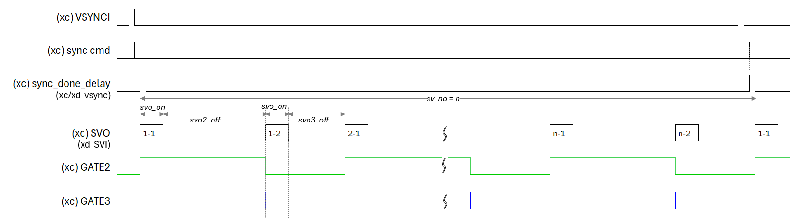
XC24R
SVO ON
Addr | Default | B15 | B14 | B13 | B12 | B11 | B10 | B9 | B8 | B7 | B6 | B5 | B4 | B3 | B2 | B1 | B0
‘h3D | 0x0000 |  |  |  |  | SVO_ON [11:0]
Bits | Fields | Descriptions
11:0 | SVO_ON | Sub vsync on duration
SVO1 OFF
Addr | Default | B15 | B14 | B13 | B12 | B11 | B10 | B9 | B8 | B7 | B6 | B5 | B4 | B3 | B2 | B1 | B0
‘h3E | 0x0000 | SVO1_OFF [15:0]
Bits | Fields | Descriptions
15:0 | SVO1_OFF | Sub vsync off duration related GATE1 signal
SVO2 OFF
Addr | Default | B15 | B14 | B13 | B12 | B11 | B10 | B9 | B8 | B7 | B6 | B5 | B4 | B3 | B2 | B1 | B0
‘h3F | 0x0000 | SVO2_OFF [15:0]
Bits | Fields | Descriptions
15:0 | SVO2_OFF | Sub vsync off duration related GATE2 signal
SVO3 OFF
Addr | Default | B15 | B14 | B13 | B12 | B11 | B10 | B9 | B8 | B7 | B6 | B5 | B4 | B3 | B2 | B1 | B0
‘h40 | 0x0000 | SVO3_OFF [15:0]
Bits | Fields | Descriptions
15:0 | SVO3_OFF | Sub vsync off duration related GATE3 signal

Slide 64
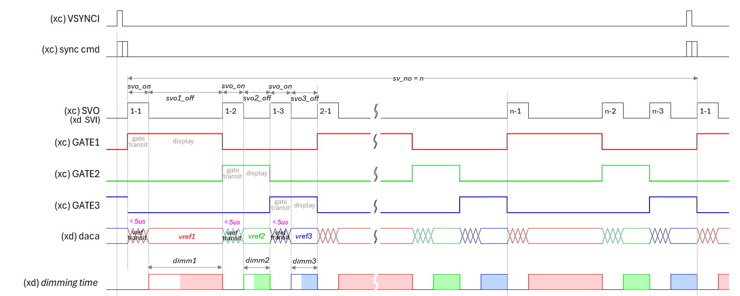
XC24R
SVO NUMBER
Addr | Default | B15 | B14 | B13 | B12 | B11 | B10 | B9 | B8 | B7 | B6 | B5 | B4 | B3 | B2 | B1 | B0
‘h41 | 0x0000 | x | x | x | x | x | SV_NO_TYPE [1:0] |  | x | x | x | SV_NO [5:0]
Bits | Fields | Descriptions
10:9 | SV_NO_TYPE | ‘d2 : svo_off 2/3 active ‘d3 : svo_off 1/2/3 active
5:0 | SV_NO | Sub vsync repeat number Total svo number is SV_NO multiplied by SV_NO_TYPE
DAC NF CONTROL
Addr | Default | B15 | B14 | B13 | B12 | B11 | B10 | B9 | B8 | B7 | B6 | B5 | B4 | B3 | B2 | B1 | B0
‘h42 | 0x0000 | x | x | DAC_LVL[1:0] |  | x | x | x | x | x | x | x | x | x | x | X | DGRJT_EN
Bits | Fields | Descriptions
13:12 | DAC_LVL | DAC level for FB control output
0 | DGRJT_EN | ‘0’ data glitch rejection disable ‘1’ data glitch rejection enable

Slide 65
XC24R
DAC CONTROL
Addr | Default | B15 | B14 | B13 | B12 | B11 | B10
‘h43 | 0x0707 | DAC_FAULT_OFF | DAC3_HOLD_EN | DAC2_HOLD_EN | DAC1_HOLD_EN | x | DAC3_DEC1_MODE
Addr | Default | B9 | B8 | B7 | B6 | B5 | B4
‘h43 | 0x0707 | DAC2_DEC1_MODE | DAC1_DEC1_MODE | DAC3_FB_MODE | DAC2_FB_MODE | DAC1_FB_MODE | DAC_SYNC_MODE
Addr | Default | B3 | B2 | B1 | B0
‘h43 | 0x0707 | DAC_AUTO_TYPE | DAC3_AUTO | DAC2_AUTO | DAC1_AUTO
Bits | Fields | Descriptions
15 | DAC_FAULT_OFF | This bit enables the DAC OUT to the initial value if the thermal event from XDs is occurred.
14 | DAC3_HOLD_EN | This bit enables to fix the DAC OUT to the current value. This can be activated in case that (CURR_TGT_DAC - current DAC OUT) value successively stays below DAC_INC_HOLD_THRESHOLD for DAC_INC_HOLD_LIMIT number which is counted per frame. This function makes the DAC OUT stay at current DAC value even though the dimming data is all zero.
13 | DAC2_HOLD_EN | 0 1 | The DAC OUT is decreased by the DAC_DEC1 whenever the FB is asserted. The DAC OUT is decreased by the arithmetic exponential value of DAC_DEC1 whenever the FB from the XDs is asserted.
12 | DAC1_HOLD_EN | 0 1 | The DAC OUT change results from the internal FB status. The DAC OUT change results from the external FBI pin status.
10 | DAC3_DEC1_MODE | 0 1 | The DAC OUT is synchronized when the SYNC commands are completed to send out to the XDs. The DAC OUT is synchronized at the VSYNCI input of the XC.
9 | DAC2_DEC1_MODE | 0 1 | The DAC OUT is decreased by the DAC_DEC1 whenever the FB is asserted. The DAC OUT is decreased by the arithmetic exponential value of DAC_DEC1 whenever the FB from the XDs is asserted.
8 | DAC1_DEC1_MODE | 0 1 | The DAC OUT is decreased by the DAC_DEC1 whenever the FB is asserted. The DAC OUT is decreased by the arithmetic exponential value of DAC_DEC1 whenever the FB from the XDs is asserted.
7 | DAC3_FB_MODE | 0 1 | The DAC OUT change results from the internal FB status. The DAC OUT change results from the external FBI pin status.
6 | DAC2_FB_MODE | 0 1 | The DAC OUT change results from the internal FB status. The DAC OUT change results from the external FBI pin status.
5 | DAC1_FB_MODE | 0 1 | The DAC OUT change results from the internal FB status. The DAC OUT change results from the external FBI pin status.
4 | DAC_SYNC_MODE | 0 1 | The DAC OUT is synchronized when the SYNC commands are completed to send out to the XDs. The DAC OUT is synchronized at the VSYNCI input of the XC.

Slide 66
XC24R
DAC CONTROL
Addr | Default | B15 | B14 | B13 | B12 | B11 | B10
‘h43 | 0x0707 | DAC_FAULT_OFF | DAC3_HOLD_EN | DAC2_HOLD_EN | DAC1_HOLD_EN | x | DAC3_DEC1_MODE
Addr | Default | B9 | B8 | B7 | B6 | B5 | B4
‘h43 | 0x0707 | DAC2_DEC1_MODE | DAC1_DEC1_MODE | DAC3_FB_MODE | DAC2_FB_MODE | DAC1_FB_MODE | DAC_SYNC_MODE
Addr | Default | B3 | B2 | B1 | B0
‘h43 | 0x0707 | DAC_AUTO_TYPE | DAC3_AUTO | DAC2_AUTO | DAC1_AUTO
Bits | Fields | Descriptions
3 | DAC_AUTO_TYPE
2 | DAC3_AUTO | 0 1 | The DAC OUT outputs the same value as the CURR_TGT_DAC at frame sync. The DAC OUT outputs the automatically optimized value according to the FB status. The DAC OUT will be calculated every frame along with the relevant registers’ set value.
1 | DAC2_AUTO | 0 1 | The DAC OUT outputs the same value as the CURR_TGT_DAC at frame sync. The DAC OUT outputs the automatically optimized value according to the FB status. The DAC OUT will be calculated every frame along with the relevant registers’ set value.
0 | DAC1_AUTO | 0 1 | The DAC OUT outputs the same value as the CURR_TGT_DAC at frame sync. The DAC OUT outputs the automatically optimized value according to the FB status. The DAC OUT will be calculated every frame along with the relevant registers’ set value.

Slide 67
XC24R
CURRENT TARGET DAC1
Addr | Default | B15 | B14 | B13 | B12 | B11 | B10 | B9 | B8 | B7 | B6 | B5 | B4 | B3 | B2 | B1 | B0
‘h44 | 0x0FA0 | x | x | x | x | CURR_TGT_DAC1 [11:0]
Bits | Fields | Descriptions
11:0 | CURR_TGT_DAC1 | This register determines the target DAC value of the corresponding frame. This value is effective from a next frame sync, so this value should be set before a next frame sync. The written value can be visible after a next frame sync is occurred. The target value can be calculated from (LED V_{F} + min V_{HD} of the XD). The initial value at the soft reset, RST1 bit=1, is the same as the DAC_MAX_LIMIT.
CURRENT TARGET DAC2
Addr | Default | B15 | B14 | B13 | B12 | B11 | B10 | B9 | B8 | B7 | B6 | B5 | B4 | B3 | B2 | B1 | B0
‘h45 | 0x0FA0 | x | x | x | x | CURR_TGT_DAC2 [11:0]
Bits | Fields | Descriptions
11:0 | CURR_TGT_DAC2 | This register determines the target DAC value of the corresponding frame. This value is effective from a next frame sync, so this value should be set before a next frame sync. The written value can be visible after a next frame sync is occurred. The target value can be calculated from (LED V_{F} + min V_{HD} of the XD). The initial value at the soft reset, RST1 bit=1, is the same as the DAC_MAX_LIMIT.
CURRENT TARGET DAC3
Addr | Default | B15 | B14 | B13 | B12 | B11 | B10 | B9 | B8 | B7 | B6 | B5 | B4 | B3 | B2 | B1 | B0
‘h46 | 0x0FA0 | x | x | x | x | CURR_TGT_DAC3 [11:0]
Bits | Fields | Descriptions
11:0 | CURR_TGT_DAC3 | This register determines the target DAC value of the corresponding frame. This value is effective from a next frame sync, so this value should be set before a next frame sync. The written value can be visible after a next frame sync is occurred. The target value can be calculated from (LED V_{F} + min V_{HD} of the XD). The initial value at the soft reset, RST1 bit=1, is the same as the DAC_MAX_LIMIT.

Slide 68
XC24R
PREVIOUS TARGET DAC1
Addr | Default | B15 | B14 | B13 | B12 | B11 | B10 | B9 | B8 | B7 | B6 | B5 | B4 | B3 | B2 | B1 | B0
‘h47 | 0x0FA0 | x | x | x | x | PREV_TGT_DAC1 [11:0]
Bits | Fields | Descriptions
11:0 | PREV_TGT_DAC1 | This register shows the target DAC value of the previous frame. This value is also valid just after a next frame sync is asserted. The initial value at the soft reset, RST1 bit=1, is the DAC_MAX_LIMIT.
PREVIOUS TARGET DAC2
Addr | Default | B15 | B14 | B13 | B12 | B11 | B10 | B9 | B8 | B7 | B6 | B5 | B4 | B3 | B2 | B1 | B0
‘h48 | 0x0FA0 | x | x | x | x | PREV_TGT_DAC2 [11:0]
Bits | Fields | Descriptions
11:0 | PREV_TGT_DAC2 | This register shows the target DAC value of the previous frame. This value is also valid just after a next frame sync is asserted. The initial value at the soft reset, RST1 bit=1, is the DAC_MAX_LIMIT.
PREVIOUS TARGET DAC3
Addr | Default | B15 | B14 | B13 | B12 | B11 | B10 | B9 | B8 | B7 | B6 | B5 | B4 | B3 | B2 | B1 | B0
‘h49 | 0x0FA0 | x | x | x | x | PREV_TGT_DAC3 [11:0]
Bits | Fields | Descriptions
11:0 | PREV_TGT_DAC3 | This register shows the target DAC value of the previous frame. This value is also valid just after a next frame sync is asserted. The initial value at the soft reset, RST1 bit=1, is the DAC_MAX_LIMIT.

Slide 69
XC24R
DAC1 OUT
Addr | Default | B15 | B14 | B13 | B12 | B11 | B10 | B9 | B8 | B7 | B6 | B5 | B4 | B3 | B2 | B1 | B0
‘h4A | 0x0FA0 | x | x | x | x | DAC1_OUT [11:0]
Bits | Fields | Descriptions
11:0 | DAC1_OUT | This value shows the current DAC out value. The initial value after POR is the DAC_MAX_LIMIT.
DAC2 OUT
Addr | Default | B15 | B14 | B13 | B12 | B11 | B10 | B9 | B8 | B7 | B6 | B5 | B4 | B3 | B2 | B1 | B0
‘h4B | 0x0FA0 | x | x | x | x | DAC2_OUT [11:0]
Bits | Fields | Descriptions
11:0 | DAC2_OUT | This value shows the current DAC out value. The initial value after POR is the DAC_MAX_LIMIT.
DAC3 OUT
Addr | Default | B15 | B14 | B13 | B12 | B11 | B10 | B9 | B8 | B7 | B6 | B5 | B4 | B3 | B2 | B1 | B0
‘h4C | 0x0FA0 | x | x | x | x | DAC3_OUT [11:0]
Bits | Fields | Descriptions
11:0 | DAC3_OUT | This value shows the current DAC out value. The initial value after POR is the DAC_MAX_LIMIT.

Slide 70
XC24R
DAC1 STATE
Addr | Default | B15 | B14 | B13 | B12 | B11 | B10 | B9 | B8 | B7 | B6 | B5 | B4 | B3 | B2 | B1 | B0
‘h4D | 0x0000 | x | x | x | x |  |  |  |  | DAC1_STATE [3:0] |  |  |  | DAC1_ST_EN [3:0]
Bits | Fields | Descriptions
7:4 | DAC1_STATE | This is for test only.
3:0 | DAC1_ST_EN | This is for test only.
DAC2 STATE
Addr | Default | B15 | B14 | B13 | B12 | B11 | B10 | B9 | B8 | B7 | B6 | B5 | B4 | B3 | B2 | B1 | B0
‘h4E | 0x0000 | x | x | x | x |  |  |  |  | DAC2_STATE [3:0] |  |  |  | DAC2_ST_EN [3:0]
Bits | Fields | Descriptions
7:4 | DAC2_STATE | This is for test only.
3:0 | DAC2_ST_EN | This is for test only.
DAC3 STATE
Addr | Default | B15 | B14 | B13 | B12 | B11 | B10 | B9 | B8 | B7 | B6 | B5 | B4 | B3 | B2 | B1 | B0
‘h4F | 0x0000 | x | x | x | x |  |  |  |  | DAC3_STATE [3:0] |  |  |  | DAC3_ST_EN [3:0]
Bits | Fields | Descriptions
7:4 | DAC3_STATE | This is for test only.
3:0 | DAC3_ST_EN | This is for test only.

Slide 71
XC24R
DAC INCREMENT 1
Addr | Default | B15 | B14 | B13 | B12 | B11 | B10 | B9 | B8 | B7 | B6 | B5 | B4 | B3 | B2 | B1 | B0
‘h50 | 0x40C2 | DAC1_INC3 [5:0] |  |  |  |  |  | DAC1_INC2 [4:0] |  |  |  |  | DAC1_INC1 [4:0]
Bits | Fields | Descriptions
15:10 | DAC1_INC3 | This value determines the amount of the DAC OUT increasement in case that the current DAC OUT stays within the range, (CURR_TGT_DAC – SOA_P3) ≤ the current DAC OUT < (CURR_TGT_DAC – SOA_P2) without any FB assertion. The increment value is added whenever the FB is not asserted every frame. Refer to the Figure 28.
9:5 | DAC1_INC2 | This value determines the amount of the DAC OUT increasement in case that the current DAC OUT stays within the range, (CURR_TGT_DAC – SOA_P2) ≤ the current DAC OUT < (CURR_TGT_DAC – SOA_P1) without any FB assertion. The increment value is added whenever the FB is not asserted every frame. Refer to the Figure 28.
4:0 | DAC1_INC1 | This value determines the amount of the DAC OUT increasement in case that the current DAC OUT stays within the range, the current DAC OUT ≥ (CURR_TGT_DAC – SOA_P1) without any FB assertion. The increment value is added whenever the FB is not asserted every frame. Refer to the Figure 28.

Slide 72
XC24R
DAC1 INCREMENT 2 & HOLD_LIMIT
Addr | Default | B15 | B14 | B13 | B12 | B11 | B10 | B9 | B8 | B7 | B6 | B5 | B4 | B3 | B2 | B1 | B0
‘h51 | 0x0820 | DAC1_INC_HOLD_LIMIT [8:0] |  |  |  |  |  |  |  |  | DAC1_INT4 [6:0]
Bits | Fields | Descriptions
15:7 | DAC1_INC_HOLD_ LIMIT | This value determines the number of frames without the FB assertion in which the current DAC stays within the range, (CURR_TGR_DAC – the current DAC) < DAC_INC _HOLD_THRESHOLD. If the counted value is same as this value, then the DAC OUT will be held at the current DAC value so that the DAC OUT will be not increased any more. This function is useful in case that the PWM data are kept to 0 for a lot of frames.
6:0 | DAC1_INT4 | This value determines the amount of the DAC OUT increasement in case that the current DAC OUT stays within the range, the current DAC OUT < (CURR_TGT_DAC – SOA_P3) without any FB assertion. The increment value is added whenever the FB is not asserted every frame. Refer to the Figure 28.
DAC1 DECREMENT & INC WAIT
Addr | Default | B15 | B14 | B13 | B12 | B11 | B10 | B9 | B8 | B7 | B6 | B5 | B4 | B3 | B2 | B1 | B0
‘h52 | 0x0400 | x | DAC1_DEC1 [6:0] |  |  |  |  |  |  | x | DAC1_INC1_WAIT [6:0]
Bits | Fields | Descriptions
14:8 | DAC1_DEC1 | This value determines the amount of the DAC OUT decrement whenever the FB is asserted. The DAC_DEC1_MODE bit allows two modes choice, one is to decrease by the amount of DAC_DEC1, and the other is to decrease by the amount of arithmetic exponential of DAC_DEC1. Refer to the Figure 28.
6:0 | DAC1_INC1_WAIT | This value determines the number of frames that the DAC OUT increment execution will wait with the FB deassertion. In case the value is set to 2, then the DAC OUT will be increased by the DAC_INC1 at the third frame if three successive frames are kept without the FB assertion. If the value is set to 0, then the DAC OUT will be increased immediately whenever the frame is without a FB assertion.
DAC1 INCREMENT HOLD THRESHOLD
Addr | Default | B15 | B14 | B13 | B12 | B11 | B10 | B9 | B8 | B7 | B6 | B5 | B4 | B3 | B2 | B1 | B0
‘h53 | 0x020A | x | x | x | x | x | x | SIGNED | DAC1_INC_HOLD_THRESHOLD [8:0]
Bits | Fields | Descriptions
9 | SIGNED | The signed bit of the DAC_INC_HOLD_THRESHOLD. The negative value can be set to ‘1’.
8:0 | DAC1_INC_HOLD_ THRESHOLD | This determines the range that the DAC_INC_HOLD_LIMIT counter will work. Refer to the DAC_INC_HOLD_LIMIT and the DAC_HOLD_EN bit in details.

Slide 73
XC24R
DAC1 FB VALID TIMER
Addr | Default | B15 | B14 | B13 | B12 | B11 | B10 | B9 | B8 | B7 | B6 | B5 | B4 | B3 | B2 | B1 | B0
‘h54 | 0x0000 | DAC1_FB_VAILD_TIMER [17:2]
Bits | Fields | Descriptions
15:0 | DAC1_FB_VAILD_ TIMER | This determines when the FB status is valid. This is the interval time from the frame sync to the FB valid. The setting value in this register is counted as much as (the value x MCLK x 4).
DAC1 MIN LIMIT
Addr | Default | B15 | B14 | B13 | B12 | B11 | B10 | B9 | B8 | B7 | B6 | B5 | B4 | B3 | B2 | B1 | B0
‘h55 | 0x0190 | x | x | x | x | DAC1_MIN_LIMIT [11:0]
Bits | Fields | Descriptions
11:0 | DAC1_MIN_LIMIT | This determines the minimum value of the DAC OUT. The value can not be set to less than decimal 100.
DAC1 MAX LIMIT
Addr | Default | B15 | B14 | B13 | B12 | B11 | B10 | B9 | B8 | B7 | B6 | B5 | B4 | B3 | B2 | B1 | B0
‘h56 | 0x0FA0 | x | x | x | x | DAC1_MAX_LIMIT [11:0]
Bits | Fields | Descriptions
11:0 | DAC1_MAX_LIMIT | This determines the maximum value of the DAC OUT. The value can not be set to more than decimal 4,000.

Slide 74
XC24R
DAC2 INCREMENT 1
Addr | Default | B15 | B14 | B13 | B12 | B11 | B10 | B9 | B8 | B7 | B6 | B5 | B4 | B3 | B2 | B1 | B0
‘h57 | 0x40C2 | DAC2_INC3 [5:0] |  |  |  |  |  | DAC2_INC2 [4:0] |  |  |  |  | DAC2_INC1 [4:0]
Bits | Fields | Descriptions
15:10 | DAC2_INC3 | This value determines the amount of the DAC OUT increasement in case that the current DAC OUT stays within the range, (CURR_TGT_DAC – SOA_P3) ≤ the current DAC OUT < (CURR_TGT_DAC – SOA_P2) without any FB assertion. The increment value is added whenever the FB is not asserted every frame. Refer to the Figure 28.
9:5 | DAC2_INC2 | This value determines the amount of the DAC OUT increasement in case that the current DAC OUT stays within the range, (CURR_TGT_DAC – SOA_P2) ≤ the current DAC OUT < (CURR_TGT_DAC – SOA_P1) without any FB assertion. The increment value is added whenever the FB is not asserted every frame. Refer to the Figure 28.
4:0 | DAC2_INC1 | This value determines the amount of the DAC OUT increasement in case that the current DAC OUT stays within the range, the current DAC OUT ≥ (CURR_TGT_DAC – SOA_P1) without any FB assertion. The increment value is added whenever the FB is not asserted every frame. Refer to the Figure 28.

Slide 75
XC24R
DAC2 INCREMENT 2 & HOLD_LIMIT
Addr | Default | B15 | B14 | B13 | B12 | B11 | B10 | B9 | B8 | B7 | B6 | B5 | B4 | B3 | B2 | B1 | B0
‘h58 | 0x0820 | DAC2_INC_HOLD_LIMIT [8:0] |  |  |  |  |  |  |  |  | DAC2_INT4 [6:0]
Bits | Fields | Descriptions
15:7 | DAC2_INC_HOLD_ LIMIT | This value determines the number of frames without the FB assertion in which the current DAC stays within the range, (CURR_TGR_DAC – the current DAC) < DAC_INC _HOLD_THRESHOLD. If the counted value is same as this value, then the DAC OUT will be held at the current DAC value so that the DAC OUT will be not increased any more. This function is useful in case that the PWM data are kept to 0 for a lot of frames.
6:0 | DAC2_INT4 | This value determines the amount of the DAC OUT increasement in case that the current DAC OUT stays within the range, the current DAC OUT < (CURR_TGT_DAC – SOA_P3) without any FB assertion. The increment value is added whenever the FB is not asserted every frame. Refer to the Figure 28.
DAC2 DECREMENT & INC WAIT
Addr | Default | B15 | B14 | B13 | B12 | B11 | B10 | B9 | B8 | B7 | B6 | B5 | B4 | B3 | B2 | B1 | B0
‘h59 | 0x0400 | x | DAC2_DEC1 [6:0] |  |  |  |  |  |  | x | DAC2_INC1_WAIT [6:0]
Bits | Fields | Descriptions
14:8 | DAC2_DEC1 | This value determines the amount of the DAC OUT decrement whenever the FB is asserted. The DAC_DEC1_MODE bit allows two modes choice, one is to decrease by the amount of DAC_DEC1, and the other is to decrease by the amount of arithmetic exponential of DAC_DEC1. Refer to the Figure 28.
6:0 | DAC2_INC1_WAIT | This value determines the number of frames that the DAC OUT increment execution will wait with the FB deassertion. In case the value is set to 2, then the DAC OUT will be increased by the DAC_INC1 at the third frame if three successive frames are kept without the FB assertion. If the value is set to 0, then the DAC OUT will be increased immediately whenever the frame is without a FB assertion.
DAC2 INCREMENT HOLD THRESHOLD
Addr | Default | B15 | B14 | B13 | B12 | B11 | B10 | B9 | B8 | B7 | B6 | B5 | B4 | B3 | B2 | B1 | B0
‘h5A | 0x020A | x | x | x | x | x | x | SIGNED | DAC2_INC_HOLD_THRESHOLD [8:0]
Bits | Fields | Descriptions
9 | SIGNED | The signed bit of the DAC_INC_HOLD_THRESHOLD. The negative value can be set to ‘1’.
8:0 | DAC2_INC_HOLD_ THRESHOLD | This determines the range that the DAC_INC_HOLD_LIMIT counter will work. Refer to the DAC_INC_HOLD_LIMIT and the DAC_HOLD_EN bit in details.

Slide 76
XC24R
DAC2 FB VALID TIMER
Addr | Default | B15 | B14 | B13 | B12 | B11 | B10 | B9 | B8 | B7 | B6 | B5 | B4 | B3 | B2 | B1 | B0
‘h5B | 0x0000 | DAC2_FB_VAILD_TIMER [17:2]
Bits | Fields | Descriptions
15:0 | DAC2_FB_VAILD_ TIMER | This determines when the FB status is valid. This is the interval time from the frame sync to the FB valid. The setting value in this register is counted as much as (the value x MCLK x 4).
DAC2 MIN LIMIT
Addr | Default | B15 | B14 | B13 | B12 | B11 | B10 | B9 | B8 | B7 | B6 | B5 | B4 | B3 | B2 | B1 | B0
‘h5C | 0x0190 | x | x | X | x | DAC2_MIN_LIMIT [11:0]
Bits | Fields | Descriptions
11:0 | DAC2_MIN_LIMIT | This determines the minimum value of the DAC OUT. The value can not be set to less than decimal 100.
DAC2 MAX LIMIT
Addr | Default | B15 | B14 | B13 | B12 | B11 | B10 | B9 | B8 | B7 | B6 | B5 | B4 | B3 | B2 | B1 | B0
‘h5D | 0x0FA0 | x | x | X | x | DAC2_MAX_LIMIT [11:0]
Bits | Fields | Descriptions
11:0 | DAC2_MAX_LIMIT | This determines the maximum value of the DAC OUT. The value can not be set to more than decimal 4,000.

Slide 77
XC24R
DAC3 INCREMENT 1
Addr | Default | B15 | B14 | B13 | B12 | B11 | B10 | B9 | B8 | B7 | B6 | B5 | B4 | B3 | B2 | B1 | B0
‘h5E | 0x40C2 | DAC3_INC3 [5:0] |  |  |  |  |  | DAC3_INC2 [4:0] |  |  |  |  | DAC3_INC1 [4:0]
Bits | Fields | Descriptions
15:10 | DAC3_INC3 | This value determines the amount of the DAC OUT increasement in case that the current DAC OUT stays within the range, (CURR_TGT_DAC – SOA_P3) ≤ the current DAC OUT < (CURR_TGT_DAC – SOA_P2) without any FB assertion. The increment value is added whenever the FB is not asserted every frame. Refer to the Figure 28.
9:5 | DAC3_INC2 | This value determines the amount of the DAC OUT increasement in case that the current DAC OUT stays within the range, (CURR_TGT_DAC – SOA_P2) ≤ the current DAC OUT < (CURR_TGT_DAC – SOA_P1) without any FB assertion. The increment value is added whenever the FB is not asserted every frame. Refer to the Figure 28.
4:0 | DAC3_INC1 | This value determines the amount of the DAC OUT increasement in case that the current DAC OUT stays within the range, the current DAC OUT ≥ (CURR_TGT_DAC – SOA_P1) without any FB assertion. The increment value is added whenever the FB is not asserted every frame. Refer to the Figure 28.

Slide 78
XC24R
DAC3 INCREMENT 2 & HOLD_LIMIT
Addr | Default | B15 | B14 | B13 | B12 | B11 | B10 | B9 | B8 | B7 | B6 | B5 | B4 | B3 | B2 | B1 | B0
‘h5F | 0x0820 | DAC3_INC_HOLD_LIMIT [8:0] |  |  |  |  |  |  |  |  | DAC3_INT4 [6:0]
Bits | Fields | Descriptions
15:7 | DAC3_INC_HOLD_ LIMIT | This value determines the number of frames without the FB assertion in which the current DAC stays within the range, (CURR_TGR_DAC – the current DAC) < DAC_INC _HOLD_THRESHOLD. If the counted value is same as this value, then the DAC OUT will be held at the current DAC value so that the DAC OUT will be not increased any more. This function is useful in case that the PWM data are kept to 0 for a lot of frames.
6:0 | DAC3_INT4 | This value determines the amount of the DAC OUT increasement in case that the current DAC OUT stays within the range, the current DAC OUT < (CURR_TGT_DAC – SOA_P3) without any FB assertion. The increment value is added whenever the FB is not asserted every frame. Refer to the Figure 28.
DAC3 DECREMENT & INC WAIT
Addr | Default | B15 | B14 | B13 | B12 | B11 | B10 | B9 | B8 | B7 | B6 | B5 | B4 | B3 | B2 | B1 | B0
‘h60 | 0x0400 | x | DAC3_DEC1 [6:0] |  |  |  |  |  |  | x | DAC3_INC1_WAIT [6:0]
Bits | Fields | Descriptions
14:8 | DAC3_DEC1 | This value determines the amount of the DAC OUT decrement whenever the FB is asserted. The DAC_DEC1_MODE bit allows two modes choice, one is to decrease by the amount of DAC_DEC1, and the other is to decrease by the amount of arithmetic exponential of DAC_DEC1. Refer to the Figure 28.
6:0 | DAC3_INC1_WAIT | This value determines the number of frames that the DAC OUT increment execution will wait with the FB deassertion. In case the value is set to 2, then the DAC OUT will be increased by the DAC_INC1 at the third frame if three successive frames are kept without the FB assertion. If the value is set to 0, then the DAC OUT will be increased immediately whenever the frame is without a FB assertion.
DAC3 INCREMENT HOLD THRESHOLD
Addr | Default | B15 | B14 | B13 | B12 | B11 | B10 | B9 | B8 | B7 | B6 | B5 | B4 | B3 | B2 | B1 | B0
‘h61 | 0x020A | x | x | x | x | x | x | SIGNED | DAC3_INC_HOLD_THRESHOLD [8:0]
Bits | Fields | Descriptions
9 | SIGNED | The signed bit of the DAC_INC_HOLD_THRESHOLD. The negative value can be set to ‘1’.
8:0 | DAC3_INC_HOLD_ THRESHOLD | This determines the range that the DAC_INC_HOLD_LIMIT counter will work. Refer to the DAC_INC_HOLD_LIMIT and the DAC_HOLD_EN bit in details.

Slide 79
XC24R
DAC3 FB VALID TIMER
Addr | Default | B15 | B14 | B13 | B12 | B11 | B10 | B9 | B8 | B7 | B6 | B5 | B4 | B3 | B2 | B1 | B0
‘h62 | 0x0000 | DAC3_FB_VAILD_TIMER [17:2]
Bits | Fields | Descriptions
15:0 | DAC3_FB_VAILD_ TIMER | This determines when the FB status is valid. This is the interval time from the frame sync to the FB valid. The setting value in this register is counted as much as (the value x MCLK x 4).
DAC3 MIN LIMIT
Addr | Default | B15 | B14 | B13 | B12 | B11 | B10 | B9 | B8 | B7 | B6 | B5 | B4 | B3 | B2 | B1 | B0
‘h63 | 0x0190 | x | x | X | x | DAC3_MIN_LIMIT [11:0]
Bits | Fields | Descriptions
11:0 | DAC3_MIN_LIMIT | This determines the minimum value of the DAC OUT. The value can not be set to less than decimal 100.
DAC3 MAX LIMIT
Addr | Default | B15 | B14 | B13 | B12 | B11 | B10 | B9 | B8 | B7 | B6 | B5 | B4 | B3 | B2 | B1 | B0
‘h64 | 0x0FA0 | x | x | X | x | DAC3_MAX_LIMIT [11:0]
Bits | Fields | Descriptions
11:0 | DAC3_MAX_LIMIT | This determines the maximum value of the DAC OUT. The value can not be set to more than decimal 4,000.

Slide 80
XC24R
OSC FLL MAN_A1
Addr | Default | B15 | B14 | B13 | B12 | B11 | B10 | B9 | B8
‘h65 | 0x8010 | OSC_MAN_EN_A | x | x | x | x | x | x | DAC_RNG_A
Addr | Default | B7 | B6 | B5 | B4 | B3 | B2 | B1 | B0
‘h65 | 0x8010 | x | x | FLT_CTL_A [1:0] |  | x | x | FLT_GAIN_A [1:0]
Bits | Fields | Descriptions
15 | OSC_MAN_EN_A | This determines the FLL_A target frequency value in manual mode.
8 | DAC_RNG_A | It is recommended to use the default value.
5:4 | FLT_CTL_A | It is recommended to set to 1.
1:0 | FLT_GAIN_A | It is recommended to use the default value.
OSC FLL MAN_A2
Addr | Default | B15 | B14 | B13 | B12 | B11 | B10 | B9 | B8 | B7 | B6 | B5 | B4 | B3 | B2 | B1 | B0
‘h66 | 0x020A | OSC_FLL_MAN_A [15:0]
Bits | Fields | Descriptions
15:0 | OSC_FLL_MAN_A | This determines the FLL_A target frequency value in manual mode.

Slide 81
XC24R
OSC FLL MAN_B1
Addr | Default | B15 | B14 | B13 | B12 | B11 | B10 | B9 | B8
‘h67 | 0x8010 | OSC_MAN_EN_B | x | x | x | x | x | x | DAC_RNG_B
Addr | Default | B7 | B6 | B5 | B4 | B3 | B2 | B1 | B0
‘h67 | 0x8010 | x | x | FLT_CTL_B [1:0] |  | x | x | FLT_GAIN_B [1:0]
Bits | Fields | Descriptions
15 | OSC_MAN_EN_B | This determines the FLL_B target frequency value in manual mode.
8 | DAC_RNG_B | It is recommended to use the default value.
5:4 | FLT_CTL_B | It is recommended to set to 1.
1:0 | FLT_GAIN_B | It is recommended to use the default value.
OSC FLL MAN_B2
Addr | Default | B15 | B14 | B13 | B12 | B11 | B10 | B9 | B8 | B7 | B6 | B5 | B4 | B3 | B2 | B1 | B0
‘h68 | 0x020A | OSC_FLL_MAN_B [15:0]
Bits | Fields | Descriptions
15:0 | OSC_FLL_MAN_B | This determines the FLL_B target frequency value in manual mode.

Slide 82
XC24R
GLOBAL WRITE DATA
Addr | Default | B15 | B14 | B13 | B12 | B11 | B10 | B9 | B8 | B7 | B6 | B5 | B4 | B3 | B2 | B1 | B0
‘h69 | 0x0000 | x | x | x | x | DATA [11:0]
Bits | Fields | Descriptions
11:0 | GLOBAL_WR_ DATA | This register represents the data to be written to the XD12 drivers daisied. This register should be written with desired value before the global-writing command is executed.
GLOBAL FAULT-READ DATA 1
Addr | Default | B15 | B14 | B13 | B12 | B11 | B10 | B9 | B8 | B7 | B6 | B5 | B4 | B3 | B2 | B1 | B0
‘h6A | 0x0000 | FAULT_CH4 [3:0] | x | x | x | FAULT_CH3 [3:0] | x | x | x | FAULT_CH2 [3:0] | x | x |  | FAULT_CH1 [3:0] | x | x | x
GLOBAL FAULT-READ DATA 2
Addr | Default | B15 | B14 | B13 | B12 | B11 | B10 | B9 | B8 | B7 | B6 | B5 | B4 | B3 | B2 | B1 | B0
‘h6B | 0x0000 | FAULT_CH8 [3:0] | x | x | x | FAULT_CH7 [3:0] | x | x | x | FAULT_CH6 [3:0] | x | x |  | FAULT_CH5 [3:0] | x | x | x
GLOBAL FAULT-READ DATA 3
Addr | Default | B15 | B14 | B13 | B12 | B11 | B10 | B9 | B8 | B7 | B6 | B5 | B4 | B3 | B2 | B1 | B0
‘h6C | 0x0000 | FAULT_CH12 [3:0] | x | x | x | FAULT_CH11 [3:0] | x | x | x | FAULT_CH10 [3:0] | x | x |  | FAULT_CH9 [3:0] | x | x | x
GLOBAL FAULT-READ DATA 4
Addr | Default | B15 | B14 | B13 | B12 | B11 | B10 | B9 | B8 | B7 | B6 | B5 | B4 | B3 | B2 | B1 | B0
‘h6D | 0x0000 | FAULT_CH16 [3:0] | x | x | x | FAULT_CH15 [3:0] | x | x | x | FAULT_CH14 [3:0] | x | x |  | FAULT_CH13 [3:0] | x | x | x
GLOBAL FAULT-READ DATA 5
Addr | Default | B15 | B14 | B13 | B12 | B11 | B10 | B9 | B8 | B7 | B6 | B5 | B4 | B3 | B2 | B1 | B0
‘h6E | 0x0000 | FAULT_CH20 [3:0] | x | x | x | FAULT_CH19 [3:0] | x | x | x | FAULT_CH18 [3:0] | x | x |  | FAULT_CH17 [3:0] | x | x | x
GLOBAL FAULT-READ DATA 6
Addr | Default | B15 | B14 | B13 | B12 | B11 | B10 | B9 | B8 | B7 | B6 | B5 | B4 | B3 | B2 | B1 | B0
‘h6F | 0x0000 | FAULT_CH24 [3:0] | x | x | x | FAULT_CH23 [3:0] | x | x | x | FAULT_CH22 [3:0] | x | x |  | FAULT_CH21 [3:0] | x | x | x
Bits | Fields | Descriptions
15:12 11:8 7:4 3:0 | FAULT_CHx | These bits represent the fault status from all XD12 drivers daisied in each channel. FAULT_CHx [3] : The THERMAL status, all bits from each channel are OR-ed. FAULT_CHx [2] : The SHORT status, all bits from each channel are OR-ed. FAULT_CHx [1] : The OPEN status, all bits from each channel are OR-ed. FAULT_CHx [0] : The FB status, all bits from each channel are OR-ed. The value will be kept the current state until the value is newly updated from a next FAULT-(AUTO)-READ execution. The OR-ed signal of the FAULT_CHx [0] is driven directly to the FB pin and the pattern depends on the FB_PWM_EN bit.

Slide 83
XC24R
PORT1 LOCAL-RW DATA 1 ~ PORT8 LOCAL RW DATA 1
Addr | Default | B15 | B14 | B13 | B12 | B11 | B10 | B9 | B8 | B7 | B6 | B5 | B4 | B3 | B2 | B1 | B0
‘h70~’h77 | 0x0000 | x | x | x | x | PORT1_LOCAL_RW_DATA 1 [11:0] ~ PORT8_LOCAL_RW_DATA 1 [11:0] |  | x | x |  | x | x |  |  | x | x | x
PORT1 LOCAL-RW DATA 2 ~ PORT8 LOCAL RW DATA 2
Addr | Default | B15 | B14 | B13 | B12 | B11 | B10 | B9 | B8 | B7 | B6 | B5 | B4 | B3 | B2 | B1 | B0
‘h78~’h7F | 0x0000 | x | x | x | x | PORT1_LOCAL_RW_DATA 2 [11:0] ~ PORT8_LOCAL_RW_DATA 2 [11:0] |  | x | x |  | x | x |  |  | x | x | x
PORT1 LOCAL-RW DATA 3 ~ PORT8 LOCAL RW DATA 3
Addr | Default | B15 | B14 | B13 | B12 | B11 | B10 | B9 | B8 | B7 | B6 | B5 | B4 | B3 | B2 | B1 | B0
‘h80~’h87 | 0x0000 | x | x | x | x | PORT1_LOCAL_RW_DATA 3 [11:0] ~ PORT8_LOCAL_RW_DATA 3 [11:0] |  | x | x |  | x | x |  |  | x | x | x
PORT1 LOCAL-RW DATA 4 ~ PORT8 LOCAL RW DATA 4
Addr | Default | B15 | B14 | B13 | B12 | B11 | B10 | B9 | B8 | B7 | B6 | B5 | B4 | B3 | B2 | B1 | B0
‘h88~’h8F | 0x0000 | x | x | x | x | PORT1_LOCAL_RW_DATA 4 [11:0] ~ PORT8_LOCAL_RW_DATA 4 [11:0] |  | x | x |  | x | x |  |  | x | x | x
PORT1 LOCAL-RW DATA 5 ~ PORT8 LOCAL RW DATA 5
Addr | Default | B15 | B14 | B13 | B12 | B11 | B10 | B9 | B8 | B7 | B6 | B5 | B4 | B3 | B2 | B1 | B0
‘h90~’h97 | 0x0000 | x | x | x | x | PORT1_LOCAL_RW_DATA 5 [11:0] ~ PORT8_LOCAL_RW_DATA 5 [11:0] |  | x | x |  | x | x |  |  | x | x | x
PORT1 LOCAL-RW DATA 6 ~ PORT8 LOCAL RW DATA 6
Addr | Default | B15 | B14 | B13 | B12 | B11 | B10 | B9 | B8 | B7 | B6 | B5 | B4 | B3 | B2 | B1 | B0
‘h98~’h9F | 0x0000 | x | x | x | x | PORT1_LOCAL_RW_DATA 6 [11:0] ~ PORT8_LOCAL_RW_DATA 6 [11:0] |  | x | x |  | x | x |  |  | x | x | x
PORT1 LOCAL-RW DATA 7 ~ PORT8 LOCAL RW DATA 7
Addr | Default | B15 | B14 | B13 | B12 | B11 | B10 | B9 | B8 | B7 | B6 | B5 | B4 | B3 | B2 | B1 | B0
‘hA0~’hA7 | 0x0000 | x | x | x | x | PORT1_LOCAL_RW_DATA 7 [11:0] ~ PORT8_LOCAL_RW_DATA 7 [11:0] |  | x | x |  | x | x |  |  | x | x | x
PORT1 LOCAL-RW DATA 8 ~ PORT8 LOCAL RW DATA 8
Addr | Default | B15 | B14 | B13 | B12 | B11 | B10 | B9 | B8 | B7 | B6 | B5 | B4 | B3 | B2 | B1 | B0
‘hA8~’hAF | 0x0000 | x | x | x | x | PORT1_LOCAL_RW_DATA 8 [11:0] ~ PORT8_LOCAL_RW_DATA 8 [11:0] |  | x | x |  | x | x |  |  | x | x | x
PORT1 LOCAL-RW DATA 9 ~ PORT8 LOCAL RW DATA 9
Addr | Default | B15 | B14 | B13 | B12 | B11 | B10 | B9 | B8 | B7 | B6 | B5 | B4 | B3 | B2 | B1 | B0
‘hB0~’hB7 | 0x0000 | x | x | x | x | PORT1_LOCAL_RW_DATA 9 [11:0] ~ PORT8_LOCAL_RW_DATA 9 [11:0] |  | x | x |  | x | x |  |  | x | x | x
PORT1 LOCAL-RW DATA 10 ~ PORT8 LOCAL RW DATA 10
Addr | Default | B15 | B14 | B13 | B12 | B11 | B10 | B9 | B8 | B7 | B6 | B5 | B4 | B3 | B2 | B1 | B0
‘hB8~’hBF | 0x0000 | x | x | x | x | PORT1_LOCAL_RW_DATA 10 [11:0] ~ PORT8_LOCAL_RW_DATA 10 [11:0] |  | x | x |  | x | x |  |  | x | x | x

Slide 84
XC24R
PORT1 LOCAL-RW DATA 11 ~ PORT8 LOCAL RW DATA 11
Addr | Default | B15 | B14 | B13 | B12 | B11 | B10 | B9 | B8 | B7 | B6 | B5 | B4 | B3 | B2 | B1 | B0
‘hC0~’hC7 | 0x0000 | x | x | x | x | PORT1_LOCAL_RW_DATA 11 [11:0] ~ PORT8_LOCAL_RW_DATA 11 [11:0] |  | x | x |  | x | x |  |  | x | x | x
PORT1 LOCAL-RW DATA 12 ~ PORT8 LOCAL RW DATA 12
Addr | Default | B15 | B14 | B13 | B12 | B11 | B10 | B9 | B8 | B7 | B6 | B5 | B4 | B3 | B2 | B1 | B0
‘hC8~’hCF | 0x0000 | x | x | x | x | PORT1_LOCAL_RW_DATA 12 [11:0] ~ PORT8_LOCAL_RW_DATA 12 [11:0] |  | x | x |  | x | x |  |  | x | x | x
PORT1 LOCAL-RW DATA 13 ~ PORT8 LOCAL RW DATA 13
Addr | Default | B15 | B14 | B13 | B12 | B11 | B10 | B9 | B8 | B7 | B6 | B5 | B4 | B3 | B2 | B1 | B0
‘hD0~’hD7 | 0x0000 | x | x | x | x | PORT1_LOCAL_RW_DATA 13 [11:0] ~ PORT8_LOCAL_RW_DATA 13 [11:0] |  | x | x |  | x | x |  |  | x | x | x
PORT1 LOCAL-RW DATA 14 ~ PORT8 LOCAL RW DATA 14
Addr | Default | B15 | B14 | B13 | B12 | B11 | B10 | B9 | B8 | B7 | B6 | B5 | B4 | B3 | B2 | B1 | B0
‘hD8~’hDF | 0x0000 | x | x | x | x | PORT1_LOCAL_RW_DATA 14 [11:0] ~ PORT8_LOCAL_RW_DATA 14 [11:0] |  | x | x |  | x | x |  |  | x | x | x
PORT1 LOCAL-RW DATA 15 ~ PORT8 LOCAL RW DATA 15
Addr | Default | B15 | B14 | B13 | B12 | B11 | B10 | B9 | B8 | B7 | B6 | B5 | B4 | B3 | B2 | B1 | B0
‘hE0~’hE7 | 0x0000 | x | x | x | x | PORT1_LOCAL_RW_DATA 15 [11:0] ~ PORT8_LOCAL_RW_DATA 15 [11:0] |  | x | x |  | x | x |  |  | x | x | x
PORT1 LOCAL-RW DATA 16 ~ PORT8 LOCAL RW DATA 16
Addr | Default | B15 | B14 | B13 | B12 | B11 | B10 | B9 | B8 | B7 | B6 | B5 | B4 | B3 | B2 | B1 | B0
‘hE8~’hEF | 0x0000 | x | x | x | x | PORT1_LOCAL_RW_DATA 16 [11:0] ~ PORT8_LOCAL_RW_DATA 16[11:0] |  | x | x |  | x | x |  |  | x | x | x
Bits | Fields | Descriptions
11:0 | PORT_{X}_LOCAL_ RW_DATA_{Y} | These registers are used to contain the data to be written/read to/from the XD12 drivers daisied to each channel for accessing the XD12 drivers’ registers. These registers should be written before executing the relevant commands, the local-reading or local-writing command. It needs to be careful to use that these registers are differently mapped according to the CH_SEG [1:0] of the LOCAL WRITE/READ COMMAND registers CH_SEG = 2’b00 : PORT1 to PORT8 are mapped to the channel 1 to 8 in order. CH_SEG = 2’b01 : PORT1 to PORT8 are mapped to the channel 9 to 16 in order. CH_SEG = 2’b10 : PORT1 to PORT8 are mapped to the channel 17 to 24 in order. The data order to be transferred to the XD12 drivers daisied in a channel_{X} : PORT_{X}_LOCAL_RW_DATA₁ to the 1st driver, PORT_{X}_LOCAL_RW_DATA₂ to the 2nd driver, ….. The data order to be received from the XD12 drivers daisied in a channel_{X} : PORT_{X}_LOCAL_RW_DATA₁ from the last driver, PORT_{X}_LOCAL_RW_DATA₂ from the (last -1) driver, ….. Refer to the Fig 15. for detail.

Slide 85
XC24R
These registers can not go outside the Global Technologies.
Test registers are protected to read operation, recommend to check function directly.
TEST CONTROL
Addr | Default | B15 | B14 | B13 | B12 | B11 | B10 | B9 | B8 | B7 | B6 | B5 | B4 | B3 | B2 | B1 | B0
‘hF0 | 0x0000 | TEST_EN | ADDR_EXT | x | x | x | DACO3_DIRECT | DACO2_DIRECT | DACO1_DIRECT | x | x | x | MCLK1_O | x | x | MCLK_SEL | MCLK64_O
Bits | Fields | Descriptions
15 | TEST_EN | Used for test only
14 | ADDR_EXT | This bit is for use extension register address group2.
10 | DACO3_DIRECT | If TEST_EN=1 and DACO3_DIRECT=1, then the written value of the CURR_TGT_DAC3 will be immediately out to an analog DAC3 module without any synchronization.
9 | DACO2_DIRECT | If TEST_EN=1 and DACO2_DIRECT=1, then the written value of the CURR_TGT_DAC2 will be immediately out to an analog DAC3 module without any synchronization.
8 | DACO1_DIRECT | If TEST_EN=1 and DACO1_DIRECT=1, then the written value of the CURR_TGT_DAC1 will be immediately out to an analog DAC3 module without any synchronization.
4 | MCLK1_O | If TEST_EN=1 and MCLK1_O=1 and MCLK32_O=0, then the internal OSC clock will be driven on pin SCLKO. If SPREAD_EN is set, then the spread clock of internal OSC will be driven.
1 | MCLK_SEL | This bit select OSC clock source for SVO9 out for TEST_EN=1.
0 | MCLK64_O | If TEST_EN=1 and MCLK1_O=0 and MCLK64_O=1, then the clock which divides the internal OSC into 64 will be driven on pin SVO9. This is used to trim the internal OSC, 25MHz, so it is careful that SPREAD_EN should be disabled on trimming so that the internal OSC clock can be trimmed to exact 25MHz without any jitters.
OTP PG ACCESS
Addr | Default | B15 | B14 | B13 | B12 | B11 | B10 | B9 | B8 | B7 | B6 | B5 | B4 | B3 | B2 | B1 | B0
‘hF1 | 0x03FF | OTP_PG_ACC_CYCLE [15:0]
Bits | Fields | Descriptions
15:0 | OTP_PG_ACC_CYCLE
OTP WRITE
Addr | Default | B15 | B14 | B13 | B12 | B11 | B10 | B9 | B8 | B7 | B6 | B5 | B4 | B3 | B2 | B1 | B0
‘hF2 | 0x0004 | OTP_PG_DONE | x | x | x | x | x | x | x | x | x | OTP_RD[1:0] |  | OTP_WSEL [3:0]
Bits | Fields | Descriptions
15 | OTP_PG_DONE | OTP write done flag register, need to be set after OTP program.
5:4 | OTP_RD[1:0] | OTP read margin check register
3:0 | OTP_WSEL | OTP write current strength control register

Slide 86
XC24R
These registers can not go outside the Global Technologies.
Test registers are protected to read operation, recommend to check function directly.
OTP RD/PROG
Addr | Default | B15 | B14 | B13 | B12 | B11 | B10 | B9 | B8 | B7 | B6 | B5 | B4 | B3 | B2 | B1 | B0
‘hF3 | 0x0000 | x | x | x | x | x | x | x | x | x | x | x | x | x | x | OTP_RD_S | OTP_PG_S
Bits | Fields | Descriptions
1 | OTP_RD_S | OTP Read transaction Start. It is recommended that this bit is set once during initialization process after POR so that it is helpful to avoid any fail of the OTP auto-downloading just after POR.
0 | OTP_PG_S | OTP Program transaction Start.
OTP PROTECT
Addr | Default | B15 | B14 | B13 | B12 | B11 | B10 | B9 | B8 | B7 | B6 | B5 | B4 | B3 | B2 | B1 | B0
‘hF4 | 0x05A5 | x | x | x | x | PROTECT [11:0]
Bits | Fields | Descriptions
11:0 | PROTECT | If the value, 0x05A5, is set, then the OTP access is protected. If the value, 0x0A5A is set, then the OTP access is allowed, and the OTP checksum function is disabled temporarily in this status so that all OTP MIRROR registers’ value can be changed without any limitation.

Slide 87
XC24R
These registers can not go outside the Global Technologies.
Test registers are protected to read operation, recommend to check function directly.
MIRROR1
Addr | Default | B15 | B14 | B13 | B12 | B11 | B10 | B9 | B8 | B7 | B6 | B5 | B4 | B3 | B2 | B1 | B0
‘hF5 | 0x1010 | x | x | x | BGR_TC[4:0] |  |  |  |  | x | x | x | VCTL_LDO[4:0]
Bits | Fields | Descriptions
12:8 | BGR_TC | BGR temperature compensation bit
4:0 | VCTL_LDO | LDO trimming bit
MIRROR2
Addr | Default | B15 | B14 | B13 | B12 | B11 | B10 | B9 | B8 | B7 | B6 | B5 | B4 | B3 | B2 | B1 | B0
‘hF6 | 0x2010 | x | x | DAC_CTL[5:0] |  |  |  |  |  | DAC1_OFS[7:0]
Bits | Fields | Descriptions
13:8 | DAC_CTL | LDO for DAC trimming bit
7:0 | DAC1_OFS | DAC1 offset compensation bit
MIRROR3
Addr | Default | B15 | B14 | B13 | B12 | B11 | B10 | B9 | B8 | B7 | B6 | B5 | B4 | B3 | B2 | B1 | B0
‘hF7 | 0x0000 | DAC3_OFS[7:0] |  |  |  |  |  |  |  | DAC2_OFS[7:0]
Bits | Fields | Descriptions
15:8 | DAC3_OFS | DAC3 offset compensation bit
7:0 | DAC2_OFS | DAC2 offset compensation bit
MIRROR4
Addr | Default | B15 | B14 | B13 | B12 | B11 | B10 | B9 | B8 | B7 | B6 | B5 | B4 | B3 | B2 | B1 | B0
‘hF8 | 0x1010 | x | x | x | LDO_OSC_CTL[4:0] |  |  |  |  | x | x | x | OSC_RCTL[4:0]
Bits | Fields | Descriptions
12:8 | LDO_OSC_CTL | LDO for OSC trimming bit
4:0 | OSC_RCTL | OSC1 frequency trimming bit
MIRROR5
Addr | Default | B15 | B14 | B13 | B12 | B11 | B10 | B9 | B8 | B7 | B6 | B5 | B4 | B3 | B2 | B1 | B0
‘hF9 | 0x1010 | VERSION[1:0] |  | OTP_CHECKSUM[5:0] |  |  |  |  |  | x | x | x | OSC_RCTL2[4:0]
Bits | Fields | Descriptions
15:14 | VERSION | Version indicator
13:8 | OTP_CHECKSUM | All OTP bits’ checksum value (Exclusive ORing)
4:0 | OSC_RCTL2 | OSC2 frequency trimming bit

Slide 88
XC24R
REGISTER GROUP2
DAC1 FB VALID CNT
Addr | Default | B15 | B14 | B13 | B12 | B11 | B10 | B9 | B8 | B7 | B6 | B5 | B4 | B3 | B2 | B1 | B0
‘h00 | 0x0000 | DAC1_FB_VALID_CNT[17:2]
Bits | Fields | Descriptions
15:0 | DAC1_FB_VALID_CNT | This is for test only. This value shows the counted value, MCLK x 4, for one frame.
DAC1 INC HOLD/WAIT CNT
Addr | Default | B15 | B14 | B13 | B12 | B11 | B10 | B9 | B8 | B7 | B6 | B5 | B4 | B3 | B2 | B1 | B0
‘h01 | 0x0000 | DAC1_INC_HOLD_LIMIT_CNT[8:0] |  |  |  |  |  |  |  |  | DAC1_INC1_WAIT_CNT[6:0]
Bits | Fields | Descriptions
15:7 | DAC1_INC_HOLD_LIMIT_CNT | This is for test only.
6:0 | DAC1_INC1_WAIT_CNT | This is for test only.
1R2
Addr | Default | B15 | B14 | B13 | B12 | B11 | B10 | B9 | B8 | B7 | B6 | B5 | B4 | B3 | B2 | B1 | B0
‘h02 | 0x0000 |  |  |  | SIGNED | IR2[11:0]
Bits | Fields | Descriptions
12 | SIGNED | The signed bit of the R2. This is for test only.
11:0 | IR2 | = (CURR_TGT_DAC – the current DAC)

Slide 89
XC24R
REGISTER GROUP2
SOA1_N11 & N1
Addr | Default | B15 | B14 | B13 | B12 | B11 | B10 | B9 | B8 | B7 | B6 | B5 | B4 | B3 | B2 | B1 | B0
‘h03 | 0x1908 | SOA_N11 [8:0] |  |  |  |  |  |  |  |  | SOA_N1 [6:0]
Bits | Fields | Descriptions
15:7 | SOA_N11 | This determines the condition whether the DAC OUT will be changed to the CURR_TGT_DAC or kept to the current DAC value in case that the condition ((CURR_TGT_DAC – PREV_TGT_DAC) + SOA_N11) < 0 is met. If the current DAC is smaller than the CURR_TGT_DAC, then the DAC OUT will be kept to the current DAC, and if not so, the current DAC will be changed to the CURR_TGT_DAC value. Normally, this function will work when the condition, ((CURR_TGT_DAC – PREV_TGT_ DAC) + SOA_N1) < 0), is occurred while the DAC OUT is increasing.
6:0 | SOA_N1 | This determines the condition whether the DAC OUT will be immediately decreased by the amount of (CURR_TGT_DAC – the current DAC) or not. Whenever the condition, ((CURR_TGT_DAC – PREV_TGT_DAC) + SOA_N1) < 0, is occurred, the DAC OUT will be immediately decreased by the amount of (CURR_TGT_DAC – the current DAC). Normally, this is working that the current frame’s target is less than the previous frame’s target by the SOA_N1. Refer to the Figure 28.
SOA1_P2 & P1
Addr | Default | B15 | B14 | B13 | B12 | B11 | B10 | B9 | B8 | B7 | B6 | B5 | B4 | B3 | B2 | B1 | B0
‘h04 | 0xC07D | SOA_P2 [3:0] |  |  |  | x | x | x | SOA1_P1 [8:0]
Bits | Fields | Descriptions
15:12 | SOA_P2 | This determines the extent to which the DAC OUT will be increased. Refer to the DAC INCREMENT 1 & 2 registers and Figure 28. in details.
8:0 | SOA1_P1 | This determines the extent to which the DAC OUT will be increased. Refer to the DAC INCREMENT 1 & 2 registers and Figure 28. in details.
SOA1_P3 & P2
Addr | Default | B15 | B14 | B13 | B12 | B11 | B10 | B9 | B8 | B7 | B6 | B5 | B4 | B3 | B2 | B1 | B0
‘h05 | 0x7D12 | SOA1_P3 [9:0] |  |  |  |  |  |  |  |  |  | SOA1_P2 [9:4]
Bits | Fields | Descriptions
15:6 | SOA1_P3 | It must be careful that this register is prohibited from being written. This determines the extent to which the DAC OUT will be increased. Refer to the DAC INCREMENT 1 & 2 registers and Figure 28. in details.
5:0 | SOA1_P2 | This determines the extent to which the DAC OUT will be increased. Refer to the DAC INCREMENT 1 & 2 registers and Figure 28. in details.

Slide 90
XC24R
REGISTER GROUP2
DAC2 FB VALID CNT
Addr | Default | B15 | B14 | B13 | B12 | B11 | B10 | B9 | B8 | B7 | B6 | B5 | B4 | B3 | B2 | B1 | B0
‘h06 | 0x0000 | DAC2_FB_VALID_CNT[17:2]
Bits | Fields | Descriptions
15:0 | DAC2_FB_VALID_CNT | This is for test only. This value shows the counted value, MCLK x 4, for one frame.
DAC2 INC HOLD/WAIT CNT
Addr | Default | B15 | B14 | B13 | B12 | B11 | B10 | B9 | B8 | B7 | B6 | B5 | B4 | B3 | B2 | B1 | B0
‘h07 | 0x0000 | DAC2_INC_HOLD_LIMIT_CNT[8:0] |  |  |  |  |  |  |  |  | DAC2_INC1_WAIT_CNT[6:0]
Bits | Fields | Descriptions
15:7 | DAC2_INC_HOLD_LIMIT_CNT | This is for test only.
6:0 | DAC2_INC1_WAIT_CNT | This is for test only.
2R2
Addr | Default | B15 | B14 | B13 | B12 | B11 | B10 | B9 | B8 | B7 | B6 | B5 | B4 | B3 | B2 | B1 | B0
‘h08 | 0x0000 |  |  |  | SIGNED | 2R2[11:0]
Bits | Fields | Descriptions
12 | SIGNED | The signed bit of the R2. This is for test only.
11:0 | 2R2 | = (CURR_TGT_DAC – the current DAC)

Slide 91
XC24R
REGISTER GROUP2
SOA2_N11 & N1
Addr | Default | B15 | B14 | B13 | B12 | B11 | B10 | B9 | B8 | B7 | B6 | B5 | B4 | B3 | B2 | B1 | B0
‘h09 | 0x1908 | SOA2_N11 [8:0] |  |  |  |  |  |  |  |  | SOA2_N1 [6:0]
Bits | Fields | Descriptions
15:7 | SOA2_N11 | This determines the condition whether the DAC OUT will be changed to the CURR_TGT_DAC or kept to the current DAC value in case that the condition ((CURR_TGT_DAC – PREV_TGT_DAC) + SOA_N11) < 0 is met. If the current DAC is smaller than the CURR_TGT_DAC, then the DAC OUT will be kept to the current DAC, and if not so, the current DAC will be changed to the CURR_TGT_DAC value. Normally, this function will work when the condition, ((CURR_TGT_DAC – PREV_TGT_ DAC) + SOA_N1) < 0), is occurred while the DAC OUT is increasing.
6:0 | SOA2_N1 | This determines the condition whether the DAC OUT will be immediately decreased by the amount of (CURR_TGT_DAC – the current DAC) or not. Whenever the condition, ((CURR_TGT_DAC – PREV_TGT_DAC) + SOA_N1) < 0, is occurred, the DAC OUT will be immediately decreased by the amount of (CURR_TGT_DAC – the current DAC). Normally, this is working that the current frame’s target is less than the previous frame’s target by the SOA_N1. Refer to the Figure 28.
SOA2_P2 & P1
Addr | Default | B15 | B14 | B13 | B12 | B11 | B10 | B9 | B8 | B7 | B6 | B5 | B4 | B3 | B2 | B1 | B0
‘h0A | 0xC07D | SOA2_P2 [3:0] |  |  |  | x | x | x | SOA2_P1 [8:0]
Bits | Fields | Descriptions
15:12 | SOA2_P2 | This determines the extent to which the DAC OUT will be increased. Refer to the DAC INCREMENT 1 & 2 registers and Figure 28. in details.
8:0 | SOA2_P1 | This determines the extent to which the DAC OUT will be increased. Refer to the DAC INCREMENT 1 & 2 registers and Figure 28. in details.
SOA2_P3 & P2
Addr | Default | B15 | B14 | B13 | B12 | B11 | B10 | B9 | B8 | B7 | B6 | B5 | B4 | B3 | B2 | B1 | B0
‘h0B | 0x7D12 | SOA2_P3 [9:0] |  |  |  |  |  |  |  |  |  | SOA2_P2 [9:4]
Bits | Fields | Descriptions
15:6 | SOA2_P3 | It must be careful that this register is prohibited from being written. This determines the extent to which the DAC OUT will be increased. Refer to the DAC INCREMENT 1 & 2 registers and Figure 28. in details.
5:0 | SOA2_P2 | This determines the extent to which the DAC OUT will be increased. Refer to the DAC INCREMENT 1 & 2 registers and Figure 28. in details.

Slide 92
XC24R
REGISTER GROUP2
DAC3 FB VALID CNT
Addr | Default | B15 | B14 | B13 | B12 | B11 | B10 | B9 | B8 | B7 | B6 | B5 | B4 | B3 | B2 | B1 | B0
‘h0C | 0x0000 | DAC3_FB_VALID_CNT[17:2]
Bits | Fields | Descriptions
15:0 | DAC3_FB_VALID_CNT | This is for test only. This value shows the counted value, MCLK x 4, for one frame.
DAC3 INC HOLD/WAIT CNT
Addr | Default | B15 | B14 | B13 | B12 | B11 | B10 | B9 | B8 | B7 | B6 | B5 | B4 | B3 | B2 | B1 | B0
‘h0D | 0x0000 | DAC3_INC_HOLD_LIMIT_CNT[8:0] |  |  |  |  |  |  |  |  | DAC3_INC1_WAIT_CNT[6:0]
Bits | Fields | Descriptions
15:7 | DAC3_INC_HOLD_LIMIT_CNT | This is for test only.
6:0 | DAC3_INC1_WAIT_CNT | This is for test only.
3R2
Addr | Default | B15 | B14 | B13 | B12 | B11 | B10 | B9 | B8 | B7 | B6 | B5 | B4 | B3 | B2 | B1 | B0
‘h0E | 0x0000 | x | x | x | SIGNED | 3R2[11:0]
Bits | Fields | Descriptions
12 | SIGNED | The signed bit of the R2. This is for test only.
11:0 | 3R2 | = (CURR_TGT_DAC – the current DAC)

Slide 93
XC24R
REGISTER GROUP2
SOA3_N11 & N1
Addr | Default | B15 | B14 | B13 | B12 | B11 | B10 | B9 | B8 | B7 | B6 | B5 | B4 | B3 | B2 | B1 | B0
‘h0F | 0x1908 | SOA3_N11 [8:0] |  |  |  |  |  |  |  |  | SOA3_N1 [6:0]
Bits | Fields | Descriptions
15:7 | SOA3_N11 | This determines the condition whether the DAC OUT will be changed to the CURR_TGT_DAC or kept to the current DAC value in case that the condition ((CURR_TGT_DAC – PREV_TGT_DAC) + SOA_N11) < 0 is met. If the current DAC is smaller than the CURR_TGT_DAC, then the DAC OUT will be kept to the current DAC, and if not so, the current DAC will be changed to the CURR_TGT_DAC value. Normally, this function will work when the condition, ((CURR_TGT_DAC – PREV_TGT_ DAC) + SOA_N1) < 0), is occurred while the DAC OUT is increasing.
6:0 | SOA3_N1 | This determines the condition whether the DAC OUT will be immediately decreased by the amount of (CURR_TGT_DAC – the current DAC) or not. Whenever the condition, ((CURR_TGT_DAC – PREV_TGT_DAC) + SOA_N1) < 0, is occurred, the DAC OUT will be immediately decreased by the amount of (CURR_TGT_DAC – the current DAC). Normally, this is working that the current frame’s target is less than the previous frame’s target by the SOA_N1. Refer to the Figure 28.
SOA3_P2 & P1
Addr | Default | B15 | B14 | B13 | B12 | B11 | B10 | B9 | B8 | B7 | B6 | B5 | B4 | B3 | B2 | B1 | B0
‘h10 | 0xC07D | SOA3_P2 [3:0] |  |  |  | x | x | x | SOA3_P1 [8:0]
Bits | Fields | Descriptions
15:12 | SOA3_P2 | This determines the extent to which the DAC OUT will be increased. Refer to the DAC INCREMENT 1 & 2 registers and Figure 28. in details.
8:0 | SOA3_P1 | This determines the extent to which the DAC OUT will be increased. Refer to the DAC INCREMENT 1 & 2 registers and Figure 28. in details.
SOA3_P3 & P2
Addr | Default | B15 | B14 | B13 | B12 | B11 | B10 | B9 | B8 | B7 | B6 | B5 | B4 | B3 | B2 | B1 | B0
‘h11 | 0x7D12 | SOA3_P3 [9:0] |  |  |  |  |  |  |  |  |  | SOA3_P2 [9:4]
Bits | Fields | Descriptions
15:6 | SOA3_P3 | It must be careful that this register is prohibited from being written. This determines the extent to which the DAC OUT will be increased. Refer to the DAC INCREMENT 1 & 2 registers and Figure 28. in details.
5:0 | SOA3_P2 | This determines the extent to which the DAC OUT will be increased. Refer to the DAC INCREMENT 1 & 2 registers and Figure 28. in details.

Slide 94
XC24R
REGISTER GROUP2
ANA_TEST
Addr | Default | B15 | B14 | B13 | B12 | B11 | B10 | B9 | B8 | B7 | B6 | B5 | B4 | B3 | B2 | B1 | B0
‘h12 | 0x0000 | x | x | x | CHOP_EN | x | x | x | CHOP_EN_OSCLDO | x | x | x | CHOP_EN_BGR | x | TEST_ANA_EN[2:0]
Bits | Fields | Descriptions
12 | CHOP_EN | The CHOP_EN determinant OSC CHOPPING enable. 0 disable 1 enable
8 | CHOP_EN_OSCLDO | The CHOP_EN_OSCLDO determinant LDO for OSC CHOPPING enable. 0 disable 1 enable
4 | CHOP_EN_BGR | The CHOP_EN_BGR determinant BGR CHOPPING enable. 0 disable 1 enable
2:0 | TEST_ANA_EN | Analog TEST MUX select bit for only test.

Slide 95

XC24R
Soldering Temperature Reflow Profile
Figure 29. Reflow Soldering information
Parameter | Pb-free soldering conditions
Average ramp-up rate (217 ℃ to Peak) | 3℃/second max.
Time of Preheat temp (from 150 ℃ to 200 ℃) | 60 ~ 120 second
Time to be maintained above 217 ℃ | 60 ~ 150 second
Peak temperature | 260 ℃
Time within 5 ℃ of actual peak temp | 30 second
Ramp-down rate | 6 ℃/second max.
Time from 25℃ to peak temp | 8 minutes max.
Table 10. Reflow Soldering Parameter
Note:
1. The reflow peak soldering temperature is peak 260°C and it is specified based on IPC/JEDEC J-STD- 020 “
Moisture/Reflow Sensitivity Classification for Non-Hermetic Solid State Surface Mount Devices”
2. Tolerance for peak proﬁle temperature (Tp) is deﬁned as a supplier minimum and a user maximum.
3. This document should serve as recommendation only. Other parameters may also affect soldering, so these profiles
do not guarantee absolute success.
4. Soldering profiles should be determined by reference to the solder and solder paste manufacturer's specifications, unless they conflict with the recommendations in this document.
5. The soldering profile and footprint information specified in this datasheet are general recommendations and are provided for reference only. The design, control, and quality assurance of the actual soldering process are the sole responsibility of the customer. The supplier assumes no responsibility for the soldering process or its results.
Important statement
Global Technologies reserves the right to change the above-mentioned information without prior notice.

Slide 96

XC24R
Body TOP Marking
< JSICAT marking >
XC24R
XXXXX
CBA2J
YWCD@
TOP VIEW
Fix. Code IC Part Name: XC24R
Assembly production Code : CBA2J,
※ Example code :2025. 07. 07
wafer Lot #1-5
Package Drawings Markings
Y → Year code
Row No. | Marking | Definition
1 | XXXXX | Fixed Code: XC24R
2 | abc | Internal code
3 | YWCD@ | Y: Year Code W: Week Code C: Wafer Code D: Traceability Wafer lot Code @: Assembly plant Code
Wafer Lot | 2024 |  | 2025 |  | 2026 |  | 2027 |  | …
 | 1-6 | 7-12 | 1-6 | 7-12 | 1-6 | 7-12 | 1-6 | 7-12 | 1-6 | 7-12
Code | - | A | B | C | D | E | F | G | … | …
W → Week code , A=W1, B=W2,….
Wafer Lot | W 1 | W 2 | W3 | W4 | … | W27 | W28 | … | W53
Code | A | B | C | D | … | A | B | … | A
C → Wafer lot, Each wafer Lot is represented by a character (Ex: A, B, C, …).
These character cycle once a week.
Wafer Lot | Lot 1 | Lot 2 | Lot 3 | Lot 4 | Lot 5 | Lot 6 | Lot 7 | Lot 8 | …
Code | A | B | C | D | E | F | G | H | …
** Font Type : Arial
Marking text tolerance : ±0.05mm
D → Traceability Code Wafer lot NO. :
A big assembly Lot consists of three wafers. Each big assembly Lot.
Lot is represented by a character (Ex: 1,2,3,…)
Wafer Lot No | 1-3 | 4-6 | 7-9 | 10-12 | 13-15 | 16-18 | 19-21 | 22-24 | 25
Code | 1 | 2 | 3 | 4 | 5 | 6 | 7 | 8 | 9
@ → Assembly plant code
 | JSICAT | SEMTECH | 3rd plant | 4th Plant
Code | J | S | * | *

Slide 97
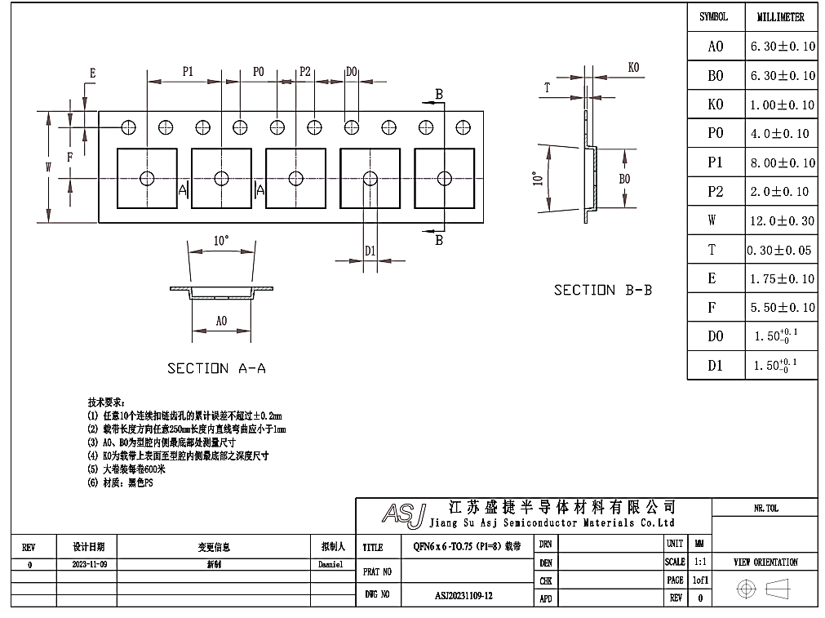

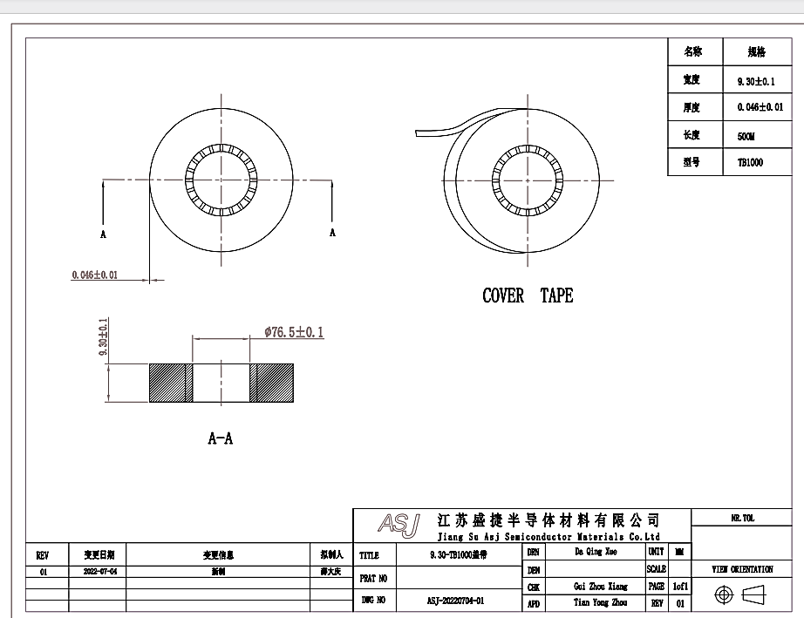
XC24R
Embossed tape and reel data
1) JSICAT
Figure 30. Tape and reel specification

Slide 98
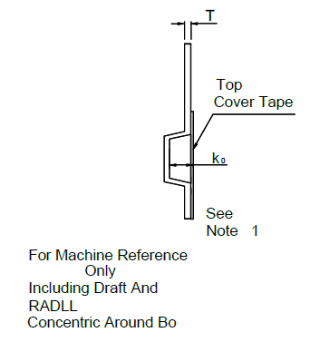
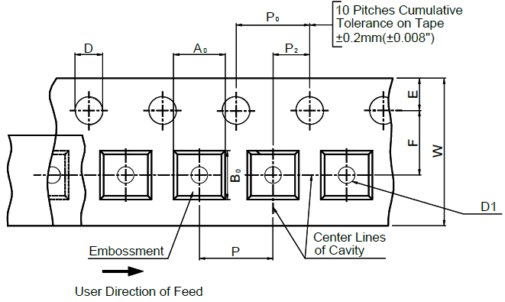
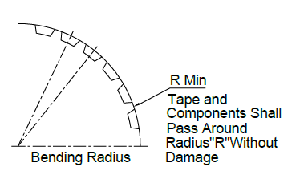
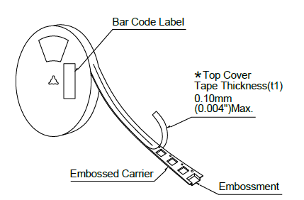
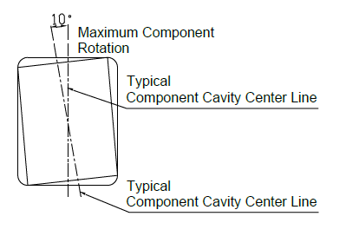
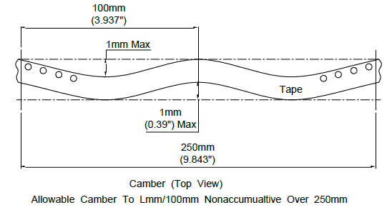
XC24R
2) Semtech
Package | Tape Size | D | D1 | E | F | P | P₀ | P₂
QFN6060 | 12mm | 1.55±0.1mm (0.063±0.004”) | 1.55±0.1mm (0.063±0.004”) | 1.75±0.1mm (0.069±0.004”) | 5.5±0.1mm (0.217±0.004”) | 8±0.1mm (0.315±0.004”) | 4±0.1mm (0.157±0.004”) | 2±0.1mm (0.079±0.004”)
Package | R Min. | T | W | A0 | B0 | K0
QFN6060 | 25mm (0.98”) | 0.20±0.05mm (0.008±0.002”) | 12mm±0.1mm (0.472±0.004”) | 6.2±0.1 mm (0.244±0.004”) | 6.2±0.1mm (0.244±0.004”) | 0.95±0.1mm (0.037±0.004”)
Figure 31. Tape and reel specification
Note : 1. Metric dimensions govern-English are in parentheses for reference only. 2. The clearance between the components and the cavity must be within 0.05 mm min. to 0.5 mm max.
3. The component cannot rotate more than 10︒ within the determined cavity.

Slide 99
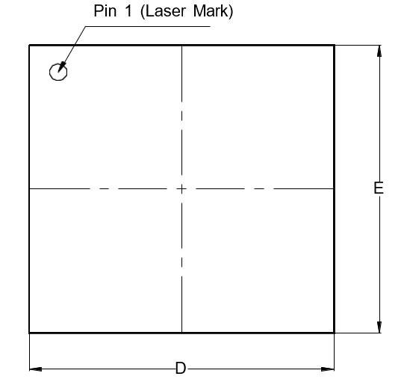
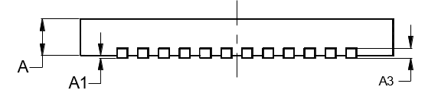
XC24R
Package specification
QFN 8080-68L Package Outline
TOP VIEW
BOTTOM VIEW
k
0.7000
C=0.4X45°
PIN#1 I.D.
E1
R
D1
b
e
L
SIDE VIEW
Symbol | Dimensions in mm
 | Min | Typ | Max
A | 0.70 | 0.75 | 0.80
A1 | 0.00 | 0.02 | 0.05
A3 | 0.203 REF
D | 7.90 | 8.00 | 8.10
E | 7.90 | 8.00 | 8.10
D1 | 6.10 | 6.20 | 6.30
E1 | 6.10 | 6.20 | 6.30
k | 0.20
b | 0.15 | 0.20 | 0.25
e | 0.30 | 0.40 | 0.50
Nd | 6.40 BSC
Ne | 6.40 BSC
L | 0.35 | 0.40 | 0.45
Note
All Dimensions Do Not Include mold flash or Protrusions.
Figure 32. Package Outline

Slide 100

XC24R
Footprint
e
Symbol | Dimensions in mm
 | Min | Nom | Max
A | 0.70 | 0.75 | 0.80
A1 | 0.00 | 0.02 | 0.05
A2 | 0.203REF
B | 0.15 | 0.20 | 0.25
D | 7.90 | 8.00 | 8.10
D1 | 6.10 | 6.20 | 6.30
E1 | 6.10 | 6.20 | 6.30
E | 7.90 | 8.00 | 8.10
e | 0.30 | 0.40 | 0.50
K | 0.20
L | 0.35 | 0.40 | 0.45
PIN #1 0.40x45°
K
D1
D
E1
L
B
E
Figure 33. Recommended Footprint
Note : The reflow peak soldering temperature is peak 260°C and it is specified based on IPC/JEDEC J-STD- 020
“Moisture/Reflow Sensitivity Classification for Non-Hermetic Solid State Surface Mount Devices”
is the trademark of Global Technologies Co., Ltd. or its subsidiaries in the Republic of Korea and/or other countries. The products of Global Technologies reserve the right to make changes without further notice to any products herein. Global Technologies makes no warranty, representation or guarantee regarding the suitability of its products for any particular purpose, nor does Global Technologies assume any liability arising out of the application or use of any product or circuit, and specifically disclaims any and all liability, including without limitation special, consequential or incidental damages. Global Technologies does not convey any license under its patent rights nor the rights of others.
is the trademark of Global Technologies Co., Ltd. or its subsidiaries in the Republic of Korea and/or other countries. Global Technologies owns the rights to a number of patents, trademarks, copyrights, trade secrets, and other intellectual property. Global Technologies reserves the right to make changes without further notice to any products herein. Global Technologies makes no warranty, representation or guarantee regarding the suitability of its products for any particular purpose, nor does Global Technologies assume any liability arising out of the application or use of any product or circuit, and specifically disclaims any and all liability, including without limitation special, consequential or incidental damages. Buyer is responsible for its products and applications using Global Technologies products, including compliance with all laws, regulations and safety requirements or standards, regardless of any support or applications information provided by Global Technologies. “Typical” parameters which may be provided in Global Technologies data sheets and/or specifications can and do vary in different applications and actual performance may vary over time. All operating parameters, including “Typical” must be validated for each customer application by customer’s technical experts. Global Technologies does not convey any license under its patent rights nor the rights of others. Global Technologies products are not designed, intended, or authorized for use as a critical component in life support systems or any FDA Class 3 medical devices or medical devices with a same or similar classification in a foreign jurisdiction or any devices intended for implantation in the human body. Should Buyer purchase or use Global Technologies products for any such unintended or unauthorized application, Buyer shall indemnify and hold Global Technologies and its officers, employees, subsidiaries, affiliates, and distributors harmless against all claims, costs, damages, and expenses, and reasonable attorney fees arising out of, directly or indirectly, any claim of personal injury or death associated with such unintended or unauthorized use, even if such claim alleges that Global Technologies was negligent regarding the design or manufacture of the part. Global Technologies is an Equal Opportunity/Affirmative Action Employer. This literature is subject to all applicable copyright laws and is not for resale in any manner.

