Slide 1


Goiko grill restauran location clustering
Mario Gonzalez

Slide 2
Problem introduction
Goiko grill is an Spanish Burger bar chain. They have restaurants throughout Spain. They want to expand into the most profitable locations possible
In order to decide which are the most profitable locations we could cluster the current restaurants and decide which type is the most profitable one and then expand into that type of restaurant

Slide 3
The data
Restaurant list gathered from goiko grill web page
Geo location for those restaurants collected manually
Venues data gathered with the foursquare api

Slide 4
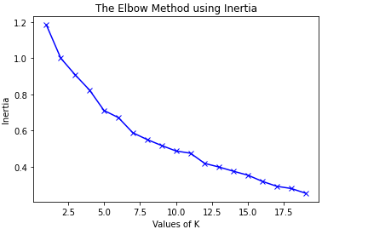
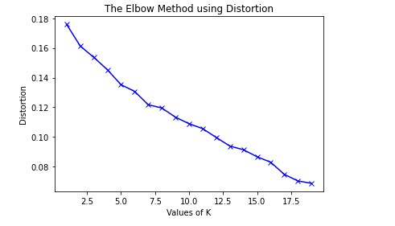
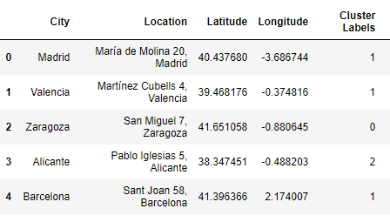
Methodology
Elbow method, we used the elbow method to determine the amount of clusters.
Algorithim, we used k means clustering to conduct our analysis

Slide 5
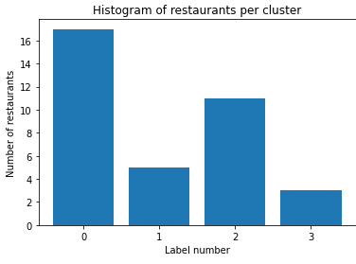
Results
Label 0: Leisure areas
Label 1: Cosmopolitan cities and áreas
Label 2: City based shopping areas
Label 3: Out of city shopping malls

Slide 6
Discusión and conslusion
We have been able to cluster the data into 4 different cateogires
We have been able to determine which type of restaurant is abailable in each city
Further data (profitability) is needed to determine which are the most succesful types of restaurant and therefore help on the expansion

