Slide 1
Session 6 - PL/SQL
Documentation
D59428.pdf on the R:\drive
R:\AJennings\DT354-3\EDB\Practical
  PL/SQL Fundamentals Student Guide
Intro and Chapter 1 today
See also Tutorial notes – tutorial2.pdf
And also
http://docs.oracle.com/cd/E11882_01/index.htm

Slide 2
Differences Between Anonymous
Blocks and Subprograms
Anonymous Blocks | Subprograms
Unnamed PL/SQL blocks | Named PL/SQL blocks
Compiled every time | Compiled only once
Not stored in the database | Stored in the database
Cannot be invoked by other applications | Named and, therefore, can be invoked by other applications
Do not return values | Subprograms called functions must return values.
Cannot take parameters | Can take parameters

Slide 3
Naming Conventions of PL/SQL
Structures Used in This Course
PL/SQL Structure | Convention | Example
Variable | v_variable_name | v_rate
Constant | c_constant_name | c_rate
Subprogram parameter | p_parameter_name | p_id
Bind (host) variable | b_bind_name | b_salary
Cursor | cur_cursor_name | cur_emp
Record | rec_record_name | rec_emp
Type | type_name_type | ename_table_type
Exception | e_exception_name | e_products_invalid
File handle | f_file_handle_name | f_file

Slide 4
PL/SQL
Procedural Language/ SQL
Write your own source using a ‘.sql’ filename extension - Ex. hello.sql
Compile it using Oracle
  There is no object file
  Code is stored in the Data_Dictionary
  As a Procedure, or Function

Slide 5
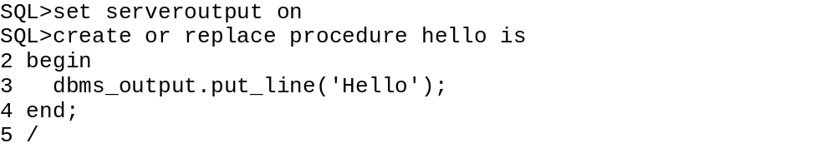
PL/SQL - Example
Procedure created.
SQL> execute hello
Hello ‘John’
PL/SQL procedure successfully completed.
What is dbms_output? It is a package in Oracle
What is put_line? It is a procedure in that package
Set Serveroutput on command directs the SQL*Plus session to dump buffered
text to your screen upon completion of a program.

Slide 6
PL/SQL ……
You can save the content of your file in hello.sql
You can then run the file
SQL>@hello.sql
Procedure created.
NOW - Create a PL/SQL block that invokes the HELLO procedure. Do this by creating a text file with a SQL extension. Name the file RUN_HELLO.sql.

Slide 7
PL/SQL ……
The following illustrates the syntax for a PL/SQL block (the
Forward slash is the SQL*Plus command to compile and execute
the script).
DECLARE ---optional, not necessary if no var
Variables
BEGIN
Body of PL/SQL code.
END:
/
Note – a PL/SQL block is different from a stored procedure. HELLO is a compiled
object in the database. You must first compile HELLO.SQL
Then you can execute the procedure.

Slide 8
PL/SQL
--Filename: RUN_HELLO.SQL
BEGIN
FOR run_count IN 1..5 LOOP
hello;
END LOOP;
END;
/
SQL>@run_hello
Hello John
Hello John
Hello John
Hello John
Hello John

