Slide 1
DT-354-3 Business Modelling Assignment 1
Oisín Coburn C13523917

Slide 2

Rockall Technologies

Slide 3
Introduction
I have chosen to present the activities of this organisation as I have spent two full Summers in the past two years working in various roles in this organisation and I feel confident in my understanding as to how Rockall Technologies operates on a day-to-day basis.
I have decided that the best approach to take in terms of identifying business processes in this organisation would be to identify all of the business processes which come together in order to provide a finished product to a client instead of focusing on to the processes of gaining new clients and cost negotiation,planning etc involved in the company.

Slide 4
Overview
Rockall technologies is a software company which specialises in collateral management solutions for a numerous banks worldwide (I will elaborate on this in the next slide).
The company was founded over 20 years ago and its European headquarters is currently located at West Pier business park, Monkstown , Co. Dublin.

Slide 5
Overview (continued)
Rockall Technologies produces a web application named ‘Collate’ which bank employees use on a day-to-day basis in order to record important information such as client Information, loan Information and information on the collateral used by the client in order to back up their loans.
Rockall consists of several teams each of which plays an important role in producing a finished product which caters to each of their client’s specific needs.In theese slides i will focus the three teams involved in developing the finished product.

Slide 6
Rockall Technologies 3 Teams
Product Implementation Product Team Support Team Team
Works on adding new functionality to existing product.
Customises the product to suit each specific Bank depending on their requirements.
Deals with Product issues found by the Banks

Slide 7

Product Team
This is the team which works on developing the standard product and consists of the most high-level and experienced software developers in the organisation as this team focuses on adding new functions to an already large and complex system.
When the Product team works on developing Collate they do not consider specific bank’s needs as instead they focus on bringing in new functionality to the standard product.

Slide 8

Product Implementation Team
This is the team which focused on making changes and customising the product in order to satisfy each bank’s business requirements.
These requirements vary from bank to bank and can range from something small like a few label-changes or specific information to be recorded on certain pages to more large requirements like creating all the username and passwords which the bank will need to login to the system.
It is up to the Product implementation team to make the necessary changes to Collate before a finished version is shipped to each respective Bank.

Slide 9
Product Implementation Team members
Product Owners- These are the team members which liaise with the Banks in order to get a clear picture of each Bank’s specific requirements and changes to be brought into the system.
Configuration- This is the sub-team which actually implement the changes required by the bank to the code provided by the Product Team.
Quality Assurance- This is the the sub-team which ensures all necessary changes are implemented before the finished product is shipped out to the Banks.

Slide 10

Support Team
This is the team which deal with product issues found by banks which they found whilst using the system.
It is important for the Support team to have a strong understanding of the products functionality as often issues reported turn out to be false alarms caused by the bank’s misuse of the product.

Slide 11
Rockall Technologies Business Processes

Slide 12
Product Team -Business Processes
1 Software developers work on adding new functionality to existing product.
-These members are responsible for improving the product by adding code for new functions, increasing the general performance and user-friendliness of the system.
Quality Assurance team test new functionality and report issues if found.
-These members give the green light that all new improvements function as they should and that no other existing product features are affected by these changes

Slide 13

Product Team -Business Processes
3. Software developers fix issues found by QA team and at the end of every two weeks all code is packaged into a release and handed over to the Product Implementation Team.
-This is a back and forth process between the software developers and the qa team in regard to finding new issues ,retesting them, and either reporting back if the issue still is not resolved or else confirming that the issue found has been fixed.

Slide 14
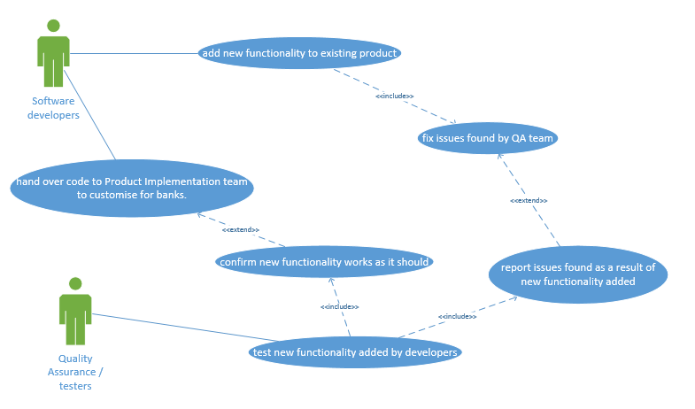
Product Team use case diagram

Slide 15
Product Implementation Team -Business Processes
4. Product Owners contact the Banks in order to identify the Bank’s specific requirements and preferences which they would like to see implemented on the product.
-This is normally done through “workbench” sessions where Product Owners will sit down with members of the banks and run through what information they would like to record on the system in order to decide what fields should be displayed on certain pages and also what types of assets/ loans they would like to record information on.

Slide 16
Product Implementation Team -Business Processes (Continued)
5. Once the Product Owners have a clear idea as to what the Banks would like implemented they then gather all of these requirements in document form which is then sent onto the Configuration team to implement these changes.
-This is normally done through excel sheets listing all relabelling and new fields to be added per page along with what new loan/asset types are to be added to the system.

Slide 17

Product Implementation Team -Business Processes (Continued)
6. The Configuration team will then implement these changes to the Collate product they receive from the product team.
-It is a product function that these changes can be implemented by inserting certain values into the database, i.e. so the work of the configuration team will not affect the code which software developers on the Product team uses when they work on the product.

Slide 18

Product Implementation Team -Business Processes (Continued)
7. The Quality Assurance run through the documentation of the new changes to be added as per bank request will carefully run through each page on the product to ensure that all of the required changes made are present.
-Once the configuration team has finished implementing their changes they will deploy the product in web application form onto the web servers so the Quality Assurance team can begin testing the application as the banks will use it.

Slide 19
Product Implementation Team -Business Processes (Continued)
8. If any changes required by the banks have not made it through the Quality Assurance team will notify the Configuration team.
-The Configuration team will then implement these changes and re-deploy the code for the Quality Assurance Team to re-test and repeat this process if any further issues are found.Once all of the Quality Assurance team is happy that the product is customised to the Banks standards as specified ,the code is then sent to the bank for them to start using.

Slide 20
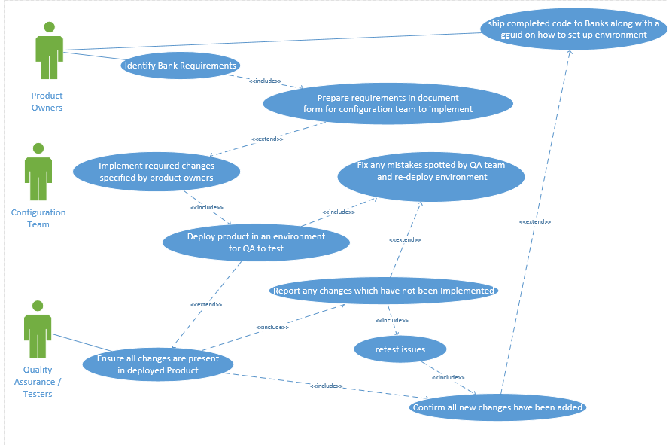
Product Implementation Team use case diagram

Slide 21
Support Team Business Processes
9. When an issue is found the banks will contact the support team who will then work alongside the banks in order to find a step-by-step way of reproducing the issue and then offer a solution to the Bank.
Once the above is satisfied the Support team will then explain and walk through the issue with the Product Team who will then find out what product version the Bank is working off and then depending on the issue will send out a new version for the bank to use instead and possibly a solution (often an sql query) to amend any incorrect data stored as a result of the issue .

Slide 22
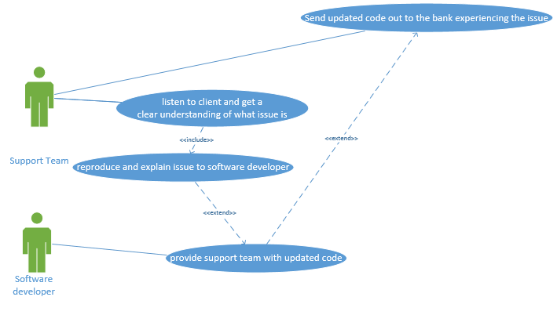
Support Team use case diagram

Slide 23
Suggested Business Process Improvements

Slide 24
Suggested process Improvements
Product Implementation team issue fixing process
1. Less taking down, changing and re-deploying of the product when minor issues are found, instead collect list of issues and only re-deploy when a significant amount of changes have been made.

Slide 25
1.Product Implementation issue fixing process
Current Process:
Currently when the Quality Assurance team finds and reports any issues with changes implemented by the configuration team they will report the issue to the configuration team.The configuration team will then upgrade the environment with their change implemented for the Quality Assurance team to re-test.This is all done on a case by case basis

Slide 26
1.Product Implementation issue fixing process
Suggested process:
When the Quality Assurance team finds any issues with the customisation the configuration team has made I believe it would be more efficient to take note of those mistakes and then report them all at once at the end of a week to the configuration team. Once the configuration team has resolved the isssues and re-deployed the environment , then QA should re-check them all to see if they still exist.
Fixing and retesting issues in bulk will save the configuration a lot of time they would’ve spent team updating environments on a case by case basis.

Slide 27
Suggested process Improvements
Quality Assurance testing process.
2. Combine the two Quality Assurance teams and have all testing take place after the configuration/bank customisation process.

Slide 28
Suggested process Improvements
2. Quality Assurance Testing Process
Current Process:
Currently there are two Quality Assurance teams involved in the current product development process. One to test the new functionality added by the software developers on the product team, and one to test the bank-specific changes implemented by the configuration team.

Slide 29
Suggested process Improvements
2. Quality Assurance Testing Process
Suggested Process
I would suggest that the two QA teams should merge together and that all testing should take place after the Configuration team has customised the product to suit Bank. That way the Configuration team will not have to wait for the QA team to finish testing new functionality befor they can work on customisation and also the new larger QA team will focus on testing new functionality and ensuring the requested bank changes are present after all development has taken place.

