Slide 1
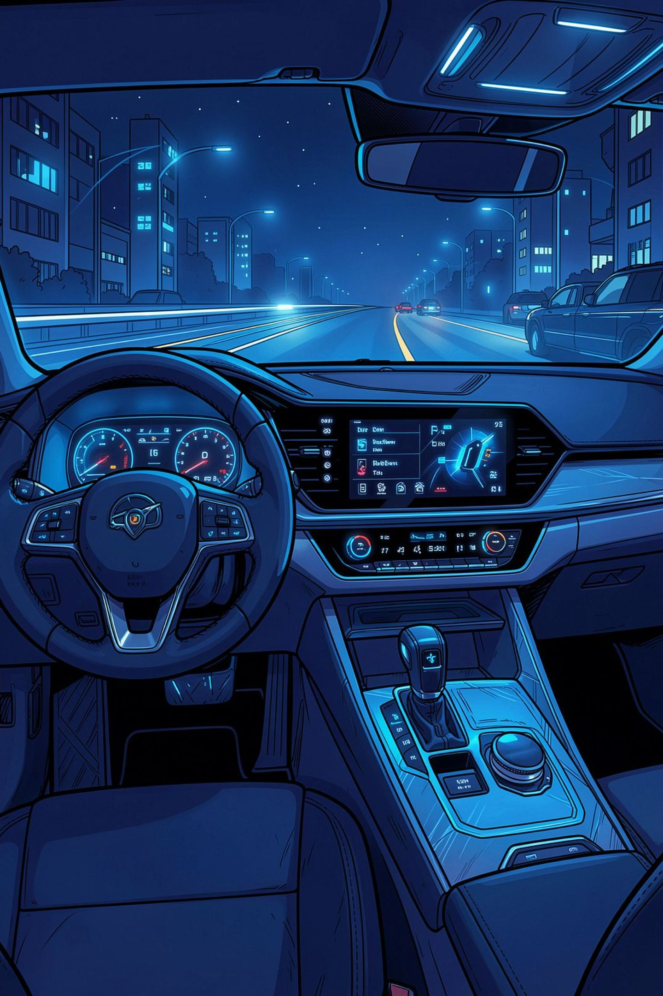
DriveFusion IVI
Oishee Bandyopadhyay | B.Tech CSE (AIML), 4th Year | IEM, Newtown

Slide 2
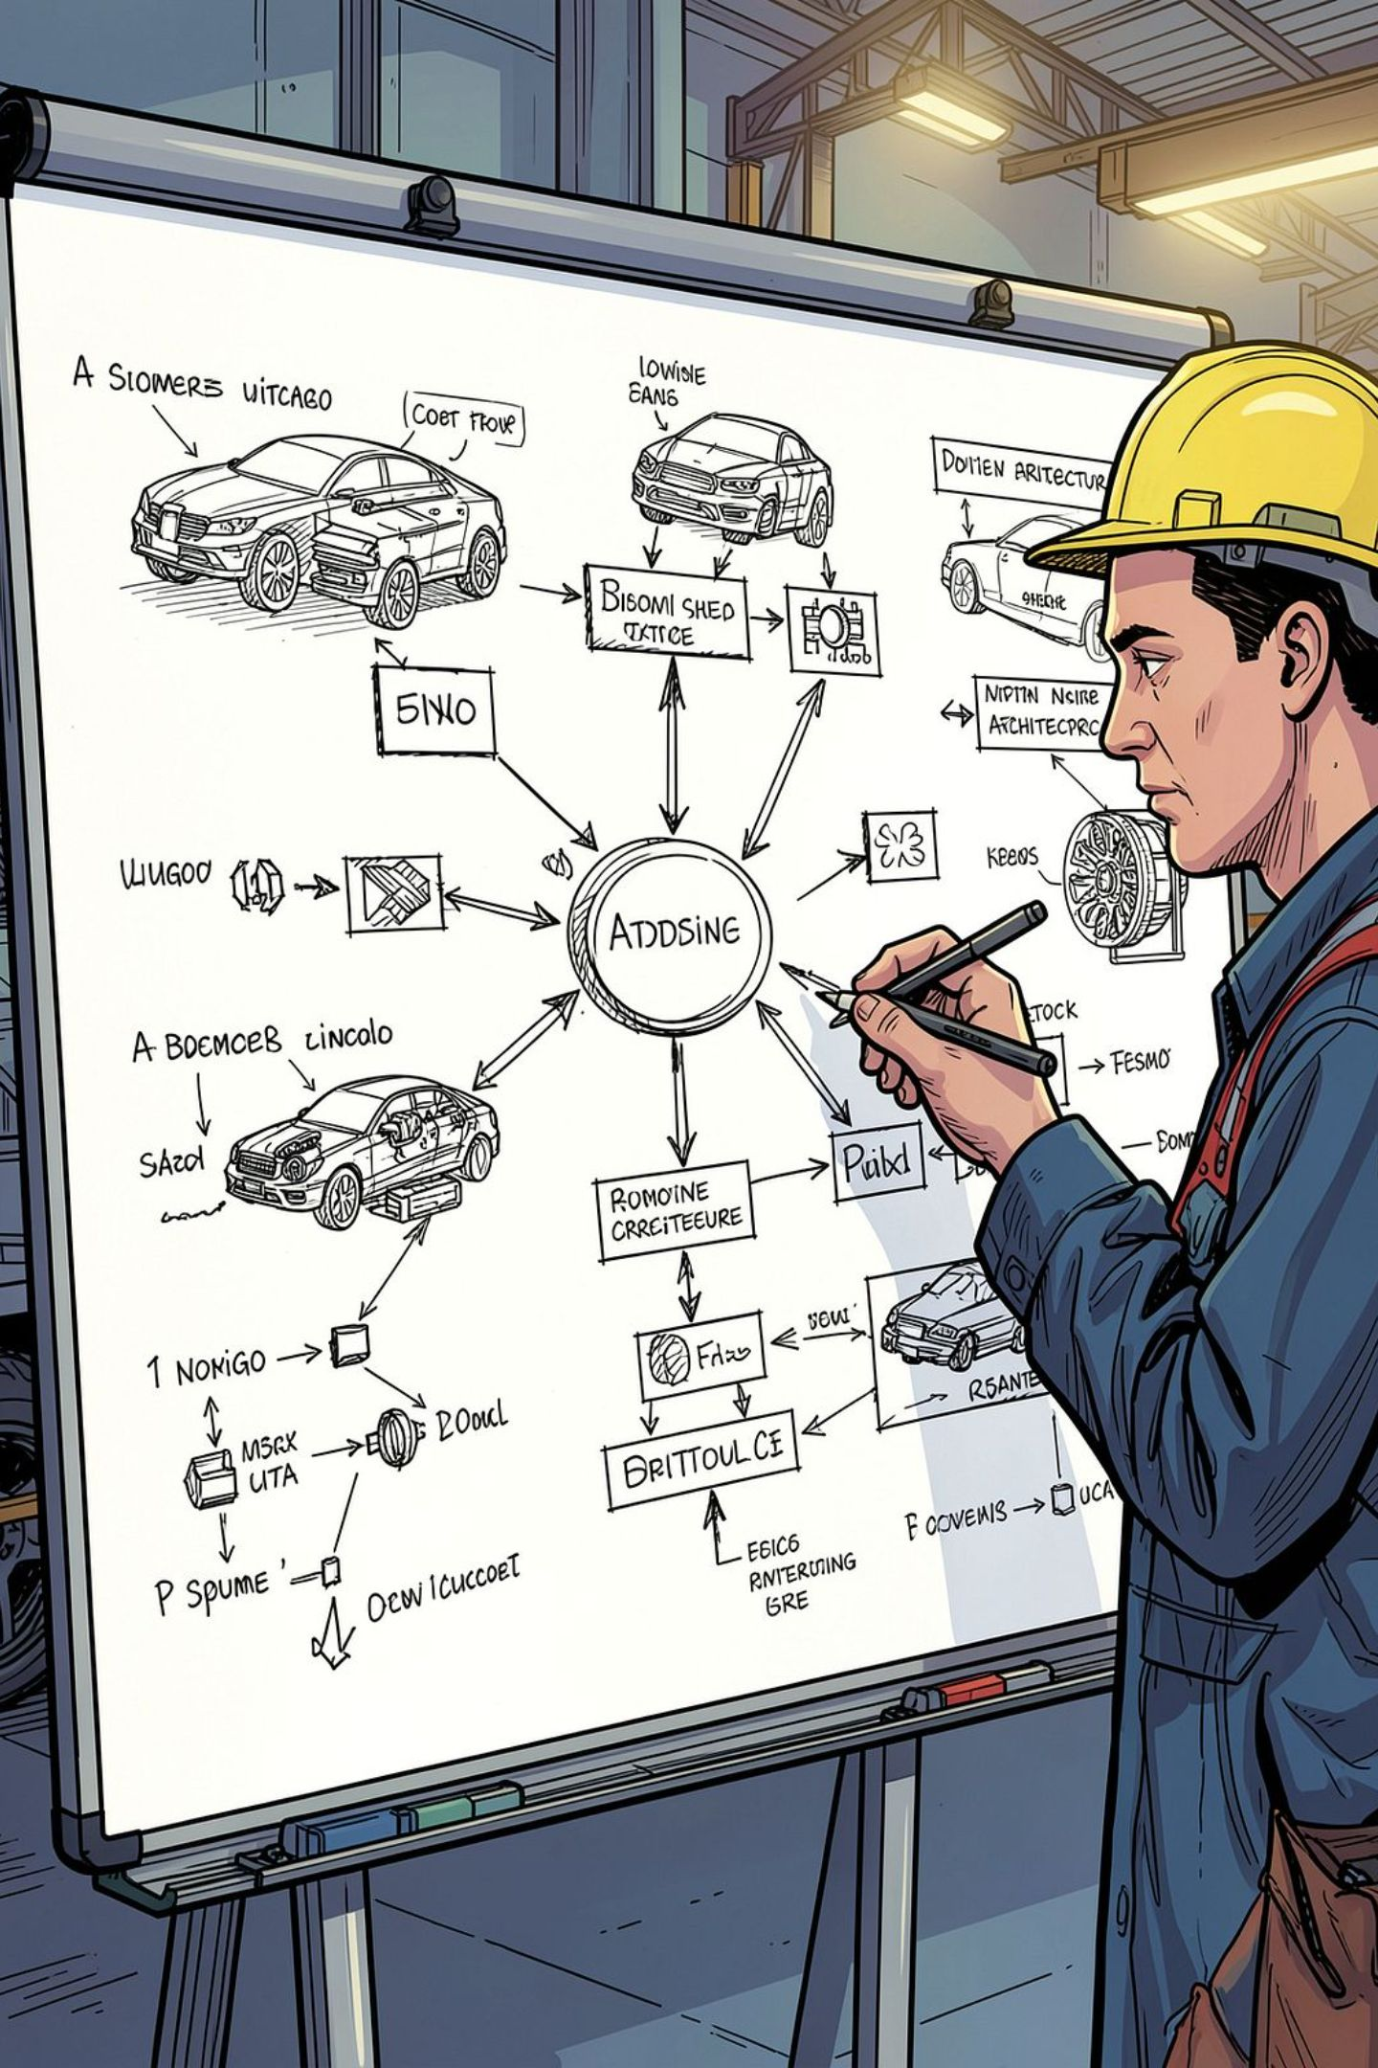
What DriveFusion Sets Out to Solve
Unified IVI Architecture
Design a cohesive in-vehicle infotainment architecture that integrates media playback, real-time navigation, and smartphone projection into a single, well-structured system — eliminating siloed components and inconsistent user experiences.
1
Interface & Data Flow Annotation
2
Define and document all component interfaces explicitly, mapping end-to-end data flows from physical inputs (CAN-FD, GNSS, USB) through service layers to output surfaces (display, cluster, HUD, speakers).
Scalable AIML Context Layer
3
Introduce an AI/ML-driven context and personalization layer while preserving a strict policy boundary — ensuring safety-oriented UI rules remain decoupled from behavioral personalization logic.

Slide 3
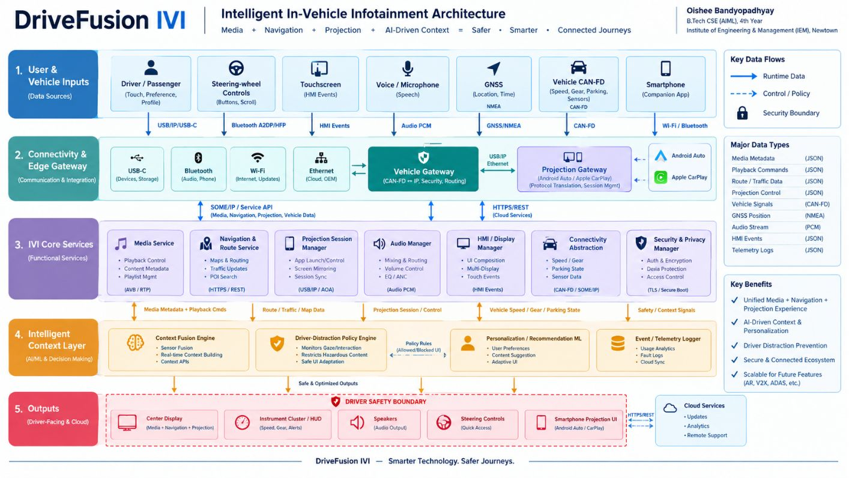
System Architecture at a Glance
Layered Design Philosophy
DriveFusion IVI follows a strict layered architecture — each layer communicates through well-defined APIs, ensuring modularity, testability, and OEM-agnostic deployment. The five layers are:
01
Inputs
Touch, steering wheel controls, voice, GNSS, CAN-FD, smartphone
02
Connectivity
USB-C, Bluetooth, Wi-Fi, Ethernet, vehicle & projection gateways
03
Services
Media, Navigation, Projection, Audio, HMI, Vehicle Data, Security
04
Intelligence
Context Fusion, Distraction Policy, Personalization ML, Telemetry
05
Outputs
Center Display, Cluster/HUD, Speakers, Steering Controls, Projection UI

Slide 4
Five Architectural Layers in Detail
🎛 Inputs
🔗 Connectivity
⚙ Services
Physical and digital entry points into the system:
Transport and gateway layer:
Core functional services exposed via APIs:
USB-C (wired projection & media)
Bluetooth A2DP/HFP & Wi-Fi Direct
Ethernet (100/1000BASE-T1)
Vehicle Gateway (CAN-FD bridge)
Projection Gateway (AA/CP bridge)
Media Service (playback, metadata)
Navigation Service (routing, ETA)
Projection Session Manager
Audio Manager (mixing, zones)
HMI Renderer & Security Manager
Capacitive touch & haptic feedback
Steering wheel controls (CAN)
Voice commands (ASR pipeline)
GNSS receiver & CAN-FD bus
Smartphone via USB/Wi-Fi/BT
🧠 Intelligence
🖥 Outputs
AIML and policy layer:
Driver-facing and system output surfaces:
Context Fusion Engine
Distraction Policy Engine
Personalization ML Models
Telemetry & Event Logger
Center Display (main HMI)
Instrument Cluster & HUD
Multi-zone Audio (speakers)
Steering feedback controls
Projection UI surface

Slide 5

Interface Contracts & Communication Protocols
Each interface in DriveFusion IVI is defined by a specific protocol and data contract, ensuring deterministic behavior and clear fault boundaries across the system.
Interface | Protocol / Transport | Primary Data Flow
CAN-FD | ISO 11898-1 (FD frame) | Vehicle state (speed, gear, door status) → Vehicle Gateway → IVI Services
USB/IP + Wi-Fi/BT | USB 3.x, Wi-Fi Direct, BT 5.x | Smartphone Projection Gateway (Android Auto / CarPlay tunnel)
SOME/IP | Scalable service-Oriented Middleware | Gateway IVI Services (service discovery, method calls, events)
HTTPS / REST | TLS 1.3, RESTful APIs | IVI Cloud (map tiles, traffic, OTA updates, telemetry ingestion)
HMI Events | Internal IPC / Binder | UI events → Service layer → Context Fusion → Rendered output
Audio PCM / GNSS | I²S / NMEA 0183 | Audio streams → Audio Manager; GNSS fixes → Navigation Service
All inter-service communication is designed to be replaceable — SOME/IP can be substituted with DDS or Franca in an AUTOSAR Adaptive deployment without changing service logic.

Slide 6

Runtime Data Paths Across Five Pipelines
Media Pipeline
Source → Media Service → Audio Manager → Speakers
Navigation Pipeline
Telemetry Pipeline
DriveFusion IVI Data Fusion
GNSS/cloud → Navigation → Policy-filtered HMI → Display/Cluster/HUD
Events → Logger → Secure cloud channel
Context Pipeline
Projection Pipeline
Vehicle+route+media+projection → Fusion → Policy → Permitted UI
Smartphone → Projection Gateway → Session Manager → HMI
Each pipeline operates with independent fault containment. The Context pipeline is the only one that consumes inputs from all others — it fuses vehicle state, route progress, media activity, and projection session data to produce a policy-gated UI decision in real time. Telemetry runs as a non-blocking side channel, logging events asynchronously to avoid impacting latency-sensitive paths.

Slide 7
What Makes DriveFusion Architecturally Distinct
Policy-First Context Architecture
Session-Isolated Projection
Safety-oriented UI rules (distraction policy) are architecturally separated from personalization ML. The Policy Engine acts as a hard gate — no ML recommendation reaches the display without passing policy validation. This satisfies ASIL-aware design principles without over-engineering the ML layer.
Smartphone projection is treated as an untrusted external session, not a native IVI component. The Projection Gateway enforces strict session boundaries — projection content cannot access vehicle data, and IVI services cannot be called directly from the projected environment. This containment model limits attack surface and simplifies certification.
Stable Service Boundaries for OEM Flexibility
Observability as a First-Class Concern
Service APIs are defined independently of the underlying OS or middleware. The architecture supports future mapping to Android Automotive OS (AAOS), AUTOSAR Adaptive, or OEM-hybrid stacks without redesigning the service layer — only the transport binding changes.
Telemetry, structured logging, and fault injection points are baked into the architecture from the start. Graceful degradation paths (e.g., offline navigation fallback, audio-only mode under high distraction) are defined per-service, not added post-hoc during integration testing.

Slide 8
VALIDATION & FUTURE SCOPE
Testing Strategy and the Road Ahead
Validation Plan
Future Scope
Before any OEM integration, DriveFusion IVI will be validated through a structured simulation-based approach:
The architecture is designed to accommodate the following extensions without structural changes:
Simulated Event Injection
AR Navigation
CAN-FD, GNSS, and projection events generated via vector tools (CANoe, dSPACE) to exercise all runtime paths.
Overlay turn-by-turn guidance on camera feed via HUD — requires camera pipeline integration and low-latency rendering path.
Fault Injection Testing
V2X Integration
Deliberate service failures, network partitions, and latency spikes to verify graceful degradation behavior.
C-V2X or DSRC messages fused into Context Engine for hazard-aware routing and predictive alerts.
Policy Scenario Coverage
Fleet Analytics
Edge-case distraction scenarios (high speed + complex UI request) to validate Policy Engine gating correctness.
Aggregated telemetry from multiple vehicles enabling OEM-level insights on usage patterns and feature adoption.
LLM Voice Assistant
On-device or cloud LLM for natural-language commands, gated through the same Policy Engine to prevent unsafe interactions.

Slide 9
Conclusion
✅ Architecture Delivered
🧠 AIML Differentiation
⚠ Deployment Readiness
DriveFusion IVI satisfies the required integration of media, navigation, and smartphone projection within a single, well-annotated architecture — with explicit interfaces, data flows, and layer responsibilities defined end-to-end.
The Context Fusion + Policy Engine + Personalization ML layer makes this project distinctive for a CSE (AIML) profile — demonstrating applied AI thinking within a safety-constrained automotive system, not just a generic ML add-on.
This is a conceptual architecture. Real vehicle deployment requires OEM validation, ASIL classification of safety-relevant paths, middleware selection (AAOS vs. AUTOSAR Adaptive), and hardware-in-the-loop testing before any production commitment.

