Slide 1
nl2bash
Final Results and Discussion
Oisin Doherty (oisind), Abhinav Gottumukkala (anak4569),
Hans Jorgensen (thehans), Lauren Martini (lmartini)

Slide 2
Motivation
Bash is the de facto language for interacting with the Linux OS
Bash’s power comes from modularity, but man pages only explain individual commands
The commands needed for complex operations (ex: xargs) can be unintuitive
Example:
English: “Change tabs to spaces in every .java file in the current directory”
Bash: find . -name '*.java' ! -type d -exec bash -c 'expand -t 4 "$0" > /tmp/e && mv /tmp/e "$0"' {} \;
Notes:
Bash commands are some of the most useful/common tools when navigating a unix (file) system/(dealing with/searching for) data in files; grep imo is incredibly useful

Slide 3
Goals
Main goal: Improve the accuracy of Tellina
Direction:
Expand Tellina’s dataset
Scrape resources such as StackOverflow for English/Bash command pairs
Clean and verify this data - crowdsourcing
Improve Tellina’s dataset
Develop better cleaning and verification tools to use on the existing dataset - crowdsourcing

Slide 4
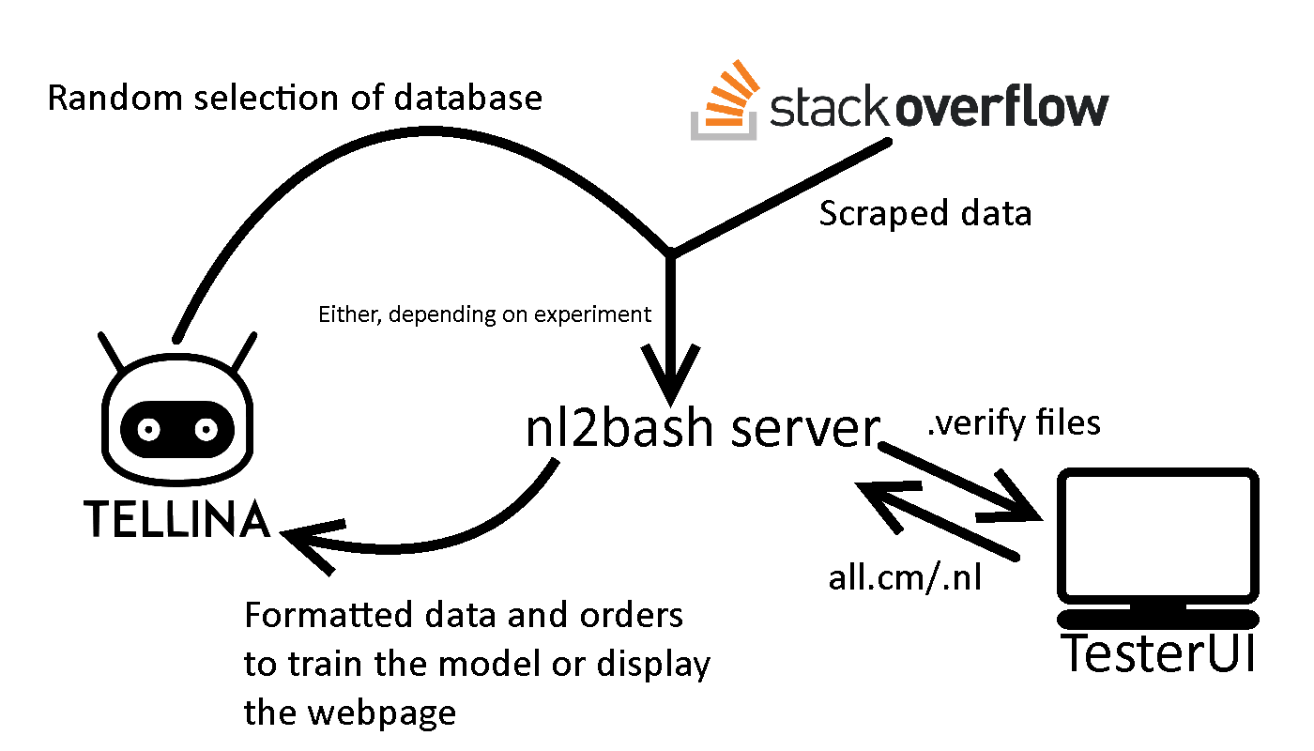
Architecture

Slide 5
Stack Overflow Scraping
Autonomous process to produce data for TesterUI: once activated, no further input is required
Reads Stack Overflow posts for posts tagged “bash”, saving question and code segments for potential code pairs
Can match multiple commands to a description
Chose to scrape HTML pages instead of using database dumps because the dumps didn’t have any clear means to find code snippets (tags, markdown indicators)

Slide 6
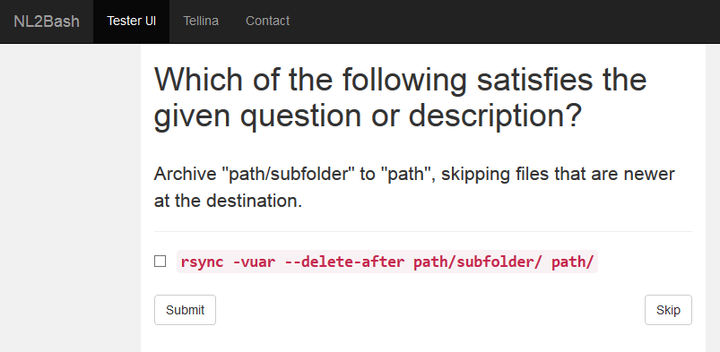
TesterUI
Minimal interface for a tester to verify that a command fits its description
Mechanical Turks task or volunteering (we did it by hand ourselves for our experiments)
Crowdsourcing or volunteering isn’t as accountable, but it’s a tradeoff with cost

Slide 7
Evaluation Methodology
Metric: Translation accuracy - percentage of English/Bash pairs marked as correct (automatic and manual analysis)
Check this for every modified version of the dataset
Multiple automatic methodologies (BLEU, TM)
Goal: More accurate translation than the current version of Tellina

Slide 8
Experiments
Control: Simply test the original dataset again
Cleaned: Sample the original dataset and remove any false matches we find
423 commands sampled from the original
22% were incorrect matches
Augmented: Add additional scraped and tested pairs from StackOverflow to the dataset (200 pages scraped)
793 potential commands from those pages
9.3% of the matches were good
Cleaned & Augmented: Both clean and augment the dataset as above
Experiment | Added | Removed | Total
Control | 0 | 0 | 12606
Cleaned | 0 | 92 | 12514
Augmented | 74 | 0 | 12680
Cleaned & Augmented | 74 | 92 | 12588

Slide 9
Results
Dataset | BLEU1 | BLEU3 | TM1 | TM3
Control | 0.49 | 0.55 | 0.62 | 0.70
Cleaned | 0.48 | 0.54 | 0.62 | 0.70
Augmented | 0.50 | 0.56 | 0.66 | 0.74
Cleaned & Augmented | 0.47 | 0.53 | 0.60 | 0.69
BLEU1/3: Bilingual Evaluation Understudy (top candidate vs. top 3 candidates) TM1/3: Max percentage of close-vocabulary overlap (top candidate vs. top 3 candidates)

Slide 10
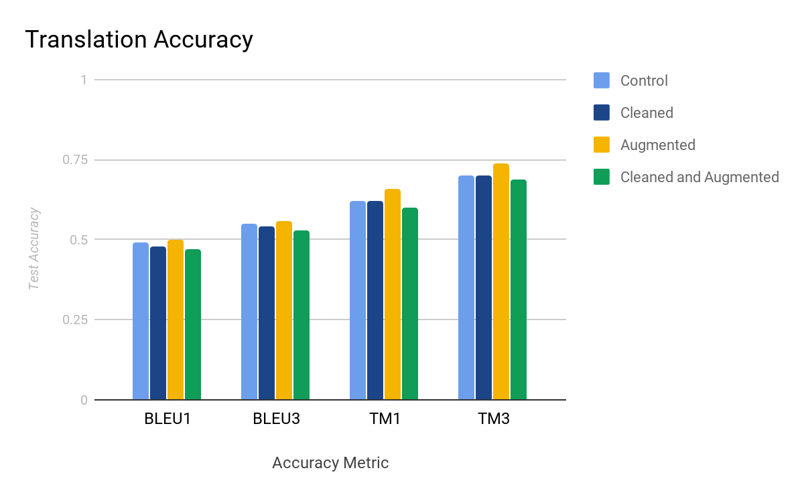
Discussion of Results
Cleaning the data made it worse in both cases
Augmenting the data alone was better than the base dataset
Results suggest more and more varied data improves quality the best

Slide 11
Next Steps
Better heuristics for scraping
9.3% of scraped commands verified usable, can be improved
Continue to gather additional, varied data for further machine translation
Consider other language training models
Word embeddings, other input languages

Slide 12
References
Lin, X. V., Wang, C., Zettlemoyer, L., & Ernst, M. D. (2018). NL2Bash: A Corpus and Semantic Parser for Natural Language Interface to the Linux Operating System. arXiv preprint arXiv:1802.08979.
Lin, X. V., Wang, C., Pang, D., Vu, K., & Ernst, M. D. (2017). Program synthesis from natural language using recurrent neural networks (Vol. 2). Technical Report UW-CSE-17-03-01, University of Washington Department of Computer Science and Engineering, Seattle, WA, USA.

