Slide 1
Tablet Sorter and Dispenser Final Year Project
Oisín O’Rourke
Software and Electronic Engineering
ATU

Slide 2
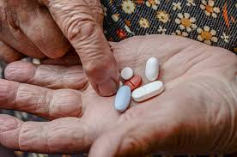
Reasons for choosing the Project
The idea of this project came to mind when I was at my Grandmothers over the summer.
One of the tedious jobs she has to do every week is to sort out her tablet prescription. We often help her with this but we aren’t always there to do this.
This job is only getting more difficult for her as her arthritis and eye sight is getting worse.
My idea was to design a device that could sit in her kitchen that could seamlessly sort out her prescription and dispense them in a way that was easy and would cause less stress.

Slide 3
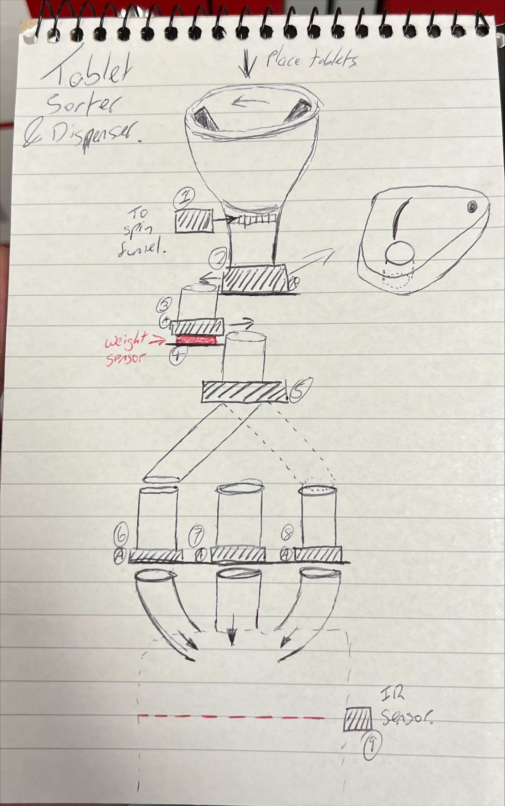
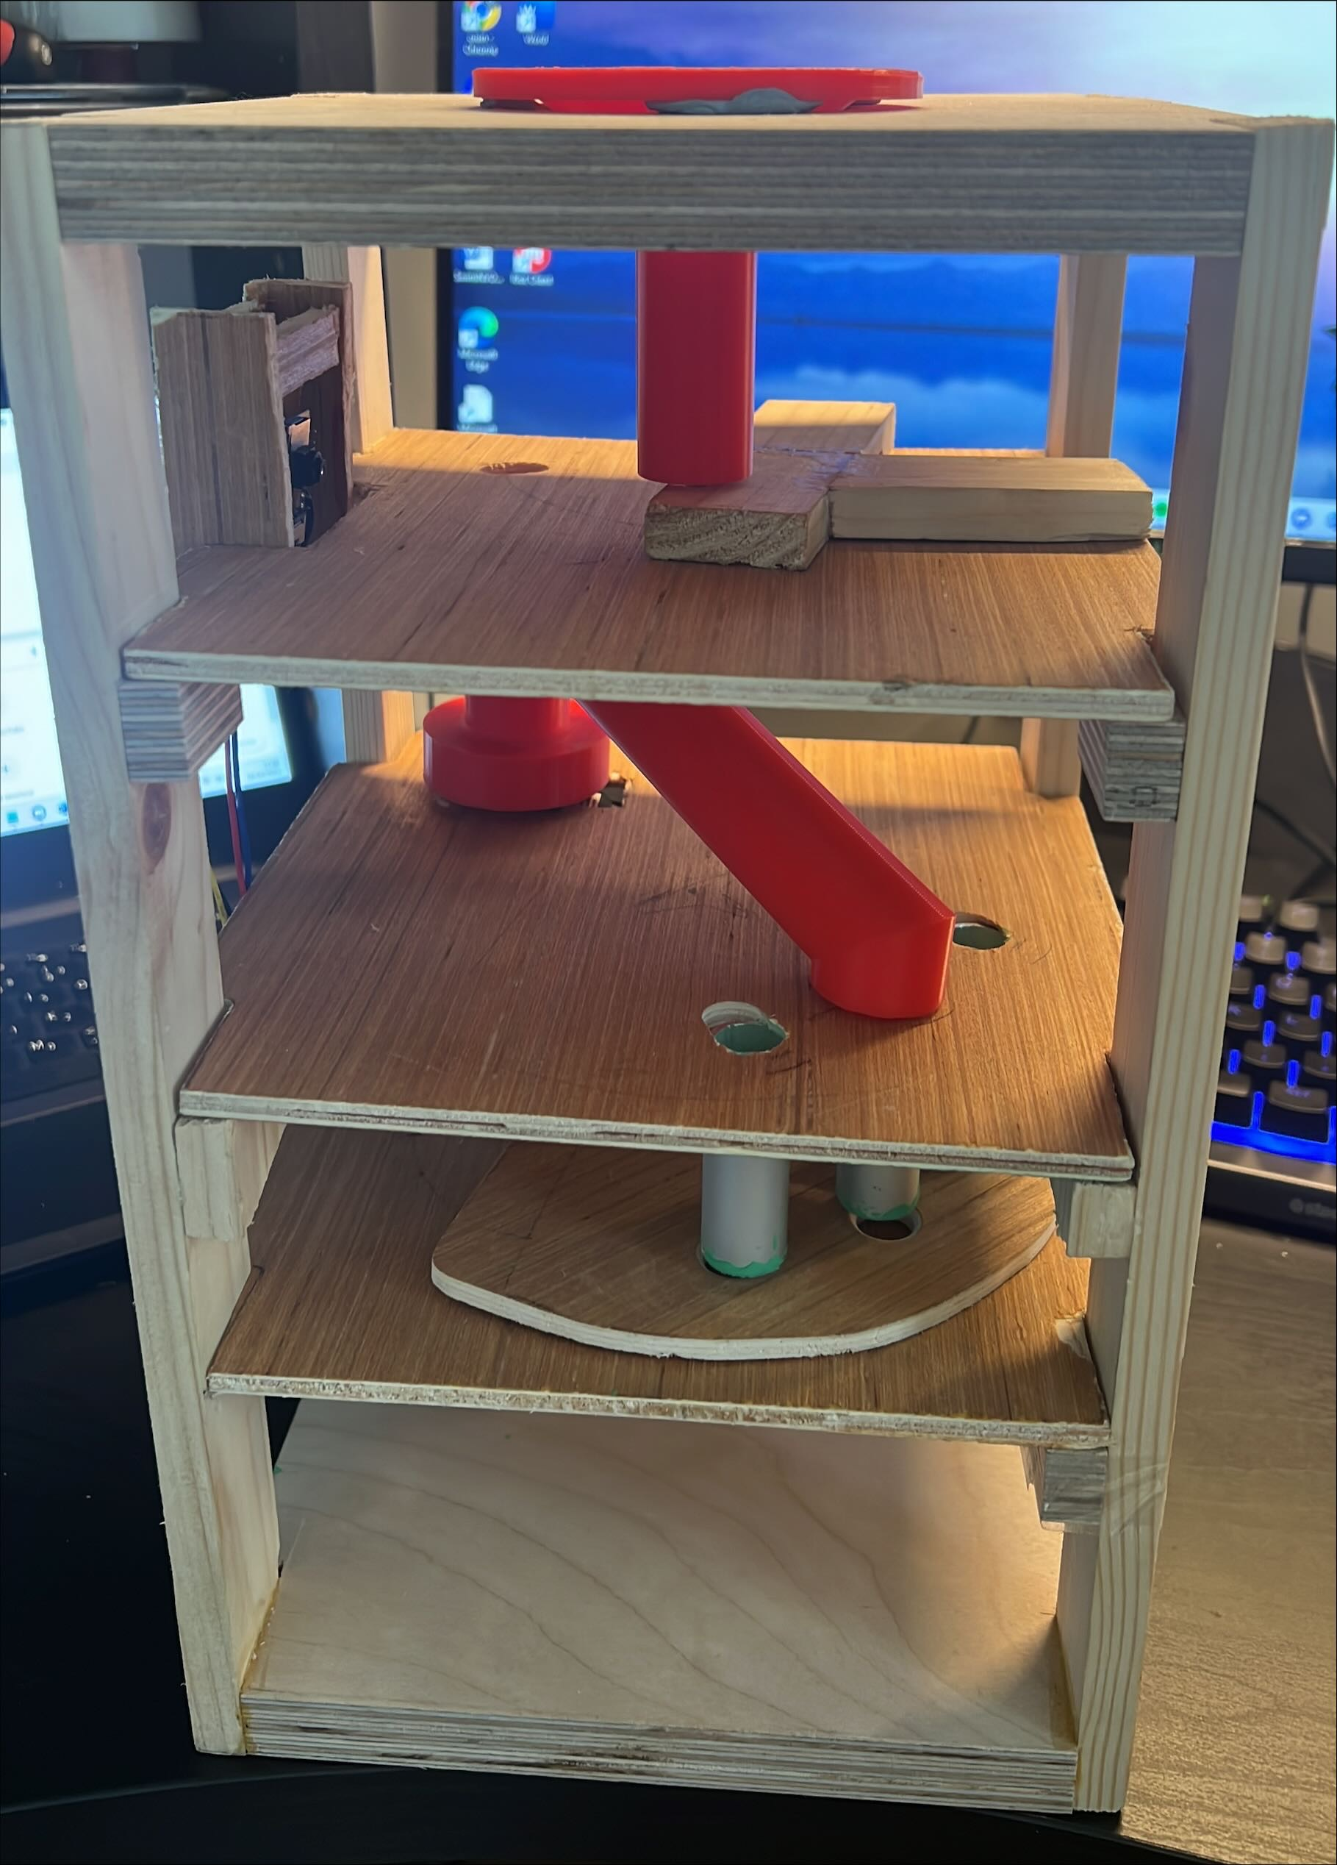
Start to Finish

Slide 4
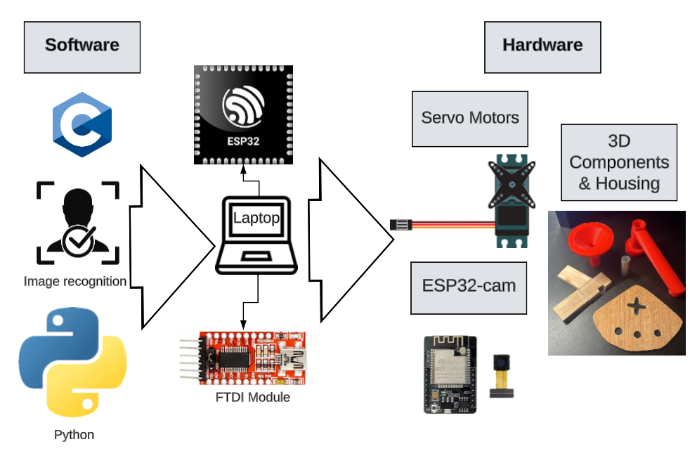
Architecture Diagram

Slide 5

Custom vision
An image recognition service that allows users to build and deploy their own image identifier models.
Docker and Postman
Used to test the image recognition model locally.
Python scripts
Used to automate the device.
C Programming
C programming on Arduino was used to code both the ESP32 to run the motors and the FTDI module that the camera runs on.
3D printing and wood working
On shape was the CAD tool used to design the funnel and sorting arm and I used many different woodworking techniques for all the other hardware components.
Technologies used

Slide 6
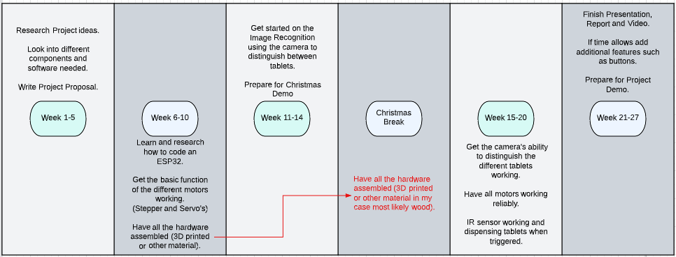
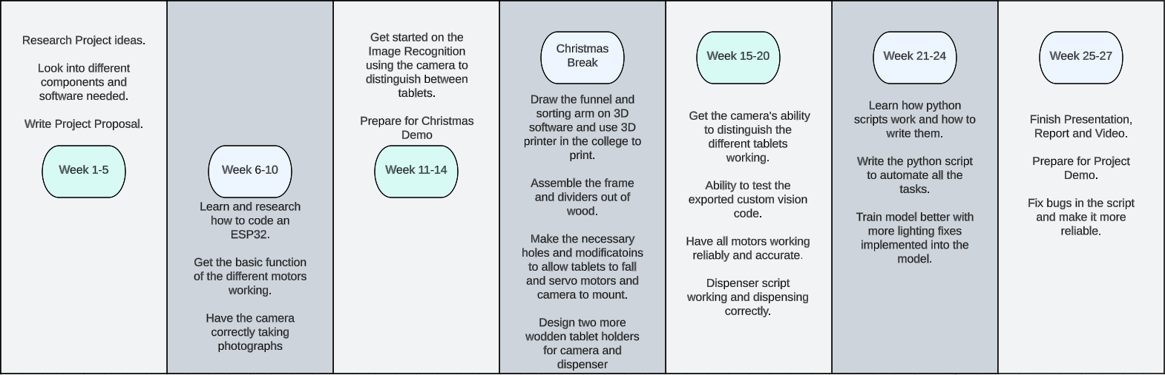
Timelines

Slide 7
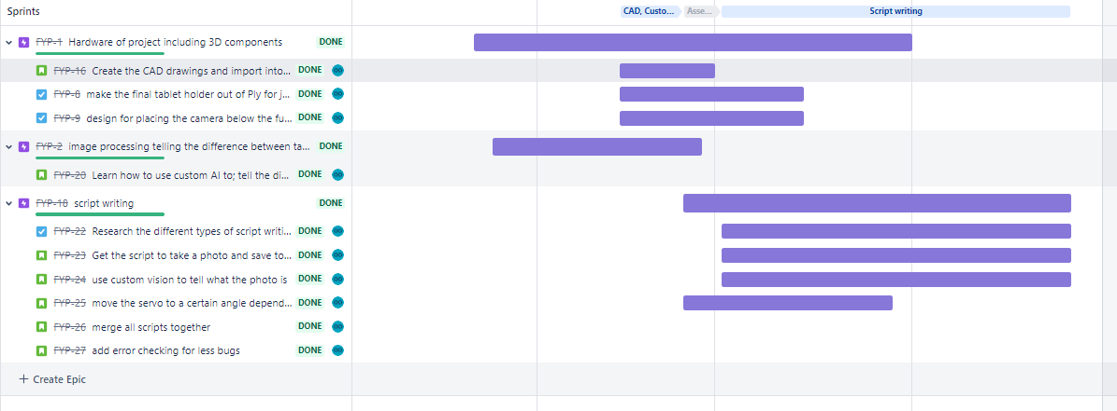
Project management tool
This tool is perfect for organising workloads and was key in helping me reach where I have in the project before the deadline.
I used this tool as it’s common among software engineers. This would benefit me after college.
Jira

