Slide 2
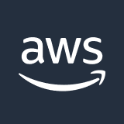





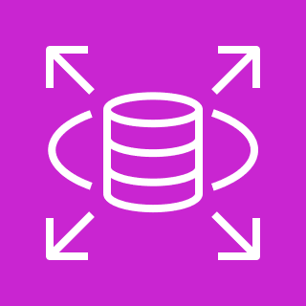

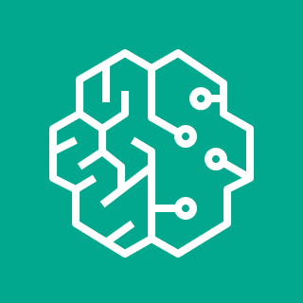
AWS Cloud
AWS Amplify and Amazon CloudFront:
AWS Amplify is used to host and deploy the static web assets (HTML, CSS, JS) of the React application.
Amazon CloudFront is connected to AWS Amplify to serve these static assets quickly to users, improving the load time of your application.
AWS Amplify
(ReactApp)
Amazon CloudFront
User
Amazon API Gateway:
Below AWS Amplify and Amazon CloudFront, Amazon API Gateway is placed to create, publish, and secure APIs.
It acts as a front door for applications to access data, logic, or functionality from the backend services, such as workloads running on AWS Lambda.
Amazon API Gateway
AWS Lambda and Amazon RDS:
AWS Lambda is connected to the API Gateway and is responsible for running the backend code (Spring Boot) in response to HTTP requests.
Amazon RDS is connected to AWS Lambda and acts as a relational database service to store user profiles, property listings, etc.
AWS Lambda retrieves or stores data in Amazon RDS based on the incoming requests from the API Gateway.
AWS Lambda
Amazon Relational
Database Service
(Amazon RDS)
Amazon S3:
Below AWS Lambda, Amazon S3 is placed to store datasets and other large files.
It acts as a object storage (scalable) to store and retrieve any amount of data at any time.
Amazon Simple Storage Service (Amazon S3)
Amazon SageMaker:
Amazon SageMaker is connected to Amazon S3 and is used for developing, training, and deploying machine learning models.
It utilizes the datasets stored in Amazon S3 for training machine learning models and deploying them to make predictions or analyse
Amazon SageMaker

Slide 3


AWS Cloud
AWS Amplify and Amazon CloudFront:
AWS Amplify is used to host and deploy the static web assets (HTML, CSS, JS) of the React application.
Amazon CloudFront is connected to AWS Amplify to serve these static assets quickly to users, improving the load time of your application.
Amazon API Gateway
- start/stop db
Amazon API Gateway:
Below AWS Amplify and Amazon CloudFront, Amazon API Gateway is placed to create, publish, and secure APIs.
It acts as a front door for applications to access data, logic, or functionality from the backend services, such as workloads running on AWS Lambda.
AWS Lambda
Amazon Relational
Database Service
(Amazon RDS)
AWS Lambda and Amazon RDS:
AWS Lambda is connected to the API Gateway and is responsible for running the backend code (Spring Boot) in response to HTTP requests.
Amazon RDS is connected to AWS Lambda and acts as a relational database service to store user profiles, property listings, etc.
AWS Lambda retrieves or stores data in Amazon RDS based on the incoming requests from the API Gateway.
Simple Notification Service Gets Alert (inactive db)
Amazon S3:
Below AWS Lambda, Amazon S3 is placed to store datasets and other large files.
It acts as a object storage (scalable) to store and retrieve any amount of data at any time.
Cloudwatch monitors DB Connections
Amazon SageMaker:
Amazon SageMaker is connected to Amazon S3 and is used for developing, training, and deploying machine learning models.
It utilizes the datasets stored in Amazon S3 for training machine learning models and deploying them to make predictions or analyse

Slide 4
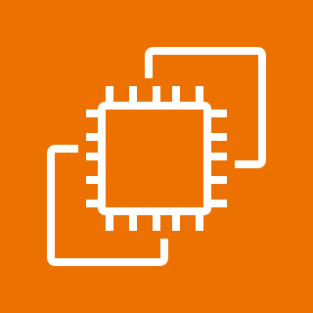
AWS Cloud
AWS Amplify
(ReactApp)
Amazon Elastic Compute Cloud (Ubuntu)
Amazon API Gateway
AWS Lambda
Amazon Relational
Database Service
(Amazon RDS)

