Slide 1
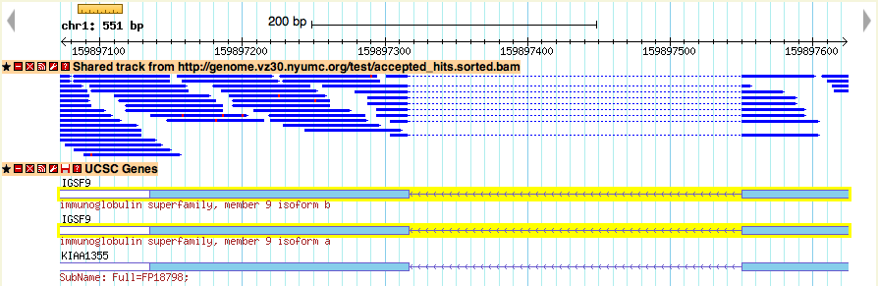
Hands-on Tutorial: RNA-seq Analysis using Cluster Computing
NYU Center for Health Informatics and Bioinformatics

Slide 2
Intro to RNA-seq
Quick review of ssh login to HPC cluster
10 essential Linux commands
HPC Environment Modules
Sun Grid Engine commands for batch jobs
Reference Genomes (igenomes)
basic RNA-seq workflow:
FASTqc > Tophat > Cufflinks > Cuffdiff
Creating an SGE script for your workflow

Slide 3
RNA-seq
Gene expression can be estimated by measuring RNA in the cell
Northern Blots: one gene per experiment
Microarray: pre-built probes for lots of genes
RNA-seq: sequence and count millions of RNA molecules present in the sample
RNA-seq has larger dynamic range, correlates more closely with qPCR, identifies transcript isoforms, discovers novel genes

Slide 4




Extract RNA from samples
biological replicates for every condition!

Slide 5
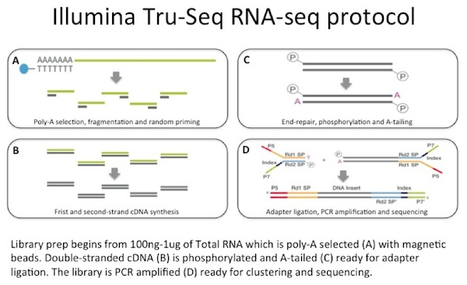
James Hadfield, BiteSizeBio.com

Slide 6
Illumina mRNA Sequencing
Random primer PCR
Poly-A selection
Fragment & size-select

Slide 7

FASTQ format: sequence + qualilty
@SRR350953.5 MENDEL_0047_FC62MN8AAXX:1:1:1646:938 length=152
NTCTTTTTCTTTCCTCTTTTGCCAACTTCAGCTAAATAGGAGCTACACTGATTAGGCAGAAACTTGATTAACAGGGCTTAAGGTAACCTTGTTGTAGGCCGTTTTGTAGCACTCAAAGCAATTGGTACCTCAACTGCAAAAGTCCTTGGCCC
+SRR350953.5 MENDEL_0047_FC62MN8AAXX:1:1:1646:938 length=152
+50000222C@@@@@22::::8888898989::::::<<<:<<<<<<:<<<<::<<:::::<<<<<:<:<<<IIIIIGFEEGGGGGGGII@IGDGBGGGGGGDDIIGIIEGIGG>GGGGGGDGGGGGIIHIIBIIIGIIIHIIIIGII
@SRR350953.6 MENDEL_0047_FC62MN8AAXX:1:1:1686:935 length=152
NATTTTTACTAGTTTATTCTAGAACAGAGCATAAACTACTATTCAATAAACGTATGAAGCACTACTCACCTCCATTAACATGACGTTTTTCCCTAATCTGATGGGTCATTATGACCAGAGTATTGCCGCGGTGGAAATGGAGGTGAGTAGTG
+SRR350953.6 MENDEL_0047_FC62MN8AAXX:1:1:1686:935 length=152
#---+83355@@@CC@C22@@C@@CC@@C@@@CC@@@@@@@@@@@@C?C22@@C@:::::@@@@@@C@@@@@@@@CIGIHIIDGIGIIIIHHIIHGHHIIHHIFIIIIIHIIIIIIBIIIEIFGIIIFGFIBGDGGGGGGFIGDIFGADGAE
@SRR350953.7 MENDEL_0047_FC62MN8AAXX:1:1:1724:932 length=152
NTGTGATAGGCTTTGTCCATTCTGGAAACTCAATATTACTTGCGAGTCCTCAAAGGTAATTTTTGCTATTGCCAATATTCCTCAGAGGAAAAAAGATACAATACTATGTTTTATCTAAATTAGCATTAGAAAAAAAATCTTTCATTAGGTGT
+SRR350953.7 MENDEL_0047_FC62MN8AAXX:1:1:1724:932 length=152
#.,')-2--/@@@@@@@@@@<:<<:778789979888889:::::99999<<::<:::::<<<<<@@@@@::::::IHIGIGGGGGGDGGDGGDDDIHIHIIIII8GGGGGIIHHIIIGIIGIBIGIIIIEIHGGFIHHIIIIIIIGIIFIG

Slide 8
RNA-seq vs. qPCR

Slide 9
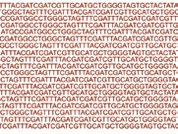
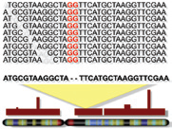
Data Analysis Pipeline
Reads
Alignments
Read counts
Differential Expression
gene | HTC.neg.rep1
CD79A | 480.6384705
MZB1 | 341.2034394
FDCSP | 144.6685958
CXCL13 | 224.285861
FCRLA | 98.49801945
SLAMF7 | 250.0736081
PHEX | 4.626536748
POU2AF1 | 305.5975177
SPIB | 126.2189589
LTB | 263.2459306
IL2RG | 383.5641411
CD19 | 111.8179974
gene | HTC.pos.rep2 | HTC.pos.rep3 | PTC.neg.rep1 | PTC.neg.rep2 | logFC | PValue | FDR
CD79A | 38.04 | 36.02 | 0.74 | 0.26 | -6.89 | 5.71E-17 | 8.49E-13
MZB1 | 22.80 | 45.43 | 0.21 | 0.50 | -6.58 | 1.90E-16 | 1.41E-12
FDCSP | 10.20 | 2.29 | 0.17 | 0.00 | -8.89 | 1.27E-15 | 5.08E-12
CXCL13 | 16.37 | 6.02 | 0.04 | 0.05 | -7.25 | 1.46E-15 | 5.08E-12
FCRLA | 8.42 | 6.61 | 0.16 | 0.03 | -7.37 | 1.71E-15 | 5.08E-12
SLAMF7 | 19.00 | 36.71 | 2.36 | 1.58 | -4.60 | 4.48E-15 | 1.11E-11
PHEX | 0.24 | 2.93 | 81.67 | 41.51 | 4.31 | 2.52E-14 | 5.02E-11
POU2AF1 | 33.49 | 23.90 | 3.58 | 3.12 | -4.60 | 2.73E-14 | 5.02E-11
SPIB | 7.74 | 1.62 | 0.24 | 0.16 | -6.50 | 3.25E-14 | 5.02E-11
LTB | 18.90 | 10.14 | 2.40 | 1.54 | -4.56 | 3.54E-14 | 5.02E-11
IL2RG | 33.53 | 37.38 | 6.44 | 5.12 | -3.83 | 3.72E-14 | 5.02E-11
CD19 | 13.77 | 1.71 | 0.64 | 0.34 | -6.34 | 4.88E-14 | 6.04E-11
LOC96610 | 50.85 | 130.54 | 8.28 | 10.19 | -4.43 | 6.61E-13 | 7.55E-10
IGLL5 | 392.76 | 498.21 | 0.84 | 2.54 | -6.00 | 7.28E-13 | 7.73E-10
PIM2 | 33.75 | 104.19 | 10.83 | 9.86 | -3.45 | 7.95E-13 | 7.87E-10
Map reads to genome, count reads per gene, normalize, compare counts across different samples (statistical test)

Slide 10
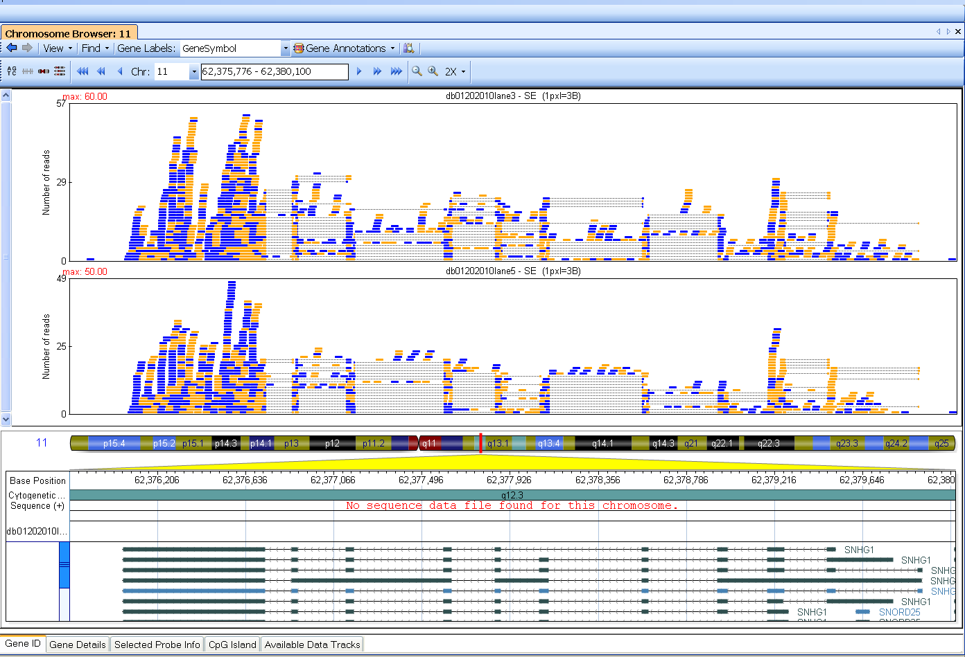

Slide 11
RNA-seq Informatics Workflow
Check error rate
Filter out rRNA
Align to genome (including splice junctions)
Sum reads for each gene
Differential expression
Alternatively spliced exons
Sequence variants (SNPs, indels, translocations)

Slide 13
CHIBI HPC Cluster: Phoenix
Custom-designed, powerful, state-of-the-art, power- and cost-efficient, shared computing resource.
• 2 Head “Login” Nodes
• 2 Intel Sandy Bridge 2.6GHz CPUs, 16 processing cores, 128GB Random Access Memory (RAM)
each.
• 64 Compute “Worker” Nodes
• 2 Intel CPUs, 16 processing cores, 128GB RAM each, 8 GB/core.
• 5 GPU Compute Nodes
• 2 Intel CPUs, 16 processing cores, 128 GB RAM each
• NVIDIA Tesla Kepler K20 GPU accelerator (2496 cores, 1.17 TFLOPS)
• 1 High Memory Compute Node
• 4 Intel CPUs, 32 processing cores, 1 TB RAM
• Networks:
Private 10Gbit Message Passing Network
Private 10Gbit Data (Input-Output) Network to Primary Isilon data storage cluster.
Public 10Gbit interface to the Enterprise Campus Network
• Data Storage:
1 PetaByte (1015 Bytes) raw High-throughput, Scalable, EMC/Isilon Data Storage Clusters & mirror backup
Total CPU Cores: 1,170
Total GPU Cores: 12,480
Total RAM: 10TB
Performance: (est.) 28TFLOPS

Slide 14
ssh login to phoenix
Username: your NYULMC Kerberos id
Hostname: phoenix.med.nyu.edu
> ssh –X userID@phoenix.nyumc.org
We prefer to use the more secure two-factor “key pair” authentication rather than passwords.

Slide 15
This is a minimal list of Linux commands that you must know for file management:
ls (list)
cd (change directory)
cp (copy)
mv (move)
rm (remove/delete)
mkdir (make directory)
rmdir (remove directory)
pwd (print working directory)
more (view by page)
cat (view entire file on screen)
All of these commands can be modified with many options.
Learn to use Linux ‘man’ pages for more information.

Slide 17
Sun Grid Engine
Commands for your program go in a shell script
Can include a series of commands that call different programs in a workflow
Submit the shell script to a “queue” with the SGE qsub command
can build a loop that runs the same commands on many data files, each one becomes a separate ‘job’ and can run on a different compute node

Slide 18
SGE: Useful Commands
qsub Submit job.
qstat Check status of running jobs or queues.
qacct Get accounting information on finished jobs.
qdel Delete (kill) running job.
qlogin Start interactive shell on compute node.
Use sparingly and remember to logout when finished.

Slide 19
Load Your Programs
The Phoenix HPC system has many users and a lot of installed software
Different versions of some programs are available
Each program requires a specific set of supporting libraries, data, etc.
These are managed with Environment Modules

Slide 20
Environment Module Commands
module avail List available modules.
module list List currently loaded modules.
module load name Load named module.
module unload name Unload named module.
module help name See help on named module.

Slide 21
igenomes
igenomes is a set of common reference genomes pre-installed on the cluster for everyone to use.
You access it by first loading the igenomes module: > module load igenomes
This creates an alias $IGENOMES_ROOT which points to the Reference Genome files.

Slide 22
Software Workflow
FASTQC > TopHat > Cufflinks ||> Cuffdiff
Can use qlogin to run one program at a time interactively from command line
module load fastqc
module load tophat
module load cufflinks
module load igenomes

Slide 23
FASTQC shows average sequence quality per base along reads, base distribution, also finds overrepresented sequences:
> module load fastqc
> fastqc -o . /ifs/data/tutorial/JZ5_R1.chr19.fastq
> firefox JZ5_R1.chr19_fastq/report.html

Slide 24
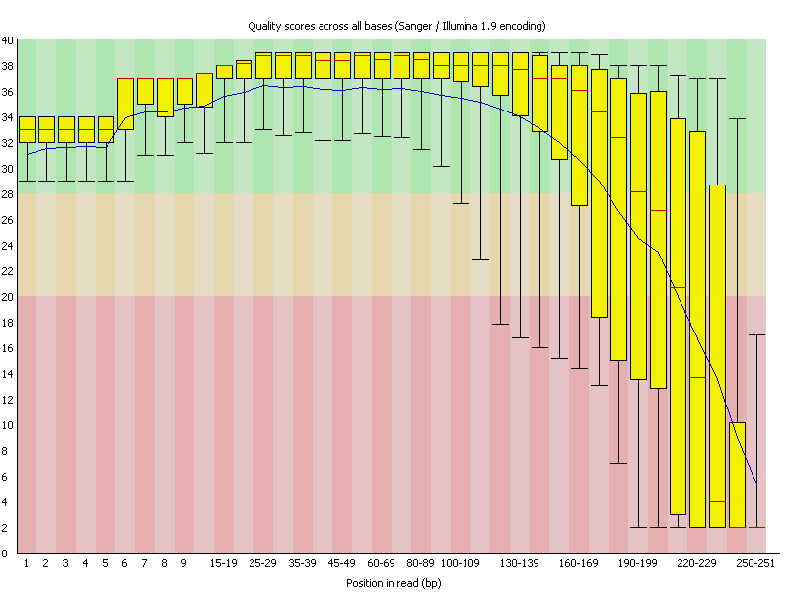
FASTQC

Slide 25
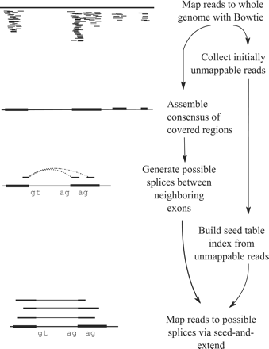
TopHat/Cufflinks
RNA-seq can be used to directly detect alternatively spliced mRNAs.
Trapnell C et al. Bioinformatics 2009;25:1105-1111

Slide 26
TopHat aligns FASTQ data files to a Reference Genome. It also makes use of genome annotation (gene names, location of exons on genome).
You have the option to find new splice junctions and align reads outside of known genes/exons
>module load bowtie2
>module load tophat
> tophat –o JZ5_output --transcriptome-index $Ref_Genome/genes $Ref_Genome/Bowtie2Index/genome
/ifs/data/tutorial/JZ5_R1.chr19.fastq

Slide 27
There are two workflows you can choose from when looking for differentially expressed and regulated genes using the Cufflinks package. The first workflow is simpler and is a good choice when you aren't looking for novel genes and transcripts. This workflow requires that you not only have a reference genome, but also a reference gene annotation in GFF format.
The second workflow, which includes steps to discover new genes and new splice variants of known genes, is more complex and requires more computing power. The second workflow can use and augment a reference gene annotation GFF if one is available.

Slide 28
OPTIONAL
Cufflinks counts reads per gene, identifies novel transcript isoforms writes a new GTF file. This is the optional, more complex workflow.
> module load cufflinks
> cufflinks –g $REF_ANNOT/genes.gtf
S1_out/accepted_hits.bam

Slide 29
Cuffdiff calculates differential expression between two sets of RNA-seq data files (treatment vs. control), using BAM files created by TopHat.
cuffdiff $REF_ANNOT/genes.gtf T1_r1_hits.bam,T1_r2_hits.bam C2_r1_hits.bam,C2_r2_hits.bam

Slide 30
tophat.sge script
#!/bin/bash
#$ -S /bin/bash
#$ -cwd
module load igenomes
module load samtools/0.1.19
module load bowtie2
module load tophat
module load cufflinks
tophat –o $1 --transcriptome-index $IGENOMES_ROOT/Homo_sapiens/UCSC/hg19/Annotation/Transcriptome/genes $IGENOMES_ROOT/Homo_sapiens/UCSC/hg19/Sequence/Bowtie2Index/genome
$2

Slide 31
Run the script with qsub
> qsub tophat.sge JZ5 /ifs/data/tutorial/JZ5_R1.chr19.fastq
> qsub tophat.sge JZ7 /ifs/data/tutorial/JZ7_R1.chr19.fastq
> qstat

Slide 32
qlogin for Cuffdiff
cuffdiff $Ref_Annotation data1.bam data2.bam
> qlogin
> cuffdiff –o Diff $IGENOMES_ROOT/Homo_sapiens/UCSC/hg19/Annotation/Genes/genes.gtf JZ5/accepted_hits.bam JZ7/accepted_hits.bam

Slide 33
Cuffdiff Result
gene locus sample_1 sample_2 status value_1 value_2 log2(fold_change) test_stat p_value q_value significant
ATP1A3 chr19:42470733-42498428 q1 q2 OK 1.21246 29.7143 4.61515 -3.12585 0.00177293 0.0496814 yes
C19orf38 chr19:10959105-10980360 q1 q2 OK 7.21903 147.921 4.35687 -3.37125 0.00074829 0.0255025 yes
CD37 chr19:49838676-49865714 q1 q2 OK 50.3636 4202.94 6.38288 -3.18846 0.00143032 0.0429436 yes
CD70 chr19:6585849-6591163 q1 q2 OK 0.429097 41.8858 6.60901 -3.32984 0.000868954 0.0281591 yes
CD79A chr19:42381189-42385439 q1 q2 OK 3.56079 7065.35 10.9543 -8.85453 0 0 yes
CLEC17A chr19:14693895-14721956 q1 q2 OK 0.329253 123.814 8.55476 -4.4262 9.59083e-06 0.000930311 yes
CNTD2 chr19:40728114-40732597 q1 q2 OK 94.8723 4.50887 -4.39515 3.38374 0.000715053 0.0250467 yes
CRLF1 chr19:18704034-18717660 q1 q2 OK 451.785 31.8185 -3.8277 3.15241 0.00161928 0.046407 yes
EBI3 chr19:4229539-4237524 q1 q2 OK 10.7606 252.04 4.54982 -3.46471 0.000530804 0.0196866 yes
FAM129C chr19:17634109-17664648 q1 q2 OK 0.528184 243.529 8.84884 -5.58585 2.32556e-08 5.86507e-06 yes
FCER2 chr19:7753642-7767032 q1 q2 OK 0.430612 664.696 10.5921 -4.53907 5.65033e-06 0.000647734 yes
FCGBP chr19:40353962-40440533 q1 q2 OK 714.292 53.2831 -3.74476 3.92369 8.72025e-05 0.00478097 yes
FLJ22184 chr19:7933604-7939326 q1 q2 OK 91.0657 4.4967 -4.33997 3.32922 0.000870901 0.0281591 yes
FPR3 chr19:52298410-52329334 q1 q2 OK 19.9929 557.07 4.8003 -4.01145 6.03479e-05 0.00362845 yes
GZMM chr19:544026-549919 q1 q2 OK 7.3703 547.332 6.21455 -5.08715 3.63493e-07 6.54807e-05 yes
HPN chr19:35531409-35597208 q1 q2 OK 1851.49 111.135 -4.0583 3.1732 0.00150768 0.0442135 yes
ICAM3 chr19:10444451-10450345 q1 q2 OK 93.4318 1447.49 3.95349 -3.57653 0.000348183 0.01514 yes
IGFLR1 chr19:36230150-36233351 q1 q2 OK 46.3094 692.82 3.9031 -3.18998 0.0014228 0.0429436 yes
JAK3 chr19:17935592-17958841 q1 q2 OK 41.7086 560.413 3.74807 -3.49018 0.000482698 0.0190213 yes
JSRP1 chr19:2252249-2256422 q1 q2 OK 2.26314 308.507 7.09083 -5.73067 1.00034e-08 3.15357e-06 yes

Slide 34
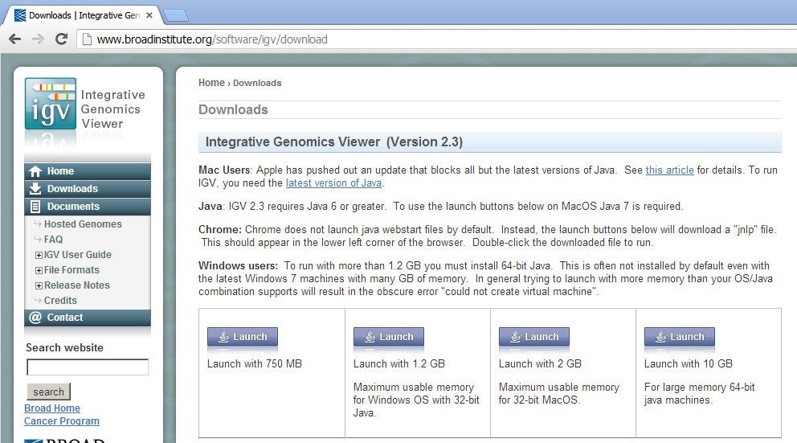
Integrated Genomics Viewer
IGV is a nice way to view the actual reads in your BAM files aligned to the reference genome (with gene annotation)
Download Java app from Broad website
Choose Mouse genome
Load BAM files.

Slide 35
Prepare index for IGV
IGV requires a .bai index file for each BAM file to rapidly find and display read data at a specific position on the genome
Use samtools to make the index
> module load samtools
> samtools index Tophat/JZ5/accepted_hits.bam Tophat/JZ5/accepted_hits.bai

Slide 36
FTP download of BAM and .bai files
Mac: Filezilla, Cyberduck
Win: Filezilla or PSFTP, & Pageant (from PuTTY website)

Slide 37
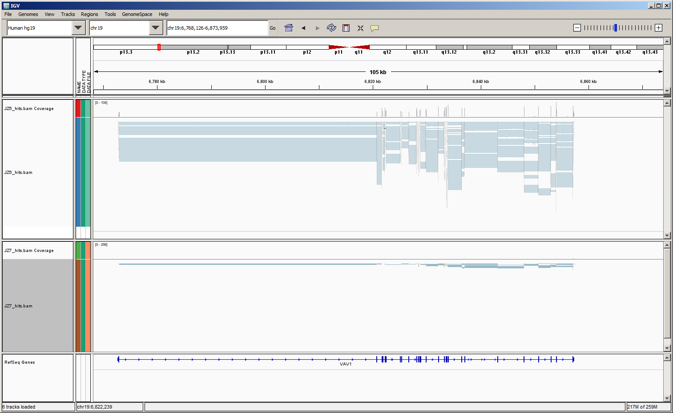
IGV screen of diff expr. gene

Slide 38
Thanks
Constantin Aliferis
Director, NYU Center for Health Informatics & Bioinformatics (CHIBI)
The NYU Genome Technology Center
Director: Adriana Heguy
Staff: Berrin Baysa
Elisa Venturini
Igor Dolgalev
The NYU Sequencing Informatics Group
Zuojian Tang
Hao Chen
Alexander Alekseyenko
Steven Shen
Phillip Ross Smith
Jinhua Wang
Alexander Statnikov
CHBI High Performance Computing Facility
Efstratios Efstathiadis Eric Peskin
All of our scientific collaborators, including:
Max Costa
Claude Desplan
David Fenyo
Daniel Merulo
David Roth
Kenneth Cadwell Matthew Murtha/Lisa Dailey
NYU Office of Collaborative Science
The NYU Clinical and Translational Science Institute, Directors: Bruce Cronstein
Judith Hochman

